Slide 1



The physics basis for implementing alternative divertor configurations on reactors
30th IAEA Fusion Energy Conference, Chengdu, China
K. Verhaegh, C. Theiler, D. Brida, et al.
Eindhoven University of Technology
k.h.a.verhaegh@tue.nl

Slide 2

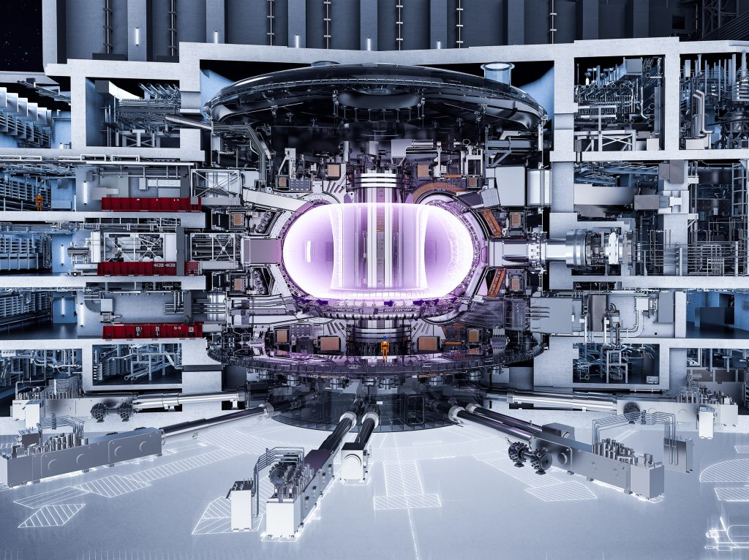
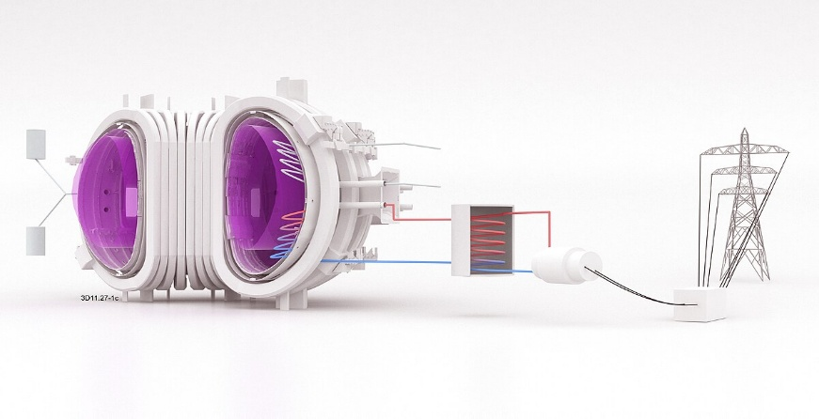
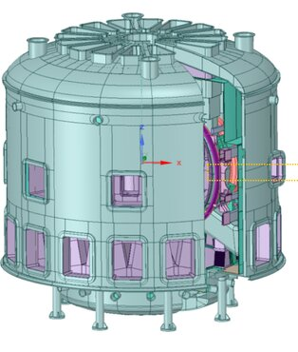
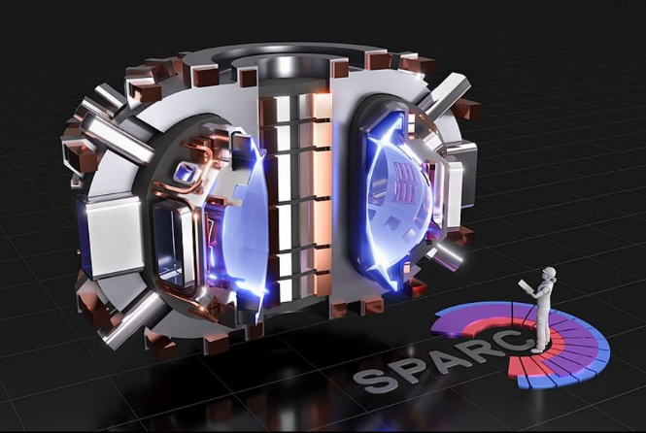
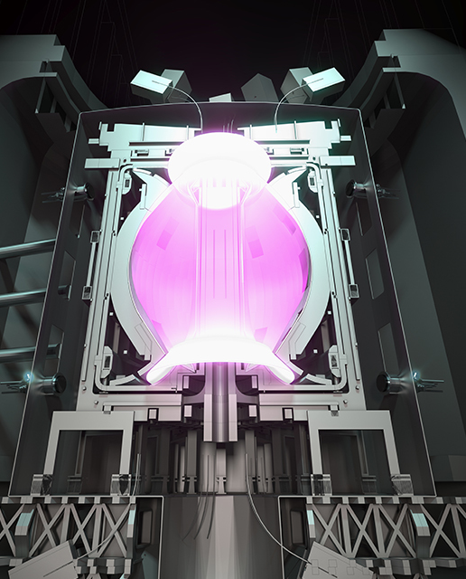
Towards fusion power plants
BEST (China) (construction 2027)
Q=5
CFETR (China) (planned 2030s)
Q=13 (891 MW electricity)
(EU-)DEMO – under design (>2040)
Q=25 (300-500 MW electricity)
ITER – under construction (2033-2039)
Q (energy out / energy in) =10
SPARC (CFS - US) (construction 2026)
Q>2
ARC (CFS – US) (planned 2030s)
100s MW electricity
Working towards fusion reactors
-> private & public sector
STEP (UK) – (under design <2040)
>0 MW electricity

Slide 3

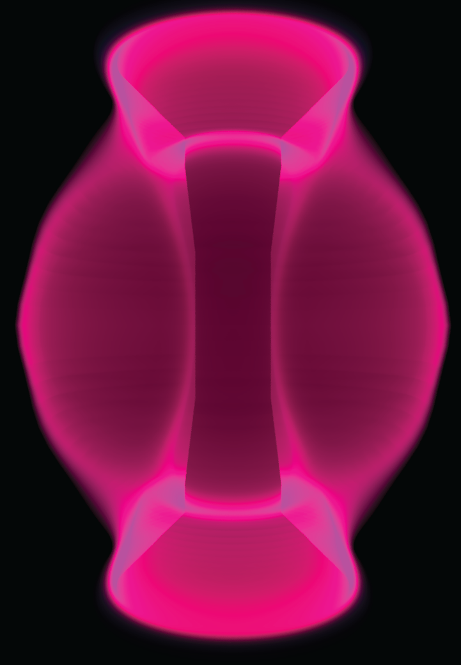


Power exhaust – a common challenge towards fusion energy
Order-of-magnitude heat flux reductions required !
Unmitigated heat flux reactor: >> 100 MW/m²
Tolerable engineering limit: < 5-10 MW/m²
Solution: Detachment !
MAST-U
Ray-tracing
Conventional
$$q_{u}$$
Heat flux
reduction
~x4
Impurity power dissipation
Detachment (5 eV) -> power, particle, mom. Loss
But, requires massive impurity & fuel injection
    Deteriorates core performance
    Reactor extrapolations uncertain
    Careful control required (slow actuators)
>x10
$$q_{t}$$
Can exhaust be tackled in a reactor ?
  New solutions as risk mitigation
N₂, Ne, Ar, …
D₂, …

Slide 4
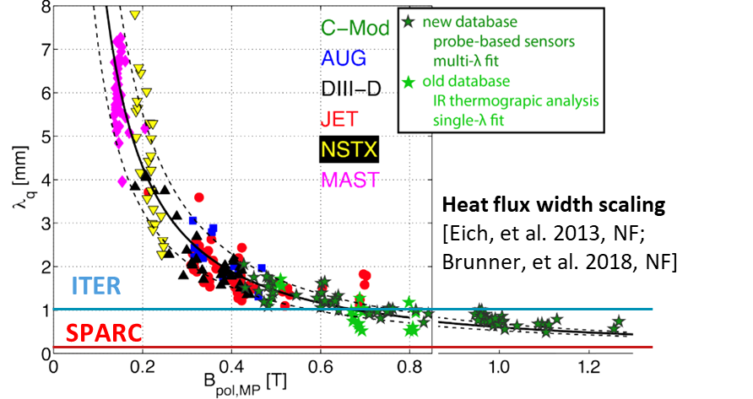

Power exhaust – a common challenge towards fusion energy
Order-of-magnitude heat flux reductions required !
Unmitigated heat flux reactor: >> 100 MW/m²
Tolerable engineering limit: < 5-10 MW/m²
Reactor power exhaust challenge daunting especially for compact designs
MAST-U
Conventional
$$λ_{q}$$
Can exhaust be tackled in a reactor ?
  New solutions as risk mitigation
Exhaust more daunting for compact designs
  New solutions needed as baseline
N₂, Ne, Ar, …
D₂, …

Slide 5
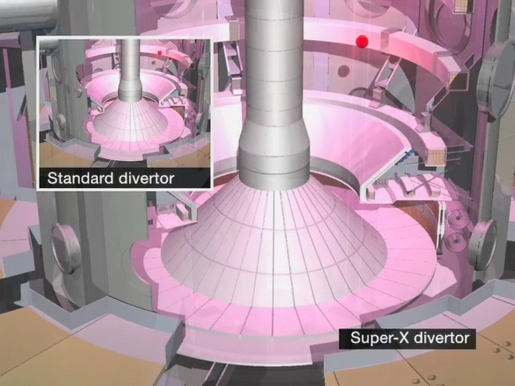

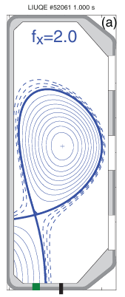
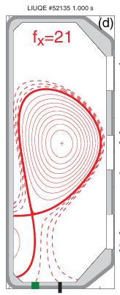
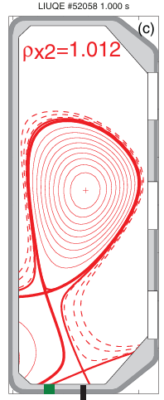
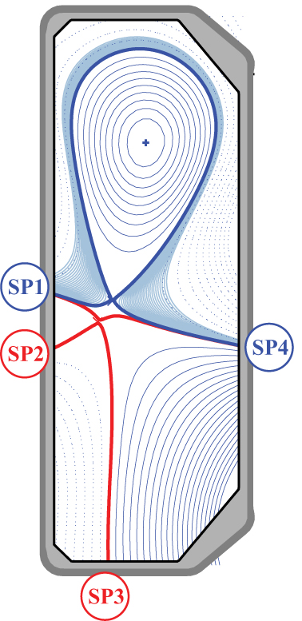
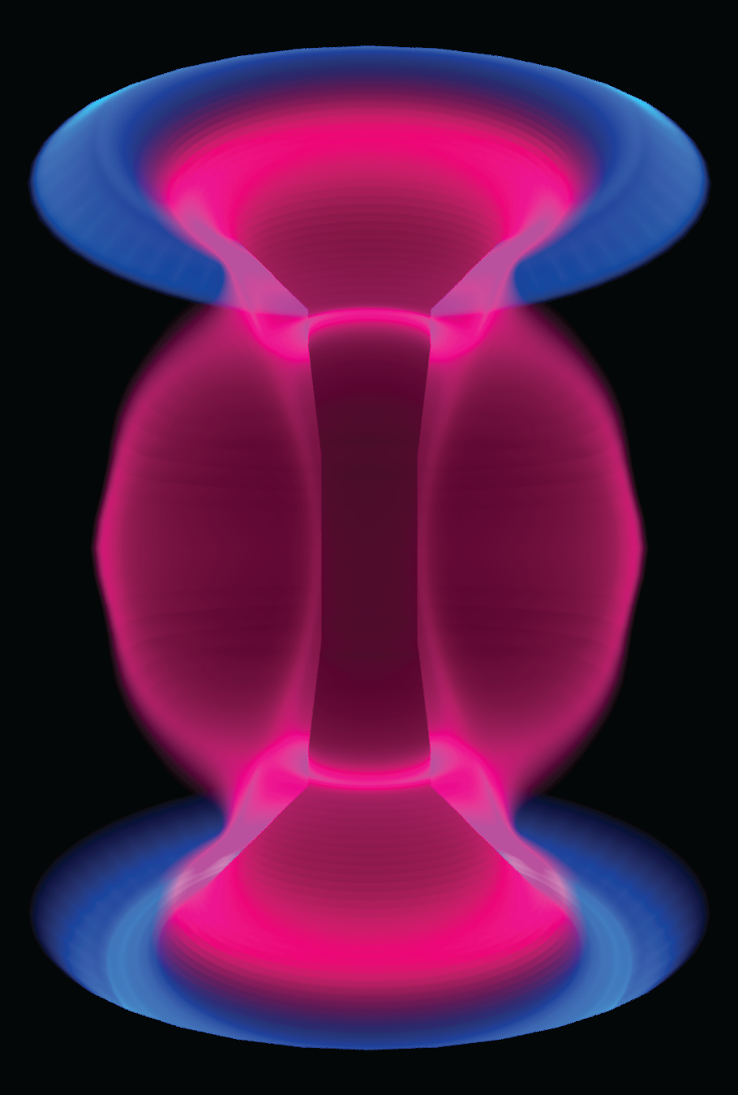
ADCs can provide solutions !
Total flux expansion
‘Super-X Divertor’
Tackle power exhaust challenge with magnetic topology
Continuum of options from small to extreme:
(leg length, baffling, flux expansion, secondary nulls, …)
Poloidal flux expansion
‘X-Divertor’
‘X-Point Target’
Conventional
‘Snowflake’
‘Conventional’
MAST-U
‘Super-X’
MAST-U
Detached !
C. Theiler, et al. 2017, Nucl. Fusion
Reimerdes, et al. 2013, NF

Slide 6
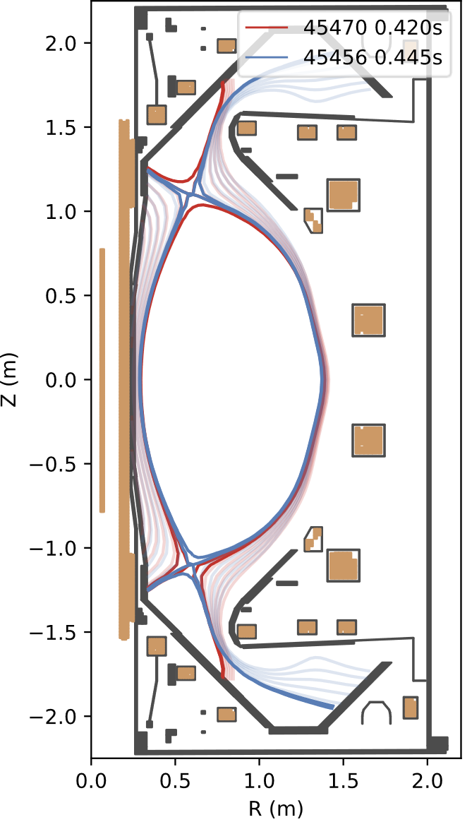
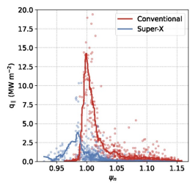
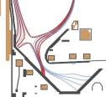
ADCs can provide solutions !
ADCs
    Promising benefits ?
    Added engineering complexity
Tackle power exhaust challenge with magnetic topology
Continuum of options from small to extreme:
(leg length, baffling, flux expansion, secondary nulls, …)
Total flux expansion
‘Super-X Divertor’
(MAST-U)
ADCs can be achieved + may pose benefits
Poloidal flux expansion
‘X-Divertor’
‘X-Point Target’
Conventional
‘Snowflake’
J. Harrison, et al. 2024, PPCF
C. Theiler, et al. 2017, Nucl. Fusion
Reimerdes, et al. 2013, NF

Slide 7



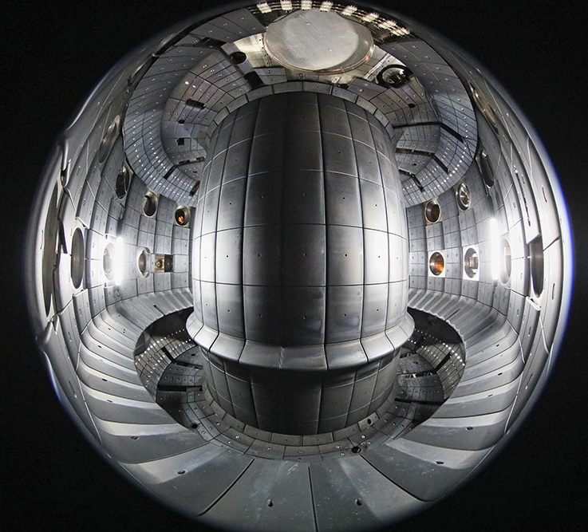
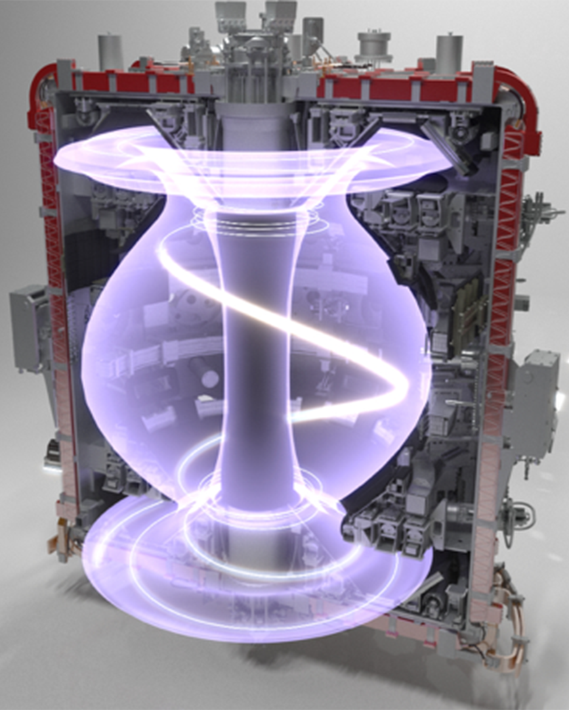
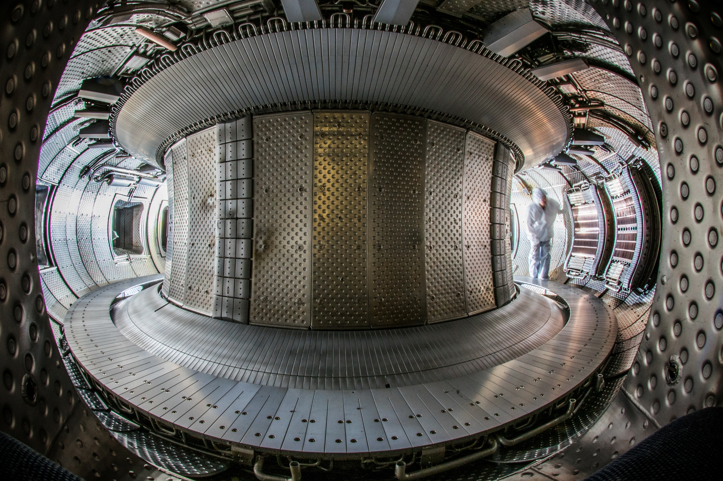
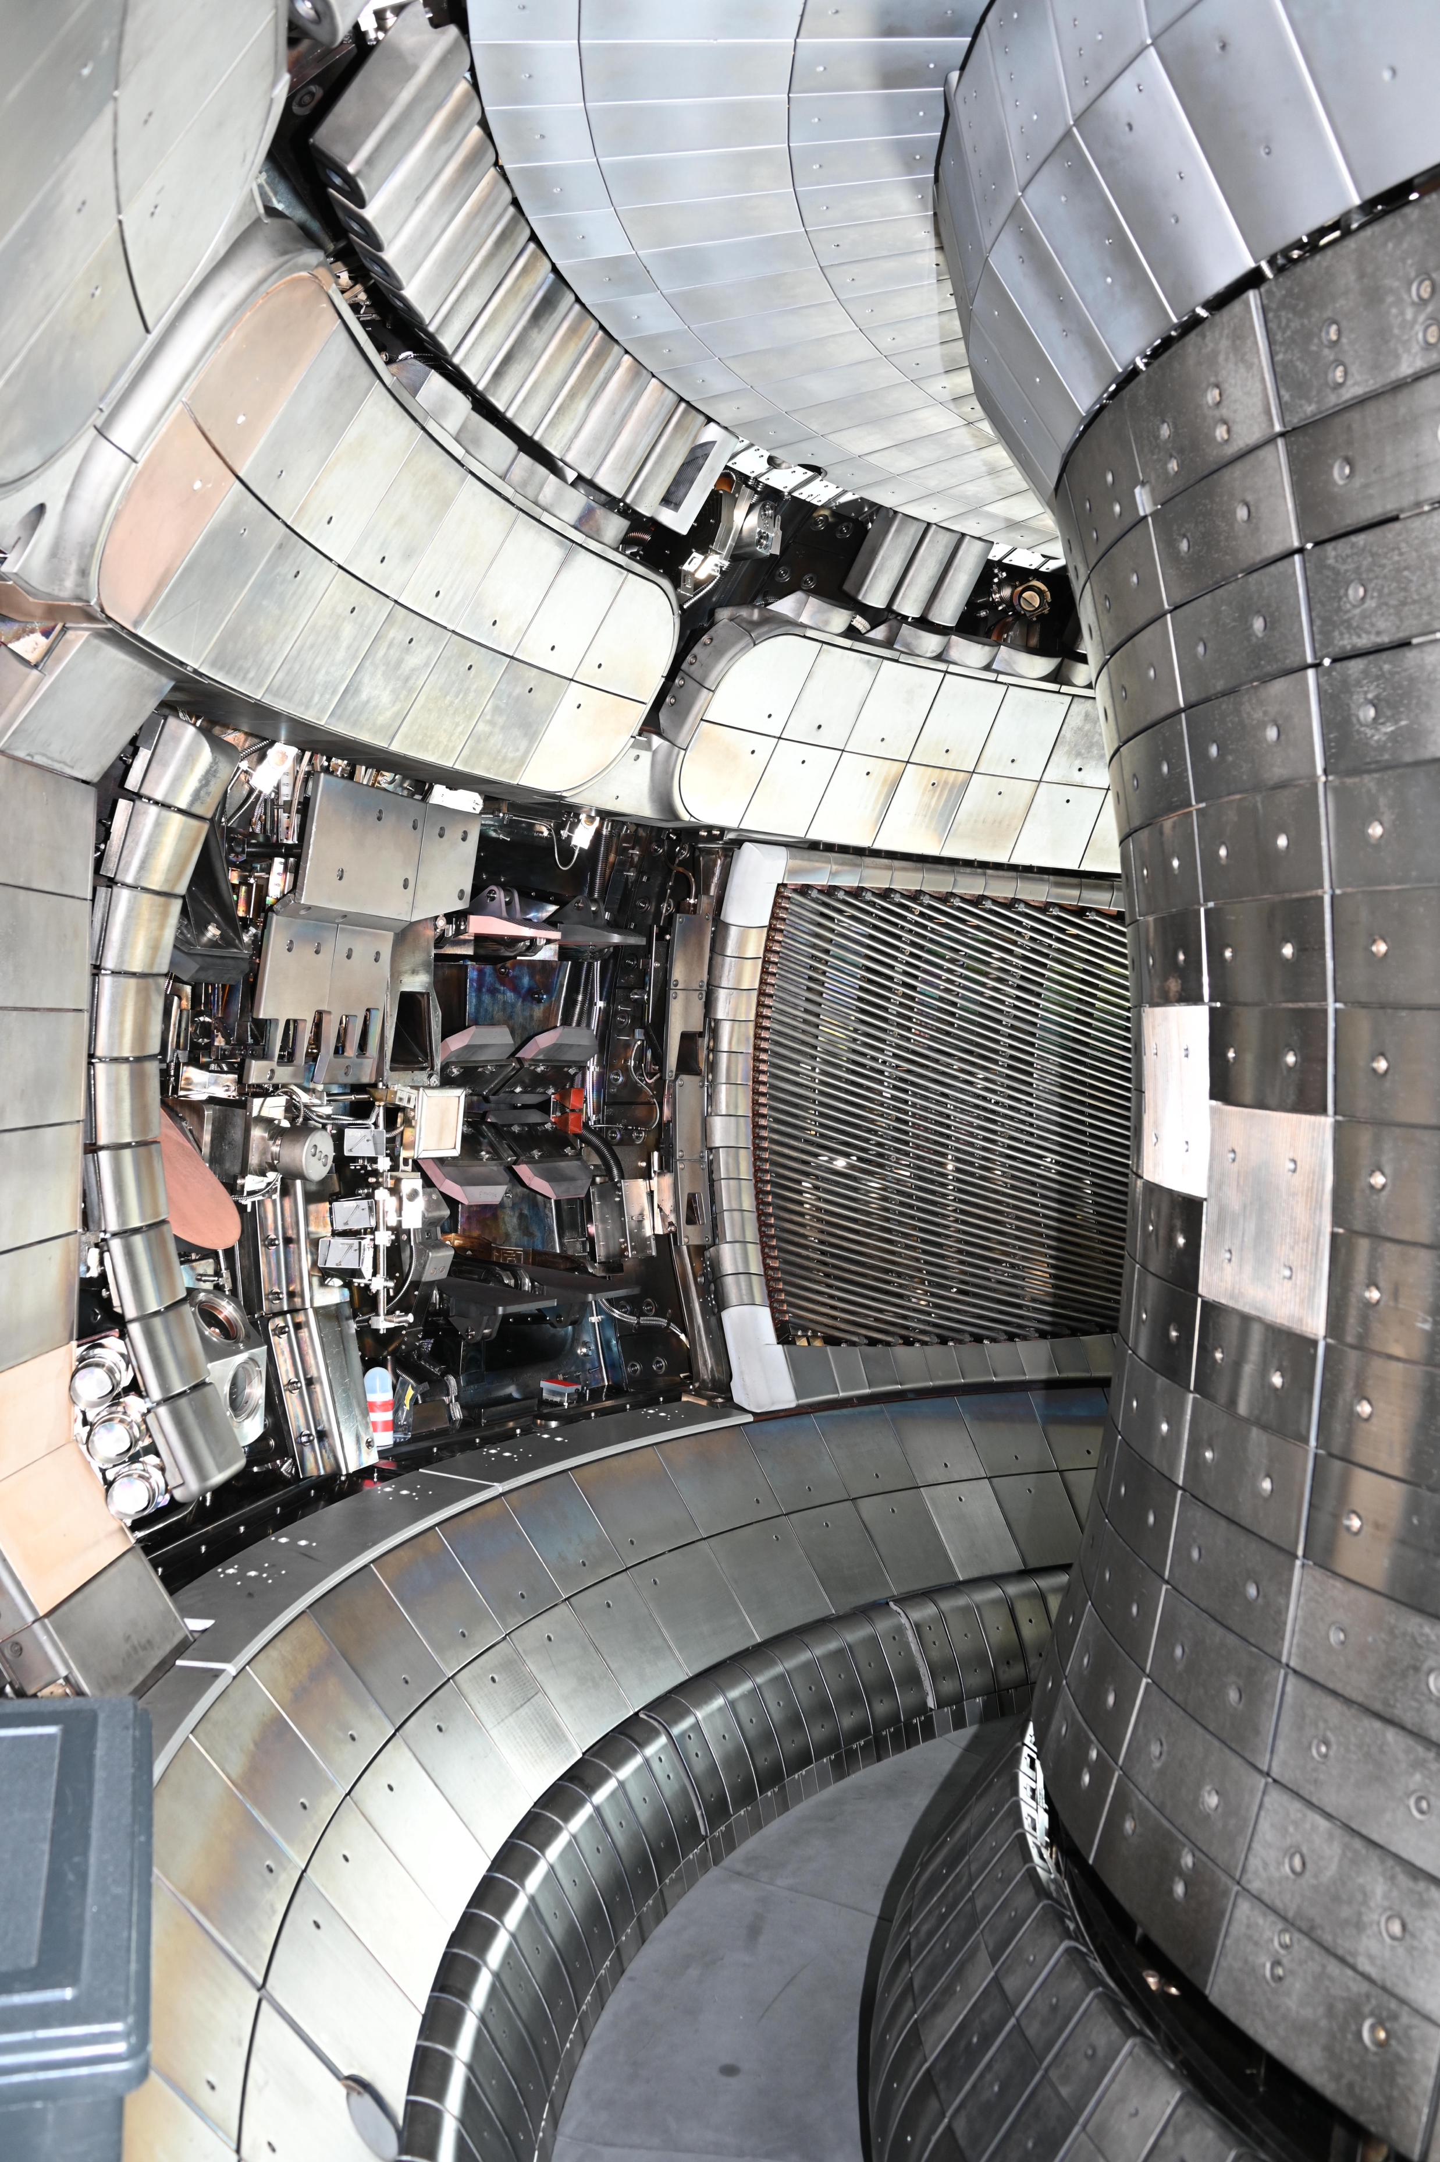
Progress in ADC research through EUROfusion
WEST (>2025)
See J. Harrison, et al.
Asdex Upgrade (>2025)
See J. Harrison, et al.
TCV (>2017)
EPFL, Switzerland
See C. Theiler, et al.
MAST Upgrade (>2020)
UKAEA, UK
See J. Harrison, et al.
ASDEX Upgrade (>2025)
IPP, Germany
See T. Pütterich, et al.
WEST (>2025)
CEA, France
See J. Bucalossi, et al.
Long pulse double-null
Extreme shaping flexibility
Ongoing / future
This talk
Extreme shaping + baffling integration
New upper divertor
-> study ADCs at high power
Combine unique features EUROfusion tokamaks
-> take ADCs from concept to reactor maturity

Slide 8











Author list
WEST (>2025)
See J. Harrison, et al.
Asdex Upgrade (>2025)
See J. Harrison, et al.
¹⁴ See author list of T. Putterich, et al. this conference
¹⁵ See author list of J.R. Harrison, et al. this conference
¹⁶ See author list of C. Theiler, et al. this conference
¹⁷ See author list of J. Bucalossi, et al. this conference
K. Verhaegh¹, C. Theiler², D. Brida³, M. Carpita², O. Février², P. Figueiredo^{6,1} , A. Hakola⁴, J. Harrison⁵, B. Kool^{6,1}, K. Lee², T. Lunt³, N. Lonigro^{8,5}, D. Moiraf⁷, D. Moulton⁵, B. Sieglin³, M, Zurita², F. Albrecht³, C. Beckley⁵, M. van Berkel^{6,1}, C. Bowman⁵, B. Brown², M. Czarski⁹, G. Derks⁶, R. Ducker², G. Durr-Legoupil-Nicoud², F. Federici¹⁰, N. Fedorczak⁷, J. Flanagan¹¹, S. Henderson⁵, Z. Huang⁵, D. Greenhouse⁸, J. Karhunen⁴, S. Kachkanov⁵, S. Kobussen^{6,1}, B. Labit², H. Lindl², B. Lipschultz⁸, J. Lovell¹⁰, A. Mancini³, S. Menmuir⁵, R. Mishra⁹, R. Morgan², K. Murray¹¹, P. Muscente¹³, N. Osborne⁵, E. Pawelec¹², O. Pan³, A. Perek², H. Reimerdes², P. Ryan⁵, R. Scannell⁵, S. Silburn⁵, E. Tonello², A. Tookey⁵, M. Wigram¹³, M. Winkel¹, T. Wijkamp⁶, Q. Xia⁵, L. Xiang⁵ , the ASDEX Upgrade Team¹⁴, the MAST Upgrade team¹⁵, the TCV team¹⁶, the WEST team¹⁷, the EUROfusion WPTE team¹⁸
1
13
Team effort !
55 authors
13 institutes
5 consortia
12
2,16
5,15
10
4
7,17
18
6
8
3,14
9
11

Slide 9
Progress in ADC research through EUROfusion
WEST (>2025)
See J. Harrison, et al.
Asdex Upgrade (>2025)
See J. Harrison, et al.
Present
Major benefits for reactor integration
without adverse core impact
Multiple ADCs obtain similar benefits
Moderate shaping can improve exhaust
Past
Future
ADCs can be achieved + may pose benefits
Reactor-relevant P_{SOL}/R
We understand the physics behind it
Harness for divertor optimisation
Improve physics basis ITER & beyond
Combine unique features EUROfusion tokamaks
-> take ADCs from concept to reactor maturity

Slide 10
Progress in ADC research through EUROfusion
Power exhaust benefits
Tangible benefits for reactor integration without adverse core impact
EUROfusion philosophy:
  Combine unique traits fusion devices
May pose some benefits
C. Theiler, et al. 2017, NF
….
Large benefits for reactor integration
Steady-state, control & transient management
Understand those benefits
Use to optimise divertor design reactors
ADCs -> solutions to optimise

Slide 11
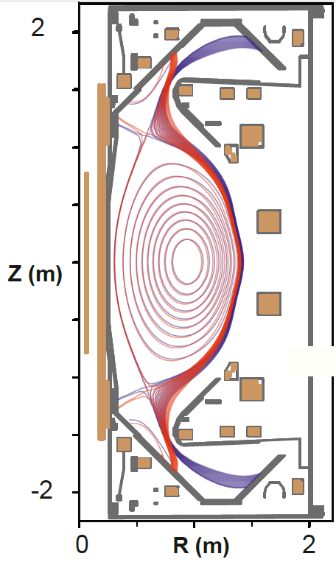
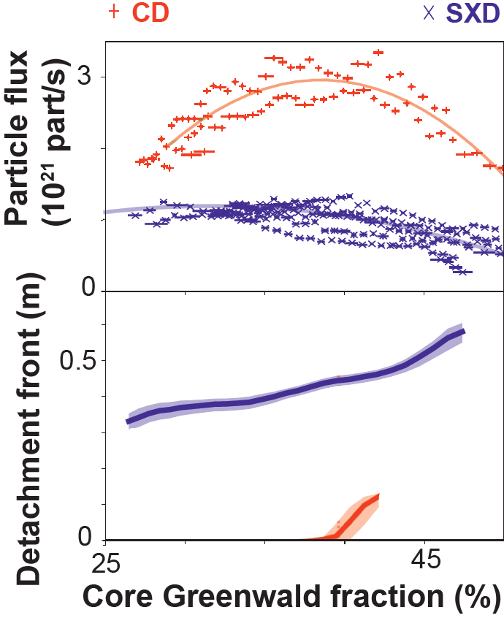
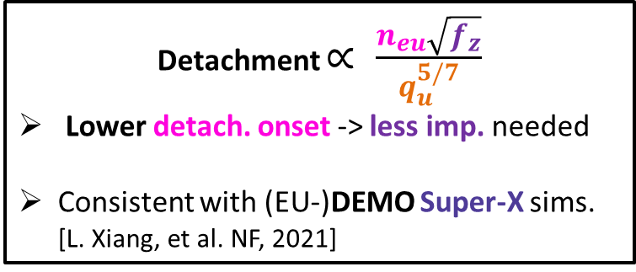
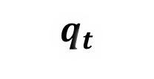
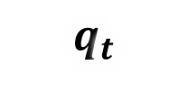


Power exhaust benefits – detachment access
MAST-U
Low n_{e, sep} / high P_{SOL} (1.5 MW) -> challenge divertor (P_{SOL} / R λ_{q} n_{e, sep}²)
Similar results in H-mode (3.5+ MW)
Conventional CD
Super-X SXD
Benefits without core degradation
Detachment onset reduction
Detachment window increase (> x3.5)
Impurity
Radiation
Ionisation
h𝜈
h𝜈
Detachment
$$q_{u}$$
$$q_{t}$$
$$q_{t}$$
B →
$$q_{t}$$
X-point
h𝜈
h𝜈
Detachment front (L_{pol})
Detached (SXD)
Detachment $∝ \frac{n_{eu}\sqrt{f_{z}}}{q_{u}^{5/7}}$
Lower detach. onset -> less imp. needed
Consistent with (EU-)DEMO Super-X sims. [L. Xiang, et al. NF, 2021]
Attached (CD)
Core Greenwald fraction (%)

Slide 12
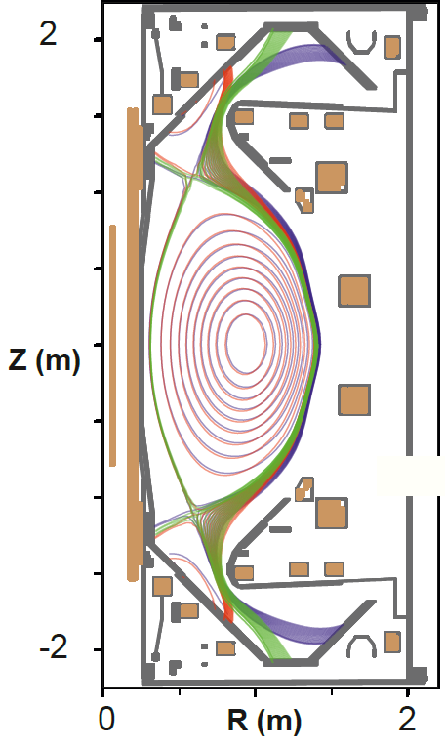
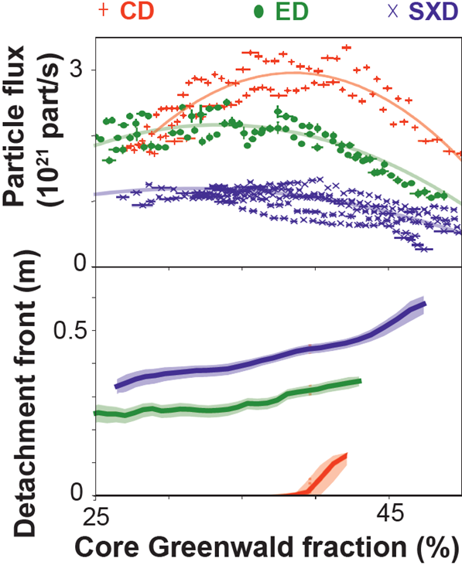

Power exhaust benefits – detachment access
MAST-U
Total flux expansion ED < STEP !
Similar to DEMO SXD & ARC (!)
Conventional CD
Elongated ED
Super-X SXD
Benefits without core degradation
Detachment onset reduction
Detachment window increase (> x3.5)
[K. Verhaegh, et al. 2025, Commun. Phys]
Impurity
Radiation
Ionisation
h𝜈
h𝜈
Detachment
$$q_{u}$$
$$q_{t}$$
$$q_{t}$$
B →
$$q_{t}$$
X-point
h𝜈
h𝜈
Detachment front (L_{pol})
Detachment $∝\frac{n_{eu}\sqrt{f_{z}}}{q_{u}^{5/7}}$
Super-X benefits maintained in less extreme shape
Core Greenwald fraction (%)
Total flux expansion

Slide 13
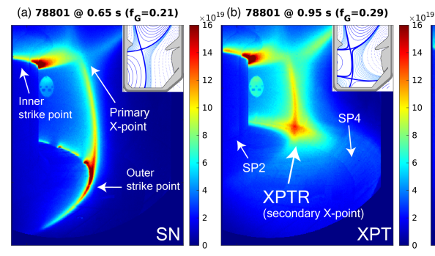
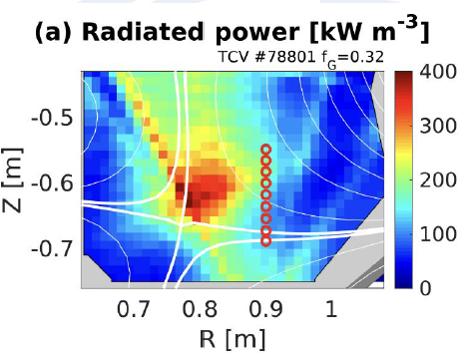
TCV’s X-Point Target Divertor
TCV
[K. Lee, et al. 2025, Phys. Rev. Lett.]
Discovery of the X-Point Target Radiator
(XPTR) regime
  Strong power dissipation – x-point radiator
  structure in secondary null
  Localised power dissipation without XPR risks
X-Point Target Radiator discovered on TCV – localised power dissipation in secondary null
X-Point Target –
Featured in SPARC & ARC

Slide 14
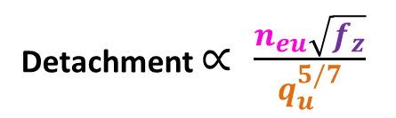
TCV’s X-Point Target Divertor
TCV
CIII emission front
~ 5-9 eV
Discovery of the X-Point Target Radiator
(XPTR) regime
  Strong power dissipation – x-point radiator
  structure in secondary null
  Localised power dissipation without XPR risks
XPT benefits maintained at highest
power/low density (P_{SOL} / R λ_{q} n_{e, sep}²)
X-Point Target
Detached
X
X-Point Target Radiator discovered on TCV – localised power dissipation in secondary null
X-Point Target – detached
where conventional attached !
x 2.2 seeding
x 3 heating
Detachment $∝ \frac{n_{eu}\sqrt{f_{z}}}{q_{u}^{5/7}}$
High power XPT could be detached at higher power with less impurity injection (!)
Conventional
Attached
X

Slide 15
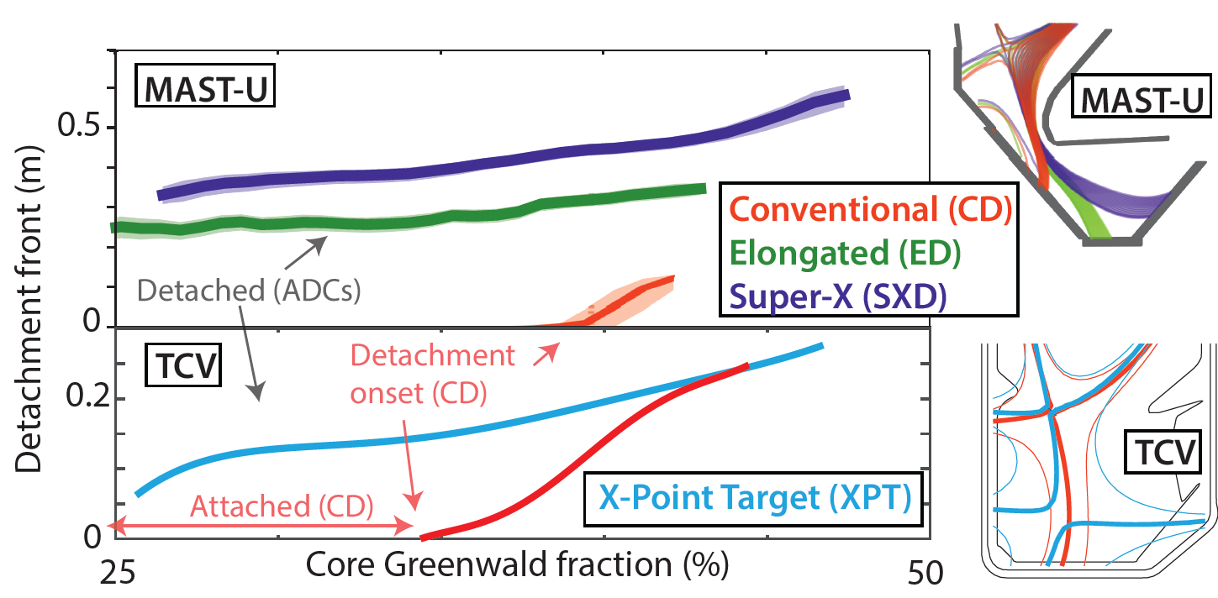
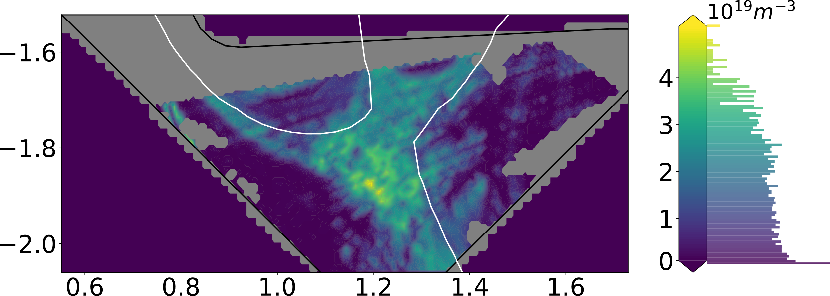
Power exhaust benefits – improved detachment
MAST-U & TCV
[K. Lee, et al. 2025, Phys. Rev. Lett]
[K. Verhaegh, et al. 2025, Commun. Phys]
Benefits without core degradation
Detachment onset reduction
Detachment window increase (> x3.5)
Reduced heat loads
[N. Lonigro, et al. AAPPS-DPP, 2025]
MAST-U
SXD + XPT
Two different concepts -> similar power exhaust benefits !
Power exhaust benefits
Possibility to combine ADC features !
Total flux expansion, …
CD
ED
SXD (MAST-U)
Add secondary null
(X-Point Target)
XPT (TCV)

Slide 16
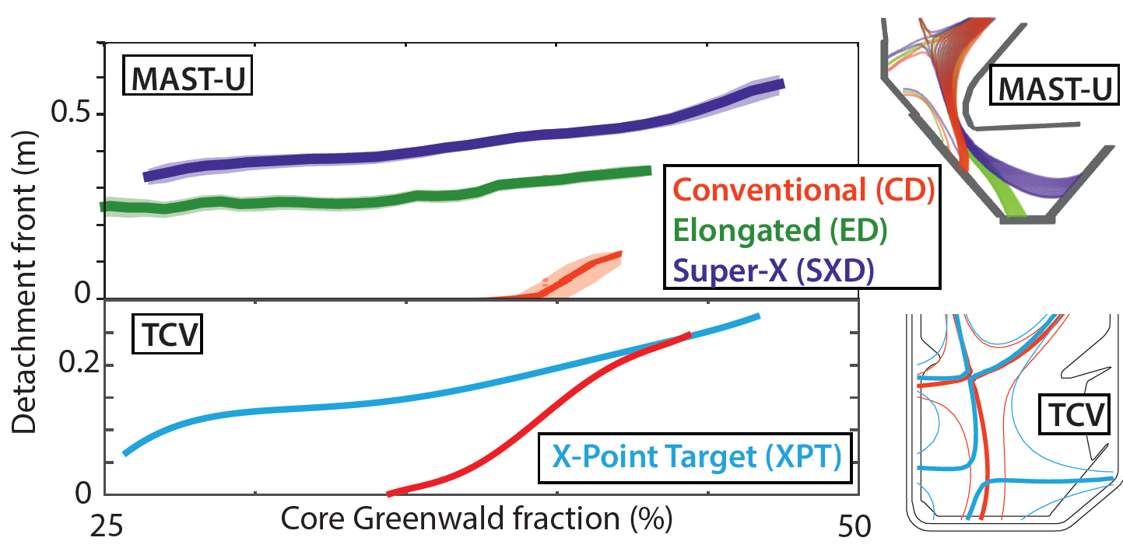
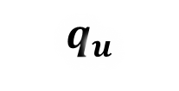



Power exhaust benefits – reduced sensitivity
MAST-U & TCV
[K. Lee, et al. 2025, Phys. Rev. Lett]
[K. Verhaegh, et al. 2025, Commun. Phys]
Benefits without core degradation
Detachment onset reduction
Detachment window increase (> x3.5)
Reduced heat loads
Reduced detachment sensitivity (x5)
Conventional (CD)
Elongated (ED)
Super-X (SXD)
X-Point Target
Detachment less sensitive to core (!)
Impurity
Radiation
Ionisation
h𝜈
h𝜈
Detachment
SXD, ED & XPT – all three strongly reduced core sensitivity !
$$q_{u}$$
$$q_{t}$$
$$q_{t}$$
B →
$$q_{t}$$
Power exhaust benefits
X-point
Total flux expansion, …
h𝜈
h𝜈
CD
ED
SXD (MAST-U)
Add secondary null
(X-Point Target)
Detachment front (L_{pol})
XPT (TCV)

Slide 17
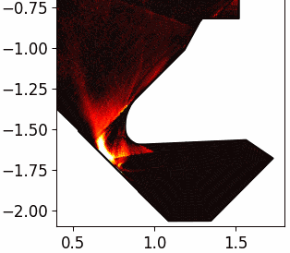
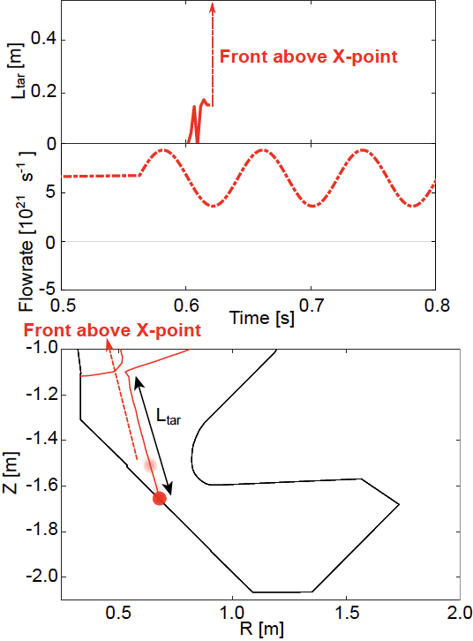
Reduced sensitivity -> improved resilience to perturbations
ADCs can greatly boost passive absorption (!)
MAST-U
[B. Kool, et al. 2025, Nat. Energy]
Dynamic perturbation
CD – very sensitive (MAST-U)
L_{pol} (m)
Conventional divertor
Impurity
Radiation
Ionisation
h𝜈
h𝜈
Detachment
$$q_{u}$$
$$q_{t}$$
$$q_{t}$$
Fueling
(10²¹ part./s)
B →
$$q_{t}$$
X-point
h𝜈
h𝜈
D₂ Fulcher emission – ionisation proxy
Detachment front (L_{pol})
L_{pol}
Actuator response
Fast transients
(too fast to
actuate on
Slow transients
(power exhaust
control ?)
Quasi-steady
state
Passive absorption reliance

Slide 18
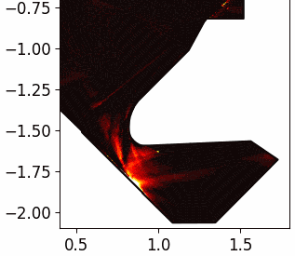
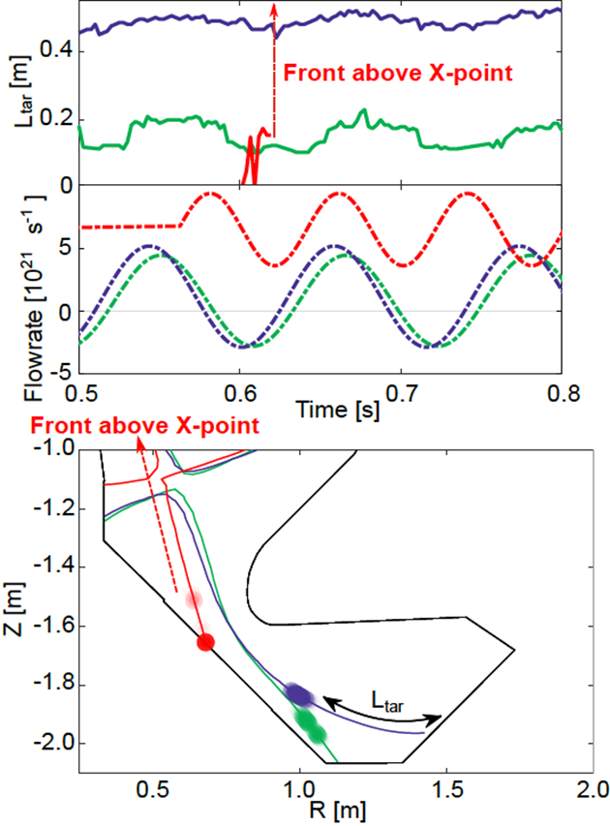
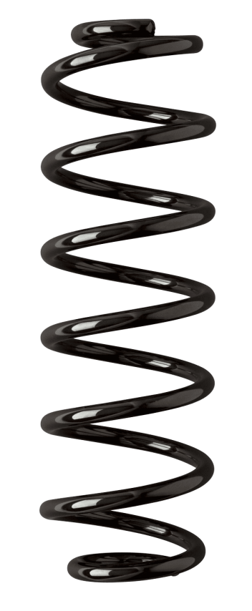
Reduced sensitivity -> improved resilience to perturbations
ADCs can greatly boost passive absorption (!)
MAST-U & TCV
[B. Kool, et al. 2025, Nat. Energy]
Dynamic perturbation
CD – very sensitive (MAST-U)
ED/SXD – very insensitive
XPT – very, very insensitive
L_{pol} (m)
Super-X Divertor
Fueling
(10²¹ part./s)
ADCs can act as shock absorber -> give actuators more time for control
Actuator response
Fast transients
(too fast to
actuate on
Slow transients
(power exhaust
control !)
Quasi-steady
state
L_{pol}
CD sensitivity
Reduced sensitivity
No sensitivity
Passive absorption reliance

Slide 19
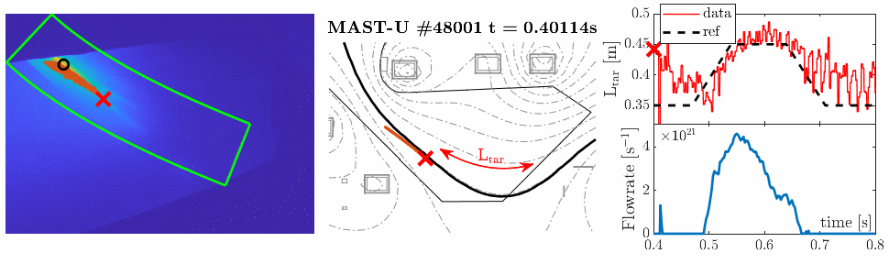
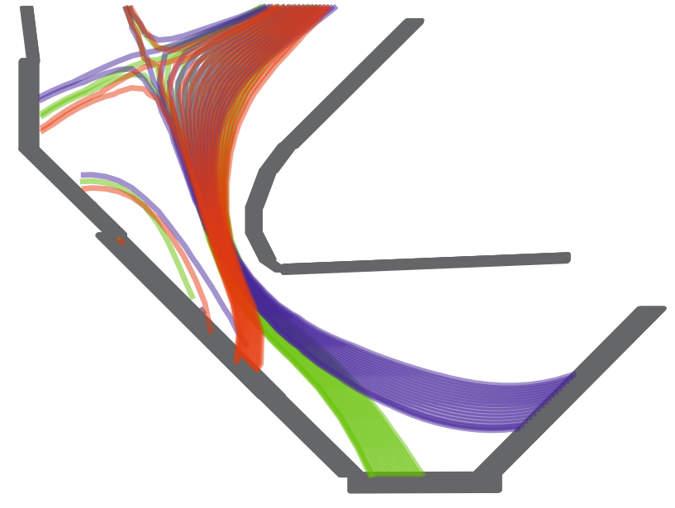




ADCs can aid power exhaust control
MAST-U
Impurity
Radiation
Ionisation
L_{pol} (m)
$$q_{u}$$
h𝜈
h𝜈
Detachment
$$q_{t}$$
$$q_{t}$$
B →
$$q_{t}$$
L_{pol}
X-point
h𝜈
h𝜈
D₂ Fulcher emission – ionisation proxy
Detachment front (L_{pol})
[B. Kool, et al. 2025, Nat. Energy]
ADCs can act as shock absorber -> give actuators more time for control
Detachment front controlled in
real-time in MAST-U SXD and ED
Not possible in MAST-U CD due to sensitivity
Actuator response
Fast transients
(too fast to
actuate on
Slow transients
(power exhaust
control !)
Quasi-steady
state
Higher fidelity detachment control possible in MAST-U ADC’s, but impossible in MAST-U CD (!)
Passive absorption reliance

Slide 20
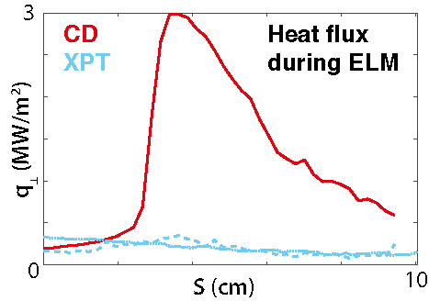
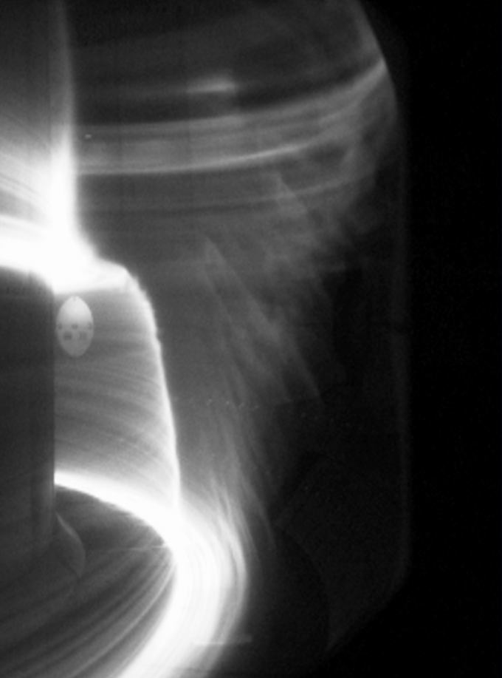
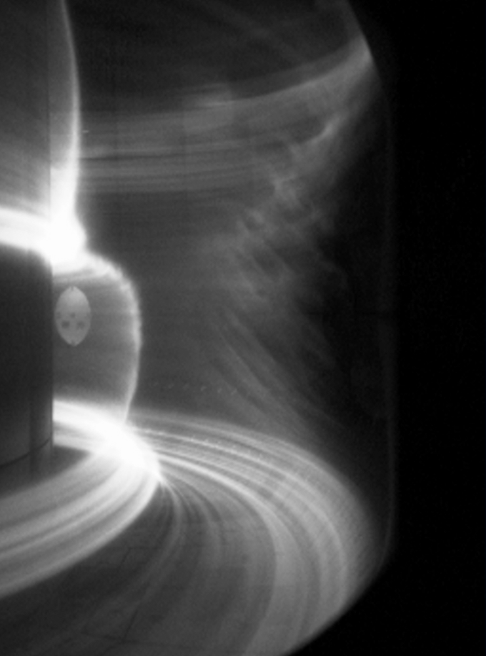
ADCs can improve handling of fast transients
[B. Kool, et al. 2025, Nat. Energy]
TCV
87081
1.5254s
87080
1.4070s
XPT
CIII emission reaches 2d X-point
Conventional
CIII reaches target
ADCs can improve handling of fast transients
Actuator response
[M. Zurita, et al. APS, 2025
Fast transients
(too fast to
actuate on)
Slow transients
(power exhaust
control)
Quasi-steady
state
Transient buffering also observed in MAST-U Super-X (see R. Scannell, et al.)
Passive absorption reliance
[J. Flanagan, et al. Nucl. Fusion 2025]
Preliminary

Slide 21
Progress in ADC research through EUROfusion
Physics basis of ADCs
What drives these benefits and how can we harness that knowledge ?
EUROfusion philosophy:
  Combine unique traits fusion devices
May pose some benefits
C. Theiler, et al. 2017, NF
….
Large benefits for reactor integration
Steady-state, control & transient management
Understand those benefits
Use to optimise divertor design reactors
Magnetic topology (total flux expansion & secondary null)
  Detachment access & reduced sensitivity
Divertor (poloidal) leg length/volume
  Power/particle losses
Neutral baffling
  Decouples divertors from core
  Enables shaping benefits to be obtained
We now have validated tools for ADC implementation !
We now understand why
The most successful cases work so well
Other configs. yielded less benefits
Consistent with simulations (!)
ADCs -> solutions to optimise

Slide 22
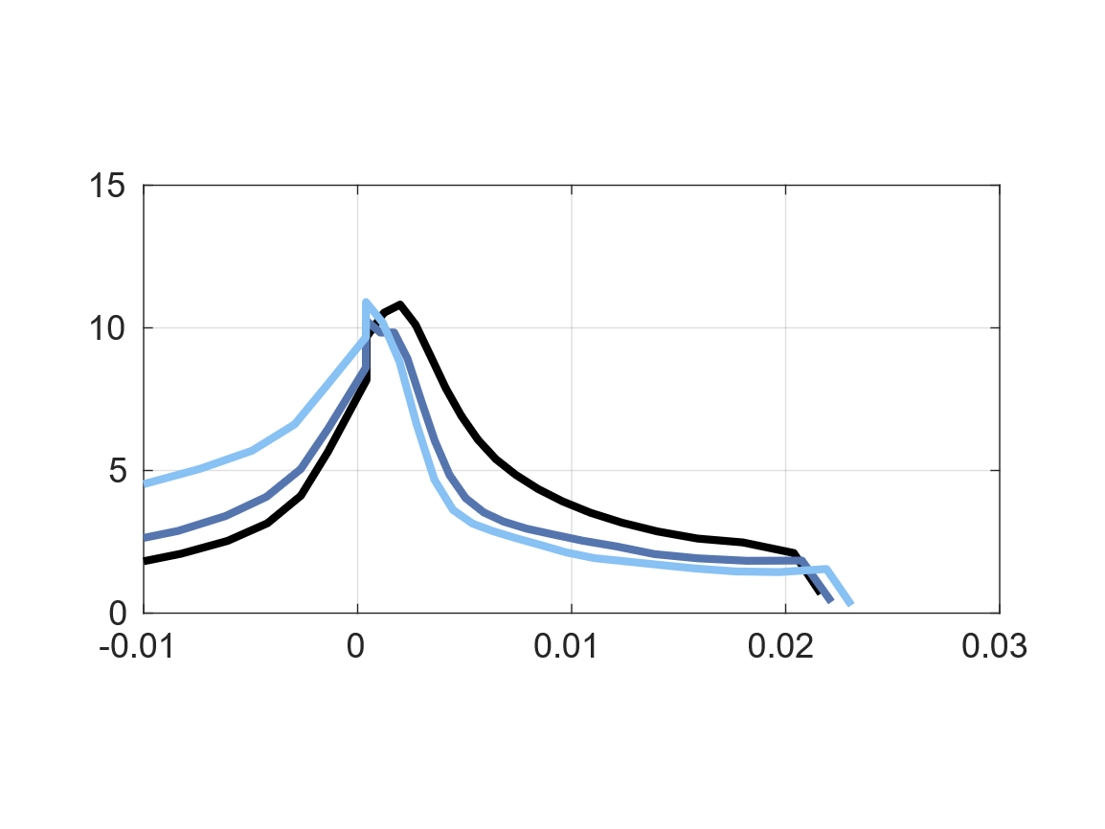
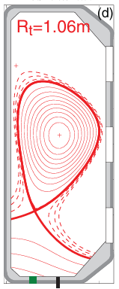
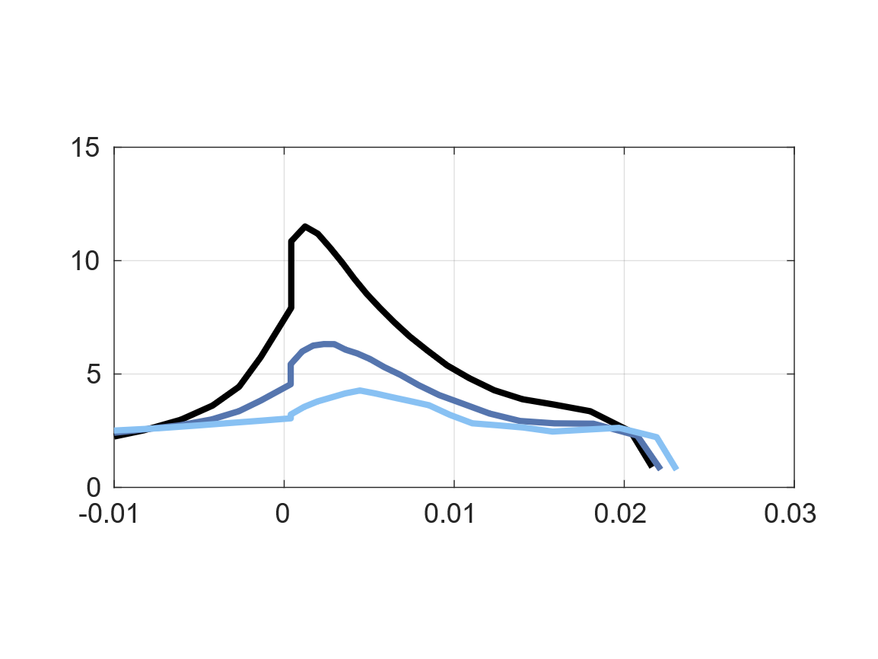


We understand why and when ADCs yield big benefits (!)
Validation of the importance of including drifts exhaust modelling
WEST (>2025)
See J. Harrison, et al.
Asdex Upgrade (>2025)
See J. Harrison, et al.
TCV
$$T_{e,t} (eV)$$
SOLPS-ITER
Some ADCs yielded less benefits than expected but we understand why
Benefits poloidal flux expansion TCV
relatively small
  Drift simulations reproduce results
Benefits Super-X TCV relatively small
  Baffling not as strong -> neutral
  escape -> flows -> negate SXD
  benefit [M. Carpita, et al. 2024, NF]
DRIFTS
Preliminary
No change !
NO
DRIFTS
?
[E. Tonello, et al.
this conference]
[M. Carpita, et al. AAPS, 2025]
$$dr_{u} (m)$$
Validated tools/sims. for ADC implementation !
We now understand why
The most successful cases work so well
Other configurations yielded less benefits
Neutral baffling
Maximises plasma-neutr. Inter. & decouples divertor-core
Enables divertor shape detachment benefits
To be validated

Slide 23
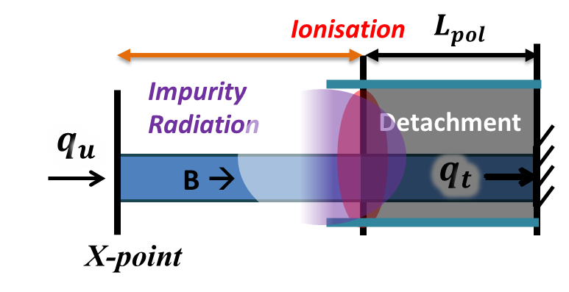
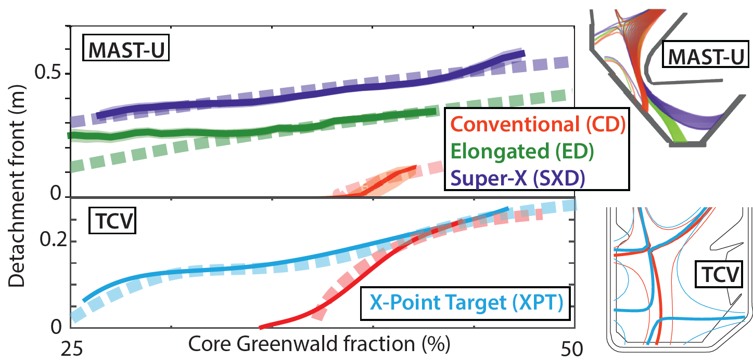

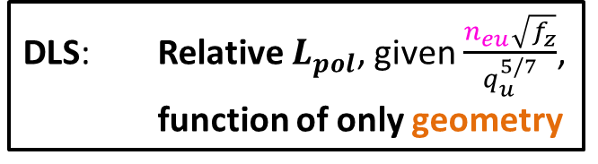

Reduced model: magnetic topology drives detachment front
$$L_{pol}$$
Ionisation
Divertor (poloidal) leg length/volume
  Power/particle losses
Divertor topology (total flux expansion & secondary null)
  Detachment access & reduced sensitivity
Neutral baffling (similar neutral pressure CD & ED & SXD )
  Enables shaping benefits to be obtained
Impurity
Radiation
Detachment
$$q_{u}$$
$$q_{t}$$
$$q_{t}$$
B →
$$q_{t}$$
X-point
MAST-U + TCV
Detachment front (L_{pol}) (m)
DLS: Relative $L_{pol}$, given $\frac{n_{eu}\sqrt{f_{z}}}{q_{u}^{5/7}}$,
function of only geometry
Core Greenwald fraction (%)
DLS prediction (calibrated to CD detachment onset)
Reduced models enable exploring balance exhaust benefits & engineering complexity
Detachment front as function of only shape (DLS) [Lipschultz, 2017, NF; Cowley, 2023 NF; Myatra, 2023, NF]
Predicts detachment onset, window & sensitivity
Agrees with experiments
Neutral baffling
Maximises plasma-neutr. Inter. & decouples divertor-core
Enables divertor shape detachment benefits
Preliminary

Slide 24
















Analysis: neutral buffer -> deepens detachment
h𝜈
h𝜈
B →
$$q_{t}$$
B →
X-point
h𝜈
h𝜈
$$L_{pol}$$
MAST-U
$$q_{u}$$
B →
$$q_{t}$$
B →
$$q_{u}$$
Detached -
Plasma-neutr.
$∝L_{pol}{×p}_{n}$
B →
$$q_{t}$$
B →
$$q_{u}$$
$$q_{t}$$
Detached -
Plasma-neutr.
$∝L_{pol}{×p}_{n}$
B →
B →
Ion sources / sinks
[N. Osborne, et al. 2025, NF]
[K. Verhaegh, et al. 2025, Commun. Phys.]
12
Novel Insights -> Novel Solutions
Plasma parameters similar at same poloidal distance to X-point
Longer divertor legs ( ED & SXD ) + baffling
more ion sinks & mom. Losses -> deeper detachment
$$L_{pol}$$
$$q_{u}$$
$$q_{t}$$
Neutral baffling
Maximises plasma-neutr. Inter. & decouples divertor-core
Enables divertor shape detachment benefits
B →
B →
$$q_{u}$$
B →
$$q_{t}$$
B →
$$q_{u}$$
B →
$$q_{t}$$
B →

Slide 25




ADCs as understanding & model validation tool
Validation of the importance of including drifts exhaust modelling
WEST (>2025)
See J. Harrison, et al.
Asdex Upgrade (>2025)
See J. Harrison, et al.
MAST-U + TCV
[K. Verhaegh, et al. 2025, Commun. Phys.]
Example 2: ADC research highlighted errors plasma-neutral interactions exhaust modelling
Example 1: Validation of the importance of drifts in exhaust modelling
[E. Tonello, et al. this conference]
Example $Dα$ emissivity
[Wijkamp, 2023, NF]
SOLPS-ITER simulations
[J. Karhunen, D. Moulton, et al.]
Default rate
Validate importance of drifts in exhaust
simulations
  Necessary to reproduce TCV results
New rate
Extrapolating reactor simulations
(STEP) shows significant impact
Errors:
>200% ion sinks
200-800% dissociation
ADC research can help tackling gaps in general power exhaust understanding & model validation
ITER and beyond
[Verhaegh, et al. 2024, NF]

Slide 26



Next steps: ADCs at reactor-relevant power
WEST (>2025)
See J. Harrison, et al.
Asdex Upgrade (>2025)
See J. Harrison, et al.
AUG
Snowflake ADCs achieved at high power
MAST-U + TCV – up to 4-5 MW
ADC configurations tested up to 20 MW input power (!) on ASDEX Upgrade
Preliminary
Conventional
(upper single null)
Snowflake minus
(upper single null)
ADC geometries obtained (camera + magnetic reconstruction) – analysis underway
[D. Brida, et al. APS, 2025]
[T. Lunt, et al. IAEA Div Conc, 2025]
[B. Sieglin, et al. EPS, 2025]
(See T. Lunt, et al. this conference)
[Zammuto, et al. 2021, FED]

Slide 27

Next steps: ADCs at reactor-relevant power
WEST (>2025)
See J. Harrison, et al.
Asdex Upgrade (>2025)
See J. Harrison, et al.
DTT
Divertor Test Tokamak (DTT) equilibria
[DTT research plan]
MAST-U + TCV – up to 4-5 MW
ADC configurations tested up to 20 MW input power (!) on ASDEX Upgrade
Prepare for DTT to push ADCs to even higher power (42.5 MW)
DTT Timeline
[F. Crisanti, et al. 2024, Nucl. Fusion]
Now Construction
2029 Commissioning & test 17.5 MW
2034 Relevant-power studies 26.5 MW
2038 DEMO-like divertor test 42.5 MW
ADC equilibria (EU-)DEMO
[H. Reimerdes, et al. 2020, NF]

Slide 28


Take away message
Tangible power exhaust benefits for reactors
  Not only limited to lower heat loads
  More flexibility for steady-state solution,
  exhaust control, transients, ….
We understand the physics of these benefits
  Continuum of ADCs provides these benefits
  Enable balancing engineering complexity
  and power exhaust benefits
Magnetic topology as a tool for model validation
and general divertor optimisation
ADCs -> towards reactor implementation

