Slide 1
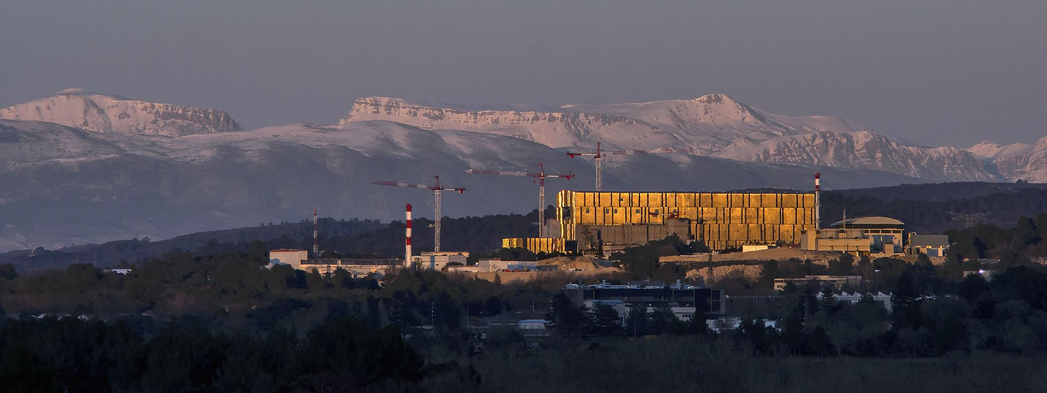

CHANGE OF WALL MATERIAL FROM BERYLLIUM TO TUNGSTEN IN THE NEW ITER BASELINE: PHYSICS BASIS, IMPLICATIONS FOR RESEARCH PLAN AND WALL DESIGNS FOR ITS OPERATIONAL PHASES
Alberto Loarte
On behalf of co-authors from ITER Organization and ITER Members
30th IAEA Fusion Energy Conference, Chengdu, China, 15 October 2025
The views and opinions expressed herein do not necessarily reflect those of the ITER Organization.

Slide 2
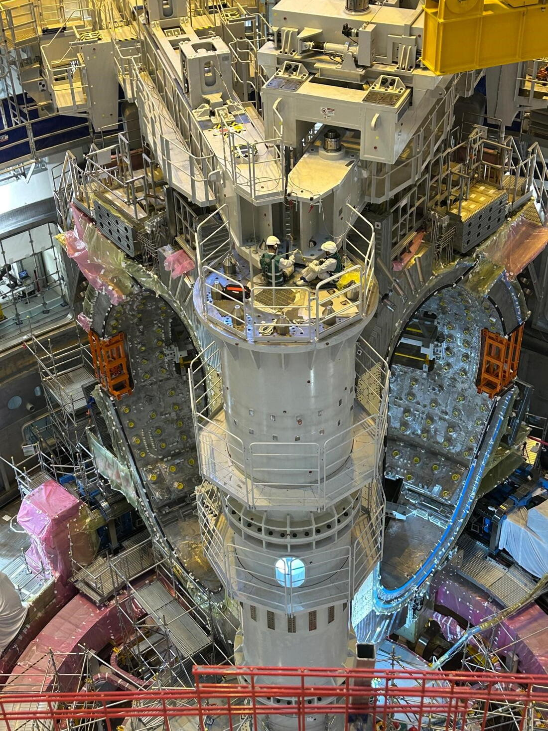
Outline
Summary of new baseline, W Wall strategy and risks
    W wall advantages + risks
    ITER Research Plan and wall strategy
Vacuum conditions
Scenario Phases
  Limiter
  L-mode diverted
  H-modes : SRO and DT-1
W wall design to optimize advantages for SRO and DT-1
Conclusions

Slide 3
New baseline, W wall strategy and risks

Slide 4
W wall advantages in ITER and risks
Physics basis for tokamak operation with W walls much stronger than at start of ITER construction
W wall provides advantages to new ITER baseline compared to Be
▪ Low erosion rate → Longer PFC lifetime
▪ Low Tritium retention
▪ High melting point → Higher resilience to disruption loads (higher I_{p} before large scale melting in unmitigated events and easier mitigation )
W wall introduces new risks
    ▪ Loss of O₂ gettering → vacuum conditions
▪ Increased plasma W contamination risk → large P_{rad} (radiative collapse, loss of H-mode, ….)
New baseline has been optimized to maximize W wall advantages and reduce risks

Slide 5
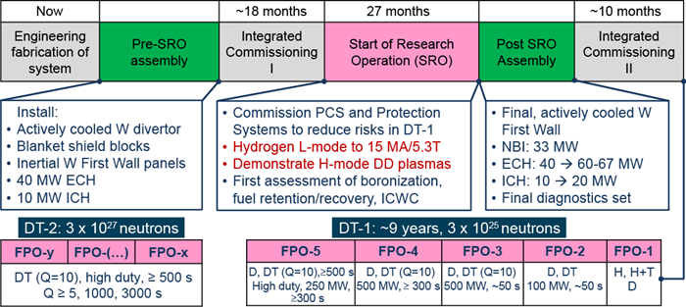
New baseline and IRP : W wall strategy
Robust achievement of Projects’ goals in three phases : Start of Research Operation (SRO), 1st DT phase (DT-1) + 2nd DT phase (DT-2)
Realistic operational assumptions and minimization of technical risks
  SRO : scenario development and commissioning of systems → inertially cooled W wall
  DT-1 : W water cooled wall + P_{aux} = 103 – 120 MW → higher P_{rad} in scenario development + D - DT

Slide 6
W wall and Vacuum Conditions

Slide 7
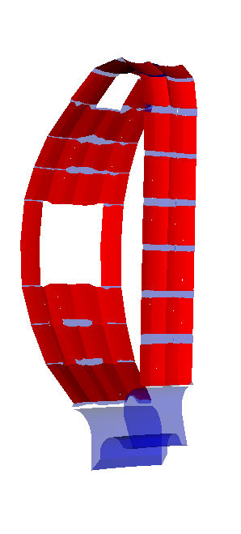
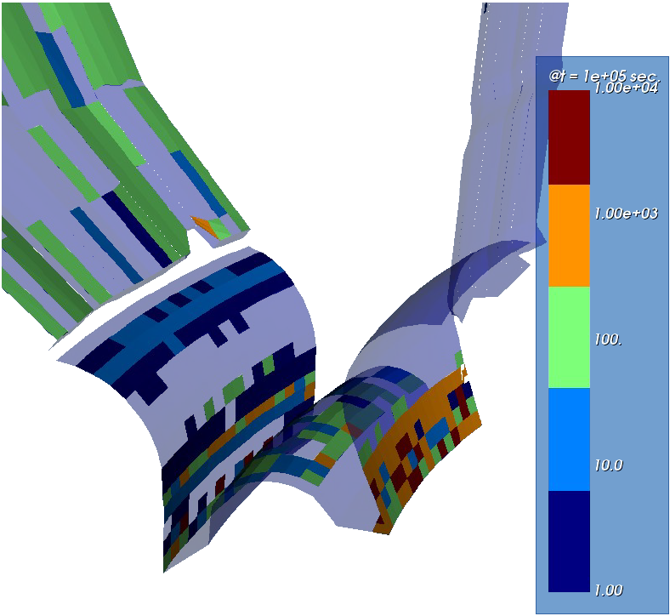
Boronization system reduces O₂ risk
Boron provides O₂ gettering → 14 diborane injection points + 11 GDC anodes
T. Wauters NME 2025
Lifetime of B layer evaluated by erosion-deposition (WallDYN3D)
  short on plasma exposed areas
  ~ few 10⁴ s in remote areas → O₂ gettering not to cover W by B
50 nm B binds ∼1–5 × 10²⁰ O₂/m² → 10% wall area absorbs 2.5 -12.5 weeks 316 SL outgassing
Maximum boronization frequency 2 weeks (STM)
Wall-deposited B erodes and migrates to divertor or is covered by W → 0.3 H per B
Plasma operation + ICWC to remove H
K. Schmid NME 2024 and ISFN R&D
t = 10⁵ s
< 10 μm B:W
t = 0 s
100 nm B
    J. Hobirk - Tungsten limiter Start-up experiments (ASDEX Upgrade, WEST) – 15/10 17:30
    D. Mateev – Fuel retention and recovery in JET – 16/10 17:05
    E. Geulin – WEST wall conditioning with Boron – 18/10 8: 30 P7

Slide 8
Scenario phases : Limiter

Slide 9
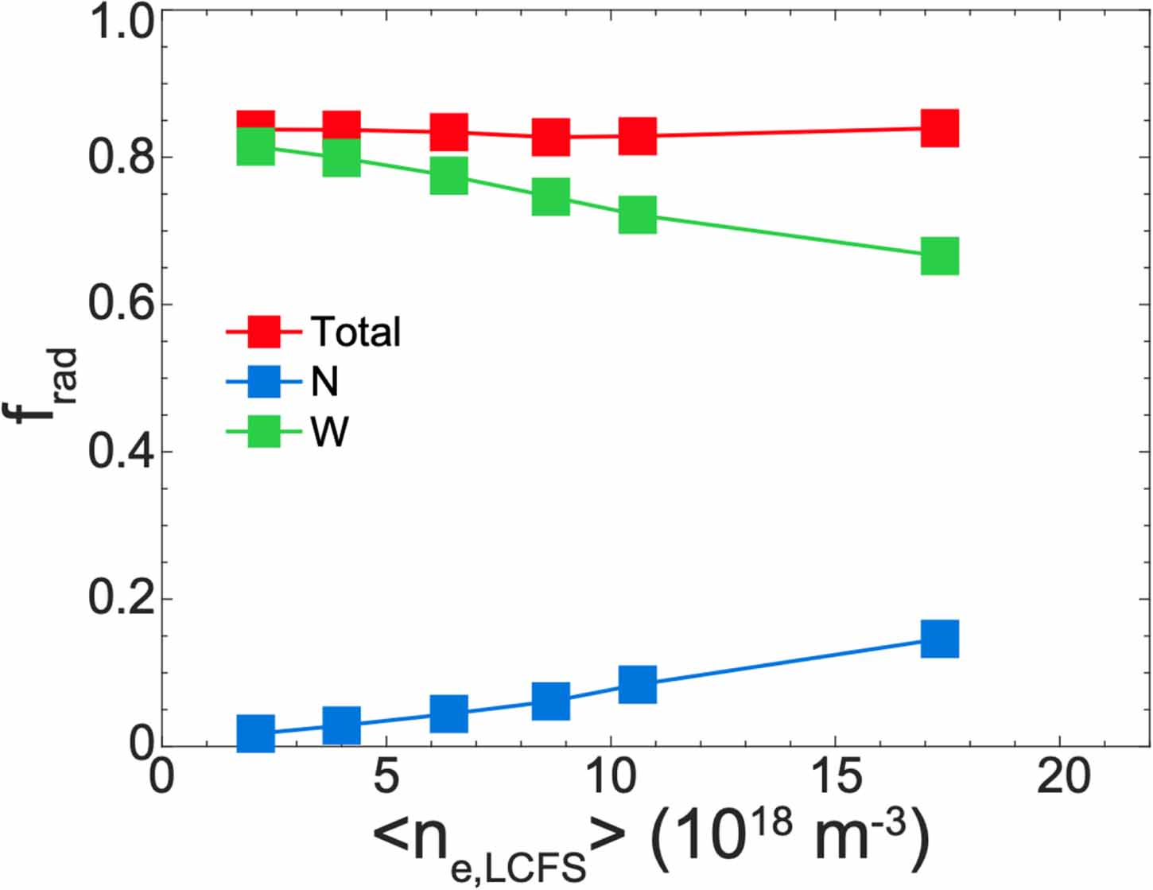
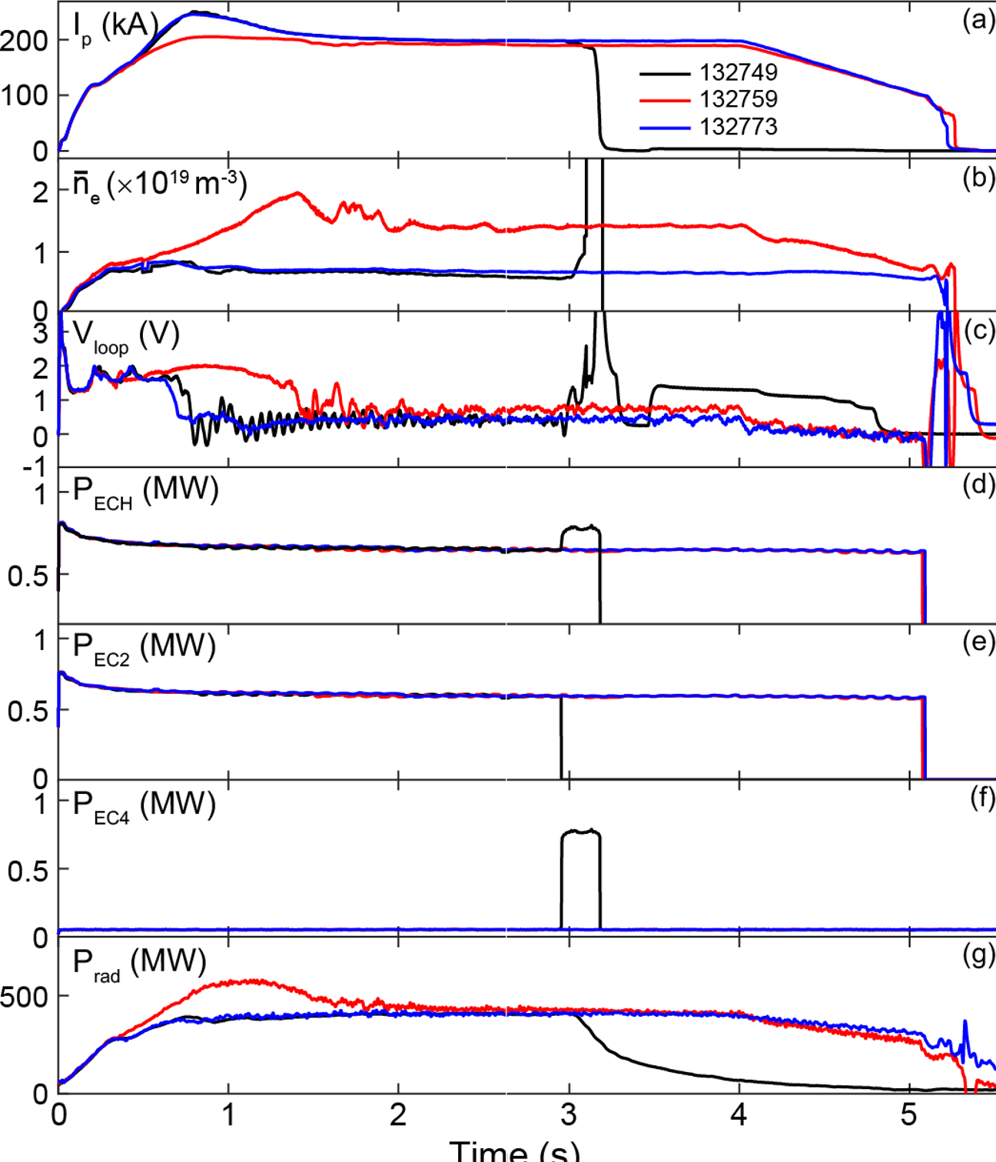
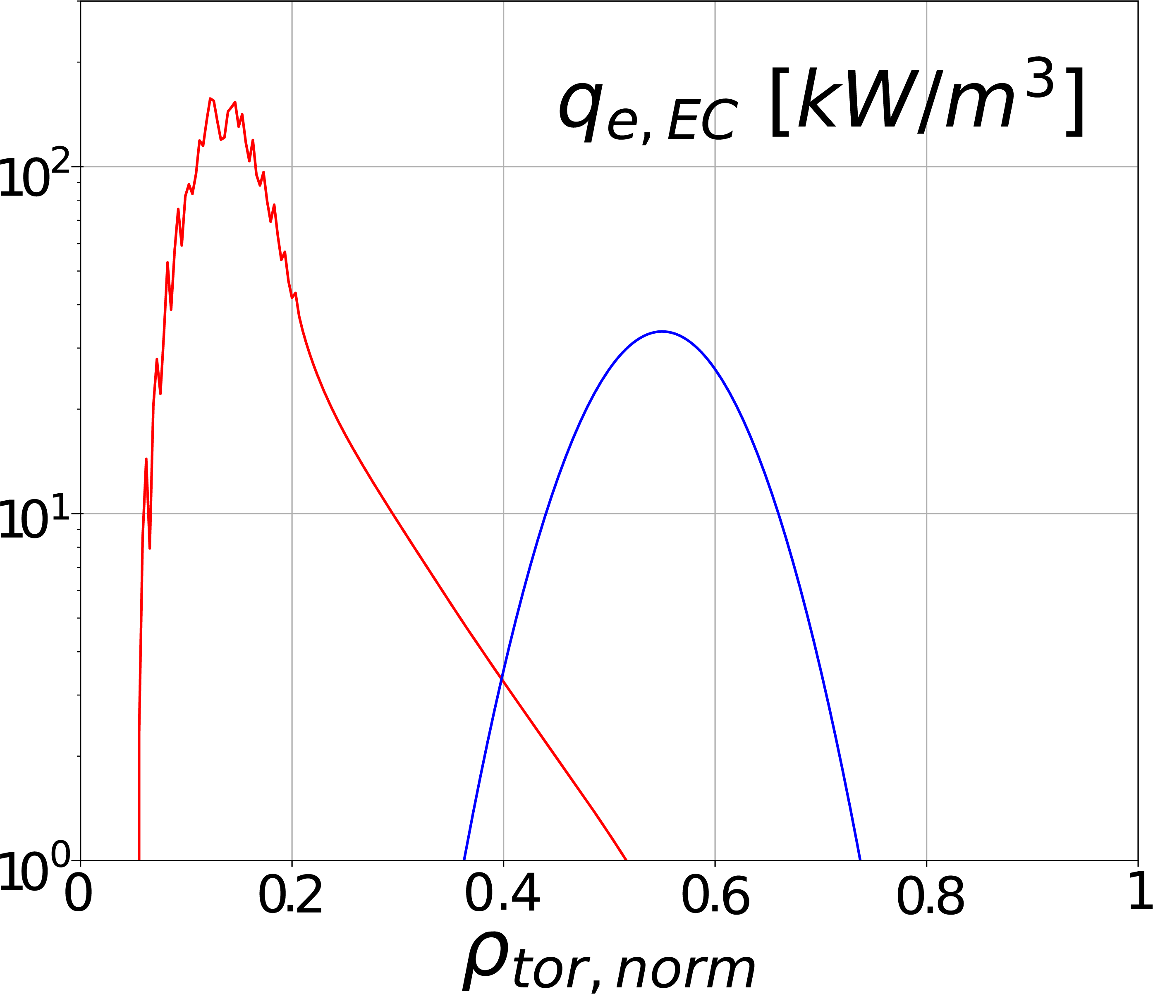
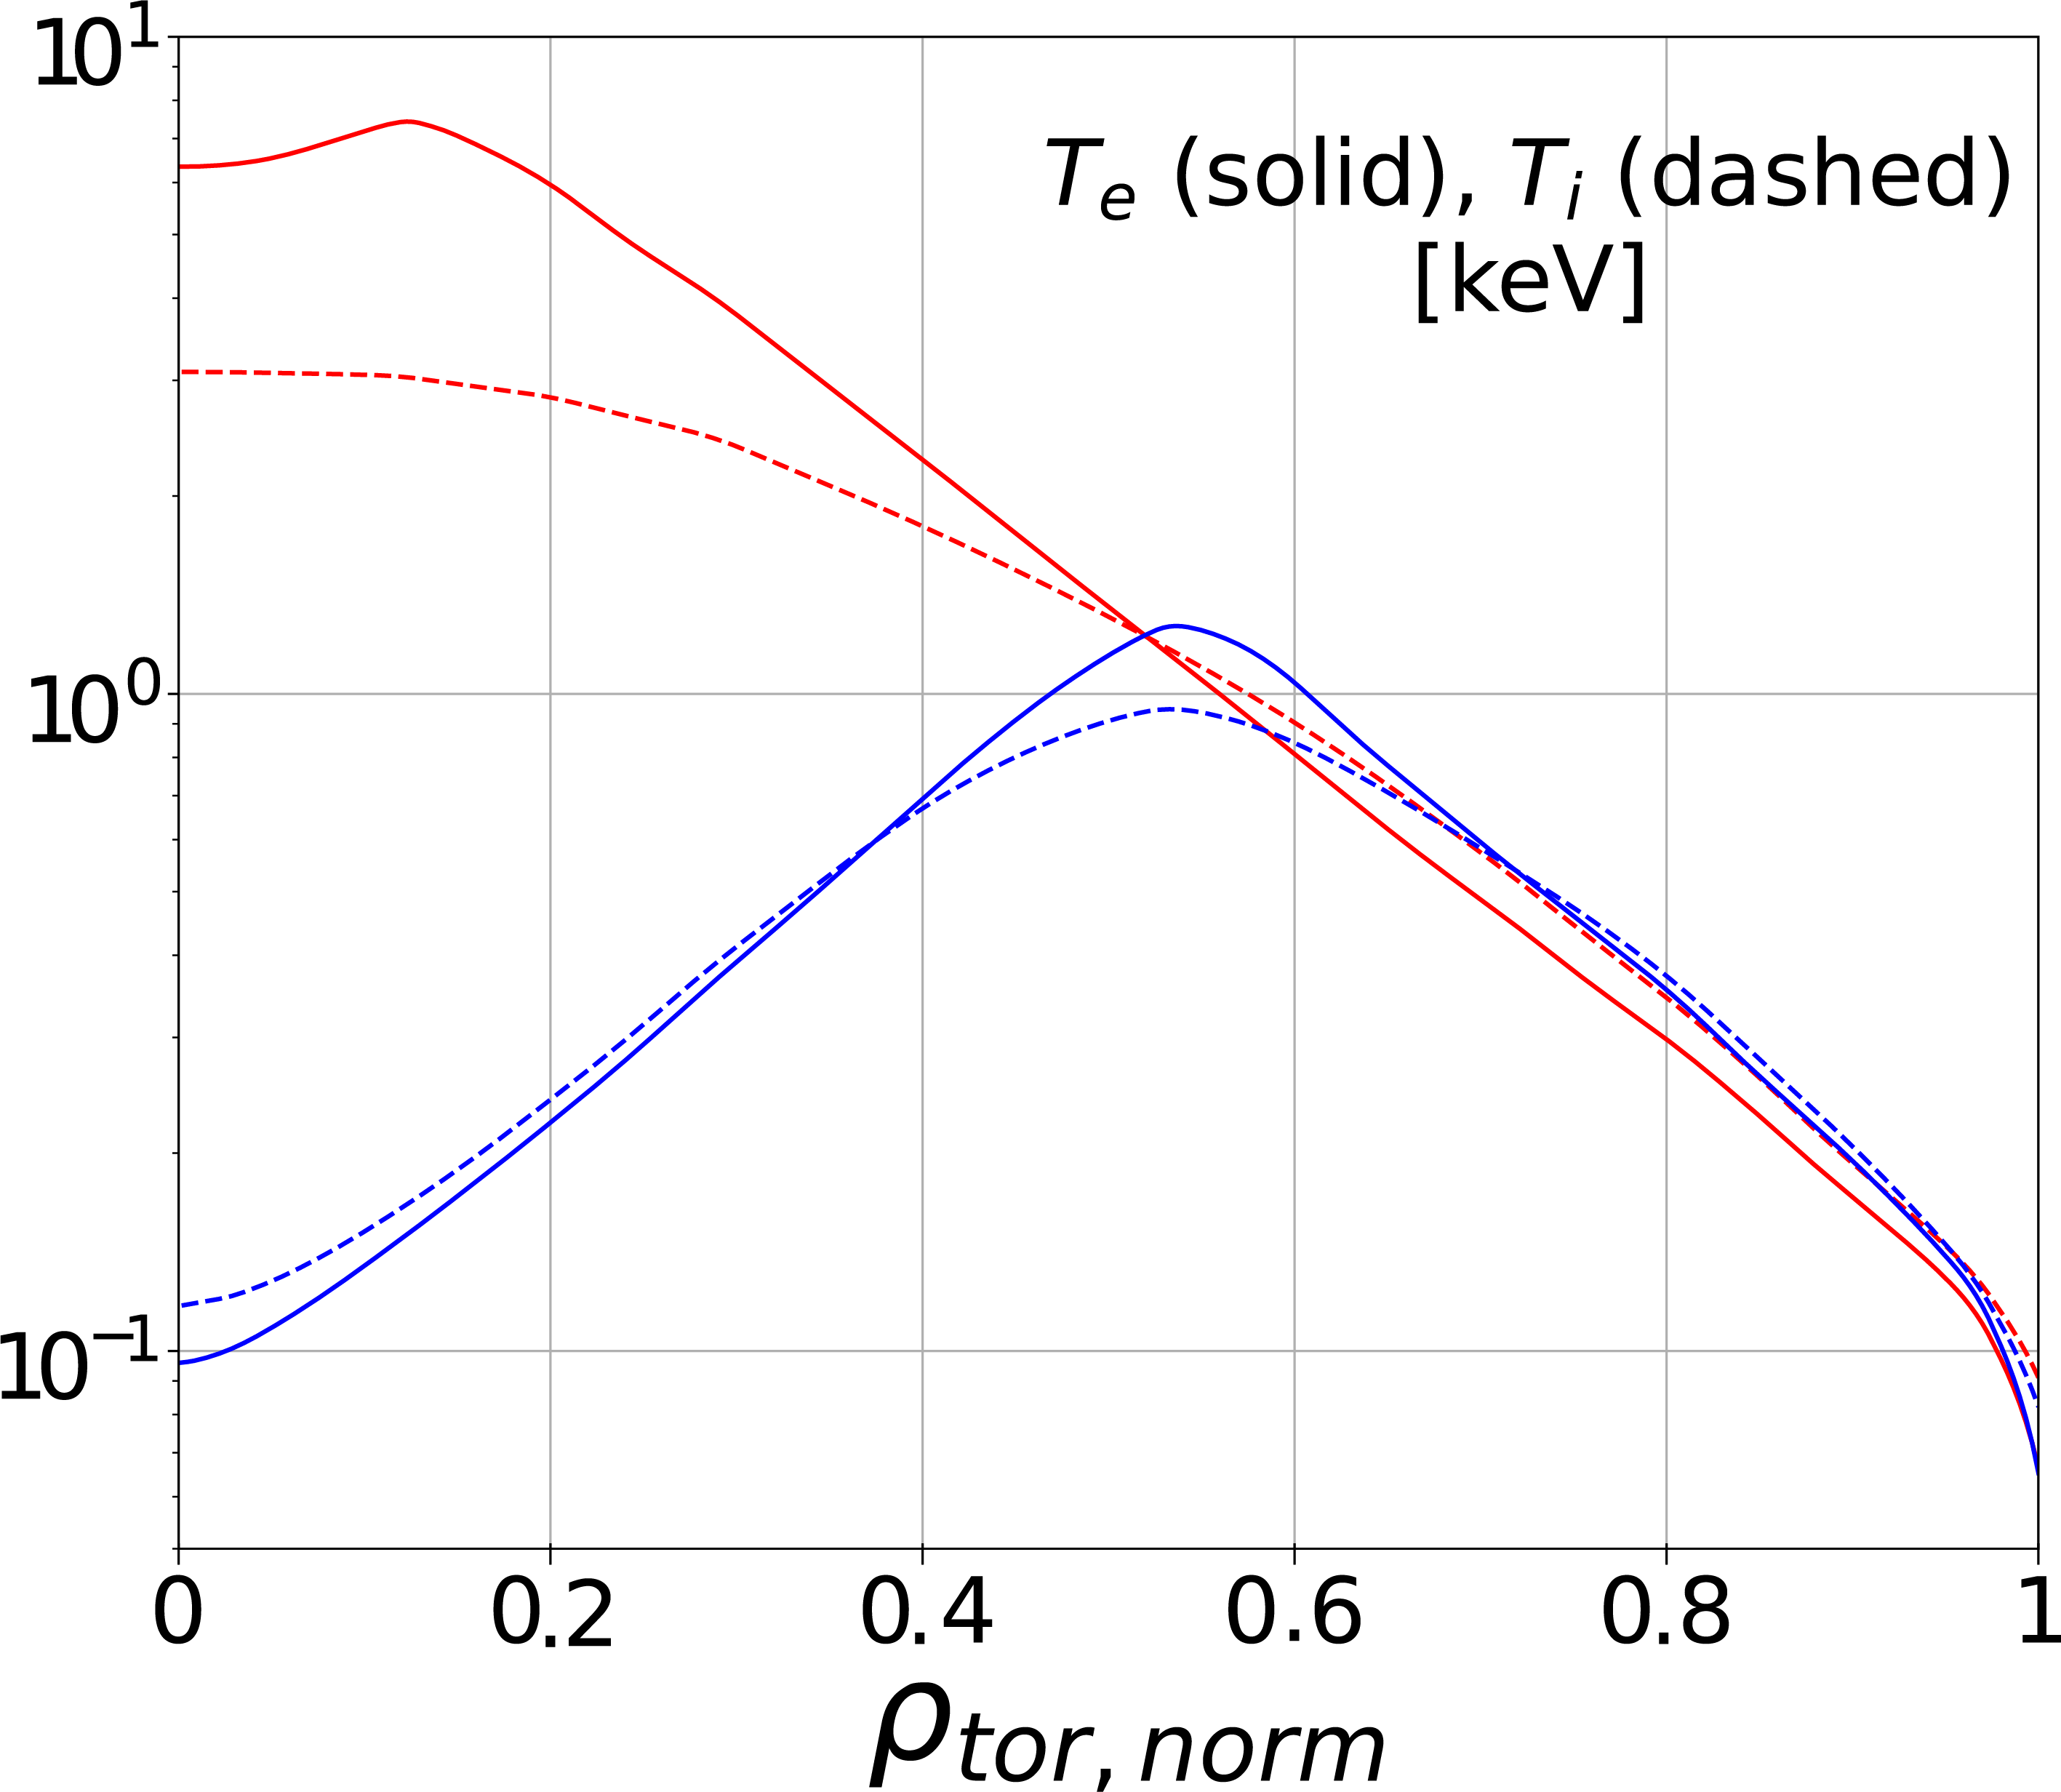
W radiation: low limiter loads but central ECH essential
Limiter phase → easy W penetration into core plasma → strongly self regulated system T_{e} Γ_{W} P_{rad} T_{e} (ITER modelling and experiments)
Central ECH required to avoid radiative collapse by W → B_{t} = 2.65 & 5.3 T
ITER - Y. Zhang – NF 2025
ITER - JINTRAC - Pitts- NME 2025
EAST
    X. Gong – EAST experiments to support IRP – 14/10 14:25
    M. Schneider – Integrated Modelling – 15/10 17:30
    J. Hobirk - Tungsten limiter Start-up experiments (ASDEX Upgrade, WEST) – 15/10 17:30

Slide 10
Scenario phases : L-mode diverted

Slide 11
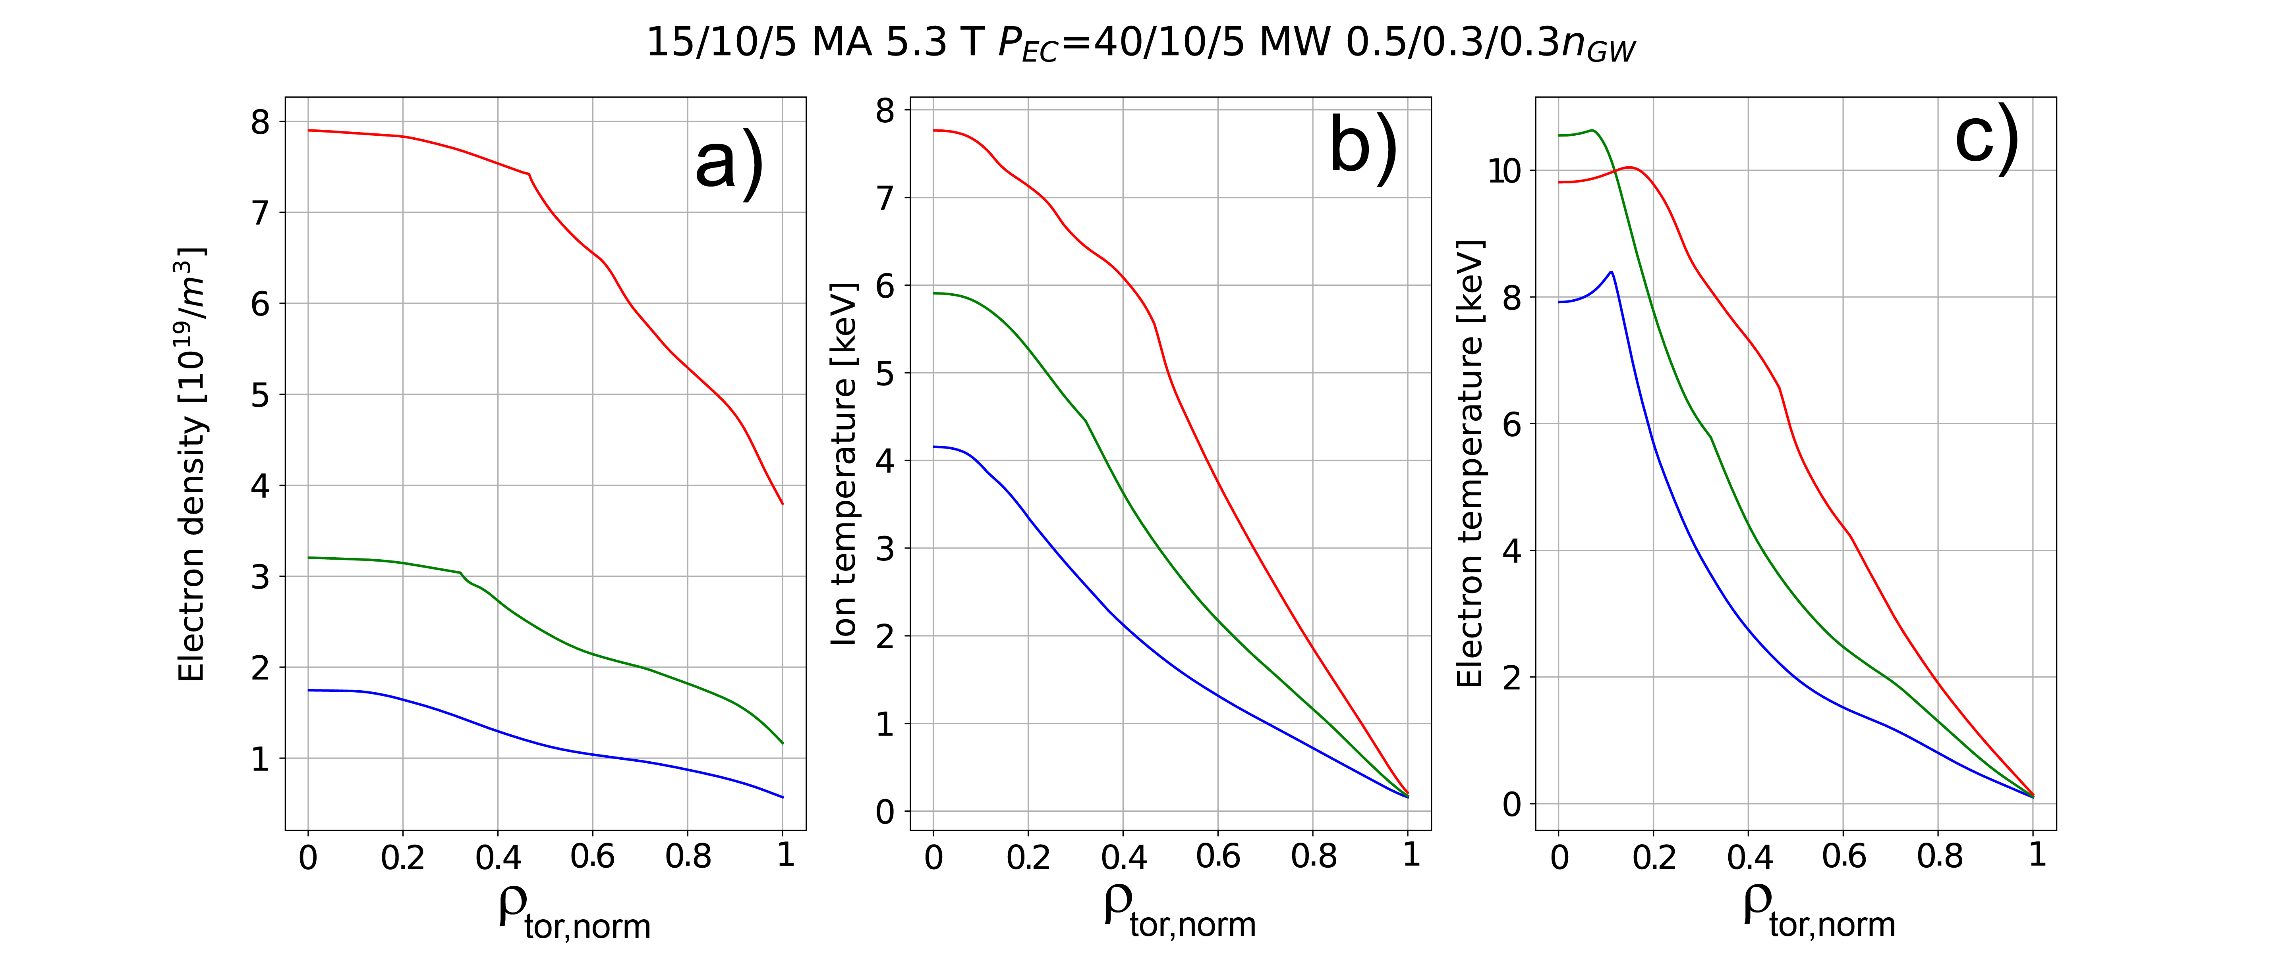
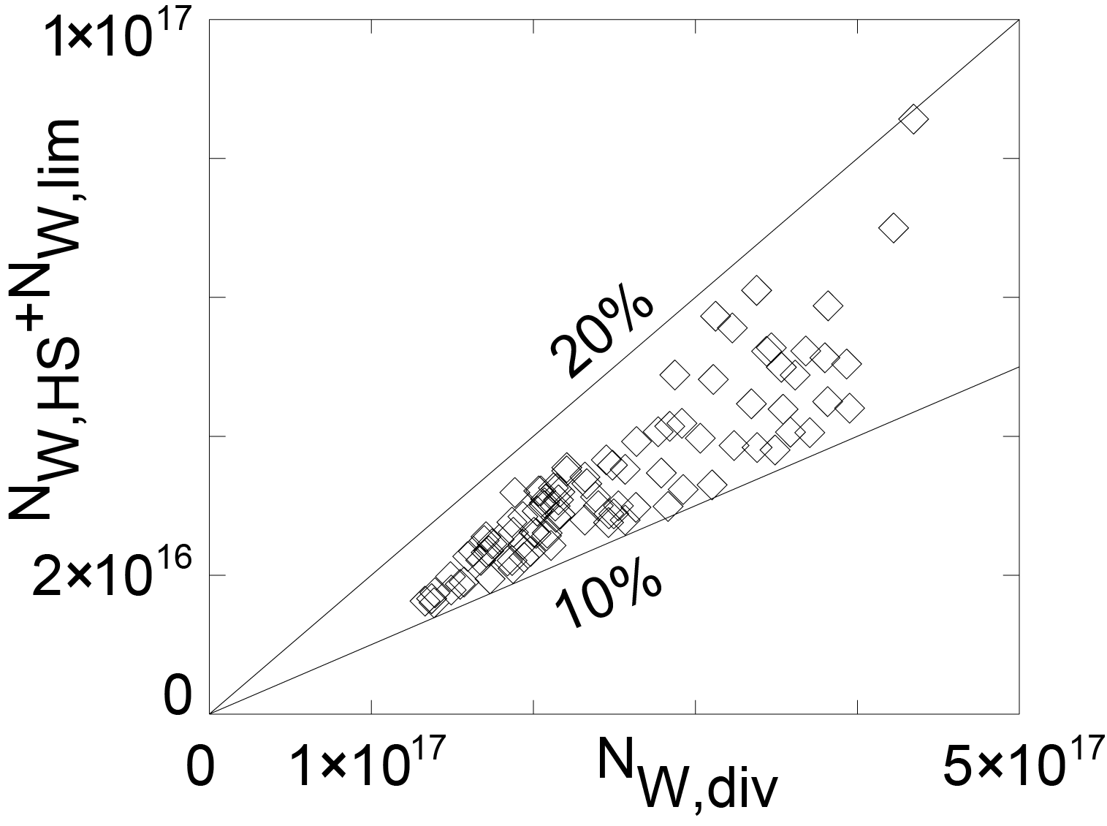
Low W wall risk for ECH heated L-modes
Low/medium I_{p} ECH heated L-modes resilient to W accumulation & radiative collapse (low absolute n_{e} and high T_{e}) due to limited equipartition
ITER - JINTRAC – Loarte - PPCF 2025
ASDEX Upgrade – Dux – NF 2011
    S.H. Kim – Development of High-Fidelity Plasma Simulator – 17/10 14:00 P6
    M. Schneider – Integrated Modelling – 15/10 17:30
    D. Fajardo – Validated integrated modelling of W in experiments and ITER – 18/10 8:30 P7

Slide 12
Scenario phases : H-mode
SRO ELMy H-mode
Controlled ELM H-mode Q ≥ 10

Slide 13
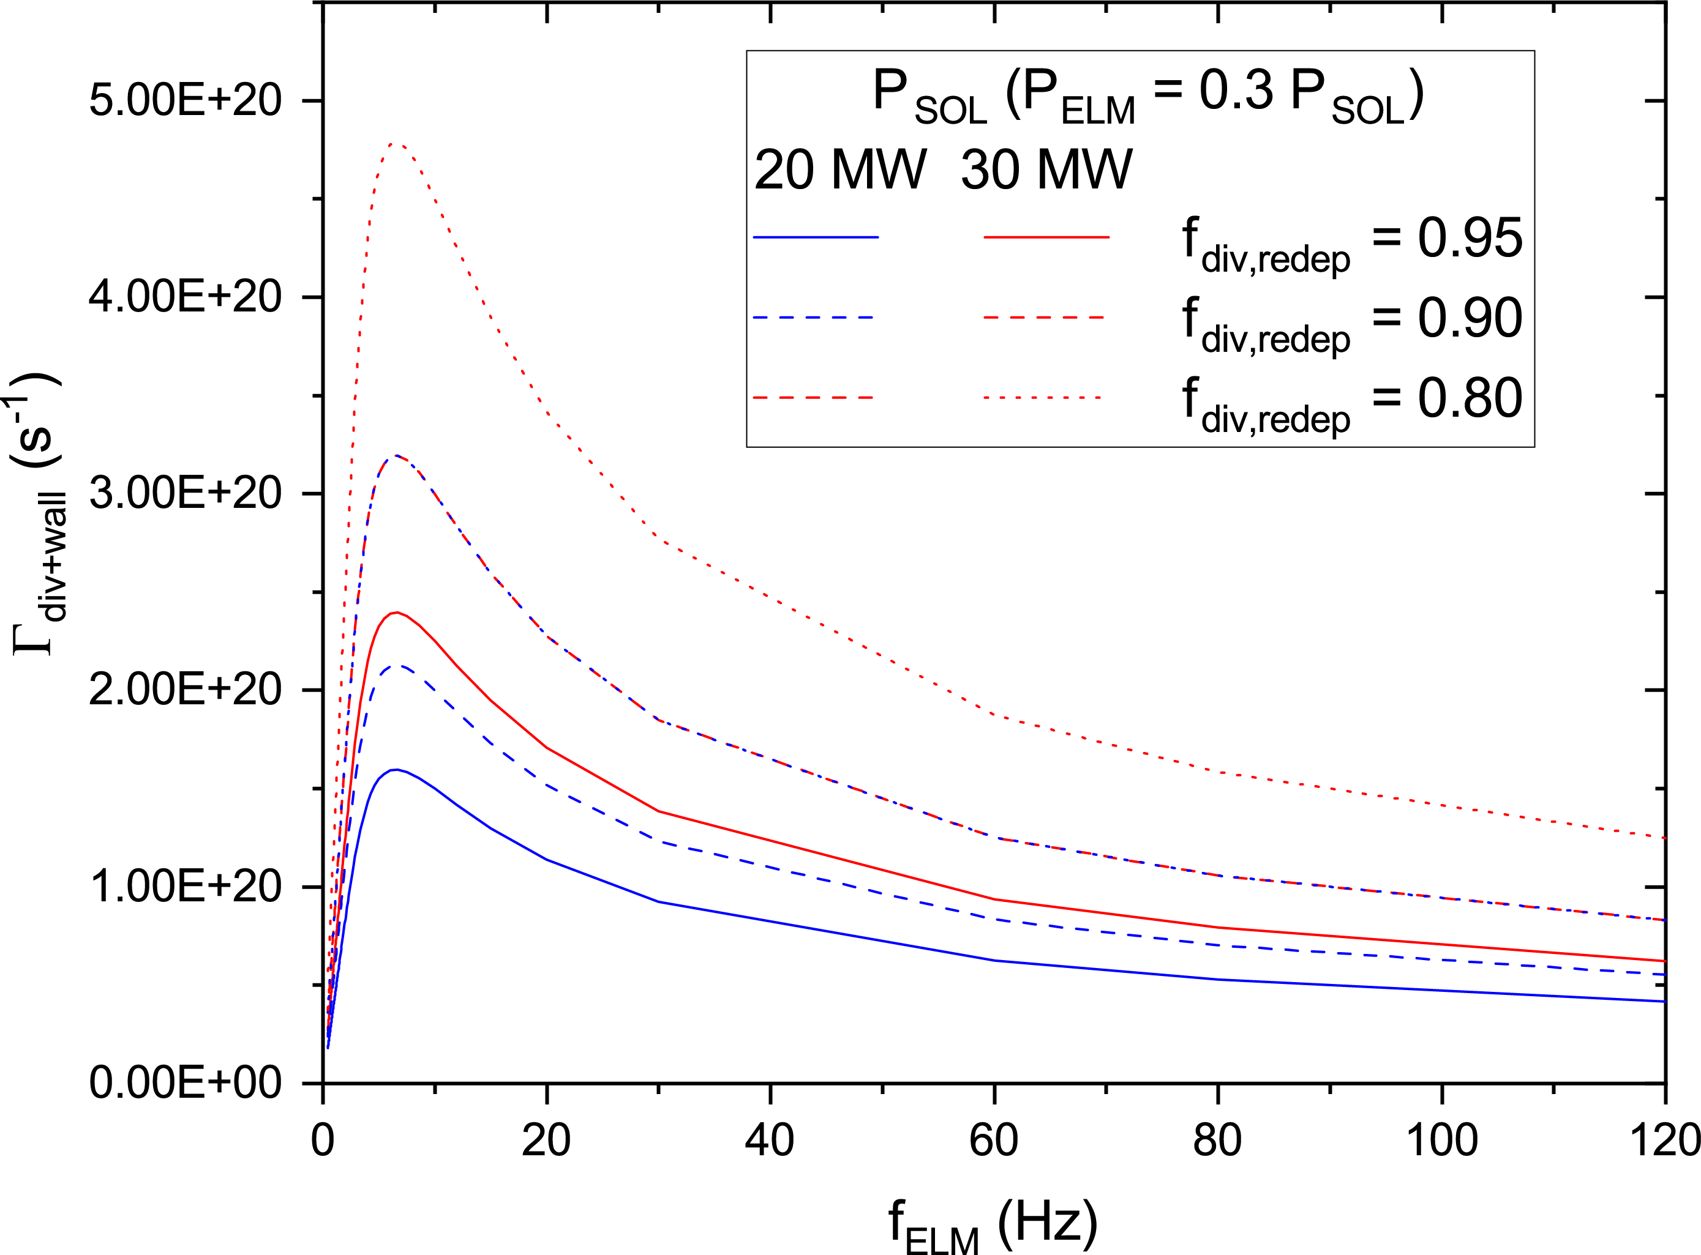
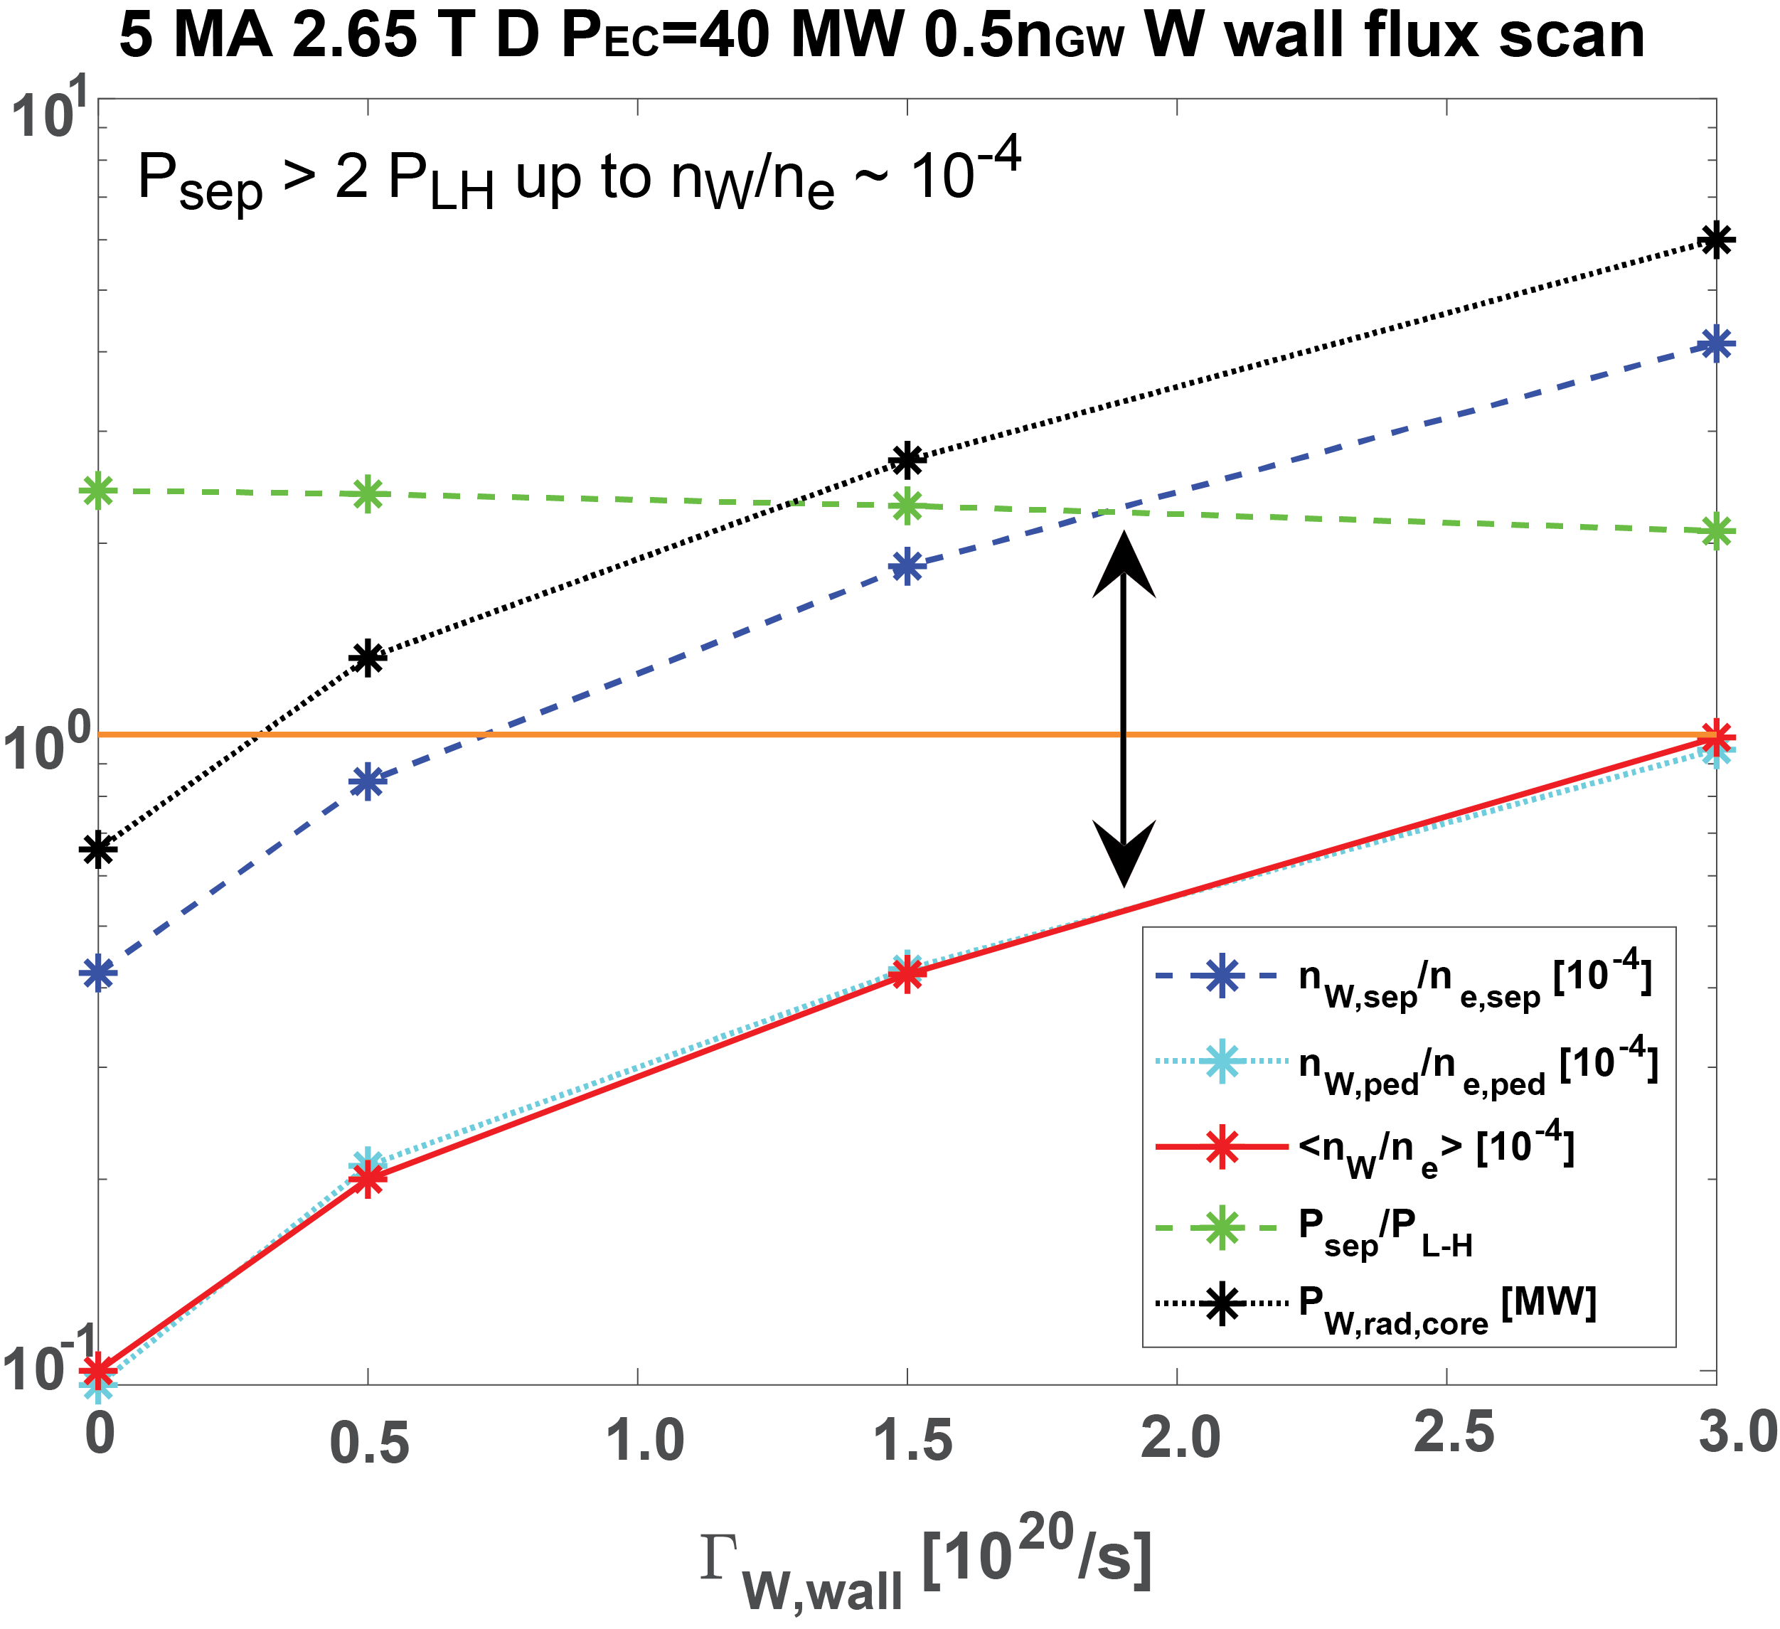
ELM control essential for SRO ELMy H-modes
ELMs melt divertor monoblock gaps for I_{p} ≥ 5 MA/2.65 T and also contaminate core plasma by W → H-mode scenario to be developed in SRO
<Γ_{ELM}^{W influx}> (SOLPS + experimental guidance) + JINTRAC → requirements
JET- Huber – NME 2020
ITER - JINTRAC – Loarte - PPCF 2025
  f_{ELM} ≥ 20 Hz required → 4 pellet injectors (f_{pellet} ~ 60 Hz) and full set of ELM control coils
  5 MA/2.65 T ECH H-mode resilient to W influxes : Low <n_{e}>, T_{e} ~ 10 keV + W pedestal screening
    S.H. Kim – Development of High-Fidelity Plasma Simulator – 17/10 14:00 P6
    M. Schneider – Integrated Modelling – 15/10 17:30

Slide 14
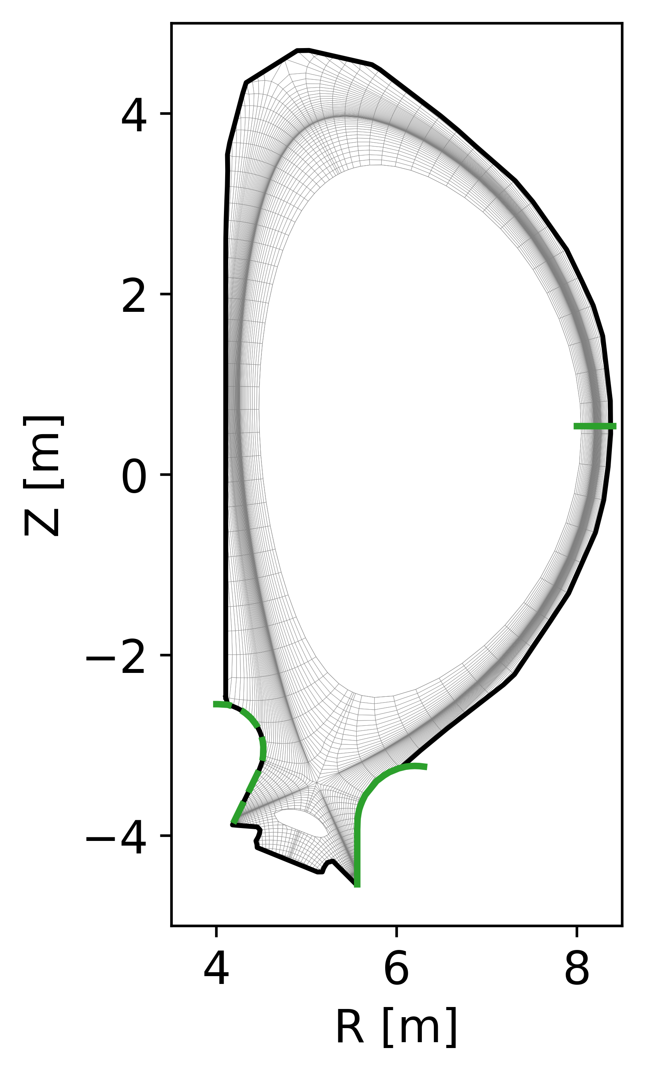
Impact of W wall on Q ≥ 10 is low/moderate - I
Suppressed/no-ELM regime required for Q ≥ 10 → modelled with D_{ped}, χ_{ped} anomalous for main ions and anomalous + neoclassical for W
Improved evaluations : W sources from modelling + self-consistent SOL plasma (largest P_{wall} and Γ_{wall} compatible with design) → Ne main driver for W wall source
ITER - SOLPS – Pshenov
ERO2.0 (W gross erosion) – C. Bauman
    E. Kaveeva – First SOLPS-ITER wide grid SOL simulations of Q ≥ 10 – 15/10 14:00

Slide 15
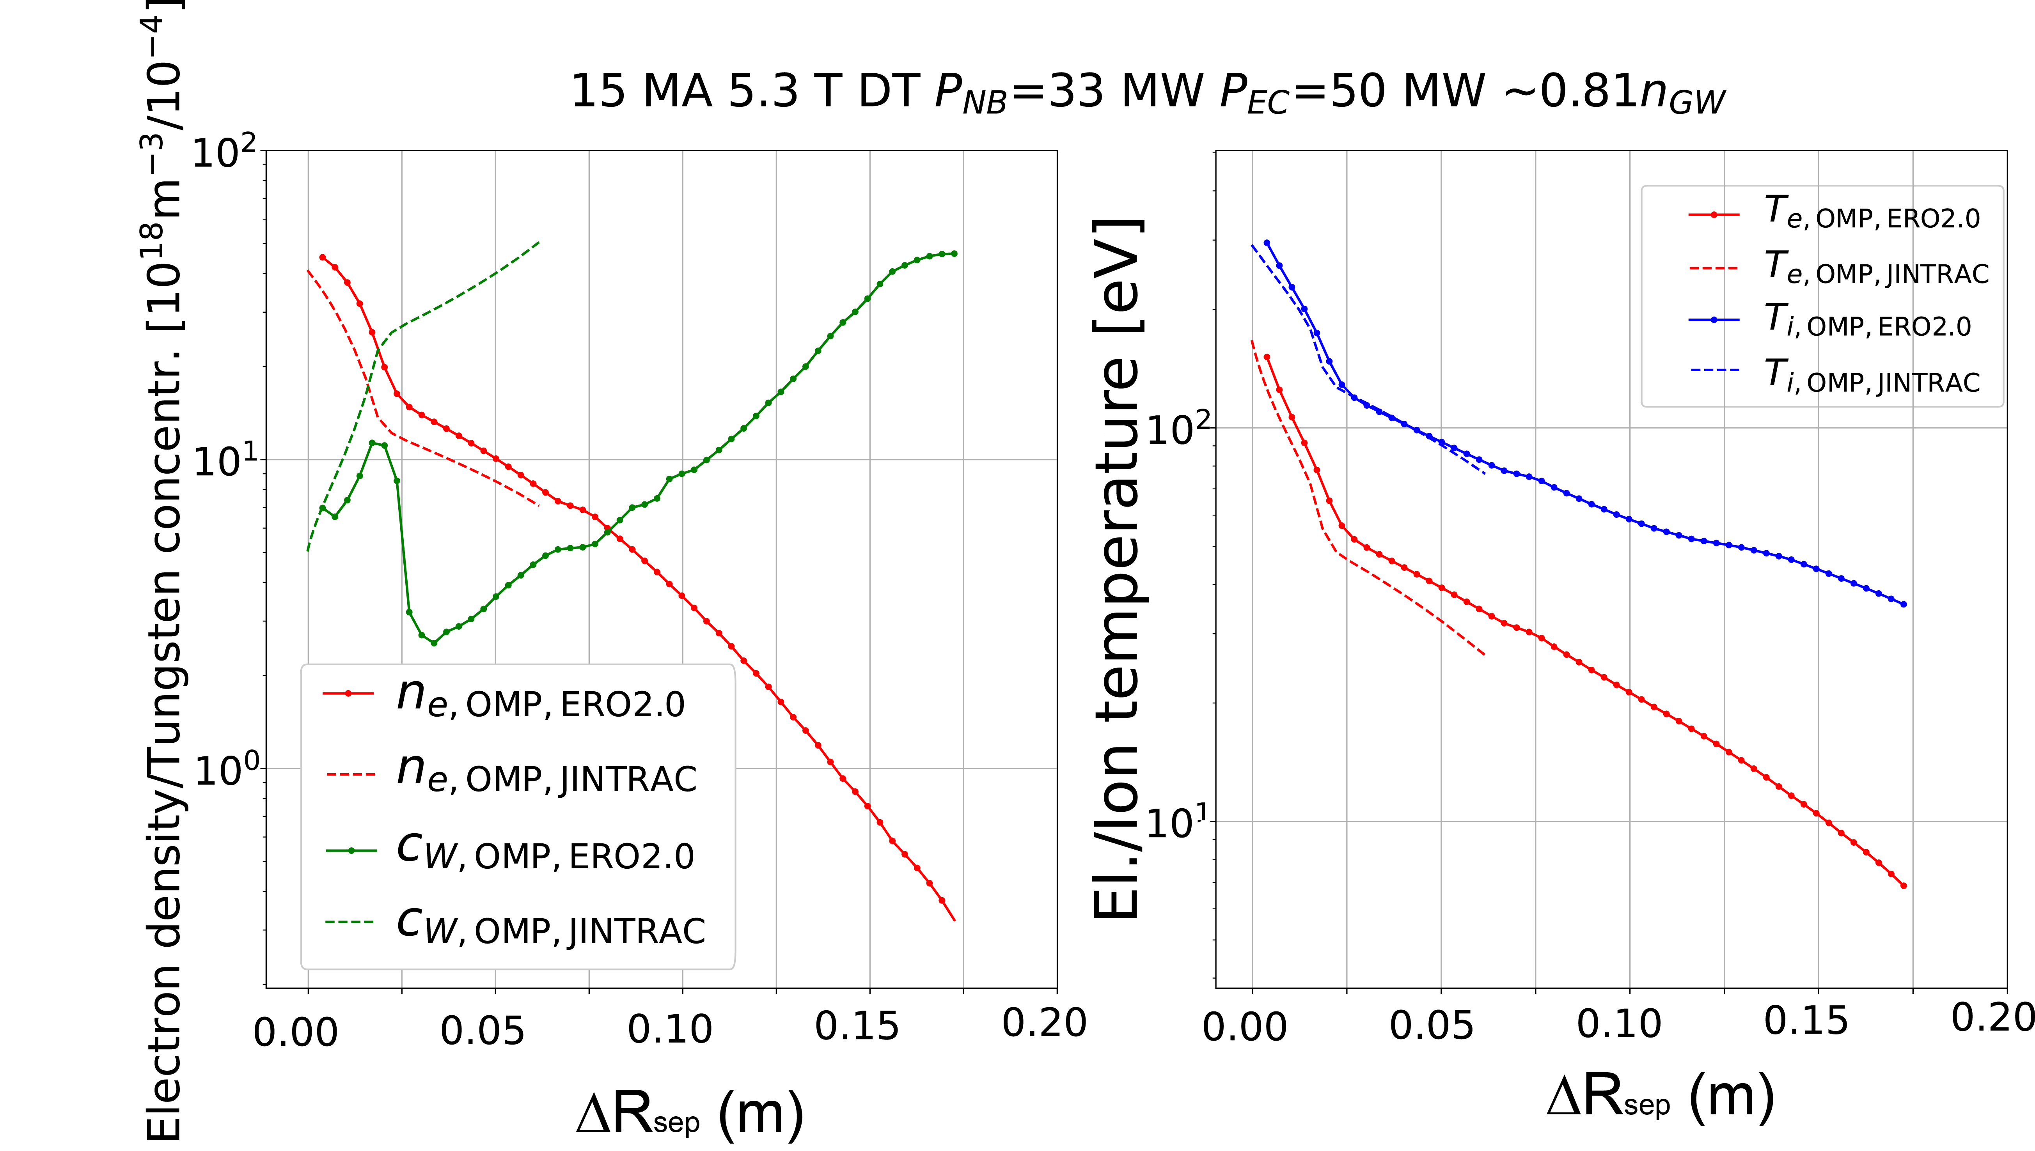
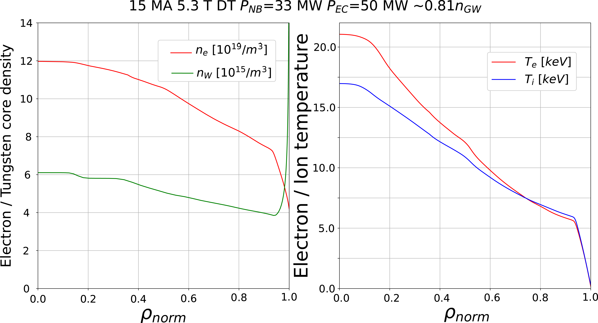
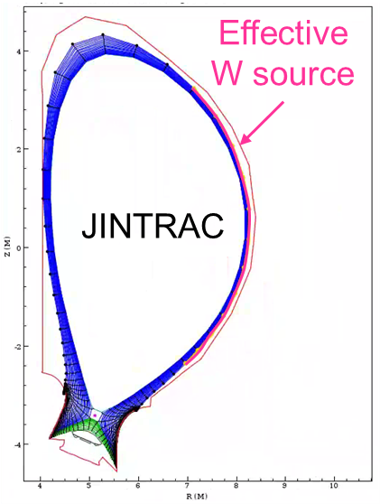
Impact of W wall on Q ≥ 10 is low/moderate - II
Integrated modelling : JINTRAC core plasma + near SOL + ad-hoc wall source to match n_{W}/n_{e}|_{sep} for “largest possible” W source
  P_{aux} ~ 80 MW and P_{fusion} = 500 MW with P_{sep}/P_{LH} > 1.5 → Q > 6 for “worst possible case”
  W pedestal screening confirmed as key to maintain fusion performance
ITER – JINTRAC - Köchl

Slide 16
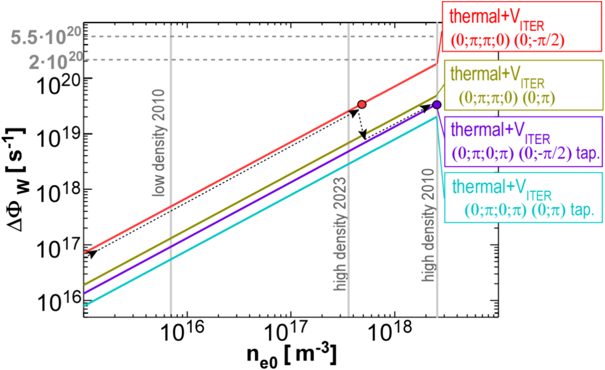
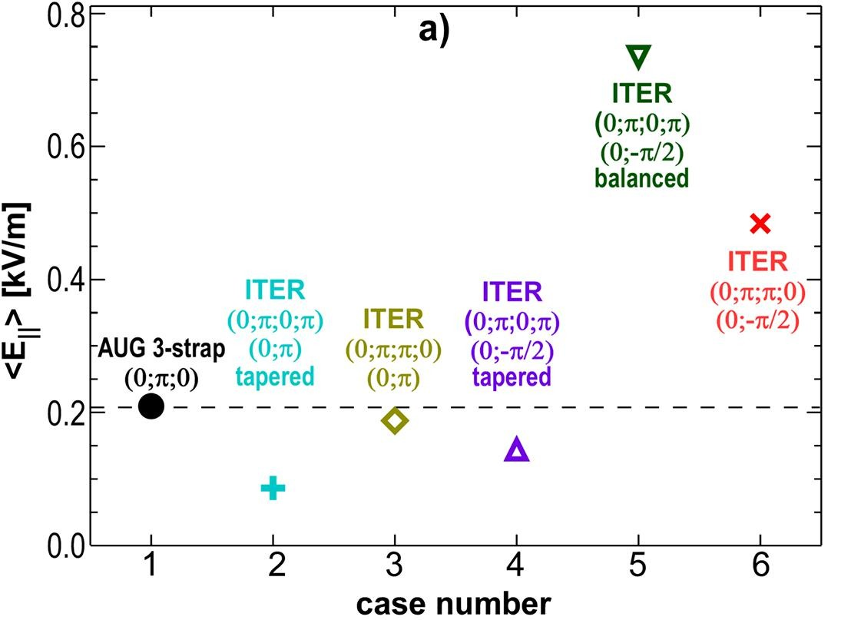
DT-1 ICH and W source
ICH antenna flexibility used to achieve ~ 3-strap like E_{II}
W source by ICH << W wall source (~10²¹ W/s) to be confirmed in SRO → upgrade to 20 MW for DT-1
V, Bobkov NME 2024 & L. Colas NME 2025
ITER – JINTRAC - Köchl
P_{ICH} = 10 MW
SOLPS-ITER
wide grid

Slide 17
W wall design to optimize advantages for SRO and DT-1

Slide 18
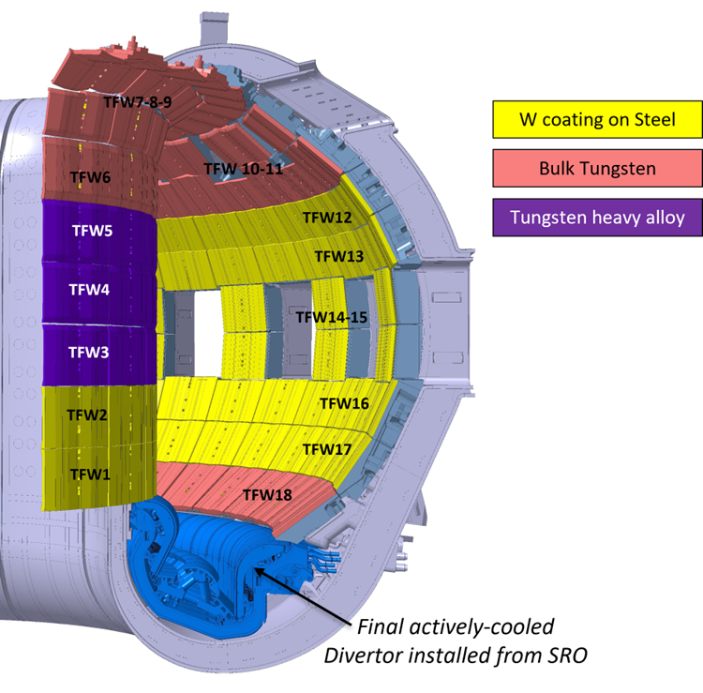
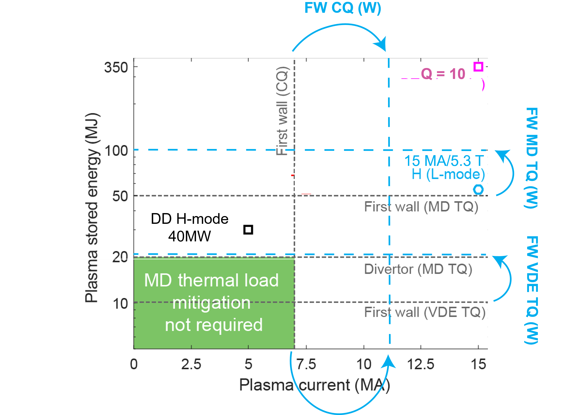
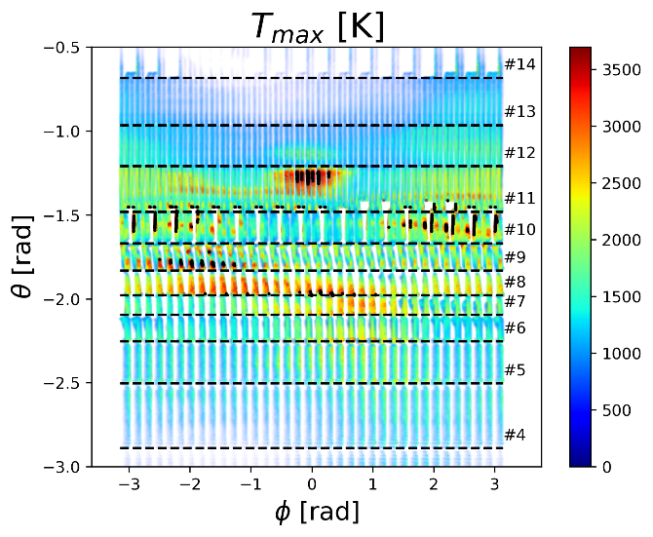
SRO wall : Scenarios + resilience to unmitigated loads :
Cost: choice of W material based on stationary & transient loads (up to 15 MA)
Optimized for resiliency to unmitigated/partially mitigated transient loads
ITER 15 MA unmitigated VDE – JOREK – Artola
T_{melt} ~ 3400 ºC
W (wt.%) 97
Ni (wt.%) 2
Fe (wt.%) 1
T_{melt}~1500 ºC
In-vessel VS to decrease risk of downwards VDE
    M. Schneider – Integrated Modelling – 15/10 17:30
    J. Artola – Modelling of thermal Loads during VDEs at JET and ITER – 18/10 8:30 P7

Slide 19
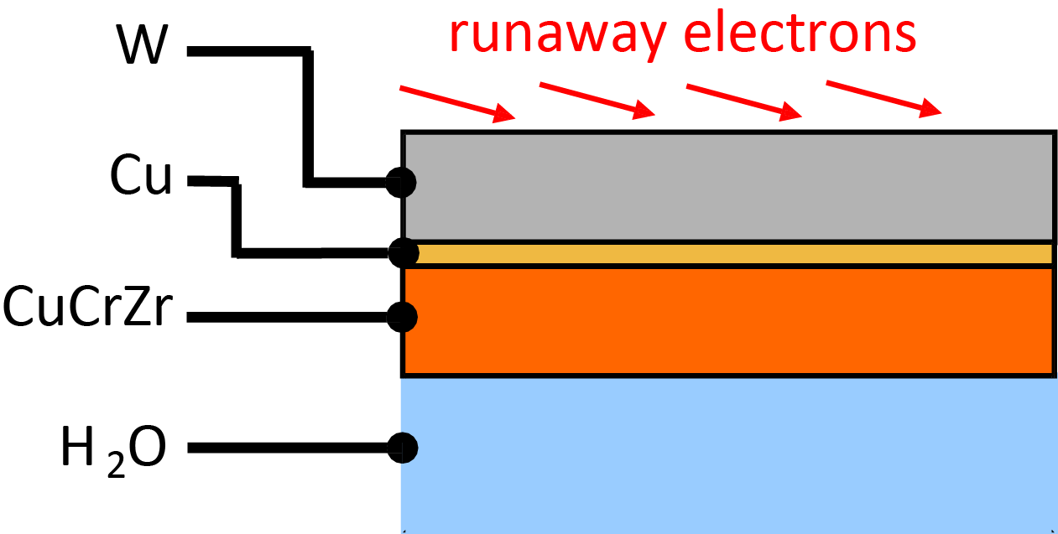
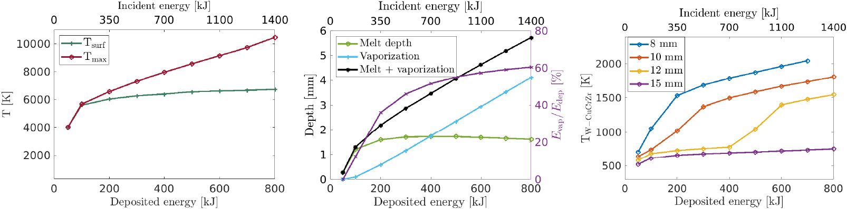
DT-1 wall: high Q scenarios + runaway loads
Stationary heat fluxes input to design as for Be wall
Resilience to disruptions (high T_{melt}) + high stopping power (runaway electrons)
  W thickness increased to 12 mm to reduce risk of water leaks in runaway loaded areas
  Runaway mitigation remains essential with DT-1 W wall
ITER – GEANT4 + MEMENTO - S. Ratynskaia – Sub. PPCF 2025
on FW-apex
on FW-apex
E_{RE-kin} ~ 2000 KJ/ I_{p-RE}(MA)
E_{RE-mag} ~ 200 MJ (I_{p-RE}(MA)/9.5)²
    S. Ratynskaia – https://arxiv.org/abs/2509.20261

Slide 20
Conclusions
Advantages/risks of W wall in ITER assessed using experiments and modelling
New baseline includes new/modified systems and operational strategies to mitigate risks of W wall : boronization, increase of P_{ECH} & P_{tot} (also for Q ≥ 10 with 3.10²⁵ n in DT-1), operation with central ECH at 2.65 T and 5.3 T, etc.
Staged installation of systems (SRO and DT-1) includes risk minimization : inertially cooled W wall and ELM control schemes in SRO
W wall design in SRO & DT-1 optimized to maximize resilience to disruption loads : reduce melting by unmitigated disruptions and runaway risk (DT-1)
  Support by Members’ fusion researchers is essential to:
  Perform experiments to address open R&D issues ITR-25-005
  Further develop integrated models and their validation with experiments

Slide 21
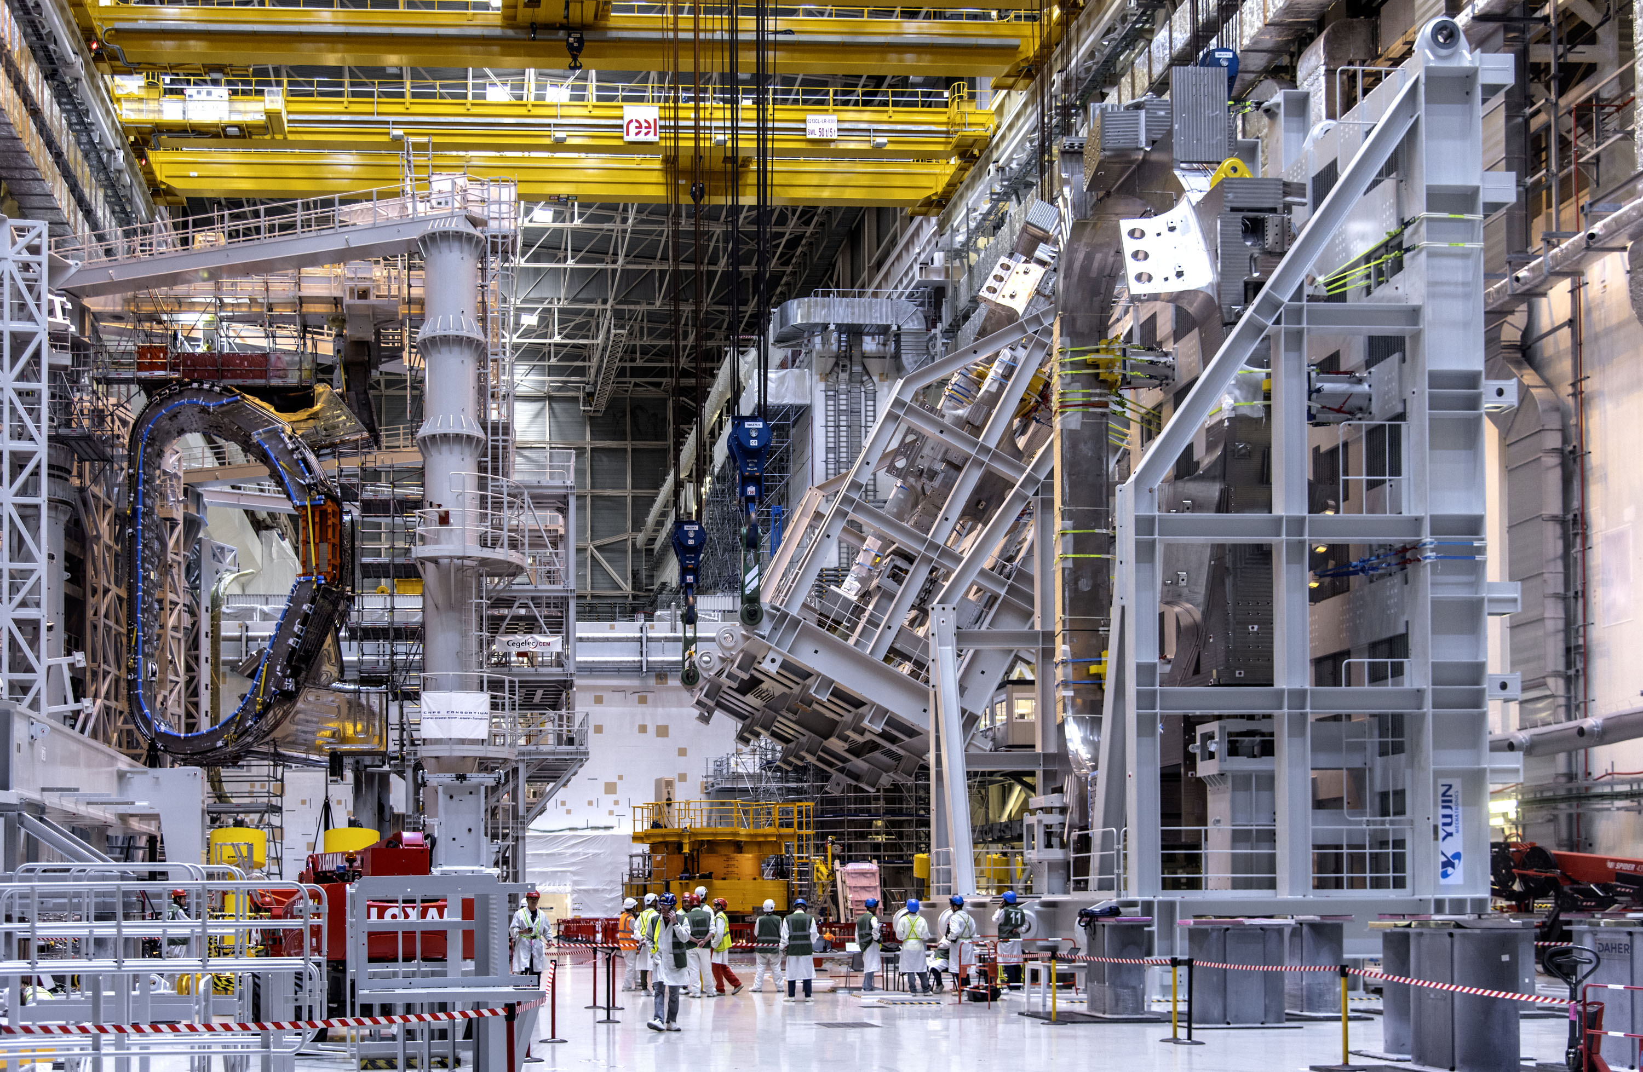
Thanks for your attention !

Slide 22
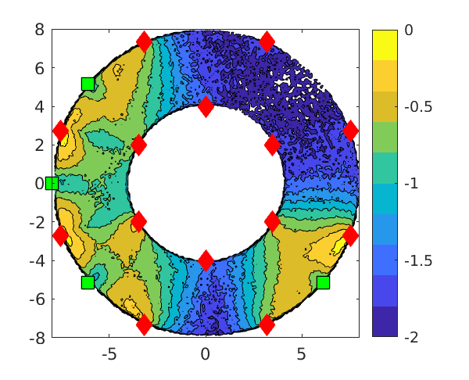
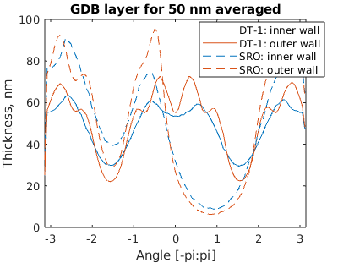
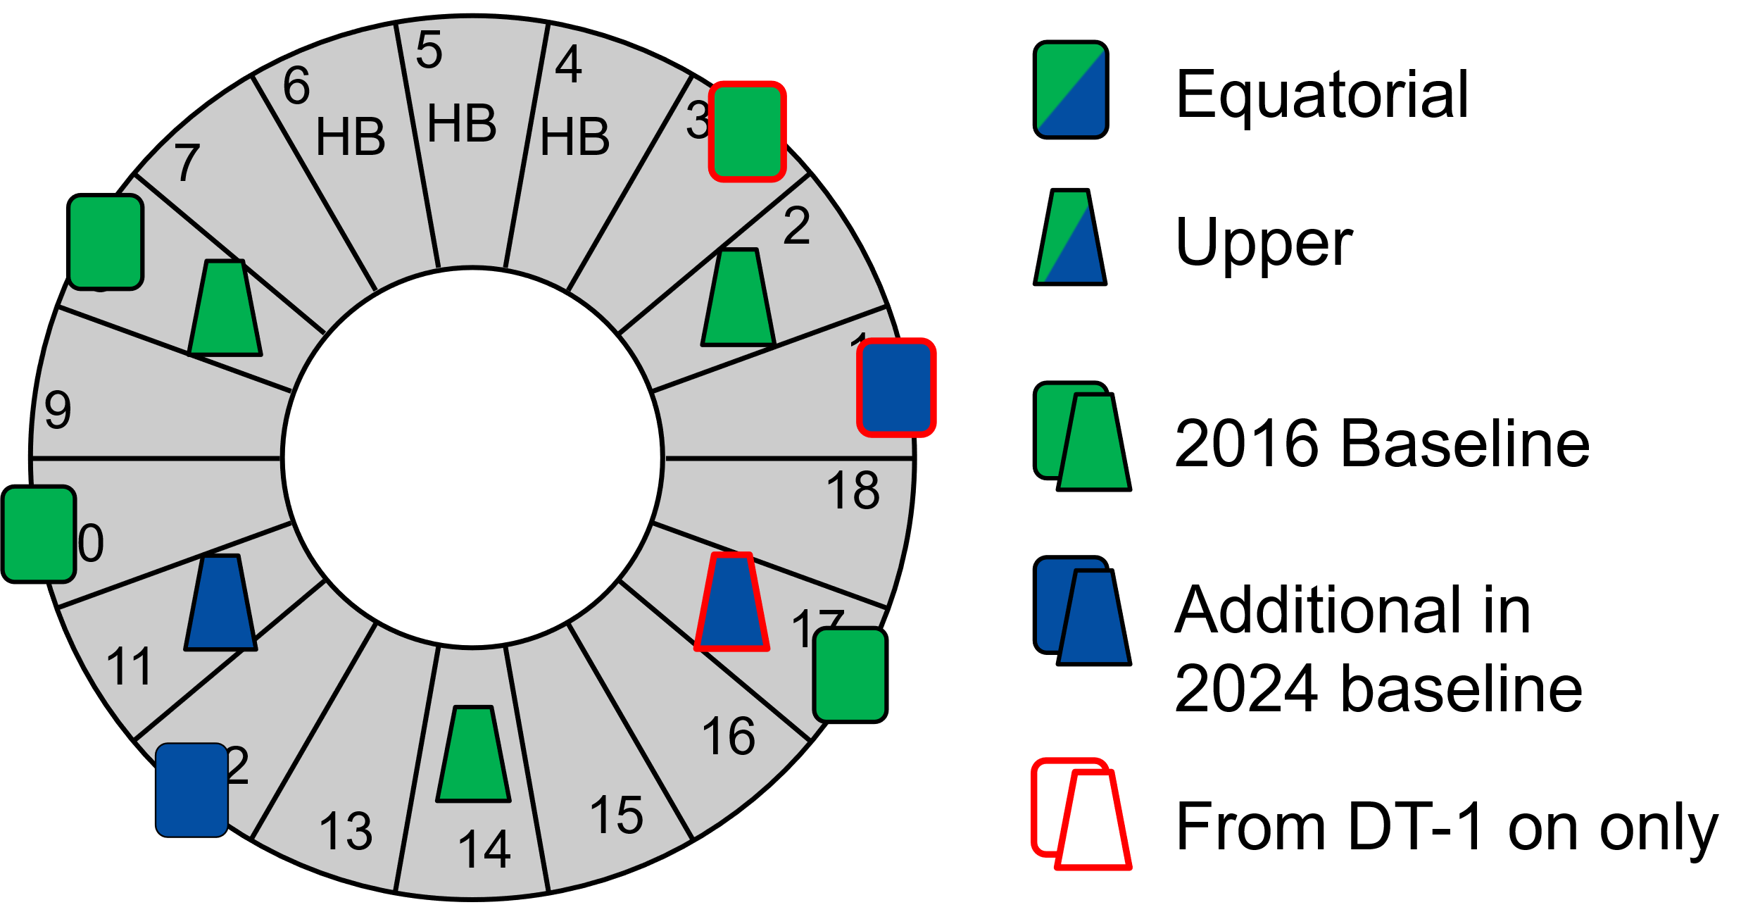
Boronization - I
Boron provides O₂ gettering → 14 diborane injection points + 11 GCD anodes
Non-symmetric GDC anode distribution at in SRO & non-uniform boronization → experiments show boronization needed but spatial distribution not too critical
B₂H₆ ionization and dissociation in SRO
T. Wauters NME 2025
    J. Hobirk - Tungsten limiter Start-up experiments (ASDEX Upgrade, WEST) – 15/10 17:30
    E. Geulin – WEST wall conditioning with Boron – 18/10 8: 30 P7

Slide 23
Boronization - II
Lifetime of B layer evaluated by erosion-deposition WallDYN3D → short on plasma exposed areas and ~ few 10⁴ s in remote areas → boronization for O₂ gettering not to cover W
50 nm B binds ∼1–5 × 10²⁰ O₂/m² → 10% wall area 2.5 -12.5 weeks 316 SL outgassing
Maximum boronization frequency 2 weeks (STM)
Wall deposited B erodes and migrates to divertor or is covered by W → 0.3 H per B in deposits
Plasma operation + ICWC to remove H
K. Schmid NME 2024 and ISFN R&D
t = 10⁵ s
< 10 μm B:W
t = 0 s
100 nm B
    D. Mateev – Fuel retention and recovery in JET – 16/10 17:05

Slide 24
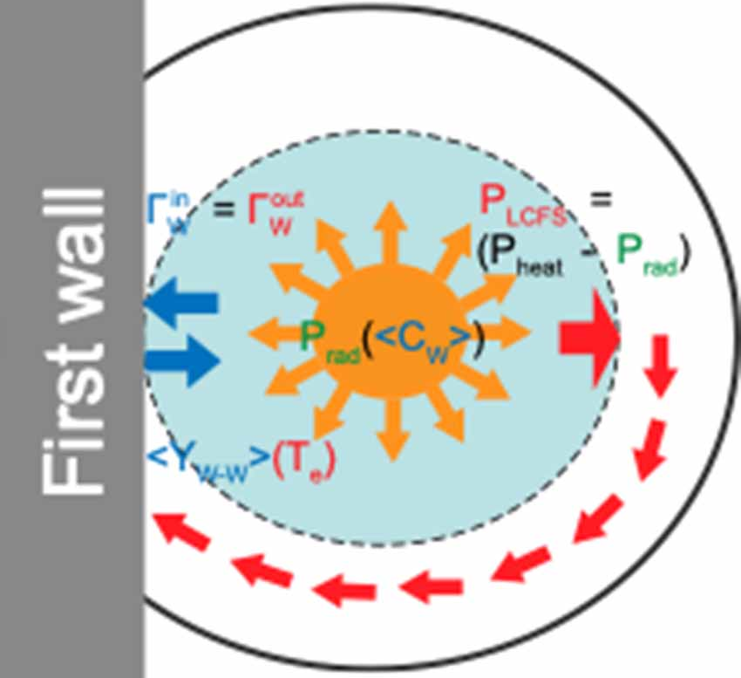
Limiter - I
During limiter phase plasma is in direct contact with W wall
Strongly self regulated system T_{e} Γ_{W} P_{rad} T_{e} in ITER modelling and experiment (EAST, ASDEX Upgrade, WEST, …)
ITER - Y. Zhang – NF 2025
EAST - Pitts- NME 2025
    X. Gong – EAST experiments to support IRP – 14/10 14:25
    M. Schneider – Integrated Modelling – 15/10 17:30
    J. Hobirk - Tungsten limiter Start-up experiments (ASDEX Upgrade, WEST) – 15/10 17:30

Slide 25
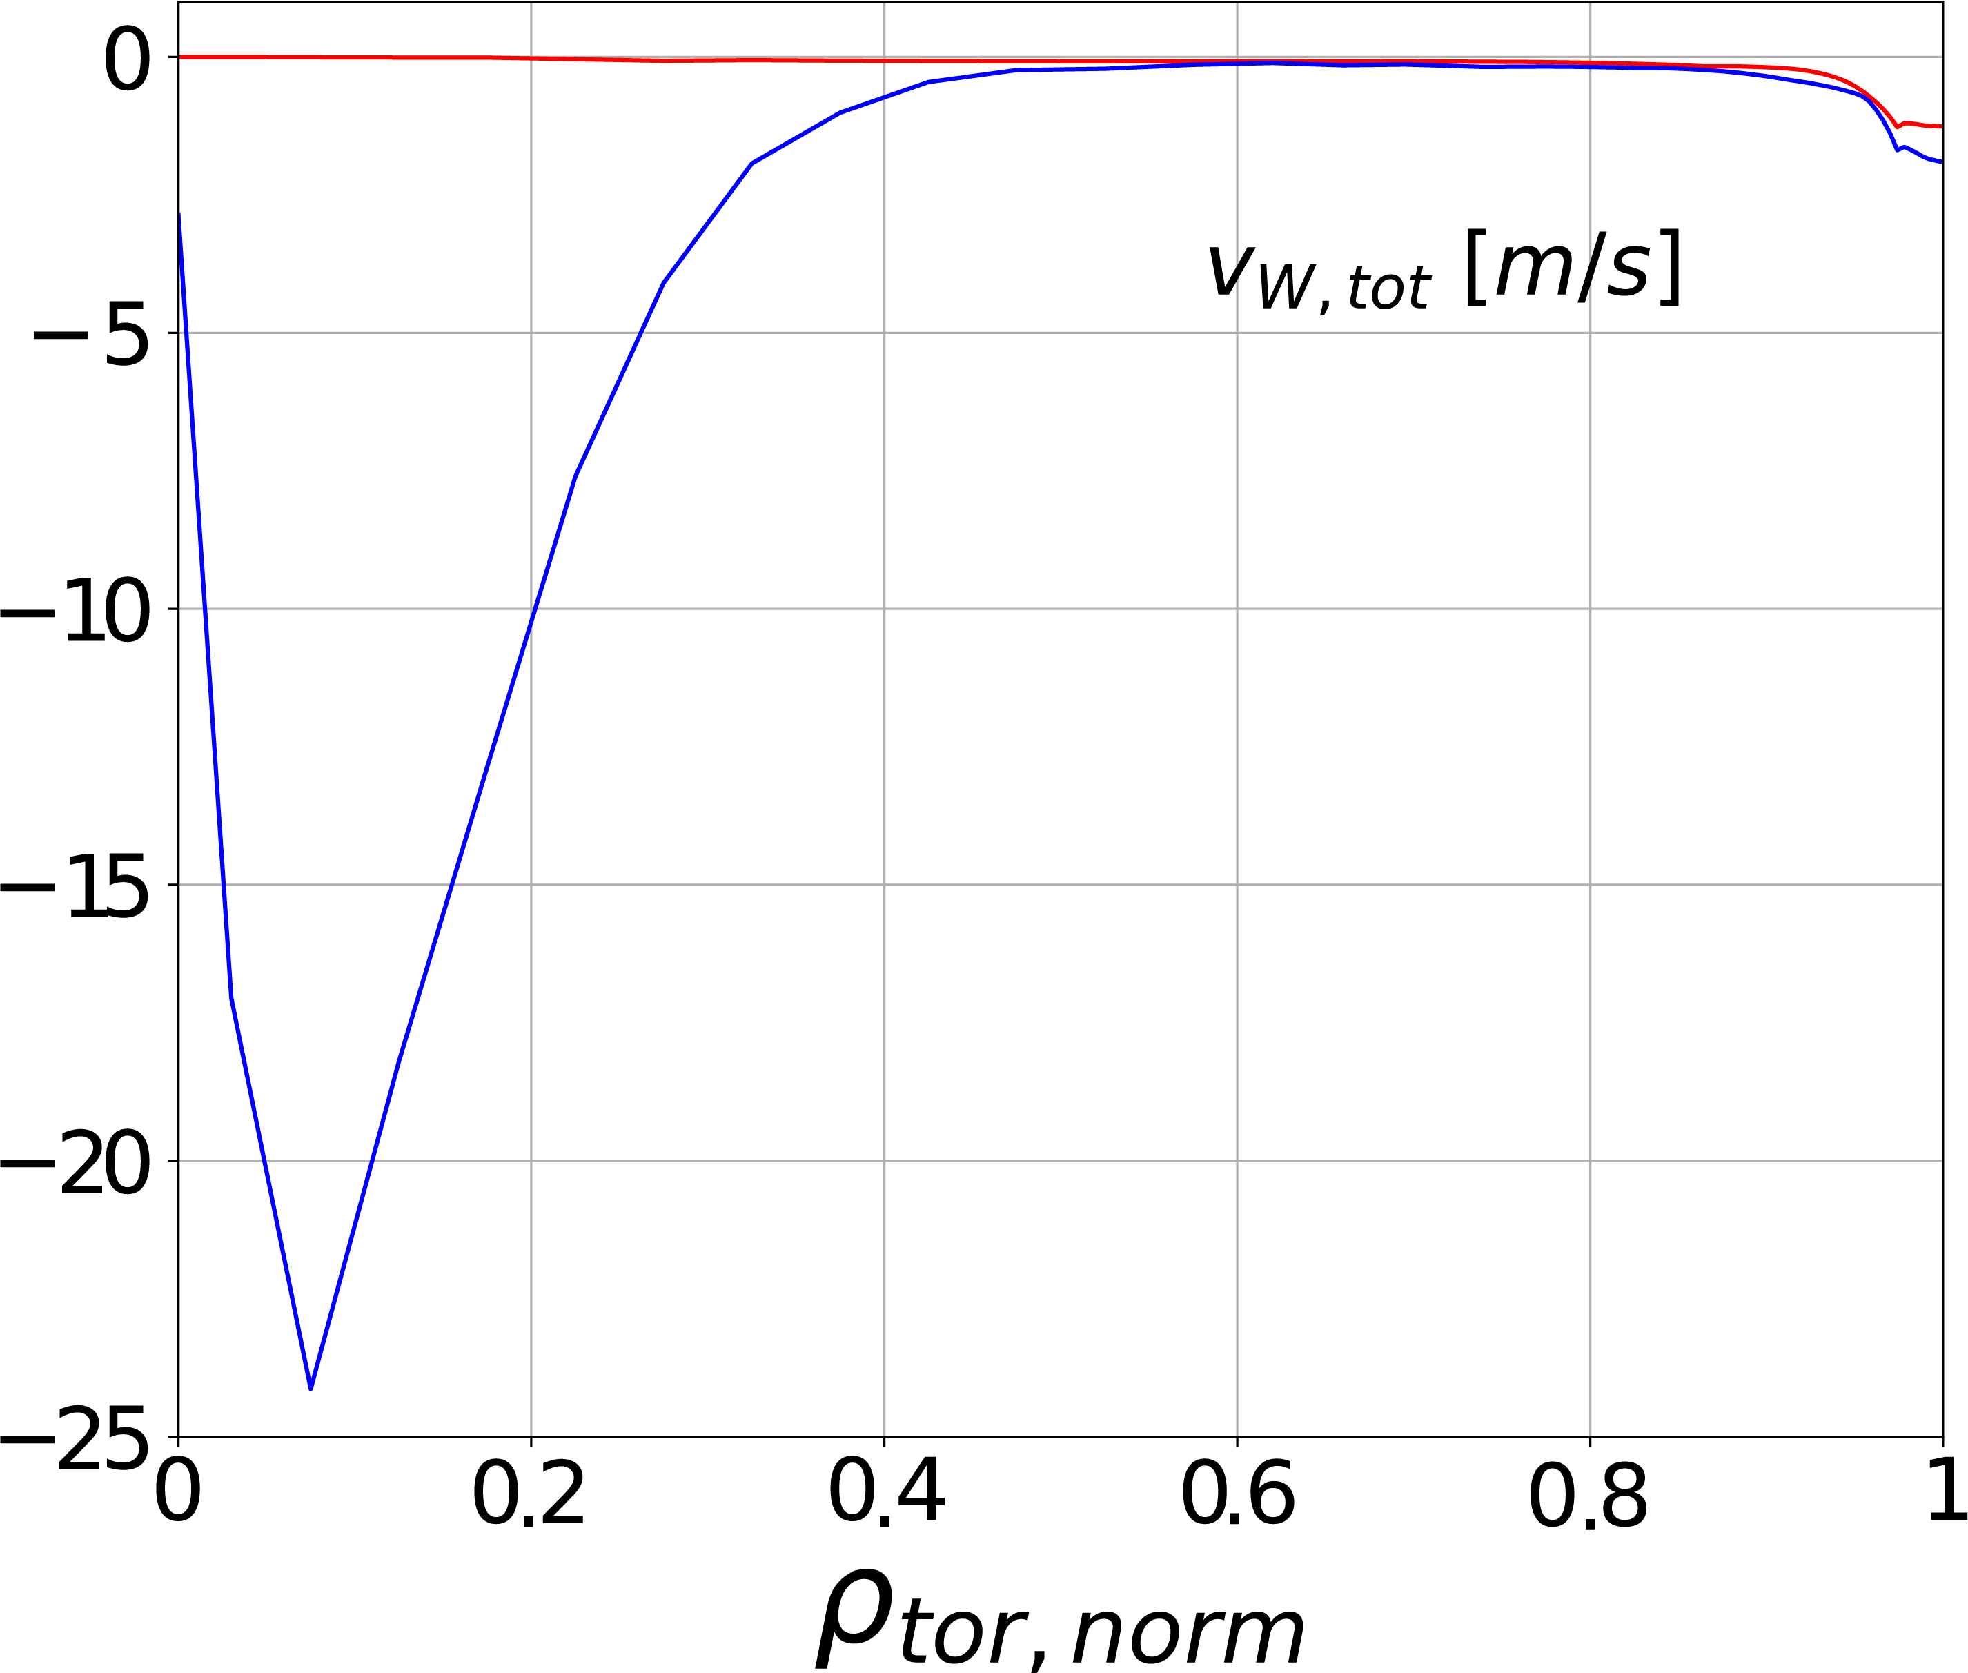
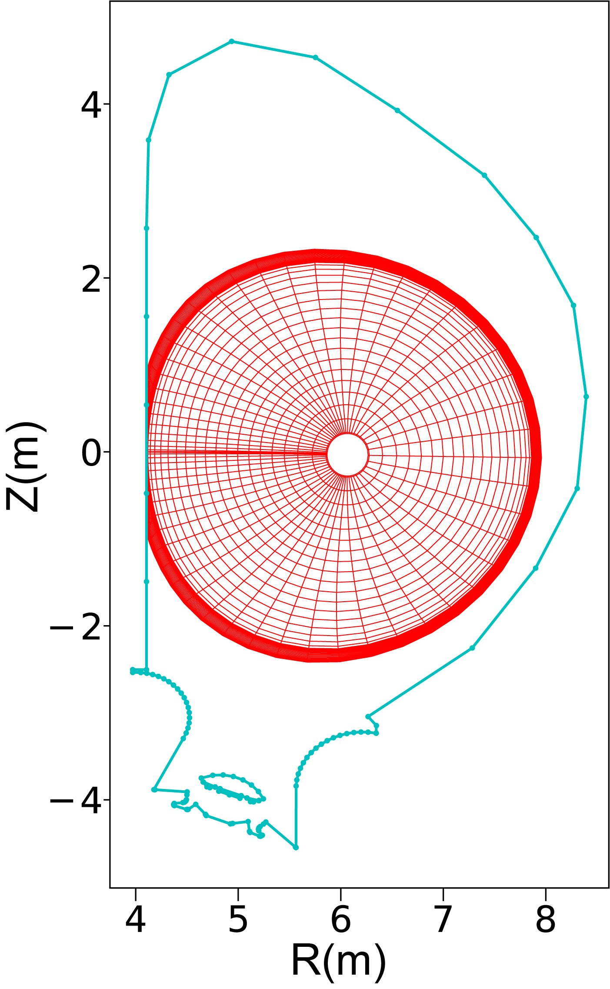
Limiter - II
W accumulation and radiative collapse can occur due to unfavourable core W transport and power balance in ITER and present experiments
Central ECH needed to avoid ITER limiter phase collapse → B_{t} = 2.65 & 5.3 T
ITER - JINTRAC - Pitts- NME 2025
    X. Gong – EAST experiments to support IRP – 14/10 14:25
    M. Schneider – Integrated Modelling – 15/10 17:30
    D. Fajardo – Validated integrated modelling of W in experiments and ITER – 18/10 8:30 P7
    J. Hobirk - Tungsten limiter Start-up experiments (ASDEX Upgrade, WEST) – 15/10 17:30

Slide 26
L-mode diverted - I
L-mode plasmas with conditions typical of 15 MA ramp-up flat-top modelled
Low/medium I_{p} L-modes resilient to W accumulation & radiative collapse
ITER - JINTRAC – Loarte - PPCF 2025
ASDEX Upgrade – Dux – NF 2011
    S.H. Kim – Development of High-Fidelity Plasma Simulator – 17/10 14:00 P6
    M. Schneider – Integrated Modelling – 15/10 17:30
    D. Fajardo – Validated integrated modelling of W in experiments and ITER – 18/10 8:30 P7

Slide 27
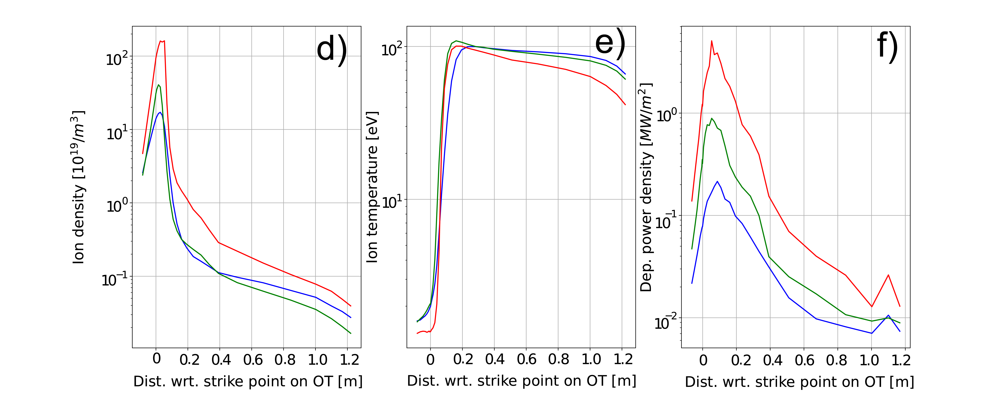
L-mode diverted - II
Low <n_{e}> and T_{e} ~ 10 keV by use of central ECH provide resilience to W accumulation and radiative collapse for low/medium I_{p}
ITER - JINTRAC – Loarte - PPCF 2025
    S.H. Kim – Development of High-Fidelity Plasma Simulator – 17/10 14:00 P6
    M. Schneider – Integrated Modelling – 15/10 17:30
    D. Fajardo – Validated integrated modelling of W in experiments and ITER – 18/10 8:30 P7

Slide 28
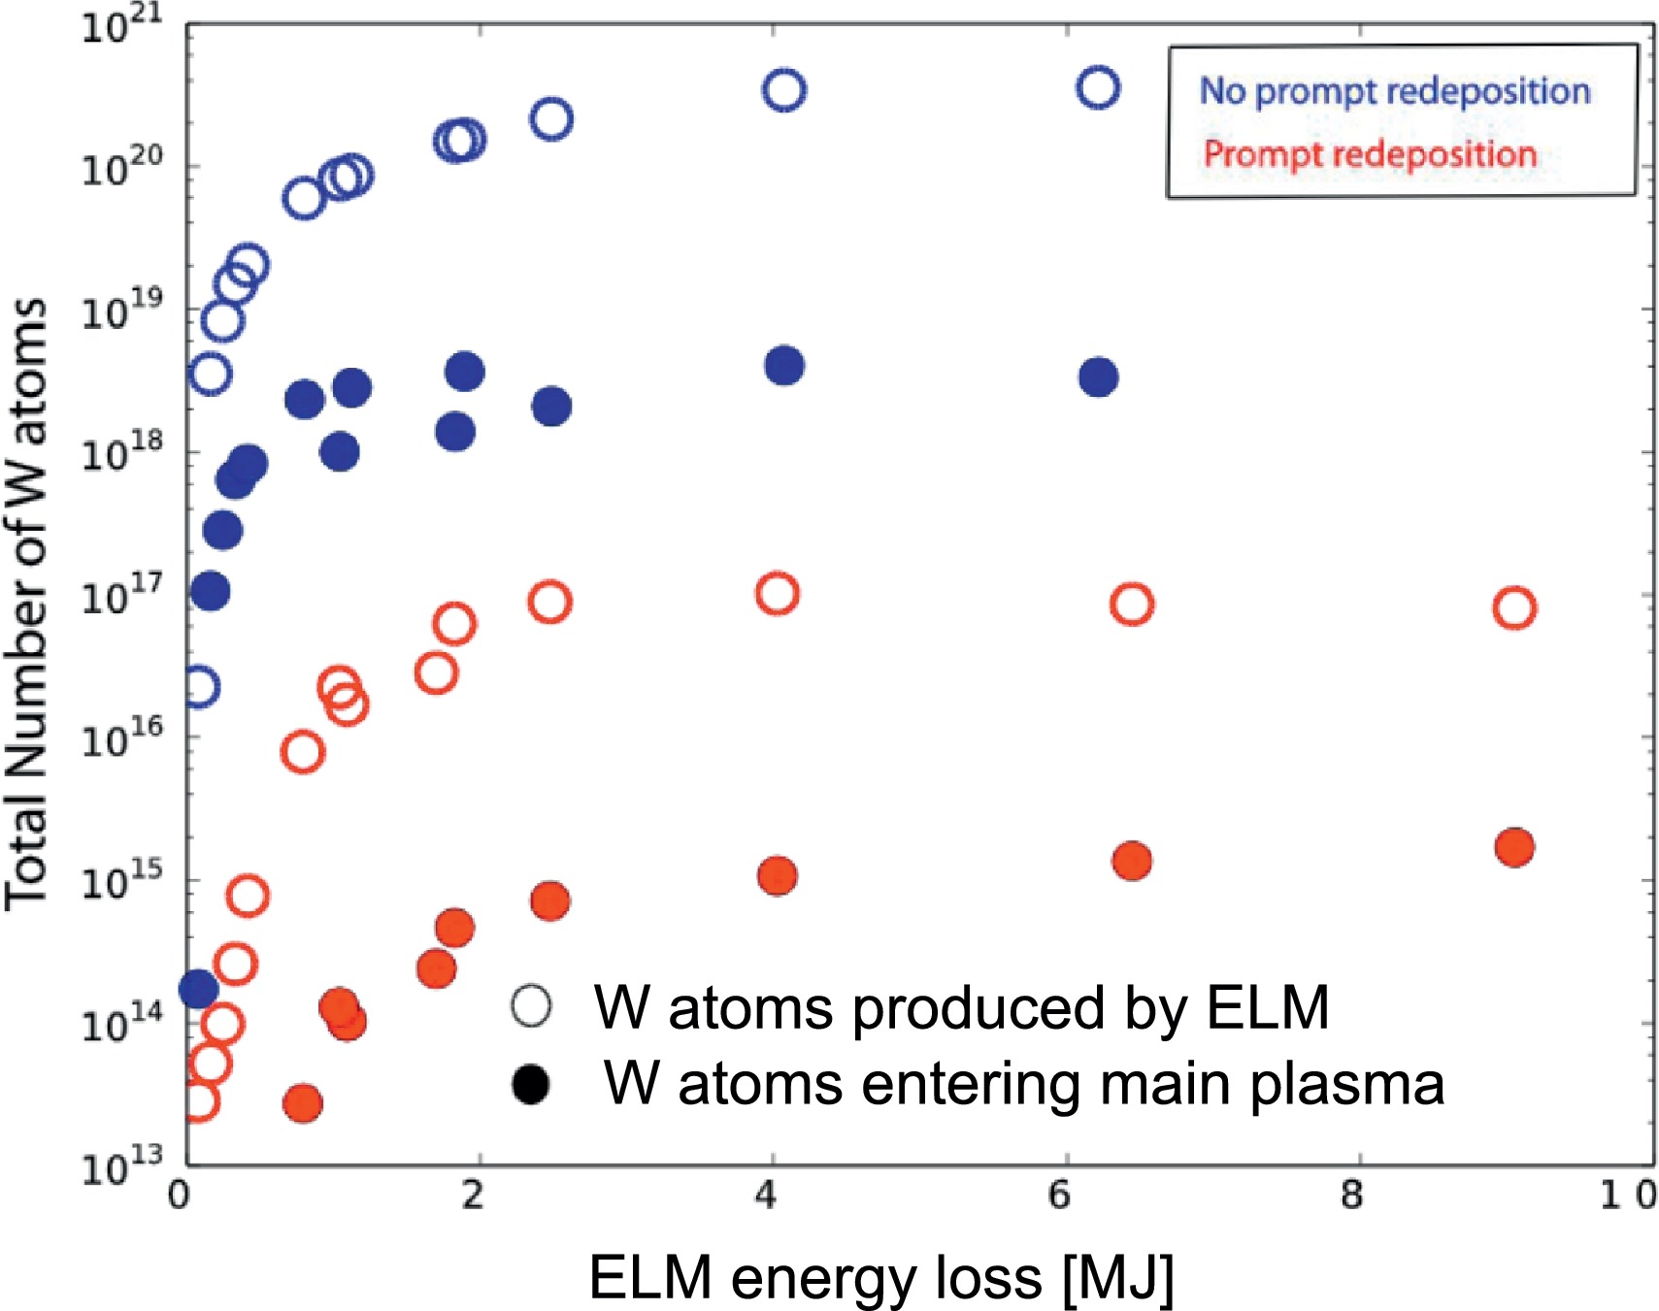
SRO ELMy H-mode - I
ELMs expected to melt divertor monoblock gaps for I_{p} ≥ 5 MA/2.65 T
Instantaneous Γ_{ELM}^{W-div influx} modelled from SOLPS modelling and used to evaluate average <Γ_{ELM}^{W influx}> using experimental guidance
SOLPS-ITER – Dux – NME 2017
ITER - JINTRAC – Loarte - PPCF 2025
    S.H. Kim – Development of High-Fidelity Plasma Simulator – 17/10 14:00 P6
    M. Schneider – Integrated Modelling – 15/10 17:30

Slide 29
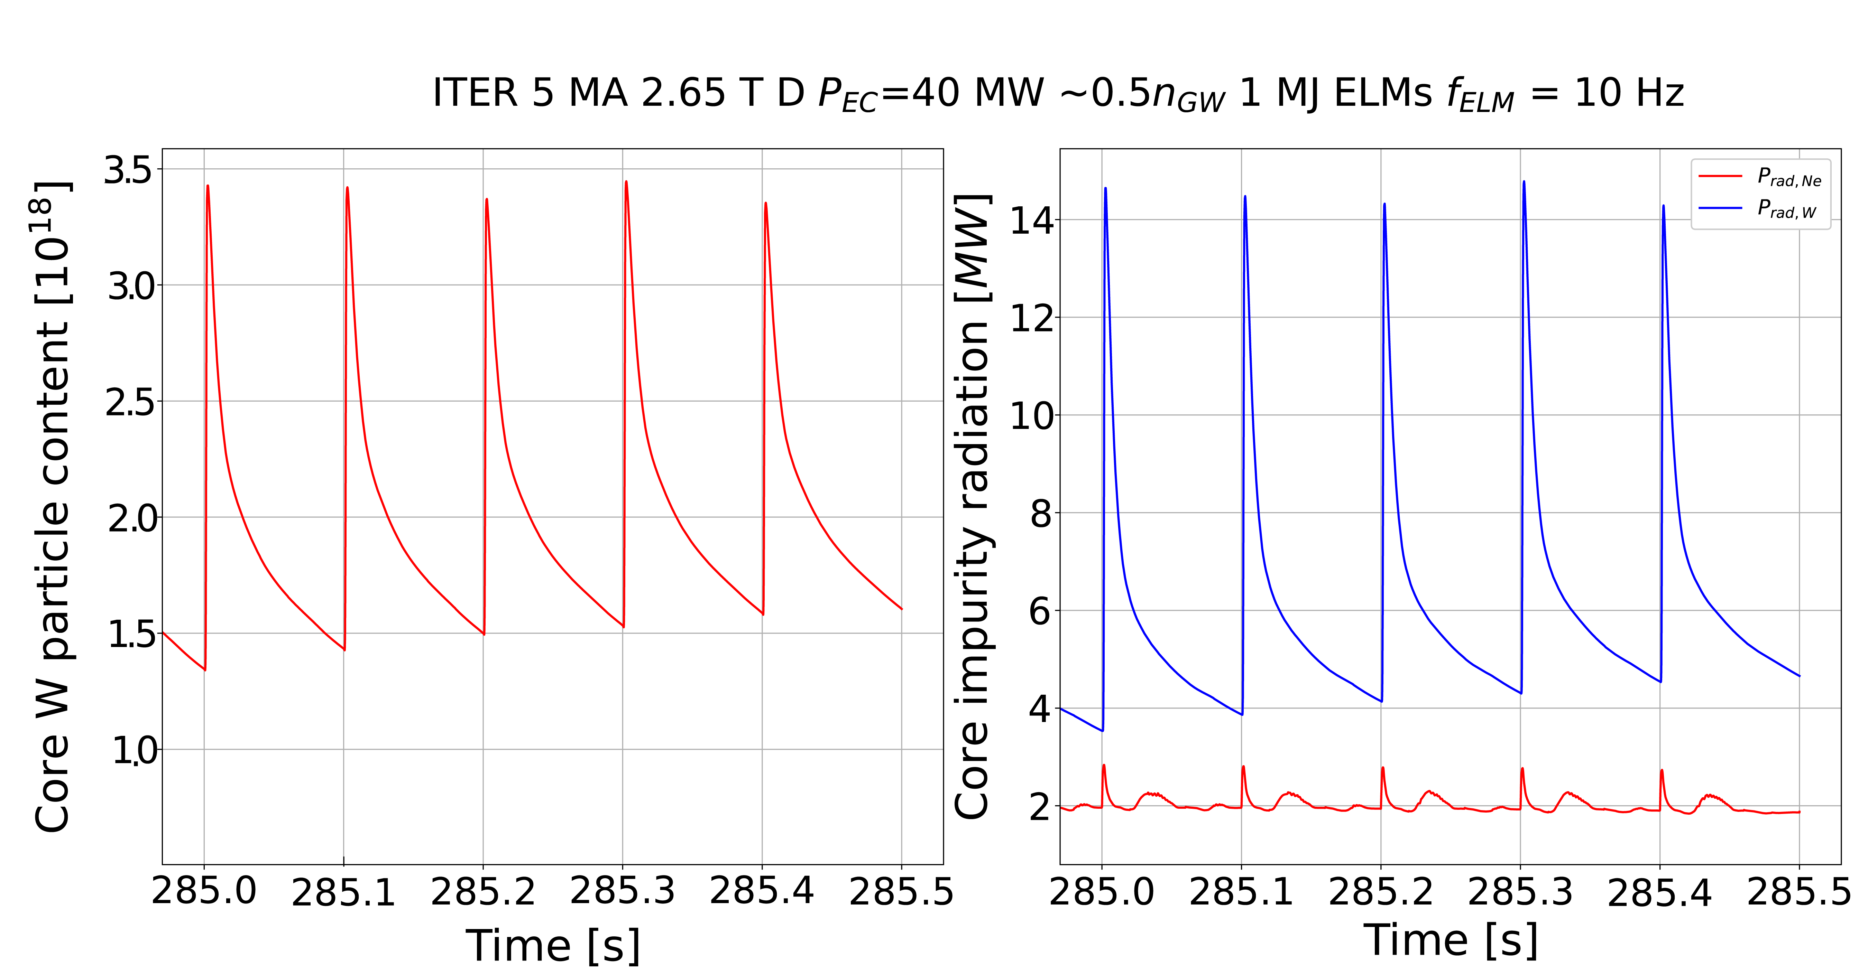
SRO ELMy H-mode - II
Wall source scanned in JINTRAC to compare with <Γ_{ELM}^{W influx}>
  f_{ELM} ≥ 20 Hz required → 4 pellet injectors (f_{pellet} ~ 60 Hz) and full set of ELM control coils
  5 MA/2.65 T ECH H-mode resilient to W influxes : Low <n_{e}>, T_{e} ~ 10 keV + W pedestal screening
Instantaneous P_{rad}^{ELM-W} → Max tolerable ΔW_{ELM}
ITER - JINTRAC – Loarte - PPCF 2025
<n_{W}/n_{e}>
    S.H. Kim – Development of High-Fidelity Plasma Simulator – 17/10 14:00 P6
    M. Schneider – Integrated Modelling – 15/10 17:30

Slide 30
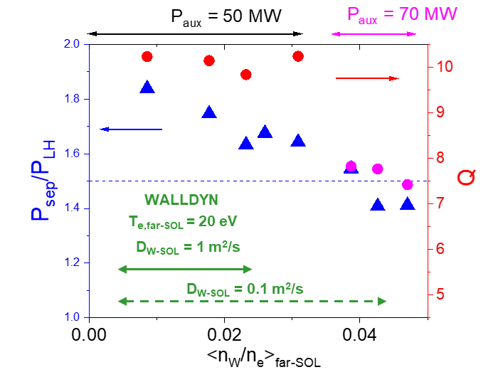
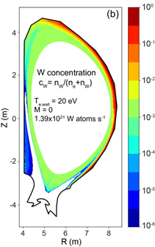
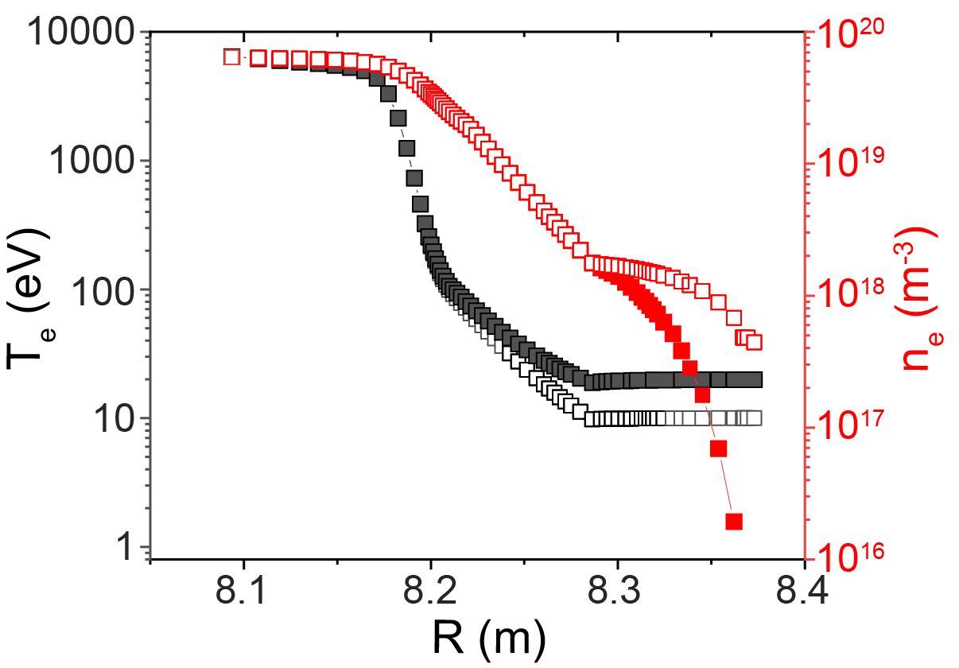
DT-1 Q ≥ 10 - I
Suppressed/no-ELM regime required for Q ≥ 10: D_{ped}, χ_{ped} anomalous for main ions and anomalous + neoclassical for W → W wall low/medium risk
Initial evaluations : W sources from modelling + ad-hoc far SOL
  W divertor/wall sources (edge modelling + ad-hoc far SOL) : Ne main driver for W source
  Integrated modelling (near SOL ad-hoc wall source) : W pedestal screening essential
K. Schmid NME 2024
ITER - JINTRAC – Loarte - PPCF 2025
    M. Schneider – Integrated Modelling – 15/10 17:30

Slide 31
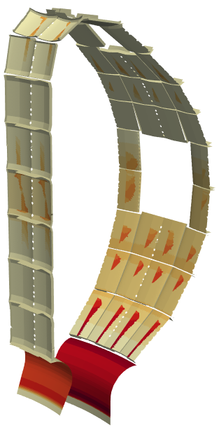
DT-1 Q ≥ 10 - II
Improved modelling for “largest possible” W source with SOLPS-ITER wide grid + ERO2.0 → P_{wall} ~ 20 MW and Γ_{plasma-wall}/ Γ_{plasma-div} ~ 0.1
W divertor/wall sources : Ne confirmed as main driver for W source
ITER - SOLPS – Pshenov
ERO2.0 (W gross erosion) – C. Bauman
10²¹
10²⁰
10¹⁹
erosion flux [m⁻²s⁻¹]
10¹⁸
10¹⁷
10¹⁶
10¹⁵
    E. Kaveeva – First SOLPS-ITER wide grid SOL simulations of Q ≥ 10 – 15/10 14:00

Slide 32
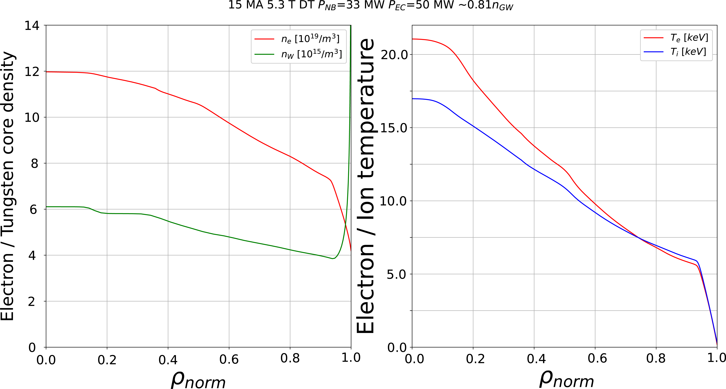
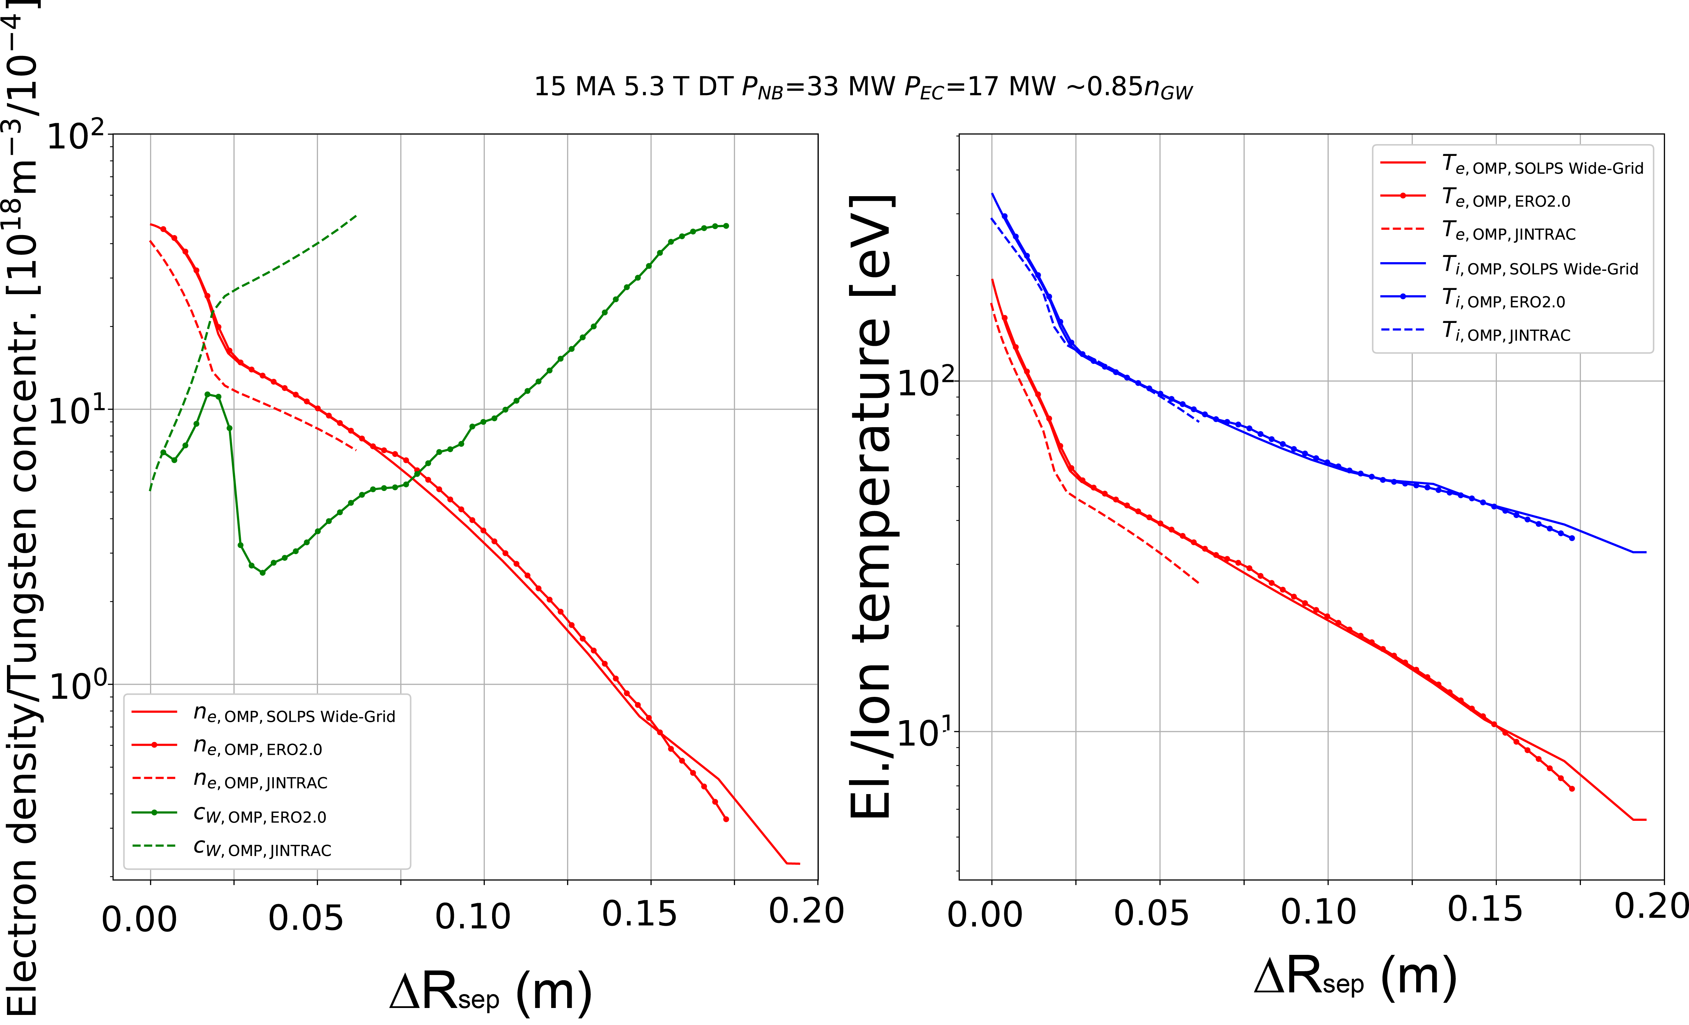
DT-1 Q ≥ 10 - II
Integrated modelling : JINTRAC core plasma + near SOL + ad-hoc wall source to match n_{W}/n_{e}|_{sep} for “largest possible” W source
  P_{aux} ~ 80 MW maintain P_{fusion} = 500 MW → Q > 6 for “worst possible case” confirmed
  W pedestal screening confirmed as key to maintain fusion performance
ITER – JINTRAC - Köchl

Slide 33
DT-1 ICH and W source
ICH antenna flexibility used to achieve ~ 3-strap like E_{II}
W source by ICH << W wall source (~10²¹ W/s) to be confirmed in SRO → upgrade to 20 MW for DT-1
V, Bobkov NME 2024 & L. Colas NME 2025
ITER – JINTRAC - Köchl
P_{ICH} = 10 MW
SOLPS-ITER
wide grid

Slide 34
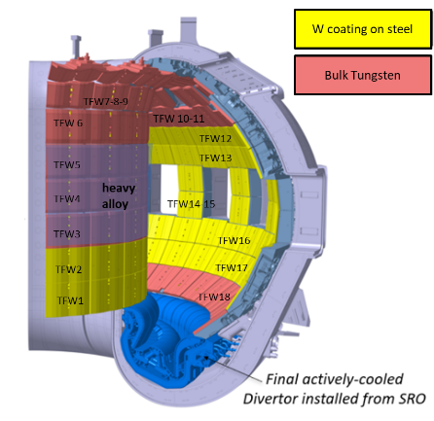
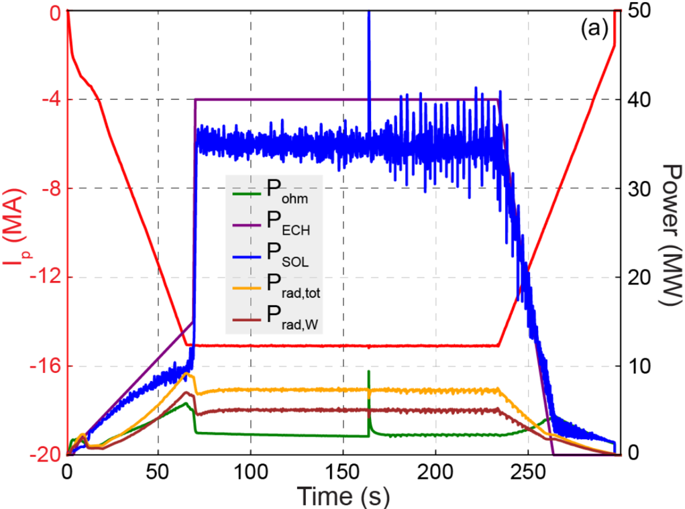
Wall design for SRO (inertially cooled)
Stationary heat fluxes and integrated energy input to design
Resilience : widest risk possible operational space (inc. unmitigated disruptions)
Cost: choice of W material based on stationary and transient loads
ITER - JINTRAC - Pitts- NME 2025
T_{melt} ~ 3400 ºC
W (wt.%) 97 Ni (wt.%) 2 Fe (wt.%) 1
T_{melt}~1500 ºC
In-vessel VS to decrease risk of downwards VDE
ITER – JOREK – Artola
    M. Schneider – Integrated Modelling – 15/10 17:30
    J. Artola – Modelling of thermal Loads during VDEs at JET and ITER – 18/10 8:30 P7

Slide 35
Wall design for DT-1 (water cooled)
Stationary heat fluxes input to design
Resilience to disruptions (high T_{melt}) + high stopping power (runaway electrons)
  W thickness increased to 12 mm to reduce risk of water leaks in runaway loaded areas
  Runaway mitigation remains essential with DT-1 W wall
ITER – GEANT4 + MEMENTO - S. Ratynskaia – Sub. PPCF 2025
on FW-apex
on FW-apex
on FW-apex
E_{RE-kin} ~ 2 MJ/ I_{p-RE}(MA)
E_{RE-mag} ~ 200 MJ (I_{p-RE}(MA)/9.5)²
    S. Ratynskaia – https://arxiv.org/abs/2509.20261

