Slide 1
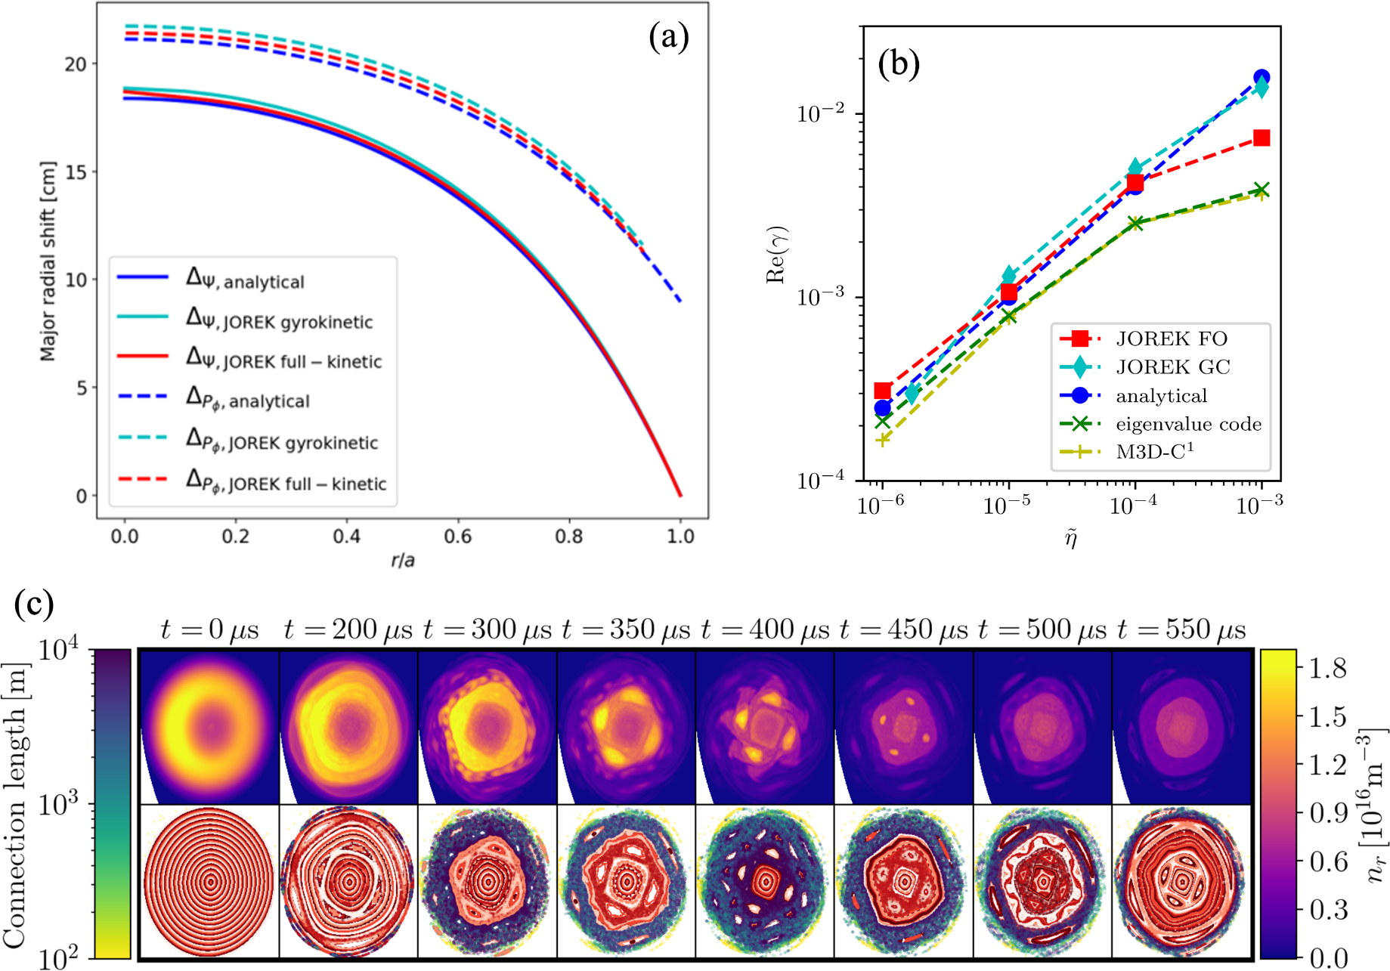
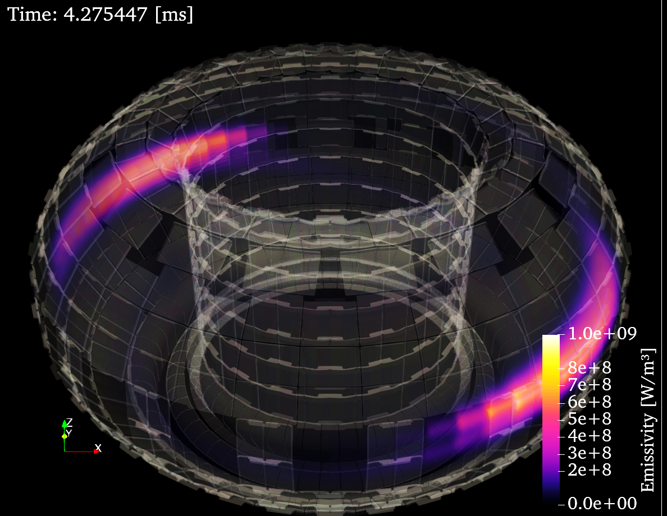
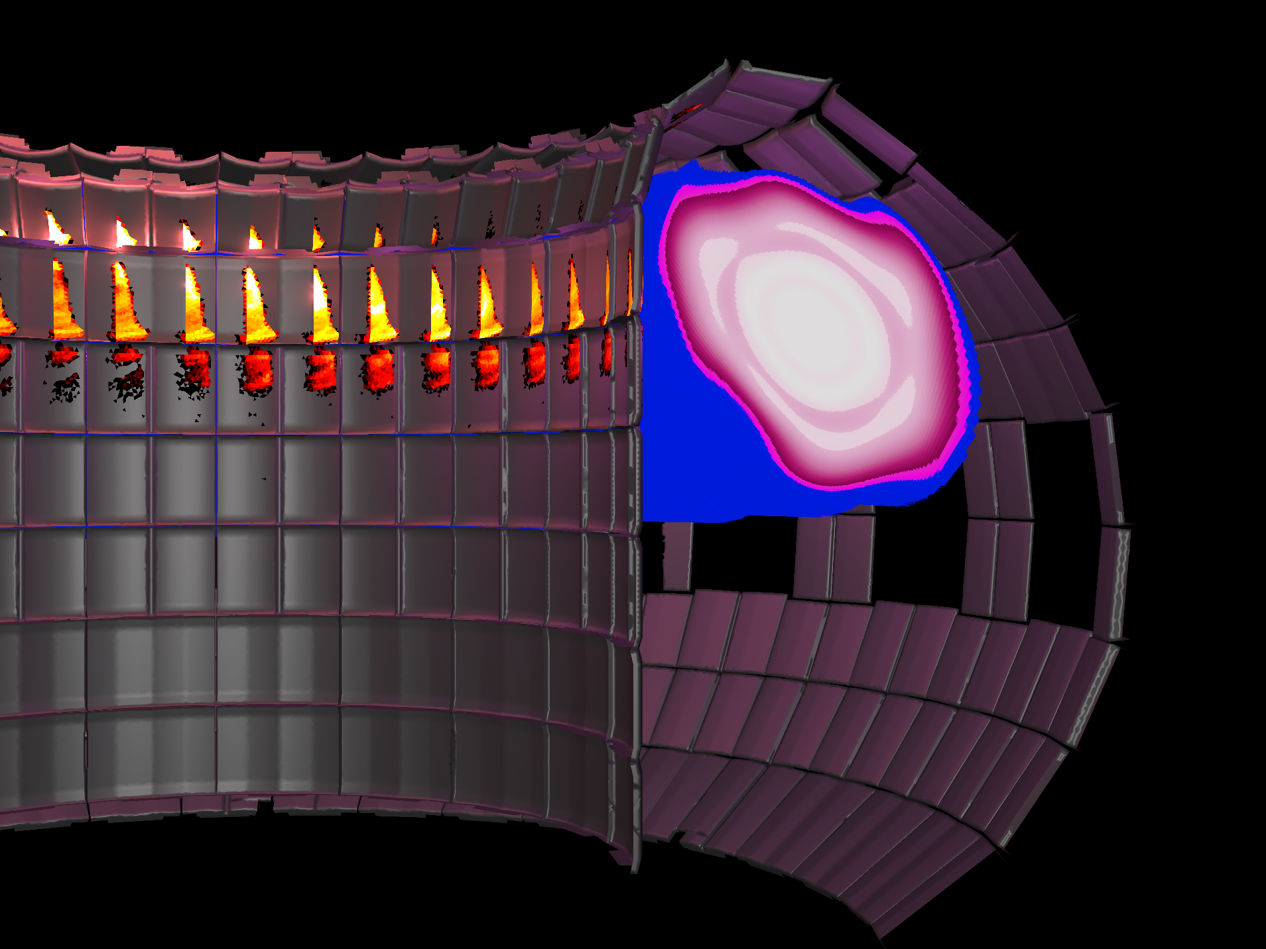
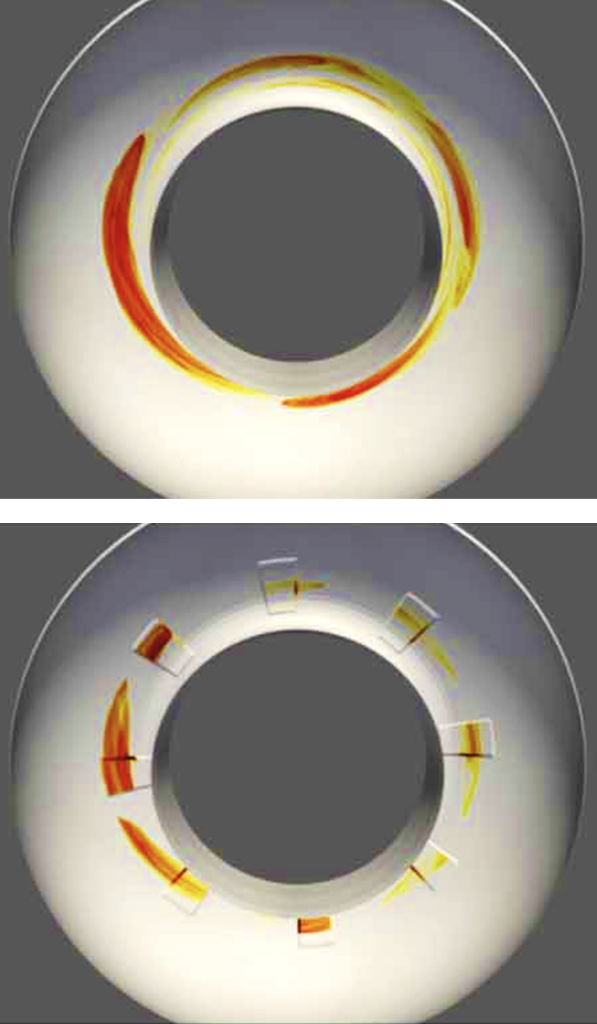
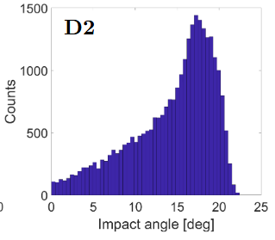
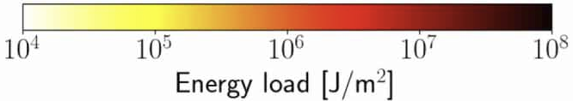
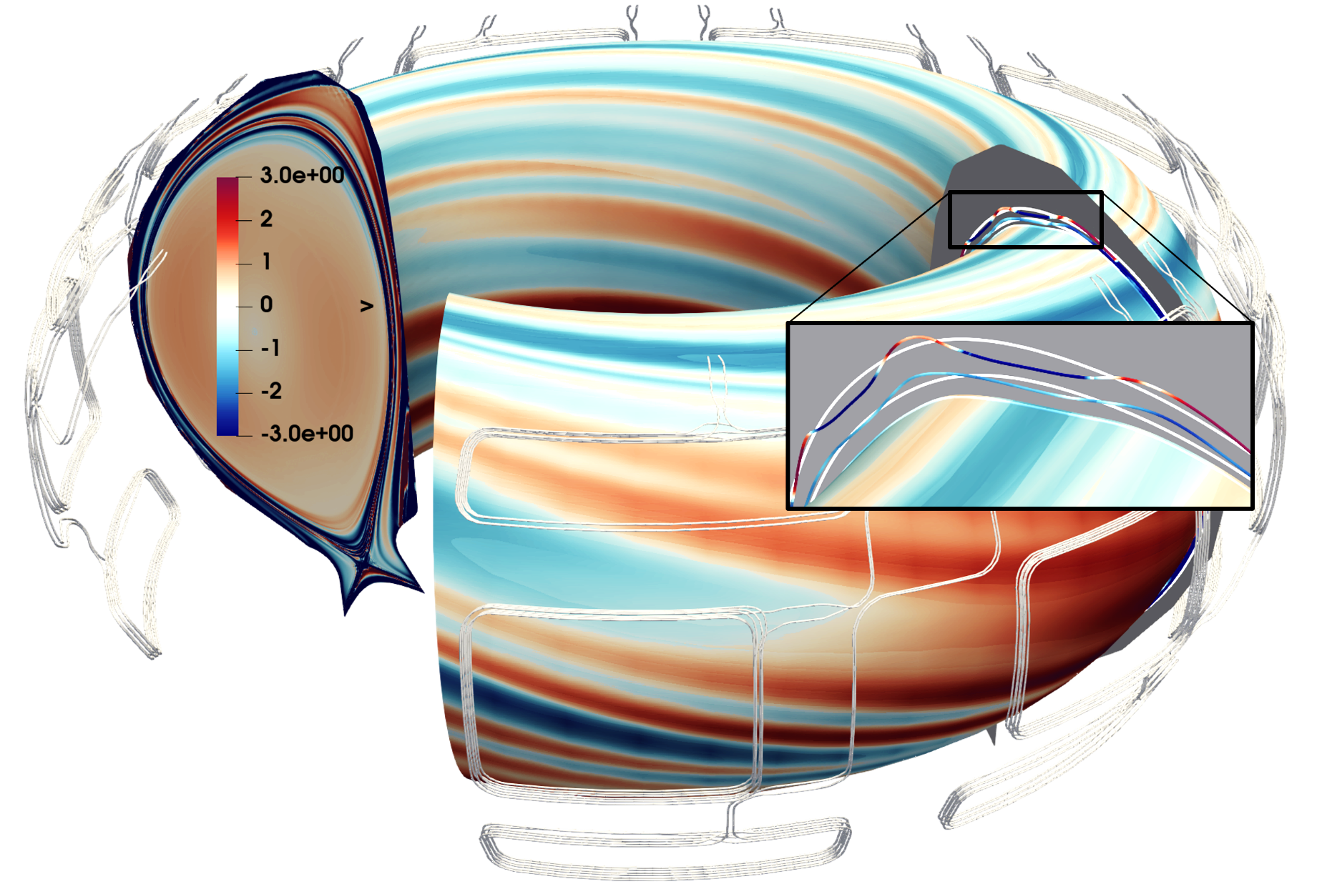
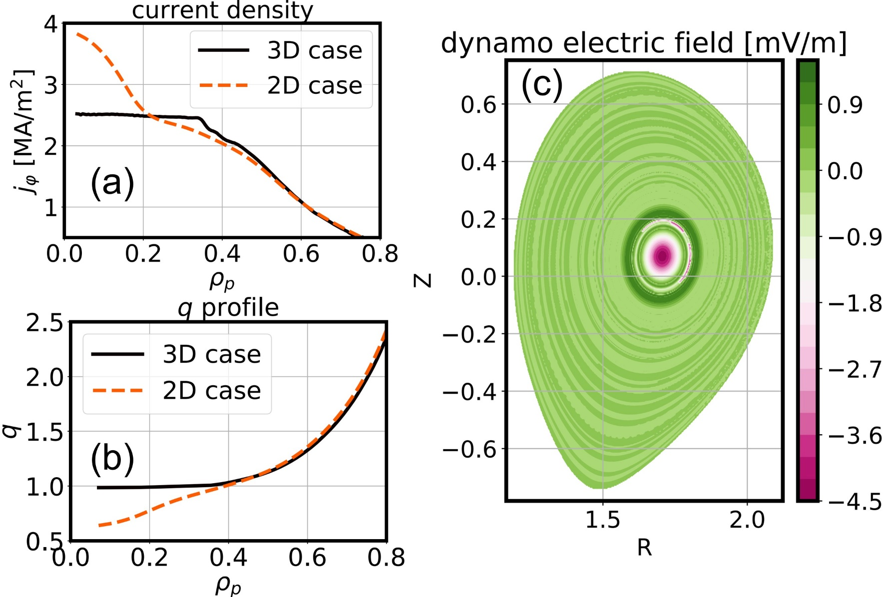
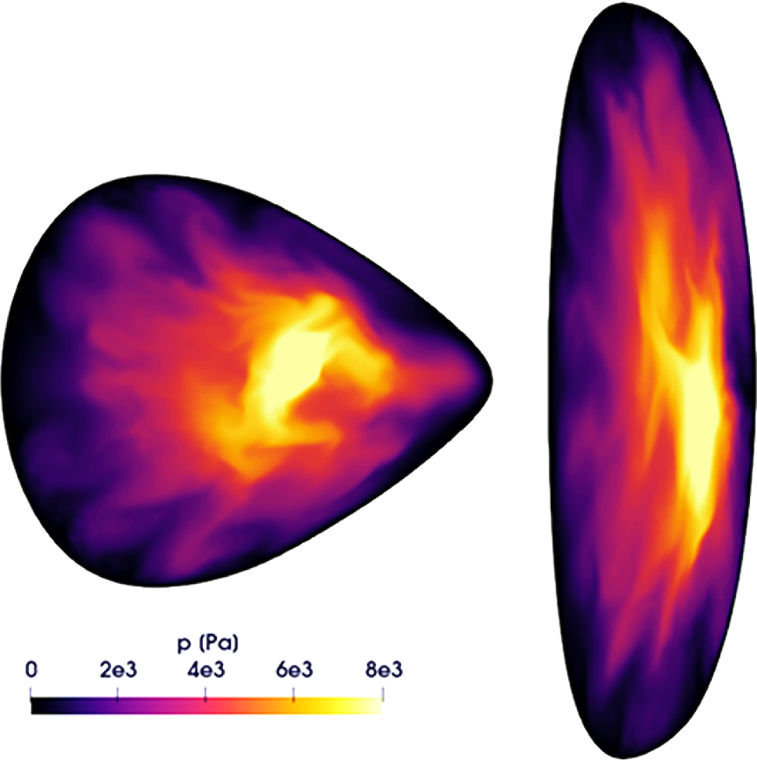


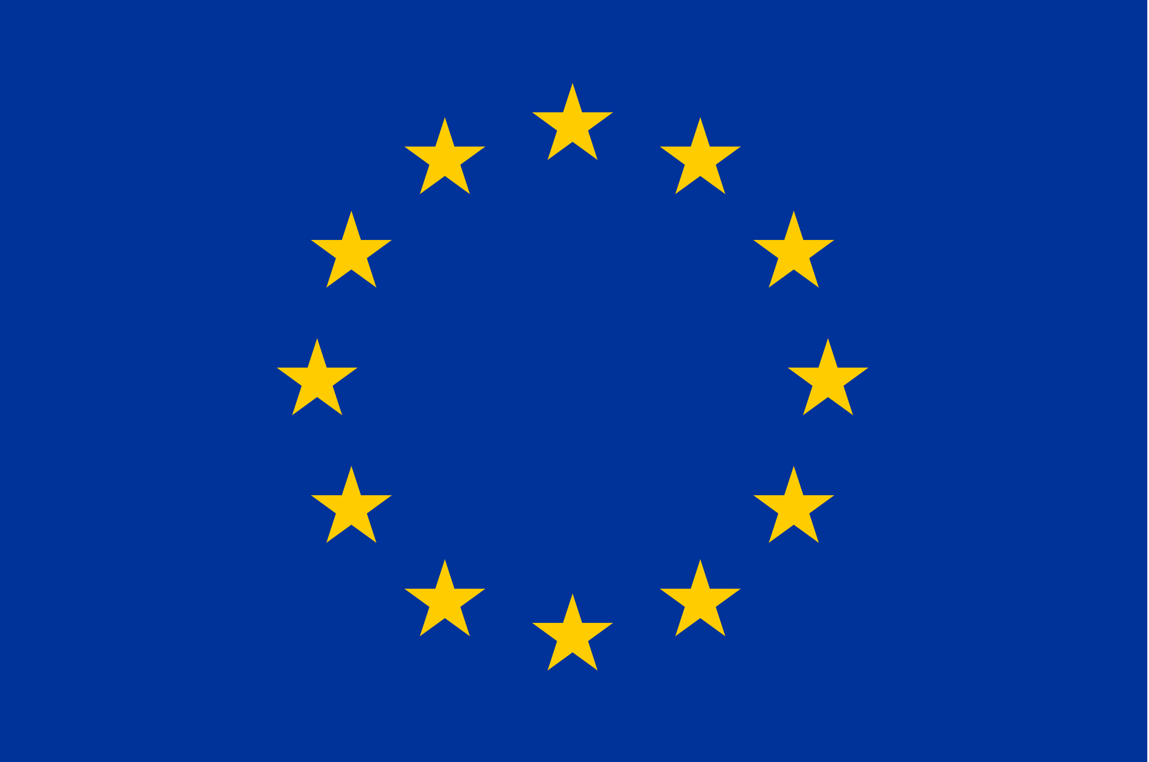

JOREK contributions to the predictive understanding of transient phenomena in future tokamaks and stellarators
M Hoelzl¹, GTA Huijsmans², FJ Artola³, N Schwarz³, D Hu⁴, G Su^{1,5}, E Nardon², N Isernia⁶, P Rac¹, A Cathey¹, M Kong⁷, K Aleynikova¹, F Antlitz¹, T Atane¹, S Bakes⁸, V Bandaru⁹, M Becoulet², H Bergstroem¹, A Bhole¹⁰, D Bonfiglio¹¹, M Calcagno¹¹, J Carpenter¹², E Carra¹, F Cipolletta¹³, E Crovini¹⁴, V Dwarka¹⁵, L Edes⁷, E Emanuelli¹⁶, A Fil², LV Greco¹, I Holod¹, S Hu¹⁷, C Jiang⁴, T Kant^{18,3}, SK Kim¹⁹, S Korving³, A Kryzhanovskyy¹¹, SJ Lee²⁰, Y-C Liang¹, Z Liang^{21,1}, S-J Liu¹, YL Liu²¹, ZX Lu¹, D Maris^{22,3}, D Mendonca¹, V Mitterauer¹, K Munechika³, N Nikulsin¹, B Nkonga¹⁰, H Nystroem²³, K Obrejan², SJP Pamela⁸, J Puchmayr¹, L Puel^{2,3}, R Ramasamy¹, C Rogge¹, G Rubinacci⁶, L Singh², C Sommariva⁷, R Sparago^{1,3}, Y Sun⁴, M Szucs^{1,3}, W Tang¹, F Vannini¹, O Varley¹, S Ventre⁶, F Villone⁶, C Wang⁷, L Wang¹⁷, F Wouters¹, and H Zhang¹
¹Max Planck Institute for Plasma Physics, Garching and Greifswald, Germany ²CEA, IRFM, Saint-Paul-lez-Durance, France ³ITER Organization, Saint Paul Lez Durance, France ⁴School of Physics, Beihang University, Beijing, China ⁵Department of Applied Physics and Applied Mathematics, Columbia University, New York, USA ⁶Consorzio CREATE, Universita degli Studi di Napoli Federico II, Napoli, Italy ⁷EPFL, Swiss Plasma Center SPC, CH-1015 Lausanne, Switzerland ⁸UKAEA, Abingdon, Oxfordshire, UK ⁹Indian Institute of Technology, Guwahati, India ¹⁰University Cote d’Azur and Inria d’UniCA, Nice Sophia-Antipolis, France ¹¹Consorzio RFX and CNR-ISTP Padova, Italy ¹²Department of Physics, Durham University, Durham, United Kingdom ¹³Barcelona Supercomputing Center (BSC), Placa d’Eusebi Guell, 1-3, 08034 Barcelona, Spain ¹⁴Department of Mathematics, Imperial College London, United Kingdom ¹⁵Delft University of Technology, Delft, the Netherlands ¹⁶NEMO Group, Dipartimento Energia, Politecnico di Torino, Torino, Italy ¹⁷Southwestern Institute of Physics, Chengdu, China ¹⁸Institute for Plasma Research (IPR), Gandhinagar, India ¹⁹Princeton Plasma Physics Laboratory, Princeton, USA ²⁰Seoul National University, Seoul, Republic of Korea ²¹School of Physics, Dalian University of Technology, Dalian, China ²²DIFFER, Eindhoven, The Netherlands ²³KTH Royal Institute of Technology, Stockholm, Sweden
Matthias.Hoelzl@ipp.mpg.de
ID: 2679
See https://www.jorek.eu
Abstract
Selected Results
Transient plasma processes in magnetic confinement fusion plasmas are a focus of work with JOREK, addressing both tokamaks and stellarators
Applications include ELMs, exhaust, disruptions, vertical displacement events, runaway electrons, core instabilities, mitigation & control, etc.
Models include reduced and full MHD with two-fluid extensions, various hybrid fluid-kinetic models, and electrostatic ITG & TEM models
This poster highlights selected recent developments and results
  Disruptions
VDE and electromagnetic force studies for CFETR
Scan of D/mixed SPI across full TQ & CQ for AUG & JET [3]
Dual SPI in H-mode and degraded H-mode plasmas for ITER (Fig 2) [4]
RE wall load and material damage assessment for ITER (Fig 3) [1]
RE wall load studies with sacrificial limiters in EU-DEMO (Fig 4)
First RE termination studies with the 3D full-f kinetic RE model
Kinetic effects for MHD modes in RE beams studied [2]
Kinetic avalanche and hot-tail sources implemented and tested
Pedestal and Edge
Quiescent H-mode predictions for HL-3 [5]
Dynamic X-point radiator and small-ELM burn-through in AUG
Tungsten transport by RMPs and detachment control in ITER (Fig 5)
Tungsten sputtering and transport in EAST
Core
Flux pumping for sawtooth control studied at realistic AUG parameters and scans to assess accessibility regimes (Fig 6) [6,7]
Pellet material assimilation studies with advanced non-local heating schemes
ITG & TEM in X-point plasmas with positive/negative triangularity
Stellarator
Non-linear dynamics beyond the Mercier stability criterion (Fig 7)
ECCD induced crashes of different size in W7-X
Selected Developments
Hybrid fluid-kinetic SOL/divertor models further improved and validated
Hybrid fluid-kinetic full-f model for runaway electrons (Fig 1) [1,2]
Hybrid fluid-kinetic framework modularized for arbitrary combinations of fluid & kinetic species, e.g., for RE beam + companion plasma studies
Virtual casing principle extended to halo currents and validated
GPU porting of fluid and kinetic models
IMAS integration was further advanced
Novel iterative solver and preconditioner techniques explored
Outlook
Complete halo current coupling for lateral force assessments
Further extend the hybrid fluid-kinetic capabilities and port them to stellarator applications
Complete porting to accelerated HPC platforms
Fig 1: Kinetic RE model validation (a,b)
and first application to termination (c)
Fig 2: SPI induced helical radiation band
in ITER
Fig 3: RE wall deposition in ITER used for
successive wall damage assessments
Fig 4: RE wall loads in an
EU-DEMO concept without
and with sacrificial limiter
Fig 5: Neoclassical cross-field transport
in an ITER RMP plasma
Fig 6: Flux pumping scenario in AUG
with q0 clamping to unity
Fig 7: Plasma dynamics of a
Mercier unstable plasma
For references as well as further developments and results, please refer to the corresponding IAEA-FEC manuscript.
Some work is described in detail at this conference: [1] H Bergstroem, [2] S-J Liu, [3] M Kong, [4] D Hu, [5] Z Liang, [6] H Zhang, [7] A Bock, [8] F Jenko
Part of this work has been carried out within the framework of the EUROfusion Consortium, funded by the European Union via the Euratom Research and Training Programme (Grant Agreement No 101052200 — EUROfusion). The Swiss contribution to this work has been funded by the Swiss State Secretariat for Education, Research and Innovation (SERI). Views and opinions expressed are however those of the authors only and do not necessarily reflect those of the European Union, the European Commission or SERI. Neither the European Union nor the European Commission nor SERI can be held responsible for them. Part of this work has been carried out in collaboration with the ITER Organization. ITER is the Nuclear Facility INB no. 174. The views and opinions expressed herein do not necessarily reflect those of the ITER Organization. This publication is provided for scientific purposes only. Its contents should not be considered as commitments from the ITER Organization as a nuclear operator in the frame of the licensing process. Preconditioning development is partly financed by the Dutch Research Council (NWO) Veni grant (PI V. Dwarka).
+ contributions worldwide

