Slide 1
Recent Advances in Plasma Control and Physics Research in the Large Helical Device
Kenji Tanaka and LHD experiment group
National Institute for Fusion Science

Slide 2

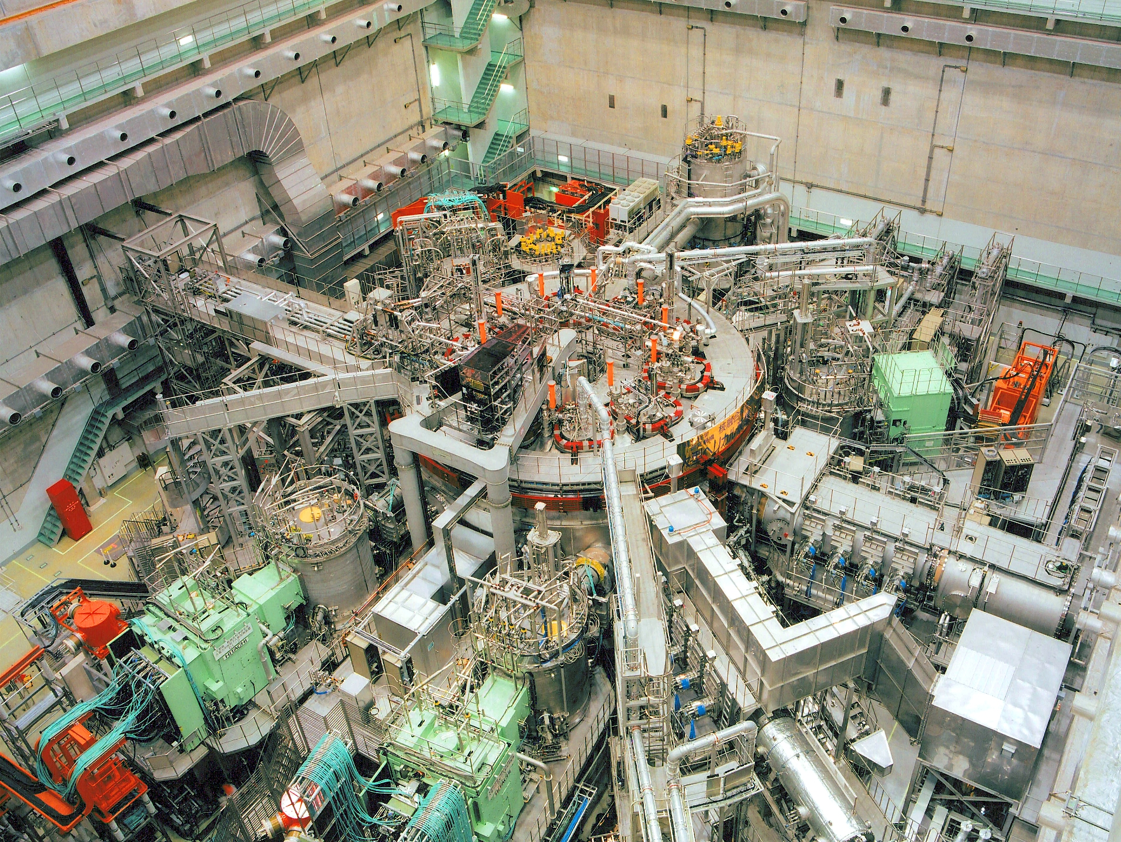
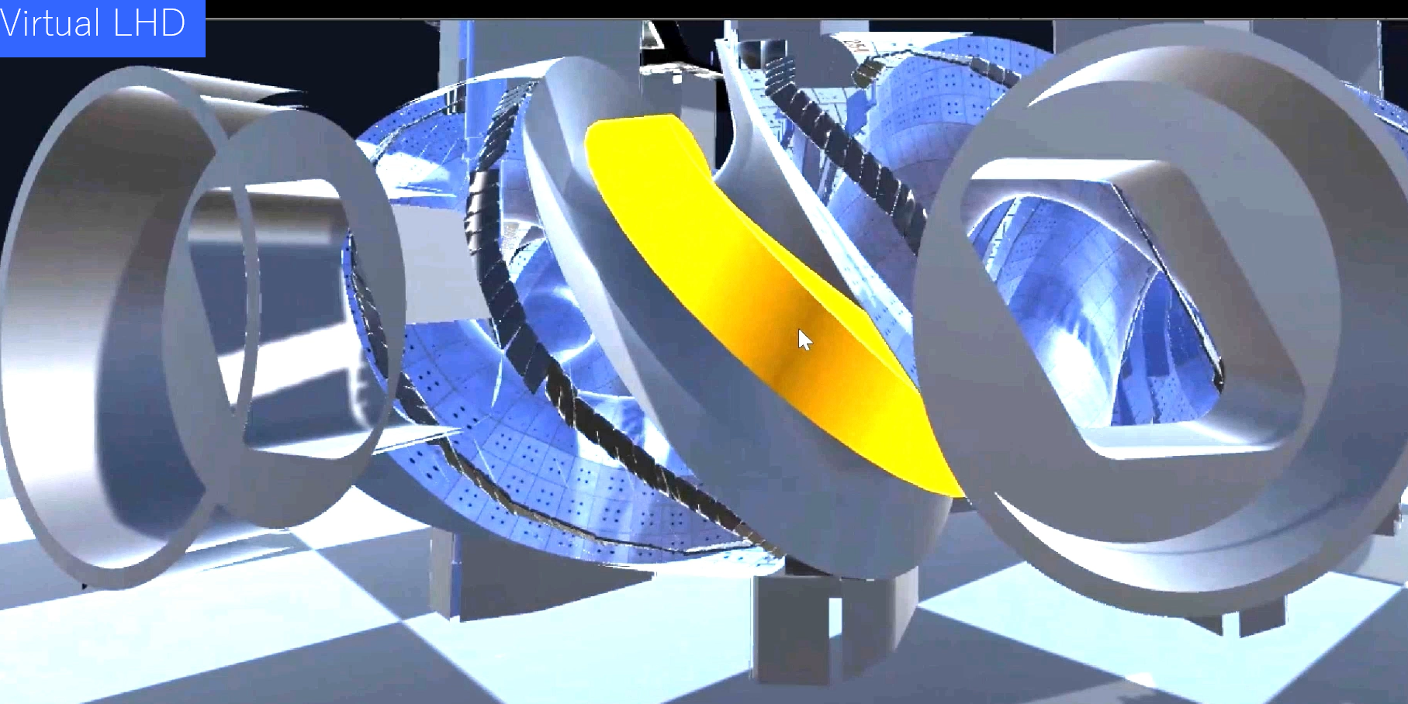
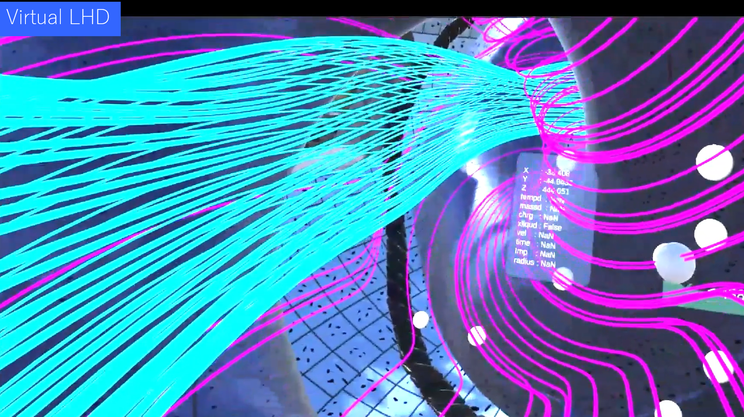
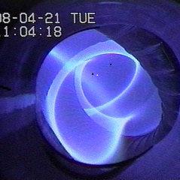
Large Helical Device, R=3.6m, a=0.6m, V=30m³, B_{tmax}=3T started in 1998
3xNNB (180keV/5MW), 2xPNB(40keV/6MW) total 27MW
ECH 2x77GHz, 2x154GHz ECH(each 1MW) total 4MW
ICRH 38.47MHz 2MW
48min. 36GJ input (Muto et al, FST2015)
Ti=10keV, Te=6keV at 1x10¹⁹m⁻³
(Osakabe et al, NF2022)
Virtual LHD
Ohtani 17 Oct., 14:00 TEC-CTRL Posters 6
150chYAG Thomson
50ch CXRS
Phase Contrast imaging
Doppler reflectometry
Millimetre backward scattering
HIBP
Li powder

Slide 3
Physics issues for plasma control
There are interactions and interplay in plasmas, for the reliable control of plasma , it is necessary to understand:
Interplay of bulk and impurity ions to keep good confinement and to avoid impurity accumulation
2. Interactions of turbulence to control transport
i) Interactions of ion and electron scale turbulence
ii) Interplay of local and non-local characteristics
iii) Interactions of different turbulence modes
3. Interactions between waves and energetic particles
α−particles predominantly heat electrons
Possibility of the direct ion heating by wave-particle interaction
Based on physics knowledge, advanced plasma control using data assimilation is presented by Morishita (17 Oct 8:30 TEC-CTRL Oral).

Slide 4
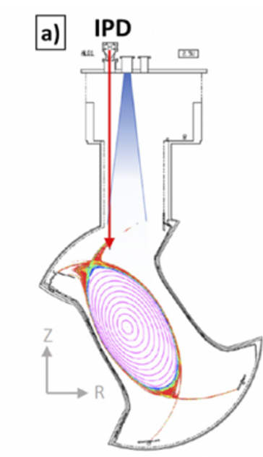
Real time wall conditioning by impurity powder dropper was successfully demonstrated
Boron powder dropping
Light Impurity powder (B, BN, C, Li, Si) are dropped.
(R. Lunsford et al, NF 2022)
Energy confinement improved with reduction of turbulence
(F. Nespoli et al, Nat. Phys. 2022)
Intrinsic Impurity in-flux reduced with impurity powder
(F. Nespoli et al, NF2023)

Slide 5
Core heavy impurity transport was enhanced by Li powder
Red; with Li, Blue without Li
D. Medina-Roque 16th Oct, 8:30
EX-C posters 3
Improvement of energy confinement was found.
Decay time of Mo31+ is clearly shorter with Li powder indicating enhancement of heavy impurity transport.→This is in clear contrast to the improvement of bulk confinement
Analyses of classical/neoclassical transport and turbulence driven transport are underway.
Molybdenum TESPEL (Tracer-Encapsulated Solid Pellet) was injected at 5.225s for the investigation of heavy impurity transport.
Notes:
Present analyses showed that classical transport is dominant in the collisional transport of Mo. In other words, classical transport is much higher in Mo flux. This is a good news, since classical transport does not depend on the toroidal configuration, possibly these observation can be found in other devices.
"According to SFINCS calculations, the effect of Li granule on
transport of Mo^31+ is likely dominated by classical diffusion."

Slide 6
Simultaneous measurements of ion and electron scale turbulence.
T. Tokuzawa (Comm. Physics 2025)
15 Oct, 10:35 EX-C poster 1
After the bifurcation
Quiescent
Grassy
Ion-scale turbulence
Both at ρ = 0.9
Doppler reflectometry
Electron-scale turbulence
Ion scale kρ_{s}~1.5
electron scale kρ_{s}~7.0
Millimetre backward scattering
Anti-correlation of i-scale and e-scale turbulence was found.

Slide 7


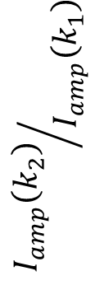
Turbulence anisotropy changes after confinement bifurcation.
$$∝k_{r}^{−1}$$
$$∝k_{θ}^{−1}$$
Turbulence
eddy
$${I_{amp}\left(k_{2}\right)}/{I_{amp}\left(k_{1}\right)}$$
at ρ = 0.9
Before bifurcation:
Radially elongated turbulence eddy
After bifurcation:
Isotropic turbulence.
Receiver2/Receiver1 shows turbulence anisotropy
Notes:
Change of the anisotropy affects the confinement as well.
Ion scale turbulenceが強い時はradially elongated.
これはi-scaleの乱流がelongationした。
i-scaleが弱くなるとその影響が小さくなりistropicになった。

Slide 8
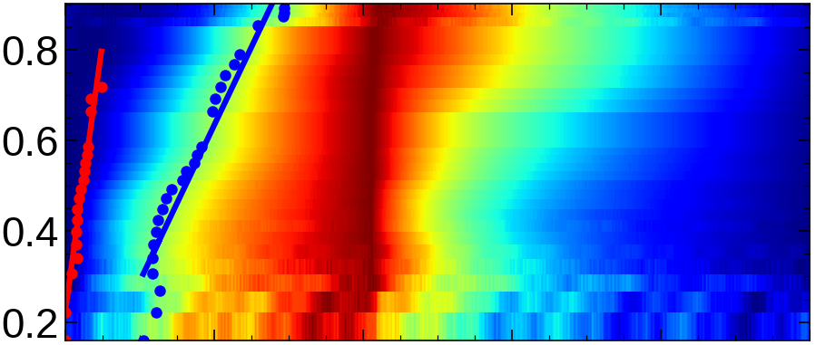
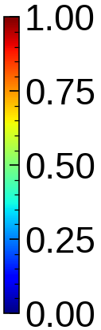
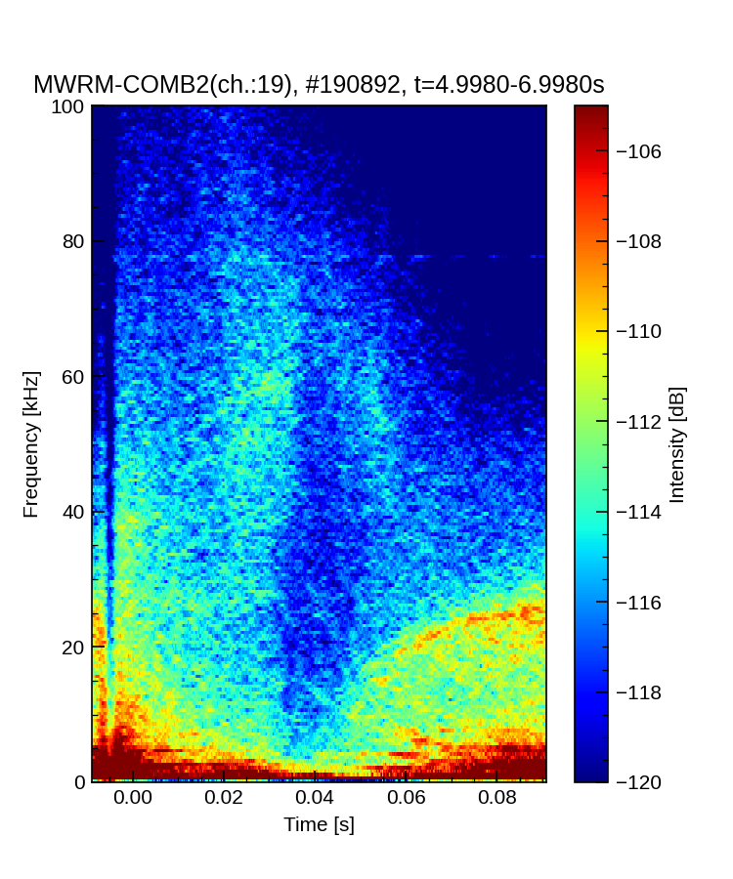

Local and non-local turbulence co-exists in the electron scale turbulence
Conditional averaged 25Hz ECH modulation
Kenmochi
15 Oct, 10:35, EX-C Posters 1
Electron-scale
turbulence by backward scatering
r_{eff}/a₉₉
$$δT_{e}/δT_{e,max}$$
Local turbulence (50-100kHz) follows change of Te gradient
Non-local turbulence (10-20kHz) is excited almost simultaneously throughout the entire plasma region. → Connection between the edge and core.
local
turbulence
Edge ρ=0.8
nonlocal
turbulence
Heat center ρ=0
0 20 40 80 100
Time(ms)
Notes:
This observation suggests direct connection of core and edge
プラズマ全領域でBSのクロスコリレーション解析を行っていますが、
励起のタイミングがプラズマ全領域で100us以内のラグしか無く、かつエラーバーの範囲で同時ですので、
現時点では伝播か同時励起か判別できません。

Slide 9
Density ramp up experiments shows turbulence transition.
Turbulence transitions from ITG to RI
Local flux tube gyrokinetic ITG growth rate
Kinoshita et al. PRL 2024
Turbulence is measured by 2D-PCI (k=0.1~0.8mm⁻¹, kρ_{s}~0.2, f=20-500kHz)
At transition density (n_{tr}) density, turbulence level becomes minimum.
At transition density (n_{tr}) density, turbulence phase velocity in lab . frame changes becomes from i-dia. to e-dia. direction.
Two fluid MHD Resistive Interchange (RI) growth rate
Minimum turbulence level
ITG
RI

Slide 10
Turbulence phase velocity in the lab frame can be indicator of ITG or RI
We consider keeping turbulence minimum condition at turbulence transition by feedback control.
What determines the turbulence transition (n_{e}, T_{e}, T_{i}, T_{e}/T_{i}, dn_{e}/dr, dT_{e}/dr , dT_{i}/dr ……)?

Slide 11
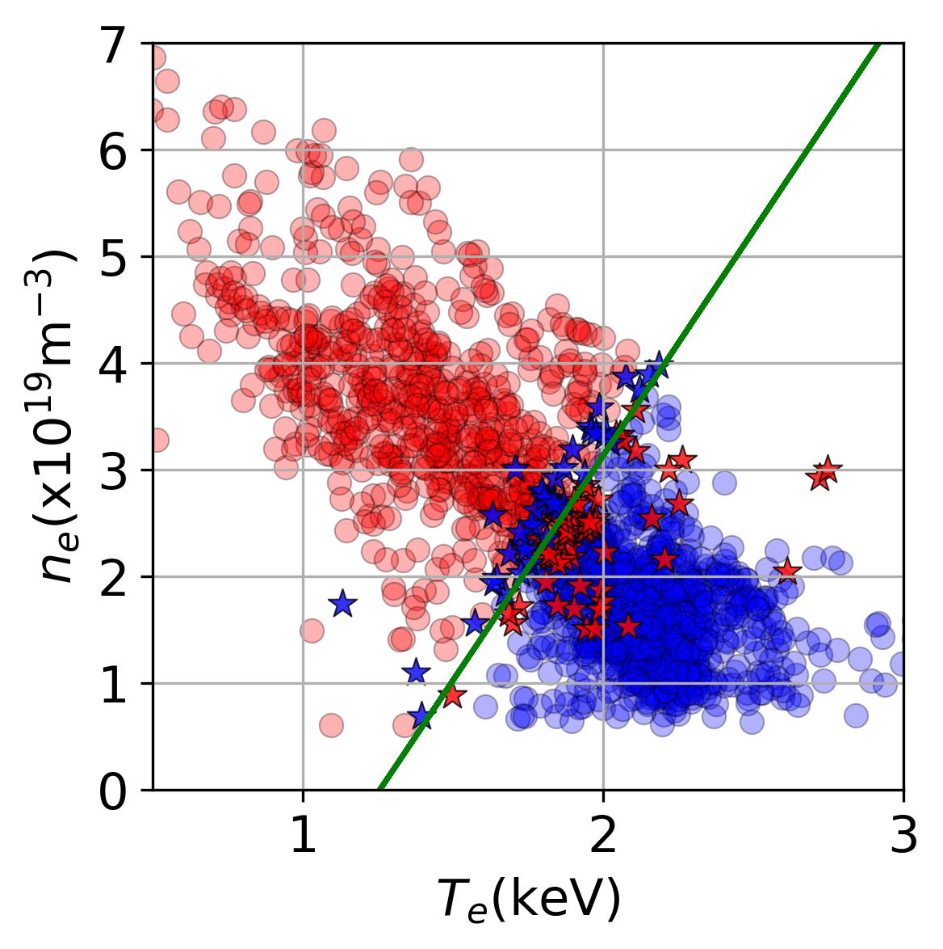
Keeping turbulence transition condition improved confinement.
at ρ=0.5-0.7
n_{e} = 4.20T_{e} - 5 .28
Kinoshita
17 Oct 11:40 Oral
e-dia. RI
e-dia. RI
#193313
W/O control
RI dominant
#193337
W/control
RI is supressed due to the lowering resistivity with ECRH
i-dia. ITG
i-dia. ITG
W/O ctrl
W/Octrl
2000 data machine learning established transition condition.
ECH power was controlled to keep transition
Notes:
We evaliuated the condtion of ITG and RI from propagation direction.
Scaning heating power and density, we surveyed 2000 data point
We surveyed the ruling parmeter temertur demtiy te,erture ratio and grdients

Slide 12
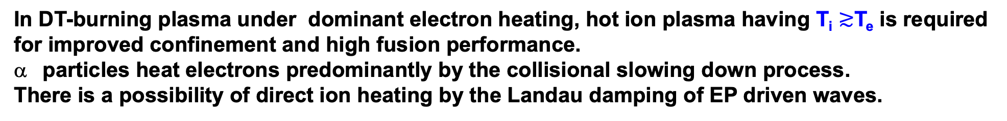
Ion heating by ion Landau damping was found in LHD
In DT-burning plasma under dominant electron heating, hot ion plasma having T_{i} $≳$T_{e} is required for improved confinement and high fusion performance.
particles heat electrons predominantly by the collisional slowing down process.
There is a possibility of direct ion heating by the Landau damping of EP driven waves.
D+
T+
He2+ (α particle)
n
+
+
+
+
+
+
e-
Heating by collisional damping of α particles
-
Landau damping
Excitation
Landau damping of energetic particle driven Alfven mode in plasma centre
Landau damping of energetic particle driven MHD burst in plasma periphery region
Notes:
=>TAE等のphase velocity =V_A >> V_ti =>resonant dampingは無視できる。高ベータトカマクプラズマでion accoustive waveとのcouplingでion Landau dampingは起こりうる。Phase velocityがV_tiに近くくなるGAMやEGAMがion Landau dampingの候補。
helical plasma でのEICはresistive interchangeが高速イオンで不安定化。Interchangeなのでiota=1 付近でk//~0. Phase velocity omega(~8 kHz)/k// はv_tiより相当高く、ion Landau resonance は？ ただ、私の発表内容では無関係。

Slide 13
Obvious reduction in EGAM potential fluctuations during T_{io}-increase phase
e-heating
Toi, 16 Oct 14:00 EX- W Posters 4
Turbulence does not change → no improvement in anomalous transport
Energetic particle driven Geodetic Alfven Mode (EGAM) is identified by Alfven spectroscopy with magnetic probes, HIBP and AE3D code
EGAM damping correlates well with T_{io}-increase
The EGAM frequency does not respond to the T_{io}-increases.→Supporting evidence of EGAM
Collision process (slowing down of NNB and equipartition heating) does not account for the increase of T_{io} and additional P_{i} is required
n=0
T_{io} and <P_{i}> with collisional heating process
Notes:
Iota=1/2 1/3を通過することが必要

Slide 14

Ion heating by Landau damping is also found in EP driven MHD burst
$$±0.1ms$$
Integral of f(v//)
0.7 keV
2.2keV
MHD burst appears just before decrease of neutron rate → Evidence of EP driven mode
Ida, 18 Oct 9:30 PD oral
MHD burst deforms ion velocity function and increases ion temperature

Slide 15
Summary: We have found the key knowledge to solve issues
Interplay of bulk and impurity ions to keep good confinement and to avoid impurity accumulation → Li powder improves bulk transport and degrades heavy impurity transport.
2. Interaction of turbulence to control transport
i) Interaction of ion and electron scale turbulence
→ anti-correlation of i-scale and e-scale
ii) Interplay of local and non-local characteristics → co-existence of both
iii) Interaction of different turbulence modes → ITG-RI transition is controlled
and leads to improved confinement
3. Interaction between waves and energetic particles
α−particles predominantly heat electrons
Possibility of the direct ion heating by wave-particle interaction
→ heating by the ion Landau damping

Slide 16
All presentations from the LHD experiment group
Wed, 15 Oct. 8:55 OV Oral (Tue, 14 Oct 14:00 OV poster)
K. Tanaka+, “Recent advances in plasma control and physics research in the large helical device”
Wed, 15 Oct. 10:10 EX-C Posters 1
N. Kenmochi+, “Experimental identification of coexisting local and non-local turbulence”
K. Nagaoka+, “Configuration dependence of turbulent transport with zonal flow effects”
M. Nishiura+, “Bifurcated particle transport states driven by regulatory energetic ions in LHD plasmas”
T. Tokuzawa+, “Discovery of cross-scale nonlinear interaction and bifurcation in multi-scale turbulence in LHD plasma”
Thu, 16 Oct. 8:30 EX-C Posters3
D. Medina-Roque+, “Impact of Li granule injection in the improvement of bulk energy and particle transport and expulsion of mid/high-Z impurities in the LHD heliotron”
Thu, 16 Oct. 14:00 EX-W Posters 4
H. Igami+, “Observation of lower hybrid harmonic waves accompanied by sidebands with distinct ion cyclotron frequency intervals excited by nonlinear process at multiple dual resonances in a fusion oriented plasma”
K. Toi+, “Observation of non-collisional ion heating in helical plasmas under dominant electron heating condition by neutral beam injection on LHD”
Fri, 17 Oct. 11:40 EX-C(Oral) (the same day, 14:00 Posters 6)
T. Kinoshita+, “Direct control of turbulence for improved plasma confinement”
Fri, 17 Oct. 8:30 TEC-CTL(Oral) (the same day, 14:00 Posters 6)
Y. Morishita+, “Development of data assimilation system ASTI toward digital twin control of fusion plasma”
Fri, 17 Oct. 8:30 EX-S Posters 5
Y. Takemura+, “Frequency Hysteresis of MHD Instabilities in Helical and Tokamak Plasmas”
Fri, 17 Oct., 14:00 TEC-CTRL Posters 6
H. Ohtani+(Post Deadline), “Immersive VR-based visualization and analysis of fusion plasmas using digital-LHD and virtual-LHD”
H. Yamaguchi+, “An overview of a proposed new experimental stellarator: variable symmetry torus”
Sat, 18 Oct 9:30 Post Deadline Oral (Fri, 17 Oct. 14:00 Poster 6)
K. Ida+, “Observation of core ion energy increase caused by the Landau damping of MHD wave in the periphery of LHD plasma”

Slide 17
Backup

Slide 18
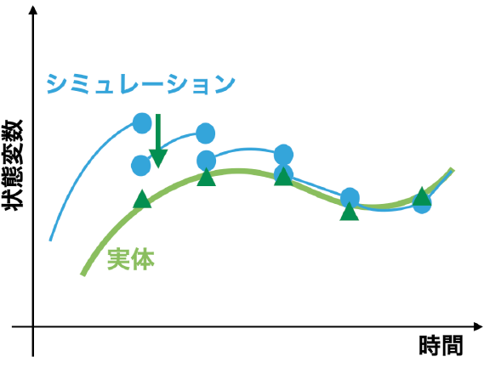
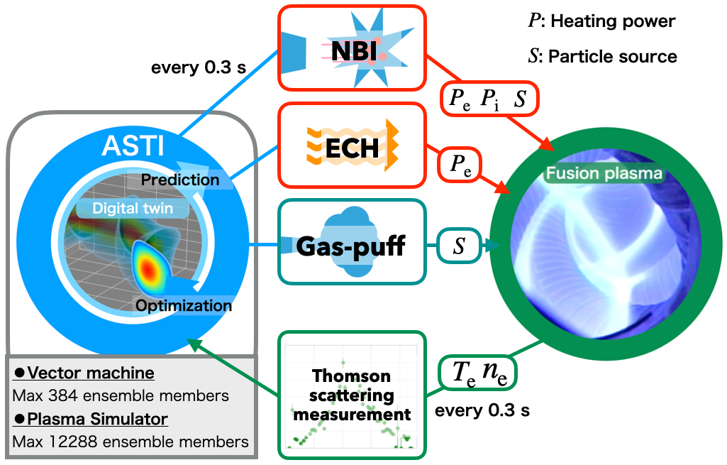
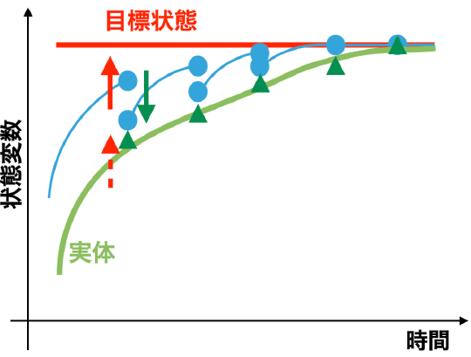
ASTI (Assimilation System for Toroidal plasma Integrated simulation)
DA for control
Y. Morishita (Sci. Rep. 2024) 17 Oct 8:30 Oral
Simulated variable
Target Variable
DA for prediction
filtered probability→ input of next simulation
Simulated variable
observation
simulation
Variable
Prediction and control
Variable
Probability
Observed variable
Observed variable
Time
Variables
Time
Observed variables are assimilated to the target variable
Real time simulations with input data from real time signals are carried out and predict the profiles at next timing.
The control works to minimize the difference of target and observation/prediction.
Real time
Notes:
Real time Thomson data is sent to super computer. Then power balance analyses and time dependent prediction are performed. Since input parameter has some probability,

Slide 19
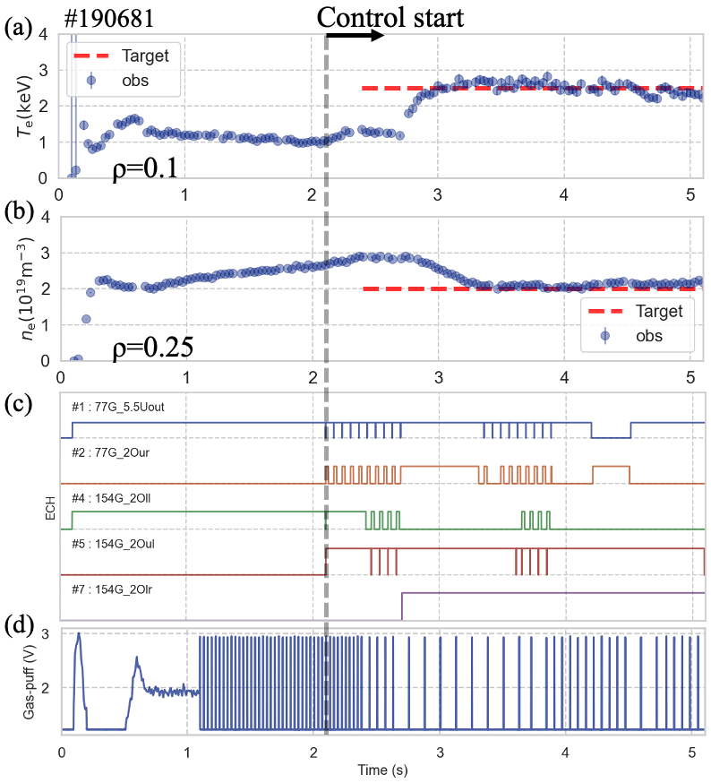
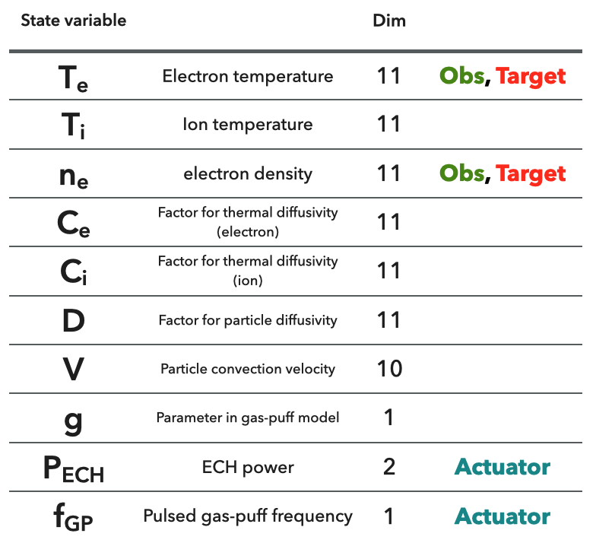
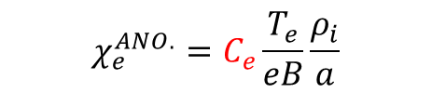
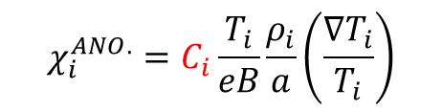




Realtime profile control is successfully demonstrated by using ASTI system
Heat transport model of electrons and ions is based on Gyro-Bohm model
$$χ_{e}^{ANO.}=C_{e}\frac{T_{e}}{eB}\frac{ρ_{i}}{a}$$
$$χ_{i}^{ANO.}=C_{i}\frac{T_{i}}{eB}\frac{ρ_{i}}{a}\left(\frac{∇T_{i}}{T_{i}}\right)$$
$$χ_{s}=χ_{s}^{NC}+χ_{s}^{ANO.}$$
Coefficients Ce, Ci, d, v are optimized by DA.
Particle transport uses simple model
$$D=dD^{ANO.}$$
$$D^{ANO.}is spatialy constant$$
$$V=V_{neo}+v$$

Slide 20
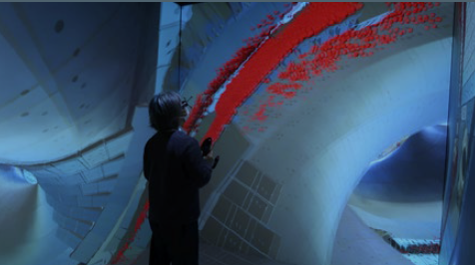
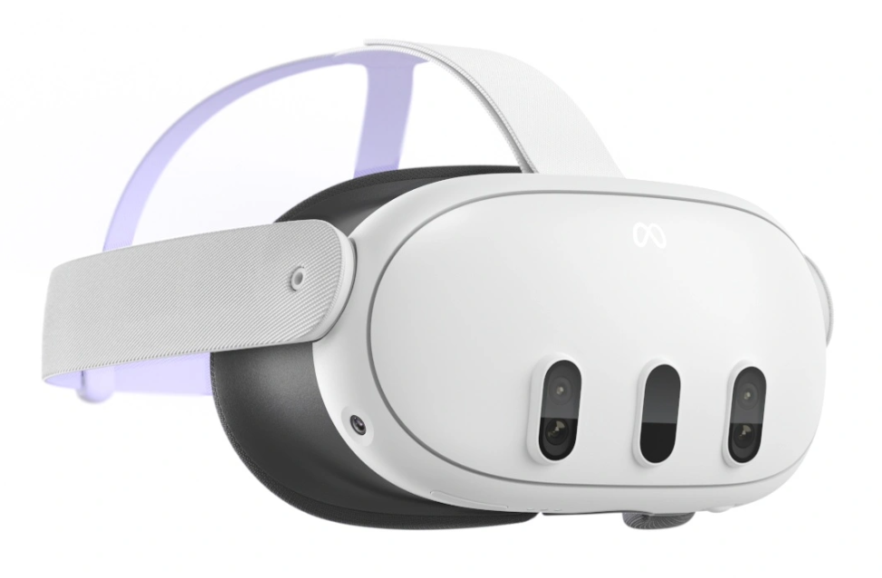
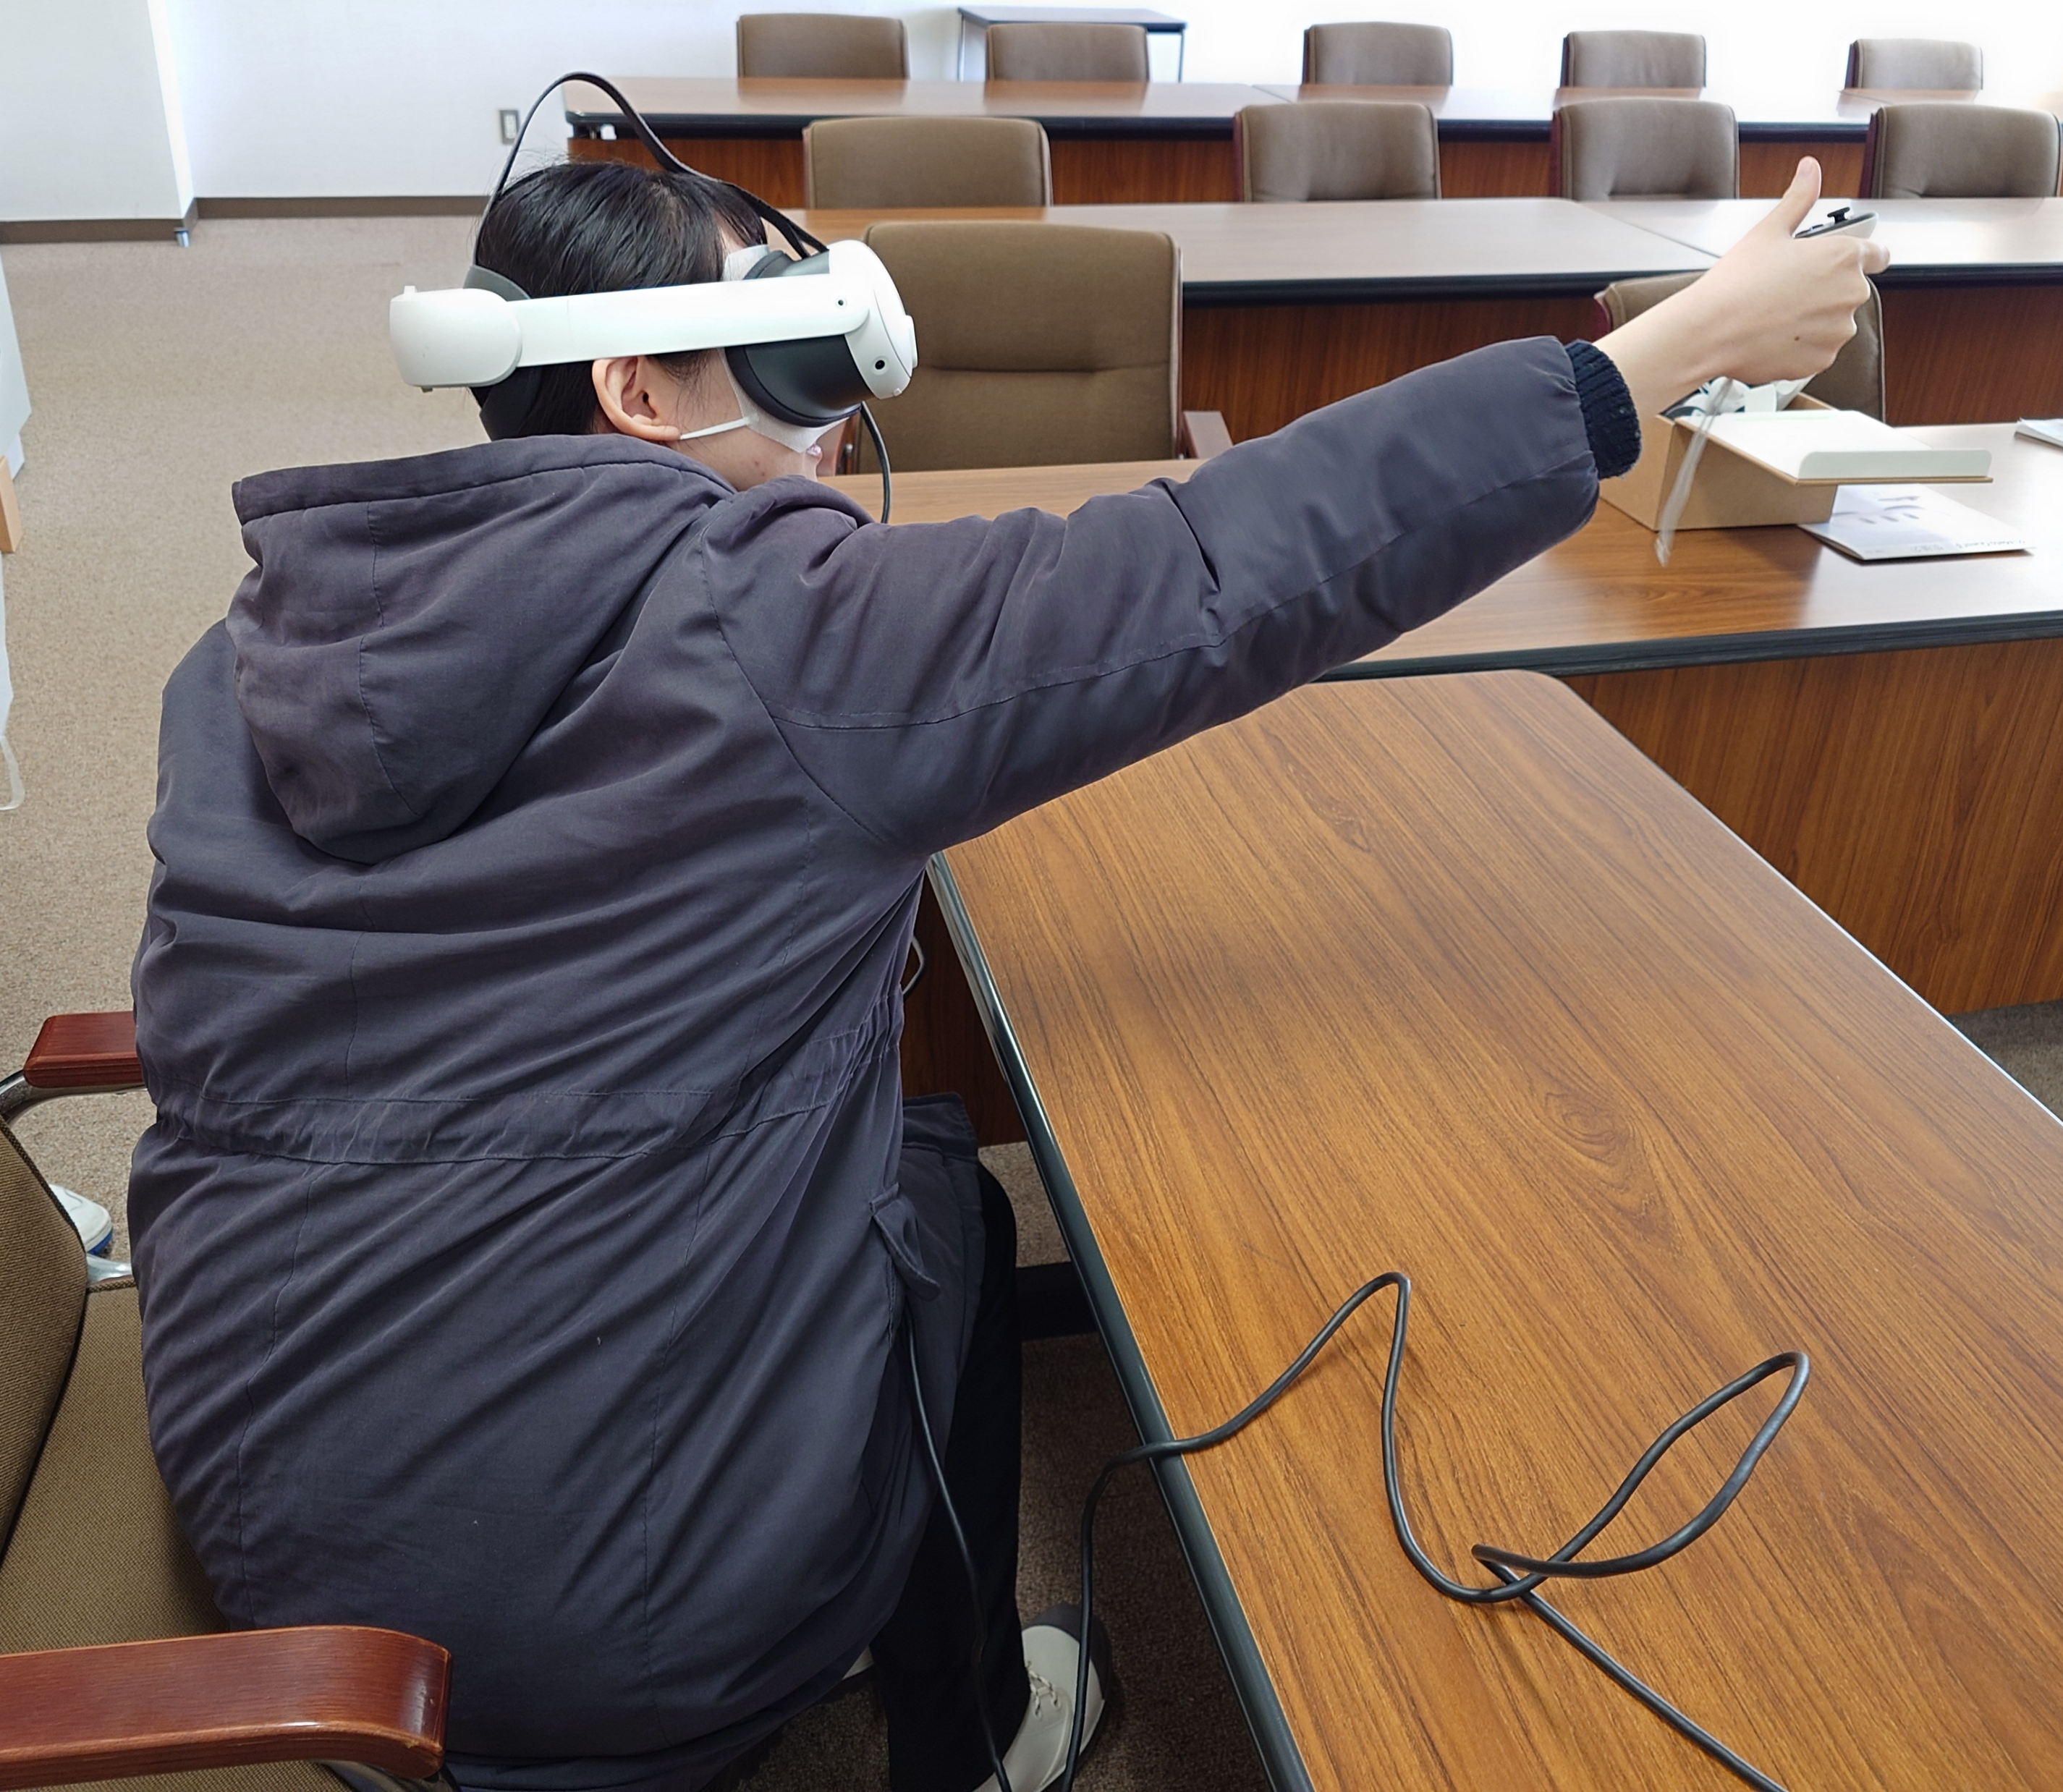
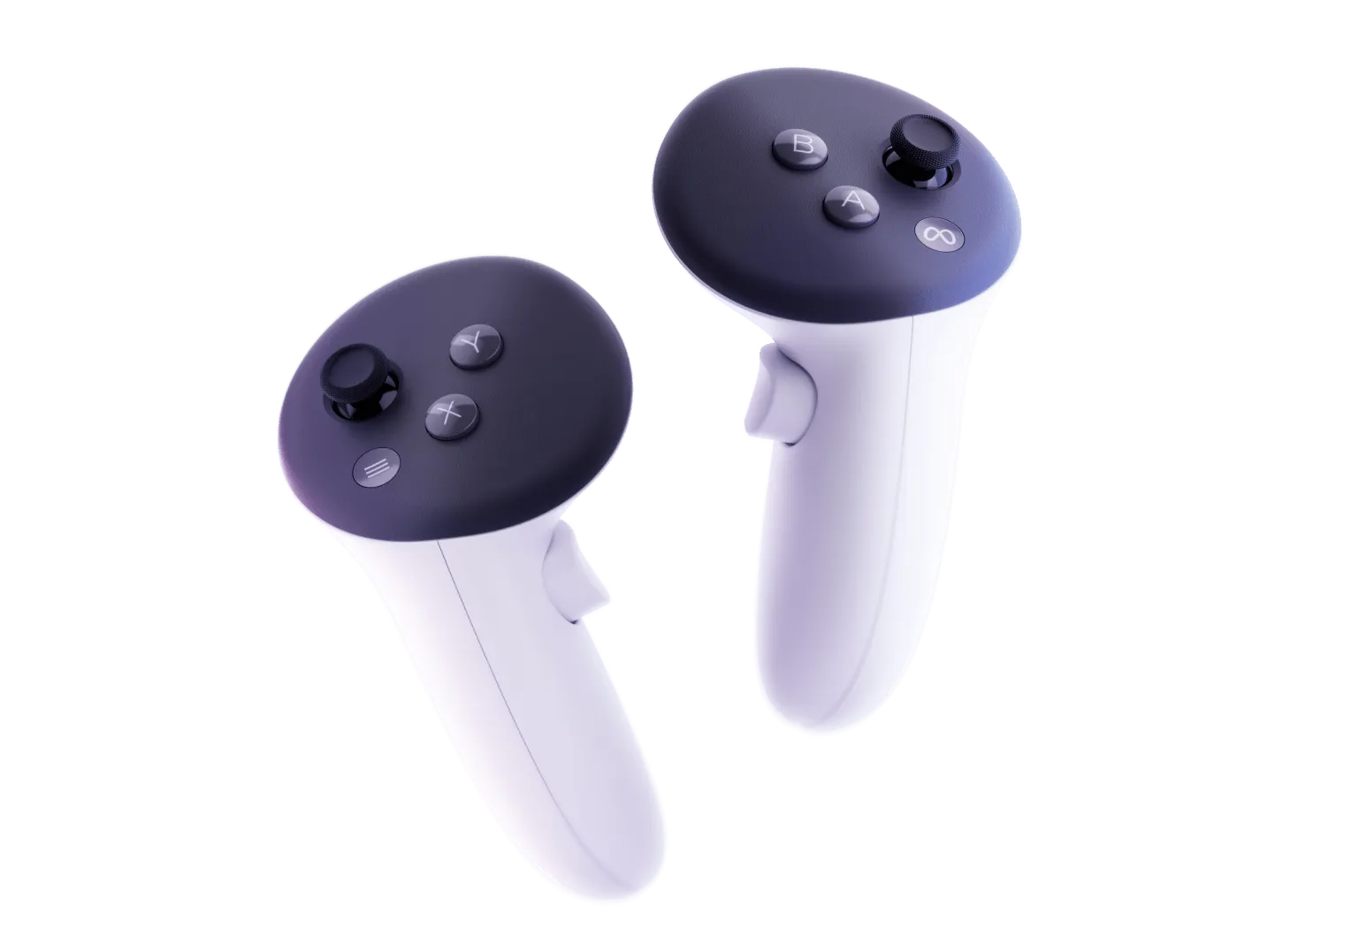
Head Mounted Display of Virtual Reality system of LHD was developed
H. Ohtani et al, 17 Oct., 14:00
TEC-CTRL Posters 6 (post deadline)
Visualization of triton impacts
Room size (4x4x4m) VR system for LHD(CompleXcope)
Newly developed HMD VR system for LHD
Kageyama et al,
Proceedings of 16th Int. Conf. on the Numerical Simulation of Plasmas (1998)
Ohtani et al,
J. Visualization. (2022)
Notes:
VR works as a useful tool.
We can check interference of the in-vessel equipment.
But if only this is the purpose, VR is not very different from 3D-CAD.
But VR is much better than 3D CADS to understand the physics.
This movies indicates to show the motion of the impurity powder

Slide 21
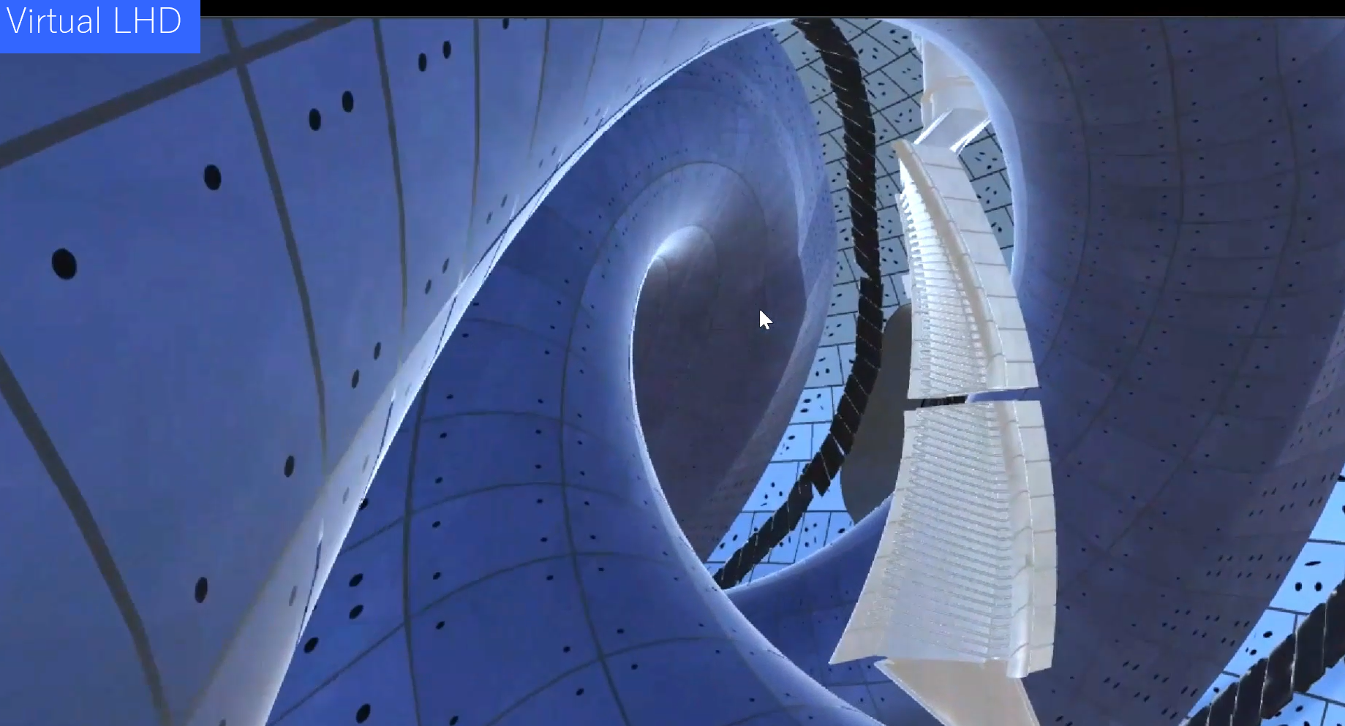
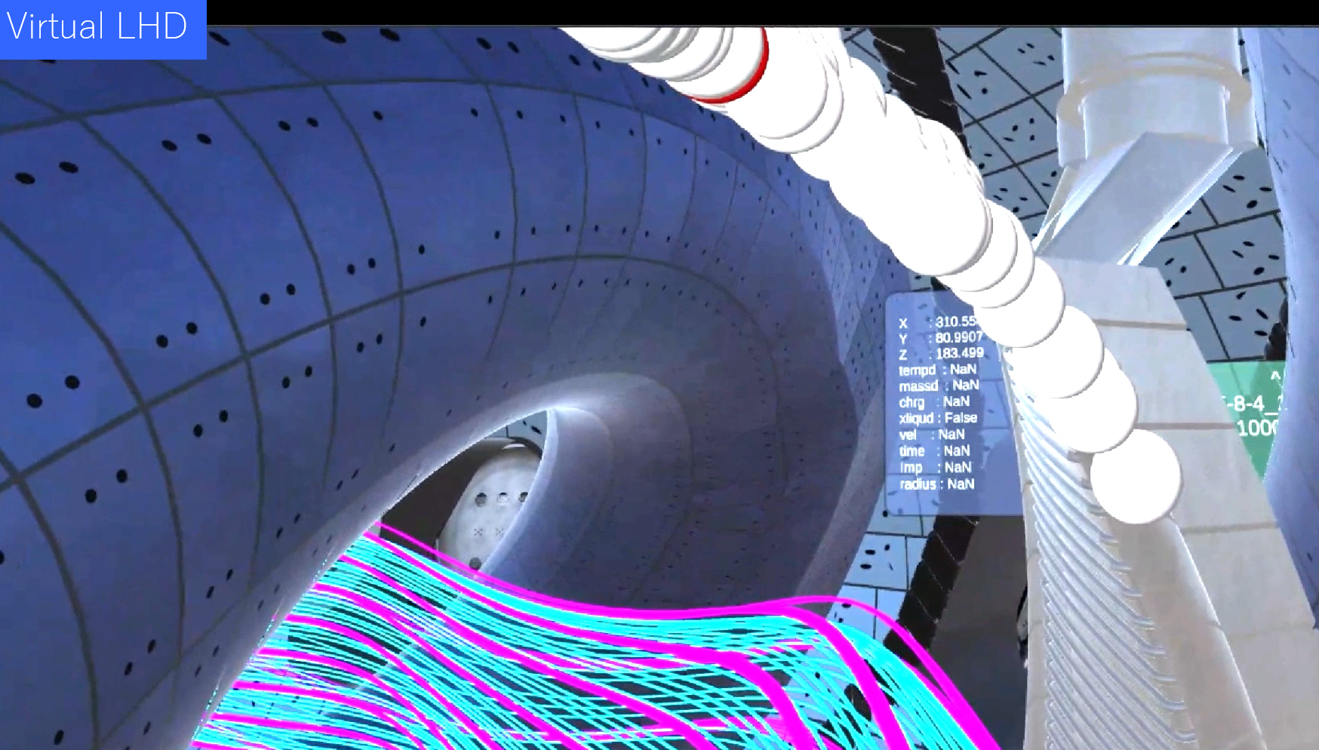
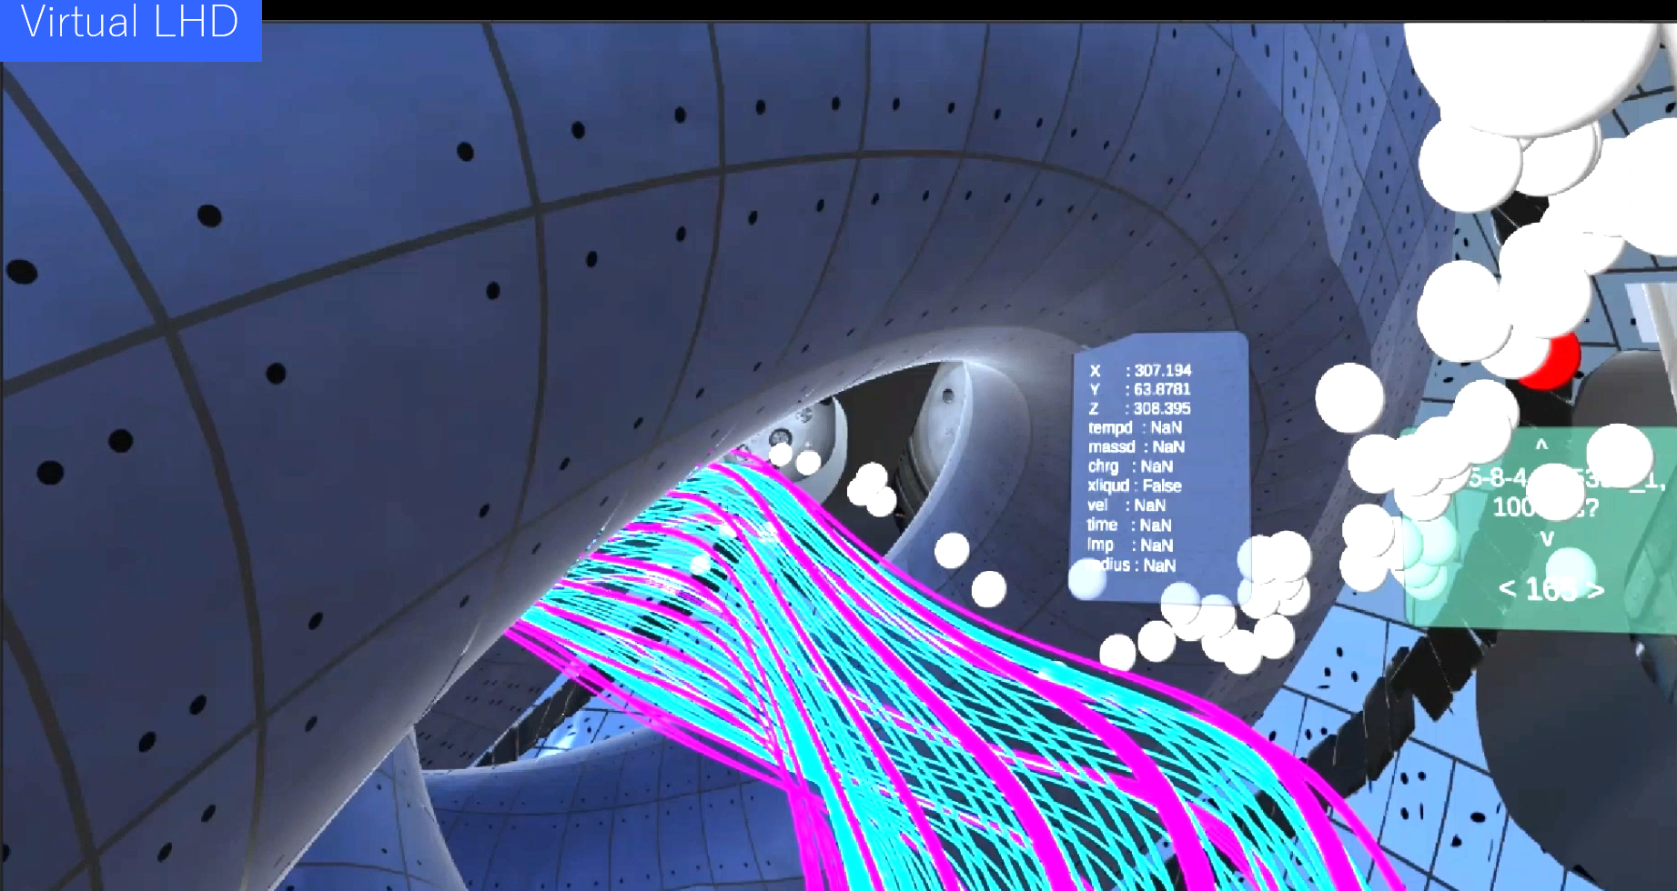
Li drop in the Virtual LHD
Li powder

