Slide 1
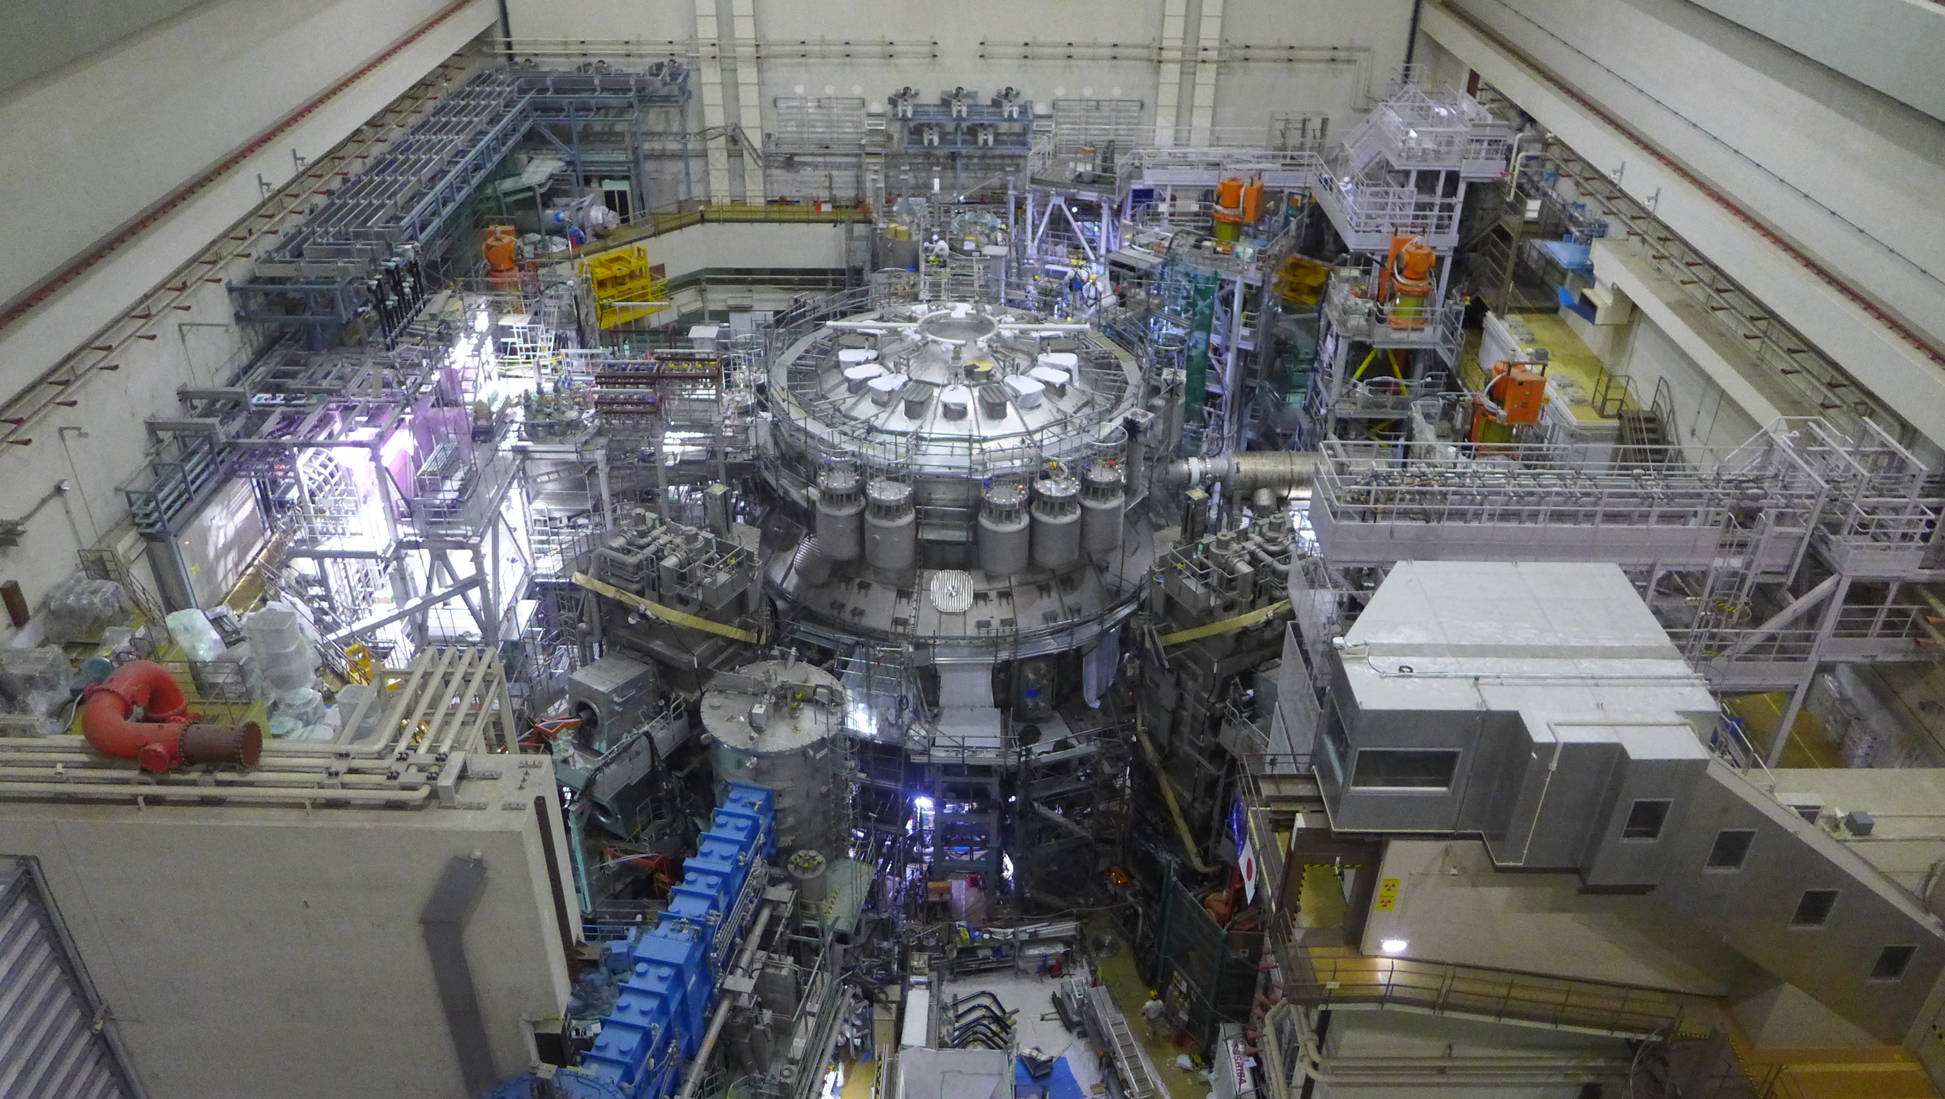




FIRST JT-60SA PLASMA OPERATION AND PLANS IN VIEW OF ITER AND DEMO
J. Garcia on behalf the JT-60SA integrated project team

Slide 2
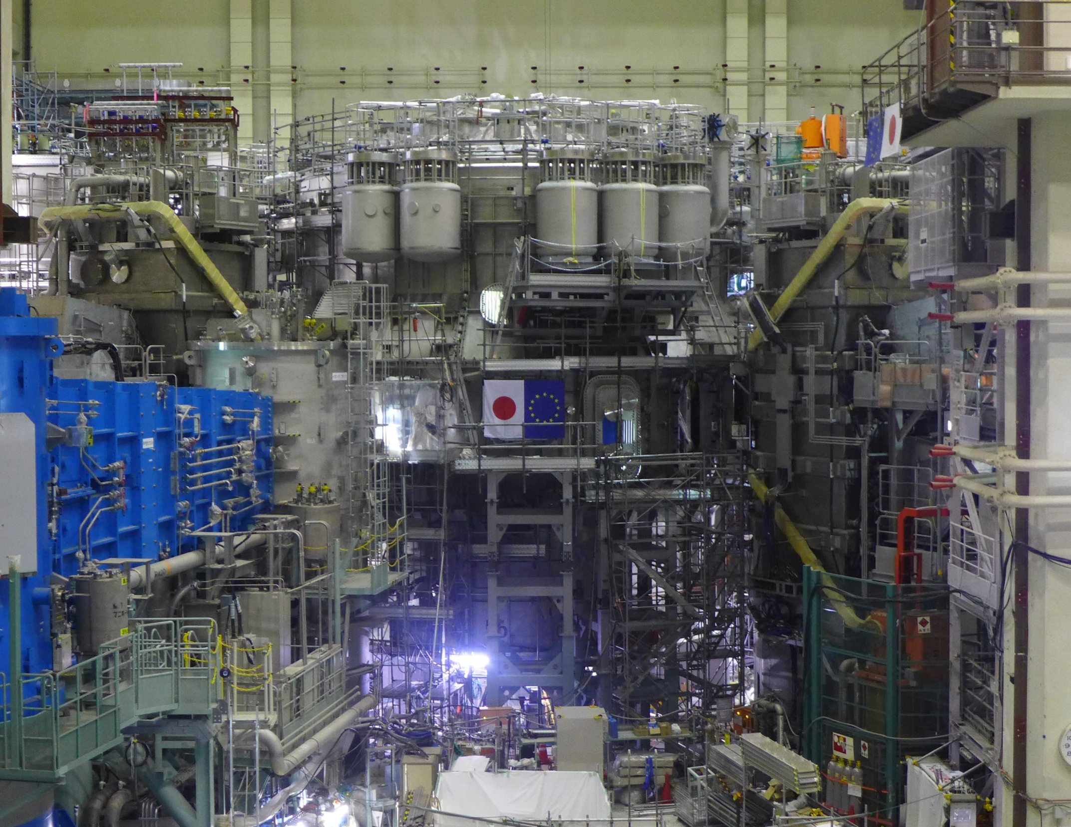















Outline
The JT-60SA tokamak
Integrated commissioning and OP-1 results
Status of the JT-60SA project, timeline and scientific priorities
Preparation for future campaigns
Conclusions

Slide 3
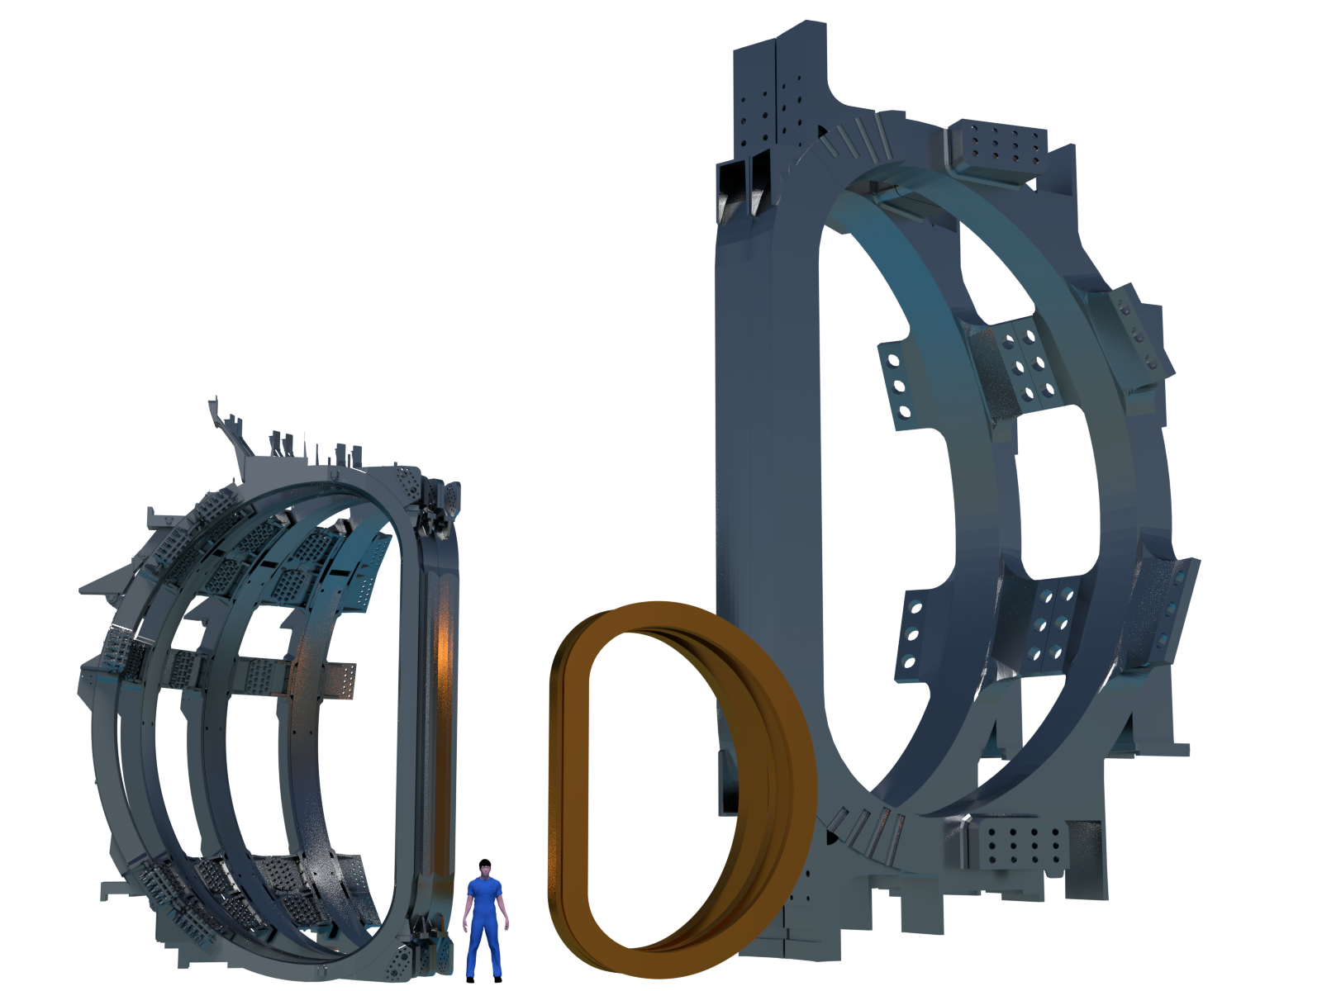
JT-60SA: large step beyond JET towards ITER
JT-60SA is the largest tokamak before ITER
JT-60SA represents an intermediate step between JET and ITER
ITER
JT-60SA
JET

Slide 4
JT-60SA: large step beyond JET towards DEMO
JT-60SA is the largest tokamak before ITER
JT-60SA represents an intermediate step between JET and ITER
Unlike JET, JT-60SA can address long pulse steady-state operation
Continuous operation is important for DEMO
ITER
JT-60SA
JET

Slide 5
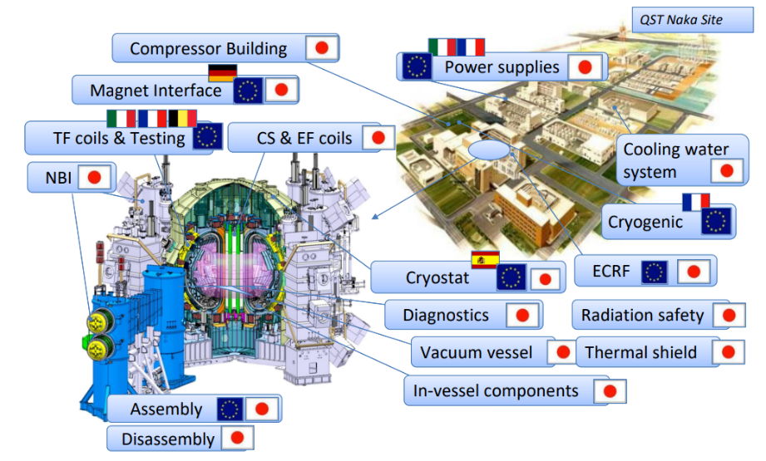
The JT-60SA tokamak: an international platform
Designed and built jointly by Japan and EU at the Naka site under the Broader Approach agreement
[Y. Kamada, NF 2022]
[H. Shirai, NF 2024]

Slide 6
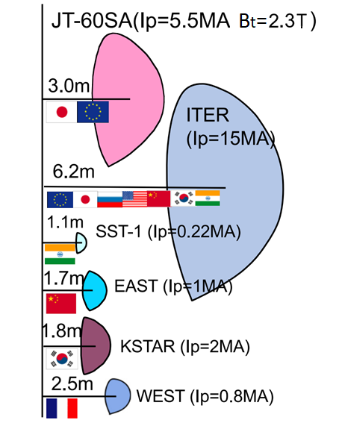
The JT-60SA tokamak configuration
Designed and built jointly by Japan and EU at the Naka site under the Broader Approach agreement
Fully superconducting, high current, highly shaped
a = 1.2 m

Slide 7
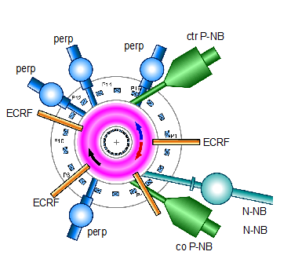
The JT-60SA tokamak configuration
Designed and built jointly by Japan and EU at the Naka site under the Broader Approach agreement
Fully superconducting, high current, highly shaped
High input power flexibility, ECRH (7MW) and NBI (34MW)
Jointly exploited by Japan and EU
a = 1.2 m
&
1
2

Slide 8
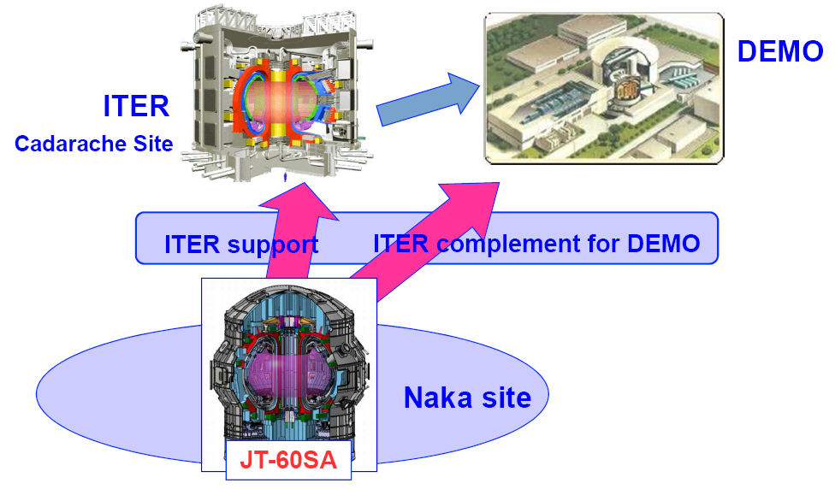

The JT-60SA project objectives
Contribute to early realization of fusion energy by:
  supporting the comissioning, start-up and exploitation of ITER
  complementing ITER in resolving key issues for DEMO
  train the next generation of fusion physicists and engineers
The most important goal of JT-60SA is:
  to decide the practically acceptable DEMO plasma design
  including practical and reliable plasma control schemes

Slide 9
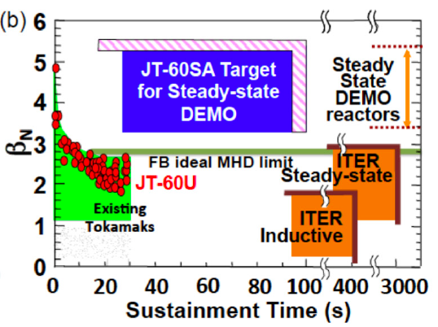
JT-60SA: a scientific and operational challenge
JT-60SA aims at challenging normalized plasma parameters
  High: beta, non-inductive current fraction, normalized density, confinement

Slide 10
JT-60SA: a scientific and operational challenge
JT-60SA aims at challenging normalized plasma parameters
  High: beta, non-inductive current fraction, normalized density, confinement
While working at high absolute plasma parameters:
  Ip=5.5MA
  Peak Thermal Energy ~20MJ
  Peak DD Neutron rate ~1e17s⁻¹
  Sustained period ~100s

Slide 11
Outline
The JT-60SA tokamak
Integrated commissioning and OP-1 results
Status of the JT-60SA project, timeline and scientific priorities
Preparation for future campaigns
Conclusions

Slide 12
End of 2023: Integrated comissioning and OP1
Hardware integrated comissioning:
  Purpose is to commission each sub-system and confirm machine readiness for plasma operation
  Designed technical requirement is satisfied? each sub-systems works as designed?
OP1:
  Achieve a MA-class divertor plasma
  Demonstrate stable plasma control from current-up to ramp-down
  Electron Cyclotron Resonance Heating (ECRH) assisted start-up in low parallel electric field (E||) conditions
[M. Yoshida, PPCF 2025]

Slide 13
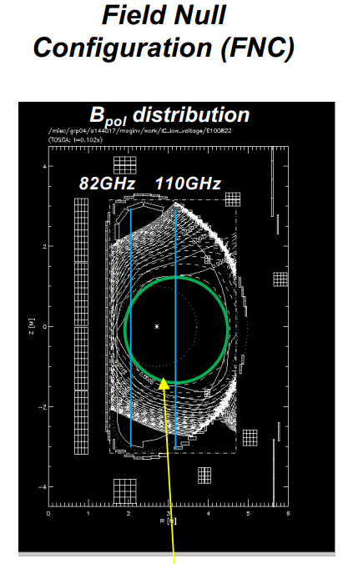
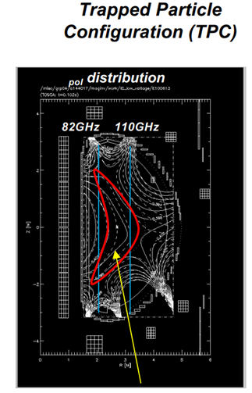


Predict first modeling for first plasma
Predict first simulations showed easier start-up with TPC and ECRH
ψ
T. Wakatsuki, EX/7 2689

Slide 14

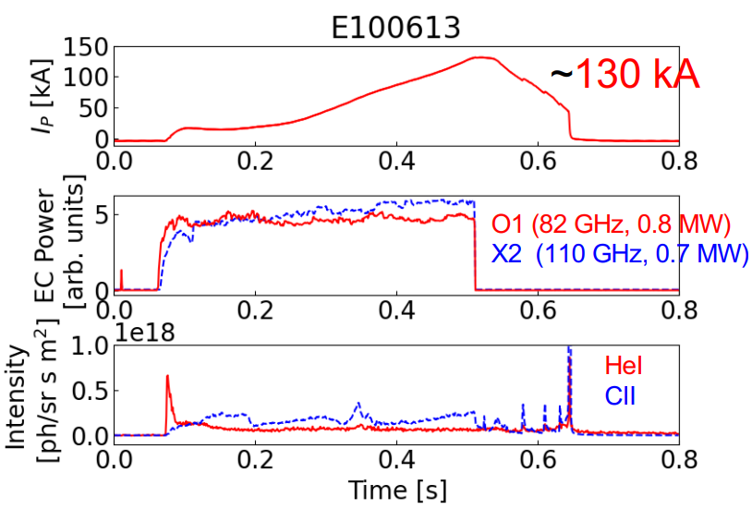
First Plasma Was Obtained on 23rd October 2023
Predict first simulations showed easier start-up with TPC and ECRH
After several FNC attempts, first plasma achieved at first trial using TPC
T. Wakatsuki, EX/7 2689

Slide 15
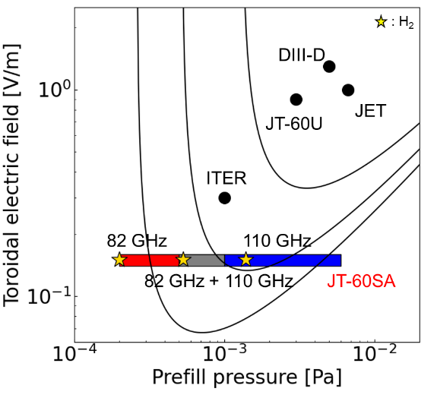
First Plasma Was Obtained on 23rd October 2023
Predict first simulations showed easier start-up with TPC and ECRH
After several FNC attempts, first plasma achieved at first trial using TPC
1000 m
500 m
200 m
Even lower E//, 0.15 V/m, than expected in ITER→ Encourage ITER low E|| start-up
T. Wakatsuki, EX/7 2689

Slide 16
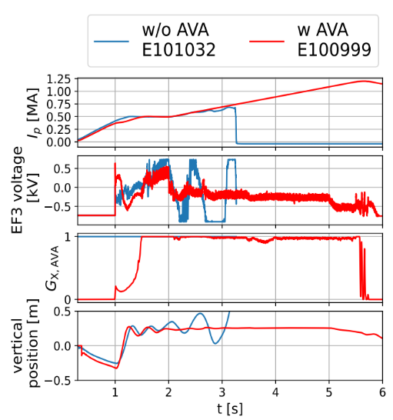
Adaptive voltage allocation (AVA): a key plasma control scheme
Potential saturation of poloidal coils voltage found in predict-first simulations
AVA: adjusts the balance between the position and shape control and the Ip control
Successfully tested during OP-1 with pre-optimized gains from the nonlinear simulator MECS
Importance of predict-first modelling
S. Inoue, EX/7 2898

Slide 17
VDE Prediction and Control Scheme Were Demonstrated
VDE predictor and control algorithm were developed using machine learning
Upper single-null plasma
VDE region in model
  Vertical velocity v, decay-index n, used for VDE prediction
Deliberate downward VDE was demonstrated
  Coil voltage set to 0
decay-index n
Machine learning and AI techniques being developed during the start-up with limited input data
Upward
(natural)
Downward (controlled)
Vertical velocity v (m/s)
Important development for future large superconducting tokamaks → ITER
[S. Inoue, NF2024]

Slide 18
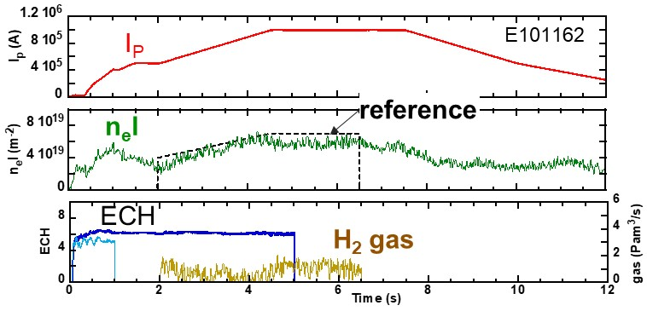
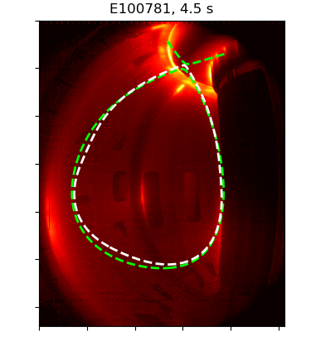
JT-60SA is a MA class tokamak
T. Szepesi, P1 2811
[M. Yoshida, PPCF 2025]
I_{P}=1 MA is obtained with well controlled diverted plasma in H₂ and optimized breakdown/build up scenario.
Density feedback control was a success.
Strike points clearly identified with visible camera EDICAM

Slide 19
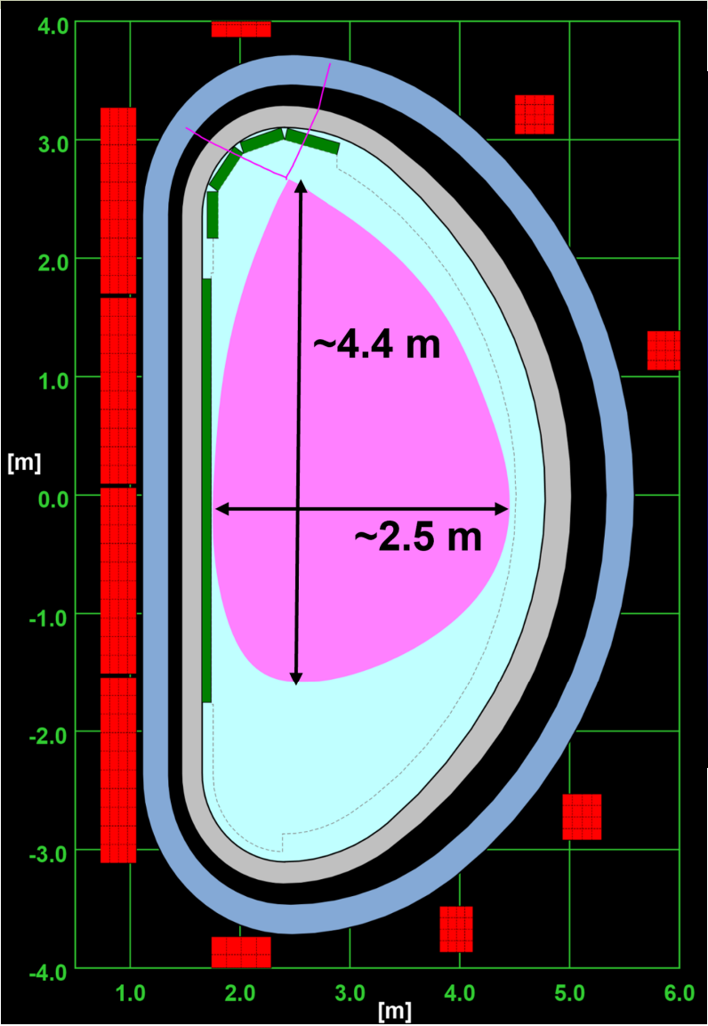
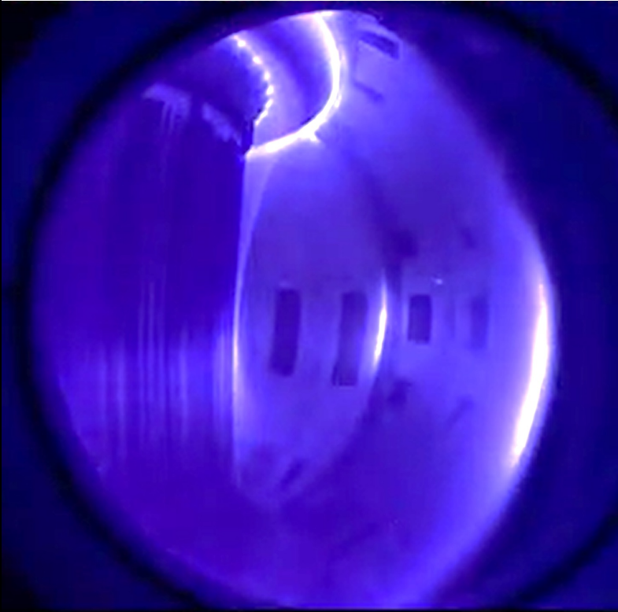
Record plasma volume → going beyond JET
JT-60SA produces largest plasma volume, 160 m³, beyond JET plasmas, ~100 m³
Record plasma current up to 1.2 MA in a superconducting tokamak
S. Inoue, EX/7 2898

Slide 20
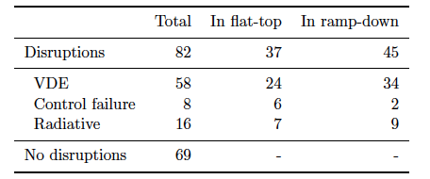
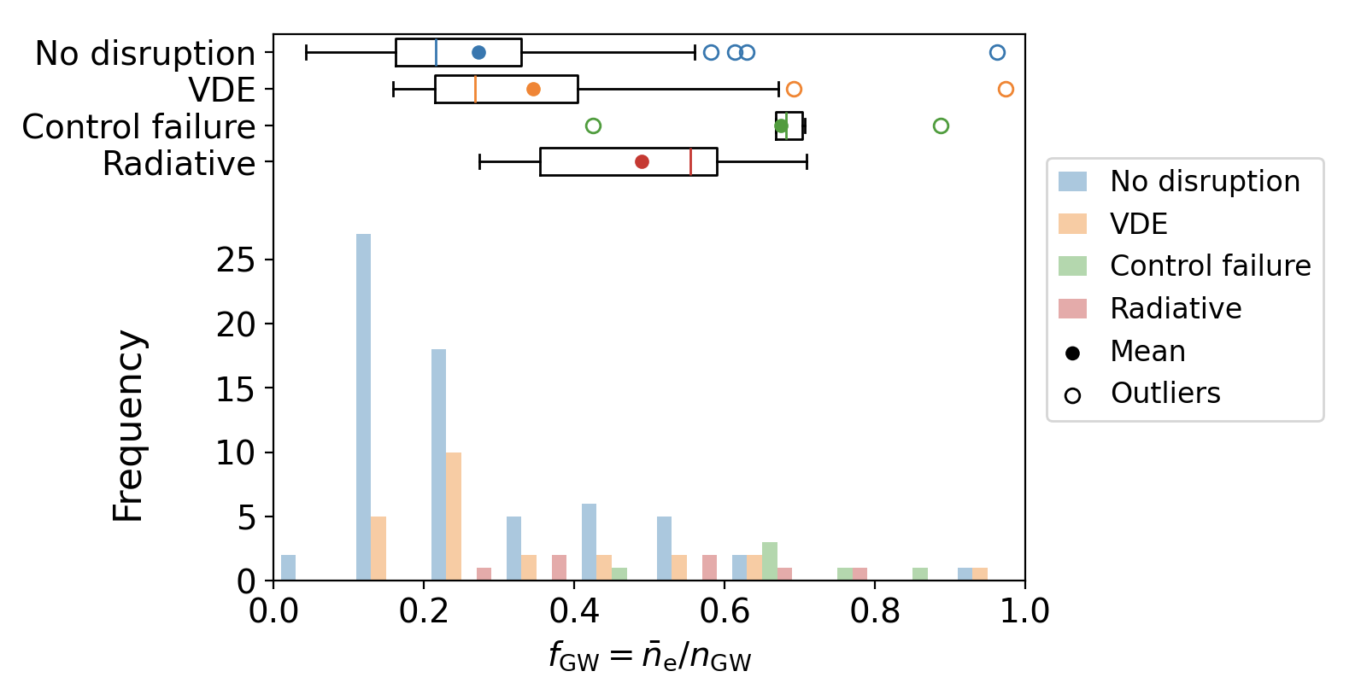
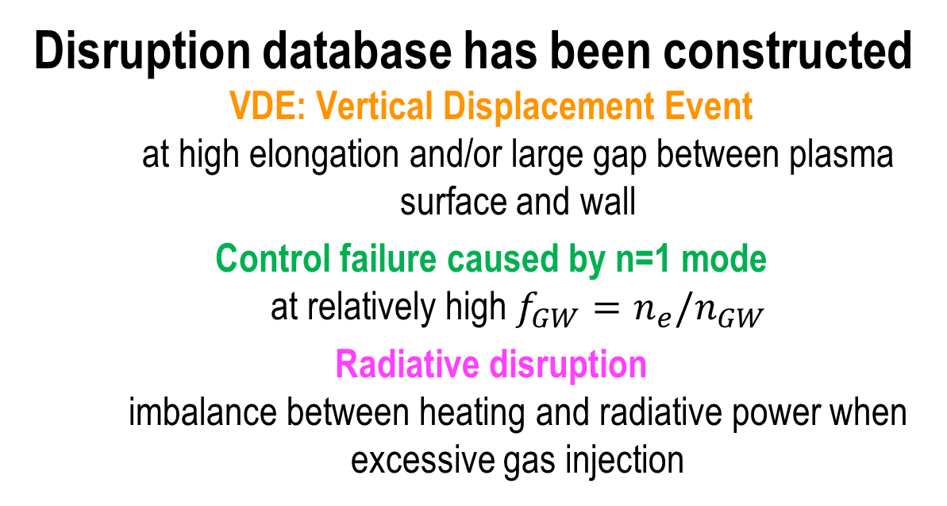
Classification of the causes for disruptions
I_{P} = 0.28-1.07 MA
Disruption database has been constructed
  VDE: Vertical Displacement Event
    at high elongation and/or large gap between plasma surface and wall
  Control failure caused by n=1 mode
    at relatively high $f_{GW}=n_{e}/n_{GW}$
  Radiative disruption
    imbalance between heating and radiative power when excessive gas injection
JT-60SA data being included in multi machine disruption database→ Essential for extrapolations
Y. Yokoyama, P5 2690

Slide 21
Focus during OP-1 for Run Away electrons generation→ role of MHD
Neutron flux monitors (NFMs) are used to indirectly detect the RE loss on PFCs
Correlation between REs and n=1 MHD activity, caused by tearing modes→ Necessity of MHD control even during start-up
Hard X-Ray (HXR) dosimetry for the evaluation of REs done with visible camera EDICAM
T. Szepesi, P1 2811
REs generation detected at low E||→ mitigation techniques necessary even in the start-up
S. Sumida, P5 2692

Slide 22
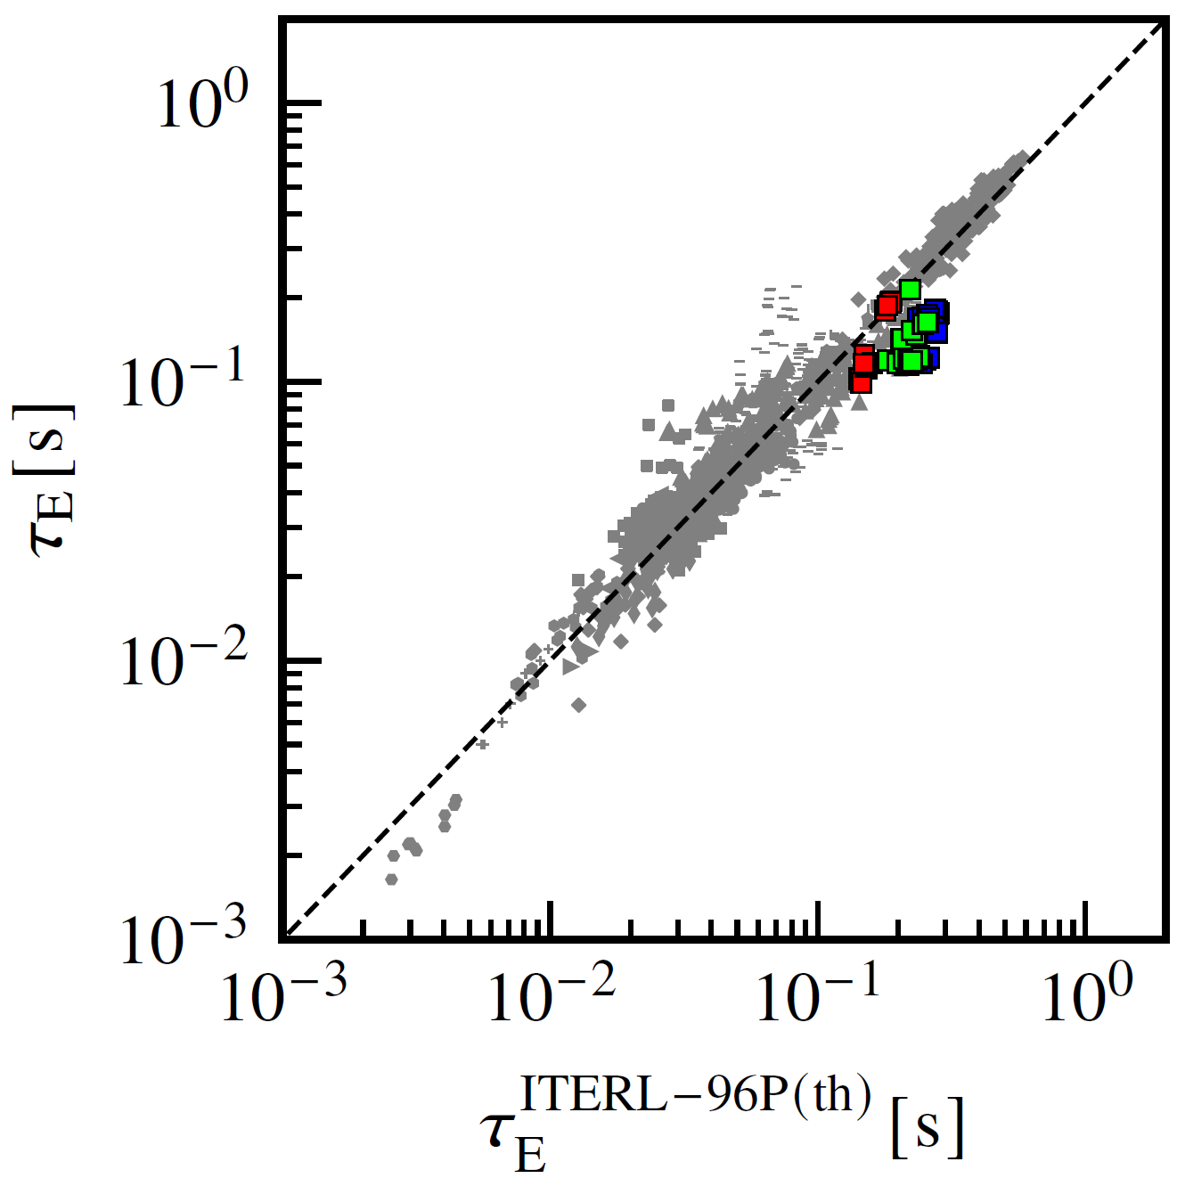
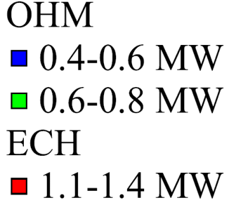
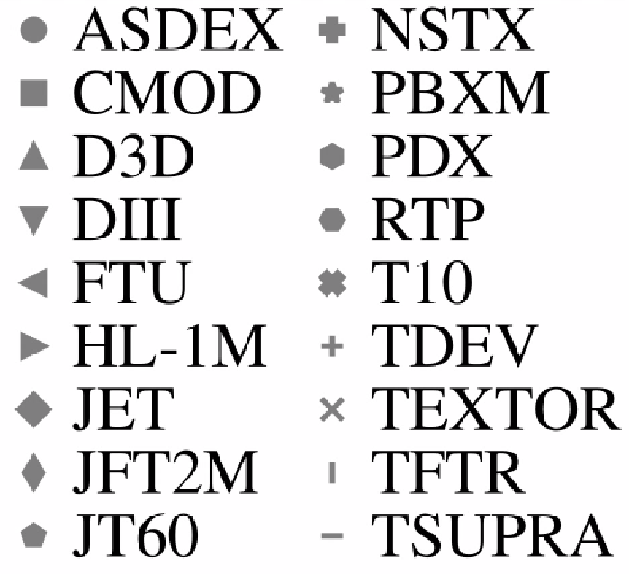
Plasma energy time confinement during OP-1
τ_{E} ~ 0.1 - 0.2 s
Energy confinement ~100-200 ms in I_{P}=1 MA plasmas
  Consistent with expo. time-decay of W_{sto}~130ms
  Generally consistent with the ITERL-96P scaling
  Dependent on LOC or SOC plasma regime
Initial JT-60SA plasmas show general agreement with expectations from tokamak databases
Y. Ohtani, P1 2851
[M. Yoshida, PPCF 2025]

Slide 23
Outline
The JT-60SA tokamak
Integrated commissioning and OP-1 results
Status of the JT-60SA project, timeline and scientific priorities
Preparation for future campaigns
Conclusions

Slide 24
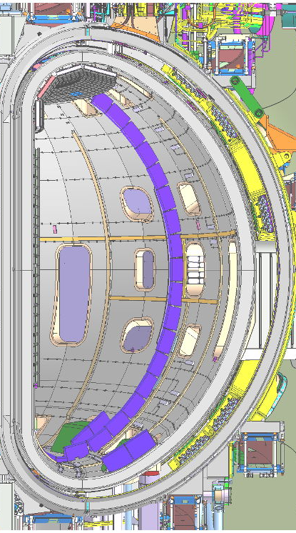


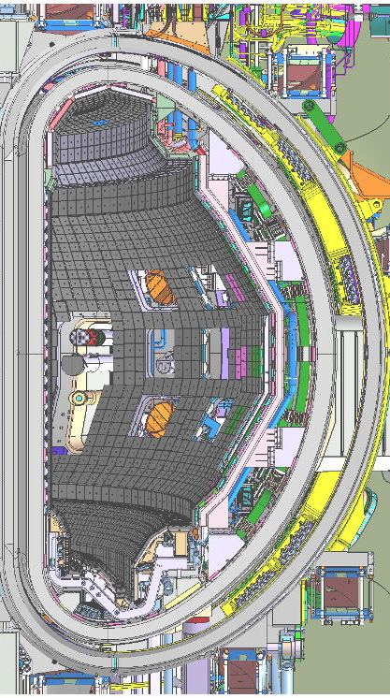
Timeline for JT-60SA
Initial research phase I (C wall and divertor)
Initial research phase II (C wall and divertor)
JT-60SA is in a phase of maintenance and enhancement (ME1):
  Input power upgrade:
      EC: 1.5 MW → 3 MW​ (82, 110, 138 GHz)
      NB: 0 MW → 16 MW(H) / 23.5 MW(D)​: 10 MW of 500 keV negative-ion NBI​
  Lower divertor
  Several plasma control coils
    Error Field Correction coil (EFCC), Resistive Wall Mode coil (RWMC), First Plasma Position Control coil (FPPCC)
  Upgraded Diagnostics​ (Thomson Scattering, ECE, CXRS, etc…)
  Massive gas injection for disruption mitigation
  Stabilizing plate : CuCrZr heat sink + Carbon tiles
Transition from ME1 to OP2 in 2026
IC+OP1
Heating power
(1.5 MW)
Limiter
S. Kojima, P7 2716
Heating power
(19/26.5MW)
OP2
MGI
Graphite tiles
C. Sozzi, P6 2827
Stabilizing plate
Lower divertor
Cryopump

Slide 25

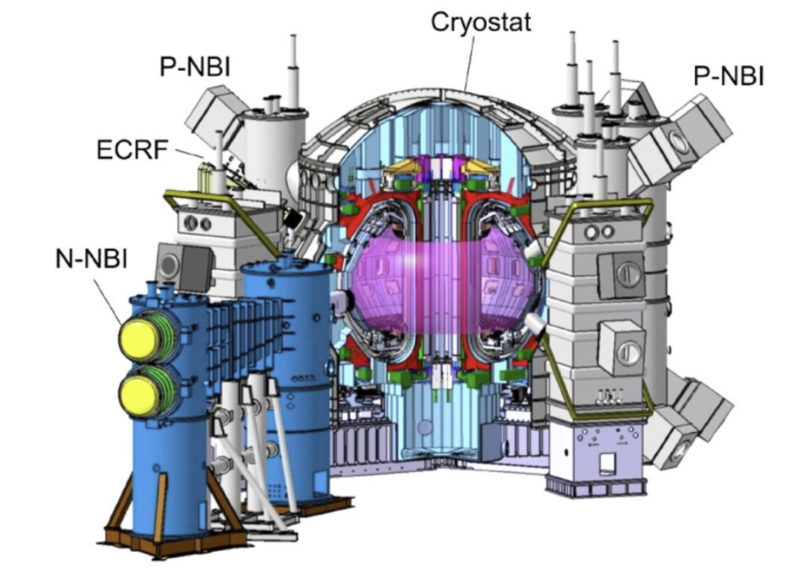
JT-60SA scientific priorities in the initial phase
Integrated research phase (W actively cooled divertor and W wall)
Initial research phase I & II (C inertial divertor and C wall)
OP2 (P_{in}=26.5MW)
Stable operation at high current heated plasma
H-mode access
First high beta plasma attempt
OP3 (P_{in}=26.5MW)
High confinement H-mode plasmas at high current including ELM control
Physics of energetic particles
Study of high beta plasmas
OP4 (P_{in}=33MW)
Disruption mitigation and avoidance at high current in H-mode
Heat load to divertor mitigation
High beta plasmas compatible with radiative divertor
OP5- (P_{in}=41MW)
Long pulse operation in W environment
Including scientific and operation preparation for the W phase

Slide 26
Outline
The JT-60SA tokamak
Integrated commissioning and OP-1 results
Status of the JT-60SA project, timeline and scientific priorities
Preparation for future campaigns
Conclusions

Slide 27
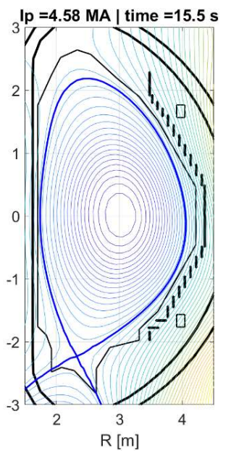

Scenario preparation for OP2
 | Ip/Bt (q₉₅) | β_{N}/β_{p}
Baseline | 4.6 MA/2.28 T (q₉₅ ~ 3) | ~1.8/<1
Hybrid | 2.7 MA/1.70 T (q₉₅ ~ 4) | ~ 2-3/~1
Internal Transport Barrier | 1.7-2.0 MA/1.70 T (q₉₅ > 6) | > 3.5/>>1
  Three typical scenarios for OP2 have been investigated
  New pulse design simulator being developed
E. Joffrin, P1 2720

Slide 28
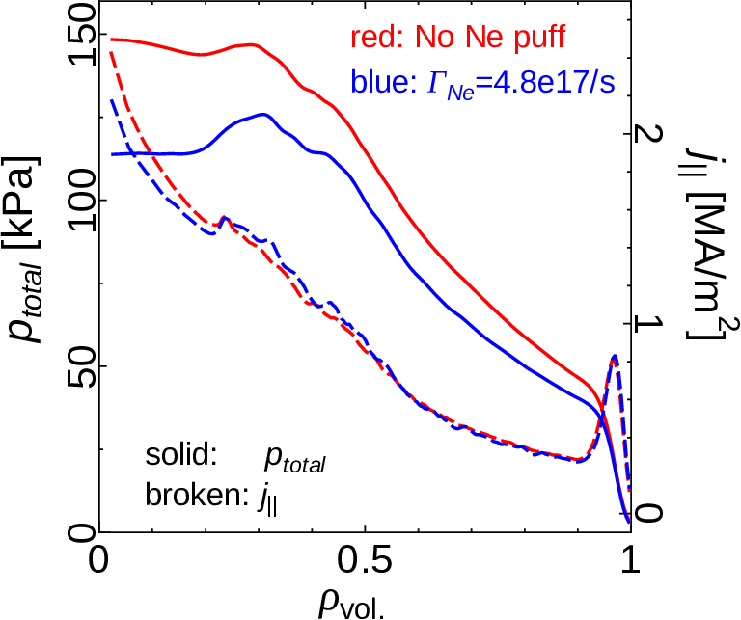
Scenario preparation for OP2
 | Ip/Bt (q₉₅) | β_{N}/β_{p}
Baseline | 4.6 MA/2.28 T (q₉₅ ~ 3) | ~1.8/<1
Hybrid | 2.7 MA/1.70 T (q₉₅ ~ 4) | ~ 2-3/~1
Internal Transport Barrier | 1.7-2.0 MA/1.70 T (q₉₅ > 6) | > 3.5/>>1
  Three typical scenarios for OP2 have been investigated
  SOL-PEDESTAL-CORE integrated simulations performed with GOTRESS+
  Target scenarios are possible with OP2 conditions
  Control of heat flux q_{flux}<~10MW/m² to divertor can be obtained with impurity injection
N. Aiba, TH/4 2890

Slide 29
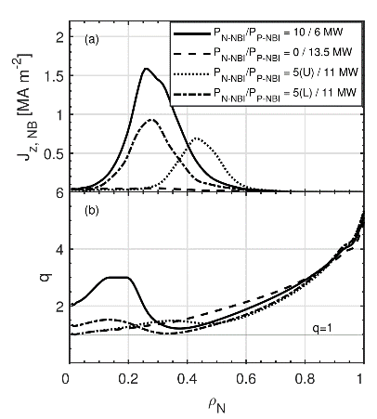
Scenario preparation for OP2
 | Ip/Bt (q₉₅) | β_{N}/β_{p}
Baseline | 4.6 MA/2.28 T (q₉₅ ~ 3) | ~1.8/<1
Hybrid | 2.7 MA/1.70 T (q₉₅ ~ 4) | ~ 2-3/~1
Internal Transport Barrier | 1.7-2.0 MA/1.70 T (q₉₅ > 6) | > 3.5/>>1
  Three typical scenarios for OP2 have been investigated
  JINTRAC simulations show strong impact of N-NBI current drive on q profile
  Flexibility for tailoring of the q profile with ECCD and NBI
[S. Gabriellini, NF 2025]

Slide 30
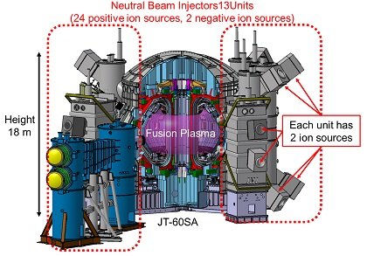
Fast ions studies possible with N-NBI
Fast ion physics studies area a priority with N-NBI at 500keV and P-NBI 85keV
Interaction between fast ion driven modes and turbulence found
[A. Iantchenko, NF 2024]
P-NBI 85keV
N-NBI 500keV

Slide 31
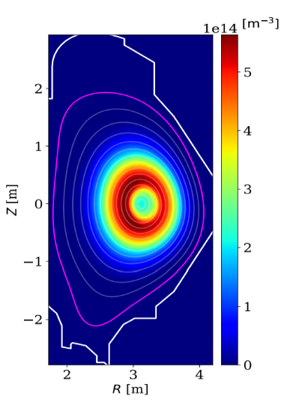
α particle physics studies with ³He plasmas
Fast ion physics studies area a priority with N-NBI at 500keV and P-NBI 85keV
Interaction between fast ion driven modes and turbulence found
α particle physics can be studied with N-NBI injection
D_{beam}+³He → ⁴He (3.6MeV) + p (14.7 MeV), which has its maximum cross-section close to 500keV for fast D
Significant off-axis α particle production in reversed q profile→ interplay between α and MHD
[A. Iantchenko, NF 2024]
Y. Kazakov, P4 3333
R. Coelho, P2 3269
S. Nowak, P6 3171

Slide 32
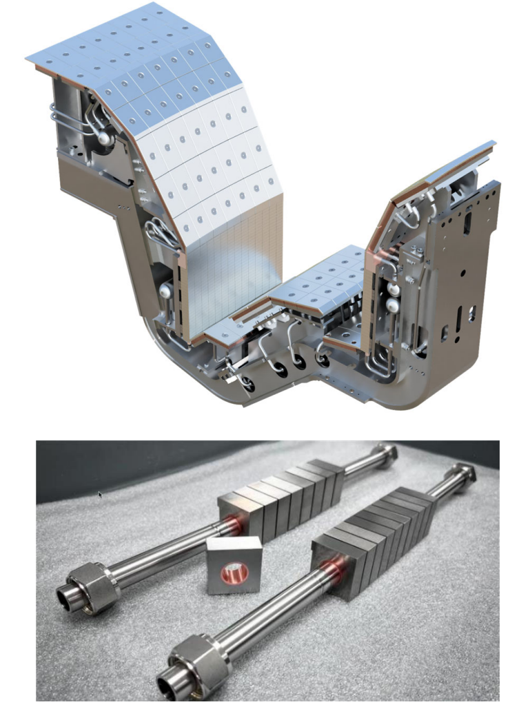
Transition to W PFCs
Long pulse operation will be carried out in the integrated research phase with W PFCs→ ITER support and DEMO design
Tungsten divertor under development
  Monoblocks for inner and outer vertical targets
  Solid tungsten bolted tiles elsewhere
Design starting for first wall
Predict first modelling ongoing for assessing:
  optimized divertor design
  additional ECRH heating and W screening
  boronization system
  additional diagnostics
M. Richou, TEC/2 3023
[G. Rubino, EPS 2024]
[C. Angioni in preparation]

Slide 33
Outline
The JT-60SA tokamak
Integrated commissioning and OP-1 results
Status of the JT-60SA project, timeline and scientific priorities
Preparation for future campaigns
Conclusions

Slide 34
Conclusions
JT-60SA was jointly constructed and is jointly funded and exploited by Japan and EURATOM
First plasma was achieved in 2023
OP1 has demonstrated the importance of predict first and machine learning activities even for start-up phase
Now implementing major enhancements to in-vessel components, heating systems & plasma diagnostics
Operation restarts in 2026 targeting high plasma current and H-mode
Experimental programme being developed by the Experiment Team
Aim to transition to a tungsten environment in time to provide results to support ITER and DEMO in the early 2030s

Slide 35
JT-60SA contributions in the 30th IAEA-FEC
DISRUPTIONS AND MHD INSTABILITIES OBSERVED IN THE INITIAL OPERATION PHASE OF JT-60SA T. Yokoyama P5 2690
CHARACTERISTICS OF RUNAWAY ELECTRON LOSS IN THE INTEGRATED COMMISSIONING OF JT-60SA S. Sumida P5 2692
Confinement property in the JT-60SA plasma in the first operational phase Y. Ohtani P1 2851
DEVELOPMENT OF EQUILIBRIUM CONTROL SIMULATOR AND EXPERIMENTAL DEMONSTRATION OF ADVANCED ISO-FLUX EQUILIBRIUM CONTROL DURING THE FIRST OPERATIONAL PHASE OF JT-60SA S. Inoue EX/7 2898
H-mode operation scenarios in JT-60SA initial research phase predicted by integrated core-pedestal-SOL/divertor simulation N. aiba TH/4 2890
MECHANISMS OF WALL CONDITIONING PLASMA PRODUCTION USING FUNDAMENTAL AND SECOND HARMONIC ELECTRON CYCLOTRON WAVES IN JT-60SA M. Fukumoto P7 2839
OPTIMAL DESIGN OF FAST PLASMA BOUNDARY CONTROL CONSIDERING VERTICAL INSTABILITY FEATURES USING IN-VESSEL COILS IN JT-60SA S. Kojima P7 2716
INVESTIGATION OF PLASMA PARAMETERS IN SAWTOOTH OSCILLATION BY ABSOLUTE INTENSITY OF SOFT X-RAY EMISSION IN JT-60SA INTEGRATED COMMISSIONING PHASE R. SANO P1 2793
MACHINE ENHANCEMENT OF TOKAMAK DEVICE FOR THE JT-60SA NEXT OPERATION H. KAYANO P6 2835
DEVELOPMENT OF LOW INDUCTIVE ELECTRIC FIELD PLASMA START-UP IN JT-60SA W. Takuma EX/7 2689
EFFECT OF COLLISION PROCESSES IN DIVERTOR PLASMAS ON THE TOKAMAK OPERATIONAL WINDOW D. Umezaki P5 2801
Improvements of Magnet Power Supply System and Achievements in Coil Energization Tests for First Plasma of JT-60SA K. Yamauchi P7 3043
RESULTS OF ELECTRON CYCLOTRON HEATING AND CURRENT DRIVE SYSTEM OPERATION IN THE INTEGRATED COMMISSIONING PHASE ON JT-60SA H. Yamazaki TEC/5 IAC/1
PERFORMANCE OF JT-60SA SUPERCONDUCTING MAGNET OPERATION IN INTEGRATED COMMISSIONING TEST K. Tsuchiya TEC/5 IAC/1
Recent Progress of Dissimilar Material Bonding Technique with Spark Plasma Sintering Method for High Heat Load Plasma Facing Components in Reactor-relevant Devices T. MORISAKI P7 3127
OVERVIEW OF THE EUROPEAN CONTRIBUTION TO THE DIAGNOSTIC EQUIPMENT OF JT-60SA FOR THE NEXT OPERATIONAL PHASES C. Sozzi P6 2827
Alpha particle generation and confinement in D-3He scenarios in JT-60SA R. Coelho P2 3269
Insights from fast-ion physics studies on JET in support of JT-60SA and ITER rebaseline Y. Kazakov P4 3333
Sawteeth dynamics in JT-60SA baseline scenarios with effects on NTM onset S. Nowak P6 3171
Utilizing a visible camera in the first operation phase(s) of a fusion device T. Szepesi P1 2811
Pulse design simulator for JT-60SA E. Joffrin P1 2720
ACTIVELY COOLED PLASMA FACING COMPONENTS DESIGN FOR W7X AND JT-60SA IN SUPPORT OF THE ITER DIVERTOR M. Richou TEC/2 3023
INTRA-SHOT TOOLS FOR PLASMA SCENARIO OPTIMIZATION AND MAGNETIC CONTROL M. Mattei P6 2757

