Slide 1
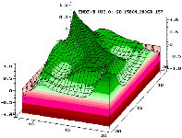
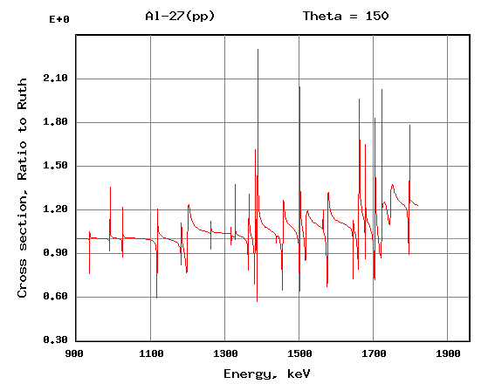
ABSTRACT
Title of Your Paper
Name of Author (s)
Department Name and/or Institution Name
your-email@email.com
OUTCOME / RESULTS
ID: XXX
The poster should be a visual presentation of your paper. Please read the IAEA guidelines on the preparation and submission of virtual posters first.
Write a summary of your paper in bullet points. The summary should only address key points of your paper.
Submit this poster as a single slide, presentation
Be sure that your results are clear and self-explanatory.
Please ensure any logos, graphics or images inserted are of a high resolution to avoid them pixelating.
Your poster will be made available on the IAEA Conference and Meetings App. There will be a commenting box placed under each poster for authors to interact with participants, answer any questions they have and initiate further discussions.
CHALLENGES / METHODS / IMPLEMENTATION
This section can be adjusted to address “challenges”, “methods”, “implementation” or others depending on the content of your paper, should demonstrate clear view/vision of your topic.
Using graphs/figures are recommended to provide information visually. Authors are responsible for ensuring that nothing in their papers infringes any existing copyright. Make sure to label the graph/figures clearly and indicate source, as necessary.
The message that your poster contains should be clear and understandable without the requirement of oral explanation. If relevant, methods should be presented simply and concisely.
BACKGROUND / INTRODUCTION
CONCLUSION
This section should be used to explain the background of or introduce your paper. Make sure to identify objectives of your topic.
You may adjust size of these text boxes as needed.
If you have any questions, please contact the organizers of the conference.
Draw conclusions of your paper. You may also raise further questions or discussion topic for the session.
Please save your file with the abstract ID number and your last name. The e-poster must be submitted by Friday, 9 May 2025 via INDICO.
For questions, please contact icaro@iaea.org
ACKNOWLEDGEMENTS / REFERENCES
Column 1 | Column 2 | Column 3 | Column 4

