Slide 1
Bulk, surfaces,
and grain boundaries
AMPMI 2024
@ Metsätalo, University of Helsinki, Finland
in the lifetime of cascades in W
Byeongchan Lee Kyung Hee University, Korea, July 18, 2024

Slide 2
Acknowledgments
PhD students: Younggak Shin, Vichhika Moul (Kyung Hee University)
Collaborator: Keonwook Kang (Yonsei University)
Funding
National Research Foundation of Korea (NRF) grant funded by the Korea government (MSIT) (No. 2020R1A2C201510913)
Korea Hydro & Nuclear Power Co., LTD (No. 2022-Tech-11).

Slide 3
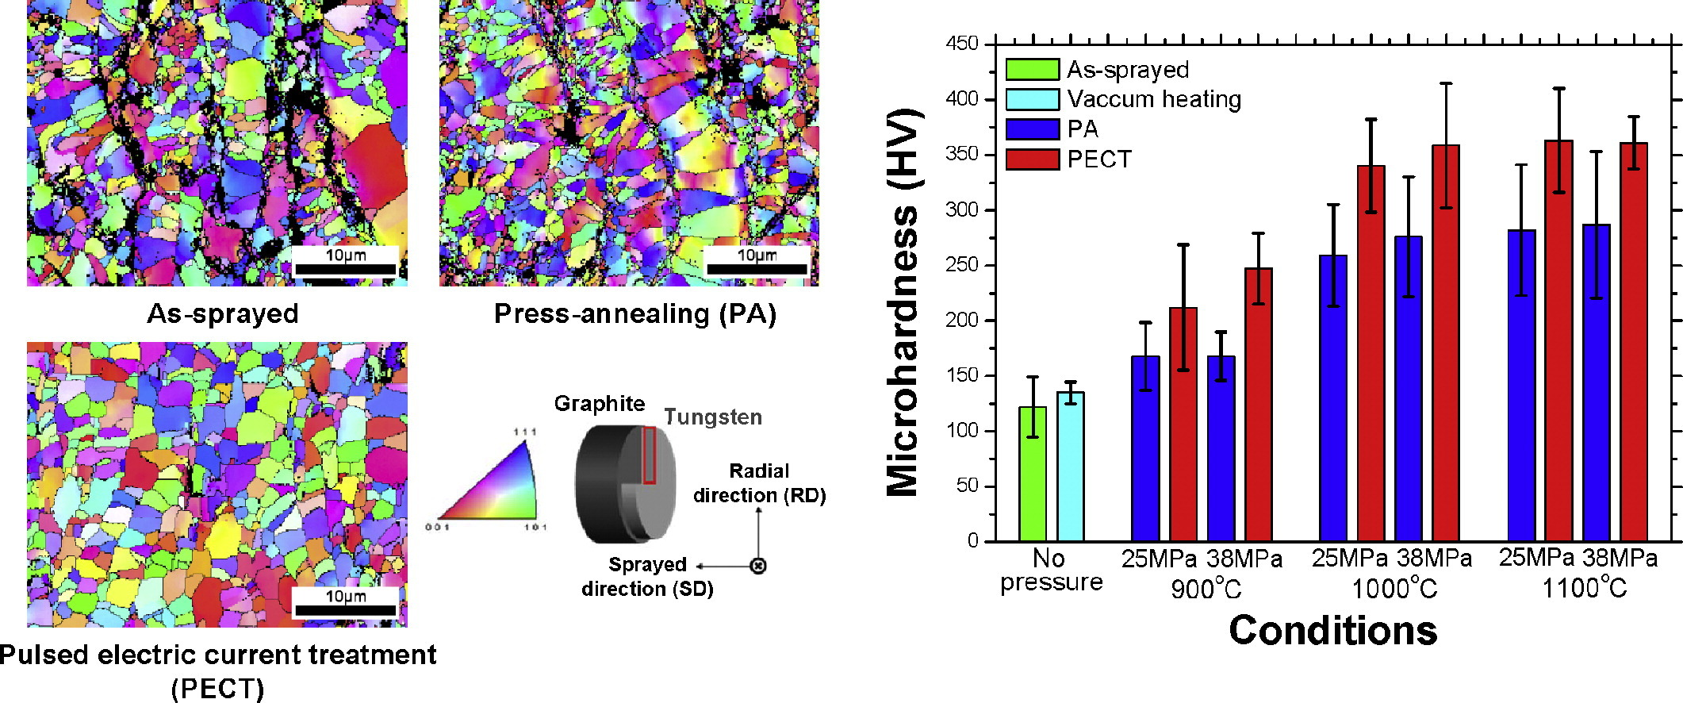
Mechanical properties
depend on grain uniformity (let alone H-P)
Sprayed W
Y. J. Lee et al. | Int. J of Refractory Metals and Hard Materials 60, 99 (2016)

Slide 4
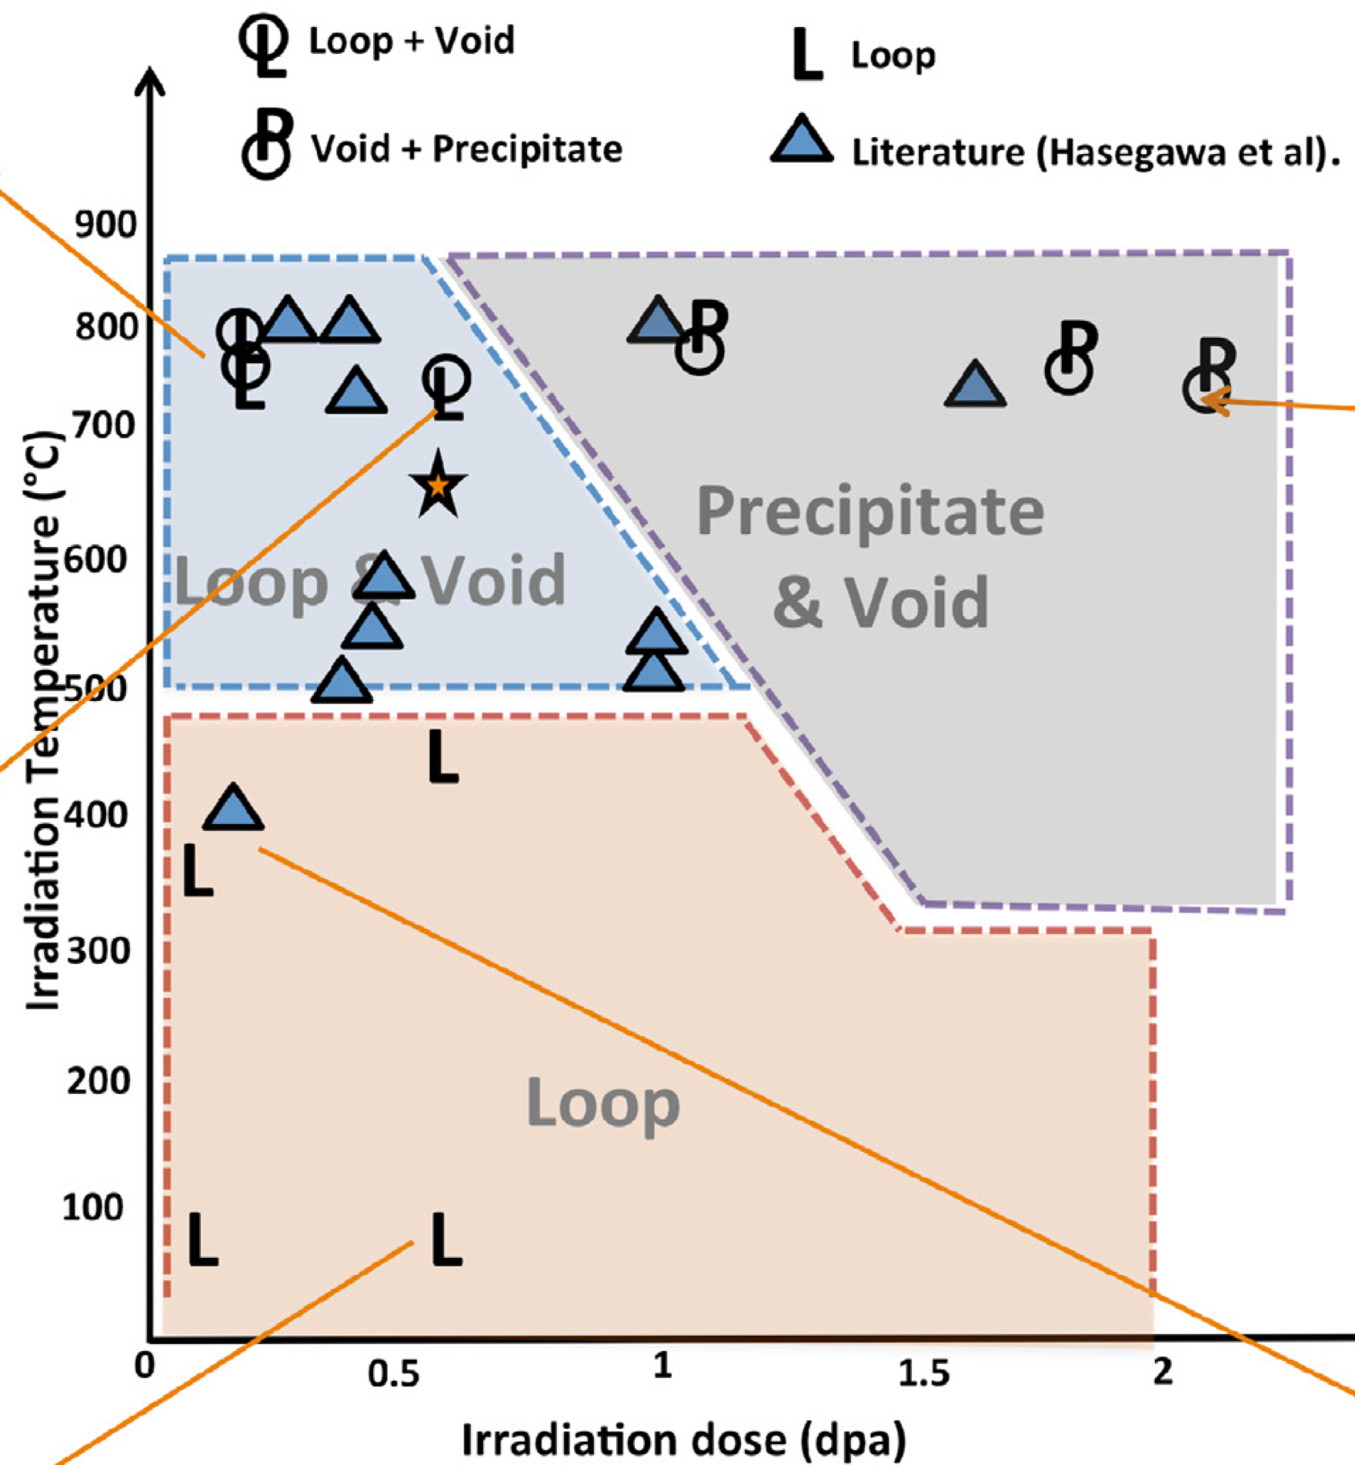
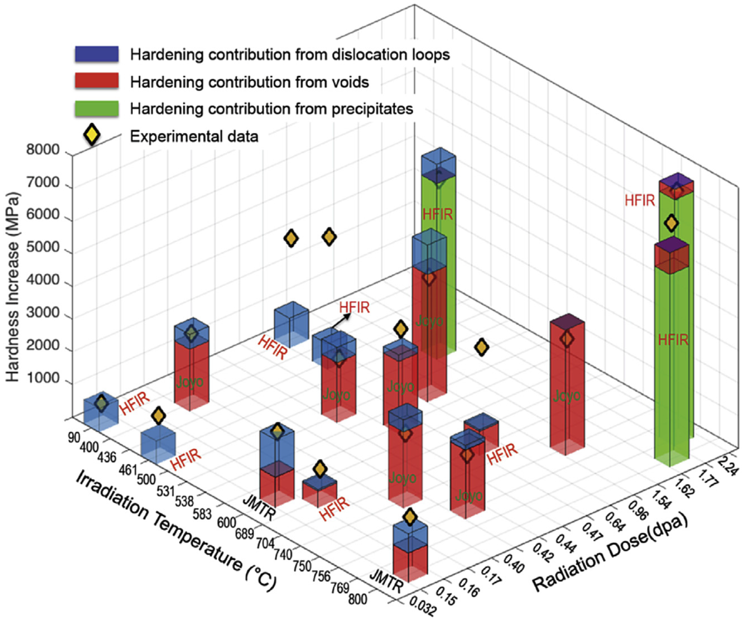
Mechanical properties
of n-irradiated materials
X. Hu et al. | JNM 480 235 (2016)
J. Marian et al. | Nucl. Fusion 57, 092008 (2017)

Slide 5
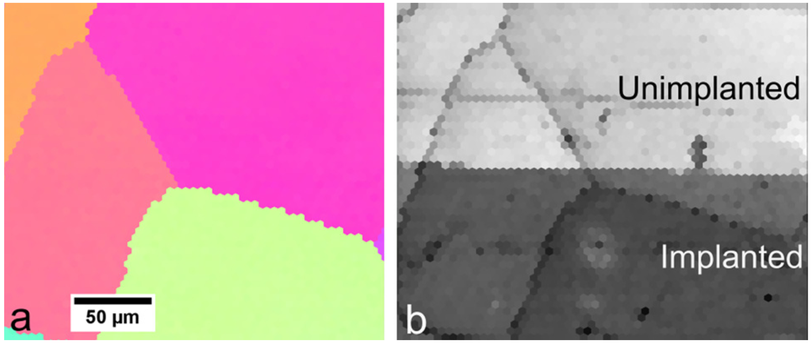
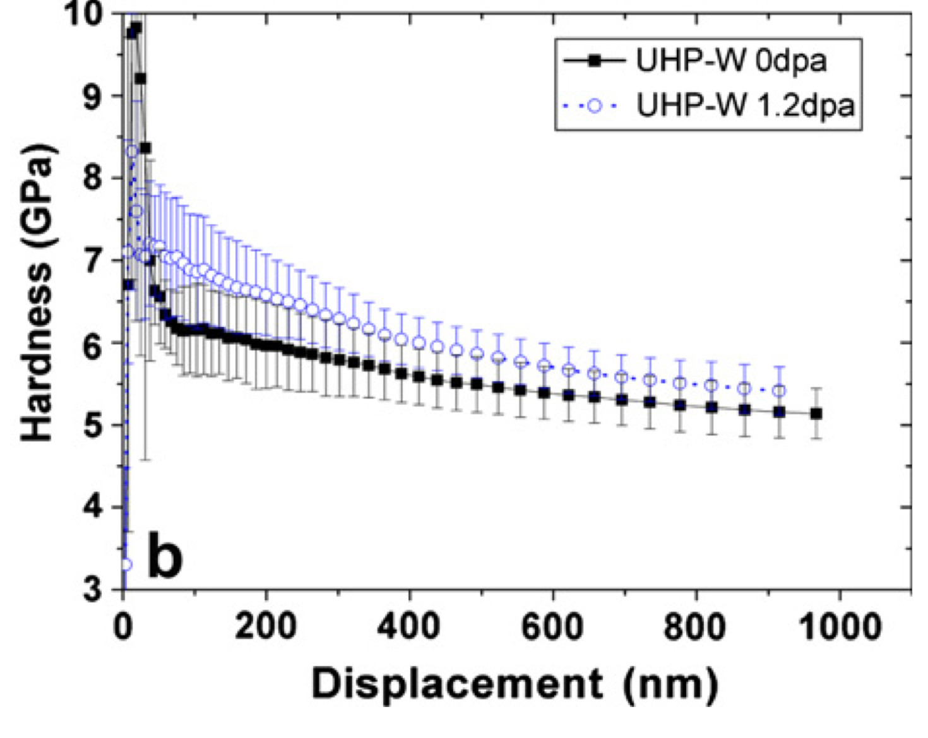
Grain boundaries remain nearly unchanged
Microstructure has changed though
self-ion irradiated W
(a) Inverse pole figure and (b) image quality map produced using EBSD
D.E.J. Armstrong et al. | JNM 432, 428 (2013)

Slide 6
Is GB transparent
to neutron irradiation?

Slide 7
Is GB transparent
to neutron irradiation?
Likely!!
Insufficient facts always invite danger.

Slide 8
What’s in this talk…
Primary Knock-on Atoms to simulate n-irradiated cascades
Cascades
In periodic bulk
Near surface
Near grain boundary
Damage detection methods
Preliminary results

Slide 9
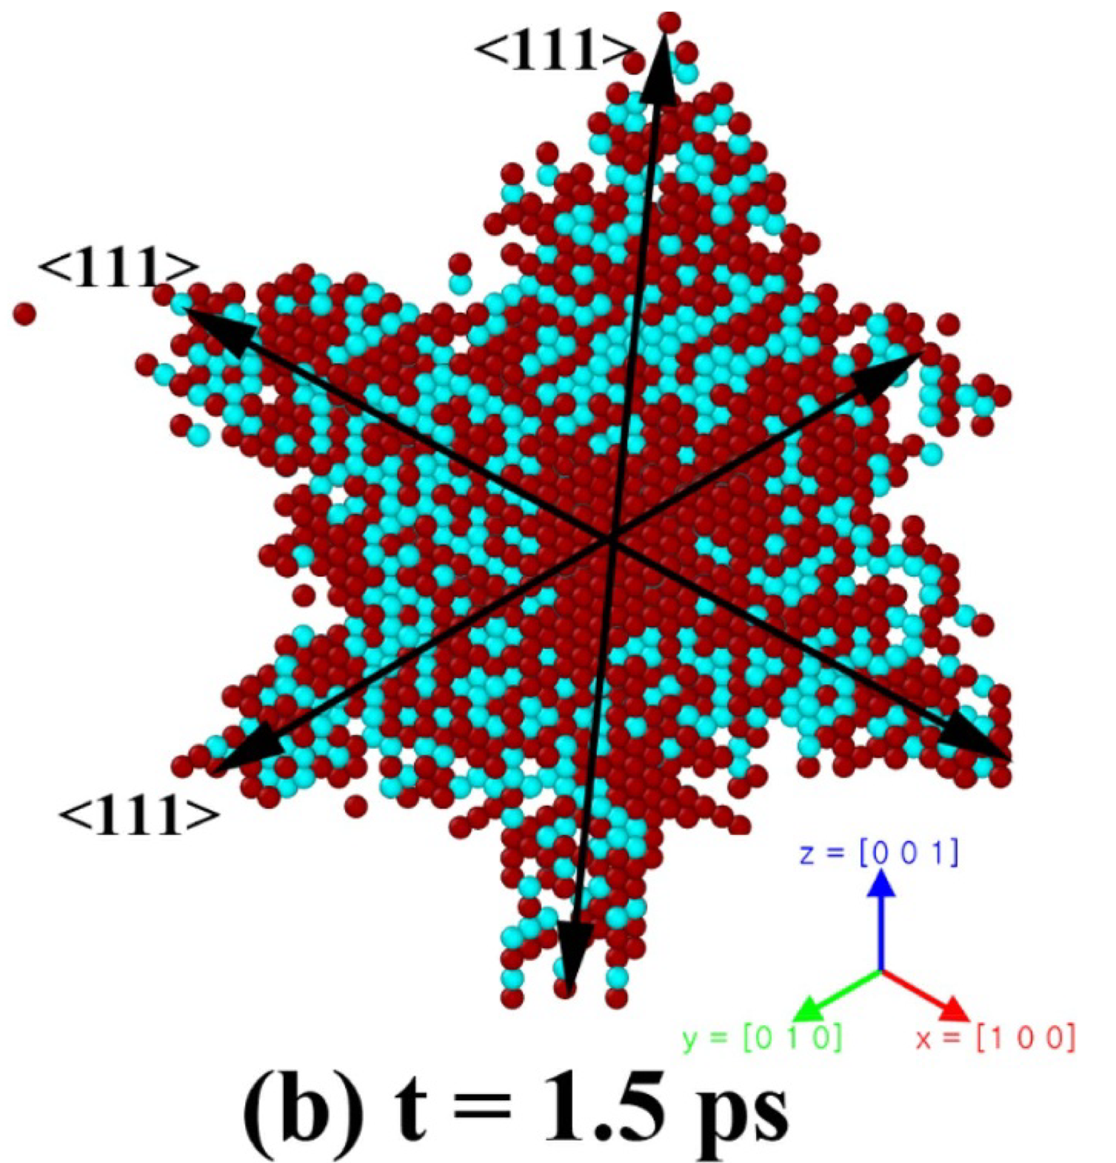
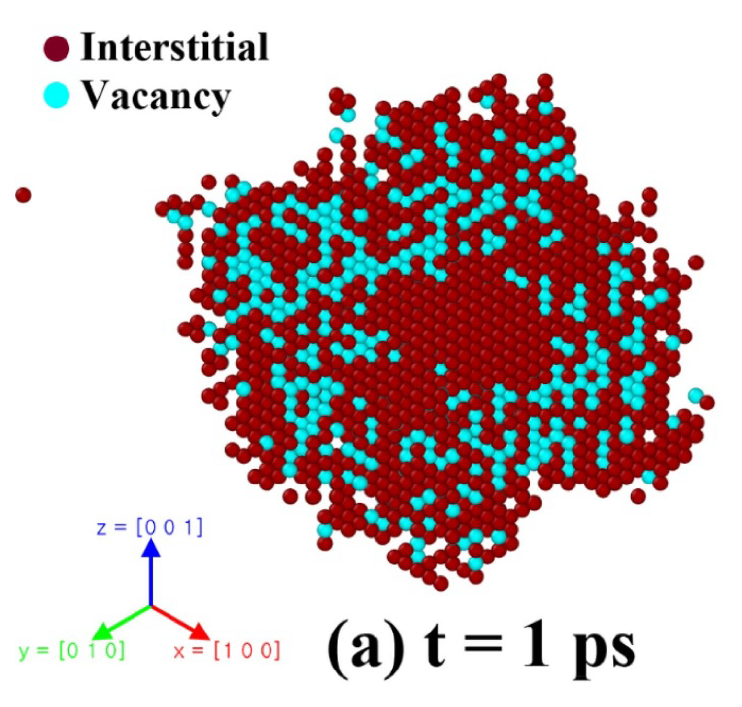
Irradiation damages
Wigner-Seitz (W-S) analysis
in single crystalline bulk
H.G. Lee, S. Yoo, B. Lee, and K. Kang | Nuclear Fusion 60 (2020)
FS-AT / ZBL as implanted by Fikar and Schaeublin

Slide 10
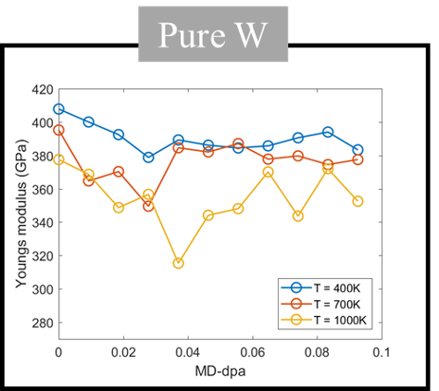
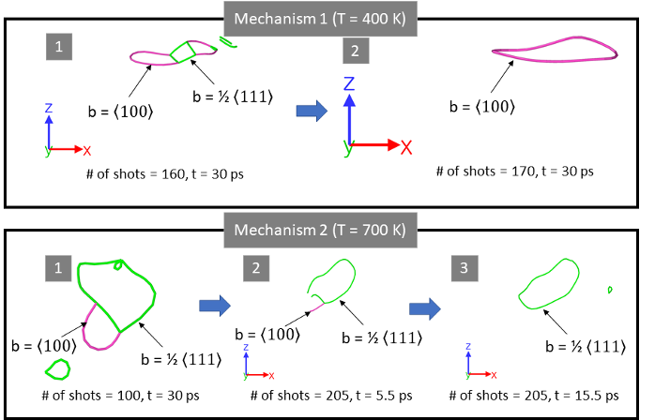
Total defect neutrality in periodic bulk
# vacancies = # SIAs
Young’s modulus
H.G. Lee et al. | unpublished

Slide 11
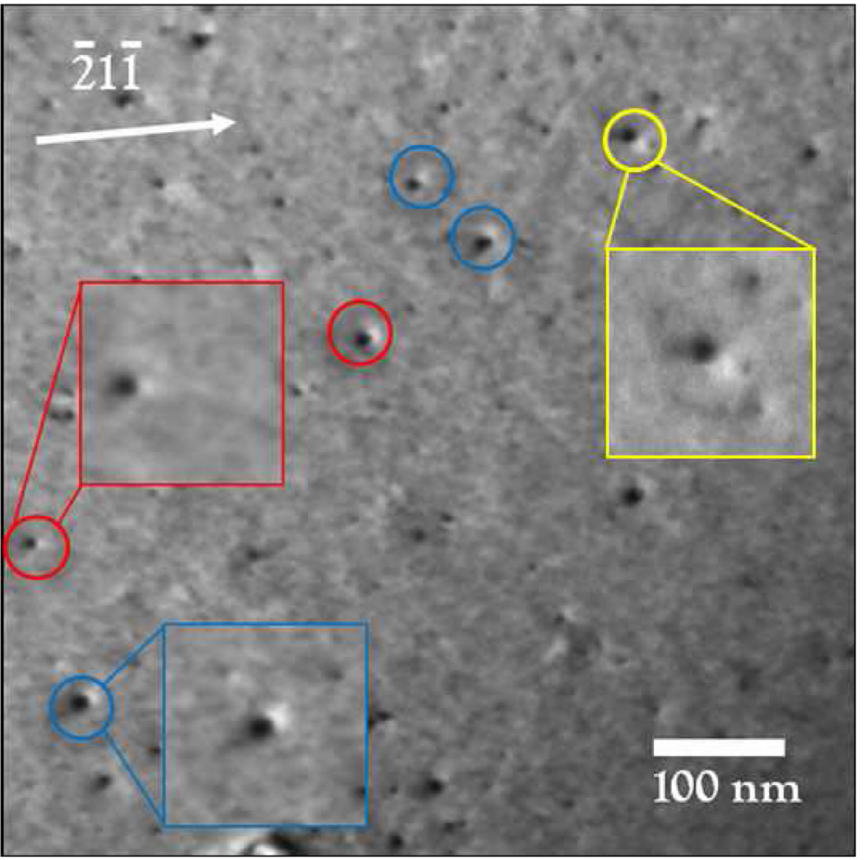
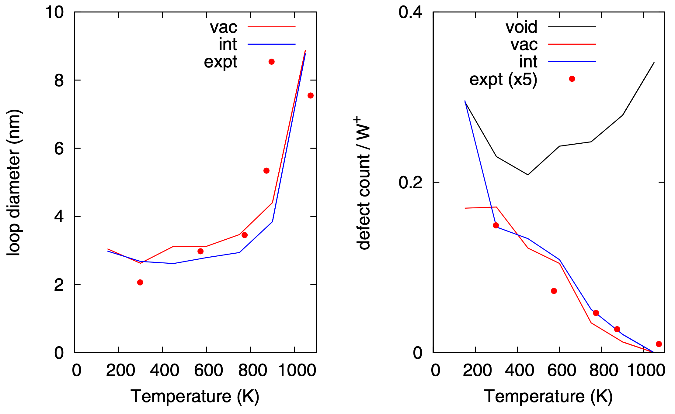
Irradiation damages
in W foils
“the largest loops to be predominantly of prismatic 1/2⟨111⟩ type and of vacancy character”
~ 0.01 dpa w/ 150 keV W+ @ 300K
⟨100⟩ vac loop
sheared
1/2⟨111⟩ vac loop
edge 1/2⟨111⟩ vac loop
D. R. Mason et al. | J. Phys.: Condens. Matter 26 (2014) 375701

Slide 12
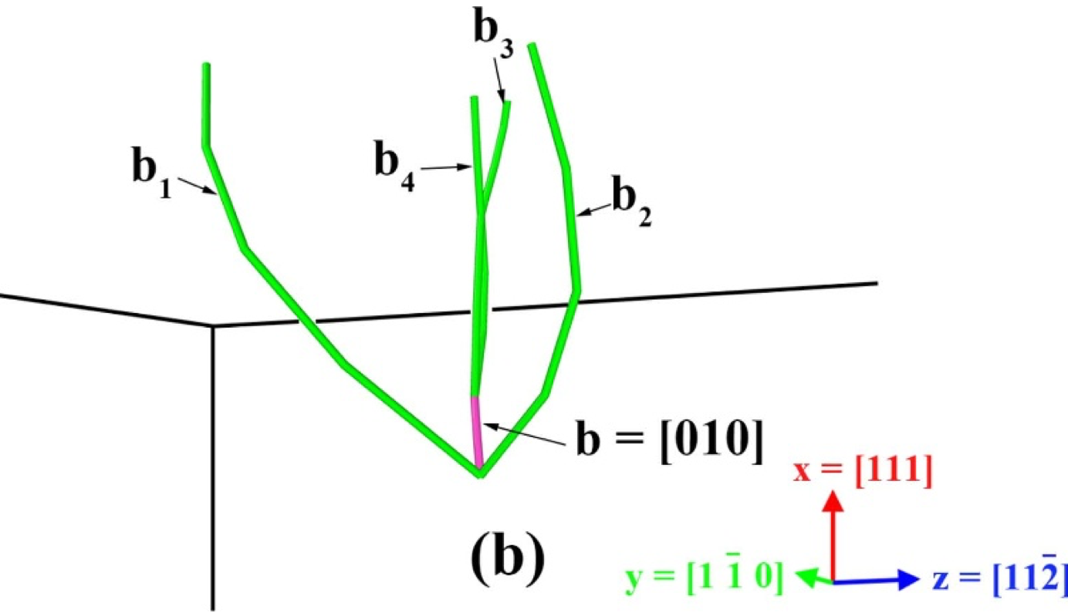
Irradiation damages
near surface
Mobile (vacancy) dislocation loop
Immobile (vacancy) dislocation network
Surface ~ a defect sink w/ infinite capacity
H.G. Lee et al. | Nuclear Fusion 60 (2020)

Slide 13
Irradiation damages
near grain boundary (GB)
Grain boundary ~ a defect sink w/ finite capacity
Common Neighbor Analysis (CNA) showing non-BCC atoms

Slide 14
GBs absorb defects
Then what?
Possible scenarios
Diffusion inside GBs
Dislocations
Crystal growth
May be in the form of GB motion for small-area boundaries

Slide 15
We need defect counts
Wigner-Seitz as implemented in popular tools
Based on initial atomic positions
1 vac + 1 int
Interstitial
Initial state
Final state

Slide 16
W-S0
with a fictitious perfect lattice
Volume-based

Slide 17
W-S0
with a fictitious perfect lattice

Slide 18
W-S0
W-S cell
(Primitive cell)
fails in polycrystalline structures
Translation of reference lattice hardly matters
Rotation matters!!
Interstitials
Interstitial-vacancy pair FALSE detection
Vacancy

Slide 19
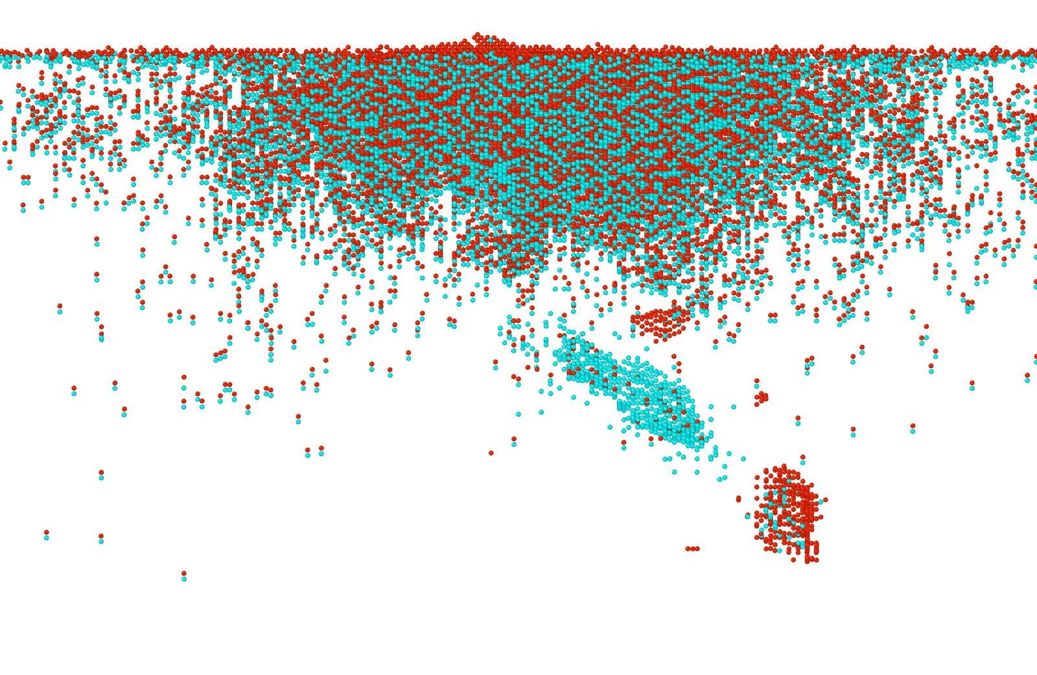
W-S
Vacancy
Interstitial
fails even for a clean GB
<100>
<111>
Due to rotation and/or distortion of lattice around cascade residuals
100 nm x 100 nm x 300 nm
PKA Energy = 300 keV @ 823K
PKA location = 1nm from GB

Slide 20
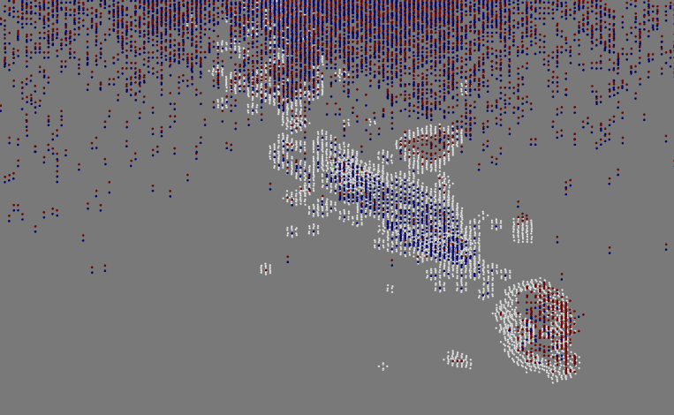
CNA+WS
Vacancy
Interstitial
Interstitial loops

Slide 21
CNA+DXA

Slide 22
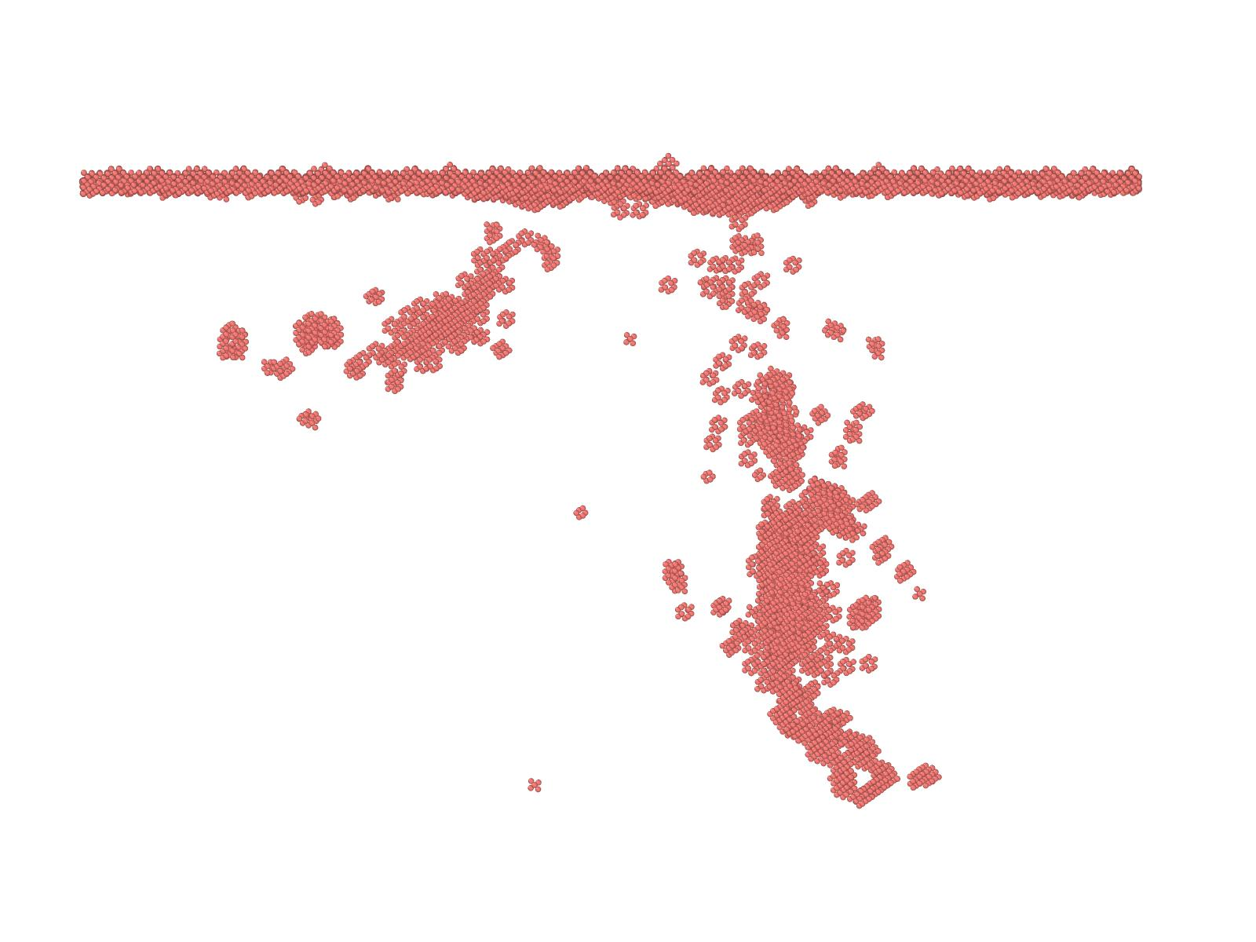
How to separate defects
0 ps
defect count = 65,798
in GB from those in bulk w/ defect type info?
<100>
CNA only tells you either crystalline or other
Initial GB
36.13 ps
<111>
defect count = 70,170
bcc <100>/<111>
100 nm x 100 nm x 300 nm
PKA Energy = 300 keV @ 823K

Slide 23
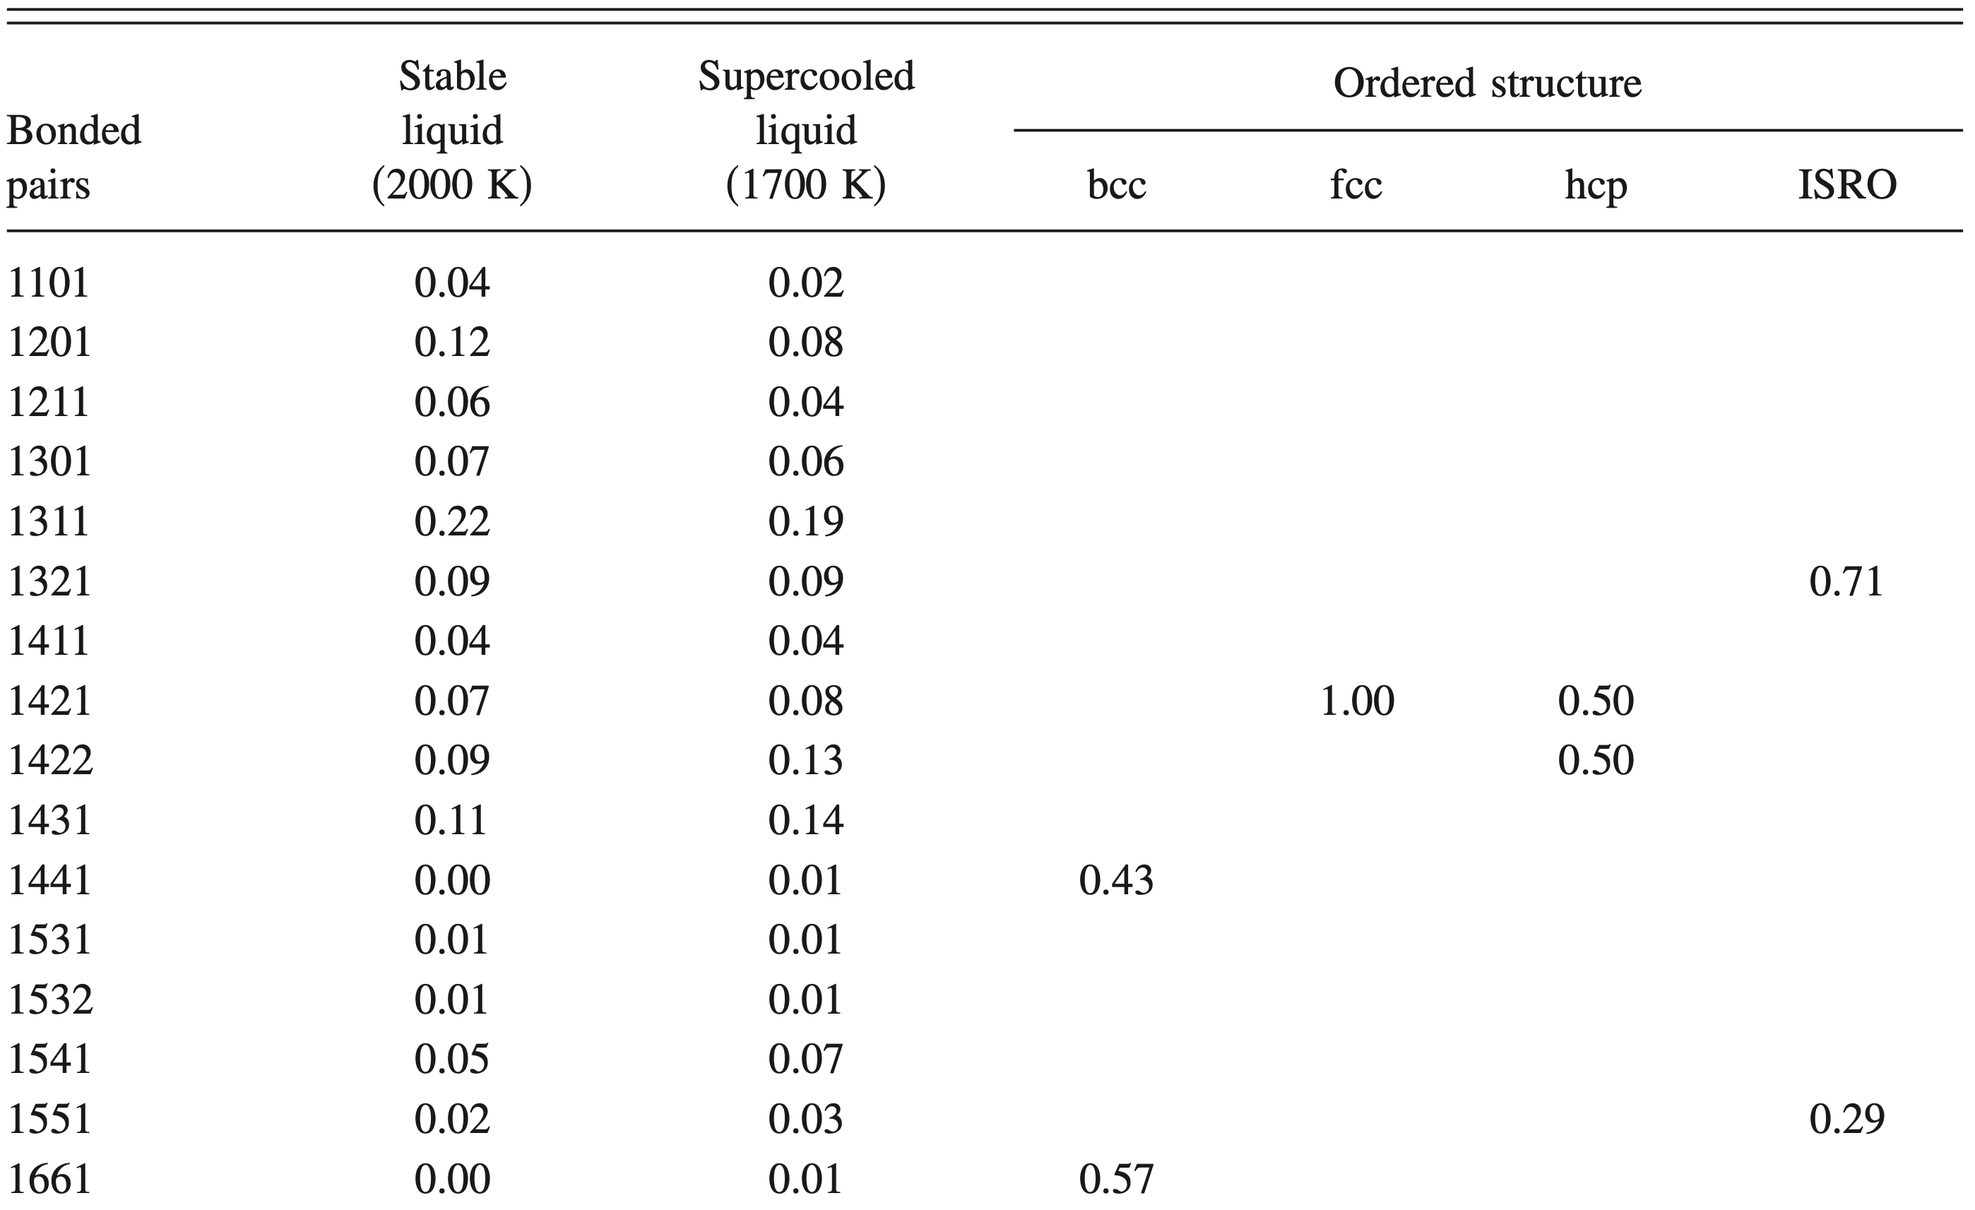
Deep inside
CNA
atom of interest
probe neighbor
common neighbors
B. Lee et al. | JCP 129, 024711 (2008)

Slide 24
CNA goes beyond non-bcc
vacancy
<111> DB
<110> DB

Slide 25
CNA
with pair types

Slide 26
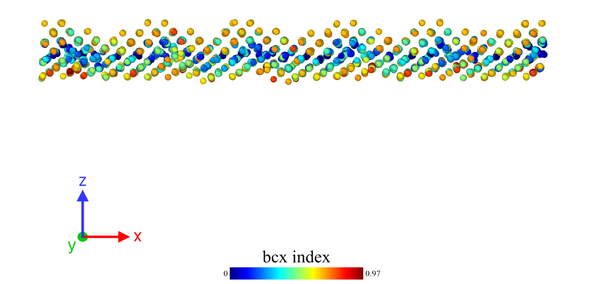
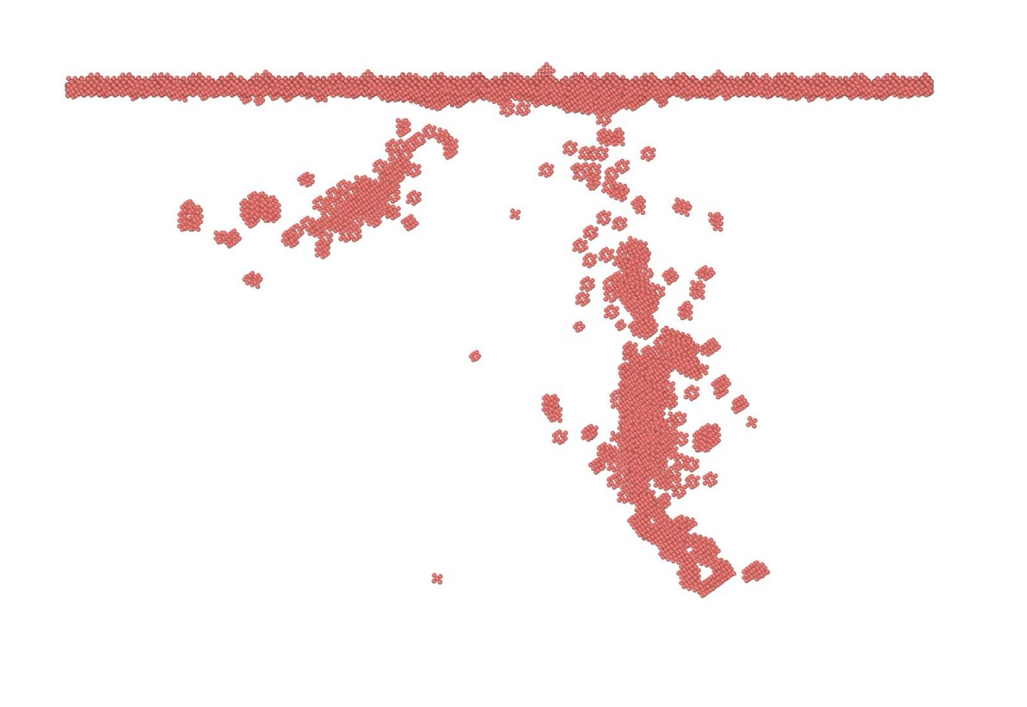
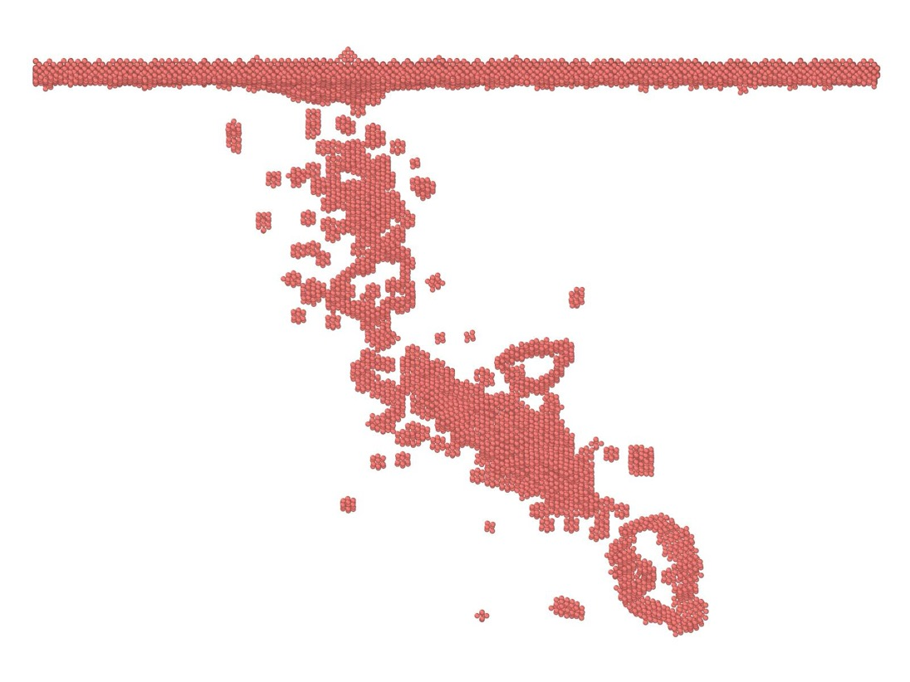
Crystal growth
0 ps
36.13 ps
GB atoms : 3,771
Bulk defects : 0
GB atoms : 3,686
Bulk defects : 1,118
from GB
Front view
Side view
CNA w/ pair type results

Slide 27
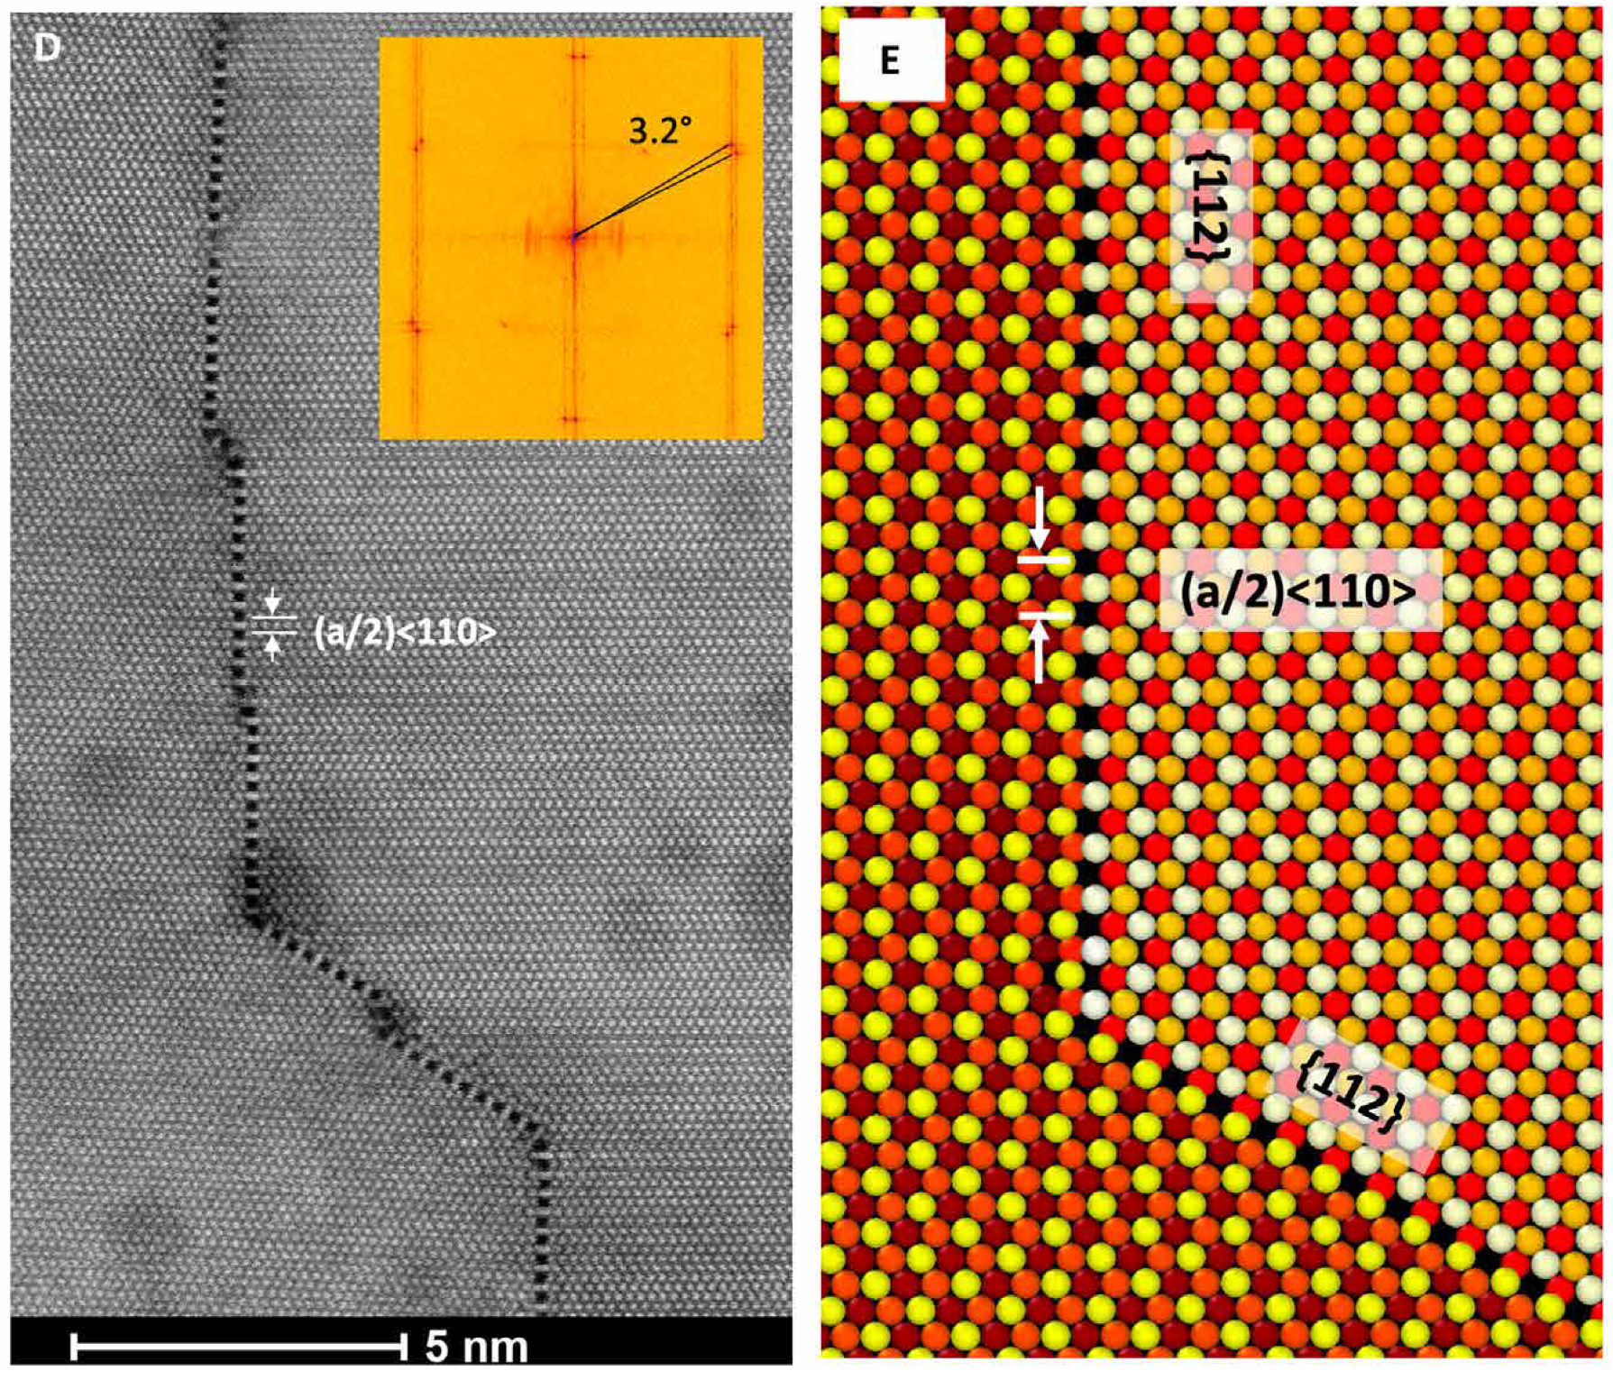
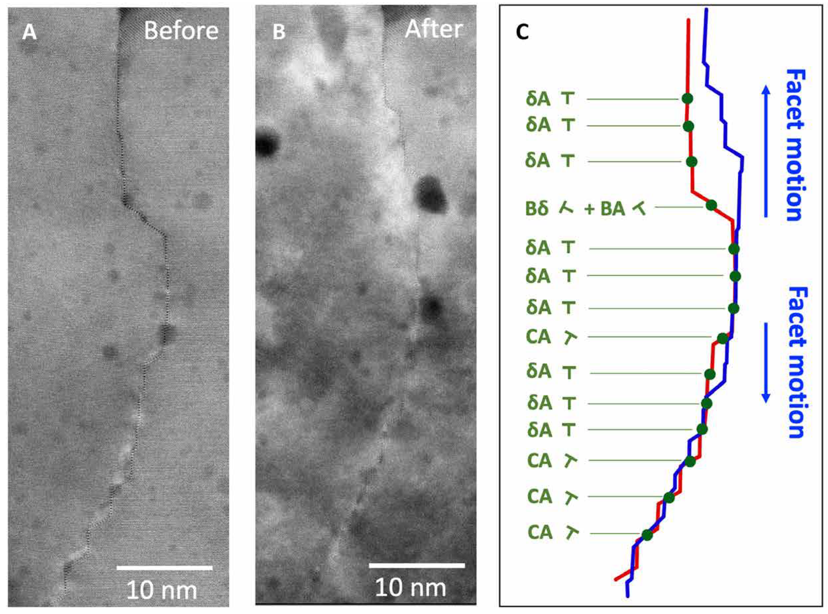
Irradiation damages
near GB
~ 1 dpa w/ 2.8 MeV Au⁴⁺
Pt Σ3 {112} GBs
C. M. Barr et al. | Sci. Adv. 8, eabn0900 (2022)

Slide 28
End of evolution scenario?
Moving Vs Flattening?
Kinetically limited
Energetics driven
(annealing?)
End of evolution
Against energetics

Slide 29
Is GB transparent
to neutron irradiation?

Slide 30
Likely… as far as GB degradation goes
GB is a defect sink, which in turn make it the source of other defects
It will be interesting to see how GBs do
in the presence of transmutation and hydrogen

Slide 31
Remarks
During irradiation
CNA seems promising for detections of various defects including GBs
Fine-tuning in progress
Irradiation may stabilize the microstructure?
GBs may realign to reduce energy penalty
GB energy reduction = grain growth?

Slide 32
Future outlook
Y. Shin et al. | unpublished
K. Heinola et al. | Phys. Rev. B 82, 094102 (2010)

Slide 33
Thank you!
Suomenlinna, July 17, 2024

Slide 34
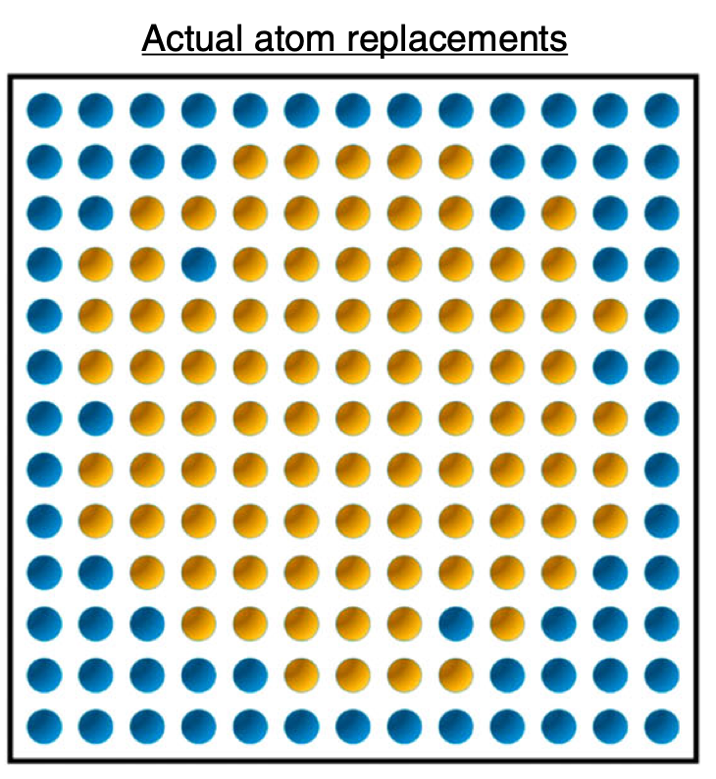
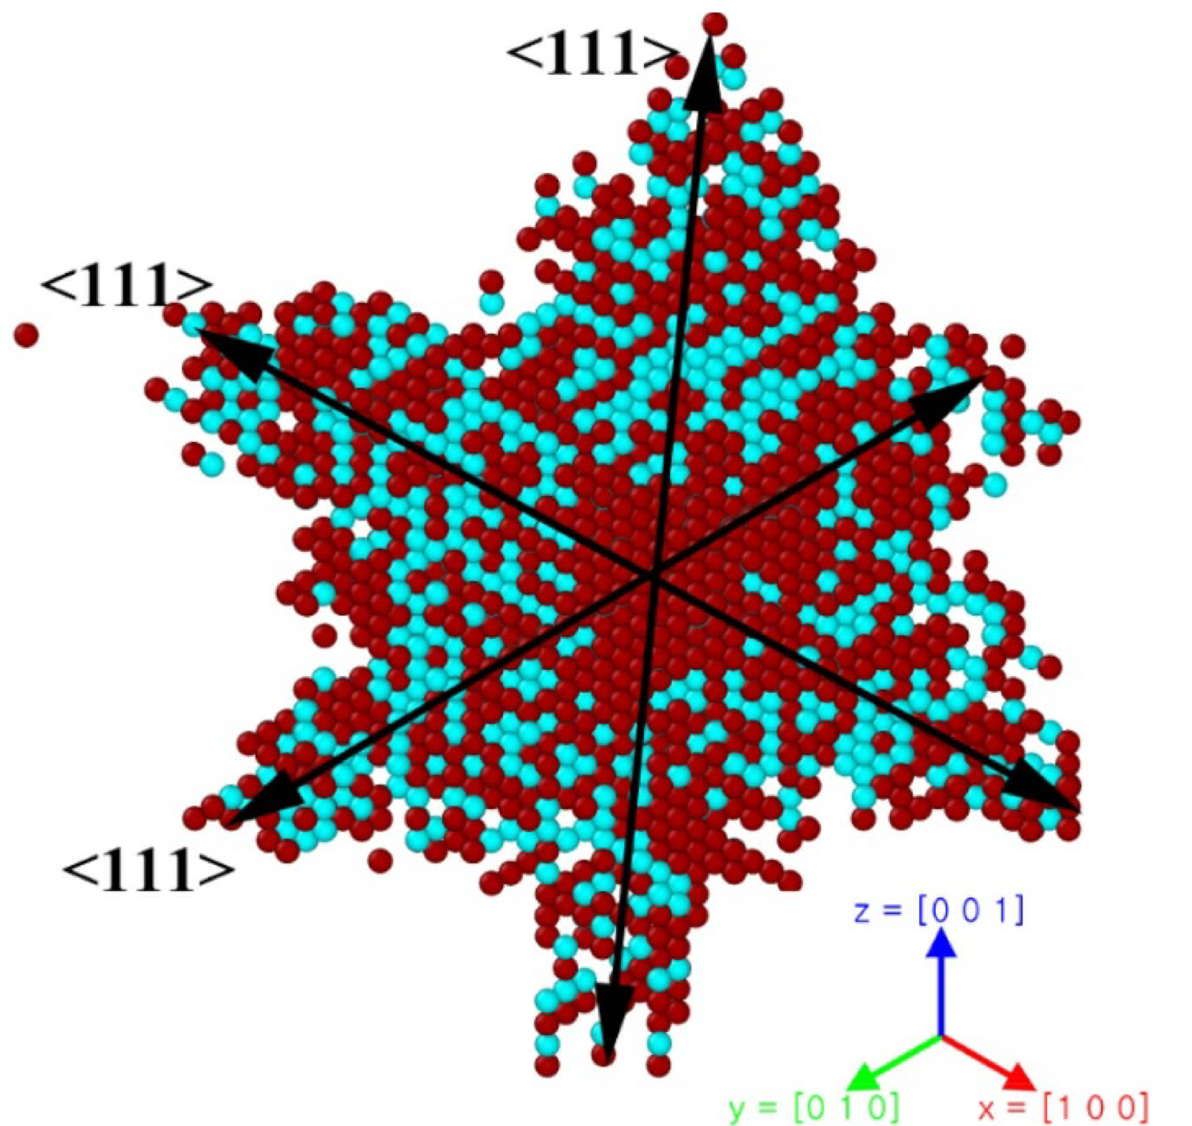
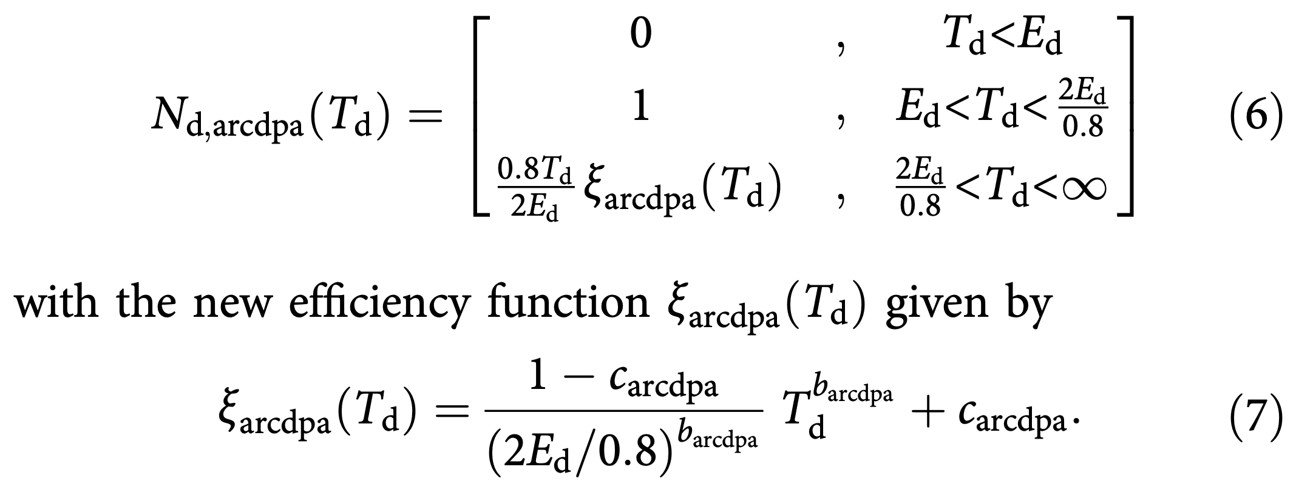
Defect counts
Dose Vs microstructure
Wigner-Seitz (W-S) analysis
arc-spa
K. Nordlund et al. / Nature Comm (2018)9:1084

Slide 35
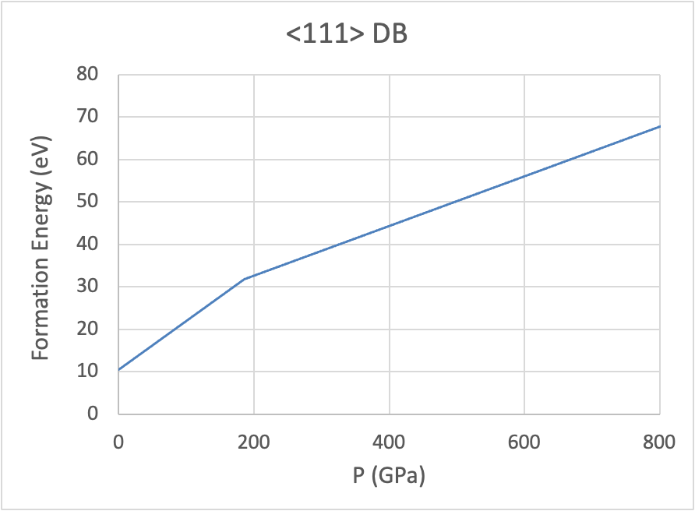
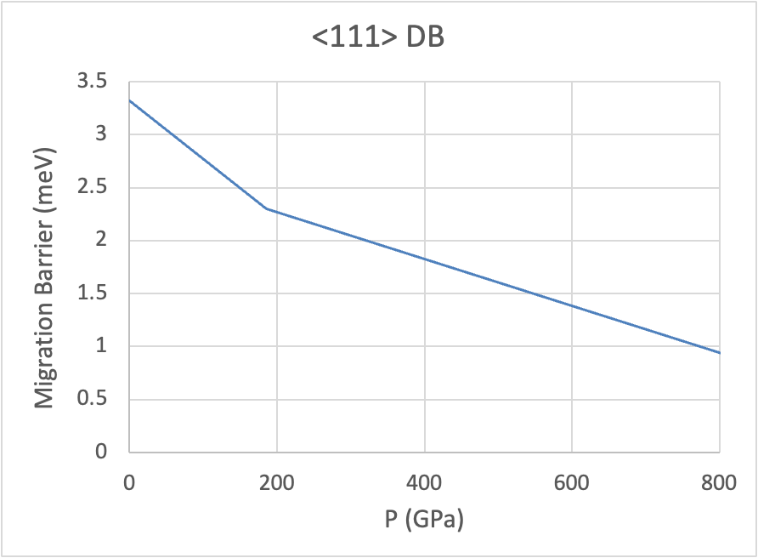
Residual defects
Due to stress field

Slide 36
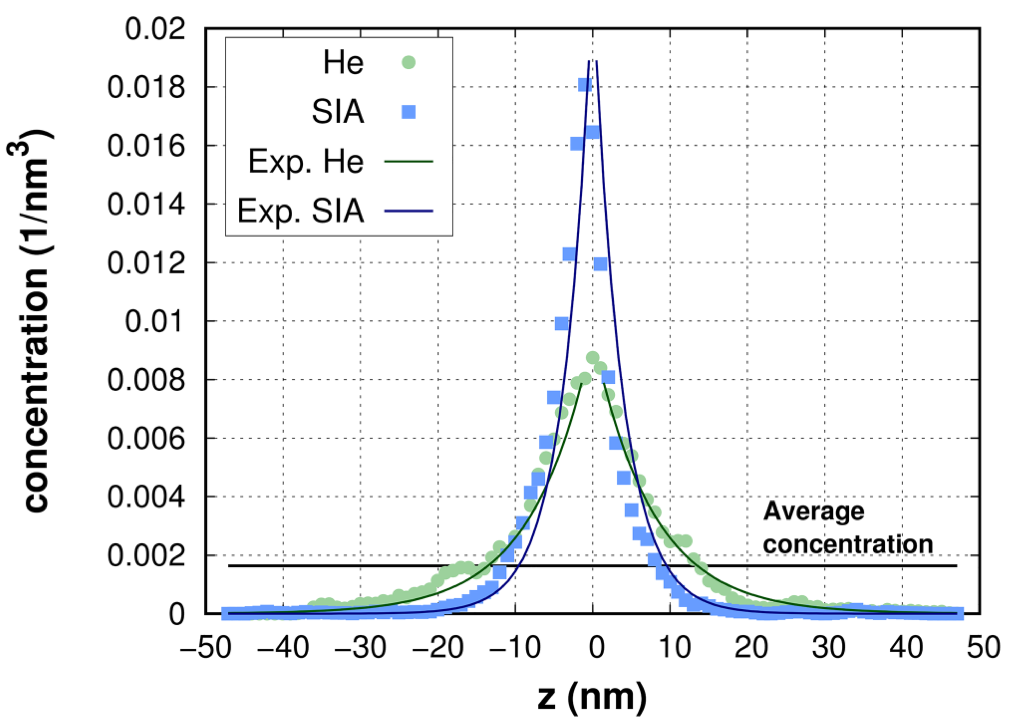
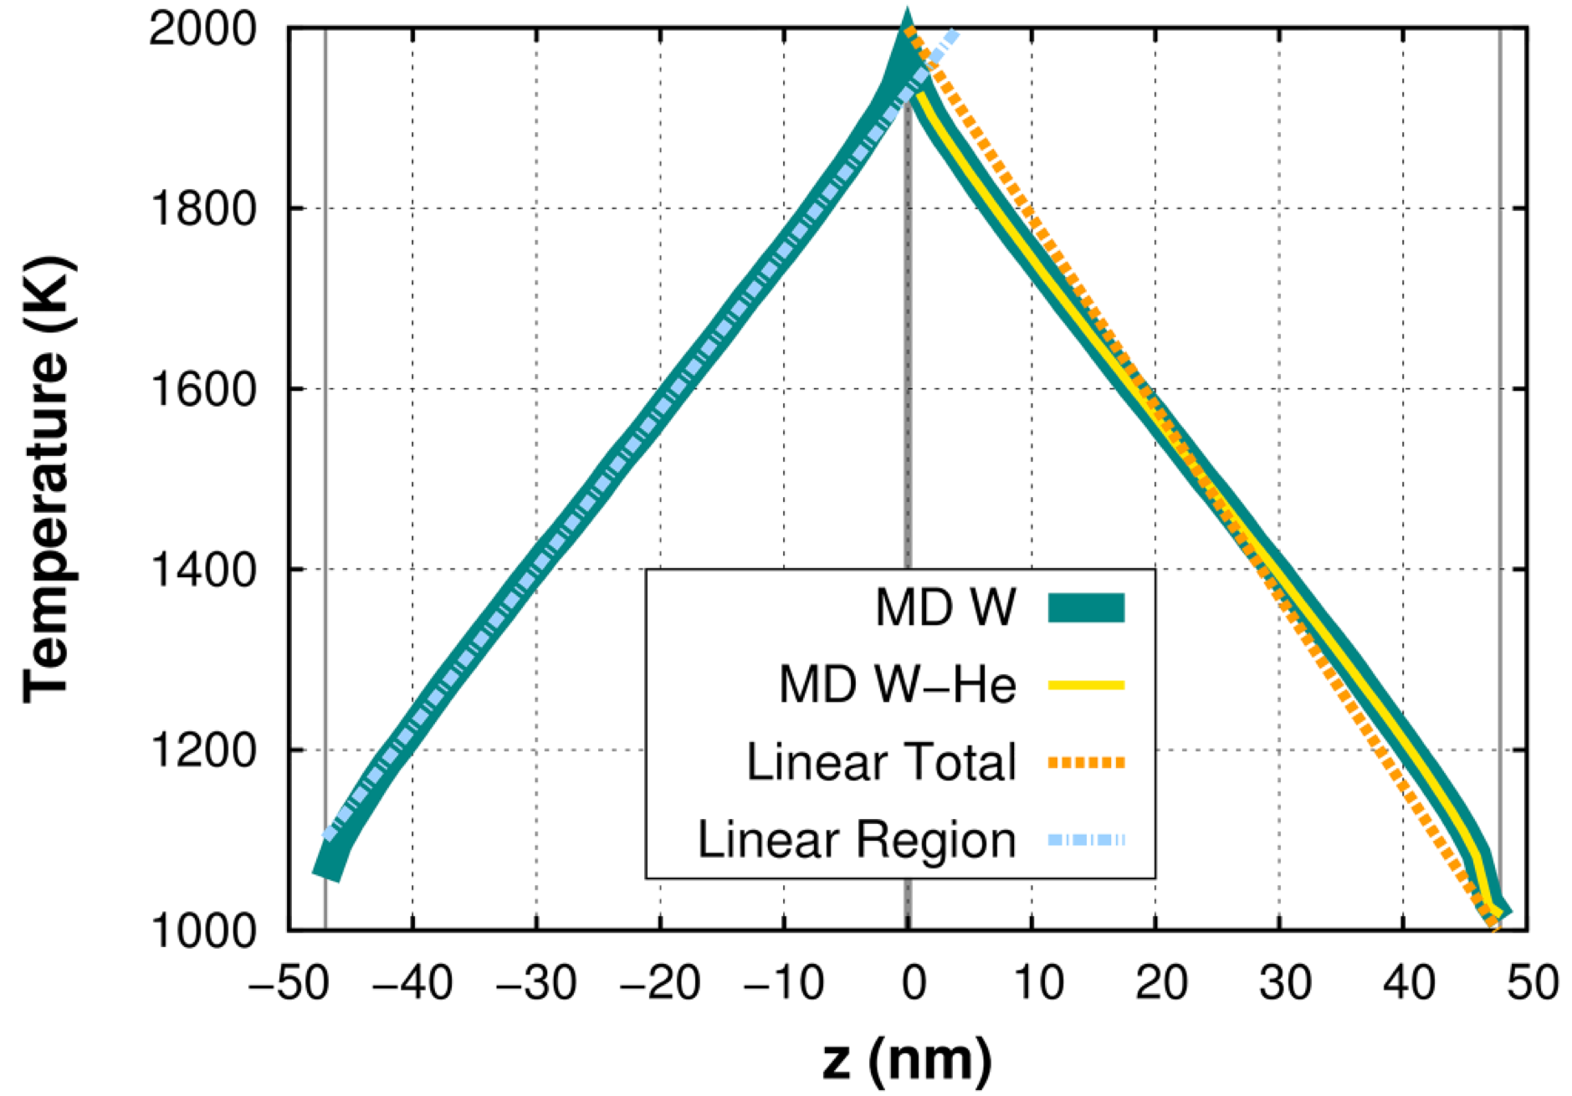
Residual defects
Due to temperature field
Mart ́ınez et al., J. Appl. Phys. 130, 215904 (2021)

Slide 37
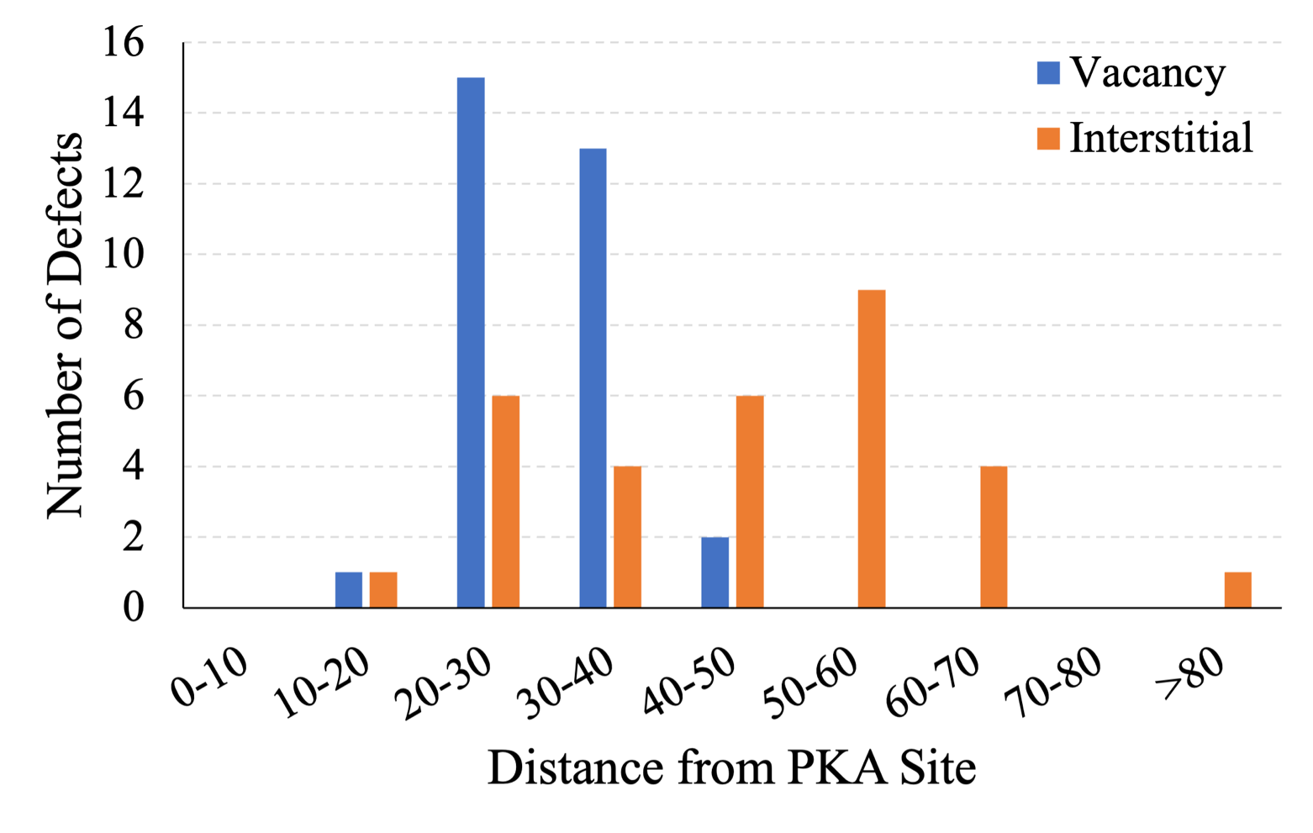
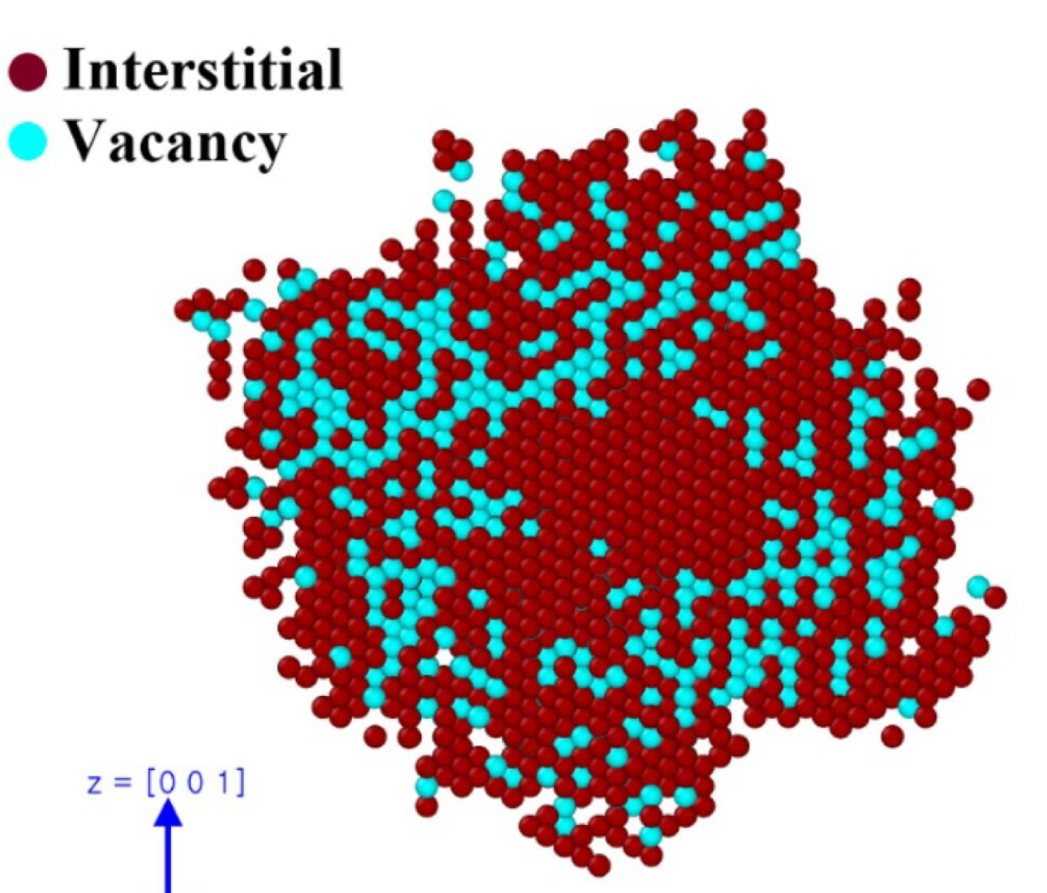
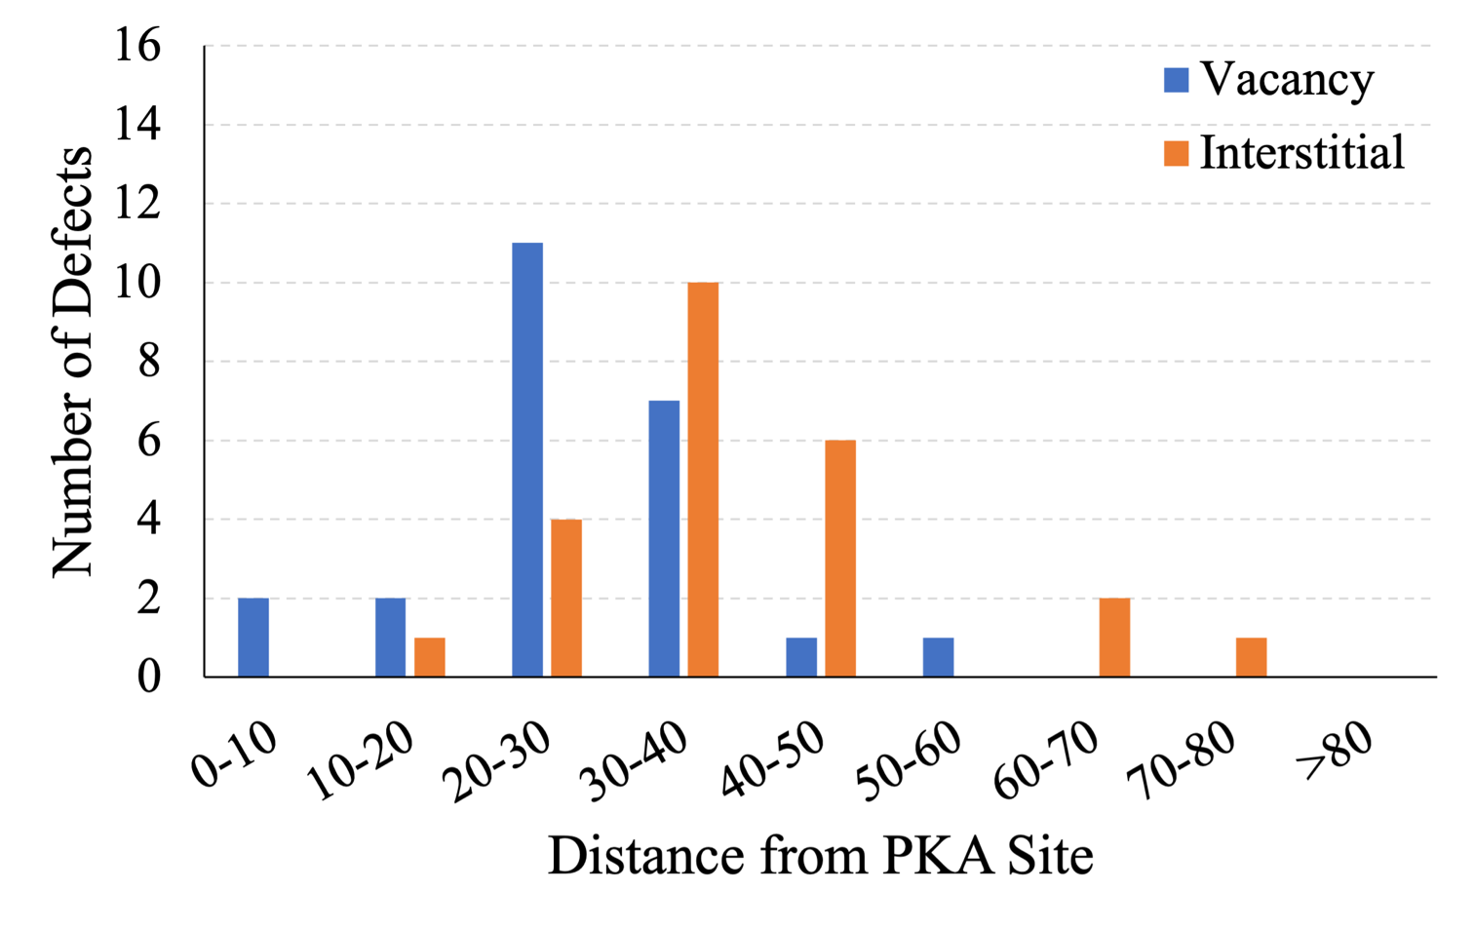
Irradiation damages
PKA E = 20 keV @ 300K
in bulk
P downwind:
SIA concentration increasing
Defects within 10 nm radius
T downwind:
SIA concentration decreasing
Y. Shin and B. Lee, unpublished

Slide 38
CNA Vs. PTM
Polyhedron Template Matching
Selected sample:
100-111 / 1nm / 300keV
In cascade region
0 ps
36.13 ps
CNA
PTM
CNA
PTM
defects = 65 798
defects = 58 615
defects = 70 170
defects = 63 150

Slide 39
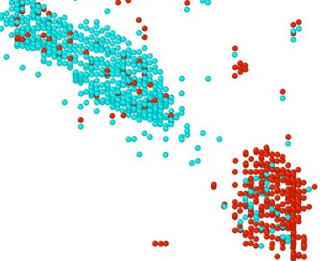
W-S
Vacancy
Interstitial
fails even for a clean GB
<100>
<111>
100 nm x 100 nm x 300 nm
PKA Energy = 300 keV @ 1nm from GB
Due to rotation and/or distortion of lattice around cascade residuals

Slide 40
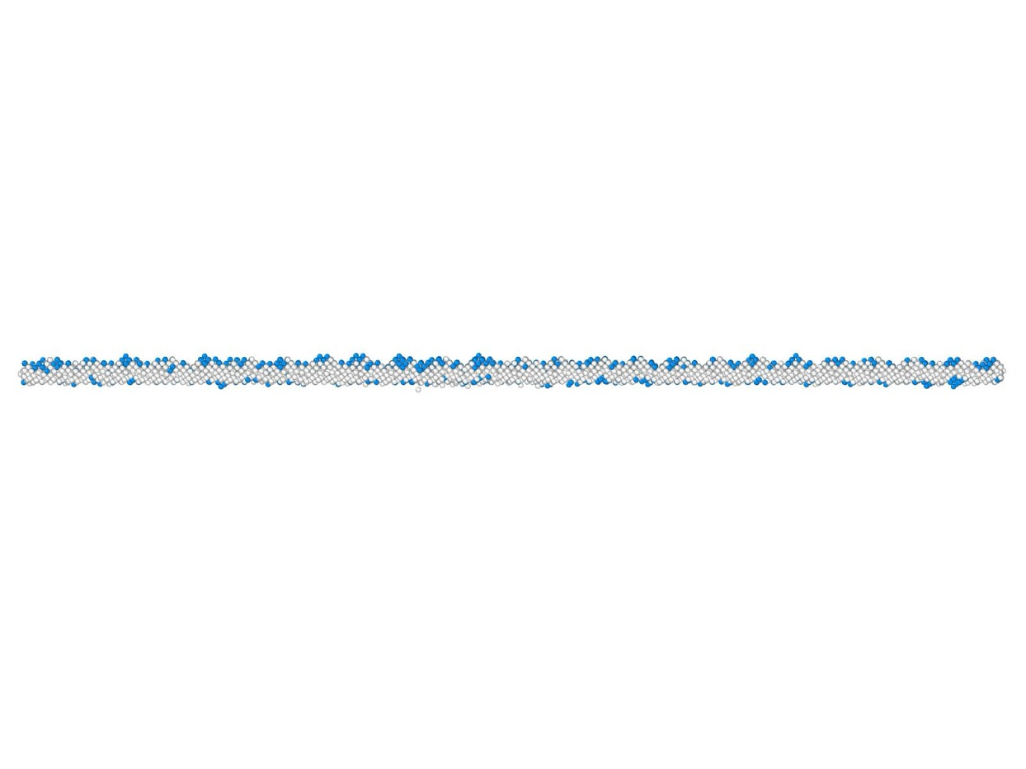
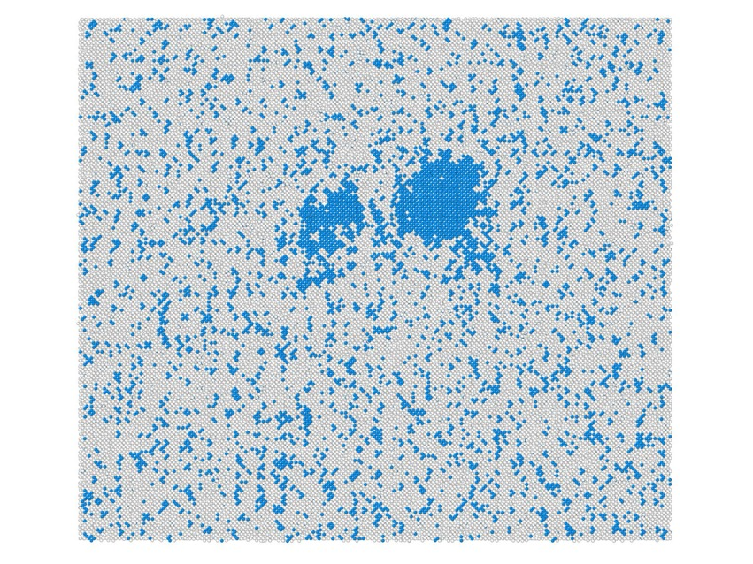
Crystal growth
0 ps
Non-BCC : 65,798
BCC : 0
from GB
<100>
Initial GB
CNA results
Non-BCC : 57,354
BCC : 8,444
<111>
36.13 ps
bcc <100>/<111>
100 nm x 100 nm x 300 nm
PKA Energy = 300 keV @ 1nm from GB

Slide 41
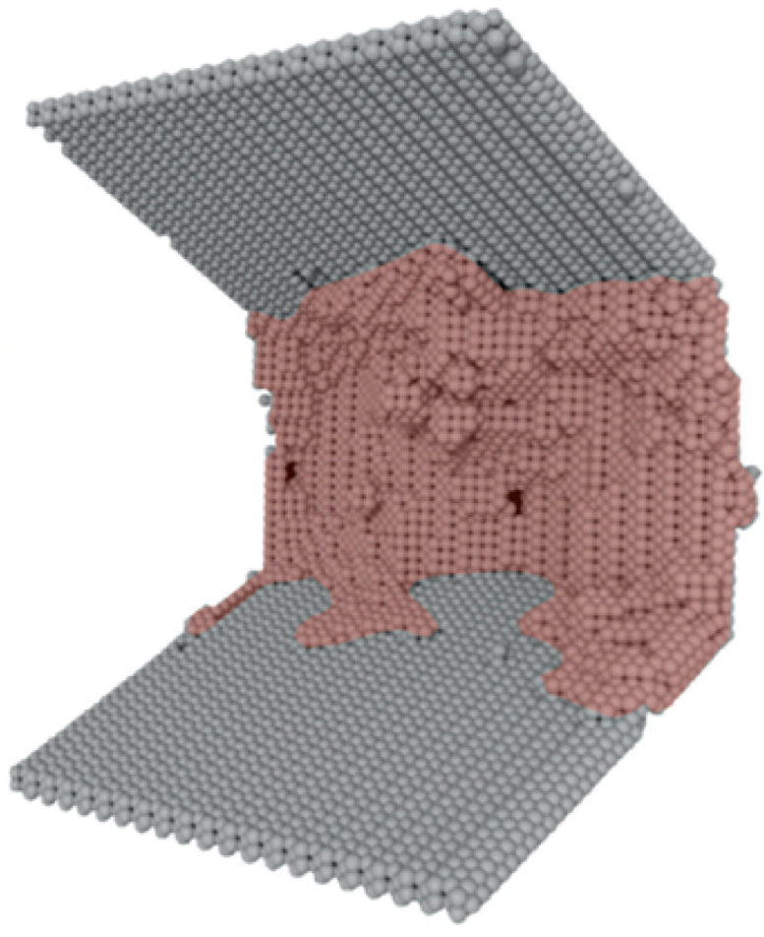
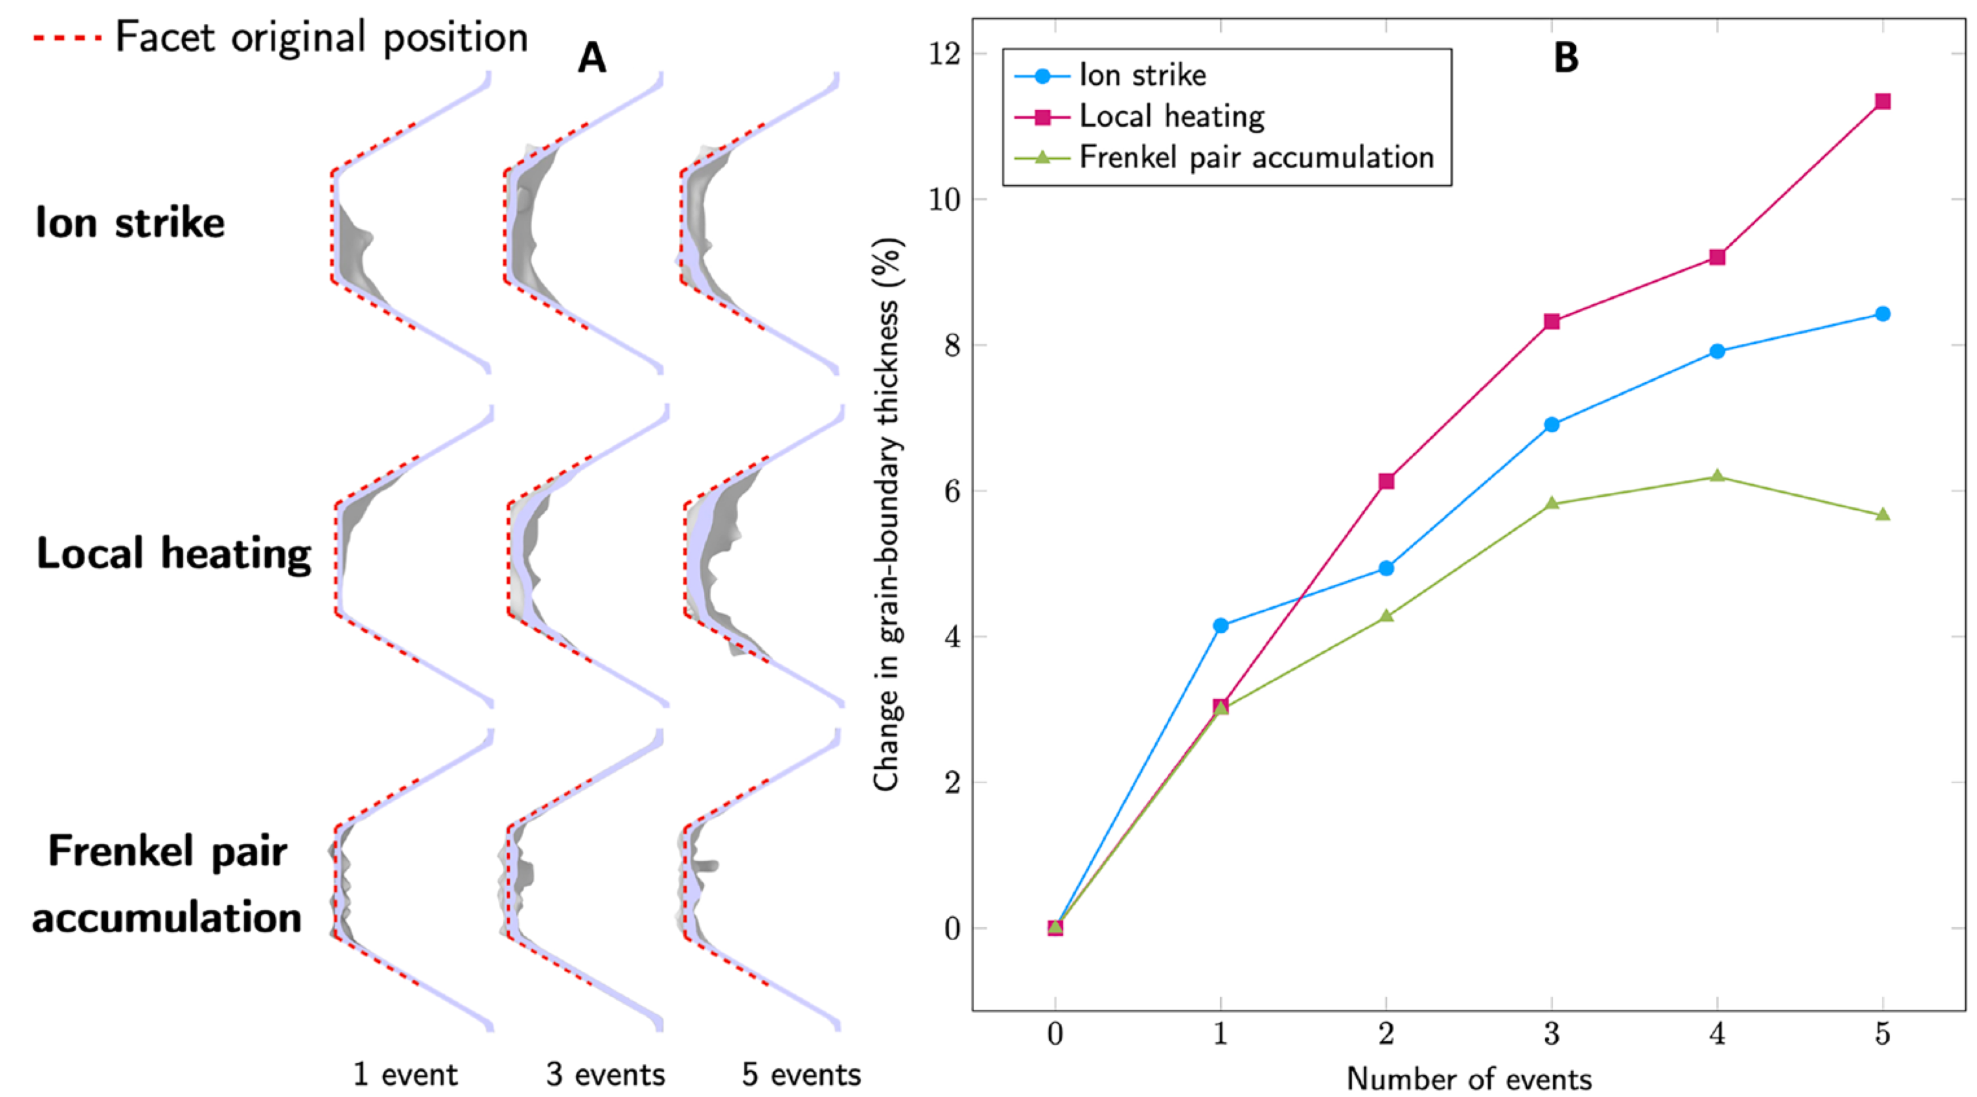
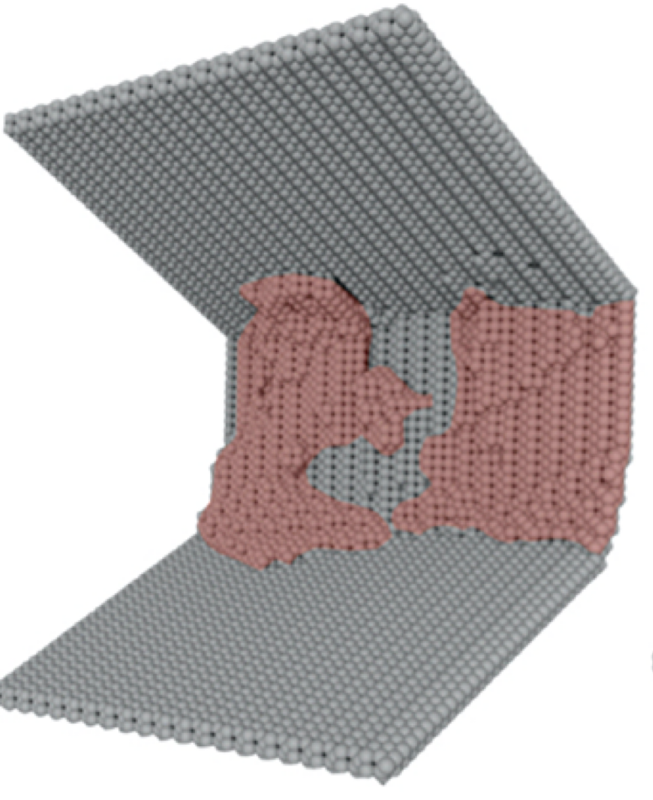
GB evolution
Grain boundary thickness increases
PKA Energy = 10 keV @ 300K
C. M. Barr et al. / Sci. Adv. 8, eabn0900 (2022)

Slide 42
GB energetics
to find optimum
Nucleation
Crystal growth
Dislocations
Energetics
GB facet/surface energies
GB area

Slide 43
How to quantify point defects
near GBs
CNA
atom-based
Unable to detect vacancy
GBs detected
Could be expensive
Hyperparameter dependence

Slide 44
How to quantify point defects
near GBs
W-S
Lattice-based
Initial configuration assumed to be perfectly crystalline
Unable to detect GBs but may detect changes in GBs

Slide 45
How to quantify point defects
near GBs
W-S0
Lattice-based
Initial configuration assumed to be perfectly crystalline
Symmetry-based
Unable to detect GBs

