Slide 1

Hydrogen isotope dependence in
dissociative electron attachment
Vincenzo Laporta
Istituto di Scienza e Tecnologia dei Plasmi (ISTP) - CNR, Italy
The Decennial IAEA Technical Meeting on Atomic, Molecular and Plasma-Material Interaction Data for Fusion Science and Technology
15–19 Jul 2024
Metsätalo, University of Helsinki, Finland

Slide 2
Plan of the presentation:
Introductory theory for electron-molecule scattering
ab-initio state-resolved cross sections for DeA
D₂ vibrational relaxation time

Slide 3
Plan of the presentation:
Introductory theory for electron-molecule scattering
ab-initio state-resolved cross sections for DeA
D₂ vibrational relaxation time

Slide 4


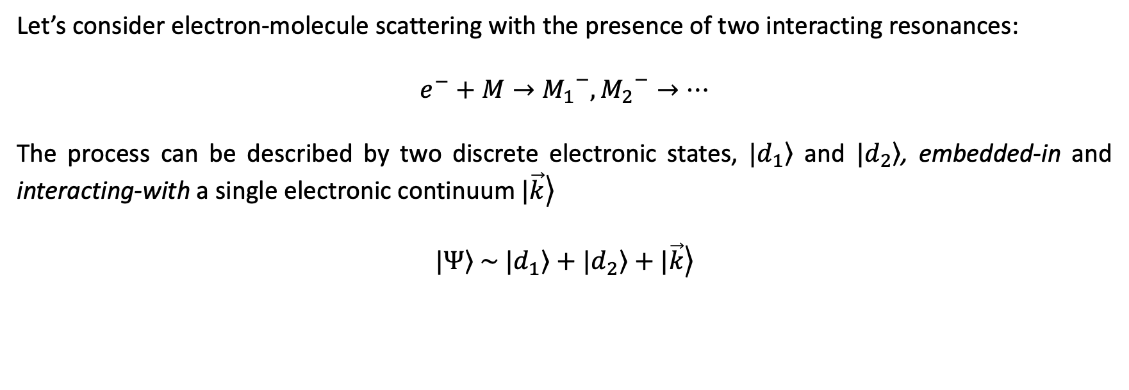
Some theoretical details
Let’s consider electron-molecule scattering with the presence of two interacting resonances:
$$e^{−}+M→{M_{1}}^{−},{M_{2}}^{−}→…$$
The process can be described by two discrete electronic states, $\left.|d_{1}\right\rangle$ and $\left.|d_{2}\right\rangle$, embedded-in and interacting-with a single electronic continuum $\left.|\vec{k}\right\rangle$
$$\left.|Ψ\right\rangle \sim \left.|d_{1}\right\rangle +\left.|d_{2}\right\rangle +\left.|\vec{k}\right\rangle$$
Interaction between
electron and neutral molecule
Resonant bound state

Slide 5
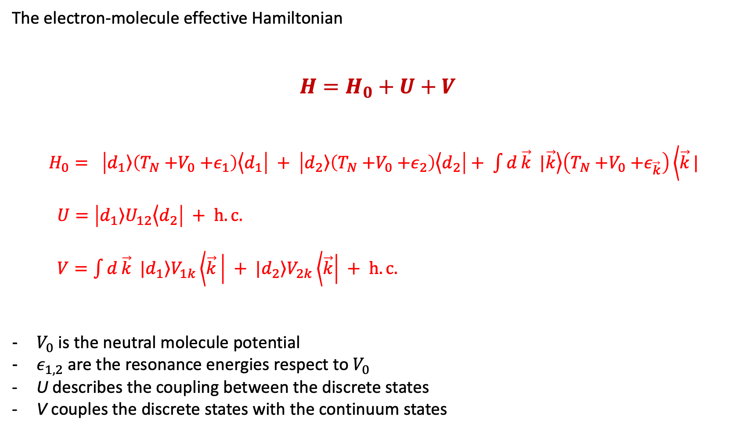
The electron-molecule effective Hamiltonian
$$H=H_{0}+U+V$$
$H_{0}= \left|\left.d_{1}\right\rangle \left(T_{N}{+V}_{0}{+ε}_{1}\right)\left\langle d_{1}\right.\right| + \left|\left.d_{2}\right\rangle \left(T_{N}{+V}_{0}{+ε}_{2}\right)\left\langle d_{2}\right.\right|+ \int{d}\vec{k}\left. |\vec{k}\right\rangle \left(T_{N}{+V}_{0}{+ε}_{\vec{k}}\right)\left\langle \vec{k}\right.|$
$U=\left|\left.d_{1}\right\rangle U_{12}\left\langle d_{2}\right.\right| + h.c.$
$V=\int{d}\vec{k}\left. |d_{1}\right\rangle V_{1k}\left\langle \vec{k}\right.\left| +\left. |d_{2}\right\rangle V_{2k}\left\langle \vec{k}\right.\right| + h.c.$
$V_{0}$ is the neutral molecule potential
$ε_{1,2}$ are the resonance energies respect to $V_{0}$
U describes the coupling between the discrete states
V couples the discrete states with the continuum states

Slide 6
The electron-molecule effective Hamiltonian
$$H=H_{0}+U+V$$
$H_{0}= \left|\left.d_{1}\right\rangle \left(T_{N}{+V}_{0}{+ε}_{1}\right)\left\langle d_{1}\right.\right| + \left|\left.d_{2}\right\rangle \left(T_{N}{+V}_{0}{+ε}_{2}\right)\left\langle d_{2}\right.\right|+ \int{d}\vec{k}\left. |\vec{k}\right\rangle \left(T_{N}{+V}_{0}{+ε}_{\vec{k}}\right)\left\langle \vec{k}\right.|$
$U=\left|\left.d_{1}\right\rangle U_{12}\left\langle d_{2}\right.\right| + h.c.$
$V=\int{d}\vec{k}\left. |d_{1}\right\rangle V_{1k}\left\langle \vec{k}\right.\left| +\left. |d_{2}\right\rangle V_{2k}\left\langle \vec{k}\right.\right| + h.c.$
$V_{0}$ is the neutral molecule potential
$ε_{1,2}$ are the resonance energies respect to $V_{0}$
U describes the coupling between the discrete states
V couples the discrete states with the continuum states

Slide 7
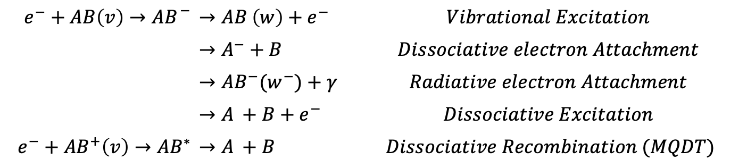
Processes occurring for resonant electron-molecule scattering
$$e^{−}+AB\left(v\right)→{{AB}_{ }}^{−}$$ | $$→{AB}^{ }\left(w\right)+e^{−}$$ | $$Vibrational Excitation$$
 | $$→A^{−}+B^{ }$$ | $$Dissociative electron Attachment$$
 | $$→{AB}^{−}(w^{−})+γ^{ }$$ | $$Radiative electron Attachment$$
 | $$→A^{ }+B+e^{−}$$ | $$Dissociative Excitation$$
$$e^{−}+{AB}^{+}\left(v\right)→{AB}^{∗}$$ | $$→A^{ }+B^{ }$$ | $Dissociative Recombination (MQDT)$

Slide 8
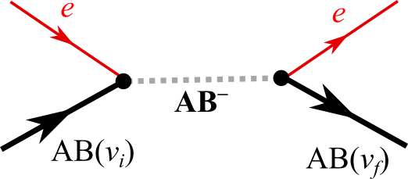

Slide 12
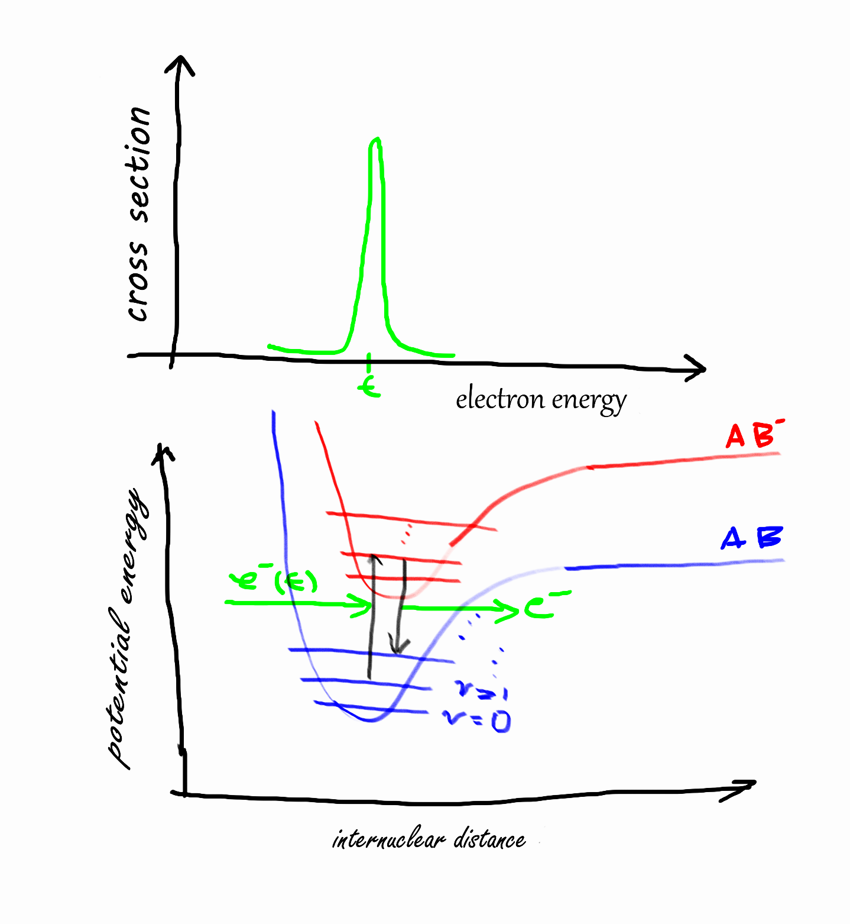
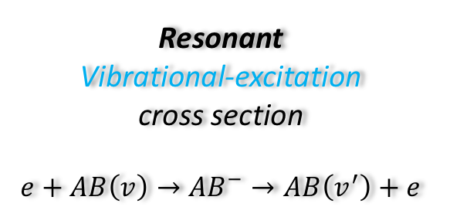
Resonant
Vibrational-excitation
cross section
$$e+AB\left(v\right)→{AB}^{−}→AB\left(v^{′}\right)+e$$
J. N. Bardsley and F. Mandl, Reports on Progress in Physics, 31, 471 (1968)

Slide 13
Resonant
Vibrational-excitation
cross section
$$e+AB\left(v\right)→{AB}^{−}→AB\left(v^{′}\right)+e$$
E
J. N. Bardsley and F. Mandl, Reports on Progress in Physics, 31, 471 (1968)

Slide 14
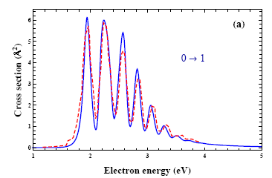
Resonant
Vibrational-excitation
cross section
$$e+AB\left(v\right)→{AB}^{−}→AB\left(v^{′}\right)+e$$
E
N₂
J. N. Bardsley and F. Mandl, Reports on Progress in Physics, 31, 471 (1968)

Slide 15
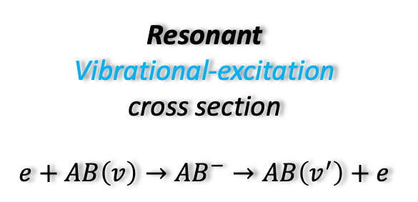
Resonant
Vibrational-excitation
cross section
$$e+AB\left(v\right)→{AB}^{−}→AB\left(v^{′}\right)+e$$
E
J. N. Bardsley and F. Mandl, Reports on Progress in Physics, 31, 471 (1968)

Slide 16





Dissociative electron Attachment
Radiative electron Attachment
$$e^{−}+AB\left(v\right)→{AB}^{−}→A^{−}+B^{ }$$
$$e^{−}+AB\left(v\right)→{AB}^{−}→{AB}^{−}(w^{−})+γ^{ }$$
$${A+B}^{ }$$
Total energy
$$e^{−}$$
$$A^{−}+B^{ }$$
resonant state
$$v$$
$$w^{−}$$

Slide 17
Dissociative electron Attachment
Radiative electron Attachment
$$e^{−}+AB\left(v\right)→{AB}^{−}→A^{−}+B^{ }$$
$$e^{−}+AB\left(v\right)→{AB}^{−}→{AB}^{−}(w^{−})+γ^{ }$$
$${A+B}^{ }$$
Total energy
$$e^{−}$$
DEA
$$A^{−}+B^{ }$$
resonant state
$$v$$
$$w^{−}$$

Slide 18
Dissociative electron Attachment
Radiative electron Attachment
$$e^{−}+AB\left(v\right)→{AB}^{−}→A^{−}+B^{ }$$
$$e^{−}+AB\left(v\right)→{AB}^{−}→{AB}^{−}(w^{−})+γ^{ }$$
$${A+B}^{ }$$
Total energy
$$e^{−}$$
DEA
$$A^{−}+B^{ }$$
REA
resonant state
$$v$$
$$w^{−}$$

Slide 19

The R-matrix method
$$e^{−}$$
Inner region
a
A—B
Outer region
J. Tennyson, Phys. Rep., 491, 29 (2010)

Slide 20
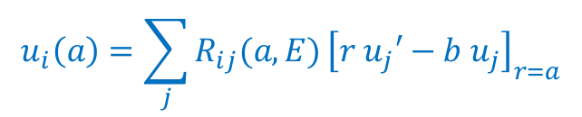
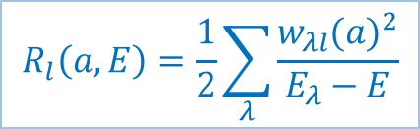
The R-matrix method
Inner region: N+1 electrons; ab-initio quantum chemistry codes, including exchange correlations; continuum orbitals
$$u_{i}\left(a\right)=\sum_{j}{R_{ij}(a,E)}{\left[r{ u}_{j}′−b{ u}_{j}\right]}_{r=a}$$
$$R_{l}\left(a,E\right)=\frac{1}{2}\sum_{λ}{\frac{{w_{λl}(a)}^{2}}{E_{λ}−E}}$$
$$e^{−}$$
Inner region
a
A—B
Outer region
J. Tennyson, Phys. Rep., 491, 29 (2010)

Slide 21
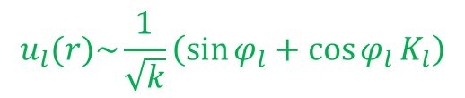
The R-matrix method
Inner region: N+1 electrons; ab-initio quantum chemistry codes, including exchange correlations; continuum orbitals
$$u_{i}\left(a\right)=\sum_{j}{R_{ij}(a,E)}{\left[r{ u}_{j}′−b{ u}_{j}\right]}_{r=a}$$
$$R_{l}\left(a,E\right)=\frac{1}{2}\sum_{λ}{\frac{{w_{λl}(a)}^{2}}{E_{λ}−E}}$$
$$e^{−}$$
Inner region
a
A—B
Outer region: exchange and electron-electron correlations are neglected and it need to take into account only long–range multi–polar interactions between the scattering electron and the target
$$u_{l}(r)\sim \frac{1}{\sqrt{k}}\left(\sin{φ_{l}}+\cos{φ_{l}}K_{l}\right)$$
J. Tennyson, Phys. Rep., 491, 29 (2010)

Slide 22
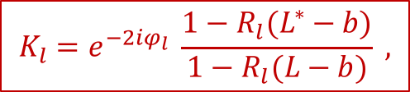
The R-matrix method
Inner region: N+1 electrons; ab-initio quantum chemistry codes, including exchange correlations; continuum orbitals
$$u_{i}\left(a\right)=\sum_{j}{R_{ij}(a,E)}{\left[r{ u}_{j}′−b{ u}_{j}\right]}_{r=a}$$
$$R_{l}\left(a,E\right)=\frac{1}{2}\sum_{λ}{\frac{{w_{λl}(a)}^{2}}{E_{λ}−E}}$$
$$e^{−}$$
Inner region
Boundary: Target wavefunction has zero amplitude
a
A—B
$$K_{l}=e^{−2iφ_{l}} \frac{1−R_{l}(L^{∗}−b)}{1−R_{l}(L−b)} ,$$
Outer region: exchange and electron-electron correlations are neglected and it need to take into account only long–range multi–polar interactions between the scattering electron and the target
$$u_{l}(r)\sim \frac{1}{\sqrt{k}}\left(\sin{φ_{l}}+\cos{φ_{l}}K_{l}\right)$$
J. Tennyson, Phys. Rep., 491, 29 (2010)

Slide 23
Plan of the presentation:
Introductory theory for electron-molecule scattering
ab-initio state-resolved cross sections for DeA
D₂ vibrational relaxation time

Slide 24


$$D_{2}$$
$$D_{2}^{−}$$
Local Complex Potential Model
First time (in my knowledge) of using this approach to calculate
vibrationally-electronically-excited collisions
V. Laporta, et al., Plasma Phys. Control. Fusion 63, 085006 (2021)

Slide 25




Potentials and couplings for D₂/D₂⎻
$$Γ_{X^{−}}$$
Ψ_{k} = A Σ_{i,j} a_{i,j,k} φ_{i}^{N} η_{i,j} + Σ_{i} b_{j,k} φ_{j}^{N+1}
$$Γ_{B^{−}}$$
$$D_{2} /{ D}_{2}^{−}$$
R-matrix
calculations
$$Γ_{C^{−}}$$

Slide 26
Potentials and couplings for D₂/D₂⎻
$$Γ_{X^{−}}$$
Ψ_{k} = A Σ_{i,j} a_{i,j,k} φ_{i}^{N} η_{i,j} + Σ_{i} b_{j,k} φ_{j}^{N+1}
$$Γ_{B^{−}}$$
$$D_{2} /{ D}_{2}^{−}$$
R-matrix
calculations
$$Γ_{C^{−}}$$

Slide 27


$$D_{2}^{+}$$
$$D_{2}$$
$$D_{2}^{−}$$
$$D_{2} /{ D}_{2}^{−}$$

Slide 28

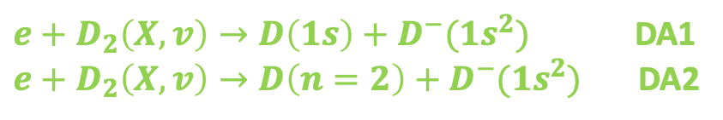
$e+D_{2}\left(X,v\right)→D\left(1s\right)+D^{−}(1s^{2})$ DA1
$e+D_{2}\left(X,v\right)→D\left(n=2\right)+D^{−}(1s^{2})$ DA2
$e+D_{2}(X,v)→e+D_{2}\left(X,w\right)$ elastic, VE1

Slide 29


$e+D_{2}(B,v)→e+D_{2}\left(B,w\right)$ elastic, VE3
$e+D_{2}\left(B,v\right)→D\left(n=2\right)+D^{−}(1s^{2})$ DA3

Slide 30
Comparison with data in literature

Slide 31
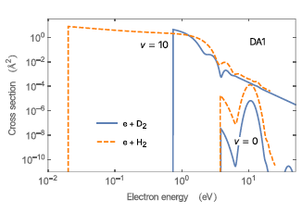
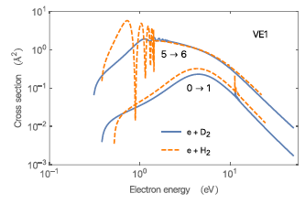
Isotopic effect for D2 and H2
Isotopic effect on dissociative electron attachment
Isotopic effect on vibrational excitation

Slide 32
Plan of the presentation:
Introductory theory for electron-molecule scattering
ab-initio state-resolved cross sections for DeA
D₂ vibrational relaxation time

Slide 33
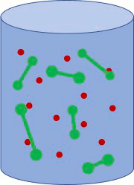

Electron-vibration energy exchange
T = T_{e} = const
State-to-State kinetics for electron-D₂ collisions
Master equation approach

Slide 34
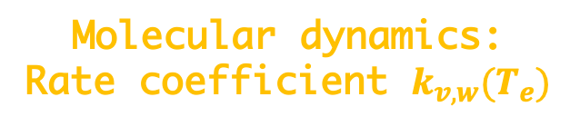
Electron-vibration energy exchange
T = T_{e} = const
State-to-State kinetics for electron-D₂ collisions
Master equation approach
Molecular dynamics:
Rate coefficient $k_{v,w}(T_{e})$

Slide 35
Electron-vibration energy exchange
T = T_{e} = const
State-to-State kinetics for electron-D₂ collisions
Master equation approach
Vibrational distribution function
n_{tot} = 10²² part/m³
95% of D₂
5% of e
T_{gas} = 10000 K
T⁰_{vib} = 1000 K
equilibrium
equilibrium
initial
T⁰_{vib}
out-of-equilibrium

Slide 36


Electron-vibration energy exchange
Vibrational Relaxation time of D₂
$$\frac{1}{k_{1−0}}$$
n_{tot} = 10²² part/m³
95% of D₂ 5% of e
V. Laporta, L. Vialetto, D. Reiter in preparation (2023)

Slide 37

Electron-vibration energy exchange
Vibrational Relaxation time of D₂
$$\frac{1}{k_{1−0}}$$
Landau-Teller model
n_{tot} = 10²² part/m³
95% of D₂ 5% of e
V. Laporta, L. Vialetto, D. Reiter in preparation (2023)

Slide 38
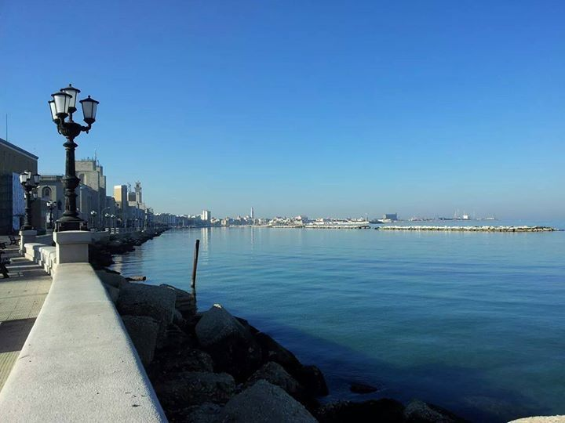
Thank you for your attention

