Slide 1
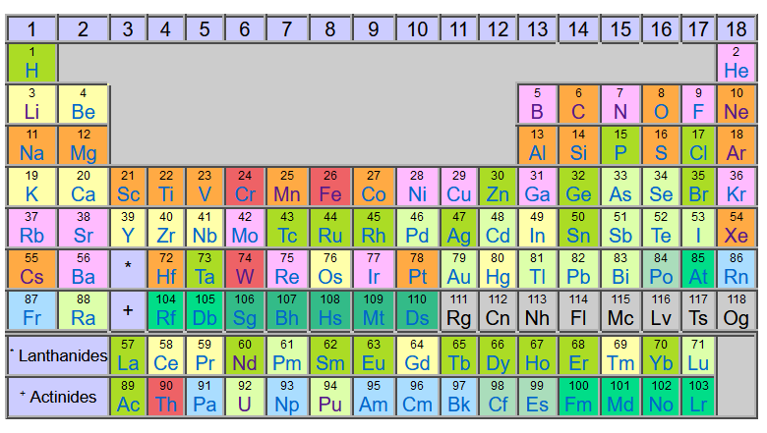
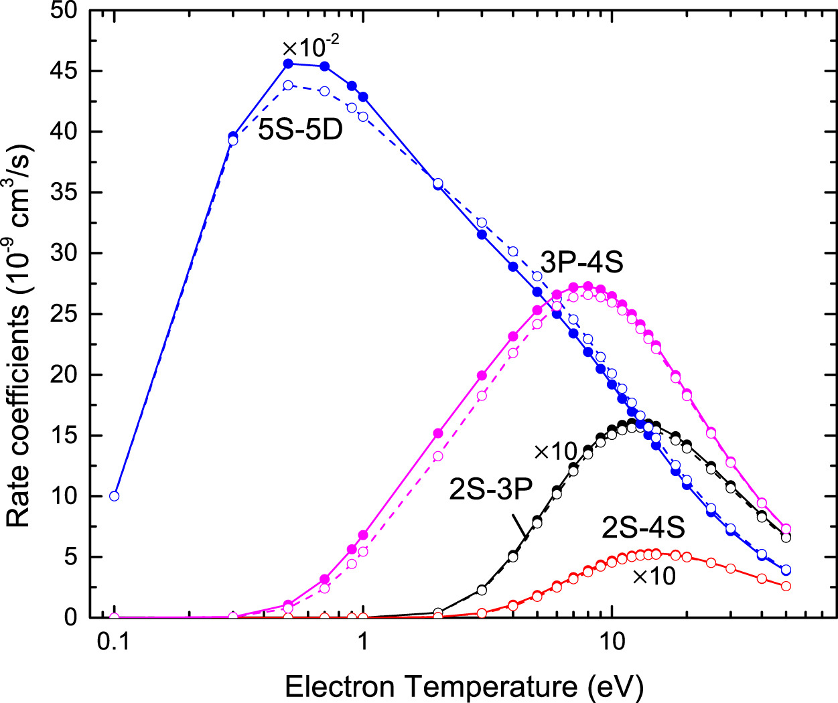
NIST research program on atomic data and modeling for fusion
Yuri Ralchenko
Atomic Spectroscopy Group
National Institute of Standards and Technology
Gaithersburg, MD 20899, USA
The Decennial IAEA Technical Meeting on Atomic, Molecular and Plasma-Material Interaction Data for Fusion Science and Technology
Helsinki, Finland
July 15, 2024

Slide 2

Acknowledgments
NIST
Dipti
A. Kramida
J. Reader
J.N. Tan
G. O’Neil
P. Szypryt
A. Naing
J. Dreiling
D. Swetz
J. Gillaspy
T. Das
Y. Podpaly
V. Azarov
Clemson University
E. Takacs
H. Steiger
A. Hosier
T. Burke
J. Marler
R. Silwal
A. Gall
Y. Yang
S. Sanders
IAEA
C. Hill
FSZ Juelich
O. Marchuk
M. Sackers
Curtin University
D. Fursa
I. Bray
H. Umer
NAU
D.R. Schultz
NIFS
I. Murakami
D. Kato
H. Sakaue
C. Suzuki
UEC
N. Nakamura
Drake Univ.
K. Bartschat
O. Zatsarinny
Queen’s Univ.
C. Ballance

Slide 3
Spectroscopy of highly charged ions
Critical evaluation of atomic data
Atomic Databases
Collisional-radiative modeling and V&V
NIST spectroscopy program for support of fusion research goes back to early 1970s:
Iron group elements
Mo
Ge, Ga
Dozens of compilations of
critically evaluated spectroscopic
data such as energy levels, spectral lines,
and radiative transition probabilities

Slide 4
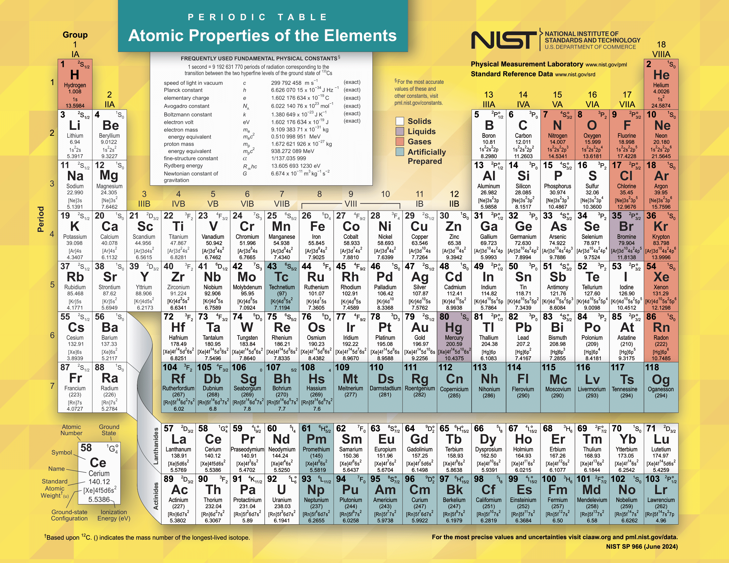
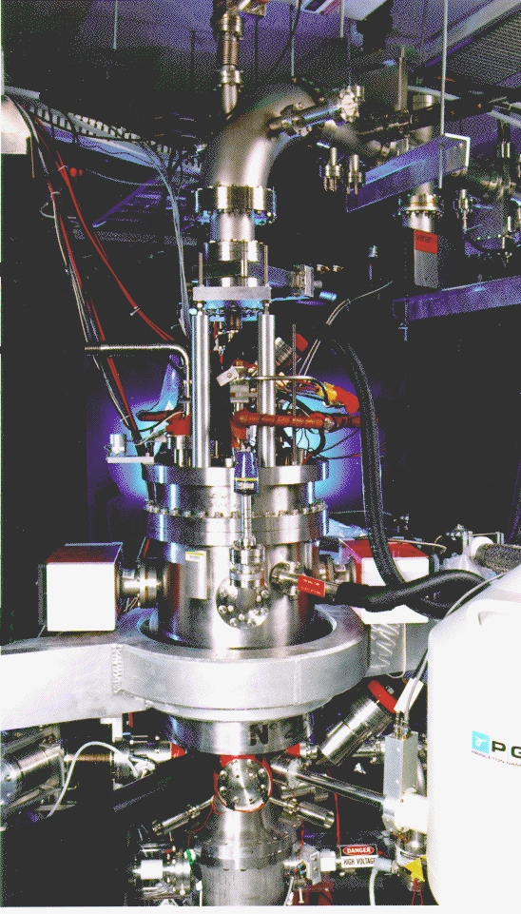
Spectroscopy of highly charged high-Z ions
Electron beam ion trap
E_{b} up to 30 keV
Can reach (60-70)+ ions
EUV grazing-incidence spectrometer (1-30 nm)
X-ray transition-edge-sensor microcalorimeter
(500-8,000 eV, spectral resolution 4 eV @6 keV, temporal resolution δt ≥ 10 μs)

Slide 5
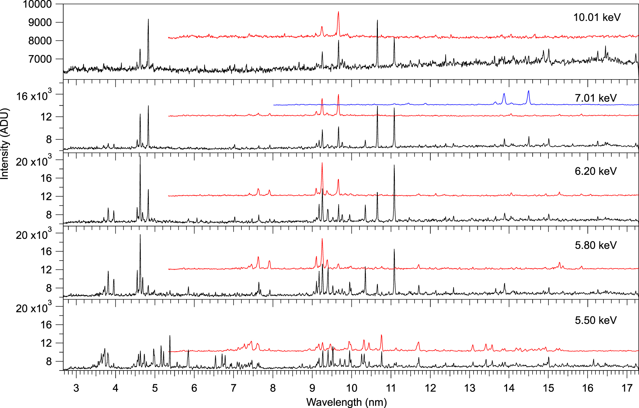
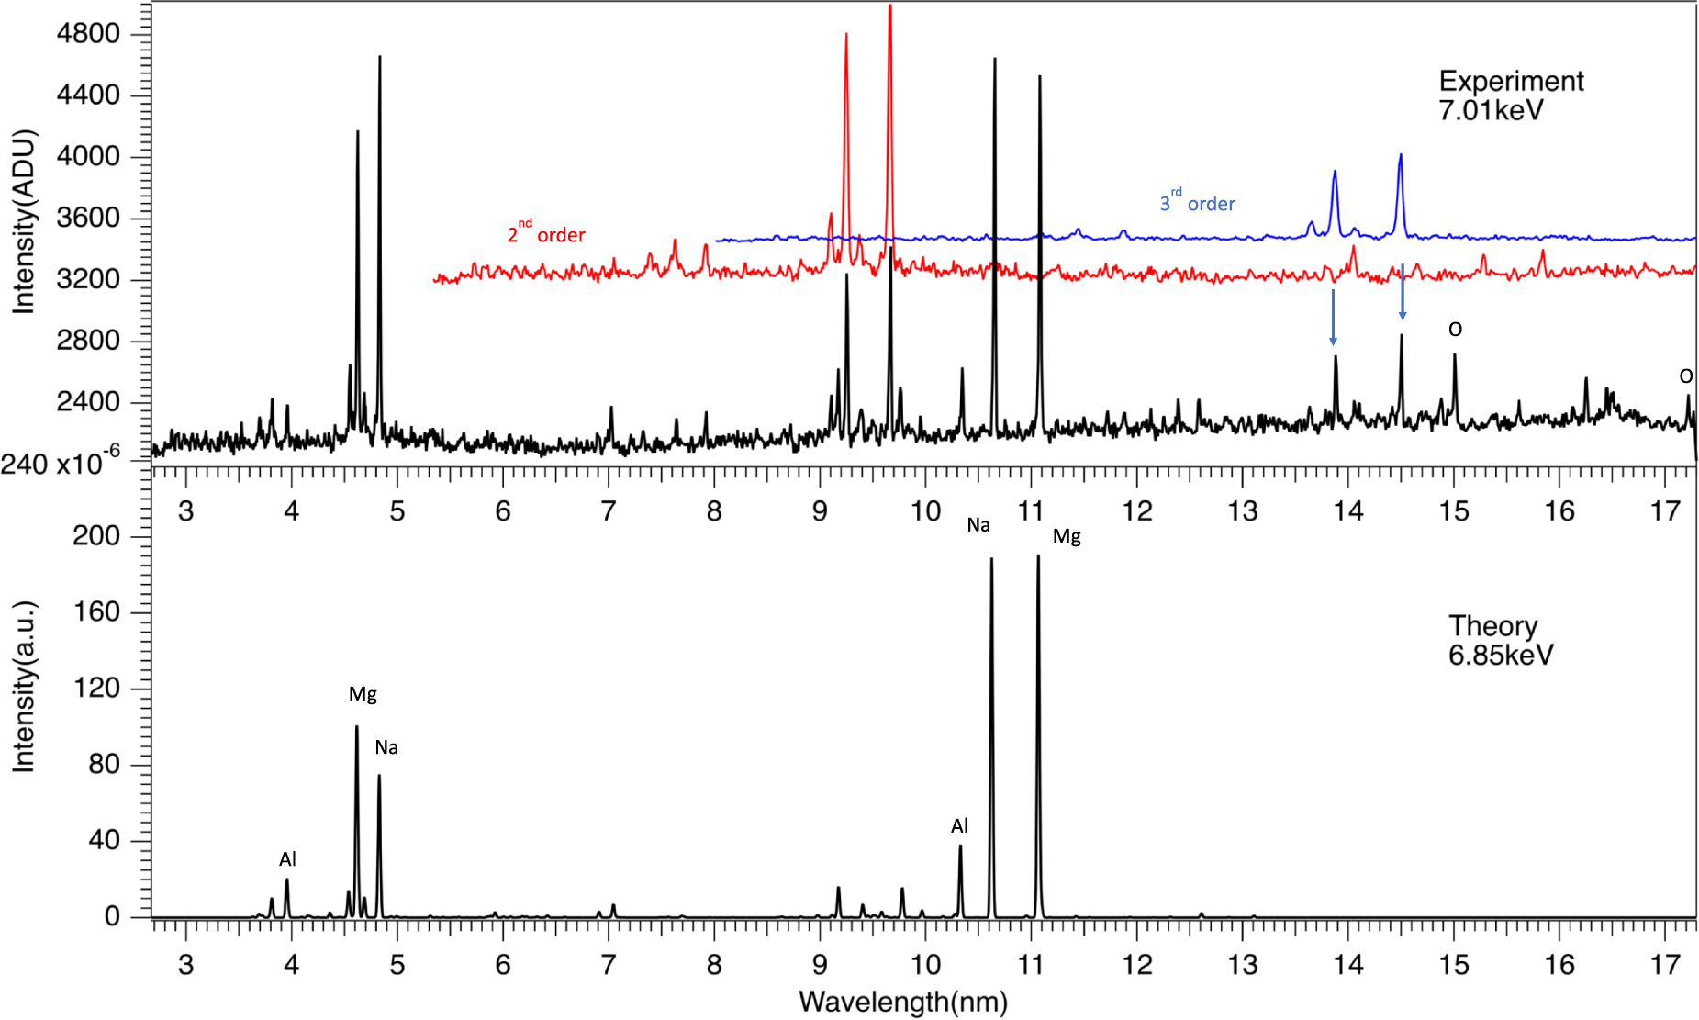
EBIT: EUV spectroscopy of ~30-times-ionized Nd
Y. Yang et al., JQSRT 56, 175003 (2023)

Slide 6
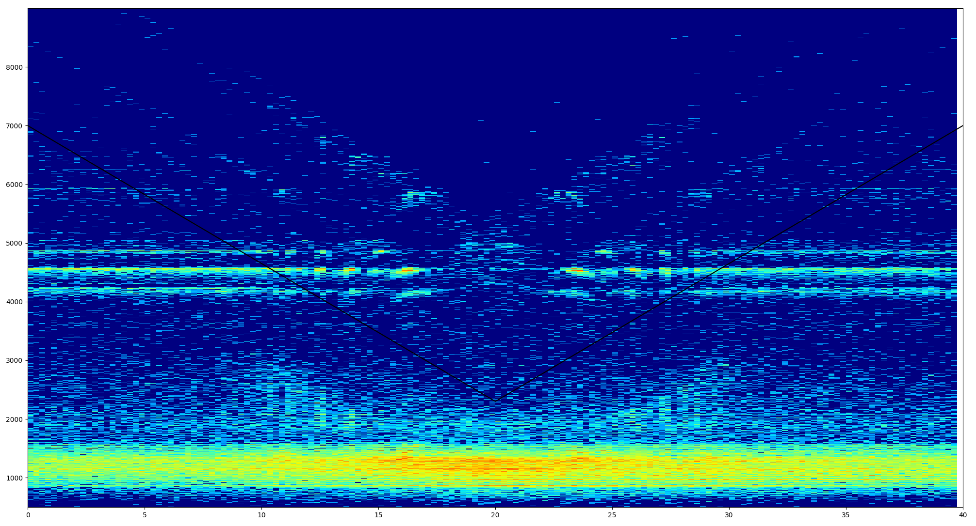
EBIT x-rays: LMn resonances in highly-charged Xe
Photon energy (2000-9000 eV)
Time (ms)

Slide 7
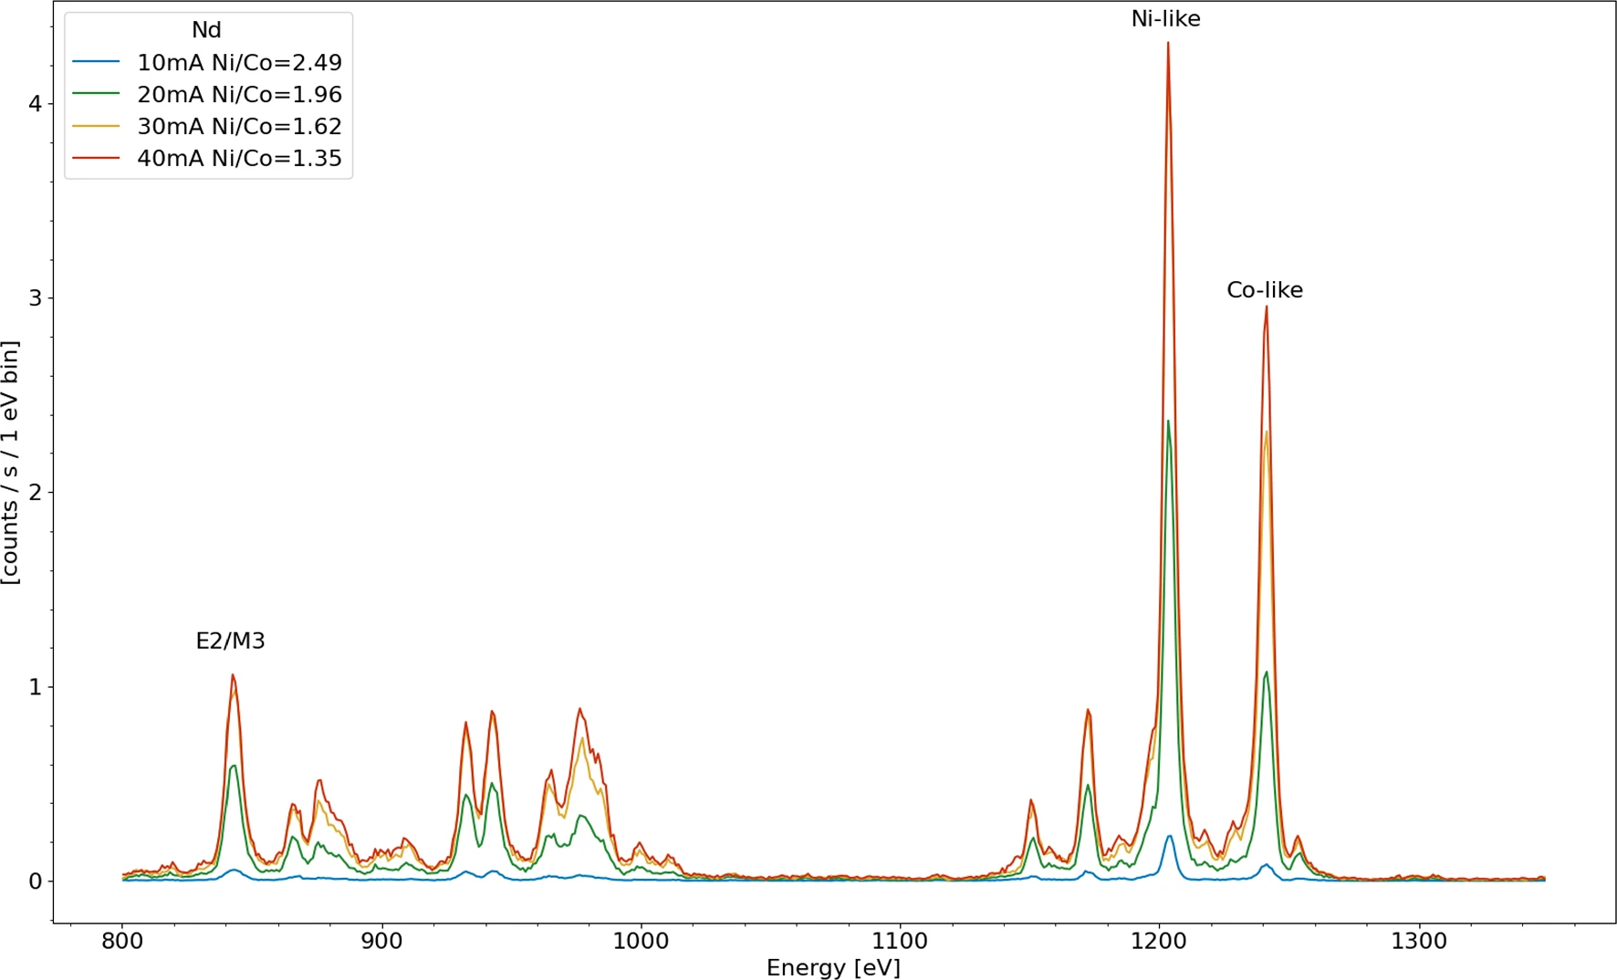
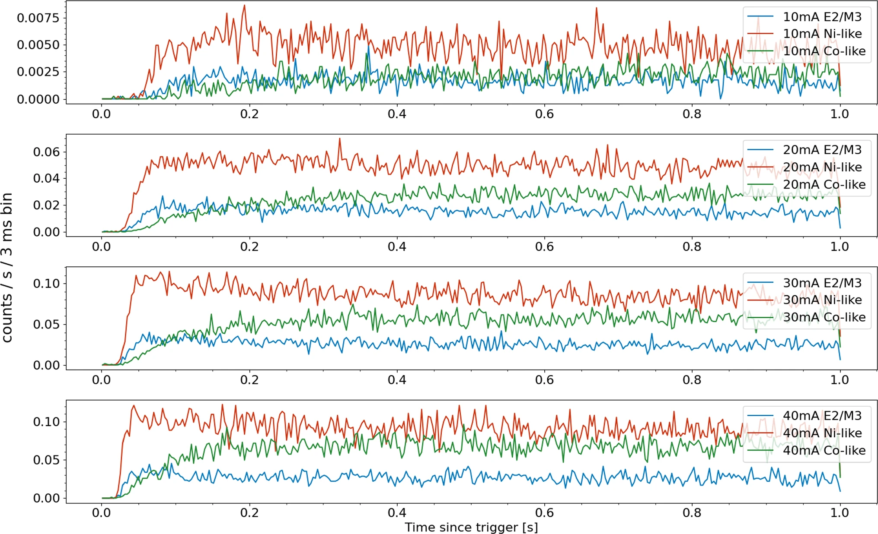
Spectroscopy of highly charged high-Z ions (cont’d)
Density dependence of abundances due to ionization from a metastable state (3d⁹4s J=3 in Ni-like ions)
T. Burke et al., EPJD 56, 175003 (2023)

Slide 8
Critical evaluation of collisional data
Recommended collisional data for Be I and Be II
  Dipti et al., ADNDT 127-128, 1 (2019)
  Dipti et al., ADNDT 156, 101634 (2024)
CX recombination data for H+W⁶⁴⁺
  Ralchenko and Schultz, PPCF 61, 125007 (2019)
CX recombination spectroscopy for W^{q+} (q=61-66) for ITER applications
  Dipti, Ralchenko and Schultz, PPCF 63, 115010 (2021)
NIST
Dipti, Das, Ralchenko
IAEA
Hill, Chung
Drake Univ.
Bartschat, Zatsarinny
Queen’s Univ.
Balance
Curtin Univ.
Bray, Fursa, Umer

Slide 9
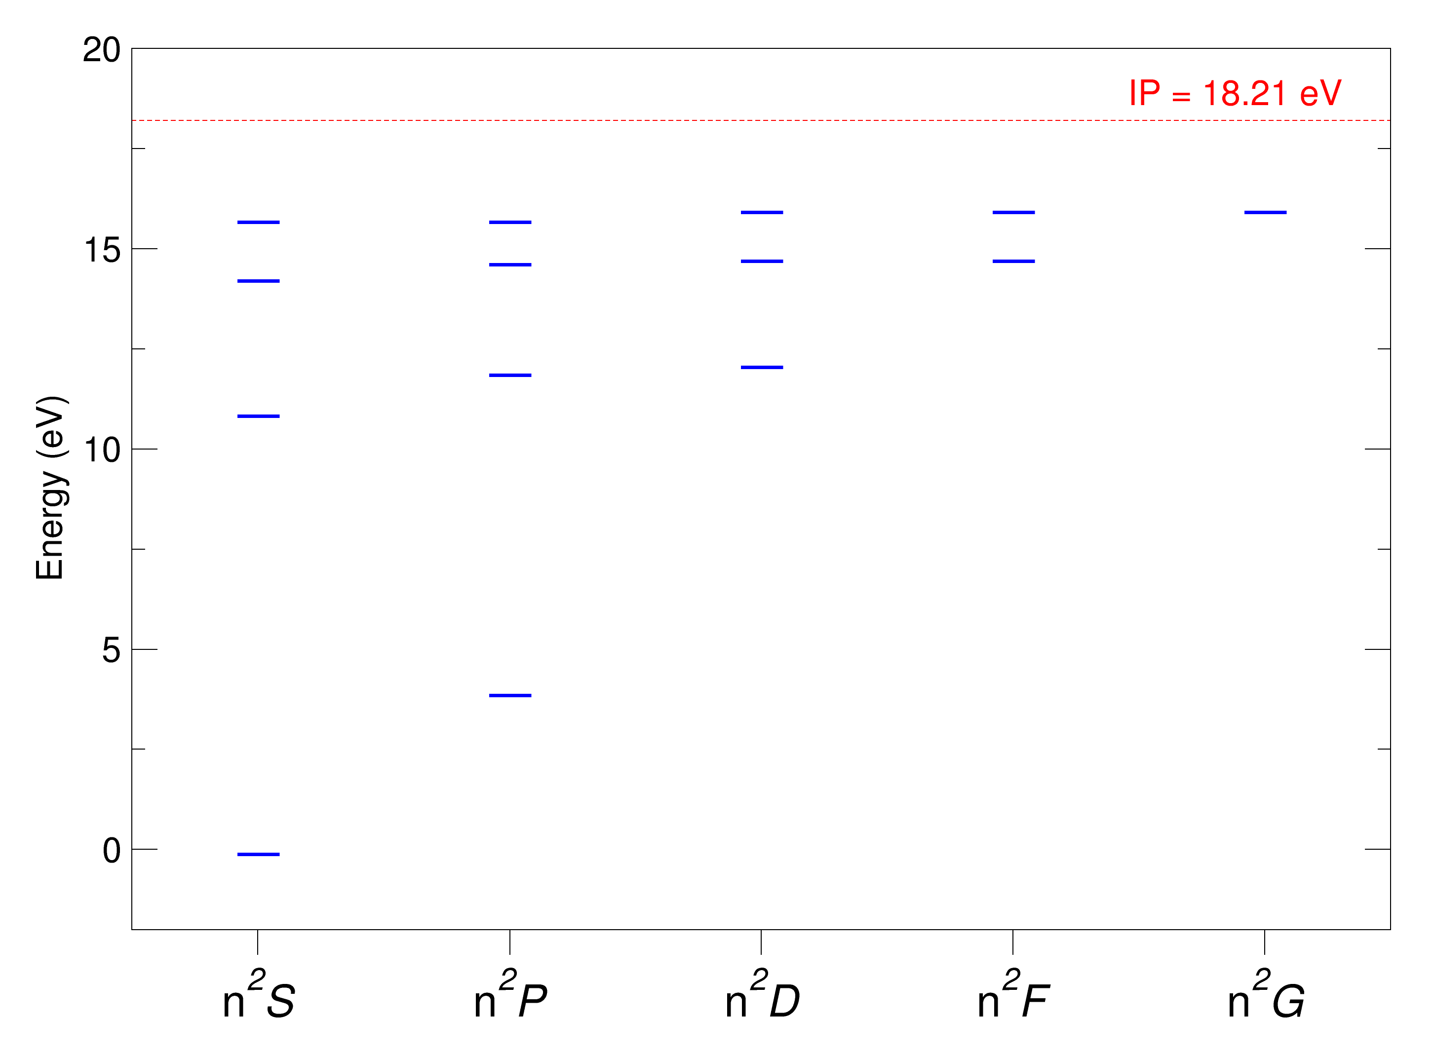
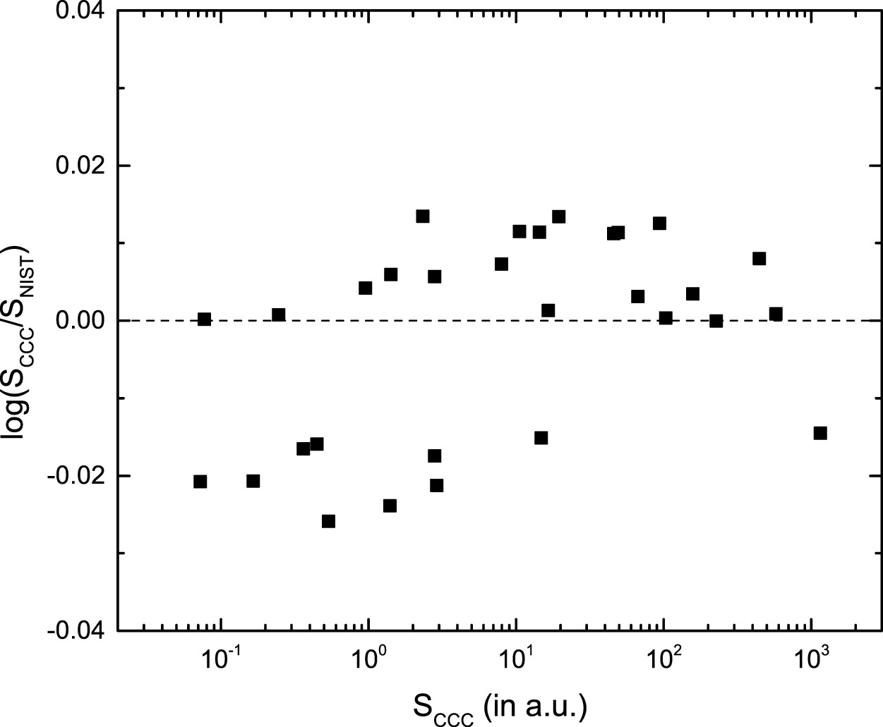
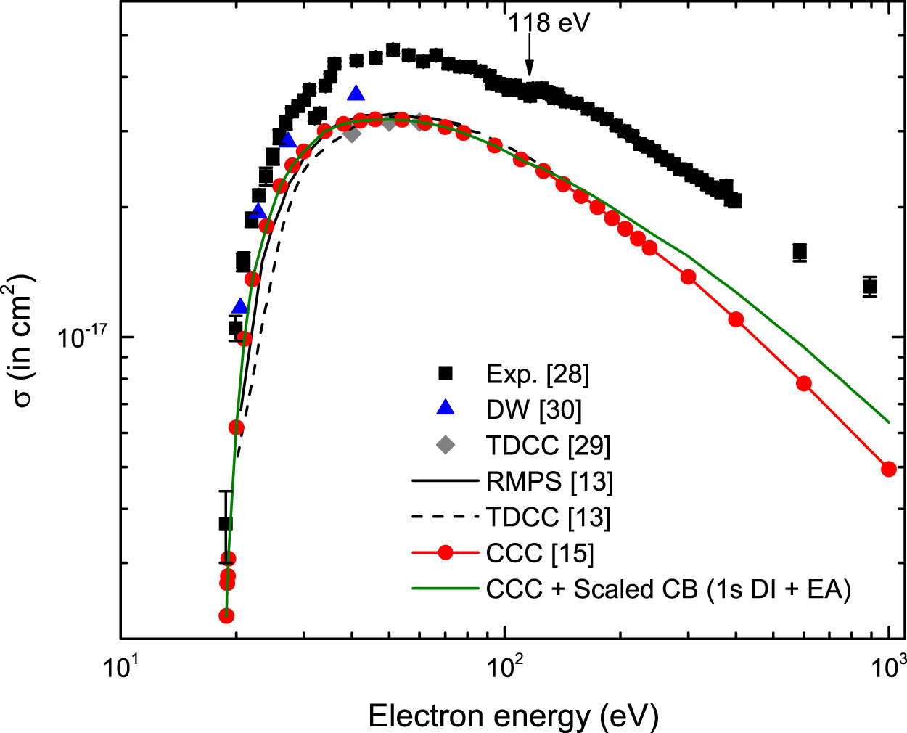
Collisional data: e+Be II
Data source: CCC-84 results (extensive comparisons with other experimental and theoretical data)
Li-like ion, 14 lowest n²L terms up to n=5
CCC f-values vs. NIST
Ionization cross section
  Dipti et al., ADNDT 156, 101634 (2024)

Slide 10
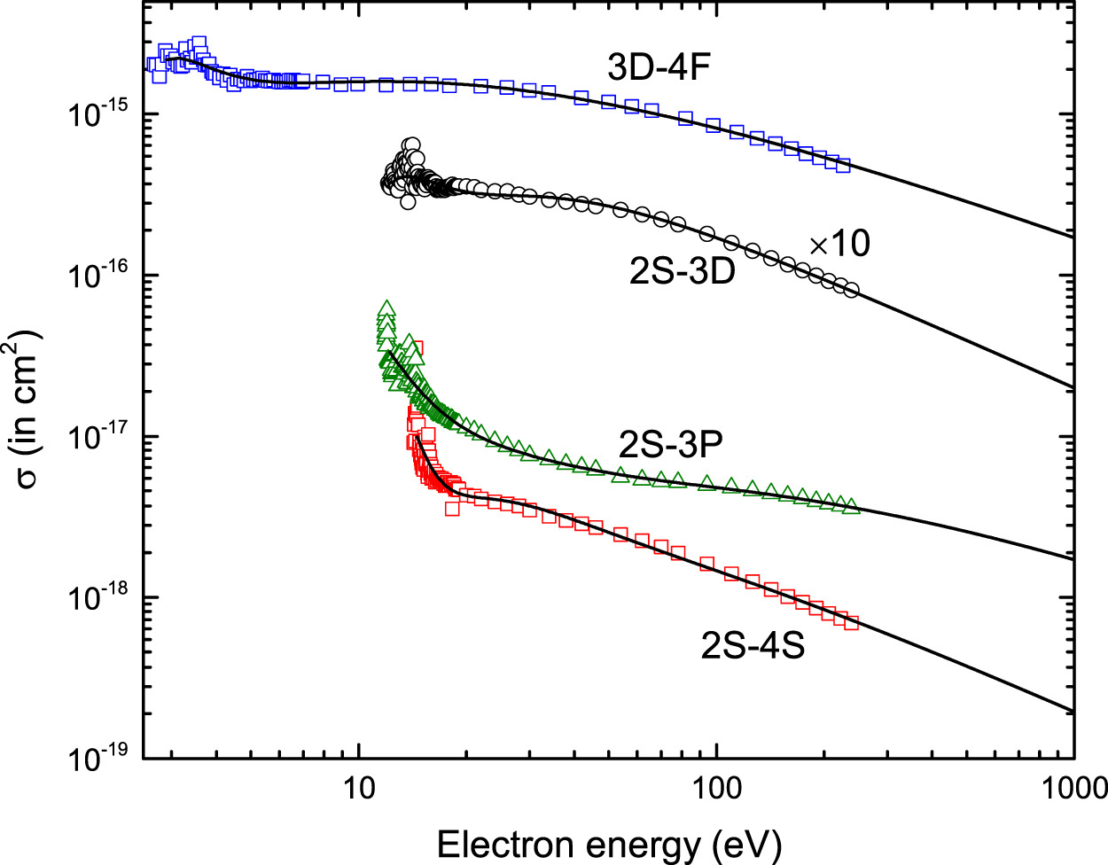
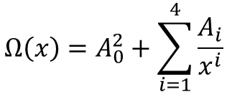
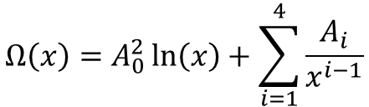
Collisional data: e+Be II (cont’d)
Collision strengths
Fitting formulas:
Rate coefficients
Optically allowed:
$$Ω\left(x\right)=A_{0}^{2}\ln\left(x\right)+\sum_{i=1}^{4}{\frac{A_{i}}{x^{i−1}}}$$
Optically forbidden:
$$Ω\left(x\right)=A_{0}^{2}+\sum_{i=1}^{4}{\frac{A_{i}}{x^{i}}}$$
  Dipti et al., ADNDT 156, 101634 (2024)

Slide 11
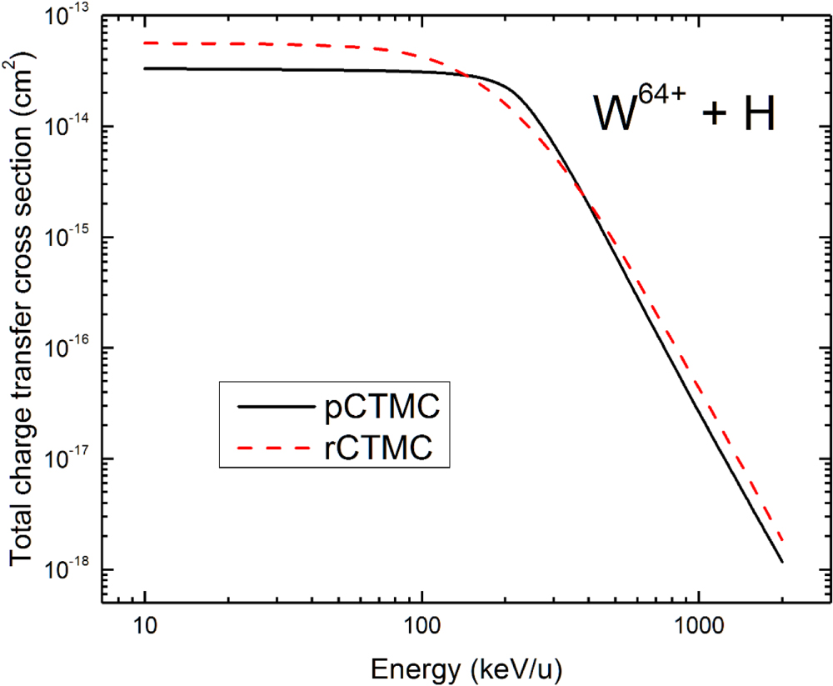
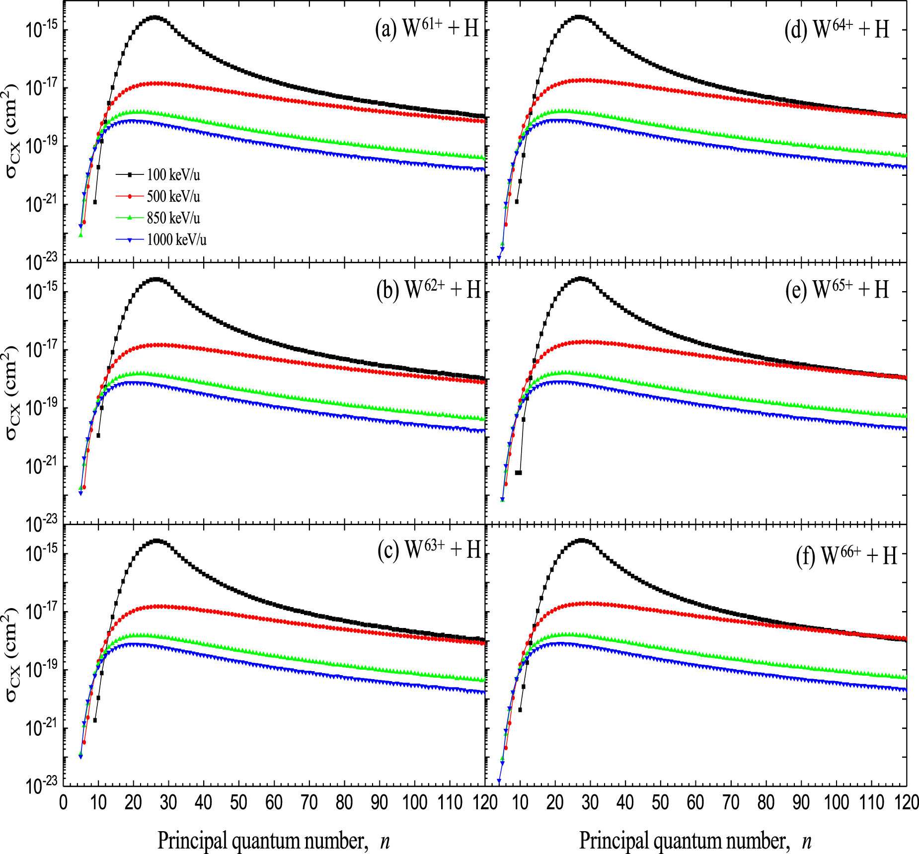
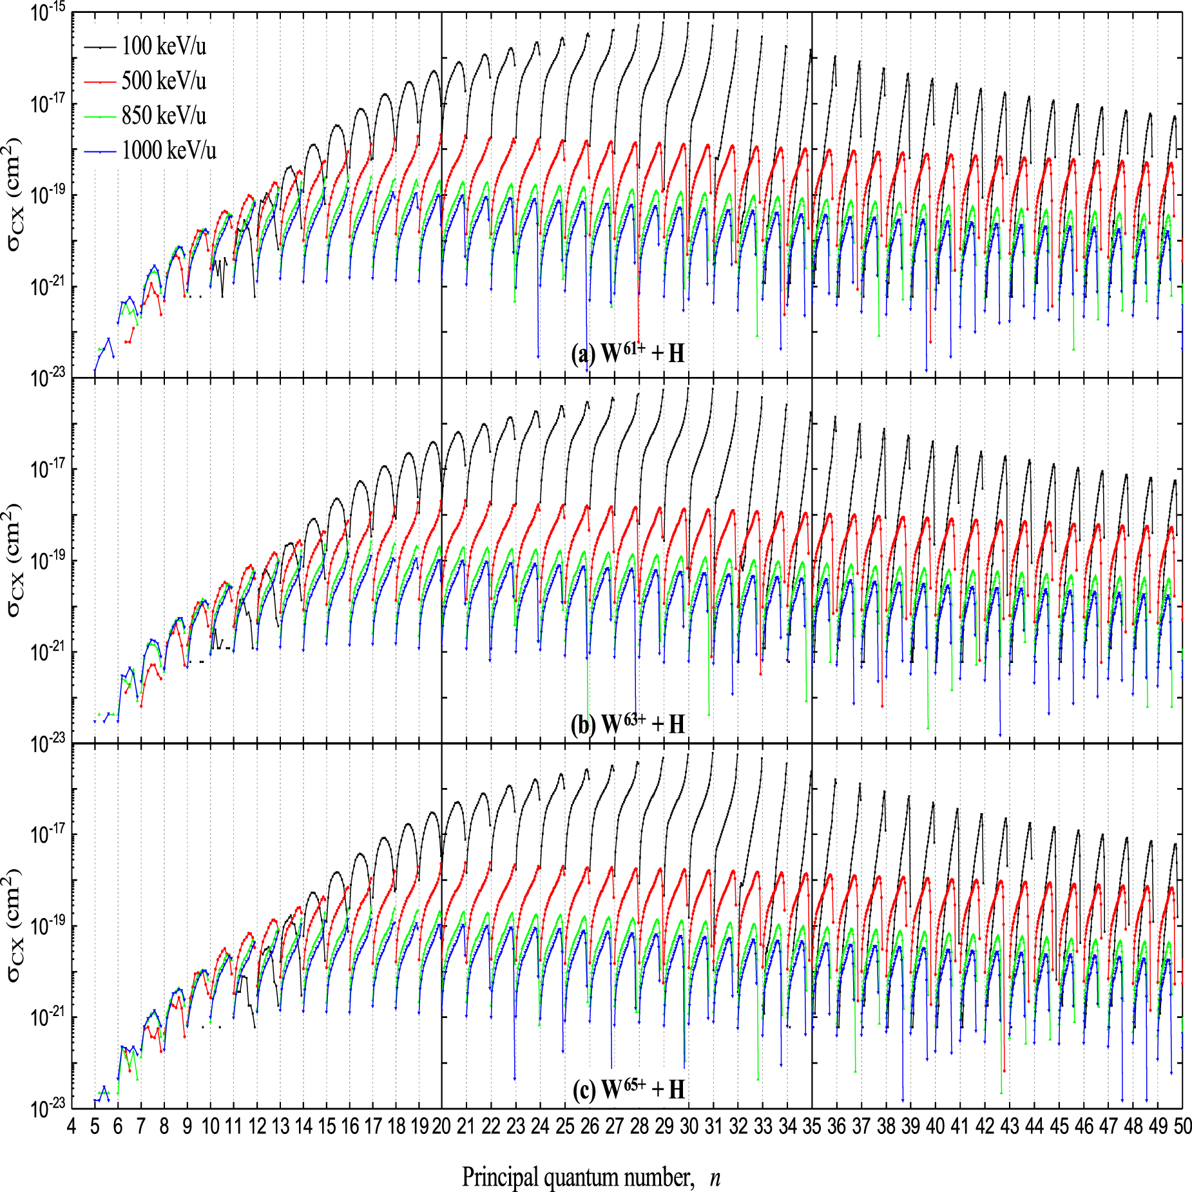
Collisional data: CXRS H+W⁽⁶¹⁻⁶⁶⁾⁺
First shot at Ne-like ions
Very small cross section for high energies!
Extension to 6 most abundant ions
  Dipti, Ralchenko and Schultz, PPCF 63, 115010 (2021)

Slide 12
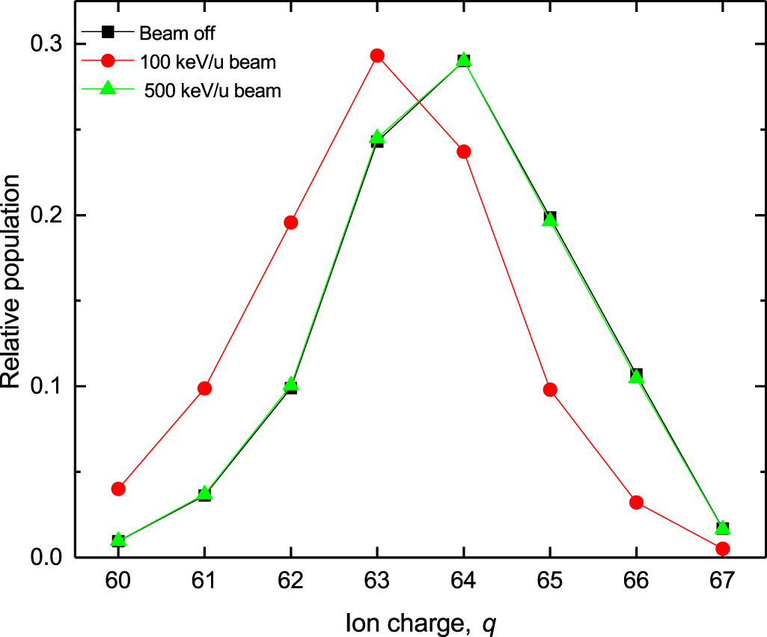
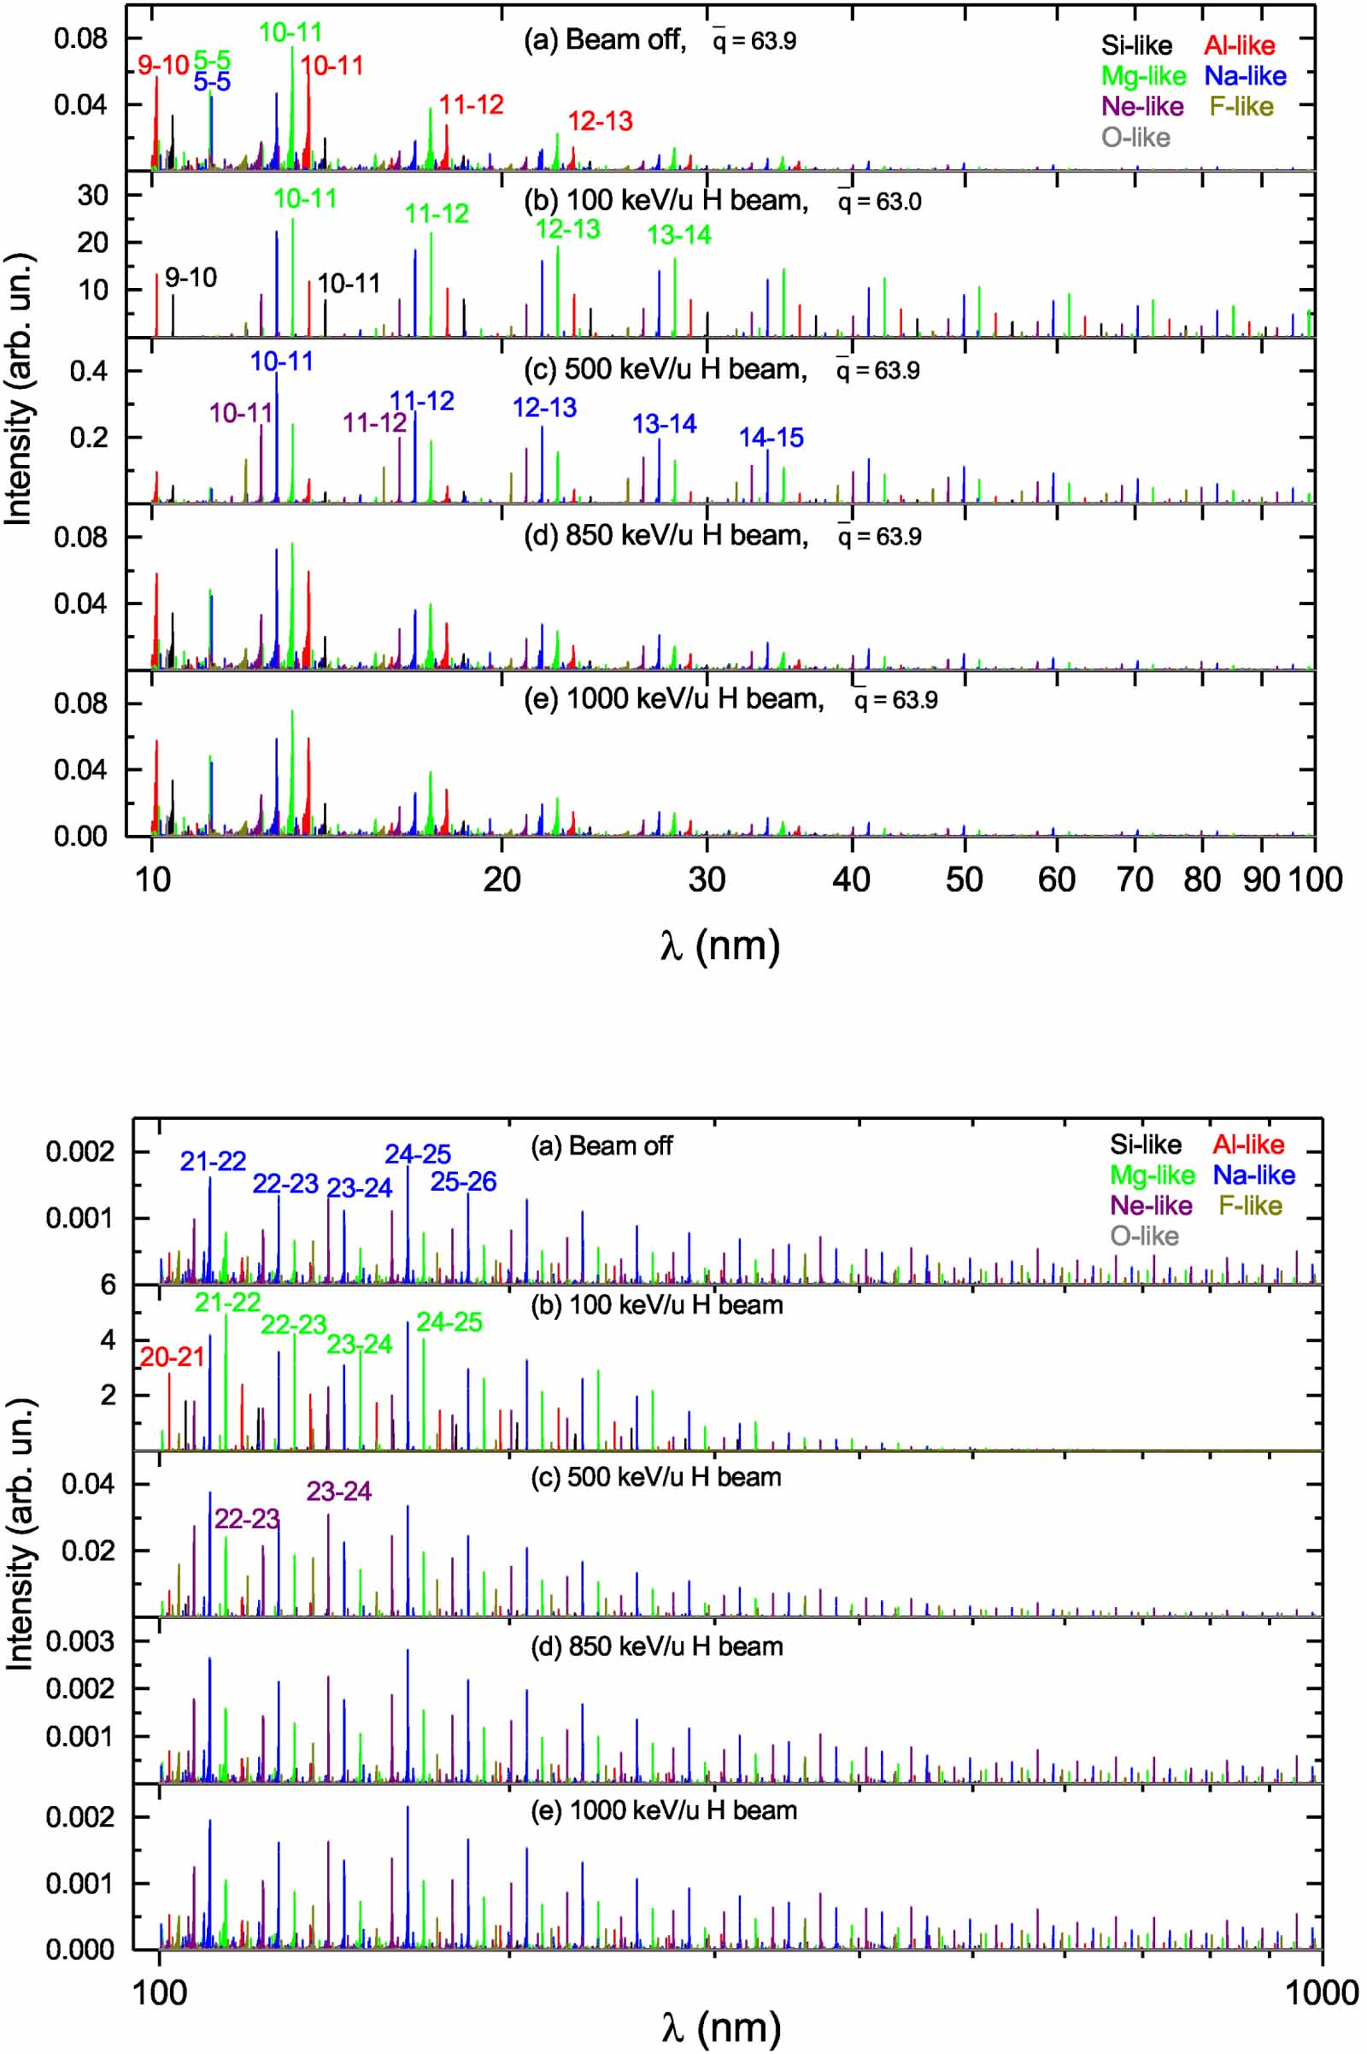
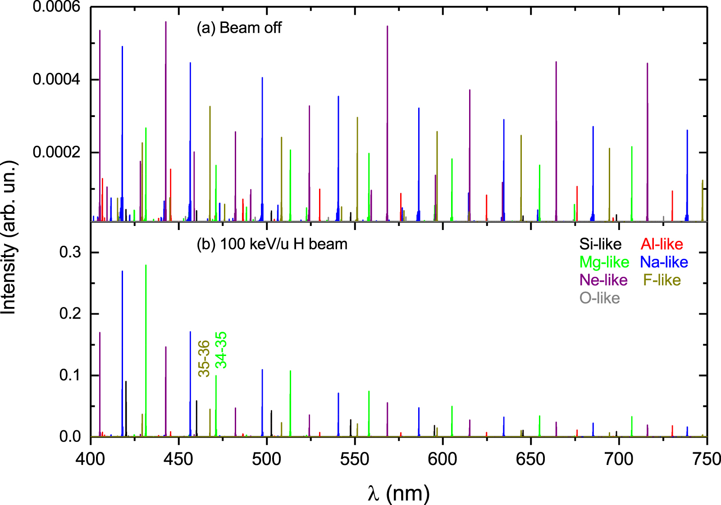
Collisional data: CXRS H+W⁽⁶¹⁻⁶⁶⁾⁺
High beam energies do not shift the ionization balance because of small CX cross sections
100 keV/u: significant modification of the spectra
  Dipti, Ralchenko and Schultz, PPCF 63, 115010 (2021)

Slide 13

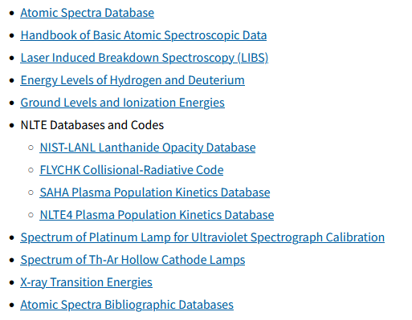



NIST Atomic Databases
https://www.nist.gov/pml/atomic-spectroscopy-databases

Slide 14
Critically evaluated data compilations
Energy levels of He-like ions (He I to Ds CIX): ~5000 levels
All H-like ions from He II to Ds CX
Dielectronic Li-like satellites from 1s2l2l’: C to U
C II, Fe II, Ac I-III, Ni V, Hf I, F I, Ne I, Sc I, Zn I, Xe I, Re III-V, Os III, Bi I, Ar I, K I, Sc I, Zn II, As I, Br I, Kr I, Nb IV, Y VII, In I, Au I...
Numerous ionization potentials updated
For the 16 energy levels of the 1s2l2l’ core-excited configurations of Li-like ions, 999 absolute and 35 relative experimental energy-level measurements from 101 publications have been collected and analyzed. Modern statistical theory methods (e.g., “dark uncertainty”) were applied to derive the final uncertainties.

Slide 15
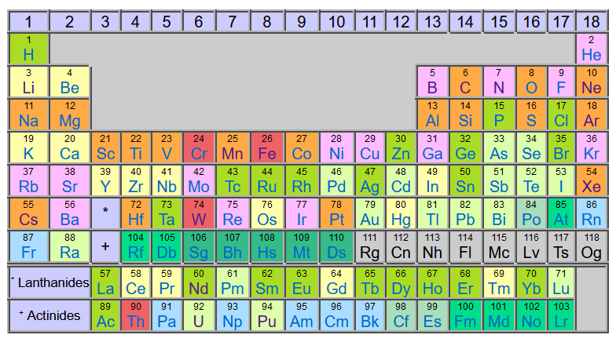
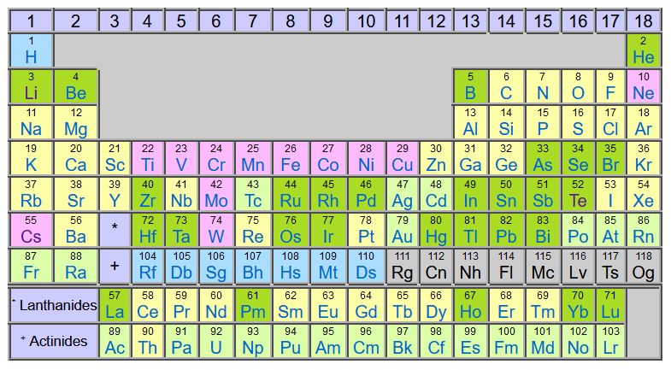
Atomic Spectra Database v.5.11: data content
~300,000 Lines
(128,000 probabilities)
~120,000 Levels

Slide 16
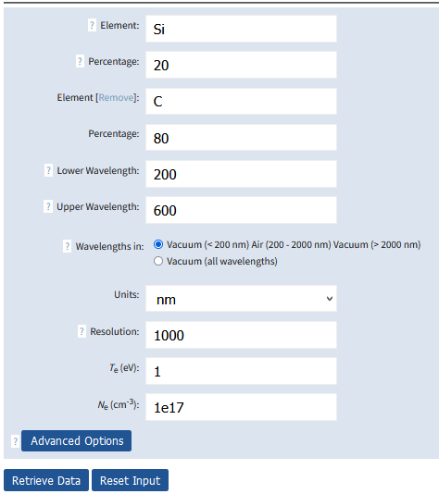
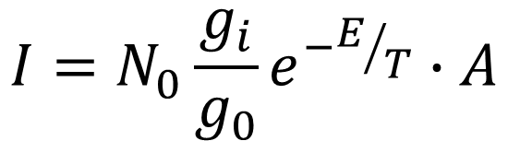
NIST LIBS Database
Low temperature, high density: Saha-LTE!
$$I=N_{0}\frac{g_{i}}{g_{0}}e^{−E/T}∙A$$
All needed data
are already in ASD
Calculation of Saha/LTE spectra for any element or combination thereof in ASD
Arbitrary plasma parameters (but Saha/LTE!) and spectrum resolution
ASD-based
Graphical services
Problem: not all ions, A’s
https://physics.nist.gov/LIBS

Slide 17
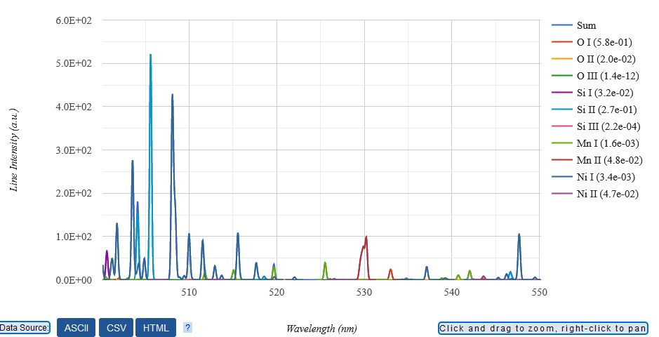
NIST LIBS Database
5% Mn + 5% Ni + 30% Si + 60% O
T_{e} = 1 eV
N_{e} = 10¹⁷ cm⁻³
R = 3000
Direct comparison with measured data
https://physics.nist.gov/LIBS

Slide 18
Next decade?..
Continue critical evaluation of spectroscopic data for fusion (e.g., CRP on injected impurities)
Expansion of atomic databases
Collisional data: update the He I data (new CCC results due to D. Fursa et al.), B ions (?)
Spectroscopy of highly-charged high-Z ions for fusion diagnostics
Collaboration with IAEA and other fusion institutions

Slide 19
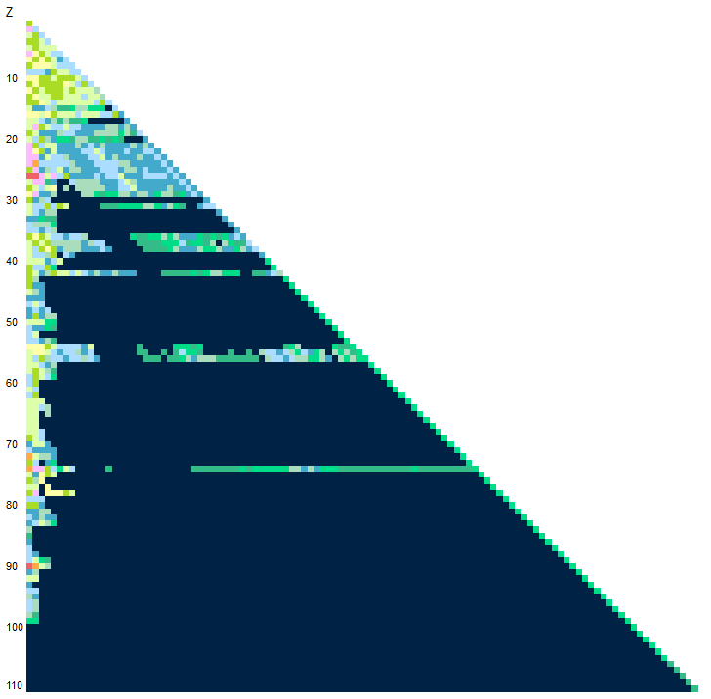
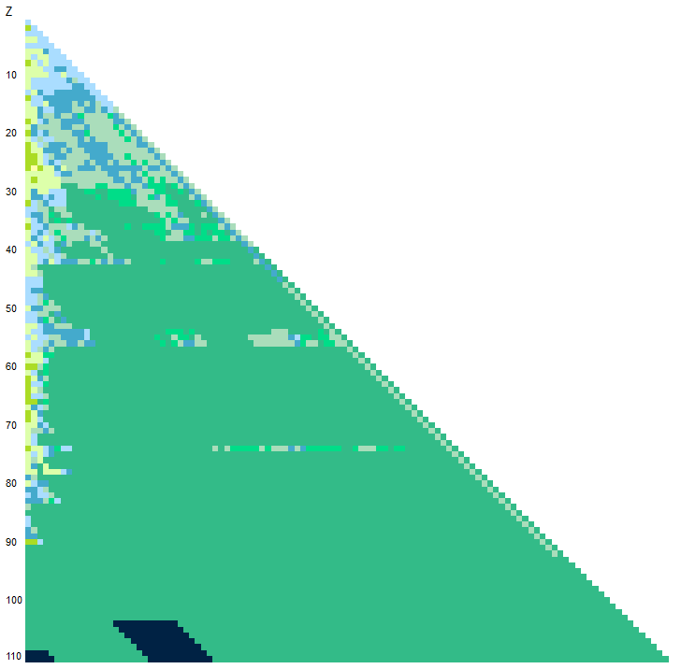
ASD v.5.11 (Dec 2023)
https://physics.nist.gov/asd
Lines: 297,381
Probabilities: 128,322
Levels: 119,081
Mo
Nuclear charge
W
Ion charge

