Slide 1

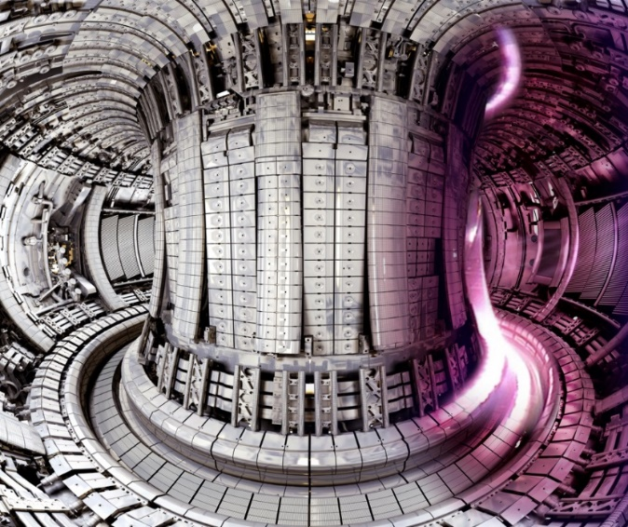
Plasma-Wall Interactions
in all-Metall Fusion Devices
- the W erosion quest
Sebastijan Brezinsek and JET contributors / TSVV-7 team
Institute of Fusion Energy and Nuclear Waste Management - Plasma Physics
Forschungszentrum Jülich
Faculty of Mathematics and Natural Sciences
Heinrich Heine University Düsseldorf
JET

Slide 2




25 years of PWI fusion research in a nutshell (my view)
The dream is to get plasma-facing components based on an element „TOKAMAKIUM“:
no sputtering, no fuel retention, neutron resistant, good thermomechanical properties, …
The dream is a plasma „T-MODE“ with perfect confinement:
no plasma-wall interaction, no CX-wall interaction, highly radiative in the divertor, …
=> Both doesn‘t exist as such and we need to find a compromise (now)
Novel components on basis of W under qualification and close to the material needs.
Plasma solutions on basis of radiative x-point or mantle are close to the plasma needs.
Boronisation used as „fix“ to overcome issues with W if O present
Note, some plasma properties are masked by the low-Z impurities

Slide 3
Plasma-Surface Interaction Processes
Divertor und SOL plasma conditions:
T_{e}=1-100 eV
n_{e}=5x10¹⁷-1x10²¹m⁻³

Slide 4
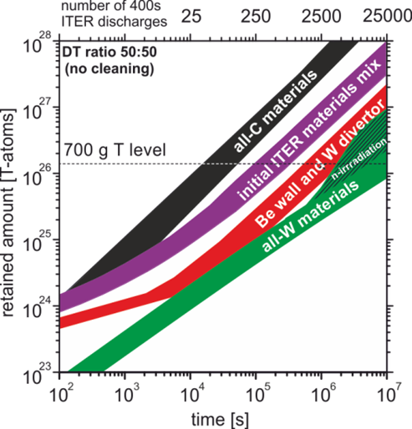
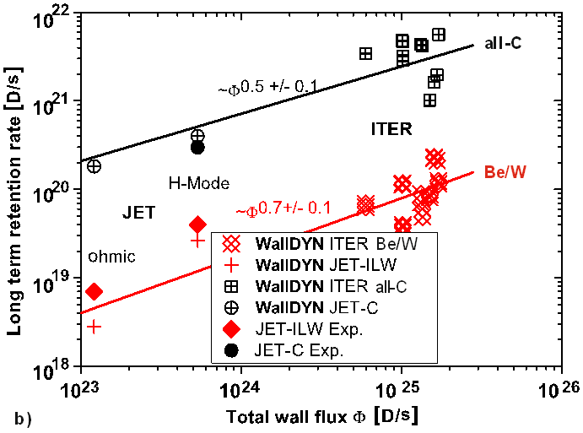
ITER PFC selection history and Tungsten PFCs
Fuel retention predictions for ITER
by the EU Task Force PWI in 2009
Demonstration in JET: from
C to Be+W retention drops
and predictions for ITER OK
Be damage due to disruptions in JET,
ITER construction delays and new
W results from ASDEX Upgrade, etc.:
=> full-W ITER PFCs from day 1
better reactor proxy
recover part of delay
early physics exploitation
use of B as O getter
R.A Pitts PSI 2024
New issue to be addressed:
Can Q=10 be achieved with W?
What is the tolerable W wall source?
How to deal with the B as “fix”?
~1 year full DT
operation
J. Roth et al.
J. Nucl. Mat. 2009
K. Schmid et al.
J. Nucl. Mater. 2015
S. Brezinsek
Nucl. Fus. 2013

Slide 5
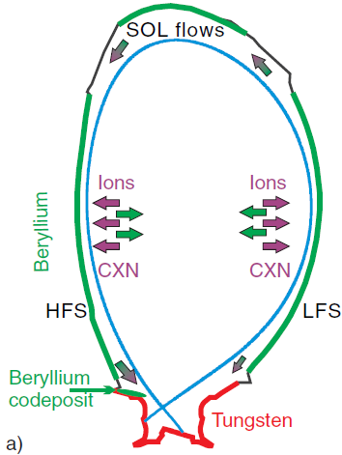
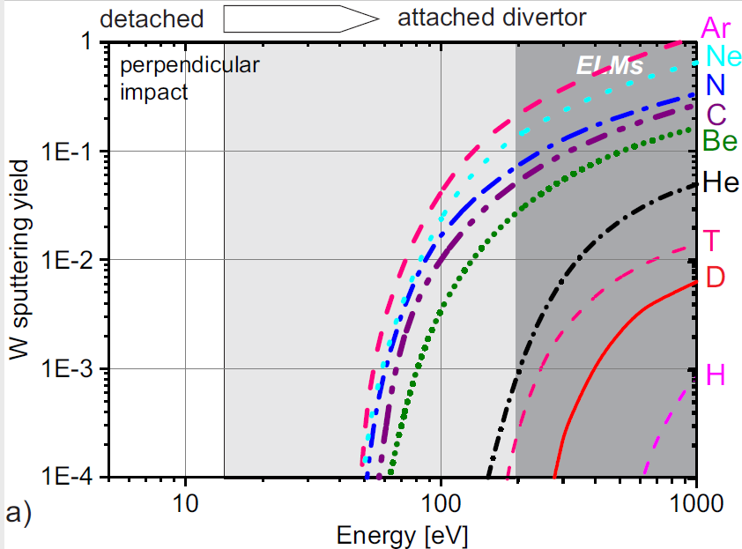
Physical Sputtering of W
Binary-collision approximation with perpendicular impact of mono-energetic projectiles (SD-TRIM)
JET
W sputtering by intrinsic (Be, C) or seeding impurities (Ne, Ar, N) above threshold energy E_{th}
Noticeable sputtering by D⁺ above E_{in}~250eV
Be sources and
migration in JET
Dominant in JET-ILW: Be ions ~ 0.5-1.5%
S. Brezinsek et al.
NF 2015

Slide 6
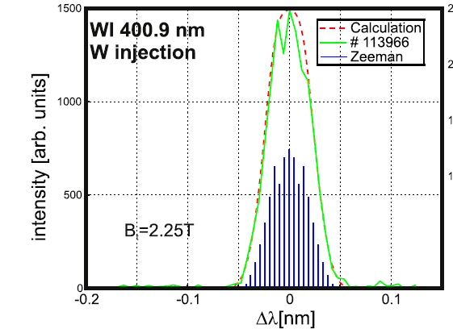
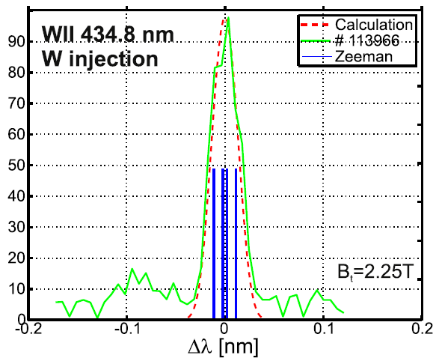
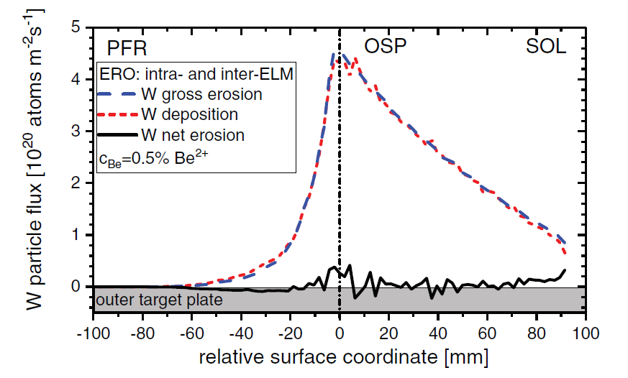
Source: gross and net erosion of tungsten
Be⁺
⊗ B
r_{L}
W⁺
r_{L}
λ_{ion}
Be⁰
W⁰
λ_{ion}
wall element
Larmor radius: r_{L} = M·v⊥/q·B
Ionisation length: λ_{ion} = v⊥/<σv>_{ion}·n_{e}
ρ_{prompt} = λ_{ion}/r_{L}
Prompt re-deposition of W if r_{prompt} < 1
Results in LOW net erosion for W if r_{prompt} < 1
Spectroscopy measures gross W erosion via WI emission
WI to WII spectroscopy can provide the redeposition factor
Post-mortem analysis measures integrated net W erosion
ERO-Modelling can disentangle gross and net erosion
S. Brezinsek et al.,
Nucl. Fus. 2019
A. Kirschner et al.
Notes:
Tierry

Slide 7
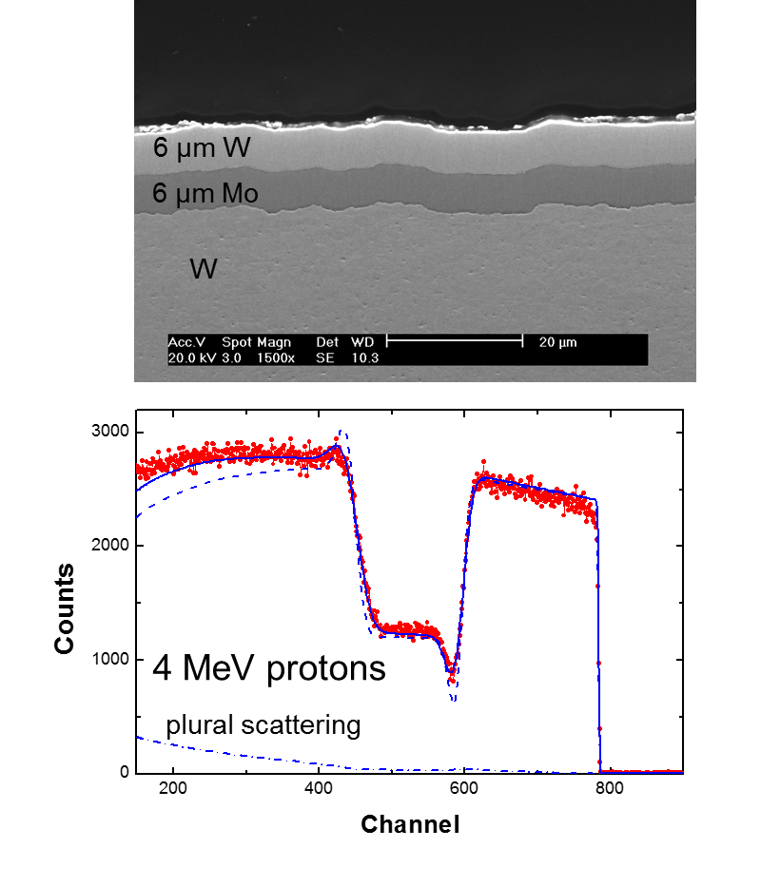
Gross and Net Erosion of W
Optical Emission Spectroscopy (WI):
gross erosion of W [in situ]
Post-Mortem Analysis Techniques:
net erosion of W [ex situ]
edge plasma
Marker Coating Technique
used for dedicated PFCs
IoniSation
Branching Ratio
EXcitation
Erosion Yield
W II
'
h
ν
S
B '
*
+
W⁺
W⁺
X'
B_{t}
W I
W I
S
RBS
h
ν
B
W
*
W
W bulk
W
Mo
re-deposition
Z
X
Imp
H,D,T
Y
M. Mayer et al.
NME 2017
W PFC
Difference provides local W balance: eroded, re-deposited, and transported away
Erosion of W is in general low => enough fluence to compare both methods required

Slide 8
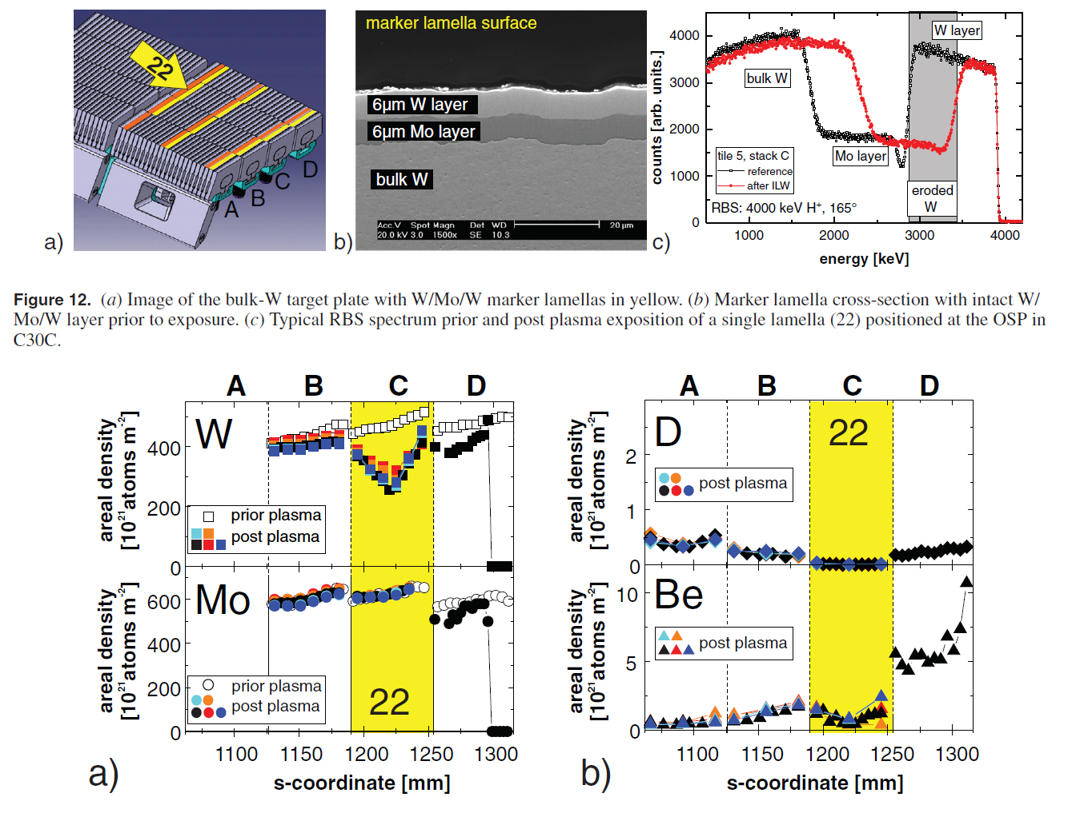
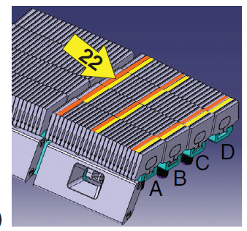
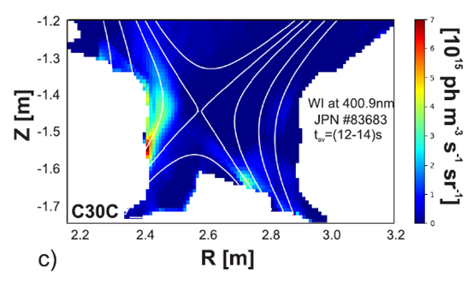
Gross and Net Erosion of Tungsten in JET
Net W erosion at OSP measured [M. Mayer JNM 2017]
~1.5µm at OSP in 900s H-mode phase (C30C)
Net W erosion: 2.4-4.8 g (RBS and marker tiles)
Gross W erosion: 40-60 g (WI spectroscopy)
W prompt re-deposition fraction: >95%
ERO confirms very high W re-deposition: > 98%
S. Brezinsek et al.
Nucl. Fus. 2019
M. Mayer et al.
Very effective “screening” of gross eroded W

Slide 9
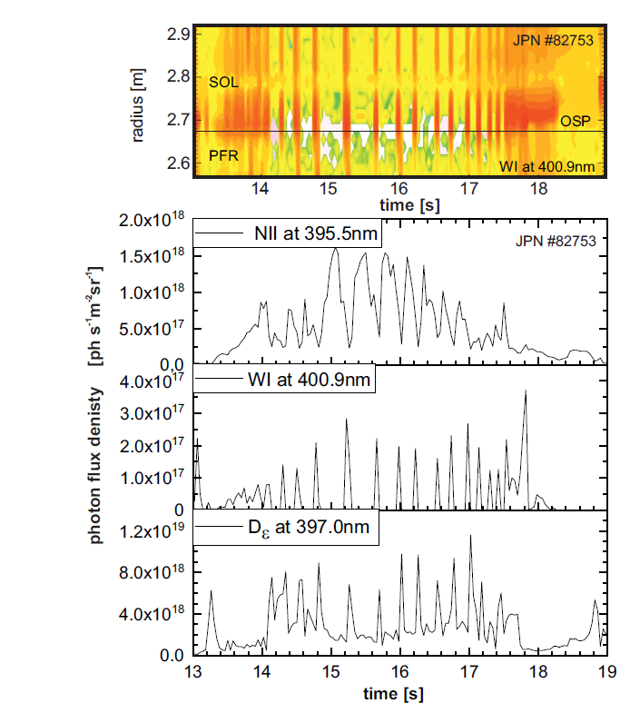
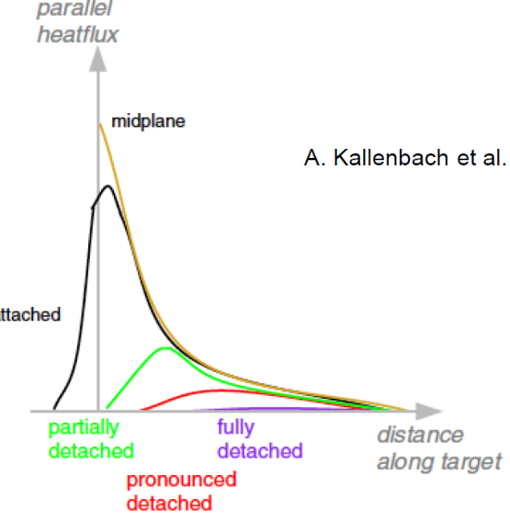
ELM-induced W Sputtering in Detached Conditions
ELM
Inter-ELM W source can be eliminated
when divertor is semi-detached and impact
energies below the threshold for impurities
Intra-ELM W source can burn through the
cushion of hydrogen and seeding neutrals
Partial detachment required
ELM suppression required
Spectroscopy often used
for W and “power”
control => T_{e} sensitivity

Slide 10
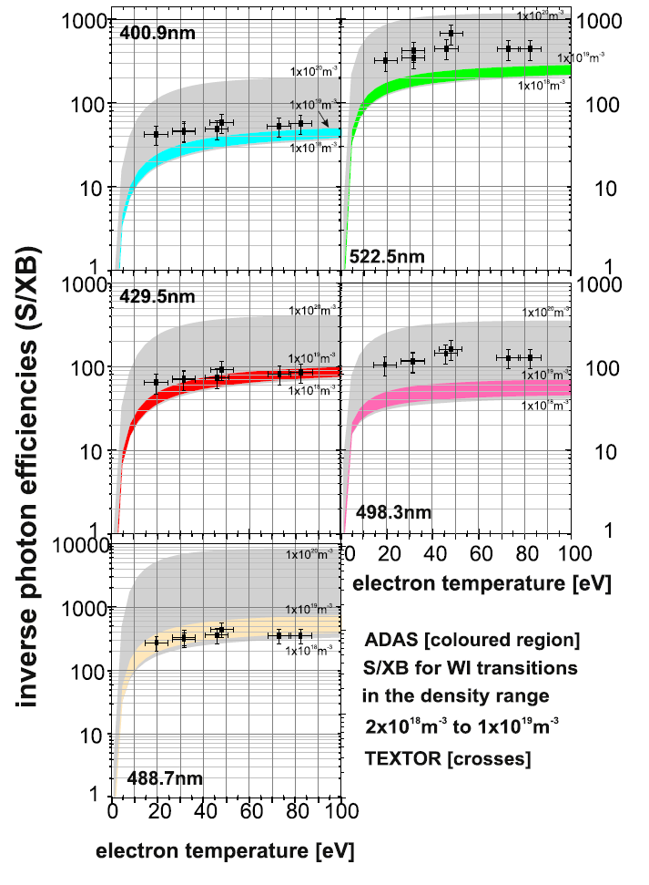
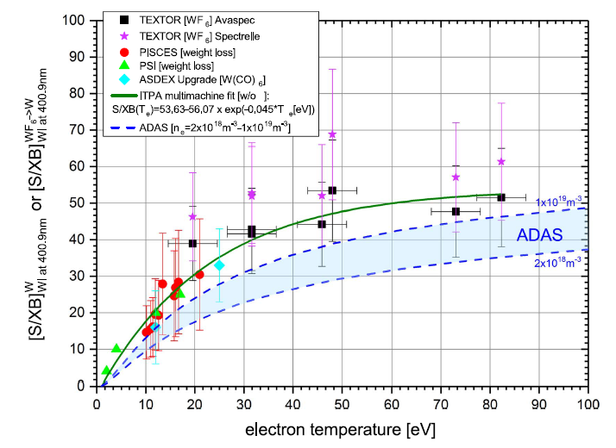
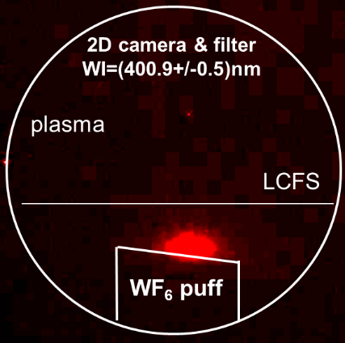
Photon Effciencies: Experiment and ADAS
Experimental data is “effective” assuming WF₆ dissociation is complete
Experimental data in general in good agreement with ADAS (lower)
Largest deviation for the “lowest” ground state transition (λ=498.3nm)
TEXTOR W calibration
SOL
S. Brezinsek et al.
Phys. Scripta 2017

Slide 11
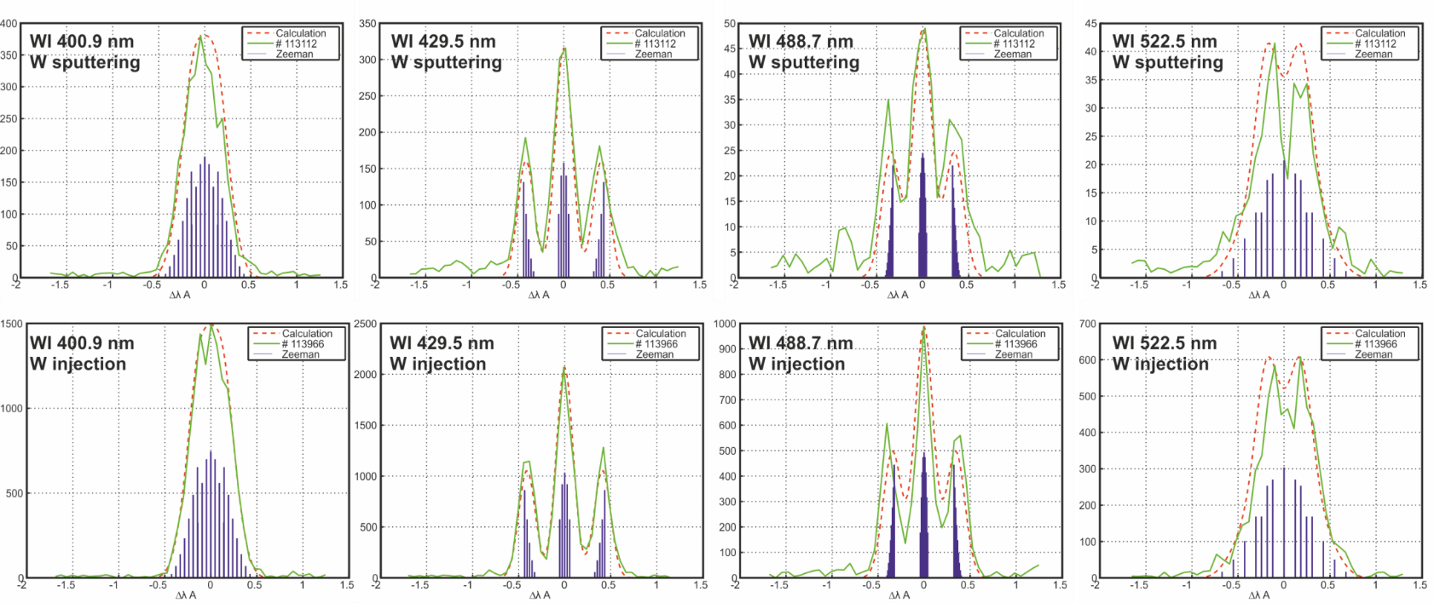
Injected W and Sputtered W: WI emission
  Calibration of W lines with WF6 injection (dissociation at about T_{e}~0.1eV)
W from WF₆ dissociation representative for W from sputtering?
  No difference in line shape of different WI and WII lines
  Lines and ratios of WI lines comparable in sputtered and injected W
  WII lines measured and quantified in WF₆ injections

Slide 12
Tungsten Migration: Erosion, Transport, and Deposition
W migration
erosion
transport
deposition
very short range
e.g. within
one gyration
W erosion
W transport
short range
e.g. within
divertor leg
W depostion
long range
e.g. divertor
to main chamber
W „graveyard“
Local balance equation => net erosion = gross erosion – deposition
Large Larmor radius for W⁺ => competes with ionisation length => prompt re-deposition
Surface roughness increases the re-deposition probability => reduces net erosion

Slide 13
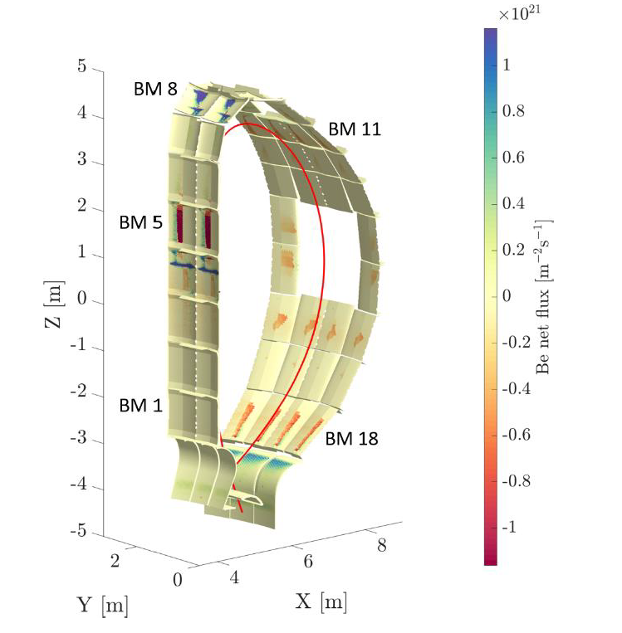
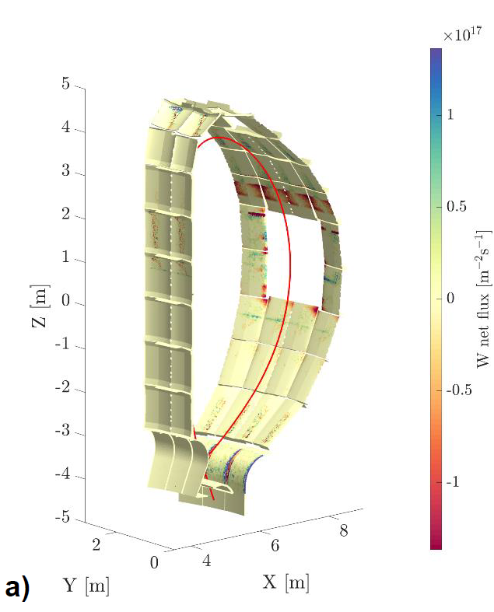
What would be different in a full-W ITER?
Exchange Be by W in ERO2.0 and keep the semi-detached Q=10 scenario*
x10²¹
x10¹⁷
A “full-W ITER” would provide:
Low first wall W erosion
Low T co-deposition with W
Residual T retention by implantation in the wall
Increase of T retention with neutron damage in FPO-2
Require boronisation in case
of high O content (e.g. start-up)
What is the tolerable W wall source and W influx to the plasma?
A. Eksaeva et al.
NME 2022
Net erosion of the first wall is drastically reduced by about 4 orders of magnitude for the peak erosion
Residual sputtering caused mainly by impurity ions, 0.5% Ne ions (used to seed), and energetic CX HI

Slide 14
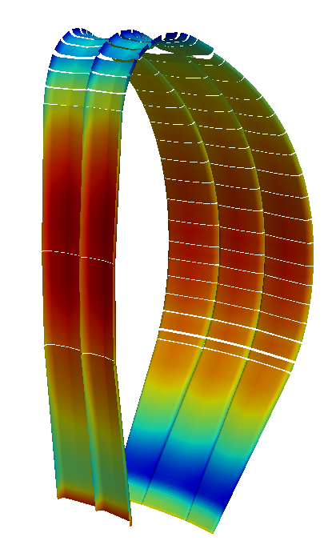
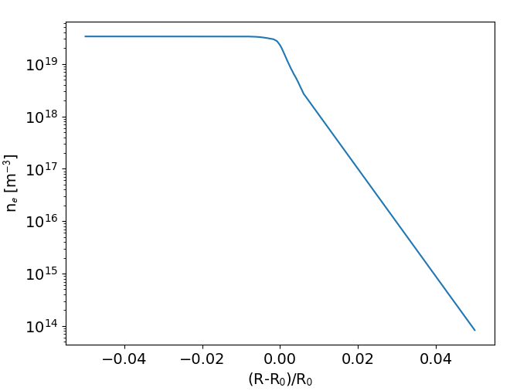
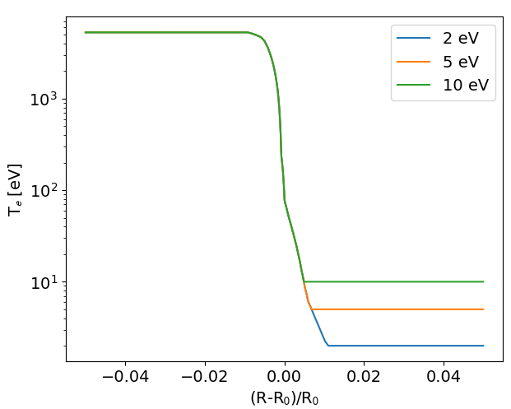
DEMO: Plasma Extrapolations up to the first wall
SOLPS-ITER plasma solution for H-mode with Ar seeding and detached divertor => F. Subba NF et al.
Scan in temperature to the wall to investigate threshold effects
10¹⁸
electon density [m⁻³]
w
a
l
l
plasma
10¹⁰
Extrapolation of the plasma up to the first wall and 3D contour
Exponential decay
2eV beyond Ar ion threshold
5eV at Ar ion threshold
10eV ITER assumption

Slide 15
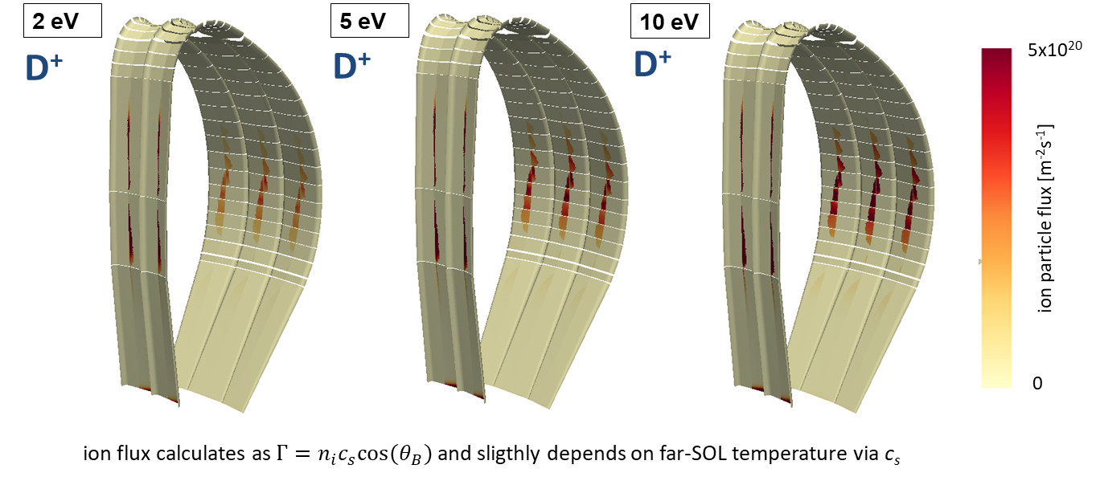
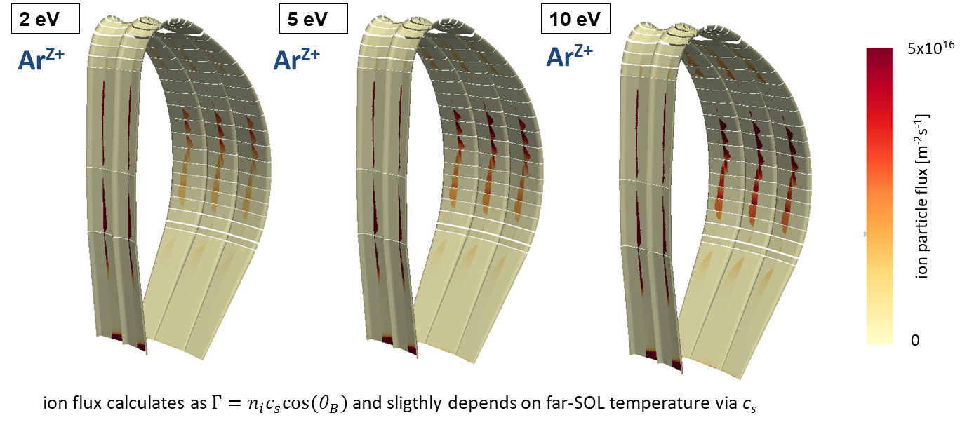
DEMO: Fluxes to the W wall
All ionisation stages of Ar ions spatially resolved included
C. Baumann et al.

Slide 16
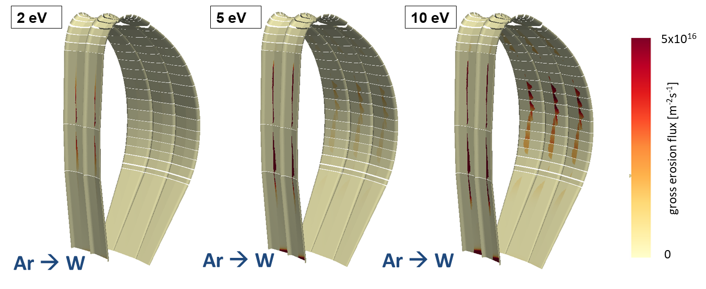
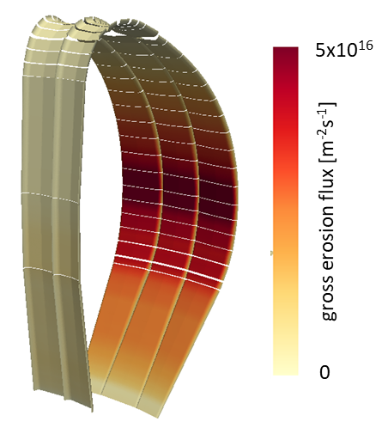
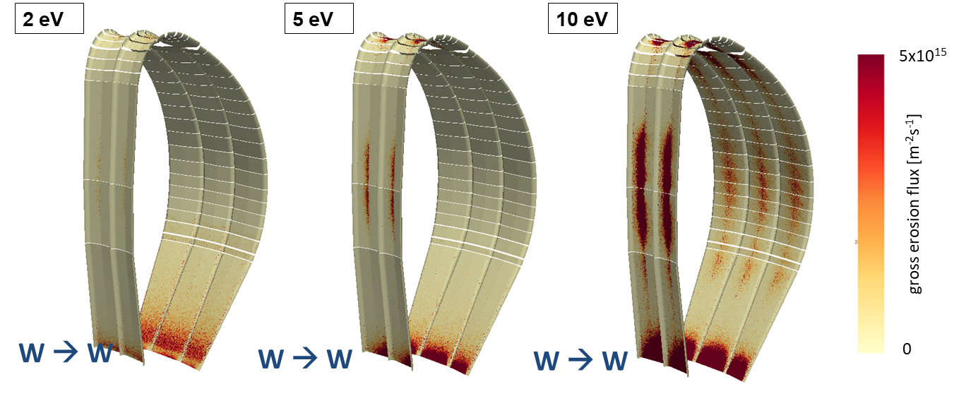

W sputtering sources by impinging ions and CX atoms
No W sputtering by residual D ions
as below W sputtering threshold and low residual flux
Here: strong CX induced W sputtering
=> CXN from EIRENE post-processing
ERO2.0
C. Baumann et al.

Slide 17
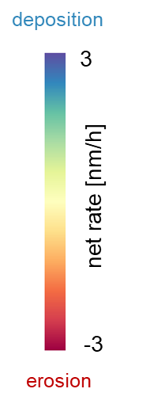
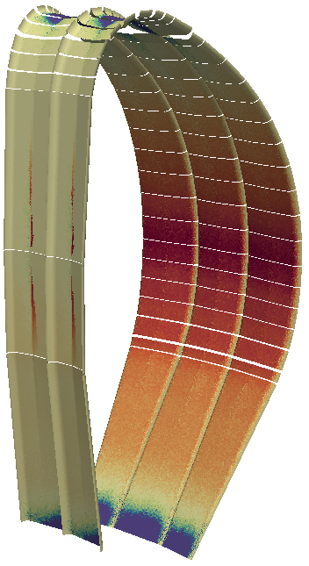
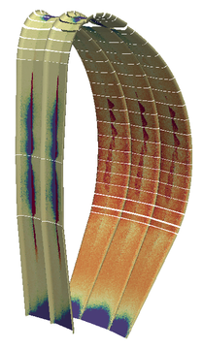
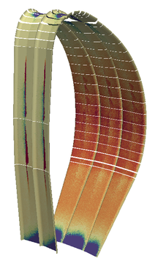
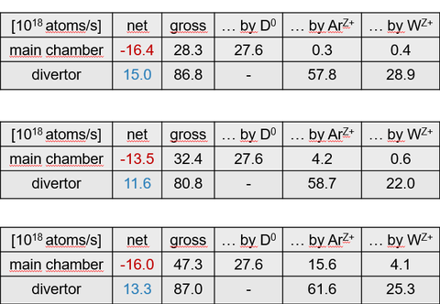
Net W sputtering pattern for a DEMO run with ERO2.0
2 eV
Very sensitive on input plasma parameters at recessed areas!
10 eV
5 eV
Waiting for SOLPS-ITER wide-grid plasmas with full-W and Ne seeding for ITER
Provide W influx to ITER from the first wall is next!
C. Baumann et al.
c.baumann@fz-juelich.de

Slide 18
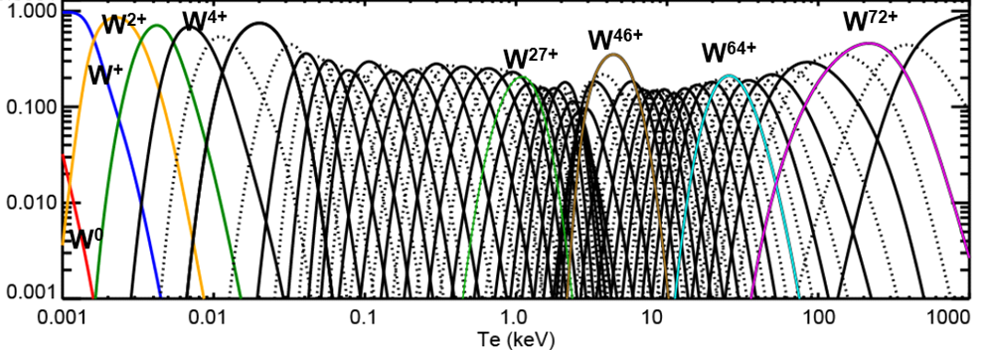
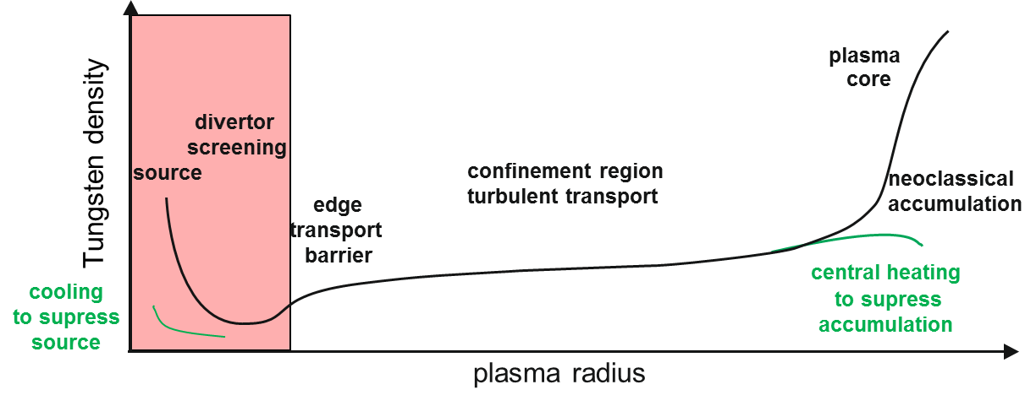
The Challenge with W Transport and Spectroscopy
divertor
edge
core
T. Pütterich PPCF 2008
Benchmark of workflow in full-W ASDEX
Upgrade with improved diagnostic set in W without BORONISATION would be useful to validate ERO2.0
simulations for ITER!
This includes also spectroscopy of higher
W ionisation stages
(WII..W IX)
to be simulated in ERO2.0.
fractional abundance
Fractional abundance as function of T_{e} or R => not fully ionized in core
Structure complex => multiple approaches to simulate and model W
AUG and JET used as test bed / provision of atomic data for W / EBIT
Extrapolation to ITER conditions challenging (T_{e} range)

Slide 20
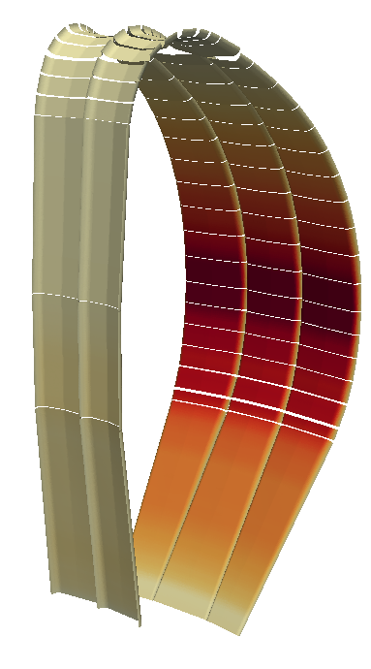
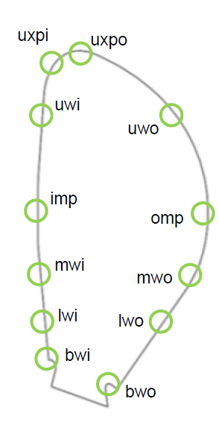
Gross erosion rate …
D⁰ → W
5x10¹⁶
rate is the same for all cases
peak flux at OMP is 5.41x10¹⁶ m⁻²s⁻¹
calculated using 12 spectra provided by Sven
(green locations) → each spectra gives us an
effective yield at this location
for surface cell not directly connected to a spectrum,
interpolation with the two closest effective yields will
be done based on distance to these locations
gross erosion flux [m⁻²s⁻¹]
0

Slide 21
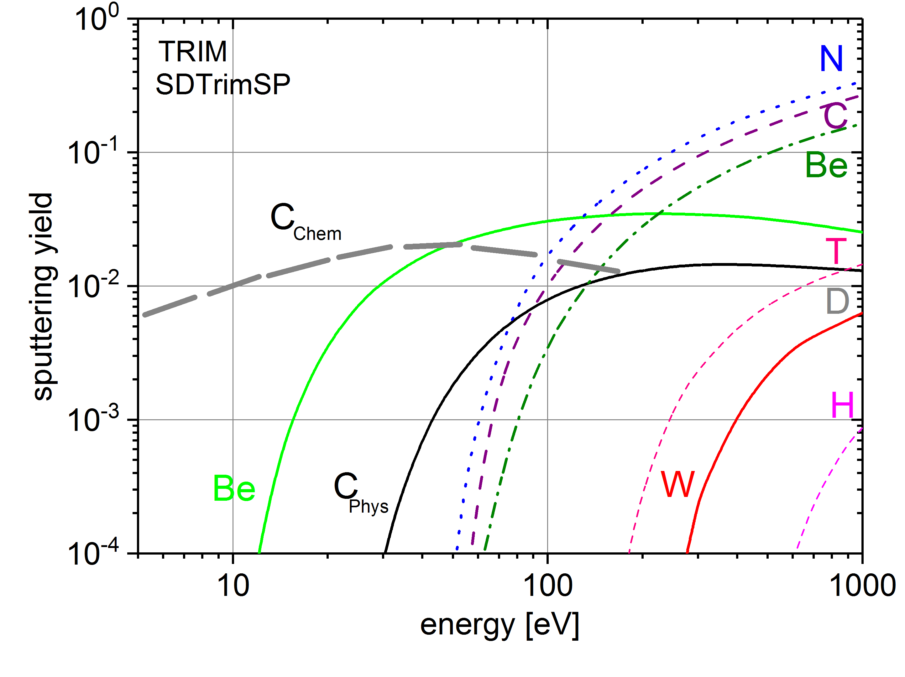
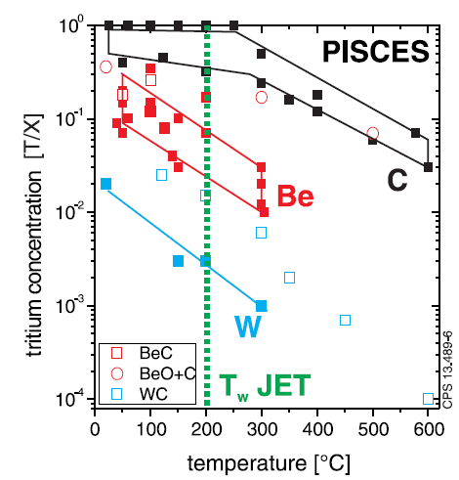
Selection of Plasma-Facing Materials: Low or High-Z?
Steady-state plasmas operation for a DT plasmas in a reactor class device
Lifetime and safety
Core plasma compatibility
Tritium cycle and safety
Low-Z: strong wall erosion;
for C due to chemical erosion
High-Z: low erosion;
for W mainly induced by impurities
Main fuel retention process
for C and Be: co-deposition
W: implantation only
Low-Z: limited by dilution
High-Z: limited by radiation

Slide 22
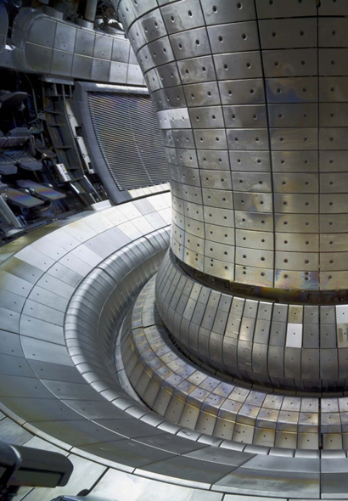
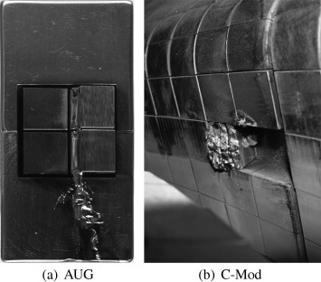
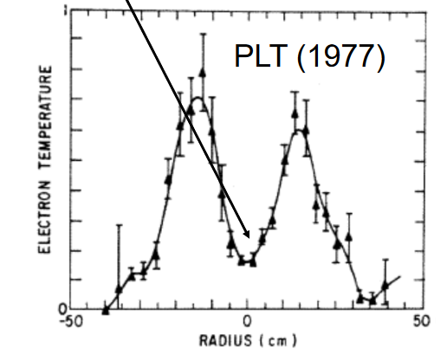
Challenges in the use of Tungsten Walls
Need to adapt scenario and ensure impurity control / wall conditions
J. W. Coenen et al., J. Nucl. Mater. 2013
Cooling of plasma
core can occur and “switch off” the hot plasma!
Melting of high-Z metals
can occur and cause
stop of plasma operation!
V. Arunasalam et al., EPS 1978
ASDEX Upgrade
Experience to operate successful with W gained in ASDEX Upgrade, JET, WEST: review JET+AUG: R. Neu et al. IEEE Trans Plasmas 2013

Slide 23
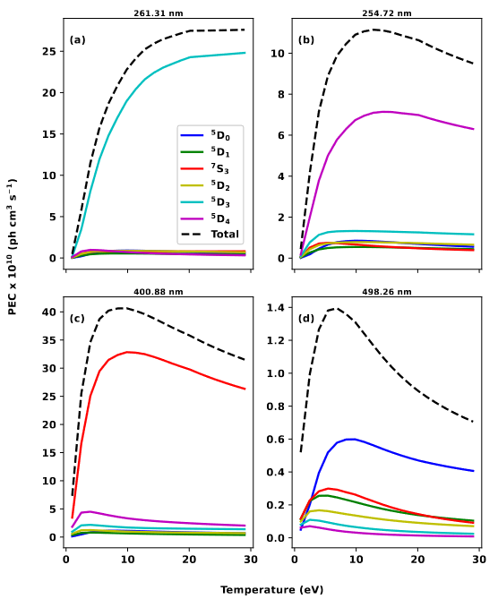
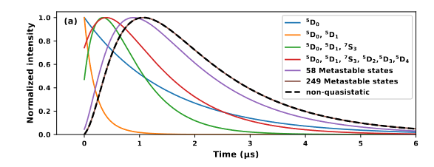
Large challenge: ground state population of W
Role of metastables in the population of most prominent lines
relevant (see also A. Eksaeva 2017)
Different experiments under evaluation and cross-CRM
benchmark ongoing and revisited
New experiments in PSI-2 with LIF to measure
direct the W ground state in preparatio
Thesis Curtis 2020
Auburn CRM

Slide 24
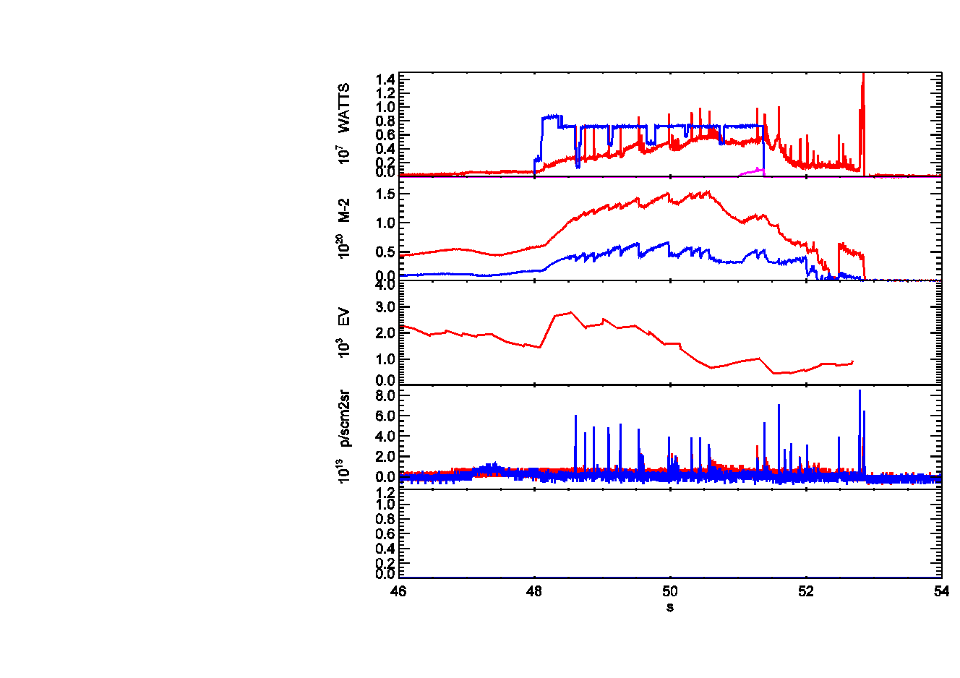
What can get wrong? Microscopic W particle influx
W accumulation occurs when ELM frequency / gas is too low
Single W particles are also a problem
81578
81765
P_{NBI}
P_{ICRH}
P_{rad}
n_e^{line}_{centre}
n_e^{line}_{edge}
ELM frequence too low
W peaking
Sawteeth die out
W accumulation
Temperature collapse
T_{max}
hollow T_{e} profile
hollow T_{e} profile
Be II in. divertor_{I}
Be II out. div.
H98y
FGDL
G. F. Matthews et al.
Plasma performance lost, but discharge survives often (L-mode transport)
If W event too large => disruption => disruption avoidance or mitigation system mandatory
B. Sieglin et al., FED 2020 / L. Baylor et al., Nucl. Fus. 2019

Slide 25
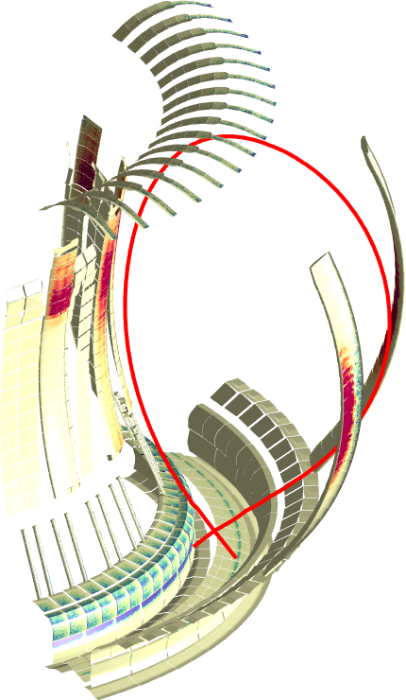
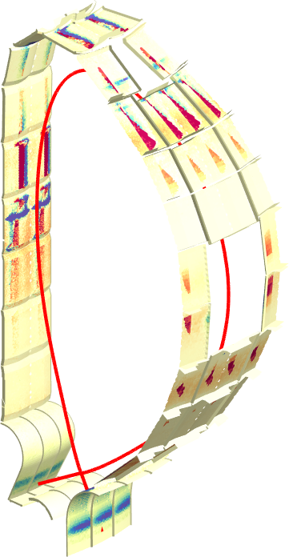
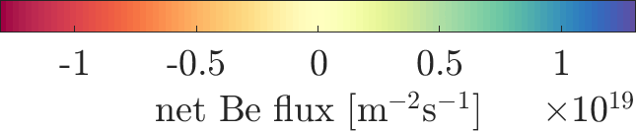
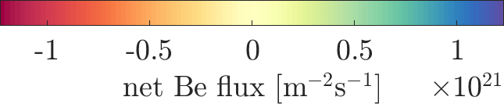
From JET to ITER with the ERO2.0 code
JET
ITER
case with zero SOL flow
Be deposition on inner divertor apron
4 m
8 m
Be deposition: main
chamber: 18%
divertor: 58%
“gaps”: 24%
Be deposition: main
chamber: 90%
divertor: 10%
“gaps”: <1%
J. Romazanov PSI2020

Slide 26
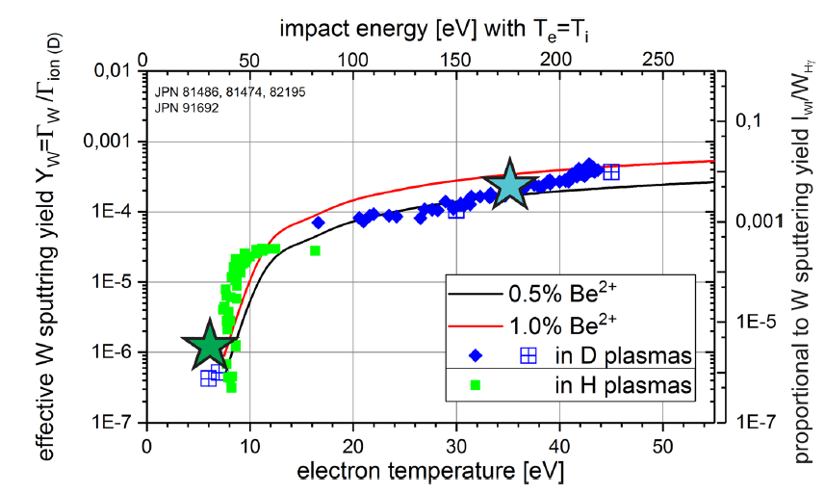


W source: physical sputtering of W in JET with ILW
Gross sputtering yield of W from spectroscopy
Increasing seeding by N
S. Brezinsek et al.,
Nucl. Fus. 2019
detached
G. van Rooij et al.,
J. Nucl. Mater. 2013
detached
L. Aho-Mantilla et al.
J. Nucl. Mater. 2013
W sputtering by intrinsic (Be) or seeding impurities (Ne, Ar, N) when above threshold energy E_{th}
Operation in detached divertor inhibits W sputtering
(cold divertor plasmas with T_{e}<8 eV)
All measured on bulk W tiles with low surface roughness!

Slide 27



JET: Intra-ELM W sputtering
Critical measure: pedestal
temperature before/after collapse
Fuel ions and impurity ions “ballistic” when hitting
the target plate (<0.5ms) – no time to fully
thermalize => very high impact energy (keV)
(free streaming model: C. Guillemaut et al.)
n_{e}
S. Brezinsek
NF2019
W sputtering determined by impact of ionic species: fuel ions dominates at <1% Be incident flux
If seeding species present in pedestal, they can dominate…

Slide 28


ELM flushing operation window in H-mode plasmas
Gas injection is changing ELM frequency and W inter- and intra-ELM source
N. den Harder et al.
Nucl. Fus. 2016
S. Brezinsek et al.
Nucl. Fus. 2019
Increase of W source in ELMy H-mode up to max frequency of ~60Hz in JET
Reduction of W source at higher frequencies / type III ELMs?
Indication of W-flushing or increased transport at ELM frequencies above 40Hz

Slide 29

Comparing JET-ILW and ITER Conditions
JET-ILW – a test bed for ITER and its operational phases
 | JET-ILW (D/C30C) | ITER (DT baseline) | ITER (H PFPO-1)
Plasma time (H-mode) | 900 s | 400 s | 200 s
Number of pulses | 151 | 1 | 1
Input power | 12 MW | 150 MW | 20 MW
Energy input | 7.2 GJ | 60 GJ | 4 GJ
Divertor ion fluence | ~2.0x10²⁶ D/m² | ~2.5x10²⁷ D/m² | ~2x10²⁶ D/m²
Divertor ion flux | ~2.2x10²³ D/sm² | ~6.3x10²³ D/sm² | ~1x10²³ D/sm²
Wetted area | ~1 m² | ~2.5 m² | ~2.5 m²
ELM frequency | 30 Hz | ~30 Hz (pacing) | -/tbe
Number of ELMs | 30 000 | 12 000 | -/tbe
comparable in plasma-wall interactions physics
comparable in scrape-off layer and exhaust plasma physics
Deduced from SOLPS calculations
S. Wiesen et al. J. Nucl. Mat. 2015
A. Kukushkin et al. Fusion Eng. Des 2011

Slide 30


Quasi-steady-state Conditions in JET-ILW
“footprint” of JET-ILW in H-mode plasmas
Global material erosion/deposition pattern
Global fuel retention studies
Comparison in-situ and ex-situ analysis
IR
top
view
Campaign 30C – quasi-steady-state conditions:
High reproducibility of discharges (#151)
H-mode plasmas with static divertor strike-line
  attached outer divertor (T_{e}~35eV)
  semi-detached inner divertor (T_{e}~7eV)
f_{ELM}=30Hz, ΔW_{ELM}=160KJ, 30 000 ELMs
Low disruption rate (<3%)
T_{surface} [°C]
toroidal direction
S. Brezinsek NF2013, K. Schmid NF2014, S. Wiesen NME2017
J. Romazanov NME 2019, J. Denis NME 2019
plasma duration
For comparison - first year operation:
105 000 ELMs during H-mode
12 h in divertor configuration
target coordinate [mm]
16.07.2024

Slide 31


Intra- and Inter-ELM Sputtering of W: semi-detached leg
Left: ELM-induced W sputtering
ERO-modelling (MC+impurity transport) coupled with PIC simulation of ELM events (1keV, 500ms) reproduces the W sputtering by burn-through in otherwise detached conditions (A. Kirschner et al.)
95%-98% of W is locally re-deposited in the model => agrees well with experiment

Slide 32


Rough vs. Smooth W Surface: AUG Experiment
ASDEX Upgrade Standard L-mode plasma
Net erosion at OSP by impurity ions (C, N, O)
Net deposition in SOL close to OSP in case of nominal/rough surface
No deposition in SOL in case of smooth surface
20-30 nm W layer
on graphite with
different roughness:
smooth: R_{a}~0.3 μm
nominal: R_{a}~1.0µm
rough: R_{a}~4.0µm
A. Lahtinen EPS 2017
Same plasma: W surface can vary between NET erosion and NET deposition due to surface roughness
Mixture of local re-deposition of eroded W and
W flux from main chamber responsible

Slide 33

Tungsten Hydride: : ⁶Π-⁶Σ⁺ Transition
Observation of WD molecule at very high D⁺ fluxes (10²³ions s⁻¹m⁻²) on cold W surfaces (<600K)
Chemically Assisted Physical Sputtering by C ions
with sufficient high impact energy (~100eV)
S. Brezinsek NME 2019
33

Slide 34




Tungsten Hydride: : ⁶Π-⁶Σ⁺ Transition
AUG
Not produced in plasma
as WF₆ injection in D plasma
Intensity [arb. units]
Observed in ASDEX Upgrade
and produced during ELMs
too (D⁺ ions at high energy)
λ [nm]
Intensity [arb. units]
Looking forward to see a
molecular modelling….
S. Brezinsek PSI 2018
34

Slide 35



Tungsten hydride (isotopologues)
E_{th}
T_{e} at OSP
continuum
KT3C WT at R~2.7m
#100109
SOL
Intensity [arb. units]
Radius [tracks]
KT3C
WT Q
PFR
time [s]
Molecular release via WX with X=H,D,T
E_{th}
continuum
KT3C WH at R~2.7m
#98386
Additional channel for W erosion
Vanishes at low T_{e} => E_{th} identified
Quantification ongoing, but “very low” in comparison to PS
WI and WX spatially shifted
SOL
Intensity [arb. units]
Radius [tracks]
WD
PFR
KT3A
WI 400.9nm
time [s]
S. Brezinsek et al.,
NME 2019
E. Pawelec et al.

