Slide 1
Data dissemination: addressing users’ feedback and needs
Marco Verpelli
Consultancy Meeting on Information Exchange on Developments and Operations of Nuclear Data Dissemination Services
Vienna, 15-19 February 2024

Slide 2
Rationale
Users’ feedback has been the major driver for the development of dissemination tools.
Here below some relevant examples

Slide 3
Requests for custom queries on Structure & Decay data
Plot A vs B(E2) strengths for transitions from first excited J^{π} 2`⁺ states to the Ground State
Plot Sn vs A for Led
Plot A vs δ for E2/M1 transitions from J^{π} 2`⁺ to 2⁺ for e-e nuclides having 60 < A <150

Slide 4
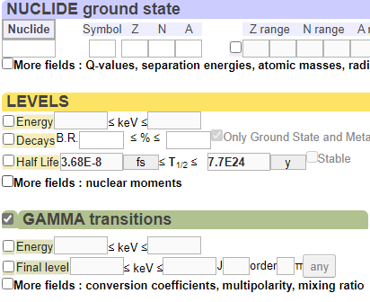
This required to parse the ENSDF into a data model easy to navigate, with an interface that translates the physics problem into a query

Slide 5
It’s not (only) the format, but the data model
This below could be a JSON-formatted ENSDF dataset
{“nuclide”:“135Xe“, “dataset”:“adopted”, “records”:
{“type”: “L“ {“start”:10, “end”:19 , “value”:70
It is JSON, but would not provide a data model, it would not make possible to query
the database without heavy programming and a deep knowledge of the ENSDF.
An example on how data model and format are entangled is the ‘ ‘ (blank) in some uncertainty fields …

Slide 6
… depending on the context in which it is placed, it can mean:
Take it from the Normalisation record at the beginning of the file
It is unknown
It is zero
As a result , the uncertainty of some reference gamma lines
in a decay is often not retrievable from the ENSDF
dissemination tools

Slide 7
Requests for mobile devices
Then we started to get requests for access from mobile devices.
The data model was dumped in a SQLite database and wrapped
in an app with graphic and query capabilities:
Now we try to design web applications that adapt their interface
to the device : TALYS World
Isotope Browser

Slide 8
Requests for API, Open Source, and Python
More and more, users are mainly interested in automated data download.
To address this need, we made available an API api_v0_notebook
There are some problems though that restrict the full machine readability of
the database. Some of them were addressed when building the RIPL
discrete levels database.
Futher problems raise when treating decay radiations: the „same“ gamma
may be present in the database with different energies and intensities…

Slide 9
… See for example :
Gamma | Start level | End level | Dataset
energy | energy | energy |
119.46 | 1082.842 | 963.358 | Adopted Sm-152
118.97 | 1082.816 | 963.363 | Decay Eu-152 to Sm-152
119.44 | 1082.88 | 963.40 | Decay Eu-152-m to Sm-152
119.5 | 1082.77 | 963.25 | Decay Pm-152 to Sm-152
This makes it difficult, for example, to overlap all decay datasets to have an overall gamma spectrum, a request we often receive

Slide 10
To have a database fully machine readable and navigable, I am testing an extension of the approach taken for RIPL, which includes the decay radiation:
NDLab 0.1
The Notebook included shows how to program in Python using this tool

