Slide 1
PIGE in NDF: implementation and round robin results
Nuno P. Barradas
nunoni@ctn.tecnico.ulisboa.pt, N.Pessoa-Barradas@iaea.org
On leave from Centro de Ciências e Tecnologias Nucleares, Instituto Superior Técnico, Universidade de Lisboa
Presently at the International Atomic Energy Agency. The views expressed do not reflect those of the IAEA or its Member States.

Slide 2
Overview
Basic principles of PIGE calculation from first principles
Implementation
Handling of stopping power
Handling of cross sections
Definition of sub-layers
NDF code
Basic data
Language etc
Input and output
IAEA intercomparison of PIGE codes
Some results
Final comments

Slide 3
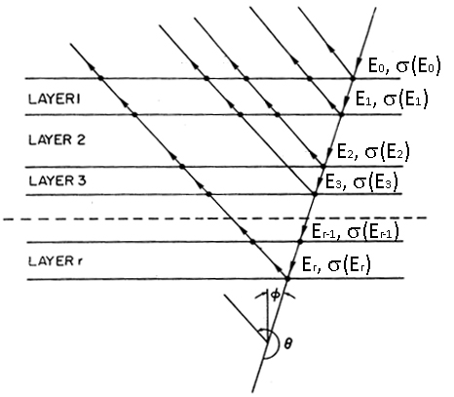
Basic principles of PIGE simulation
Divide sample into sub-layers
Calculate incident energy on each layer: energy loss
Calculate cross section on each layer: from tabulated cross section
Assume no absorption of γ rays
Integrate yield over all layers
Points to consider:
In a sub-layer, do we take the cross section on top or bottom of layer, or something else (integrate over sub-layer)?
In a sub-layer, do we calculate energy loss with the stopping power at top of the layer, or something else (integrate over sub-layer)?
Straggling can have strong effect in multilayered samples

Slide 4
Implementation: Stopping power (1)
In NDF, any combination of sources of stopping powers can be used:
Tabulated (i.e. experimental ):
For elements
For molecules (e.g. SiO₂)
Calculated:
ZBL95
ZBL2000
SRIM: used in this case
MSTAR
SRIM: called at first use of a given ion in a given element in a given energy range
Produces a file with 5000 stopping values calculated for equally spaced energy values
If same ion/element/energy range needed again, and version of SRIM did not change, then file is read
Linear interpolation made on tabulated values

Slide 5
Implementation: Stopping power (2)
In a sub-layer:
If energy loss in sub-layer smaller than ½ the energy step in internal table, take the stopping power at top of the layer
Otherwise integrate over sub-layer (3- or 5-point Simpson)
Because stopping power changes slowly, this is accurate enough, as long as sub-layer not enormously thick

Slide 6
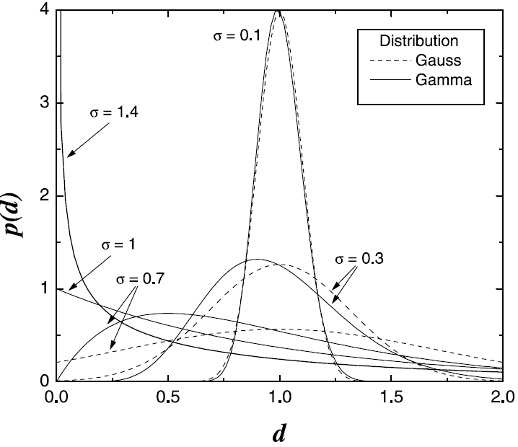
Implementation: Energy spread
In-built models: Bohr, Chu, Tschälär
WDEPTH: used to calculate Doppler (0.1 keV)
Doppler added in quadrature with FWHM
Energy spread shape: Gaussian or gamma function (inspiration from Matej’s paper on roughness)
Options taken
“Gaussian”: Bohr straggling, no Tschälär, Doppler=0.1 keV, Gaussian
“Full”: Chu+Tschälär, Doppler=0.1 keV, gamma function

Slide 7
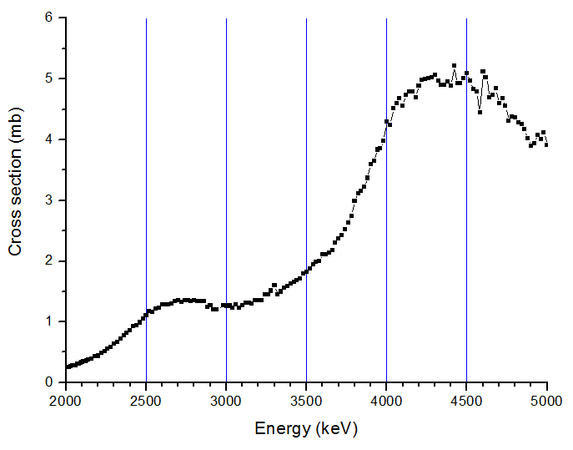
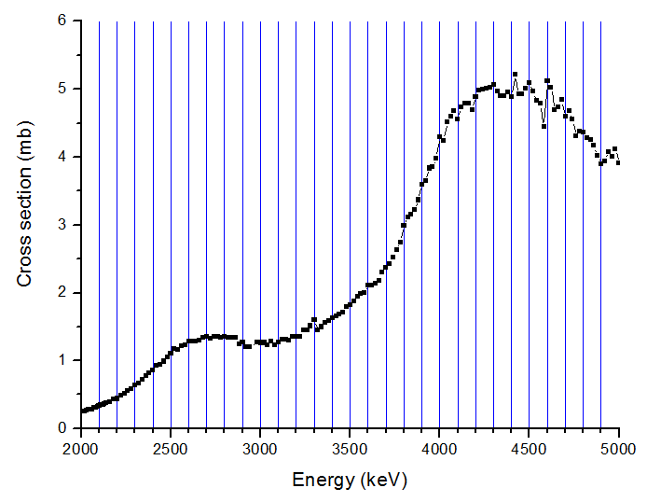
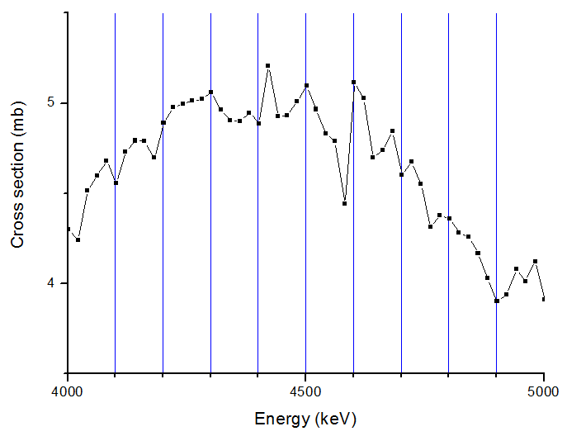
Implementation: Cross section (1)
Three issues:
Initial yield is user input
Integration within each sub-layer essential whenever cross section changes faster than sub-layer energy width
Convolution with energy spread essential in layered targets, where (real) layer energy width comparable to resonance width
NDF integrates experimental cross sections over each sub-layer

Slide 8
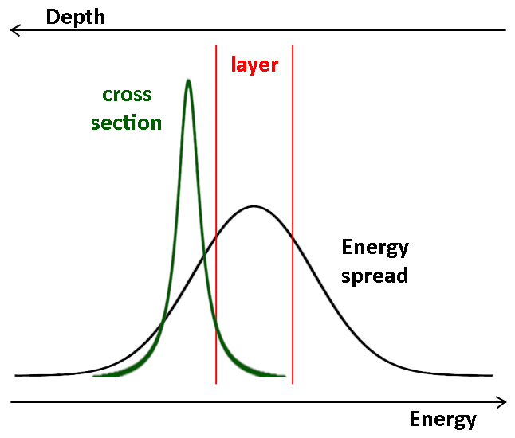
Implementation: Cross section (2)
Three issues:
Initial yield is user input
Integration within each sub-layer essential whenever cross section changes faster than sub-layer energy width
Convolution with energy spread essential in layered targets, where (real) layer energy width comparable to resonance width
Example for p-RBS:
1 μm Mylar film under a 4.2 μm Ni film
NDF integrates cross section over energy spread
Yield can change dramatically for thin layers
In bulk targets, shape can change as well

Slide 9
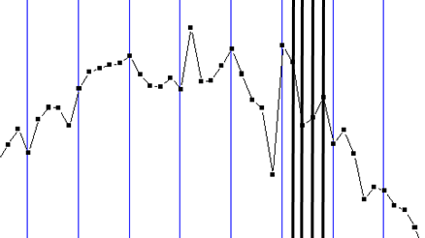
Implementation: Definition of layers
Usually following method for sub-division of layers is used:
User defines internal layer thickness for 1.5 MeV ⁴He RBS (default: 50x10¹⁵ at/cm²)
NDF scales to actual problem by scaling to stopping powers
Maximum and minimum imposed. In this case, not needed
Whenever cross section is not Rutherford (i.e. RBS and ERDA), and a file is input:
Autolayer: Create further sub-layers, by creating extra division points at all energies where a cross section value is given
In present case, little difference towards simple sub-division

Slide 10
Code: Basic data
Navogadro=6.022140857e23
pi=3.141592654
e_charge=1.6021766208e-19
e0_permitivity=8.854187817e-12
c following are in kg
p_mass=1.672621898e-27
n_mass=1.674927471e-27
e_mass=9.10938356e-31
c following is in amu
e_mass_u=5.485799090e-4
Isotopic masses and natural abundances: ²⁷Al 100%.
NDF uses single precision (compil: extended precision) except in critical routines

Slide 11
Code: Language etc
NDF is written in Fortran (insert version here: whatever is available in compiler):
Compiler: Digital/Microsoft
Possibly some very few compiler extensions are used; none on actual calculations
No libraries used
PIXE routine is in C, compiled as object with Fortran/C interface
Described in Status of IBA data analysis and simulation software, E. Rauhala et al., Nucl. Instrum. Methods Phys. Res. B244 (2006) 436-456
Took part in International Atomic Energy Agency intercomparison of Ion Beam Analysis software, N.P. Barradas et al., Nucl. Instrum. Methods Phys. Res. B262 (2007) 281-303.
Took part in International Atomic Energy Agency intercomparison of Ion Beam Analysis software, N.P. Barradas et al., Nucl. Instrum. Methods Phys. Res. B 468 (2020) 37-47
Proprietary, commercial, general purpose, in active (currently slow) development
PIGE routine partly open source, input data including stopping power and cross sections come from NDF

Slide 12
Code: Input and output
Input
(basic data)
(NDF stuff: license, config file, etc)
“Experimental” data: table of Energy/Yield
Calculation is made independently, consecutively, for each energy in table
Depth profile to be calculated
Experimental conditions
Calculation options
Output
Calculation: table with Energy/Experimental yield/Calculated yield
Result file with all calculations made, options, depth profile, etc
(assorted files with extra information, including intermediary calculations etc)

Slide 13
Intercomparison: Autolayer
Calculations for automatic further subdivision of layers at each energy given in the cross section file (autolayer)
Up to 1 part in 100000 difference. Autolayer on more stable: hence reported values used autolayer on

Slide 14
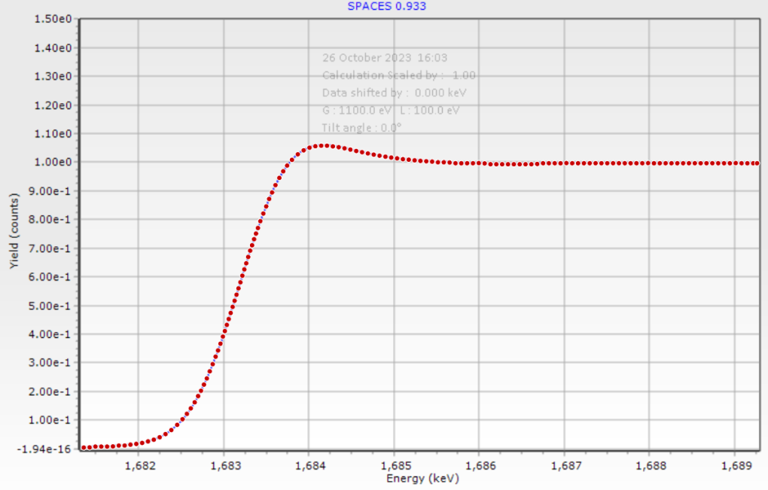
Intercomparison: NDF vs SPACES, calc 2 (1)
Used apps.automeris.io/wpd to extract numerical data. Not fully accurate (depends on manual input of 2 x and 2 y reference data points)
Normalized SPACES to NDF
It seems like NDF fairly reproduces SPACES, with a shift in the Lewis peak for 1 keV
But… let’s calculate with 50 eV steps

Slide 15
Intercomparison: NDF vs SPACES, calc 2 (2)
NDF overestimates the Lewis peak: gamma function not realistic at very small energy losses

Slide 16
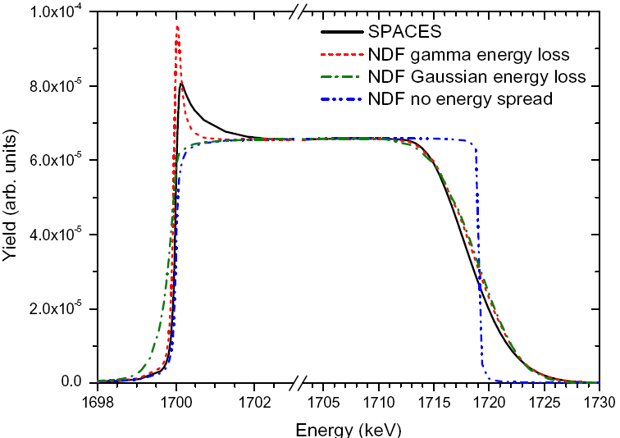
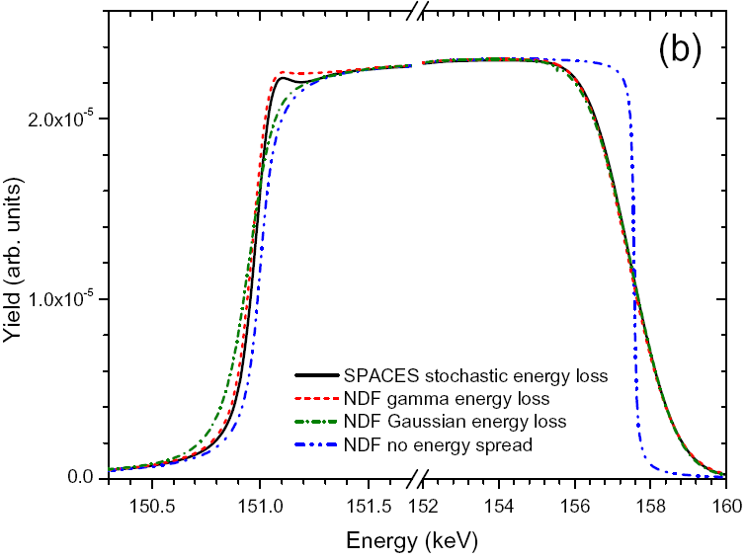
Intercomparison: NDF vs SPACES, calc 2 (3)
Not a new result! This limitation in the NDF model is already known since 2010
C: stronger straggling, lower stopping, hence much stronger Lewis effect

Slide 17
Intercomparison: calc 7 (1)
All three codes agree extremely well for Gaussian straggling
NDF significantly different for full straggling:
Curves for ERYA-Prof and SIMNRA are nearly identical with Gaussian and full straggling. This is unexpected since “Gaussian” was defined as “Bohr, no Tschälär”, while “Full” was “best model” (for NDF, Chu+Tschälär+Doppler)

Slide 18
Intercomparison: calc 7 (2)
First step: look at, for e.g. 2000 and 2040 keV beam energy:
Energy before scattering
FWHM for Gaussian (i.e. Bohr) and full (i.e. Chu+Tschälär)
(Gaussian vs. gamma does not play a role, results are nearly identical)

Slide 19
Intercomparison: calc 7 (3)

Slide 20
Intercomparison: calc 7 (4)

Slide 21
Intercomparison: calc 7 (5)
Nuno’s personal conclusions:
NDF results follow what is expected from the assumptions taken on what “Gaussian” and “full” mean.
ERYA and SIMNRA: for similar assumptions, results would seem to be wrong. Question: what were in fact the assumptions?

Slide 22
Intercomparison: Some final comments
NDF results depend for some of the calculations on the integration step: too large and they deviate.
Current integration step comes from a built-in universal parameter for all techniques in NDF: 50x10¹⁵ at/cm² for 1.5 MeV in Si ⁴He-RBS; normalized to stopping power ratio for other cases
It can be changed by the user (within the ranges 0.1 and 1000 x10¹⁵ at/cm² )
Values below 50 down to about 10 (did not try lower): stable calculation
Values above 100-200: deviations observed

Slide 23
Thank you!

