Slide 1
2024 IAEA Technical Meeting on Long Pulse Operation of Fusion Devices
14-18 October 2024 at IAEA Headquarters, Vienna, https://conferences.iaea.org/event/381/
Bring together junior and senior fusion scientists, plasma physicists and engineers in order to cover the physics and engineering issues of long-pulse operation for tokamak and stellarator facilities
Programme prepared by the IEA CICLOP (Coordination on International Challenges on Long duration Operation) group along the 4 Topics
LPO Long-Pulse and Steady-State Operation and Control
PWI Plasma Wall Interactions, Exhaust and Control
HCD Long-Pulse Heating and Current Drive
RAMI (Reliability Availability Maintainability Inspectability) and Nuclear Technologies
Session Chairs to summarise highlights of the main issues raised in particular in the context of the extrapolation towards ITER, Volumetric Neutron Source & fusion power plant
Guide discussions during the sessions, closing session on Thursday & scientific gaps
Plasma Physics and Controlled Fusion special issue https://iopscience.iop.org/collections/ppcf-240322-513

Slide 2
Special PPCF issue following the IAEA TM meeting on Long Pulse Operation
https://iopscience.iop.org/collections/ppcf-240322-513
Submission process
The collection will feature contributions from the meeting
same review process as regular articles
Authors are invited to contact one of the guest editors
Please submit via online submission form.
You should submit the appropriate article type for your submission then choose 'Special Issue Featuring Selected Papers from the 2nd IAEA Technical Meeting on Long-Pulse Operation of Fusion Devices'
Deadline for submissions 31 January 2025

Slide 3
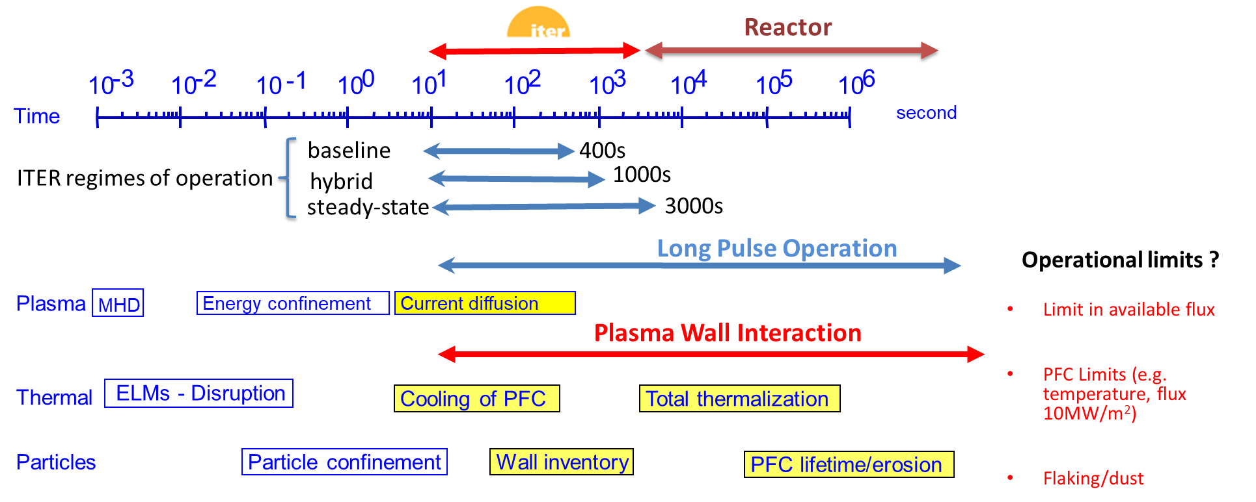
Long Pulse Operation (LPO)
Stable plasma for duration well above the plasma confinement time and approaching plasma wall integration time scales
ITER 100-400 s H-mode regime belongs to the LPO category
LPO for testing tritium breeding blanket (ITER, volumetric neutron source)

Slide 4
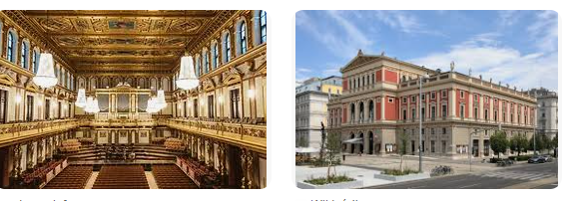
Musikverein , Wednesday 16 October 19h30 Concert Wiener Symphoniker
If you wish to join , book online
https://www.musikverein.at/spielplan/
Musikvereinspl. 1, 1010 Wien, Autriche
ENJOY THE MEETING and FRUITFUL DISCUSSIONS

Slide 6
Programme gaps towards LPO
Develop LPO at higher power/fusion performance in regimes compatible with the power handling capacity of the facility
machine/engineering (e.g. limit in energy or temperature for the PFC)
physics limits (e.g. transient events like disruption or ELMs, first-wall erosion).
Develop LPO in fully/semi-detached divertor and address PFC compatibility with the core plasma performance
Ageing of PFC materials in long-pulse detached regimes
Develop operational tools & procedures (e.g. wall conditioning, monitoring, plasma formation) ready to be transferred to ITER
Develop control methods to remain within a stable operational domain ready to be transferred to ITER
Develop LPO with burning plasmas in a nuclear facility with a large level of neutron flux and fluence

Slide 7
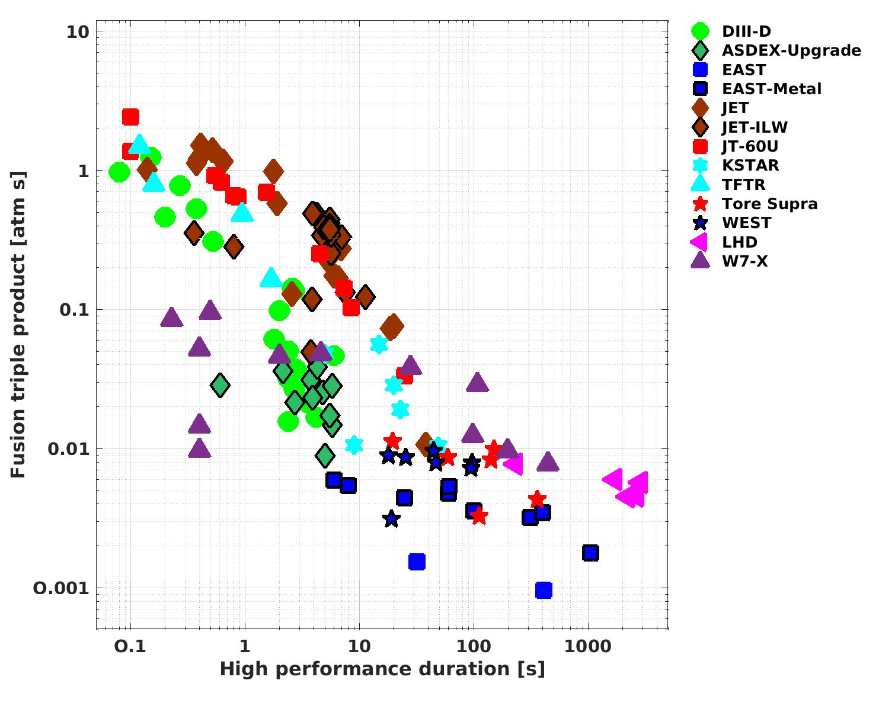
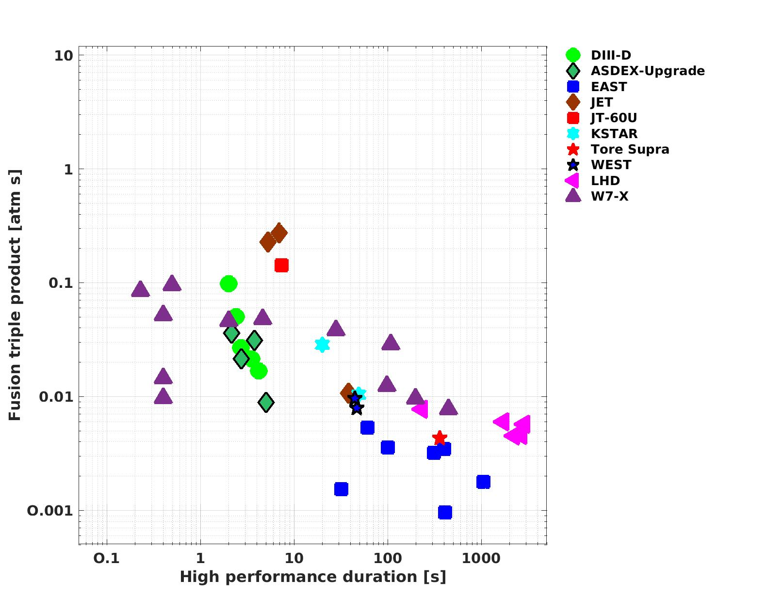
The integration challenge: reduction of fusion performance by 2 orders of magnitude when increasing duration from ~1 s to 100 s
Core ion pressure [Atm] x confinement time [s] vs high performance duration
baseline
hybrid
Non-inductive operation
SS
Facilities with LPO capability

