Slide 1
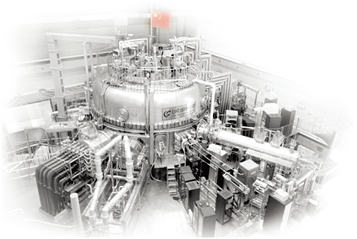

Experimental Research of EAST Start-up towards the First Plasma of ITER
by
J. Qian¹, W. Liu¹, B. Zhang¹, H. Sun², R. Chen¹, H. T Kim², R. A. Pitts³, R. Ding¹, J. Huang¹, T. Jia¹, P. Li¹ and X. Gong¹
¹Institute of Plasma Physics, Chinese Academy of Sciences, Hefei, China
²United Kingdom Atomic Energy Authority, Abingdon, United Kingdom
³ ITER Organization, Route de Vinon sur Verdon, 13115 St Paul Lez Durance, France
Presented at the
Second Technical Meeting on Long-Pulse Operation of Fusion Devices, Vienna, Austria, IAEA Headquarters
October 14-18, 2024
E-mail: jpqian@ipp.ac.cn

Slide 2
Outline
Introduction
Optimization of magnetic field configuration
Robust startup with ECW assistance
  Low-Et burn-through and Ip ramp-up in a large range of prefill gas pressure
  Tolerance to high impurity level
The dependence of prefill gas pressure on ECW power
Plasma Start-up with W Limiter on EAST

Slide 3
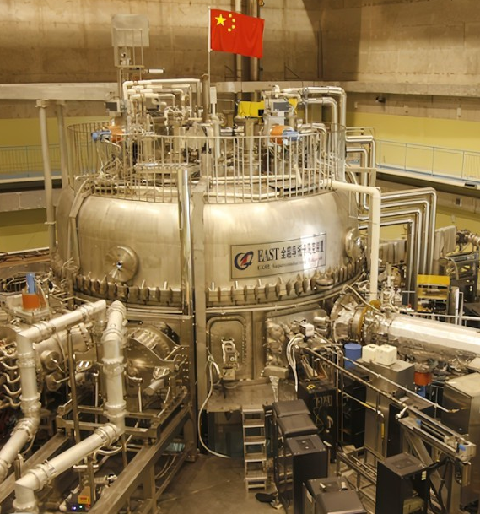
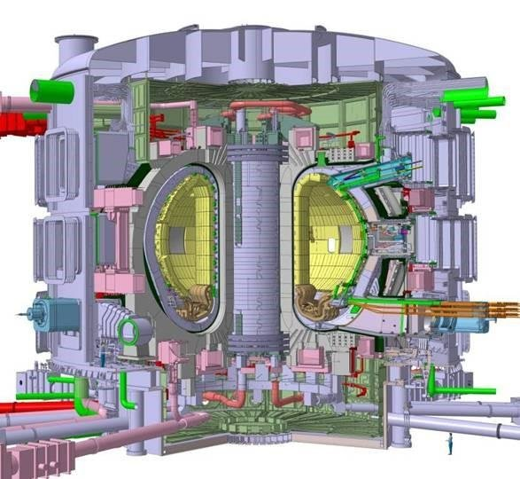
EAST: A Platform for the ECW Assisted Startup with ITER-like Features
Full superconducting magnets
Low toroidal electric field
Thick vacuum vessels
Long magnetic field penetration time
Full metal wall
Burn-through of high-Z impurities
ECW heating/current drive
Pre-ionization and startup assistance
EAST
ITER

Slide 4
Plasma Startup in EAST
Pre-ionization and assisted startup with RF is important for plasma recovery in the beginning of EAST campaign
Without any assistance of RF, one to many “short” discharges were reluctantly repeated
The study of ECW assisted plasma startup on EAST include:
  Optimization of magnetic field configuration
  Breakdown with different pre-ionization methods
  Operation domain (E_{t}, prefill gas pressure)
  Sensitivity to impurity

Slide 5
Optimized Magnetic Field Configuration
Wide Null field configuration (NFC): stray field < 5 Gs
Trapped particle configuration (TPC): mirror-like vertical field (10 – 50 Gs)
NFC TPC
4.9 kA
-0.3 kA
4.6 kA
+
=

Slide 6
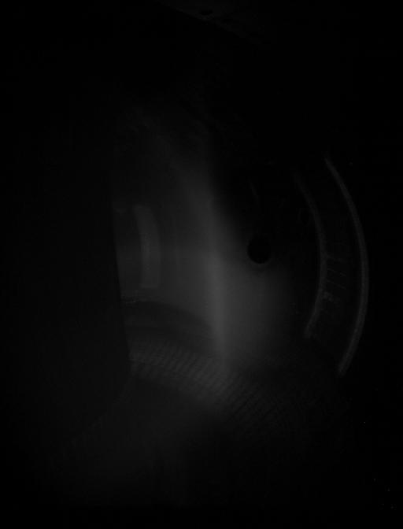
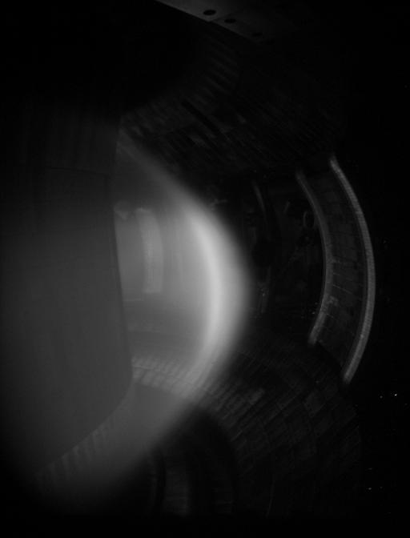
Optimized Magnetic Field Configuration
Wide Null field configuration (NFC): stray field < 5 Gs
Trapped particle configuration (TPC): mirror-like vertical field (10 – 50 Gs)
NFC TPC
#132913
#133042

Slide 7
Optimized Magnetic Field Configuration
Non-inductive breakdown (E_{t} = 0) with optimized NFC and TPC
Before optimization
After optimization
E_{t} = 0
Chen et al. Nucl. Fusion (2024)

Slide 8
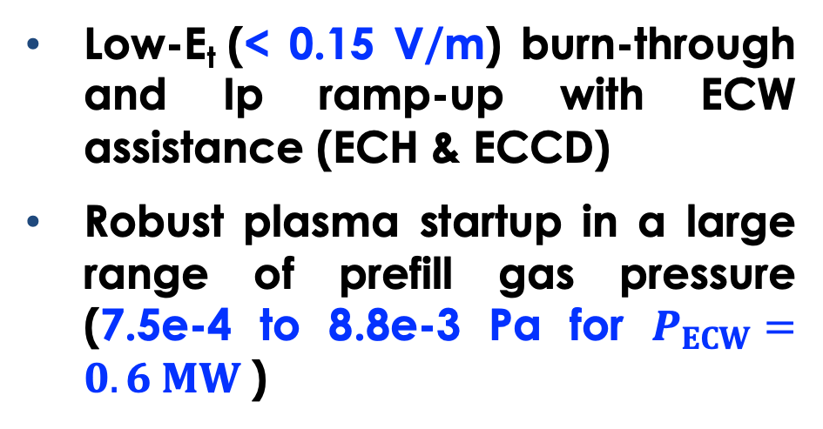
Robust Plasma Startup with ECW Assistance
-> burn-through & I_{p} ramp-up
Low-E_{t} (< 0.15 V/m) burn-through and Ip ramp-up with ECW assistance (ECH & ECCD)
Robust plasma startup in a large range of prefill gas pressure (7.5e-4 to 8.8e-3 Pa for $P_{ECW}=0.6 MW$)
Support to ITER:
Save of flux consumption
Lower requirement to PS for PF coils
Avoidance of runaway electrons
Effective startup assistance

Slide 9
Impact of Wall Condition (impurities) on Plasma Startup
Plasma startup with the B-wall is a challenge in EAST experiments due to the high power loss from impurity emission
The impact of wall condition (impurities) on the plasma startup was confirmed by the DYON code

Slide 10
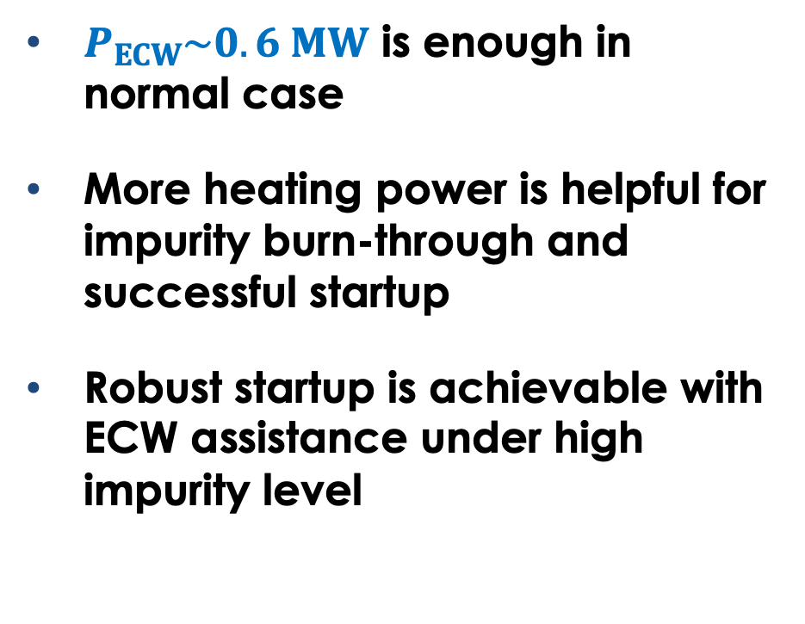
Tolerance to High Impurity Level for ECW Assisted Plasma Startup
$P_{ECW}\sim 0.6 MW$ is enough in normal case
More heating power is helpful for impurity burn-through and successful startup
Robust startup is achievable with ECW assistance under high impurity level

Slide 11
The Dependence of Critical Prefill Gas Pressure on ECW Power
Power threshold for burn-through is higher than that for breakdown in EAST
Higher ECW power is required for burn-through with higher gas pressure
A linear dependence of the critical prefill gas pressure on the ECW power, consistent with the simulation results [1]
Power threshold for burn-through in EAST (~0.48 MW), equivalent to ~7.2 MW for ITER
[1] H. T. Kim 2013 PPCF; [2] J. Sinha 2022 NF
[2]

Slide 12
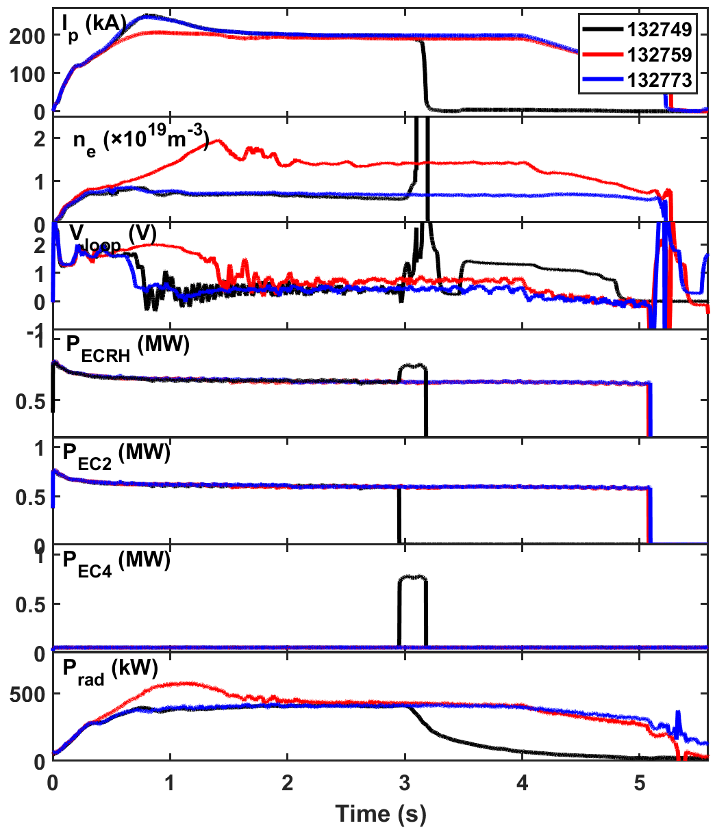
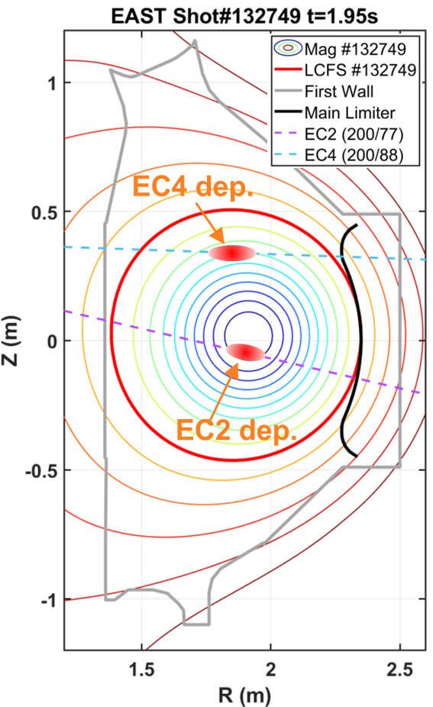
Plasma Start-up with W Limiter on EAST
#132773 & #132749: n_{e}/n_{GW} ~0.15;
#132759: n_{e}/n_{GW} ~0.35
Total radiated power saturates for both densities at the same value of ~0.4 MW and thus at a radiated fraction of ~0.6
Switching EC from on-axis to off-axis leads to disruption

Slide 13
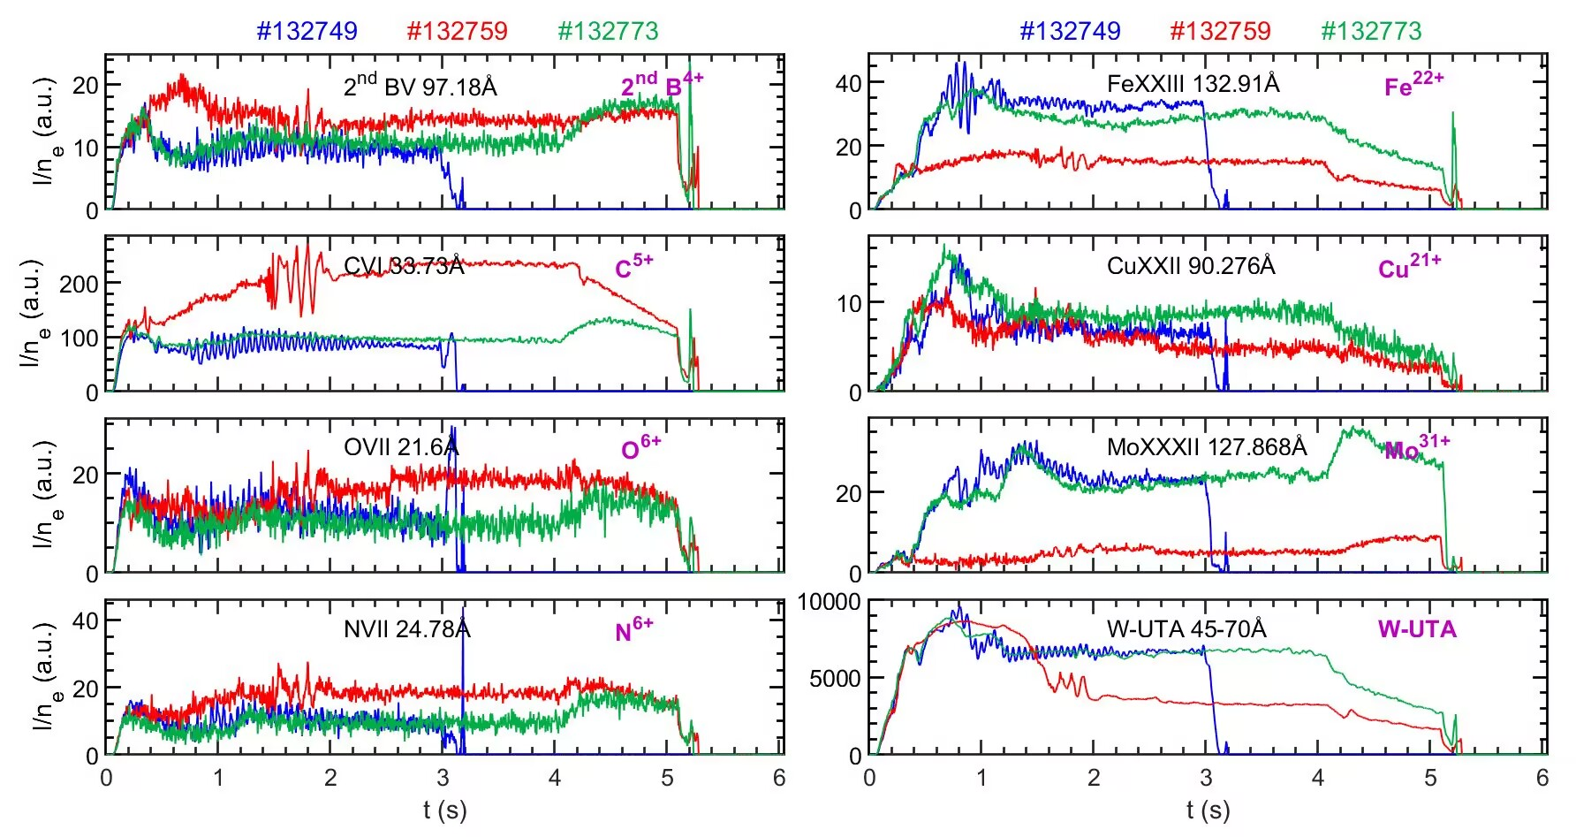
Core Impurity Emission Signals from EUV Spectroscopy
Heavier impurity emission decreases with increasing density, consistent with a reduced edge source
No clear change of core W impurity emission when EC is changed from on-axis to off-axis

Slide 14
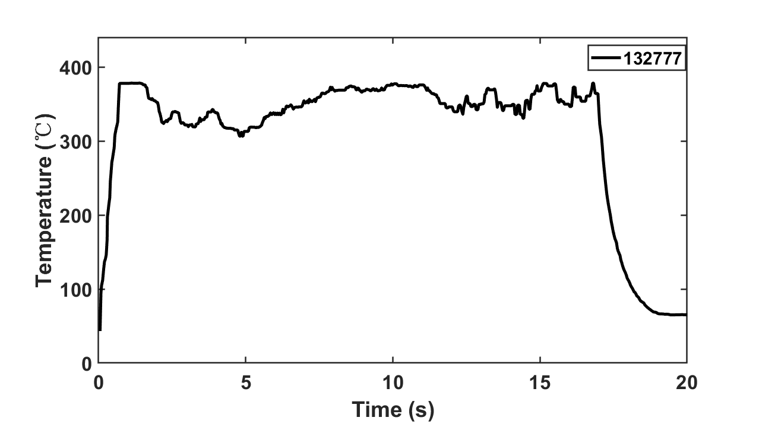
Sustained Limiter Discharge ~17s
  Stable temperature on the limiter observed
  Pulse length limited by volt-seconds

Slide 15
Summary
Optimization of magnetic field configuration was carried out for the robust plasma start-up
Low-E_{t} startup with ECW assistance supports ITER
Plasma start-up with W Limiter has been carried out in EAST for the first time

Slide 16
Thank you for your attention！

