Slide 1
Long-pulse operation in the fully metallic tokamak WEST: control and scenario development
Rémy Nouailletas, P. Moreau, R. Mitteau, S. Kerboua Benlarbi, C. Reux, A. Gallo, D. Weldon, P. Maget, A. Ekedahl, B. Santraine and the WEST team
Technical Meeting on Long-Pulse Operation of Fusion Devices
Vienna, Austria from 14 to 18 October 2024

Slide 2
Outline
Controlling a plasma during long-duration, what’s so difficult?
Controlling the loop voltage
Monitoring plasma facing components
Long-duration scenario: WEST recipes
Conclusion / Perspectives

Slide 3
Difficulty of long-duration plasma
Reach plasma duration close to the internal plasma dynamic time constant is the easy part of long-duration scenario
After addressing this noble core physic issues, the dirty work starts:
Save the magnetic flux
Keep the plasma MHD free
Avoid impurity pollution (outgassing)
Deal with slag, dust
Deal with steady-state limits of the machine
Learn to cross fingers

Slide 4
Outline
Controlling a plasma during long-duration, what’s so difficult?
Controlling the loop voltage
Monitoring plasma facing components
Long-duration scenario: WEST recipes
Conclusion / Perspectives

Slide 5
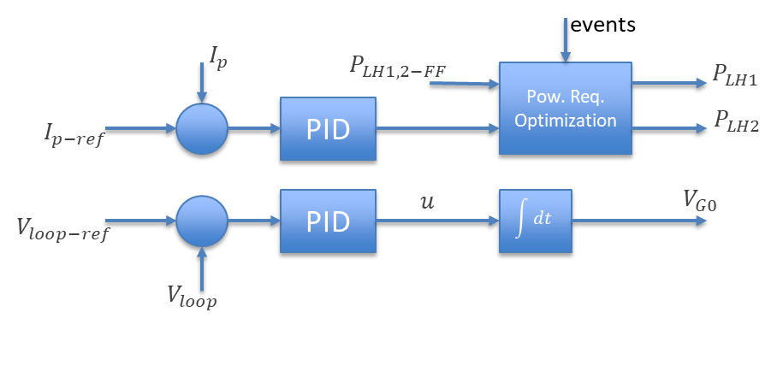
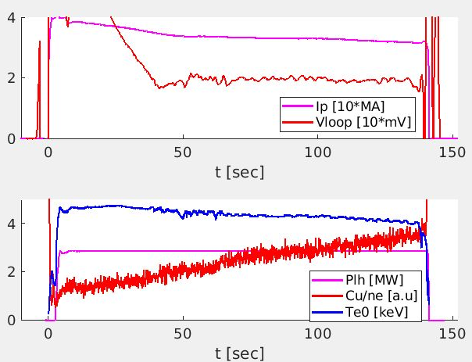
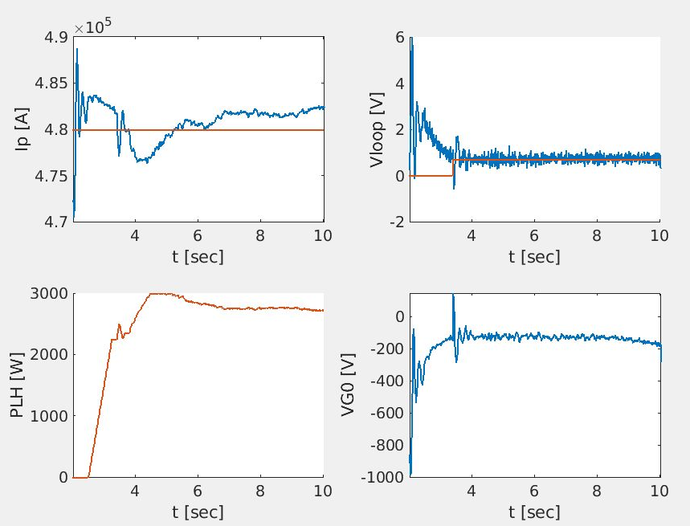
Loop voltage feedback control
The duration of the pulse is directly linked to the flux consumption. At very low loop voltage, a small offset implies a very large variation of the pulse duration.
Efficient loop voltage control is required but without plasma current, deviations of which are linked to plasma resistance increase
Thus dual Ip/Vloop control is required:
The plasma current is controlled using LH power
The loop voltage is controlled using the Central Solenoid Voltage
t
F_{pmin}
Δt
WEST flight simulator
PLH [kW]
WEST#59183

Slide 6
Outline
Controlling a plasma during long-duration, what’s so difficult?
Controlling the loop voltage
Monitoring plasma facing components
Long-duration scenario: WEST recipes
Conclusion / Perspectives

Slide 7
Monitoring Plasma Facing Components
Long-duration plasmas reveal long time-scale dynamics:
PFC components can take hundred of seconds to reach steady-state temperatures (1) although they are actively cooled
Some temperatures increase during the full discharge and require specific analysis (flakes, reflection…) (2)
ROI6.1
ROI6.2
ROI6.3
ROI6.2
ROI6.3
ROI6.1
ROI6.3
LH1 launcher and ROI definition
Regions of Interest: Temperatures against soft limits (dashed red) and hard limits (solid yellow) on LH1 launcher WEST #59763
(1)
(2)

Slide 8
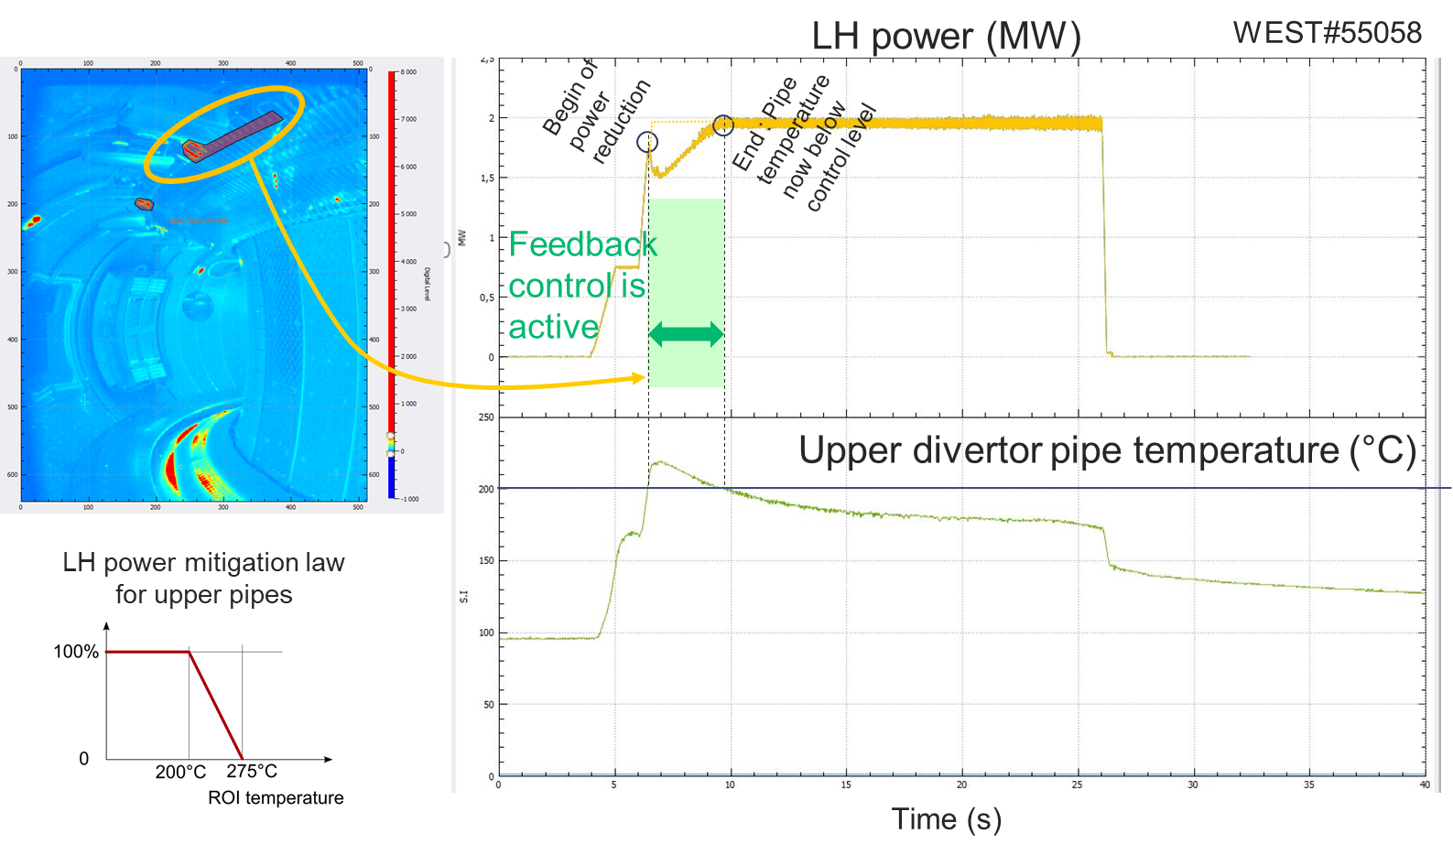
Monitoring Plasma Facing Components
To avoid reaching temperature limits and melting PFCs, feedback control is engaged to reduce the power request when PFC temperatures are approaching their respective limits:
Electron ripple losses coming from LH power ramp-up
Overheat upper diverter pipe leading to water leak risk
PCS decreases LH power requests proportionally to temperature excursion until safe wall conditions are back

Slide 9
Outline
Controlling a plasma during long-duration, what’s so difficult?
Controlling the loop voltage
Monitoring plasma facing components
Long-duration scenario: WEST recipes
Conclusion / Perspectives

Slide 10
Long-duration scenario: WEST recipes
Long-duration scenario should
Minimizes the flux consumption
Uses a plasma shape compatible with steady-state capability of the coils
Heats the plasma without heating the PFCs…
Set a q profile that is MHD free
Take care of all thermal limits that can be reached (cooling loops, semi-inertial hidden elements…)
On WEST:
The iron core of the machine saves flux → good for long-pulse ☺
PF coils are actively water-cooled → they could be steady-state for a range of current ☺
The CS current should be closed to 0 during flat-top → the X-point formation and the early phases of the discharge should be well designed to reach this target at the beginning of the flat-top 😐
LH launchers don’t drive current at the plasma center → very hard to get stable and MHD free plasma current profile ☹
J.M. Bernard: Towards a long-pulse ECRH system for WEST (15th October, 16:10)
X. Regal-Mezin: Lower Hybrid current drive long-pulse operation state of art on WEST (15th October, 16:55)

Slide 11
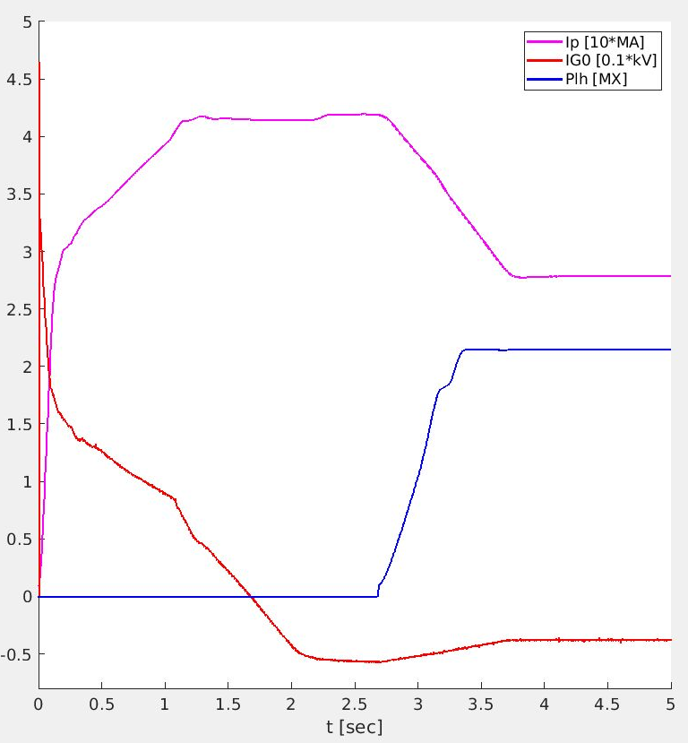
Ramp-up
WEST#59763
Start with the maximal flux value available (I_{G0} = 35 kA)
Plasma current overshoot to 400 kA and then synchronized decrease to 280 kA with LH power ramp-up → sharp density current profile to avoid tearing mode
Reach |I_{G0} | < 5 kA when at the beginning of the flat-top → compatible with steady-state value of the cooling loop
P. Manas: Long-pulse operation in a W environment : feedback from WEST (14th October, 16:10)
T. Fonghetti: WEST operational domain predictions of L-mode non-inductive discharges with an integrated modeling approach (17th October, 10:35)

Slide 12
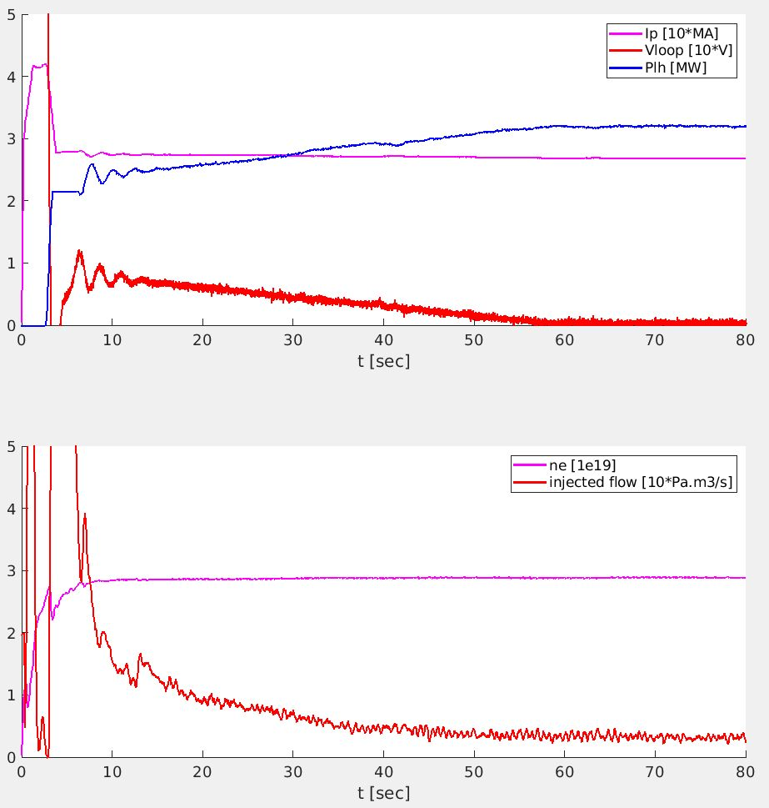
Flattop first part
WEST#59763
Ip/Vloop control start
Constant density
Start of Vloop/Ip control mode (transition to improve)
Long decrease of the plasma current from 280 kA to 270 kA during 50 s
Long decrease of the loop voltage (feedback control) from 10 mV to 3 mV during 50 s
Aim: keep a stable q profile free of MHD

Slide 13
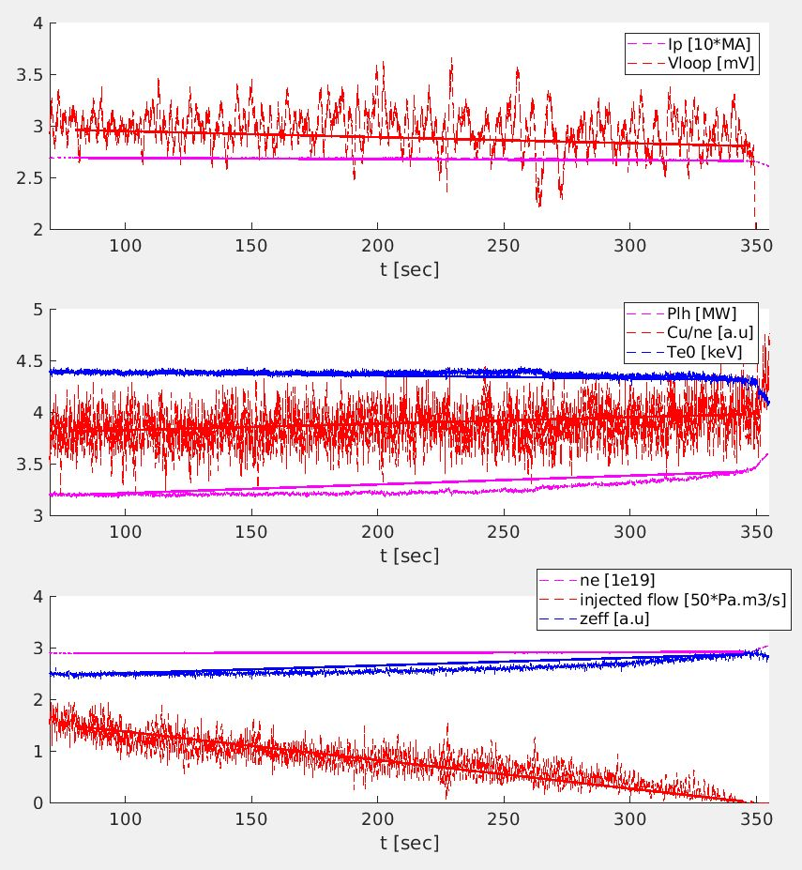
Flattop second part
WEST#59763
Because of the long-time dynamics of the interactions between the wall and the plasma, there is no plasma steady-state, strictly speaking
Decrease injected gas flow to 0 to keep density constant → Outgassing of passive elements?
Increase of Z_{eff} → Impurity source?
Slow increase of the LH power to keep the loop voltage and plasma current constant (feedback control)
Feedback control could minimize the impact of these dynamics keeping the main parameters constant, however the cure can be worse than the disease.
Impurity increase
Z_{eff} and plasma resistivity increase
Ip/Vloop control increases LH power
Copper erosion increase
Parameters | Variation between 80s and 345s
I_{p} | 1.1%
V_{loop} | 5.2% (0.15mV)
P_{lh} | 7.0%
Cu/n_{e} | 4.3%
n_{e} | 0.95%
q_{D2} | 98.7%
Z_{eff} | 16.0%
Te0 | 1.7%
L. Meunier: WEST: the challenges of reaching 100% of actively cooled components for long-pulse operation (16th October, 11:55)

Slide 14
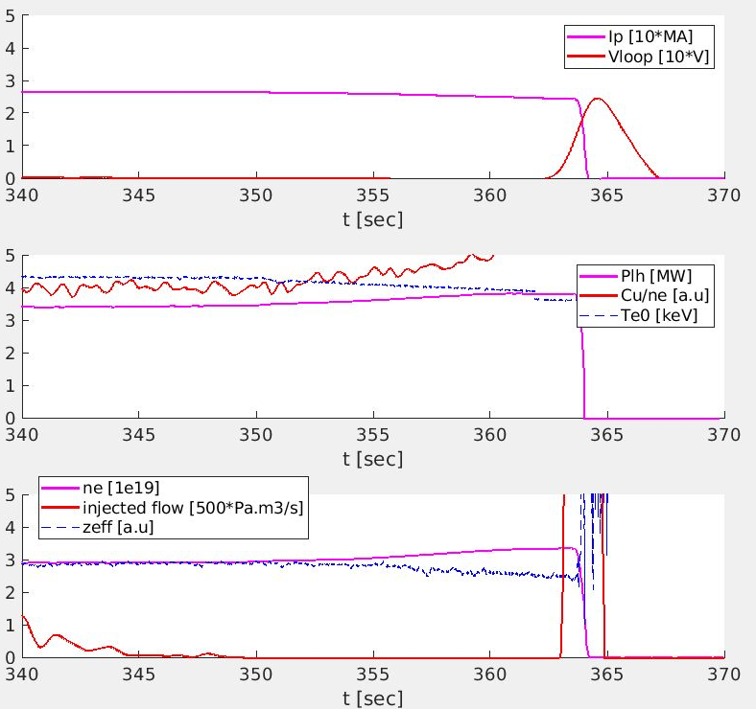
Plasma end
WEST#59763
Even 0 injected gas flow can’t compensate for the outgassing
Density continues to increase
The Greenwald limit is reached and the plasma disrupts
With each long-duration plasma attempt, the outgassing seems to be less and less important
Plasmas longer than 3 minutes seem to clean the components that were not very well baked, effectively conditioning the machine

Slide 15
Reproduce long-duration pulse
Achieving a long-duration plasma has strong impact on the wall conditioning
Several plasmas are required to recover good conditions for a new try
Several random events could end the discharge prematurely (slag, dust…)
New control room strategy:
Succeed on a long-duration plasma (i.e. >3min)
Run an ohmic pulse at 500 kA until a detached plasma is achieved
Retry a long-duration plasma
Wash, rinse, repeat…
Pulse number | Duration | Comment
59756 | 27,5s | Warm-up
59757 | 298s | Good first try
59758 | 0s | Non Sustainable Breakdown (NSB)
59759 | 3,5s | Early disruption with LH ramp-up
59760 | 0s | No gas
59761 | 3,5 | Early disruption
59762 | 106s | Detached but survived
59763 | 364s | Record !
59764 | 0s | NSB
59765→59768 | 3,5s | Early disruptions with LH ramp-up
59769 | 10s | Ohmic, Detached
59770 | 12s | Ohmic Detached but better
59771→59777 | Max: 115s | Scenario lower density (MHD issue)
59778 | 60s | Repeat 59763
59778 | 3,5s | Repeat 59763 (Early disruption)
59780 | 182s | Repeat 59763
V. Lamaison: WEST: Long-pulse operation in a tokamak (16th October, 11:30)

Slide 16
Outline
Controlling a plasma during long-duration, what’s so difficult?
Controlling the loop voltage
Monitoring plasma facing components
Long-duration scenario: WEST recipes
Conclusion / Perspectives

Slide 17
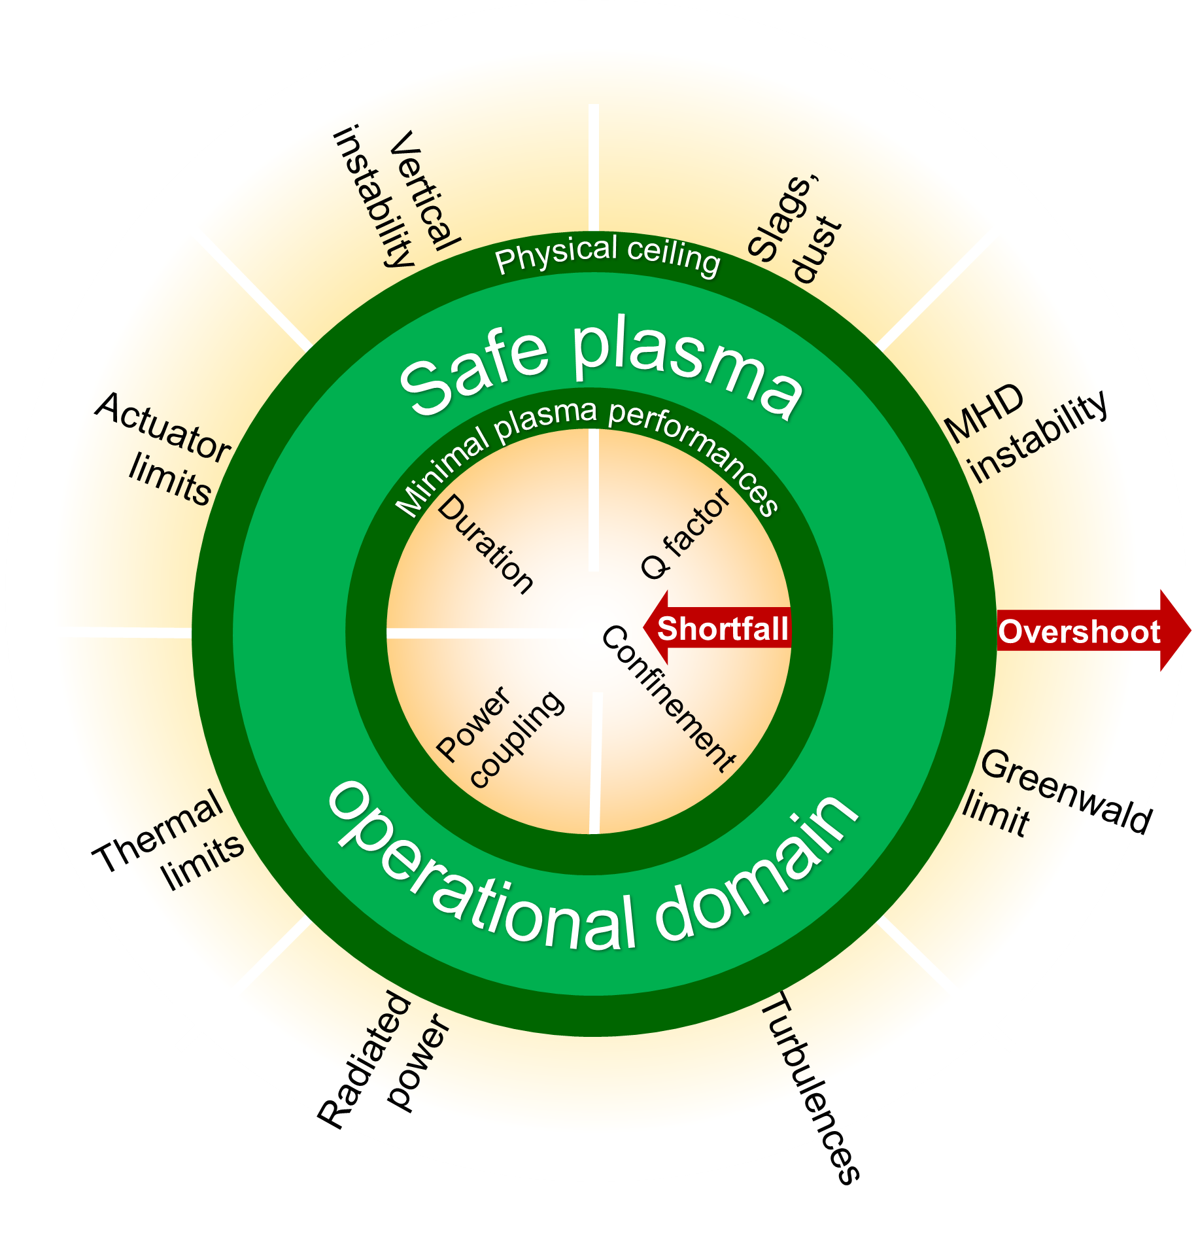
Conclusion
On WEST, dynamics between the wall and the plasma could have a huge time constant (>1min) and become more relevant than plasma core dynamics
Several controllers have been implemented to deal with these dynamics and try to reach steady-state
However several main parameters don’t reach steady-state despite a flattop of about 300 s
Repeating long-duration plasmas is also a challenge because of the legacy left by each attempt

Slide 18
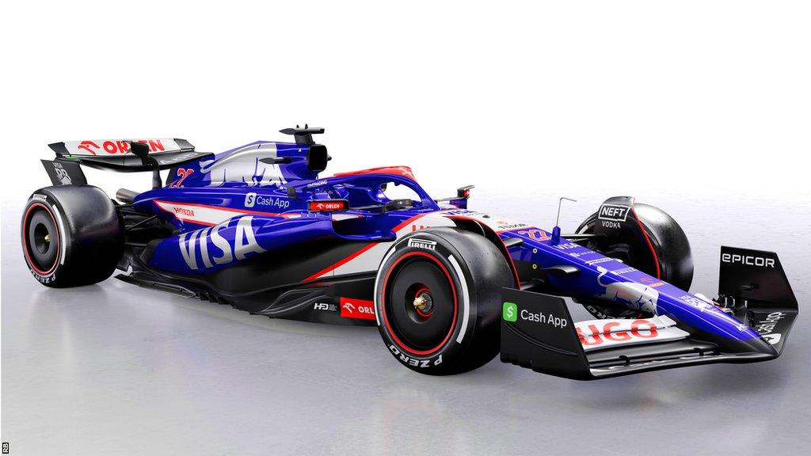
Perspectives
Future fusion power plants will be dirty machines:
Weak pumping in front of plasma volume
PFCs subject to erosion/deposit cycles
Air/water leaks despite all the promises
But should perform plasma during several minutes with a satisfactory reproduction rate
We need to learn to operate dirty machine:
Feedback control to avoid vicious circles → Control models to simulate several minutes of plasma, integrate wall/plasma interaction into the models
Systems to recover/maintain the wall conditioning during the plasma discharge → Injection Powder Dropper
Scenarios with plasma robust to events (Slag, dust…) → Sacrifice the performance target to increase robustness

Slide 19
Thank you for your attention
Technical Meeting on Long-Pulse Operation of Fusion Devices
Vienna, Austria from 14 to 18 October 2024

Slide 20
WEST CODAC Overview
PCS
Supervision
Diagnostics
(DMAG,…)
Timing system unit
(APILOT)
Database
Permission flag
Actuators major faults
Timing system network
Message system/
Ethernet network
Real time network
Optic fibers
DDIV1/2
DPOLO
DGAZ
DFCI
DHYB
DFCE
Converter
Copper cables
Divertor coils supply
Poloidal system supply
Gas injection
hardware
ICRH
hardware
LH
hardware
20
ECRH
hardware
Direct link with the hardware layer

Slide 21
PCS Overview
WEST PCS on DCS (Discharge Control System: AUG real time framework)
Segment based approach
Controllers developed using Matlab Simulink and Compiler toolbox
Gateway between DCS and WEST CODAC using WESTbox
Database
DCS server
Real time network
Pulse data files
Pulse schedule files
Ethernet network
Timing system network
Timing system unit
DCS
Cycle Master
Reference generator
TIPC
Supervision
ChronoPCI AP
Communication with Timing system network
Heating permission flag
Segment manager
Shared memory
WESTbox
Magnetic control
TIPC
Actuators
Heating control
TIPC
Dolphin Gateway
Communication with RT network
Diagnostics
Fueling control

Slide 22
Monitoring Plasma Facing Components: example
Electron ripple losses coming from LH power ramp-up
Overheat upper diverter pipe leading to water leak risk
PCS decreases LH power requests proportionally to temperature excursion until safe wall conditions are back

Slide 23
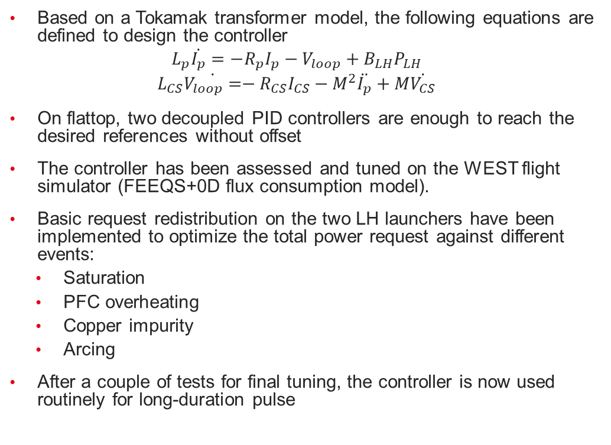
Loop voltage feedback control
Based on a Tokamak transformer model, the following equations are defined to design the controller
$$L_{p}\dot{I_{p}}=−R_{p}I_{p}−V_{loop}+B_{LH}P_{LH}$$
$$L_{CS}\dot{V_{loop}=}−R_{CS}I_{CS}−M^{2}\ddot{I_{p}}+M\dot{V_{CS}}$$
On flattop, two decoupled PID controllers are enough to reach the desired references without offset
The controller has been assessed and tuned on the WEST flight simulator (FEEQS+0D flux consumption model).
Basic request redistribution on the two LH launchers have been implemented to optimize the total power request against different events:
Saturation
PFC overheating
Copper impurity
Arcing
After a couple of tests for final tuning, the controller is now used routinely for long-duration pulse
WEST flight simulator
PLH [kW]

