Slide 1
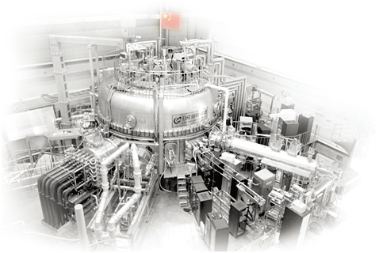
Feedback control of LHW-plasma coupling for long pulse operation in EAST
by
B.J. Ding, Q. P Yuan, C.B. Wu, Y.C. Li, G.H. Yan, J. H. Wu, B. Cao, J.H. Yang, W. Sun, M.H. Li , M. Wang, W. D. Ma, J.F. Shan, F.K. Liu, J.P. Qian, X.Z. Gong, and EAST Team
Institute of Plasma Physics, Chinese Academy of Sciences, Hefei, China
Presented at the
2nd Technical Meeting on Long-Pulse Operation of Fusion Devices
Vienna, Austria, IAEA Headquarters
Oct 15, 2024
*E-mail: bjding@ipp.ac.cn

Slide 2
Outline
Background and Motivation
LHCD system in EAST
Experimental setup of the gas fueling
Design of wave–plasma coupling feedback control
Experiments of coupling feedback control
Test of a single SMBI pulse
Experiments with multi-pulse SMBI
Comparison of response between LGP and SMBI
Summary

Slide 3
Background and Motivation
•Prospect:
Scientific aim of EAST: long-pulse plasma with high performance, which is supported by LHCD.
For advanced Tokamak operation (eg., CFETR), LHCD could be one possible tool to sustain plasma current and control current profile.
•Challenge:
Good LHW-plasma coupling is the first condition for LHCD capability.
The density in front of the grill will be below the cut-off density for coupling in fusion reactor, due to long distance between plasma and antenna.
Local gas puffing (LGP) is proposed!

Slide 4
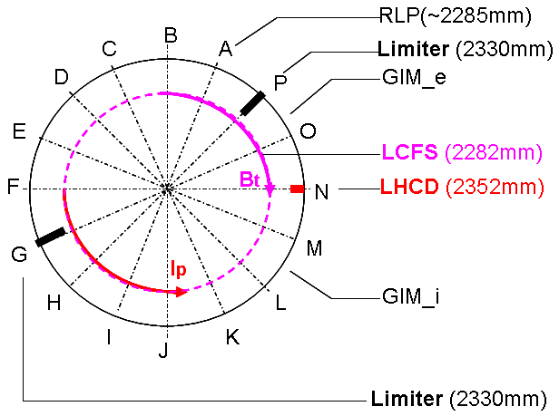
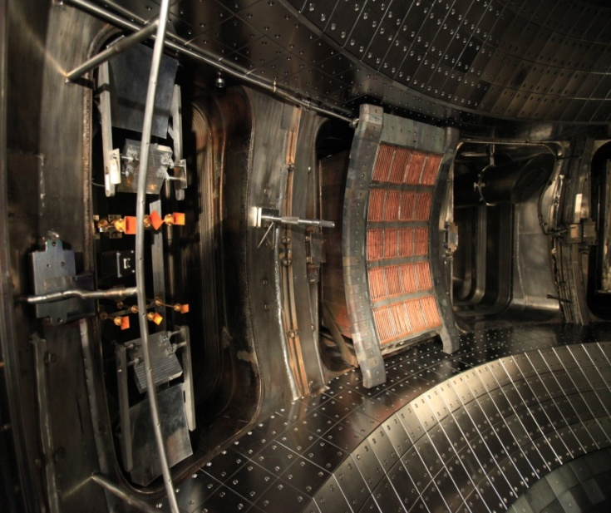
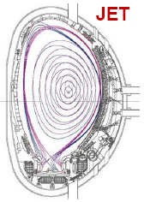
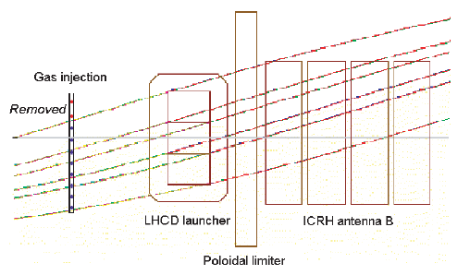
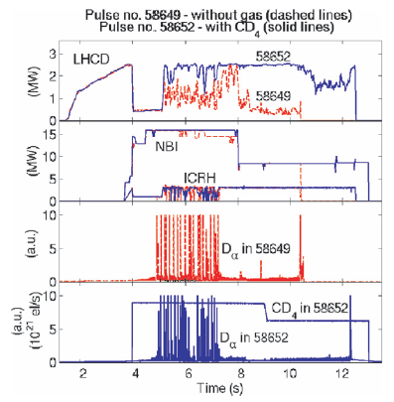
Local gas puffing (LGP) is effective to improve LHW-plasma coupling
First realization in JET
Demonstration and experiments in EAST
M
O
N
P
LGP in electron-side is better than that in ion-side
RC is smaller in the case of local gas puffing.

Slide 5
Challenge and Motivation
However,
The gas puffing above was usually pre-set before the discharge.
The density in front of the grill is under constantly changing conditions during the discharge.
When faced with transients or unforeseen changes in the plasma, pre-set gas programs can fail to improve LHW coupling, harm plasma performance, or even extinguish the plasma.
Therefore, gas flows is necessary to be calculated in real time and be feedback controlled via gas fueling.
Motivation: To sustain good LHW-plasma coupling in long pulse plasma.

Slide 6
LHCD System in EAST
□Objectives:
✓ √ Current drive, steady-state operation
✓ √ Electron heating, q profile control, etc
□ 2.45GHz LHW System:
✓ √ A 4MW system has been upgraded from the previous 2MW system since 2011
✓ √A PAM antenna has been successfully commissioned, demonstrating its coupling and CD capability.
□ 4.6GHz LHW System:
✓ √A 6MW system has been put into use since 2014
Stationary RF dominant H-mode over 400s has been achieved!

Slide 7
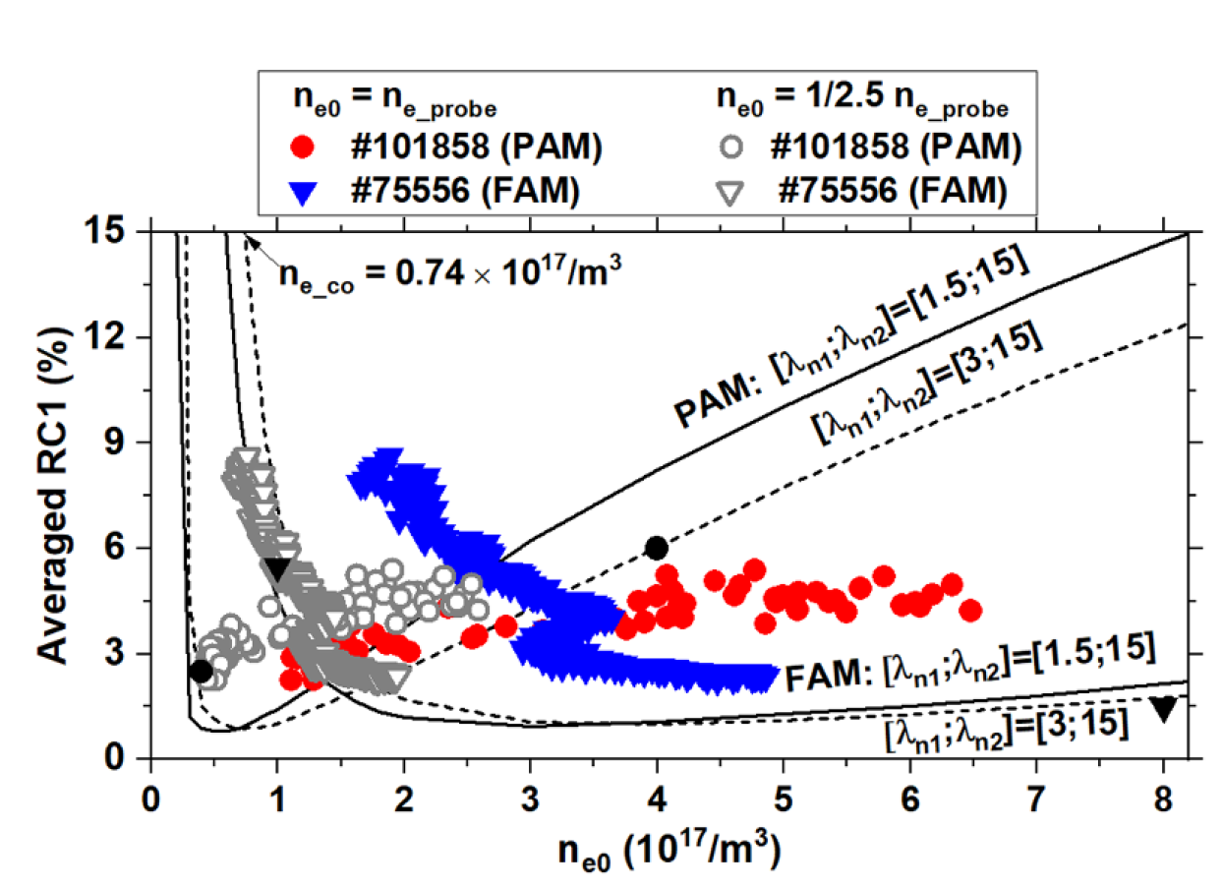
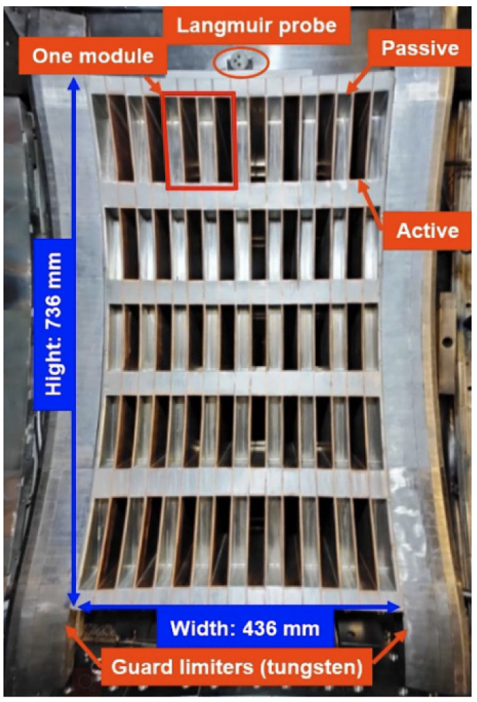
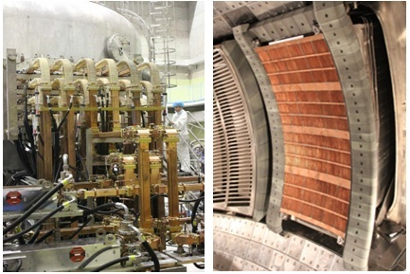
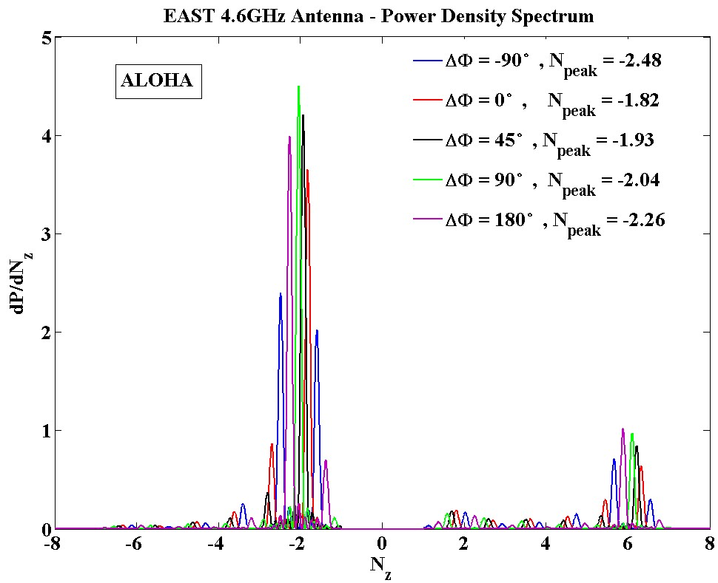
LHCD system in EAST
4MW/2.45GHz
FAM
PAM
Better coupling for PAM
20 main waveguides arranged in an array of 5 rows and 4 columns. （20 klystrons)
6MW/4.6GHz (FAM)
Max. power injected: ~ 3.5MW
N//^{peak}=1.79 ~ 2.26 (-90⁰~180⁰)
24 main waveguides arranged in an array of 4 rows and 6 columns. （24 klystrons)

Slide 8
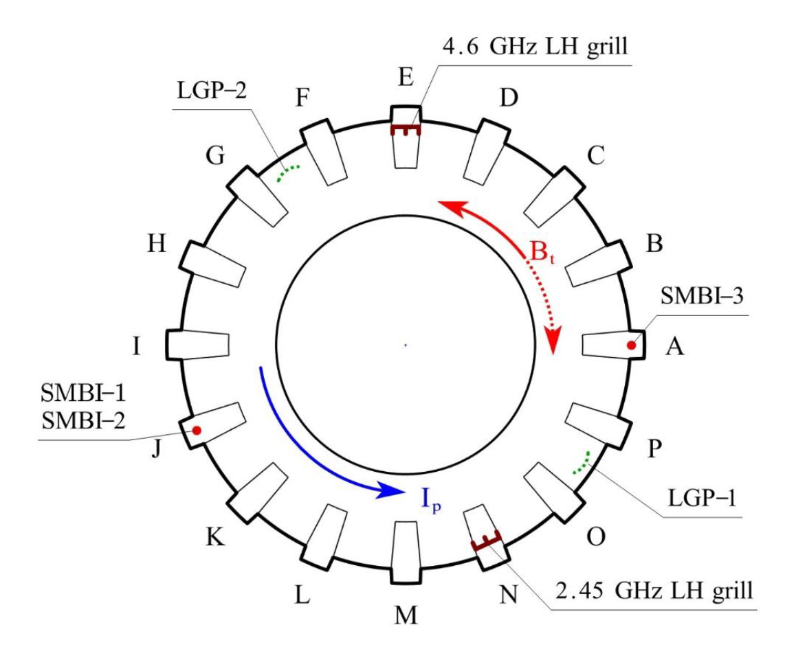
Experimental setup arrangement of the gas fueling system in EAST
4.6GHz LH grill
☻ 5 fueling systems, which could be used to enhance the electron density in front of the LH antenna, including
--2 LGP systems fed by a piezoelectric valve (LGP-1 and LGP-2)
--3 SMBI systems (SMBI-1, SMBI-2, and SMBI-3)
☻ Taking 4.6 GHz LH antenna as the reference, LGP-2, SMBI-1, and SMBI-2 locate at the electron-drift side, whereas LGP-1 and SMBI-3 locate at the ion-drift side.
☻ LGP-2，SMBI-2, SMBI-3 and 4.6GHz LHCD are chosen for the study.
LGP-2
SBMI-3
SBMI-1
SBMI-2
LGP-1
2.45GHz LH grill

Slide 9
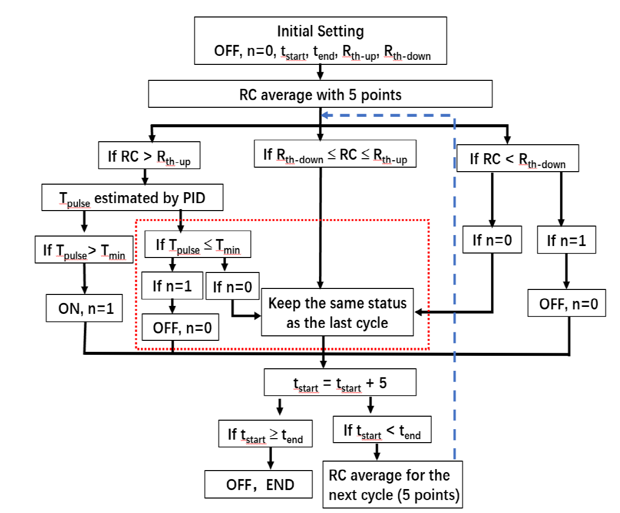
Design of wave–plasma coupling feedback control
□ Using a proportion integration differentiation (PID) method
□ Taking RC of LH power as the reference, due to the uncertainty of edge density measurement.

Slide 10
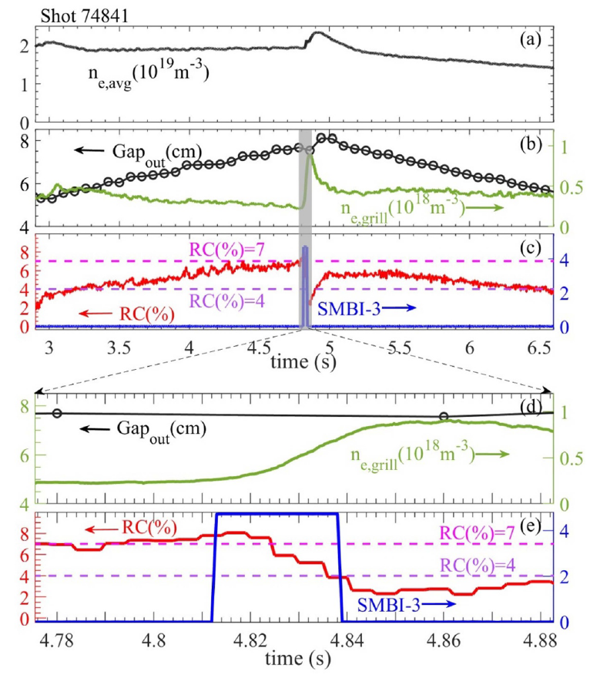
Test of single SMBI pulse indicates that the feedback control progress works correctly and is valid for LHW–plasma coupling improvement.
□ R_{th-up} and R_{th-down} are set as 7% and 4%
□ Gap_{out} was scanned from a small value (∼1.8 cm) to a larger value (∼4.0 cm), and then back to a∼1.8 cm, to change the LHW–plasma coupling actively
ON
OFF
□ With the increase in Gap_{out}, the density at the grill decreases gradually to 2.5 × 10¹⁷ m⁻³, accompanying the increase in the RC.
□ When RC reaches ∼7%, SMBI is switched on, leading to the density at the grill increasing and the RC decreasing quickly.
□ When RC decreases to 4%, SMBI is switched off, being consistent with the increased edge density of 7.5 × 10¹⁷ m⁻³, which satisfies wave–plasma coupling conditions.
10

Slide 11
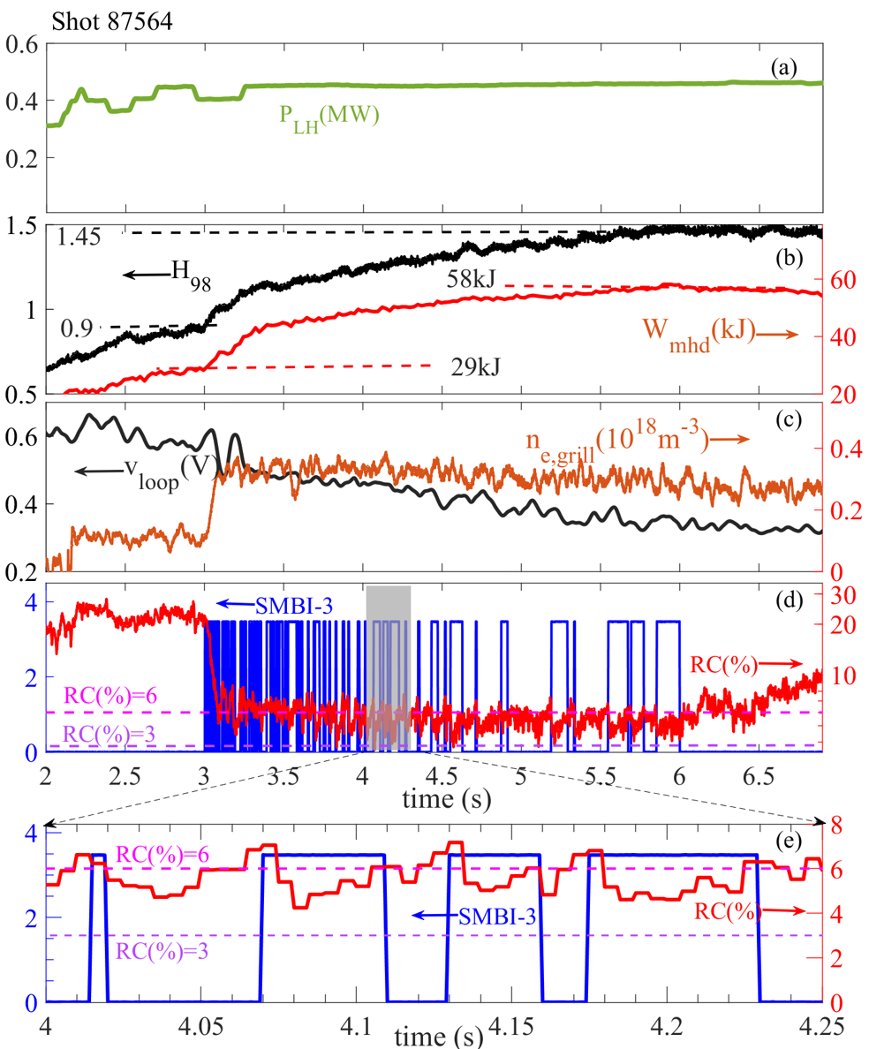
Experiments with multi-pulse SMBI indicate LHW coupling power is improved by the feedback, being helpful for CD capability, stored energy, and plasma performance
□ R_{th-up} and R_{th-down} are set as 6% and 4%,respectively.
□ The feedback control is applied from 3 s to 6 s.
□ After the feedback application, n_{e,grill} increases quickly to 3.0 × 10¹⁷ m⁻³ from 1.1 × 10¹⁷, and the RC decreases sharply to a value around 6% from 20% .
□ During the process of multi-pulse SMBI, n_{e,grill} remains at about 3.0×10¹⁷ m⁻³ and the RC between 3% and 6% is almost maintained.
□ V_{loop} decreases from ∼0.6 V to ∼0.4 V, W_{mhd} increases from 29 kJ to 50 kJ, H₈₉ (=τ _{E}/τ _{EITER89-P}) increases from 0.9 to 1.5,implying a certain improvement in the plasma performance.

Slide 12
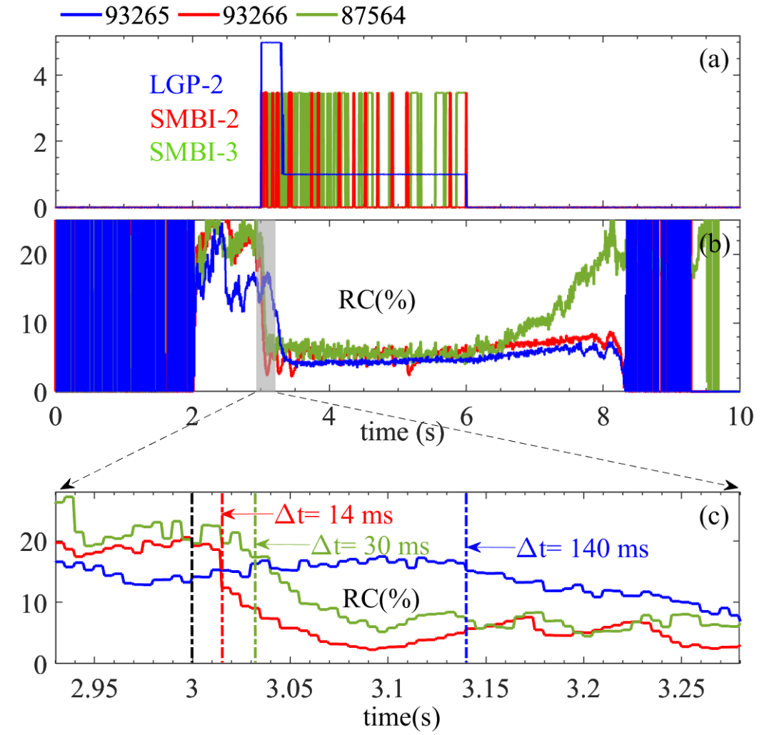
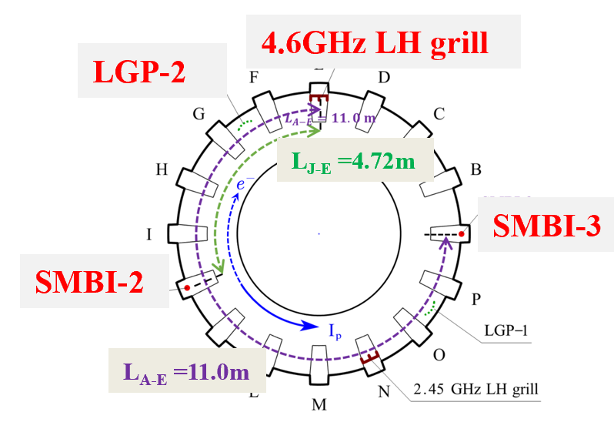
Comparison of response between LGP and SMBI
LGP-2 vs SMBI-2, located in the electron-drift side of the LH antenna
⇒SMBI-2 is better than LGP-2, mainly due to different response time of fueling system.
2. SMBI-2 vs SMBI-3, located at the electron-drift side and the ion-drift side
SMBI-2 is a little better than SMBI-3， being consistent with the discrepancy in the magnetic connection length.
(Δt_{SMBI-3}/ Δ t_{SMBI-2}~L_{J-E}/L_{A-E})
After the gas is ionized near the gas injection, the movement of electron to LH grill from electron-drift side along the magnetic field line is considered.
(Clock-wise direction)
The fastest feedback response time is SMBI fed on the electron-drift side and the slowest response is LGP, between which is SMBI fed on the ion-drift side.

Slide 13
Summary
□ It is the first time that LHW–plasma coupling feedback control has been designed and realized in EAST via the PID method by choosing the RC LHW power as the reference for gas puffing feedback.
□ The feedback control can work correctly and maintains good LHW–plasma coupling effectively for a long time.
□ The improvement in LHW power due to coupling feedback is helpful for current drive capability, stored energy, and plasma performance.
□ The response time of the RC with SMBI is faster than that by the piezoelectric valve, and SMBI puffing on the electron-drift side of the LH antenna is preferred for the control.
Studies offer an effective way to sustain good LHW coupling in steady-state operation in the future.

