Slide 1


Technical meeting on long pulse operation of fusion devices, 14-18 Oct. 2024，Vienna, Austria
Effect of boron coating on long pulse high confinement plasma in EAST with full metal wall
G. Z. Zuo^{1*} , Y.H. Guan¹, W. Xu², Z. Wang¹, Z. Sun³, H.M. Zhang¹, R. Maingi³, T. Wauters⁴
R. Ding¹, L. Wang¹, X.Z. Gong¹, and J. S. Hu¹ and EAST team
zuoguizh@ipp.ac.cn
15th 10, 2024
¹Hefei Institutes of Physical Science, Chinese Academy of Sciences, China
²Institute of Energy, Hefei Comprehensive National Science Center, China
³Princeton Plasma Physics Laboratory, USA
⁴ITER Organization, France

Slide 2
Outline
  Background and motivation
  Experiment setup
  Recent experiment results
  Summary and Outlook

Slide 3
Why boron coating used with tungsten first wall？
Traditional solid W PFMs faces severe challenges:
  Extreme particle and heat flux
  Erosion of wall materials
  Impurity and confinement degradation
Boron(B): low-Z material as an alternative
coating material for future devices:
  Getter impurities, typically oxygen
  Limit W material enters plasma
  Ease plasma operations
Boronization process, IC/STAC-29/3.3.

Slide 4
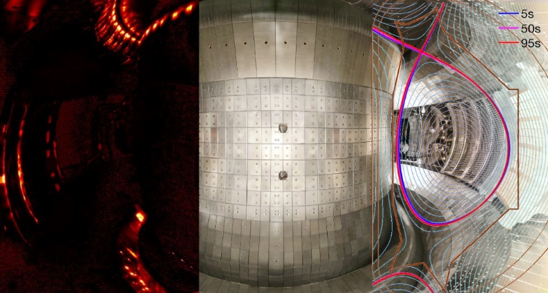
B coating on full metal wall in EAST for supporting ITER new baseline
Aiming to long pulse high-performance discharges
EAST Targets
100s&10MW
1000s H mode
ITER-like configuration (DN, USN, LSN)
R=1.7-1.85m, a=0.4-0.45m, BT=3.5T
Wall materials in EAST: ITER like W divertor, Mo first wall.
Develop B coating to reduce heavy metal impurity, specially for W, to further extend long pulse plasma operation for EAST and ITER devices.

Slide 5
Outline
  Background and motivation
  Experiment setup
  Recent experiment results
  Summary and Outlook

Slide 6
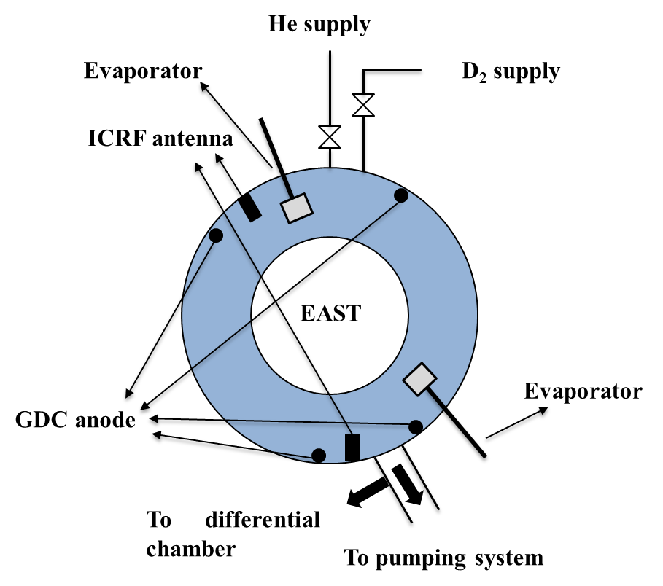
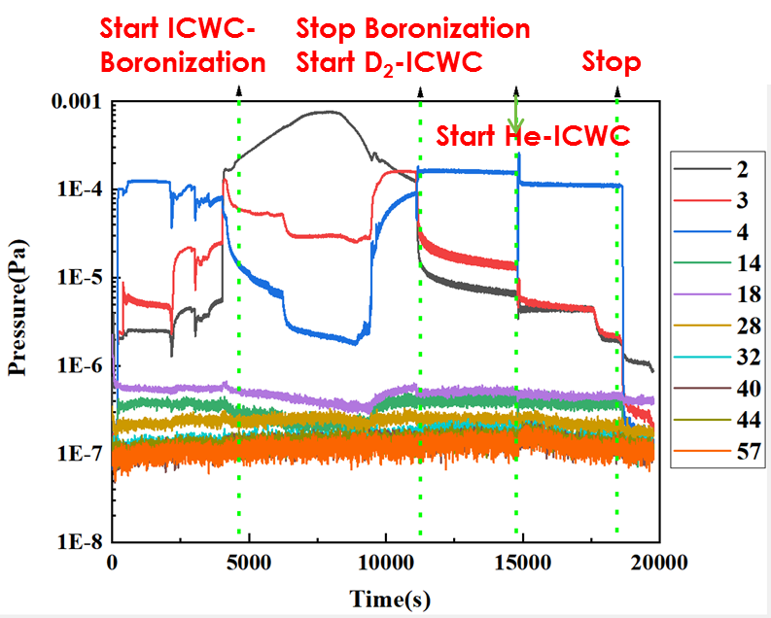
B coatings assisted by ICWC/GDC
Before boronization, 30 min of He ICWC/GDC cleaning.
~10g C₂B₁₀H₁₂ was heated to 80~100◦C, assisted with D/He ICWC/GDC.
D/He ICWC/GDC was continued for 30-120 min to remove co-deposited H in boron film.
Main parameter of ICWC：
  B_{t} ~0.5 T，power(30-50 kW)
  Working pressure: 0.05 Pa
  Duty cycle(1:10-1:2)
Main parameter of GDC：
  Power(2.4 kW)
  Working pressure: 0.5 Pa

Slide 7
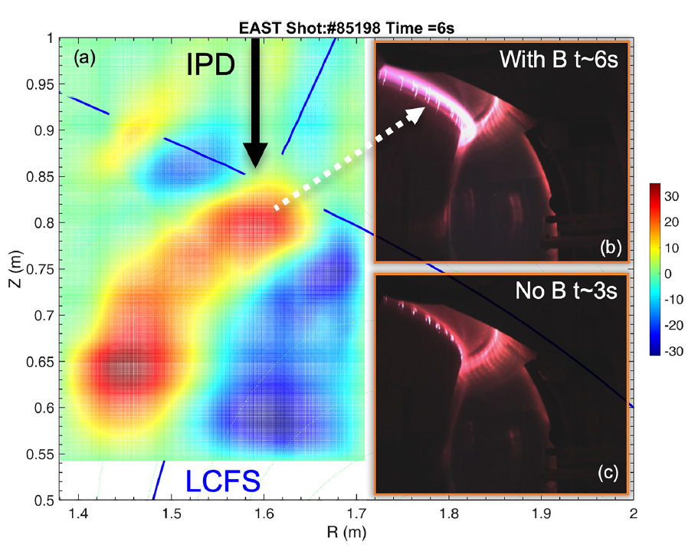
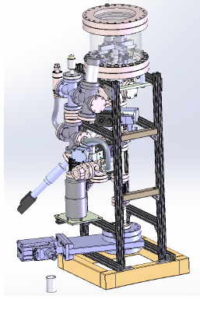
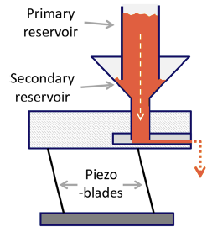
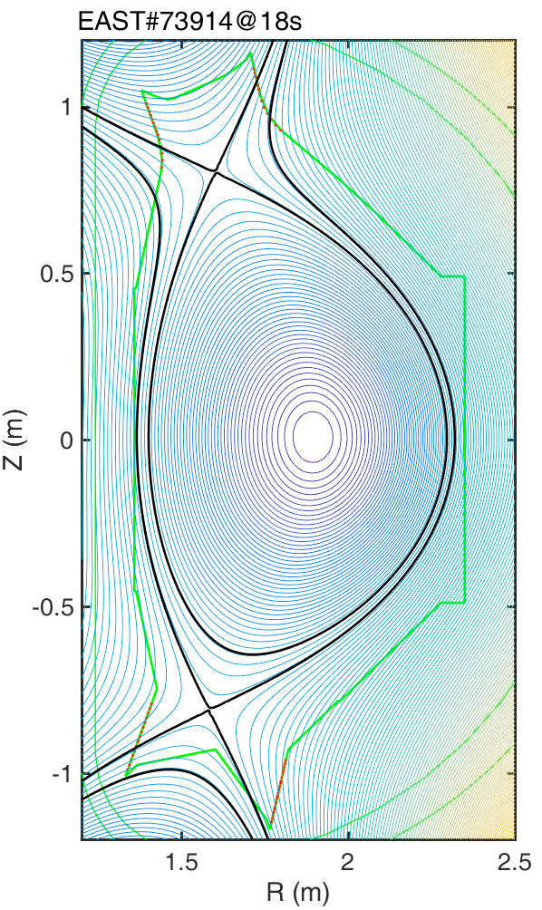
Real-time B powder injection without plasma operation interruption
Four chambers loaded with lithium & boron.
B injection flow rate 0-200mg/s, average size 150 μm, injection velocity ~10m/s.

Slide 8
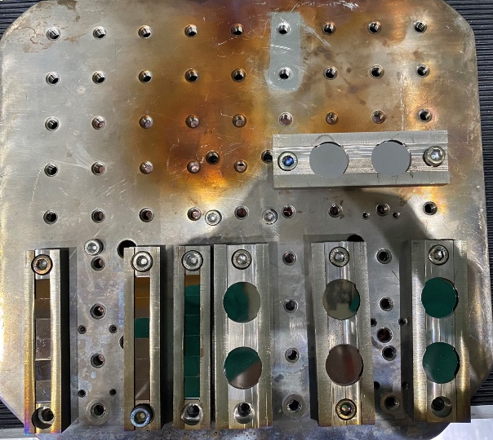
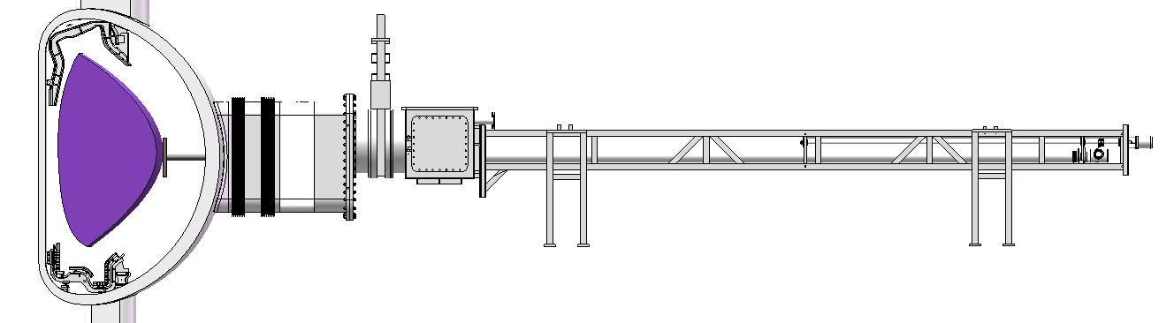
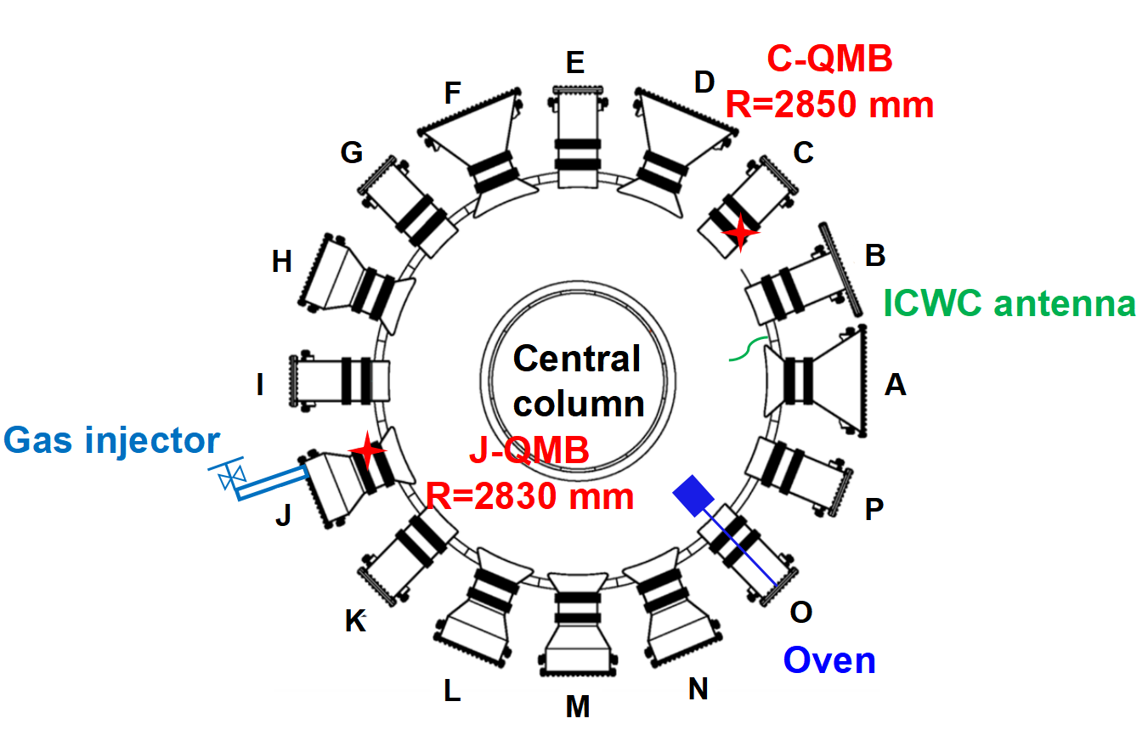
Key diagnostics for boron film analysis
Plasma
Sample plate
Exchange box
Drive motor
Tungsten substrate
Gate valve
Vacuum vessel
Oven
Tungsten (W) samples :13 mm × 10 mm × 1 mm
Samples: H and J ports at mid plane in situ measurement
Sample analysis: SEM, XPS, FIB, RBS, ERD, and TDS,RAMAN
Wall retention analysis: particle balance analysis

Slide 9
Outline
  Background and motivation
  Experiment setup
  Recent experiment results
  Summary and Outlook

Slide 10
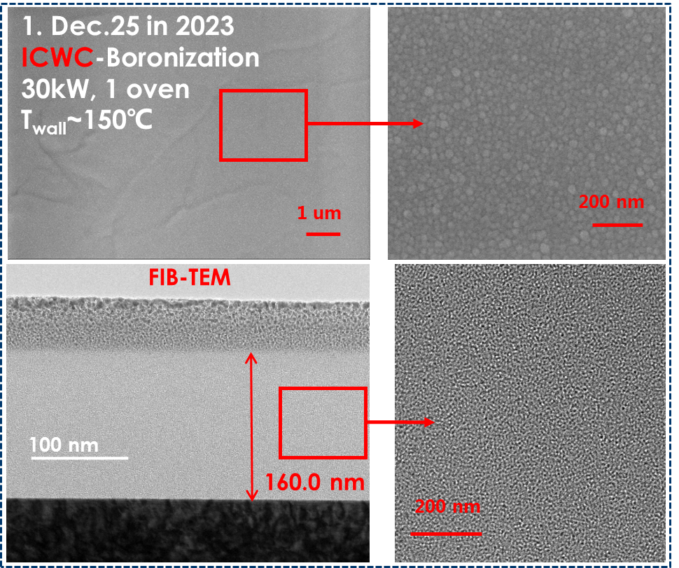
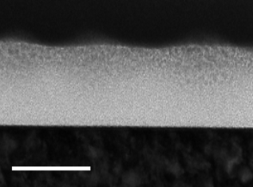
The thickness of boron film was 20-292nm
Jan. 08 in 2024 J window
Jan. 08 in 2024 H window
92.78 nm
127 nm
100 nm
100 nm
ICWC boronization Date | Oven | Power(kW) | Thickness(nm)
Dec.25 in 2023 | 1 | ~30 | ~160 | 20
Jan. 8 in 2024 | 2 | ~30 | 92.7 | 127.5
Jan. 18 in 2024 | 2 | ~45 | 292 | /
The surface of the boron film has clear granular.
Boronization via 2 ovens or higher working power has more homogeneous deposition.
More homogeneous deposition during boronization assisted by GDC than that by ICWC.

Slide 11
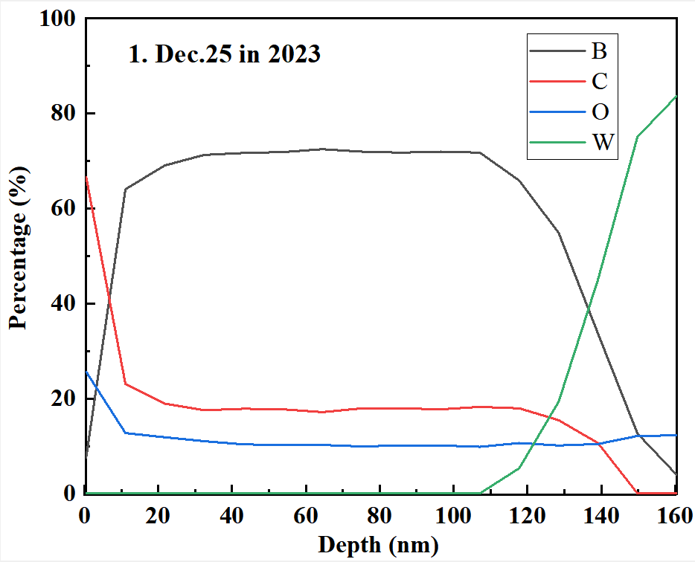
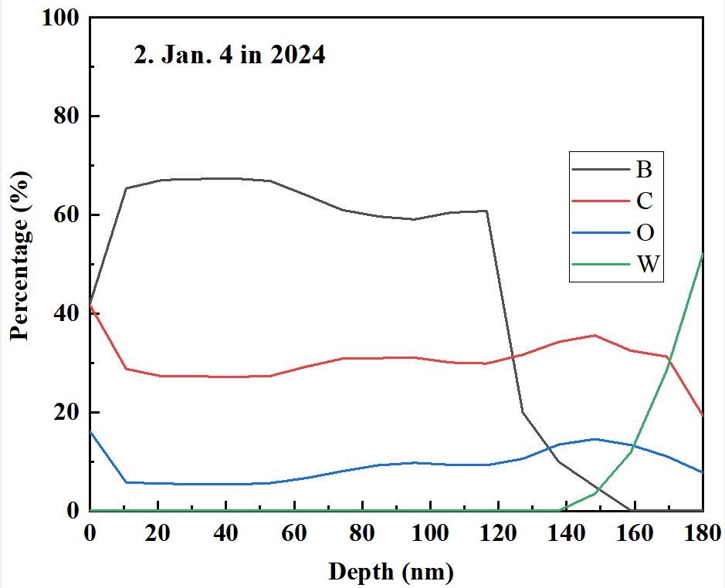
Boron film composition with GDC and ICWC
The thickness measured by XPS is consistent with the result measured by FIB.
The composition is slightly different with ICWC and GDC.
  B film with ICWC is B:C:O=7:2:1, higher ionization rate, B reacts with O and H/D.
  B film with GDC is B:C:O=13:6:1,lower ionization rate, more C deposition.

Slide 12
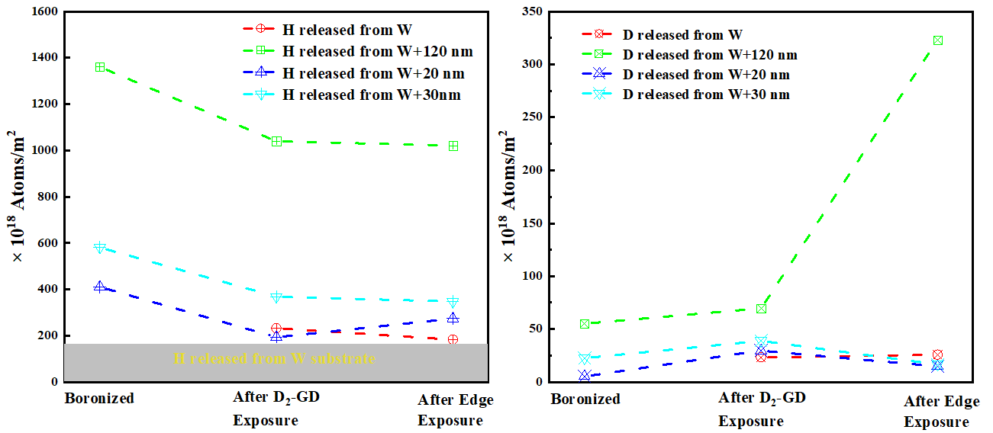
H release and removal investigation
Low-temperature plasma
Higher-temperature plasma
H and D release more with thicker boron film.
D-GDC and D-plasma can replace the co-deposited H in the boron coating film.
A 120 nm carbon boron film has a D capture capability that is 20 times that of bare tungsten.
Nuclear fusion 64(2024) 074001

Slide 13
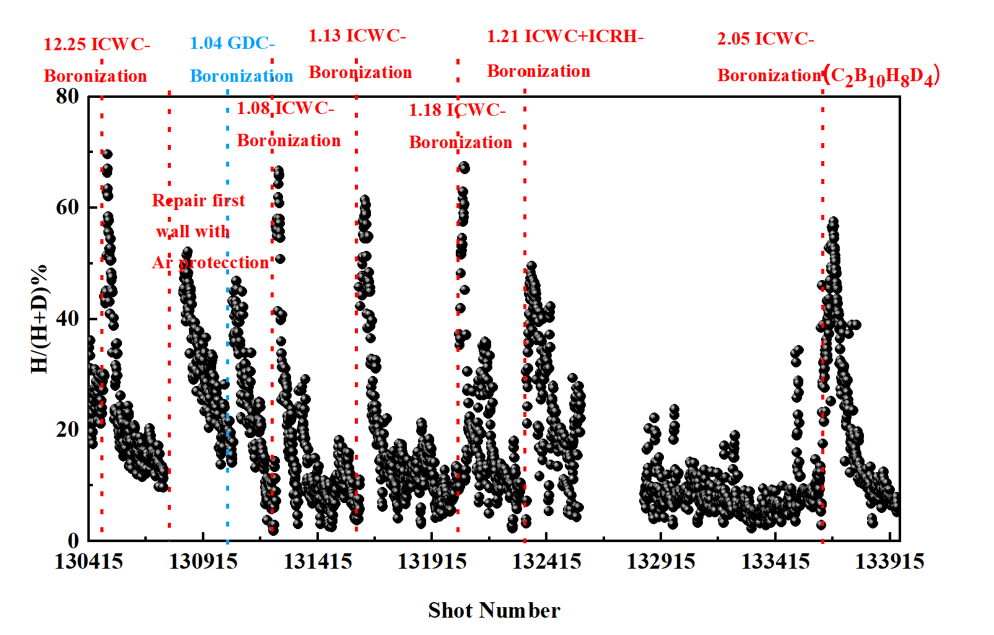
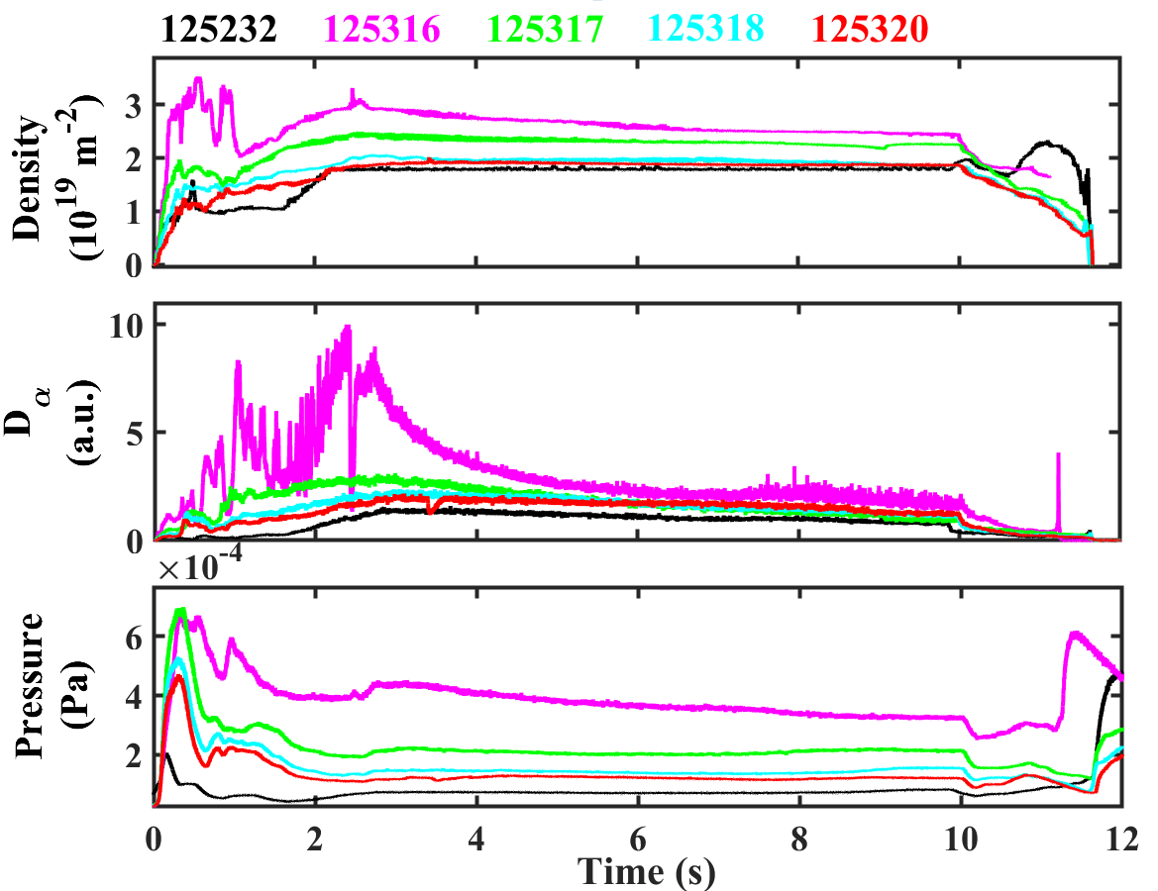
Serious H release during the initial plasma discharges after B coating
H/H+D was larger than 80% in the initial 10-20 shots, and plasma was hard to establish.
H/H+D could be decreased to ~5% with the B coating measured by RGA.

Slide 14
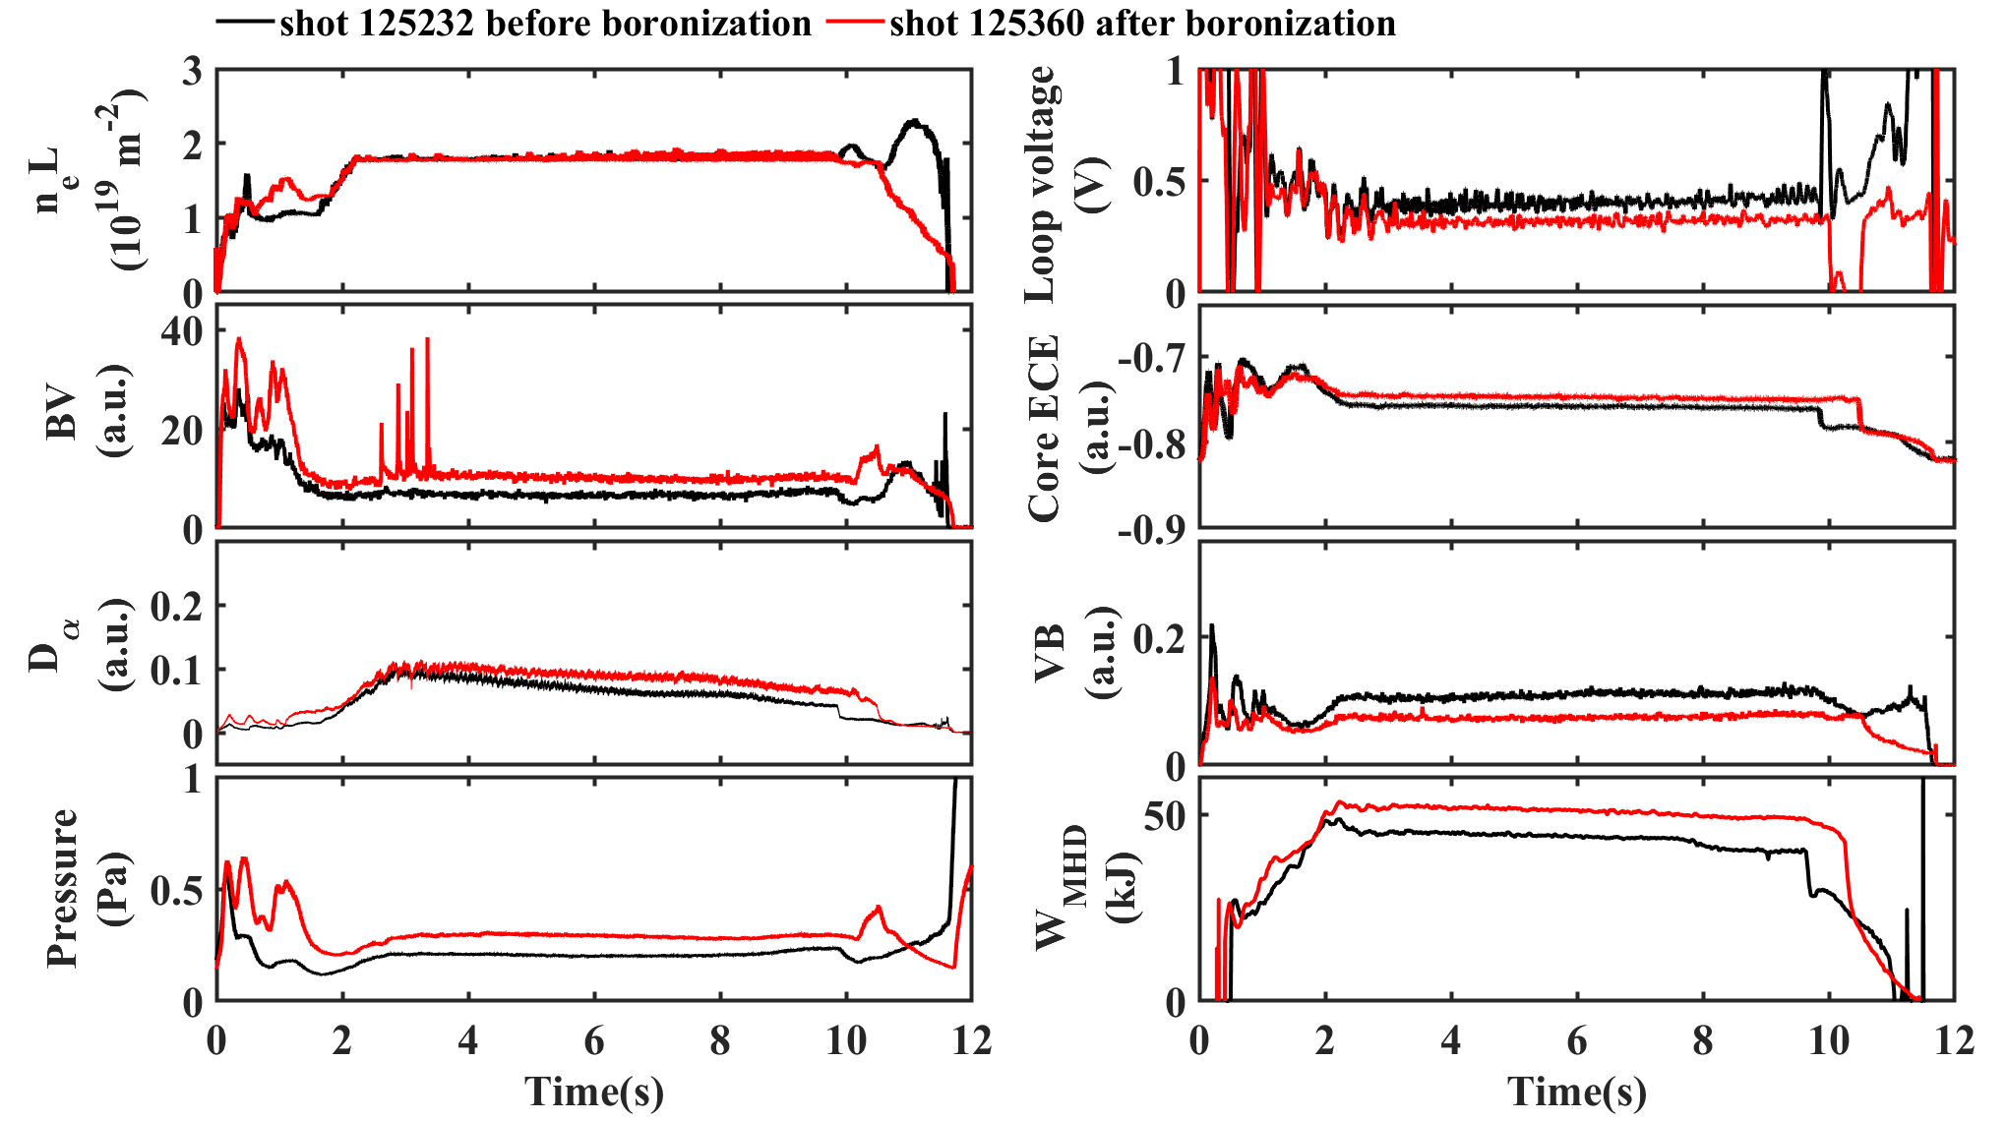
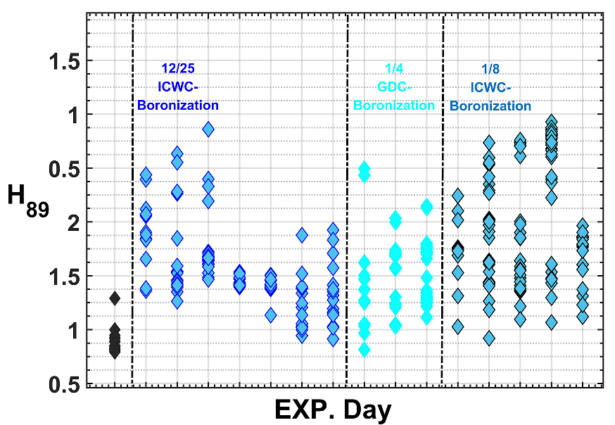
Significantly improved plasma confinement was achieved after B coating
Ip=300kA, ne~1.8×10¹⁹m⁻³, P_{EC}~0.5MW
BV, Da, neutral pressure increased after boronization.
Loop voltage and VB reduced, core ECE, and plasma stored energy increased.

Slide 15
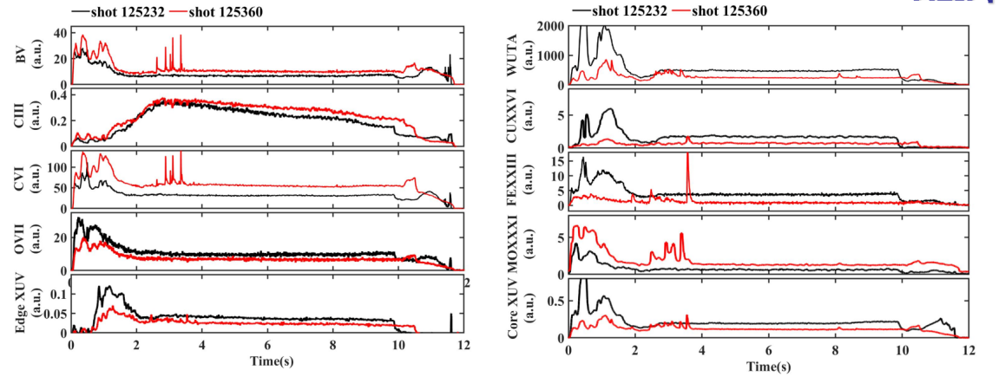
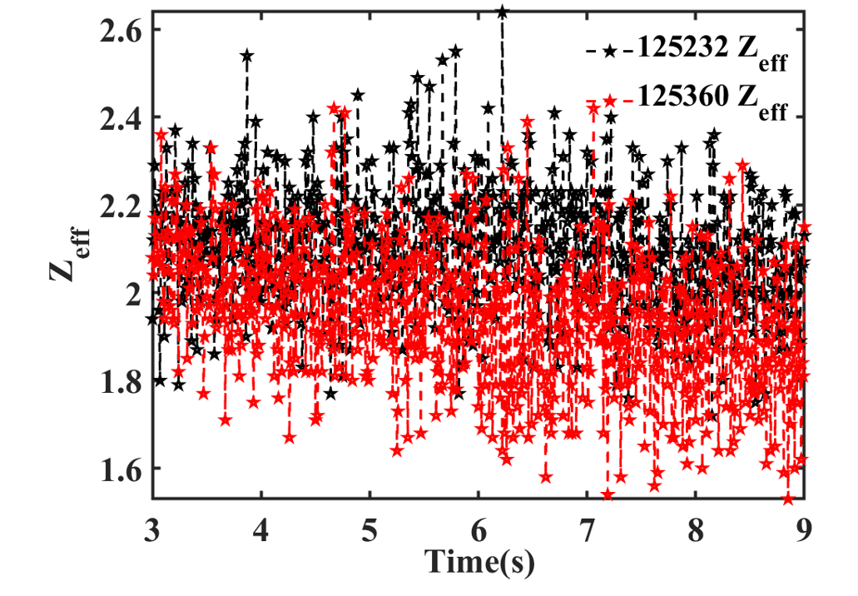
Reduced impurities and Zeff with B coating
The impurity radiation including oxygen and the heavy impurity such as W, Fe and Cu decrease obviously.
Zeff reduces from 2.2 to 2, contributing to improve plasma confinement.

Slide 16
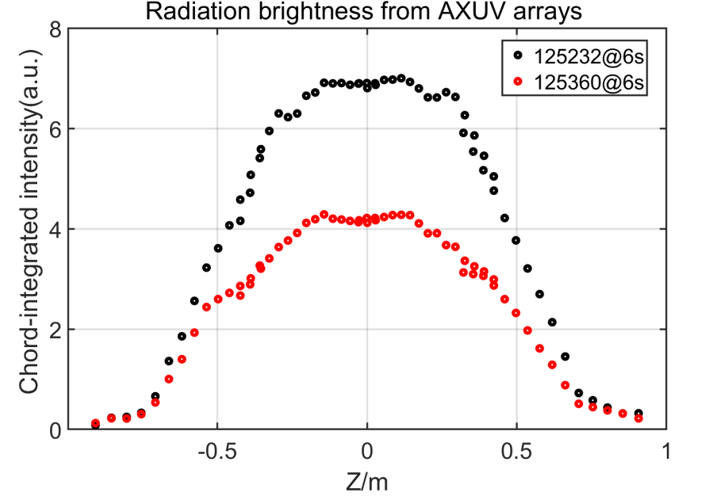
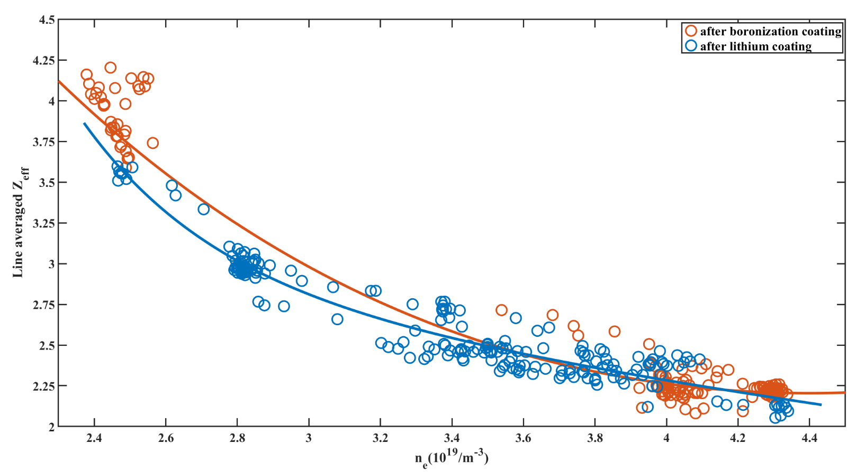
  Similar impurity control capability with Li and B coatings
  XUV profile had a clear decrease at the plasma core zone after boronization.
  Zeff kept at similar level with Li and B coatings.

Slide 17
A decreased plasma confinement with B coating compared with Li coating
H_{98,y2}
H_{98,y2}
β_{P}
f_{GW}
Compared with Li coating, the confinement reduced by 10-15% with B coating.
Decreased plasma confinement was probably due to increased H release with B coating.
Notes:
EC

Slide 18
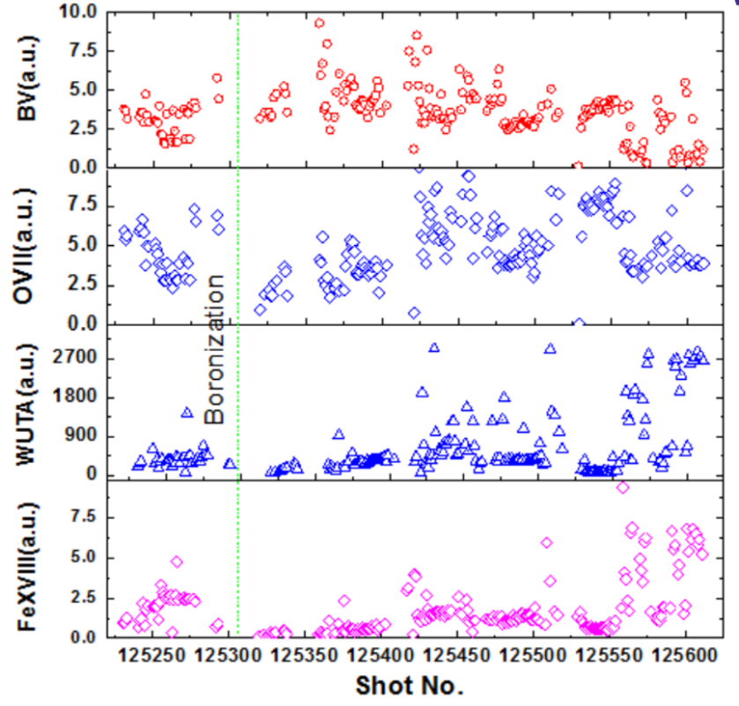
Lifetime of Boronization is ~160 shots about 1700s
After boronization, B emission increased significantly. While, O, W, and Fe radiation decreased.
As the discharge progressed, B film was consumed, BV gradually decreased, impurities radiation showed an increasing trend.
~160 shots

Slide 19
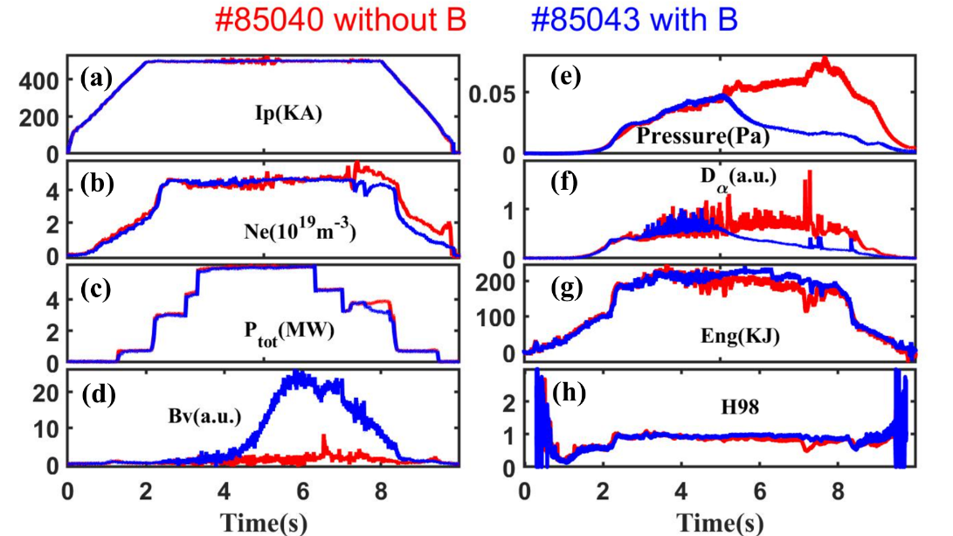
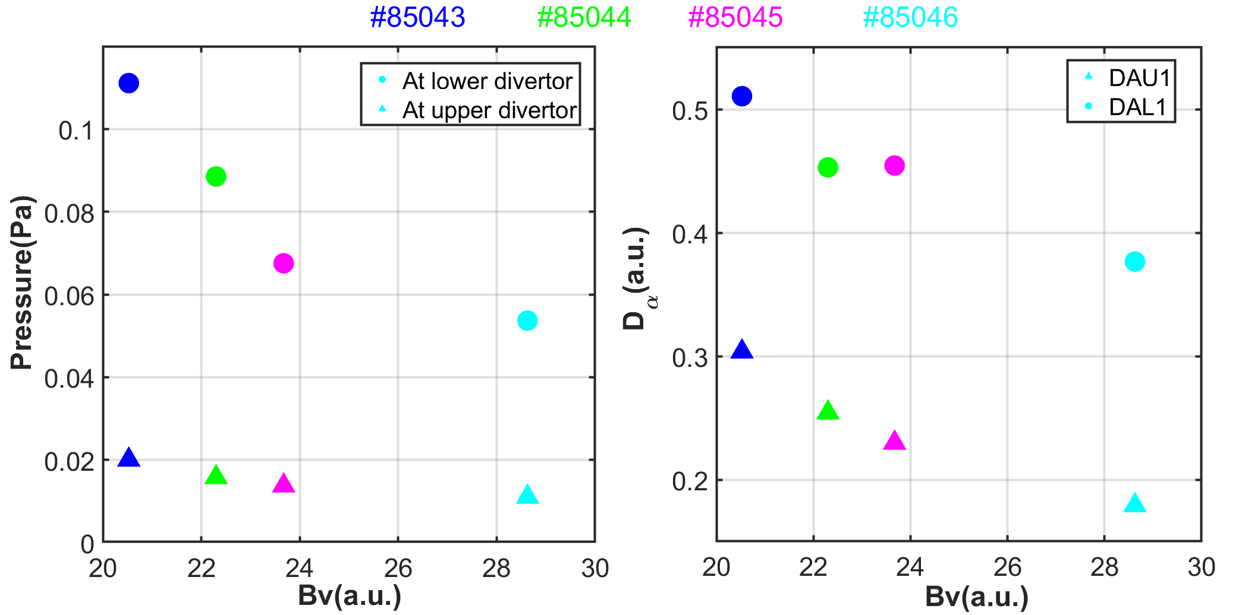
Reduced fuel recycling by real time Boron powder injection in EAST
Fuel particle recycling gradually reduced reaching up to 80% with the B powder injection.
Increasing the injected amount of B powder effectively reduced fuel recycling.
Comparison of fuel particle recycling w/o B powder injection
Evolution of fuel recycling as a function of Bv emission intensity
G.Z.Zuo, et al.,Mater. Res. Express (2023)

Slide 20
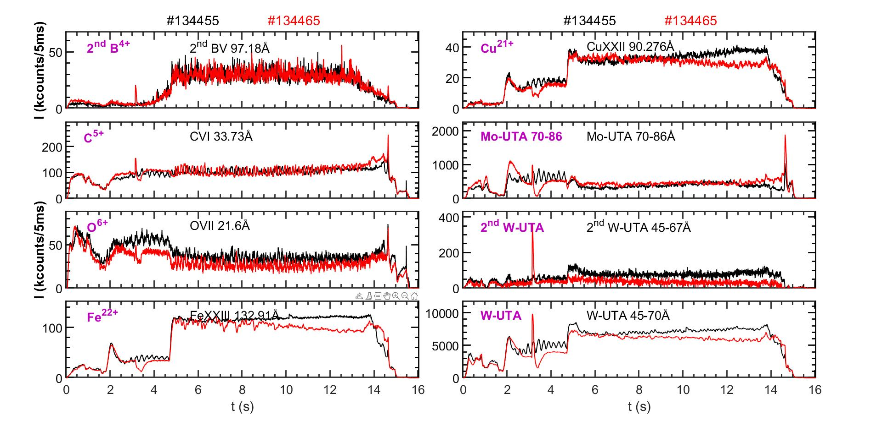
Reduced heavy metal impurities with B injection
With boron powder injection, heavy metal impurities including Fe, Cu and W decreased.

Slide 21
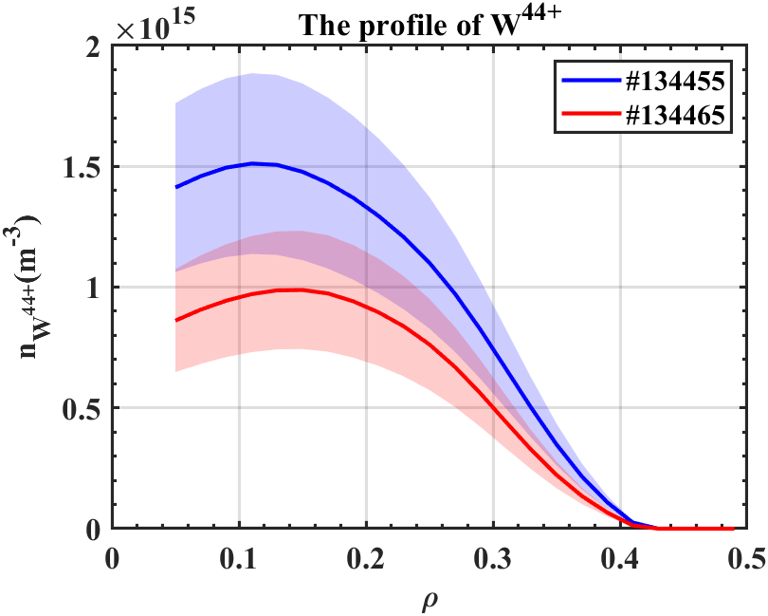
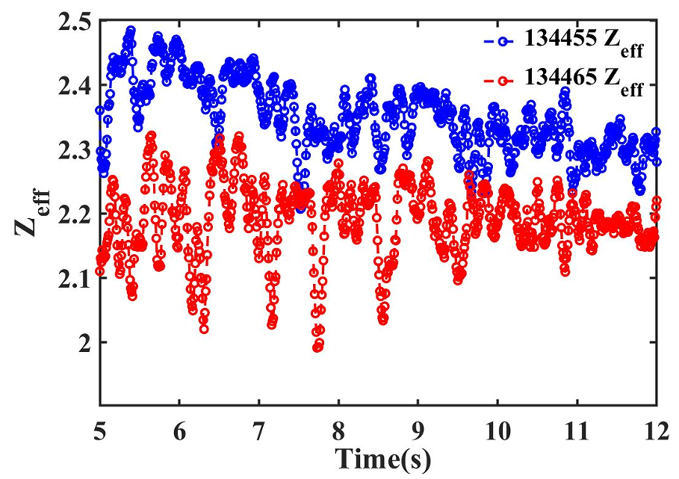
Reduced W impurity and Zeff with B powder injection
#134455 First shot with B injection #134465 after some shots with B injection
W impurity content decreased to 10⁻⁵ as the boron powder continuously injecting.
With boron powder injection, Zeff decreased from 2.4 to 2.2.

Slide 22
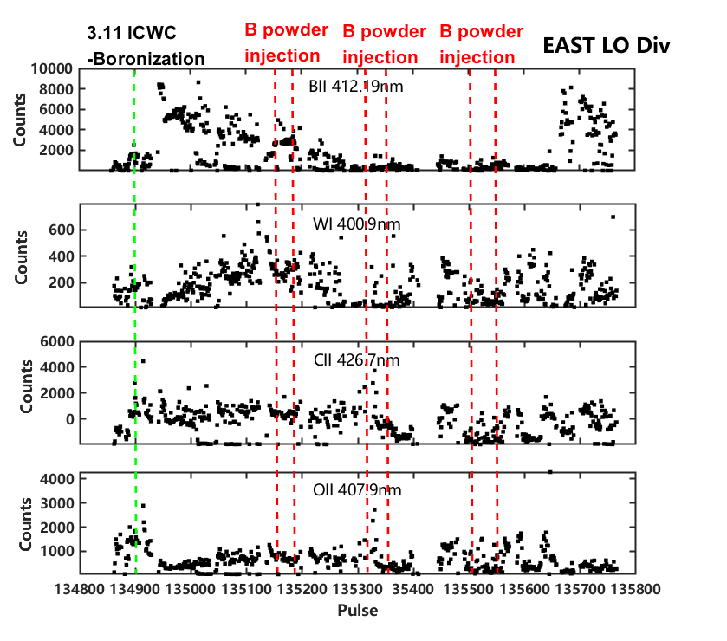
Effectively impurity control achievement via B coating and B injection
After B coating, BII and CII increased significantly, and then gradually decreased.
B powder was injected for refreshing boron film.
>100s H mode

Slide 23
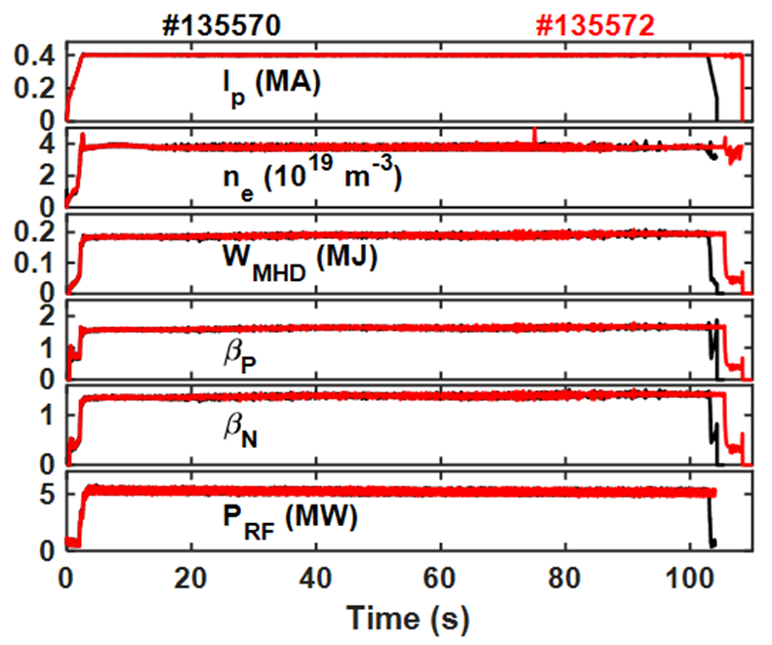
Develop B coating technologies to effectively extend pulse length of H mode plasmas
B coatings and B powder injections before long pulse H mode plasmas
400kA, ne~3.8, Wmhd~200kJ
EC2~0.6MW EC4~0.8MW
EC1+3~1.6MW LH2~2.2MW
Repeatable H-mode plasmas #135570(105s), #135572(108s)
Total radiated power is steady
Core W impurity content maintains ~10⁻⁵

Slide 24
Outline
  Background and motivation
  Experiment setup
  Recent experiment results
  Summary and Outlook

Slide 25
Summary and outlook
Boron coatings assisted by ICWC/GDC and real time B injection have been performed in EAST machine with full metal first wall.
  B film characteristics was systematic analyzed with various coating conditions.
  Lifetime of boronization was about 160 shots ~1700s.
  Impurity radiation including oxygen and heavy impurities decreased significantly, Zeff decreased from 2.2 to 2, and increased stored energy.
  However, H release was very serious during the initial plasma discharges.
  Compared to Li coating, 10-15% decreased confinement due to increased fuel recycling.
  B powder injection could control H recycling and further reduced impurities.
A 100s H mode was successfully achieved with boronization and B powder injection.
These efforts provide a very important reference for B application in ITER.

Slide 26
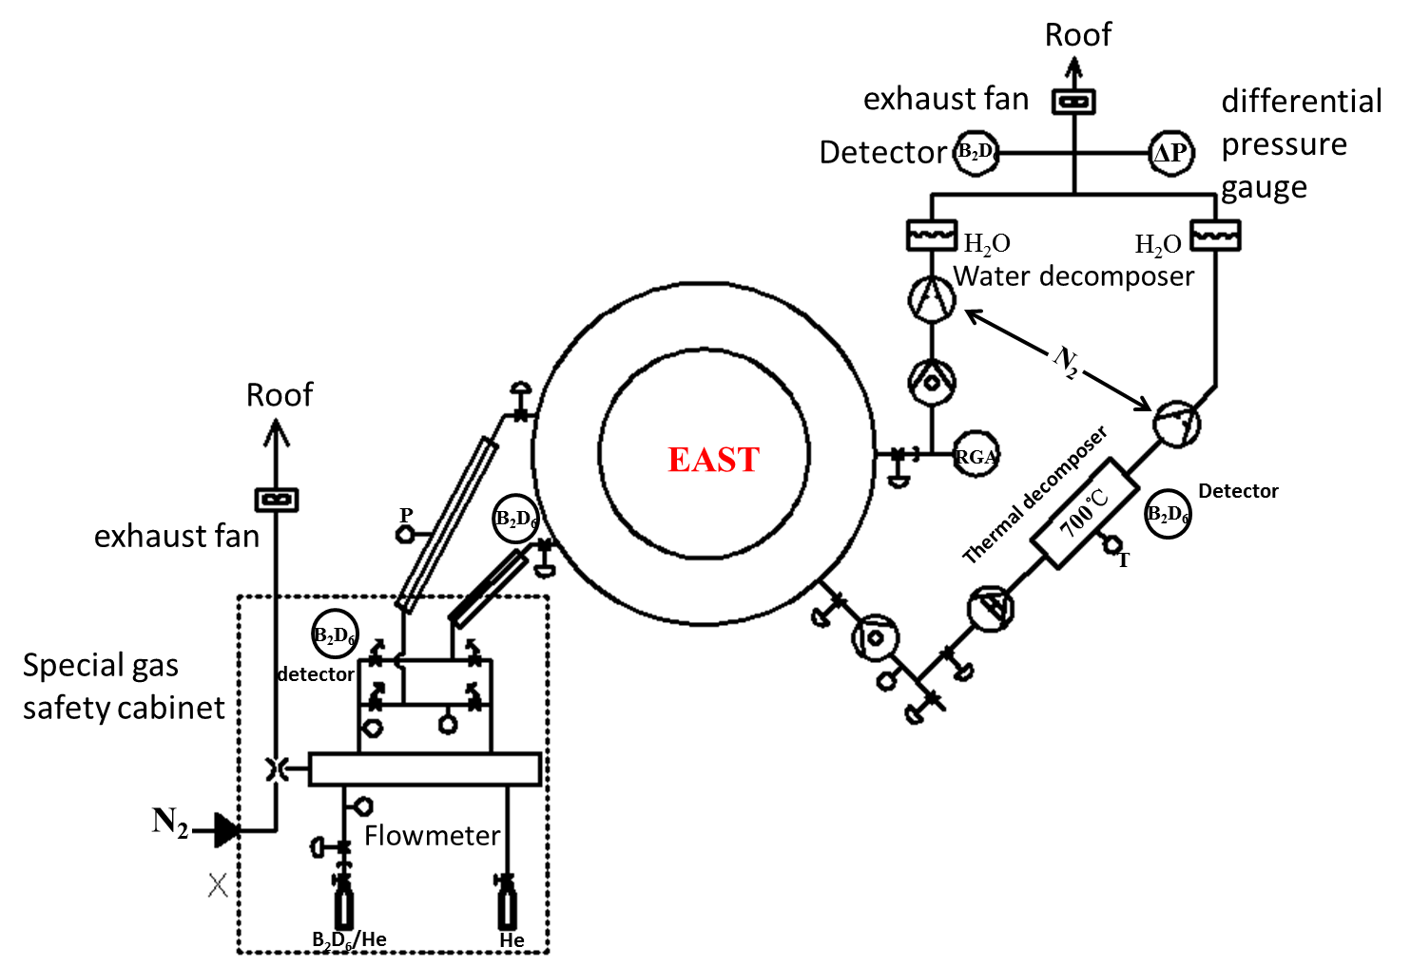
Next plan
ITER new baseline: full tungsten wall+boronization
BEST/CFETR will also use metal wall with boronization
Current boronization system in EAST
  Pre-discharge: C₂B₁₀H₁₂ +D/He-GDC/ICWC
  During plasma discharge: Boron powder injection
Upgrade of boronization system for pre-discharge coating
  Materials:
    B₂D₆ (applied in DIIID, AUG) is gas with highly toxic
  GDC with higher current and ICWC plasma assistance
  Upgrade of separate pumping system
    Molecular pump+root pump+rotary pump
  Secondary confinement structure
  Special gas safety cabinet
  Decomposer+detector

Slide 27
Thanks for your attentions！

