Slide 1
TOWARDS A LONG PULSE ECRH SYSTEM FOR WEST
J-M. Bernard^{1*}, L.Delpech¹, J.Barra¹, F.Bouquey¹, F.Clairet¹, E.Corbel¹, L.Doceul¹, F.Durand¹, R.Dumont¹, T.Fonghetti¹, P.Garibaldi¹, G.Giruzzi¹, S.Girard¹, P.Magaud¹, P.Maget¹, X.Regal-Mezin¹, P.Mollard¹, D.Mouyon¹, L.Nicolas¹, X. Mezin¹ , P.Thrierr¹, E Velly¹, and the WEST team**
¹ CEA, IRFM, F-13108 Saint-Paul-lez-Durance, France
² *Corresponding Author, **http://west.cea.fr/WESTteam

Slide 2
OUTLINE
Introduction of WEST Heating System
ECRH system Presentation
Long pulse operation is a challenge
Conclusion

Slide 3
Introduction of WEST Heating Systems
1

Slide 4
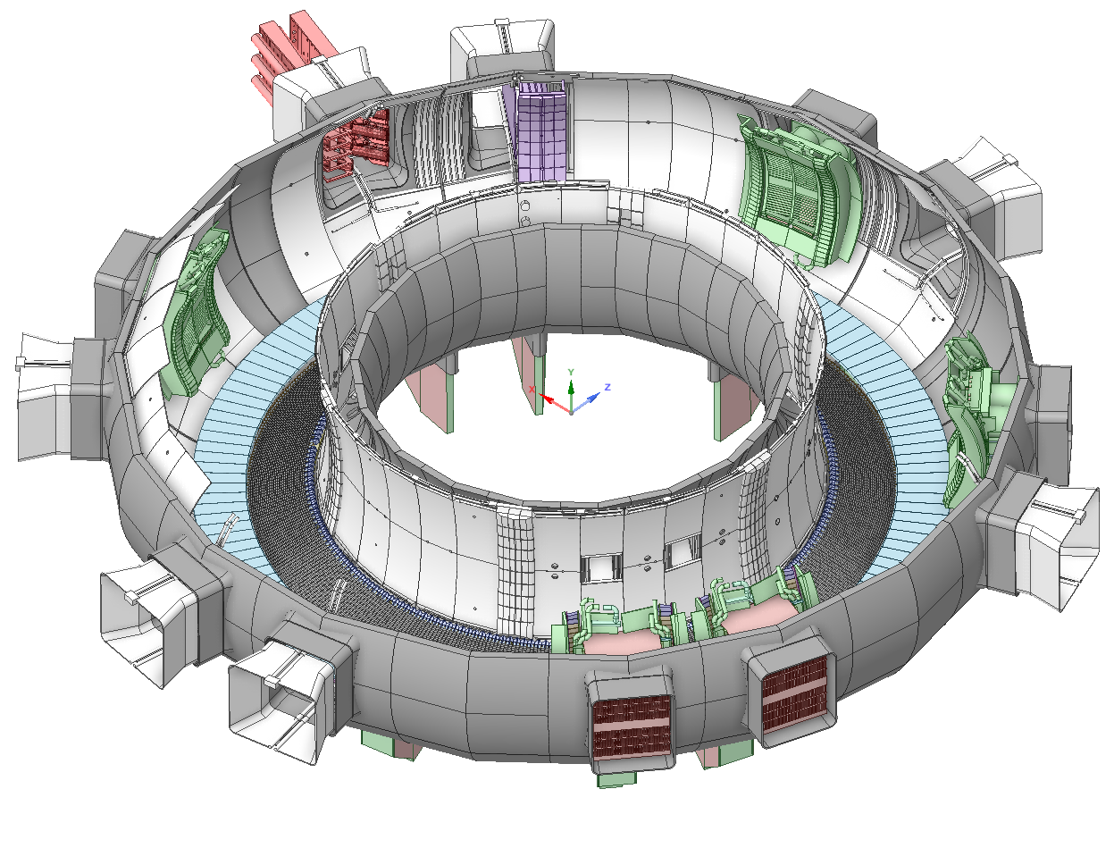
1- WEST Heating system introduction
ECRH
IC1
Up to 13 MW RF Heating & CD
LHCD system
2 launchers
LH1 at 4 MW/ 1000 s
LH2 at 3 MW / 1000 s
ICRH system
3 antennas (1 MW / 1000 s each)
ECRH
This presentation
[X. Regal Mézin this meeting]
IC3
IC2
LH1 (FAM)
(Full Active Multi-junction)
LH2 (PAM)
Passive Active Muti-junction

Slide 5
ECRH system presentation
2

Slide 6
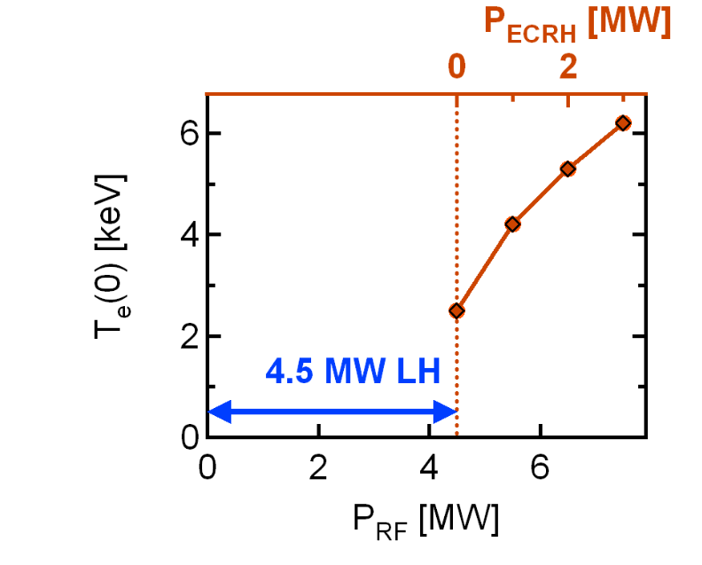
Main Features
Increase the operational domain in full W environment
Increasing central electron heating
Reduced W contamination
Ease access to H-mode
3 gyrotrons, 1 MW / 1000 s each (Thales)
Operational Frequency 105 GHz
Transmission line waveguides Ø 63,5 mm (General Atomics)
One dummy load for gyrotrons commissioning (Calabazas Creeks corp..)
[ Integrated Modeling P Manas 2021 ]

Slide 7
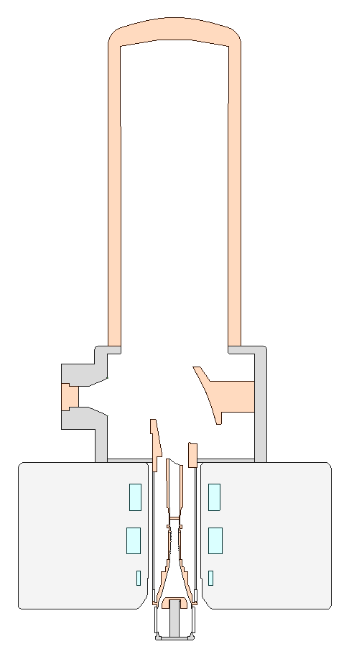
Description of the system
Torus hall
Transmitter
Vacuum system
Power dummy load
Cooling loop
Antenna
Transmission line
RF SWITCH
Gyrotrons
Plasma
Valves
RF SWITCH
DC Break
Belows
GYR3
POLARIZER
RF SWITCH
DC Break
Valves
Belows
GYR2
Valves
POLARIZER
DC Break
RF SWITCH
Belows
GYR1
POLARIZER
CODAC and interlocks
High power supplies
Plant Control System

Slide 8
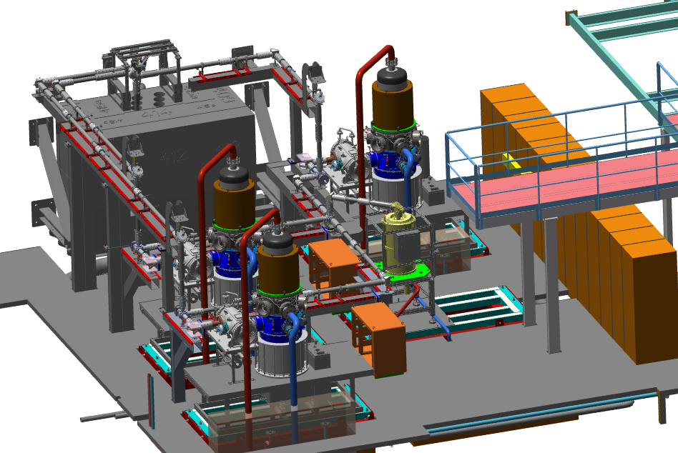
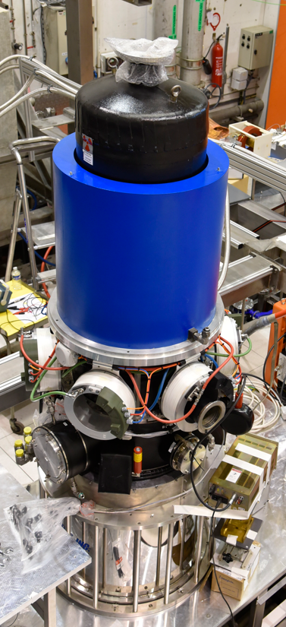
Layout of the gyrotron hall and transmission lines
1st Gyrotron
TH1511
Hall
CODAC Cubicles
3 Gyrotrons
Waveguides
Cooling pipes
MOU
Magnet
Power Load

Slide 9
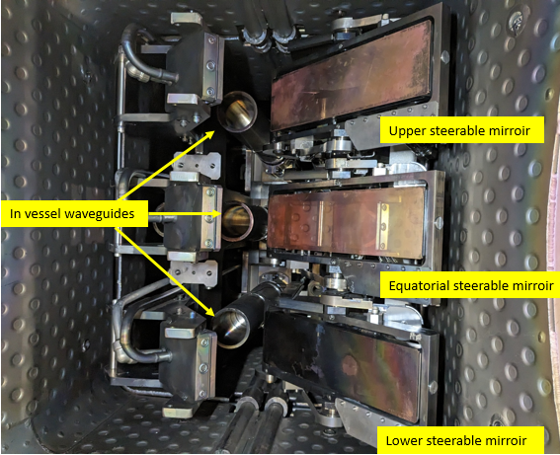
Antenna
6 water cooled mirrors (3 fixed / 3 steerable)
Frame and internal ss waveguides are not water cooled yet
Thermo couple embbeded for thermography
Current limitation 1 MW/10 s for each line
In vessel calibration of the steerable mirrors done this spring 2024
Upper steerable mirror
Miror position | Angular variation | Tolérencies
Upper | Toroidaly ± 25° Poloidaly +11°/-17° | Toroidaly ~ ± 0,4° Poloidaly ~ ± 0,6°
Equatorial | Toroidaly ± 25° Poloidaly ± 17°
Lower | Toroidaly ± 25° Poloidaly +17°/-11°
Equatorial steerable mirror
Lower steerable mirror

Slide 10
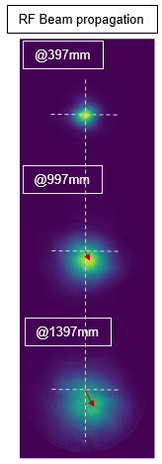
Main results of commissionning of the first Gyrotron
At KIT on Fulgor Test bed
1 MW / 3 ms achieved in december 2023
Infrared measurement at output of gyrotron
Calculated modal purity better than 96 %
Oscillation at 105 GHz
1 MW / 2,5 s June 2024
Frequency shift 212 MHz @ 1 MW power
RF Beam Propagation
Infrared measurement at output of gyrotron

Slide 11
Long pulse operation a challenge
3

Slide 12
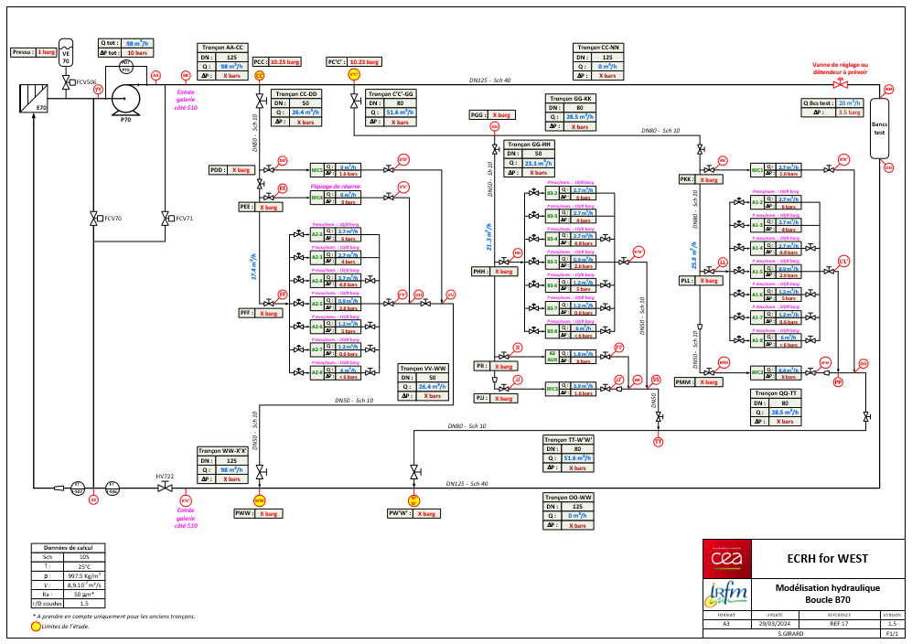
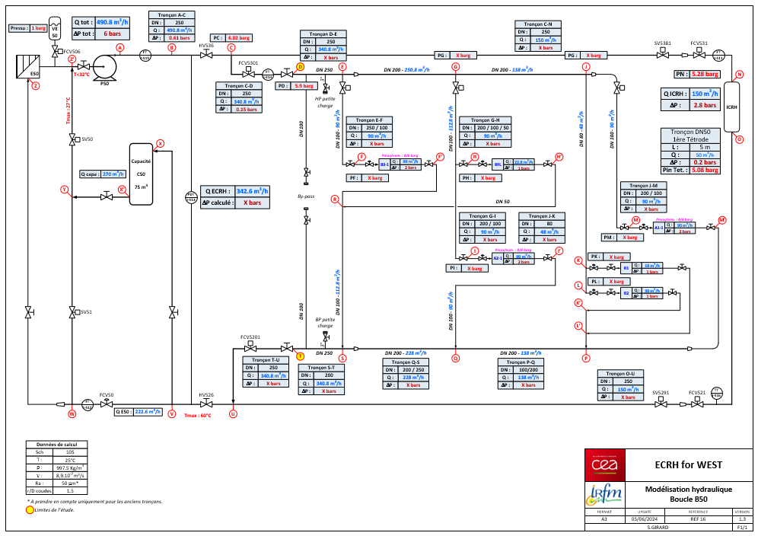
Two Water loops will be used
First one used for high pressure drop components and low flow rate
Small components: Waveguides, Elbows...
10 bar
~98 m³/h
Second one used for low pressure drop but high flow rate
Large components: Gyrotrons, water load
6 bar
~340 m³/h
Piping and Instrumentation Diagram (P&ID)
(Upgrade under work)

Slide 13
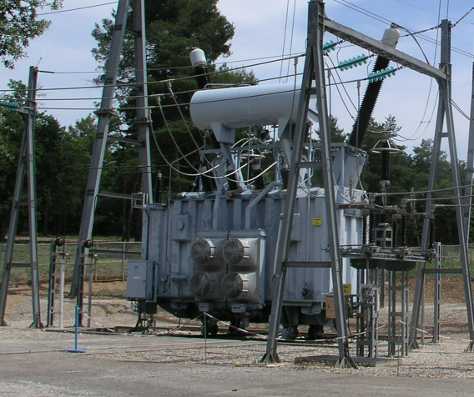
Power supply an other challenge
Need permanant energy source for long pulse
A dedicated distribution network exists at IRFM at 400 kV
Transformer of 90 MW for poloidal coils and heating systems.
For ECRH
(efficiency ~50 %)
3 gyrotrons of 3 MW = 6 MW of power supply 1000 s
Transformer 400 kV / 66 kV

Slide 14
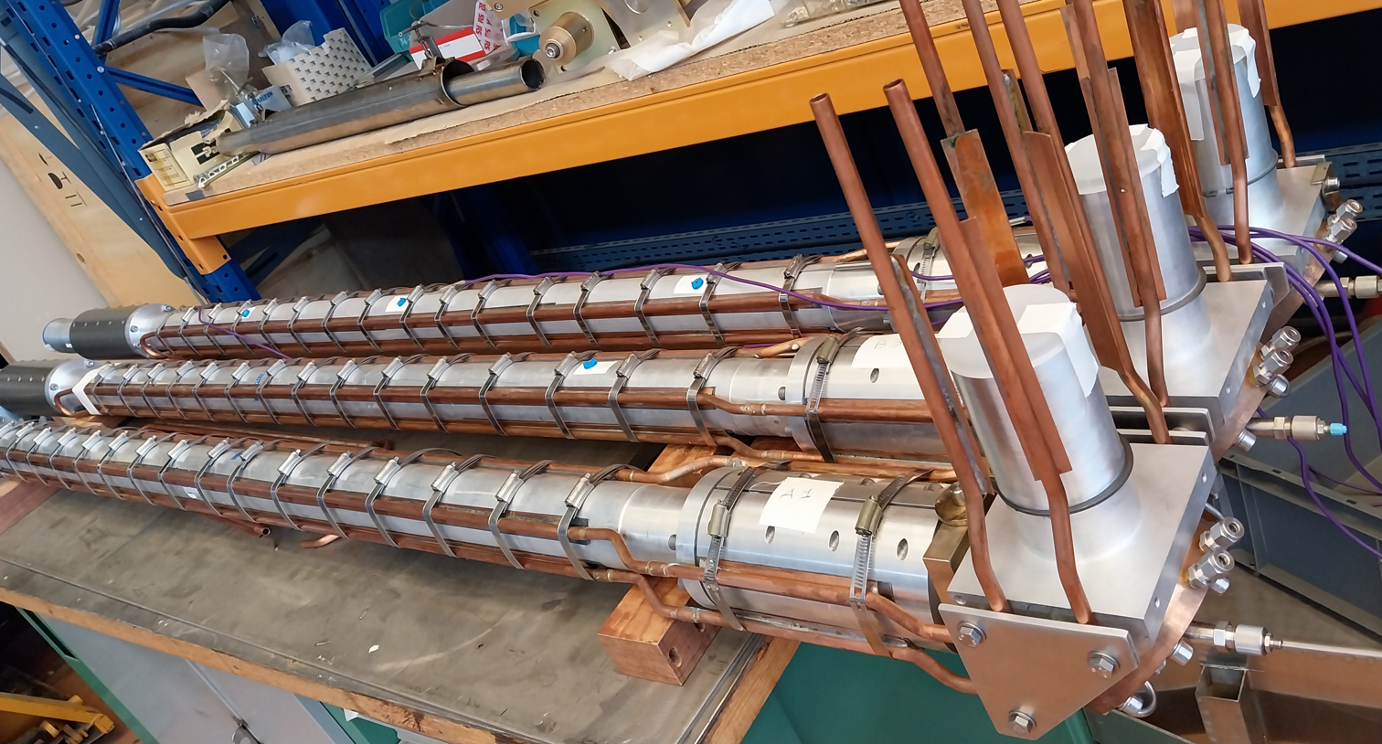
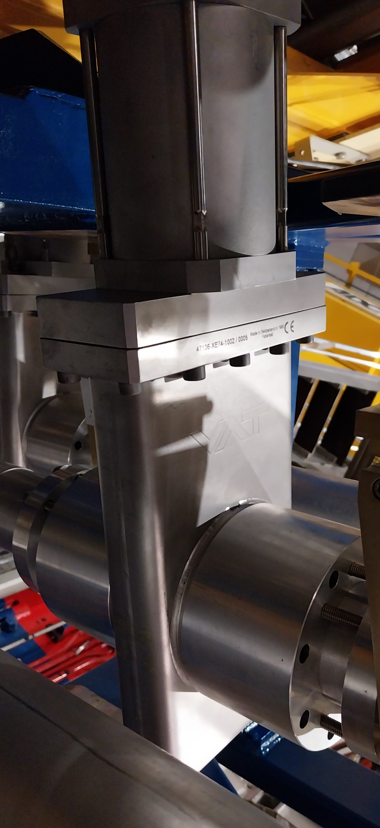
RF components and transmission lines
Part of waveguides (Water cooled)
Design of the load to be validated
long pulse operation (Water cooled)
Valves, Belows and DC break (Not cooled yet)

Slide 15
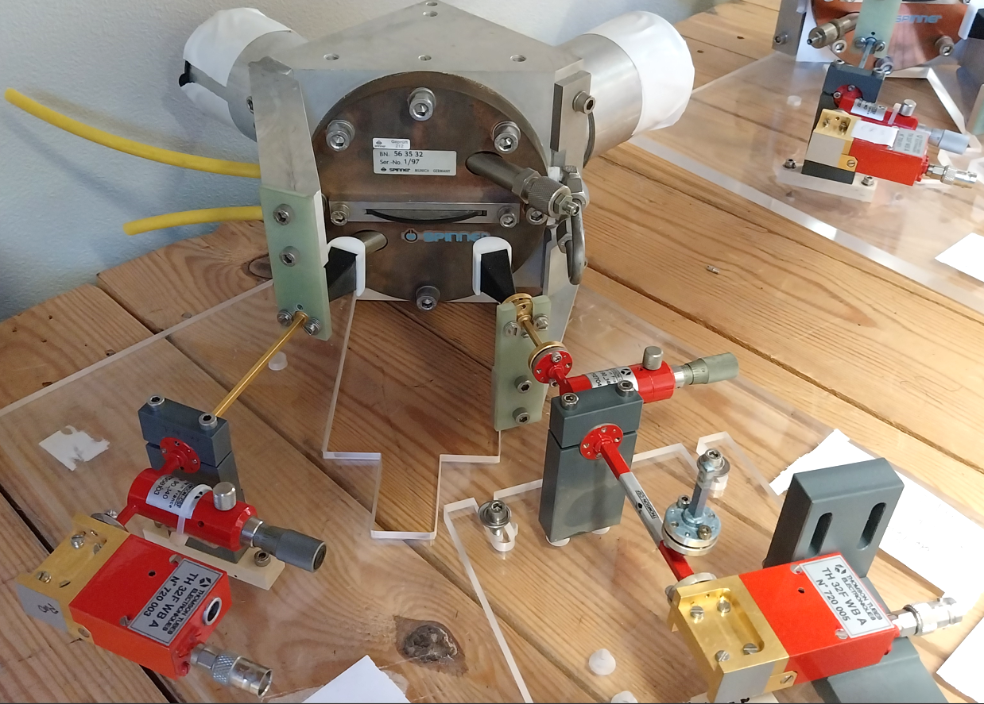
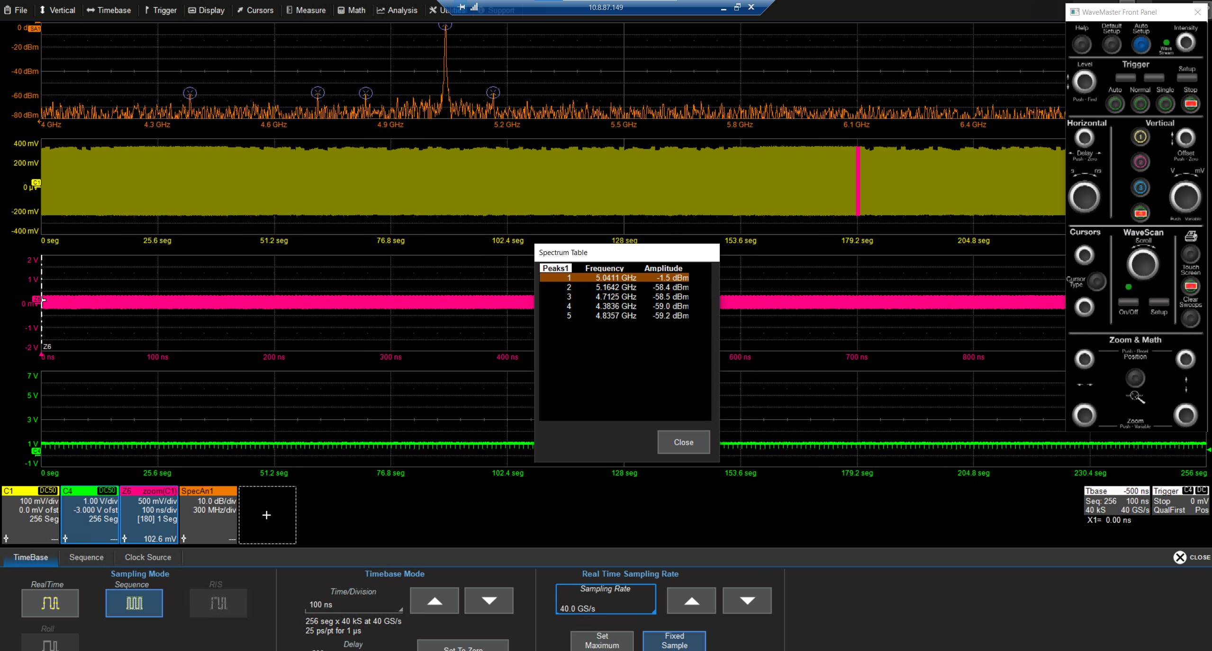
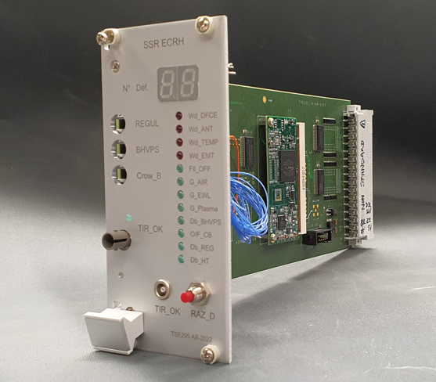
Interlocks and CODAC
Each Gyrotron is equipped with 45 thermocouples
Monitoring of the output power by
Calorimetry
Millimeter wave measurements
Monitoring the Spectral purity
with down converter and fast acquisition oscilloscope
Fast safety card
Mode loss detection
Over heating on gyrotron / Transmission lines / antenna
Arc detection (MOU, TL )
Over voltage/over current
Gyrotron Vacuum fault
Data acquisition
~1 Mo/s
1Go / 1000 s

Slide 16
Conclusion
4

Slide 17
Conclusion
3 MW / 1000 s ECRH system is under construction
It will increase the WEST operational domain.
First Gyrotron validated on short pulse duration
Need more commissionning for long pulse
1000 sec is a real challenge regarding the auxiliaries
increase the complexity, but available at IRFM
The antenna, and some RF line components are not yet cooled
Need some future upgrade
The first shot with ECRH in WEST
Foreseen by the end of this year
The second and third gyrotron are foreseen to be integrated next year

Slide 18
Thank you for your attention
This meeting
P.Manas ”Long pulse operation in a W environment : feedback from WEST”
X.Regal Mézin ”Lower Hybrid current drive long pulse operation state of the art on WEST”
R/Nouilletas “Long pulse operation in a W environment : feedback from WEST”
T.Fonghetti « WEST operational domain predictions of L-mode non-inductive discharges with an integrated modeling approach”
L.meunier « WEST: the challenges of reaching 100% of actively cooled components for long pulse operation”
V. Lamaison ”WEST – operation of long pulse fusion Tokamak”
Fusion engineering and design:
A new 3MW ECRH system at 105 GHz for WEST (https://doi.org/10.1016/j.fusengdes.2022.113360).
Operational domain for the new 3MW/1000s ECRH System on WEST (https://doi.org/10.1051/epjconf/202327702006)

