Slide 1
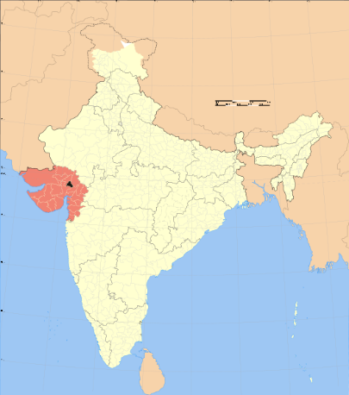
Performance of PAM launcher in ADITYA-U tokamak
P. K. Sharma^{1,2}, J. Kumar, K. K. Ambulkar, P. R. Parmar, C. G. Virani, S. Sharma, C. Singh, A. L. Thakur, J. Ghosh^{1,2}, R. Tanna, H. Raj, R. Kumar, K. Yadav, S. K. Pathak^{1,2}, V. Siju, ADITYA Team and Diagnostic Team.
^{1.}Institute for Plasma Research, Bhat,
Gandhinagar-382428, Gujarat, INDIA
^{2.}Homi Bhabha National Institute, Anushaktinagar, Mumbai – 400094, Maharashtra, INDIA
I
P
R
GANDHINAGAR

Slide 2
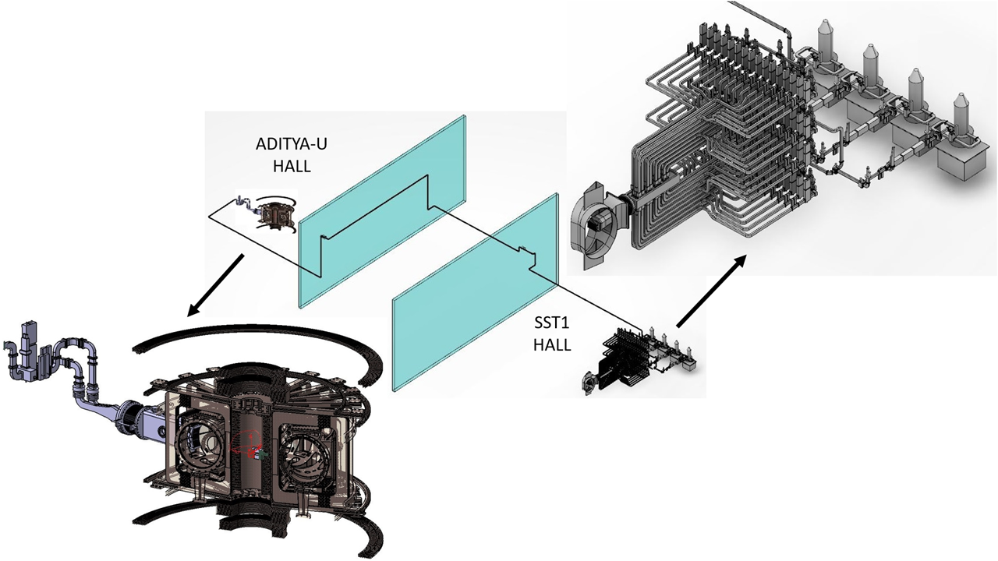
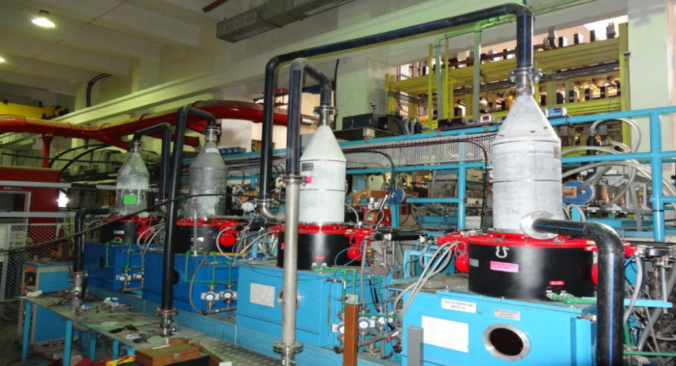
HP source system to feed PAM launcher

Slide 3
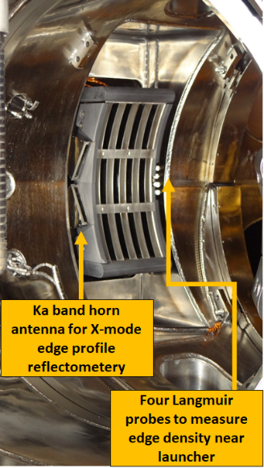
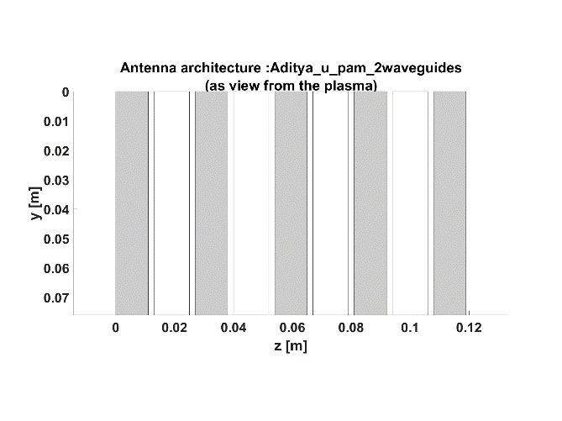
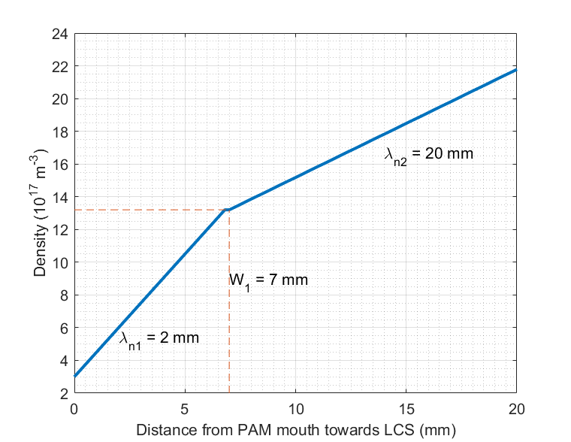
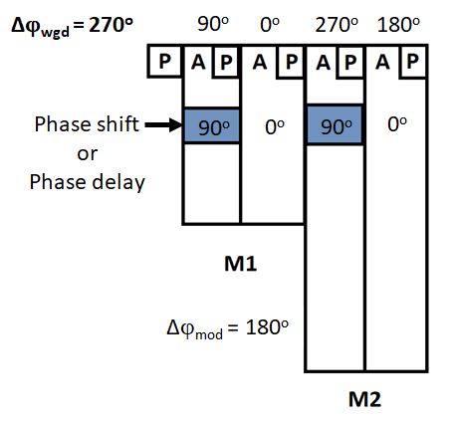
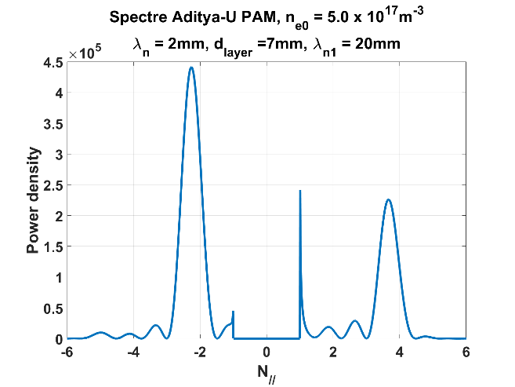
PAM architecture/Spectrum
$$n_{e}\left(r\right)=n_{e−PAM}\left(1+ \frac{r}{λ_{n1}}\right) 0 ≤r ≤w_{tile}$$
$$n_{e}\left(r\right)=n_{e−tile}\left(1+ \frac{r−w_{tile}}{λ_{n2}}\right) r>w_{tile}$$

Slide 4
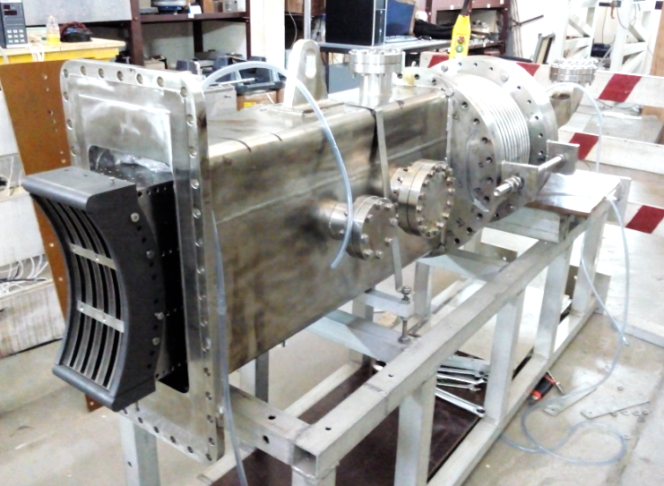
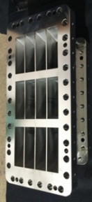
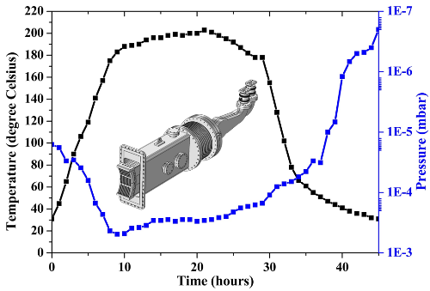
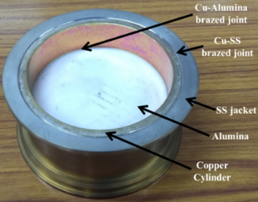
PAM launcher is compact, simpler & relevant to reactor type machine
PAM for ADITYA-U
Return Loss = 25 dB (estimated 26 dB)
Insertion Loss = 0.11 dB (estimated 0.08 dB)
Horizontal/vertical flaring module
Mode convertor
P_{rf} ~ 250 kW-1s.
Jain, Y. M., et. al., FED, 147, 2019, 1112225.
Permanent
φ-shifter
Vac. achieved ~ 10⁻⁸ mbar
Baking cycle ~ 50 hrs.
Power divider
Jain, Y. M., et. al., JEWA, 2021, 1915187.
rf window section

Slide 5
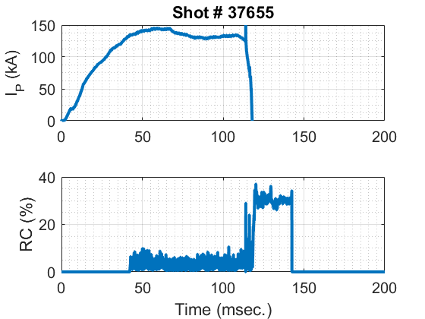
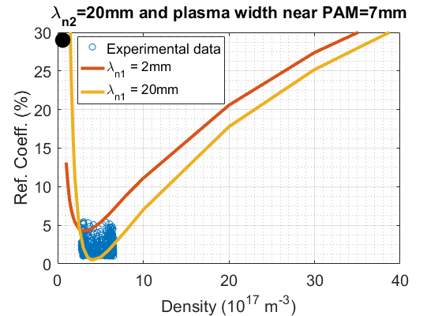
LH coupling results

Slide 6
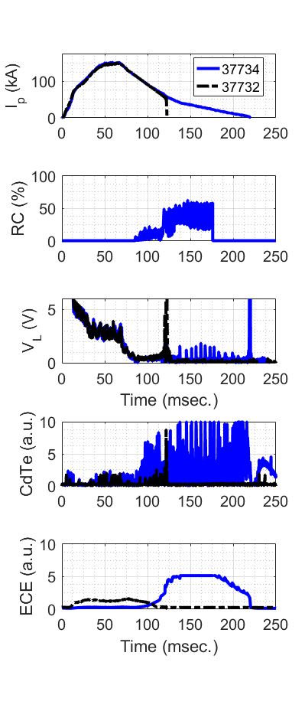
LH Expts. with +ve convertor only.
Plasma current is elongated up to ~220ms.
RC initially remains low but increases towards end. Probably due to low edge density.
Nearly zero loop voltage during LH current phase.
CdTe detector signal significantly increases during LH phase indicating generation of supra-thermal electrons due to LH wave particle interactions.
Similarly 2nd harmonic ECE signal also increases significantly confirming supra-thermal electrons generation due to LH wave particle interactions.

Slide 7
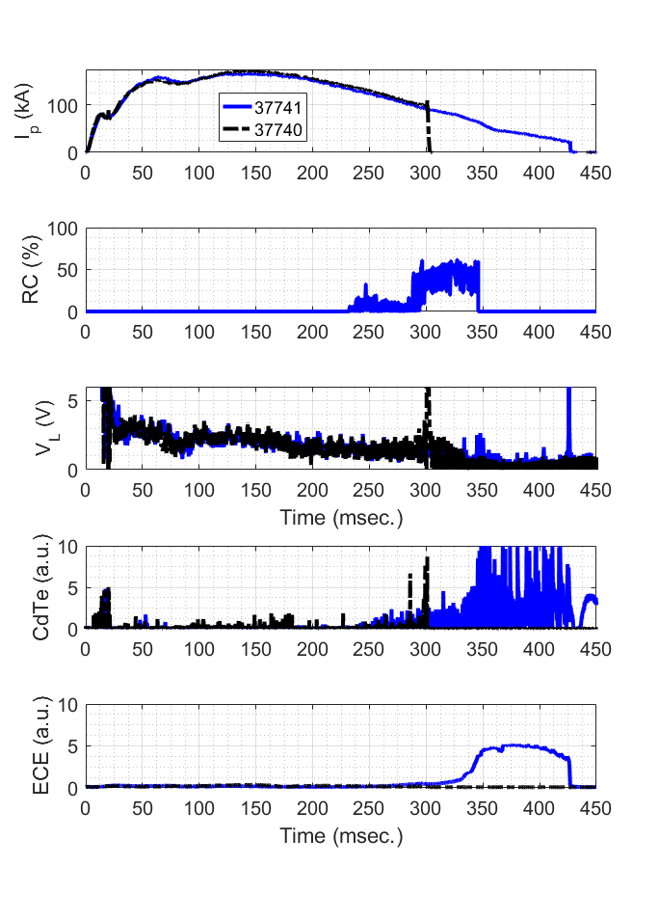
LH Expts. with –ve convertor.
Plasma current is elongated up to ~430ms.
RC initially remains low but increases towards end. Probably due to low edge density.
Nearly zero loop voltage during LH current phase.
CdTe detector signal significantly increases during LH phase indicating generation of supra-thermal electrons due to LH wave particle interactions.
Similarly 2nd harmonic ECE signal also increases significantly confirming supra-thermal electrons generation due to LH wave particle interactions.

Slide 8
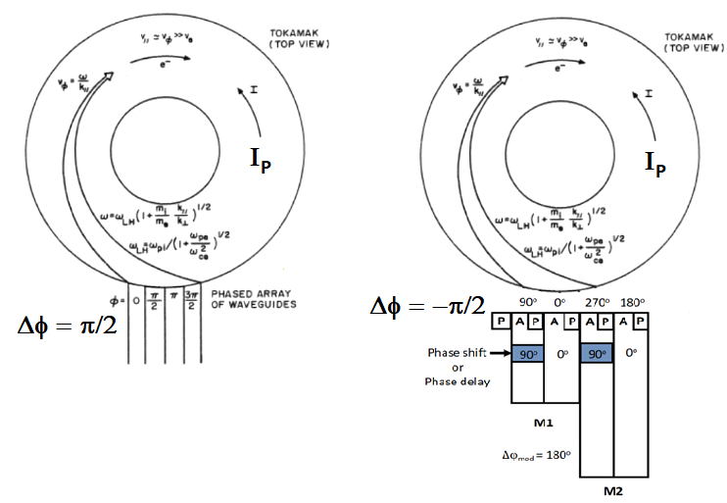
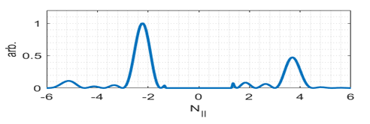
Directionality of LHW’s
Grill launcher was launching the correct spectrum to drive I_{P} in CW direction.
Sharma, et. al., FED, 2007
In ADITYA-U, the I_{p} is in CW direction.
CCW direction
It appears that for PAM launcher, the launched spectrum is driving I_{P} in opposite direction.
Responsible for CD in CCW direction
Responsible for CD in CW direction
To drive LH current in the same direction, the relative phasing should be opposite for grill and PAM launcher.

Slide 9
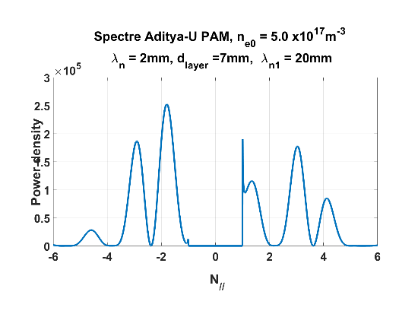
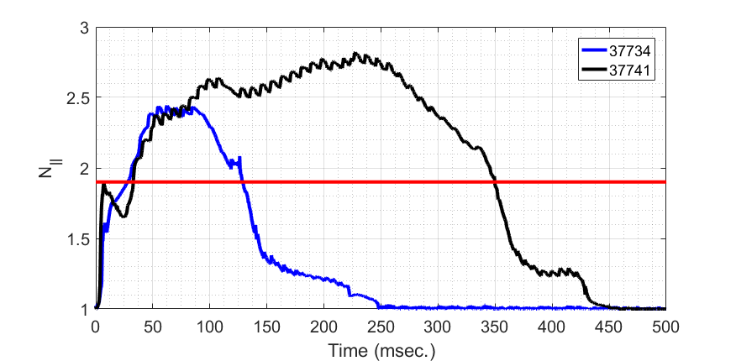
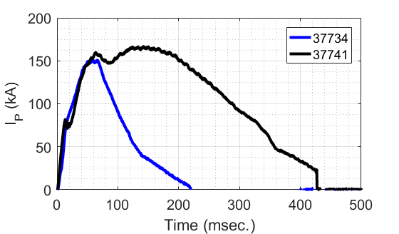
Directionality to be changed
$$N_{||}^{acc}= \frac{ω_{pe}}{ω_{ce}}+ \sqrt{1+ \frac{ω_{pe}^{2}}{ω_{ce}^{2}}− \frac{ω_{pi}^{2}}{ω_{o}^{2}}}$$
Responsible for CD in CCW direction
Responsible for CD in CW direction
It appears that opposing peak (N|| <-1.9) leads to drop in CD.
Later when accessibility condition decreases (below ~1.9), the supporting peak (N|| > 1.5) starts driving current efficiently and so the CD slope changes and eventually current elongates a bit further but because of less power/poor coupling it is not able to drive current further.
I_{P} could not be sustained probably due to opposing peak of the spectrum

Slide 10
Probable approach
Two options:
Rotate the PAM launcher up-side down.
Requires major machine opening.
* For un-installation
* For re-installation
Extensive mechanical work involved
(ii) Change the direction of I_{P}
Seems reasonable and viable (our team is working on it.)

Slide 11
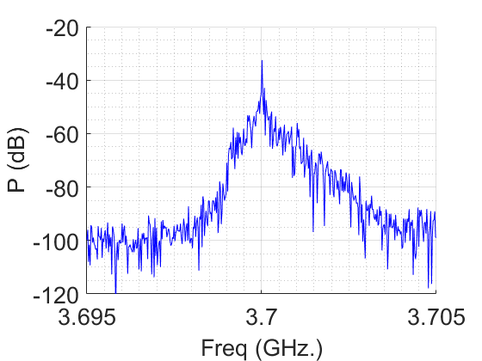
Frequency spectrum broadening.
Frequency broadening is observed, indicating presence of non-linear wave interactions with the launched pump wave and accounts for parametric decay instabilities (PDI).
The PDI excited sideband waves not only lead to power depletion of the pump wave but also excite waves with higher N|| which eventually reduces the CD efficiency drastically.
Peak around ~3.699 GHz. is observed which is around ~30 dB down.
Prominent broadening on the down shifted side may correspond to an ion cyclotron sideband down-shifted by approximately ~1 MHz and may be attributed to the interactions of inaccessible waves (N||> 1.0) with edge plasma density.

Slide 12
Conclusions and discussions
The 3.7GHz-250kW-1second PAM launcher is successfully installed and commissioned on ADITYA-U tokamak.
It is designed to launch LHWs having N|| centered at 2.25 when two modules are relatively phased at 180º. The relative phasing between the active waveguide is fixed at 270º. The two module PAM launcher provides flexibility in launching N|| from 1.875 to 2.625 when phasing between the modules is varied from 90º to 270º.
It is powered by the same high power klystrons based rf system which feeds the SST1 LHCD system through a long transmission line.
The high power rf conditioning of the PAM launcher is conducted till acceptable reflection coefficient is observed.
LH experiments is carried out by launching rf power up to ~100kW in to 100-175 kA Ohmic target plasmas formed with positive and negative convertor operation.
Low reflection coefficient (~5-7%) is observed even when launcher is placed 20-25mm behind limiter and matches well with predicted simulation results from ALOHA code.

Slide 13
Conclusions and discussions (…Contd.)
In negative convertor operation, LH could support plasma current up to ~430ms whereas in positive convertor operation it could sustain current up to ~220ms.
The interaction of LHWs with plasma, in both the cases, is further confirmed, with diagnostics like 2nd ECE and CdTe detector signals which shows immediate response when LHCD power is injected in to the plasma.
The measurement of the spectrum shows reasonable broadening around the pump wave. The broadening is prominent on the lower frequency side with a peak around 3.699 GHz suggesting ion-cyclotron sideband down shifted by ~1 MHz and is attributed to the interactions of inaccessible waves with edge plasma density fluctuations.
The reflection coefficient increased significantly towards the end of the plasma shot suggesting very low density near PAM mouth. Here, the launching of ECRH power helped in improving the reflection coefficient to a large extent but even in such condition the plasma current could be extended significantly.
The inability to drive the plasma current non-inductively for extended period is attributed to the directionality of the waves launched by the PAM launcher.
It is proposed to reverse the direction of plasma current in the next LHCD experimental campaign by reversing the polarity of the magnetic field system and extend the plasma duration over extended period.

Slide 14
Thank you for your kind attention

Slide 15
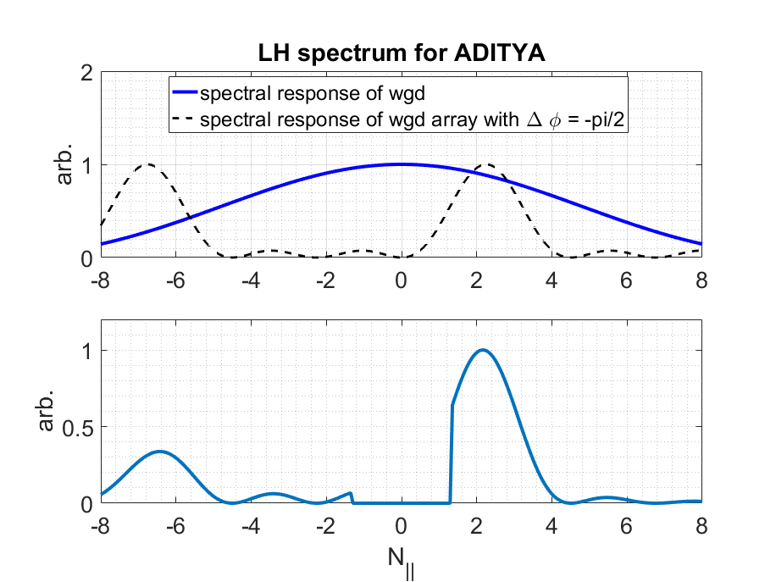
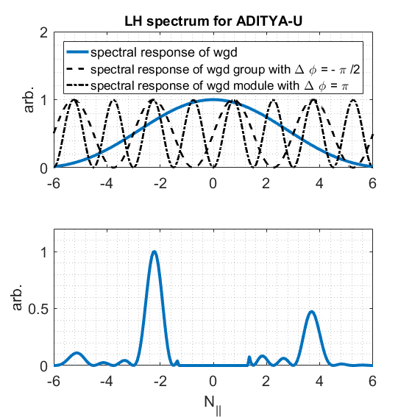
Directionality of LHW’s
Fourier transform of electric field
Parameter | ADITYA | ADITYA-U
d_{A} | 7mm | 12mm
d_{P} | --- | 11mm
d_{W} | 2mm | 2mm
P = (d_{A} + d_{W}) + (d_{P} + d_{W}) | 9mm | 27mm
$$N_{a}$$ | 4 | 1
$$δφ_{a}$$ | -90º (270º) | -90º (270º)
N_{g} | 1 | 2
$$δφ_{g}$$ | 0º | -90º (270º)
N_{m} | 1 | 2
$$δφ_{m}$$ | 0º | 180º
(i) Response aperture
$$P_{o}(N_{||})∝{\left(\frac{Sin\left({φ_{o}}/2\right)}{k}\right)}^{2}$$
$φ_{o}$ = k*d_{A}
(ii) Response of array
$$P_{a}(N_{||})∝{\left(\frac{Sin\left(N_{a}{θ_{a}}/2\right)}{Sin\left({θ_{a}}/2\right)}\right)}^{2}$$
$θ_{a}= δφ_{a}+k(d_{A}+d_{W}$)
(iii) Response of group
$$P_{g}(N_{||})∝{\left(\frac{Sin\left(N_{g}{θ_{g}}/2\right)}{Sin\left({θ_{g}}/2\right)}\right)}^{2}$$
$$θ_{g}= δφ_{g}+k\left[\left.\left(d_{P}+d_{W}\right)+ N_{a}(d_{A}+d_{W}\right)\right]$$
$$P_{m}(N_{||})∝{\left(\frac{Sin\left(N_{m}{θ_{m}}/2\right)}{Sin\left({θ_{m}}/2\right)}\right)}^{2}$$
(iv) Response of module
$$θ_{m}= δφ_{m}+kN_{g}\left[\left.\left(d_{P}+d_{W}\right)+ N_{a}(d_{A}+d_{W}\right)\right]$$
P$(N_{||})∝$ $P_{o}(N_{||})$*$P_{a}(N_{||})$*$P_{g}(N_{||})$*$P_{m}(N_{||})$

Slide 16
Design calculation of PAM launcher
$N_{||}= \frac{1}{kP}\left({δφ}_{g}+nπ\right)\left[1− \frac{1}{N_{m}} \frac{\left({δφ}_{m}− π\right)}{\left({δφ}_{g}+ nπ\right)}\right]$ = 2.25
$\left(δφ_{g}+nπ\right)$ = 270º or 3$π$/2
For, P = 27mm, k*P = 2$π$/3 for f_{o} = 3.7 GHz.

