Slide 1
Prediction and Avoidance session
Discussion

Slide 2
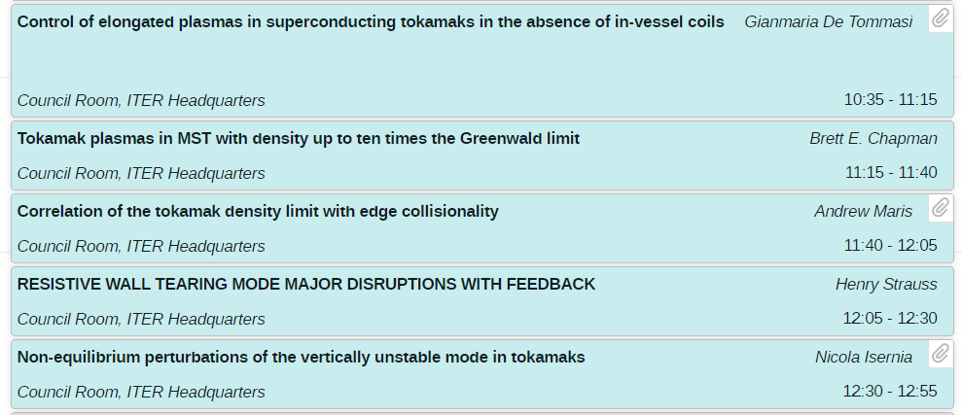
Prediction and Avoidance session
Multimodal super-resolution diagnostics for analyzing fast transient events in fusion plasma - Azarakhsh Jalalvand
Implementation of a cross-device model for halo current in the DECAF code as a criterion for the determination of disruption mitigation action - Veronika Zamkovska
Advances in High Accuracy Physics-Based Tokamak Disruption Event Characterization and Forecasting Including Real-time Deployment - Steven Sabbagh
Assessment of vertical controllability using DECAF, and predictive capability of a vertical stability metric for tokamak plasmas - Matt Tobin
Transfer learning with a parsimonious disruption predictor: from JET C-wall to the metallic wall - Jesús Vega
Cross-tokamak disruption prediction via domain adaptation and generalization - Fengming Xue

Slide 3
IAEA Technical Meeting
Contributions in three areas
ML and AI techniques
Physics (RWM, Density limit)
Advanced control (Vertical stabilization)
Questions/points for the discussion
Work on “cross tokamak prediction” – How to test this before ITER
Integration/synergy between physics (analysis, modelling, theory and ML techniques). Some advances but is this enough?
Advanced control in a “disruption free operation” perspective. How these techniques can be used to extend the domain of “safe” operation in tokamaks?

