Slide 1
Non-equilibrium perturbations of the vertically unstable mode in tokamaks
N. Isernia* and f. villone*
Third IAEA Technical meeting on plasma disruptions and their mitigation
3 september 2024
* Università degli Studi di Napoli, Federico II (Italy)

Slide 2
Non-equilibrium perturbations of the vertically unstable mode in tokamaks
Special acknowledgement:
F. J. Artola, M. Hoelzl, N. schwarz
3 september 2024

Slide 3
Outline
Motivation: translating physics requirements to control engineers
The rigid filament model: asymptotic solution and phase portrait
Mapping dynamic perturbations to quasi-static models
Validation of the theory on a TCV-like geometry
Comparison of Thermal Quench perturbation in dynamic and massless MHD models [preliminary!]
$$⋅$$
$$⋅$$
$$⋅$$
X
X
$$F_{z}$$
X
X
X

Slide 4
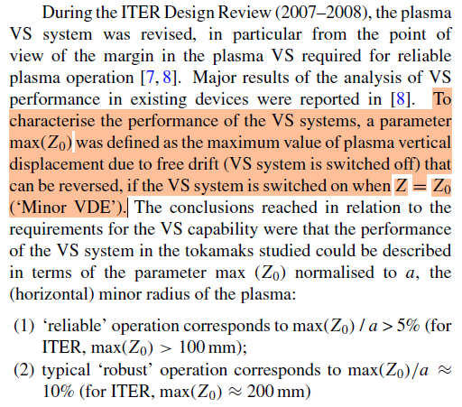
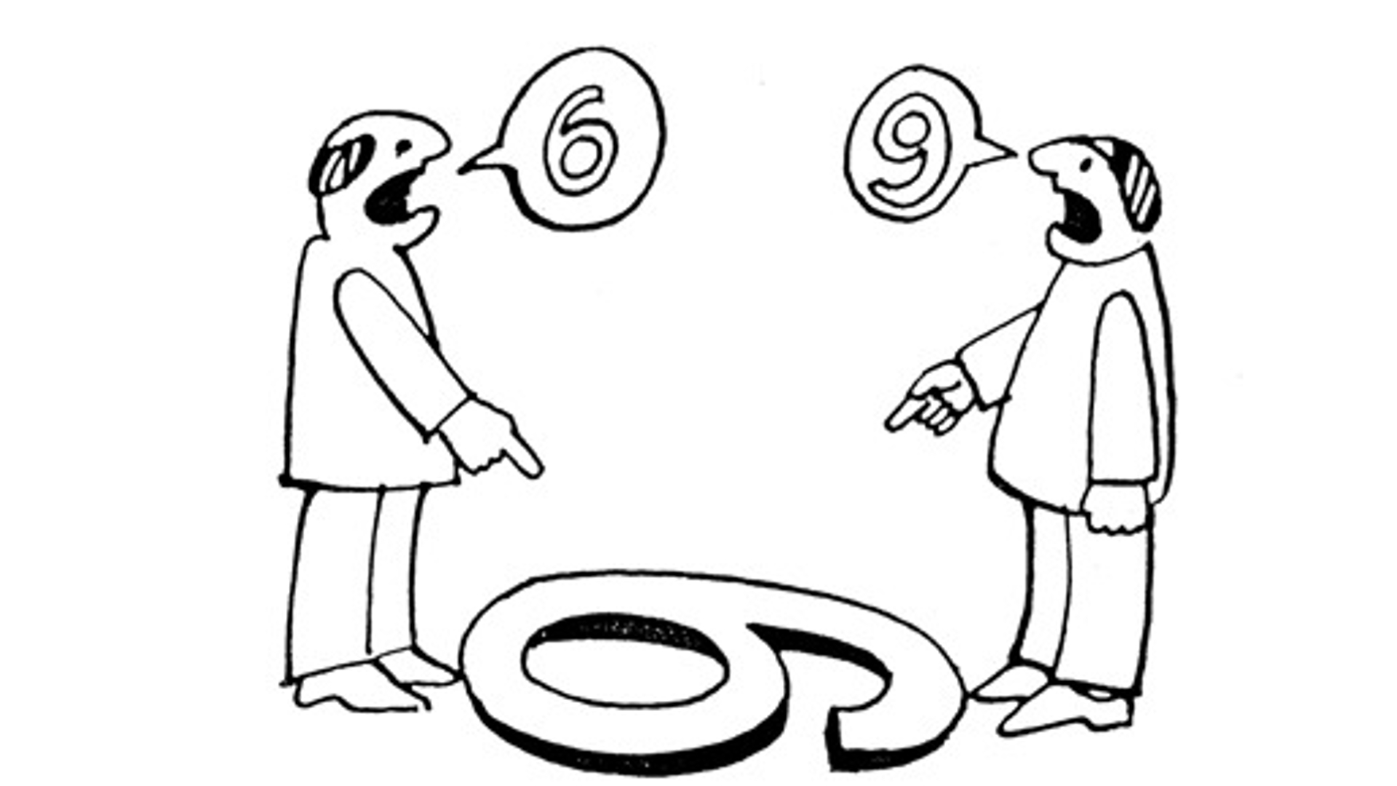
Motivation
Maximum allowable vertical displacement: a mass-less definition
Comparing massy models with engineering oriented mass-less models
Make physicists and engineers agree on models and definitions!
Y. Gribov et al 2015 Nucl. Fusion 55 073021

Slide 5
Rigid Filament Model
Assumptions
Wall Single-mode model
plasma = rigid, axisymmetric, current-carrying ring
Only vertical displacements allowed
State variables:
vertical position $z_{p}$
vertical velocity $v_{p}$
wall currents $I_{w}$
Eventual input:
active coil currents $I_{a}$
$\frac{d}{dt}\left[\begin{matrix}i_{u} \\ v_{p} \\ z_{p}\end{matrix}\right]=\left[\begin{matrix}−1/τ_{u} & −F_{I}^{u}/L_{u} & 0 \\ F_{I}^{u}/m_{p} & 0 & F_{z}^{a0}/m_{p} \\ 0 & 1 & 0\end{matrix}\right] \left[\begin{matrix}i_{u} \\ v_{p} \\ z_{p}\end{matrix}\right]$
plasma mass: $m_{p}$
inductance and resistance wall: $L_{u}$, $R_{u}$
time constant wall single mode: $τ_{u}=L_{u}/R_{u}$
stabilising force per unit wall current: $F_{I}^{u}$
destabilising force per unit displace: $F_{z}^{a0}$
Notes:
Plasma ring
- F_i^u is proportional to the palsma current and the z-derivative of the mutual inductance plasma – wall unstable current
- F_z^a0 is proportional to the plasma current, the active currents and the second z-derivative of the mutual inductance between active coils and plasma ring

Slide 6
Rigid Filament Model
Asymptotic solution via singular perturbation method*:
Unstable mode
Growth rate: $γ_{u}=\frac{1}{m_{u}τ_{u}}$
$$z_{0}\left(t\right)=\left[Δz_{0}+\frac{1}{m_{u}F_{z}^{a0}}\left(F_{I}^{u} Δi_{u,0}+F_{z}^{a0}Δz_{0}\right)\right]\exp\left(γ_{u}t\right)+$$ $$−\frac{1}{m_{u}F_{z}^{a0}}\left[F_{I}^{u} Δi_{u,0}+F_{z}^{a0}Δz_{0}\right]\cos\left(\frac{\sqrt{m_{u}}}{τ_{A}}t\right)\exp\left[−\frac{m_{u}+1}{2}γ_{u}t\right]+$$ $$+\frac{τ_{A}}{\sqrt{m_{u}}}Δv_{0}\sin\left(\frac{\sqrt{m_{u}}}{τ_{A}}t\right)\exp\left[−\frac{m_{u}+1}{2}γ_{u}t\right]$$
Hypothesis:
$$\frac{τ_{A}}{τ_{u}}≪1$$
$m_{u}>0→$the instability is brought to the electromagnetic time scale!
Damped oscillatory modes*
*Nicola Isernia and Fabio Villone 2023 Plasma Phys. Control. Fusion 65 105007
Notes:
- The growth rate is defined based on the stability margin and the electromagnetic time scale associated to the plasma unstable vertical motion

Slide 7
Rigid Filament Model
Asymptotic solution
Main properties
Unstable mode
$$z_{0}\left(t\right)=\left[Δz_{0}+\frac{1}{m_{u}F_{z}^{a0}}\left(F_{I}^{u} Δi_{u,0}+F_{z}^{a0}Δz_{0}\right)\right]\exp\left(γ_{u}t\right)+$$ $$−\frac{1}{m_{u}F_{z}^{a0}}\left[F_{I}^{u} Δi_{u,0}+F_{z}^{a0}Δz_{0}\right]\cos\left(\frac{\sqrt{m_{u}}}{τ_{A}}t\right)\exp\left[−\frac{m_{u}+1}{2}γ_{u}t\right]+$$ $$+\frac{τ_{A}}{\sqrt{m_{u}}}Δv_{0}\sin\left(\frac{\sqrt{m_{u}}}{τ_{A}}t\right)\exp\left[−\frac{m_{u}+1}{2}γ_{u}t\right]$$
Direction of unstable motion is determined both by $Δz_{0}$ and $Δi_{u,0}$
The unstable motion is not solicited if the wall response is: $Δi_{u,0}+\frac{F_{I}^{u}}{L_{u}}Δz_{0}=0$
Oscillatory modes are not solicited if the perturbation is quasi-static:
$Δv_{0}=0$
$F_{I}^{u} Δi_{u,0}+F_{z}^{a0}Δz_{0}=0$
Ideal wall
Damped oscillatory modes*
Mech. Equilibrium
* See also Barberis Tet al Journal of Plasma Physics, 88:905880511 (2022)
Notes:
- The initial velocity has no impact on the oscillatory modes.

Slide 8
Rigid Filament Model
Phase portrait (approximate)
Main properties
#1 weaker wall reaction than in the quasi-static limit
$$z$$
Unstable direction:
$$e_{1}=\left[\begin{matrix}F_{I}^{u} & 0 & F_{z}^{a0}\end{matrix}\right]′$$
Plane damped oscillatory modes: $e_{2}=\left[\begin{matrix}{\left(F_{I}^{u}\right)}^{2}/L_{u} & 0 & F_{I}^{u}\end{matrix}\right]$ $e_{3}=\left[\begin{matrix}0 & 1 & 0\end{matrix}\right]′$
Initial electro-mechanical equilibrium point is a saddle!
Unstable direction
(equilibrium!)
$$i_{u}$$
Trace in the $\left(z,i_{u}\right)$ plane
of damped oscillatory mode plane
(ideal wall response!)
Notes:
Plane parallel to the velocity direction and the ideal wall reaction carries the damped oscillations of the dynamical system
The motion is upward if the force due to the initial current perturbation overwhelms the ideal wall reaction force due to the initial displacement (and vice-versa)
Highlighted reaction current weaker than in the equilibrium case

Slide 9
Rigid Filament Model
Phase portrait (approximate)
Main properties
#2 stronger wall reaction than in the quasi-static limit weaker than ideal wall limit
$$z$$
Unstable direction:
$$e_{1}=\left[\begin{matrix}F_{I}^{u} & 0 & F_{z}^{a0}\end{matrix}\right]′$$
Plane damped oscillatory modes: $e_{2}=\left[\begin{matrix}{\left(F_{I}^{u}\right)}^{2}/L_{u} & 0 & F_{I}^{u}\end{matrix}\right]$ $e_{3}=\left[\begin{matrix}0 & 1 & 0\end{matrix}\right]′$
Initial electro-mechanical equilibrium point is a saddle!
Unstable direction
(equilibrium!)
$$i_{u}$$
Trace in the $\left(z,i_{u}\right)$ plane
of damped oscillatory mode plane
(ideal wall response!)
Notes:
Plane parallel to the velocity direction and the ideal wall reaction carries the damped oscillations of the dynamical system
The motion is upward if the force due to the initial current perturbation overwhelms the ideal wall reaction force due to the initial displacement (and vice-versa)
Highlighted reaction current weaker than in the equilibrium case

Slide 10
Rigid Filament Model
Phase portrait (approximate)
Main properties
#3 stronger wall reaction than in the quasi-static limit even stronger than ideal wall limit
$$z$$
Unstable direction:
$$e_{1}=\left[\begin{matrix}F_{I}^{u} & 0 & F_{z}^{a0}\end{matrix}\right]′$$
Plane damped oscillatory modes: $e_{2}=\left[\begin{matrix}{\left(F_{I}^{u}\right)}^{2}/L_{u} & 0 & F_{I}^{u}\end{matrix}\right]$ $e_{3}=\left[\begin{matrix}0 & 1 & 0\end{matrix}\right]′$
Initial electro-mechanical equilibrium point is a saddle!
Unstable direction
(equilibrium!)
$$i_{u}$$
Trace in the $\left(z,i_{u}\right)$ plane
of damped oscillatory mode plane
(ideal wall response!)
Notes:
Plane parallel to the velocity direction and the ideal wall reaction carries the damped oscillations of the dynamical system
The motion is upward if the force due to the initial current perturbation overwhelms the ideal wall reaction force due to the initial displacement (and vice-versa)
Highlighted reaction current weaker than in the equilibrium case

Slide 11
Dynamic to massless map
Projection in phase space
$$z$$
Projection to the massless model should be «parallel» to the ideal wall response (hyper-)plane
$$Δz_{qs,0}=\frac{m_{u}+1}{m_{u}}Δz_{0}+\frac{F_{I}^{u}}{m_{u}F_{z}^{a0}}Δi_{u,0}$$
Highlighting the force-imbalance correction:
$$Δz_{qs,0}=Δz_{0}+\frac{1}{m_{u}F_{z}^{a0}}\left(F_{Z}^{a0}Δz_{0}+F_{I}^{u}Δi_{u,0}\right)$$
WRONG!
$$i_{u}$$
Notes:
Direct comparison of the usual quasi-static (mass-less) solution to the asymptotic solution illustrated here allows immediately to identify the mapping between the full-dynamic initial conditions and the initial conditions to be set in the quasi-static model to obtain a similar solicitation of the vertically unstable mode.
The mapping is similar in case of the rigid filament model with multiple currents (i.e. multiple modes)

Slide 12
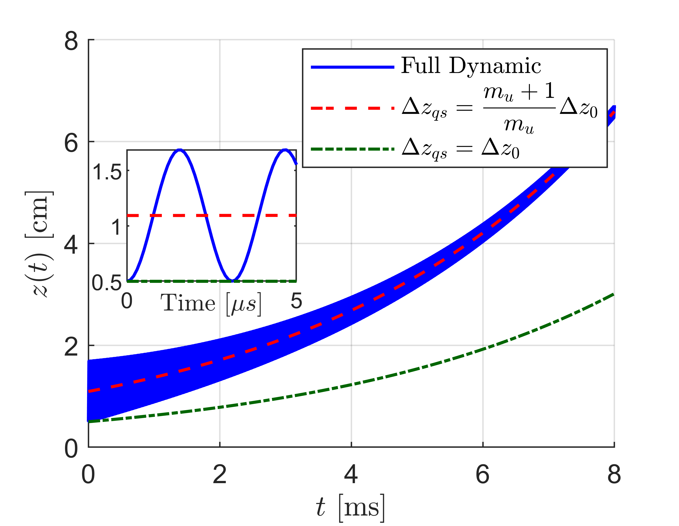
TCV-like example
electromagnetic time inst: $τ_{u}=5.3$ ms
stability margin: $m_{u}=0.842$
time constants ratio: $τ_{A}/τ_{u}≃{10}^{−5}$
$$Δz_{0}=5 mm \\ Δi_{u,0}=0 A$$
*Nicola Isernia and Fabio Villone 2023 Plasma Phys. Control. Fusion 65 105007
Notes:
Direct comparison of the usual quasi-static (mass-less) solution to the asymptotic solution illustrated here allows immediately to identify the mapping between the full-dynamic initial conditions and the initial conditions to be set in the quasi-static model to obtain a similar solicitation of the vertically unstable mode.
The mapping is similar in case of the rigid filament model with multiple currents (i.e. multiple modes)

Slide 13
TCV-like example
«Virtual» experiment: plasma ring moved with constat velocity in a specified time $Δt$
$→$ scan in the normalized time $Δt/τ_{u}$
The final stabilizing current is given by: $Δi_{u,0}=−\frac{F_{I}^{u}}{L_{u}}\left[\frac{Δz_{0}}{Δt/τ_{u}}⋅\left(1−e^{−Δt/τ_{u}}\right)\right]$
$$F_{I}^{u}Δi_{u}+F_{z}Δz=0$$
$$\frac{Δt}{τ_{u}}≃1$$
(20)
$$\frac{Δt}{τ_{u}}≃\left(e−2\right)\frac{m_{u}+1}{e−m_{u}−1}$$
*Nicola Isernia and Fabio Villone 2023 Plasma Phys. Control. Fusion 65 105007
Notes:
For a motion which is much faster than the one given by (20) we find smaller solicitation of the unstable mode, and stronger solicitation of the oscillatory behaviour
For a motion which is slower than the quasi-static limit one, we again trigger oscillations and we also charge much more the unstable behaviour
The point here is whether perturbation/control mechanism exist which can drive the plasma ring in such out-of-equilibrium initial condition

Slide 14
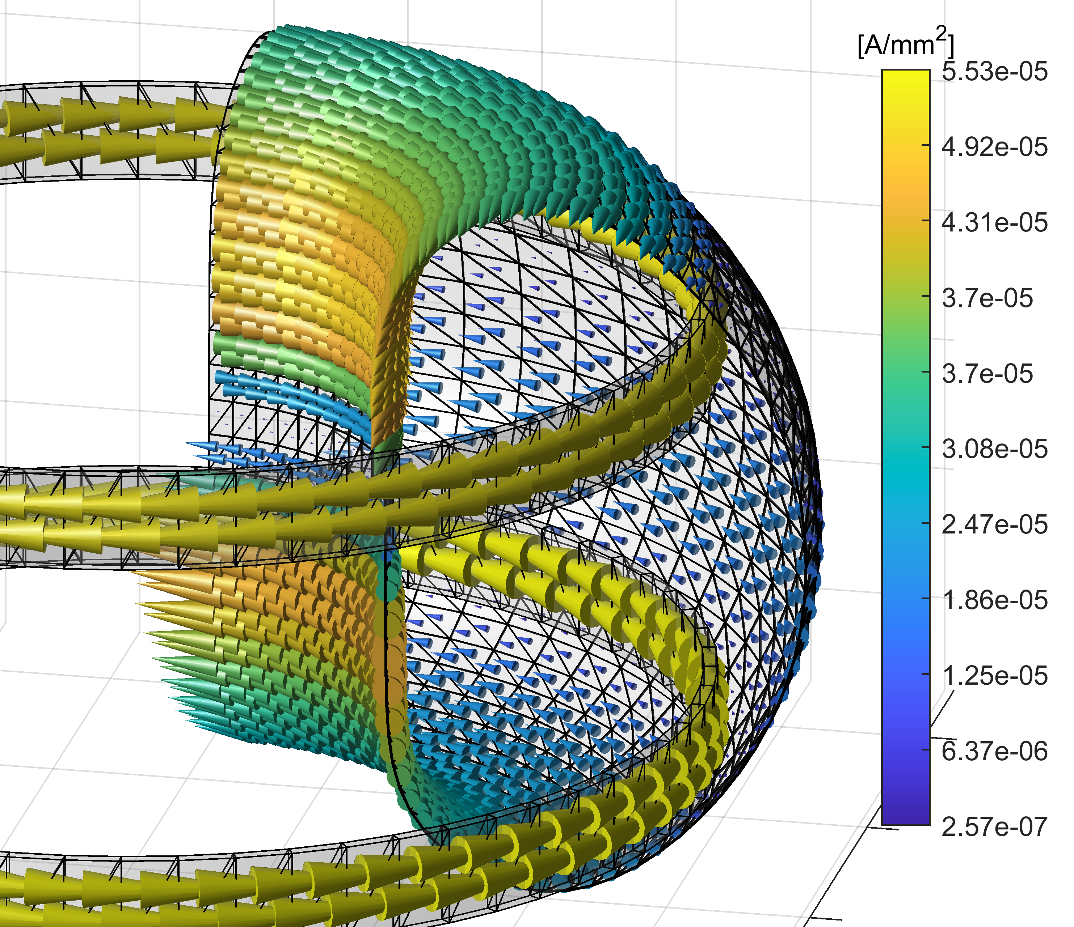
MHD models comparison
JOREK-CARIDDI
Reduced Magneto-Hydro-Dynamic 3D
Single temperature, no neutrals, axisymmetric, without $v_{∥}$
DISCLAIMER: simulations not meant to get realistic experiments!
Identical wall model!
CarMa0NL
Magneto-Hydro-Static 2D with 3D wall
Equilibrium parameters are an input
Notes:
free-boundary models
The wall model is exactly the same between CarMa0NL and JOREK-CARIDDI, hence we can compare one-to-one the wall currents. In particular we project the current on the unstable egienmode as found in the linearized model obtained by CarMa0NL at the initial time instant of MHD equilibrium.

Slide 15
JOREK-CARIDDI
ASDEX-U like initial MHD equilibrium
Scan simulations with $k_{⊥}$ perturbation, i.e. with different Thermal Quench times
Diffusion coefficients scaled properly so that the ratio among diffusion times* is the same for all simulations ($η$, $k_{∥}$, $D_{⊥}$, $D_{∥}$)
Alfvén time and wall time constants are the same for all simulations
Thermal quench time**:
$$Δt_{TQ}=\frac{t_{90\%}−t_{20\%}}{0.7}$$
$t_{X \%}=$ time when the thermal energy reaches the $X \%$ of the pre-disruption value
$$Δt_{TQ}∈\left[6,600\right] μs$$
* See details in: F J Artola et al 2024 Plasma Phys. Control. Fusion 66 055015
** Definition used in: G. Arnoux et al Nucl. Fusion 49 085038 (2009)
Notes:
- Beforehand it was verified that the result is indipendent from the viscosity (i.e. the motion is not limited by viscous phenomena)

Slide 16
JOREK-CARIDDI
ASDEX-U like initial MHD equilibrium
Scan simulations with $k_{⊥}$ perturbation, i.e. with different Thermal Quench times
Diffusion coefficients scaled properly so that the ratio among diffusion times* is the same for all simulations ($η$, $k_{∥}$, $D_{⊥}$, $D_{∥}$)
Alfvén time and wall time constants are the same for all simulations
Thermal quench time**:
$$Δt_{TQ}=\frac{t_{90\%}−t_{20\%}}{0.7}$$
$t_{X \%}=$ time when the thermal energy reaches the $X \%$ of the pre-disruption value
$$Δt_{TQ}∈\left[6,600\right] μs$$
* See details in: F J Artola et al 2024 Plasma Phys. Control. Fusion 66 055015
** Definition used in: G. Arnoux et al Nucl. Fusion 49 085038 (2009)
Notes:
- Beforehand it was verified that the result is indipendent from the viscosity (i.e. the motion is not limited by viscous phenomena)

Slide 17
JOREK-CARIDDI
Notes:
Variations of plasma current in the order of 0.3 % may be observed, which shall not be particularly relevant on the overall plasma motion, as demonstrated later by the CarMa0NL simulations.
Anyway due to the perturbation time (which mainly drives a radial motion) the plasma current variation has an impact on the projection of wall currents on the unstable eigenvector

Slide 18
CarMa0NL
CarMa0NL is run imposing a $β_{0}$ evolution consistent with the JOREK-CARIDDI thermal energy;
The plasma current is either kept fixed or varied as in JOREK-CARIDDI
Remainder equilibrium parameters are kept fixed
Time step scaled in each simulation according to the TQ time
$$j_{φ}\left(\tilde{ψ},R\right)=R\left[λ\frac{β_{0}}{R_{0}}{\left(1−{\tilde{ψ}}^{α_{m,p}}\right)}^{α_{n,p}}\right]+\frac{1}{R}\left[λ R_{0} \left(1−β_{0}\right){\left(1−{\tilde{ψ}}^{α_{m,f}}\right)}^{α_{n,f}}\right]$$
Notes:
-$β_{0}$ is proportional to the poloidal beta $β_{p}$

Slide 19
Comparison $Z_{p}$
The mass-less model predicts nearly the same $Δz$ at the end of TQ for all $Δt_{TQ}≤200 μs$
For longer TQ times the wall is not anymore “ideal”
The different vertical position variation for small $Δt_{TQ}$ in JOREK-CARIDDI could be indeed related to plasma inertia
Open question: can we map the initial conditions between dynamic and massless also for MHD models?

Slide 20
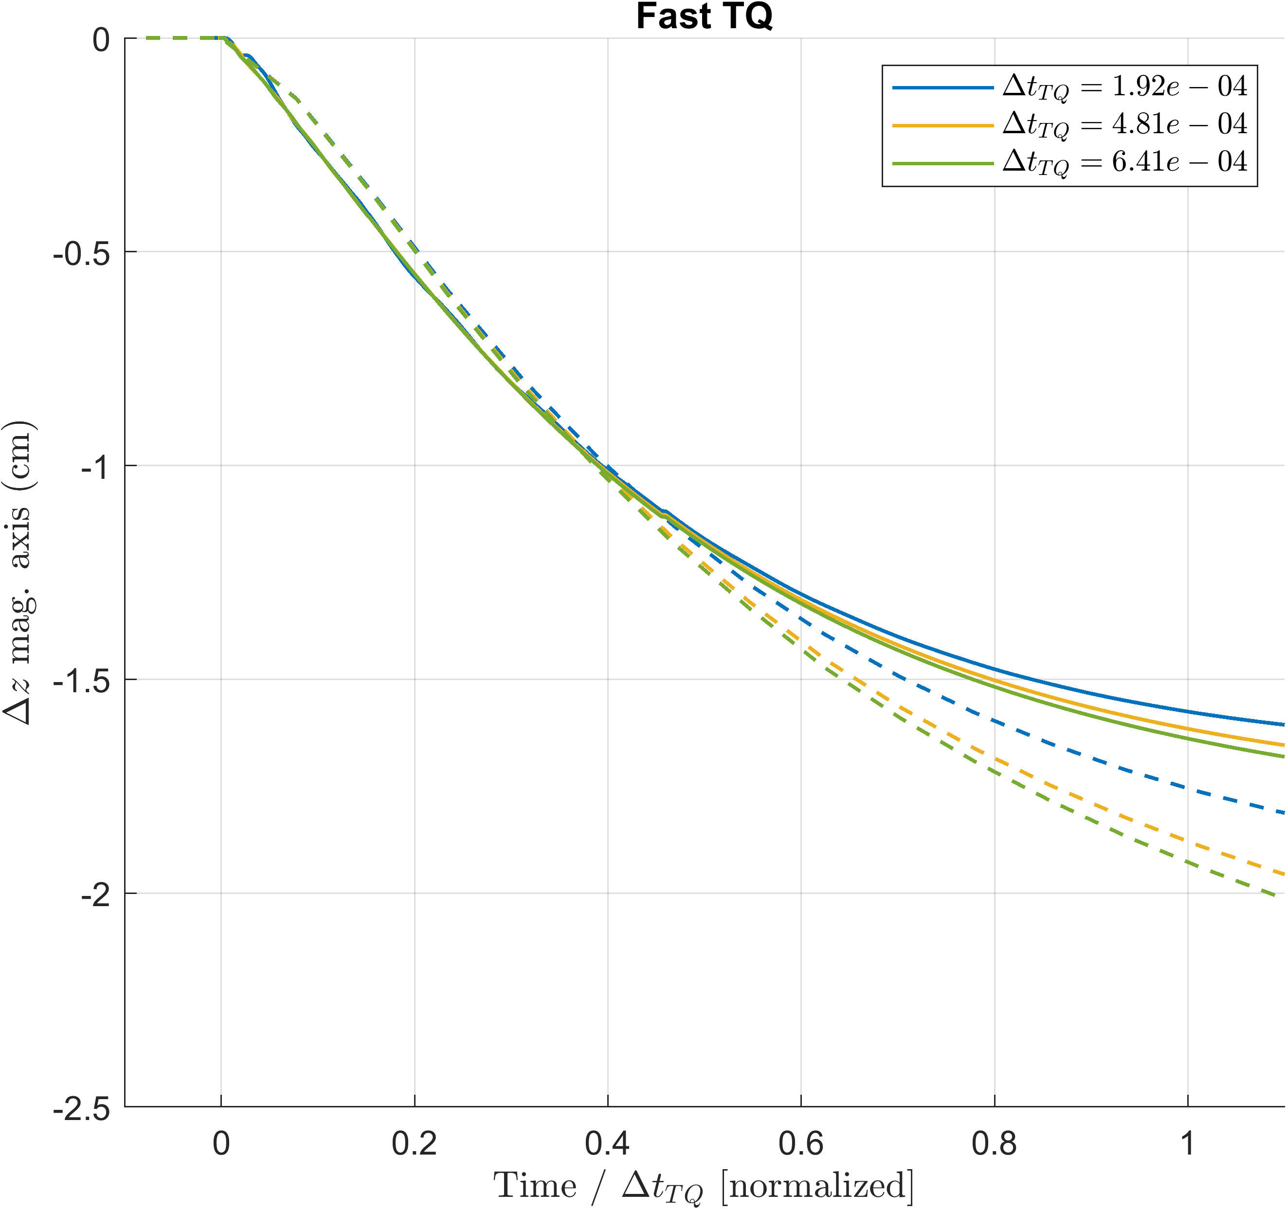
Comparison $Z_{p}$
$$τ_{A}=\sqrt{\frac{m_{p}}{F_{z}^{a0}}}≃2μs$$
$$m_{p}≃2.2 μg$$
$$F_{z}^{a0}≃602 kN/m$$
Fast TQ
Average TQ
Slow TQ
$$20 μs$$
$$τ_{iw}=200 μs$$
$$τ_{A}≃2 μs$$
$$2 ms$$
$$20 ms$$
$$τ_{u}≃200 ms$$
Test region TQ time

Slide 21
Comparison $Z_{p}$
Interpretation #1: we find oscillations at the end of TQ when TQ time gets closer to the Alfvén time
Interpretation #2: oscillations persist at the end of TQ when we are in the “ideal wall limit” region
How to discriminate? Either scan in $τ_{A}$ or in $τ_{u}$, TQ time fixed at the threshold between persistent/damped oscillation
Ideal wall limit region
$$τ_{iw}=200 μs$$
$$20 μs$$
$$2 ms$$
$$20 ms$$
$$τ_{u}≃200 ms$$
$$τ_{A}≃2 μs$$
Test region TQ time

Slide 22
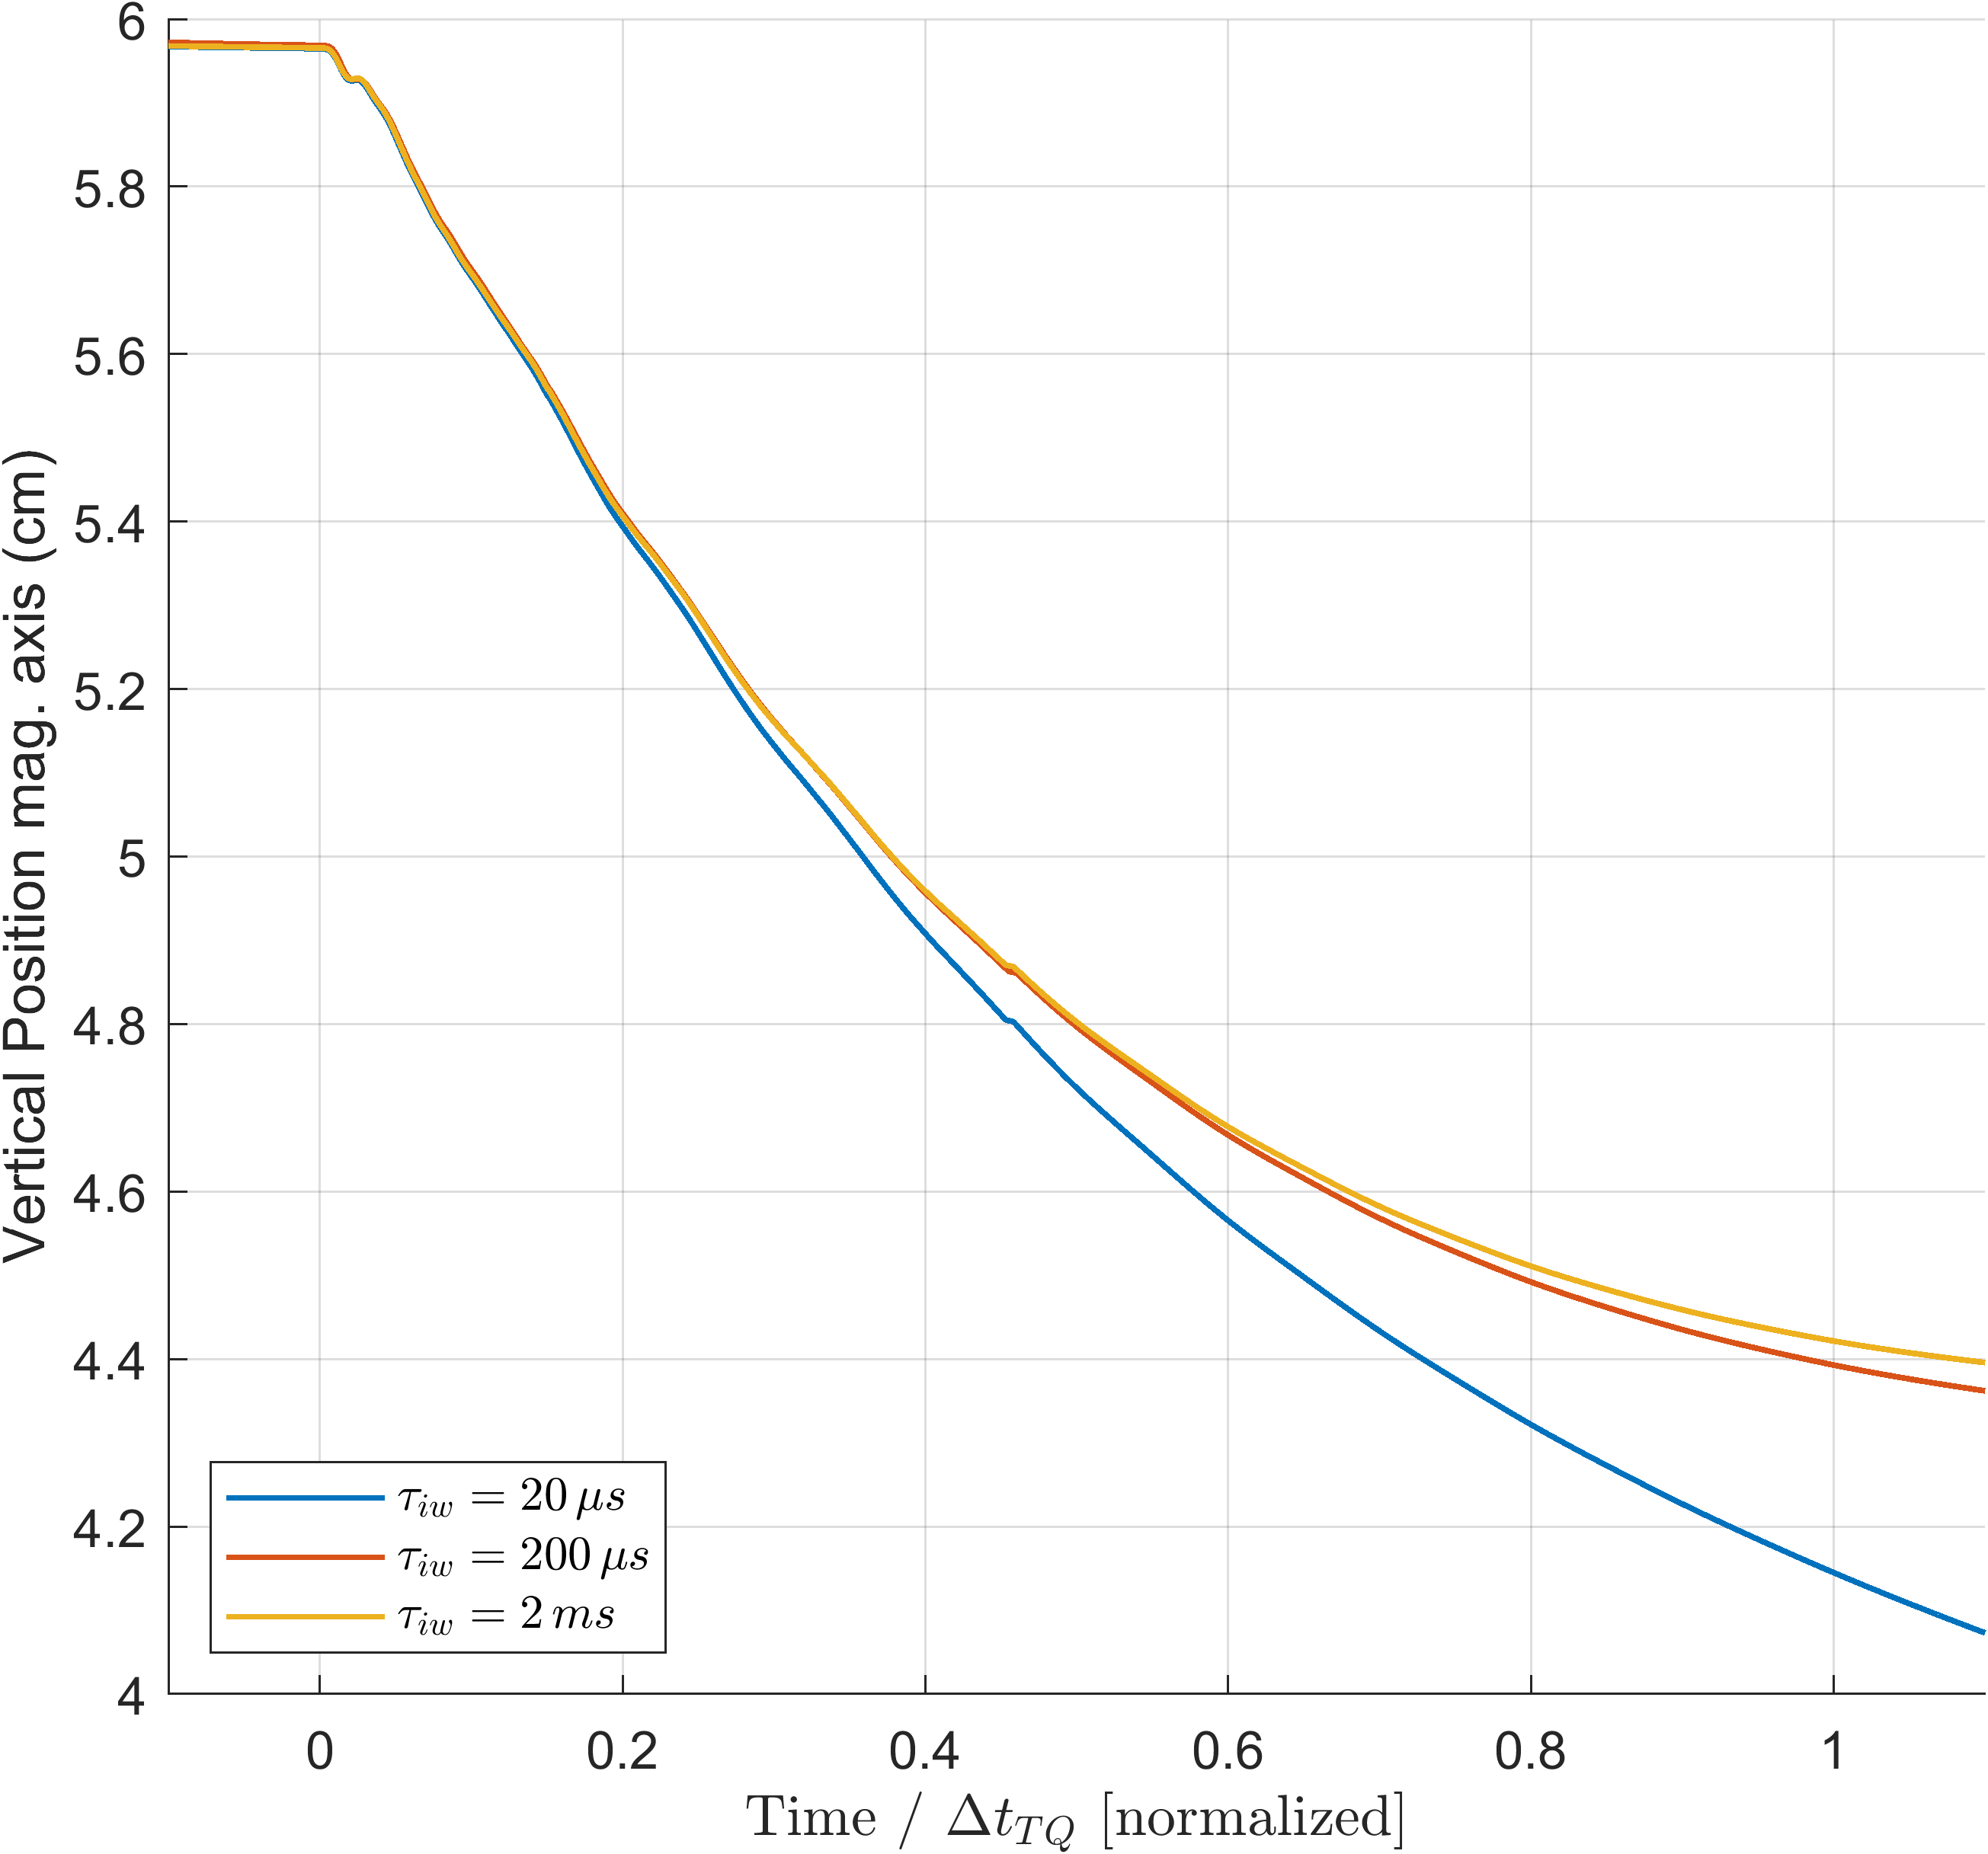
Comparison $Z_{p}$
How to discriminate? Either scan in $τ_{A}$ or in $τ_{u}$, for the TQ time which seems to represent the threshold between persistent/damped oscillation
Same set up, scan in wall resistivity.
Making $τ_{u}$ higher did not introduce oscillations
Ideal wall limit region
$$τ_{iw}=200 μs$$
$$20 μs$$
$$2 ms$$
$$20 ms$$
$$τ_{u}≃200 ms$$
$$τ_{A}≃2 μs$$
Test region TQ time

Slide 23
Discussion
conclusions
Possible future work
Comparison of dynamic and massless models require careful mapping of initial conditions (along the «ideal wall reaction» hyper-plane)
Simple $β_{p}$ drop of massless models may be not so accurate for fast TQ times (and eventually conservative)
For $Δt_{TQ}→τ_{A}$ we may observe inertial phenomena on the magnetic axis vertical position during/after the TQ
Investigate the role of plasma current diffusion in simple rigid filament models;
The role of other possible damping factors for the oscillation shall be studied (both in rigid and fluid models)
Translate the mapping between dynamic and mass-less models from the rigid to the fluid context

Slide 24
References
[1] Nicola Isernia and Fabio Villone 2023 Plasma Phys. Control. Fusion 65 105007
[2] F. J. Artola et al 2024 Plasma Phys. Control. Fusion 66 055015
[3] Y. Gribov et al 2015 Nucl. Fusion 55 073021
[4] T. Barberis et al 2022 Journal of Plasma Physics 88 905880511
[5] G. Arnoux et al 2009 Nucl. Fusion 49 085038
[6] E. A. Lazarus, J. B. Lister, and G. H. Neilson 1990 Nucl. Fusion 30 111
[7] N. Isernia et al 2023 Phys. Plasmas 30 113901
[8] M. Hoelzl et al 2021 Nucl. Fusion 61 065001
[9] F. Villone et al 2013 Plasma Phys. Control. Fusion 55 095008

Slide 25
BACKUP slides

Slide 26
Rigid Filament Model
Assumptions
plasma = rigid, axisymmetric, current-carrying ring
Only vertical displacements allowed
State variables:
vertical position $z_{p}$
vertical velocity $v_{p}$
wall currents $I_{w}$
Eventual input:
active coil currents $I_{a}$

Slide 27
Rigid Filament Model
Strategy of solution
Wall Single-mode model
Stability margin: $m_{u}=\left[\frac{{\left(F_{I}^{u}\right)}^{2}}{L_{u}}−F_{z}^{a0}\right]/F_{z}^{a0}$
Alfvèn time: $τ_{A}=\sqrt{m_{p}/F_{z}^{a0}}$
“Small” parameter: $ε=τ_{A}/τ_{u}$
Truncated expansion:
$$z_{p}=z_{0}+ε z_{1}+ …$$
Two time scale separation:
$$\frac{d}{dt}=\frac{1}{ε}\frac{∂}{∂t_{1}}+\frac{∂}{∂t_{2}}$$
$${\left(\frac{τ_{A}}{τ_{u}}\right)}^{2}\left[{\overset{⃛}{z}}_{p}+\frac{1}{τ_{u}}{\ddot{z}}_{p}\right]+\frac{m_{u}}{τ_{u}^{2}}{\dot{z}}_{p}−\frac{1}{τ_{u}^{3}}z_{p}=0$$
plasma mass: $m_{p}$
inductance and resistance wall: $L_{u}$, $R_{u}$
time constant wall single mode: $τ_{u}=L_{u}/R_{u}$
stabilising force per unit wall current: $F_{I}^{u}$
destabilising force per unit displace: $F_{z}^{a0}$
$m_{u}>0→$the instability is brough to the electromagnetic time scale!
Notes:
- Let us lump the state space model into a third order dynamical system in the variable $z_{p}$
Stability margin allows to discriminate whether the stabilising force per unit current gets solicitied enough in the ideal wall limit to compensate for the de-stabilising force, bringing the overall vertical instability to the electromagnetic time-scale
We analyse here only cases where $m_{u}>0$ HYPOTHESIS
- The Alfvèn time is the typical time-scale of the vertical instability in the no-wall limit
- The Alfvèn time is usually much smaller than the electromagnetic time scale of the unstable mode, due to large plasma current, relative proximity of plasma to wall structures, and relatively good conductivity of the vacuum vessel

Slide 28
Rigid Filament Model
Asymptotic solution
Main properties
Unstable mode
$$z_{0}\left(t\right)=\left[Δz_{0}+\frac{1}{m_{u}F_{z}^{a0}}\left(F_{I}^{u} Δi_{u,0}+F_{z}^{a0}Δz_{0}\right)\right]\exp\left(γ_{u}t\right)+$$ $$−\frac{1}{m_{u}F_{z}^{a0}}\left[F_{I}^{u} Δi_{u,0}+F_{z}^{a0}Δz_{0}\right]\cos\left(\frac{\sqrt{m_{u}}}{τ_{A}}t\right)\exp\left[−\frac{m_{u}+1}{2}γ_{u}t\right]+$$ $$+\frac{τ_{A}}{\sqrt{m_{u}}}Δv_{0}\sin\left(\frac{\sqrt{m_{u}}}{τ_{A}}t\right)\exp\left[−\frac{m_{u}+1}{2}γ_{u}t\right]$$
Direction of unstable motion is determined solely by initial wall current and initial displacement
Oscillatory modes are not solicited if the perturbation is a quasi-static one:
$Δv_{0}=0$
$F_{I}^{u} Δi_{u,0}+F_{z}^{a0}Δz_{0}=0$
$$z_{u}≥0↔\left(1+m_{u}\right)F_{z}^{a0}Δz_{0}+ F_{I}^{u} Δi_{u,0}≥0$$
$$z_{u}≥0↔F_{I}^{u}⋅\left(\frac{F_{I}^{u}}{L_{u}}Δz_{0}+Δi_{u,0}\right)≥0$$
Upward/downward direction determined only by the sign of $Δz_{0}$when: $\left|Δi_{u,0}\right|≤\frac{F_{I}^{u}}{L_{u}}\left|Δz_{0}\right|$
Damped oscillatory modes*
$$F_{I}^{u}={\left.I_{pl}\frac{∂M_{u,p}}{∂z}\right|}_{I_{u},V_{p},Z_{p} }$$
Opposite of the electric current inductively induced by a plasma ring displacement $Δz_{0}$!
Notes:
- The direction of the motion is determined by $Δz_{0}$ alone only when the initial current perturbation is below the inductive reaction limit!

Slide 29
Rigid Filament Model
Asymptotic solution
Main properties
Unstable mode
$$z_{0}\left(t\right)=\left[Δz_{0}+\frac{1}{m_{u}F_{z}^{a0}}\left(F_{I}^{u} Δi_{u,0}+F_{z}^{a0}Δz_{0}\right)\right]\exp\left(γ_{u}t\right)+$$ $$−\frac{1}{m_{u}F_{z}^{a0}}\left[F_{I}^{u} Δi_{u,0}+F_{z}^{a0}Δz_{0}\right]\cos\left(\frac{\sqrt{m_{u}}}{τ_{A}}t\right)\exp\left[−\frac{m_{u}+1}{2}γ_{u}t\right]+$$ $$+\frac{τ_{A}}{\sqrt{m_{u}}}Δv_{0}\sin\left(\frac{\sqrt{m_{u}}}{τ_{A}}t\right)\exp\left[−\frac{m_{u}+1}{2}γ_{u}t\right]$$
Unstable direction:
$$e_{1}=\left[\begin{matrix}F_{I}^{u} & 0 & F_{z}^{a0}\end{matrix}\right]′$$
Plane damped oscillatory modes: $e_{2}=\left[\begin{matrix}{\left(F_{I}^{u}\right)}^{2}/L_{u} & 0 & F_{I}^{u}\end{matrix}\right]$ $e_{3}=\left[\begin{matrix}0 & 1 & 0\end{matrix}\right]′$
Initial electro-mechanical equilibrium point is a saddle!
Damped oscillatory modes*
Notes:
Zeroing the oscillatory terms, we find that the unstable direction is the equilibrium one
Zeroing the unstable direction, we find that the oscillatory modes lay on the plane of the wall inductive response

Slide 30
Comparison $R_{p}$
The mass-less model predicts nearly the same $ΔR$ at the end of TQ for all $Δt_{TQ}≤200 μs$
For longer TQ times the wall is not anymore “ideal”
The different radial position variation for small $Δt_{TQ}$ in JOREK-CARIDDI should be indeed related to plasma inertia
Open question: can we map the initial conditions between dynamic and massless also for MHD models?

Slide 31
Comparison $Z_{p}$
$$τ_{A}=\sqrt{\frac{m_{p}}{F_{z}^{a0}}}≃2μs$$
$$m_{p}≃2.2 μg$$
$$F_{z}^{a0}≃602 kN/m$$
$$≃11μs$$
$$20 μs$$
$$200 μs$$
$$τ_{A}≃2 μs$$
$$2 ms$$
$$20 ms$$
$$τ_{u}≃200 ms$$
Test region TQ time

