Slide 1
DECAF update and study of the relationship between electron temperature collapses and disruption triggering
G. Bustos-Ramirez¹, S.A. Sabbagh¹, J.D. Riquezes¹, F.C. Sheehan¹, G. Tillinghast¹, M. Tobin¹, V. Zamkovska¹, H.K. Lee¹, J. Jepson¹, C. Ham², Thornton² , J.G. Bak³, M.J. Choi³, G. Cunningham², K. Erickson⁴, H. Han³, J. Harrison², J. Kim³, A. Kirk², W.C. Kim³, W.H. Ko³, J.H. Lee³, J.W. Lee³, K.D.Lee³, Y.S. Park³, J.S. Yoo⁴, S.W. Yoon³
¹Department of Applied Physics and Applied Mathematics, Columbia University, New York, NY, USA
²UKAEA, Abingdon, UK
³Korea Institute of Fusion Energy, Daejeon, Republic of Korea
⁴Princeton Plasma Physics Laboratory, Princeton, NJ, USA
3rd Technical Meeting on Plasma Disruptions and their Mitigations, ITER Headquarters, September 3-6 2024
KOREA INSTITUTE
OF FUSION ENERGY
Supported by US DOE grants DE-SC0018623, DE-SC0020415, and DE-SC0021311

Slide 2
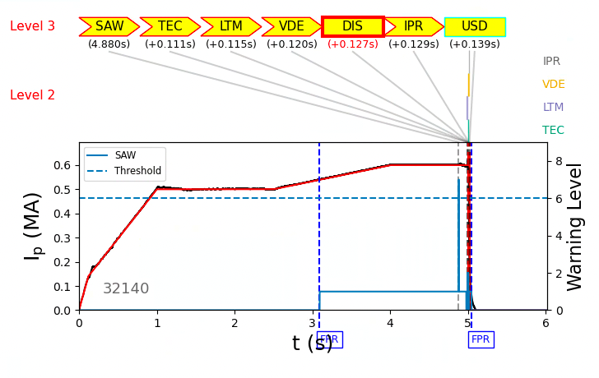
The DECAF code identifies the event chain leading to a disruption
A collection of physical models analyzes experimental data to raise a warning level when in proximity to a disruption.
Level 3 warning indicates imminent disruption if no action is taken.
Disruption event chain
Automated analysis of up to all shots available from multiple machines
Test physics models.
Iterative workflow to improve accuracy.
Provides physics understanding of events leading to disruptions.
KSTAR

Slide 3
DECAF* provides a solution to disruption prediction and forecasting for disruption mitigation. Successful workflow to high accuracy established
DECAF goal: correctly predict disruptions in every plasma from every available, full tokamak database, with sufficient time for disruption avoidance or mitigation
DECAF meets key requirements (See S.A. Sabbagh poster (107), this meeting)
Physics-based: required for several reasons (machine-agnostic, scalability, etc.)
High accuracy: prediction performance > 98% (!) for ITER, and beyond [1,2,3]
Deterministic: very difficult for a statistical solution to have high accuracy [1]
Real-time proven: also at high accuracy [2]
Multi-device database tests: DECAF accesses 9 device DBs (NDA soon for device 10)
Workflows to high accuracy: some shown in DECAF presentations at this meeting
*U.S. and international patents pending
[1] DECAF main reference: S.A. Sabbagh, et al., Phys. Plasmas 30 (2023) 032506; https://doi.org/10.1063/5.0133825 )
[2] S.A. Sabbagh, et al., IAEA FEC 2023
[3] M.T. Tobin, et al., (accepted PPCF 2024)

Slide 4
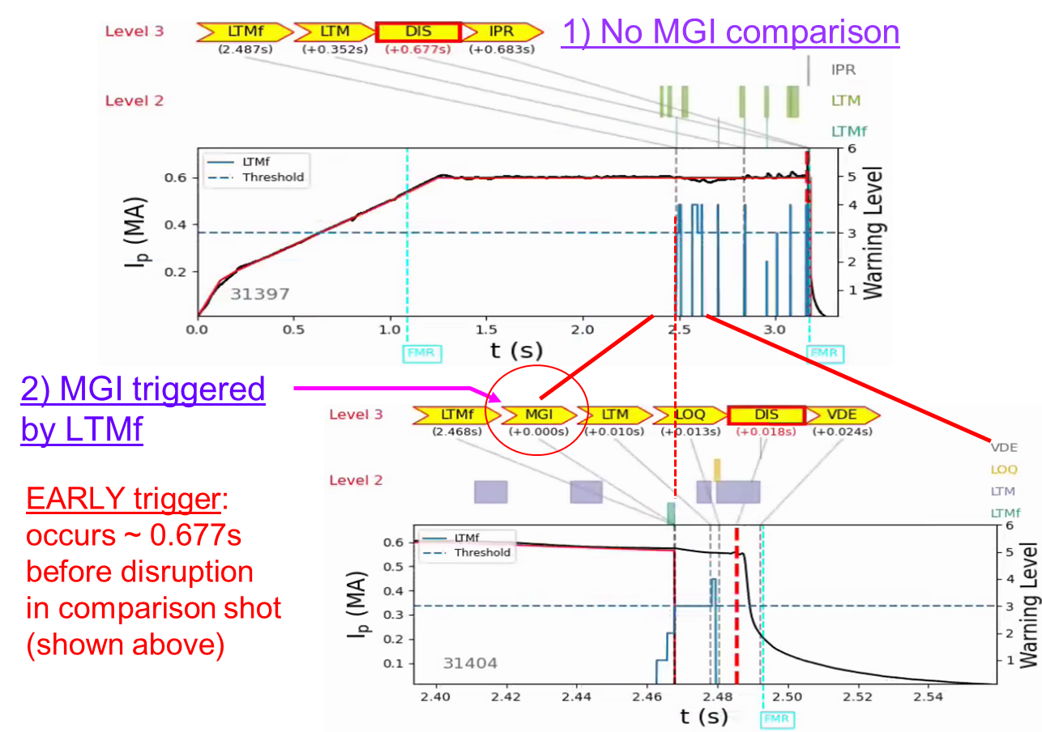
Real-time DECAF* has demonstrated high accuracy disruption prediction / forecasting for disruption mitigation. Move to deployment.
Real-time DECAF high accuracy demonstrated (See S.A. Sabbagh poster, this meeting)
100% accuracy in dedicated experiments on KSTAR [2]
Real-time disruption mitigation demonstrated
Different target plasmas subject to mode locking
50% balance of disrupted / non-disrupted plasmas, over 50 plasmas
Early forecasting to allow disruption avoidance
Steps toward deployment on ITER starting
Real-time DECAF high accuracy demonstrated (See S.A. Sabbagh poster, this meeting)
*U.S. and international patents pending
[1] DECAF main reference: S.A. Sabbagh, et al., Phys. Plasmas 30 (2023) 032506; https://doi.org/10.1063/5.0133825 )
[2] S.A. Sabbagh, et al., IAEA FEC 2023

Slide 5
Disruption prediction and avoidance is necessary for optimal operation and longevity of components in tokamak devices.
“
Two factors determine whether magnetically confined toroidal plasmas tend to disrupt:
(1) The robustness of the centering of the plasma within the chamber […].
(2) The robustness of the magnetic surfaces, which confine the plasma.
Allen H. Boozer; Theory of tokamak disruptions. Phys. Plasmas 1 May 2012; 19 (5): 058101.
VDE, SHP events in DECAF*
Posters: 105, 109
”
Topic of the talk: Monitoring flux surfaces for signs of increase disruptivity.
Due to the fast thermal transport along the field lines, electron temperature evolution serves as a diagnostic of the ‘health’ of the magnetic surfaces and particle confinement

Slide 6
Major changes in the magnetic topology are observed through electron temperature crashes
If the magnetic surfaces are modified, electrons are the first to know.
The first order gradient in $T_{e}$ occurs due to fast thermal transport following flux surface tearing.
Fast change in local / global magnetic topology.
→Electron temperature collapses.
Monitoring depends on crash type
NTM triggering.
H→L mode.
Radiative events.
Recovery
ELM, SAW, …
Continuous monitoring
Discrete analysis
Plasma state in equilibrium.
Plasma state in vicinity to collapse
Opening of the field lines: $T_{e}$ crashes.
Change in the plasma state.
Trigger disruption chain
$T_{e}\left(core\right)$
$\frac{T_{e}\left(core\right)}{∫T_{e}dR}$
$q_{0}, P_{ped}, β_{N},$ etc.
MHD mode present.
Soft gradient
Crash identification.
Crash characterization.
ELM
SAW
TEC (global $T_{e}$ collapse)
Plasma state around $τ_{collapse}$.
Stable operation at lower performance.
$T_{e}$ collapse can give an early disruption warning, from 100 ms to ~1 s!

Slide 7
Analysis of the $T_{e}$ collapses performed in 3 stages
Crash Identification.
Crash characterization.
Plasma state around crash time.
Monitoring depends on crash type
NTM triggering.
H→L mode.
Radiative events.
Recovery
ELM, SAW, …
Continuous monitoring
Discrete analysis
Plasma state in equilibrium.
Plasma state in vicinity to collapse
Opening of the field lines: $T_{e}$ crashes.
Change in the plasma state.
Trigger disruption chain
$T_{e}\left(core\right)$
$\frac{T_{e}\left(core\right)}{∫T_{e}dR}$
$q_{0}, P_{ped}, β_{N},$ etc.
MHD mode present.
Soft gradient
Crash identification.
Crash characterization.
- ELM
- SAW
- TEC (global $T_{e}$ collapse)
Plasma state around $τ_{collapse}$.
Stable operation at lower performance.

Slide 8
Analysis of the $T_{e}$ collapses performed in 3 stages
Crash Identification.
Crash characterization.
Plasma state around crash time.
Monitoring depends on crash type
NTM triggering.
H→L mode.
Radiative events.
Recovery
ELM, SAW, …
Continuous monitoring
Discrete analysis
Plasma state in equilibrium.
Plasma state in vicinity to collapse
Opening of the field lines: $T_{e}$ crashes.
Change in the plasma state.
Trigger disruption chain
$T_{e}\left(core\right)$
$\frac{T_{e}\left(core\right)}{∫T_{e}dR}$
$q_{0}, P_{ped}, β_{N},$ etc.
MHD mode present.
Soft gradient
Crash identification.
Crash characterization.
- ELM
- SAW
- TEC (global $T_{e}$ collapse)
Plasma state around $τ_{collapse}$.
Stable operation at lower performance.

Slide 9
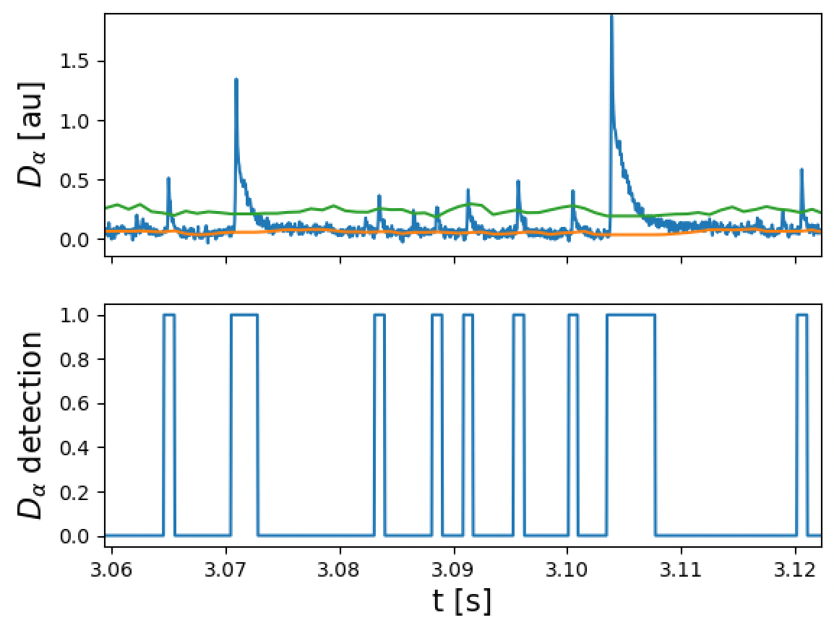
Edge and core $T_{e}$ crashes are robustly identified through different methods
$T_{e}$ channel
Core crash identification by convolution of core $T_{e}$ channel with specialized kernel [1].
$$T_{e}[eV]$$
Multichannel analysis to remove non-physical peaks and noise.
Convolved signal
$$t [s]$$
Edge crash identification by peak detection above dynamic threshold in $D_{α}$ signal.
(Running std) * Threshold
Running mean
Mean and standard deviation calculated from historic data → Causal.
Peaks weighted for the calculation of mean and std.
[1] A Gude etal 2017 PlasmaPhys.Control.Fusion 59 095009

Slide 10
Analysis of the $T_{e}$ collapses performed in 3 stages
Crash Identification.
Crash characterization.
Plasma state around crash time.
Monitoring depends on crash type
NTM triggering.
H→L mode.
Radiative events.
Recovery
ELM, SAW, …
Continuous monitoring
Discrete analysis
Plasma state in equilibrium.
Plasma state in vicinity to collapse
Opening of the field lines: $T_{e}$ crashes.
Change in the plasma state.
Trigger disruption chain
$T_{e}\left(core\right)$
$\frac{T_{e}\left(core\right)}{∫T_{e}dR}$
$q_{0}, P_{ped}, β_{N},$ etc.
MHD mode present.
Soft gradient
Crash identification.
Crash characterization.
- ELM
- SAW
- TEC (global $T_{e}$ collapse)
Plasma state around $τ_{collapse}$.
Stable operation at lower performance.

Slide 11
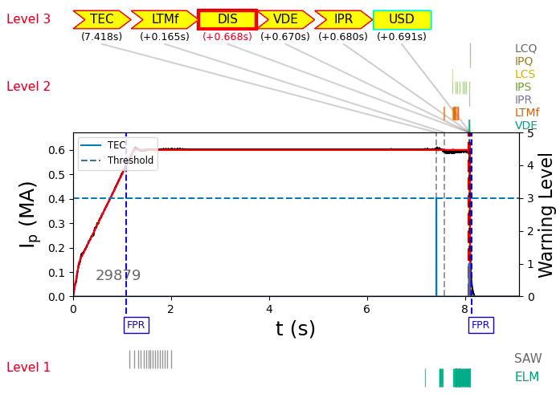
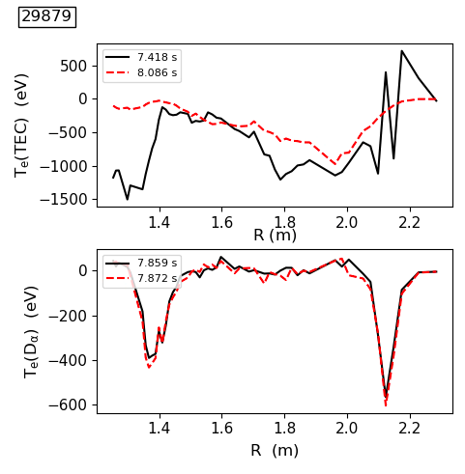
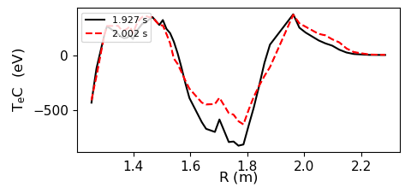
General approach: reconstruct a crash profile that can uniquely map to physics events
TEC
Global event
ELM
Edge localized
KSTAR
Goal is to produce a set of basis function describing local electron temperature collapses.
SAW
Core localized, inversion radius

Slide 12
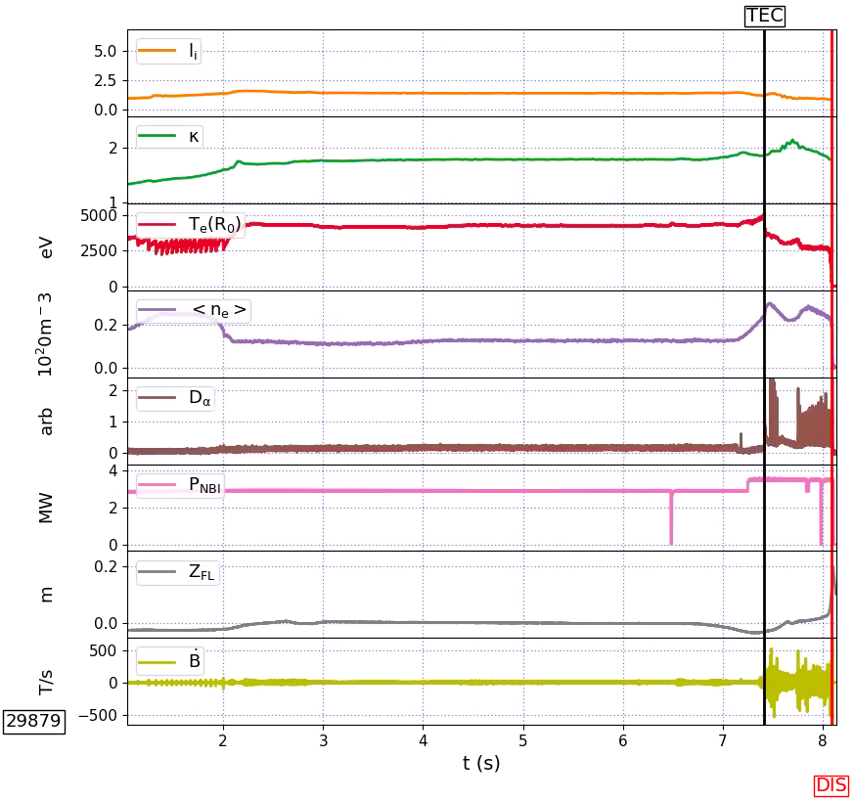
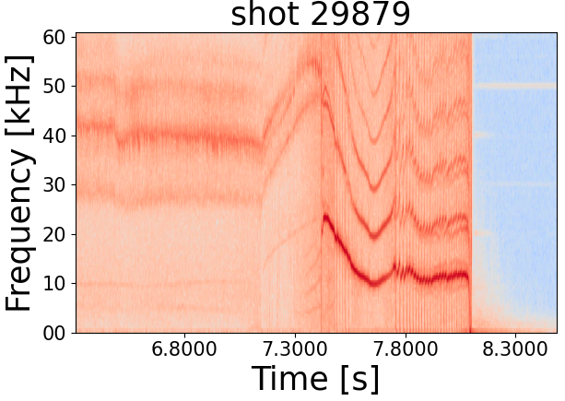
Example: Coupling between core and edge modes identified through the crash profile.
KSTAR
FRE
TEC
Ideal Mode
TEC
FRE

Slide 13
Analysis of the $T_{e}$ collapses performed in 3 stages
Crash Identification.
Crash characterization.
Plasma state around crash time.
Monitoring depends on crash type
NTM triggering.
H→L mode.
Radiative events.
Recovery
ELM, SAW, …
Continuous monitoring
Discrete analysis
Plasma state in equilibrium.
Plasma state in vicinity to collapse
Opening of the field lines: $T_{e}$ crashes.
Change in the plasma state.
Trigger disruption chain
$T_{e}\left(core\right)$
$\frac{T_{e}\left(core\right)}{∫T_{e}dR}$
$q_{0}, P_{ped}, β_{N},$ etc.
MHD mode present.
Soft gradient
Crash identification.
Crash characterization.
- ELM
- SAW
- TEC (global $T_{e}$ collapse)
Plasma state around $τ_{collapse}$.
Stable operation at lower performance.

Slide 14
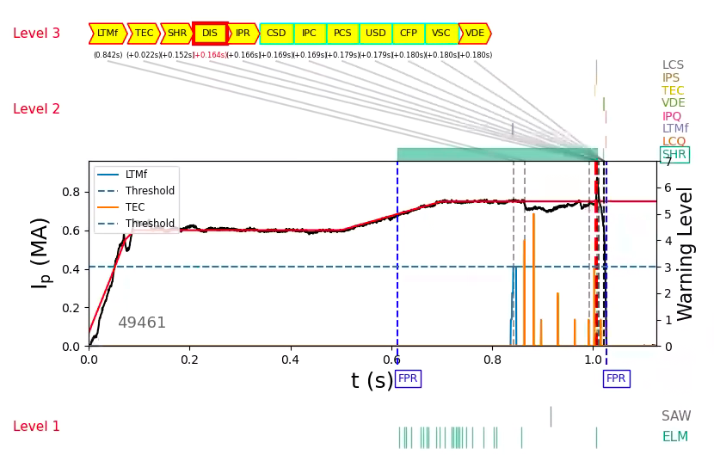
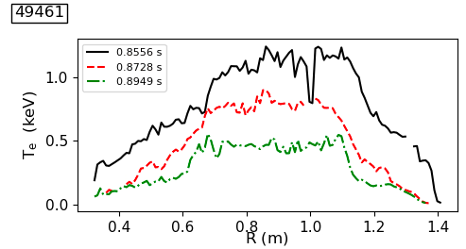
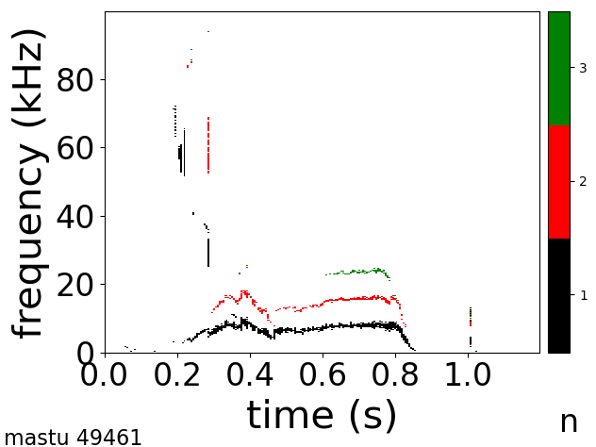
TEC signatures change in magnetic topology after mode locks to the machine wall
TEC
MAST-U
Delayed disruption caused by LTM
Stochatization of the field lines following mode locking causes further TEC events until plasma disrupts.

Slide 15
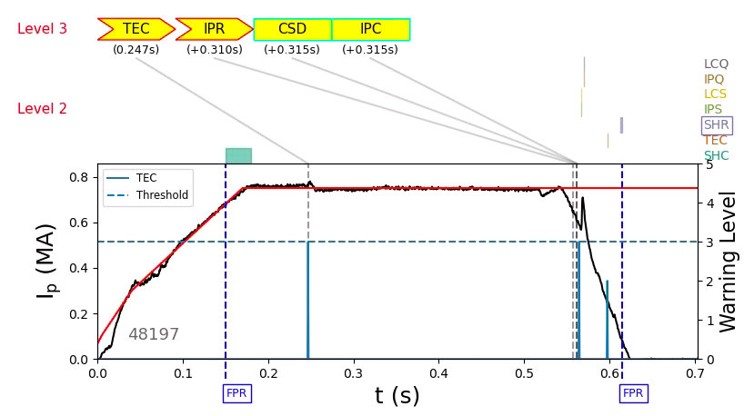
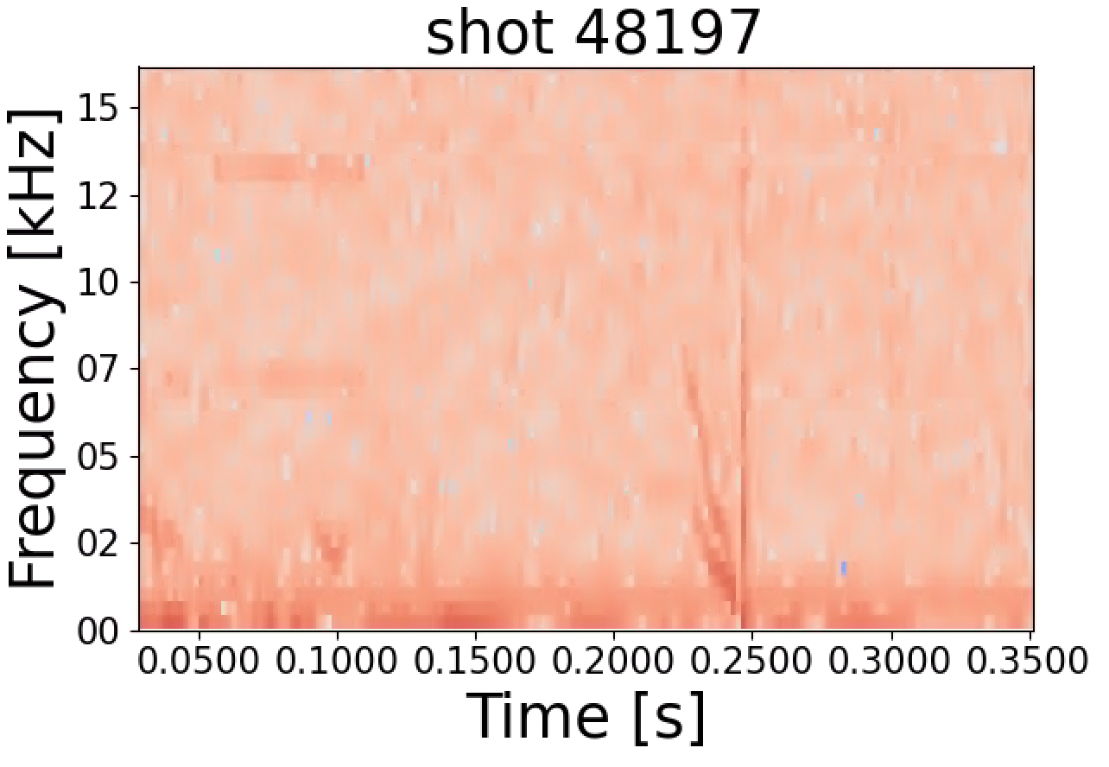
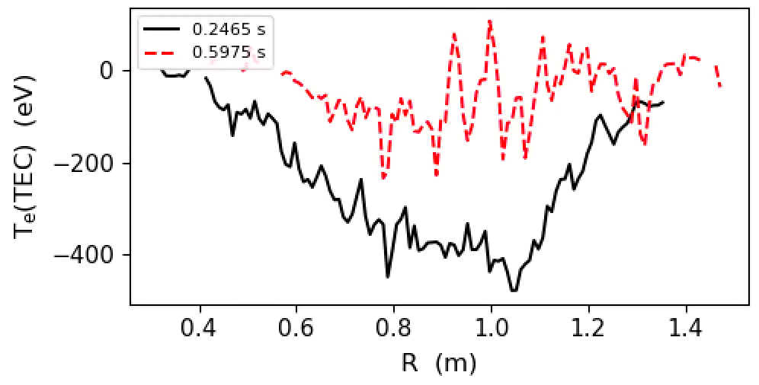
TEC event identifies different physics events: characterized by plasma state during collapse
Two types of TEC events in this shot, both false positives (reached level3).
TEC that signatures the change in magnetic topology after an initial low amplitude mode locks.
TEC + Current spike signatures an internal reconnection event during ramp-down
MAST-U
Models require additional physics to improve accuracy.

Slide 16
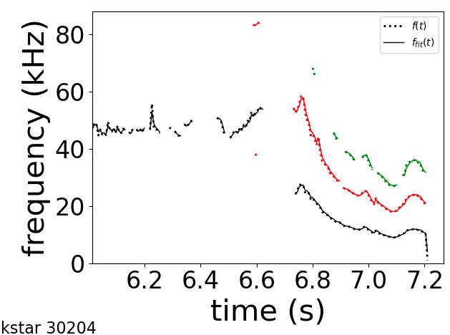
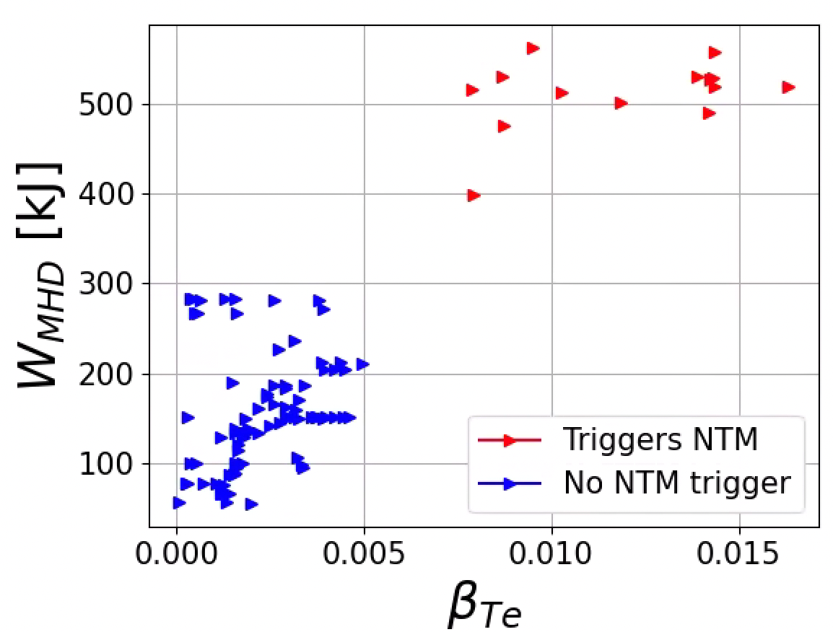
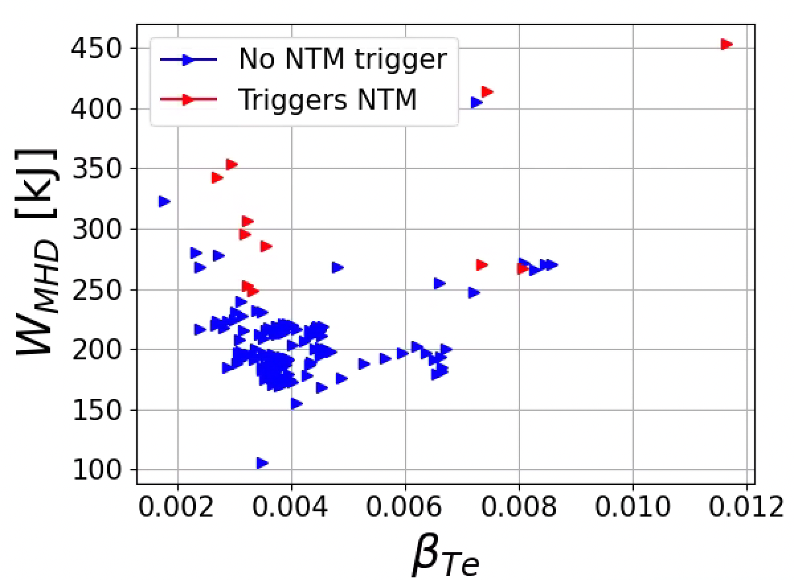
Example: clear separation in parameter space between TEC crashes triggering NTMs in KSTAR
Automatic recognition of NTM triggering in DECAF mode analysis decomposition.
TEC Crashes
SAW Crashes
TEC
Magnetic spectrogram mode analysis
NTM triggered
Precursor
$β_{Te}$ calculated using the state of the $T_{e}$ profile:${ β}_{Te}=\frac{\frac{1}{R_{0}}∫T_{e}dR ∗n_{e}[m^{−3}]}{\frac{B_{0}^{2}}{2μ_{0}}}$ .
$W_{MHD}$ correlates with energy available to seed a disruption.
Complete stability analysis before and after crash in near future.
Crash classification is of critical importance!

Slide 17
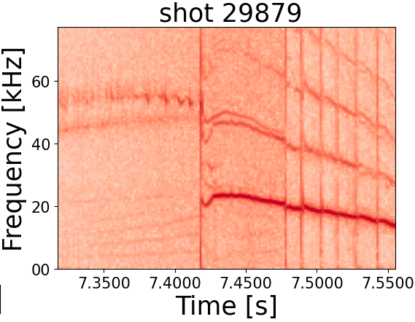
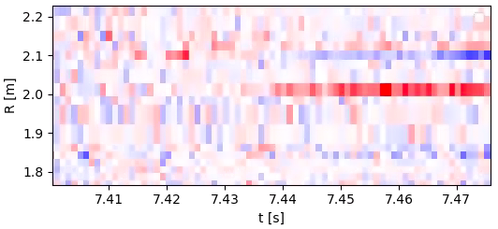
Preventive ECCD triggered by TEC event could relax the injection power and beam alignment requirement for NTM stabilization
DECAF’s estimation of island width based on ECE detects island starts growing ~20 ms after TEC.
Similar phenomena observed in ASDEX-U [1] and NSTX [2].
Preventive growth suppression using ECCD on the rational surface before neoclassical effects dominate dynamics.
Experiments in DIIID [3] and TCV [4] show relaxed requirements in EC power and beam alignment for preventive ECCD
DECAF island identification (7.439 s)
Estimated island
width (2/1)
Ideal phase
(~7.418 - 7.439 s)
TEC (7.418 s)
TEC
Experimental proposal submitted to use TEC event to trigger preventive ECCD in KSTAR.
[1] V. Igochine etal 2017 Nucl.Fusion 57 036015
[2] S.A. Sabbagh et al 2010 Nucl. Fusion 50 025020
[3] E. Kolemen etal 2014 Nucl.Fusion 54 073020
[4] M Kong etal 2022 PlasmaPhys.Control.Fusion 64 044008

Slide 18
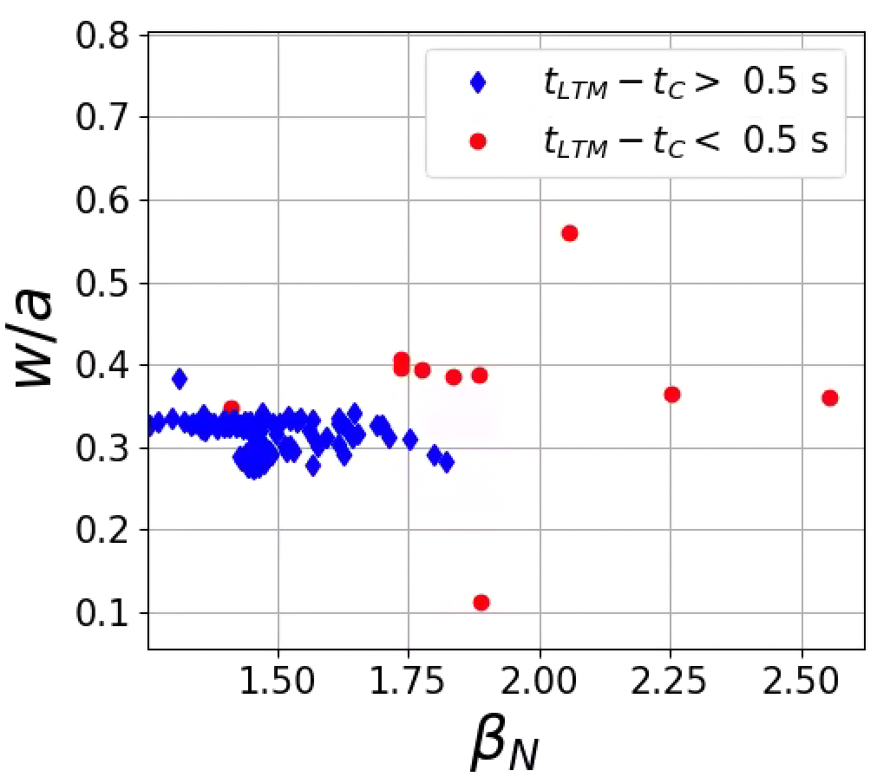
Disruption forecast space with respect to $β_{N}$ and w/a defines a ‘stable’ plasma state region
Crash parameters and plasma state with respect to LTM time onset $t_{LTM}$ (Level 3 DECAF warning).
Disruptive SAW crashes occur in a different region related to initial sawtooth phase.
Wider SAW crashes more likely to seed NTM due to coupling with higher harmonic rational surfaces.
Comparisons with theory [1,2] in the near future.
Physics-based threshold implementation.
Evaluation of the Modified Rutherford equation.
Optimization through DECAF workflow.
[1] F Porcelli et al, Plasma Phys. Control. Fusion 38 (1996) 2163–2186.
[2] L. Bardóczi et al, PHYSICAL REVIEW LETTERS 127, 055002 (2021)

Slide 19
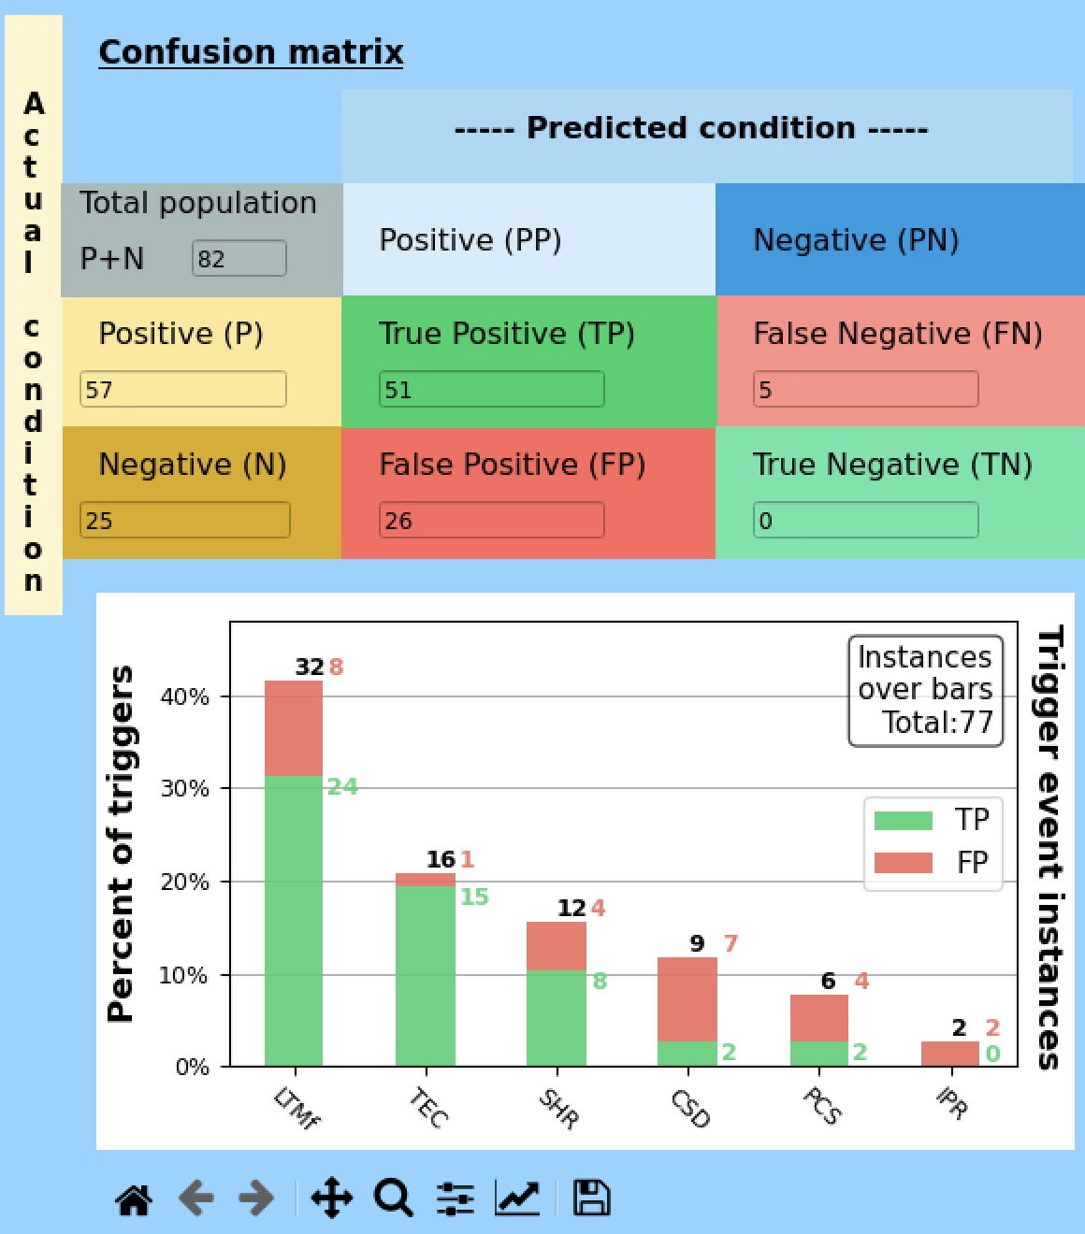
TEC implemented in DECAF able to locate true positive triggers
KSTAR
79 KSTAR shots analyzed in the range [28700 – 28799]*, with 100% true positive TEC triggers.
TEC identified as the trigger event in ~20% of the shots in 3THR2 experiment in MAST-U .
Further improvements to the events accuracy through DECAF workflow.
See Poster 107, S. Sabbagh.
MAST-U
* None of the shots in previous plots are on this shot range.

Slide 20
Electron temperature collapse analysis provides early disruption warnings and physics understanding of disruption phenomena
DECAF demonstrated high accuracy disruption prediction and avoidance offline and in real-time.
Fast changes in the magnetic field topology can be monitored through fast changes in the evolution of the electron temperature → $T_{e}$ collapses.
A general formalism has been formulated to identify and categorize electron temperature crashes.
A family of base functions which identify a crash profile map to key physical events.
Analysis of the plasma state after a $T_{e}$ collapse, along with the crash parameters can provide early disruption warnings.
DECAF implementation allows the analysis of the entire databases (soon for TEC, SAW, etc).
Iterative DECAF workflow to optimize physics involved and warning thresholds.

Slide 21
EXTRA SLIDES

Slide 22
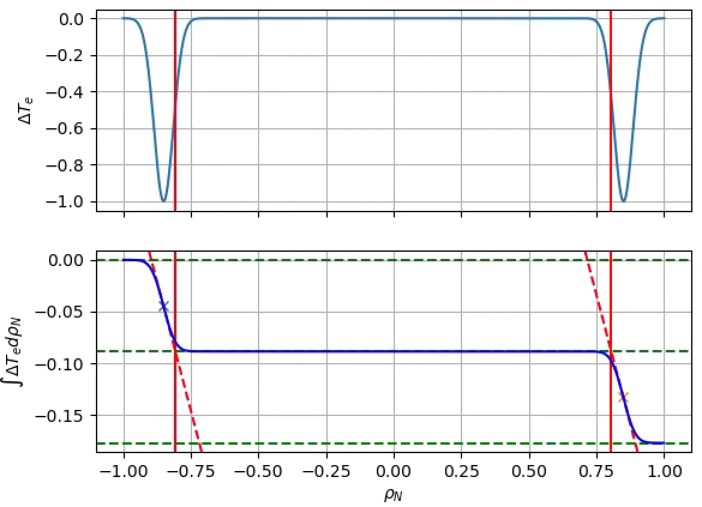
SAW and ELM crash profiles characterization through physics-based principles using base functions
$$ΔT_{e}(SAW)$$
$$ΔT_{e}(ELM)$$
Unperturbed region
Core crash
Inversion radius
$$δρ_{2}$$
$$δρ_{1}$$
$$CorePenetration= \frac{δρ_{1}+δρ_{2}}{2}$$
General detection methodology using a single formalism to tie $T_{e}$ crashes to physics phenomena.

Slide 23
Disruption in shot 29879
Ideal mode
NBI power increase
ELMing phase
TEC

Slide 24
TEC implemented in DECAF able to locate true positive triggers
79 KSTAR shots analyzed in the range [28700 – 28799]*
5 shots seed NTM, which then locks.
120 - 180 ms before LTMf, and 200 – 560 ms before DIS).
2 shots seed NTM which doesn’t lock, then disrupts later in the shot due to another physical mechanism.
253 and 164 ms before LTMf.
.
Real time implementation ongoing!
* None of the shots in previous plots are on this shot range.

Slide 25
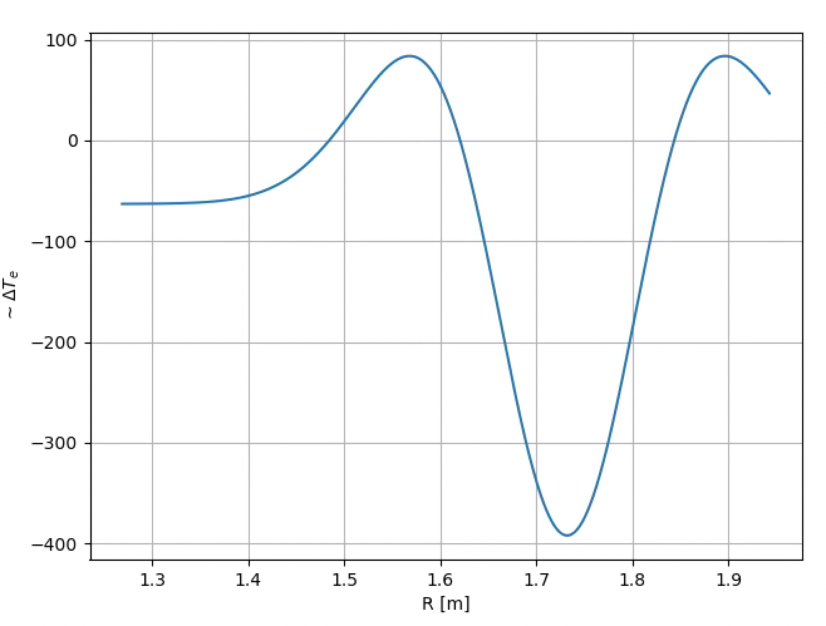
Discrimination of sawtooth activity performed using an analytical estimation of the SAW crash base function
Crash profile for SAW is related to a particular base function
Core crash
$$y=A\left(1−{\left(\frac{R−R_{0}}{σ}\right)}^{2}\right)e^{−\frac{1}{2}\left(\frac{2{\left(R−R_{0}\right)}^{2}}{σ^{2}}\right)}+B$$
Inversion radius
Correlation with base function to extract important crash parameters:
Inversion radius.
Amplitude.
Crash radial location and extent.

Slide 26
TEC identified as the trigger event in ~20% of the shots in 3THR2 experiment in MAST-U

Slide 27
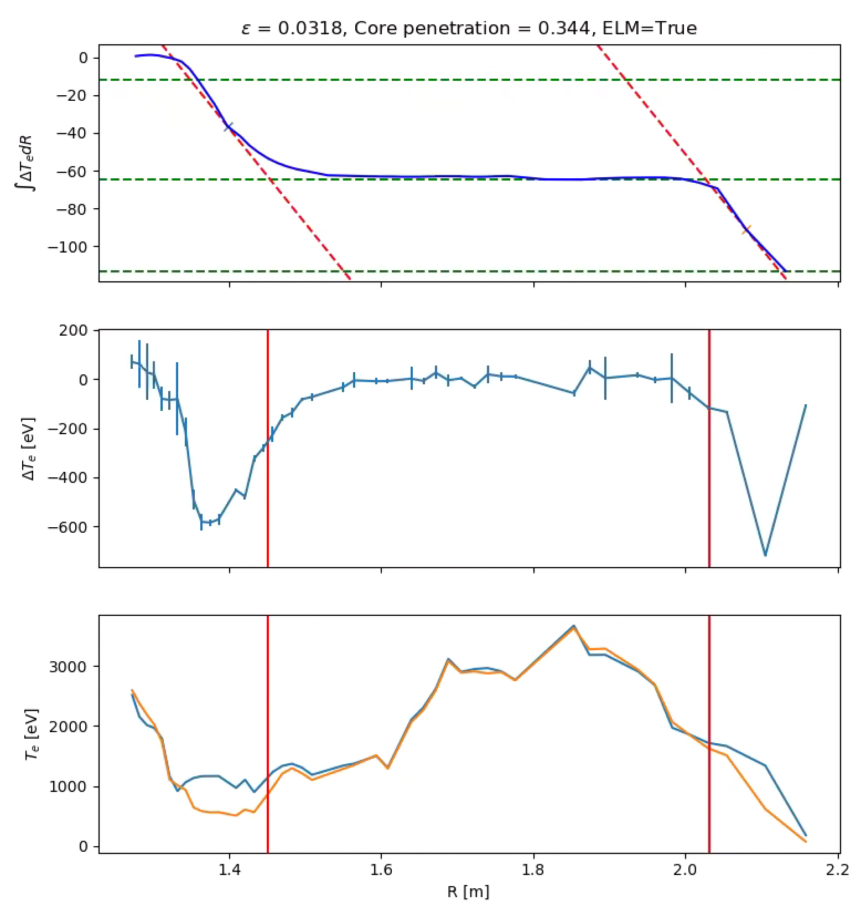
A good fit to ELM base function can be obtained only by geometric parameters using a $ρ_{N}(R,Z=0)$ mapping
Comparison with ELM base function easier in the integrated crash profile.
Unperturbed region
$$ICP (ρ_{N}=−1)$$
$$δρ_{2}$$
$$ICP(ρ_{N}=0)$$
$$δρ_{1}$$
Local slope
$$ICP(ρ_{N}=1)$$
Calculate how ‘unperturbed’ the localized region is:
Calculate core penetration as:
$$ε=\sum_{i}{\left(\frac{ICP\left(ρ_{N}=0\right)−ICP_{i}}{ICP_{i}}\right)}$$
$$CorePenetration= \frac{δρ_{1}+δρ_{2}}{2}$$

