Slide 1
Combining Adaptive Learning and Physics-Guided Machine Learning for Prediction and Control of Anomalies and Disruptions in Tokamaks
Third Technical Meeting on Plasma Disruptions and their Mitigation
Riccardo Rossi¹, Michela Gelfusa¹, Teddy Craciunescu², Ivan Wyss¹, Jesus Vega³ and Andrea Murari^{4,5}
on behalf of JET Contributors and the EUROfusion Tokamak Exploitation Team
¹Department of Industrial Engineering, University of Rome “Tor Vergata”, Via del Politecnico 1, 00133, Rome, Italy
²National Institute for Laser, Plasma and Radiation Physics, Magurele-Bucharest, Romania
³Laboratorio Nacional de Fusión, CIEMAT. Av. Complutense 40, Madrid, Spain
⁴Consorzio RFX (CNR, ENEA, INFN, University of Padova, Acciaierie Venete SpA), C.so Stati Uniti 4, 35127 Padova, Italy
⁵Istituto per la Scienza e la Tecnologia dei Plasmi, CNR, Padova, Italy
Contact: r.rossi@ing.uniroma2.it
Work funded by Riccardo Rossi EUROfusion Researcher Grant “Development and implementation of a physics-based multi-machine plasma instability detection and classification system for disruption avoidance, prevention, and mitigation”, AWP22-ERG-ENEA/Rossi

Slide 2
Outline
Aim of the Work
Paths to Disruption Considered
Database
System Architecture
Single Anomaly Classifier
Magnetic anomaly Detection
Electron Temperature Anomaly Detection and Classification
Radiative Pattern Anomaly Detection and Classification
Alarm and Control Logic and System Architecture
Statistical Analysis
Conclusions

Slide 3
Outline
Aim of the Work
Paths to Disruption Considered
Database
System Architecture
Single Anomaly Classifier
Magnetic anomaly Detection
Electron Temperature Anomaly Detection and Classification
Radiative Pattern Anomaly Detection and Classification
Alarm and Control Logic and System Architecture
Statistical Analysis
Conclusions

Slide 4
Aim of the work
Development of a not a simple disruption predictor, but a system for anomaly detection and classification.
Main Features
Multiclass
Detection and Classification of Plasma Anomalies, providing useful information for the control system and DMS
Physics-informed machine/deep learning
Physics-informed deep learning allows to constrain model with both data and physics, allowing for more reliable predictors with the capability to extrapolate using physical models, improving also transferability.
Ensemble of predictors
Instead of one deep model, simpler detector/classifier have been developed for specific anomalies. This improves the explainability of the model, reduce the data requirements for training, and the transferability to other tokamaks.
Adaptive learning
Adaptive learning allows to update the training set pulse by pulse, avoiding performance degradation (obsolescence)

Slide 5
Outline
Aim of the Work
Paths to Disruption Considered
Database
System Architecture
Single Anomaly Classifier
Magnetic anomaly Detection
Electron Temperature Anomaly Detection and Classification
Radiative Pattern Anomaly Detection and Classification
Alarm and Control Logic and System Architecture
Statistical Analysis
Conclusions

Slide 6
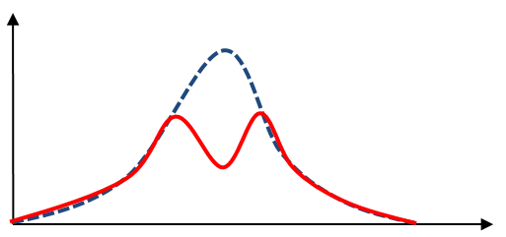
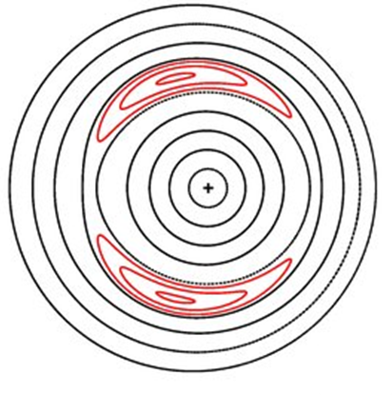
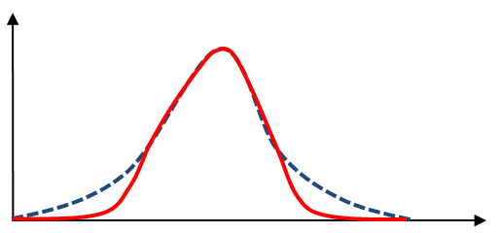
Typical Paths to Disruptions
Core Radiation
Electron temperature
hollowness
MHD mode destabilisation
Disruption
Edge radiation
Electron temperature
Edge cooling
Pucella G. et al. “Onset of tearing modes in plasma termination on JET: the role of temperature hollowing and edge cooling”, Nuclear Fusion, 2021
Rossi R. et al. “A systematic investigation of radiation collapse for disruption avoidance and prevention on JET tokamak”, Matter and Radiation at Extremes, 2023

Slide 7
Outline
Aim of the Work
Paths to Disruption Considered
Database
System Architecture
Single Anomaly Classifier
Magnetic anomaly Detection
Electron Temperature Anomaly Detection and Classification
Radiative Pattern Anomaly Detection and Classification
Alarm and Control Logic and System Architecture
Statistical Analysis
Conclusions

Slide 8
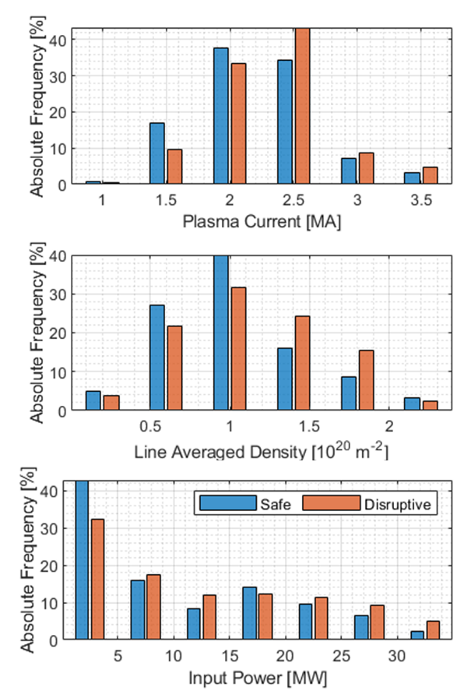
Database
The database consists of 1683 JET pulses, spanning from the high-power DD campaign to the full tritium and DT campaign (C38, C39, C40, C41). The DB includes 1141 not disruptive pulses and 542 disruptive.
 | C38 | C39 | C40 | C41 | Total
Total | 907 | 168 | 310 | 298 | 1683
Safe | 653 | 133 | 184 | 171 | 1141
Disruptive | 254 | 35 | 126 | 127 | 542
Ramp Up Disruptions | 0 | 0 | 0 | 0 | 0
Flat Top Disruptions | 62 | 23 | 33 | 33 | 151
Ramp Down Disruptions | 192 | 12 | 93 | 94 | 391

Slide 9
Outline
Aim of the Work
Paths to Disruption Considered
Database
System Architecture
Single Anomaly Classifier
Magnetic anomaly Detection
Electron Temperature Anomaly Detection and Classification
Radiative Pattern Anomaly Detection and Classification
Alarm and Control Logic and System Architecture
Statistical Analysis
Conclusions

Slide 10
System Architecture
Tokamak (plasma)
Detectors and Classifiers Ensemble
Diagnostics
Mode Locked Amplitude
Internal Inductance
Plasma Current
MHD anomaly detector
Electron temperature anomaly detector and classifier
Thomson Scattering (HRTS)
Alarm classification system
Radiative anomaly detector and classifier
Bolometer cameras
Control System
Only real-time compatible signals have been used
All algorithms have computational times compatible with real-time
Disruption Mitigation System

Slide 11
Outline
Aim of the Work
Paths to Disruption Considered
Database
System Architecture
Single Anomaly Classifier
Magnetic anomaly Detection
Electron Temperature Anomaly Detection and Classification
Radiative Pattern Anomaly Detection and Classification
Alarm and Control Logic and System Architecture
Statistical Analysis
Conclusions

Slide 12
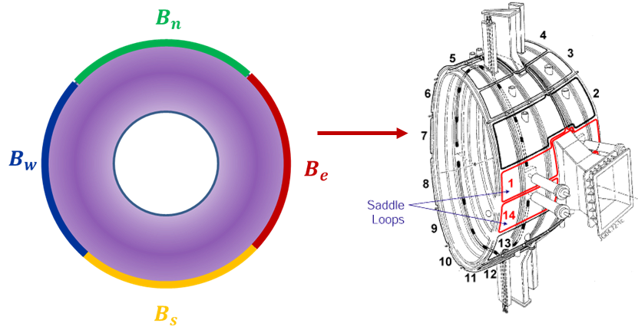
Magnetic anomalies
Before disruptions, in most discharges, a big MHD mode (usually a 2,1) increases in amplitude and decreases in frequency still it “locks” to the wall.
By specific magnetic coils it is possible to monitor both the frequency and the magnitude of the modes.
Combining the mode lock amplitude with other plasma quantities (such as the internal inductance) it is possible to improve prediction accuracy.
Peluso E., Rossi R., et al. “Alternative Detection of n = 1 Modes Slowing Down on ASDEX Upgrade”, Applied Sciences 10 (21), 2020

Slide 13
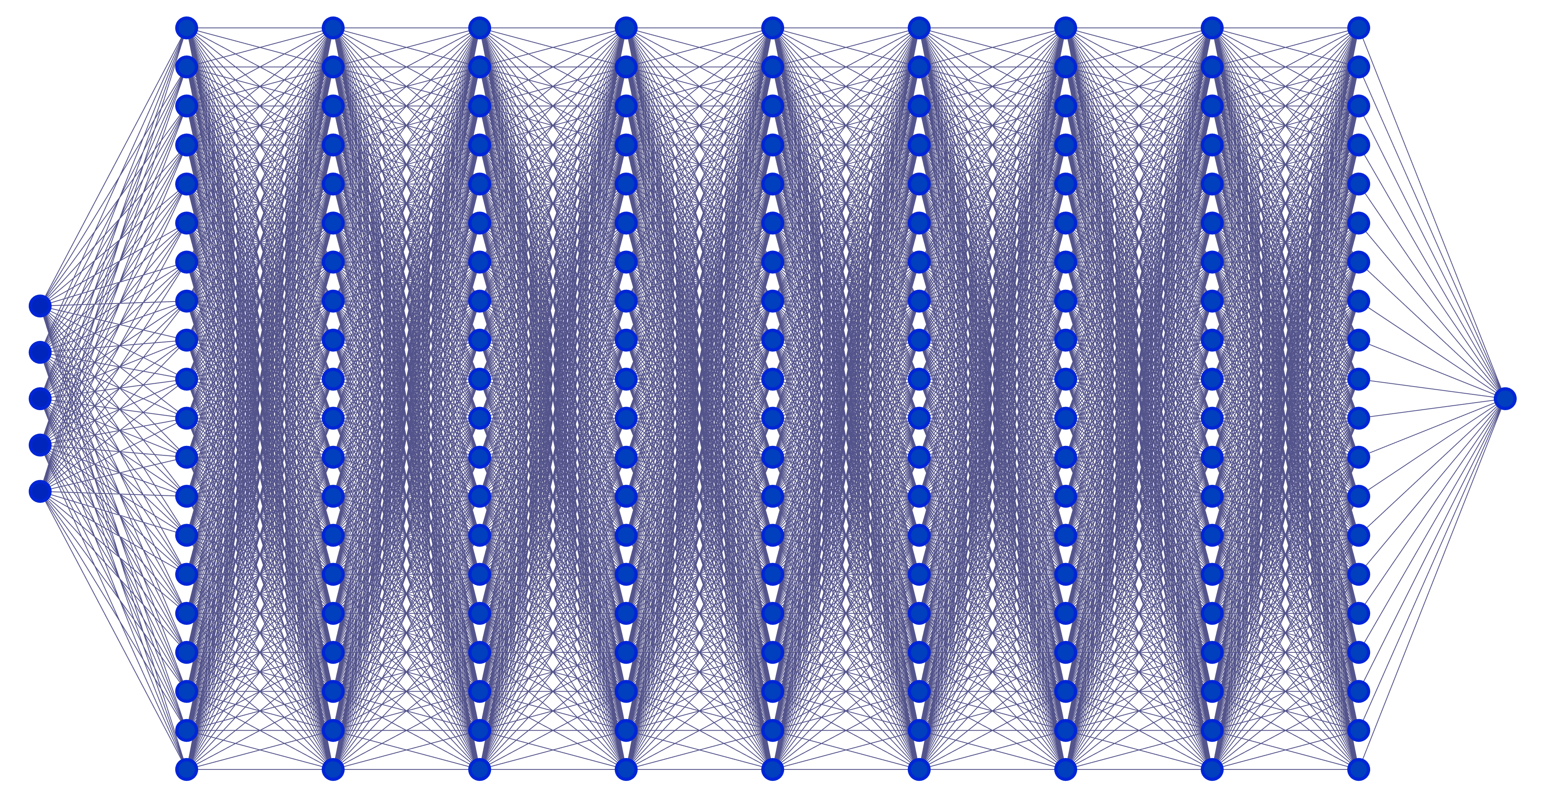
Physics-Informed Neural Networks (PINNs)
A machine/deep learning algorithm can be described as a function $f(θ,X)$ where X are the features (inputs) and $θ$ are the parameters to be tuned.
In supervised learning, $θ$ are tuned with “example”, i.e. data already labelled (in our case, for binary prediction, disruptive and safe previous pulses).
In Physics-Informed Learning, $θ$ can be tuned minimising a loss function that takes into account both typical supervised loss and a physics-based loss function.
Features (Input)
Target (Output)
Features (Input)
Target (Output)
Loss Data
Loss Data
Parameters Update
Parameters Update
Loss Physics
Rossi R. et al. “On the potential of physics-informed neural networks to solve inverse problems in tokamaks”, Nuclear Fusion, 2023

Slide 14
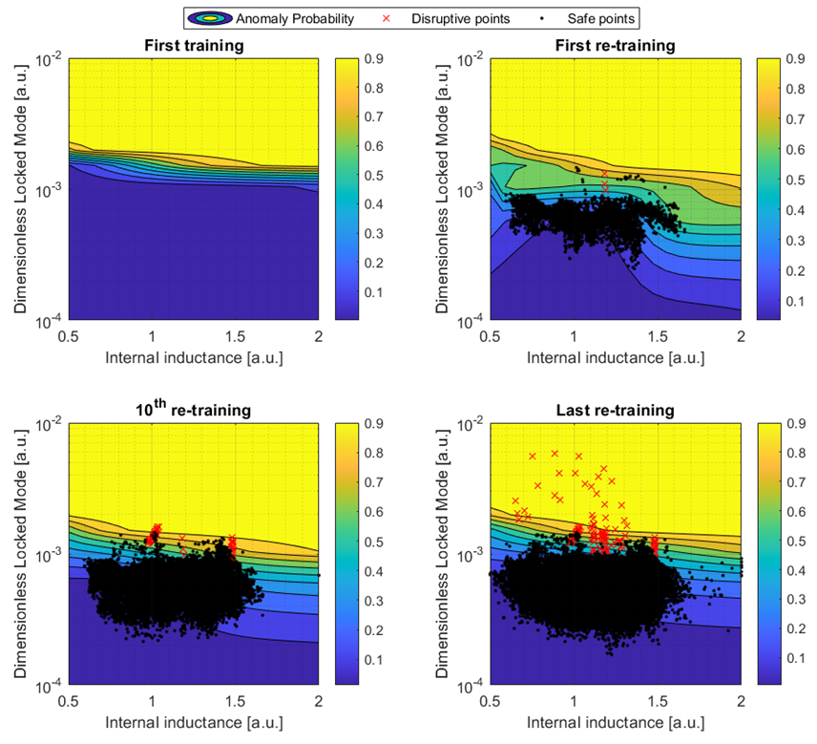
PINN classification of Mode Locking
At the beginning, no data is present. The predictor is trained with physics.
Pulse-by-pulse, data populates the training set and the PINN is updated. However, physics is still used for regions in presence of data scarcity and for extrapolation (allowing also for physics-informed transfer learning).
Rossi R., et al. “A hybrid physics/data-driven logic to detect, classify, and predict anomalies and disruptions in tokamak plasmas” Nuclear Fusion, 2024

Slide 15
Outline
Aim of the Work
Paths to Disruption Considered
Database
System Architecture
Single Anomaly Classifier
Magnetic anomaly Detection
Electron Temperature Anomaly Detection and Classification
Radiative Pattern Anomaly Detection and Classification
Alarm and Control Logic and System Architecture
Statistical Analysis
Conclusions

Slide 16
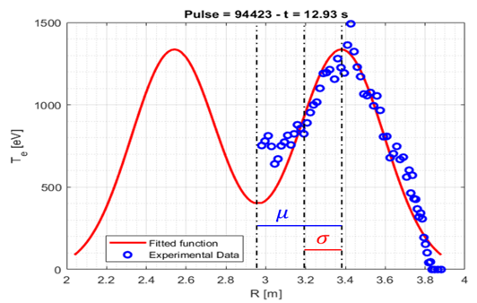
Electron Temperature Hollowness
The electron temperature profile is expected to have the maximum value on the magnetic axis (plasma core).
Electron temperature hollowness may occur, leading to destabilisation of magnetic configuration (MHD modes triggering).
Detection and classification of electron temperature hollowness has been based on a simple statistical indicator that is stable, universal, accurate and specific.
No training is needed.
$$G{\left(r\right)}_{bimodal}=Ae^{−\frac{{\left(r−μ\right)}^{2}}{2σ^{2}}}\left(1+e^{−\frac{2μr}{σ^{2}}}\right)$$
Warning time [s] | Sensitivity | 1-Specifity | Accuracy
1.09 | 97.09% | 0.00% | 99.56%
$$GFH=\frac{μ}{σ}=\sqrt{2D_{B}}$$
Rossi R. et al. “Development of robust indicators for the identification of electron temperature profile anomalies on JET”, PPCF 2022

Slide 17
Electron Temperature Edge Cooling
$$T_{e}$$
Enough hot plasma is expected inside the separatrix.
If edge electron temperature is too low (Edge Cooling), resistivity dominates and MHD modes may be triggered.
Detection and classification of electron temperature edge cooling has been based on another statistical indicator that is stable, universal, accurate and specific.
No training is needed.
It aims at measuring the magnetic radius at which 98% of temperature is contained.
98%
$$ρ_{98}$$
-a
a
$$CDF_{T}\left(r\right)=\frac{\int_{−a}^{ρ_{98}}{T_{e}dr}}{\int_{−a}^{a}{T_{e}dr}}=0.98$$
$$CBC=1/{ρ_{98}}$$
Warning time [s] | Sensitivity | 1-Specifity | Accuracy
0.320 | 99.90% | 0.00% | 99.98%
Rossi R. et al. “Development of robust indicators for the identification of electron temperature profile anomalies on JET”, PPCF 2022

Slide 18
Outline
Aim of the Work
Paths to Disruption Considered
Database
System Architecture
Single Anomaly Classifier
Magnetic anomaly Detection
Electron Temperature Anomaly Detection and Classification
Radiative Pattern Anomaly Detection and Classification
Alarm and Control Logic and System Architecture
Statistical Analysis
Conclusions

Slide 19
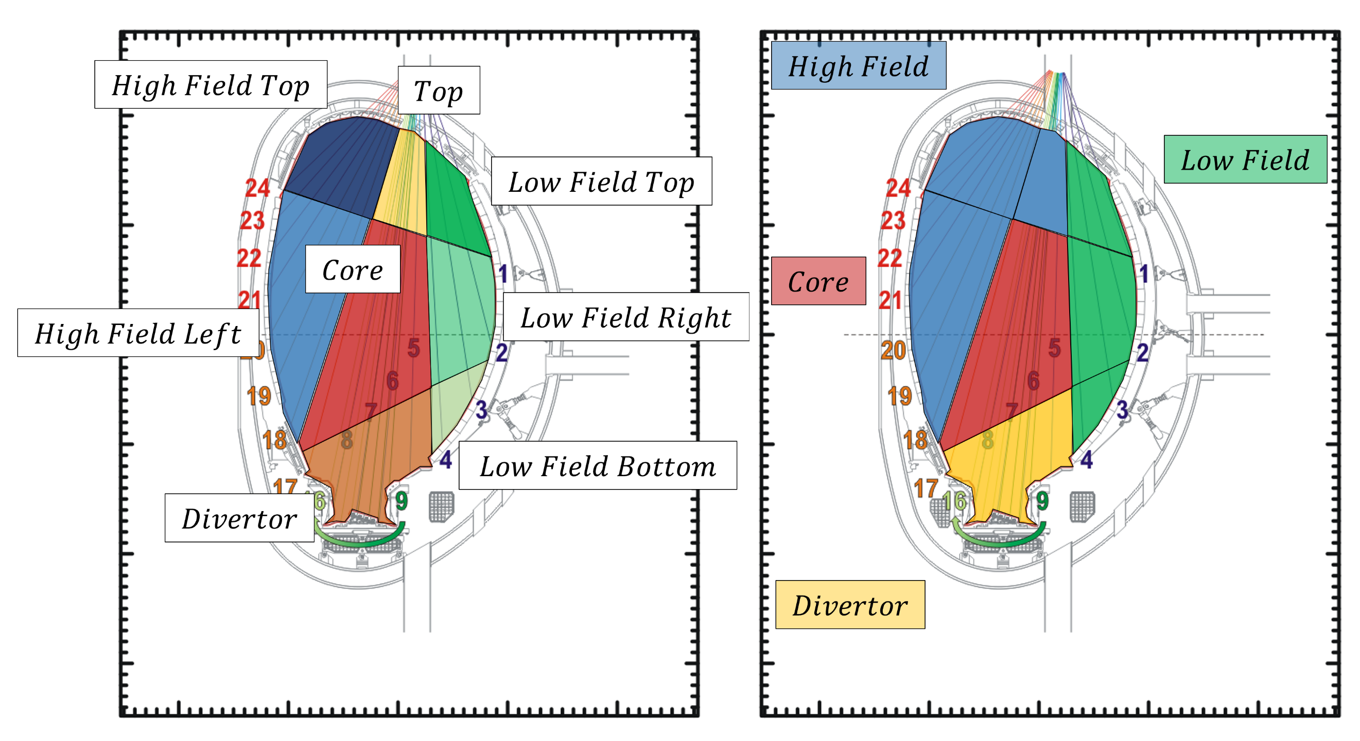
Radiative Anomalies
Radiation is a loss of energy.
Too high local radiation leads to local cooling:
Core Radiation: Electron Temperauture Hollowness
MARFE Radiation: Edge Cooling
Low Field Side Radiation: Edge Cooling
Anomalous Divertor Radiation: Edge Cooling
Measuring local radiation is fundamental.
In tokamaks, we have bolometers (or diodes), which measure the line-integrated emissivity.
We need fast inversion techniques. A simple low spatial fast inversion inversion has been developed to evaluate the radiation in specific regions of the tokamak.

Slide 20
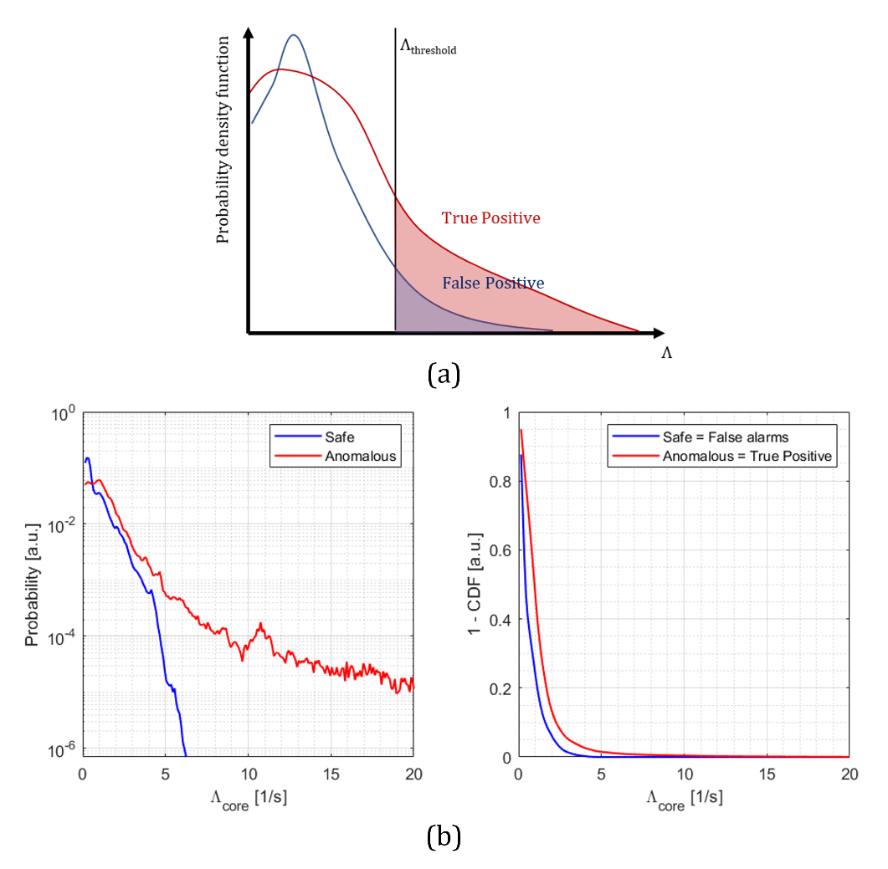
Radiative Anomalies Detection and Classification
A simple low-spatial resolution fast-time inversion has been developed to monitor the emitted power in specific region of the plasma.
Computational time is acceptable for real-time applications (10 to 100 μs).
Anomaly indicators have been calculated as the inverse of local radiative cooling times:
$$\frac{1}{τ_{rad,i}}=Λ_{i}=\frac{P_{rad.i}}{W_{p}}$$
Rossi R. et al. “A systematic investigation of radiation collapse for disruption avoidance and prevention on JET tokamak”, Matter and Radiation at Extremes, 2023

Slide 21
Outline
Aim of the Work
Paths to Disruption Considered
Database
System Architecture
Single Anomaly Classifier
Magnetic anomaly Detection
Electron Temperature Anomaly Detection and Classification
Radiative Pattern Anomaly Detection and Classification
Alarm and Control Logic and System Architecture
Statistical Analysis
Conclusions

Slide 22
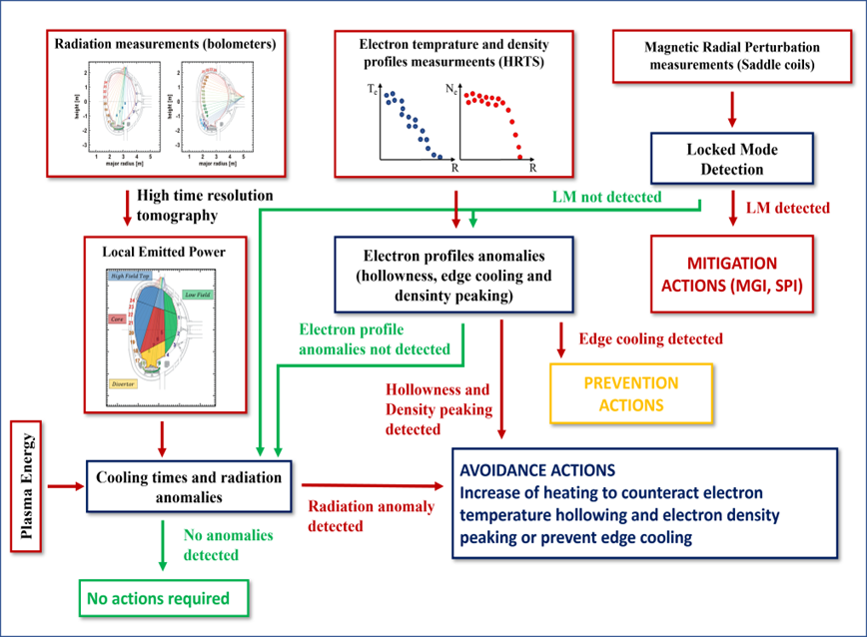
Alarm and mitigation/prevention/avoidance control logic
Given the paths to disruptions and the typical time scales of the various phenomena, one can propose a control and mitigation schemes which:
Radiation anomalies trigger control schemes to counteract local cooling (both edge and core)
Hollowness trigger control schemes to sustain core heating
Edge Cooling trigger early termination of the plasma (Prevention)
MHD anomaly trigger mitigation actions
Murari A., Rossi R., et al. “A control oriented strategy of disruption prediction to avoid the configuration collapse of tokamak reactors”, Nature Communications, 2024

Slide 23
Outline
Aim of the Work
Paths to Disruption Considered
Database
System Architecture
Single Anomaly Classifier
Magnetic anomaly Detection
Electron Temperature Anomaly Detection and Classification
Radiative Pattern Anomaly Detection and Classification
Alarm and Control Logic and System Architecture
Pulse Examples and Statistical Analysis
Conclusions

Slide 24
Results – Statistical analysis
Hypotising a minimum time for successful avoidance (200 ms), prevention (100 ms) and mitigation (10 ms), expected statistics on the database has been evaluated.
These results have been obtained starting with no data in the training set (only physics guided at the beginning) and the predictors have been retrained with new data pulse-by-pulse (adaptive learning).
Wrong early terminations at high plasma current (> 2 MA) are very low (2%).
Some safe pulses have alarms in radiation patterns and electron temperature profile, but these are not false alarms (anomaly present but not disruptive). Important to be detected for control and not mitigation!
 | Total | Mitigation | Prevention | Avoidance
Disruptive JET DMV | 36 | 3 | 5 | 28
Disruptive JET JTT | 19 | 1 | 0 | 18
Disruptive JET no actions | 20 | 5 | 4 | 11
Safe JET JTT | 33 | 7 | 0 | 10
Safe JET no actions | 178 | 0 | 0 | 0
Murari A., Rossi R., et al. “A control oriented strategy of disruption prediction to avoid the configuration collapse of tokamak reactors”, Nature Communications, 2024

Slide 25
Results – Warning times statistics
Warning times are extremely improved using eletron temperature and radiation anomaly indicators, going from a median value of 200 ms for a MHD-based detector to 900 ms combining MHD, electron temperature and radiation anomalies.
High warning times from radiation and electron temperature are important since they allows for control schemes to recover from the instability and avoid disruptions.
Disruptive Time vs DMV | Mitigation | Prevention | Avoidance
Mean [ms] | 481 | 135 | 1115
Median [ms] | 165 | 118 | 689
Min [ms] | 25 | 80 | 135
Murari A., Rossi R., et al. “A control oriented strategy of disruption prediction to avoid the configuration collapse of tokamak reactors”, Nature Communications, 2024

Slide 26
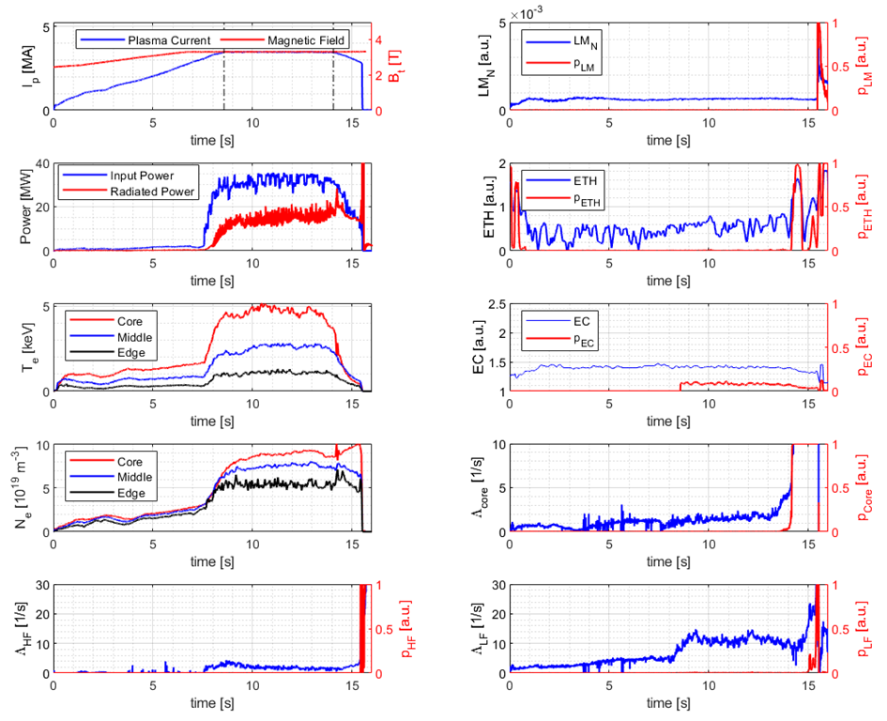
Results – Example 1 – Pulse 96486 (core-hollowness-mode locking- disruption)
Murari A., Rossi R., et al. “A control oriented strategy of disruption prediction to avoid the configuration collapse of tokamak reactors”, Nature Communications, 2024

Slide 27
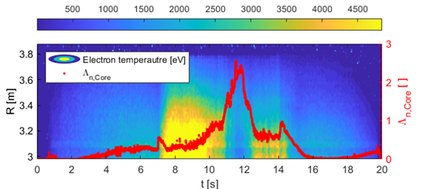
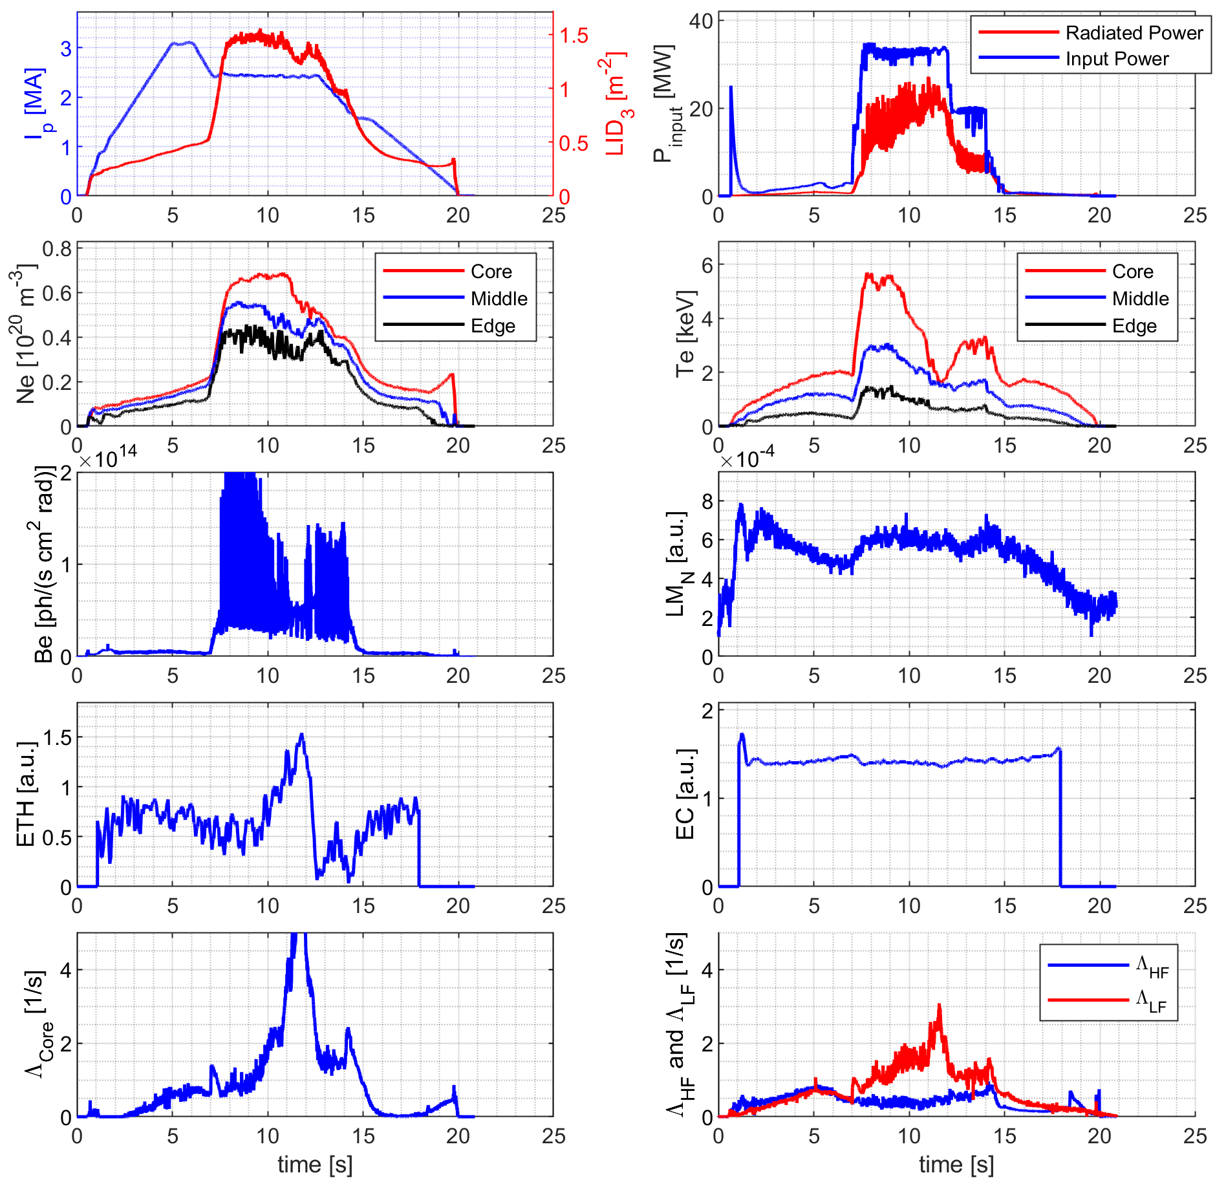
Results – Example 2 – Pulse 96491 (core-hollowness-recovering)
Murari A., Rossi R., et al. “A control oriented strategy of disruption prediction to avoid the configuration collapse of tokamak reactors”, Nature Communications, 2024

Slide 28
Outline
Aim of the Work
Paths to Disruption Considered
Database
System Architecture
Single Anomaly Classifier
Magnetic anomaly Detection
Electron Temperature Anomaly Detection and Classification
Radiative Pattern Anomaly Detection and Classification
Alarm and Control Logic and System Architecture
Statistical Analysis
Conclusions

Slide 29
Conclusions
A new disruption predictor has been developed combining physics and data driven indicators and machine learning.
The predictor is able to detect and classify MHD, electron temperature and radiative anomalies, allowing the control system to take the proper countermeasures.
Several “Simulations” of prediction in four JET campaigns have been performed, starting from no previous training set (simulating the beginning of the operation of a new tokamak, like ITER)
Performances are very high in terms of accuracy, sensitivity, specificity, and warning times, suggesting that this hybrid methodology implemented with adaptive learning is a good candidate for ITER and other new reactors.
Future Developments
Implementation of new anomalies (e.g. density limits)
Implementation of the predictor to other tokamaks to gather experience for ITER.

Slide 30
Combining Adaptive Learning and Physics-Guided Machine Learning for Prediction and Control of Anomalies and Disruptions in Tokamaks
Third Technical Meeting on Plasma Disruptions and their Mitigation
Riccardo Rossi¹, Michela Gelfusa¹, Teddy Craciunescu², Ivan Wyss¹, Jesus Vega³ and Andrea Murari^{4,5}
on behalf of JET Contributors and the EUROfusion Tokamak Exploitation Team
¹Department of Industrial Engineering, University of Rome “Tor Vergata”, Via del Politecnico 1, 00133, Rome, Italy
²National Institute for Laser, Plasma and Radiation Physics, Magurele-Bucharest, Romania
³Laboratorio Nacional de Fusión, CIEMAT. Av. Complutense 40, Madrid, Spain
⁴Consorzio RFX (CNR, ENEA, INFN, University of Padova, Acciaierie Venete SpA), C.so Stati Uniti 4, 35127 Padova, Italy
⁵Istituto per la Scienza e la Tecnologia dei Plasmi, CNR, Padova, Italy
Contact: r.rossi@ing.uniroma2.it

Slide 31
Adaptive Training Logic
A realistic adaptive training logic has been implemented, starting from zero training pulses (everything based on physics and statistical indicators).
MHD training
Physics + Data.
Data labelled following these rules:
No Alarm No disruptions:
Stable time slices
Disurption occurred:
last 100 ms are anomalous time slices
Temperature anomalies training
No Training is Needed
Radiation anomalies training
Physics + Data.
Data labelled following these rules:
No Alarm No disruptions:
Stable time slices
Disurption occurred or MHD/Eletron Temperature detected:
last 2000 ms are anomalous time slices

Slide 32
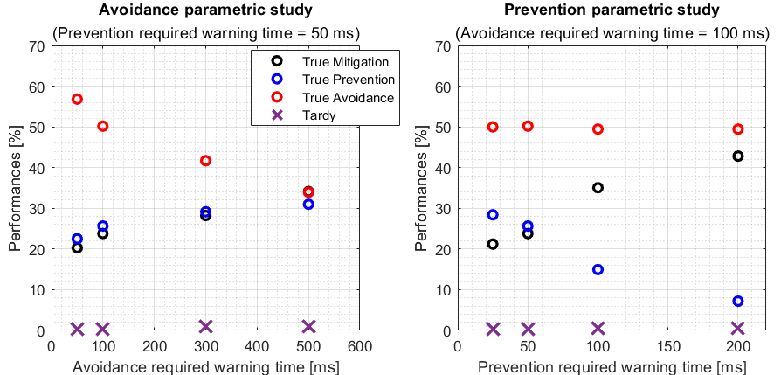
Results – Sensitivity analysis
Control strategies are under development and improvements. Of course, the quality of the predictor is a function of time required by the control system to perform mitigation, prevention, and avoidance.
We performed a sensitivity analysis of our algorithm varying avoidance and prevention times.
Rossi R., et al. “A hybrid physics/data-driven logic to detect, classify, and predict anomalies and disruptions in tokamak plasmas” Nuclear Fusion, 2024

Slide 33
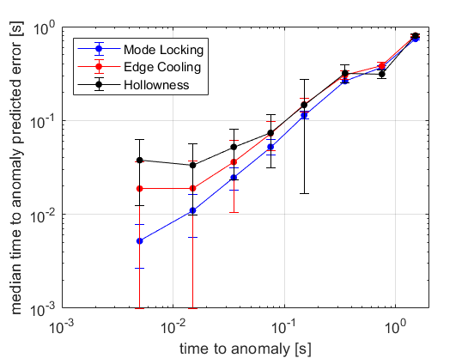
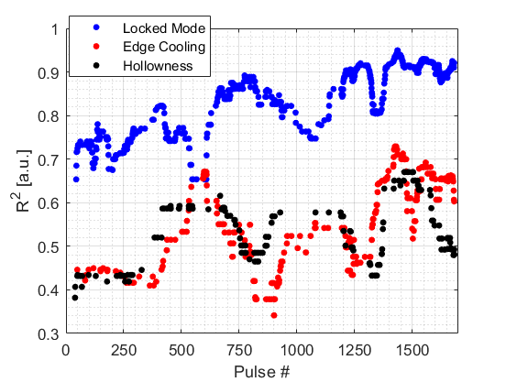
Results – Time To Anomaly Prediction
A time to anomaly predictor has been developed based on neural networks.
Prediction of MHD anomalies is good, since their a usually preceed by other anomalies.
Probably, it may have sense to predict an anomaly proximity indicator and not a time-to-anomaly, being it depedent also to the control system.
Rossi R., et al. “A hybrid physics/data-driven logic to detect, classify, and predict anomalies and disruptions in tokamak plasmas” Nuclear Fusion, 2024

Slide 34
Results – Comparison with JET Control System
We compare our results with JET disruption detection and control system.
Results validate the goodness of the predictor
(larger warning times and predictions in line with JET control system)
 | Total | Mitigation | Prevention | Avoidance
Disruptive JET DMV | 36 | 3 | 5 | 28
Disruptive JET JTT | 19 | 1 | 0 | 18
Disruptive JET no actions | 20 | 5 | 4 | 11
Safe JET JTT | 33 | 7 | 0 | 10
Safe JET no actions | 178 | 0 | 0 | 0
Disruptive Time vs DMV | Mitigation | Prevention | Avoidance
Mean [ms] | 481 | 135 | 1115
Median [ms] | 165 | 118 | 689
Min [ms] | 25 | 80 | 135
Murari A., Rossi R., et al. “A control oriented strategy of disruption prediction to avoid the configuration collapse of tokamak reactors”, Nature Communications, 2024

Slide 35
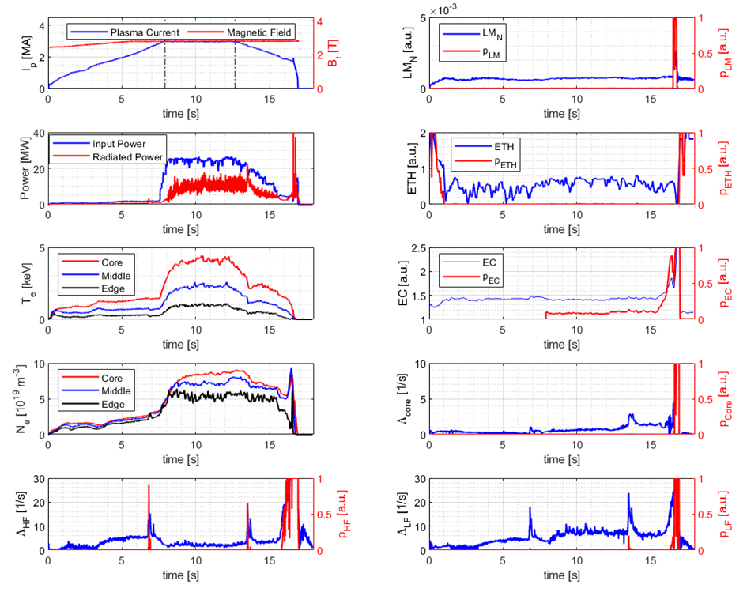
Results – Example 2 – Pulse 94650
Murari A., Rossi R., et al. “A control oriented strategy of disruption prediction to avoid the configuration collapse of tokamak reactors”, Nature Communications, 2024

