Slide 1
Shattered Pellet Technology and related developments at the ITER DMS support laboratory
Sándor Zoletnik
On behalf of the ITER DMS Support laboratory team and including key contributions from ITER DMS Task Force

Slide 2
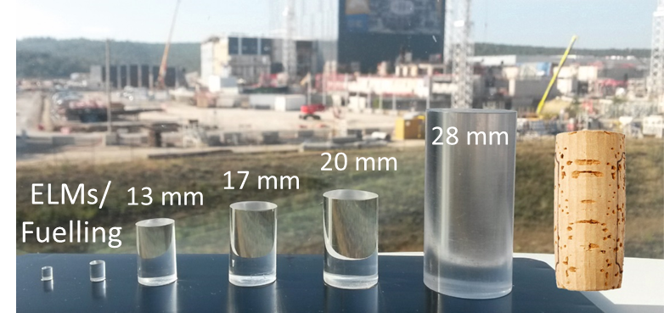


ITER DMS Support Laboratory
The ITER DMS support laboratory is part of the R&D of the ITER DMS taks force
Designing, manufacturing, commissioning and operating an SPI
injector for 19 and 28.5 mm diameter H, D, Ne, H-Ne pellets
Measuring pellet fragmentation
Testing propellant gas retention
Developing pellet recipes providing reliable launch
Testing various components of the ITER SPI system
Location: Centre for Energy Research, Budapest, Hungary
Contract start date: November 2020, first pellet: December 2021, ~ 800 pellets launched
Related projects:
Optical Pellet Diagnostic (OPD) concept development and demonstration (ITER 2020-23)
Fast shutter development (ITER 2022-23)
OPD prototype development (ITER 2024-25)
MGI/SPI launch valve development (HUN-REN 2023-24) (See poster 100 by D. Refy)
Figure from M. Lehnen
JET ITER

Slide 3
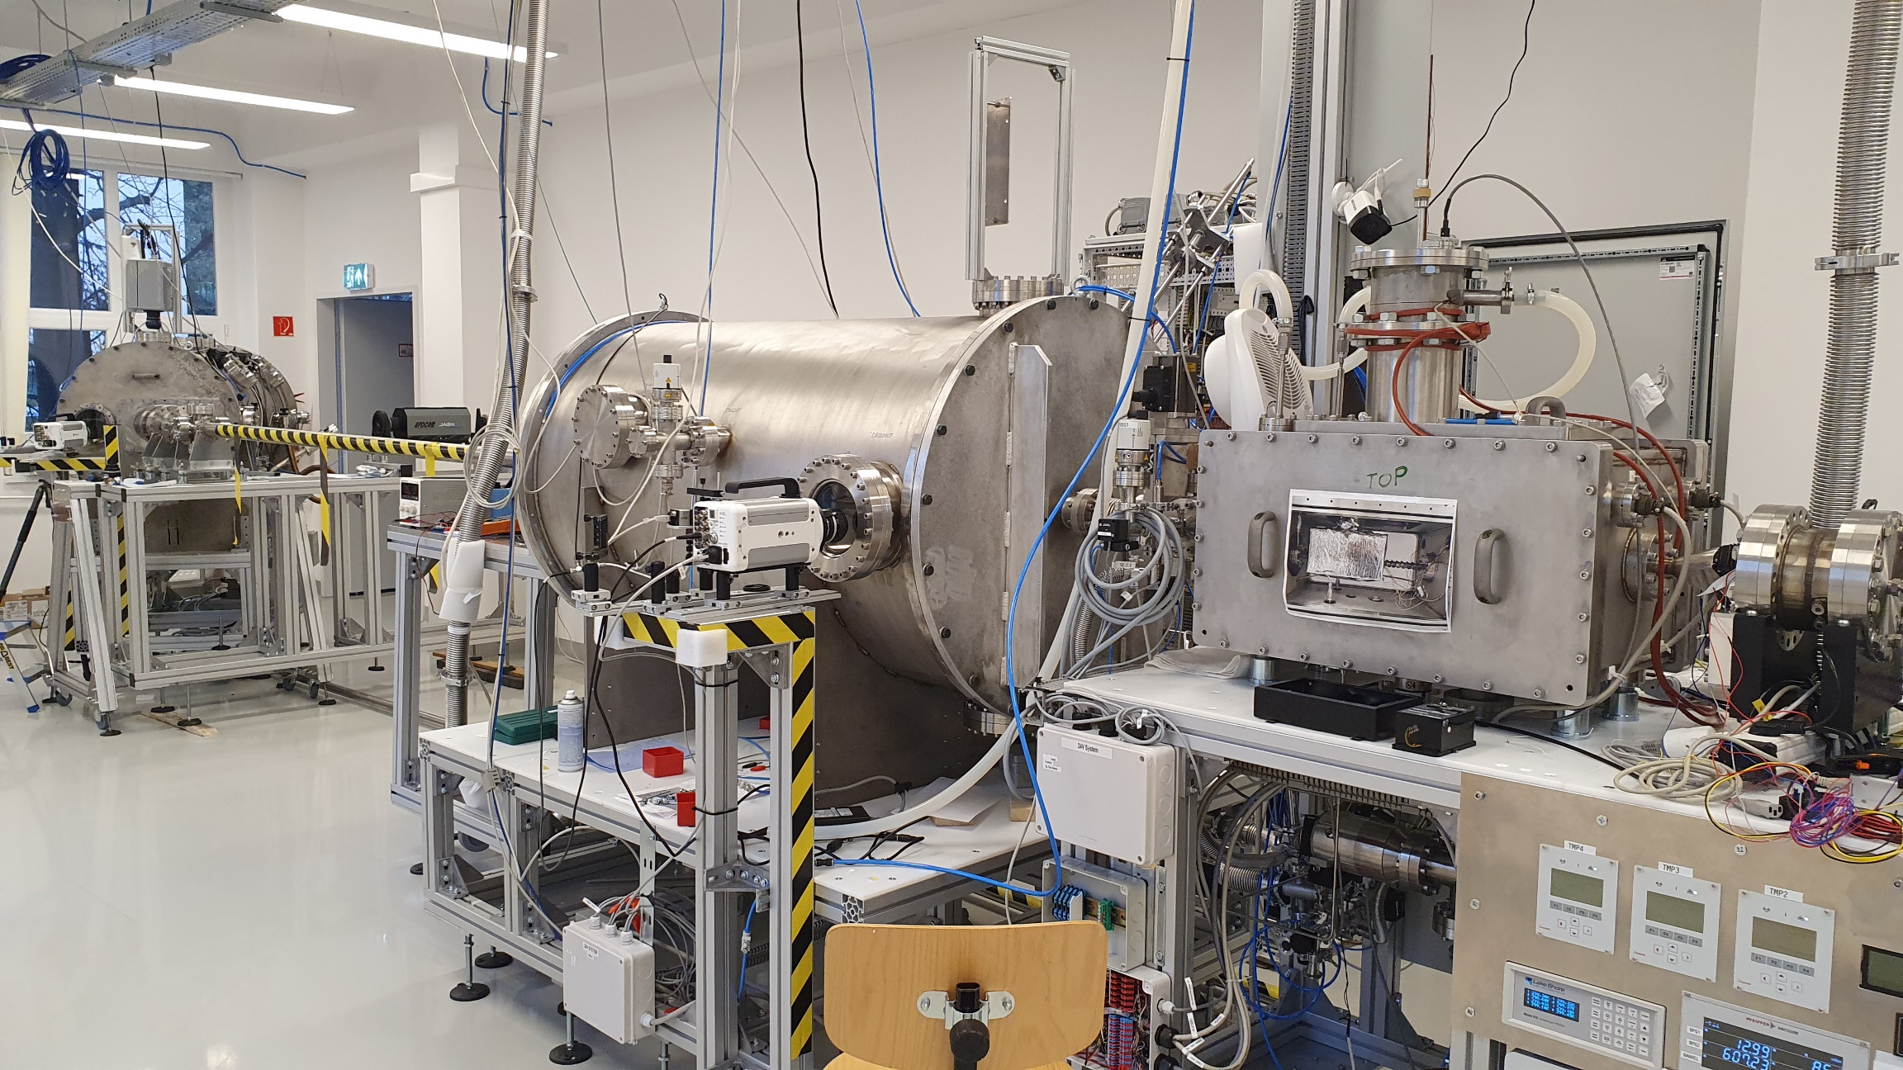
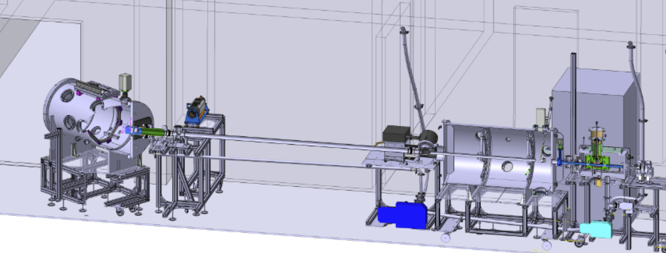
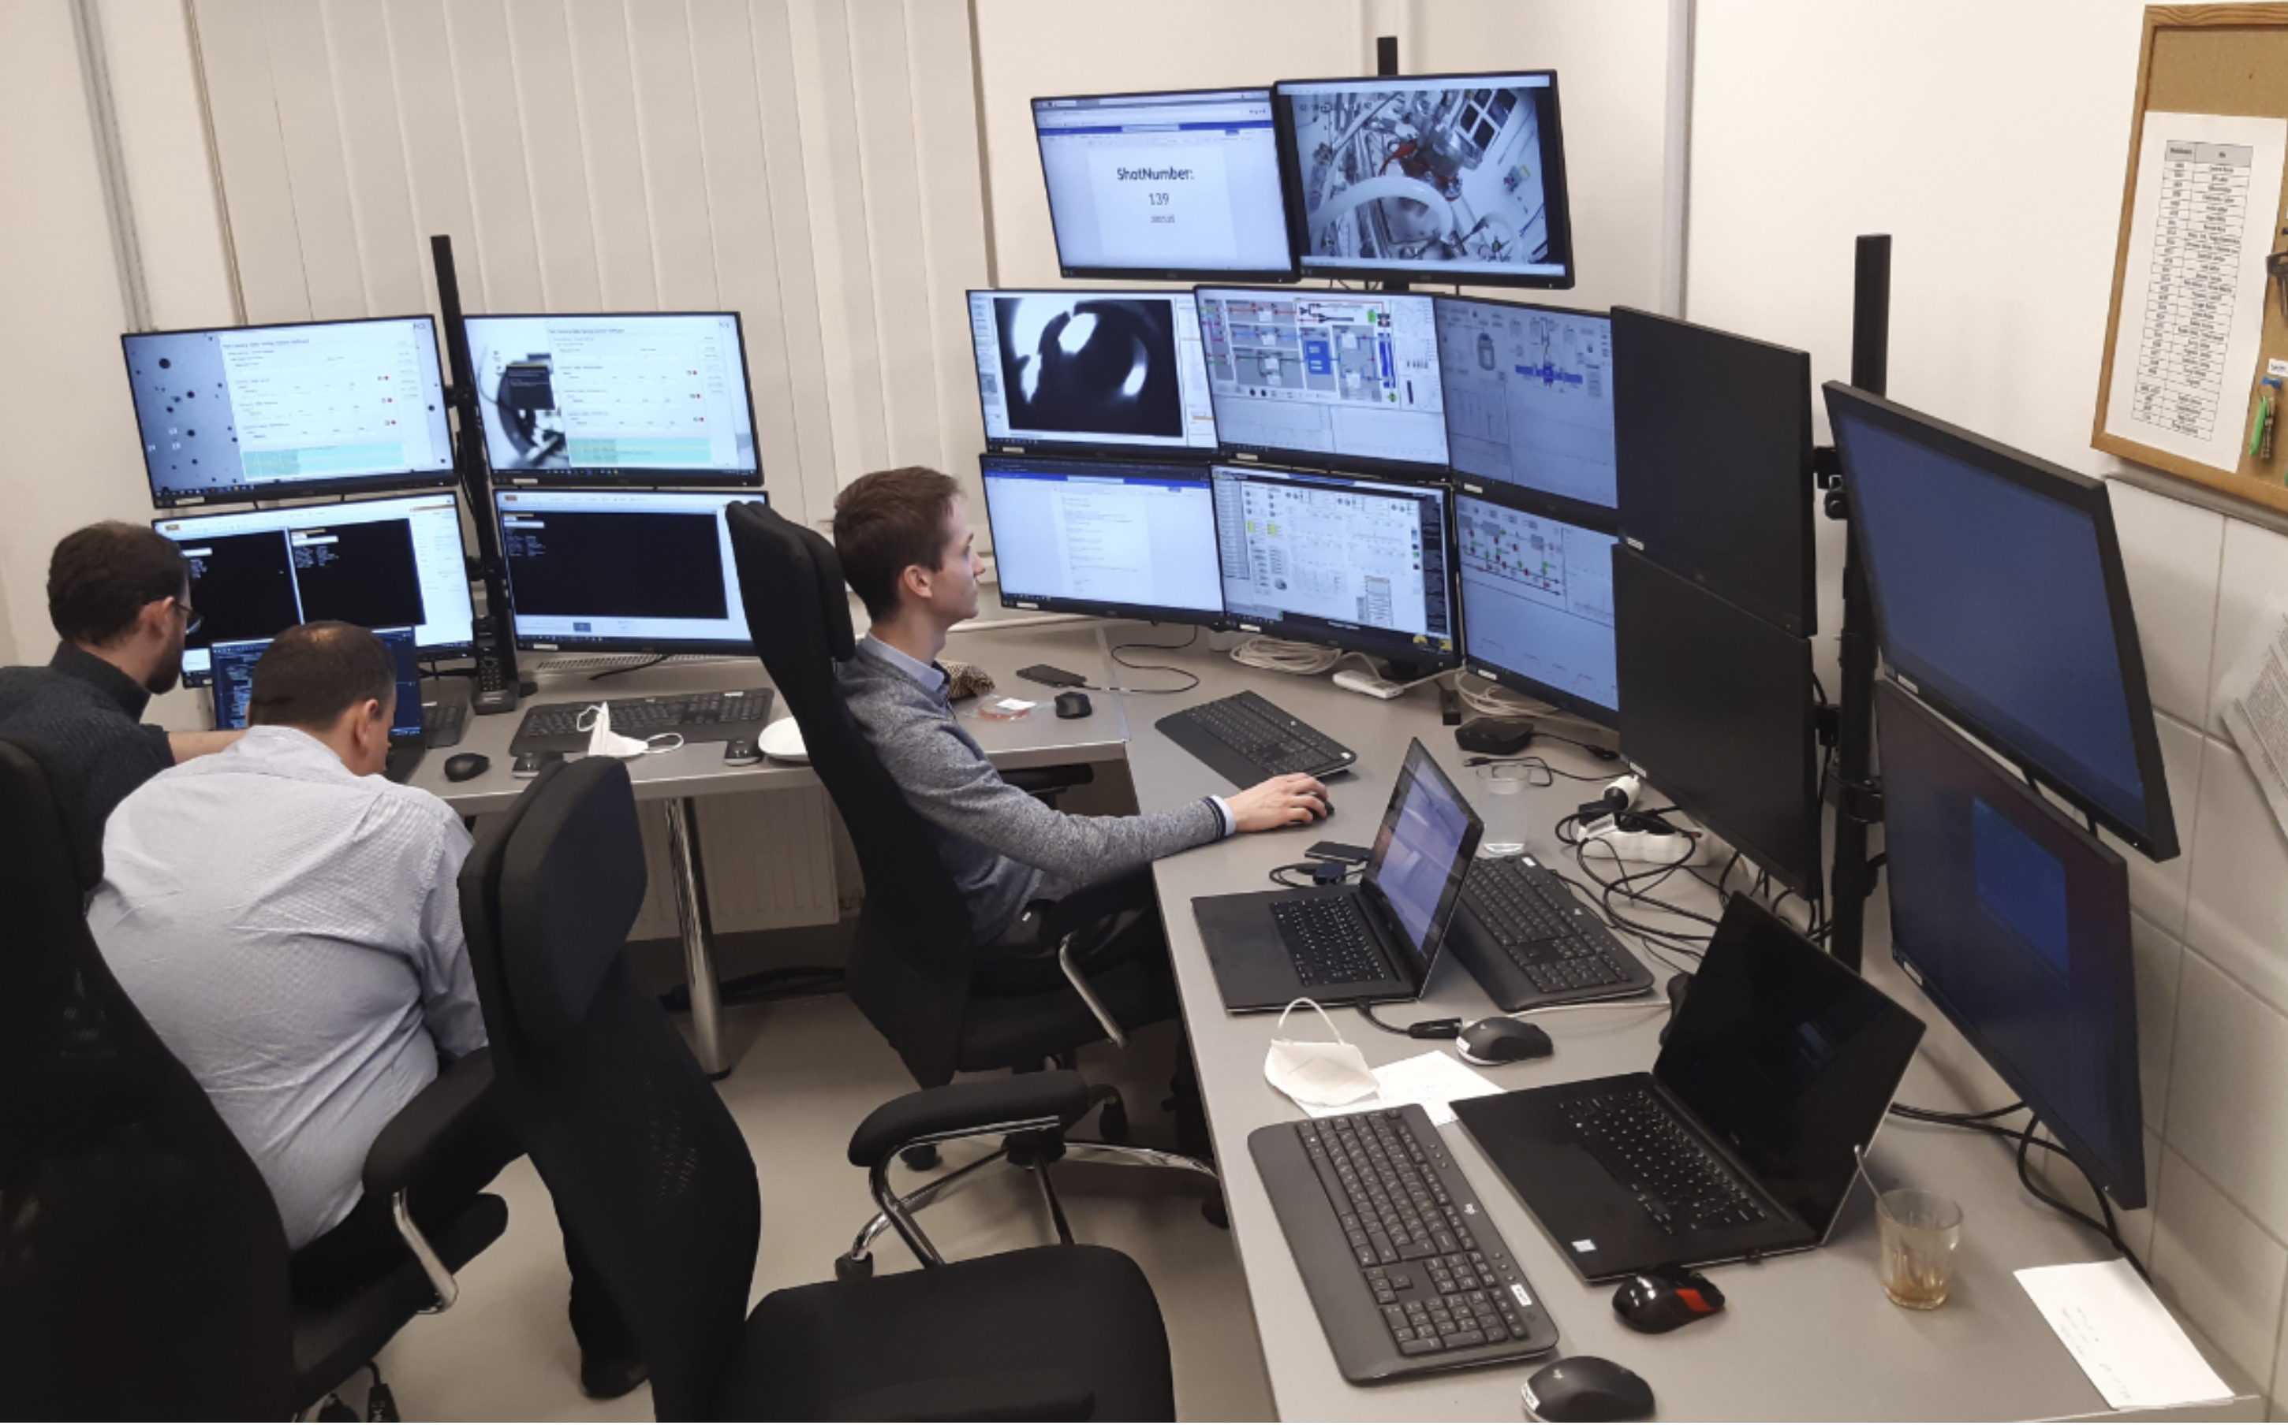
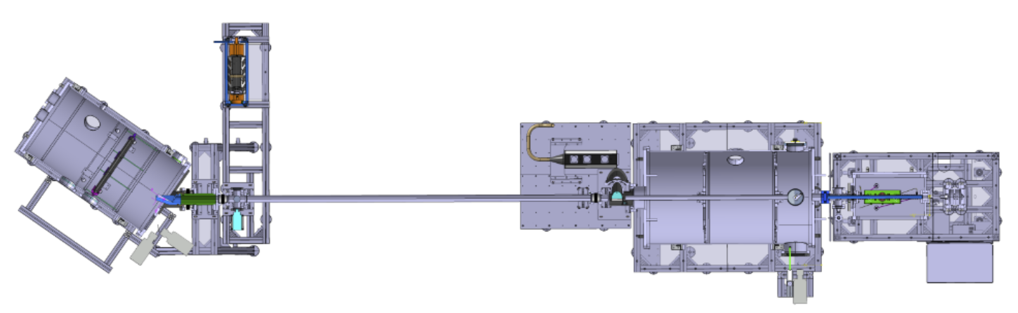
Support laboratory, first setup
Shard analysis chamber
Gap3
OPD @ Gap2
Gap1
Injector
Flight tube
Prop. rec.
chamber
Fast valve
S. Zoletnik, et al, Fus. Eng. Des. 190 113701 (2023)

Slide 4
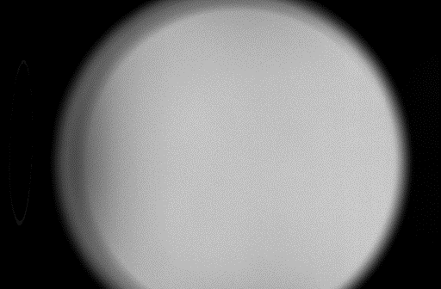
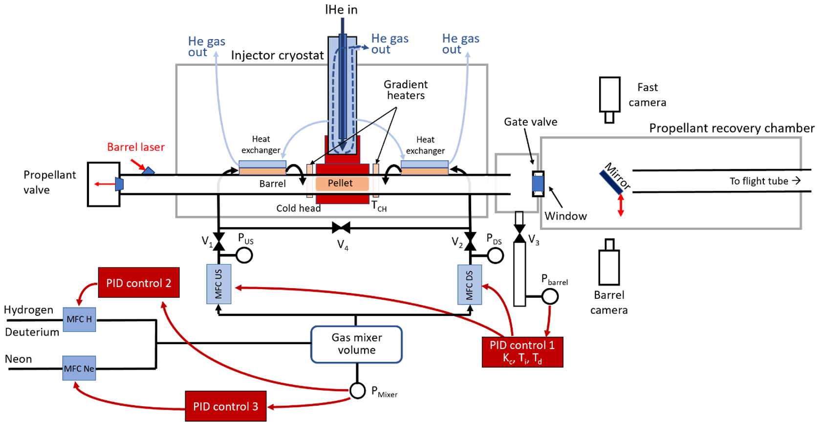
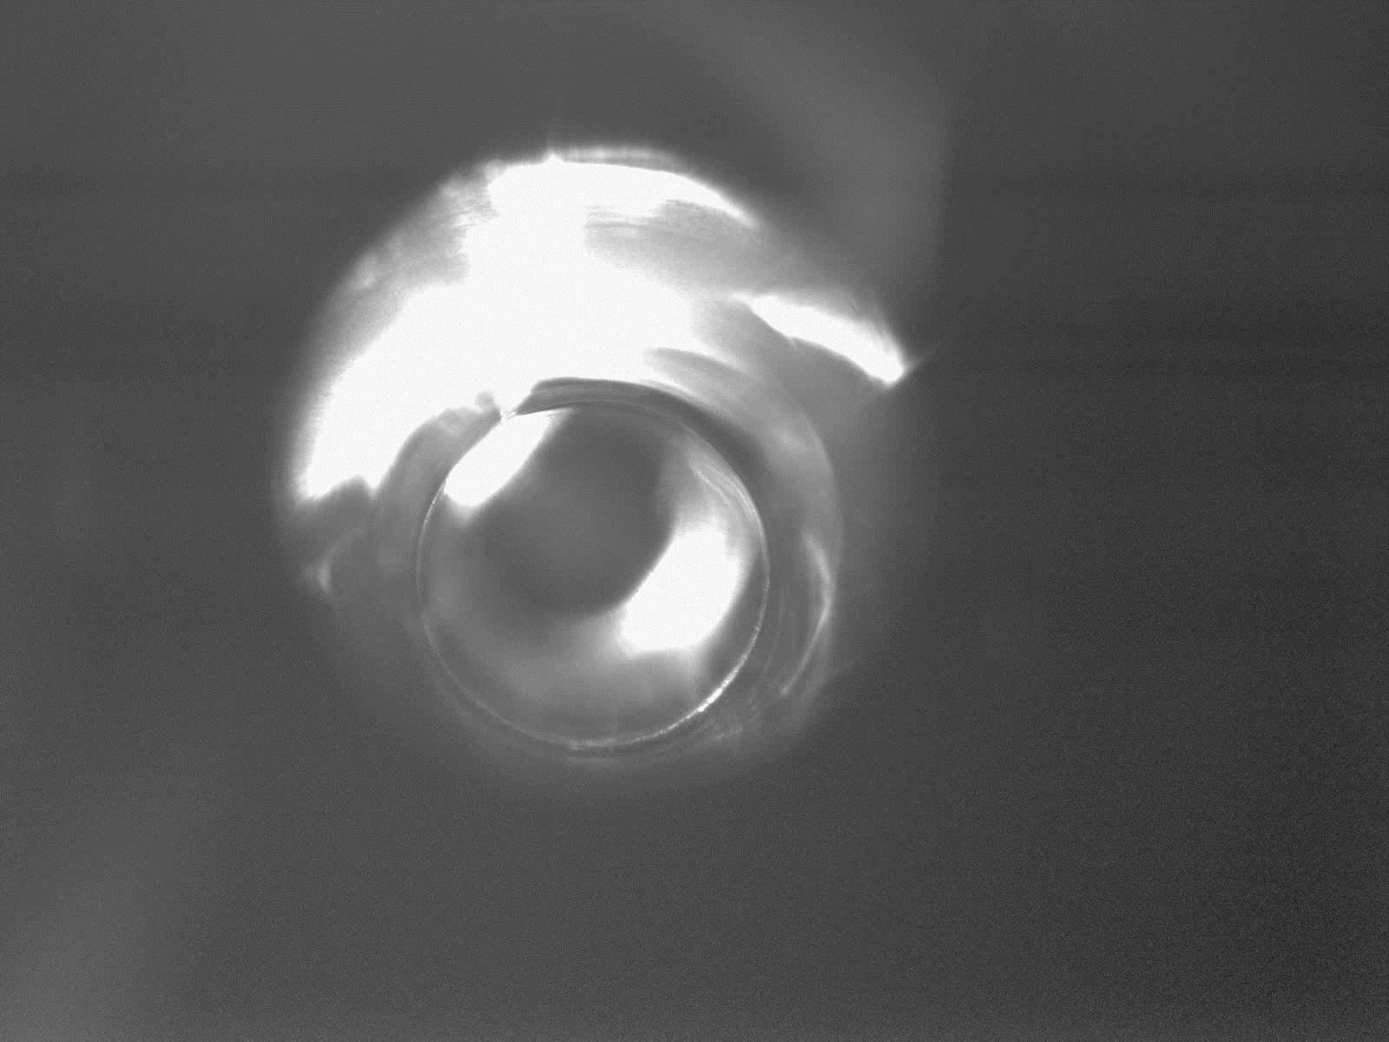
Pellet injector and diagnostics
Liquid He evaporation cooling (different fromITER) → 5 K cold head temperature
Gas precooler
Barrel camera for pellet growth diagnostic
Eddy current driven launch valve
MFC-based gas system
Full computer control
Pellet shadowgraphy
D.I. Réfy, et al, Fus. Eng. Des.
194 113893 (2023)
Barrel camera video (5 sec/frame)
E. Walcz, et al, Fus. Eng. Des. 191 113584 (2023)
G. Kocsis, et al, Fus. Eng. Des. 190 113515 (2023)

Slide 5
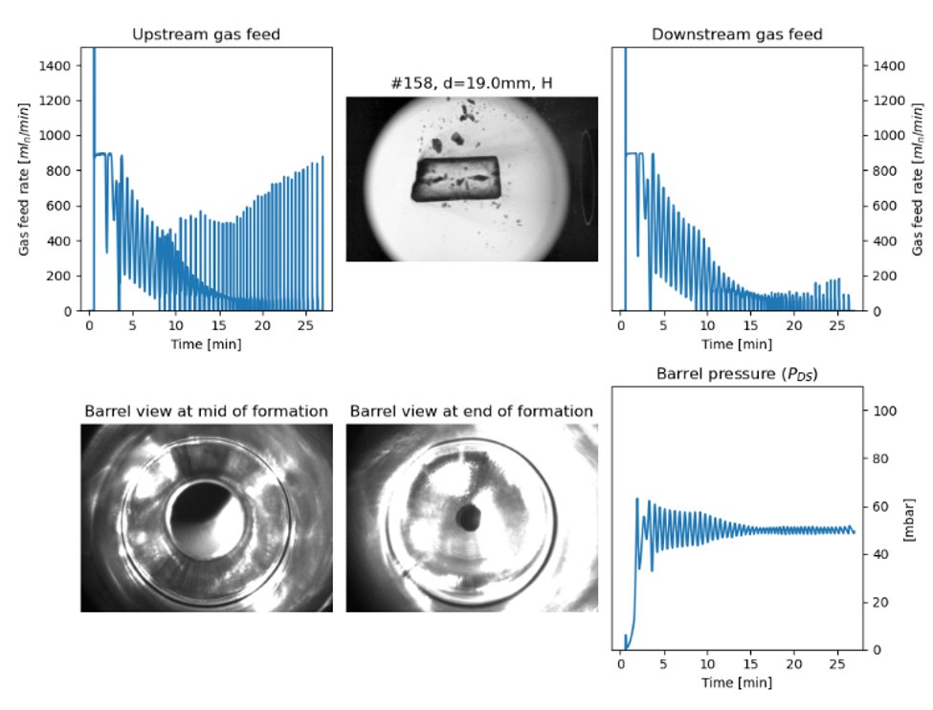
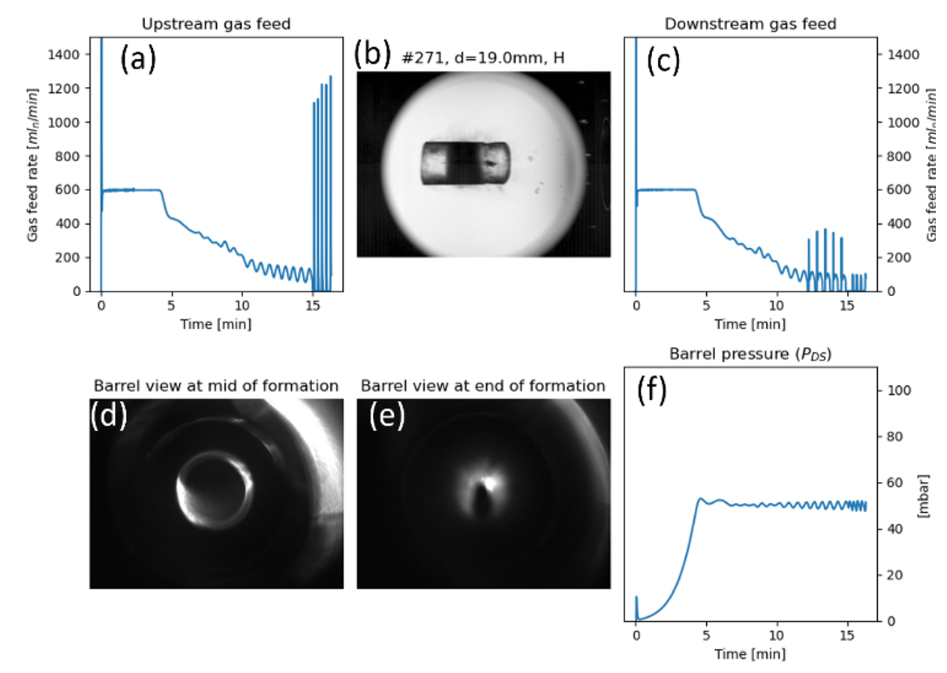
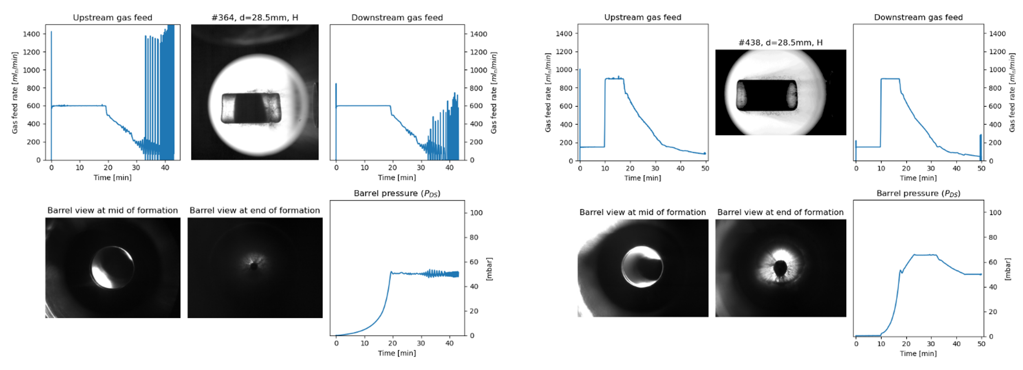
Protium pellets
At 5K critical parameter is gas feed rate at start
Slow feed → dark (snow) layer → easy launch
Fast feed → transparent pellet → easily breaks
At 8-10 K pellets are transparent but break
28.5 mm darkshell pellet is considered as ideal
Launches intact
50 min production time + 10 min cooling
19 mm
Strong gas
flow
S. Zoletnik, et al, Nucl. Fus. 64 096033 (2024)
28.5 mm
darkwaist darkshell
19 mm darkwaist

Slide 6
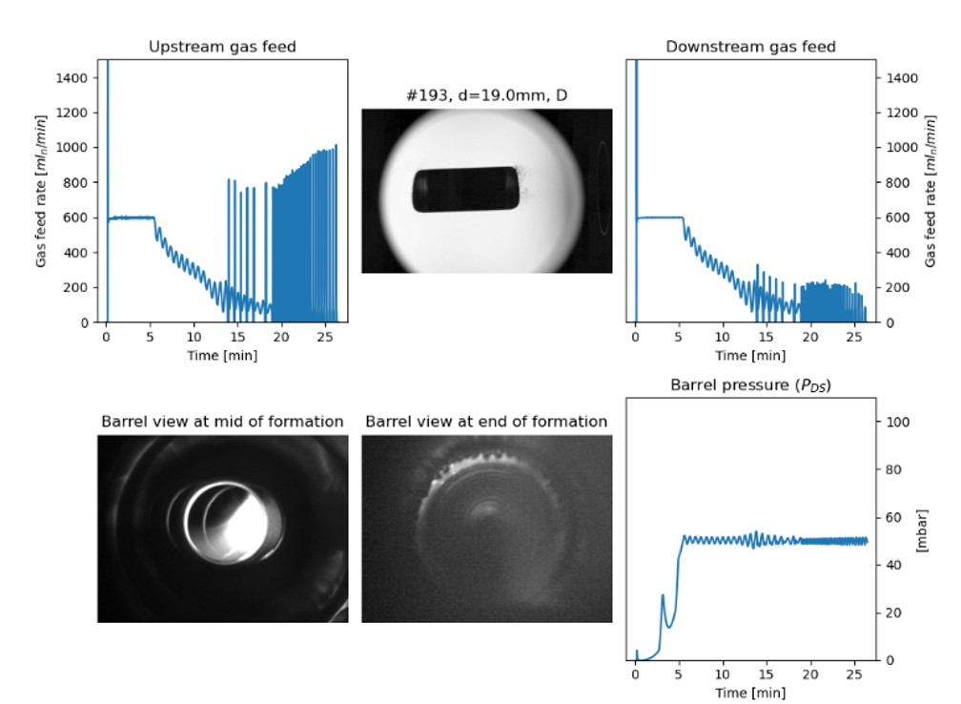
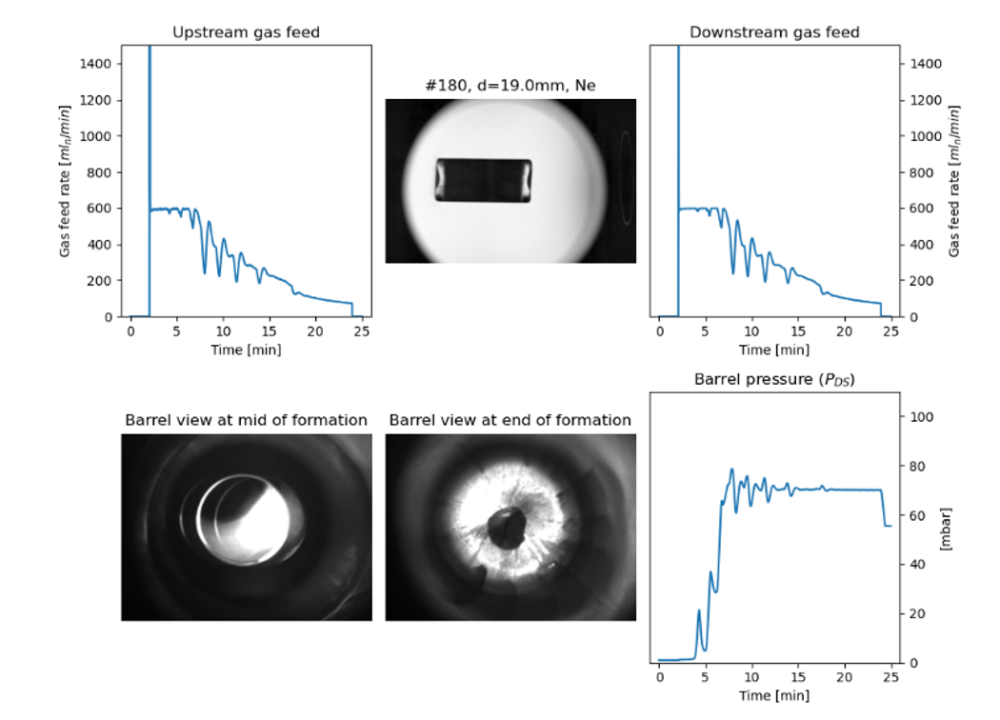
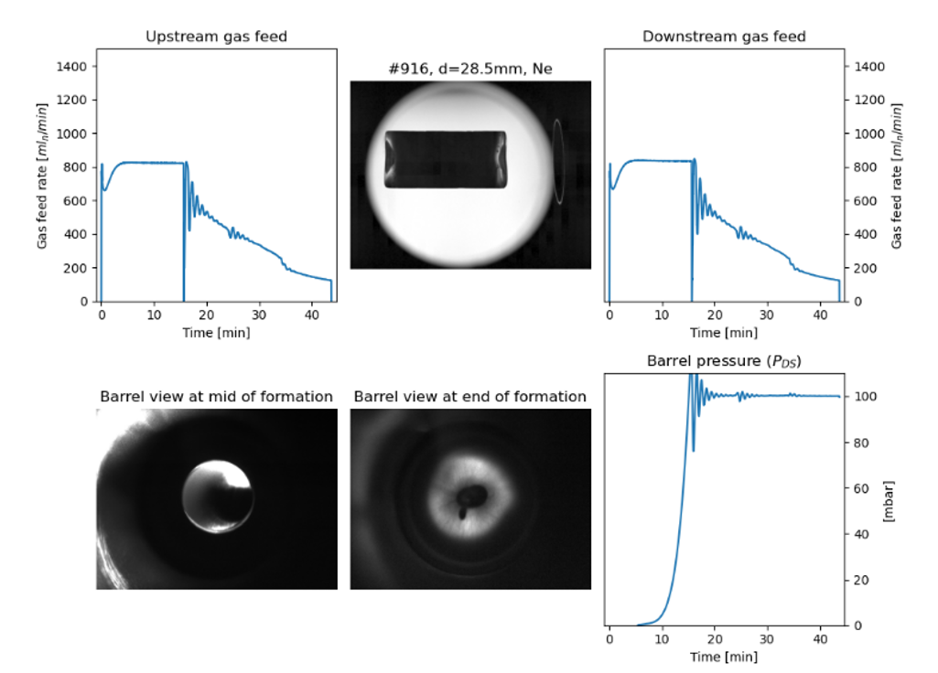
Deuterium and neon pellets at 5 Kelvin
At 5 K D and Ne pellets all look dark in shadowgraphy after launch
Ne pellets at 5K can easily be launched, in contrast to expectation
19 mm deuterium pellet @ 5K
28.5 mm neon pellet @ 5K
19 mm 28.5 mm

Slide 7
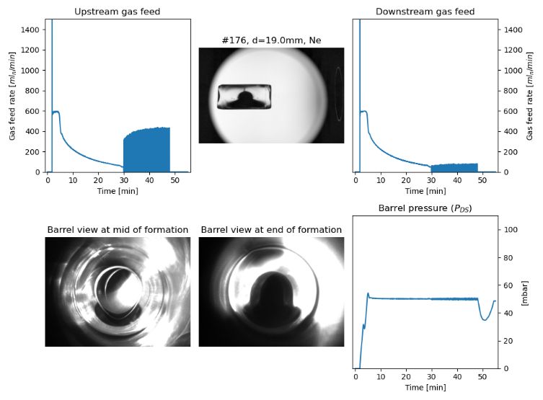
Neon pellets at 12 Kelvin
Neon pellets at 12 Kelvin are mostly transparent.
They can not be launched even with 150 bar valve pressure.
They can be launched only when warmed to 18 Kelvin.

Slide 8
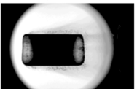
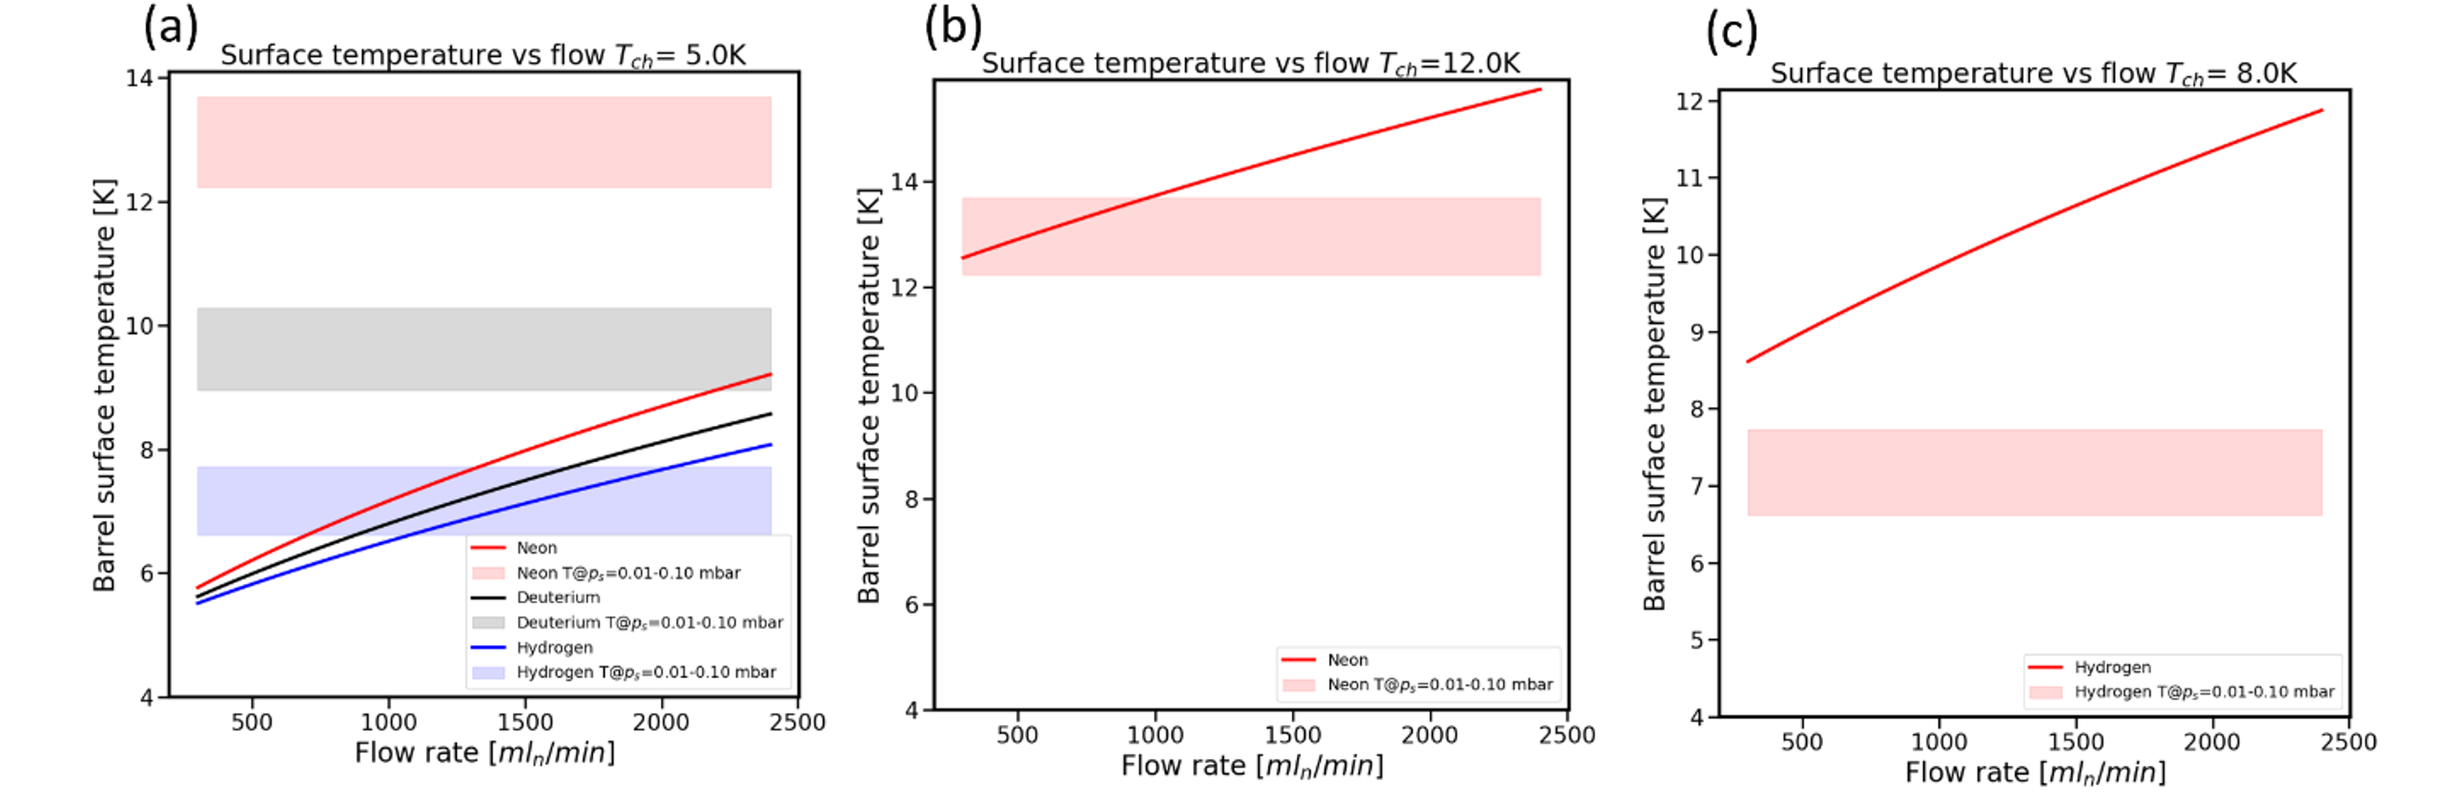
Conditions for snow formation understood
Cold barrel acts as strong cryopump
Barrel surface is heated by desublimation
At limited gas flow pressure becomes low in centre
→ cold barrel → gas cools → snow forms
Barrel
Cold head
Gas feed
p
Gas feed
Temperature range corresponding to saturation pressure corresponding to measured 10⁻²...10⁻³
pressure
Snow may form when the barrel surface temperature is below the saturation temperature
gas is overdense
H, D, Ne @ 5K
Ne @ 12K
H @ 8 K
These plots are capable only to indicate trends, as the exact barrel pressure distribution is not known.
S. Zoletnik, et al, Nucl. Fus. 64 096033 (2024)

Slide 9
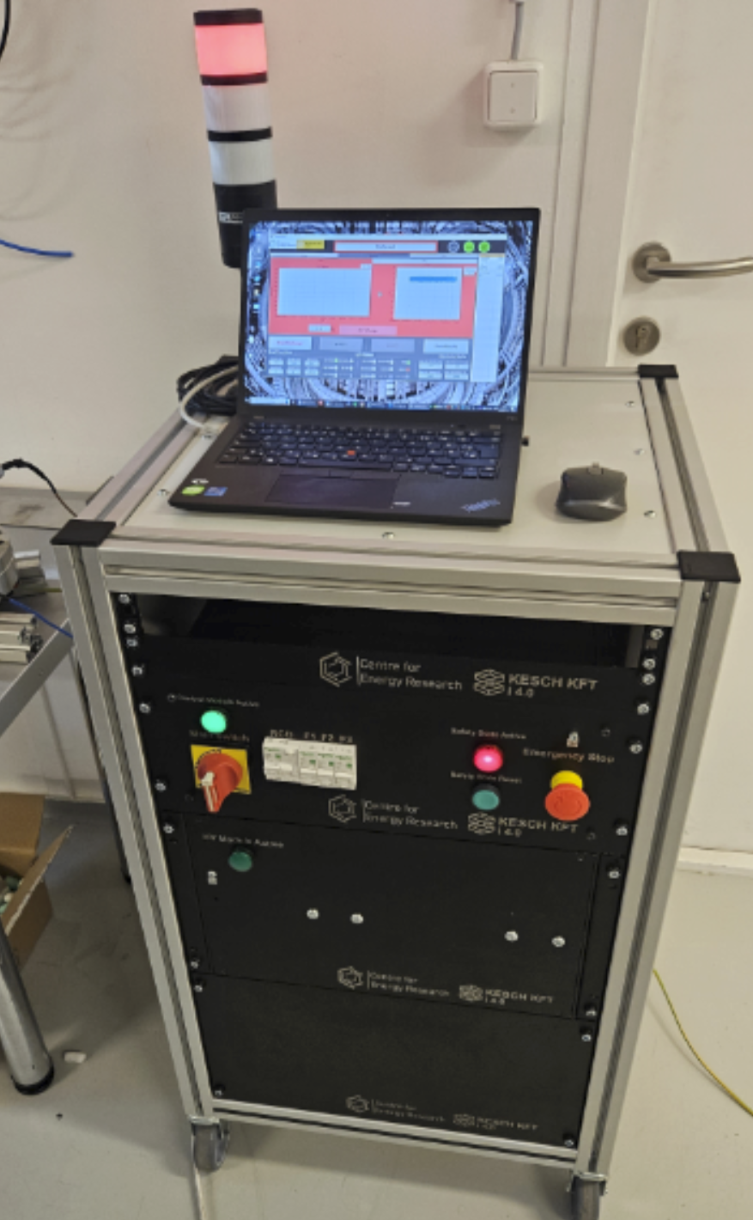
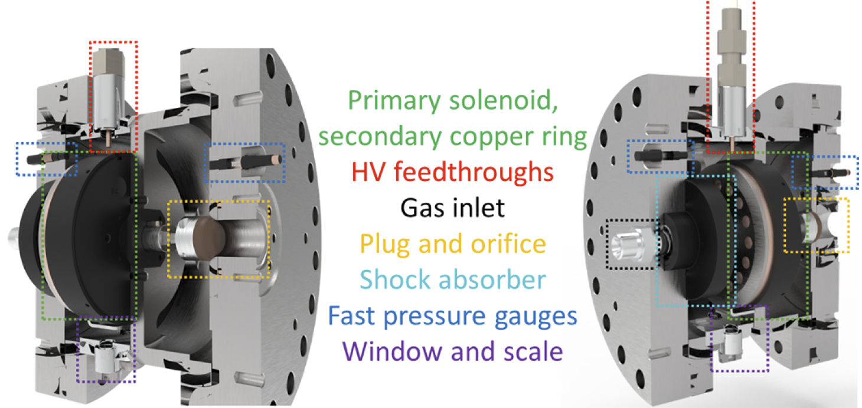
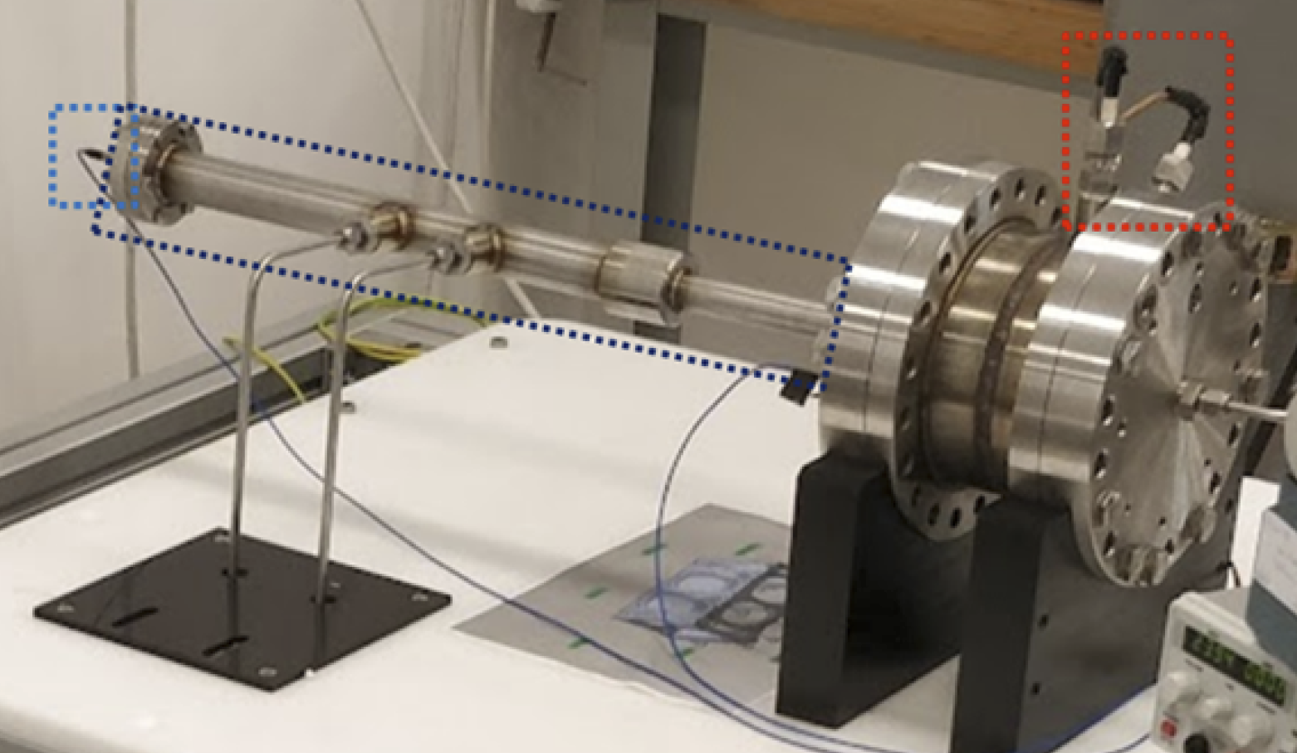
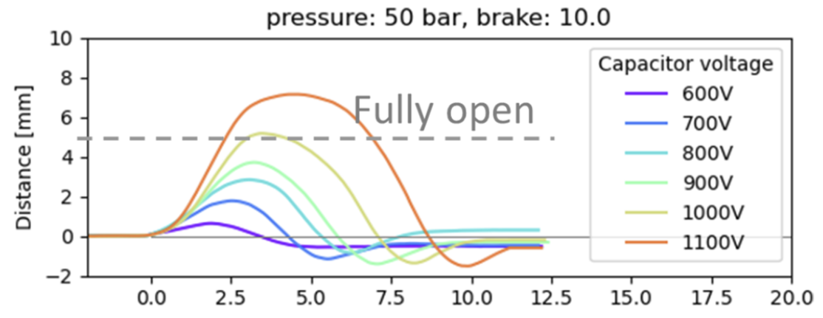
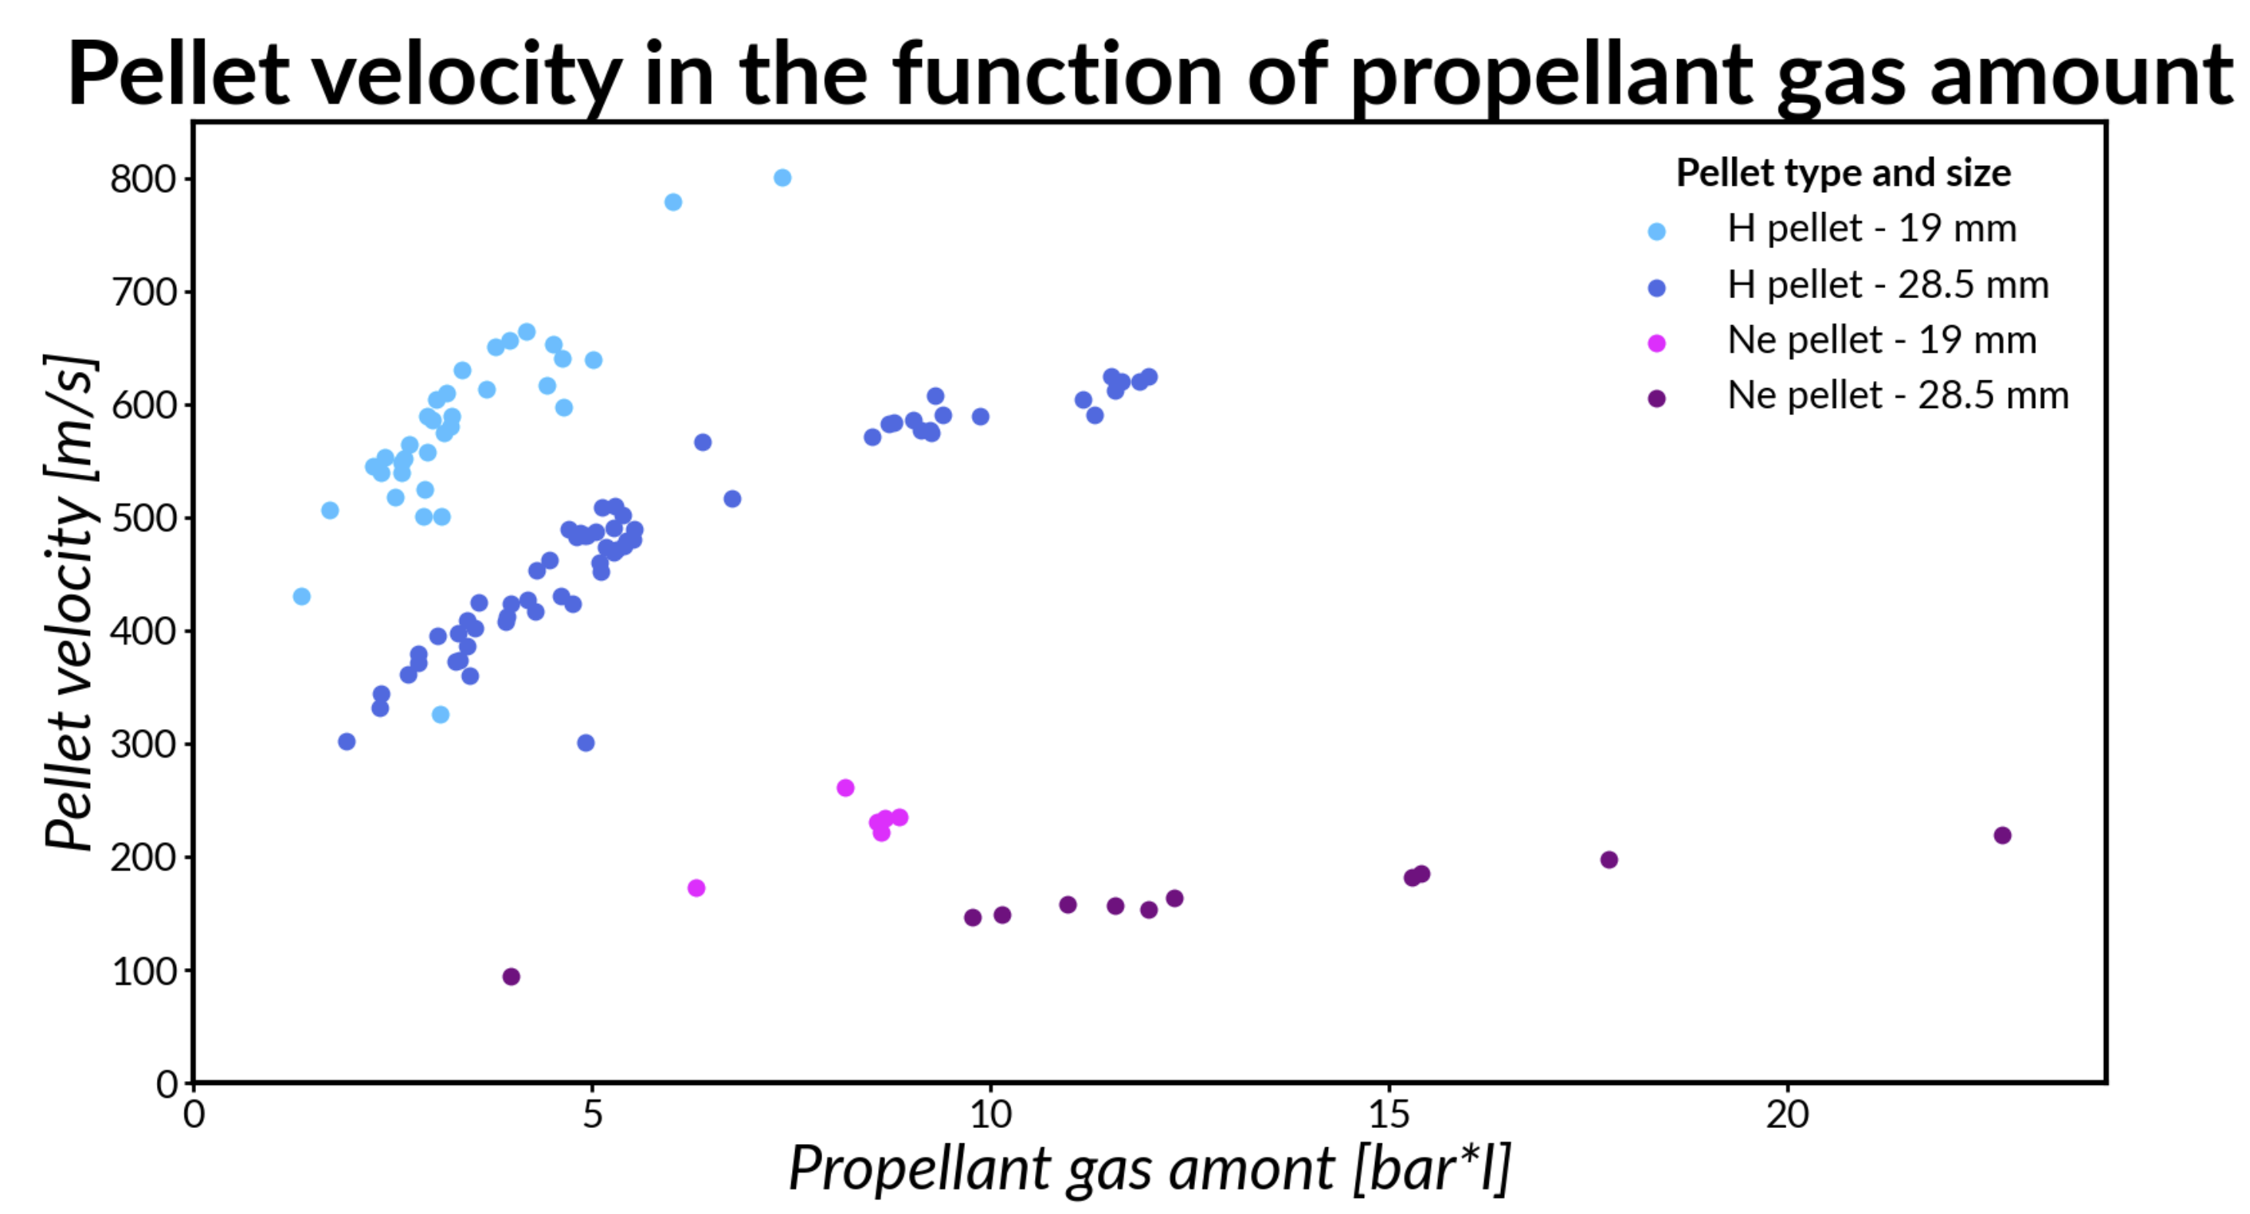
Pellet launch
Special high-pressure lauch valve developed
0.9 l volume, p<150 bar
20 mm diameter nozzle
Eddy current actuator, opening time: 1.5-6 ms
Injected gas amount < 20 bar-liter
Full computer control
Valve tested in detail on mockup, magnetic
field testing is planned for 2024
New ITER-compatible version is under
development
More than 800 pellets launched:
19 and 28.5 mm diameter
Ne: 100-250 m/s
H: 300 – 800 m/s
See poster 100 by D. Réfy
D. I. Refy, et al, Fus. Eng. Des.
194 113893 (2023)
A. Kovacs, et al, Fus. Eng. Des.
202 114303 (2024)

Slide 10
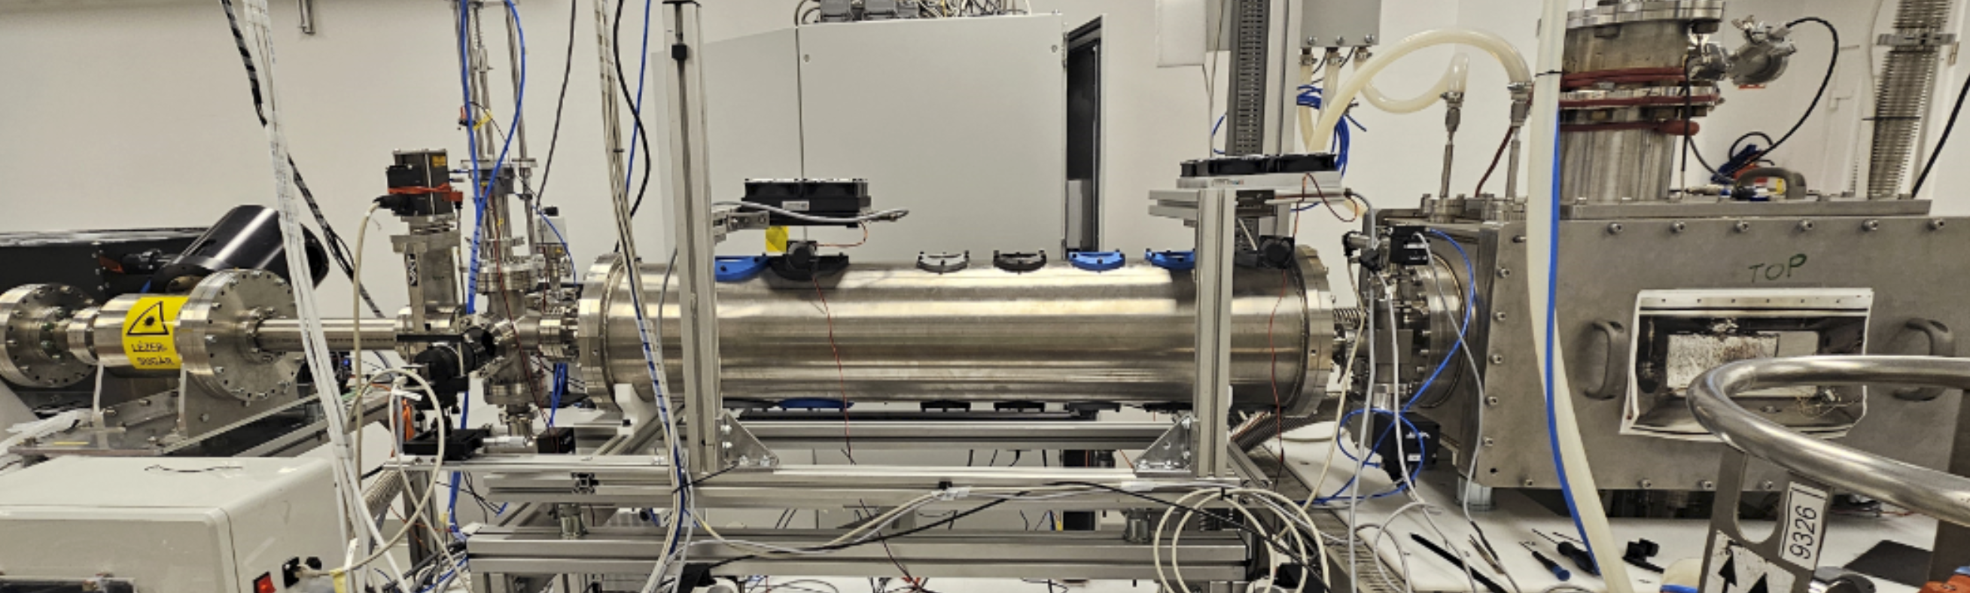
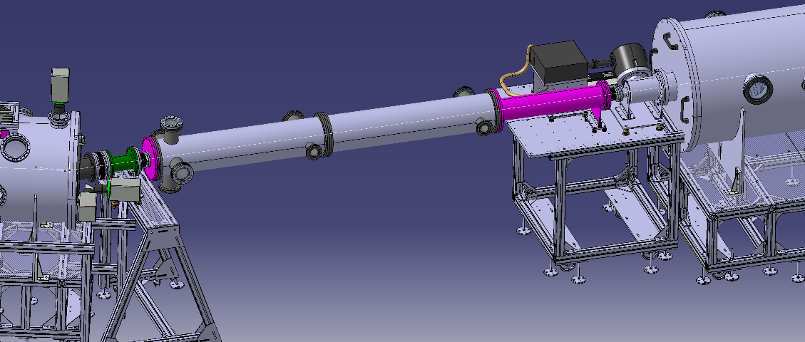
Propellant suppressor
In first setup suppressor was 1 m³ volume with flight tube
→ not compatible with ITER dimensions
Various ITER-size (50 l) gas suppressors studied:
Barrel extension with openings to reduce pressure behind pellet
→ reduce pellet velocity directional scatter and rotation
Internal structures to retain gas
  → reduce gas overtaking pellet in flight tube
Large diameter flight tube installed
to measure pellet flight without
interaction with flight tube
Suppressor with
observation windows and pressure gauges
OPD
Injector

Slide 11
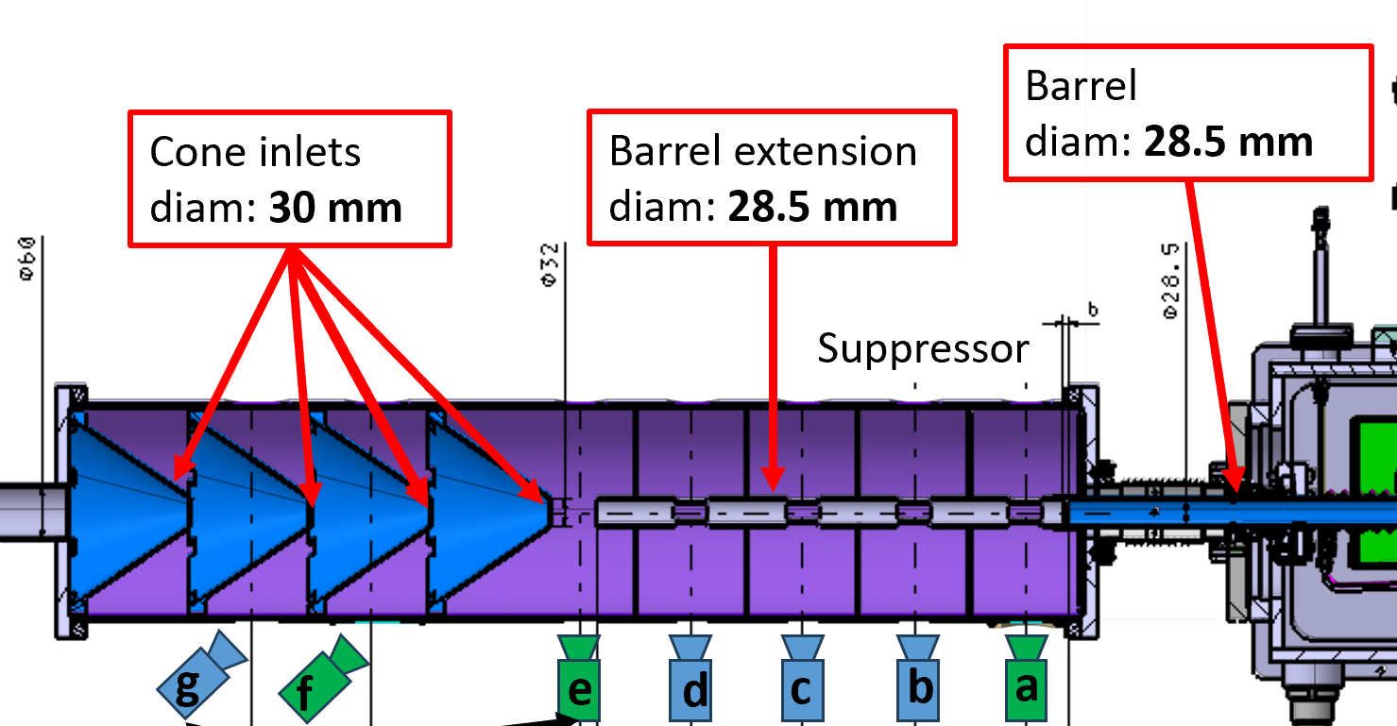
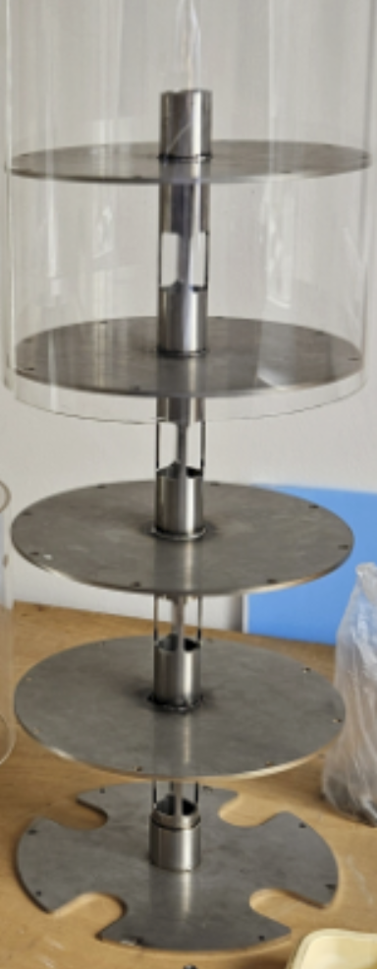
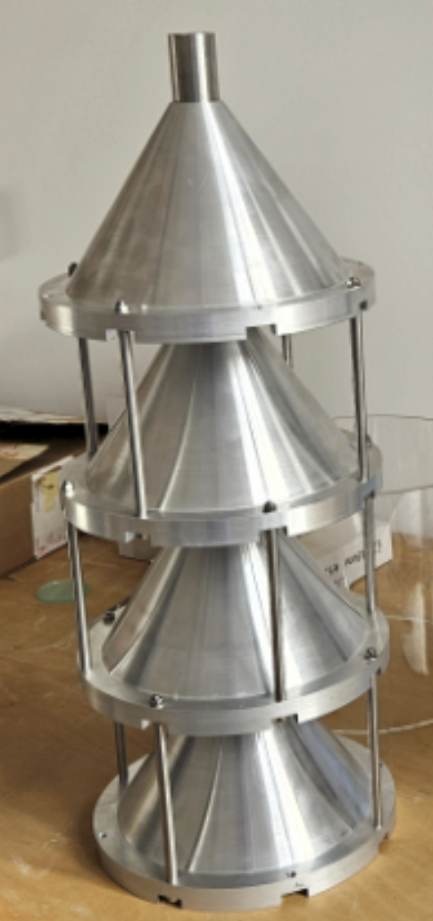
Suppressor variations: compartments and funnels
Barrel extension with rectangular cutouts in compartments
Funnels with 0.75 mm clearance around pellet
All pellets broke!

Slide 12
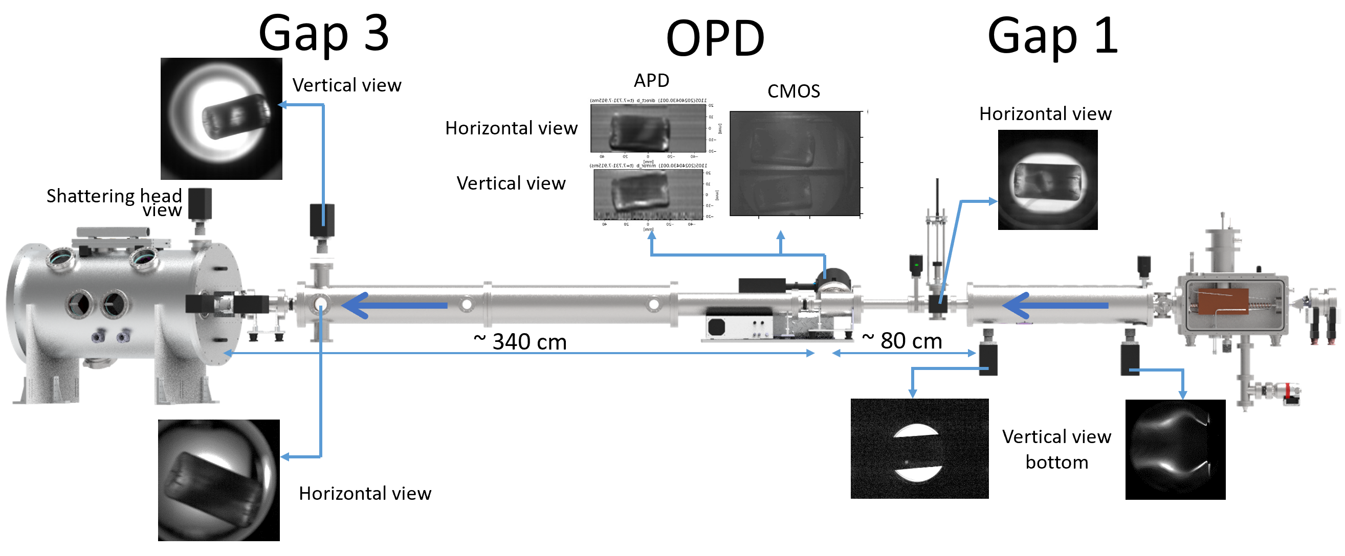
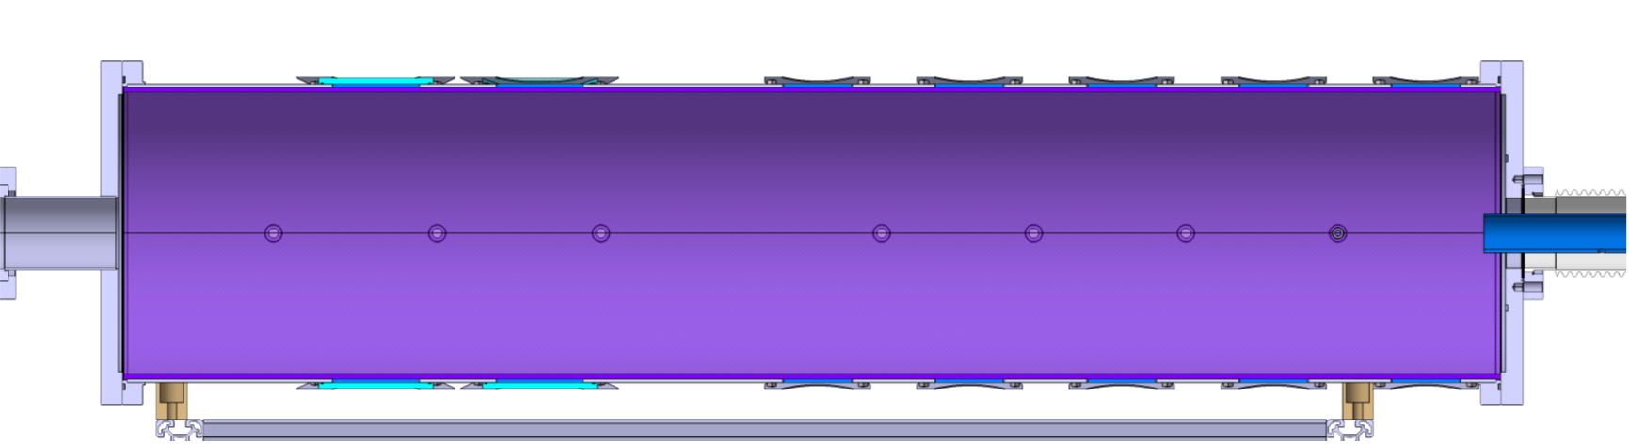
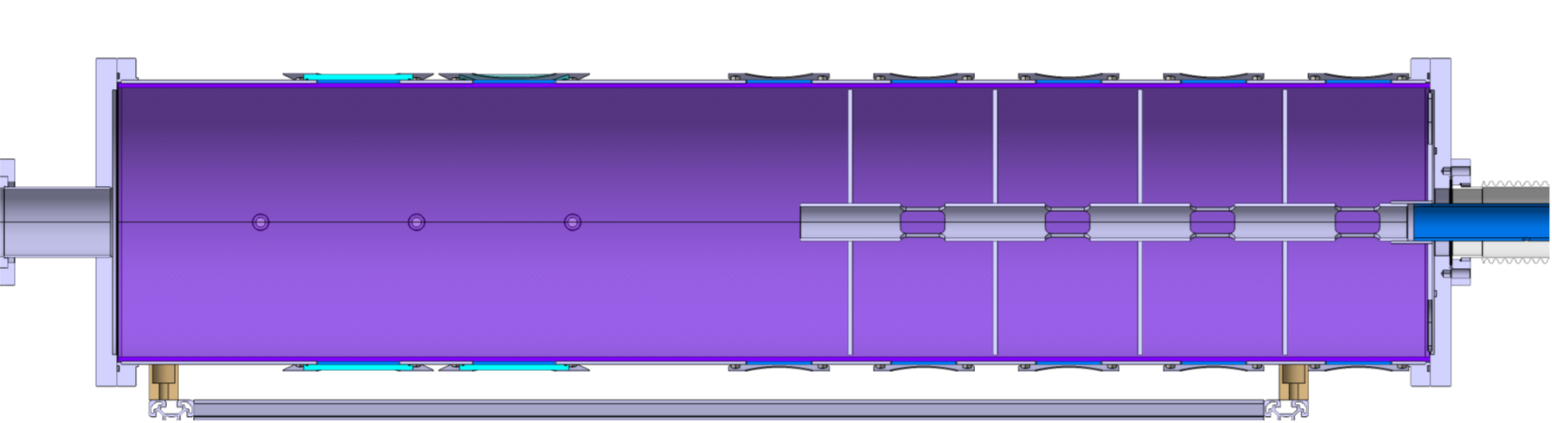
Suppressor variations: empty suppressor and barrel extension
Barrel extension
with rectangular cutouts
Empty suppressor
Pellet location and rotation measured at 3 places: suppressor, OPD, shattering head entry
Pellet arrival location and rotation calculated
10-15 28.5 mm darkshell pellets launched in each configuration

Slide 13
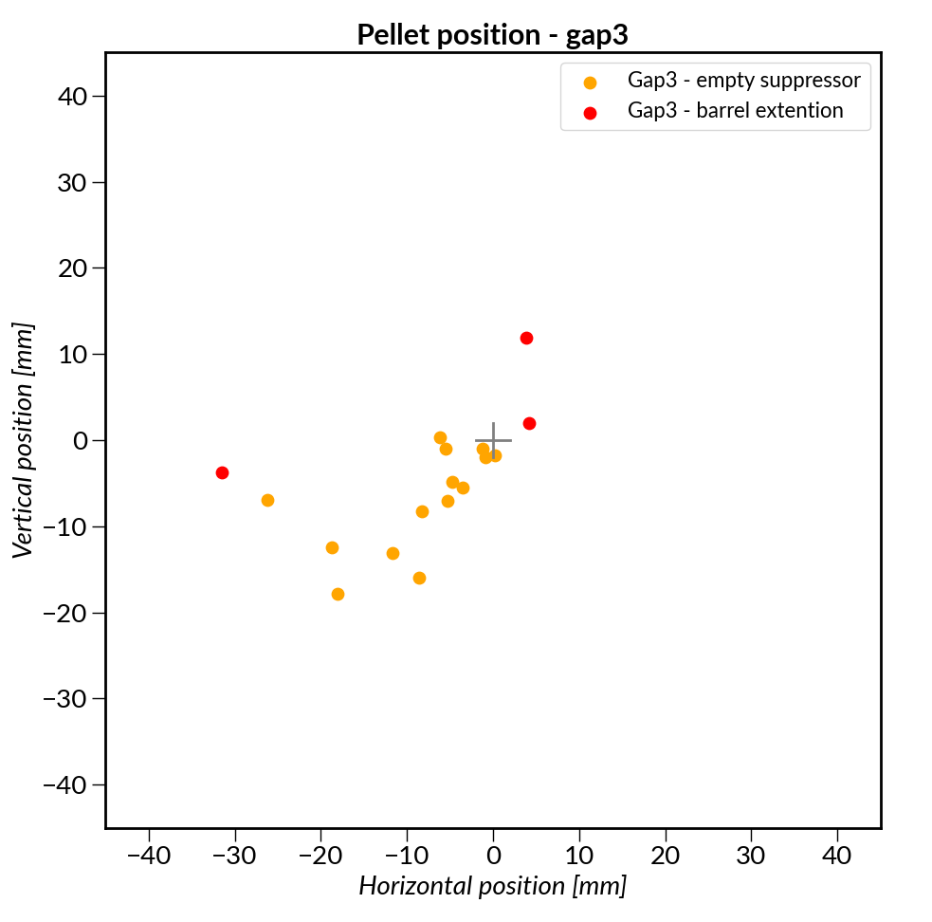
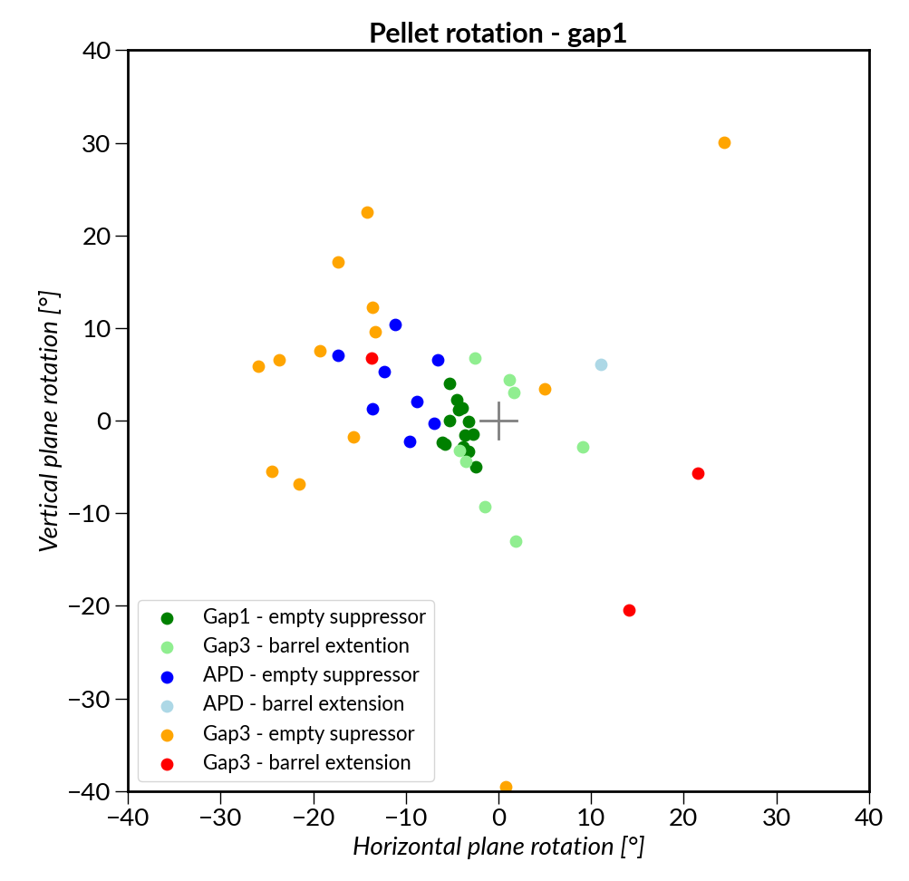
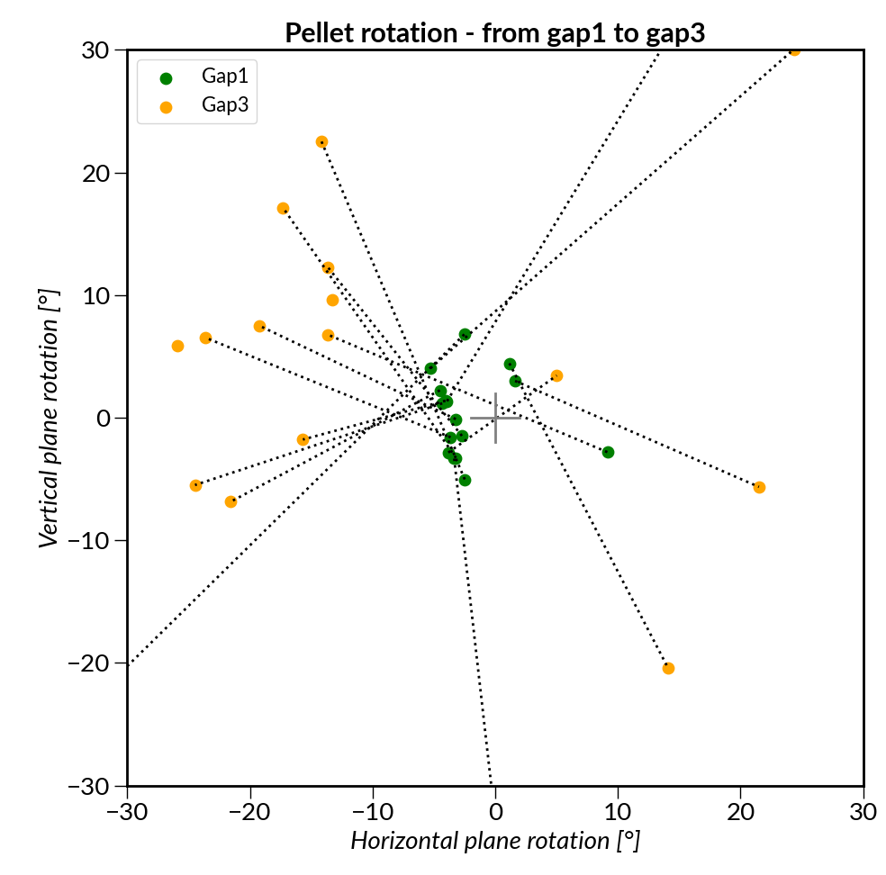
Location and rotation with two suppressor variations
Barrel extension with cutouts: nearly all pellets are damaged
Empty suppressor: With correct alignment all pellets fly intact through whole system
Pellet postion
Pellet rotation
Pellet position at
shattering head
+- 15 mm scatter of pellets at shattering head:
→ marginal for ITER configuration
Pellet rotation up to 30 degree at shattering head:
→ not acceptable for ITER configuration

Slide 14
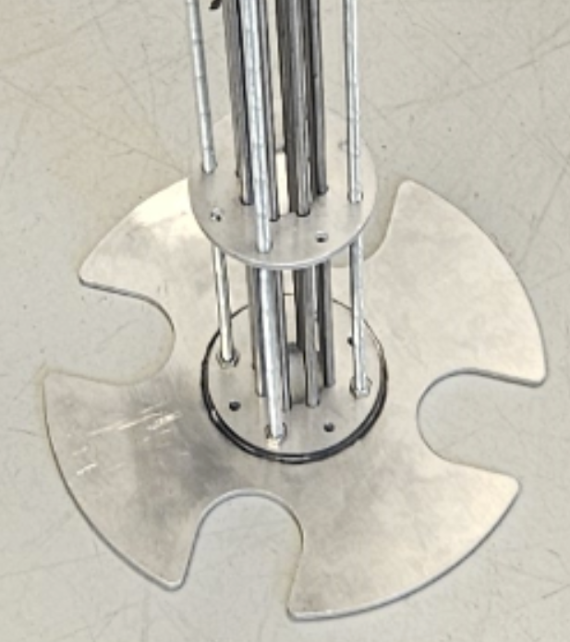
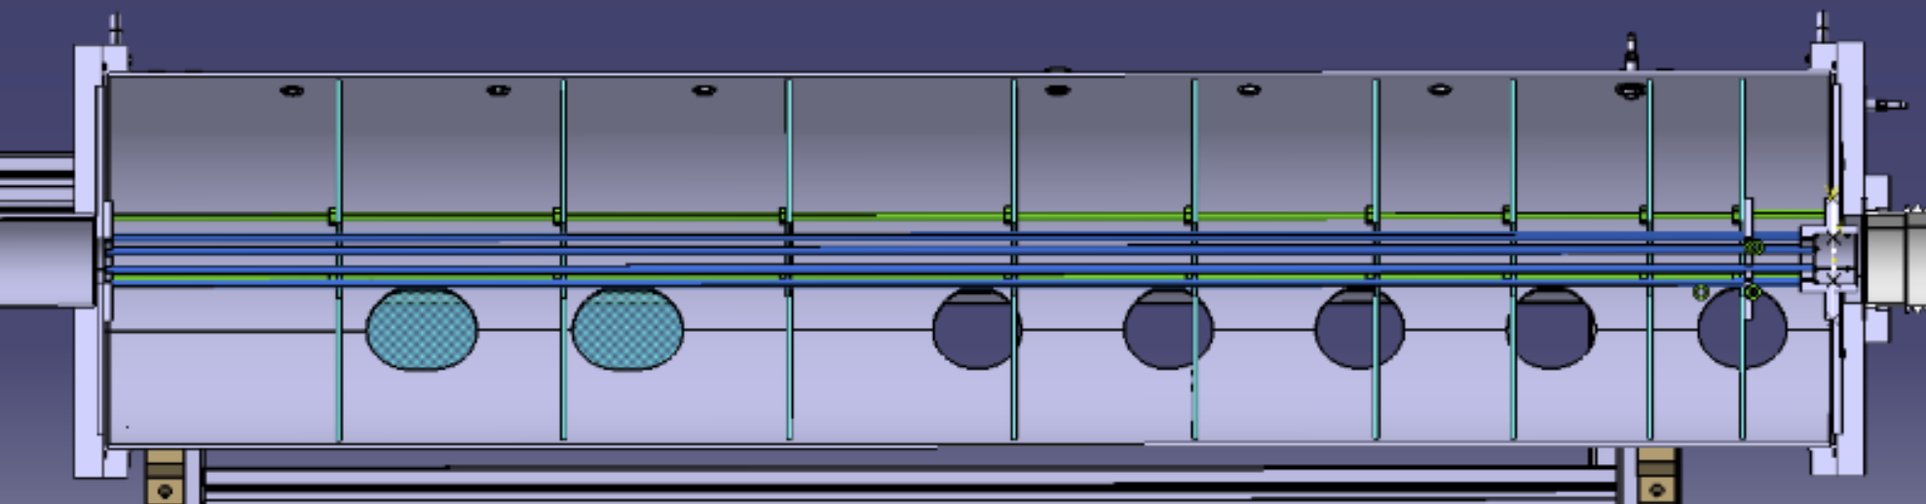
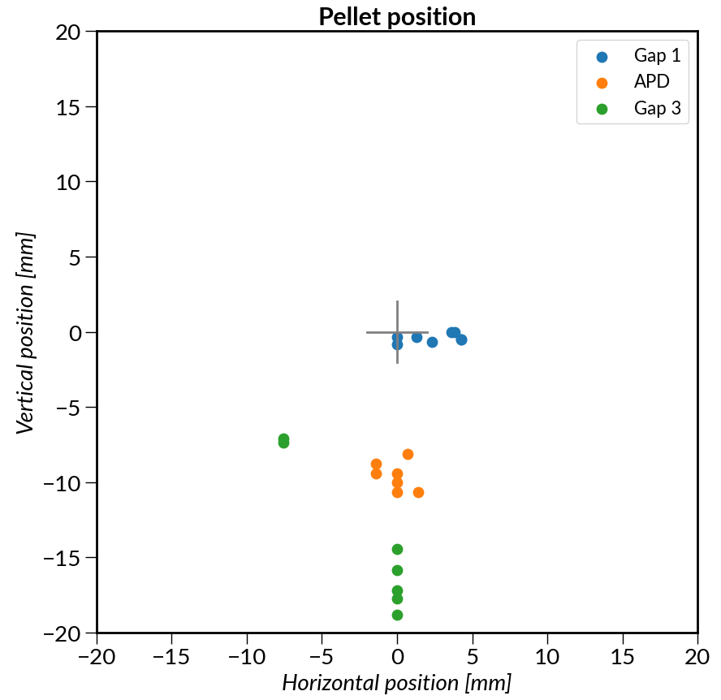
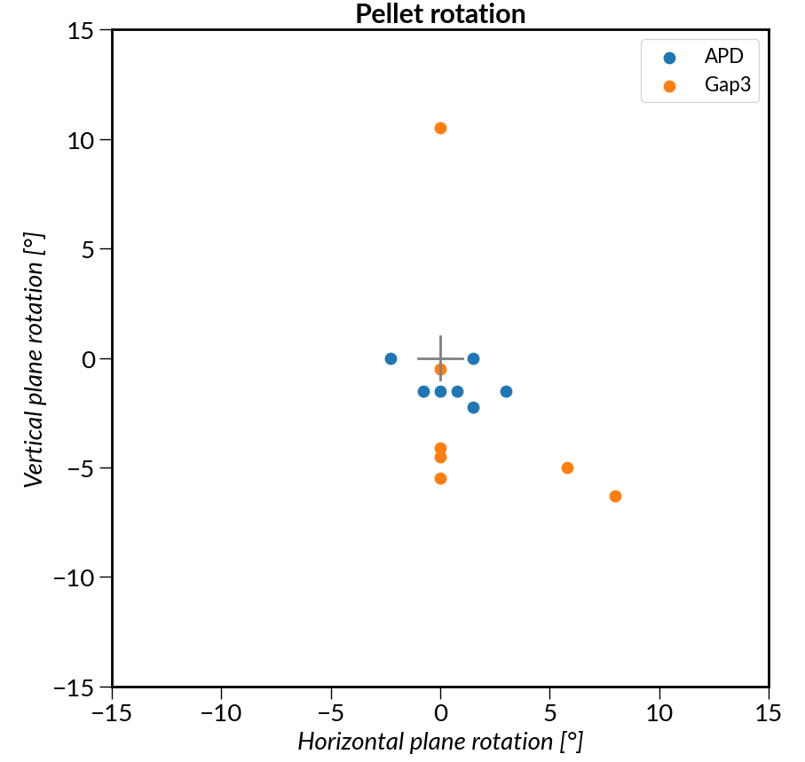
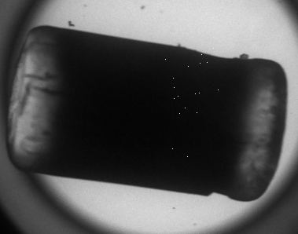
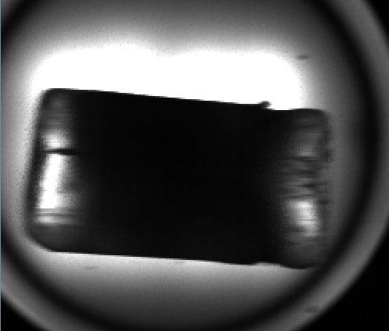
Suppressor with wirecage
Cage constructed from 8 pc. 5 mm SS wires + compartments
(Original idea: M. Lehnen and S. Jachmich)
Gas can expand
Pellet is lead until low pressure
Gas is retained in compartments
First measurements with wirecage
Pellet postion
Pellet position scatter at shattering head:
+- 3 mm
Pellet rotation at shattering head:
+- 10 degree
Suppressor with wirecage seems to fulfil
requirements.
Pellet rotation
At shattering head
(New alignment)
(2 pellets)
After suppressor
At
shattering
head
OPD
OPD
At shattering head
(No horizontal position data)

Slide 15
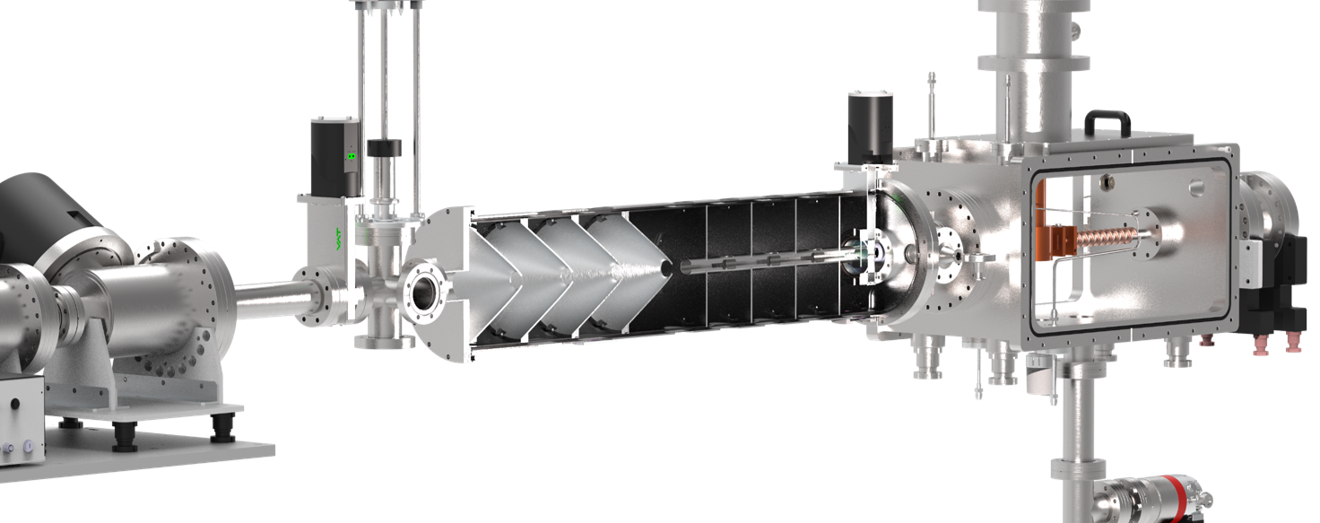

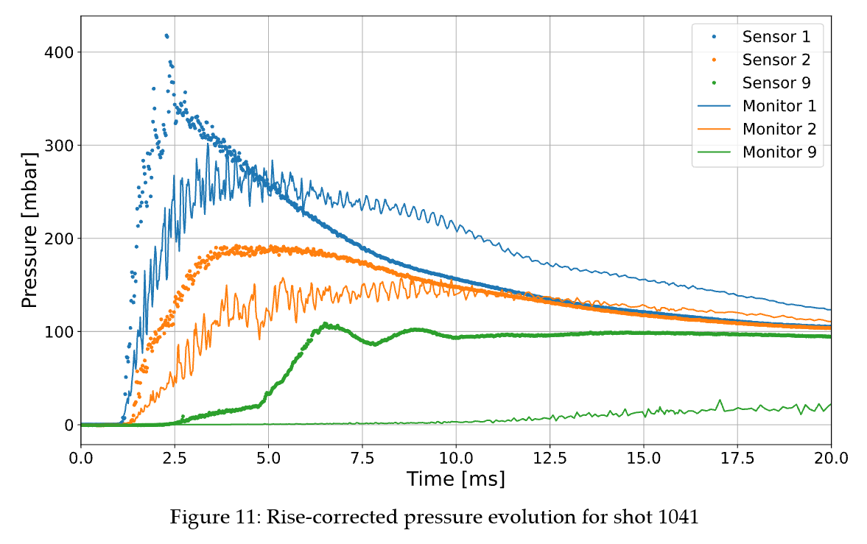
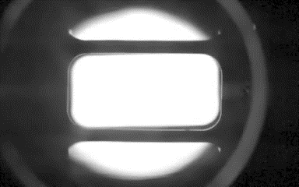
Gas retaining in suppressor
CFD modeling by ITER (A. Horvath) for compartments and funnels:
Ideal pellet, no rotation
No gas from barrel before pellet
1
2
3
Pressure measurements in experiment compared
to model:
Measured pressures systematically higher
Gas and dust seen to leave barrel before pellet
For other suppressor configurations modelling and measurement data analysis are ongoing at Support Laboratory

Slide 16
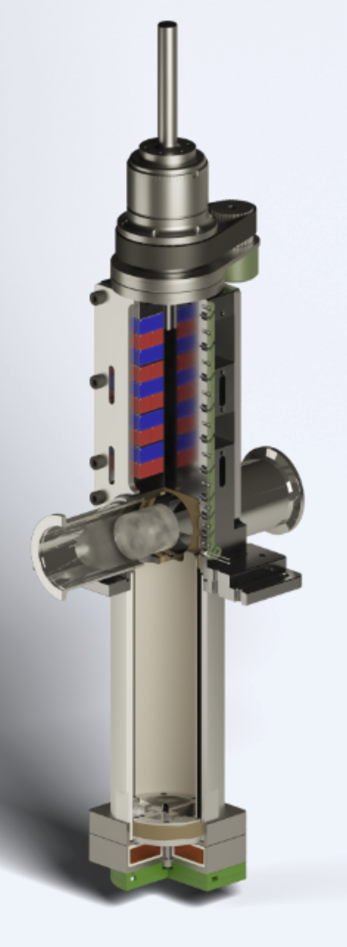
Last resort: fast shutter
Fast shutter is an optional element in ITER DMS system:
close behind pellet so as propellant gas cannot overtake it during flight
To be triggered by OPD real-time processing.
Concept demonstrated by our team:
40 mm flight tube
2 ms closing time
10 000 cycle test
Leakage below limit
Magnetic break
Eddy current actuator
Al ring
Coil
See poster 100 by D. Réfy

Slide 17
Optical pellet diagnostic (OPD)
The aim of the OPD is to give real-time (1 ms) information to the ITER control system about the launched SPI pellet: quality, velocity, direction
The control system will know the launch result before the pellet is shattered
At present not clear what the control system will do with the information
Two step development:
Concept proposal and demonstration in the Support Lab (2020-23)
ITER prototype OPD development (2024-25)

Slide 18
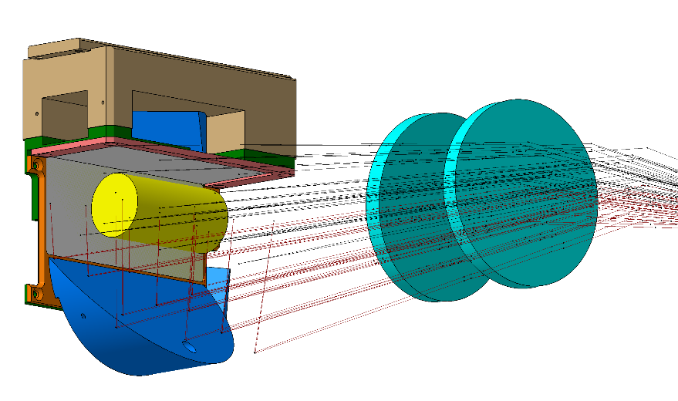
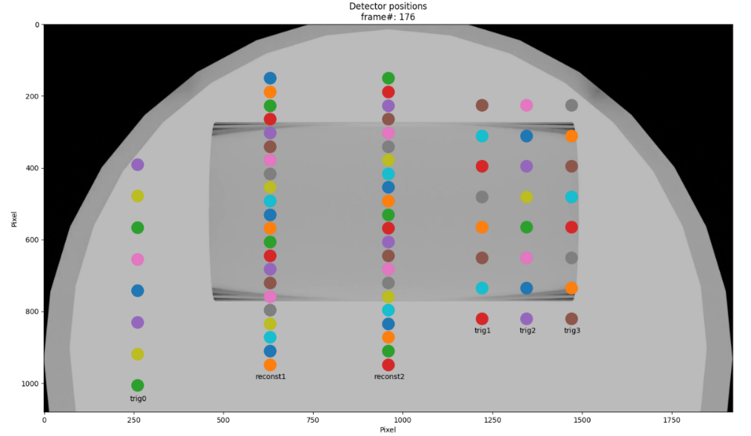
OPD Concept
Frontend optics
Only one optical window is available
Two pellet views with mirror
Shadowgraphy – diffusors behind the pellet
(diffusors are lit up from the front)
Relay optics to bioshield
Mirror, few lenses transmit light to bioshield
Combined detector system:
1. Detector array
Scanning the pellet with thin lines of sight (LOS) + triggering LOS
Continuous illumination (750 nm)
Fibres connect to detectors 100 m from tokamak
→ detectors will survive DT phase
2. CMOS cameras
3 cameras – 3 pellet locations
Exposure and 100 ns laser pulse triggered by detectors
Cameras in port cell: will probably die in DT operation
Shadowgraphy – two views
Pellet
Mirror
Sketch of the frontend optics
LOS arrangement on one pellet view

Slide 19
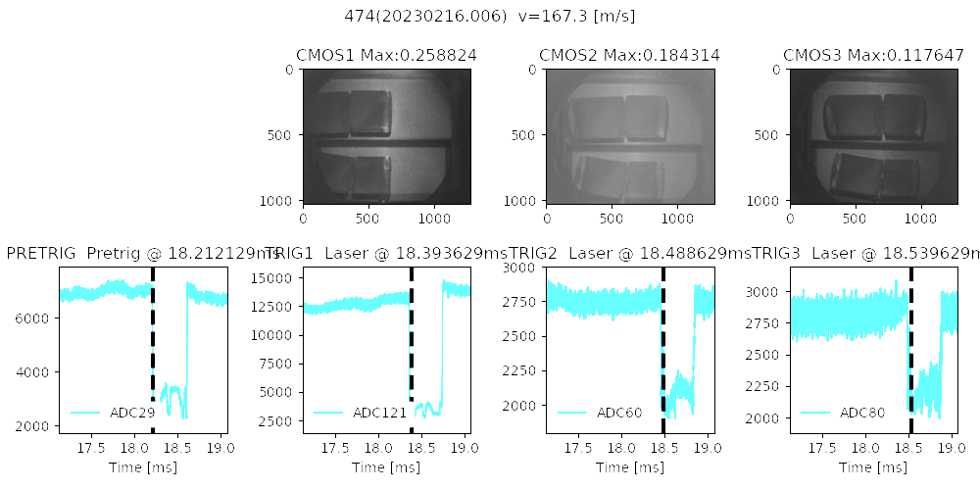
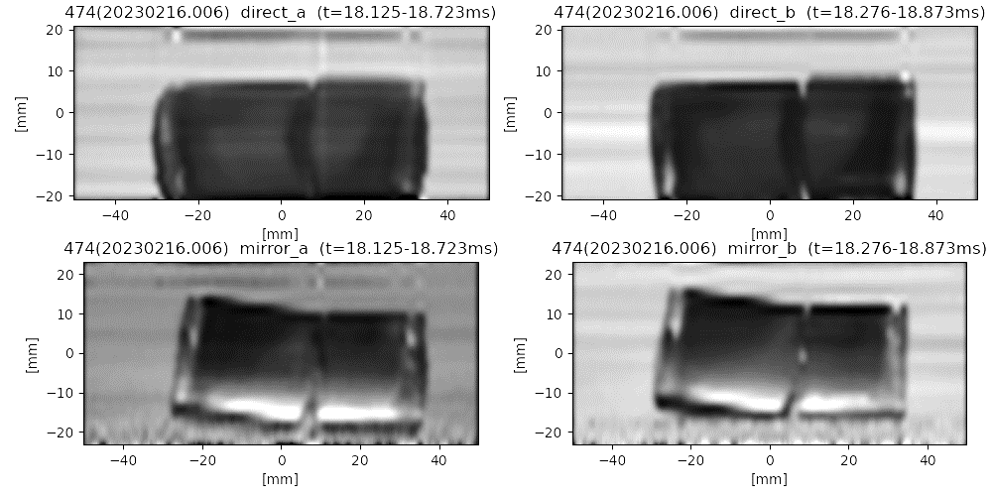
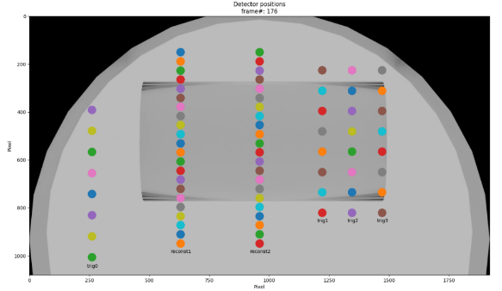
Example OPD measurements
Pellet broken into two pieces
Camerra measurement
trigger at 3 locations
Trigger signals
Pellet image reconstructed from scanning LOS
Horizontal view
LOS row 1 row 2
Vertical view
LOS row 1 row 2

Slide 20
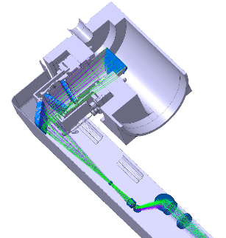
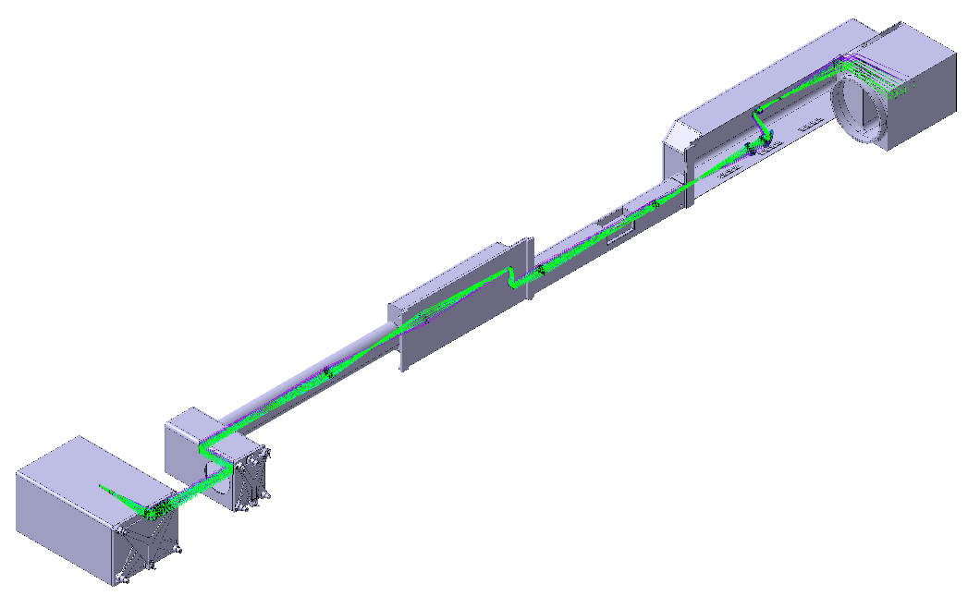

Optical pellet diagnostic prototype
Concept of the
frontend optics
ITER prototype OPD development (2024-25)
  Optics (frontend, relay to bioshield)
  Detectors, cameras
  Lasers, electronics
  Software
  Special fibre bundle
  The most complex fibre bundle for ITER
    ~100 m
    128 fibres for detection
    7 fibres for illumination
    multi-fibre connectors
Frontend
Bioshield
cameras
and fibre plate
Concept of the
full optics
Detectors
Fibre bundles
~ 100 m
OPD fibre bundle concept
Lasers

Slide 21





Pellet shattering in the support laboratory
Two shattering heads were tested up to now
20-degree, open shattering head (shutter plate)
15 degree box-type (current ITER design)
Illumination from the side, observation from top
Two types of shattering:
Fast pellet: dust cloud + small fragments
Slow pellet: large fragments
Shattering head

Slide 22


Laser curtain diagnostic
Concept
Illuminate a thin plane (observable area: min. 40x40 cm)
Beam dump to prevent reflections
Fragments within plane scatter light, rest is dark
Observe with a fast camera
  Distance to camera is well defined → fragment size
Line laser sources
Fast camera

Slide 23


Evaluation: segmentation procedure
Fragment identification (python)
skimage.filters.threshold_local
+
ndimage.label
$$A=πr^{2}$$
$$r=\sqrt{A/π}$$
$$d_{avg}=2\sqrt{A/π}$$

Slide 24
Fragment size distribution measured
#435: H pellet, v = 584 m/s
#439: H pellet, v = 416 m/s

Slide 25
Fragment velocity distribution
#435: H pellet, v = 584 m/s
#439: H pellet, v = 416 m/s

Slide 26
Final conclusions
The ITER DMS Support Laboratory investigated processes and developed components for the ITER DMS system:
Pellet recipes:
Snow formation enables easy launch with “darkshell” recipe
Propellant valve:
Up to 150 bar, 20 bar-liter in few ms
Propellant suppressor:
Wirecage pellet guide provides reliable pellet position/rotation
Gas retaining target and capabilities are not clear, need further investigation
Fast shutter:
Available as backup solution if gas cannot be retained in suppressor
Optical pellet diagnostic:
Rad-hard concept demonstrated, prototype being developed
Shattering process:
Fragment distribution measured
Amount of gas from fragmentation is not clear yet

Slide 27
BACKUP SLIDES

Slide 28


Pellet desublimation model
Pfreeze:
2D axially symmetric geometry
Heat transport in ice and barrel
Pellet material heat conduction from literature
Self-consistent calculation of desublimation,
gas heat conduction and surface temperature
Numerical mesh moving with pellet surface
Constant barrel gas pressure
→ gas flow, cold head power,... from model
Temperature in barrel wall and pellet
Gas flow rate
(log scale)
Temperature profile at Z=9.5 mm
S. Zoletnik, et al, EPS Plasma Conf. 2021 P2.1057

Slide 29






Comparison of modelling with experiment
Experimental barrel pressure is used in model → gas flow (desublimation rate) calculated
Hole
closure
Protium
Deuterium
Neon
Experimental gas flow (desublimation rate) at start is systematically below modelled
Deviation is larger for dark pellets:
gas does not reach into core of pellet
→ uniform gas pressure in model not valid
→ would need coupled gas flow and desublimation model (under development)

Slide 30

Cryogenic snow formation
Assumption 1:
The dark layer forms when the pellet gas cools below the temperature corresponding to the temperature where the pressure equals the saturation pressure → saturation temperature
Assumption 2:
The dark (snow) layer is limited to the pellet surface
→ consider conditions at start of formation
Saturation pressure vs temperature
T_{sat} (Ne)
T_{sat} (H)
T_{sat} (D)

Slide 31




Calculating barrel surface temperature
Heat load on the barrel can be calculated from the measured Φ gas flow rate
The heat load is balanced by heat conduction through the barrel wall to the cold head:
From the two equations the barrel surface temperature can be calculated as a function of
gas flow rate.

Slide 32

Snow formation for H pellet depends on local pressure
Pair of measurements with one-sided feeding at the start of pellet formation
Snow always forms on opposite side of gas feed

Slide 33

Snow (dark layer) is only on surface
Few images taken nearly opposite to pellet velocity
Image just before pellet hits shattering head
Dark layer is bright as
illumination
is coming from side
Dark axial stripe

