Slide 1
Pellet Size Optimization for the ITER SPI
IAEA TM on Disruptions
U. Sheikh¹, S. Jachmich², G. Bodner³, J. Decker¹, N. Eidietis³, O. Ficker⁴, M. Hoppe⁵, Z. Huang⁶, M. Kong¹, D. Kos⁶, M. Lehnen², E. Nardon⁷, C. Paz-Soldan⁸, S. Silburn⁶, B. Stein-Lubrano⁹, J. Svoboda⁴, C. Reux⁷ and JET Contributors¹⁰
¹ EPFL, Swiss Plasma Center (SPC), CH – 1015 Lausanne, Switzerland
² ITER Organization, Route de Vinon-sur-Verdon - CS 90 046, 13067 St Paul Lez Durance Cedex, France
³General Atomics, San Diego, CA, USA
⁴Institute of Plasma Physics of the CAS, Prague, Czech Republic
⁵KTH Royal Institute of Technology, Stockholm, Sweden
⁶CCFE, Culham Science Centre, Abingdon, Oxon OX14 3DB, United Kingdom
⁷CEA, IRFM, F-13108 St-Paul-Lez-Durance, France
⁸Columbia University, New York, NY, USA
⁹MIT Plasma Science and Fusion Center, Cambridge, MA 02139, USA
¹⁰See the author list of “Overview of T and D-T results in JET with ITER-like wall” by C.F. Maggi et al. to be published in Nuclear Fusion special issue: Overview and summary papers from the 29th Fusion Energy Conference (London, UK, 16-21 October 2023).

Slide 2
Introduction
Disruption mitigation prevents damage through thermal load, electromagnetic load and runaway electron (RE) impact via
  Radiation emission of plasma thermal stored energy
    For thermal load mitigation
  Rapid cooling and electron density increase through dilution
    For RE avoidance
  Control of current quench (CQ) rate via resistivity through impurity content
    For EM load mitigation
  RE impact mitigation via benign termination
    Achieved via an MHD instability in a low electron density companion plasma

Slide 3
Introduction
Shattered pellet injection (SPI) stands out as a promising technique for mitigation
  Foreseen for ITER
  Can produce pellets of deuterium (D) or mixtures of deuterium/neon (D/Ne)
    ITER will use H instead of D, kept as D in this talk for simplicity
Current prevailing strategy involves a staggered injection
  Pure D SPI for dilution cooling and increase in electron density (for RE suppression)
  Neon doped SPI for thermal load mitigation and CQ rate control
Pellet timing balances requirement for D assimilation and risk of TQ onset
  If TQ occurs prior to Ne/D pellet, thermal damage possible
  If Ne/D pellet too early, pure D pellet not assimilated or core density not increased
    Ne/D pellets cause TQ in ~few ms

Slide 4
Introduction
ITER needs to decide on optimum pellet size: present choice is 28.5mm diameter
In a staggered injection scheme for a 15MA H-mode DT plasma this delivers
  1.5×10²⁵ hydrogen atoms through 8 pellets (15% assimilation)
  Followed by 5.6×10²⁴ atoms by 3 neon doped pellets
    Relatively very small amount of neon required for thermal and EM load mitigation (0.4-5e22 Ne in total of ~2e25)
    Additional barrels available for redundancy
Current modelling: this is insufficient to prevent RE generation in the nuclear phase
  [Vallhagen NF 2022], [Vallhagen NF 2024]
An RE mitigation strategy must be compatible with the chosen SPI configuration
The question for today: Is the current pellet sizing compatible with RE avoidance and RE benign termination mitigation?
  Spoiler: it’s not

Slide 5
RE Avoidance

Slide 6
RE Avoidance via Core Density Increase
Goal: Increase density and reduce temperature
  Suppression of hot tail generation by diluting and cooling the plasma on a `slow’ timescale
  Suppression of T beta decay seed by increasing collisionality and thus the critical energy to run away
Done via first pure D SPI
Two challenges:
  Plasmoid drift prevents core fuelling
  Significant time required for core density increase

Slide 7
Plasmoid Drift/Rocket Effect – Tracking Method
Two methods were used to track the pellet trajectories
Max. intensity method:
  Only tracked pixel inside LCFS with maximum intensity
Gradient method
  Looked for the front edge of the pellet by analyzing a gradient of pixel intensities
Pellet trajectories fit using both methods, and then choose the one that closest resembles the FC video
Pellet trajectory = trajectory of maximum emission

Slide 8
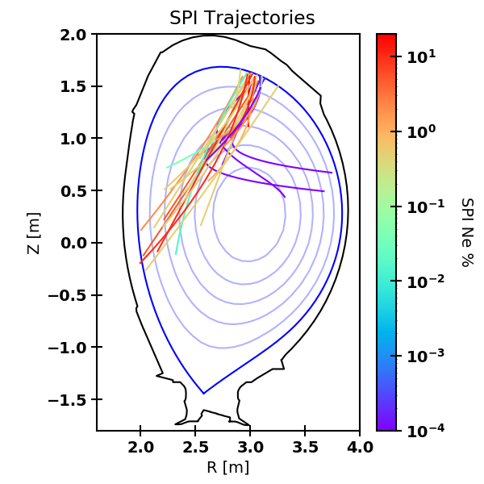
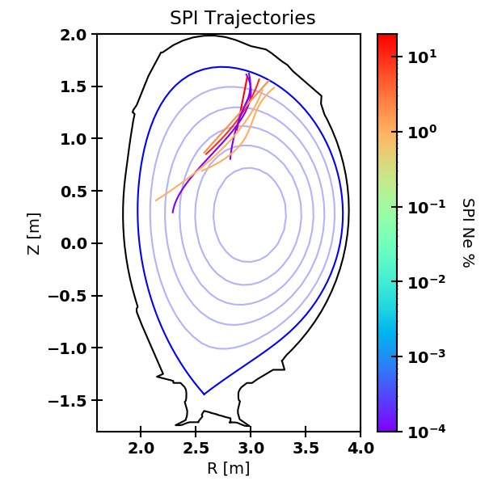
Plasmoid Drift/Rocket Effect – Ne/D Mixtures at 4 MJ
Trajectory appears stable at ~0.1% Ne at 4 MJ
  Log scale for Ne/D%
Clear at low velocity, less evident at high velocity
  Smaller shards, shallower assimilation,… ?
Low Velocity (<400m/s)
High Velocity (400+m/s)

Slide 9
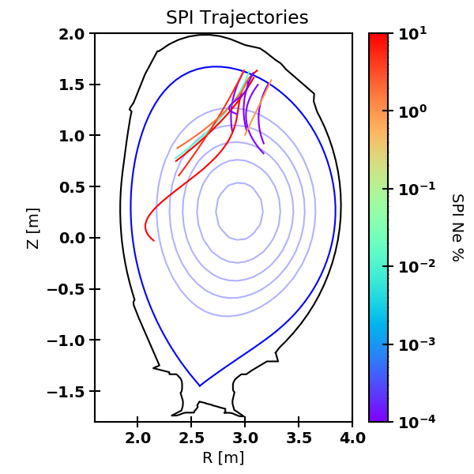
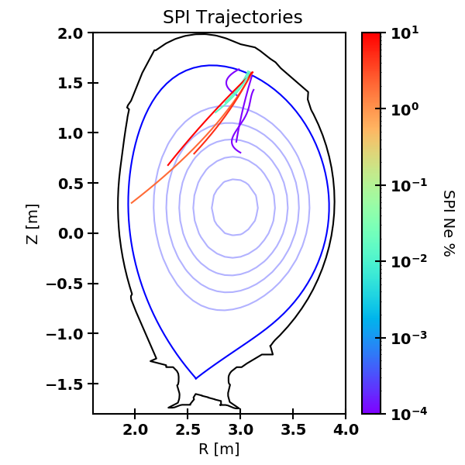
Plasmoid Drift/Rocket Effect – Ne/D Mixtures at 8 MJ
Similar results at 8MJ
  Drifts more evident at high velocity
Fewer data points to constrain doping required
Low Velocity (<400m/s)
High Velocity (400+m/s)

Slide 10
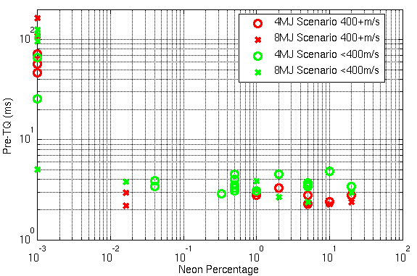
RE Avoidance – Hitch 1
Based on trajectory analysis, we will need to dope pellets with neon
  Detailed analysis on-going to determine how much doping is required
Neon doping reduces the pre-thermal quench duration (TQ) to <5ms on JET
  Reduced time window for second pellet and core density assimilation

Slide 11
RE Avoidance – Hitch 2
If the plasma is seeded, the pre-TQ duration is further reduced on JET
  Pure D SPI goes from several 10s of ms to below 10ms
Reduces available assimilation time and second SPI window

Slide 12
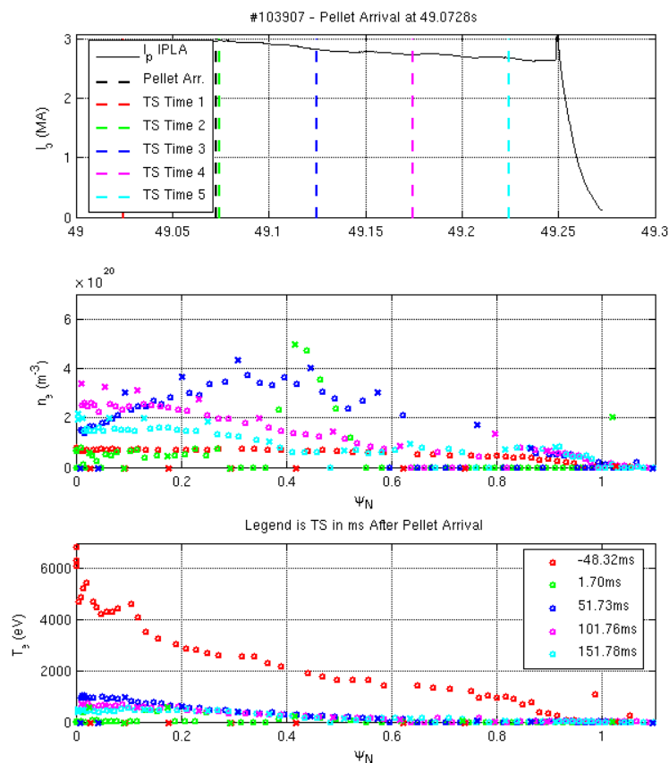
RE Avoidance – Hitch 3
Thomson Scattering (TS) profiles following a pure D SPI indicate 10s of ms to achieve core n_{e} increase on JET
  8MJ scenario example
n_{e} peak is still at 0.4 Ψ_{N} 50ms after pellet arrival
  Core n_{e} has doubled
Peak core n_{e} occurs 100ms after pellet arrival
  Decreases again at 150ms
Core T_{e} is still ~1keV at 100ms
  Reduces to ~500eV by 150ms

Slide 13
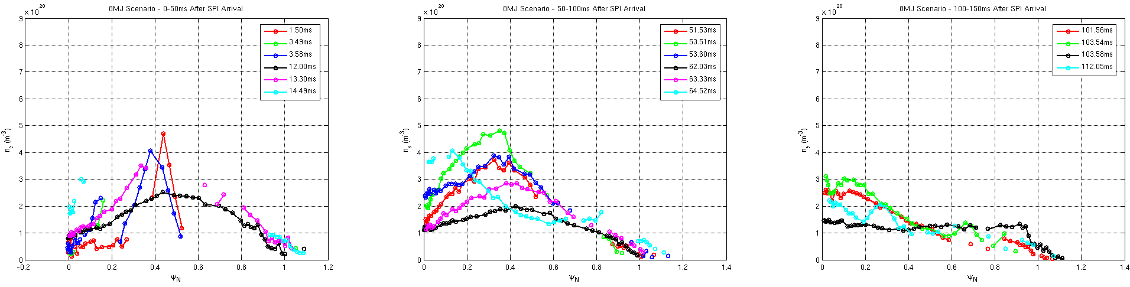
RE Avoidance – Hitch 3
Using multiple 8MJ discharges, we can explore effective higher time resolution
Core n_{e} only increased in one discharge by 15ms (similar result for 4MJ scenario)
  Some discharges show little increase in core n_{e} even after 60ms (1e20 m⁻³ prior to pellet arrival)
  One discharge shows no increase in core density even after 100ms
Core n_{e} appears to reduce after 100ms
  Likely due to particle confinement

Slide 14
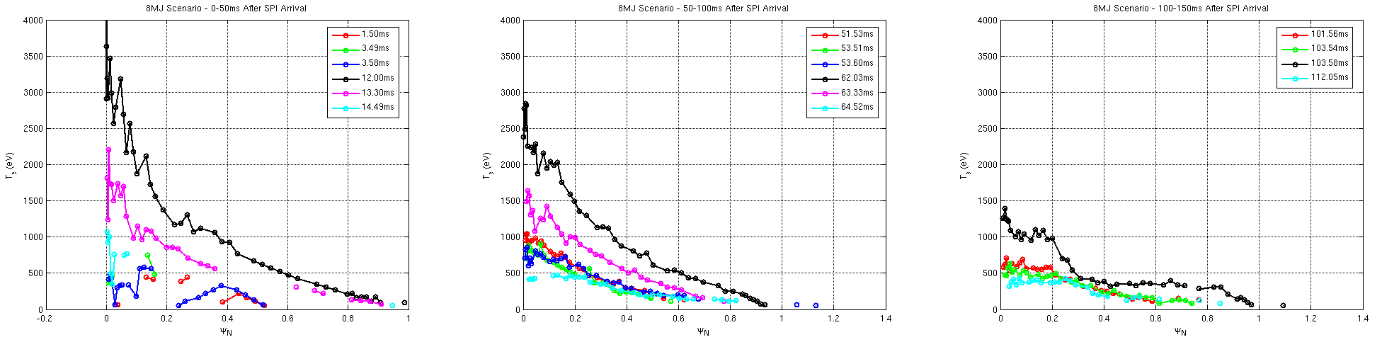
RE Avoidance – Hitch 3
Pre-SPI T_{e} reference is ~6keV
Core T_{e} can vary greatly in first 15ms
  High radiation from fragment ablation compromises Te-measurement at some positions
  Core T_{e} varies between 0.5-2.5keV after 50-100ms
Stabilizes at 500eV in most cases after 100ms

Slide 15
RE Avoidance Summary
Large pellet size chosen to inject quantities for RE avoidance
Even with this large injection, modelling predicts it is insufficient to prevent RE generation in the nuclear phase
  [Vallhagen NF 2022], [Vallhagen NF 2024]
Experiments on JET indicate:
With neon doping for drift suppression the pre-TQ duration will reduce significantly
Plasma seeding will further reduce the pre-TQ duration
10s of ms are required for core n_{e} increase and T_{e} decrease on JET
  Even with only 0.016% Ne doping, TQ is triggered within 10 ms
Take away message: Given what we see on JET, it’s very unlikely we will achieve the core n_{e} required for RE avoidance

Slide 16
RE Mitigation via
Low-Z Benign Termination

Slide 17
RE Mitigation via Low-Z Benign Termination
Goal: Reduce the companion plasma n_{e} to produce a fast growing instability that expels REs over large wetted area
Achieved via D SPI to cool the companion plasma via conduction
Two challenges:
  Lower limit in neutral pressure to ensure sufficient cooling via conduction
  Upper limit in neutral pressure due to RE impact ionisation

Slide 18
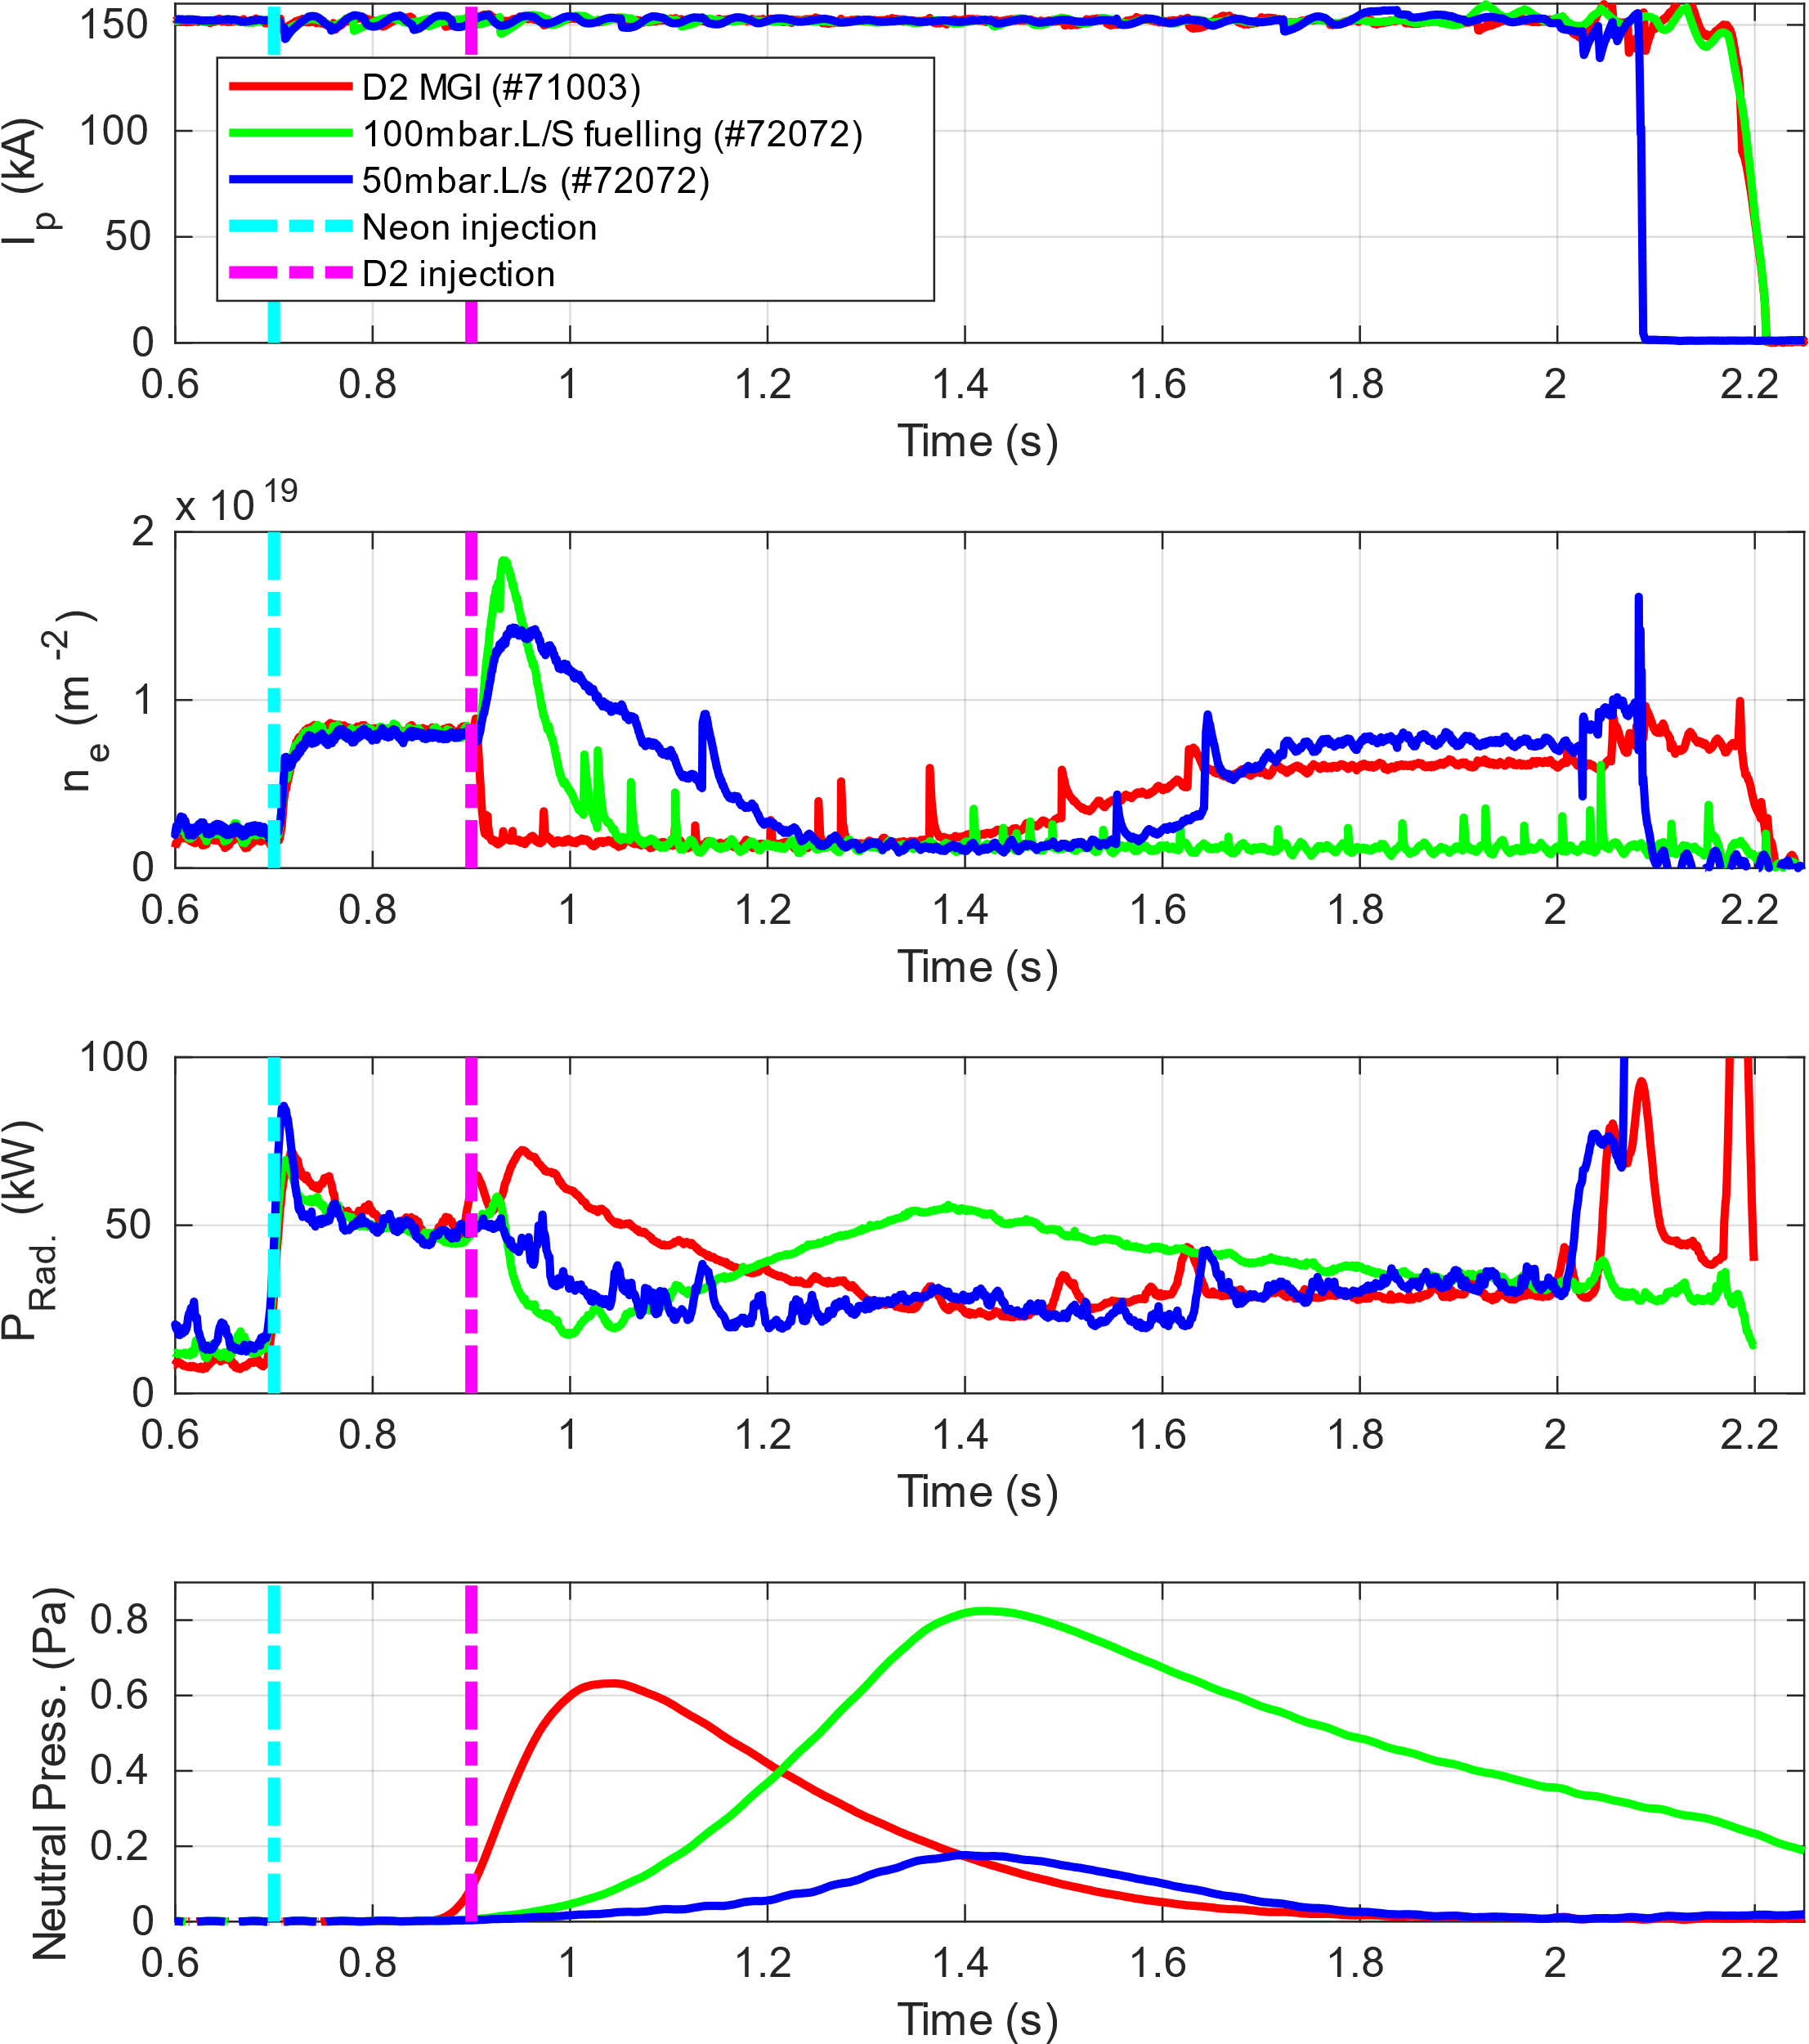
Neutral Pressure Lower Limit
TCV
Recombination of companion plasma strongly linked to neutral pressure on AUG and TCV
  DIII-D use injected quantity
  JET dataset more complex
Example discharges from TCV show radiated power dropping until recombination
  Increases again at high neutral pressure when RE interaction with neutrals increases
Energy loss mechanism at lower limit is conduction
  Agnostic of injection method

Slide 19
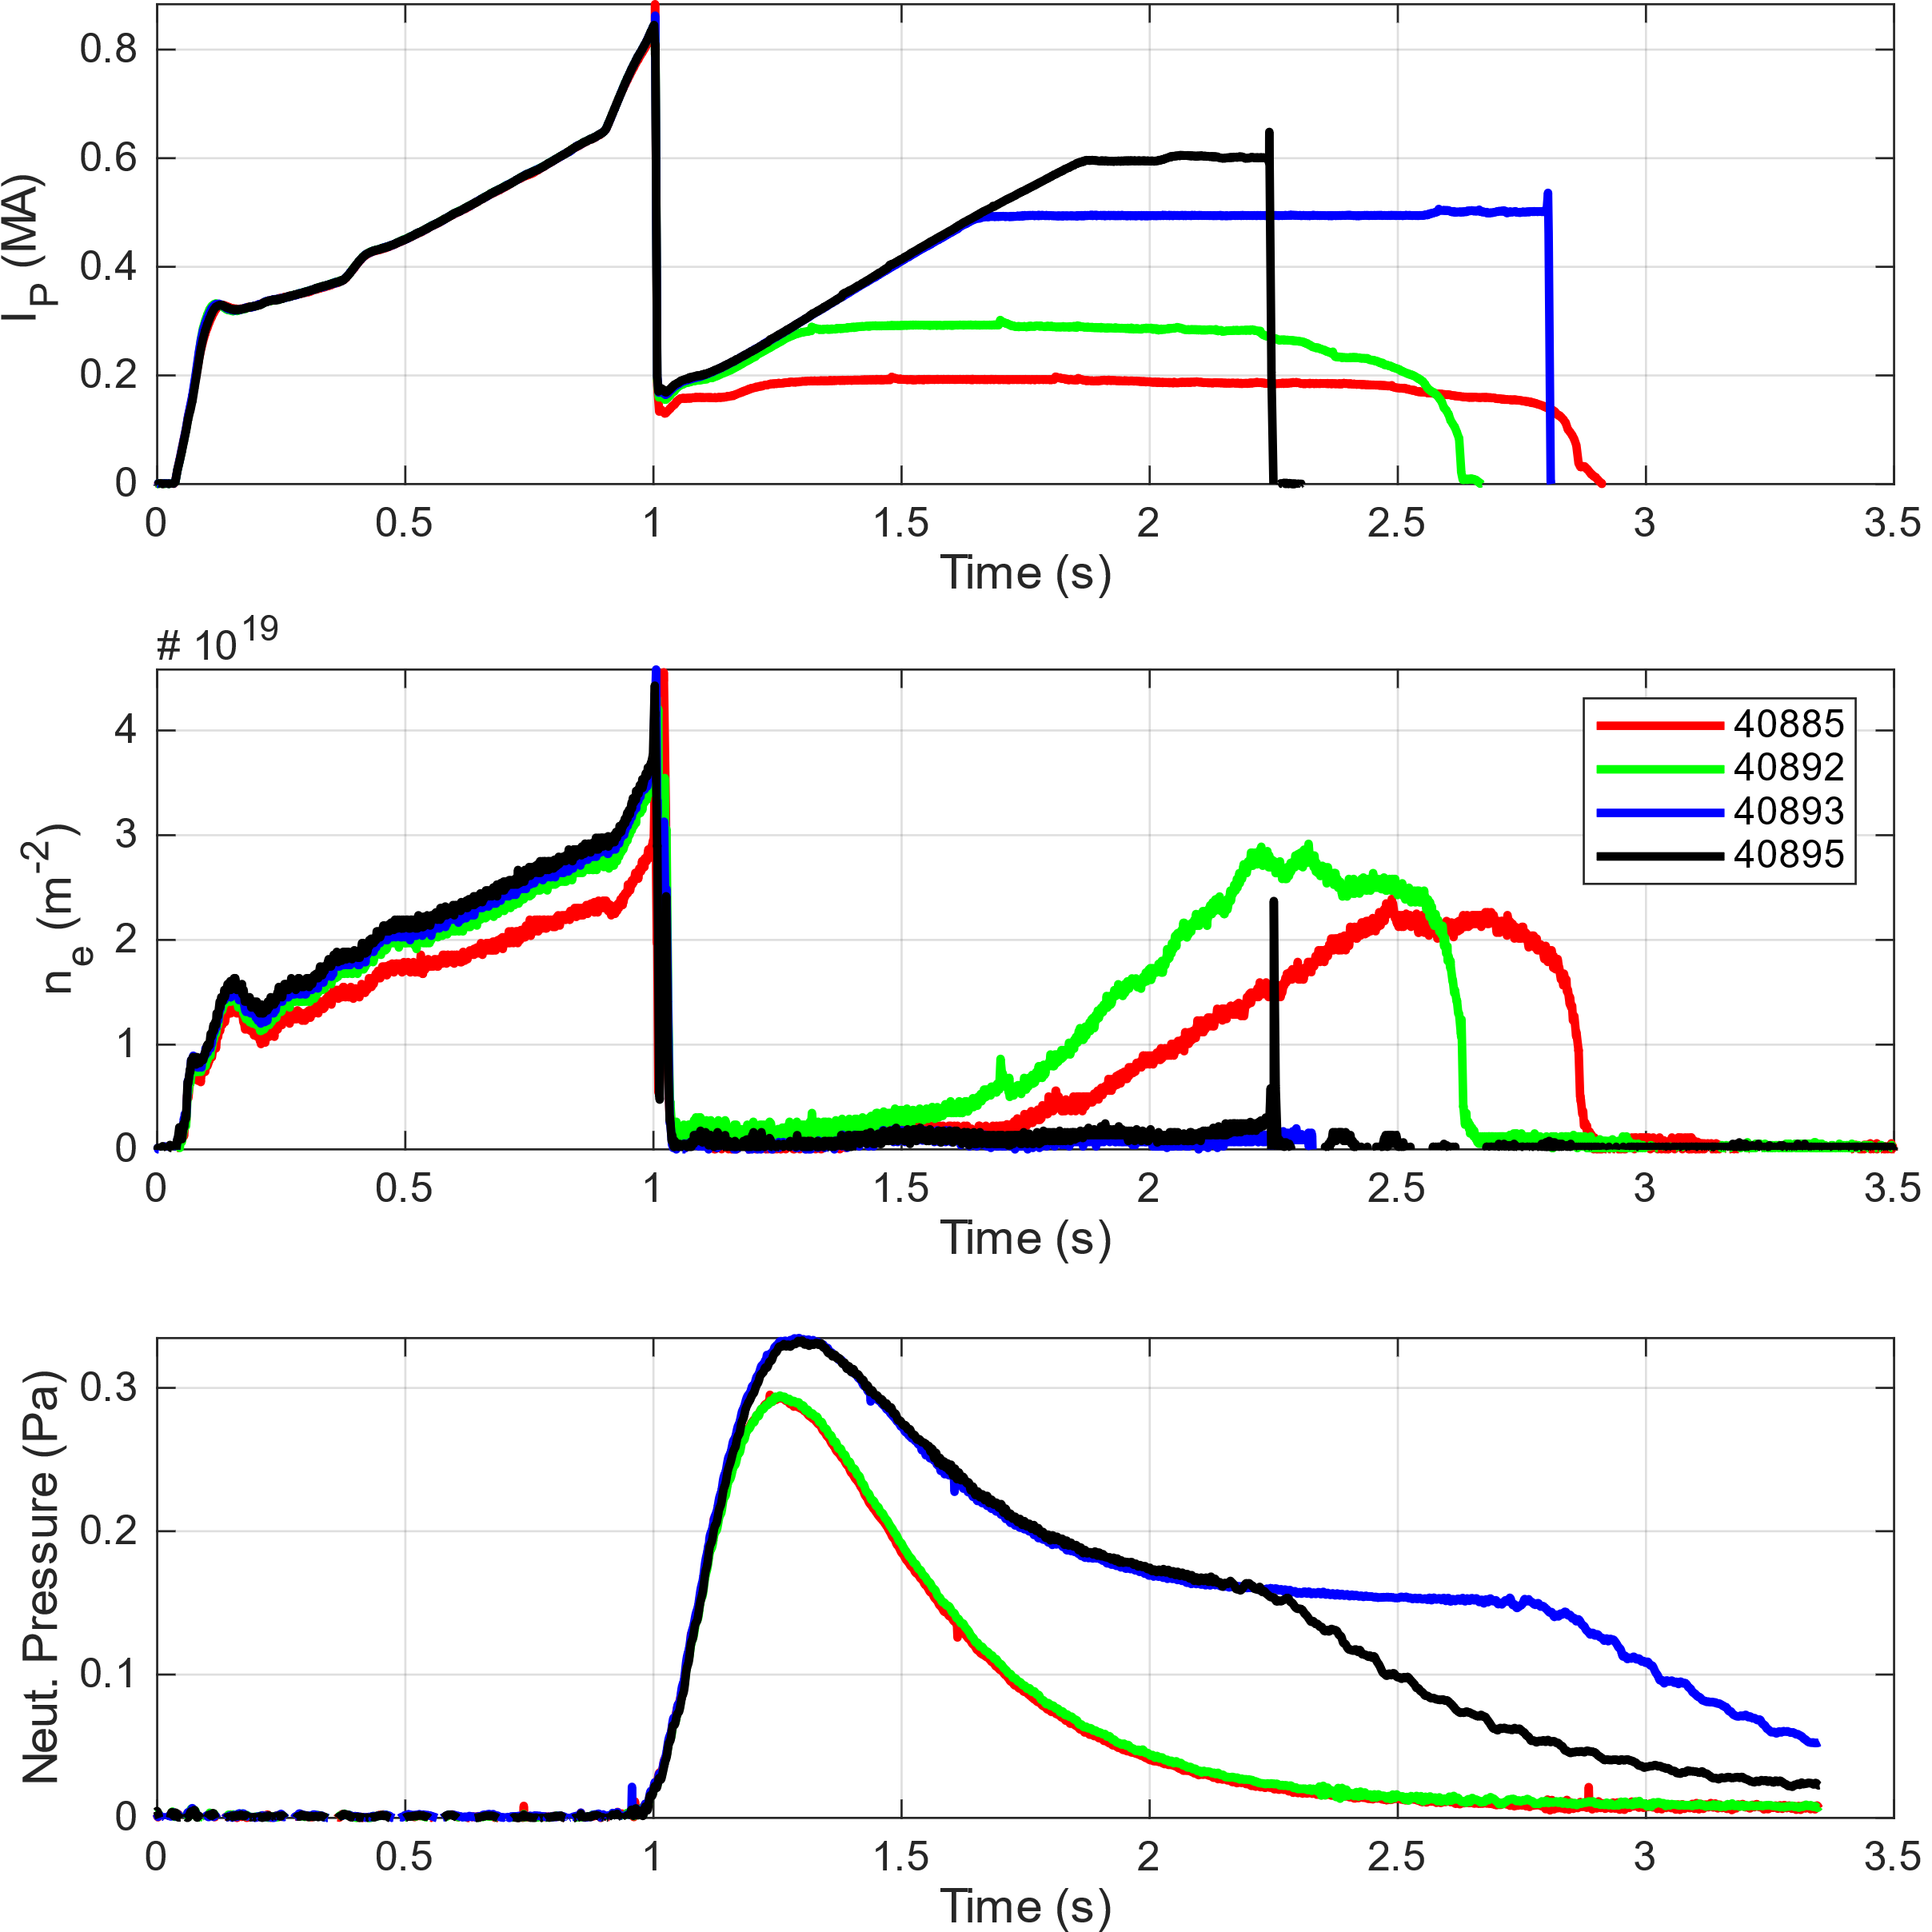
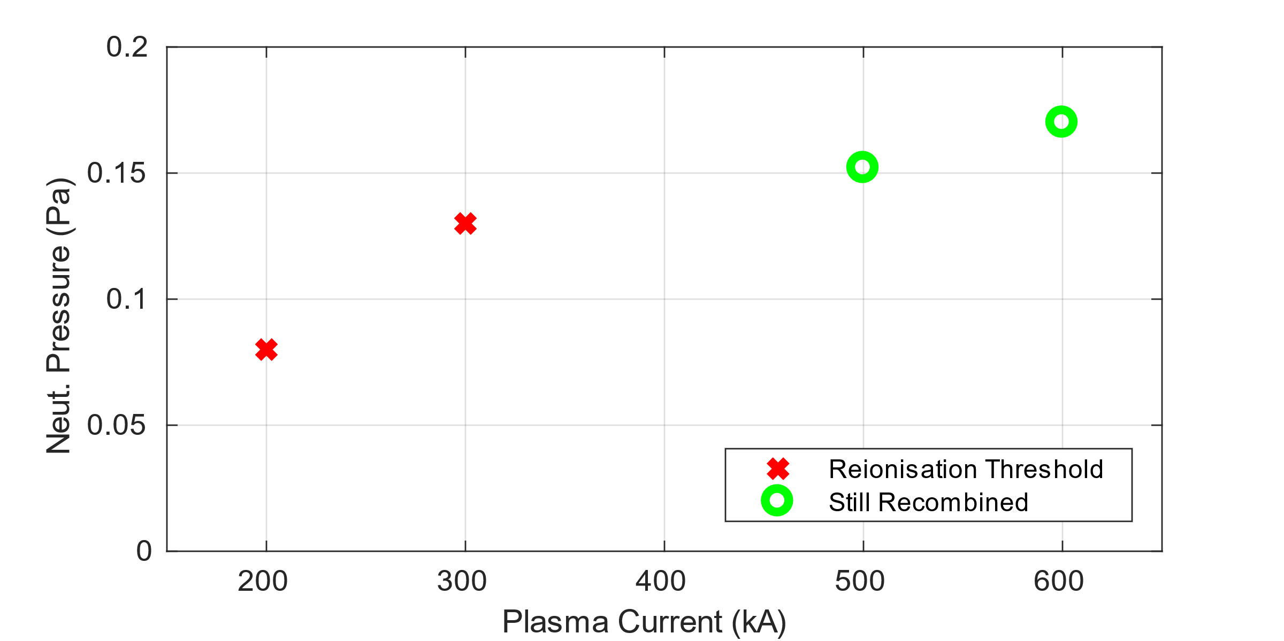
Neutral Pressure Lower Limit
AUG
Lower limit is sensitive to RE current (AUG example)
Also sensitive to impurity species and quantity
  Conclusion from TCV experiments with Ne, Ar, Kr

Slide 20
Cross Machine Database From ITPA MDC-23
Current density (top)
Impurity density x Z² (mid)
The two multiplied (bottom)
Colours for machines

Slide 21
Cross Machine Database From ITPA MDC-23
All species and currents
… it’s a mess
  No evident trend between machines
Shows need for power balance model
  As well as comparison of neutral pressure inference techniques
Lessons possible…
  For example, H conducts better than D
    Lower pressure for metal walls?
  Good news for ITER

Slide 22
Cross Machine Database From ITPA MDC-23
ITER ballpark
  High current density
    15MA, a=2m -> 1200 kA/m²
    5MA, a=1m -> 1600 kA/m²
      Ignoring q limits for now
  Low impurity density
    Current estimate 4e21-5e22 neon particles
      Vol:1080m³, z²: 100 (Ne)
      imp dens z²: e20-e21
All scenarios achieved recombination only when pressure remained below 0.4 Pa

Slide 23
Neutral Pressure Upper Limit
n_{e} increases at high neutral pressure
  TCV results
  Measured on TS and interferometer (FIR)
T_{e} continues to decrease
  Increase in ne is attributed to RE impact ionisation
n_{e} increase agnostic to impurity species (Ar vs Ne)
  Support model of RE impact ionization

Slide 24
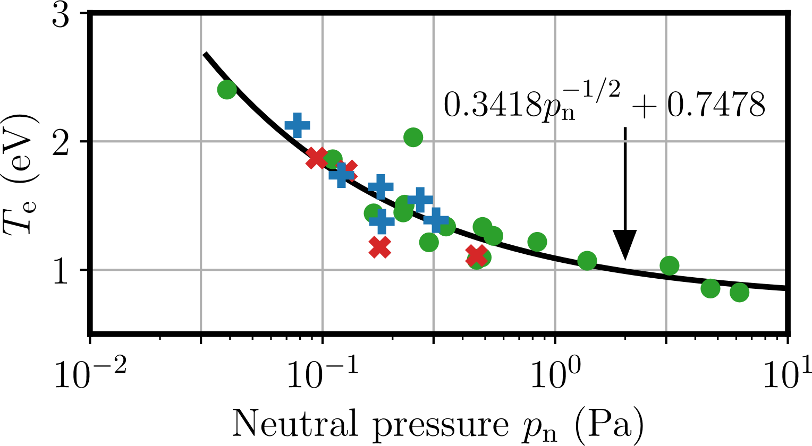
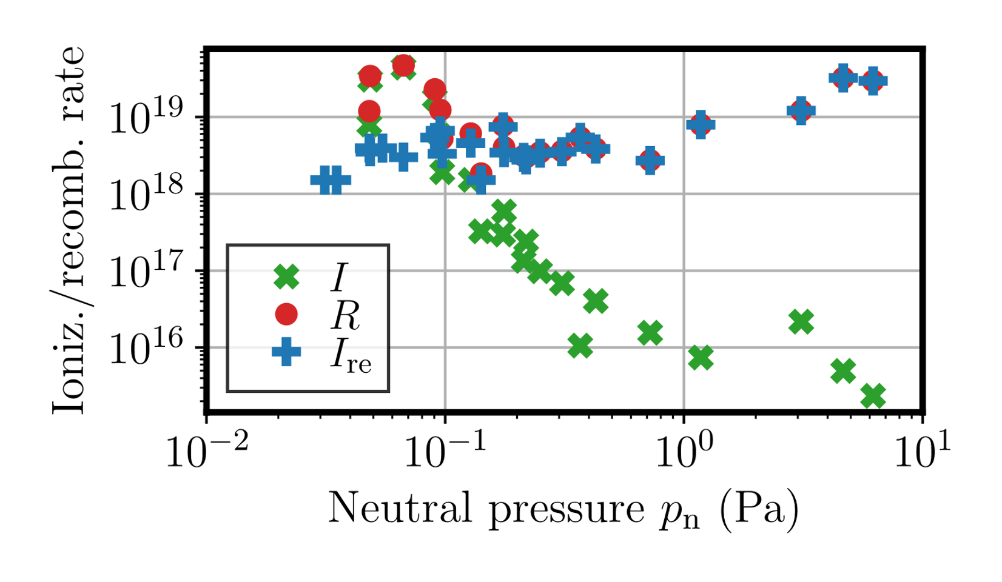
Neutral Pressure Upper Limit
Ionization dominated by RE impact ionization near upper limit
At upper limit:
  Higher pressure ⇒
  More D2 ⇒
  More RE impact ionization collisions
Details: Hoppe 2024 Joint Varenna-Lausanne International Workshop on the Theory of Fusion Plasmas

Slide 25
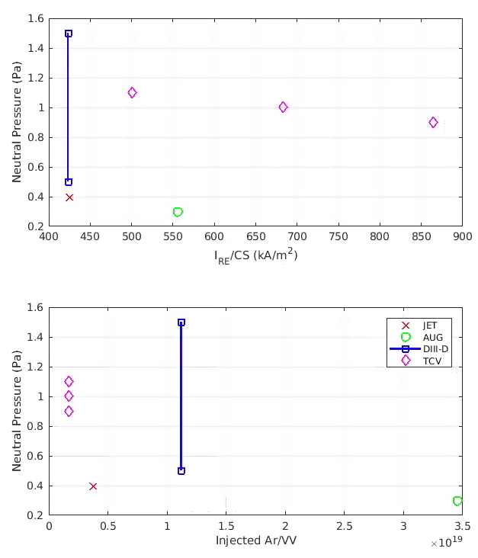
Cross Machine Database From ITPA MDC-23
JET: Limit is ~0.4 Pa (one data point)
  At 789kA, CS of 1.86m2 and 7.36e20 Ar
AUG: Always benign below 0.3 Pa
  At 425kA, CS of 0.766m2 and 1.38e21 Ar
DIII-D: Limit is between 0.5-1.5 Pa
  At 275kA, CS of 0.65m2 and 4.47e20 Ar
  No upper limit with H (instead of D)
TCV: Limit is between 0.9-1.1 Pa
  110-190kA, CS: 0.22m2, 7.2e18
Takeaway: upper limit in neutral pressure generally below 1Pa in current devices
  ITER RE current and D density will be higher
  Upper limit will decrease

Slide 26
RE Mitigation Conclusion
Current best guess is the neutral pressure for low-Z benign termination required is between 0.4-1.0 Pa
  Significant uncertainty
    Power balance model for lower limit (SOLPS)
    RE impact ionization model for upper limit
  Experimental database analysis continuing

Slide 27
Pellet Sizing Conclusions

Slide 28
Pellet Sizing Considerations
In a staggered injection scheme for a 15MA H-mode DT plasma:
  1.5×10²⁵ hydrogen atoms through 8 pellets
  Followed by 5.6×10²⁴ atoms by 3 neon doped pellets
    3 pellet constraint due to asymmetries, reduced with W wall
  Likely to be ineffective for RE avoidance based on current predictions
This produces ~30 Pa of neutral pressure
  Incompatible with low-Z benign termination upper pressure limit
    We are not concerned with the lower pressure limit given the pellet sizes

Slide 29
Pellet Sizing Discussion
ITER will have a total of 27 injectors distributed toroidally and poloidally in six ports
  Upper ports in sectors 2, 8 and 14 with 1 injector each
  Equatorial ports: sector 2 with 12 injectors, sectors 8 and 17 with 6 injectors each
Current 28.5mm diameter x 57mm length chosen
  One 28.5mm H pellet produces a pressure of 2.78Pa -> Already too high for benign termination?
Staggered injection scheme requires 8 + 3 large pellets
  Upper ports for post-TQ
  13 additional injectors available

Slide 30
Pellet Sizing Discussion
Need to reduce pellet size by factor of ~10 to be in benign termination range (0.4-1Pa)
  Need multiple pellets to explore range experimentally on ITER
Reduce size of some of the 13 available injectors:
Proposal 1: Reduce 8 barrels keep pressure below ~0.25Pa per pellet
  Max pressure rise would be 2.0Pa
Proposal 2: Reduce 6 barrels keep pressure below ~0.3Pa per pellet
  Max pressure rise would be 1.8Pa
Proposal 3: Reduce 4 barrels keep pressure below ~0.5Pa per pellet
  Max pressure rise would be 1.5Pa
Allows for redundancy in mitigation schemes
  Both RE avoidance and mitigation strategies are possible
  Enhanced assimilation in low energy plasmas (INDEX)
  Reduces constraints on propellant gas and technical design
  Potential to resize upper lateral ports for benign termination

Slide 31
Thank you

Slide 32
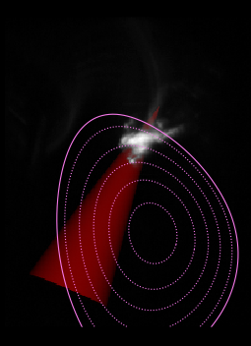
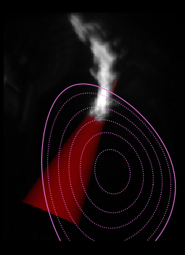
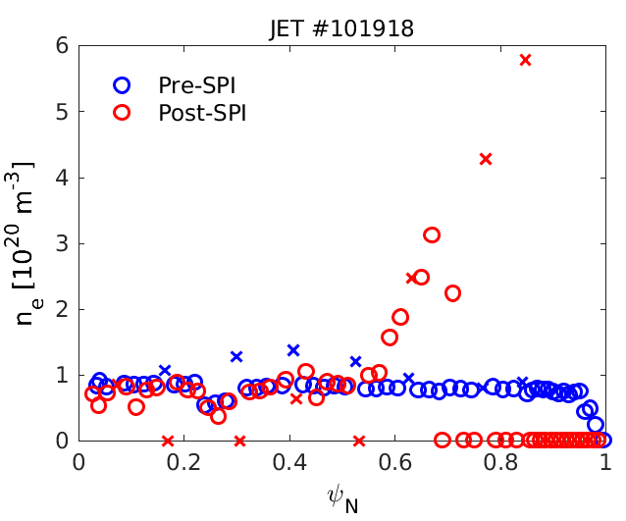

Plasmoid Drift
Preliminary analyses of plasmoid drifts (pure D2)
FC ablation at $ψ_{N}\sim 0.$6 , TS density peak at $ψ_{N}>0.8$
Earlier
At TS time
1
0.9
0.7
0.5
0.5

Slide 33
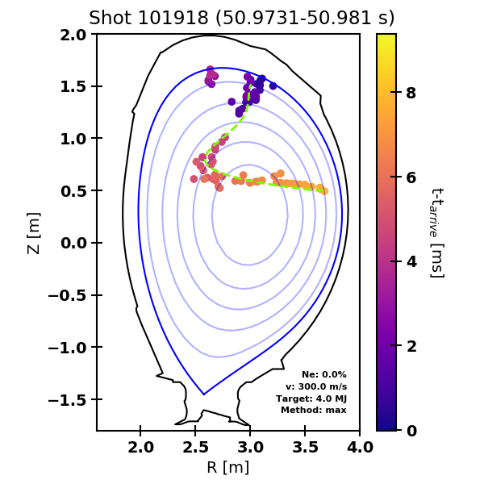
Pellet Tracking Fits (Max. Intensity Method)
For each frame, find the pixel with maximum intensity inside the LCFS
Works best for shots with a lot of ablation spreading
  These shots can confuse the gradient method
Weakness is you might not be getting the front edge of the pellet
Trajectory fit with polynomial

Slide 34
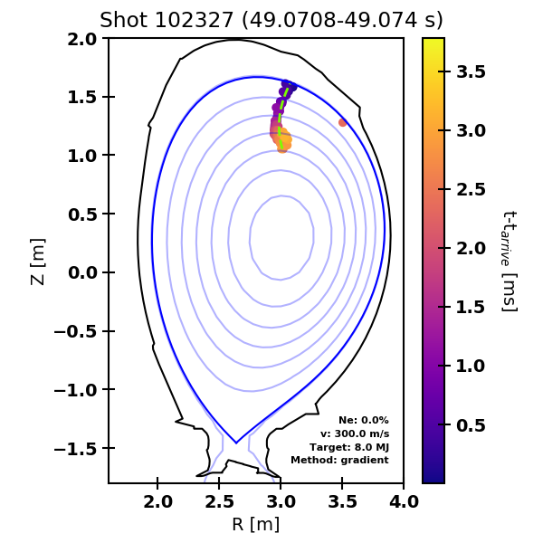
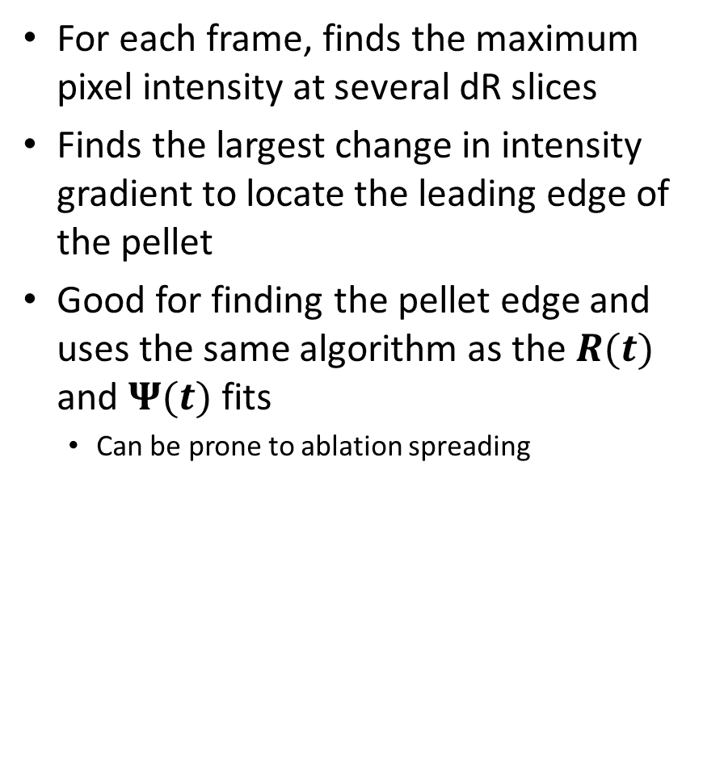
Pellet Tracking Fits (Gradient Method)
For each frame, finds the maximum pixel intensity at several dR slices
Finds the largest change in intensity gradient to locate the leading edge of the pellet
Good for finding the pellet edge and uses the same algorithm as the $R(t)$ and $Ψ(t)$ fits
  Can be prone to ablation spreading

Slide 35
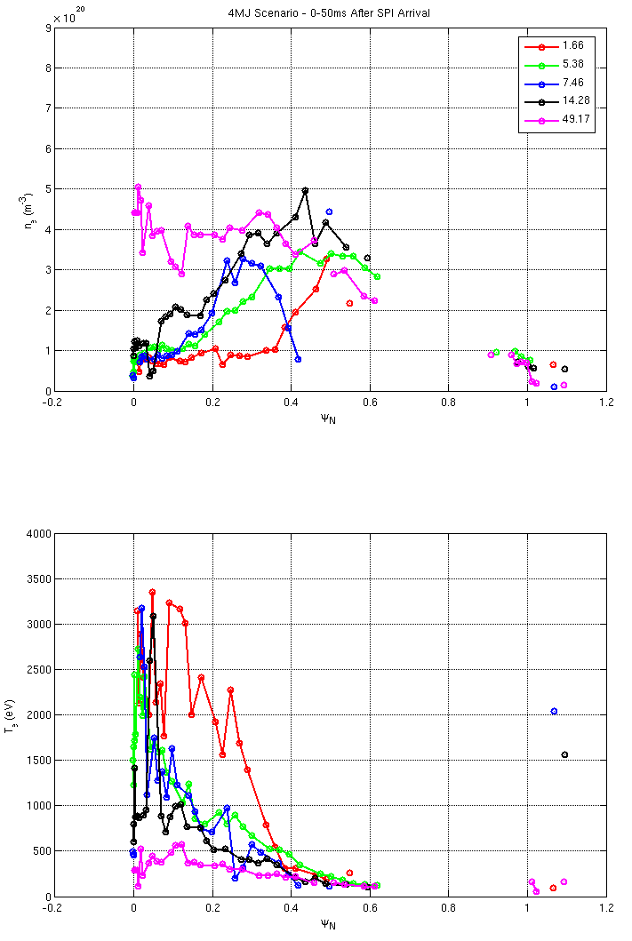
RE Avoidance – Hitch 3
Using multiple discharges, we can explore higher time resolution
Density increase at edge only until ~14ms
Core n_{e} increases between 14-50ms
  No points available between 15 and 50ms
Core T_{e} still ~1keV at 14ms
Arr->TS (ms) | 1.66 | 5.38 | 7.46 | 14.28 | 49.17
Shot | 101918 | 102347 | 105760 | 101758 | 102486
Pre-TQ (ms) | 65.8 | 89.1 | 87.8 | 56.7 | 71.6
Velocity (m/s) | 339 | 376 | 492 | 557 | 511
W-th (MJ) | 4.16 | 3.95 | 4.18 | 4.00 | 3.71

Slide 36
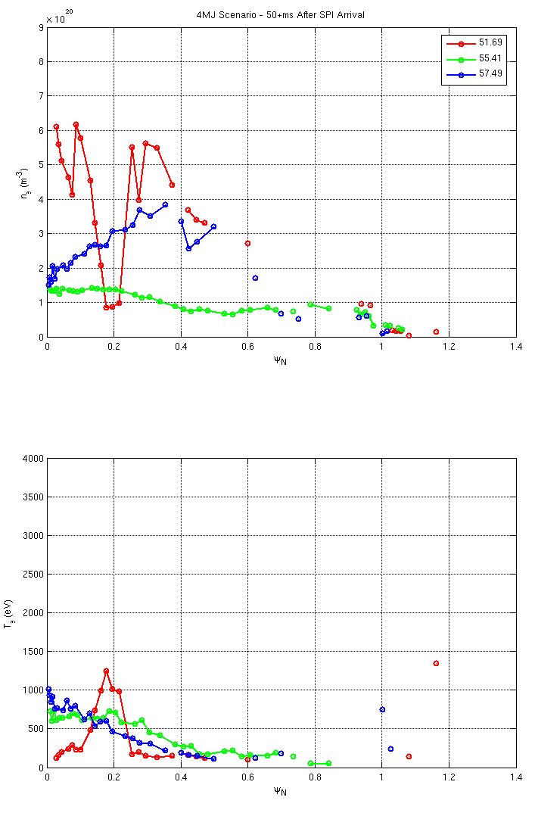
RE Avoidance – Hitch 3
Second TS point possible in pre-TQ
  50ms resolution
Small core density rise observed in 102347 (55.41ms) and 105760 (57.49ms)
  Density lost due to low particle confinement?
Core temperature still at 1keV 57ms after SPI arrival
P
Arr->1st TS (ms) | 1.66 | 5.38 | 7.46 | 14.28 | 49.17
Shot | 101918 | 102347 | 105760 | 101758 | 102486
Pre-TQ (ms) | 65.8 | 89.1 | 87.8 | 56.7 | 71.6
Velocity (m/s) | 339 | 376 | 492 | 557 | 511
W-th (MJ) | 4.16 | 3.95 | 4.18 | 4.00 | 3.71

