Slide 1
Runaway mitigation and safe termination during startup and disruptions
Xian-Zhu Tang¹
Oleksii Beznosov¹, Luis Chacon¹, Jason Hamilton¹, Zakariae Jorti¹, Michael Lively¹, Danny Perez¹, Qile Zhang, Yanzeng Zhang^{1,} Jonathan Arnaud², Chris McDevitt²
¹Los Alamos National Laboratory; ²University of Florida at Gainesville
This work was supported by the Office of Fusion Energy Sciences and Office of Advanced Scientific Computing Research through the base theory and TDS SciDAC program.

Slide 2
Outline: four scenarios/routes for runaway mitigation
Low density + warm temperature scenario → startup plasma
Runaway modification by self-driven wave instability
Implication for externally injected waves
Standard mitigation scenario by high-Z impurity injection
Hybrid quasistatic MHD + runaway kinetic simulation
CQ time scale, chamber/vessel force loading, runaway power load distribution on first wall
Termination of runaway beam by injected tungsten particulates
RE collisional slowing down versus pitch angle scattering
MCNP modeling
Integrating TQ and CQ mitigation by massive hydrogen injection
Integrated MHD (Braginskii) + radiation simulation
What are the physics constraints for optimal design
https://tds-scidac.github.io/about/

Slide 3
(I) Runaway mitigation by waves
Collisional damping of fast electromagnetic waves restricts this scenario to (low-density) warm plasmas → most relevant to reactor startup
Waves can be runaway-driven and externally injected
The basic physics is Doppler-shifted cyclotron resonance (+ Landau resonance + processional drift resonance)
Pitch-angle scattering via wave-runaway interaction → transport in momentum (energy limiting) and configuration spaces (losses).

Slide 4
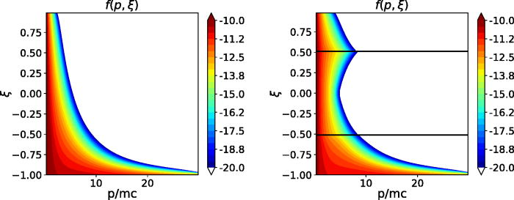
Runaway acceleration (+ knock-on collisions) → runaway beam → unstable to EM wave instabilities
Runaway distribution is beam-like → unstable to velocity space instability, but strongly collisionally damped in a cold/dense post-TQ plasma.
But the EM wave instabilities come alive at low density and warm startup plasmas
Runaway-wave interaction is a multiscale problem:
collisional time scale → runaway formation via avalanche
Runaway-driven wave instability growth rate extremely fast
Saturation time scale is still much shorter than collisional time
Our approach: Fully kinetic VPIC simulation of instability onset and saturation, from a drift-kinetic Fokker-Planck-Boltzmann solver for slowly evolving RE distribution.
Guo, McDevitt, Tang, PoP (2019)

Slide 5
Saturation: slow-X, parametric decay (e.g. whistler), secondary & tertiary instabilities (forward & backward propagating)

Slide 6
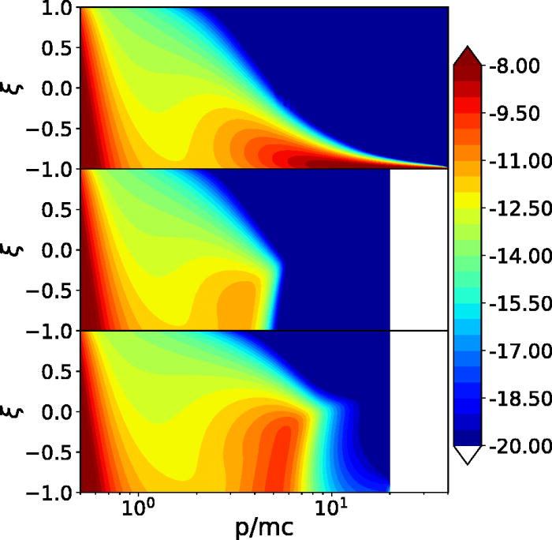
Implication for externally injected waves
Guo, McDevitt, Tang, PoP (2018)
A variety of Doppler-shifted cyclotron resonances can be targeted (for enhanced pitch angle scattering)
$ω − k_{∥}$ $v_{∥}=n Ω/γ$
Forward propagating wave: $k_{∥}$ $v_{∥}$ > 0
Backward propagating wave: $k_{∥}$ $v_{∥}$ < 0
Previously we have emphasized whistler
Helicon wave experiment on DIII-D
But our aim for ITER has been ECH
We are returning to ITER ECH problem for both startup and mitigated disruptions.
What hint are TCV & DIII-D experiments trying to give us?
The solution to the puzzle likely lies with knowing what the runaway distribution is
Radial transport implication?
Another complicated problem
requires simulation capability development/integration

Slide 7
(II) Standard mitigation scenario by high-Z impurity injection
TQ: plume radiation + parallel assimilation → toroidal radiation peaking factor
Despite the complication, the end result is quite robust:
very cold/dense post-TQ plasma
CQ: Ohmic-runaway current conversion + runaway transport and scrape-off during VDE
Key questions to answer
VDE duration control ← force loading consideration
Runaway power load on first wall: axisymmetric scrape-off versus localization on first wall via 3D fields (stochastic field lines)
Onset of violent 3D instability of the VDE column: runaway spread by stochastic field lines → benign termination

Slide 8
MHD + kinetic RE simulation → critical design tool
Why a kinetic description of runaways is essential:
McDevitt & Tang [EPL 127 (4), 45001 (2019)]: why banana orbits need to be resolved
McDevitt & Tang [PPCF 61 (2), 024004 (2019)]: runaway spatial transport
McDevitt & Tang [PRE (2023)]: surprisingly efficient runaway reconstitution after 3D MHD flush in “benign termination” ← expected for ITER/SPARC/ARC

Slide 9
What can we learn and design for?
CQ duration: precisely controlled through E_{AV} by impurity content
Force in vessel
Runaway wall loading & damage
3D stability ← j & q profile

Slide 10
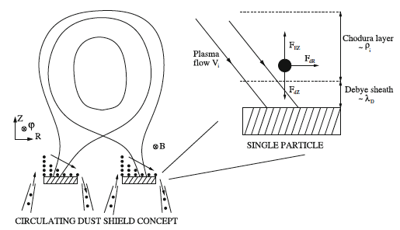
(III) What if all fails and wall-damaging runaways are coming: Last-ditch effort of putting up a tungsten dust shield
Old idea for divertor plasmas [Tang & Delzanno, Journal of fusion energy 29, 407-411 (2010)], recycled here for runaway termination [Lively, et al. NF (2024)]
W injecta for RE seed removal: Sergeev et al. NF (2021); Nardon, et al. NF (2021)

Slide 11
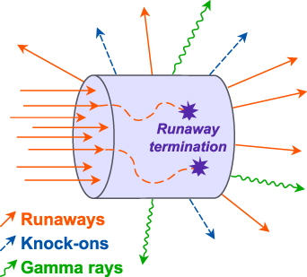
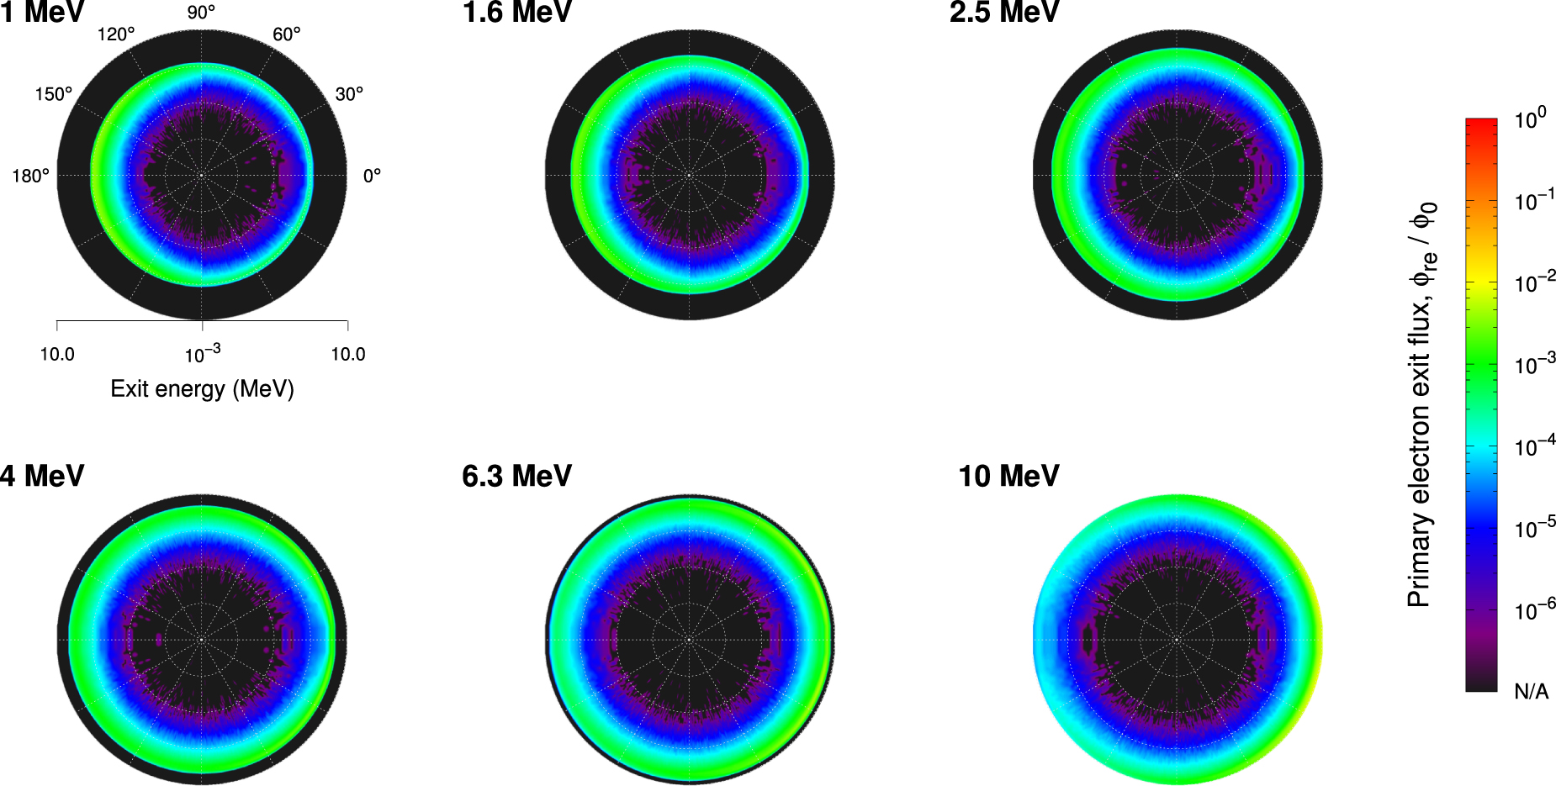
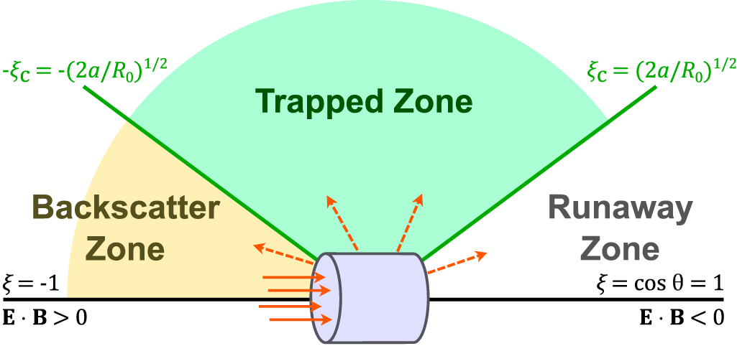
How does it work: MCNP calculations show RE stopping, pitch angle scattering, knock-ons emission, gamma emission
Perhaps most interesting physicswise is the effective pitch angle scattering of runaways by W particulates
For details, see Lively et al 2024 Nucl. Fusion 64 056019

Slide 12
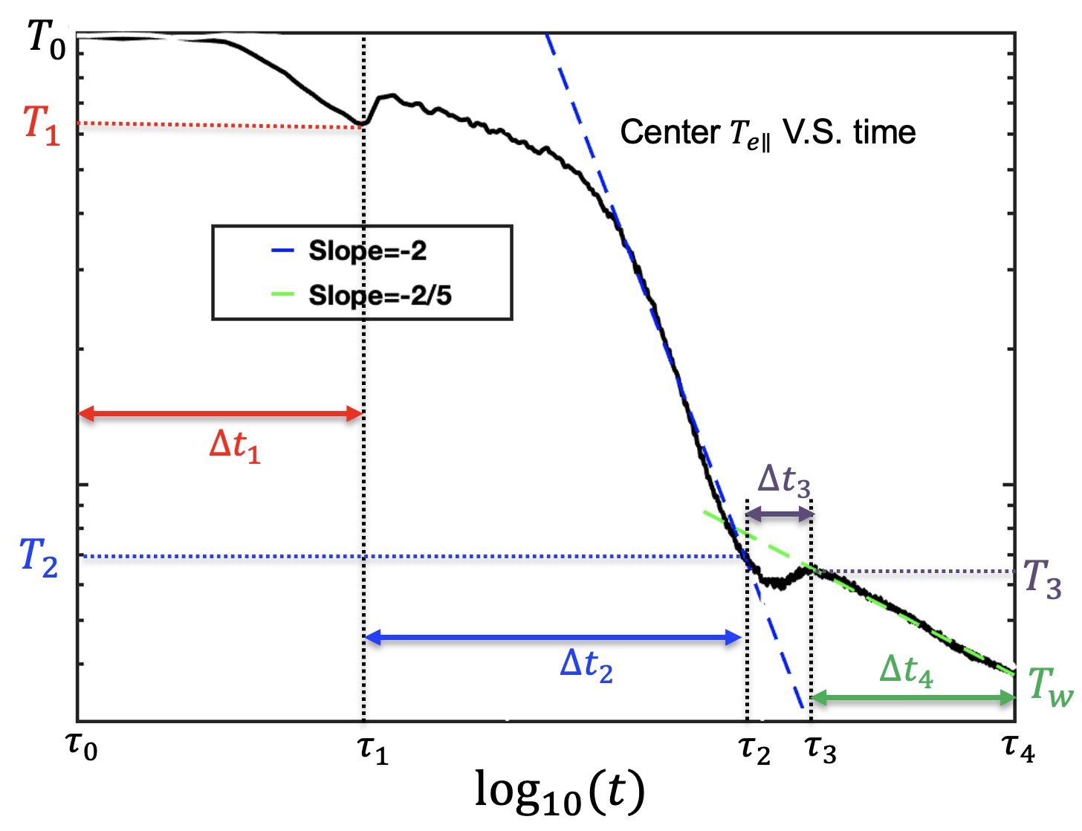
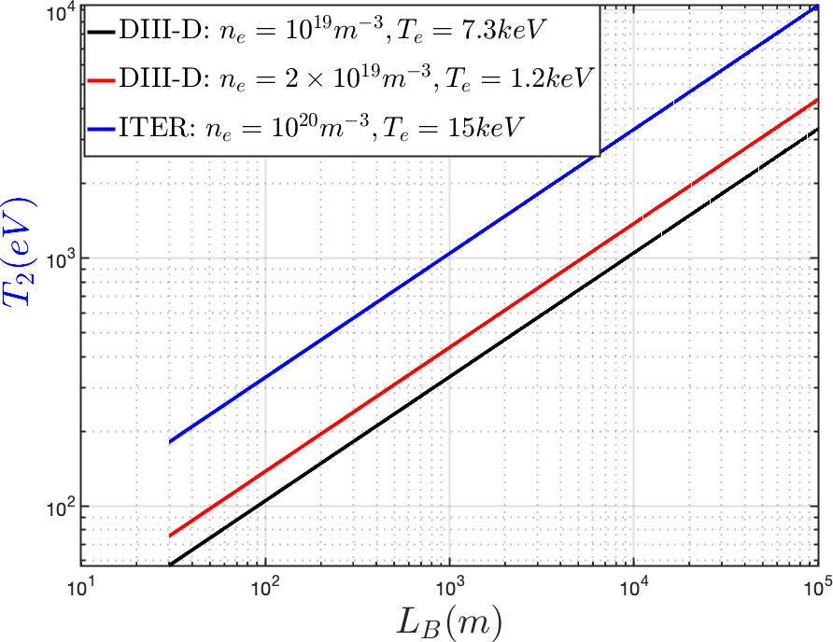
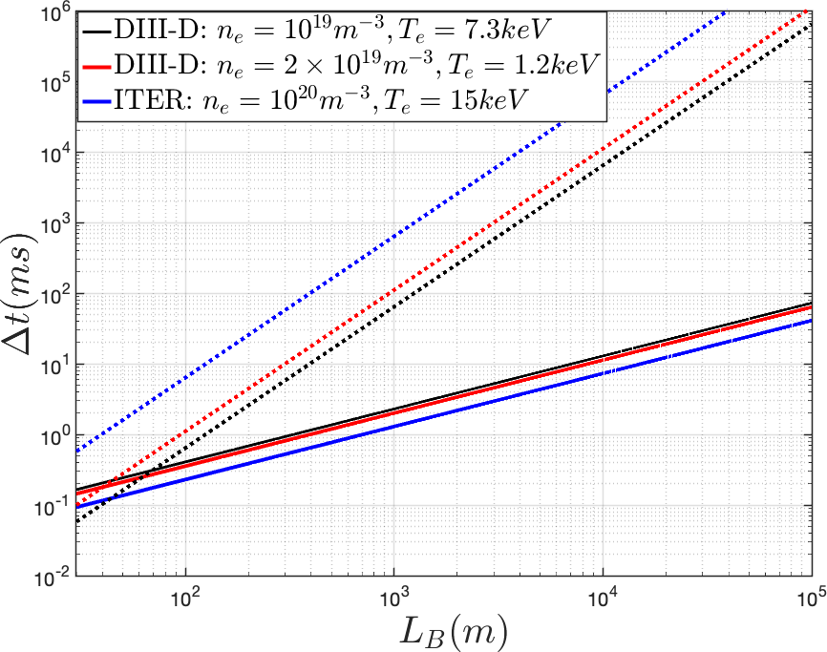
(IV) Thinking differently of an alternative physics path for disruption mitigation
Naturally occurring and mitigated disruptions:
PMI induced wall impurity or injected impurities radiatively clamps the Te to a low value (eVs) → Ohmic-to-runaway current conversion
Short TQ → thermal load mitigation → long CQ with runaway beams of relativistic energies
Can mitigation be built upon slowing down the TQ? Yes, if
Plasma remains impurity-free
Edge/boundary must be cold (and dense) to limit wall impurity production, and of course, no impurity injection
Plasma parallel transport must be collisional
High density + cool temperature
Zhang, Li, Tang, EPL (2023); Li, Zhang, Tang NF (2023)

Slide 13
ITER TQ mitigation by massive hydrogen injection → align TQ with CQ → new pathway in disruption mitigation
Recall the MST >10X n_{greenwald} experiment ; If parallel transport is slow enough, disruption changes its normal meaning and Ohmic heating is a key factor in plasma power balance

Slide 14
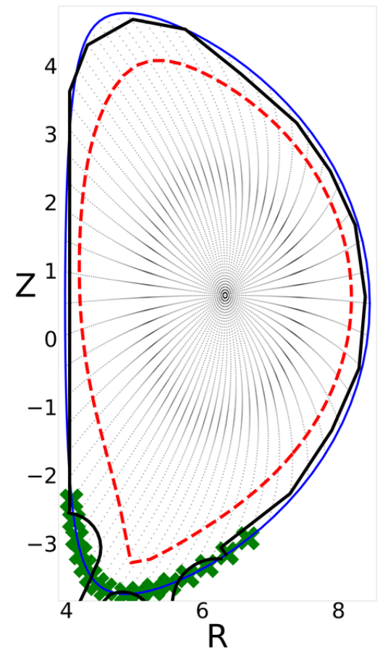
Subtleties in modeling, physics, & optimization
Collisional transport scaling is a must, but boundary condition matters too
Sheath boundary condition & wall feedback
Too low a density won’t be collisional, but too high a density is undesirable if Bremsstrahlung overwhelms Ohmic heating
Dilutional cooling can vary depending on the details of H assimilation
Could be leveraged to reduce density requirement
How to get the hydrogen in?
Is deep pellet penetration even necessary? Eric says no 😃
What matters more: enough H dumped in to shield the first wall (MGI?), and pellets pile up the H to protect the divertor
Transport in 3D fields (density-limited disruption) will take care of the rest

Slide 15
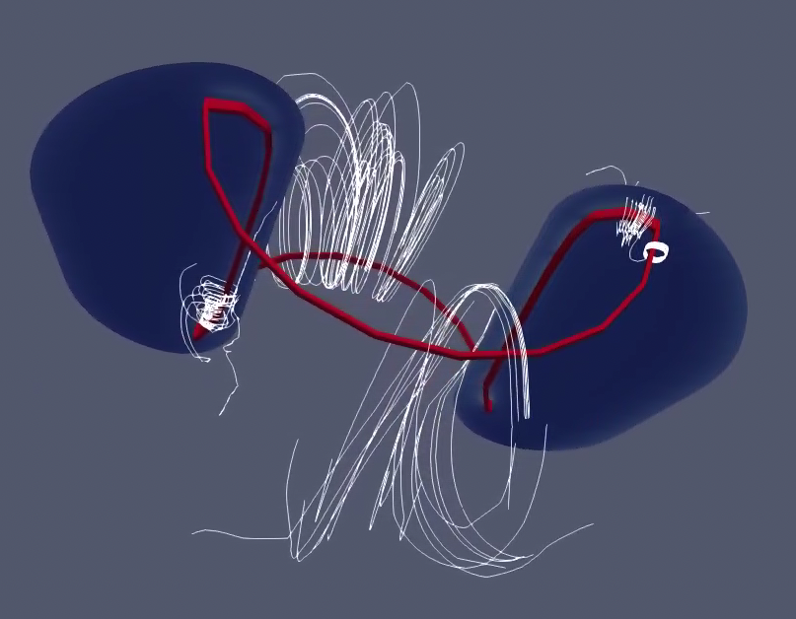
Summary
What this talk has touched upon:
Runaway mitigation by waves
Standard high-Z impurity injection for disruption mitigation
Standoff termination of runaways by tungsten particulates
Alternative path of using H injection to align TQ and CQ for runaway avoidance/minimization
What this talk has not discussed:
Pellet penetration and assimilation
Is it a critical problem for disruption mitigation? In what context? → Is a major collaborative initiative called for to (in)validate Eric’s take?
Safe termination by runaway coils
What the issues and opportunities are?
Any other ideas to pursue?

