Slide 1
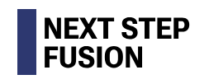
Prediction and validation of disruption-induced eddy currents and forces within engineering design cycles using ThinCurr and TokaMaker
Chris Hansen¹, A. Battey¹, A. Braun¹, N. DaSilva¹, S. Guizzo¹, J. Levesque¹, R. Sweeney², M. Lagieski², G. Subbotin³,
M. Nurgaliev³, S. Miller¹, and C. Paz-Soldan¹
1- Columbia University
2- Commonwealth Fusion Systems
3- Next Step Fusion

Slide 2
Outline
Modeling disruptive forces in 2D
TokaMaker: Axisymmetric model
Modeling to inform NTT design
Modeling to inform ARC design
Modeling disruptive forces in 3D
ThinCurr: 3D thin-wall model
Validation with commercial tools
Modeling to inform SPARC/ARC design
Design and validation on HBT-EP REMC
Coil design and installation update
Initial model validation
Summary and Conclusions

Slide 3
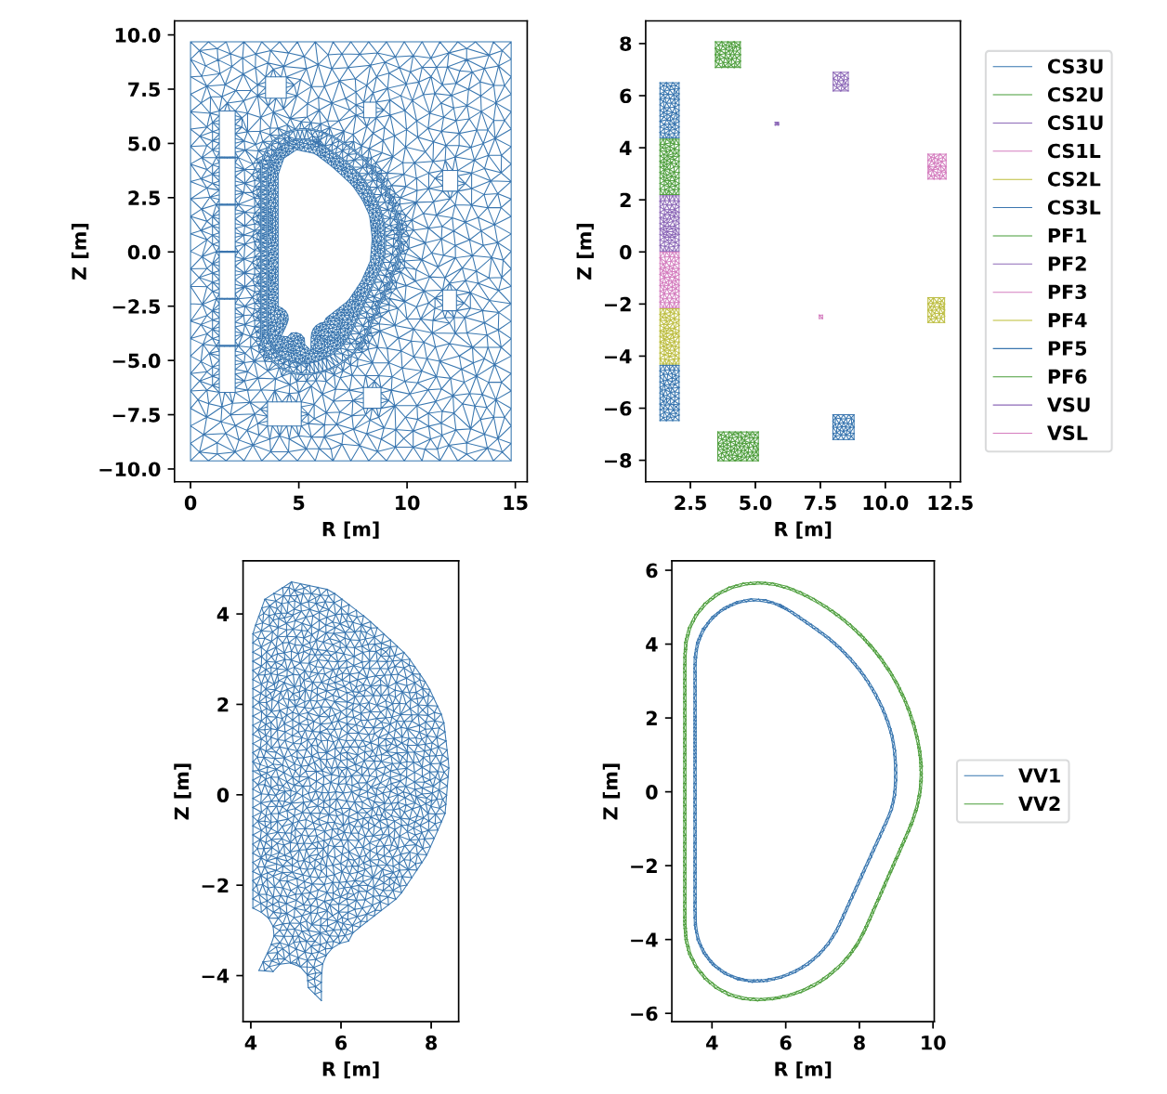
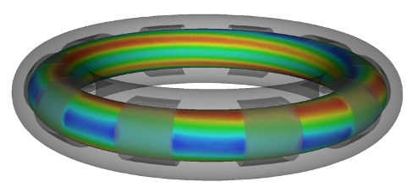
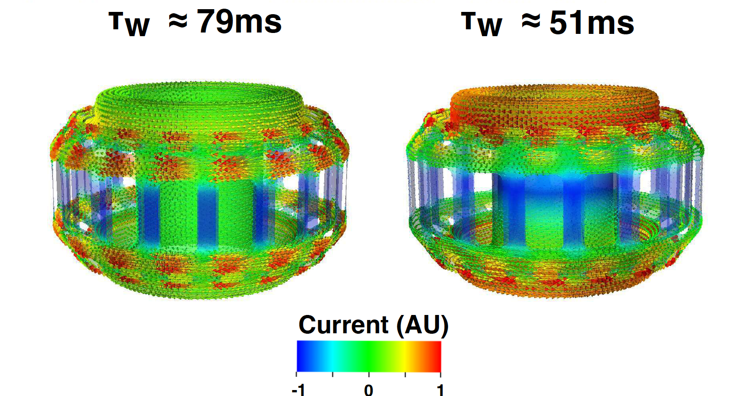
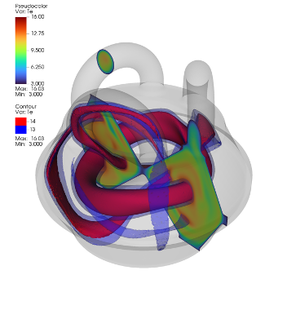
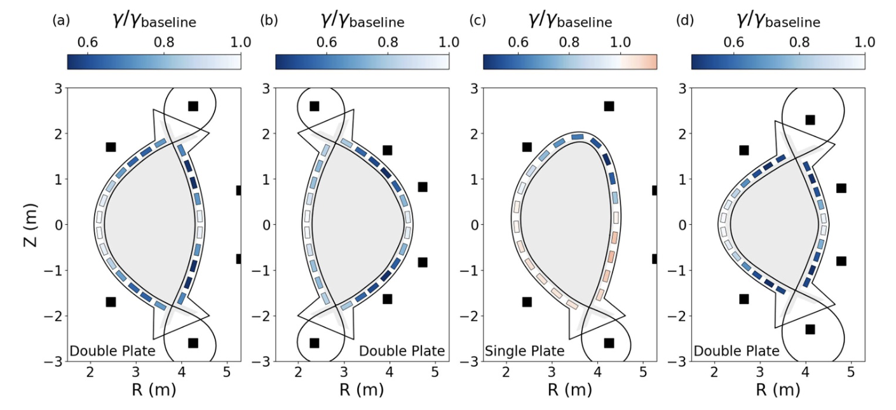
The tools discussed today are available in the open-source Open FUSION Toolkit
Fully open-source on GitHub
All tools share the same codebase
Python/Fortran/C/C++
Downloadable binaries
Contributions welcome!
Finite elements on unstructured grids
Direct meshing from CAD
Current physics tools
TokaMaker: Axisymmetric equilibrium
ThinCurr: 3D thin-wall E-M modeling
MUG: 3D time-dependent MHD
Marklin: 3D Ideal MHD equilibria (const. 𝜆)
Hansen et al., CPC (2024)
Battey et al., NF (2023)
Hansen et al., PoP (2015)
https://hansec.github.io/OpenFUSIONToolkit/
Guizzo et al., PPCF (2024)

Slide 4
Outline
Modeling disruptive forces in 2D
TokaMaker: Axisymmetric model
Modeling to inform NTT design
Modeling to inform ARC design
Modeling disruptive forces in 3D
ThinCurr: 3D thin-wall model
Validation with commercial tools
Modeling to inform SPARC/ARC design
Design and validation on HBT-EP REMC
Coil design and installation update
Initial model validation
Summary and Conclusions

Slide 5
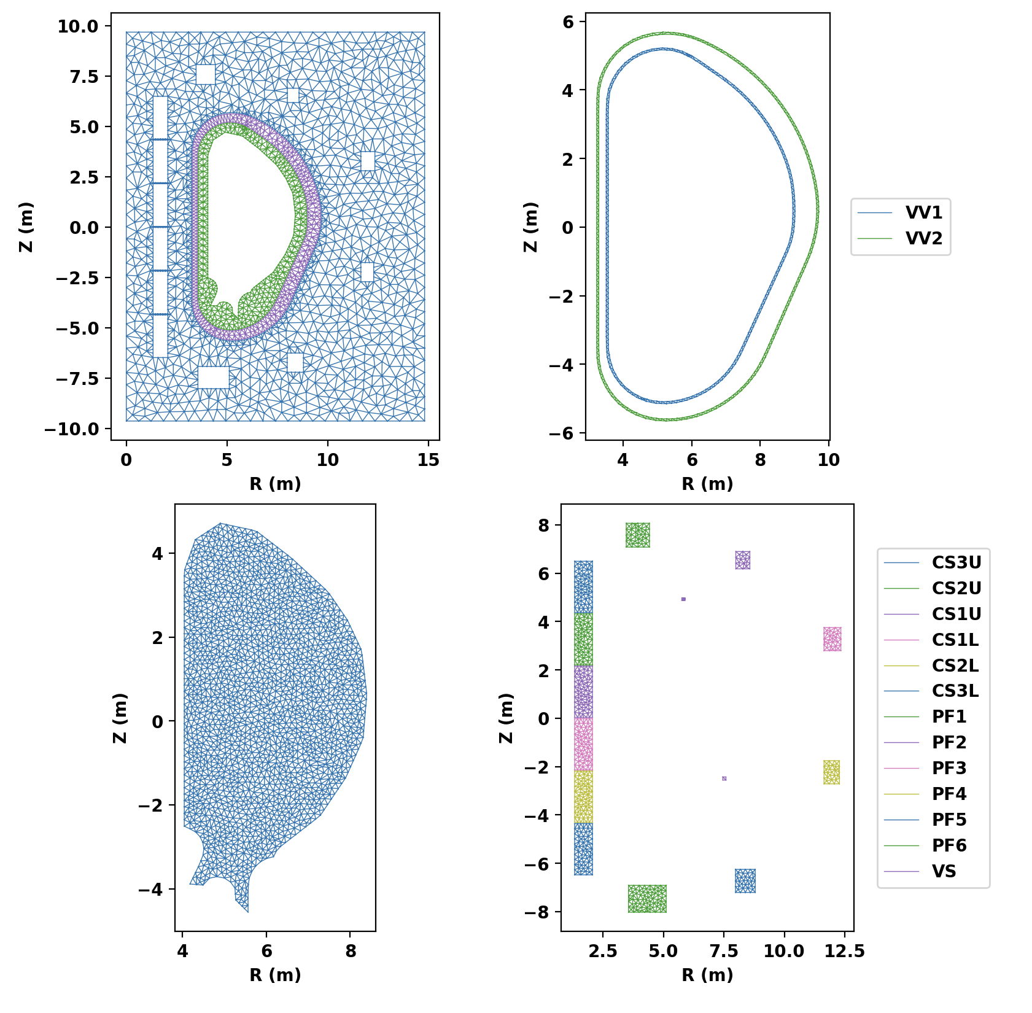
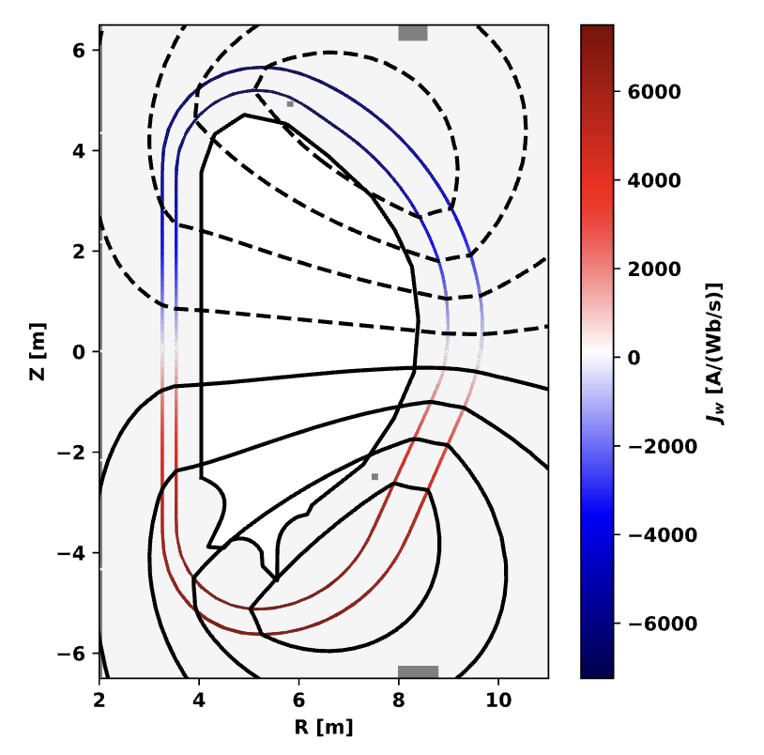
TokaMaker is a time-dependent Grad-Shafranov code that captures axisymmetric eddy current dynamics
Time-dependent Grad-Sharfanov code
Unstructured triangular grid
Variable order finite elements
Python interface with compiled backend
Currently being applied to device design
Stability/control (eg. passive structures)
Magnetic system
Axisymmetric eddy currents can be captured in forward and inverse equilibria
Fully meshed, thick-wall representation
Self-consistent evolution or specified sources
Guizzo et al., PPCF (2024)
1- Hansen et al., Comput. Phys. Commun. (2024)

Slide 6
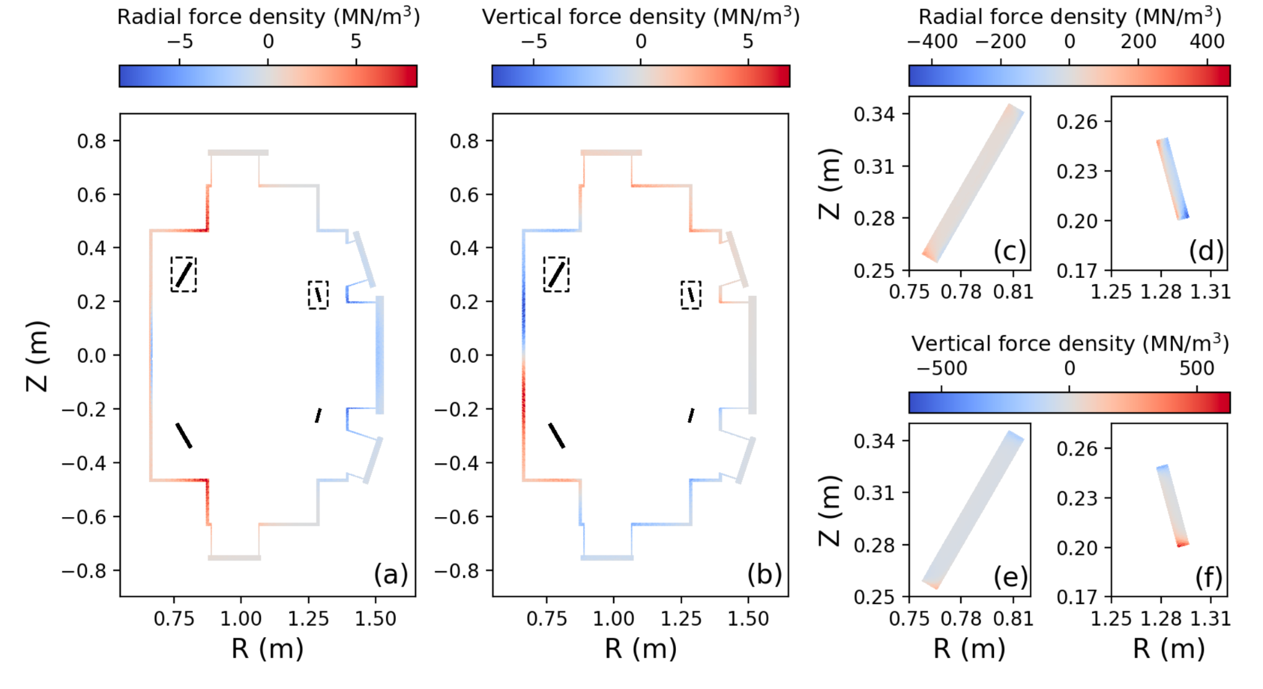
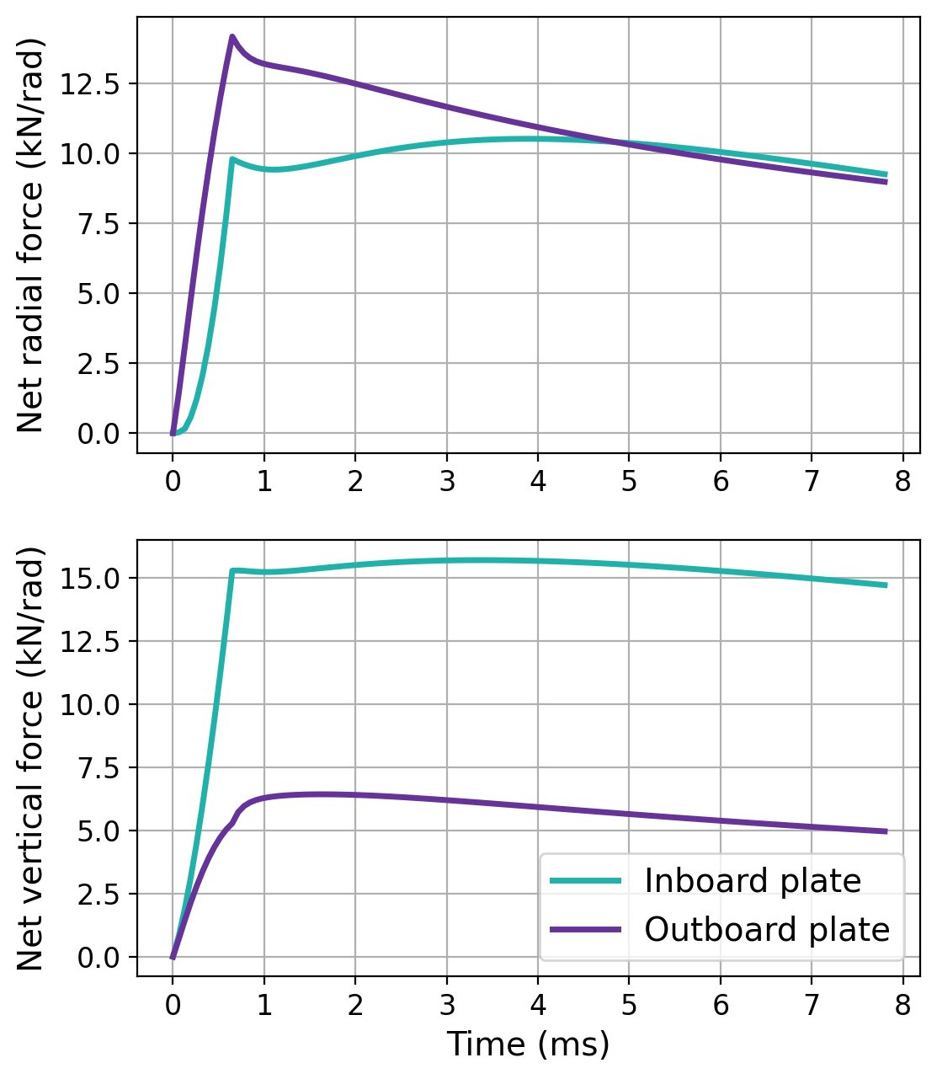
TokaMaker was used to assess forces on passive components during CQ events as part of NTT design
TokaMaker has been used to inform magnetic and early structural design for Next Step Fusion’s Negative Triangularity Tokamak (NTT)
Native NT tokamak
Focused on control development
Forces evaluated for characteristic CQ events as design evolved
Changes to stability plates, VV, etc.
Direct integration with CAD models
Scoping, design, and loads within a single tool
Equilibrium design (PFs, limiter, etc.)
Stability (linear and nonlinear)
Forces (static and dynamic)
2- Publication in preparation

Slide 7
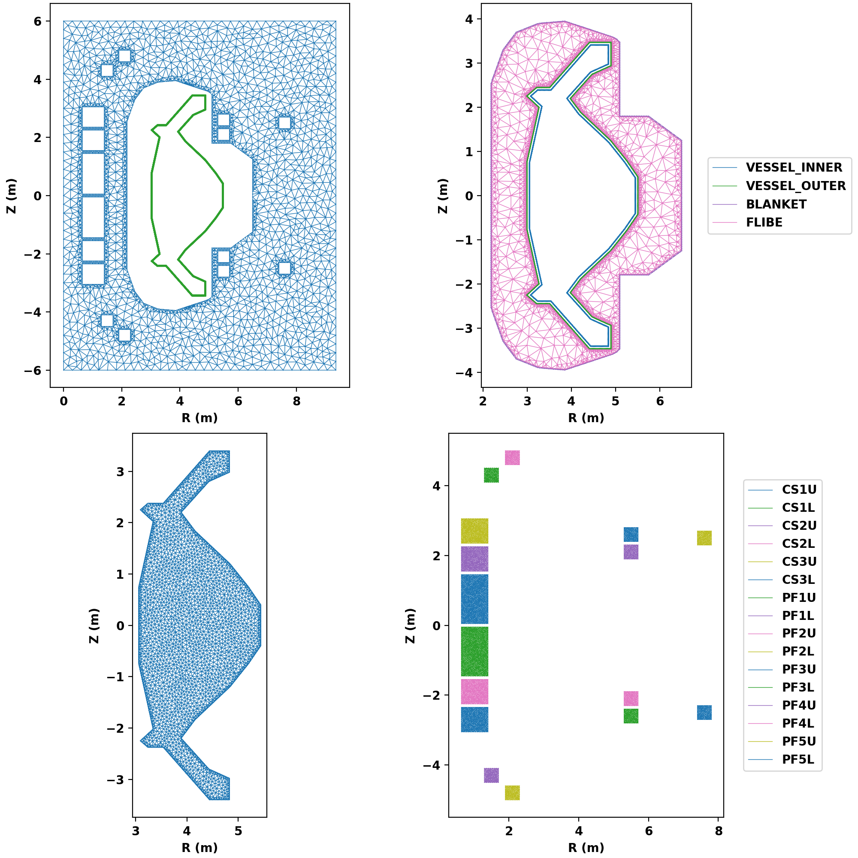
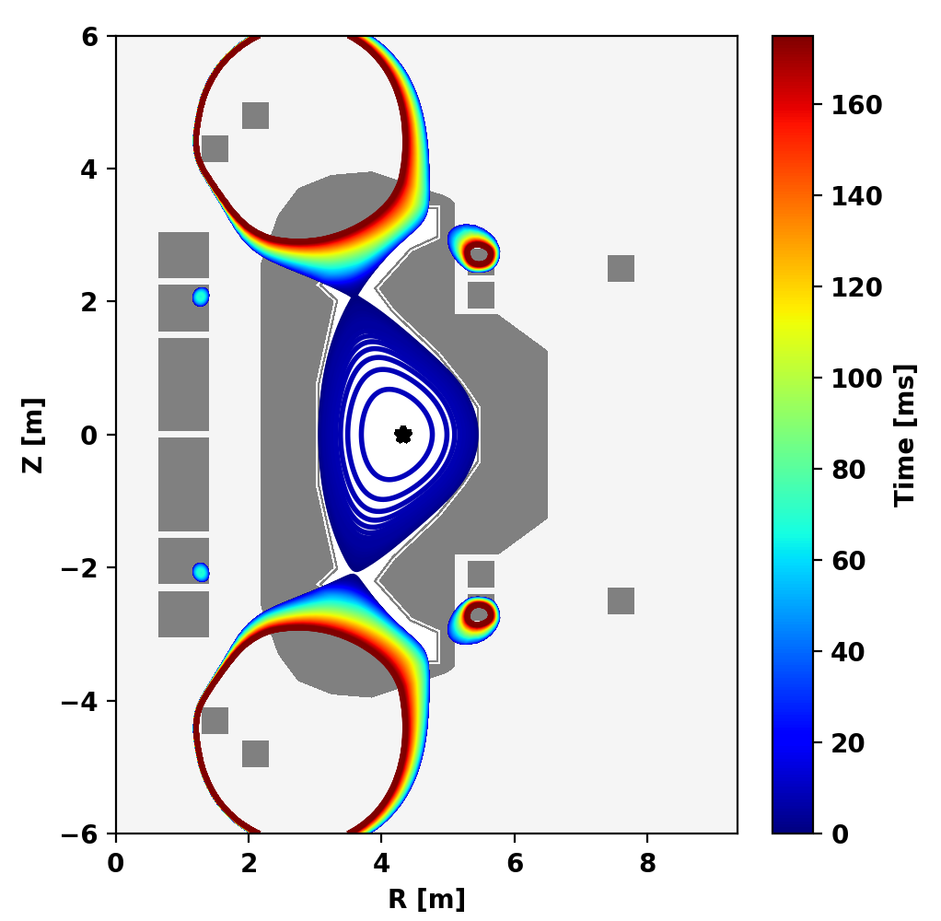
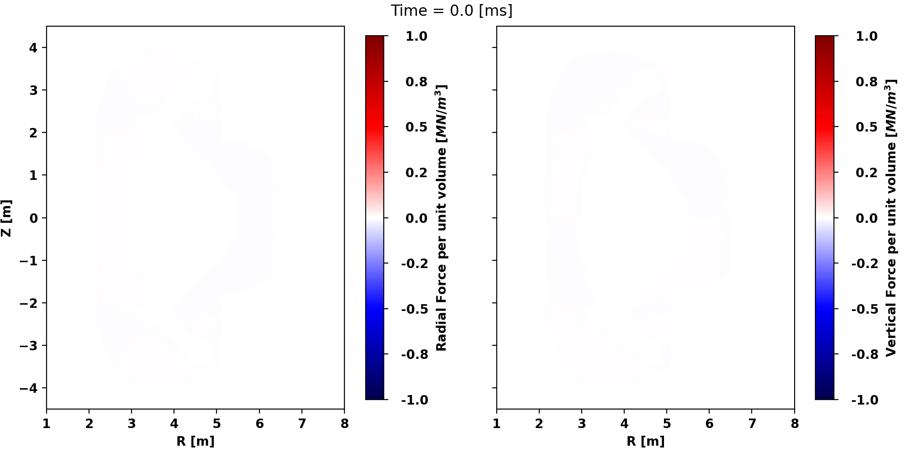
TokaMaker is also being scoped to assess forces during CQ events as part of preliminary ARC design
TokaMaker models are created directly from IDS-like device description
A variety of disruption-relevant events can be modeled
VDE, CQ, TQ/β-collapse, etc.
Self-consistent or fixed plasma evolution
Fast simulations: O(10 s) on a laptop

Slide 8
Outline
Modeling disruptive forces in 2D
TokaMaker: Axisymmetric model
Modeling to inform NTT design
Modeling to inform ARC design
Modeling disruptive forces in 3D
ThinCurr: 3D thin-wall model
Validation with commercial tools
Modeling to inform SPARC/ARC design
Design and validation on HBT-EP REMC
Coil design and installation update
Initial model validation
Summary and Conclusions

Slide 9
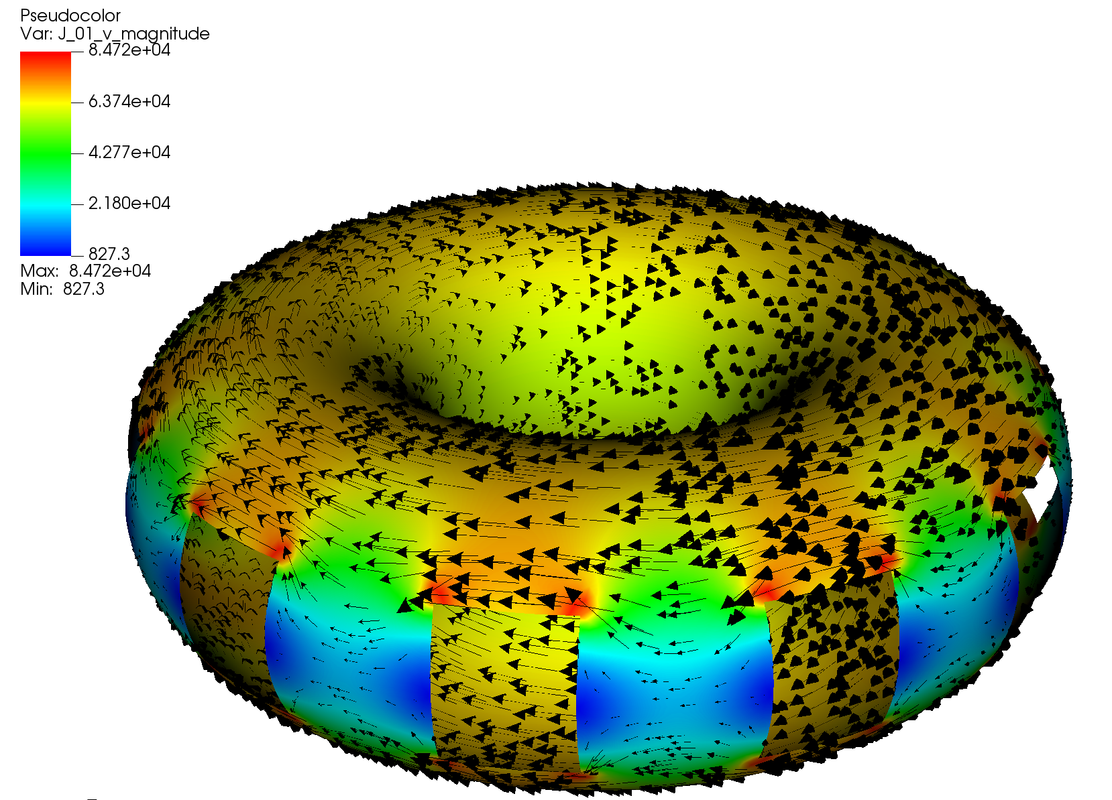
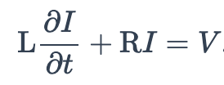
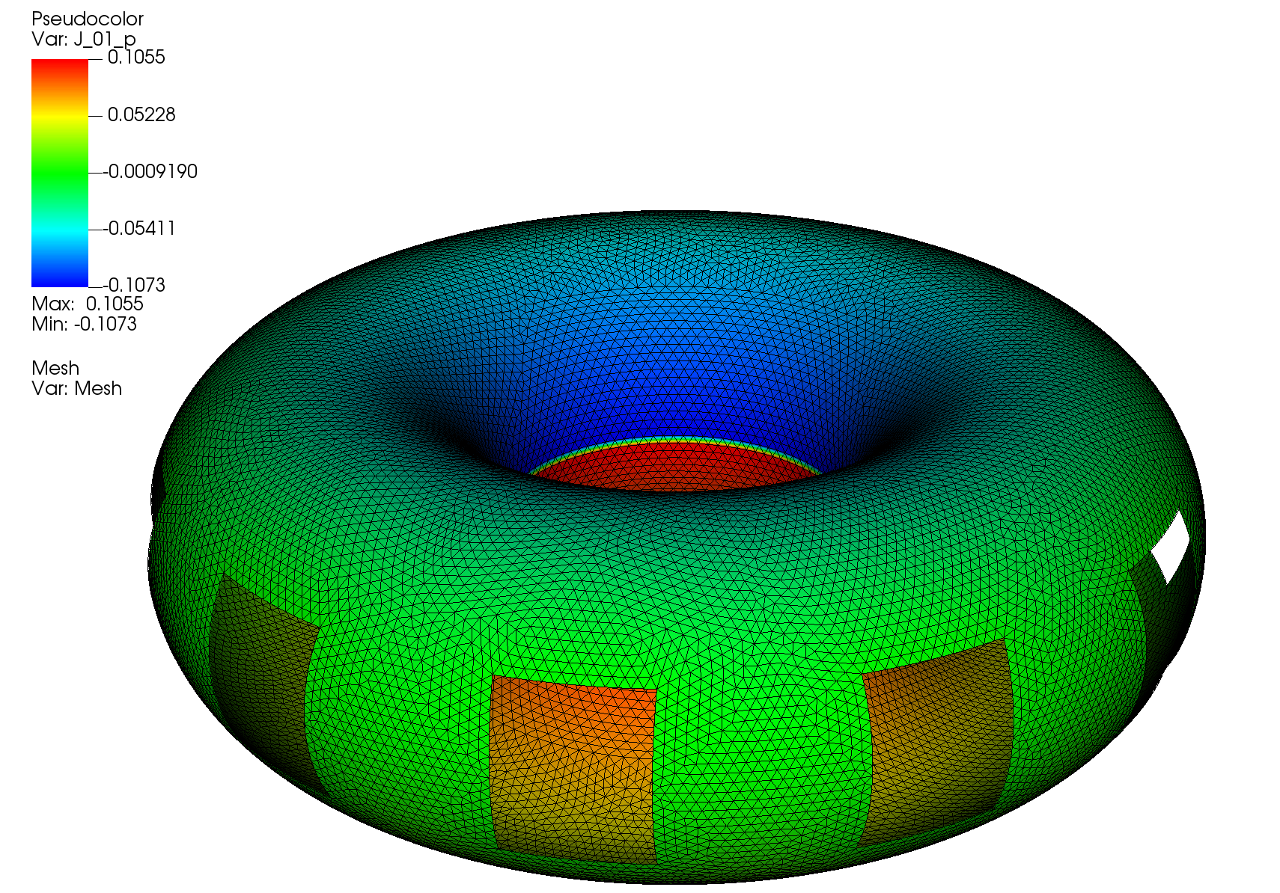
ThinCurr models inductive coupling between currents in the thin-wall limit using a finite element method
ThinCurr is primarily designed to solve inductive-resistive current dynamics in 3D
Time-domain, frequency-domain, eigenvalues
ThinCurr utilizes a Boundary Finite Element (BFEM) approach
Current represented using a scalar potential
Green’s function maps to any point in space
3- Publication in preparation

Slide 10
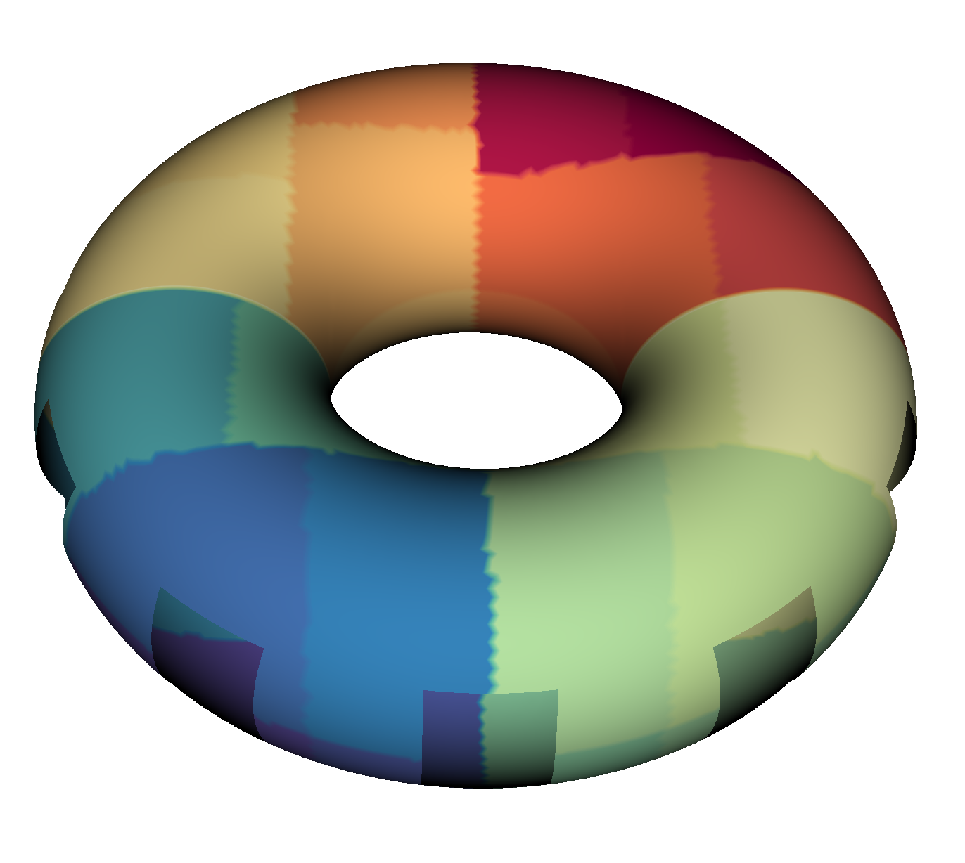
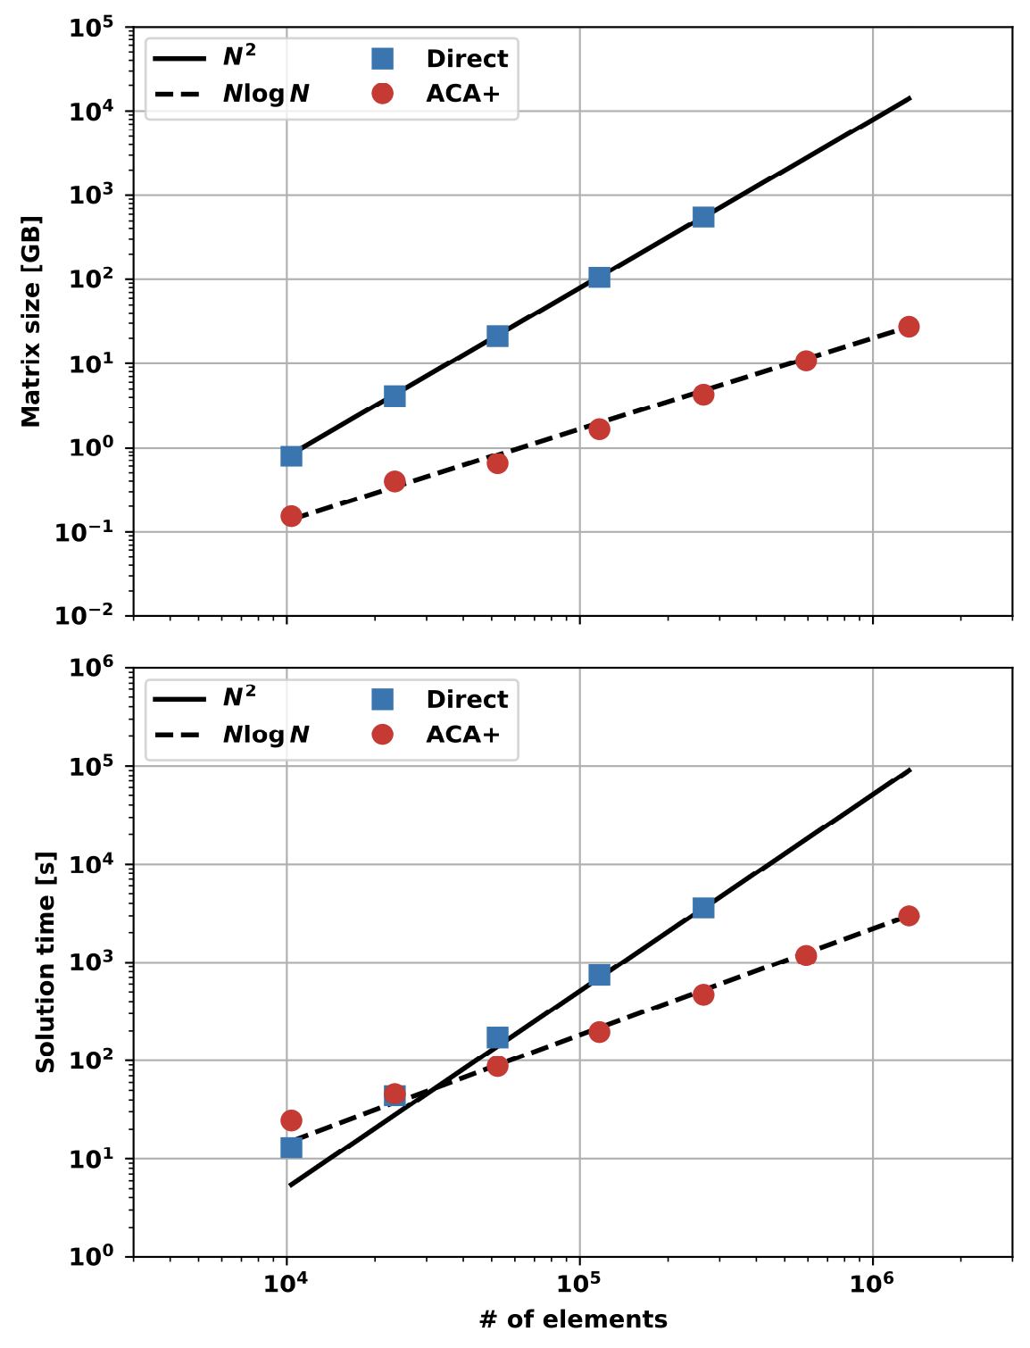
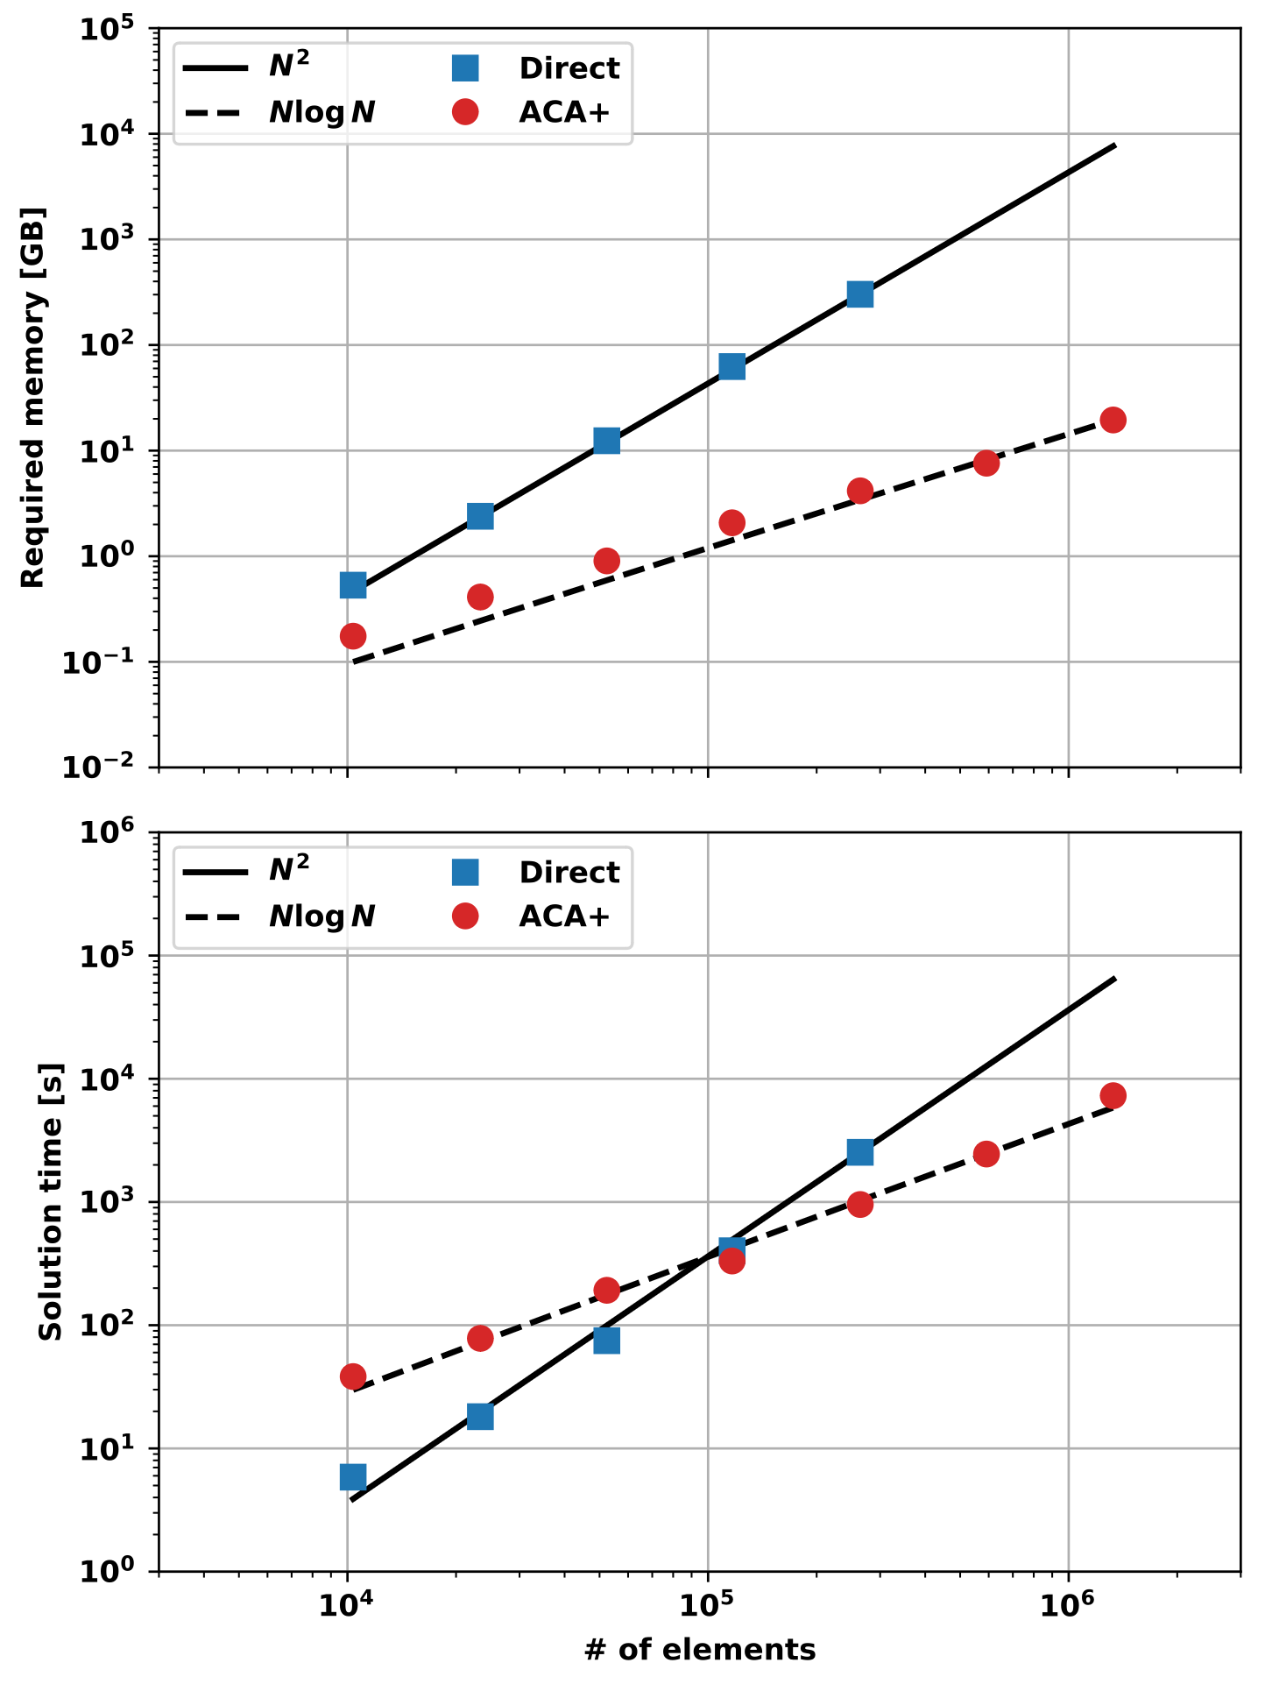
ThinCurr utilizes HODLR approximation to improve scalability of BFEM for large models
Hierarchical Off-Diagonal Low-Rank (HODLR) approximation is used for L matrix
Adaptive Cross-Approximation (ACA) is used to iteratively form low-rank blocks
Scaling is dramatically improved from O(N²) to O(N log(N)) for both memory and time
Expands access to much larger models of a given system
Applicable to B-field reconstruction as well
HODLR/ACA has some overhead, but break even occurs fairly quickly
Implementation can be optimized further
Eigenvalue solve
Time-domain solve

Slide 11
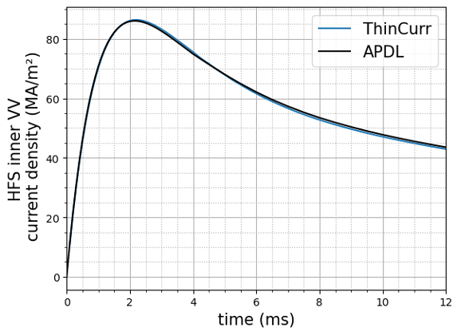
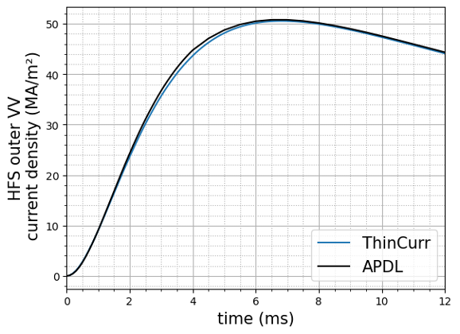
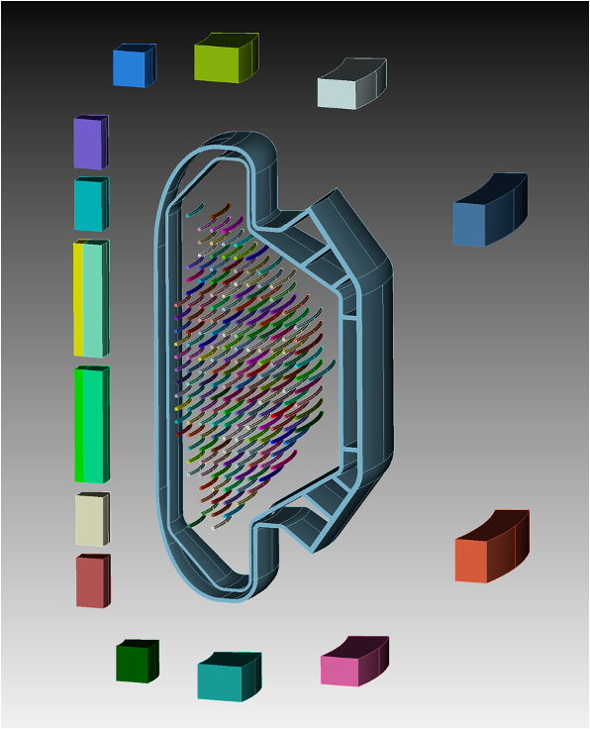
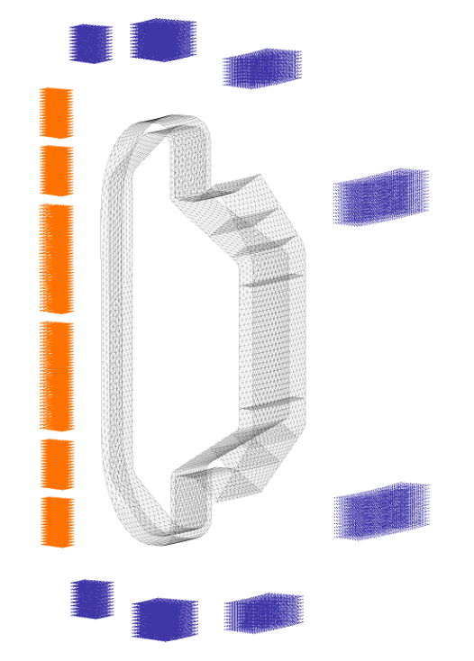
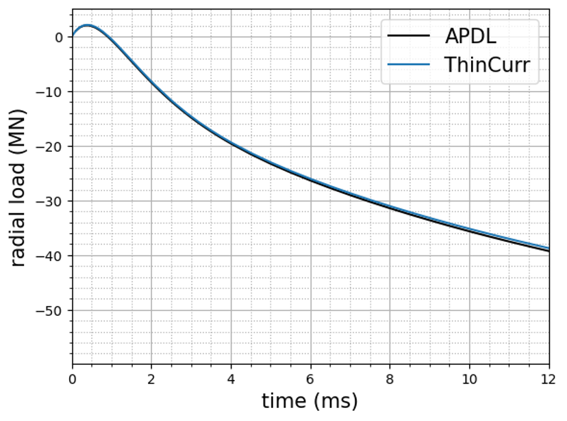
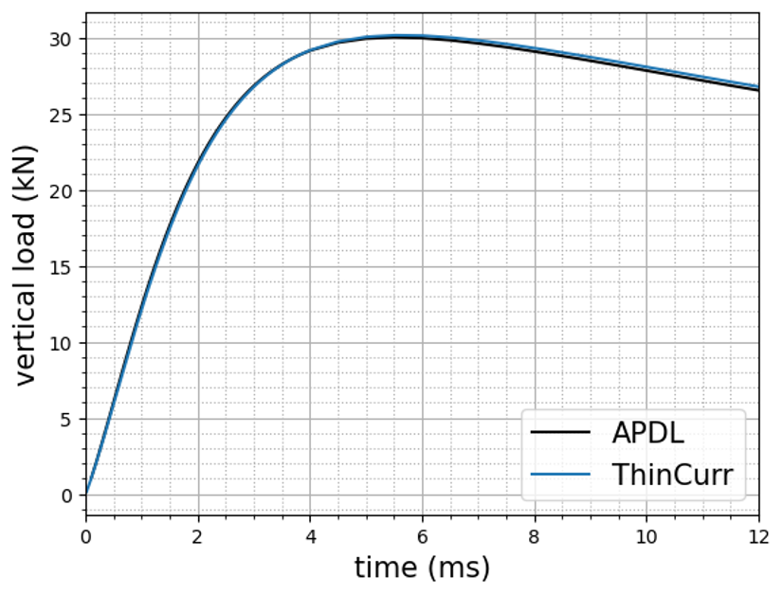
ThinCurr currents and loads have been validated with commercial analysis software (Ansys)
ThinCurr currents and forces were validated against axisymmetric Ansys model of SPARC
Excellent match in current and forces
Ansys challenging for large 3D models
ThinCurr can model full machine; necessary for low-n features (eg. REMC)

Slide 12
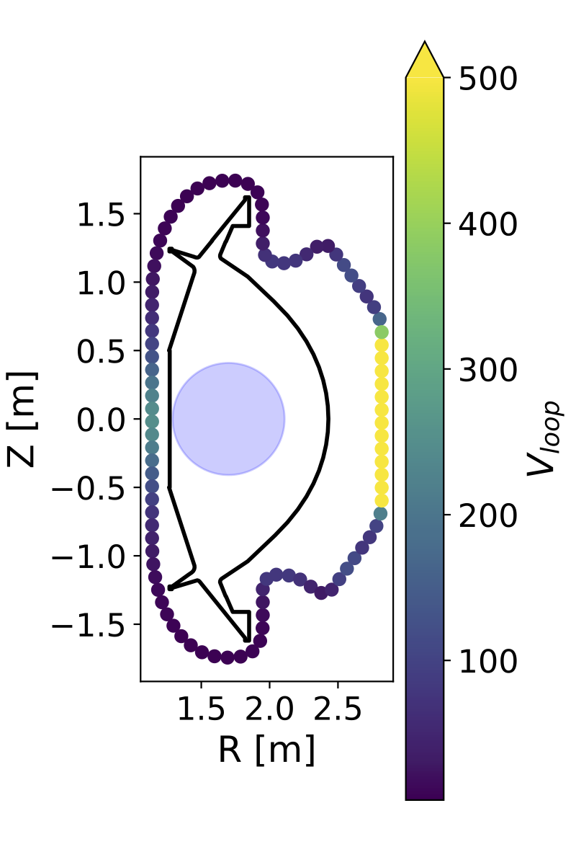
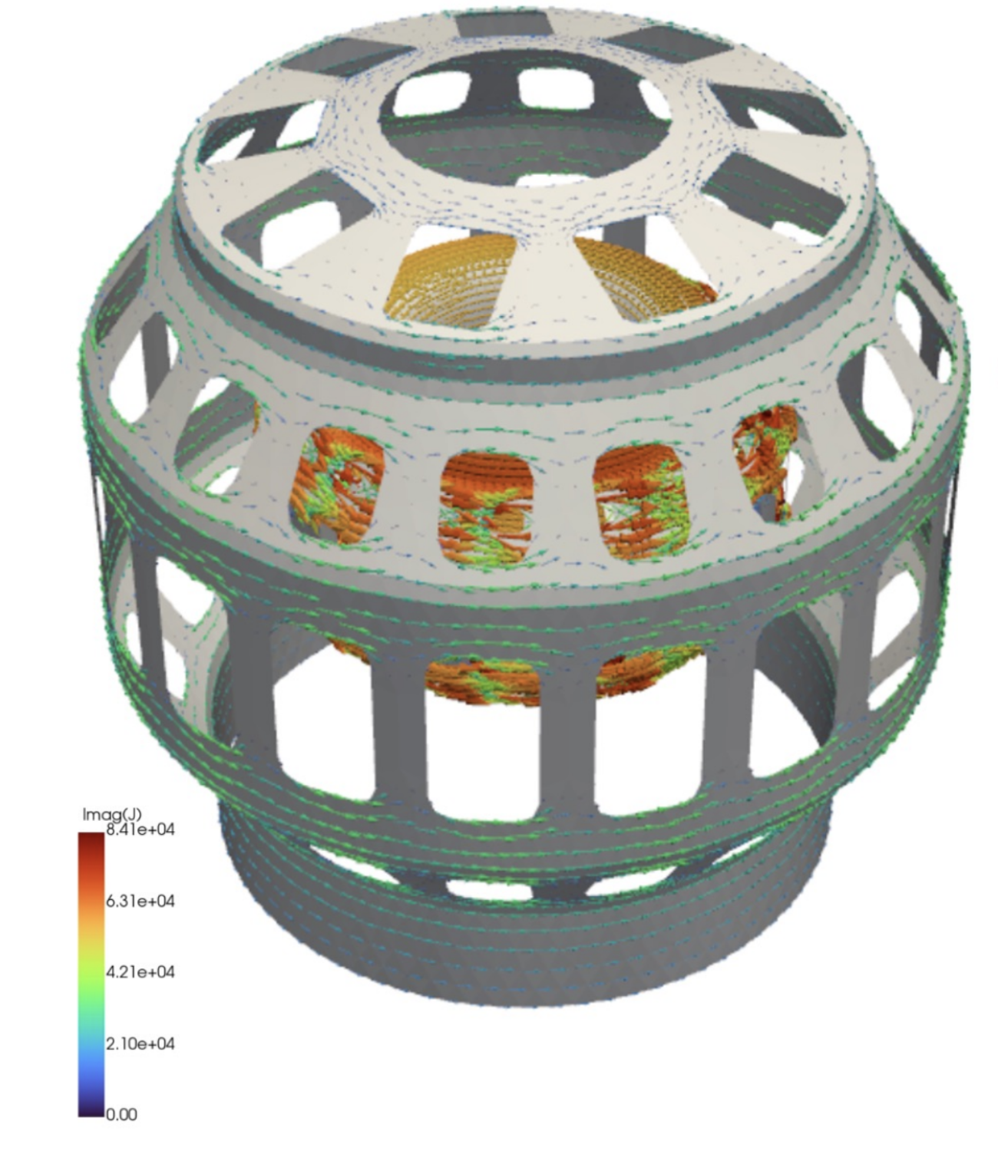
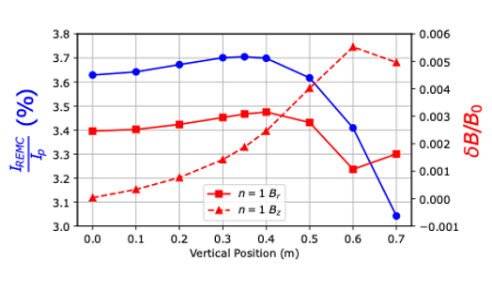
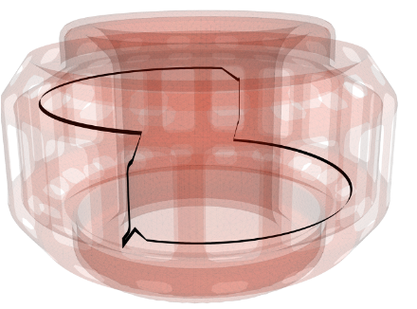
ThinCurr enables prediction of a variety of disruption loads throughout the machine design process
Induced eddy currents
Vessel, PFC, and REMC design
Forces and heating
Inductive voltages
Diagnostic and component design
Insulation requirements and short failure analysis
Direct iteration with engineering workflows
Meshing directly from CAD
Export of results to Ansys mechanical analysis in progress
3- Battey et al., Nucl. Fusion (2024)

Slide 13
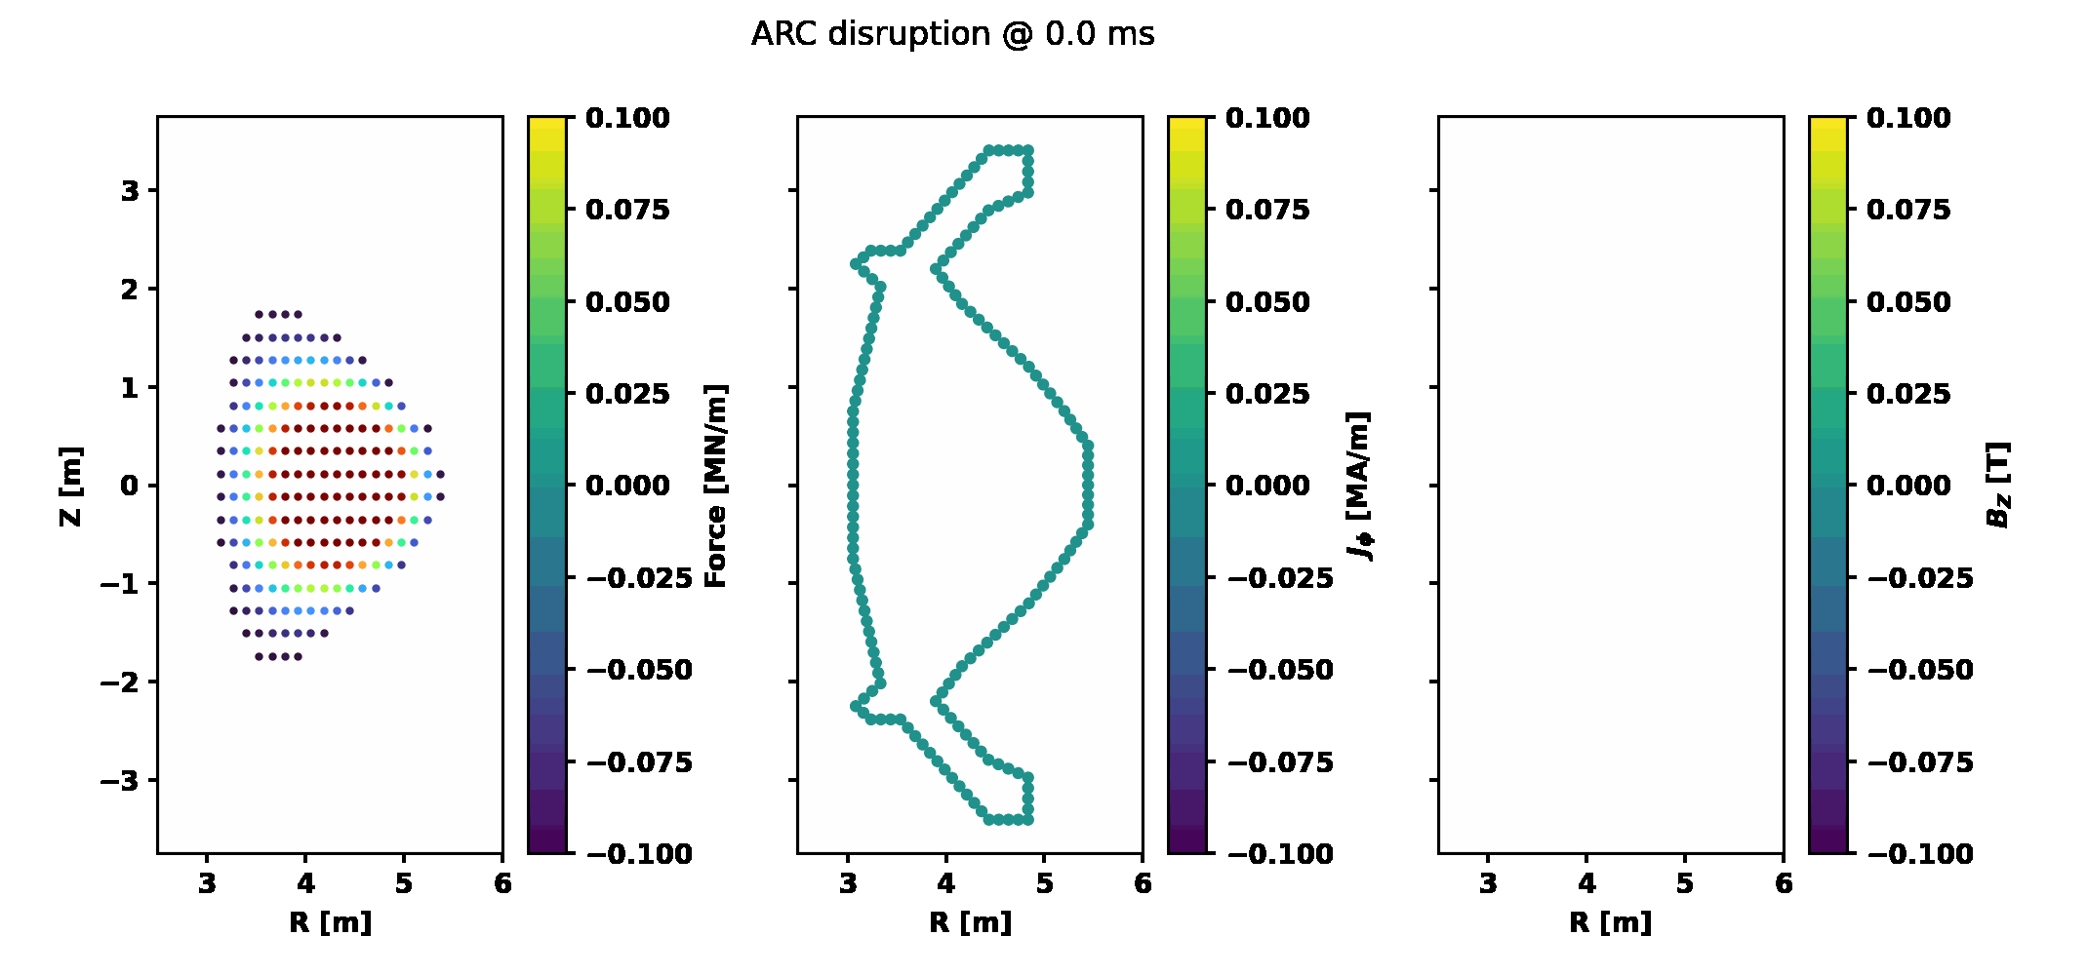
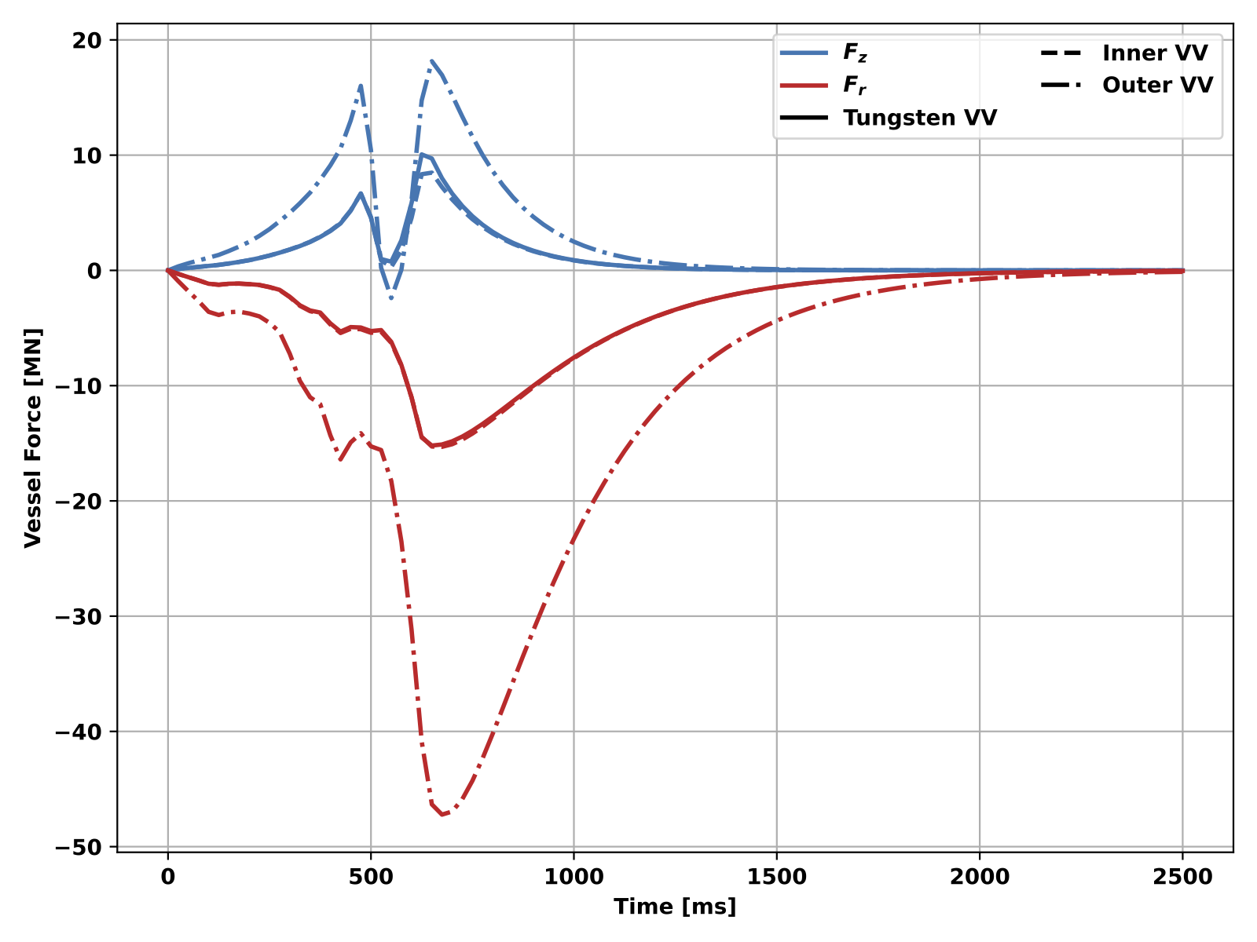
ThinCurr is being used in early vessel design for ARC to assess disruption loads from inductive coupling
Model of ARC VV evaluated on design iteration timescale
Current models are axisymmetric
Same description as TokaMaker models
Ports and other 3D structures in future
Disruptions evaluated using filament grid for plasma
Flexible for many types of CQ, VDE, etc.
Generate from reduced models or plasma predictions (TokaMaker, M3D-C1, etc.)
Workflows to use output in commercial thermo-mechanical (Ansys) analysis underway

Slide 14
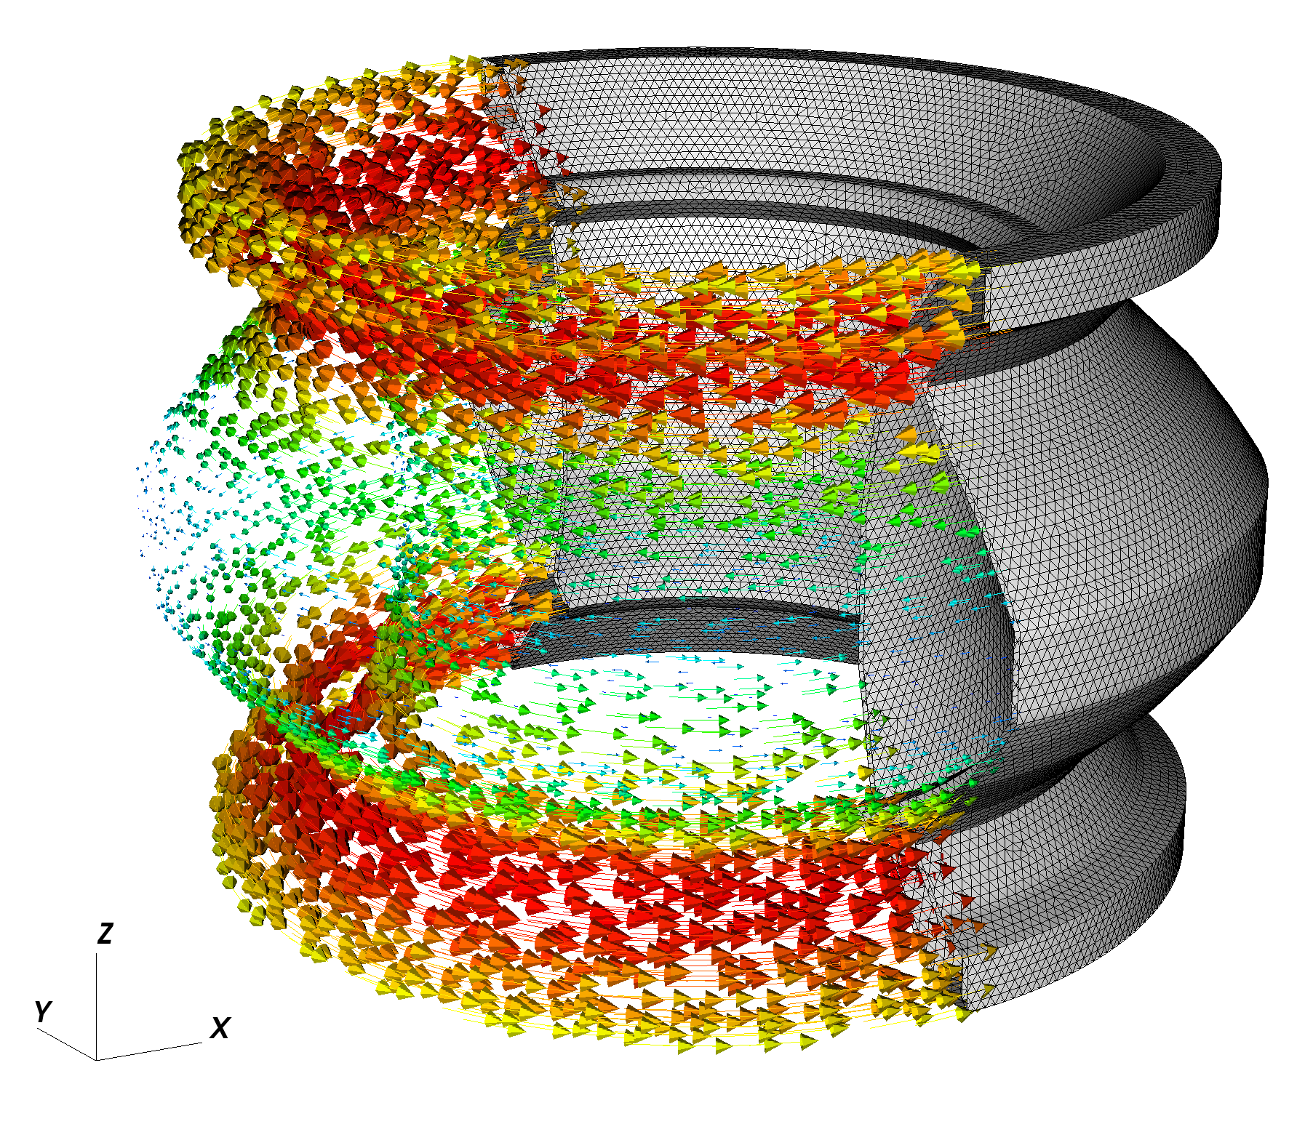
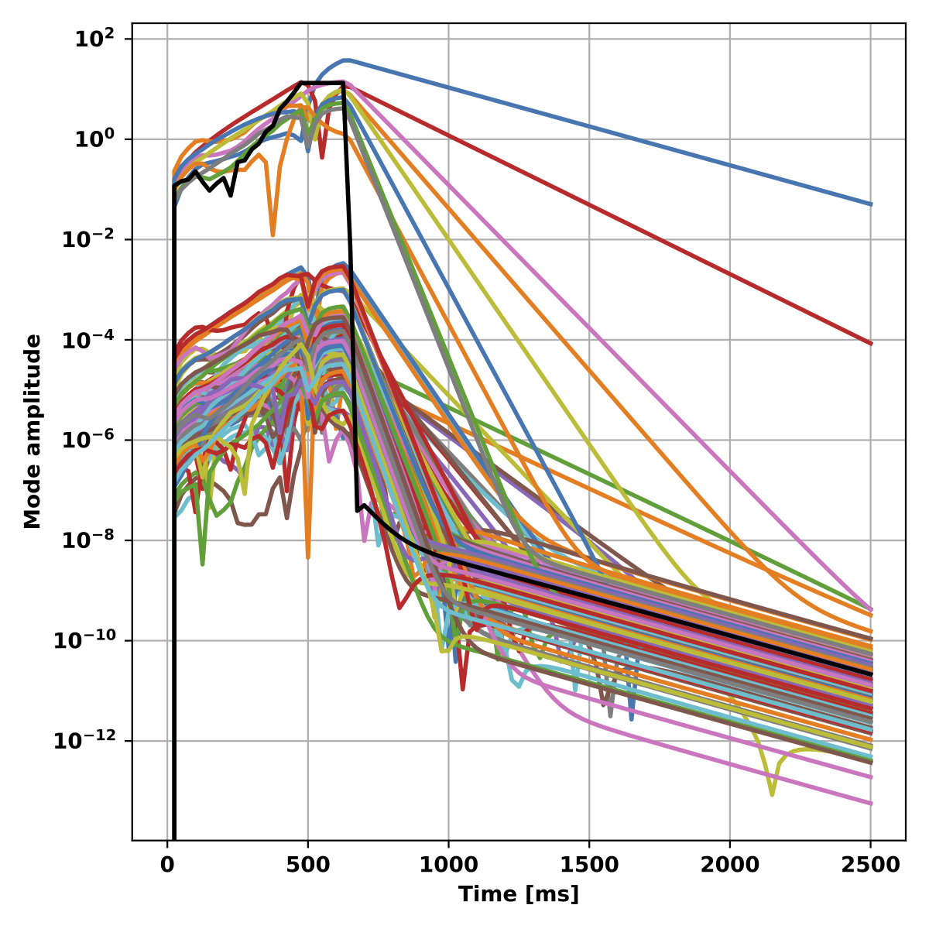
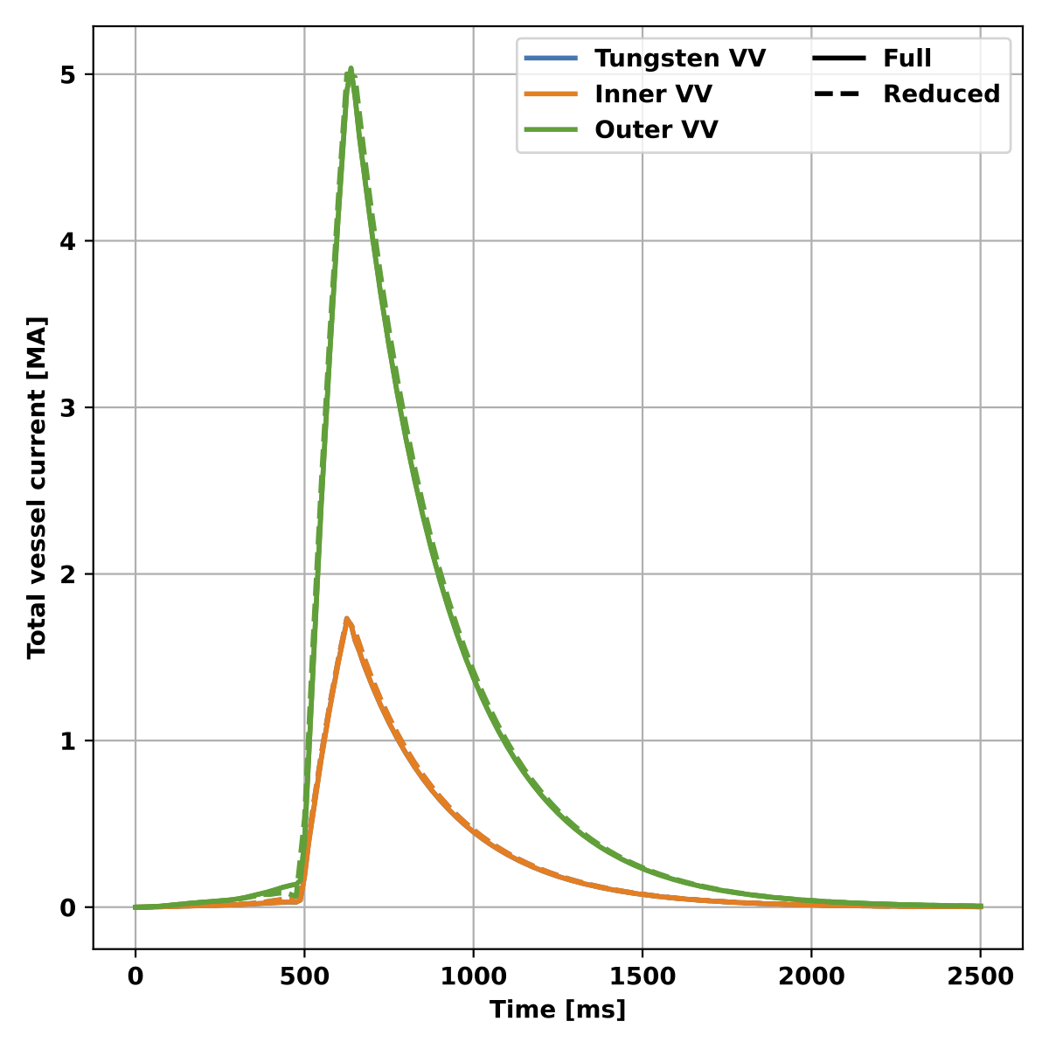
Further model reduction is possible for many design cases, enabling extremely lightweight models
Large-scale CQ dynamics only couple well to a handful of vessel eigenmodes
High grid resolution adds very fast modes that don’t contribute much
Many modes are orthogonal to plasma model (filaments)
Reduced models built from O(100) eigenmodes perform well in design contexts
O(1) inductive limit modes for fast dynamics
Computed once and used many times
Reduced models accelerate simulations to O(1-10 s) for even reactor-scale devices
Enable real time usage (eg. eddy current reconstruction)

Slide 15
Outline
Modeling disruptive forces in 2D
TokaMaker: Axisymmetric model
Modeling to inform NTT design
Modeling to inform ARC design
Modeling disruptive forces in 3D
ThinCurr: 3D thin-wall model
Validation with commercial tools
Modeling to inform SPARC/ARC design
Design and validation on HBT-EP REMC
Coil design and installation update
Initial model validation
Summary and Conclusions

Slide 16
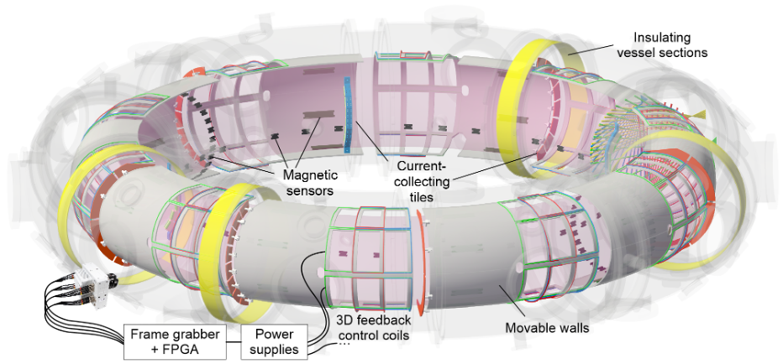
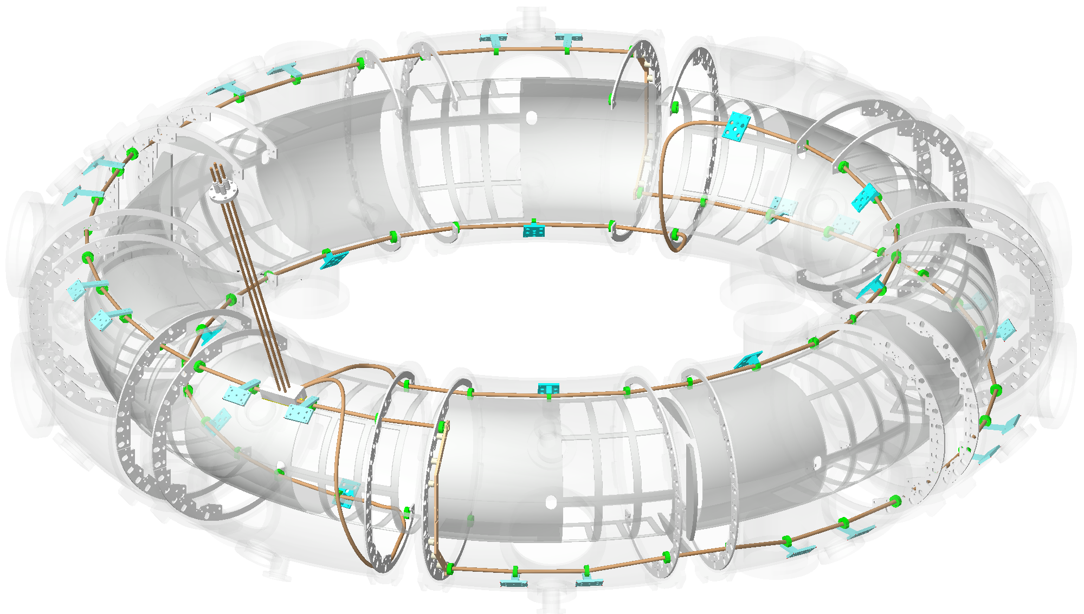
HBT-EP has installed a first of a kind Runaway Electron Mitigation Coil* for studying design considerations
HBT-EP is a small tokamak focused on understanding and control of 3D MHD
Circular, high-aspect ratio
20 segment adjustable first wall
High-resolution magnetic feedback coilset
HBT-EP has recently completed installation of an REMC in vessel
HFS and LFS† coils
Passively and actively driven
1/1 or 2/1 configurations (m/n)
* - No true runaways in HBT-EP
† - LFS coil completion in 2025
HBT-EP Typical Parameters
R₀ | 92 cm
a | 15 cm
I_{P} | ≤ 20 kA
B_{T} | 0.35 T
𝛕_{pulse} | 5 - 10 ms
T_{e} | ≤ 150 eV

Slide 17
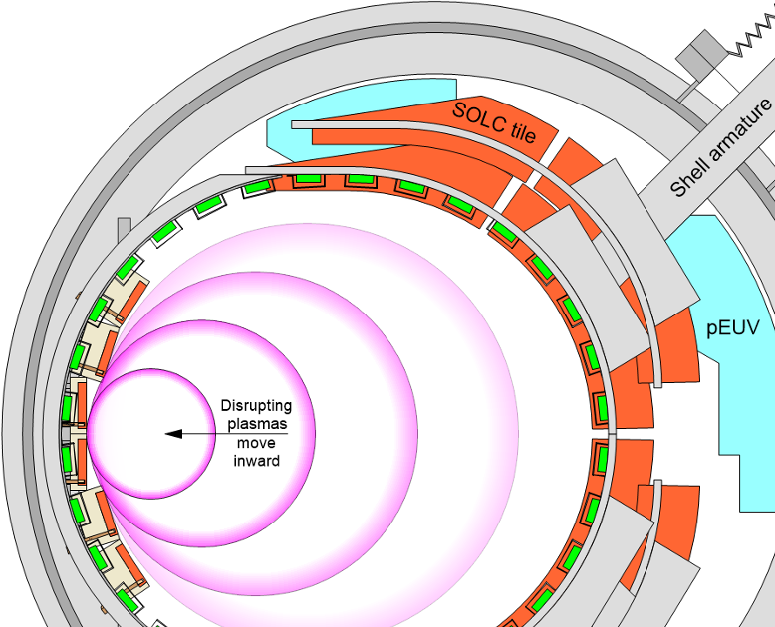
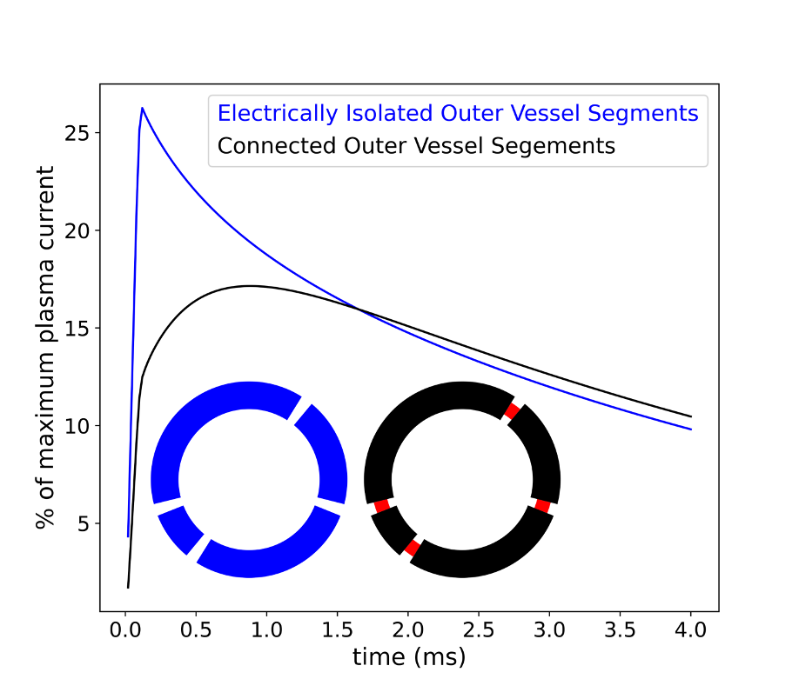
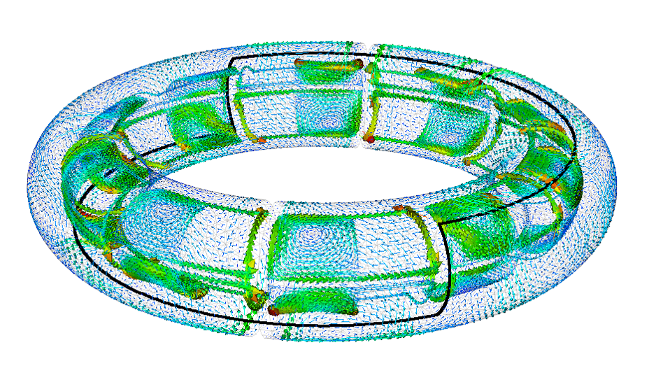
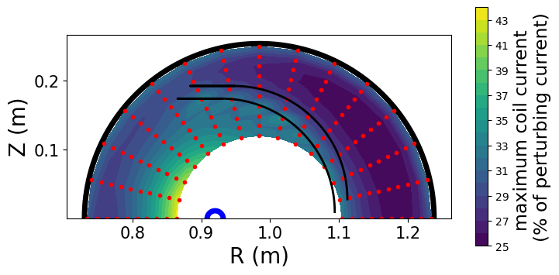
ThinCurr workflow used for DIII-D/SPARC REMCs also utilized on HBT-EP to optimize coil and support validation
Coil designs couple well to disrupting plasmas with ~20% plasma current conversion
Coupling weakly dependent on coil position
Coupling can be changed by modifying vessel electrical connections
Disruptions in HBT-EP progress toward the HFS
Every shot ends in a disruption

Slide 18
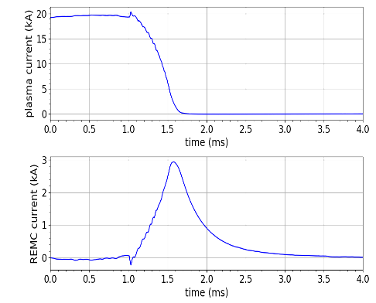
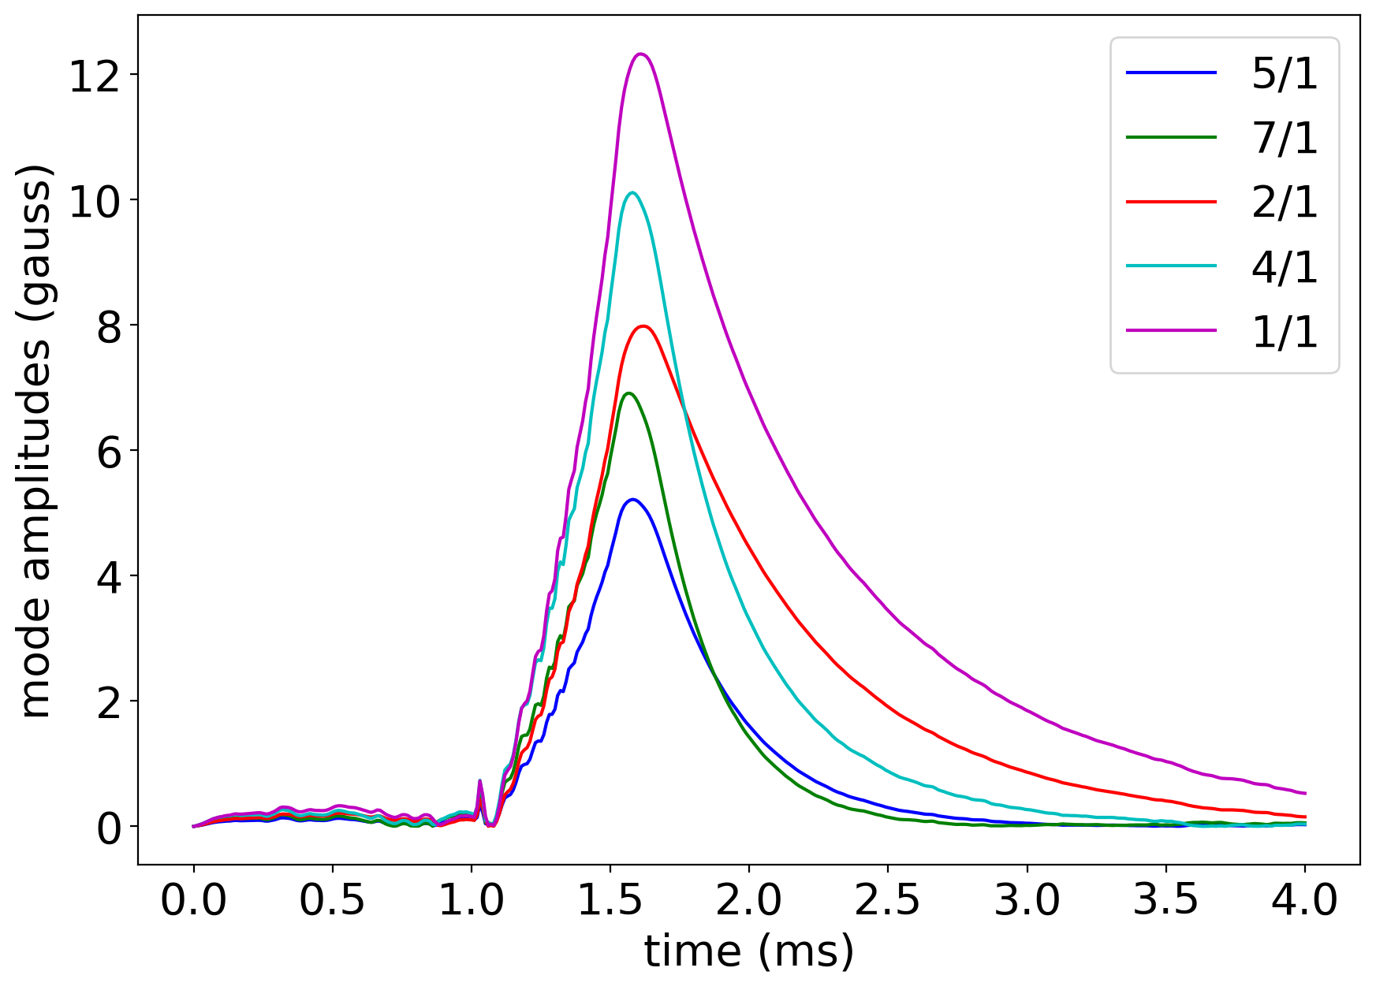
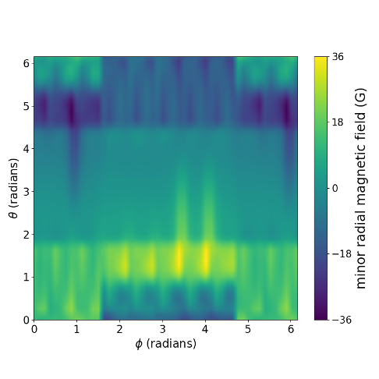
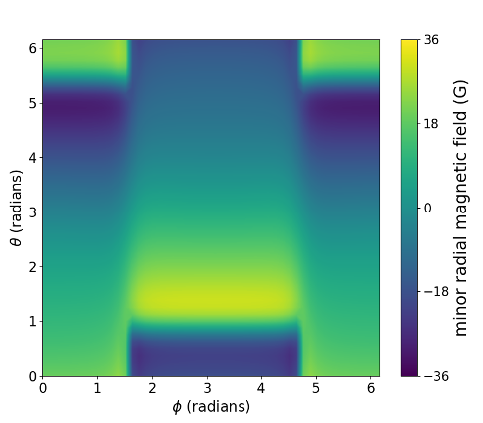
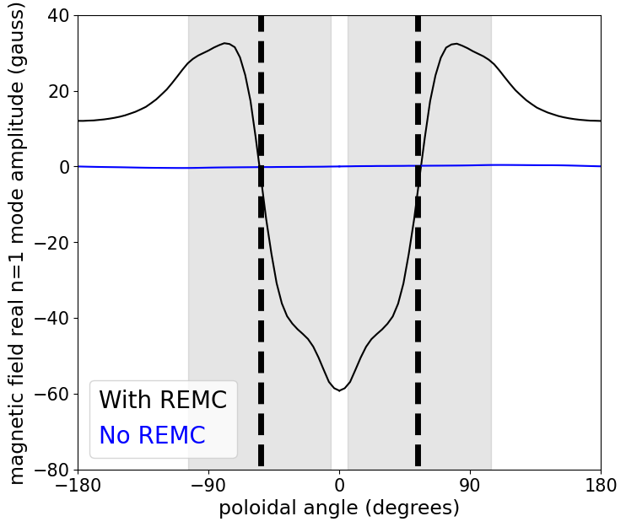
Broad mode spectrum is predicted in REMC-generated field; adjustable with wall movement
HFS and LFS coils are designed for a dominant m/n = 1/1 structure
Broad spectrum from discrete coil position
Control coils provide cross-comparison
Walls generate additional poloidal variation in applied field on plasma
Adjustable for LFS by moving wall segments
Coil Only
Full model

Slide 19
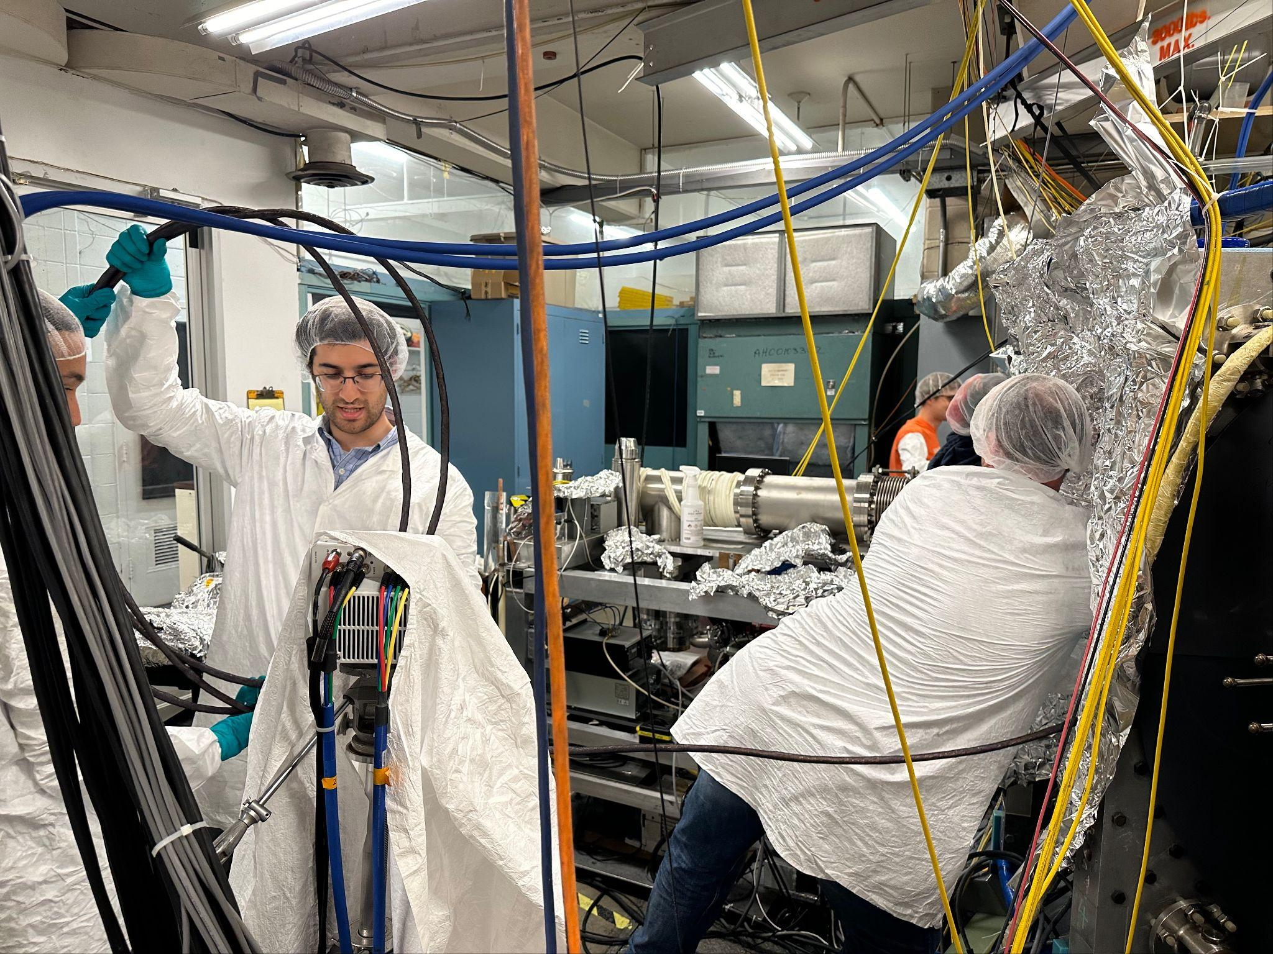
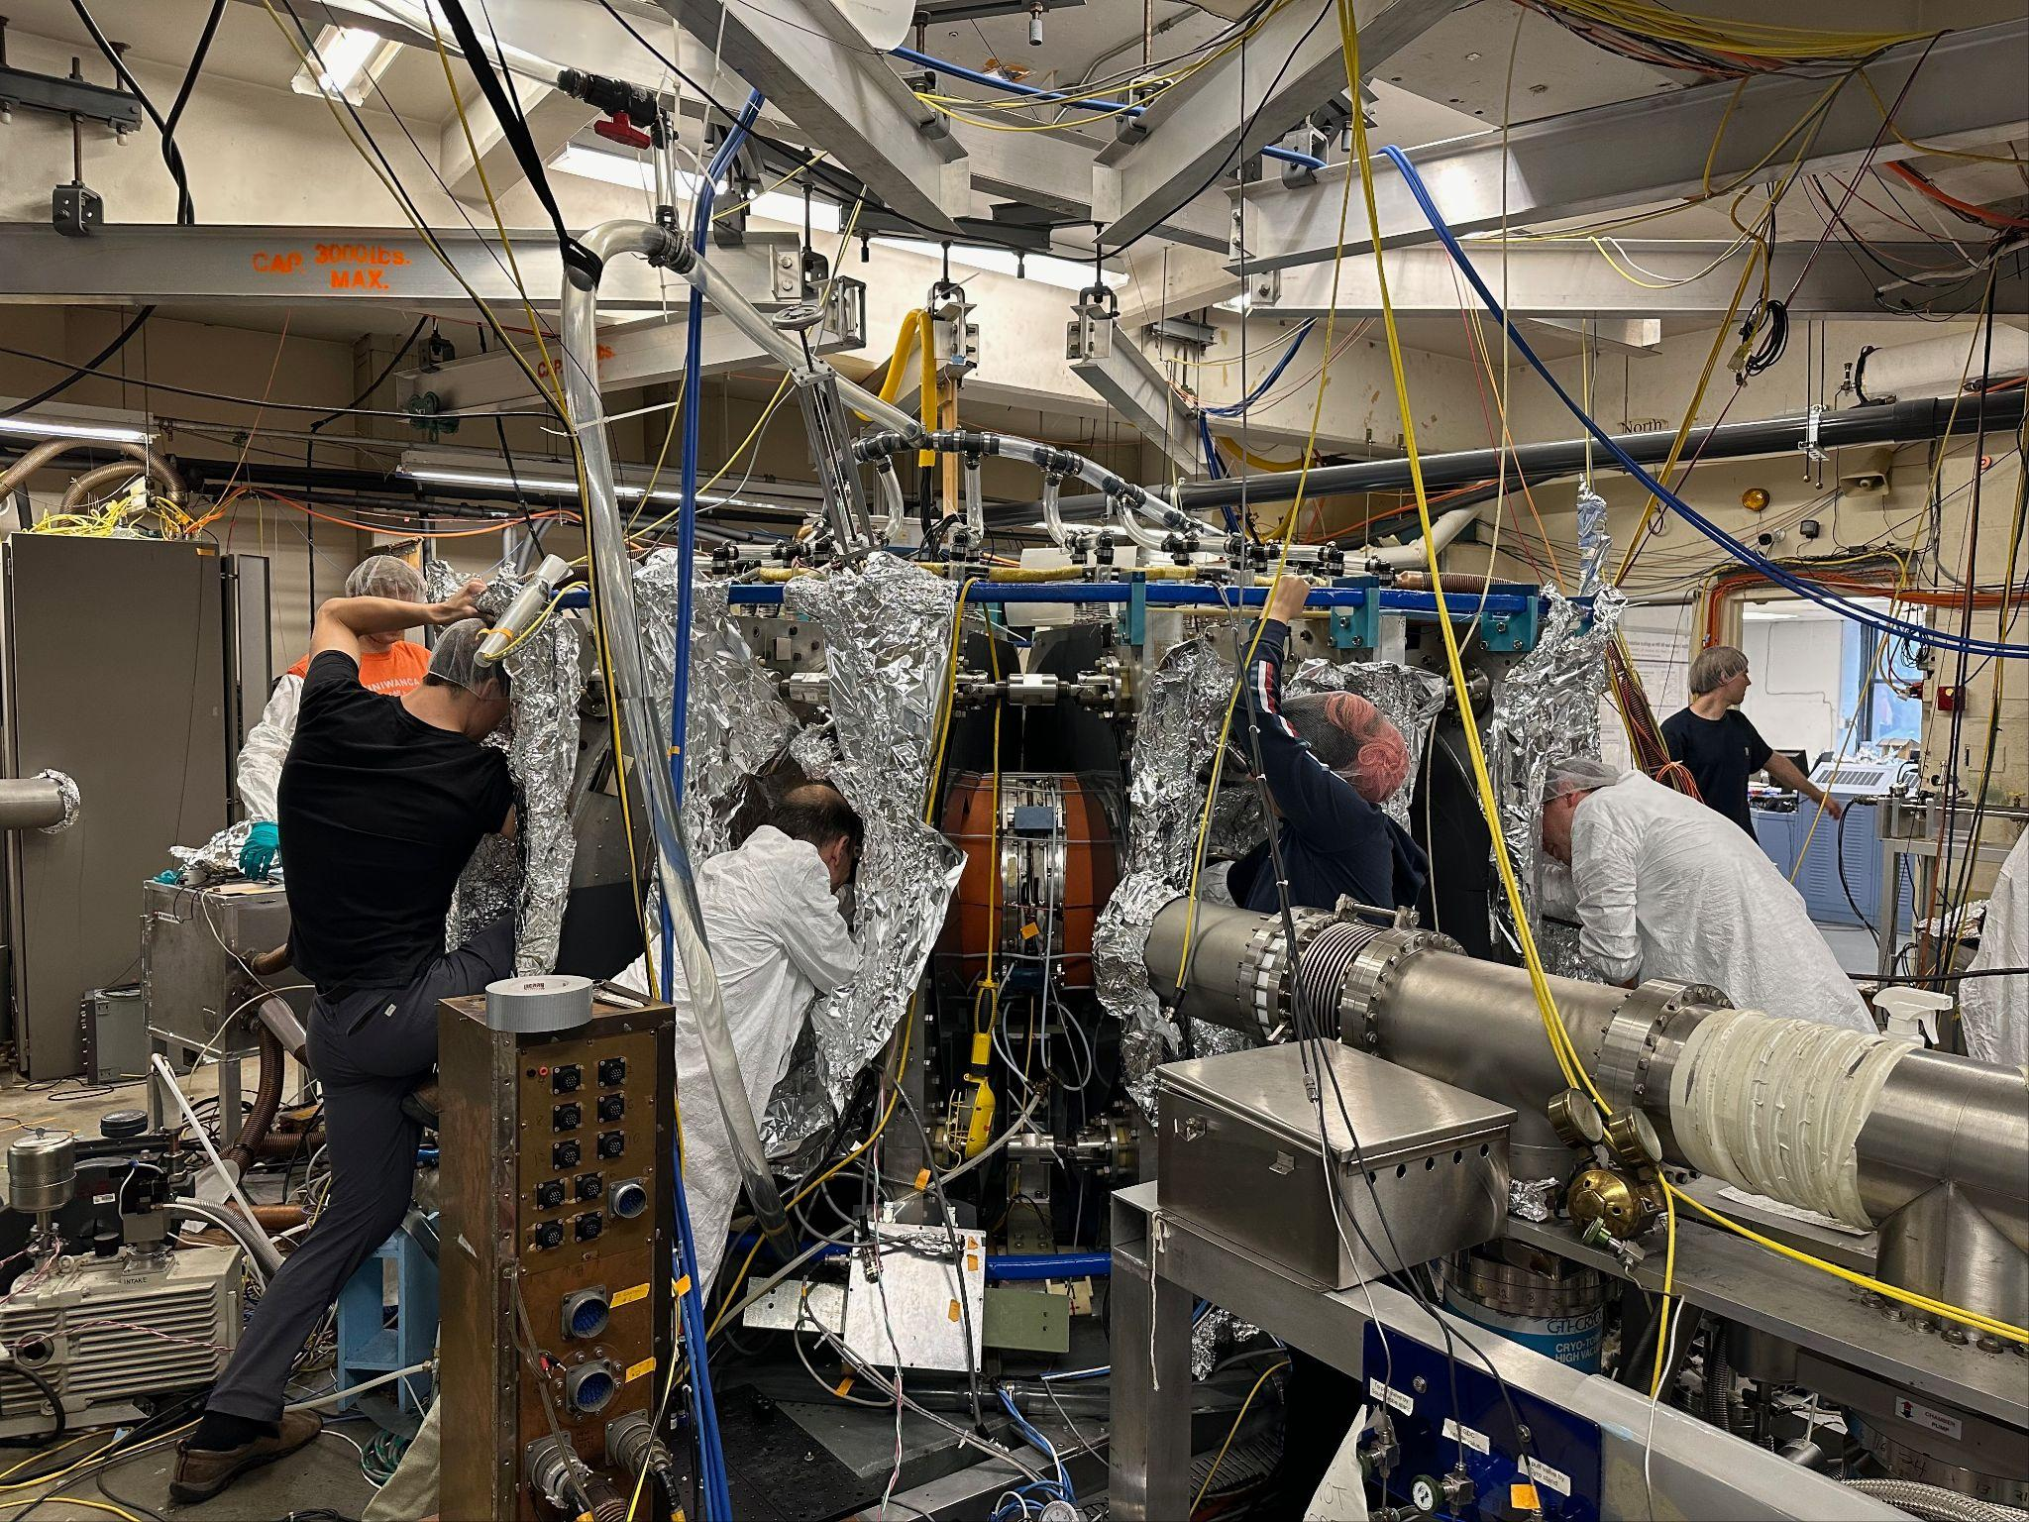
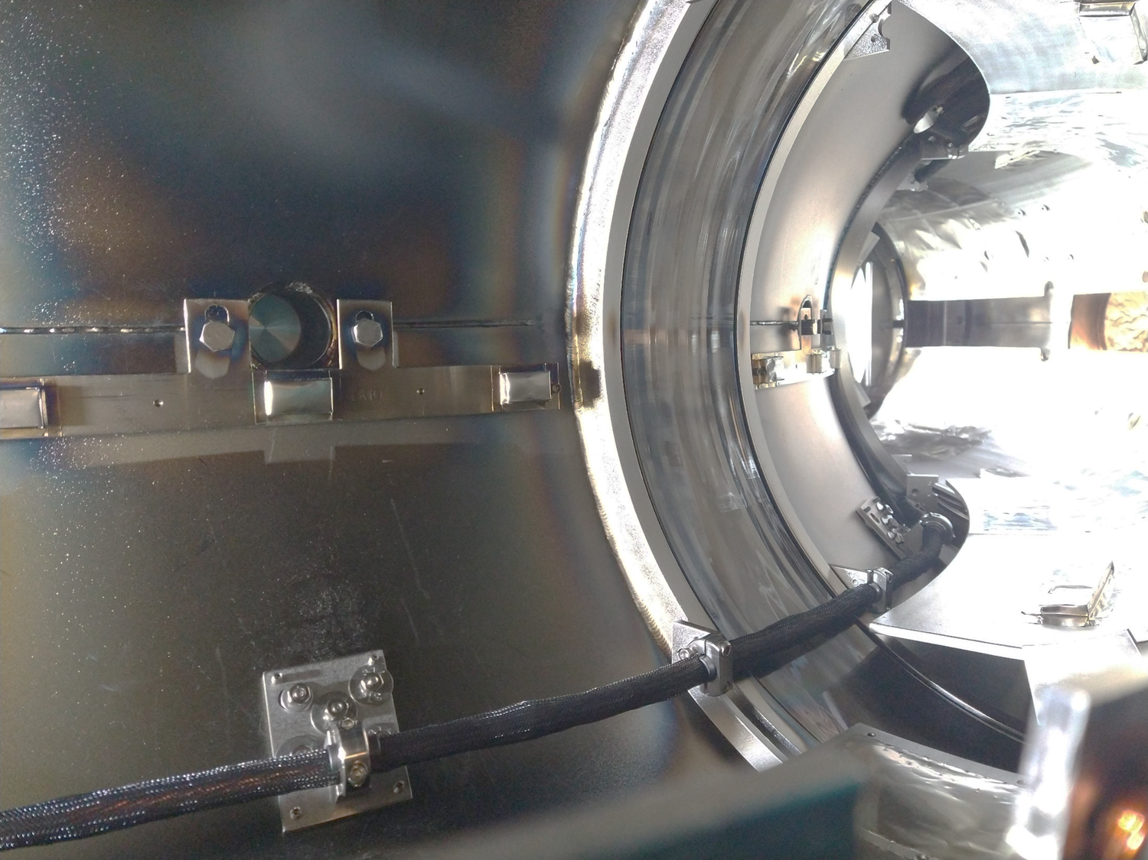
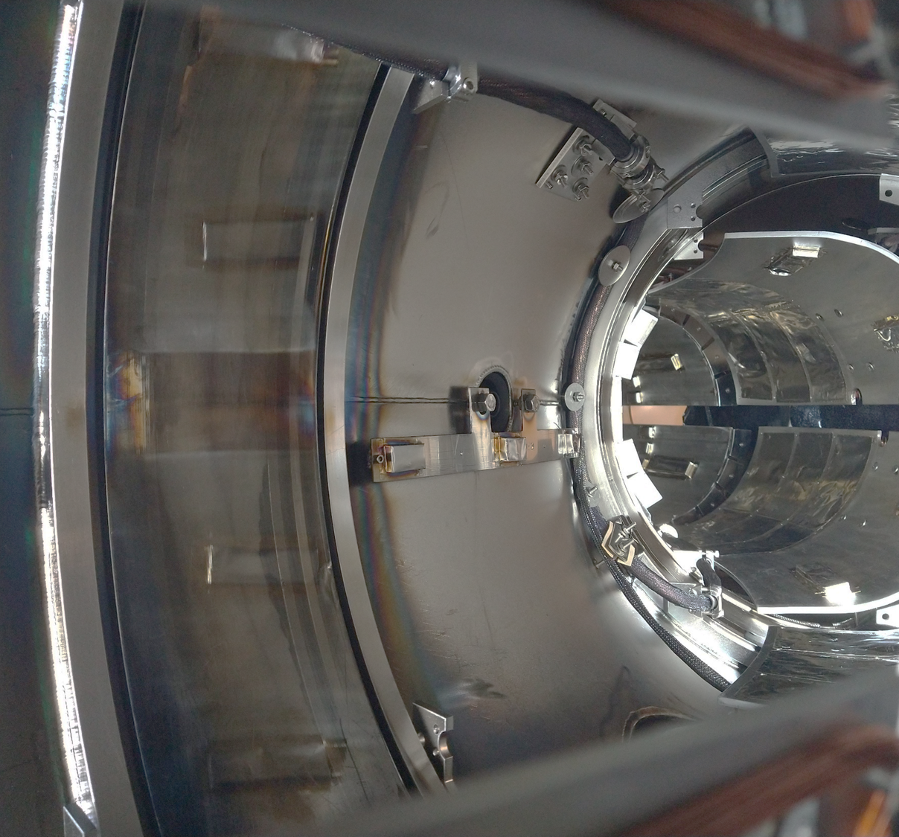
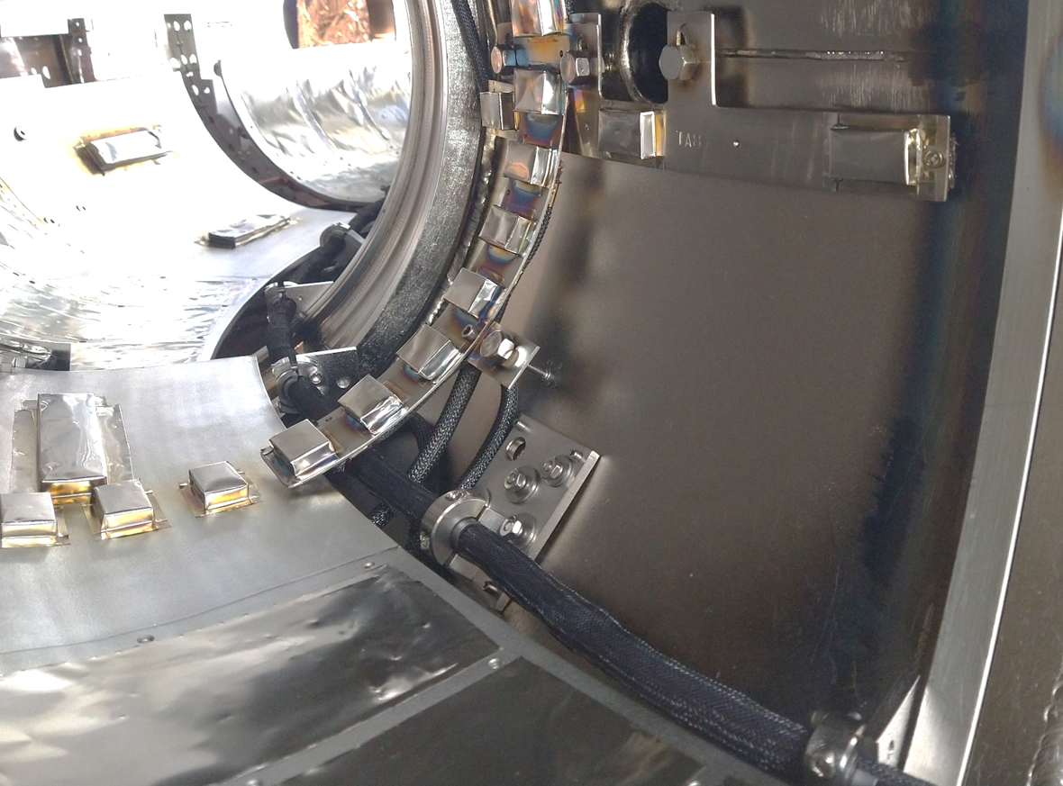
The HFS and LFS* REMCs have been installed in HBT-EP and preparations are now underway for plasma operation
* - LFS coil completion in 2025

Slide 20
Initial vacuum tests have been completed to confirm expected performance of HFS coil with active drive
An external high-power supply was used to drive the HFS coil in vacuum
1.2 kA achievable with available supplies
Sufficient for plasma response studies
ThinCurr predictions using the baseline design provide a reasonable match to “as built”
Preliminary L error < 25%
More precise measurements needed
Calibrated resistivity and inductance to be used for plasma studies
Additional tests are planned this month (pre-APS meeting)
Vacuum: OH/PF coupling
Plasma: Disruptions
Active
Passive
R_{nom}
R_{meas}

Slide 21
Summary and conclusions
A hierarchy of tools for assessing loads in disruptive CQs due to inductive effects is available in the Open FUSION Toolkit
TokaMaker, ThinCurr (full and reduced models)
Tools can couple to relevant engineering workflows (eg. CAD) and obtain results on design-relevant timescales without the use of HPC
Axisymmetric calculations run in O(10 s) and share platform with equilibrium design
3D calculations run in O(10 m) for full calculations on workstation hardware
Reduced 3D calculations run in O(10 s) while retaining design-level fidelity
Tools are being successfully applied to design of public and private devices and components
Validation performed with commercial tools and experimental data
Initial HBT-EP REMC is installed and undergoing tests in preparation for upcoming first plasma operations

Slide 22
Backup Slides

Slide 23
The HFS and LFS REMCs have been installed in HBT-EP and preparations are now underway for plasma operation

Slide 24
For general surfaces element space must be supplemented to account for topology
For multiply connected surfaces the potential must be multi-valued
Insert elements to represent “jumps” in potential on unique loops
Called “secular” terms in SIMSOPT
These correspond to “holes” in the surface
Unique “cycles”, which define a basis for the topology
If a volume is fully enclosed an element must be removed
Enclosing a volume makes the inductance matrix singular
Net flux must be zero

Slide 25
Matrix blocks associated with off-diagonal interactions exhibit low-rank structure
Scalability of problems can
N-body problem; O(N²), O(Δx⁴) matrix size
Sub-blocks of matrix exhibit low-rank structure
Interactions at long range quickly decay
Controlled approximation of the matrix by truncating these low-rank blocks
Use SVD to compress blocks
Same observation leads to Fast Multipole Method (FMM)

Slide 26
Adaptive Cross Approximation is a technique to iteratively build a low-rank approximation of a matrix
ACA+ provides an approach to iteratively approximate a matrix through sampling
Series of rank-1 updates from candidate rows/cols
Randomly selected starting point, then target largest elements
Recompress after with SVD (small matrix)
Recursively sub-divide geometry in space
Determine far-field interactions on each level
All levels: Apply ACA+ to far-field blocks
Lowest level: SVD compress near blocks; keep full block for self-interaction
Hopefully only need to compute and store a small fraction of full matrix

Slide 27
Figures bank for Chris - Anson

