Slide 1
Development and preliminary calibration of an off-normal warning system for SPARC
A.R. Saperstein, R. Sweeney, D. Boyer, A. Kumar, Z. Keith, H. Wietfeldt, A. Maris, A. Wang, M. Pharr, C. Rea
3rd Technical Meeting on Plasma Disruptions and their Mitigation – 4 September 2024

Slide 2
Creation of a cross-institutional team for the development of SPARC’s Off-Normal Warning System
CFS
MIT
Columbia
EPFL
Ryan Sweeney
Cristina Rea (PI)
Alex Saperstein (PA)
Matt Pharr (GS)
Alessandro Pau (PI)
Dan Boyer
Arunav Kumar (PA)
Allen Wang (GS)
William Wei (PA)
Nik Logan (PI)
And we welcome more collaborators!!
Henry Wietfeldt (GS)
Andrew Maris (GS)
Zander Keith (GS)

Slide 3
Overview
Scope of SPARC’s Off-Normal Warning (ONW) system
Progress on its development
ONW system structure
Creation of Off-Normal Event (ONE)-specific warnings

Slide 4
Scope of SPARC’s Off-Normal Warning (ONW) system

Slide 5
The ONW system will play two crucial roles in SPARC operations
Plasma control
Integration into the Plasma Control System
Identify when a disruption may be imminent and decide on a response based on the risk to the device
Scenario design
Integration into Pulse-Planning workflow
Identify the cause(s) of plasma disruptions and identify scenarios that may be less disruptive for future campaigns

Slide 6
SPARC’s ONW systems need to address several ITER-relevant challenges specific to high-power devices
SPARC has a “Disruption Budget”
The number of disruptions (cumulative thermal loads) the tokamak is designed to withstand
The budget needs to be managed early in operation
This requires the ONW system to be ready provided a limited amount of data
This will be a stress test of cross-machine transferability for both physics and data-driven models
This is an opportunity to test the implementation of adaptive training
Which has been explored on JET [1,2], EAST [3], ASDEX [4]
There will be little (if any) room to commission the warning system at high performance
The risk associated with an un-mitigated disruption may be too great
The ONW system needs to be tunable assuming limited performance info
The performance of the system can be unclear when running in mostly closed-loop
However, this is also an opportunity to explore the cost-benefit analysis of running in open-loop
[1] Murari, A. et al Nat Commun 15, 2424 (2024)
[2] R. Rossi et al 2024 Nucl.Fusion 64 046017
[3] arXiv:2404.08241v2
[4] B. Cannas et al 2010 Nucl.Fusion 50 075004

Slide 7
These challenges set some priorities in development
Operator friendly
When a warning fails, it needs to be clear why, as well as how to update it
The triggering of a warning should make it clear why a plasma disrupted, and suggest how to adjust the scenario for the next pulse
Starting development with physics-driven warning models
Provides the clear tuning knobs and interpretability for the low-data budget available early on
Followed by data-driven warning models
This is expected to provide higher accuracy and better warning-times provided enough data
Closed-loop and real-time Off-Normal SIMulations (ONSIMs) will be used to relieve the burden of needing real SPARC data
SPARC data + physics knowledge can potentially fill in unexplored regions of stability-space without explicit experimentation
Can potentially implement data earlier with the help of ONSIMs

Slide 8
Progress on development
ONW system structure

Slide 9
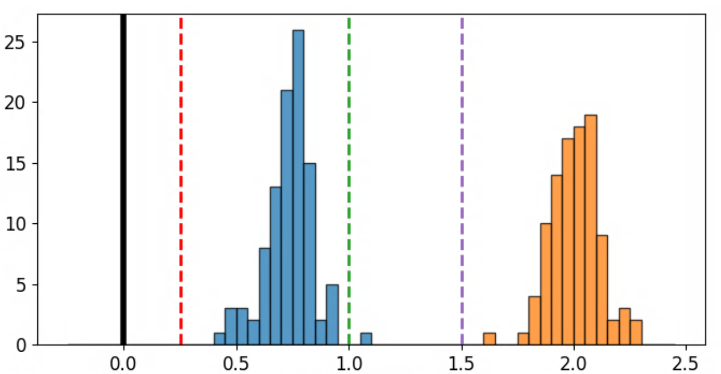
Each Off-Normal Event (ONE) has its own ONW module containing control-focused detectors within it
[5] J. Vega et al 2024 Nucl.Fusion 64 046010
[6] M Maraschek et al 2018 PlasmaPhys.Control.Fusion 60 014047
ONE
VDEs
Control response(s)
Disruption Mitigation System (DMS)
Avoidance
$$τ_{VDE} \sim τ_{warn}> τ_{DMS}$$
$$τ_{warn}≫ τ_{shape}, τ_{VDE}$$
Appropriate Detector(s)
Counts
Disruption
[5, 6]
Warning Time [au] $=t_{dis}−t_{warn}$
Optimized threshold(s)
Optimal threshold
Optimal threshold

Slide 10
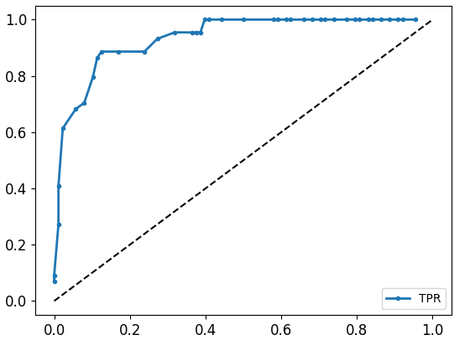
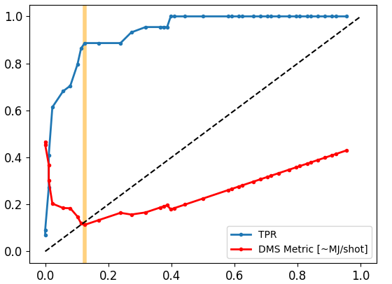
Different control responses may have different optimization metrics
A common set of performance metrics to all optimizations is the True Positive Rate (TPR) and False Positive Rate (FPR)
TPR = Frequency that the model correctly identifies an event
FPR = Frequency that the model falsely identifies an event
A flexible optimization metric has been developed for the Disruption Mitigation System (DMS) warnings based on the expected cumulative disruption loads $\left\langle D\right\rangle$
DMS Metric $=f_{m}\left(1−P_{D}\right)FPR+P_{D}FNR ∝ \sim \left\langle D\right\rangle$
$f_{m}=$ mitigation efficiency $P_{D}=$ natural disruptivity
Optimization looks for minimum in DMS Metric $∝\sim \left\langle D\right\rangle$
Performance Metrics
$$f_{m}=P_{D}=0.1$$
True Positive Rate (TPR)
$−$ DMS Metric [$\sim$MJ/shot]
False Positive Rate (FPR)

Slide 11
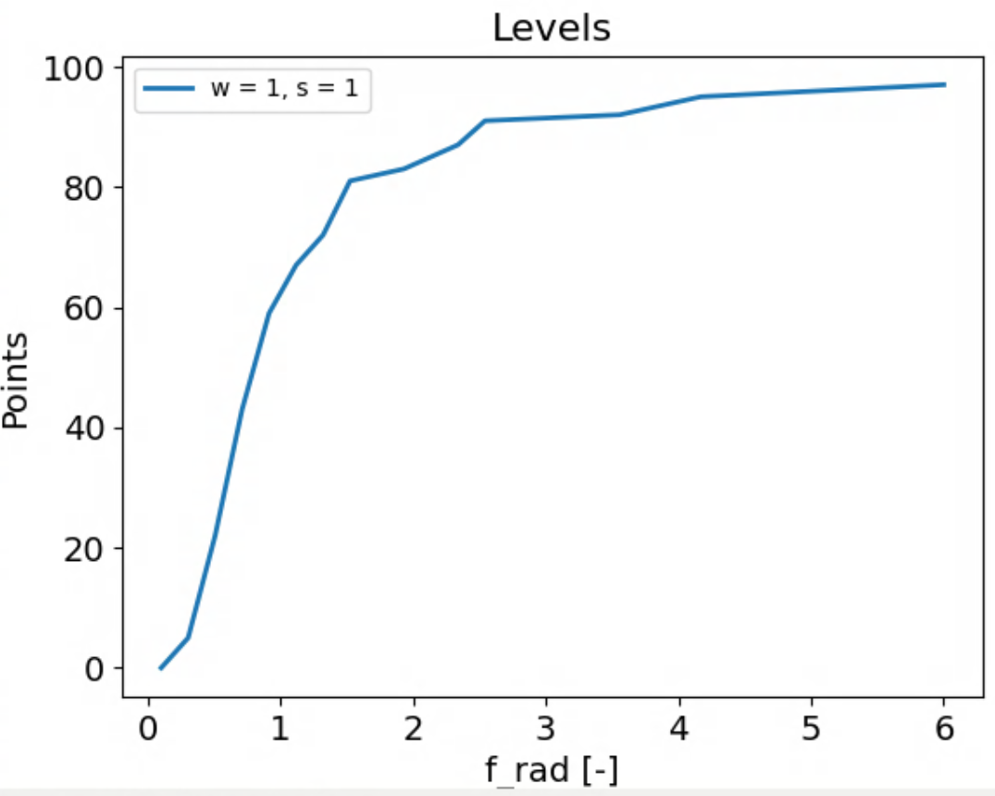
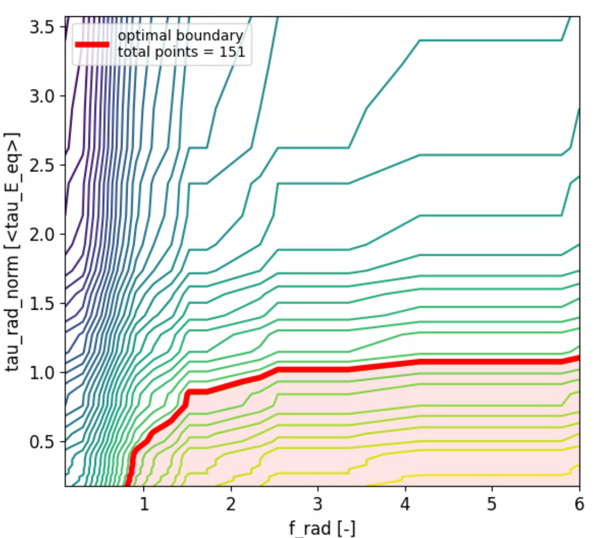
We use an extension of Gerhardt’s Points-Based model for establishing warning thresholds
Point Mapping
The original Point-Based model [7] maps thresholds $→$ points for each input and then sums them
Contours of constant sums draw stability boundaries
Used with success on NSTX by both Gerhardt [7] and DECAF [8]
The extension to this model implemented here makes the point-assignments more continuous, and easily tunable
$$Points\left(FPR\right)=w∗100∗{\left(1−FPR\right)}^{s}$$
$$Total Point Threshold= \sum_{f}{(Point{s)}_{f}}$$
2* primary tuning knobs
Weight ($w$), shape ($s$): set FPR → points mapping
$w$ sets the weight of each input
$s$ sets the shape of the $points$ profile
Points
$w=1$, $s=1$
$f_{rad}$ [ - ]
$τ_{rad,norm}$ [ - ]
[7] S.P. Gerhardt et al 2013 Nucl. Fusion 53 063021
[8] S.A. Sabbagh et al Phys. Plasmas 30, 032506 (2023)
$f_{rad}$ [ - ]

Slide 12
Progress on development
Creation of ONW modules

Slide 13
ONW detector development workflow
Demonstration
SPARC Training
Impurity Accumulation Events (IAEs): DMS
VDEs: DMS, Avoidance
$\sim$TMs
IAEs: DMS
VDEs: DMS, $\sim$Avoidance
IAEs: DMS
Create Detector
Identify inputs you want to use and performance metrics you want to optimize
Experimental Demonstration (C-Mod + others)
Demonstrate performance on an existing machine(s) and identify $t_{warn}$ distribution
ONSIMs
Generate synthetic data by simulating SPARC’s ONEs`
Implementation
Operational Tuning
Manual tuning and adaptive training
IAEs: $\sim$DMS
SPARC Plasma Control System
(thresholds, points)
Aggregate threshold
SPARC Data

Slide 14
DMS detector for Impurity Accumulation Events (IAEs) has been demonstrated on C-Mod
Success with $f_{rad}$ and $τ_{rad,norm}$[9] as IAE DMS observers
Radiative cooling timescale
$τ_{rad}=W_{th}/P_{rad}$
$τ_{rad,norm}=τ_{rad}/⟨τ_{E}⟩$
FPR,TPR $\sim \left(12\%, 85\%\right)$
Warning-time distribution is limited by distribution of radiated collapse durations on Alcator C-Mod
$σ_{τ_{Event}} \sim \left\langle τ_{Event}\right\rangle$
But $\left\langle τ_{IAE}\right\rangle$ should scale well to SPARC for longer $τ_{rad}$’s
Labeling Performance
Warning-time Distribution
TPR
$−$ DMS Metric [$\sim$MJ/shot]
FPR
$$t_{warning} [ms]$$
Stability Boundary
Event Duration Distribution
$$τ_{rad,norm} [m^{2}/s]$$
$$f_{rad} [−]$$
$$t_{event} [ms]$$
[9] R. Rossi et al 2024 Nucl. Fusion 64 046017

Slide 15
DMS detector for VDEs has been demonstrated on C-Mod
Success with $z_{error}$ and $z{∗v}_{z}$ as VDE DMS observers
FPR,TPR $\sim \left(1\%, 100\%\right)$
Better localized warning-time distribution
But still limited by short event durations
Which should scale optimistically to SPARC as well for lower $γ_{VDE}$’s
Labeling Performance
Warning-time Distribution
TPR
$−$ DMS Metric [$\sim$MJ/shot]
FPR
$$t_{warning} [ms]$$
Stability Boundary
Event Duration Distribution
$$z∗v_{z} [m^{2}/s]$$
$$z_{error} [m]$$
$$t_{event} [ms]$$

Slide 16
ONW detector development workflow
Demonstration
SPARC Training
Impurity Accumulation Events (IAEs): DMS
VDEs: DMS, Avoidance
$\sim$TMs
IAEs: DMS
VDEs: DMS, $\sim$Avoidance
IAEs: DMS
Create Detector
Identify inputs you want to use and performance metrics you want to optimize
Experimental Demonstration (C-Mod + others)
Demonstrate performance on an existing machine(s) and identify $t_{warn}$ distribution
ONSIMs
Generate synthetic data by simulating SPARC’s ONEs`
Implementation
Operational Tuning
Manual tuning and adaptive training
IAEs: $\sim$DMS
SPARC Plasma Control System
(thresholds, points)
Aggregate threshold
SPARC Data

Slide 17
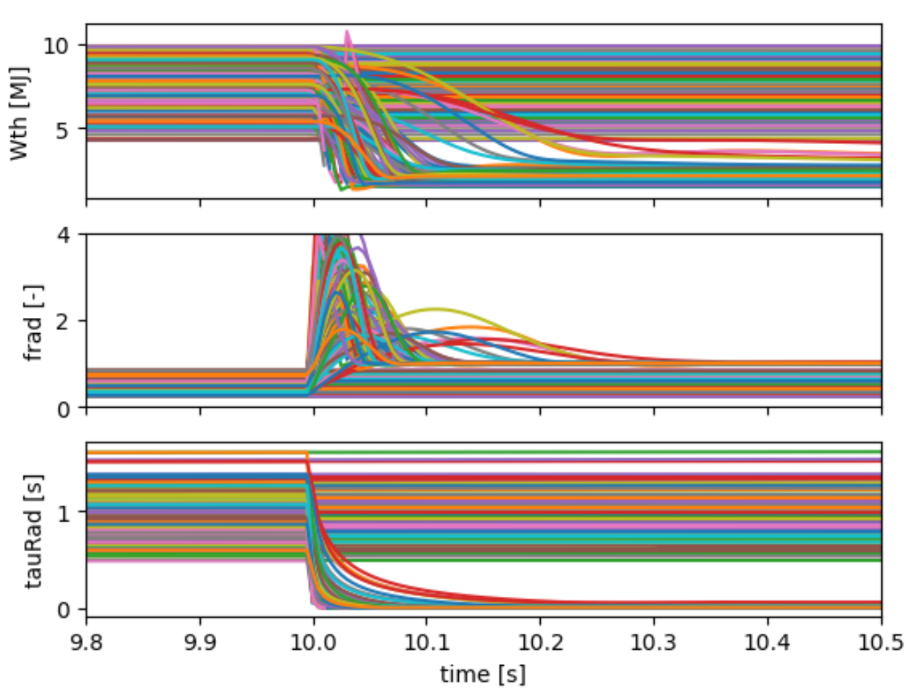
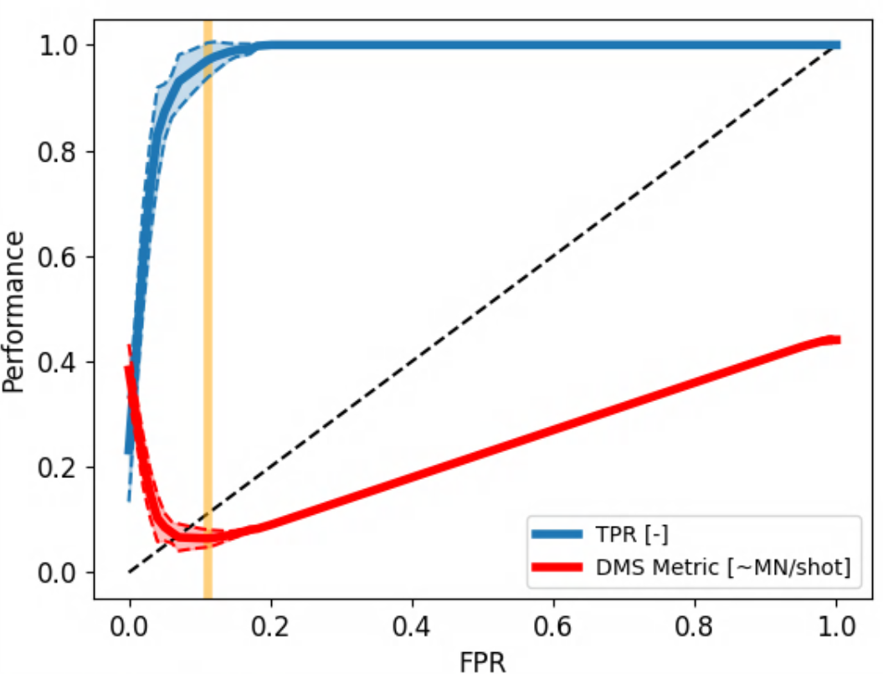
DMS detector for IAEs has been tested in simulated SPARC-like environment
Simulated Database
We have introduced IAEs and generated a database of stable and disruptive shots
A DMS detector has been trained/tested on this database
The performance is reasonable, but the physics fidelity needs to be improved to get more appropriate thresholds
$$W_{th} [MJ]$$
$$f_{rad} [−]$$
$$τ_{rad} [s]$$
time [s]
TPR
$−$ DMS Metric [$\sim$MJ/shot]
FPR

Slide 18
Summary
The structure for SPARC’s ONW system has been mostly established
Control-response structure for ONW modules
Detectors are designed to meet specific warning-time distributions
A tunable extension of the Points-Based model is used for triggering warnings
ONW modules for IAEs, VDEs, and TMs are currently in development
DMS detectors for IAEs and VDEs are working well on C-Mod, and scale optimistically to SPARC
An IAE warning module has been tested on preliminary simulations of a SPARC-like environment
An Avoidance detector for VDEs is also in the works $→$ See talk after this one
Coming soon
Collaboration with EPFL to integrate ONW development with DEFUSE, and benchmark these physics-driven models against existing scalings and data-driven models
Planning to test ONW system during ramp-up and ramp-down

Slide 19
Extra slides

Slide 20
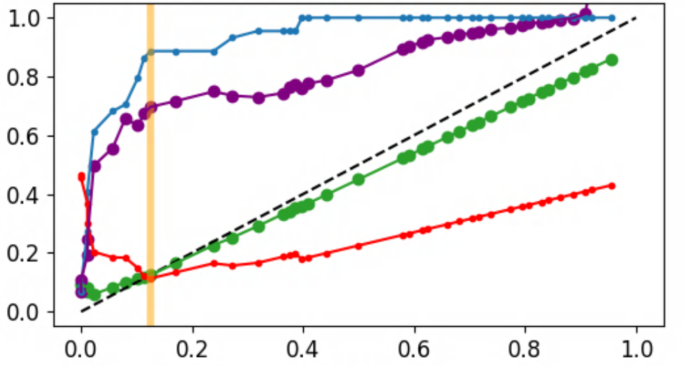
Other optimization metrics considered
Expected cumulative loads per shot
$\left\langle D\right\rangle =P_{D}\left\langle D_{um}\right\rangle \left\{1+P_{D}^{−1}f_{m}FPR−\left(1−f_{m}\right)TPR\right\}$
$\left\langle D_{um}\right\rangle =$ average un-mitigated disruption load [J or N /shot]
Expected cumulative loads over lifetime
$\left\langle D\right\rangle$ x number of shots
Other* relevant metrics
(FPR,TPR) - generic model performance
$\left\langle t_{warn}\right\rangle$ - controllability performance
ONW Failure Rate (OFR) - operation-time performance
Average disruptive load $\left\langle D\right\rangle$ - machine safety performance
True Positive Rate (TPR)
DMS Metric [$\sim$MJ/shot]
OFR [-]
Average warning-time [\30ms]
False Positive Rate (FPR)

Slide 21
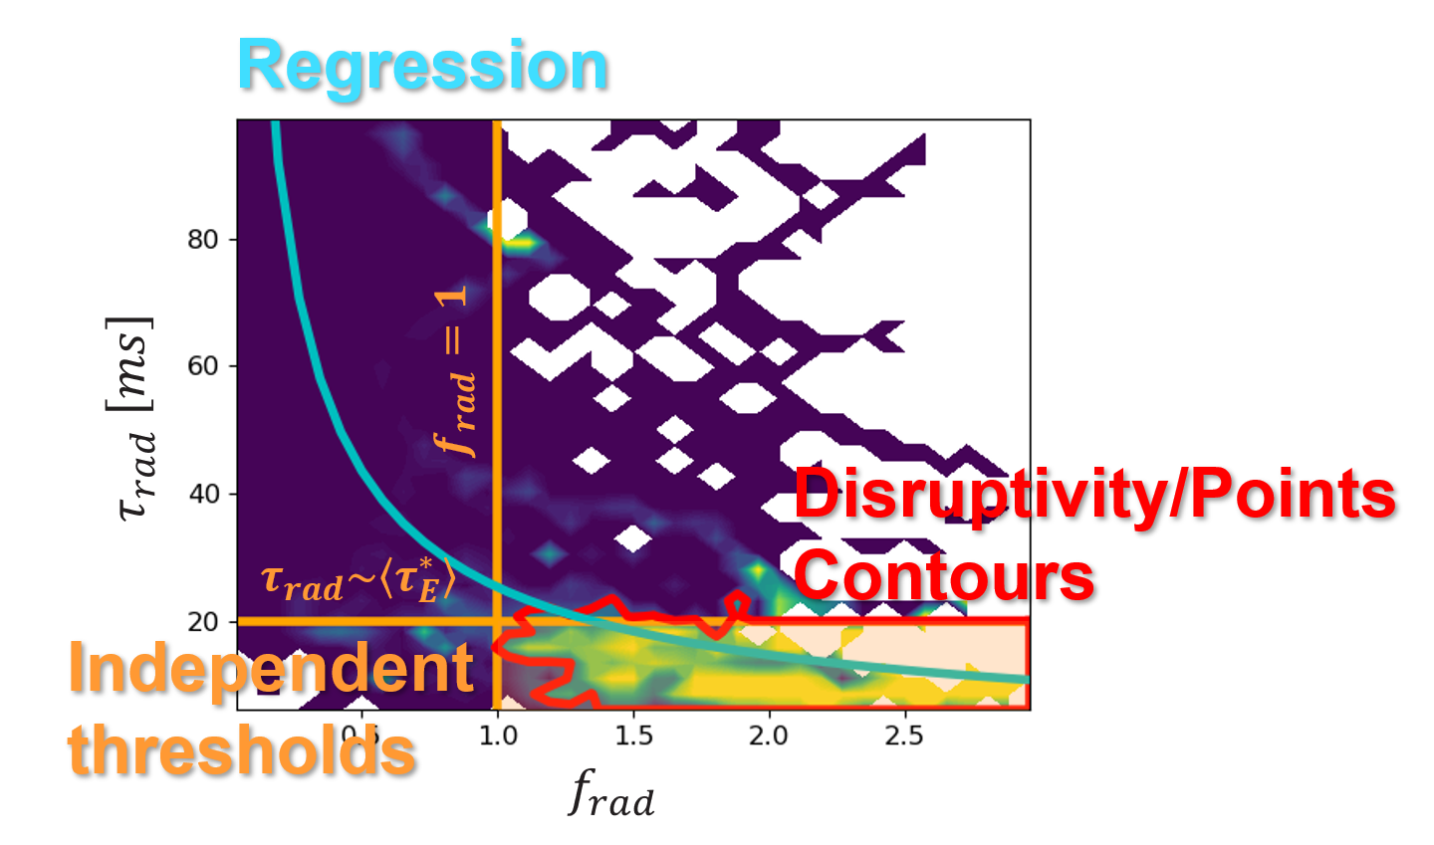
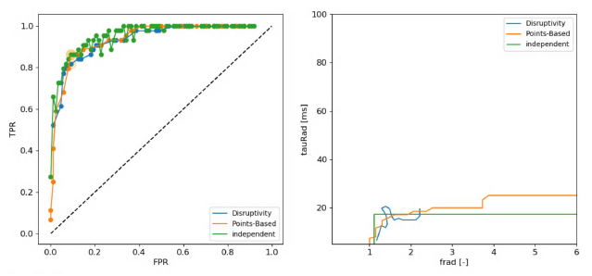
Other physics-driven models considered
Several simple and interpretable models were investigated
Independent thresholds
Disruptivity
Regression
(Gerhardt’s) Points-Based model
Why the Points-Based model?
It has similar performance and interpretability to Disruptivity, but scales better at larger dimensionality and is much more flexible to tuning

Slide 22
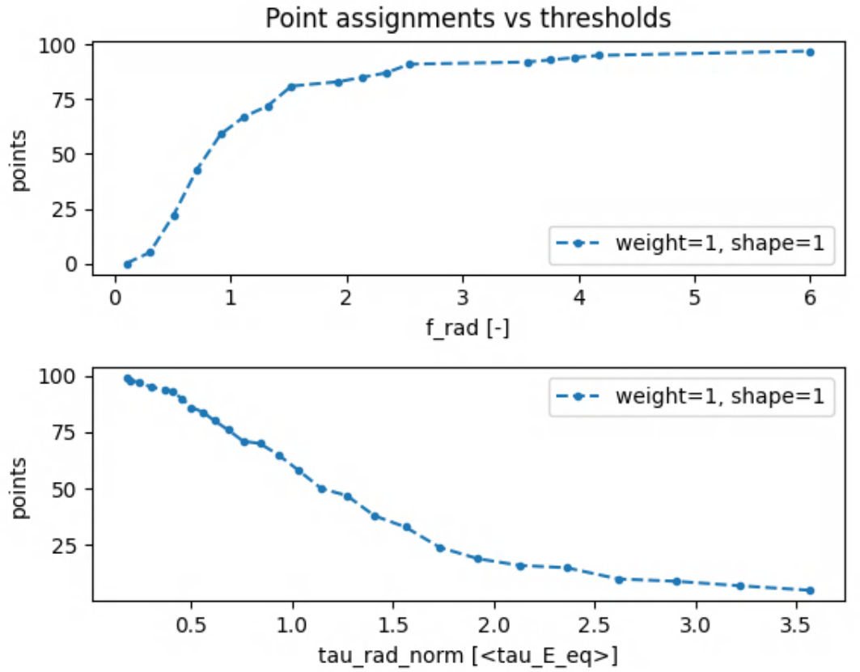
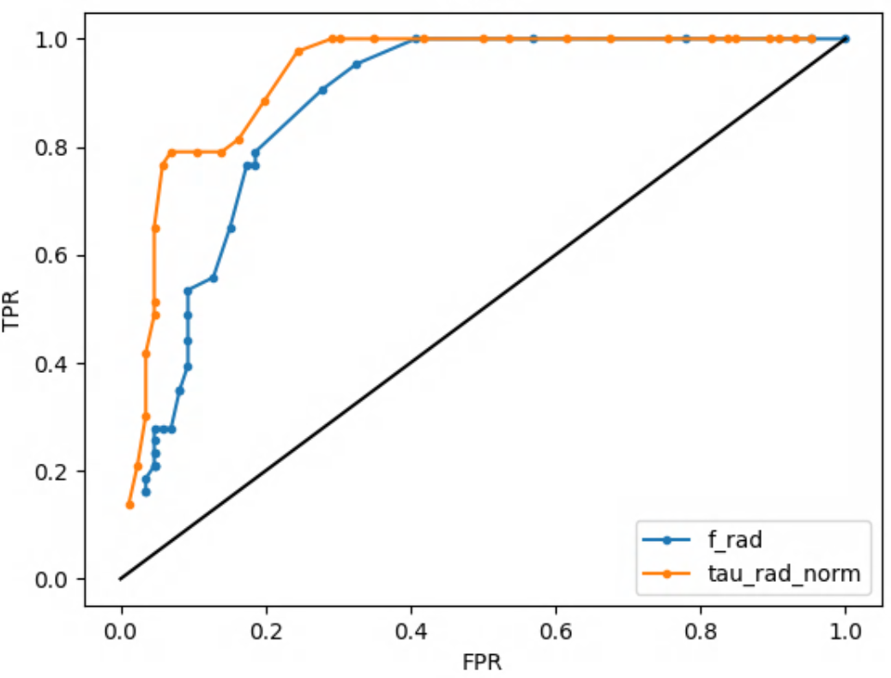
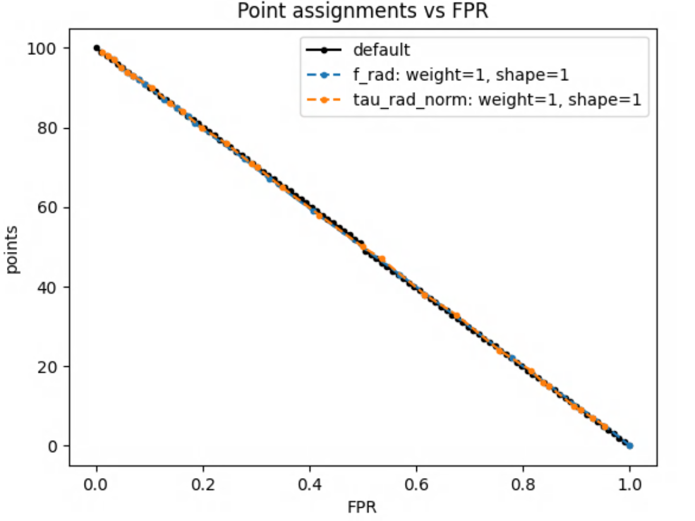
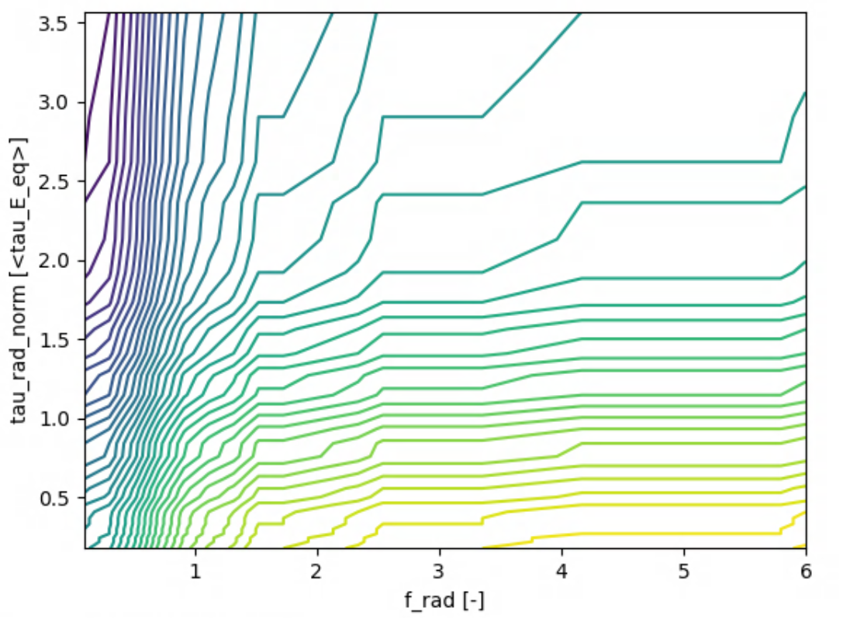
More detailed Points-model explanation
Reward lower FPRs with more points
Set by $P\left(FPR\right)=w∗100{\left(1−FPR\right)}^{s}$
(Updated by tuning)
Identify relevant thresholds for each input based on their associated FPR
(Updated by re-training)
Map thresholds $→$ points
Generate contours of constant $\sum{P}$
(Updated by optimizing relevant metric)

Slide 23
Example ONW module output (IAE DMS detector on C-Mod)
Traces of physics inputs
Trajectory in stability-space
Warnings
1120131012

Slide 24
List of ONEs to be addressed for SPARC
List based on deVries 2011
Priority
1) Likely to come up in nominal operation
1-H) … nominal H-mod operation
2) Unlikely to come up in nominal operation
IAEs
SPARC scenarios are expected to operate at higher $f_{rad}$
Sensitivity to impurity seeding issues
VDEs
High-ish elongation ($κ_{area} \sim 1.7$)
LMs
Generic disruption precursor
Event | Abbr. | Priority
Impurity Accumulation Events | IAE | 1
Vertical Displacement Event | VDE | 1
Locked Modes | LMs | 1
Rotating Tearing Modes | RMs | 1
Error Field Locked Modes | EFLMs | 1
Sawtooth Crashes | ST | 1
Inboard/Outboard Shift |  | 1
Detachment |  | 1
Edge Localized Modes | ELMs | 1-H
HL back-transition |  | 1-H
Density Limit | DL | 2
Internal Transport Barrier collapse | ITB | 2
Low safety factor | LOQ | 2
Flux consumption |  | 2

Slide 25
POPSIM + ONSIMs
POPSIM = time-dependent POPCON
POPSIM is a control-oriented tokamak plasma simulation toolbox built in the machine-learning framework JAX
Currently being developed at MIT in collaboration with CFS
Off-Normal Events SIMulations (ONSIMs) are being added to POPSIM
Physics fidelity is being improved to meet ONSIM needs
Plasma Simulator
POPSIM
Plasma Control System
PCS
ONSIMs
ONW Modules

