Slide 1

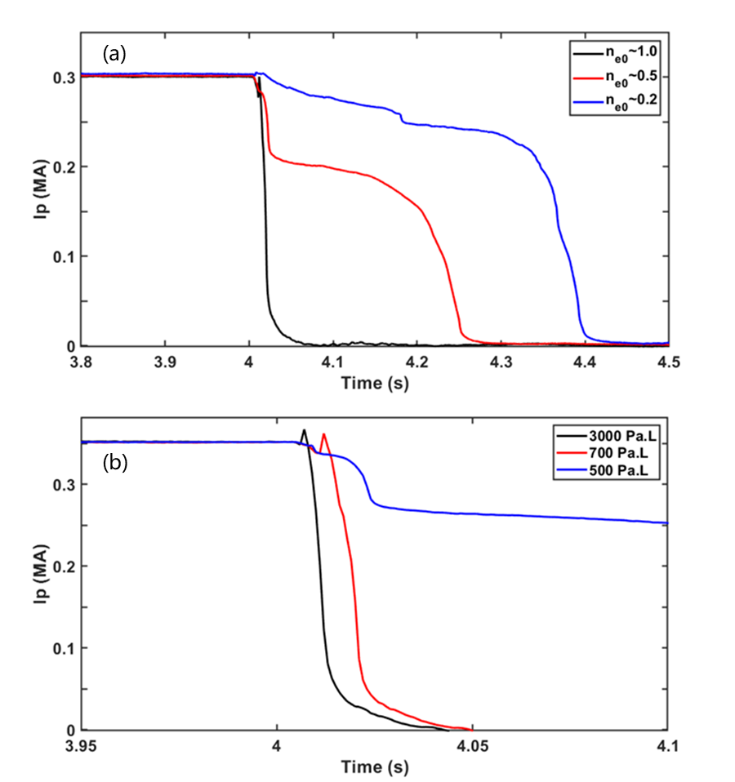
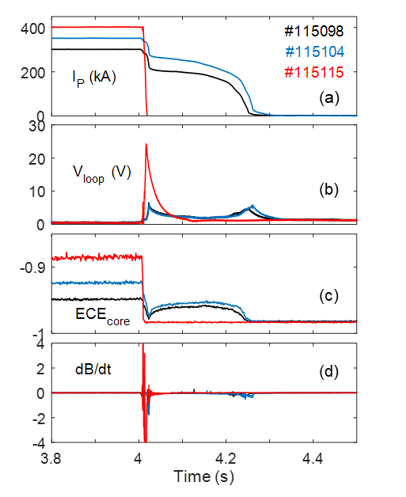
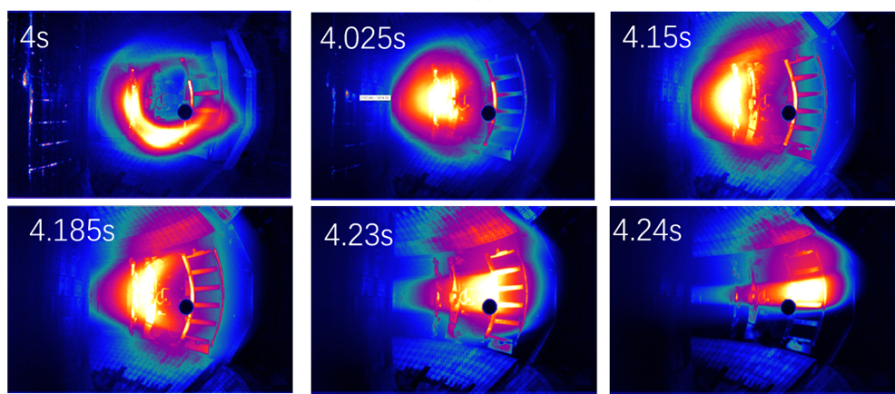
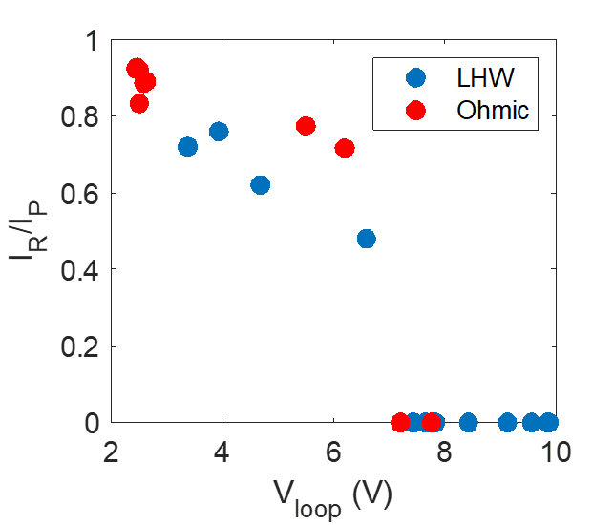
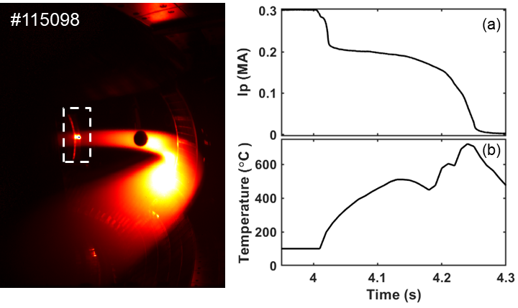
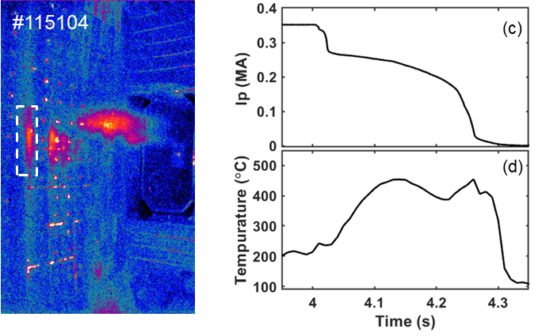
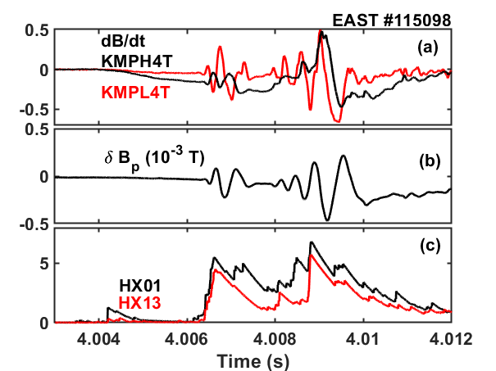
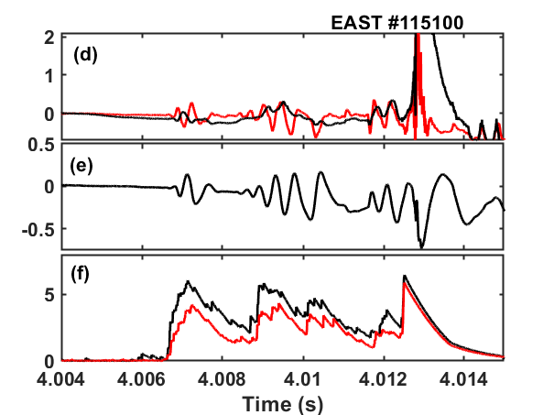
Observation of Runaway plateaus in EAST disruptions triggered by MGI
T. Tang¹, L. Zeng², D. Chen¹, S. Lin¹, H. Zhuang¹, S. Zhao^{1, 3}, B. Zhang¹, Y. Sun¹, Y. Duan¹, L. Xu¹, H. Liu¹,
R. Zhou¹, J. Qian¹, C. Luo^{1, 3}, Y. Jie¹, W. Xia^{1, 3}, X. Zhu⁴, Y. Liang⁵, X. Gao¹
¹Institute of Plasma Physics, Chinese Academy of Sciences, 230031 Hefei, China
²Department of Engineering Physics, Tsinghua University, Beijing 100084, China
³University of Science and Technology of China, Hefei 230031, China
⁴Advanced Energy Research Center, Shenzhen University, Shenzhen 518060, China
⁵ForschungszentrumJülich GmbH, Institute of Energy and Climate Research - Plasma Physics, 52425 Jülich, Germany
Email:tian.tang@ipp.ac.cn
Institute of plasma physics
Chinese Academy of Science
Introduction
Formation phase
Runaway electrons (REs) generated in disruption pose severe threats, including thermal and electromagnetic loads to tokamak. For future large-size tokamaks, REs are of great concern due to beam generated during disruption may carry tens of MA current and could cause fatal damage when REs strike to the wall. Consequently, further understanding of REs physics is essential on nowaday tokamaks to propose effective RE mitigation/avoidance methods.
Plasma parameter scan
ne scan
Typical Runaway plateau
Gas scan
Pre-disruption
Limiter configuration, circular plasma, ohmic discharge;
Ip~300-350kA
low electron density: 0.2-0.5 (10¹⁹ m⁻³);
(a)
RE plateau formation strongly depends on post-disruption density
  No plateau when post-disruption density exceed 3 (10¹⁹ m⁻³) in EAST;
  Different density evolution during disruption due to MHD.
MGI: Argon, ~400Pa.L;
Density increases causes TQ, cold plasma undergoes CQ.
(b)
Ip scan
Post-disruption
I_{RE}~210kA, I_{RE}/I_{p}~70%;
Last up to 200ms, at most 400ms;
Post-disruption density: 2.0 (10¹⁹ m⁻³);
RE seeds play key role in plateau formation
  More RE seeds, higher RE plateau;
  No plateau in Ip~400 kA may due to stronger MHD and RE seeds loss.
(c)
0-D Runaway generation model
$$\frac{d\left(n_{RE}\right)}{dt}=S_{Dreicer}+S_{Hottail}+S_{other}+S_{Avalanche}−γ_{diff}n_{RE}$$
Distribution:
  Ring-like → peak → hollow distribution;
Position:
  Drift outward and hits the LFS;
Energy:
  Higher energy than pre-disruption REs.
S_{pre}=0 kA S_{Dreicer}= 5 kA
S_{pre}=90 kA S_{Dreicer}= 0.8 kA
S_{pre}=200 kA S_{Dreicer}= 2 A
Hot spot induced by REs
Pre-disruption REs contribute to lots of RE seeds
  Few seeds from Dreicer mechanism, hot-tail seeds near 0;
  Consistent with results in discharges with LHW-heating, in which suprathermal electrons provide lots of RE seeds.
RE loss during TQ
MHD activities during TQ lead to seeds loss
3/1
2/1
2/1
  MHD appear from q=3 to q=2, both causes HXR peak;
  Indicating penetration of injected gases;
2/1
    Temperature increase due to radial drift
      Drift outward and hit LFS limiter→sharply temperature increase
      Bounced back and hit HFS wall→ hot spot on Mo wall
  Growth of 2/1 mode lead to final loss and failure of plateau formation.
Summary
Runaway plateaus have been formed in EAST disruptions via massive argon injection into low-density ohmic discharges, which are carried out with circular plasma and limiter configuration in full-metal wall condition. REs are detailly described in the following three phases:
Runaway plateau of Ip~210 kA and last up to 200ms， plateau drift outwards and finally hit the LFS;
Plateau formation strongly depends on post-disruption electron density: pre-disruption density (pre-disruption runaway population) and gases injection;
Sudden temperature increase when plateau hits the LFS;
Institute of Plasma Physics, Chinese Academy of Science

