Slide 1
DIII-D Runaway Electron Mitigation Coil Modeling and RE transport calculations with ASCOT5
V.A. Izzo (Fiat Lux)
A. Battey, C. Hansen (Columbia University)
Acknowledgement (ASCOT5 help): K. Särkimäki
Work supported by DOE-FES

Slide 2
Key points
NIMROD was used to model the DIII-D nonlinear plasma response to the planned runaway electron mitigation coil (REMC)
NIMROD includes RE drift orbit calculation, but follow only a small fixed starting population that is lost as the simulation progresses
A workflow was developed to post-process NIMROD results with the ASCOT5 orbit following code
Resulting diffusion coefficients are compared for different plasma shapes, different RE energies and pitches, and full vs. drift orbits

Slide 3
The DIII-D REMC
An inboard-wall runaway electron mitigation coil (REMC) has been designed for DIII-D, consisting of a single helical turn connected by a single vertical leg
Current in the coil is driven passively by the CQ loop-voltage to produce large 3D magnetic perturbations to help deconfine REs in the CQ phase
Inboard wall design was chosen for DIII-D due to tendency of CQ plasmas to limit on the inner wall
See: D.B. Weisberg et al (2021) Nucl. Fusion 61 106033

Slide 4
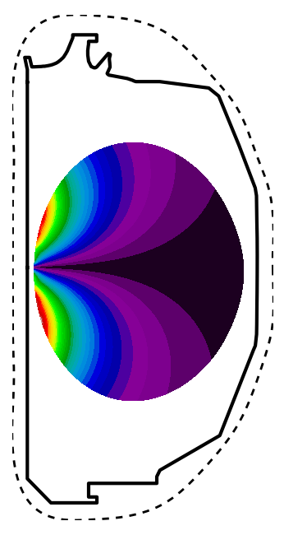
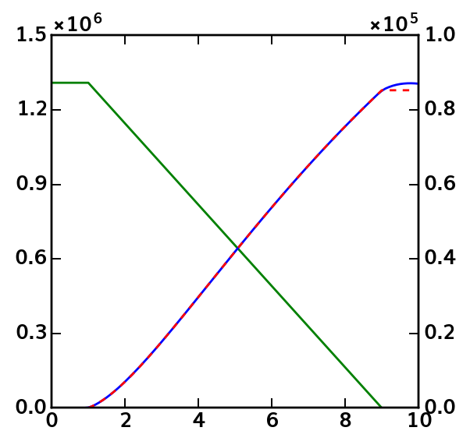
REMC response is modeled with ThinCurr
ThinCurr models the coil and surrounding conducting structures with a series of coupled circuit equations
$$L_{i,j}\frac{∂I_{i}}{∂t}+R_{i,j}I_{i}=V_{j}(t)$$
3D fields at LCFS from ThinCurr are extrapolated to NIMROD boundary for time-dependent B_{n} boundary conditions
Coil current as a function of plasma current is also taken from ThinCurr
|B_{pol}|
Model of conducting structures captures major features like portholes
Filament representation of plasma allow prescribed current rampdown
I_{REMC}(I_{p}) fit
I_{p} [MA]
I_{REMC} [MA]
coil is here
time [ms]
Simulation boundary

Slide 5
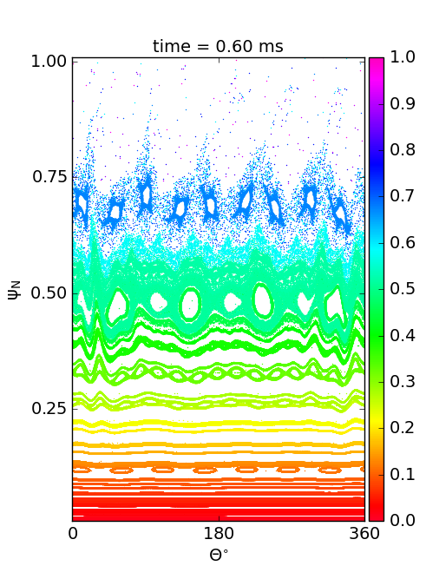
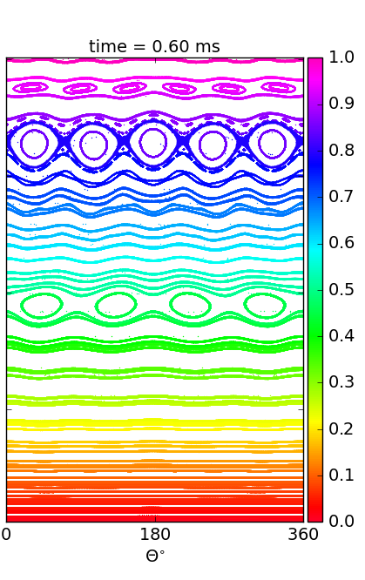
NIMROD results for IWL plasma
6/1
Vacuum fields
ThinCurr fields have more n=2 than coil vacuum fields and produce earlier island overlap
Oscillatory loss rate associates with break-up of successive rational surfaces
9/2
ThinCurr fields
5/1
8/2
4/1
ThinCurr fields
Vacuum fields

Slide 6
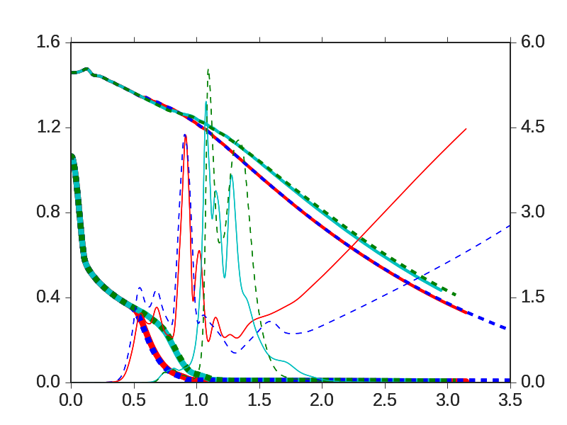
Results for LSN plasma with TQ, comparing ideal and resistive wall
I_{p}
Large quantity of Ne is deposited across the whole cross-section (poloidally and toroidally uniform)
Resistive & Ideal wall cases, w/ and w/o REMC are run
RW cases have vwall = 100 m/s ( = η/δμ₀)
Ideal
resistive
No REMC
w/ REMC
E_{mag.n=1}
W_{th} [MJ] & I_{p} [MA]
E_{mag,n=1} [kJ]
W_{th}

Slide 7
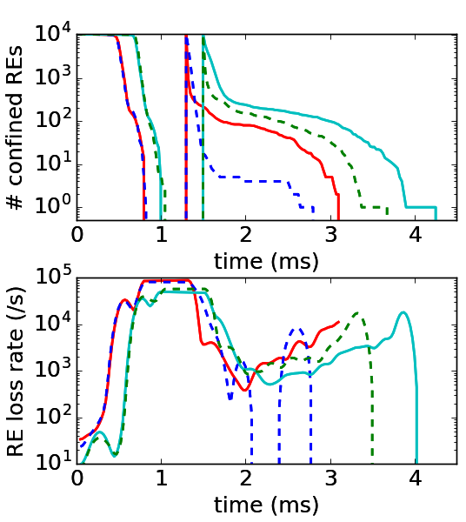
Resistive wall is particularly important when REMC is on
Ideal
resistive
No REMC
All RE test particles are lost due to the TQ MHD in every case
In each case, new population is launched 0.5 ms after initial loss (allow some time to re-heal)
Loss fraction after 0.5 ms is in ~97%-99% range for three cases: RW slightly better than IW. REMC better than not.
REMC + RW exceeds 99.9% loss
w/ REMC

Slide 8
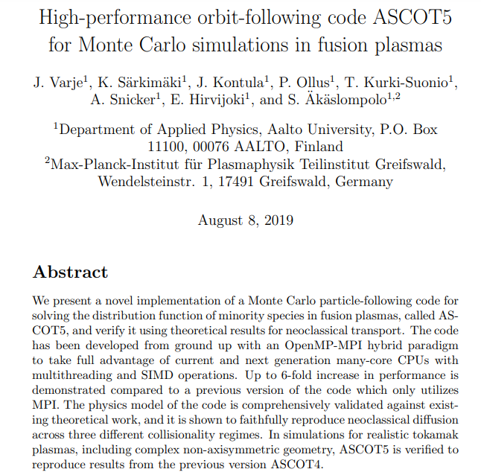
The ASCOT5 code for RE orbits calculations
https://github.com/ascot4fusion/ascot5

Slide 9
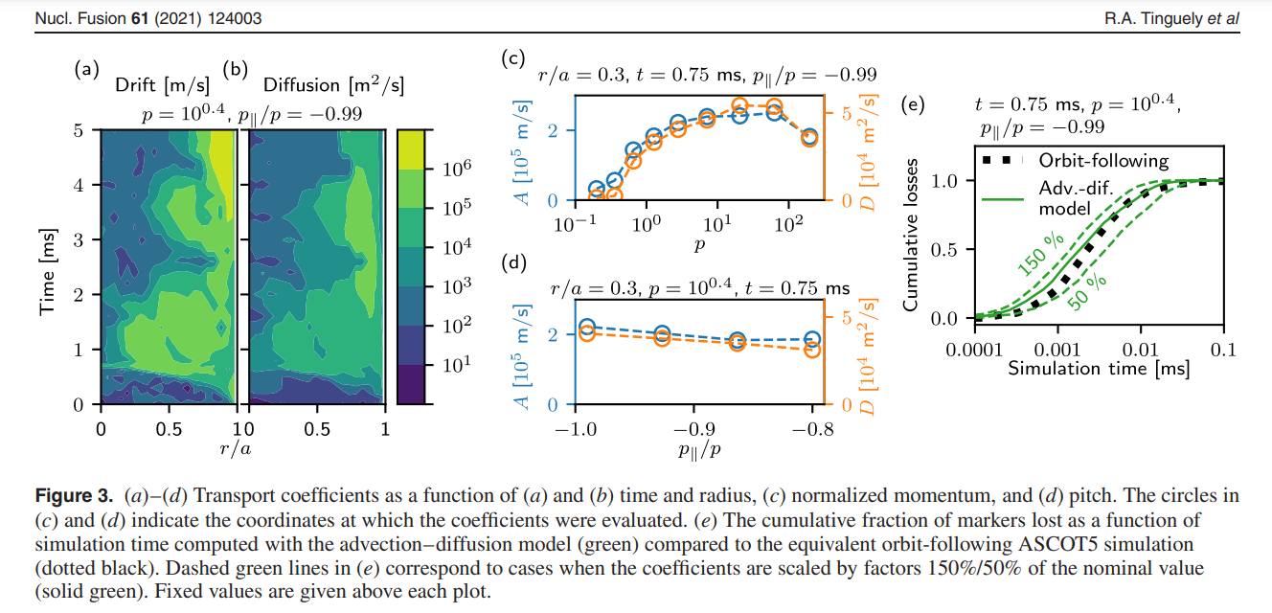
ASCOT analysis was done for SPARC

Slide 10
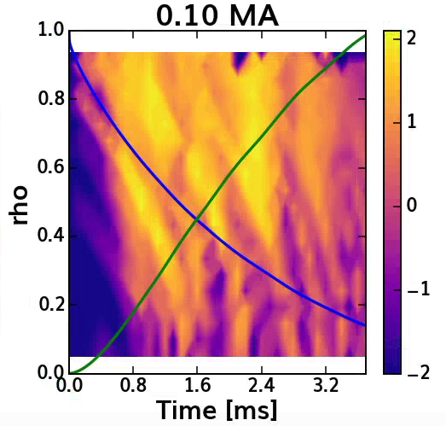
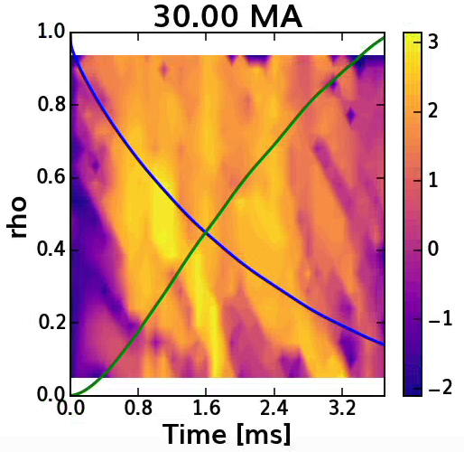
ASCOT5 diffusion coefficients from IWL case
→ All markers have pitch -0.99 and are drift orbit calculations
0.1 MeV
30.0 MeV
Log10(D m²/s)
Log10(D m²/s)

Slide 11
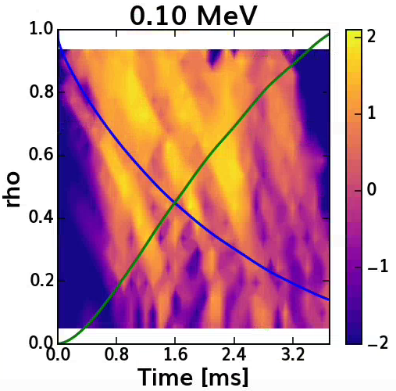
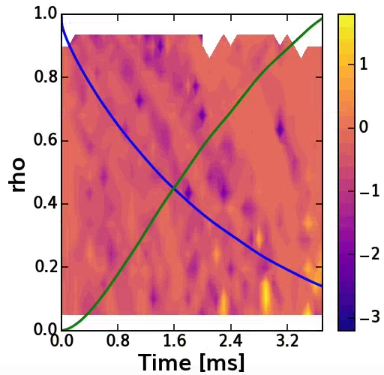
Comparison of drift vs. full-orbit
→ All markers have pitch -0.99 and energies of 0.1 MeV
Full orbits
(Drift – Full / Drift)
Log10(D m²/s)
Log10((D1-D2)/D1 m²/s)

Slide 12
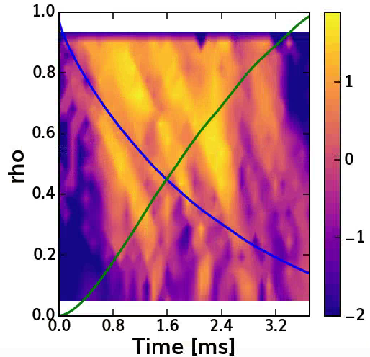
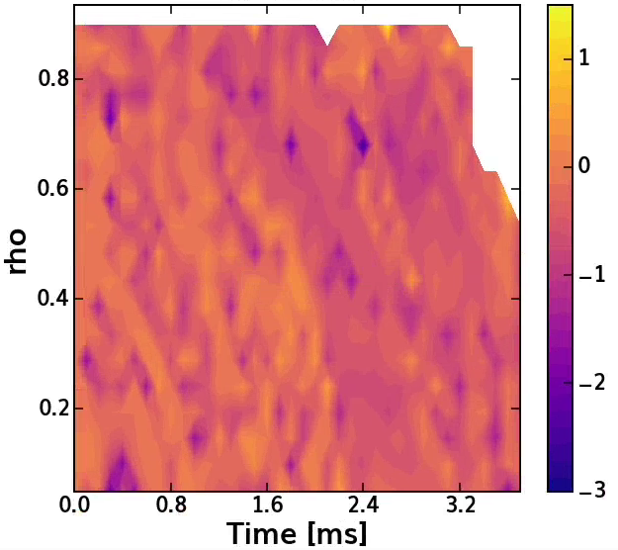
Variation of pitch angle
→ All markers have full-orbit integration and energies of 0.1 MeV
p||/p = -0.7
(p70 – p99 / p99)

Slide 13
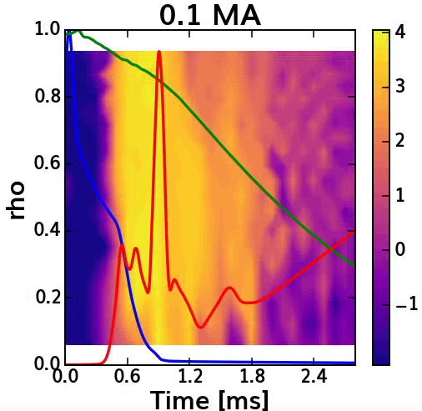
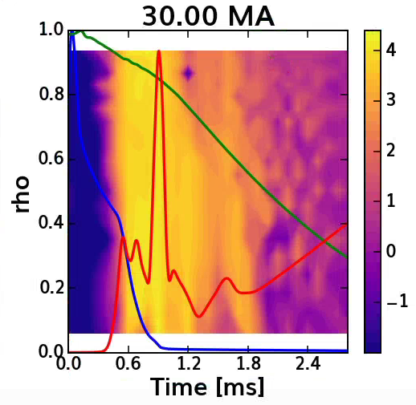
ASCOT transport results for LSN plasma
0.1 MeV
30.0 MeV

Slide 14
Summary of ASCOT5 results
Diffusion coefficients calculated for a range of energies, pitch angles, full vs. drift orbits, and two plasma shapes
Full orbits show 10’s%-O(1) differences from drift orbits
Similar change as pitch is varied
High energies show less small-scale structure associated due to islands than low energies
Largest diffusion in the thermal quench phase when TQ is included
Coefficients can be incorporated into 1D model for RE evolution

Slide 15
Incorporation of ADAS atomic data into NIMROD disruption calculations
V.A. Izzo (Fiat Lux)

Slide 16
ADAS rates replace KPRAD
KPRAD coronal non-equilibrium rates were initially incorporated into NIMROD in 2006; depend only on plasma temperature
Coding uses logarithmic-polynomial fits
ADAS collisional-radiative rates are now incorporated using Aurora
Full ADAS rates can be used when available, otherwise open-ADAS is accessed
Density and temperature-dependent rates are evaluated with bicubic splines

Slide 17
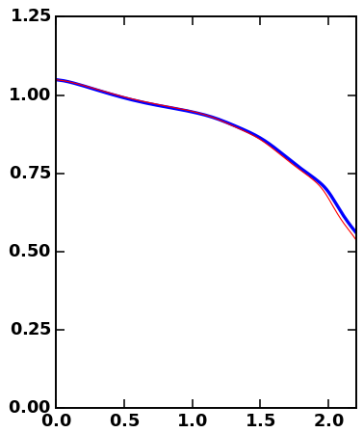
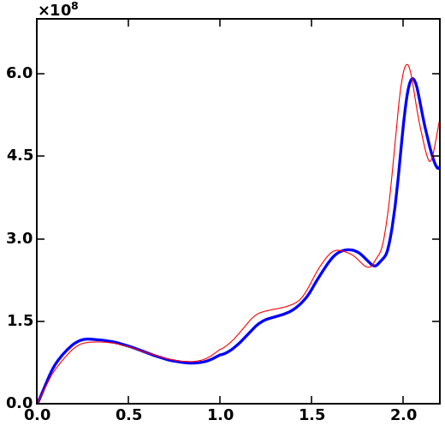
Comparison of Ar MGI into DIII-D
W_{th} (MJ)
KPRAD
P_{rad} (W)
ADAS
KPRAD
Ar MGI simulation run halfway through the TQ
ADAS
Time [ms]
Time [ms]

Slide 18
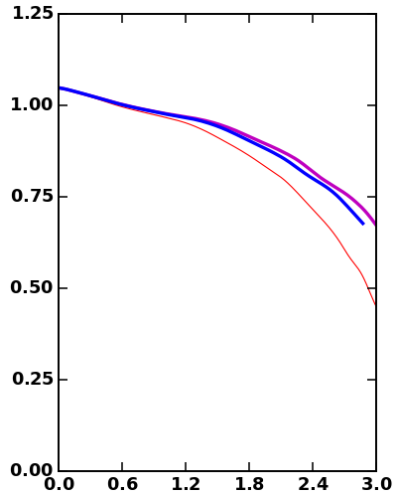
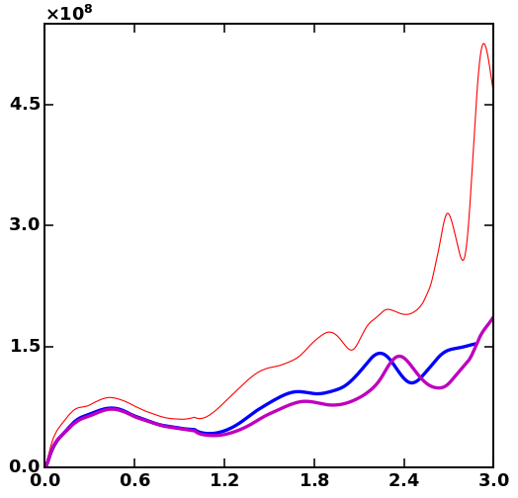
Comparison of Ne MGI into DIII-D
P_{rad} (W)
Full ADAS
Open-ADAS
KPRAD
KPRAD
W_{th} (MJ)
Full ADAS
Open-ADAS
Time [ms]
Time [ms]

Slide 19
Summary of ADAS/KPRAD comparison
Ar data from ADAS and open-ADAS is identical; radiation rate differ very slightly from KPRAD, but very similar evolution up to midpoint of TQ
Ne datasets from ADAS and open ADAS differ, but are close; KPRAD rates differ more than for Ar
Higher KPRAD radiation rates at early times leads to faster TQ onset

