Slide 1
Fluid and kinetic modeling of runaway electron seed generation during disruptions
Ida Ekmark,
M. Hoppe, T. Fülöp, R.A. Tinguely*, R. Sweeney*, P. Jansson, L. Antonsson, O. Vallhagen, I. Pusztai
Third Technical Meeting on Plasma Disruptions and their Mitigation, September 2024
* Funded by Commonwealth Fusion Systems (CFS)
Notes:
This last year
This last year, I’ve mostly been working on running and comparing fluid and kinetic simulations with the focus on disruption and runaway mitigation
15 s
Gennerellt: Mer tid att motivera plottar
Primary sources

Slide 2
Spot the difference
RE seed generation edition
Fluid simulation
Kinetic simulation
simulation
simulation
Notes:
Spot difference
Run fluid kinetic sims same, both pure, compared outputs, try find out, diff results
Today focus Runaway seed generation
Basically, you could say that I’ve played a very long and convoluted game of ”Spot the difference”.
I’ve run fluid and kinetic simulations of the same disruption scenarios, both with pure deuterium plasmas and deuterium-tritium plasmas, and compared the outputs to try to find out why they don’t give the same results.
Today, I will focus on how the RE seed generation differs between the two models
The main advantage of fluid simulations is of course that they are computationally efficient, but kinetic simulations are generally more accurate.
50 s

Slide 3
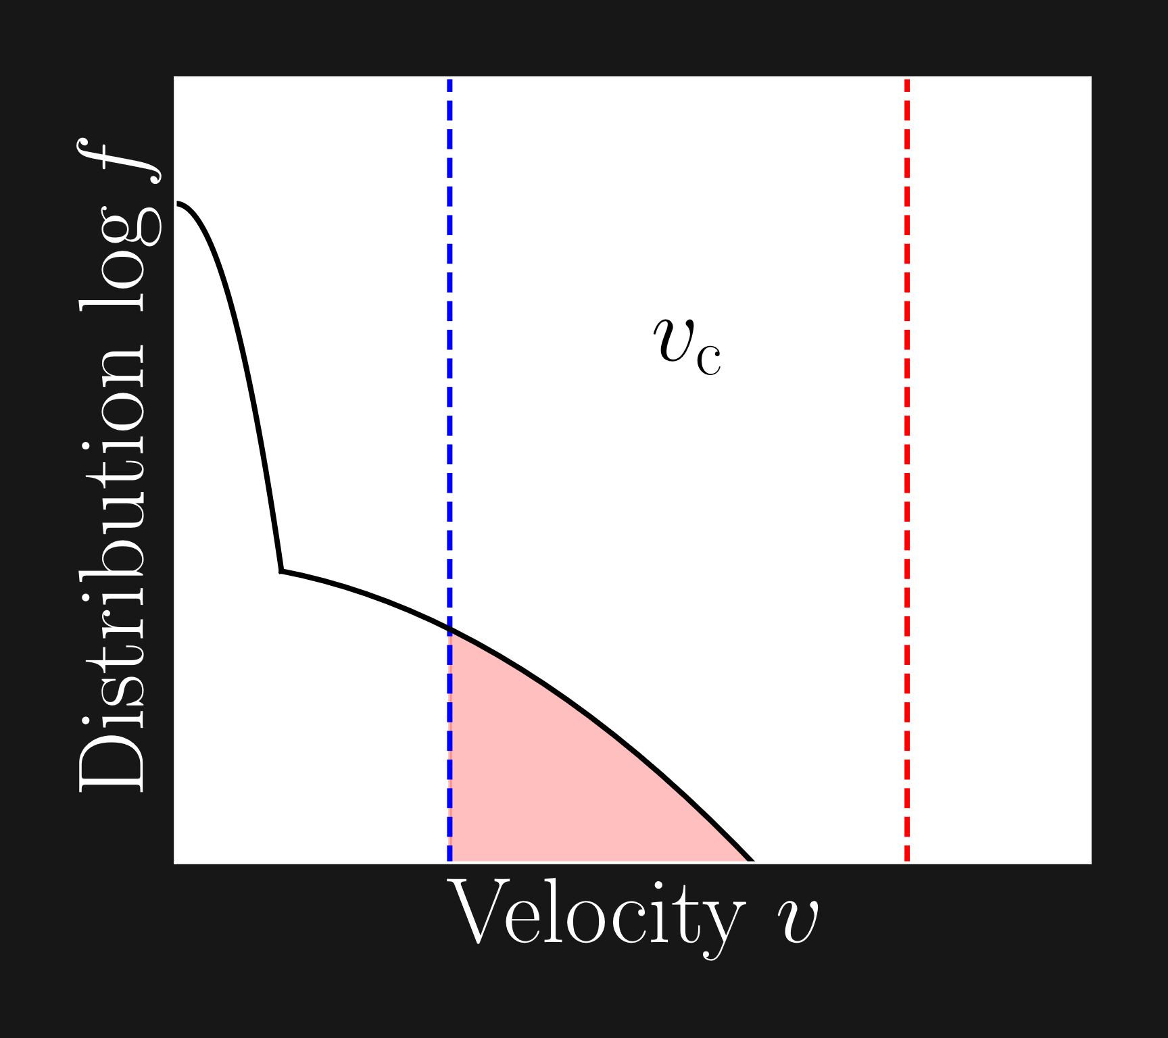
Runaway generation
Dreicer generation
Diffusive process
Hot-tail generation
Rapid cool down + electric field increase
Compton scattering and tritium beta decay
Avalanche generation
Collisions → Exponential increase
Seed generation mechanisms
Notes:
Dreicer gen, diffusive process, electrons vel below, vel above, collision other non runaway electrons
Hot-tail gen – TQ, rapid cool down, electrons higher vel not have time slow down lower collisionality, E-field spike

Slide 4
DREAM
Disruption Runaway Electron Analysis Model¹
Self-consistent evolution
Background plasma parameters as fluids
Electrons
Fluid
Kinetic
¹ M. Hoppe et al., Comp. Phys. Comm., 268, 108098 (2021)
Notes:
Simulations DREAM
Simulation tool self consistent
Background
electrons
The simulations have been performed using DREAM
DREAM simulation tool simulate REs disruptions and evolves plasma params selfconsistent
Background T, E-field, ions fluids, to lessen computational cost
The electrons can be simulated either kinetically or as fluids.
30 s

Slide 5
DREAM – Electrons
Kinetic model (reduced)
Distribution function for hot electrons
Plasma with two electron temperatures
Analytically averaged over pitch angle¹
Seed generation as momentum space flux
Fluid model
No distribution function evolved
Seed generation from (semi-)analytical formulas
¹ M. Hoppe et al., Comp. Phys. Comm., 268, 108098 (2021)
Notes:
Big difference fluid reduced kinetic, dist fun hot electrons
Electrons divided three groups
Low momenta – cold, thermal electrons, runaway electrons are electrons with momentum above critical momentum
Hot, superthermal, electrons momenta similar typical values of critical momentum
Since dist fun only hot electrons, while cold and runaways fluids, there technically two e temps – one cold one hot
especially useful MMI sims, hot initial, cold injected material.
Back distribution function, evolved Fokker-Planck + specifically analytically reduce comp cost
Good approximation, for all e momenta below critical, pitch-angle scattering typically stronger all other effects, hot e just below critical main contributors seed generation.
Using such reduced kinetic thus still enables model seed kinetically momentum space flux
Fluid –no dist, all gen rates determined by analytical and semi-analytical formulas
Aside – avalanche transport
The big difference between the fluid and kinetic models that we’ve used is that the kinetic model evolves the distribution function of the superthermal, or hot, electrons.
The distribution function is evolved using the Fokker-planck equation – more specifically, in our model we have used Fokker-planck equation which is analytically averaged over pitch angle.
It is possible to assume that the distribution is almost isotropic due to relatively low energy of these electrons.
It is evolved in a specified momentum range, which encompasses the typical values of the critical momentum.
This is what enables us to simulate the seed generation kinetically
The density of the runaway electrons is governed and evolved according to these equations.
In the fluid case, all seed generation is modelled by generation rates.
In the kinetic simulations, the runaway generation dynamics around the critical momentum is covered by momentum space flux, determined by the fokker-planck equation.
The generation above the upper limit of the momentum range is still modelled by generation rates
Aside from the seed generation mechanisms, avalanche generation and transport due to magnetic perturbations will affect the runaway density, and they are treated identically for the runaways in both models.
2 min
Mer info om populationer
Mer info om isotropic (analytically averaged)/superthermal och fördelarna med dem
Vad är superthermal electrons
Eventuellt ekvationer i ord istället
Om phi, sätta phi på figure? Säga flux phi?
Reduced kinetic model
Tydliggöra kritisk moment encompassed by momentum grid

Slide 6
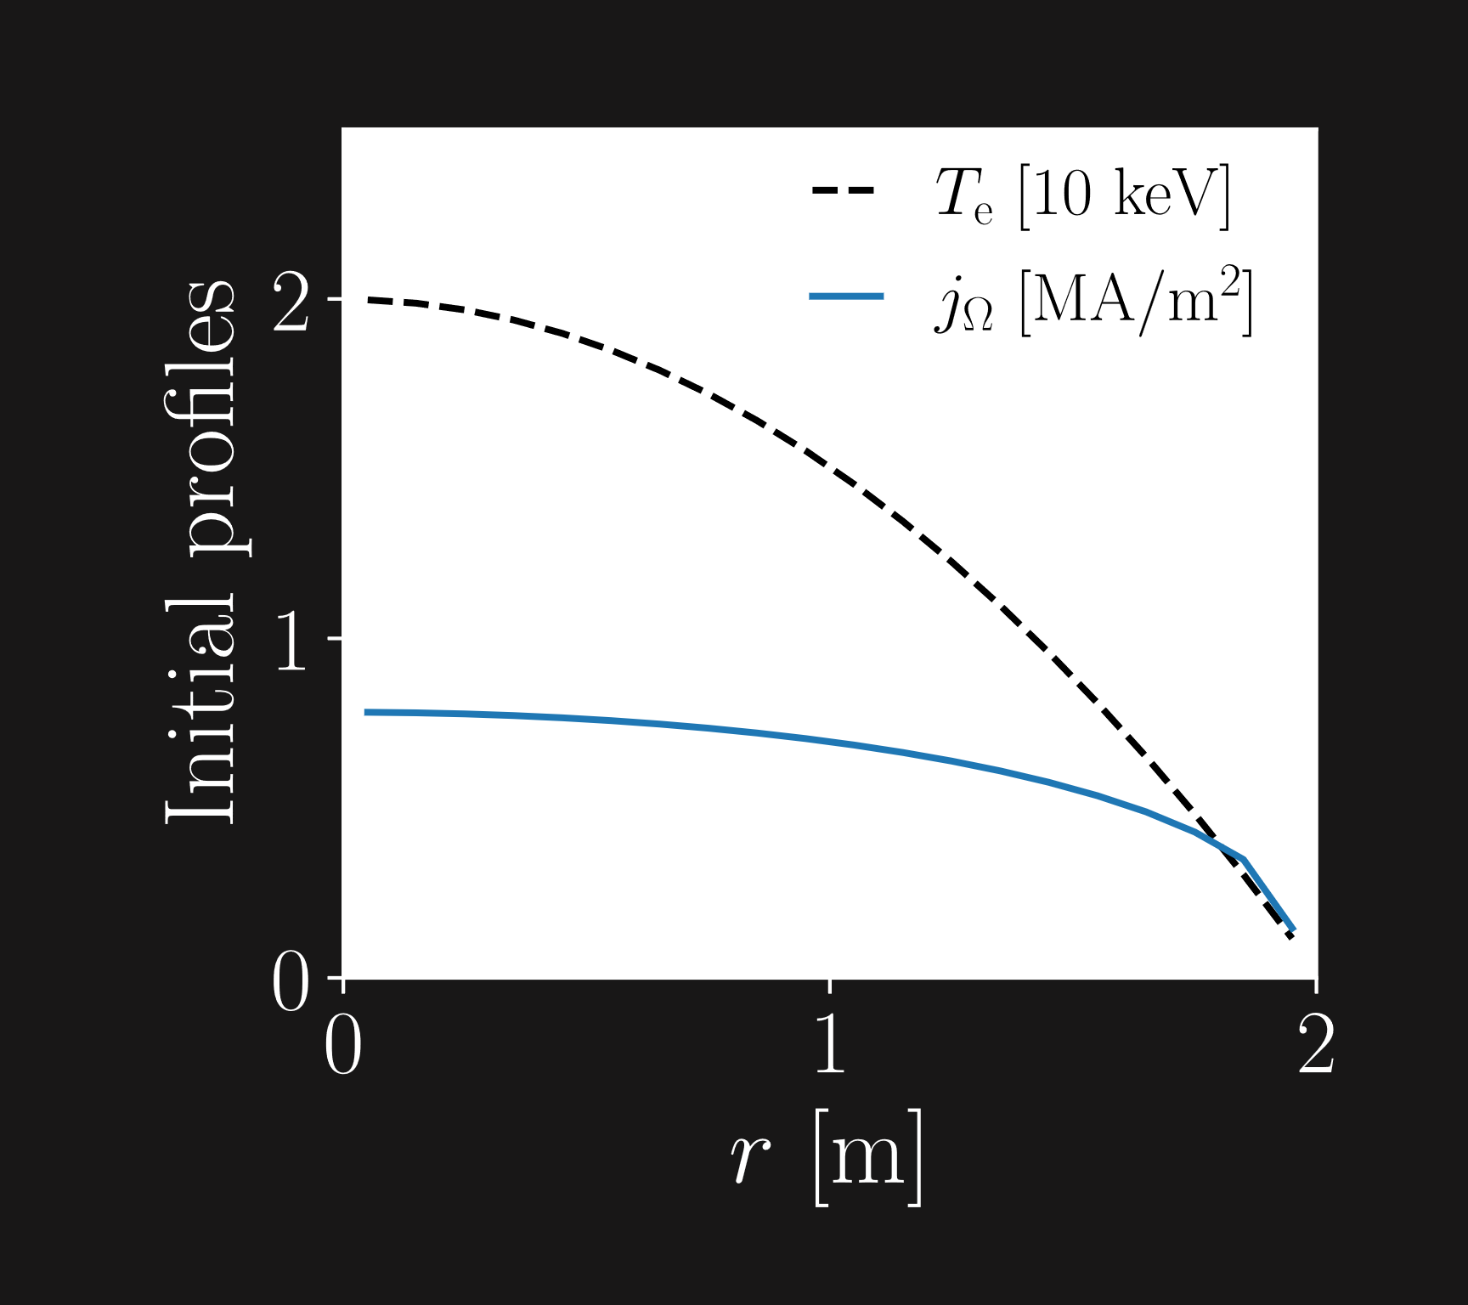
Non-activated scenario
Deuterium plasma
ITER H-mode case
Rechester-Rosenbluth diffusion with
during the TQ
RE primary sources (seeds)
Hot-tail
Dreicer
Notes:
First look non-activated scenario deuterium plasma
ITER H-mode case with 15 MA initial plasma current, profiles as in figure
Transport magnet pert modelled Rechester-Rosenbluth TQ
Primary, or seed, gen from hot-tail Dreicer
Disruption caused MMI deuterium and neon

Slide 7
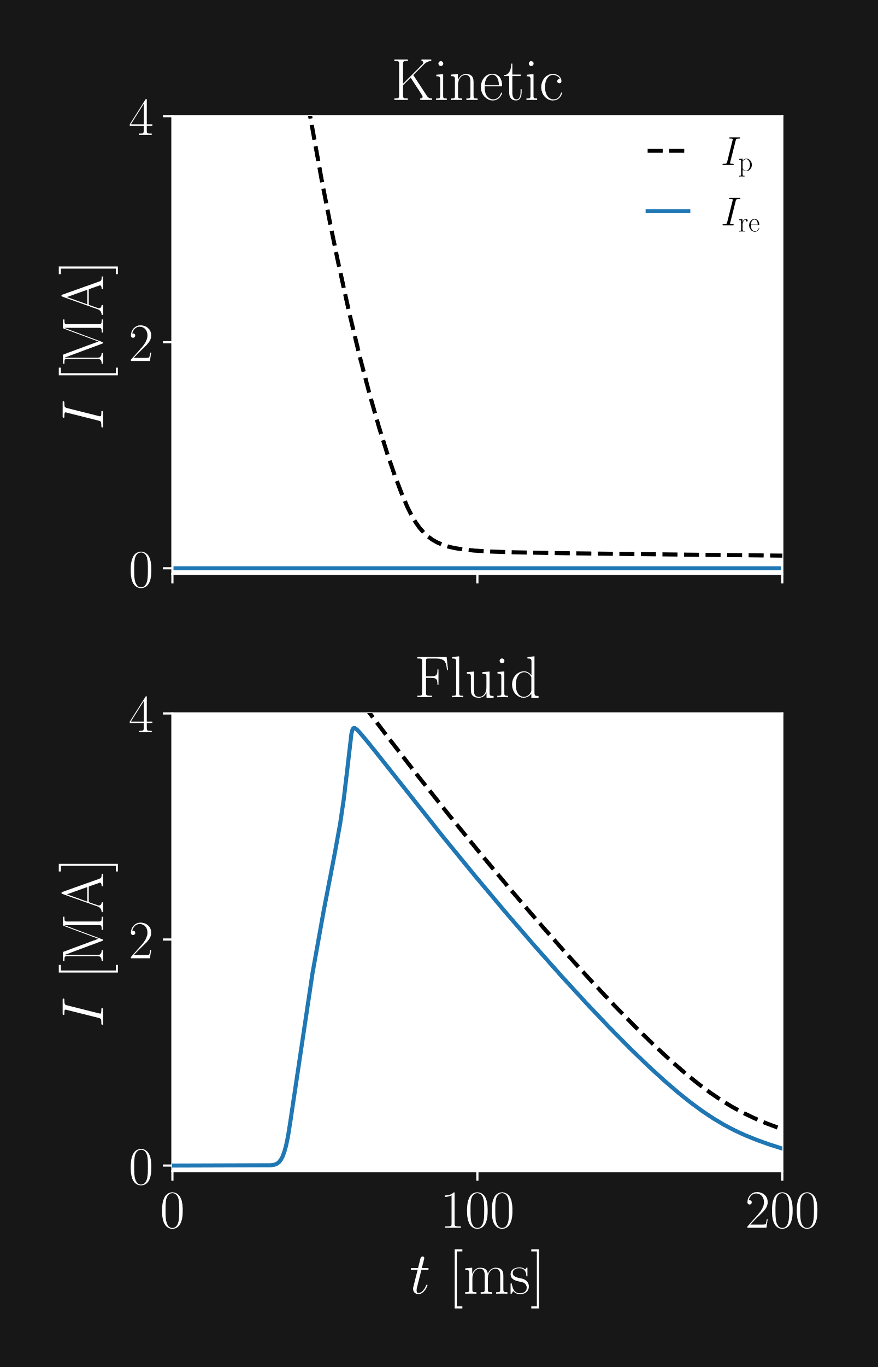
Non-activated scenario
Kinetic – Momentum space flux
Fluid – Generation rates
Dreicer: neural network
Hot-tail: estimation of distribution function²
² H.M. Smith & E. Verwichte, Phys. Plasmas., 15, 072502 (2008)
Notes:
Plasma RE current from sim scen
Fluid several MA, kinetic successful
Said Before, gen kinetic
Fluid, dreicer NN hottail formula Håkan
Requires estimate + gen rate prop
Crit momentum det estimate
Here are the plasma and runaway currents from this scenario.
The fluid simulation produces a several MA RE current, while the kinetic simulation displays successfull mitigation.
As I said before, the seed generation in the kinetic simulation is entirely made up of momentum space flux.
In the fluid simulation on the other hand, the Dreicer generation is determined by a neural network, and the hot-tail generation is determined by a formula derived by Håkan Smith.
This formula requires an estimate of the distribution function of the hot electrons, and the actual generation rate is proportional to the value of this estimated distribution function at the critical momentum.
Additionally, the critical momentum used is also determined by this estimate of the distribution function.
1 min 20 s
Förklara NN mer (eller säga mer om det senare)
Flytta footnote

Slide 8
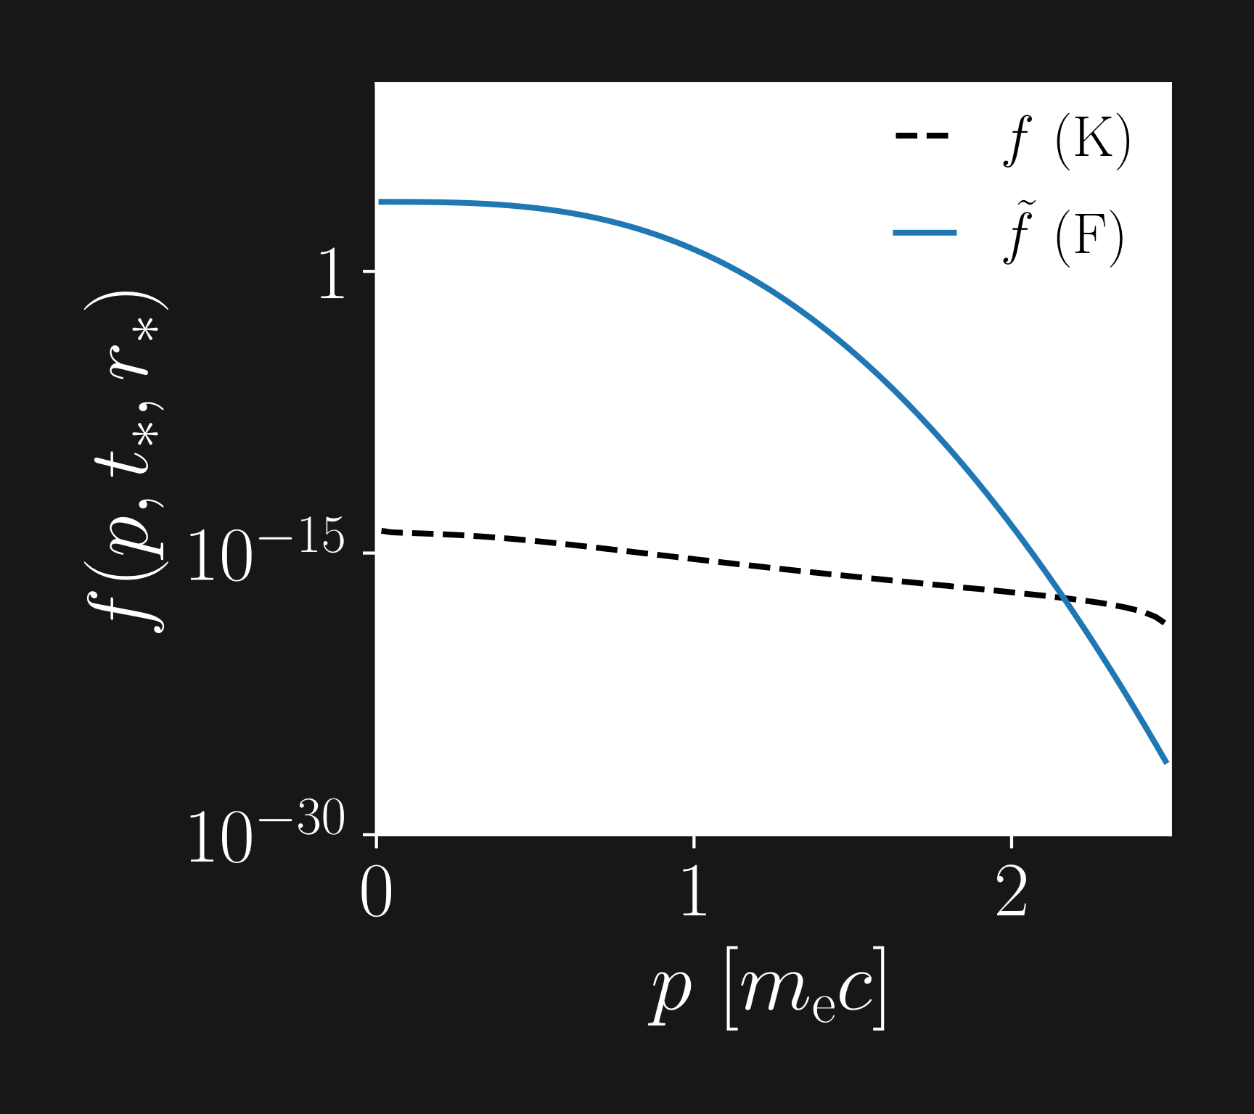
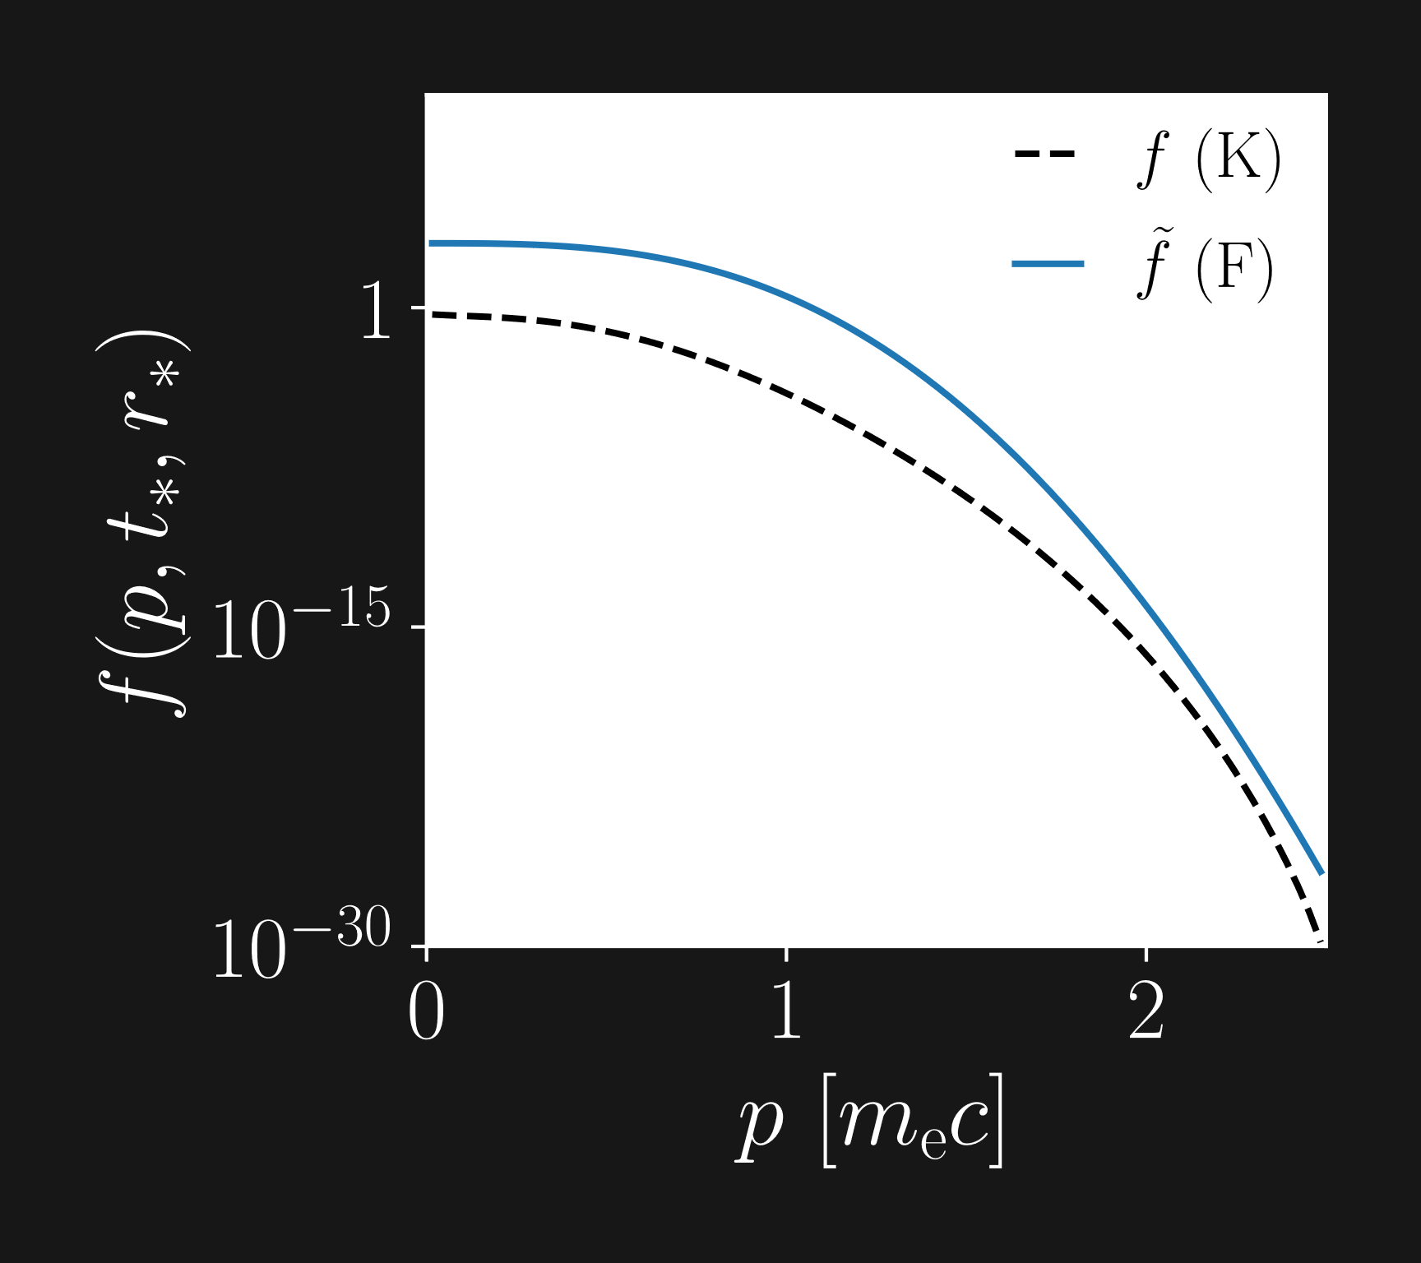
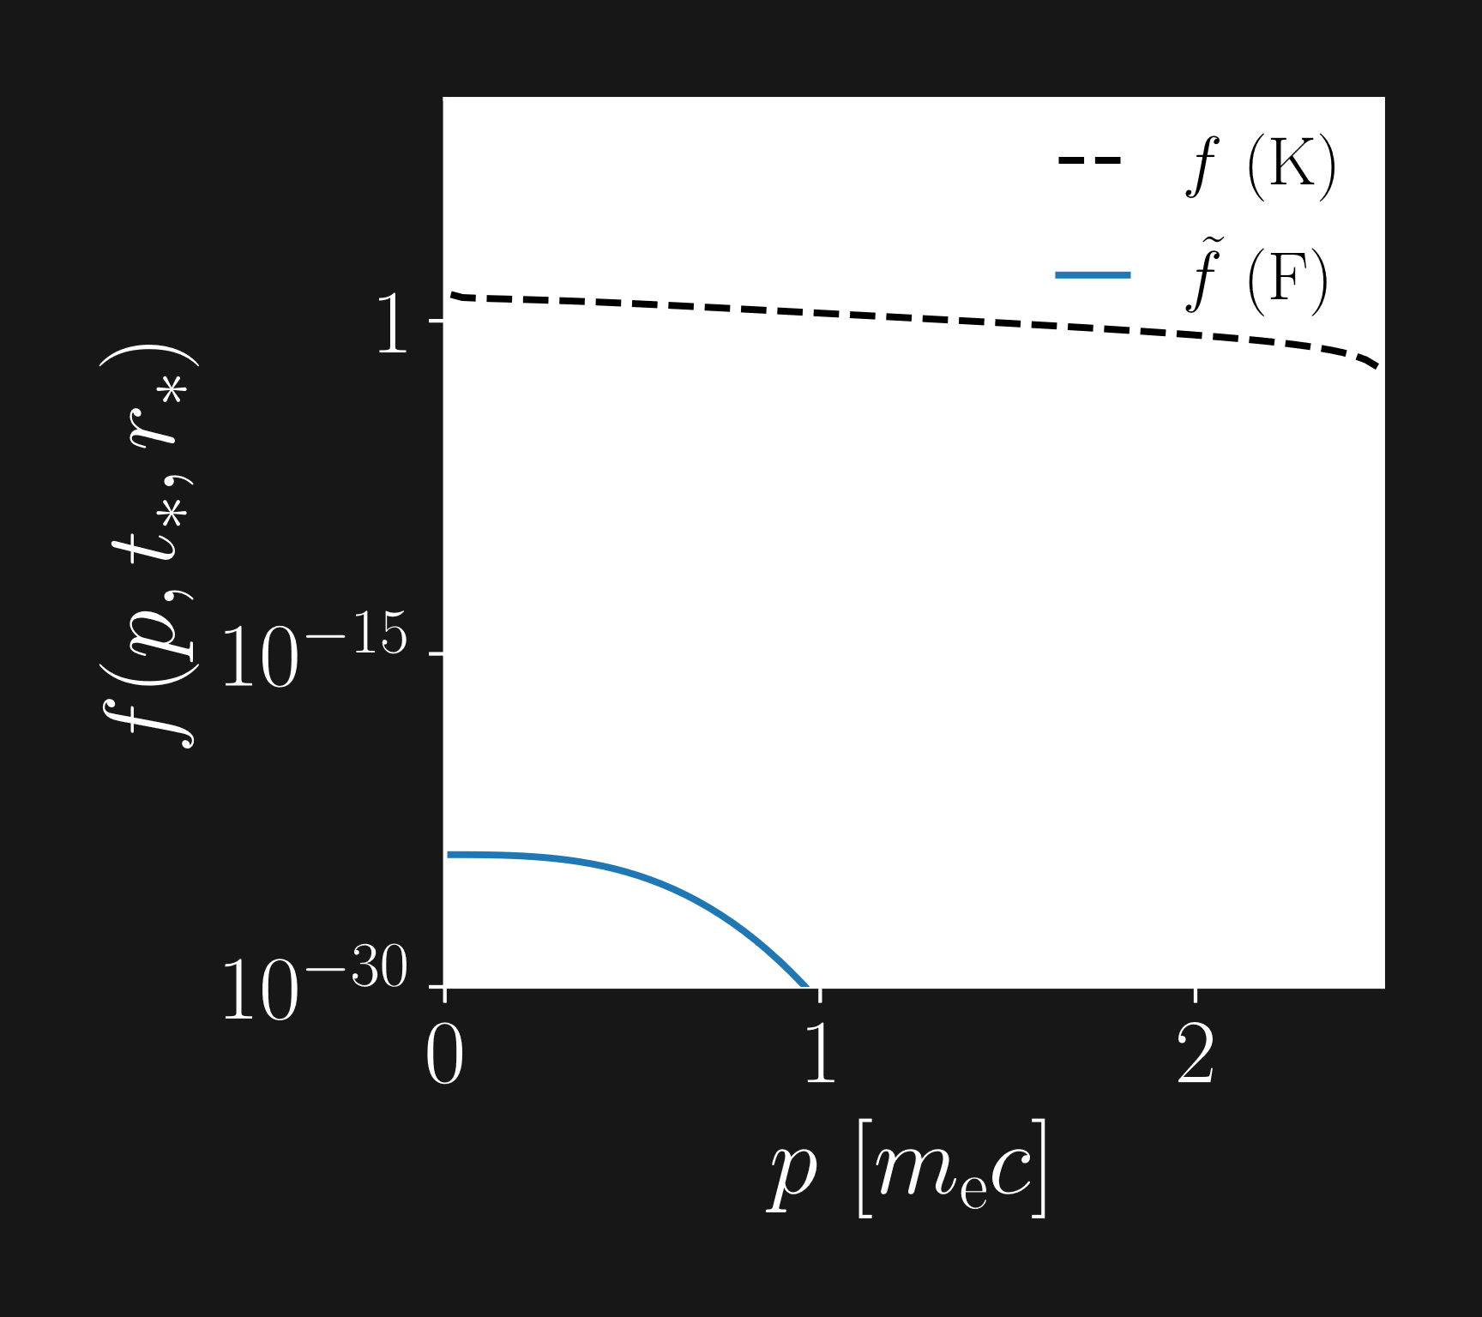
Hot-tail
Kinetic
Fokker-Planck equation
Fluid
Electric field acceleration
Radial diffusion
Collisional friction
1
Notes:
In order estimate
Expression proportional
Collisional friction effect slow down – kinetic slower fluid
Not case
Here kinetic dist fun black, fluid est blue end TQ radius maximum re dens fluid
Kinetic dist fun much smaller + one difference
What remove?
Same radius time, negligible RE density both, no e-field acc kin
Only coll fric – similar
If look radius time RE dens not negligible – when e-field acc rel
First diff spotted – diffusion negl
In order t estmimate the distribution function in the fluid case, we neglect the electric field acceleration and radial diffusion, and assume that the only relevant effect for evolving the distribution function is collisional friction.
We get an expression for the distribution function being proportional to something like this, where we have momentum, thermal momentum and the collision time.
Since collisional friction is an effect that slows down the electrons, one might expect that tha distribution function of the fluid simulation should decrease faster than the kinetic simulation, which also considers electric field acceleration.
This is however not the case.
Here we see the kinetic and fluid distribution functions at a time near the end of the TQ for the radius with maximum runaway current density at this time.
For reference, we also see the distribution functions at the start of the TQ.
As you can see, the kinetic distribution function is much smaller than the fluid one.
The one difference that can explain this is the radial diffusion from the magnetic perturbations
So what happens if we simulate without diffusion instead?
If we look at the same time and same radius, we get something like this.
The RE density is negligible for this radius, so we can assume there is almost no electric field acceleration in the kinetic case either.
For both distribution functions, the only relevant effect should be the collisional friction, and the two distribution functions should be similar, which they are.
If we instead look at a radius with non-negligible RE density, and at a time slightly later, we see that when electric field acceleration is relevant, the fluid distribution function decreases faster than the kinetic one, as we anticipated.
We have therefore found our first difference – the radial diffusion that is being neglected in the fluid model for the hot-tail generation rate, and thus causes the fluid hot-tail generation rate to be overestimated.
3 min 30 s
Ta bort p_c och initiala fördelningar
Ta bort RE-densities

Slide 9
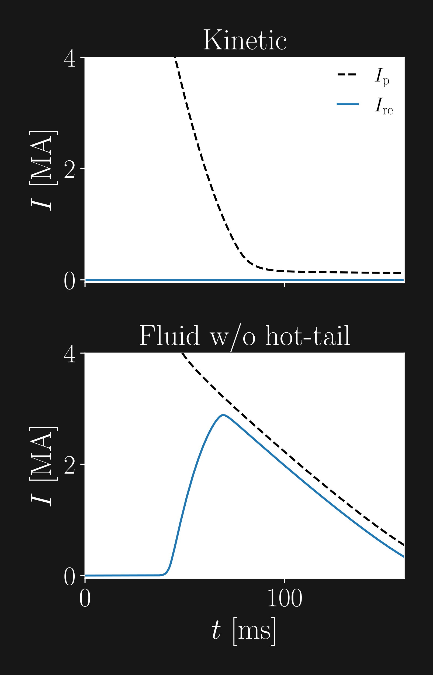
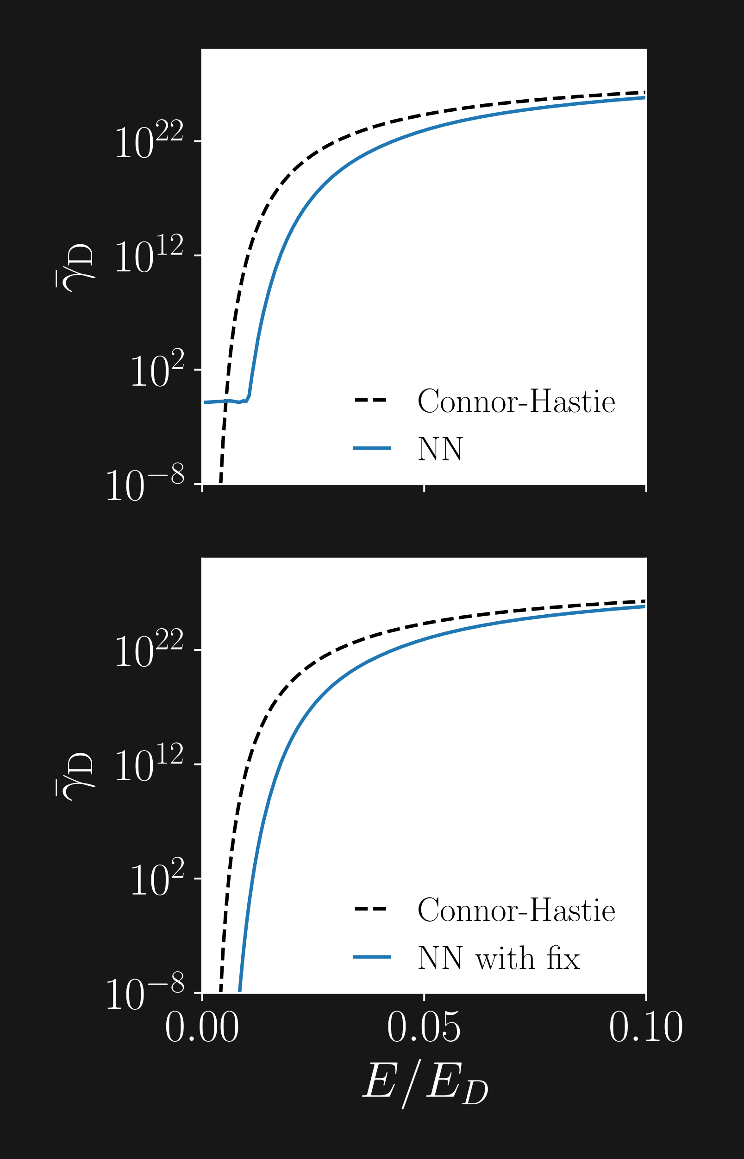
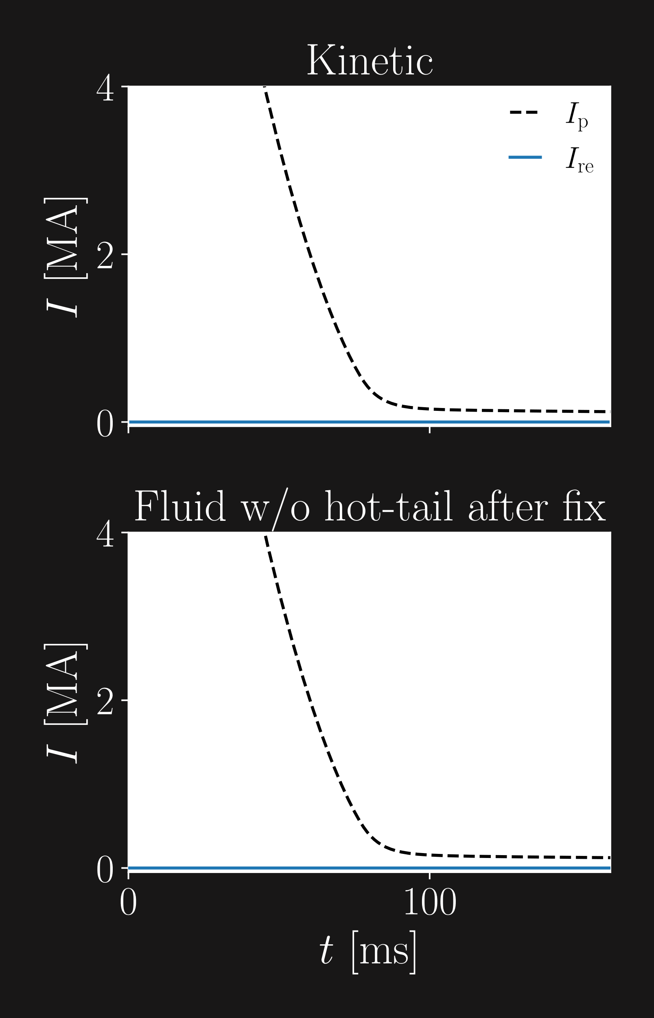
Dreicer
Kinetic
Fokker-Planck equation
Fluid
Neural network
Trained on ~100 000 kinetic simulations
Trained with
Fit of exponential function for low values of
2
Notes:
Then Dreicer?
Hot-tail negligible kin sim, turn off, isolate
Several MA
NN determins D gen E-field norm, T, n and has been trained on around 100 000 kinetic simulations with different combinations of these three parameters
Importantly – norm E data
Here predicted Dreicer rate for fixed T n and varied E-fied compared to connor-hastie overestimates
Discrepancy fluid kinetic – tail, low E
Connor hastie not, tends
Second diff spotted – NN innacurate pred low E
This we have already fixed – for low values now do fit to exponential function so dreicer gen rate tends to zero in same manner as Connor-Hastie formula
Current dynamics for fluid much more similar kinetic curr dyn
Then what about the Dreicer generation?
Now, since we know that the hot-tail generation is negligible in the kinetic simulation, we turn this the hot-tail rate off in the fluid simulation to isolate the effect of the fluid Dreicer generation.
We still get a several MA RE current.
The neural network determines the Dreicer generation rate based on the electric field normalized to the Dreicer field, temperature and electron density of the plasma.
Importantly, the normalized electric field data the NN has been trained on is larger than 0.01
If the temperature and electron density are fixed, and the electric field is varied, the NN gives the following prediction for the Dreicer generation rate.
In the plot, we see the NN-prediction compared to the Connor-Hastie formula, which is known to overestimate the Dreicer generation rate
This migth be familiar from last year for some of you, but the reason for the discrepancy we see in the RE current is this little tail for low electric fields
The Connor-Hastie formula does not have such a tail – instead it tends to zero with the electric field, as one would expect.
This is our second difference – the NN giving innaccurate values for the Dreicer rate for small values of the electric field.
2 min 10 s
Say att de kanske kommer ihåg
Minska innehållet

Slide 10
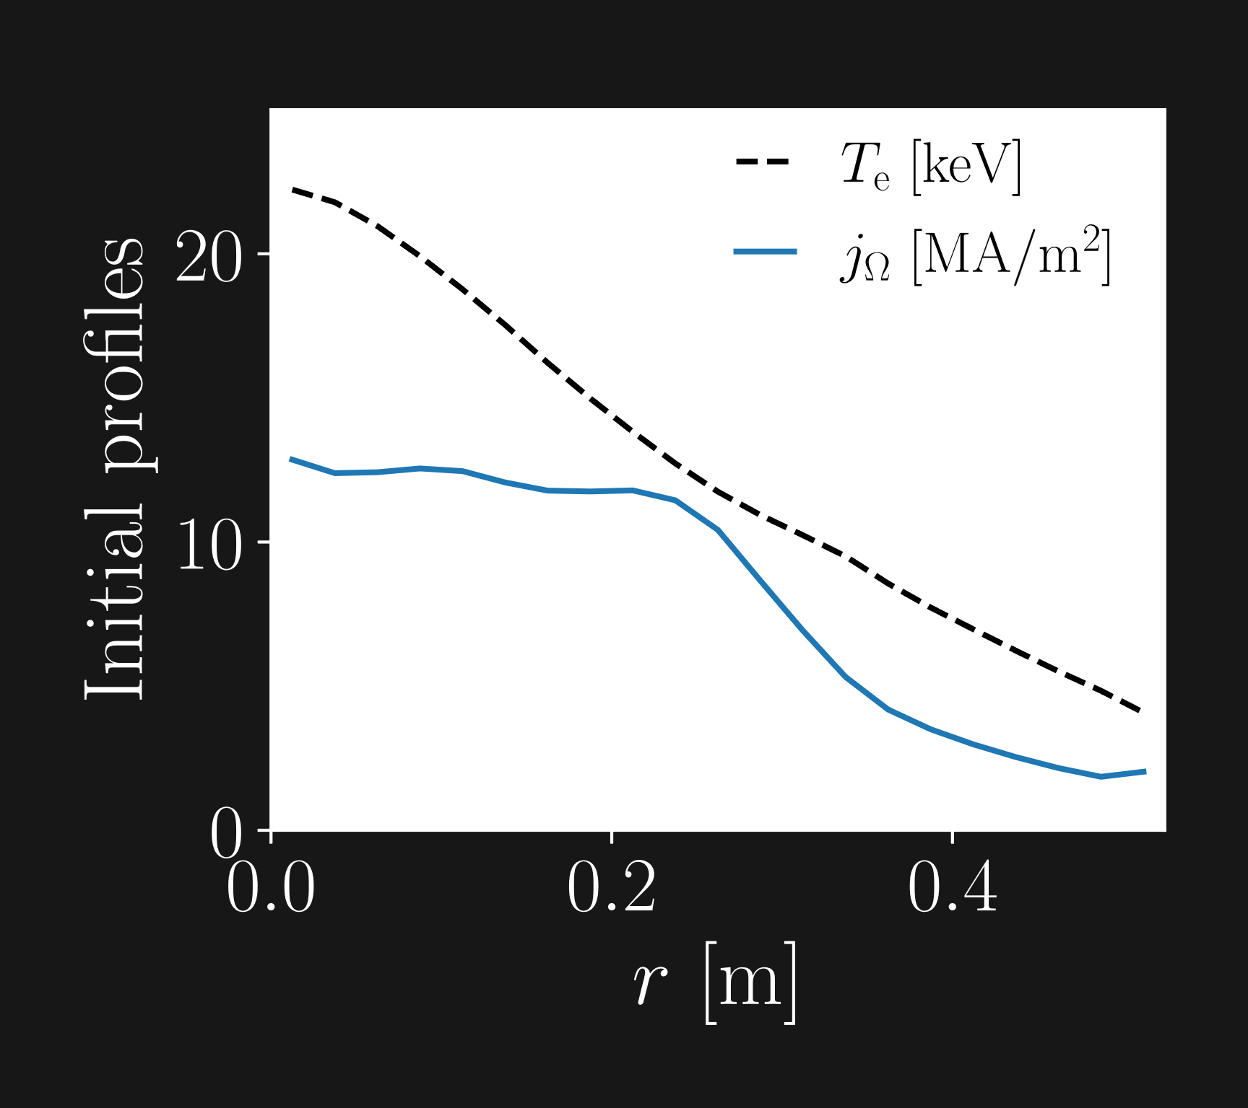
Activated scenario
Deuterium-tritium plasma
SPARC primary reference discharge
Rechester-Rosenbluth diffusion with
during the TQ
RE primary sources (seeds)
Hot-tail and Dreicer
Tritium β-decay and Compton scattering
Notes:
Move on activated Deuterium tritium
The primary reference discharge SPARC 8.7 MA and initial profiles from figure
Magnetic pert 0.3 % + disruption MMI
Aside hot-tail dreicer, RE seed gen from tritium Compton considered
But before compare act seeds affect dyn differently, implement kin versions
Let’s move on to an activated scenario
Here we instead have simulated a deuterium-tritium plasma in SPARC with 8.7 MA plasma current
We use magnetic perturbations of 0.3 %
Aside from hot-tail and dreicer, RE seed generation from tritium beta decay and compton scattering is also considered.
But before we could compare how the two activated sources would affect the dynamics differenlty in the fluid and kinetic models, we had to implement kinetic versions of these sources.
50 s
Lägg till initial profiles? I_p och B0, a
SPARC Primary reference discharge

Slide 11
Tritium β-decay
β-electrons energy spectrum
Nonrelativistic Fermi-function
Isotropic
Notes:
For tritium beta decay, increase dist fun depend E spectrum
Emmision spect depends
Also depends fermi, accounts Coulomb forces beta e helium nucl
Max enerrgy rel small, non-relativistic fermi fun, depends
Electrons emitted random uniform, assume source isotropic
Source gen small momentum element equal energy spectrum corresponding kin energy
Yields expression tritium beta decay
C comes norm energy spec, also account tritium density and half life
For tritium beta decay, the increase in the distribution function will depend on the energy spectrum of the electrons emitted during the decay.
This emmission spectrum depends on the momentum, total energy, kinetic energy, and the maximum energy possible for the electrons to obtain from the decay, which is 18.6 keV
It also depends on the Fermi-function , accounting for the Coulomb forces experienced by the beta electron and helium nucleus after the decay
Since the maximum energy is relatively small, we can use the nonrelativistic fermi function, which depends on the charge of the final nucleus (helium in our case), the normalized speed beta and the fine structure constant alpha.
Since the electrons will be emitted in a random direction with uniform probablity, we can assume that this source is isotropic in pitch angle, and thus only depend on the momentum.
The source generation for a small momentum element should therefore be equal to the beta spectrum for the corresponding small kinetic energy element
This yields the following expression, where we’ve used the expressions above.
The constant C comes from normalization of the energy spectrum, and we also account for the tritium density and half life.
1 min 50 s
Inte olika färger? En liten bulletpoint för de definitionerna
Beta, to the -power of p/gamma? Ta bort betas?

Slide 12
Compton scattering
Klein-Nishina differential cross section
Relation between deflection angle and energy
Isotropic
Notes:
Compton scattering source gen depend diff cross photons free e, Klein-nishina
This cross depends
Also need this relation defl angle photon energ, and due energy cons
Once again assume isotropic photons emitted walls around enter all almost uni dist
Source gen small momentum element equal int photon flux spectrum for corresponding e kin energ mult diff cross
Break out simplify, get this expression
Also account number e available photon scat
The compton scattering source generation depends on the differential the cross section of photons on free electrons, or the Klein-Nishina differential cross section.
The Klein-Nishina differential cross section depends on the classic electron radius, the energy of the initial and scattered photon, and the deflection angle of the scattered photon.
We also need this relation between the deflection angle and the photon energies, and due to energy conservation, the energy of the scattered photon will be equal to the initial photon energy minus the electron energy.
Once again, we can assume the source is isotropic in pitch angle, since photons will be emitted from the walls all around the plasma and thus enter the plasma from all directions with almost uniform distribution.
Source generation in a small momentum element should therefore be equal to the integrated photon flux spectrum for the corresponding electron kinetic energy, multiplied by the differential cross section
If we break out the source rate, and simplify these factors, we get the following expression, were we’ve used the expressions above.
The source rate is also proportional to the free electrons available for photon scattering.
1 min 40 s
Inte olika färger? En liten bulletpoint för de definitionerna

Slide 13
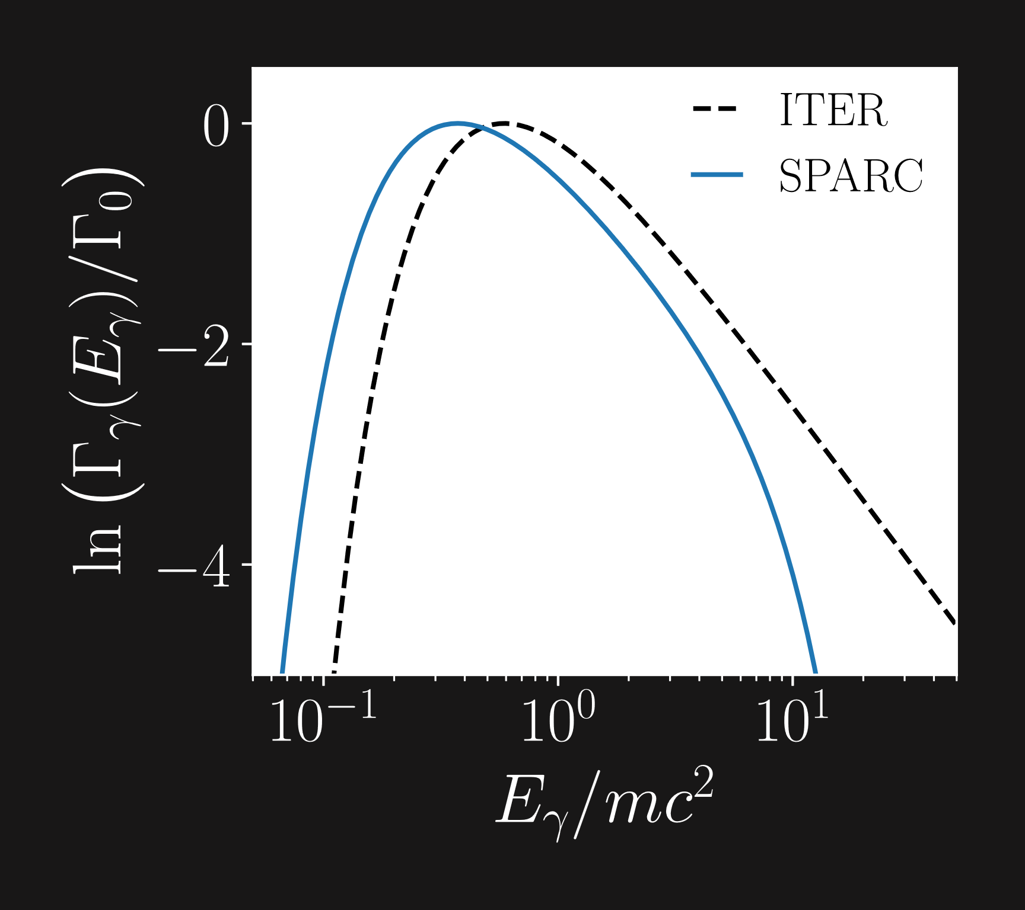
Compton scattering
Photon flux spectrum
³ J.R. Martín-Solís et al., Nucl. Fusion., 57, 066025 (2017)
⁴ Preliminary data from MCNP, Henry Boyd at CFS (2024)
Notes:
Photon flux spectr we use following form, based on the model used Martin-Solis ITER
Here gamma0 prop const total flux right,
In our simulations total flux around 18 TQ, assume 500 MW, around 15 CQ, ceased
Martin-Solis form z, fitted repr data ITER
Since we sim SPARC, fit z SPARC data
Used preliminary data obtained from Monte-Carlo N-particle simulations done by Henry Boyd at Commonwealth Fusion systems
In order good fit, add energy squared term, enables steeper decrease high enrgies
The photon flux spectrum that we use for ITER that is the one presented by Martin-Solis, which has the following form.
Here, gamma 0 is the proportionality constant to make sure that the total flux has the right size, and the total flux should be 10^18 during the TQ, which assumes 500 MW fusion power, and 10^15 during the CQ, since the fusion power will cease after the TQ
Martin-Solis uses the following form of the z-parameter, where the parameters have been fitted to some representative data.
However, since we’ve simulating an activated SPARC-scenario, we needed to get a corresponding z-parameter fitted to SPARC-data for the gamma spectrum.
But in order to get a good fit, another term had to be added, which is this energy squared term.
This term enables this steeper decrease for higher energies.
1 min 40 s
Säg att vi har fått preliminär data från SPARC
Minska här?
Hur har data erhållits
Ta bort undre figur
Inte normalisera i logaritm plot?
Footnote "preliminary data from MCNP, Henry Boyd at CFS"

Slide 14
Activated sources
³ J.R. Martín-Solís et al., Nucl. Fusion., 57, 066025 (2017)
Notes:
If now compare kin & flu act gen sources, get flu rates int mom space
Especially note both kin sources, electrons generated added dist fun hot, meaning that electrons are generated with momentum both above and below the critical momentum.
Gen momentum above crit acc then added RE pop mom flux
So if we now compare the kinetic and fluid activated generation sources, we see that we get the fluid rates if we integrate the kinetic source rates over the momentum space.
Here, W_c and theta_c is the energy and deflection angle corresponding to the critical momentum p_c
Here, I want to especially note that with both of the kinetic sources, electrons will be generated and added to the distribution function for the hot electrons for the full momentum range of the hot-tail grid.
The ones generated with a momentum above the critical momentum will be accelerated and will then added to the RE population as part of the momentum space flux.
1 min

Slide 15
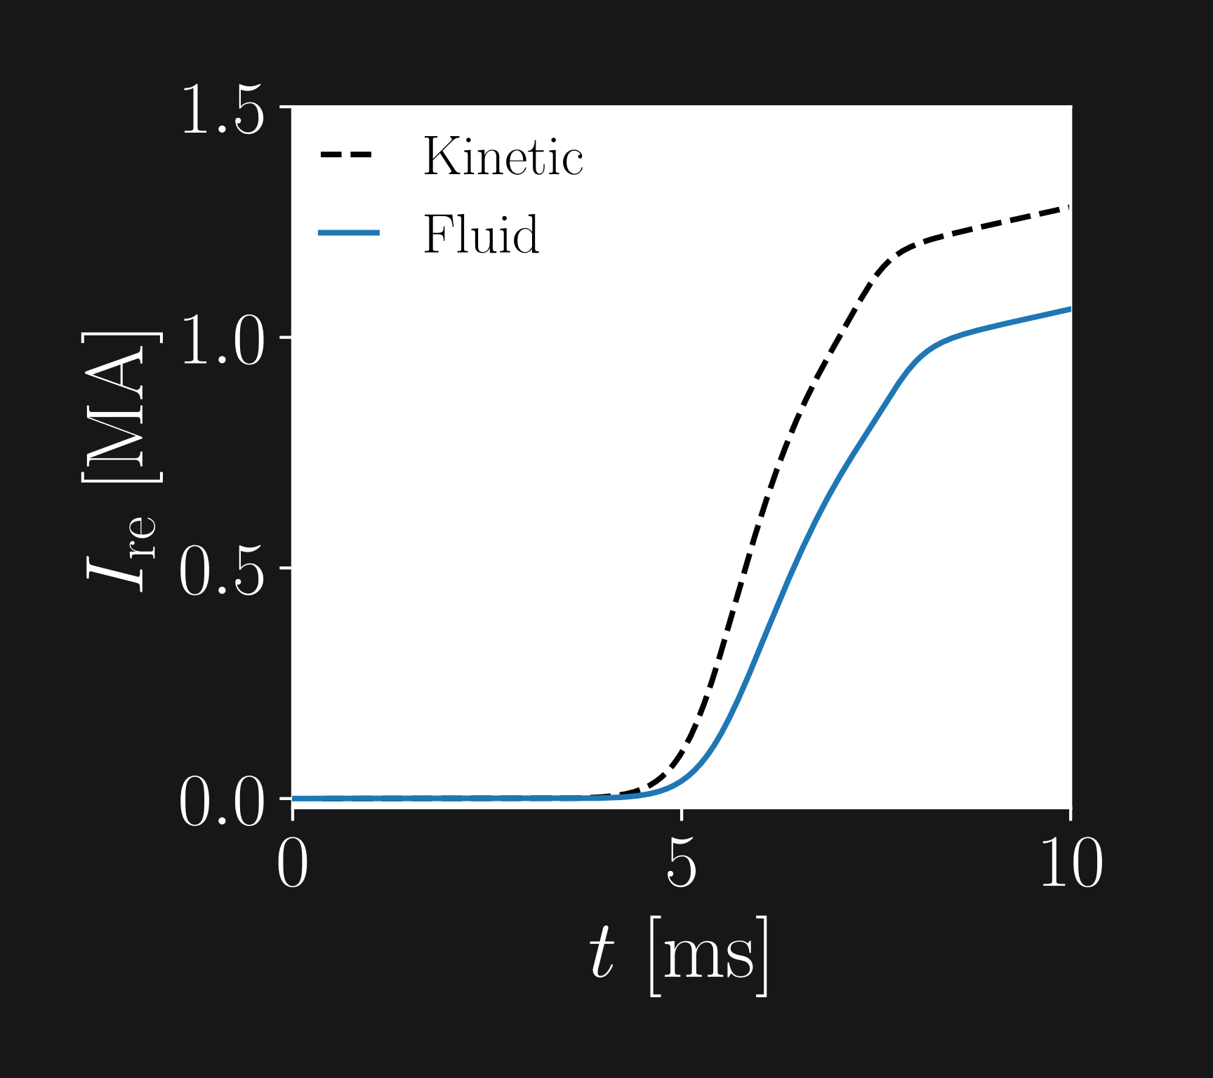
Activated scenario
RE primary sources (seeds)
Hot-tail
Dreicer
Compton scattering
Tritium β-decay
Notes:
Now move on fluid kinetic sim activated scen, we note actually higher RE curr kin case black, unlike in non-act
There still transport magn pert, fluid hot-tail still overestimated
So what happens that counteracts this in kinetic sim?
Let’s once again compare kin dist fun to estimation dist fun fluid hottail model
Now we can move on to the fluid and kinetic simulations of the activated scenario.
Here we actually get a higher runaway current in the kinetic case, unlike the non-activated case.
According to this runaway current density profile at the end of the CQ, the main reason is the higher current density around this radius.
There is still transport due to magnetic pertubations in these simulations, so the fluid hot-tail generation rate should still be overestimated.
The higher current density in the core is actually consequence of the hot-tail being overestimated, as in the non-activated case.
That raises the question about what is happening at this radius, so lets once again compare the distribution function of the hot electrons from the kinetic simulation with the estimated distribution function of the fluid hot-tail model and towards the end of the TQ
1 min 30 s
Ta bort undre figur?
Hur tydliggöra vilken radie?

Slide 16
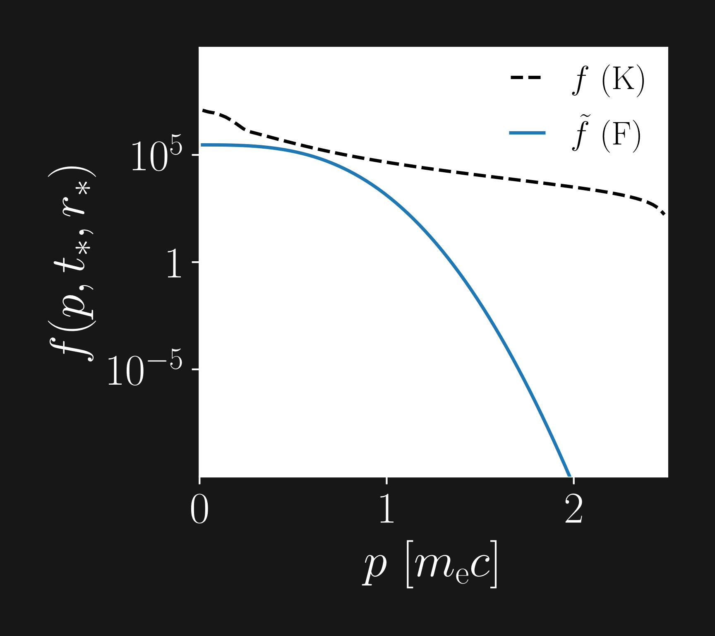
Activated scenario
Direct impact
Electrons with
Corresponds to fluid rate
Indirect impact
Electrons with
Collisions of these electrons resolved kinetically
Dynamics not captured in fluid mode
3
Notes:
Here have those dist funs, kin fun black larger than flu est blue
Reason is the addition of e from kin act sources
Since kin act sources int to fluid sources , gen above crit mom almost identical
This confirmed implementation
However, indirect increase seed gen due electron generated mom below crit, as they can achieve mom above crit mom later time, because we resolve collisions kinetically.
Dynamics not captured fluid model, only gen e above crit mom
This explains higher RE current kin sim, is important effect
Third diff spot, this indirect increase seed gen by act sources
Here we have the distribution functions, and the kinetic distribution function decreases slower than the fluid estimation.
The reason for this is the implementation of the kinetic sources.
Since the kinetic activated sources integrate to the fluid sources, the generation above the critical momentum should be almosr identical.
This, we confirmed during the implementation of the new kinetic sources as well.
However, with the addition of hot electrons at momenta lower than the critical momentum as well, the collisional activity will be higher around the critical momentum.
This leads to an indirect increase in the seed generation due to increased flux.
These dynamics is not captured by the fluid mode, which only generates electrons above the critical momentum.
This is the third difference we found between the kinetic and fluid modeling seed generation mechanisms.
1 min 30 s
- Collisional activity -> collisionality

Slide 17
Differences spotted
Estimated distribution function in hot-tail model
Neural network output for small
Fixed
Indirect increase in seed generation from kinetic activated sources
Kinetic sources derived
Non-activated
Activated
Notes:
So what differences did I spot during conv game spot diff between fluid kin seed gen
First diff spotted est dist fun fluid hot-tail model disregards transp, leading to an overestimation hot-tail gen rate
Second diff spotted NN pred low E inaccurate, bit this fixed
Finally, third diff spotted, with act sources derived kin model, source gen indirectly increased due electrons generated with momentum initially below critical momentum
MMI
ITER D dens 10^22, Ne dens 10^19
SPARC D dens 10^22, Ne dens 10^20
So, what are the differences I spotted during my convoluted game of spot the difference between fluid and kinetic source generation.
The first difference was that the estimated distribution function in the hot-tail model disregards transport of the hot electrons, leading to an overestimation of the hot-tail generation rate.
The second was that the neural network gave inaccurate predictions for the Dreicer generation rate at low electric fields, but this, we have actually fixed
Finally, the third difference I spotted is that with the activated sources we derived for kinetic simulations, the source generation is indirectly increased due to the increased collisional activity from electrons generated below the critical momentum.
1 min 10 s
Collisional activity -> collisionality
Flytta banner

Slide 18
Dreicer – Fix
Ideally
Fits to NN E-field dependence
Electron density and temperature fixed at values of current time step
Constraint: once differentiable
Notes:
Fix DREAM
Wanted dreicer tend manner – low E function form
A b positive parameters
Fix simply fit NN dep E, e dens Temp fixed values current
Furthermore, contstraint, dreicer rate fun E once
With such fit behavior, very sim had min
Current dynamics with fix, significant impact
Importantly, curr dyn with fix and wo hottail, similar kinetic current dyn
But we’ve actually fixed this in DREAM.
We wanted the dreicer generation rate to tend to zero in the same manner as the Connor-Hastie formula, which we get if we have a function of this form for low electric fields, where A and b are positive parameters
The fix then simply fits A and b to the NN E-field dependence at the current time step, with the temperature and electron density fixed.
Furthermore, we use the constraint that the generation rate as a function of the electic field should be one differentiable.
We then get this behaviour instead, which is very similar to what we had in mind.
If we look at the RE current after implementing this fix, we find that this indeed has had a significant impact.
Importantly, the current dynamics after the fix (and with the hot-tail rate removed) looks very similar to the kinetic current dynamics
1 min 30 s

