Slide 1

Implementing deep learning-based disruption predictor in a shifting data environment of new tokamak: HL-3
Zongyu Yang¹，Wulyu Zhong^{1*}，Fan Xia¹, Zhe Gao², Xiaobo Zhu¹ ，Jiyuan Li¹ ，Liwen Hu¹， Zhaohe Xu¹, Da Li¹, Guohui Zheng^{1&3}, Yihang Chen¹, Junzhao Zhang¹，Bo Li¹，Xiaolong Zhang¹, Yiren Zhu¹, Ruihai Tong¹, Yunbo Dong¹，Yipo Zhang¹，Boda Yuan¹, Xin Yu¹, Zongyuhui He¹, Wenjing Tian¹, Xinwen Gong¹ and Zhaohe Xu¹
Southwestern Institute of Physics
Tsinghua University
Nankai University

Slide 2
1、Introduction
2、Data environment of new tokamak
3、Disruption prediction in HL-3
4、Solutions for key issues
5、Summary

Slide 3
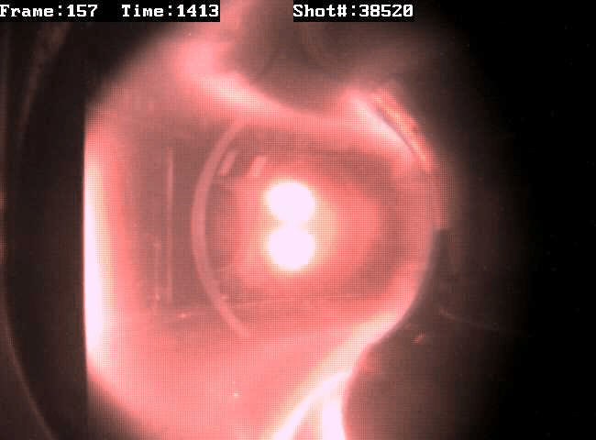
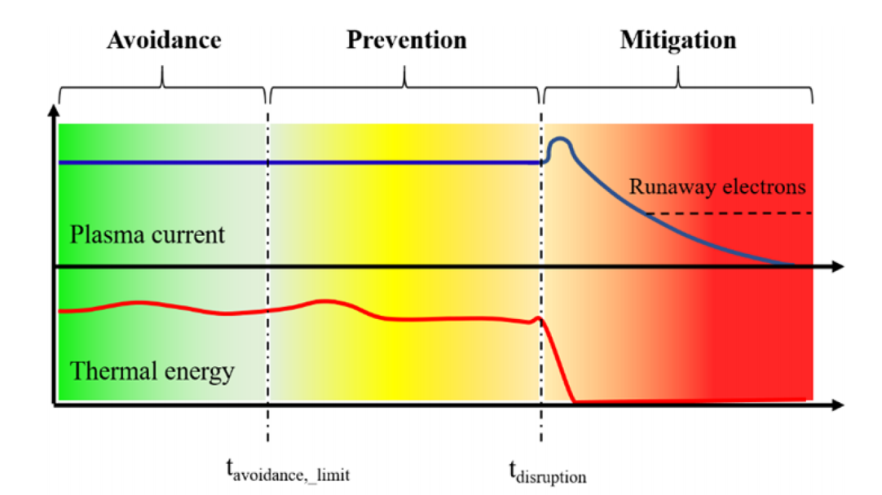
Background
Disruption poses a threat for large-scale tokamaks and fusion reactors
  Thermal loads, halo currents and runaway electrons
  The severity is positively correlated with the size of the device
To handle the risk of disruption: avoidance—prevention—mitigation
  Disruption prediction algorithm provides essential input for prevention and mitigation
A typical disruption process measured by CCD camera in HL-2A
The avoidance, prevention and mitigation paradigm to handle the risk of disruption [A. Murari, et al. NF 60 056003]

Slide 4
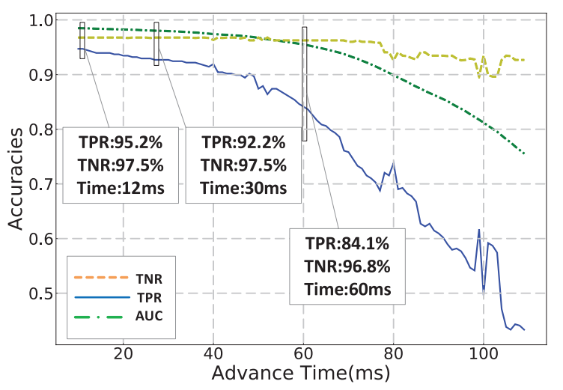
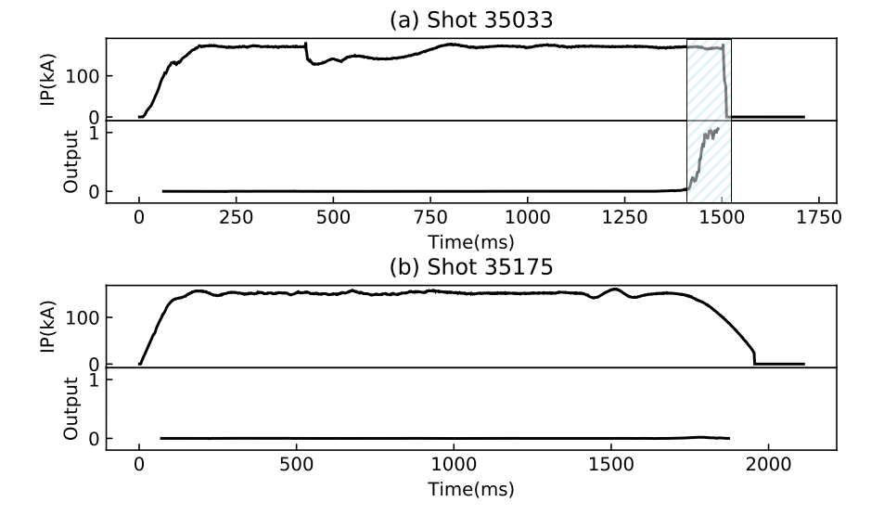
AI-based disruption prediction
Disruption prediction → disruption precursor detection
  By physical criterion? Difficult to handle diverse disruption causes and complex experiment situations.
  Using AI technique to avoid the problem: binary classification on data w/o disruption precursors
Disruption predictor based on deep learning (The case in HL-2A)
  1.5D CNN+LSTM: using parallel CNN branch to deal with data from different systems
  AUC/TPR/TNR: 0.979/0.922/0.975
Typical output of HL-2A disruption predictor during disruptive(a) and non- disruptive(b) shots
Accuracies obtained with different requirements for prediction advance time

Slide 5
1、Introduction
2、Data environment of new tokamak
3、Disruption prediction in HL-3
4、Solutions for key issues
5、Summary

Slide 6
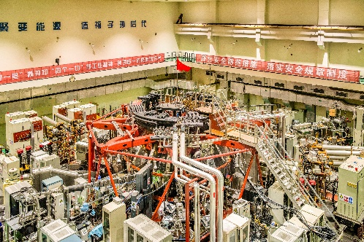
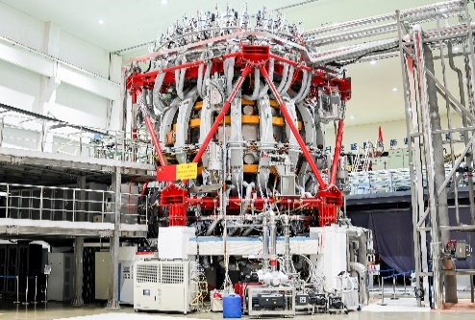

Data environment of new tokamak
Is deep-learning based disruption prediction applicable in a new tokamak?
The key issues
  Severe results of disruptions → limited training data provided for AI algorithm
  Varied parameter space → broken i.i.d assumption for AI
  Shifting operation strategies and tokamak status → frequently changed distribution of disruption causes
  Diagnostic systems built from scratch → many missing/invalid input channels
An extremely tough data environment for deep-learning
The conventional disruption prediction paradigm in HL-2A has an AUC value of 0.979
But it gets an AUC value of only 0.741 in HL-3

Slide 7
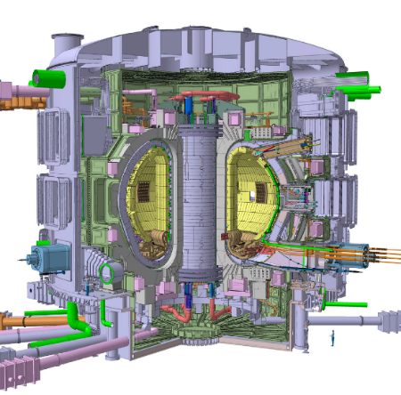
Issue 1: limited training data
Severe results of disruptions → limited training data provided for AI algorithm
  HL-2A algorithm is supported by ~8000 shots generated in 7 years(2013~2020)
  HL-3 tokamak provides only 861 shots before it goes into the dangerous parameter space
  For ITER, the training data might be more limited
HL-2A（Ip~10²kA)
  Disruption is not so dangerous
HL-3（Ip~10³kA)
  Limited disruptions are acceptable
ITER（Ip~10⁴kA)
  A few disruption will damage the device

Slide 8
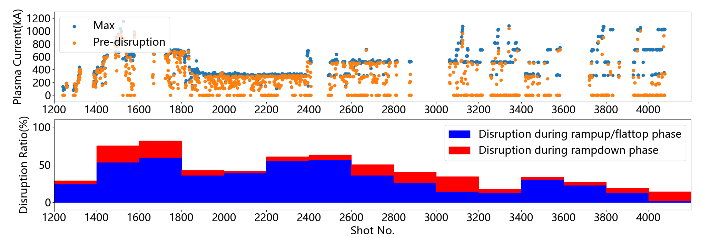
Issue 2: broken i.i.d assumption
Broken i.i.d assumption
  Machine learning assumes the algorithm is trained and applied on individual samples from identical distribution.
  In other words, the algorithm should be trained and applied in same environment
  But, a new tokamak must be operated in a shifting parameter space
Trained here
Applied here

Slide 9
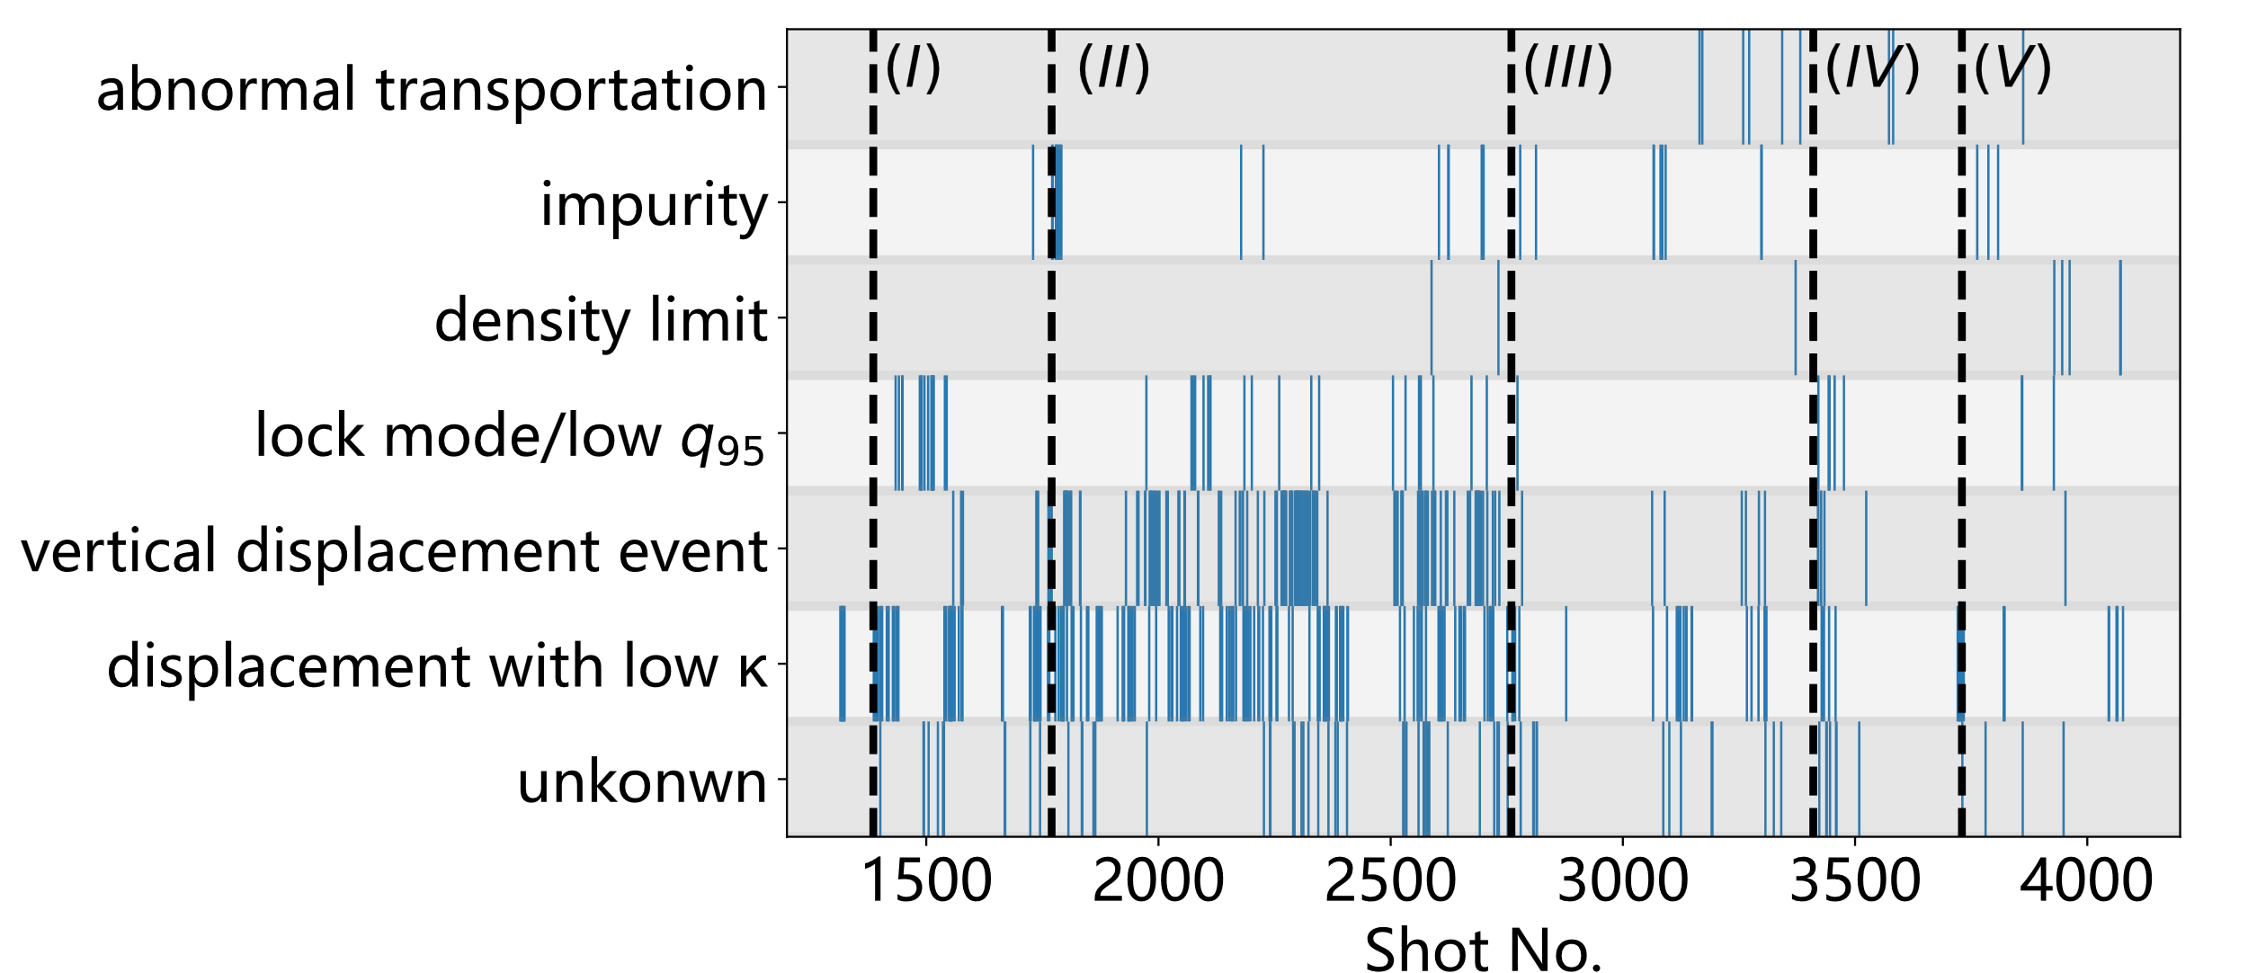
Issue 3: distribution of disruption causes
Shifting operation strategies / tokamak status → Shifting distribution of disruption causes
  (I) Promoting Ip → more low q disruptions.
  (II) Commissioning of elongated divertor configuration → more VDE
  (III) Auxiliary heating introduced → impurity and anomaly transportation
  (IV) anomaly siliconization → more MHD and displacement during ramp-up phase
  (V) High confinement mode with Ip~1MA → density limit induced by enhanced recycling

Slide 10
Issue 4: missing/invalid input channels
Newly built diagnostic systems → many missing/invalid input channels
  Missing/invalid channels in history shots further limit the available training data
  Missing/invalid channels in new shots increases the difficulty of deploying the algorithm in real time
Figure 9 The validity of main input signals for disruption prediction during training and testing shots in HL-3. The x-axis is the shot numbers, and the y-axis lists the names of input channels. The corresponding block will be filled in blue if the channel’s data is valid in the shot.

Slide 11
1、Introduction
2、Data environment of new tokamak
3、Disruption prediction in HL-3
4、Solutions for key issues
5、Summary

Slide 12
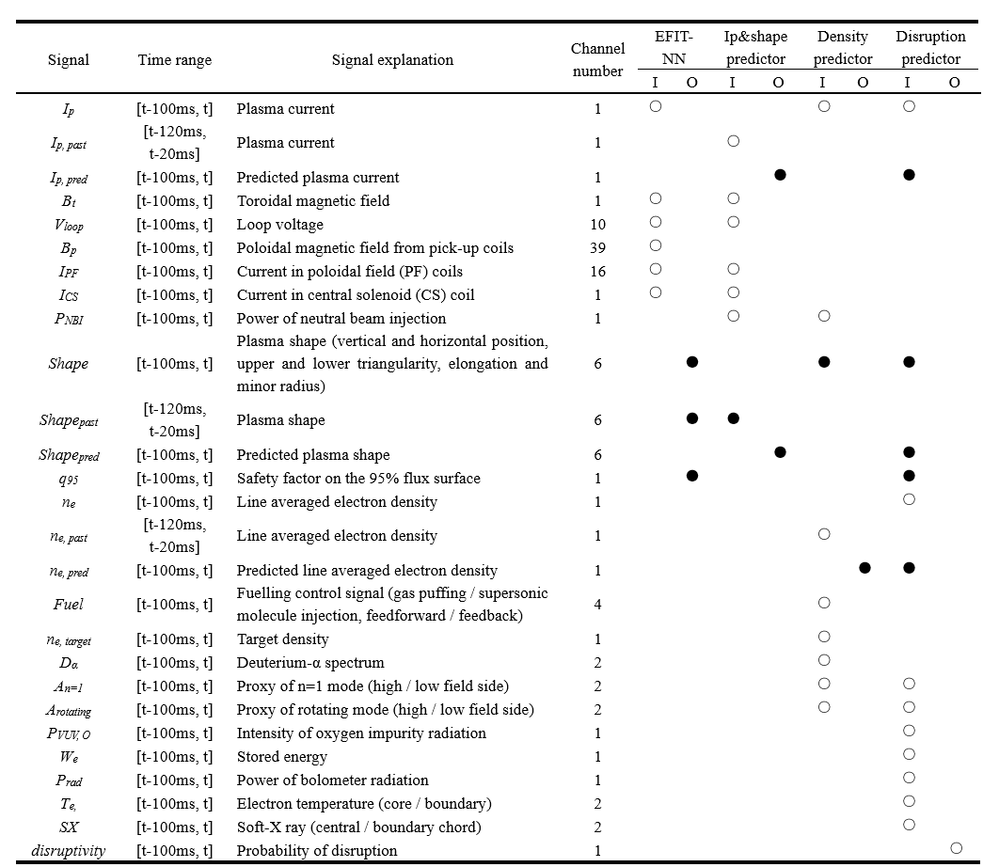
The backbone paradigm
5 submodules
  EFIT-NN
  MHD feature extractor
  Ip&shape predictor, density predictor
  Disruption predictor
HL-3 disruption predictor consists of 5 submodules
The input and output channel list

Slide 13
Performance
Overall accuracies(if threshold = 0.5)
  TPR: 87.5%, predicted 63 of 72 disruptive shots
  FPR: 12.5%, give 30 false alarms during 240 non-disruptive shots
  Prediction advance time: >10ms(otherwise the shot will be counted as unsuccessful prediction)
Accuracies counted for individual disruption causes
  Mostly > 90%, the lowest accuracy is got on shots that don’t have a clear cause.
The ROC curve of HL-3 disruption prediction algorithm. The x-axis, FPR, means the ratio of false alarms triggered during non-disruptive shots. And the y-axis, TPR means the ratio of successful predictions triggered during disruptive shots. TPR and FPR can be traded by adjusting the alarm threshold along the ROC curve.

Slide 14
Performance
Prediction advance time
  Higher than 10ms：87.5%
  Higher than 7ms：95%
  No precursors found：5%
Prediction advance time for individual disruption causes
  The lowest advance time is got on shots that don’t have a clear cause.
  2nd and 3rd lowest advance time is got on density limit and impurity induced disruptions
The distribution of prediction advance time for HL-3 disruption prediction algorithm. And the medium prediction advance time for different disruption causes

Slide 15
1、Introduction
2、Data environment of new tokamak
3、Disruption prediction in HL-3
4、Solutions for key issues
5、Summary

Slide 16
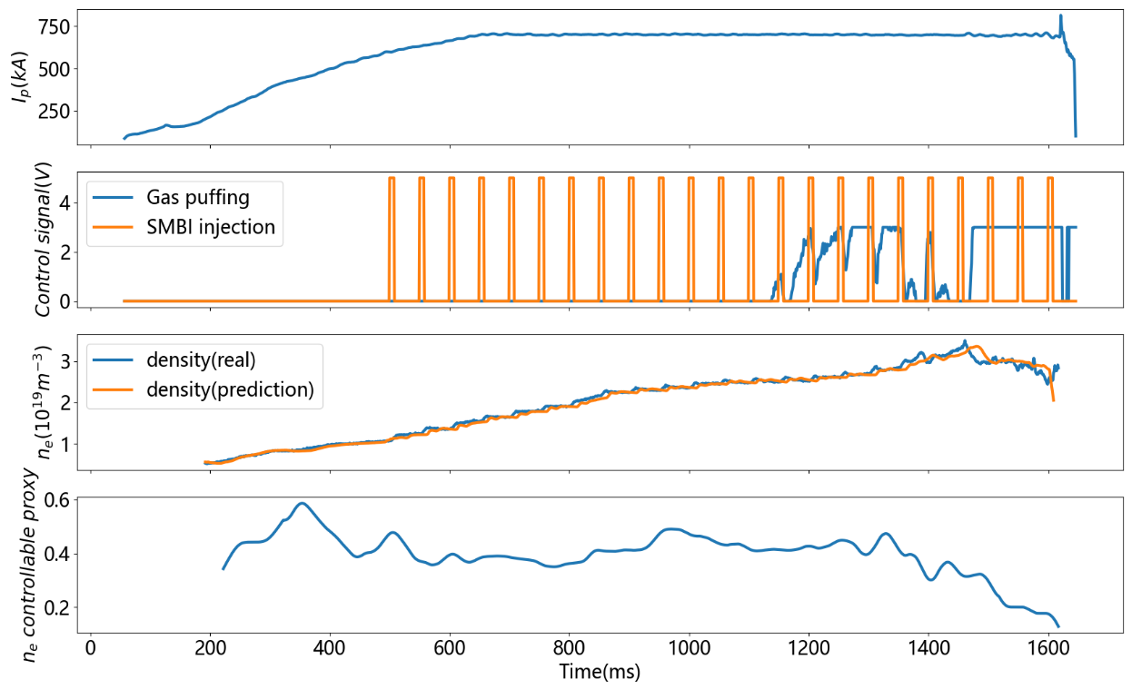
PFNN: Predict-first neural network
Stage 1: predict future plasma status
  Plasma status(T) + control actuator(T+1) → Plasma status(T+1)
Stage 2: evaluate the controllable proxy of plasma to support disruption prediction
  Predicted status(T+1) - real status (T+1) / ΔPlasma status(T+1) → controllable proxy
  Reflecting if the status of plasma is under control
(a) The NN structure of parameter prediction module (b) Comparison of the real plasma status(red) and predicted ones (black). (c) Distribution of error between real plasma status and predicted ones the 312 testing shots.
The ne controllable proxy decreases to almost 0 when ne is limited by an unexpected transportation loss(Shot 3573)
Notes:
The neural networks can realize similar predict-first performance in HL-3. In the left figure we can see the predicted curve, red dotted line, fits the experimental result well.
In addition, we find a useful function of the parameter prediction model. Let’s see the right figure. In the third subfigure, we compare the real density curve and predicted density curve. They fit well before 1500ms and then become divergent. If we calculate the consistency of the 2 curves, we will get the result in last curve, which is named as ‘ne controllable proxy’. If we compare the density injection actions in second subfigure and the density curve, we can notice that before 1500ms, the density increases as we expected according to the injection action. While after 1500ms, although we keep injecting by SMBI and gas puffing, the density doesn’t increase any more It even decreases obviously. This means that the density of plasma is out of our control due to some unexpected transportation mechanism. And parameter prediction model can accurately evaluate the proxy of controllable, which is quite helpful information for tokamak operators.

Slide 17
For missing/invalid input channels
Using neural network to reconstruct a diagnostic from others
  Help to make a more complete training dataset.
  For example, to reconstruct ne(FIR) from ECE、THz、etc
(a) The NN structure used to fill in the data of target channel in Faraday interferometer, n_{e, fir4}. (b) The input of NN consists of data from the rest channels of Faraday interferometer (n_{e, fir1}, n_{e, fir2}, n_{e, fir3}) , CO2 interferometer (n_{e, CO2}) [33], and THz interferometer (n_{e, THz}) during shot 2362. (c) The filled data of the 4th channel of Faraday interferometer during shot 2362.

Slide 18
For missing/invalid input channels
Pseudo data placeholder
  The input of algorithm consists of two parts
  Plasma status and control actuators(X), and valid flags for each input data(V)
  The X array will be replaced by W if it is invalid
  W will be set as a trainable variable and be optimized by the neural network along with the training of whole algorithm
Feature dropout
  One can intentionally set some part of V as 0 with a possibility of P. This can further promote the robustness and accuracy.
$${X^{∗}}_{t−100ms\sim t}=V∗X_{t−100ms\sim t}+\left(1−V\right)∗W$$
 | No pseudo data placeholder | With pseudo data placeholder (P = 0) | With pseudo data placeholder (P = 0.2) | With pseudo data placeholder (P = 0.4)
More but unhealthy data | 0.789 | 0.793 | 0.828 | 0.799
Fewer but healthy data | 0.516 | 0.571 | 0.635 | 0.560
Using cross channel reconstruction to fill all missing channels |  | 0.843 | 0.842 | 0.793

Slide 19
Ablation experiment
the ROC curve of the complete version of algorithm compared to the result without each of the optimizations.
All the optimizations together promote the accuracy of about 20%

Slide 20
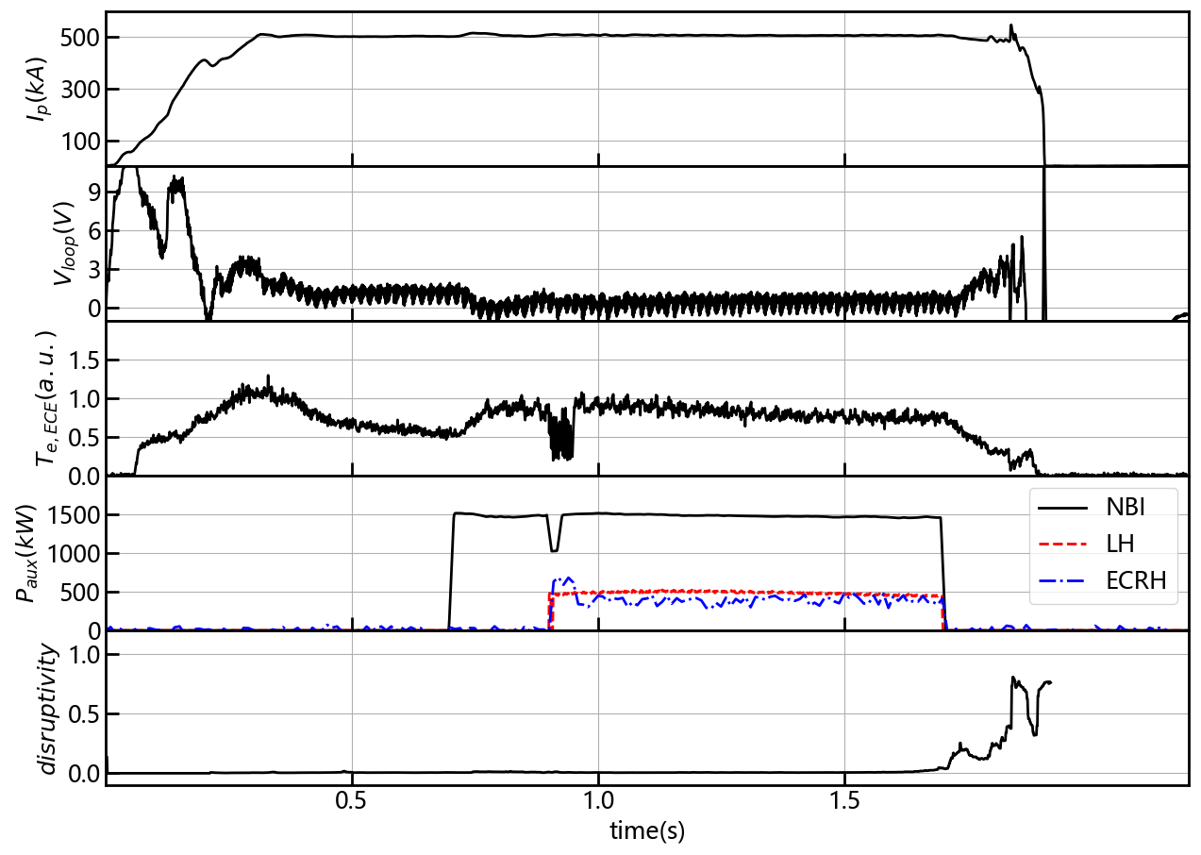
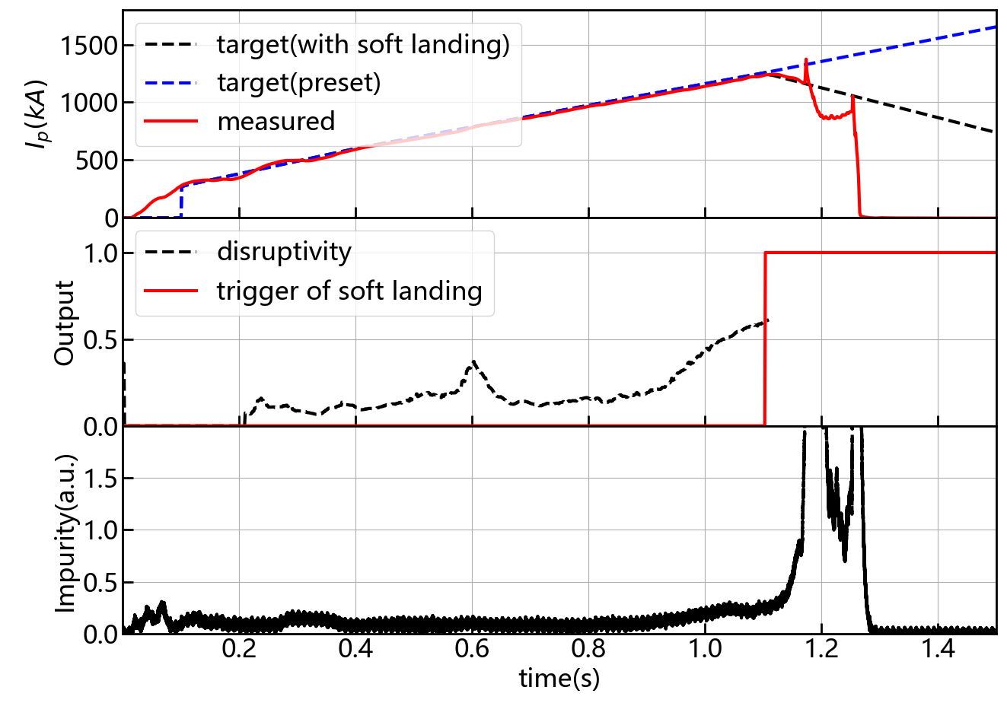
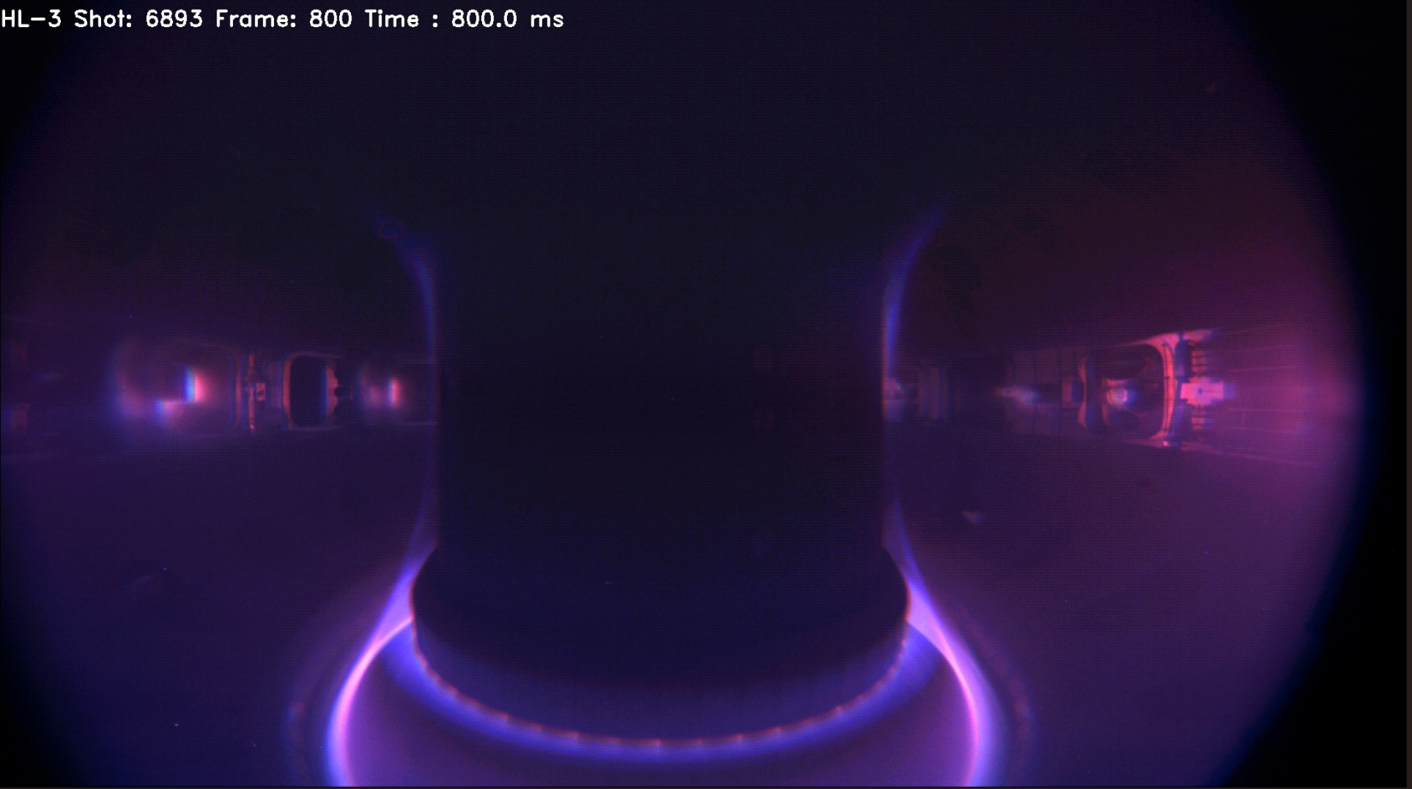
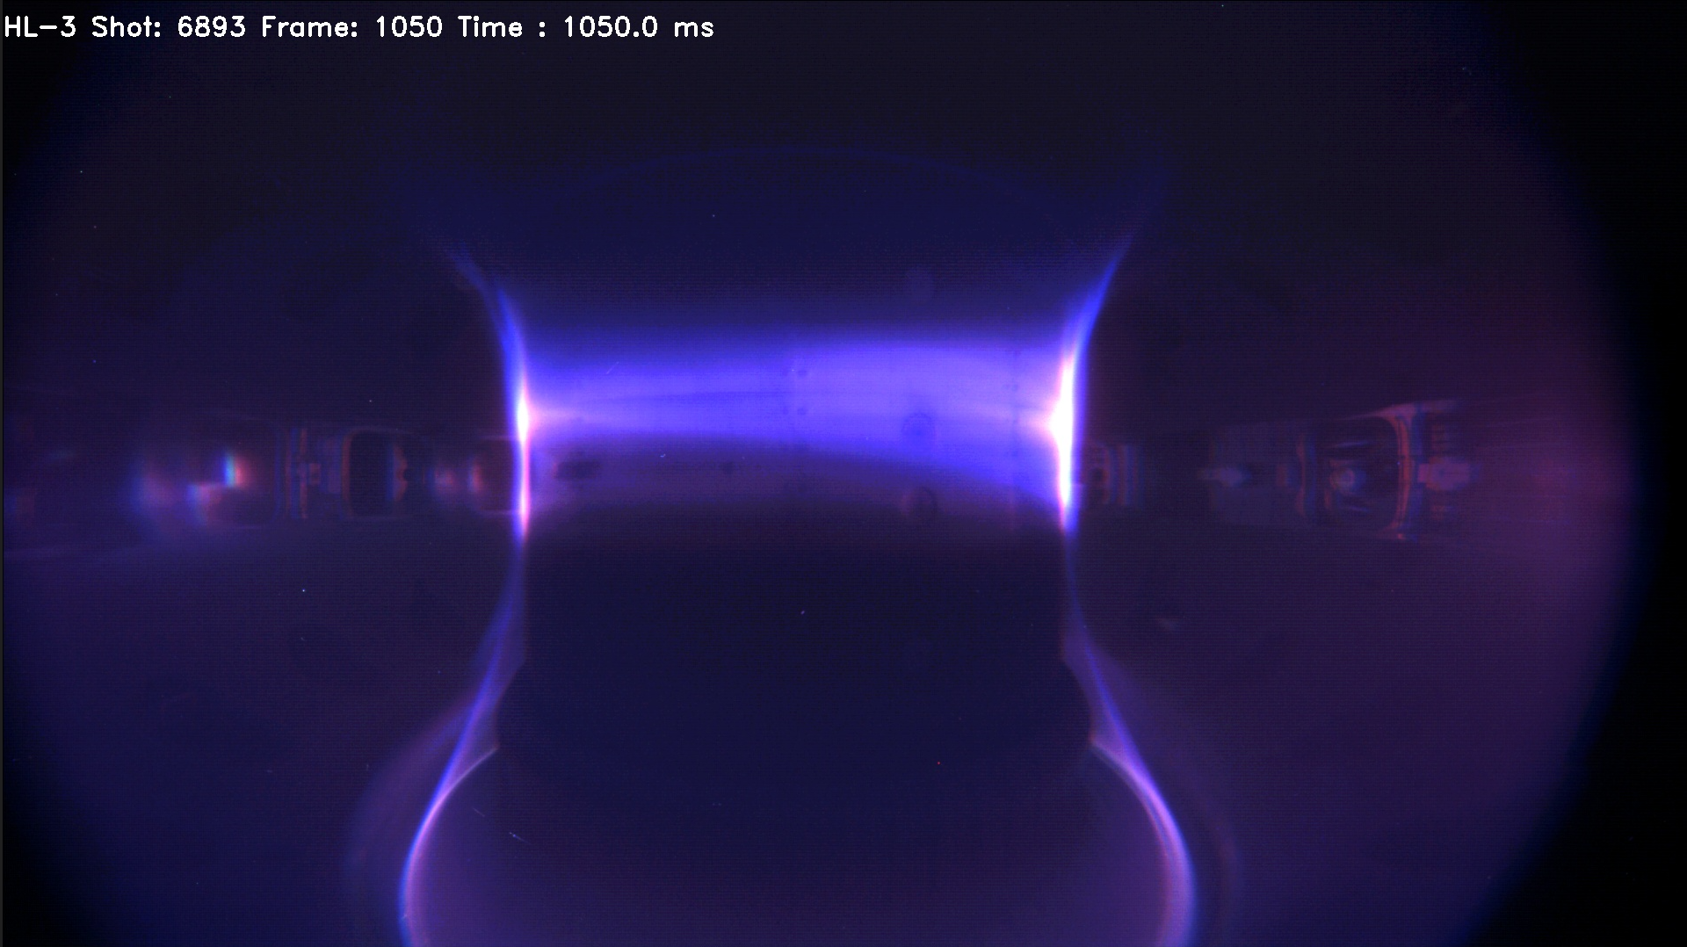
Closed loop implementation in HL-3
Closed loop between AI-based disruption prediction and soft landing control
The novel PFNN paradigm can adapt to new disruption causes and higher parameter space(1.15MA → 1.6MA)
The combination of AI and soft landing techniques minimized the risk to promote the plasma current to 1.6MA
800ms：normal status
1050ms：abnormal status
AI succeeded to predict Bo impurity induced disruption in Shot 6649, which is never seen in training data
AI predicted the high-field side impurity source induced disruption and triggered soft landing control during Shot 6893. A disruption with potentially Ip~1.4MA is replaced with a disruption with Ip~0.9MA

Slide 21
1、Introduction
2、Data environment of new tokamak
3、Disruption prediction in HL-3
4、Solutions for key issues
5、Summary

Slide 22
Summary
AI-based disruption prediction faces a lot of challenges on a newly built tokamak
  Despite the problem of lacking training data, the main obstacle is the shifting data environment
  The parameter space, operation strategies, tokamak status, disruption causes and diagnostic systems all shifts rapidly
  We proposed a series of solutions for these problems and successfully implemented AI-based disruption prediction in HL-3
  Should be helpful for the disruption prediction in future tokamaks like ITER
Future works
  Using data from other devices (HL-2A, J-TEXT, etc) to promote the accuracy
  Validate the algorithm’s ability to adapt to higher Ip, We and β_{N}
  Disruption cause recognition for disruption avoidance

