Slide 1
Why dynamic measurements are crucial for time-dependent modelling of detachment?
M. van Berkel (Matthijs), J. Koenders, T. Ravensbergen, A. Perek, and the TCV team*
DIFFER – Dutch Institute for Fundamental Energy Research, Eindhoven, the Netherlands
Ecole Polytechnique Fédérale de Lausanne (EPFL), Swiss Plasma Center (SPC), Lausanne, Switzerland
*See author list of S. Coda et al. 2019 Nucl. Fusion 59 112023

Slide 2
How do we analyze feedback control?
Two discharges from the CIII emission front control in TCV
Is the left controller as good as the right controller?
Are we able to predict how our plasma responds to certain dynamical requests?
How can we improve the control?
Notes:
Recently, we have seen many nice results of exhaust control in the literature showing that our field is clearly progressing. However, it is often not clear from the results in the literature how good the control is and how good our model knowledge is on which our control is based. To illustrate this, I want to start with a question, I here show two results from our emission front control in TCV and I would like you to think about which of the two controllers is better? (10 seconds break).
The answer is they are the same controller, only the reference trajectory is different. What this shows is that based on such pictures it is difficult to assess the controller performance. Moreover, we should ask ourself how will these pictures (and results) help us to better predict our plasma responses to certain requests (the right may), the left picture definitely not. And maybe the most fundamental, how can we improve the control based on such results.
In my opinion, it is nearly impossible without proper dynamical modelling of the plasma, be it data-based or model-based!
And to further clarify this, let me show what can go wrong without having proper model knowledge?

Slide 3
What can go wrong without a feedback control model?
Consider three different models based on different mechanisms: (inventory, transport, multiple (coupled) mechanisms)
Perform closed-loop simulation:
oscillation
improve control
increase gain
P x 10
Low-performance (PI) controller
High-performance (PI) controller
Controller stability and performance is largely determined by the dynamics!

Slide 4
Task at hand
Develop and validate control-oriented models that:
Are tractable for control purposes:
  describe (only) the relevant physics for control
  (near) real-time computable
  not only describe physics but also actuator and sensor dynamics
  understandable (as never everything can be modelled)
Can be used for commissioning the control system, e.g., ITER and DEMO (correct models)
This presentation:
I will discuss how we can validate (and determine) the relevant dynamical models necessary for control, based on measurements.

Slide 5
Outline
Differences between time-independent and (standard) dynamic modelling methods
Validation and analysis of relevant physics (for control)
Experimental determination of relevant dynamics in TCV
Analysis is based on TCV experiments and three different (theoretical) models

Slide 6
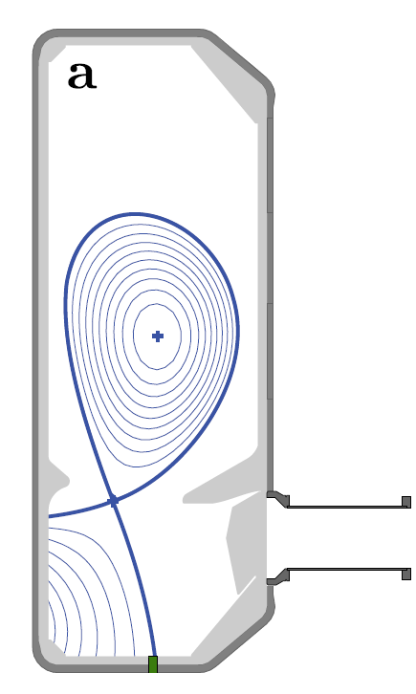
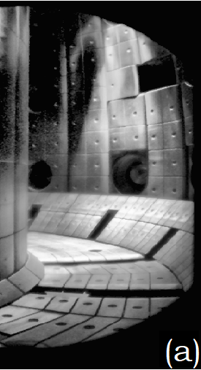
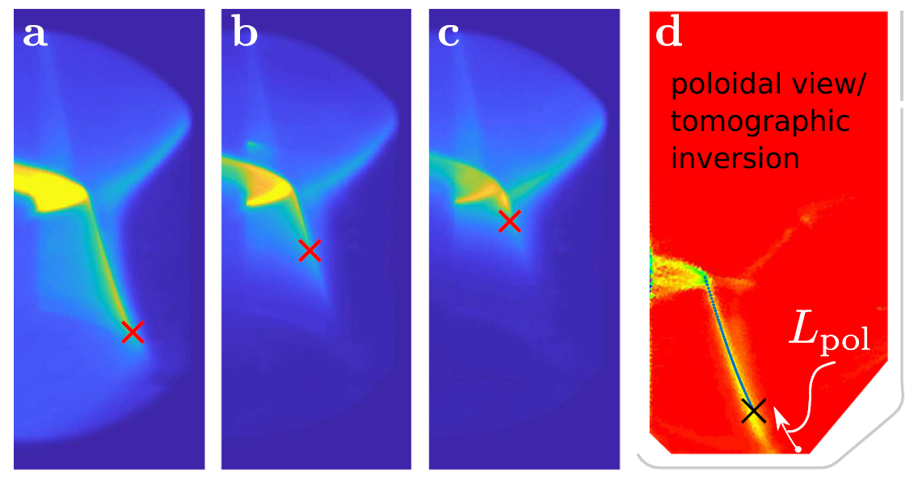
Experimental analysis
Real-time detection of emission fronts with multi-spectral imaging (MANTIS)
Impurity emission fronts (C-III, N-II) strongly related to local temperature
Actuation of front position by D2 fueling or N2 seeding
sensor: RT MANTIS
800 Hz
50% extinction
C-III ~ 8 eV
N-II ~ 6 eV
[1]
[2]
D2
OR
Controller
N2
A. Perek et al., Rev. Sci. Instrum. 90, 123514 (2019)
T. Ravensbergen et al., Nucl. Fusion 60, 066017 (2020)
T. Ravensbergen et al., Nat. Commun. 12, 1105 (2021)
J.T.W. Koenders et al., 47th EPS, (2021), P1.1058
actuator: valve

Slide 7
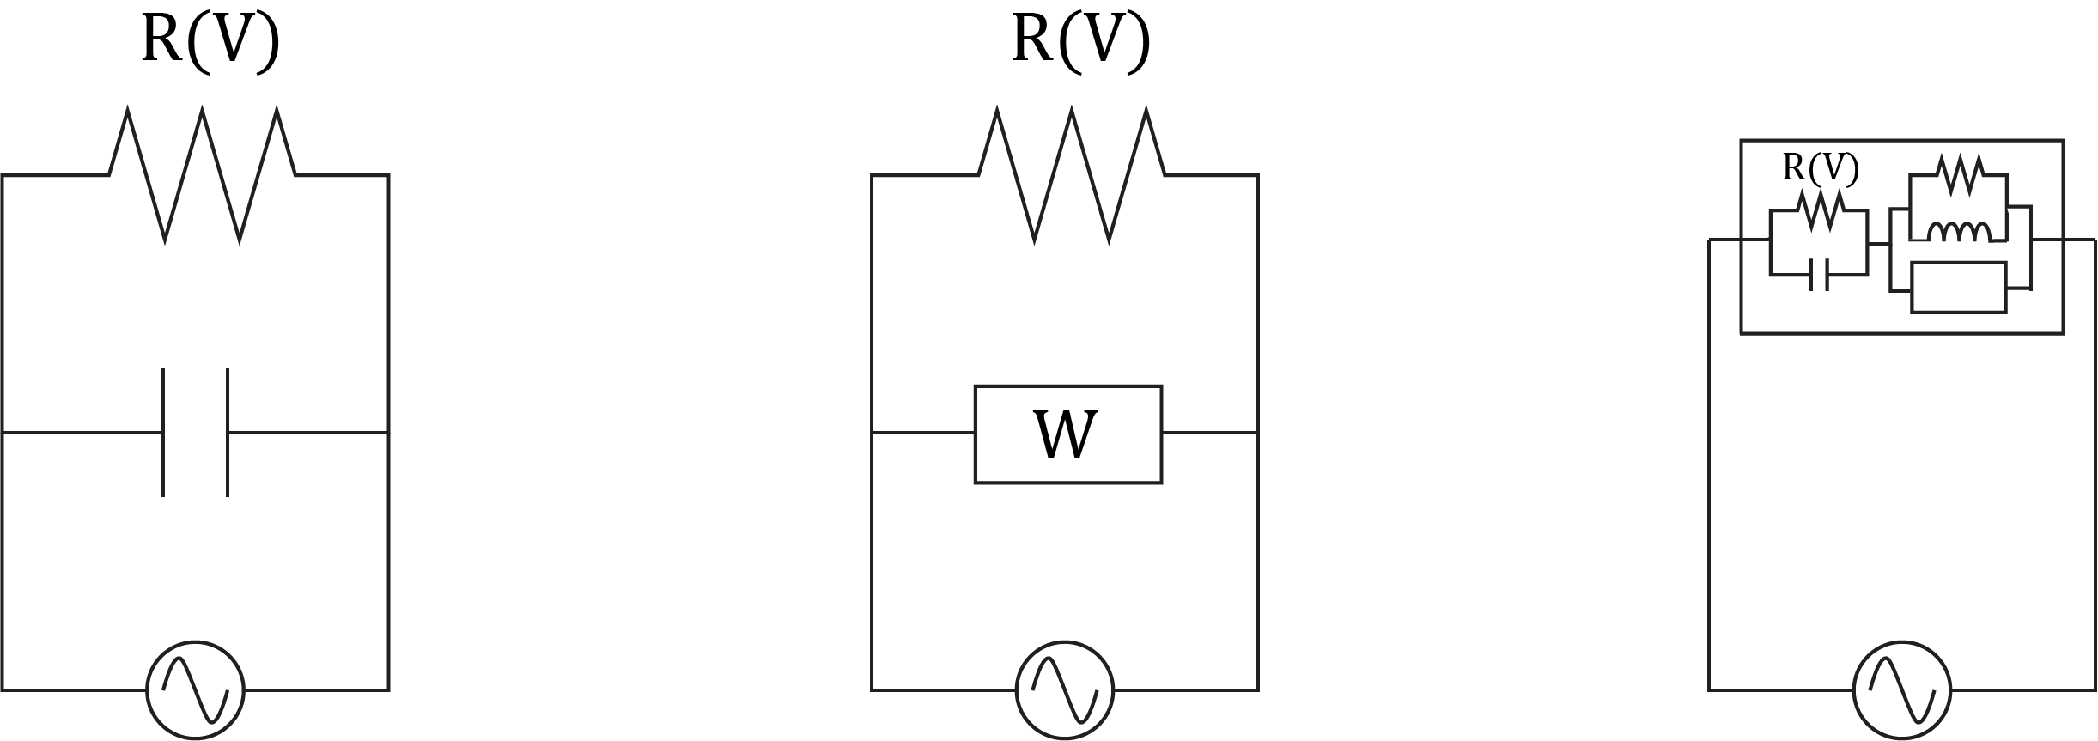








Theoretical analysis: equivalent circuit analogy for detachment physics with various mechanisms
Impedance: current $i$ (input), voltage $v$(output)
inventory
transport
inventory + higher order dynamics
$$R(v)$$
$$R(v)$$
$$R(v)$$
$$W$$
$$i=C_{1}\frac{dx}{dt}+\frac{1}{R\left(x\right)}x$$
differential equations:
$$i=C_{1}\frac{dv}{dt}+\frac{1}{R\left(v\right)}v$$
$$i=C_{2}\frac{d^{0.5}v}{dt^{0.5}}+\frac{1}{R\left(v\right)}v$$
$$a\frac{dx}{dt}+x=b\frac{d^{2}v}{dt^{2}}+2b\frac{dv}{dt}+v$$
“rational non-linear”
“diffusive non-linear”
“coupled”

Slide 8
Validation and building dynamic models: step response

Slide 9
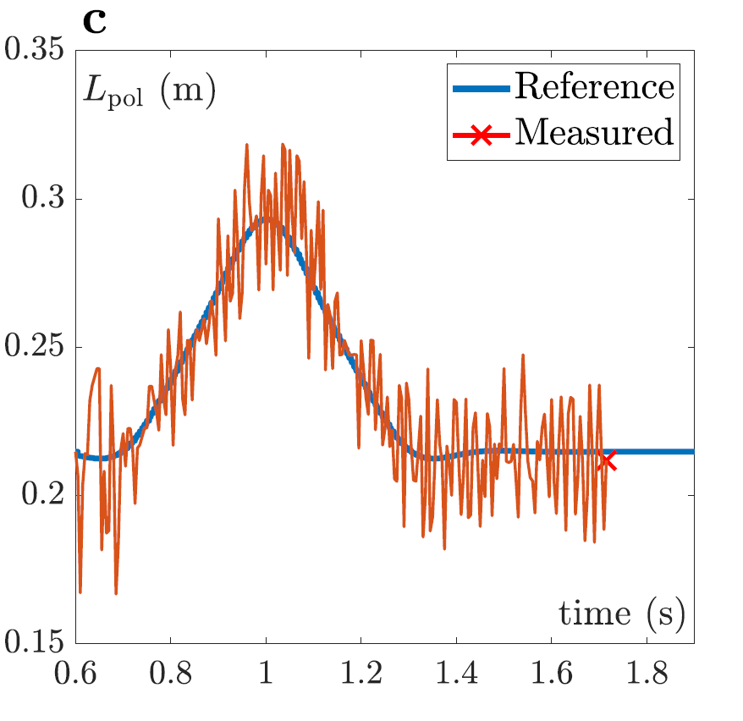
Step response of the system in feedback
Step-responses only probe the low-frequent dynamics
  Closed-loop system shows the dominant dynamical behavior of the “new” system
Low-performance (PI) controller
High-performance (PI) controller
Without further dynamic analysis impossible to determine when control system is stable and has performance!

Slide 10
Validation and building dynamic models: perturbative meas.
time domain
frequency domain

Slide 11
Validation and building dynamic models: perturbative meas.
dynamic response spread over frequency domain
time-consuming but high SNR due to periodic measurement
relevant frequency range for control (actuator range)
lowest frequencies unattainable due to length of discharge
high-frequency unattainable due to SNR and actuator limitations
multiple frequencies

Slide 12
Validation and analysis of relevant physics

Slide 13


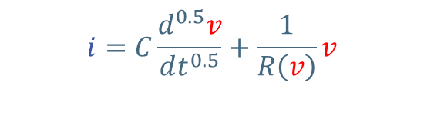
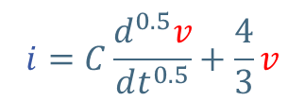
Validation of (first principle) dynamic models vs. measurements
model based local linearization
Non-linear differential eq.
$$i=C\frac{d^{0.5}v}{dt^{0.5}}+\frac{1}{R\left(v\right)}v$$
Linearization around operating point I = 0.5 A
$$i=C\frac{d^{0.5}v}{dt^{0.5}}+\frac{4}{3}v$$
Laplace domain representation
$\frac{V}{I}=\frac{1}{C_{1}√s+\frac{4}{3}}$ with $s=2πfi$

Slide 14
Validation of (first principle) dynamic models vs. measurements
model based local linearization
various operating points (non-linearity)
meas. linearization (perturbation)
validation
output
input

Slide 15
Experimental determination of relevant dynamics

Slide 16
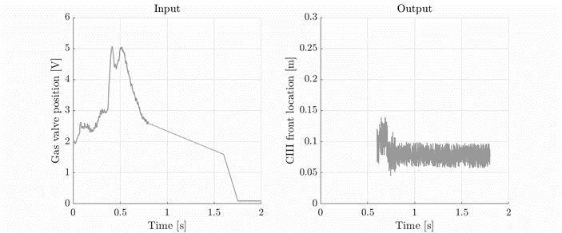
Experimental measurements TCV
steady-state non-linearity using SOLPS-ITER
frequency response function (dynamic)

Slide 17
Two simple dynamic models: fitted to data
Based on SOLPS-ITER
first order model (inventory)
fractional (transport)
²Based on J. Koenders et al., (submitted to) Nucl. Fusion, 2022

Slide 18
Improvement of dynamical models
model used for controller
first order model (inventory)
fractional (transport)
New model significantly increases prediction of plasma response
Control design model was far from optimal: clear room for improvement

Slide 19
Conclusions
Identifying the intrinsic dynamics of the physical system by system identification measurements is crucial for:
Benchmarking of dynamical models (for heat exhaust)
  Verify/reject relevant mechanisms determining the dynamics
Design high-performance controllers
  E.g. via loop-shaping, optimal control, model predictive control
Validating, prediction, and commissioning of controllers
  Necessary for ITER and DEMO and should be based on multi-machine database
  (control shown on TCV, and recently AUG, MAST-U, and possibly DIII-D this year)

Slide 20
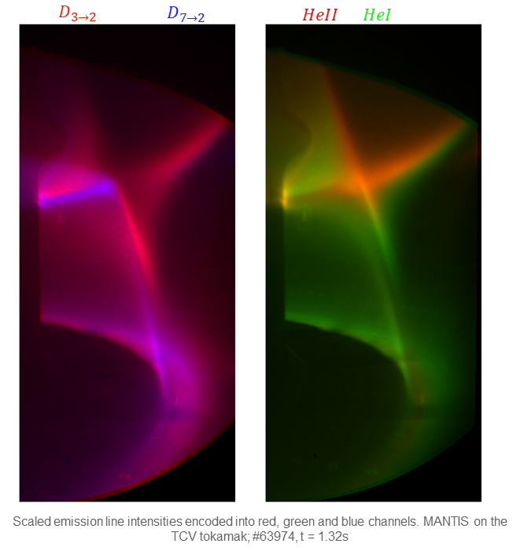
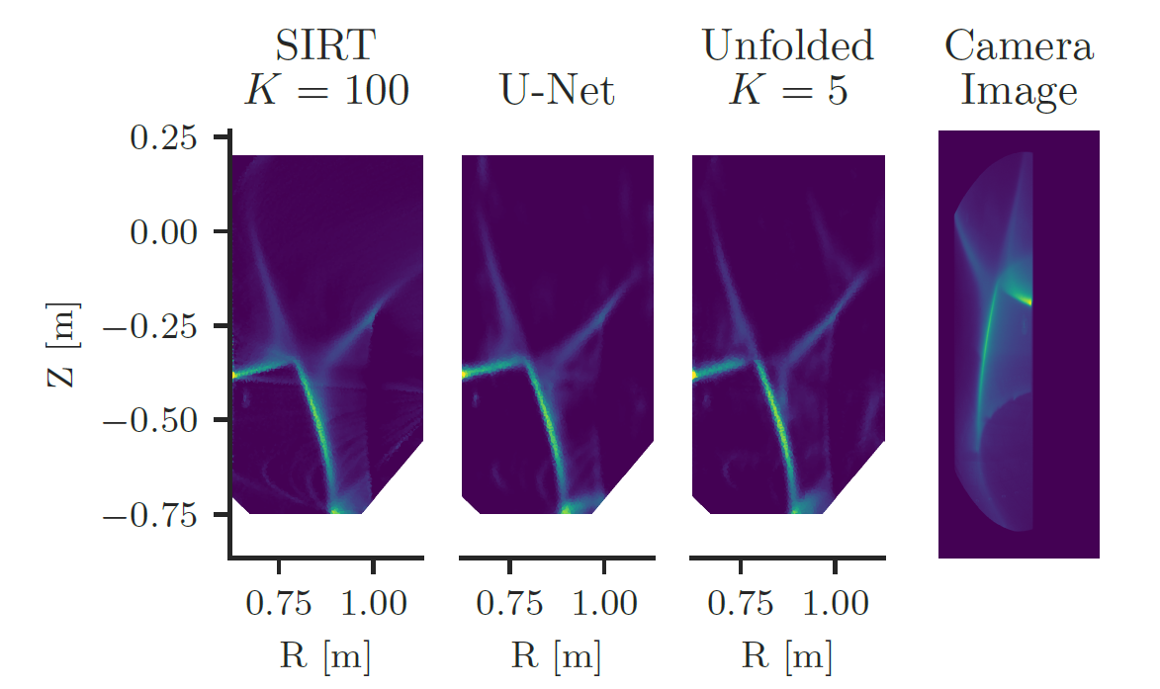
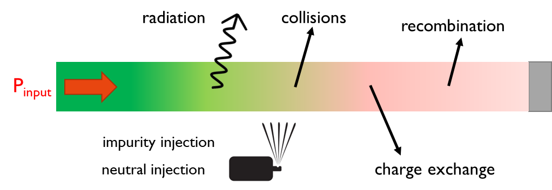
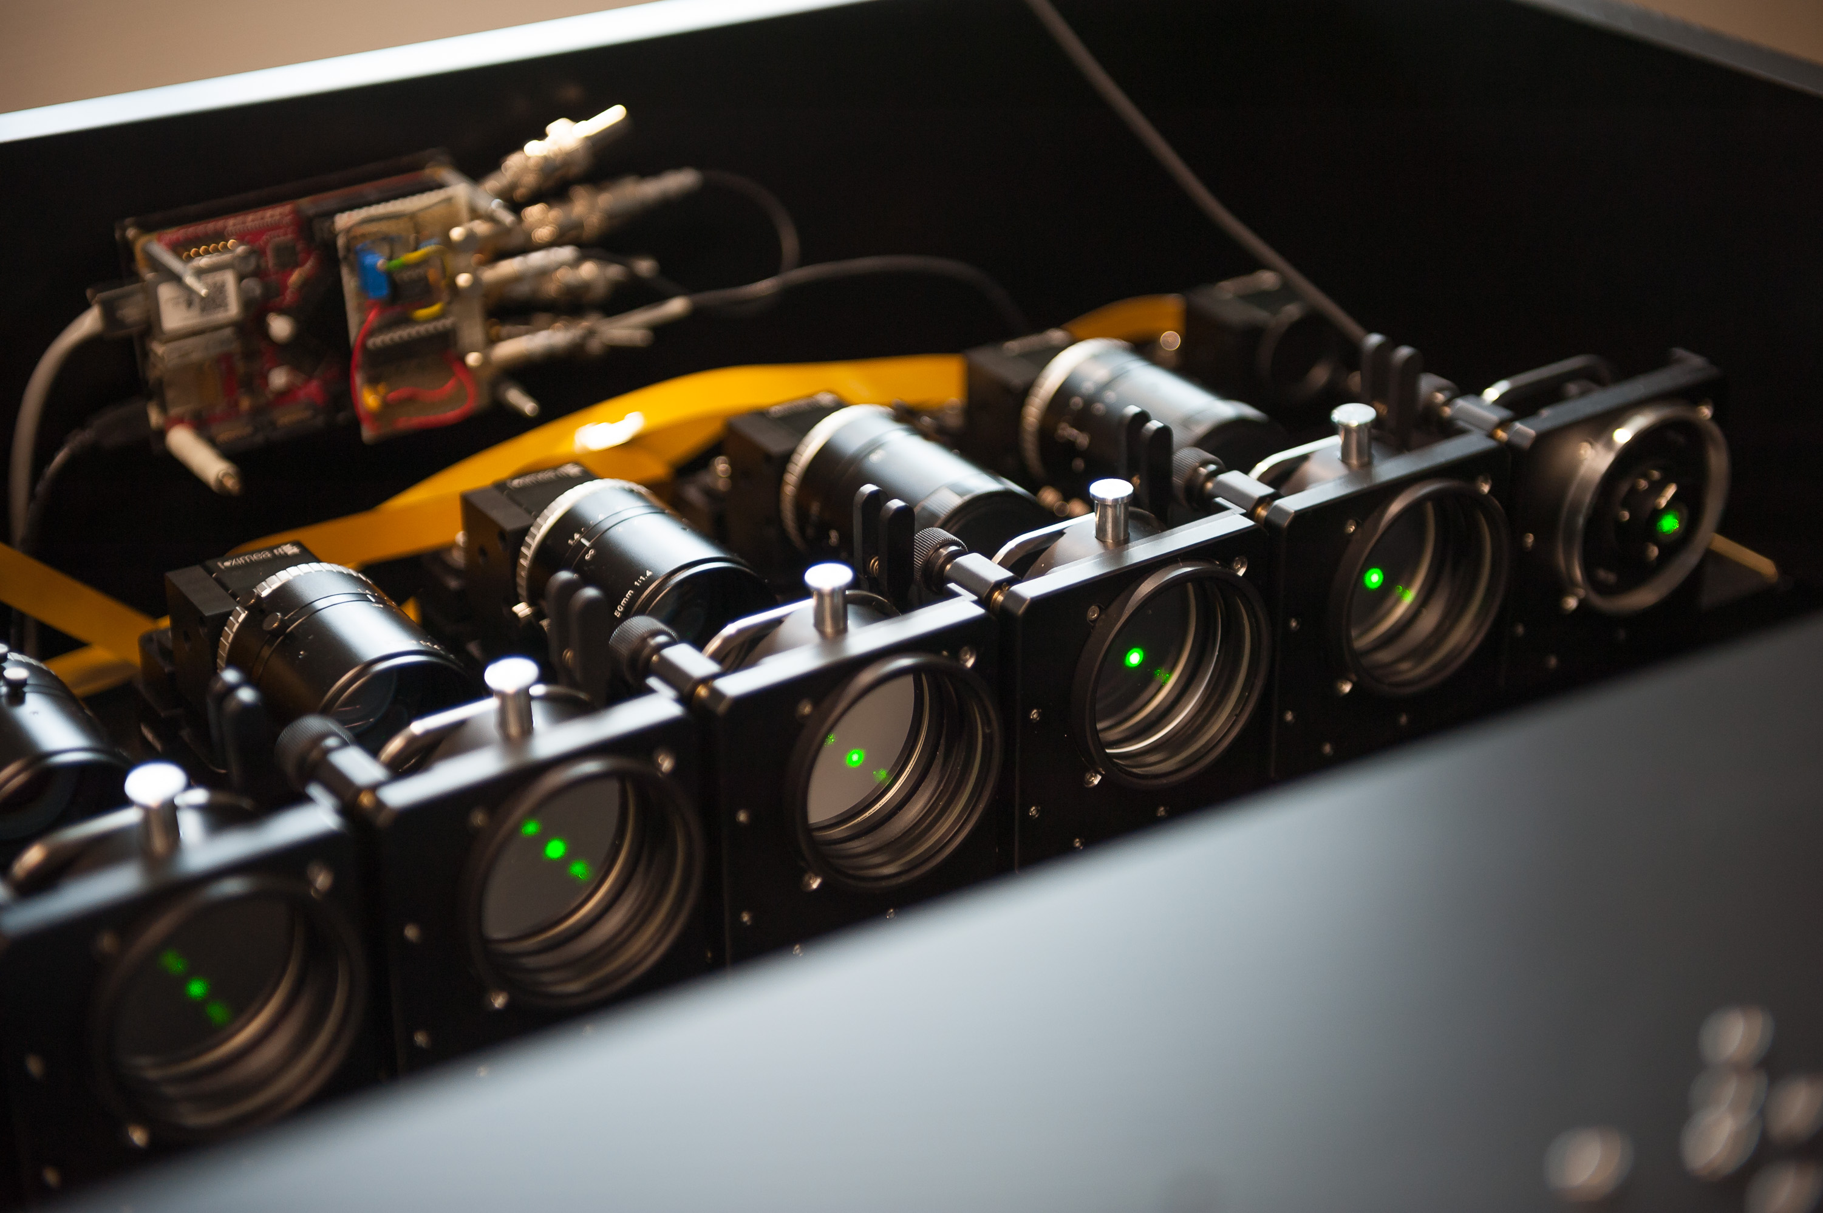
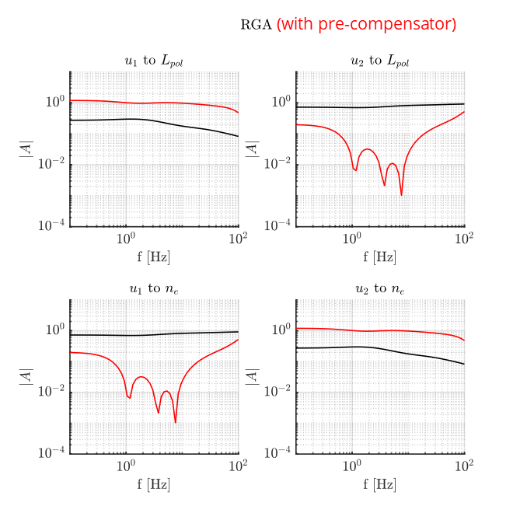
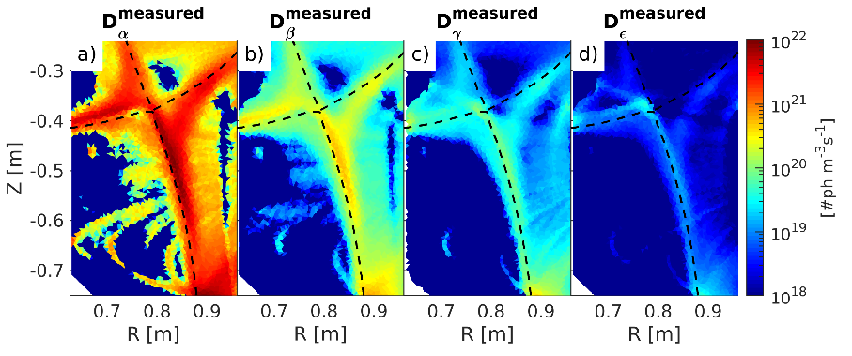
ENR: feedback of loss processes with MANTIS with TCV
feedback + feedforward
line-ratios
digital control system
(SCD)
real-time
signal processing
Bayesian interf.
Experimental demonstration
soon
$$n_{e},T_{e},n_{o},I_{rate},R_{rate},CX_{rate},P_{exc},P_{rec}$$
MIMO-decoupling

Slide 21
m.vanberkel@differ.nl

