Slide 1
Some issues with the INDEN structural material evaluations
A. Trkov, R. Capote on behalf of the INDEN Collaboration
Jozef Stefan Institute, Ljubljana, Slovenia

Slide 2
Fe-56 INDEN version “r67” (JEFF-4T2) v.s. “r61”(B81b2)
2.58577
  Version “r61” is currently included in “Beta-2”. Since then:
  Resolved resonance parameters were taken from JEFF-3.3 (fixing typos B8) the 27.77 keV resonance Γγ reduced from 1.2887 (CIELO-B8) to 1.0005 (JEFF-3.3), B71-0.86,JENDL-5:0.988
  Recommended/validated thermal cross section (E81b2=2.587 b)
  Background capture was adjusted to improve HMI001 was added also to the total to preserve unitarity
  Spurious (almost negligible) background in elastic was removed

Slide 3
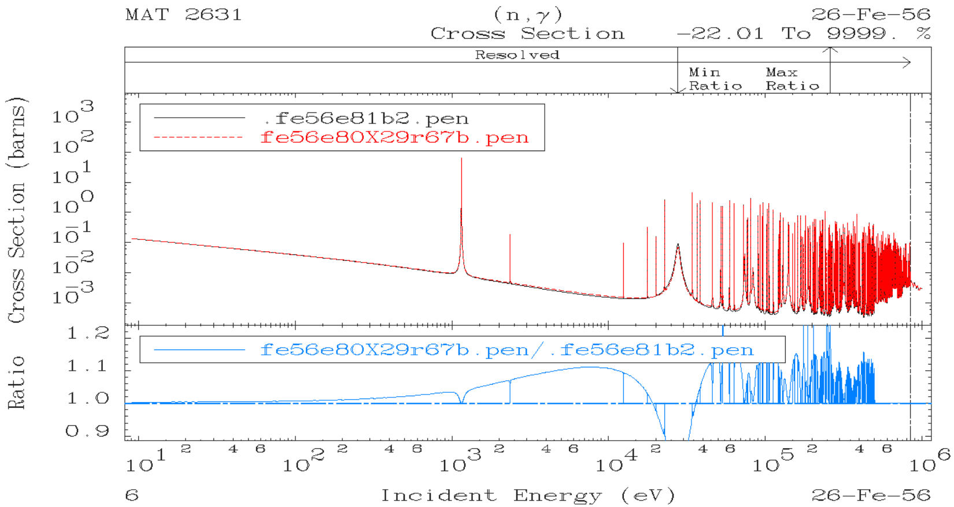

Slide 4
Fe-56 INDEN version “r67” v.s. “r67b”
Overall, Fe-56 and Fe-57 show good performance, no changes to the cross sections are needed.
Redundant MT=103 was added by summing MT 600-649 to be consistent with the covariances in MF=33/MT=103.
Cr-53 production cross section was added to MF=10/MT=5 for the convenience of the users, since the cross section is not trivial to reconstruct (requires the summation of discrete levels and the contribution from the continuum).
None of the changes has any impact on benchmarking.

Slide 5
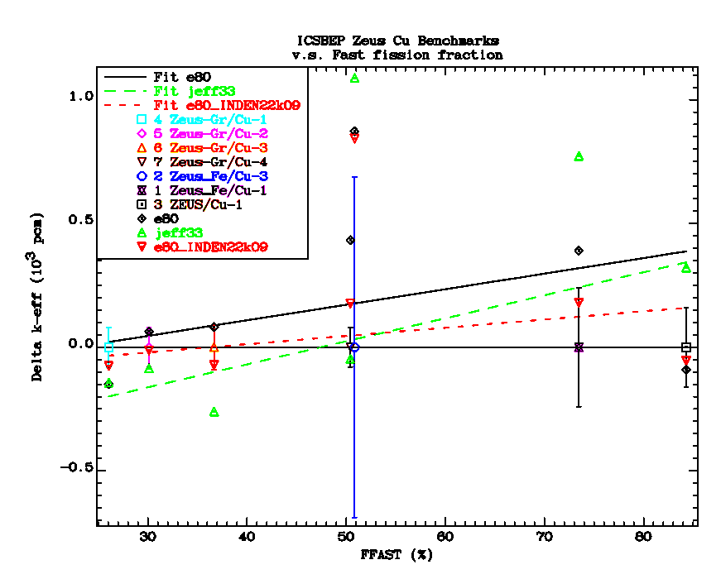
Cu-63, Cu-65
Considerable improvement in benchmark performance was achieved, but the situation is not completely satisfactory.
There is a mismatch in the angular distributions; average cosine of scattering (mu-bar) does not agree with the measured values by Popov.
Angular distributions in the file are based on the resonance parameters.
Forcing agreement with Popov data would destroy the performance in the FR0 benchmarks (IMF020, IMF022)

Slide 6
ICSBEP Benchmarks sensitive to copper
82 benchmark cases from ICSBEP were identified, with additional focus on:
  Swedish intermediate-enriched, copper-reflected FR0 cases (IMF020,022) and
  ZEUS benchmarks (HMF072, HMI006, IMF025/Pb)
  The full list of cases is available on request
ENDF/B-VIII.1b2 library is taken as reference since the INDEN evaluations for copper were adopted in this library

Slide 7
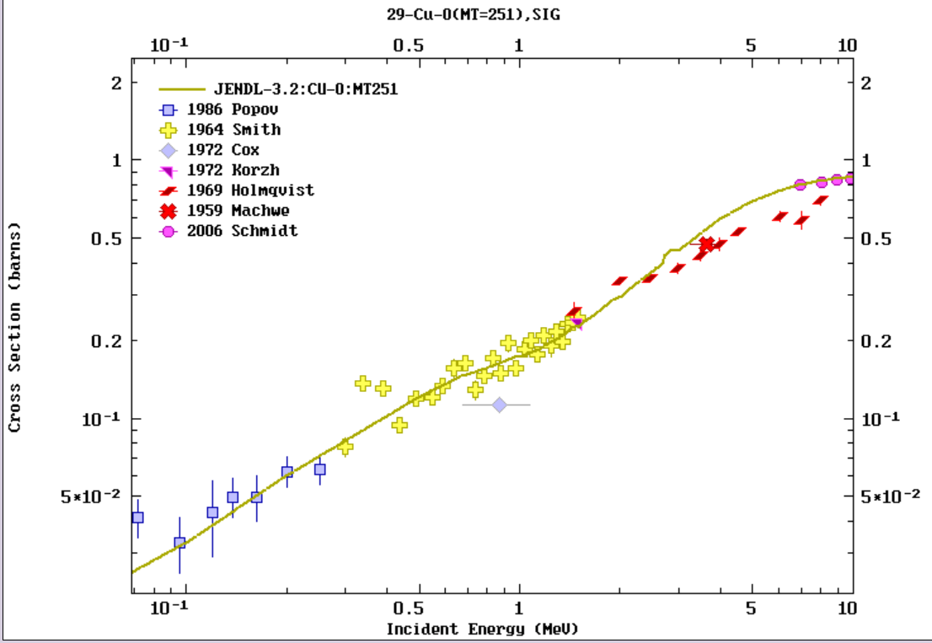
μ-bar (P1) from JENDL-3.2 is in good agreement with data (Popov, Smith, Schmidt)

Slide 8
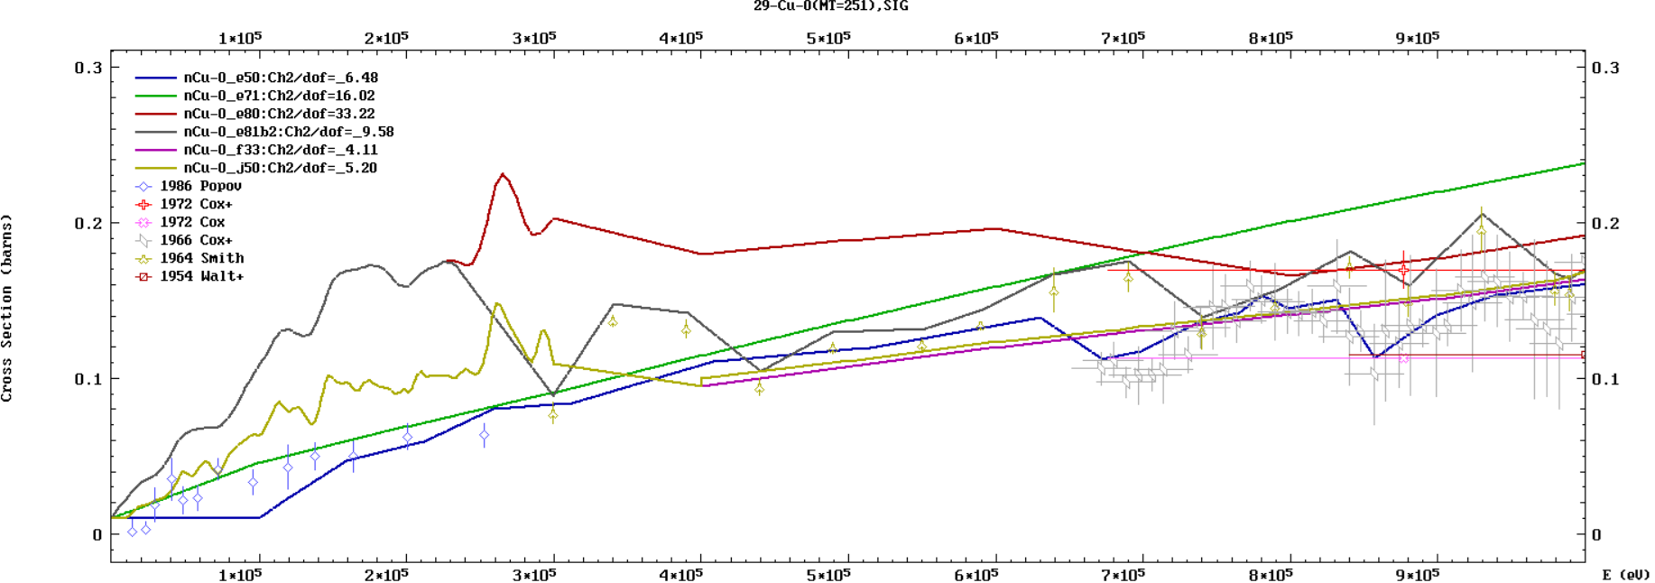
μ-bar (P1) from JENDL-5, B8, B81b2 disagree with Popov (B71 = JENDL-3 is OK); B81b2 better than B8

Slide 9
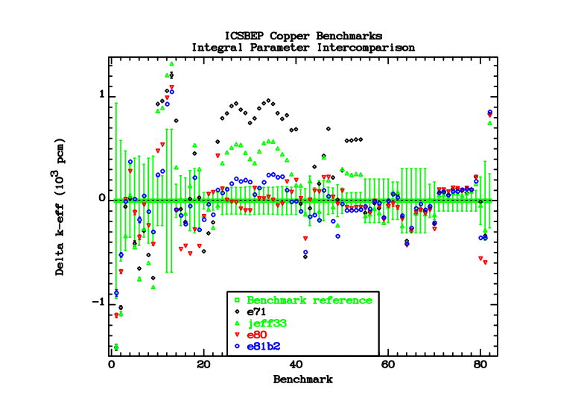
IMF020,022

Slide 10
Comments on the FR0 (IMF020,022) cases
Intermediate-enriched fuel benchmarks, copper-reflected, highly sensitive to the angular distributions.
Apparently good performance is achieved, but the anisotropy of elastic angular distributions in the low energy region is much higher than supported by the data of Popov -> COMPENSATING EFFECTS??

Slide 11
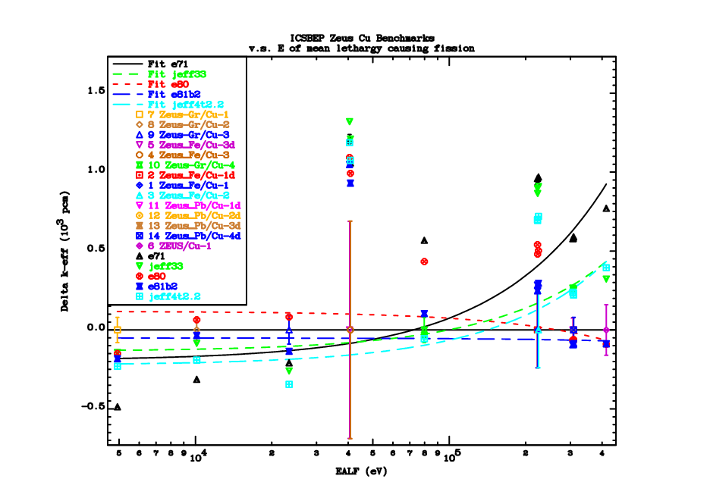
Lead improv.?

Slide 12
Comments on the ZEUS benchmarks
Benchmark cases involve:
  Highly-enriched and intermediate-enriched fuel
  Fast and intermediate spectrum
  Iron/copper, graphite/copper, lead/copper
The benchmarks are less sensitive to the angular distributions at low energies
The performance of the INDEN+B81b2 (lead) files seems good

Slide 13
Angular distributions
The average cosine of scattering for natural copper is compared to measurements
At energies above 2 MeV the evaluations are reasonably consistent with measured data
Below 2 MeV there are huge differences:

Slide 14
Angular distributions (cont.)
  ENDF/B-V (elemental) is consistent with Popov data above 0.15 MeV; above 0.7 MeV the evaluation follows Cox data, which tend to be low, compared to other measured data
  In ENDF/B-VIII.0 the angular distributions were derived from resonance parameters (with some smoothing)
  In ENDF/B-VIII.1b2 the measured data were used above 0.3 MeV; the data were not changed below this energy
  JEFF-3.3 = JENDL-5.0

Slide 15
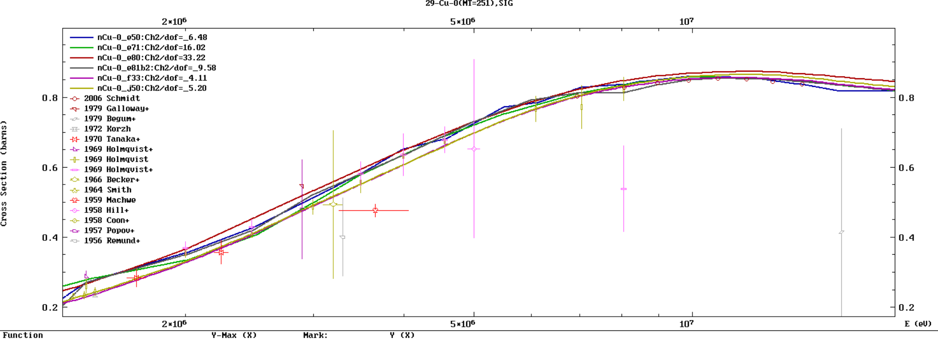

Slide 16
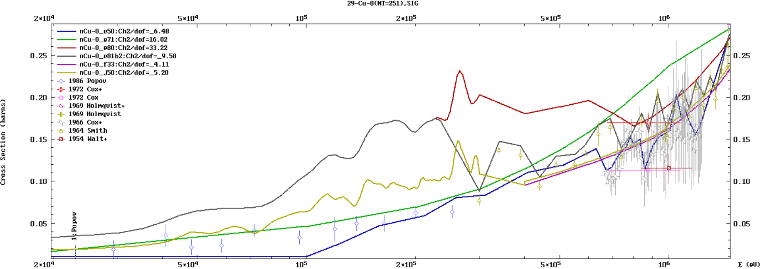

Slide 17
Conclusions
The performance of the INDEN evaluations for Cu-63,65 is generally good
However, the angular distributions below 0.3 MeV are in contradiction with the measured data by Popov
The angular distribution data in the file were derived from resonance parameters (with some smoothing applied). There is a possibility that a factor (2l+1) is erroneously included in the Legendre coefficients, but this is yet to be confirmed
Unfortunately, substituting Popov data below 0.3 MeV significantly degrades the performance on benchmarks, particularly the IMF020,022 cases. Likely there exist unidentified compensating effects, or the IMF020,022 benchmarks are wrong.
At present, no adequate solution is available ☹

