Slide 1
Recent EU legislative proposals and the impact on SMR technologies deployment
1
Guilherme Cardoso
IAEA SMR Conference – 24 October 2024

Slide 2
Introduction
2

Slide 3
Introduction
2020s - Nuclear energy starts to regain its visibility at EU level driven by:
Approaching of climate targets deadlines (2030)
Energy crisis triggered by the war in Ukraine.
Nuclear energy in general and SMRs in particular have benefited from a series of enabling measures in recent legislative proposals and initiatives:
The European Industrial Alliance on SMRs
The EU Taxonomy
The Net-Zero Industry Act
The Low-Carbon Hydrogen Delegated Act
The future of European competitiveness: report by Mario Draghi

Slide 4
The European Industrial Alliance on SMRs

Slide 5



Main Objective
The main objective of the European Industrial Alliance on SMRs is to facilitate and accelerate the development, demonstration, and deployment of the first SMRs projects in Europe in the early 2030s, by assisting emerging SMRs projects to reach the demonstration and deployment phase.
Key Documents to apply (applications are open):
The Declaration and the Terms of Reference of the Alliance.
The application form
Declaration of the Alliance needs to be signed (including the Annexes) by an authorised representative and send it to: grow-EU-SMRS-ALLIANCE@ec.europa.eu
Frequently asked questions
Updated membership list

Slide 6
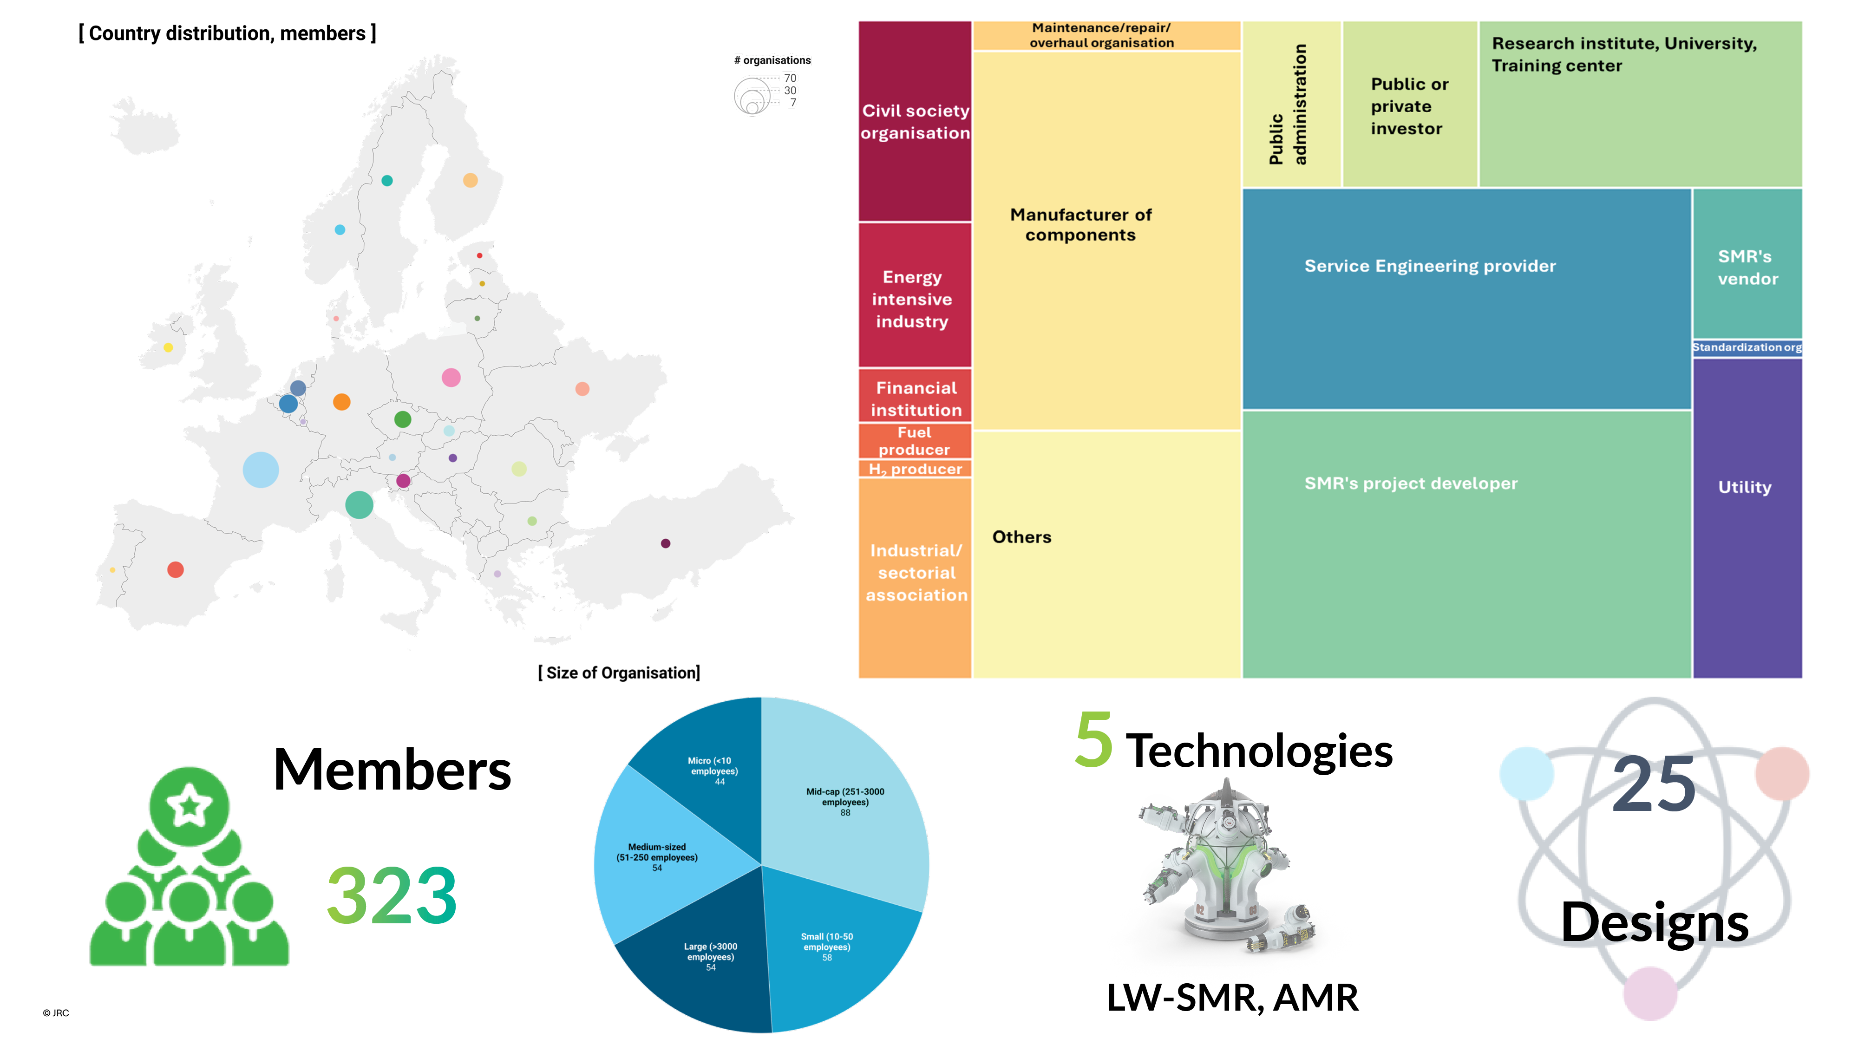

Slide 7
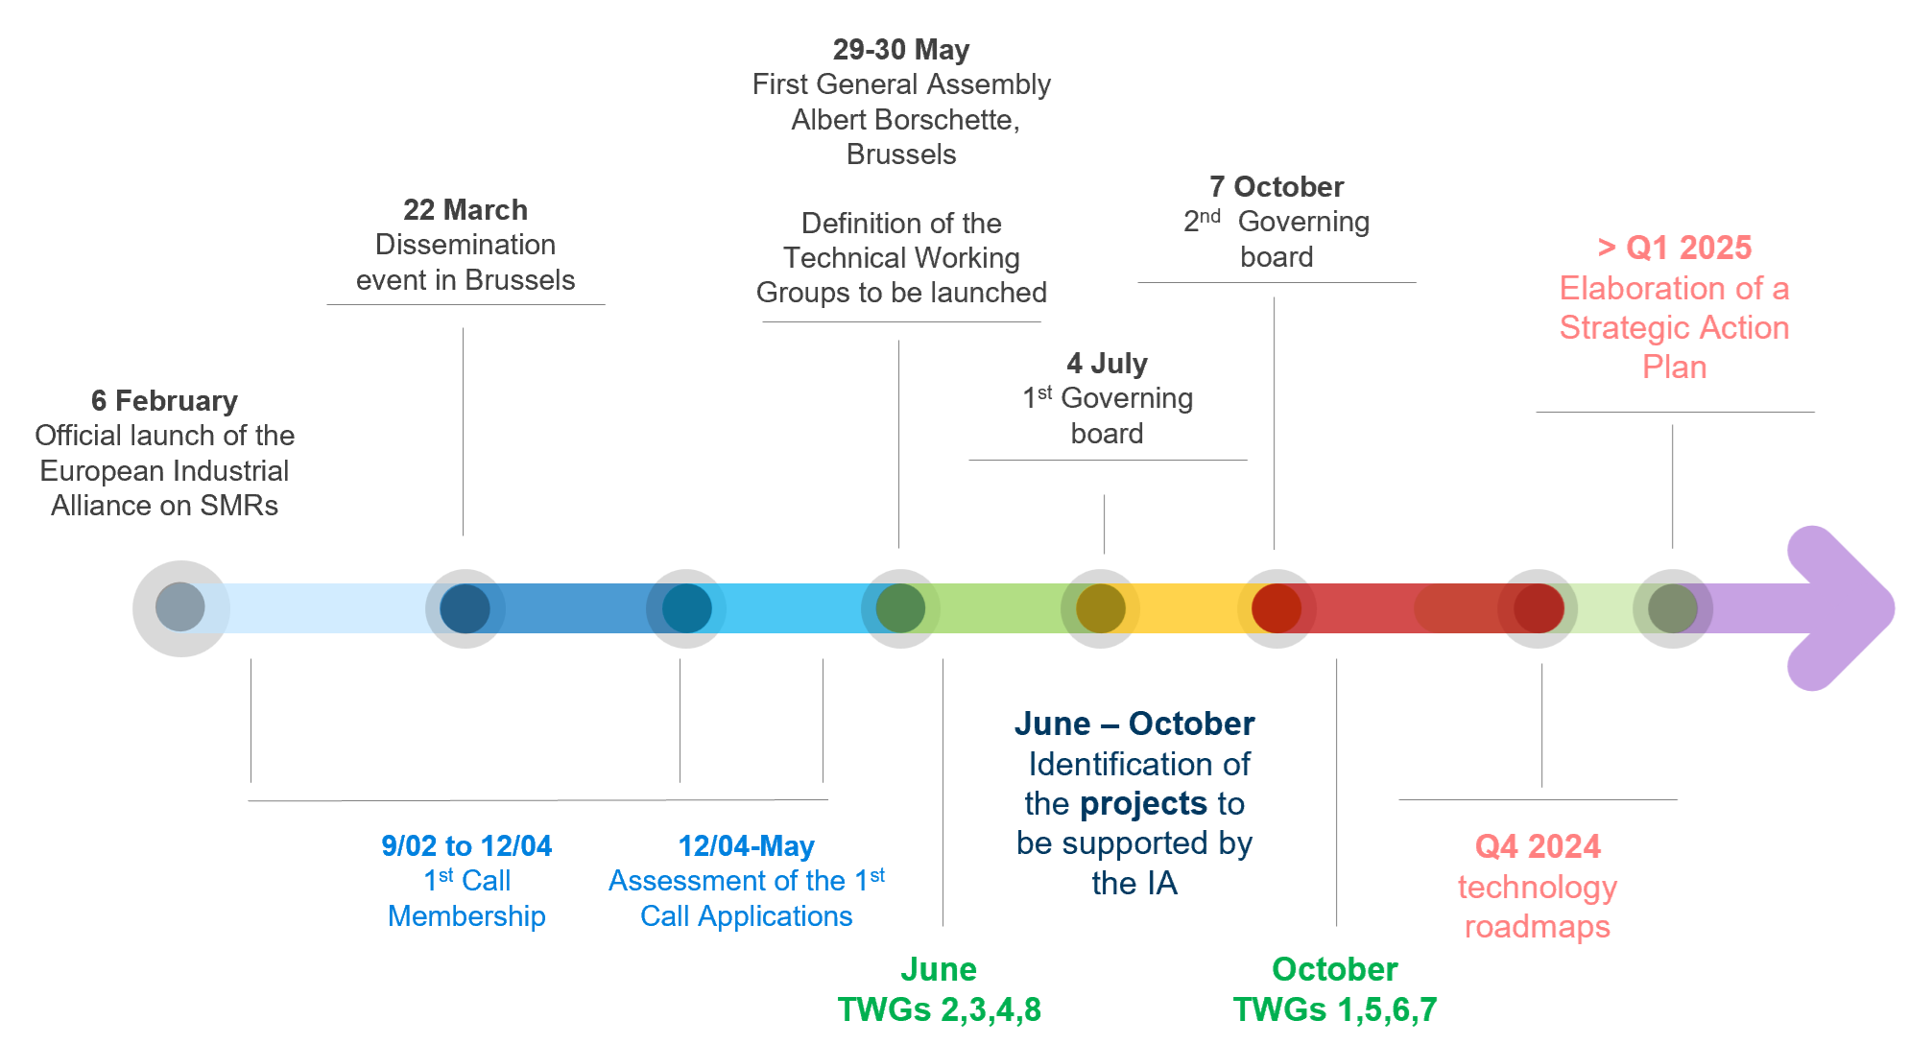
Indicative Timeline

Slide 8
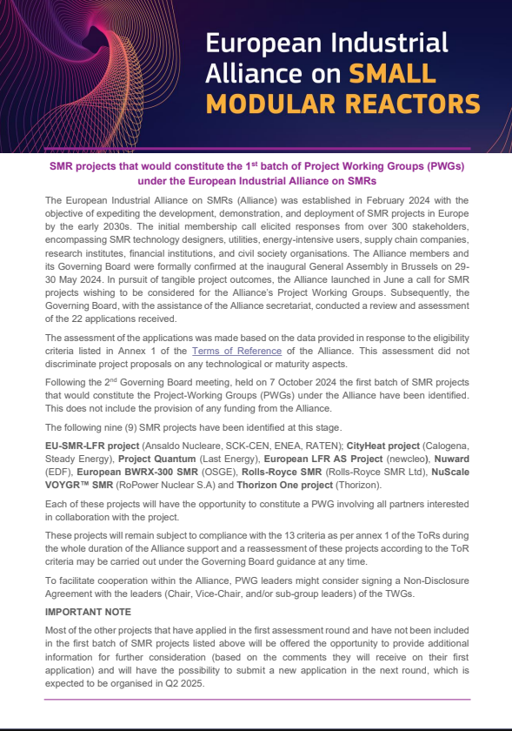
1st batch of Project Working Groups (PWGs) under the European Industrial Alliance on SMRs
As announced on 11 October, the following nine SMR projects have been identified at this stage:
EU-SMR-LFR project (Ansaldo Nucleare, SCK-CEN, ENEA, RATEN);
CityHeat project (Calogena, Steady Energy),
Project Quantum (Last Energy),
European LFR AS Project (newcleo),
Nuward (EDF),
European BWRX-300 SMR (OSGE),
Rolls-Royce SMR (Rolls-Royce SMR Ltd),
NuScale VOYGR™ SMR (RoPower Nuclear S.A)
Thorizon One project (Thorizon).

Slide 9
The EU Taxonomy

Slide 10
Goal
To direct investments towards sustainable projects & activities

Slide 11
Importance of Taxonomy
Finance
Access to finance
Policy
Message
Science is clear: nuclear is low-carbon & sustainable
Influence future policy

Slide 12
Sustainable finance taxonomy
Technical Expert Group
Joint Research Centre assessment
Article 31 Group (radioprotection experts)
+ Scientific Committee on Health, Environment & Emerging Risks opinions
Inclusion in complementary Delegated Act

Slide 13
JRC conclusion
The analyses did not reveal any science-based evidence that nuclear energy does more harm to human health or to the environment than other electricity production technologies already included in the Taxonomy as activities supporting climate change mitigation.
Nuclear is taxonomy compliant

Slide 14
Taxonomy – Future asks
Currently the nuclear fuel cycle is not considered as an enabling technology under the taxonomy.
Nucleareurope hopes that the European Commission will consider its inclusion under the taxonomy during the next mandate given its request that the EU reduces its dependence on Russian nuclear fuels.
Indeed, in order to encourage the European nuclear industry to ramp up its fuel cycle manufacturing capacity in the EU it is essential that policies such as the taxonomy provide support to this activity in order to encourage investment.

Slide 15
The Net Zero Industry Act

Slide 16
The Net Zero Industry Act
Enhances EU manufacturing capacity for net-zero technologies, including SMRs
SMRs recognized as strategic for Europe’s green transition
Regulatory and financial support to spur innovation and investment in SMRs
Supports EU leadership in SMR technology for energy transition by 2050

Slide 17
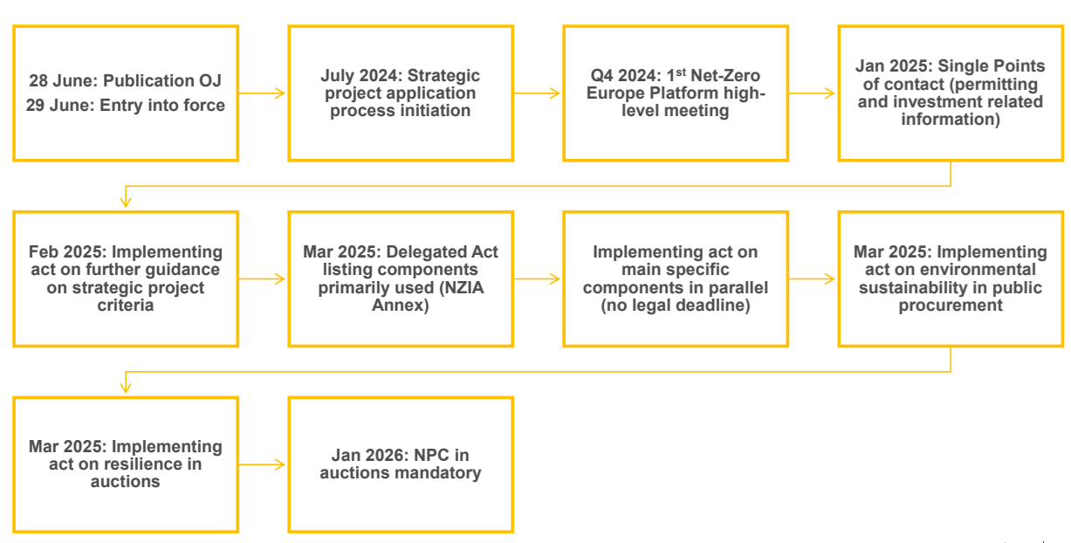
Net-Zero Industry Act (NZIA) implementation timeline

Slide 18
Net-Zero Industry Act (NZIA) – Strategic Projects
Under the Net-Zero Industry Act Regulation (EU) 2024/1735, net-zero technology manufacturing projects can apply to have their projects recognized as net-zero strategic projects.
Strategic projects under the Act are vital for enhancing the resilience, strategic autonomy, and competitiveness of the EU’s net-zero industry while aiming to scale up manufacturing of technologies essential for climate-neutrality.
Applications are assessed by the relevant MS and Projects that are granted the status will benefit from national ‘priority status’, faster permitting and other – detailed list of benefits available here.
The application process for project promoters to apply for the status of net-zero strategic project is now open on a rolling basis.

Slide 19
The Low Carbon Hydrogen Delegated Act

Slide 20
The Low Carbon Hydrogen Delegated Act
Hydrogen is set to play a crucial role in the EU decarbonisation strategy.
SMRs can play a key role in scaling up EU hydrogen production and creating a low-carbon hydrogen market
SMRs can also provide high-temperature steam for electrolysis, crucial for large-scale hydrogen production
This Act sets a methodology for assessing greenhouse gas emissions for low-carbon hydrogen production, including nuclear-based hydrogen.

Slide 21
The Low Carbon Hydrogen Delegated Act
The Delegated Act in in the process of a public consultation at the moment. What does the nuclear industry need this Act to include?
Accurate Emission Factor for Nuclear Electricity: The Delegated Act should update the emission factors for nuclear electricity using contemporary data to accurately reflect its low-carbon footprint.
Inclusion of Power Purchase Agreements (PPAs): The Act should recognize PPAs for nuclear electricity to ensure accurate carbon accounting and support the growth of the low-carbon hydrogen industry.
Project-Based Approach to Emissions Measurement: A project-based approach should be adopted to measure emissions more accurately, reflecting the unique characteristics of each hydrogen production project.
Grid Electricity and Direct Connections: The Act should include all relevant electricity sourcing options, such as grid electricity and direct connections to nuclear power, to support low-carbon fuel production.

Slide 22
The future of European competitiveness: report by Mario Draghi

Slide 23
European Competitiveness report
Mario Draghi's report on European competitiveness aims to provide strategic recommendations to enhance the EU's economic resilience and global standing, focusing on innovation, investment, and regulatory reforms.
Main takeaways:
The decarbonisation of Europe’s energy system implies the massive deployment of clean energy sources with low marginal generation costs, such as renewables and nuclear.
The EU should decouple the remuneration of renewable energy and nuclear from fossil-fuel generation by building on the tools introduced under the new Electricity Market Design – such as PPAs and two-way CfDs

Slide 24
European Competitiveness report
Main takeaways (cont.):
A key goal is to accelerate decarbonisation in a cost-efficient way, leveraging all available solutions through a technology-neutral approach.
The full benefits of the clean transition for EU competitiveness will only materialise when renewables combined with nuclear are regularly price setting and relevant investments in grids, storage and flexibility are completed.
All available technologies and solutions must be leveraged by adopting a technology-neutral approach and by developing an overall cost-efficient system

Slide 25
Conclusion

Slide 26
26

