Slide 1

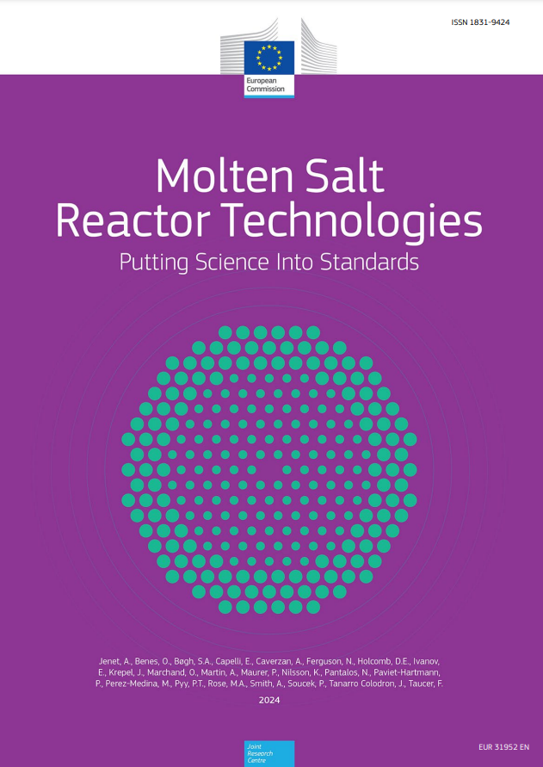
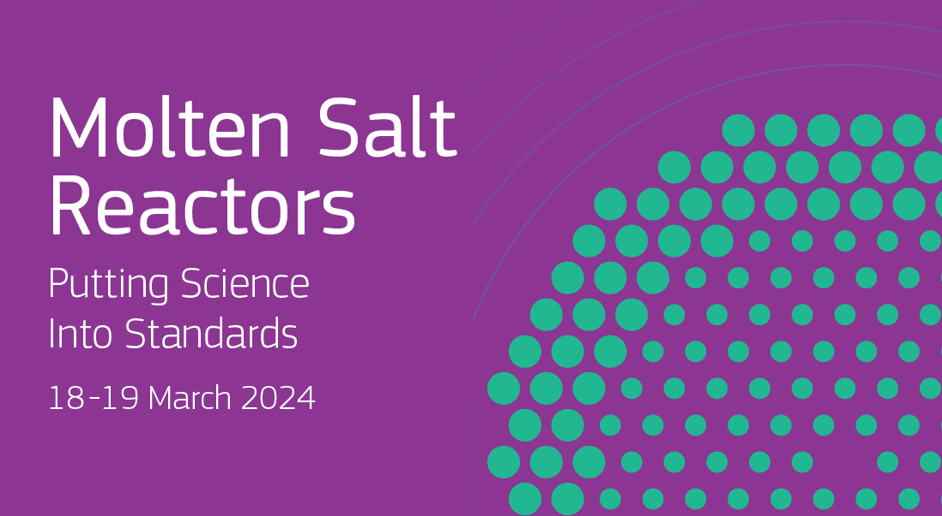
SHAPING MSR STANDARDIZATION FOR EUROPE'S ENERGY FUTURE THROUGH SCIENCE
Fabio Taucer et al. - European Commission
Fabio.TAUCER@ec.europa.eu
ID: IAEA-CN-327-434
Key Discussions and Findings from the 2024 PSIS Workshop
Safety assessments as a top priority for MSR standardization.
Importance of standardized measurement methodologies for thermo-physical properties.
Need for standards in fuel qualification processes, and material and component standards
Towards a Harmonized Framework
Benefits of a harmonized regulatory framework within the EU for MSRs.
Potential to streamline licensing processes, catalyze investment, and foster innovation.
Developing a Roadmap for MSR Standardization
Focus on robust testing protocols, fuel purity, and safety guidelines.
Importance of iterative review process and data stewardship following FAIR principles.
Inclusive process for crafting standards, leveraging workshops and focus groups.
The Role of the JRC in MSR Development
Contributing to MSR safety, safeguards, and security.
Establishment of a thermodynamic database for MSR fuel behavior.
JRC’s leadership in the Task Force on Molten Salt Reactors (MSRTF) for EU safety alignment.
The PSIS Initiative and its Impact on MSR Standardization
PSIS workshops as a foresight tool for addressing standardization needs.
The 2024 PSIS workshop focuses on identifying and fostering international collaboration in MSR standardization.
Contribution of the ‘PSIS 2024 MSR’
Aligning MSR standardization with the EU Green Deal and the Net Zero Industrial Act.
Proposing a standardization roadmap and a code-of-practice for EU-wide MSR deployment.
Establishing dedicated working groups for the development of MSR standards and codes.
About EUR 380 million annual budget
plus about EUR 80 million earned
JRC
2.800 staff
> 50 large scale research facilities
110 on line databases
> 100 economic, bio-physical and nuclear models

