Slide 2
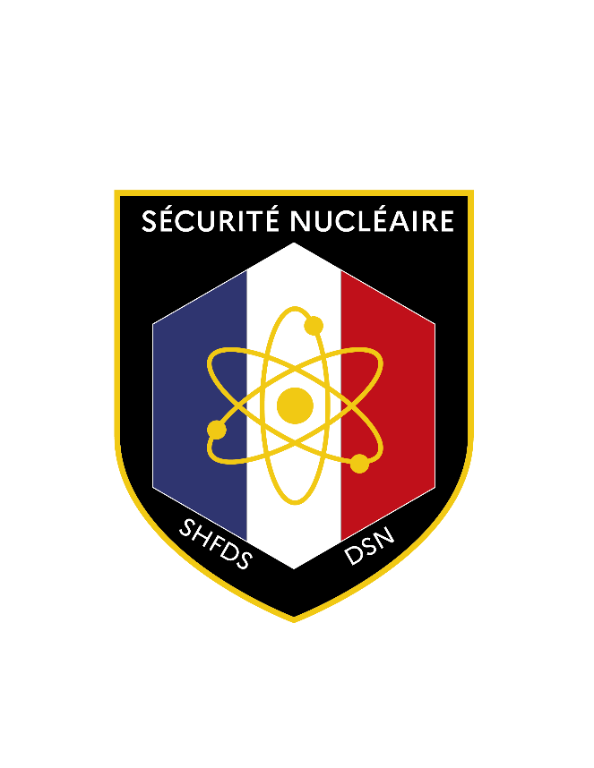
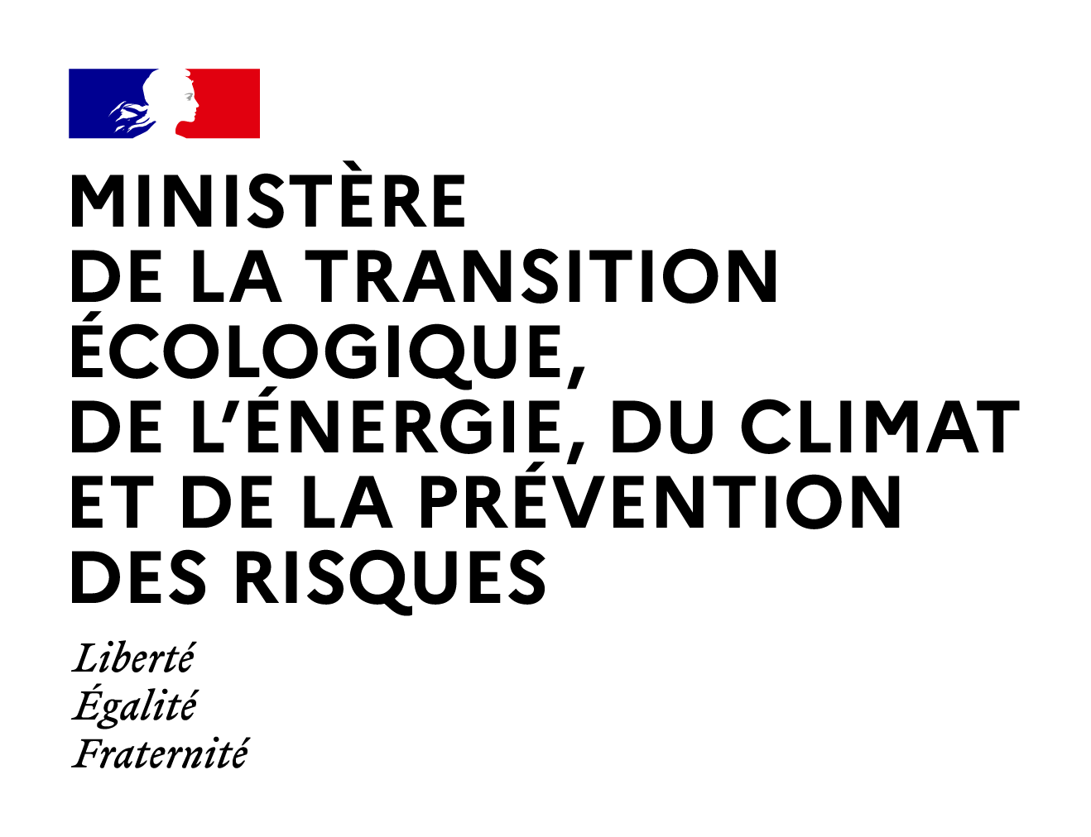
FRENCH LESSONS LEARNT REGARDING INTERFACES BETWEEN SECURITY AND SAFETY AND SAFEGUARDS, FOR SMRS
Mélissa KOPPE, Nuclear Security Department
France

Slide 3
Introduction
1 billion euros of public funds for investment in the ‘France 2030’ initiative
12 SMR projects in France, including two focused on nuclear fusion reactors
Various technologies (high-temperature reactors, fast neutron reactors, molten salt reactors etc.)
Various range of power (from 10 to 540 MWth)
Some designers would like their reactors to be operational by 2026
Two applications for nuclear material authorization received in France: for a small modular reactor and for a fuel assembly plant
Receipt of security option files planned for 2025
3

Slide 4
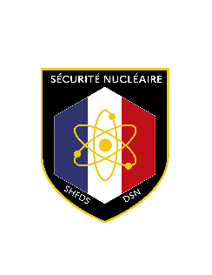

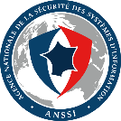
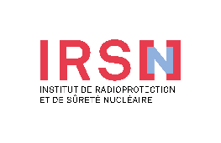
Nuclear French Regulation*
SAFEGUARDS
SAFETY
SECURITY
ONLY FOR
CYBERSECURITY
Prime Minister
Regulation & licensing
Ministry in charge of Energy
Ministry in charge of Energy
Nuclear Security Authority
Prime Minister
Euratom Technical
Committee (CTE)
Inspections by Euratom and
the IAEA
Ministry in charge of Energy
Nuclear Security
Authority (DSN)
ANSSI
French National Cybersecurity Agency
Control
(Inspections)
Control
Nuclear Safety Authority (ASN)
Laws
Euratom Treaty + IAEA commitments + international agreements
Laws
Environment Code
Defense Code
TSO
(Technical Support Organisations )
4
*This organization will change with the merger of the ASN and part of the IRSN to become the ASNR on January 1st 2025

Slide 5
Nuclear French Regulation
Security knowledge
Safeguards knowledge
Safety knowledge
Creation of a guide on French regulations for SMR designers
Recruitment of former and current nuclear security professionals by start-ups
5

Slide 6
Safety and security interfaces
French regulations
Environment Code and Ministerial order of 7 february 2012
Ministerial order of 13 april 2023
The safety report have to include, in its section dedicated to malicious acts, an overview of the residual malicious incidents that occured after the request for authorization to possess nuclear materials, reviewed by the nuclear security authority
Detailed description of theses residual malicious acts as well as the state of the facility following their occurrence
Ensure the residual malicious acts are properly taken in account in emergency plans and safety measures
The French regulation has established interfaces between nuclear safety and nuclear security
6

Slide 7
Safety and security interfaces
Synergies
New paradigm
SMRs can use passive residual heat removal systems in the event of an accident, which do not require an external power supply to operate: the reactor remains in a safe shutdown state without the need for human intervention over a long period
Many project developers leverage safety measures to demonstrate nuclear security, relying on intrinsic safety features of innovative reactors
The safety demonstration could be a tool to identify targets
7

Slide 8
Safety and security interfaces
Limits
While technological advancements enhance safety, they may not adequately address security concerns
Design choices for passive safety can introduce vulnerabilities
Safety equipment redundancy is no longer as relevant as it once was: in the case of SMRs, their compact design may increase vulnerability (ex: a sabotage attempt could simultaneously disable all safety equipment, highlighting unique security risks)
Due to the critical size and target areas of an SMR, scenarios involving malicious acts can be less complex compared to existing reactors, resulting in fewer safety challenges: study of all suspended nuclear materials
A solution optimized only from the point of view of safety can be a security disadvantage
SMR may be more vulnerable, passive system functions and safety advantages can be a drawback, or at the very least, not an advantage for nuclear security
8

Slide 9
Safety and security interfaces
Cooperation
Identifying potential synergies between safety and security should begin early in the design process to ensure robust protection
A proactive approach is essential to leverage these synergies while addressing the distinct risks posed by SMRs
Collaboration between the two authorities on safety and security interfaces is essential, but it must be conducted within the limits of information protection and the need to know
!
9

Slide 10

Security and safeguards interfaces
Nuclear materials accounting and control (NMAC) system in France: a tool to comply with security and safeguards requirements
EURATOM - IAEA
Information transmitted to EURATOM to monitor and control nuclear materials
CTE
Shared accounting between nuclear security and international safeguards requirements
DSN
Centralized Accounting System – IRSN
Tracks nuclear materials and their location
Ensures compliance with EURATOM
Send their data on nuclear materials
Nuclear material operators
10

Slide 11
Security and safeguards interfaces
New reactor designs: more compact, smaller, and complex
Security implications:
  Facility layout and access control impact on both security and safeguards
  Must enable IAEA verification while balancing security measures
IAEA surveillance: independant of national surveillance systems
Design requirements:
  Harmonize both national and international monitoring from the design stage
  Avoid interference between different monitoring systems
Effective integration of security and safeguards by the designers is essential
for compliance
11

Slide 12
3S interfaces
The external barrier can be used in all three regulations (containment, physical barrier with delay, access control)
Quality and reliability of the information
Common cyber issues, especially in teleoperation projects
All design decisions must integrate safety, security and safeguards considerations to eliminate conflicts and enhance overall project integrity
Intrinsic safety/security
Information on nuclear materials
Safety case
Design
Information
Computer / cyber security
Staff training and awareness
Materials accounting and control
Monitoring
Access
Safety
Security
Safeguards
12

Slide 13
French nuclear security department methods
Findings:
Need for flexibility and resources to effectively address designers’ projects and manage increasing 3S by design interfaces
Bilateral safety/security and security/safeguards meetings as required
(new)
Biannual 3S meetings
Objectives:
Enhance cooperation between authorities for better project understanding
Track progress in project assessments and engagements with designers
Develop solutions for interface challenges and improve synergy among authorities
13

Slide 14
… extending beyond the 3S for SMRs
!
National energy policy must consider all issues, especially security
Nuclear security issues must be understood at the highest level by decision-makers, including those not directly involved
Multiple challenges to consider in French energy policy
Type of fuel that could lead to identify new types of threat
Proliferation issues for some types of fuel
Social acceptance
No staff on site
Lack of studies on new types of fuel
Increase of nuclear material transports
No armed guards on site?
Proximity to urban areas
Biannual meetings with all government offices concerned with SMRs, including authorities responsible for energy policy
(new)
14

Slide 15
Conclusion
Need to rethink and adapt our current processes for SMRs while maintaining the same standards as with existing operators
Need to reorganize the nuclear security authority to handle the increased workload associated with SMRs
Need for better 3S coordination, and beyond, to adress all challenges of multiple SMR deployments on the territory
Need for high-level decision-making to ensure appropriate processes are in place to allow the deployments of SMRs
Coordination between authorities and between the involved ministerial departments is a key element to enable the successful implementation of SMR projects
15

Slide 16
Thank you
melissa.koppe@developpement-durable.gouv.fr
+33 1 40 81 67 83

