Slide 2
WANO and Its Members Experience in Deployment of Small Modular Reactors
Hyojin Kim
Deputy Director New Nuclear
WANO London Office

Slide 3

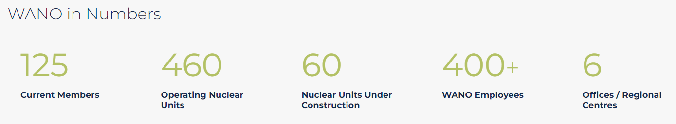
World Association of Nuclear Operators

Slide 4
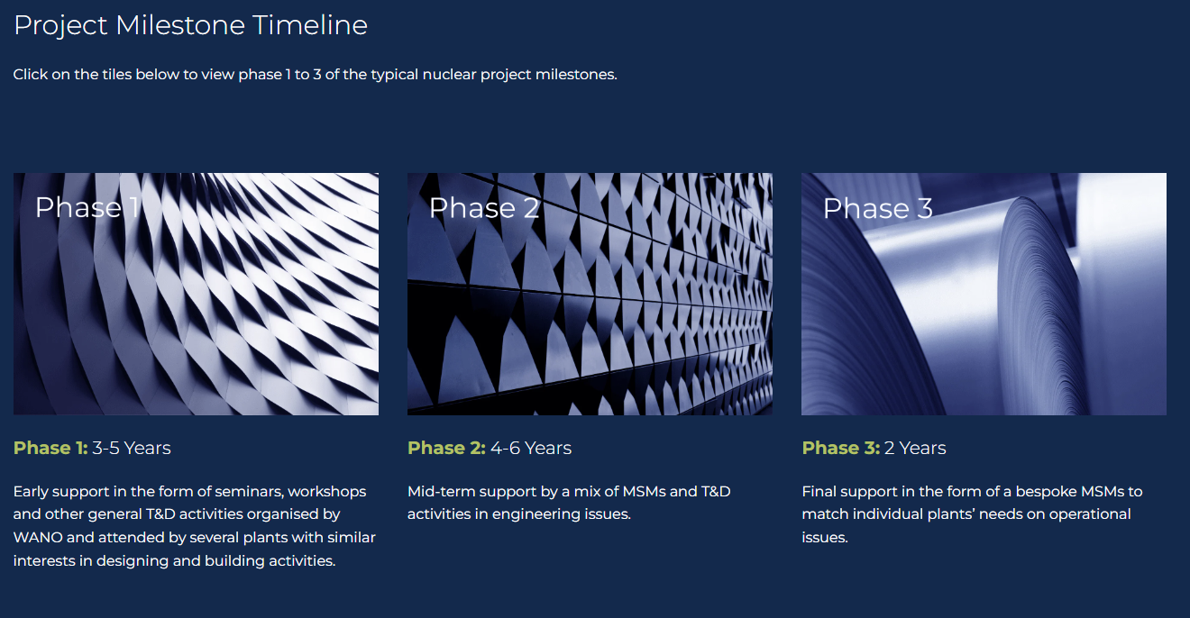
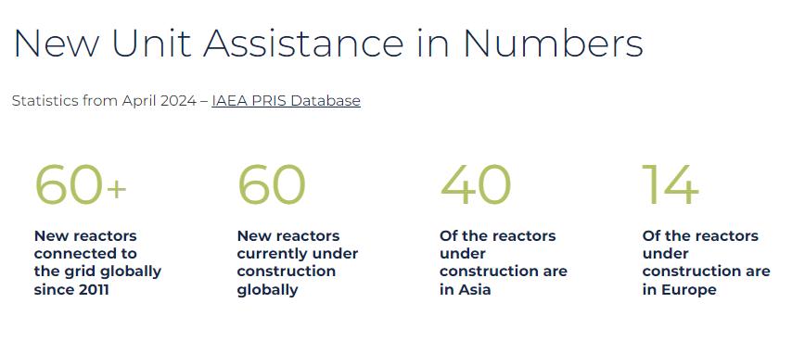
WANO Services to
New Nuclear Units

Slide 5
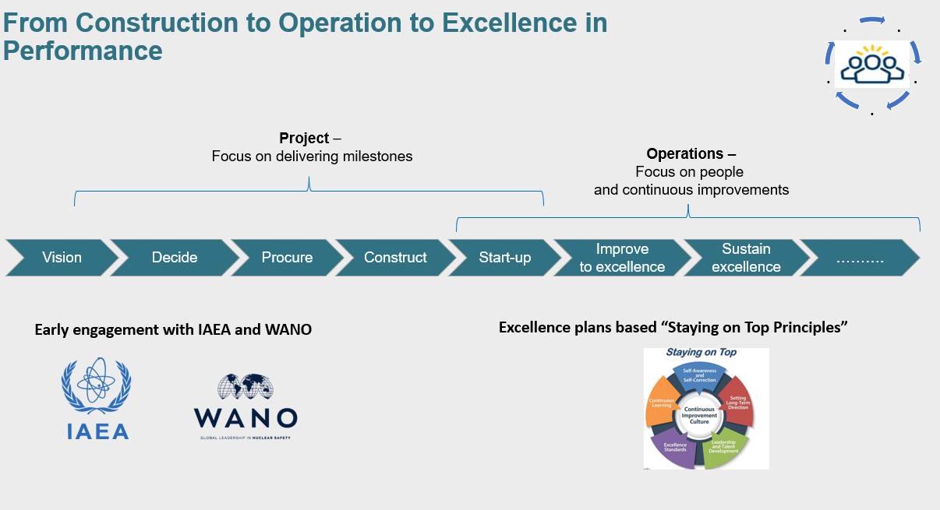
WANO Services to
New Nuclear Units

Slide 6
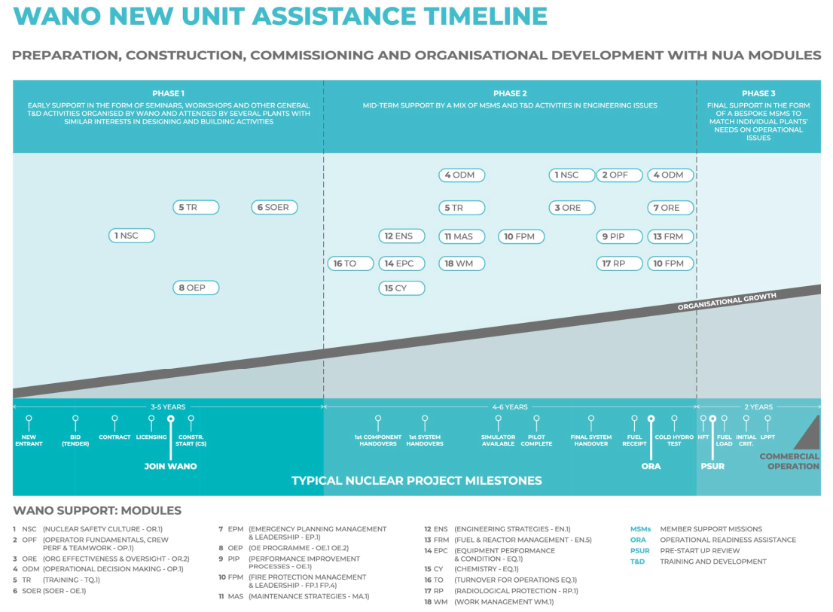
WANO Services to
New Nuclear Units
No.​ | Fundamentals​ (SMR)
01​ | Nuclear Safety Culture​
02​ | SOER
03​ | Organisational Effectiveness
04​ | ​Capacity Building & Training
05​ | Roadmap to Operational Readiness

Slide 7
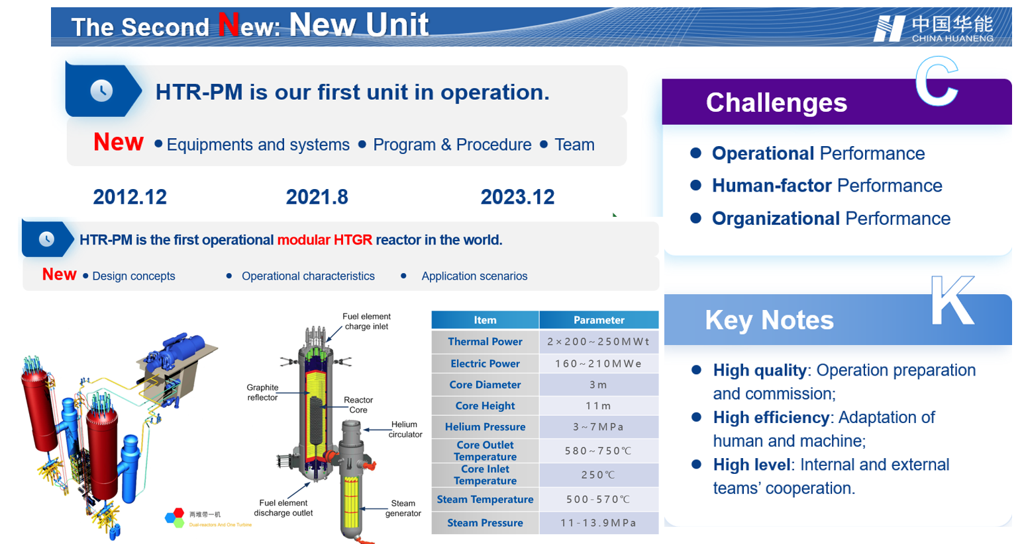
WANO Members’ SMR Deployment Experience
HTR-PM

Slide 8
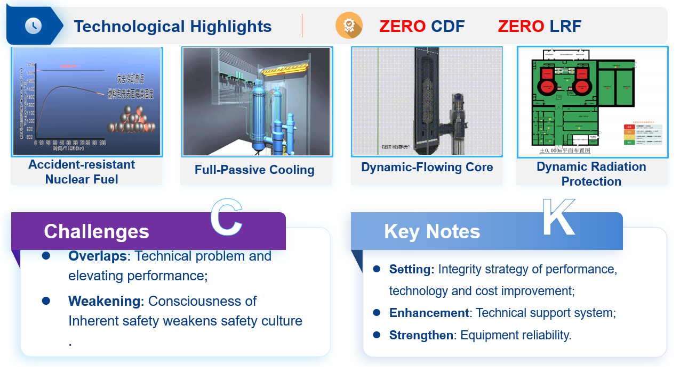
WANO Members’ SMR Deployment Experience
HTR-PM

Slide 9
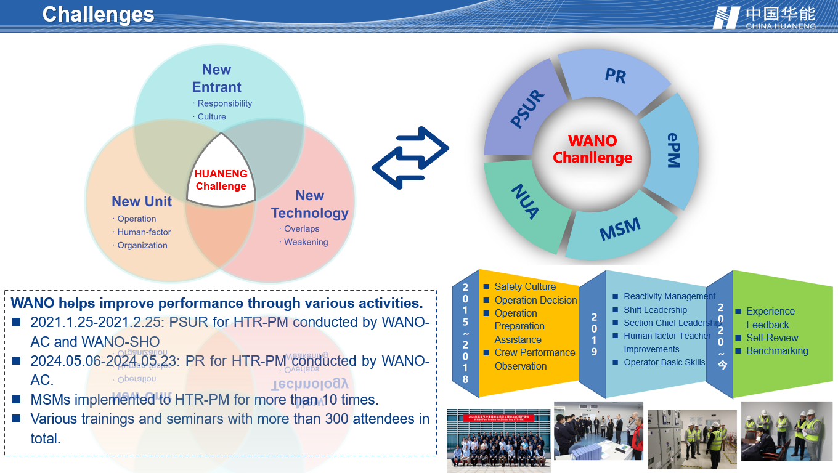
WANO Members’ SMR Deployment Experience
HTR-PM

Slide 10
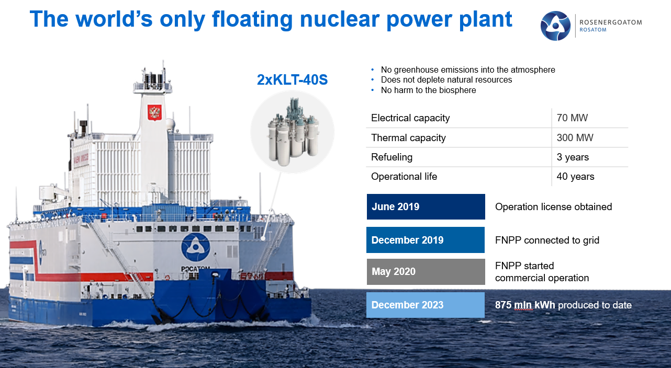
WANO Members’ SMR Deployment Experience
Floating NPP

Slide 11
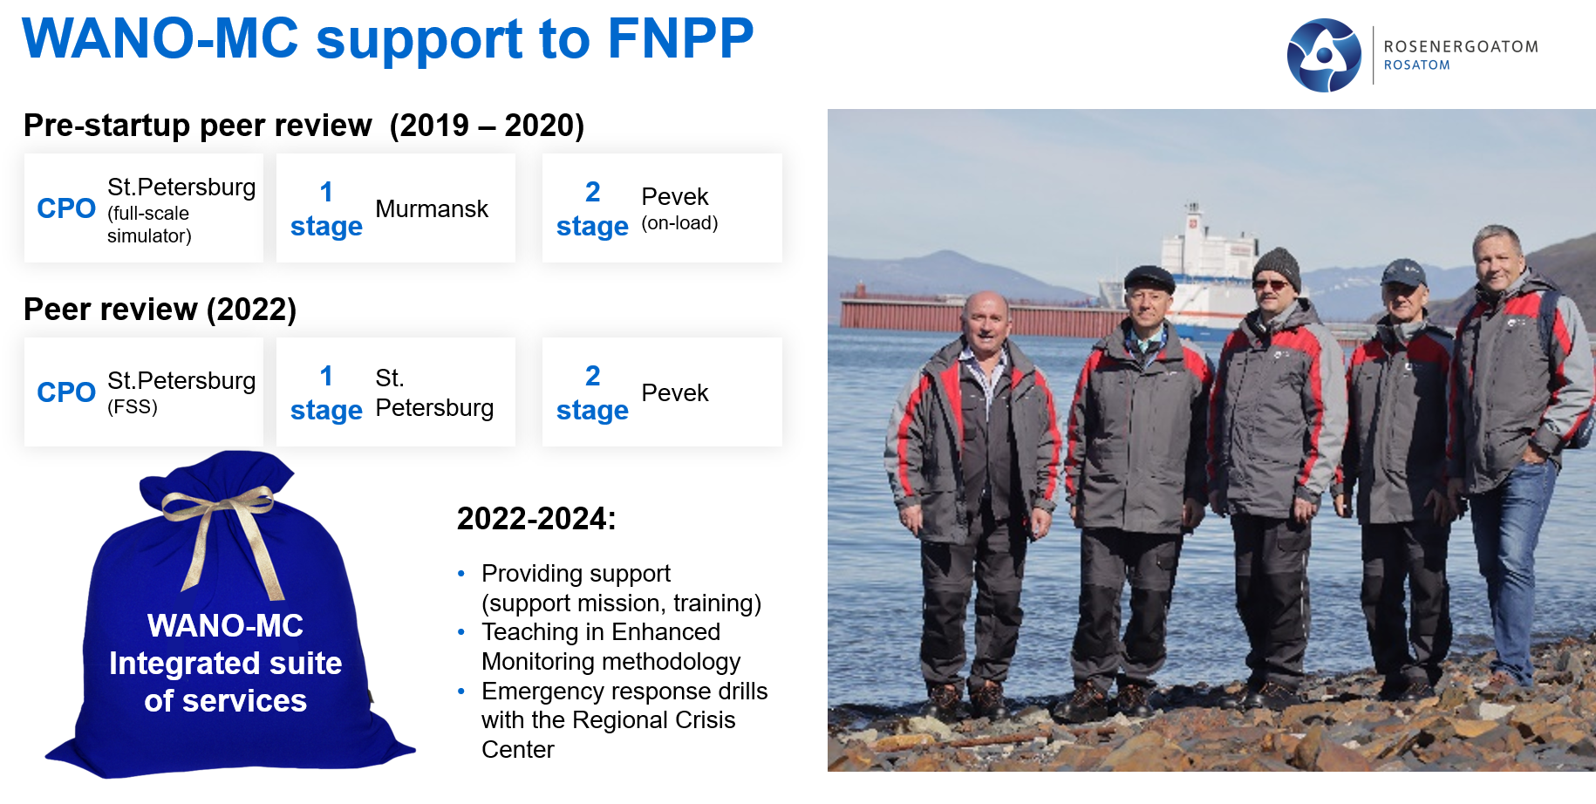
WANO Members’ SMR Deployment Experience
Floating NPP

Slide 12
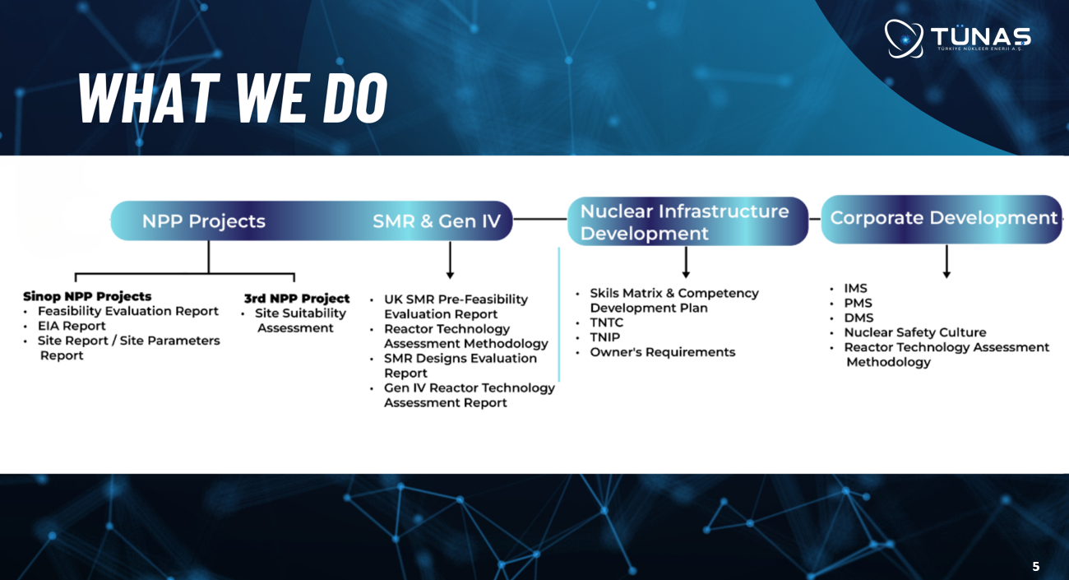
WANO New Entrant Experience
Large and Small NPPs

Slide 13
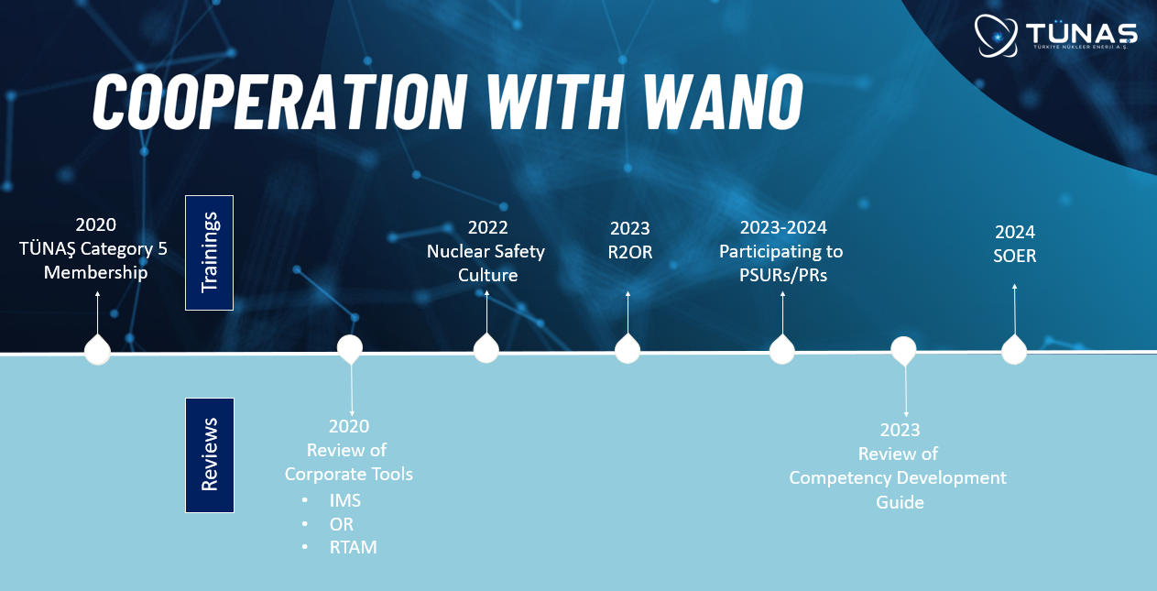
WANO New Entrant Experience
Large and Small NPPs

Slide 14
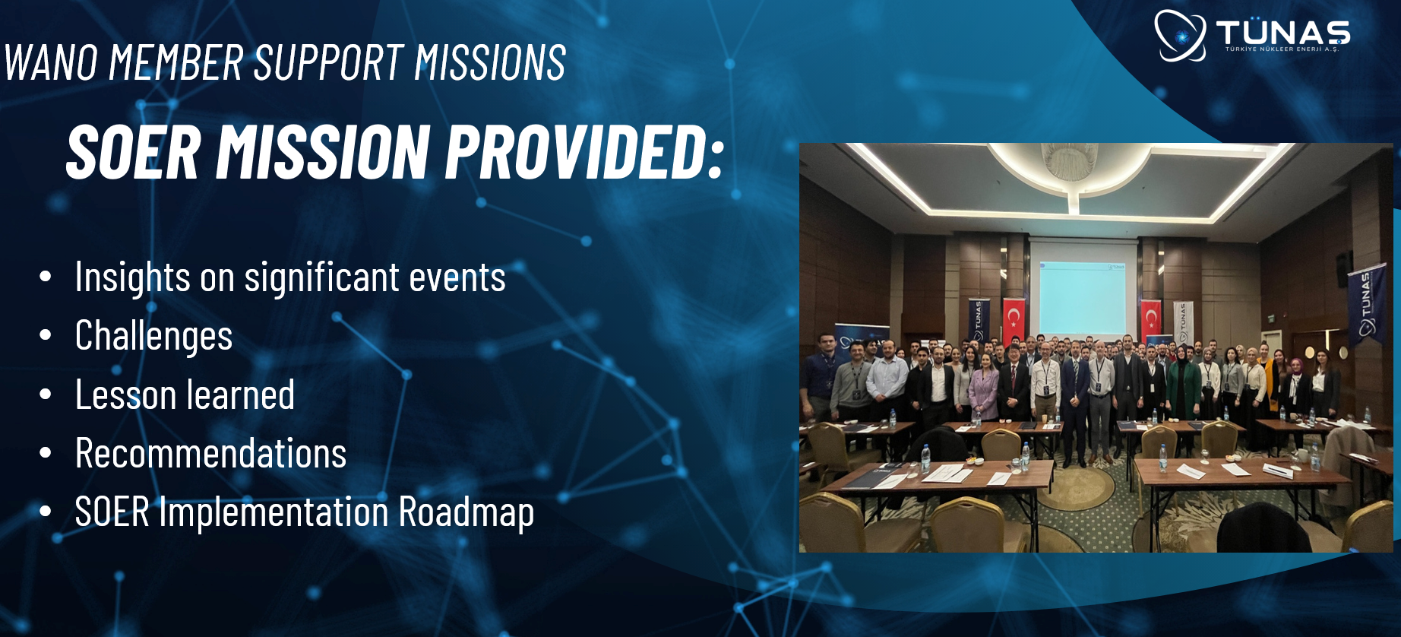
WANO New Entrant Experience
Large and Small NPPs

Slide 15
Key Take-Aways
WANO is a Nuclear Community of commercial nuclear power plant owner/operators
WANO and its members are willing to share over 35 years of vast experience in planning, construction, commissioning, startup, and operation of different technologies and different sizes of NPPs
WANO and its members work together to ensure safe, reliable, and successful deployment of new nuclear units
WANO and its members are striving for excellence in Nuclear Safety

Slide 16
Thank you so much.
hyojin.kim@wano.org

