Slide 1
Integrating Small Modular Reactors into Hybrid Energy Systems
The TANDEM Modelica Library
G. Simonini, EDF R&D, 25th October 2024
Notes:
My name … and research engineer in…
I will present our work perfomed in the European TANDEM project
to support the integration of SMR into HES
By the development on an open-source modeling library developed in Modeica

Slide 2
EU decarbonization & the TANDEM project [1]
Future energy needs:
Heat
Hydrogen
Flexible Production
SMR producing both electricity & heat
  Corresponds to 50% of EU energy needs
  Strongly dependent on fossils
  Decentralized
TANDEM main objective:
To facilitate the integration of SMR into Hybrid Energy Systems (HES) to support the European energy transition:
  By developing methodologies and tools
  By addressing safety issues and assessing the feasibility of an efficient integration
Focus on PWR (deployment in EU by the 2030s), with perspectives for AMR (by 2050).
Notes:
Let’s start with a short introduction.
The TANDEM project fits in the context of the EU energy transition.
It focuses on 3 key needs of the future energy system.
Needs of…
Carbon free heat
H2 and synthetic fuels
Flex prod to compensate RES
SMR, producing both…, can clearly contribute to address these needs
In this context, the TANDEM…
HES being a mix of producers/users exchanging different energy fluxes (electricity and heat)

Slide 3

Modeling to support the SMR the integration
EU energy scenarii + selected technologies
Safety codes modeling
Modelica TANDEM Library
Techno-economic studies (MILP)
Hybrid System Simulator
Safety studies and recommendations
Simulation of the optimized scenarii
Notes:
Several key factors are identified for a successful integration (…)
Most of them can be supported by modeling
To move towards its goals, TANDEM develops several modeling tools and we focus here on the Modelica library
It provides the briks to build a customizable simulator
That can be used:
Toghther with safety codes
Or to validate and analysesthe dynamic behavior of the HES configurations generated by optimization studies

Slide 4
The 2 HES configurations for TANDEM
District Heating
Energy Hub
Images from K. VARRI et al. “Description of selected study cases for safety, techno-economic analysis and optimization” D1.4, 2023. http://tandemproject.eu/

Slide 5




The Modelica TANDEM Library [2][3] https://gitlab.pam-retd.fr/tandem/tandem
SMR
  NSSS
  CI-BOP
Electrical Grid
District Heating
Storage
  Thermal
  Electrical Simplified
RES Simplified
[RO] Desalination Simplified
H2
  [PEM] Low Temperature Simplified
  [SOEC] High Temperature
Developed by:
Notes:
Blocks presented in the previous slide
Simplified modules: dynamic behaviour can be negleted on the HES scale

Slide 6


Supporting Libraries
ThermoSysPro & ThermoPower
Thermohydraulics (& control) modeling: power plants, heat storages, district heating…
CEA_Energy_Process_Library
Energy processes & associated media:
hydrolysis, fuel cells…
Buildings
Buildings (& supporting systems) modeling:
→ electrical grid
WindPowerPlant
Models injecting variable electrical power to the grid

Slide 7
Example of Module: the E-SMR from ELSMOR
Nuclear Steam Supply System
Conventional Island - BoP
x2
x3
Multiple models available:
Different modeling approaches:
Documentation available [2],[3] to make your choice
Control strategies
Interfaces (thermal or fluid)
Number of heat extraction points,
Inertia
→ Benchmarks to consolidate modeling approaches

Slide 8
Nuclear Steam Supply System: benchmarks
Pressurizer modeling vs. experimental data (Shippingport):
→ Impact of the thermal stratification
Models responses to typical power transients:
→Different behavior depending on the control logic
(“P on rod speed” vs “PI on reactivity”)
Power
Reactivity

Slide 9
Usages of the library
Customizable HES simulator by assembling the available bricks...
→ or even new bricks of your own ! (depending on your need)
HES operation studies:
Heat load transients (daily, seasonal…)
Response to electrical grid needs (flexibility)
Analyses of
  Architecture design
  Operation strategies
  Control logic
HES accident scenarii:
Provide realistic boundary conditions
→ solicitation on the reactor
Allow preliminary studies
CATHARE, ATHLET…
but also, potentially, neutron or thermo-mechanical codes
Optimization : MILP, genetic algorithms…

Slide 10
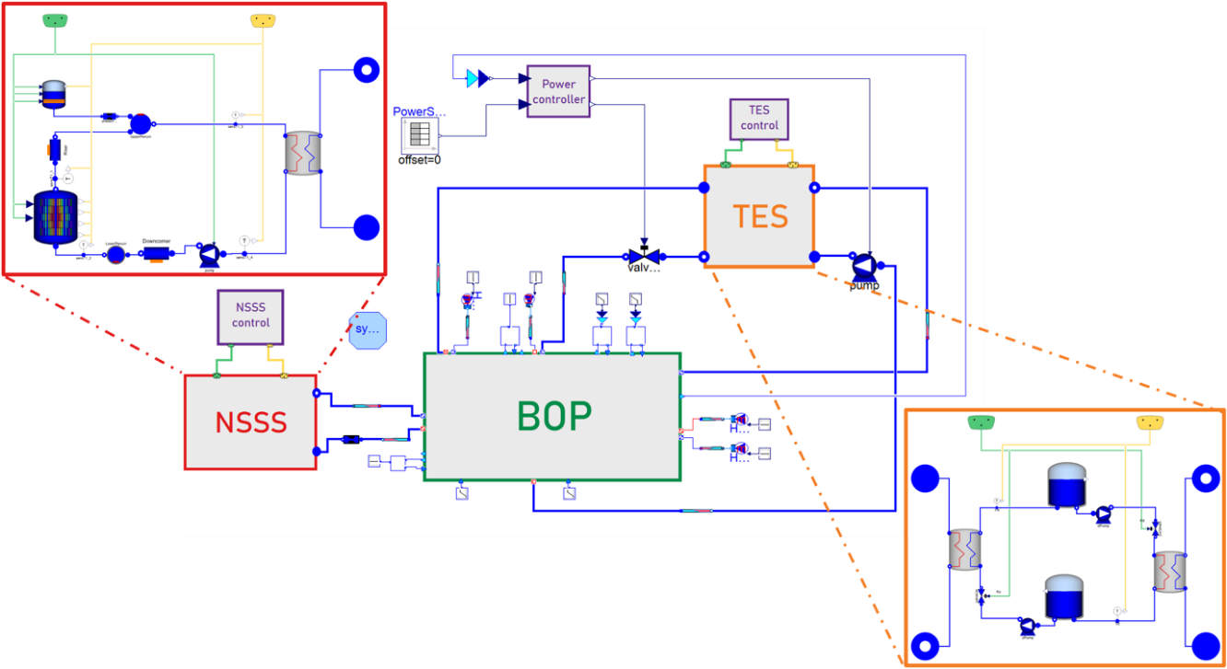

Examples of techno-economic studies
Thermal storage valorization for plant flexibility
SMR for district heating
Courtesy of G. Masotti [5]
→ Track D.13 #307
Courtesy of G. Masotti [6]

Slide 11
Conclusions
Modelica library with the bricks to build a customizable HES simulator:
SMR, heat storage, renewables, hydrolysers, district heating…
Based on well established Modelica libraries
The library enables:
  Normal operation tecno-economic studies
  More “realistic” safety studies (through coupling with safety codes)
The first version of the library has been developed for the needs of the TANDEM project…
… but it can evolve in the future depending on the usage of the community:
e.g. Advanced Modular Reactors…

Slide 12
Bibliography
C. Vaglio-Gaudard et al. « The TANDEM Euratom Project: Context, Objectives and Workplan ». Nuclear Engineering and Technology 56, nᵒ 3 (mars 2024): 993‑1001. https://doi.org/10.1016/j.net.2023.12.015.
G. Simonini et al. “Modelica models description for the ‘TANDEM’ library”, 2024. https://tandemproject.eu/resources/.
G. Simonini et al. “Integrating Small Modular Reactors into Hybrid Energy Systems: the TANDEM Modelica library”, IAEA SMR conference, Wien, Austria, 2024.
V. Ferrara « Modelling and Analysis of the Nuclear Steam Supply System of a Small Modular Reactor », Master Thesis, Politecnico di Milano, 2024. https://www.politesi.polimi.it/handle/10589/222698.
G. Masotti et al. “Simulation of flexible small modular reactor operation with a thermal energy storage system”, IAEA SMR conference, Wien, Austria, 2024.
G. Masotti et al. “Dynamic Modelling and Optimisation of a Small Modular Reactor for Electricity Production and District Heating in the Helsinki Region”. ICAPP, Las Vegas, NV, 2024.

Slide 13


G. SIMONINI, V. FERRARA, Y. HAMMADI, S. HOCINE-RASTIC
EDF, France
S. LORENZI, G. MASOTTI
Politecnico di Milano, Italy
N. ALPY, D. HAUBENSACK,
S. MATHONNIERE, R. TALPIN
CEA, France
A. BAUDOUX, D. JOURET,
F. PAPPALARDO, B. TOURNEUR
Tractebel, Belgium
giorgio.simonini@edf.fr

