Slide 1


Slide 2
Paper 384: Security Considerations for Floating Nuclear Power Plants When Stationary
Dr Ross Peel, M.Eng.
Research Fellow
Centre for Science and Security Studies
King’s College London
Notes:
Intro

Slide 3
Ambiguities of Floating Nuclear Power Plants
Nuclear regulation and licencing
Detailed legal frameworks
International Atomic Energy Agency
Various treaties
Standards
Finance and insurance
Safety best practices
National ownership and control is the norm
Maritime regulation and licencing
Detailed legal frameworks
International Maritime Organisation (IMO)
Various treaties
Standards
Finance and insurance
Safety best practices
Foreign ownership and control is the norm
Nuclear power plants
Oil platforms, barges, ships
FNPP
Overlapping area:
Ambiguities and areas without international consensus
Notes:
A huge amount of domestic and international legal, regulatory, technical, epistemic, political, financial and other issues are associated with both the nuclear industry and the maritime industry.
These have been built up over time as a result of many years hard won experience, expertise and hard learned lessons. Even today, each industry is still working hard to constantly address challenges within itself, harmonise standards domestically and internationally, and maintain safety and security. Two very complex sets of rules, standards and systems.
These were built up independently, with no idea that they might one day have to work together and tolerate one another. As a result, they are in many areas deeply incompatible, and these differences cannot be reconciled easily. Attempts have started within the IAEA and by some independent researchers to address the huge space between these two domains, but it will be the work of many years to do this.
The closest experiences we have to draw on are in transporting nuclear materials by sea – this is something we know and broadly agree how to do. However, that is very different than operating a nuclear power plant on water – nuclear materials in reactor conditions are NOT like cargo conditions. We have also used nuclear reactors on ships to power them, though these have thus far been military vessels with their own rules, or icebreaking ships operating in the Arctic fully within Russia’s territory. Once we start talking about civilian operated nuclear power plants, the left half of the diagram changes dramatically from these cases.

Slide 4
Intra-nuclear ambiguities: Is this a transport, a facility, or both?
Security Approach
This presentation covers security considerations when stationary
    Primarily facility-related
    Reactor may be operating, under construction, being (re/de)fuelled, maintained, commissioned, etc.
    How does having characteristics of transport impact facility security during the FNPP lifecycle?
TNPP
Conventional Nuclear Transport (Licensed packaged)
Licensed Nuclear Site
FNPP
Loaded Core
When stationary – a facility?
When in motion – a conveyance? A package? A ship? Something else?

Slide 5
FNPP Lifecycle Complexities – Relocation, Relocation, Relocation
1
  Design
Considerations
    Not all stages may occur in the same country
    Entire FNPP will likely be constructed at a shipyard and then relocated to operating site
    Commissioning may occur at the site of construction or operation
    FNPP may travel with fuel aboard in core
    Fuel in core may be fresh or irradiated
    Stage 5 (Relocation) may occur multiple times and at different stages
    Refuelling may occur and the plant be used again, at the same site or elsewhere
    The plant may have multiple operational periods in different locations before eventual decommissioning
2
  Manufacturing
3
  Construction
4
  Fuelling
5
  Relocation
6
  Commissioning
7
  Operations
8
  Refuelling
9
  Maintenance
10
  Decommissioning
6
  Relocation

Slide 6
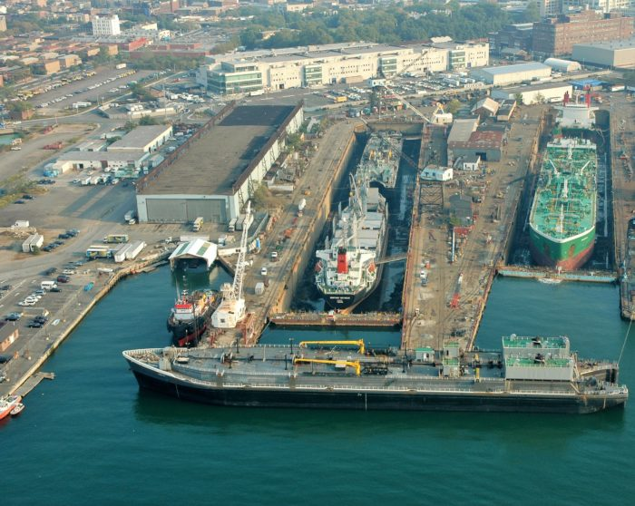
Construction and Decommissioning in Shipyards
Serial production in one or more shipyards
  Commercial shipyard conversion to nuclear?
    Need to meet appropriate security standards
    Physical, computer and insider threats
    Is there a nuclear legal/regulatory system in the country with the shipyard(s)?
  Or a bespoke shipyard?
Is nuclear material likely to be present?
  Even without, need to prevent sabotage or actions to facilitate future attacks
    Use a graded approach based on type and quantity – security measures based on risk
    Construction of large vessels in a shipyard

Slide 7
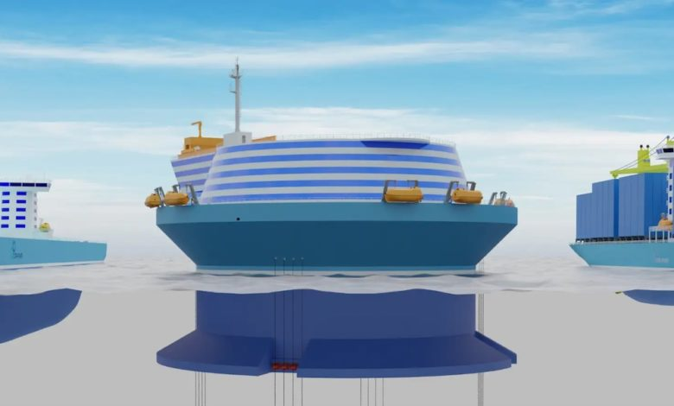
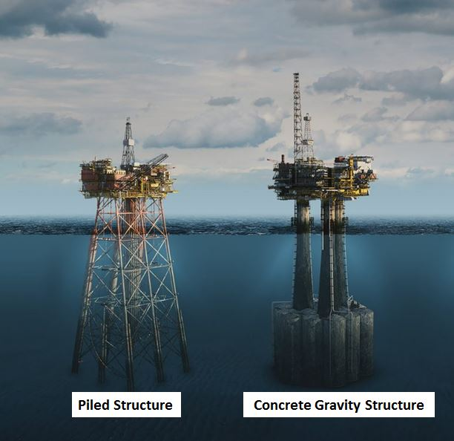
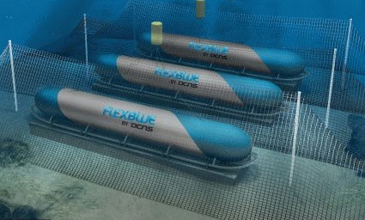
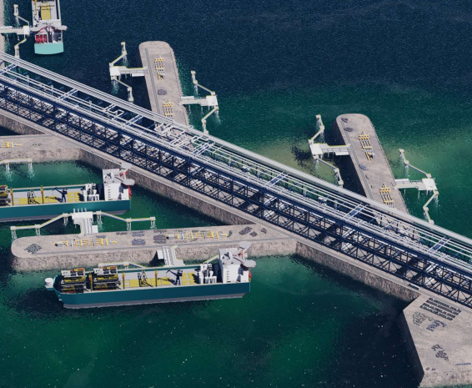
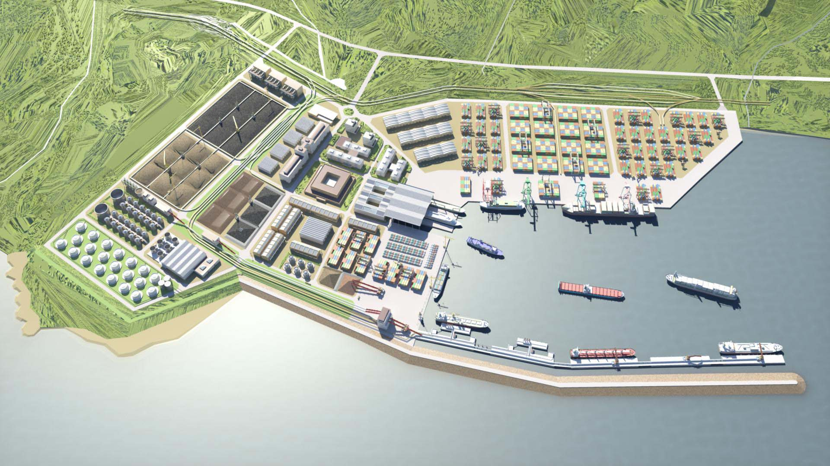

FNPP Deployment Scenarios
Floating in operation? Distance to shore? | Floating | Resting on seabed
Far from shore | 1 | 2
Close to shore | 3 | 4
These do not cover all possibilities, but are the main four distinct options.

Slide 8
Operating Scenario 1/4
Offshore floating facility
  Experience available from oil/gas industry
  Moored to seafloor, not to adjacent platforms
    Separation to limit accident consequences?
    Or close together for efficiency?
Security considerations
    Potential for capsize/sinking
    Far from response forces
    Harder to board
    Need to monitor and protect anchor cables in deep water
    Assurance of passive cooling if disconnected from shore-based power

Slide 9
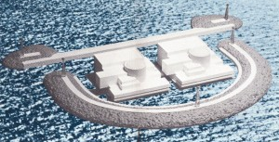
Operating Scenario 2/4
Offshore gravity-based structure
  Includes floating facilities:
    Fixed firmly to solid structures
    Ballasted to rest on seabed
    Built into artificial islands
Similar challenges overall to scenario 1….
Additional/novel security challenges
How to secure submerged structures?
How can response forces regain control?
Notes:
Experience from oil/gas industry in designing for these conditions

Slide 10
Operating Scenario 3/4
Near shore floating facility
  Commonly proposed by several developers
  Moored to shore, with aerial connection
Security Considerations
  Access via harbour/dock must be protected
  Power lines exposed?
  One or two security teams – host and supplier
    Where does responsibility start and end?
    Increased radiological consequences near shore
Siting Factors
  Within existing port? Create new port?
    Port operations may worsen safety/security
    Consequences of nuclear accident on port
    Nuclear liability and insurance

Slide 11

Operating Scenario 4/4
Near shore gravity-based structure
  Float near to shore and fix or sink in place
Siting Factors
  Similar siting considerations to land-based NPP
Safety and security challenges
  Risks and considerations combine elements of scenarios 2 and 3
    Seafloor assessments even more important than for other FNPP types:
    Subsidence risk
    Assessment of ability to retain anchors/piles
    Seismic risk assessment
Partly/fully submerged FNPP resting on seabed

Slide 12
Self-Contained or Shore Station
Self-contained FNPP
Land-based standard SMR
All safety, security, and other systems onboard
All facilities on land, nothing is sited in water
Pros:
    No permanent infrastructure on land
Cons:
    FNPP will be enlarged
    Common failure modes for critical systems
FNPP
with shore station
Pros:
    No FNPP-specific challenges
Cons:
    No FNPP-specific benefits

Slide 13
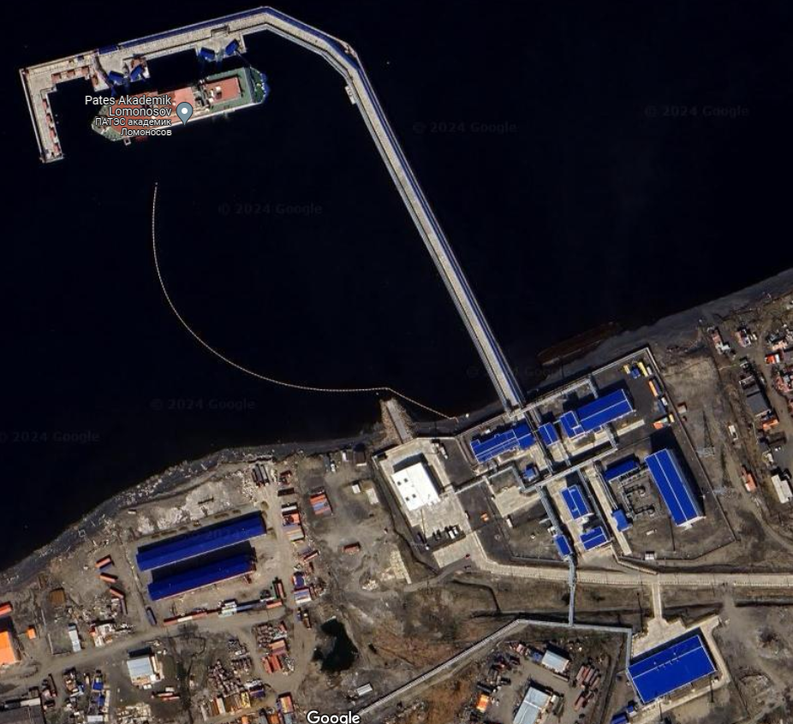
Site Preparation
Before FNPP arrives, most sites will likely need:
  Water-based infrastructure
  Protection from waves, swell
  Physical protection system elements
    Largely new to the nuclear industry
  Aerial/subsea cables – electricity, data
Shore-based infrastructure
  Electrical grid connection, e.g., switchyard
  Physical protection system elements
    Largely known approaches
  Support for maintenance/emergency response
    Akademik Lomonosov site aerial view

Slide 14
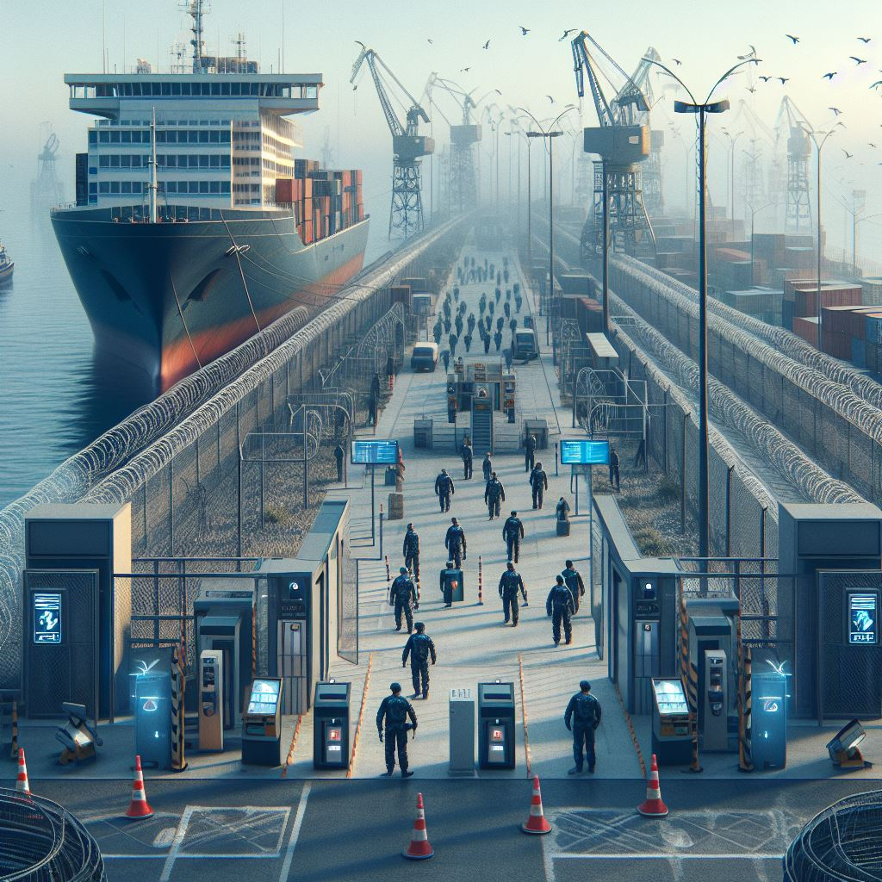
Some Security Considerations at Licensed FNPP Sites
Barriers, access control, detection systems, etc.
    Where is the site boundary – does it include water?
    Where is the protected area – just the FNPP?
    How does this change in international waters?
  Cyber and insider threat must also be managed
  Much can be in place before FNPP and fuel arrives
Legal responsibility questions
  Convention on Physical Protection of Nuclear Materials
    Can the host state outsource security responsibility? Can you verify trustworthiness?
Some IAEA guidance may not be fully applicable
Notes:
physical barriers around the FNPP and any anchor or power cables or pipelines, e.g., concrete caissons or breakwaters, floating booms, and sub-surface netting. These would likely be fitted with sensors to detect contact or damage, supported by surface and subsurface sensors as part of a complete detection system to prevent the unidentified approach of vessels or divers.

Slide 15
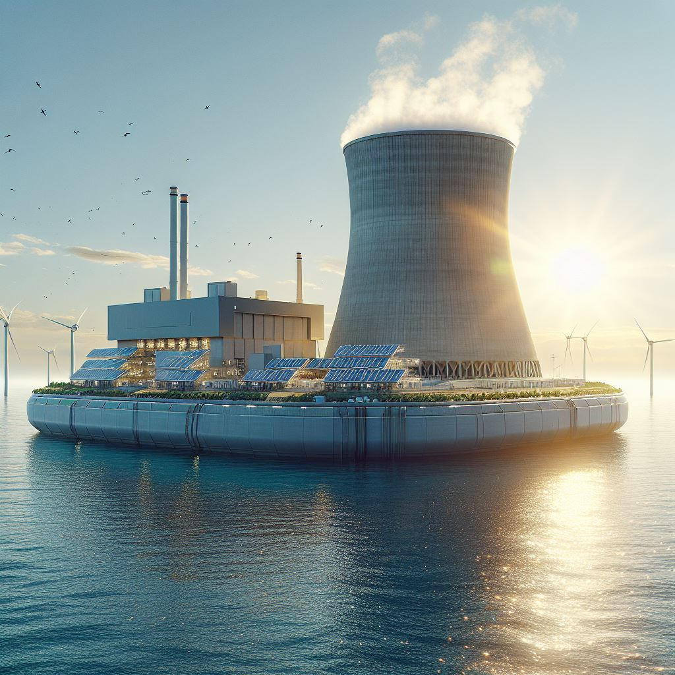
Conclusion
FNPPs have numerous potential benefits
  But we must address the novel challenges for them to be able to achieve their potential
Questions go beyond security
  Safety, non-proliferation, legal ambiguities, liability, and more
Not a facility, not transport, but a blend
  Need to take elements from both, but this will not be sufficient to address the gaps
Address questions now to build in the solutions from the start

Slide 16
Contact details/for more information
Dr Ross Peel
+44 (0)20 7848 9708 ross.peel@kcl.ac.uk www.kcl.ac.uk/people/dr-ross-peel
LinkedIn: ross-peel
Twitter: @DrRossPeel
Thank you to World Nuclear Association for financial support to attend
© 2024 King’s College London. All rights reserved.
Third party images remain the property of their respective copyright owners.

