Slide 2


Title & Content
  Introduction of a Cyberattack detection framework for Safety Systems of NPPs
  Introduction
  Consideration on Characteristics of Safety Systems
  Cyberattack Detection Framework for Safety Systems of NPPs
  Conclusion
  Korea Atomic Energy Research Institute
  Taejin Kim (taejinkim@kaeri.re.kr)

Slide 3

Introduction
  Research Necessity
    In order to cope with cyber threats in South Korea, Korea Institute of Nuclear Nonproliferation and Control (KINAC) have published technical standards for cyber security of nuclear facilities [1] and critical digital assets for nuclear facilities [2]. The technical standards require to maintain the capability for timely detection to cyberattacks, but this requirement has been satisfied through a alternative measure, which is an administrative approach of access control.
    In the past, it is expected that they are unlikely to expose threats of cyberattacks due to their air-gapped environment. However, considering the cyberattacks occurred in nuclear facilities, such as stuxnet attack occurred in Iran’s nuclear facility, malware attack in the Monju NPP of Japan, malware attack in the Kudankulam NPP of India, etc., it is necessary to have a provision to detect cyberattacks even for the ICSs separated from the external networks.
Cyberattack
Nuclear Facilities targeted by cyberattacks
Year | Nuclear Facility
2010 | Malware in Iran (Stuxnet)
2012 | Malware in Monju, Japan
2016 | Malware in Gundremmingen, German (Ramnit/Conflicker)
2027 | Ransomware in Chernobyl, Russia (LogicLocker/Petya)
2019 | Malware in Kudankulam, India (Dtrack)
Advanced Persistent Threats
[1] KINAC/RS-015, Technical Standard on Cyber Security for Computer and Information System of Nuclear Facilities, KINAC (2014).
[2] KINAC/RS-019, Technical Standard on Identification of Critical Digital Assets for Nuclear Facilities, KINAC (2015).

Slide 4
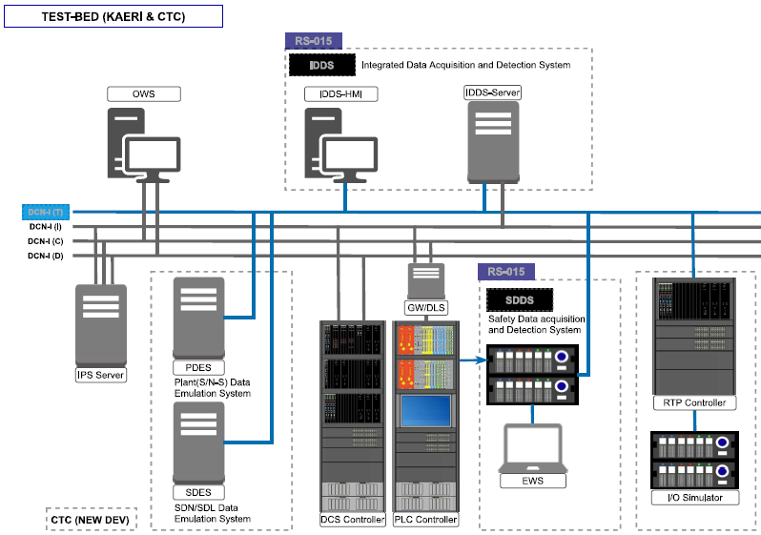
Introduction
  Research Scope
Ongoing Project (2022 ~ 2026, 5 years)
Goal: Development of cyberattack detection systems dedicated for APR1400
Main systems under development
1. Safety Data Acquisition and Detection System
Safety System Logic-based Detection by monitoring network data for safety systems
2. Integrated Data Acquisition and Detection System
Non-safety System Logic-based Detection
AI-based Anomaly Detection
Rule-based Signature Detection

Slide 5
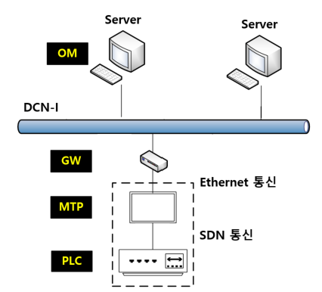
Consideration on Characteristics of Safety Systems
  Simplified Configuration of Safety Systems on APR1400
    The man-machine interface system (MMIS) of Shin Hanul 1, which is of APR1400, is localized as a digital system.
      PLC(Programmable Logic Controller): POSAFE-Q platform with internally developed operating system
      MTP(Maintenance and Test Panel): QNX which is one of commercial Real-time operating system
    Functions
      In PLC, safety functions are performed, such as generating reactor trips or engineered safety features actuation signals.
      MTP receives most of PLC variables for periodic surveillance testing of safety functions and for transmitting the variables to operators.
      GW allows traffic to flow from MTP to the external network, but blocks it in the opposite direction.

Slide 6
Consideration on Characteristics of Safety Systems
  Consideration of Safety System Characteristics for HIDS implementation
    No Impact to intrinsic safety functions
      Due to low performance of POSAFE-Q (1 core), continuous monitoring for cyberattack is challenging.
      There is no CVE(Common Vulnerabilities and Exposures) for the internally developed operating system of the PLC.
    Cyberattack detection of the PLC in the MTP based on logic-based detection algorithm
      Since the MTP receives most of PLC variables, we determined to develop logic-based algorithm to detect cyberattack against the PLC.
      There is higher possibility for the MTP to be infected than the PLC because QNX has CVEs
      The operation of the original process in the MTP can be guaranteed by adjusting priorities among processes (Characteristics of RTOS).
      Even if there are unexpected errors occurred in the MTP, it does not impact to the PLC, which performs safety functions
    Communication characteristics between the PLC and the MTP
      Due to difference of the cyber security defensive levels, the PLC communicates uni-directionally with the MTP, and not the other way around.
      Thus, there is no possibility to propagate the cyberattack to the PLC through the MTP when the MTP is compromised by a cyberattack.

Slide 7
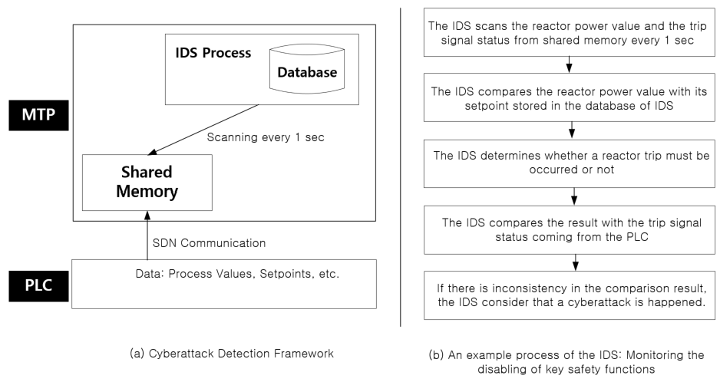
Cyberattack Detection Framework for Safety Systems of NPPs
  Development of Host-based intrusion detection system for MTP QNX
    Main Monitoring Functions of HIDS
      Modification of application binaries, data, and configuration file
      Failure of critical and running services
      Execution of unintended processes
      Unauthorized network and port access attempts
      Cyberattacks occurred in the PLC
    Cyberattacks occurred in the PLC
      Monitoring the manipulation of key constants
      Monitoring the manipulation of key setpoints
      Monitoring the disabling of key safety functions
      Monitoring the disabling of key alerts

Slide 8
Cyberattack Detection Framework for Safety Systems of NPPs
  Examples of Cyberattack Detection Framework for Safety Systems
    Monitoring the disabling of key safety functions
P_DB
MTP
 | ID | Setpoint | Max | Min
Rx Power | N01 | - | 0 | 200
PZR Pressure | P01 | - | 120 | 180
SG Pressure | P02 | - | 40 | 80
VOP Trip Setpoint | S01 | 120 | - | -
HPP Trip Setpoint | S02 | 170 | - | -
LSG1P Trip Setpoint | S03 | 70 | - | -
HIDS Process
P_DB
ID, Setpoint, Min, Max
Variables
(transmitted from the PLC to the MTP)
 | ID | Status
Rx Power | N01 | 100
PZR Pressure | P01 | 150
SG Pressure | P02 | 60
VOP Trip Setpoint | S01 | 120
HPP Trip Setpoint | S02 | 170
LSG1P Trip Setpoint | S03 | 70
Trip Status | A01 | 0
Trouble Status | A02 | 0
Shared
Memory
In HIDS Process
ID, Status
Matching “a process value in mem” with “the setpoint in P_DB”,
if “Status in mem” deviates from “Setpoint in P_DB”
if “Trip Status in mem” == 0,
cyberattack_alarm = 1.
PLC

Slide 9
Cyberattack Detection Framework for Safety Systems of NPPs
  Examples of Cyberattack Detection Framework for Safety Systems
    Monitoring the disabling of key alerts
P_DB
MTP
 | ID | Setpoint | Max | Min
Rx Power | N01 | - | 0 | 200
PZR Pressure | P01 | - | 120 | 180
SG Pressure | P02 | - | 40 | 80
VOP Trip Setpoint | S01 | 120 | - | -
HPP Trip Setpoint | S02 | 170 | - | -
LSG1P Trip Setpoint | S03 | 70 | - | -
HIDS Process
P_DB
ID, Setpoint, Min, Max
Variables
(transmitted from the PLC to the MTP)
 | ID | Status
Rx Power | N01 | 100
PZR Pressure | P01 | 150
SG Pressure | P02 | 60
VOP Trip Setpoint | S01 | 120
HPP Trip Setpoint | S02 | 170
LSG1P Trip Setpoint | S03 | 70
Trip Status | A01 | 0
Trouble Status | A02 | 0
Shared
Memory
In HIDS Process
ID, Status
Matching “a process value in mem” with “the Max./Min. in P_DB”,
if “Status in mem” is out of range based on “the Max./Min. in P_DB”
if “Trouble Status in mem” == 0,
cyberattack_alarm = 1.
PLC

Slide 10
Conclusion
  As cyberattacks become more sophisticated and complex, it is necessary to introduce an IDS for safety systems of NPPs. However, if the IDS is implemented in the PLC, it is challenging to guarantee that the IDS process does not affect the existing safety functions.
  The cyberattack detection framework suggested in this paper can detect cyberattacks occurred in the PLC without any impact to the safety functions.

Slide 11
Thank You

