Slide 2

TRACK C11: SESSION 11.4:COMPUTER SECURITY FOR SMRS:
PROTECTING THE DIGITAL FRONTLINE
MACHINE LEARNING SOLUTIONS FOR ENHANCED SECURITY IN SMALL MODULAR REACTORS: A COMPREHENSIVE APPROACH
GUNAY ABDIYEVA-ALIYEVA
24 OCTOBER 2024
VIENNA, AUSTRIA

Slide 3
ABSTRACT
The article explores the use of Machine Learning (ML) to enhance the security of Small Modular Reactors (SMRs).
It addresses both physical and cyber threats, proposing ML solutions for real-time monitoring and early breach detection.
Algorithms like Isolation Forest and One-Class SVM focus on anomaly detection, while K-Means and DBSCAN help analyze patterns in security data.
The study provides insights for improving nuclear security through advanced ML techniques.

Slide 4

01
Compared to large reactors, SMRs offer enhanced safety, productivity, and flexibility but introduce complex security challenges. Both physical and cyber systems must be protected to ensure safe operation. Traditional security methods, though essential, may not suffice against sophisticated threats. ML techniques are emerging as effective tools, enabling anomaly detection, intrusion prediction, and adaptive threat responses without compromising system integrity.

Slide 5
02
SECURITY CONSIDERATION IN SMR’s
PHYSICAL SECURITY
CYBERSECURITY
INTEGRATED SECURITY APPROACH

Slide 6

PHYSICAL SECURITY
PHYSICAL BARRIERS
ACCESS CONTROL

Slide 7
PHYSICAL SECURITY
The access into sensitive areas at the SMR facility should be carefully monitored. Only professional staff are allowed into these areas. There should be enforcement of biometric authentication, security badges, and access protocols to keep track of employee activities.
Protect critical features of SMR such as the core reactor, fuel storage areas and server rooms from unauthorized access or cyberattack through installation of physical barriers, enhanced organizations among other means.

Slide 8

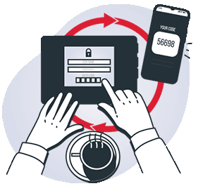
CYBERSECURITY
DISRUPTION OF OPERATIONS
DATA MANIPULATION
UNAUTHORIZED ACCESS
RANSOMWARE
SUPPLY CHAIN ATTACK

Slide 9

DISRUPTION OF OPERATIONS
Cyberattacks can target the digital control systems of SMR, which could lead to disruption of normal operations or shutdown of critical safety systems.

Slide 10

DATA MANIPULATION
Hackers may attempt to manipulate data within a control system, which may result in inaccurate readings or control commands, potentially resulting in compromised safety or efficiency.

Slide 11
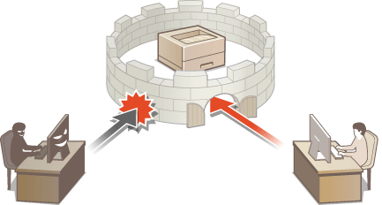
UNAUTHORIZED ACCESS
Intruders may gain unauthorized access to sensitive systems and manipulate reactor settings or extract valuable information.

Slide 12

RANSOMWARE
An incident of ransomware attack can cause disruption in operations, financial loss as well as damaging company’s reputation because it is capable of encrypting key system components or chunks of data within those components and demand for payment before these components can be accessed.

Slide 13
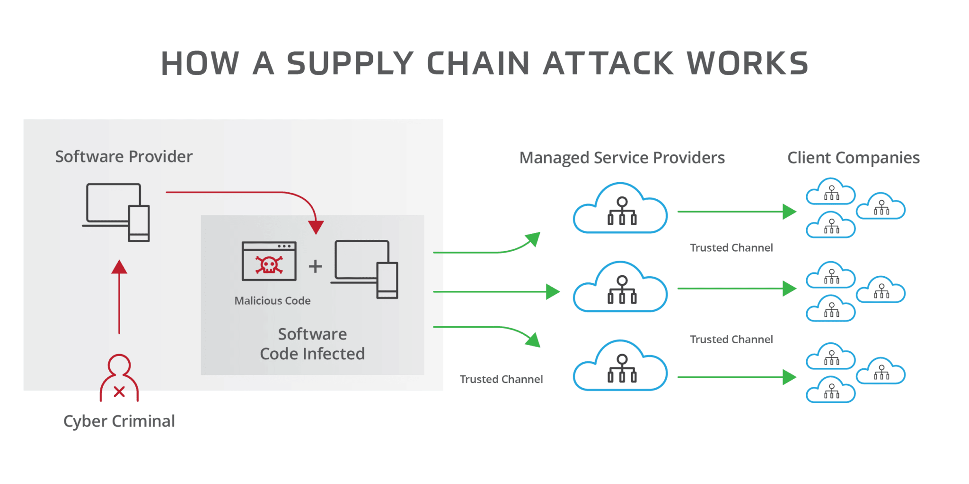
SUPPLY CHAIN ATTACK
Attackers may penetrate the supply chain and compromise components, or software used in SMR systems, resulting in possible security vulnerabilities or system failures and etc.,

Slide 14



INTEGRATED APPROACH
RISK ASSESMENT
SECURITY POLICIES AND PROCEDURES

Slide 15
03
INTEGRATION OF ML
SOLUTIONS
Anomaly detection
This proactive approach enhances the safety and reliability of SMRs.
Classification
Clustring
Clustering security incidents helps operators identify root causes and develop targeted mitigation strategies to enhance SMR security.
Anomaly detection identifies abnormal patterns in real time, enabling quick responses to breaches and improving safety.

Slide 16
CREATING A SYNTHETIC DATASET
The following is the example of a synthetic dataset for SMRs with hypothetical features:
For anomaly detection in SMR systems, synthetic datasets must be created and some of the key evaluation metrics for algorithms for anomaly detection have to be defined.
A synthetic dataset will be used with the generation done by the make_blobs method of Scikit-learn.
A dataset will be created with two features of different sensor readings within the SMR environment.
Noise in the data will be added to develop anomalies.
Scikit-learn’s make_blobs function will be used to form a manufactured dataset.

Slide 17
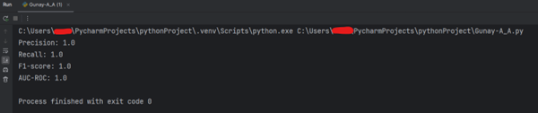

Slide 18
COMMON EVALUATION METRICS FOR ANOMALY DETECTION
Now, let's define some :
True Positives (TP): The number of correctly identified anomalies.
False Positives (FP): The number of incorrectly identified anomalies.
True Negatives (TN): The number of correctly identified normal instances.
False Negatives (FN): The number of incorrectly classified as normal events.
Precision: The proportion of correctly detected anomalies among all instances classified as anomalies
Recall (sensitivity): The proportion of correctly identified anomalies among all actual anomalies.
F1-Score: The precision and recall, providing a single metric balanced.
Area under the ROC curve (AUC-ROC): measures the model's ability to distinguish between normal and abnormal instances. Values closer to 1 indicate better performance.

Slide 19
ISOLATION FOREST
ONE-CLASS SVM
K-MEANS
ANOMALY DETECTION ALGORITHMS
DBSCAN

Slide 20
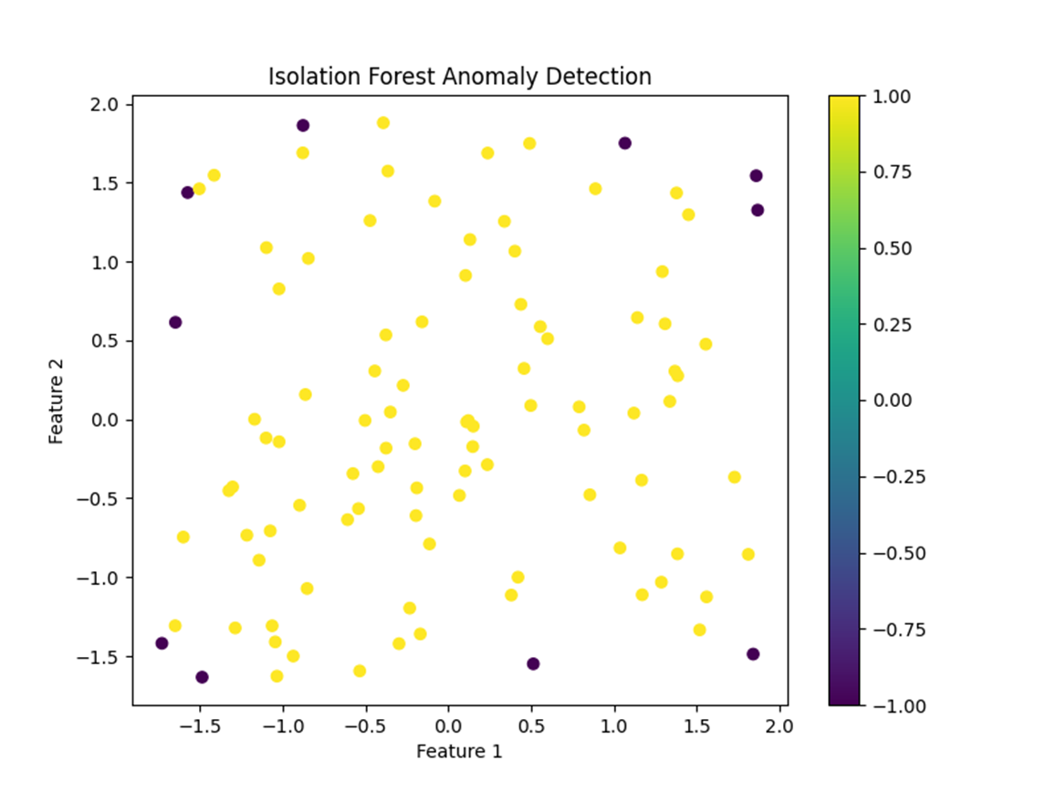
Isolation Forest and similar tree-based algorithms detect anomalies by isolating data points with unusual attribute values. In SMRs, they help identify abnormal control signals, sensor readings, or performance data, indicating potential security issues or atypical operations.
ISOLATION FOREST

Slide 21
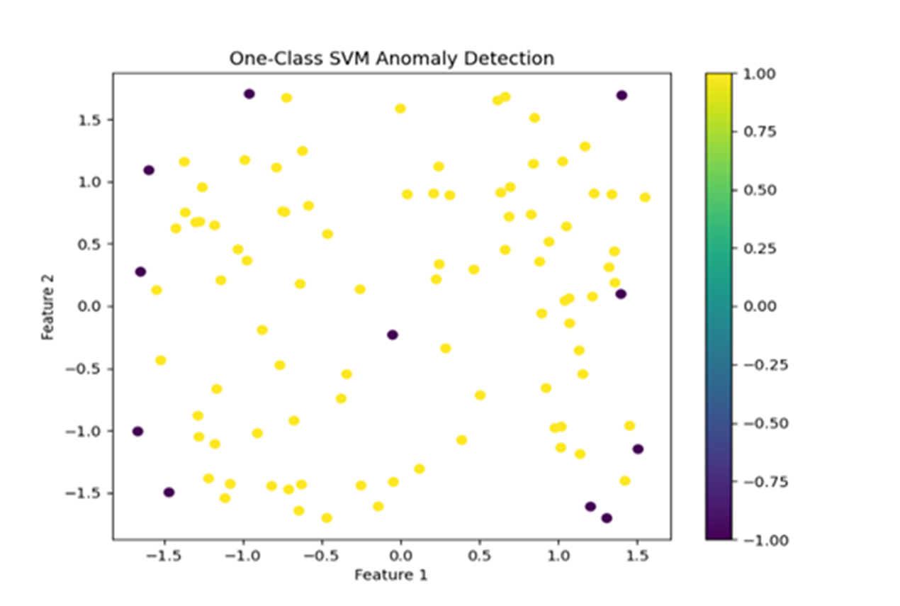
One-Class SVM learns a boundary around normal data in high-dimensional space, making it useful for anomaly detection with limited normal data. In SMRs, it analyzes sensor data, network traffic, and system logs to detect anomalies indicating security issues or abnormal behavior.
ONE-CLASS SVM

Slide 22
DBSCAN identifies clusters based on the density of data points. It is effective in detecting outliers and can handle noise, making it suitable for security data analysis in SMRs.
This helps in identifying unusual patterns in sensor readings and network traffic.
K-MEANS AND DBSCAN
K-means partitions data into a predefined number of clusters by minimizing the distance between data points and cluster centroids. In SMRs, K-means can be used to categorize normal operational data, enabling the detection of deviations that may indicate security threats or operational anomalies.

Slide 23
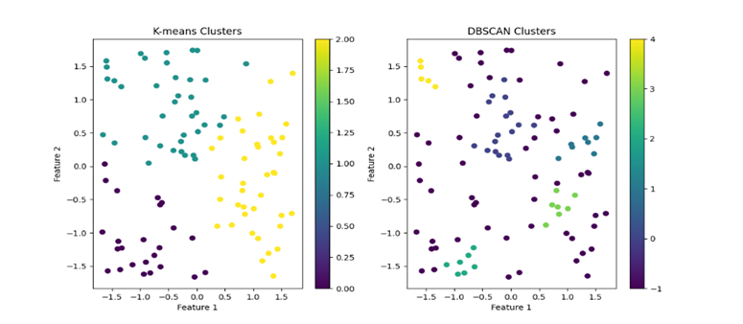

Slide 24
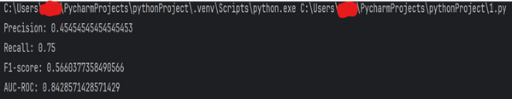
TRAINING AND TESTING

Slide 25
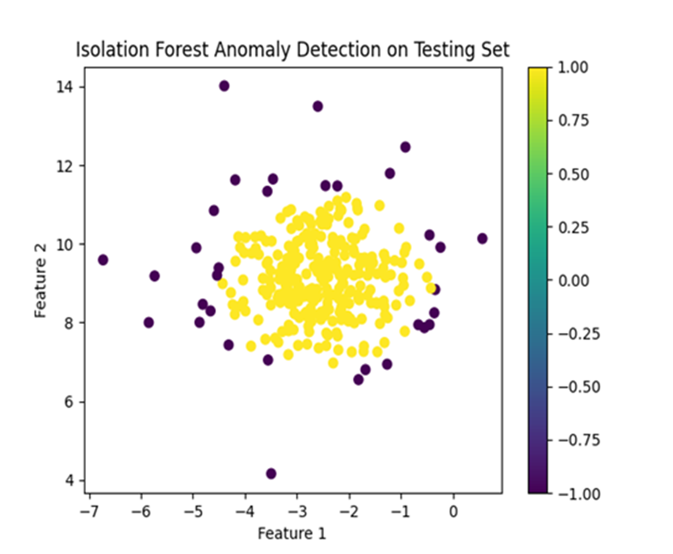
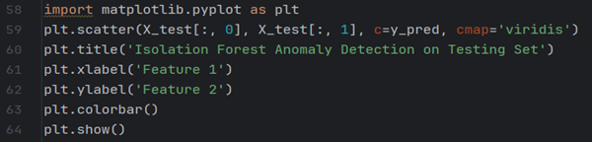
VISUALIZATION

Slide 26
FUTURE DIRECTIONS AND CONCLUSION
Efficient anomaly detection is very important in SMRs for protection from cyber-security threats.
To ensure real-time addressing of possible security breaches, SMR operators can employ modern technologies that encompass Isolation Forests as well as One-Class SVM algorithms.
In addition, operating persons in SMRs should consider a detailed information security system that involves such aspects as network segmentation, encryption, intrusion detection methods, audits, and staff training.
The cohesive combat against cyber threats is equally important and requires global nuclear infrastructure resilience improvement through international cooperation and information sharing initiatives.

Slide 27

THANKS!
DO YOU HAVE ANY QUESTIONS?
gunay.abdiyeva@scis.gov.az

