Slide 2



A Review on Security in Small Modular Reactors and Micro Nuclear Reactors
Julia GARCIA
Delvonei ANDRADE, Ricardo VENDRAMEL, Elaine RODRIGUES

Slide 3




1. Introduction
Nuclear power has been an important source of low-carbon energy
The development of microreactors and small and medium modular reactors (SMRs) increases the potential use of nuclear energy
437 operational nuclear reactors in 32 countries generated around 10% of the global electricity production and more than a quarter of the world's low-carbon production (2021)
Great potential in non-electric applications (such as district heating, hydrogen production and desalination)

Slide 4


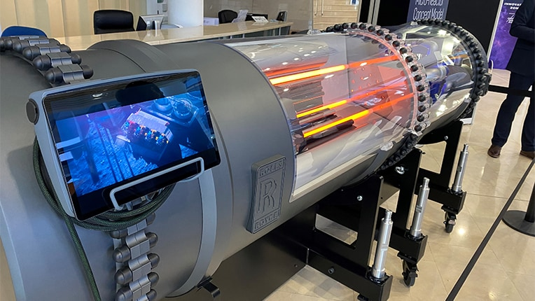





1. Introduction
More than 80 projects at different stages of development
https://www.rolls-royce.com/

Slide 5
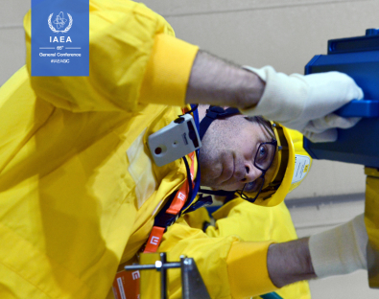
Nuclear safety and non-proliferation in a scenario of increased use of advanced technologies
This study aims to review and analyze the security aspects associated with SMRs, identifying patterns, gaps and trends to provide insights into the challenges and strategies related to the physical security of these emerging technologies.
https://www.iaea.org/

Slide 6
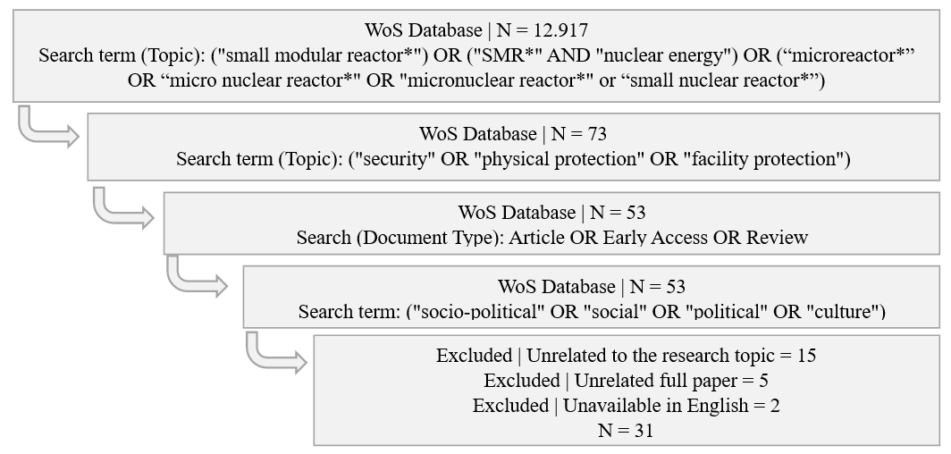
2. Methodology

Slide 7
Authors' keywords incorporated into the same label for co-occurrence analysis
(69 keywords for analysys)
13 matches - keywords with two times occurrence and two link strength (minimum)
Label | Incorporated terms
Advanced nuclear | Advanced nuclear, accident tolerant fuel, advanced nuclear reactors
Carbon free energy | Clean electrical network, net-zero, carbon free energy development
Climate change | Climate change, global warming, greenhouse gas
Energy planning | Energy market assessment, energy modeling, energy scenarios, energy systems
Fusion reactor | Fusion reactor, fusion
Governance | Governance, politics, regulation, licensing, energy policy
Nuclear power | Nuclear power plant, nuclear powerplant, nuclear energy, nuclear power, nuclear
Power | Power, electricity
Safety | Nuclear safety, criticality safety, safety, safety generation iv, safety-by-design
Security | Nuclear security, cybersecurity, nuclear proliferation and security, nonproliferation
Site assessment | Site assessment, site selection
Small modular reactor | Small modular reactor, small modular reactor deployment, small modular reactors, small modular reactors (smrs), smr, smr plant, micro modular reactor (mmr), microreactors, vehicular microreactor
Sociotech perceptions | Sociotechnical imaginaries, public acceptance

Slide 8
Criteria for categorizing the contribution levels of studies in security and non-proliferation related to SMRs
Contribution Level | Criteria considered in the content analysis
 | Security | Non-proliferation
High | Innovative technologies, advanced passive security methods, robust cyber protection strategies or highly effective monitoring and response systems | Innovative strategies and technologies that significantly increase proliferation resistance, with effective passive safeguards and methods to limit access to nuclear material
Medium | Significant improvements in security, but with less innovation or restricted applicability to certain scenarios | Relevant contribution to non-proliferation, but little innovation
Low | Little direct contribution to nuclear security, with a limited focus on security aspects or approaches already known and widely discussed in the literature | Little direct contribution to non-proliferation, with limited focus on non-proliferation resistance strategies or description of established technologies

Slide 9
3. Results and Discussion
Comparison of the Central Themes approached in SMR studies:
2008-2020 and 2021-2024
Period | Most frequent central themes | Main aspects covered
2008-2020 11 studies (35.48%) | Small Modular Reactors (SMRs) | Advantages of SMRS in terms of nuclear safety, efficiency and economic viability. Advanced reactor design and implications for the cost of electricity
 | Safety and sustainability | Contribution of SMRs to climate change mitigation and the development of carbon-free energy, with emphasis on nuclear safety aspects
 | Reactor technology and design | Studies detail various reactor technologies, with an emphasis on innovation and the safety of advanced designs
 | Energy policies and regional implementation | The implementation of SMRs has been explored in different regional contexts (such as ASEAN, Russia and China), considering energy policies and governance practices
2021-2024 20 studies (64.52%) | Security and non-proliferation | Significant increase in focus on nuclear security and non-proliferation, reflecting the importance of developing reactors that minimize the risks of nuclear accidents and proliferation
 | Energy efficiency and modeling | Efficiency analysis and energy modeling are crucial tools, with studies detailing the performance and resilience metrics of energy systems
 | Reactor technology and design | Targeting emerging and innovative technologies, such as microreactors and new types of fuels, with an emphasis on significant advances in design and safety
 | Implementation and regulation | The practical implementation of SMRs was discussed at length, addressing issues of licensing, public acceptance and financing, as well as the choice and evaluation of sites
 | Energy policies and sustainability | Energy policies and sustainability were central themes, with an emphasis on integrating SMRs into renewable energy and net-zero emissions strategies.

Slide 10
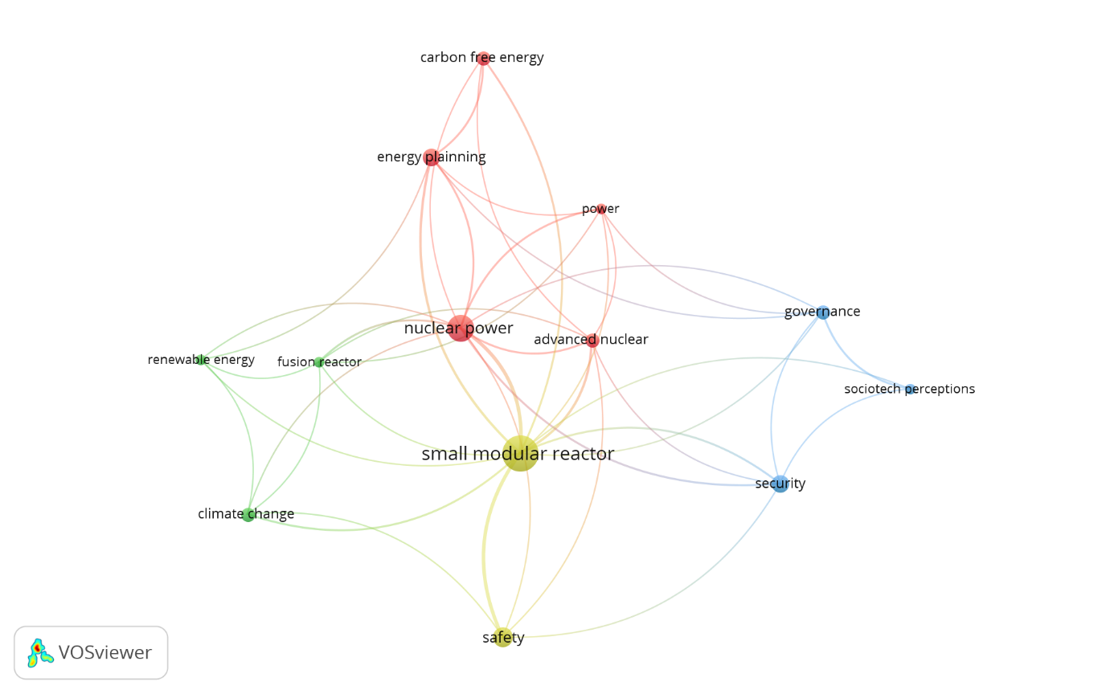
Network Graph co-occurrence between keywords
Nuclear power and energy (5 items)
Sustainability and renewable energies (3 items)
Governance and safety (3 itens)
Safety and Small Modular Reactor (2 itens)

Slide 11
Level of contribution of the studies
 | HIGH CONTRIBUTION
 | Studies | Criterias
Security | Smith et al (2008); Petrovic et al (2012); Black et al. (2015); Schmid (2021); Carless et al (2021); Nian et al (2021); Ayodeji et al (2023); Hayes et al (2023); Gateau et al (2024); Kandasamy et al (2024) 10 studies | Innovative technologies, advanced passive security methods, robust cyber protection strategies or highly effective monitoring and response systems
Non-Proliferation | Smith et al (2008); Petrovic et al (2012); Iyer et al (2014); Black et al (2015); Nian (2017); Schimid (2021); Carless et al (2021); Mitsuboshi et al (2021); Nian et al (2022); Ayodeji et al (2023); Hayes et al (2023); Zarebski et al (2023); Gateou et al (2024); Kandasany et al (2024) 14 studies | Innovative strategies and technologies that significantly increase proliferation resistance, with effective passive safeguards and methods to limit access to nuclear material

Slide 12
Level of contribution of the studies
 | MEDIUM CONTRIBUTION
 | Studies | Criterias
Security | Kessudes (2012); Vujiic et al (2012); Iyer et al (2014); Sovacool et al (2014); Eaves (2016); Nian (2017); Kimura & Asano (2019); Norouzi et al (2021); Mitsoboshi & Sagara (2021); Testoni et al (2021); Daniel & Kin (2022); Maio et al (2022); Zhang et al (2022); Saleh et al (2023); Shobeiri et al (2023); Zarebski & Katarzynski (2023); Xhmielewska-Smietanko et al (2024); Defferriere et al (2024) 18 studies | Significant improvements in security, but with less innovation or restricted applicability to certain scenarios
Non-Proliferation | Kessudes (2012); Vujiic et al (2012); Sovacool et al (2014); Eaves (2016); Kimura & Asano (2019); Norouzi et al (2021); Testoni et al (2021); Daniel & Kim (2022); Maio et al (2022); Mathew (2022); Zhang et al (2022); Saleh et al (2023); Shobeiri et al (2023); Chmielewska-Smietanko et al (2024); Defferriere et al (2024) 15 studies | Relevant contribution to non-proliferation, but little innovation

Slide 13
Level of contribution of the studies
 | LOW CONTRIBUTION
 | Studies | Criterias
Security | Merino et al (2019) Thomas (2019) Mathew (2022) 3 studies | Little direct contribution to nuclear security, with a limited focus on security aspects or approaches already known and widely discussed in the literature
Non-Proliferation | Merino et al (2019) Thomas (2019) 2 studies | Little direct contribution to non-proliferation, with limited focus on non-proliferation resistance strategies or description of established technologies

Slide 14
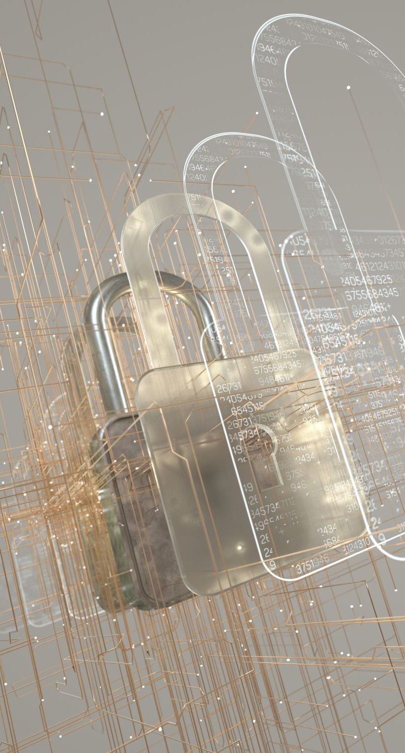
Contribution to the area of nuclear security and no-proliferation
Non-proliferation
  Reactor with a closed fuel cycle that operates autonomously for 30 years (Smith et al, 2020)
  Inherent safety and proliferation resistance, with the use of less attractive fuels and physical barriers (Smith et al, 2020)
  Passive safety and modularity (Vujiic et al, 2012; Black et al, 2015)
  Use of Bayesian networks to model and predict proliferation risks (Iyer et al (2014)
Security
  Enhanced security, combining passive security
  Cyber protection
  Collaborative approaches
  Smith et al (2008); Petrovic et al (2012); Black et al (2015); Schmid (2020); Carless et al (2021); Nian et al (2022); Ayodeji et al (2023); Hayes & Sawers (2023); Gateau et al (2024); Kansasamy & Brunner (2024)

Slide 15
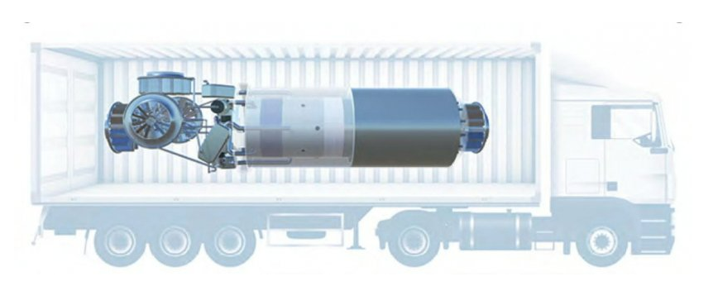
Microreactors (up to 20 MWe)
Stable and secure power especially in places where infrastructure is limited (Testoni et al., 2021)
Small size and modularity – easier to protect against nuclear proliferation threats can be developed with designs that combine passive security and proliferation resistance (Schmid 2020)
Transported more safely due to their smaller size and reduced complexity (Kimura & Asano 2019)
Small size and reduced power
Stand-alone power source or integrated into a grid
https://www.energy.gov/ne/articles/big-potential-nuclear-microreactors

Slide 16
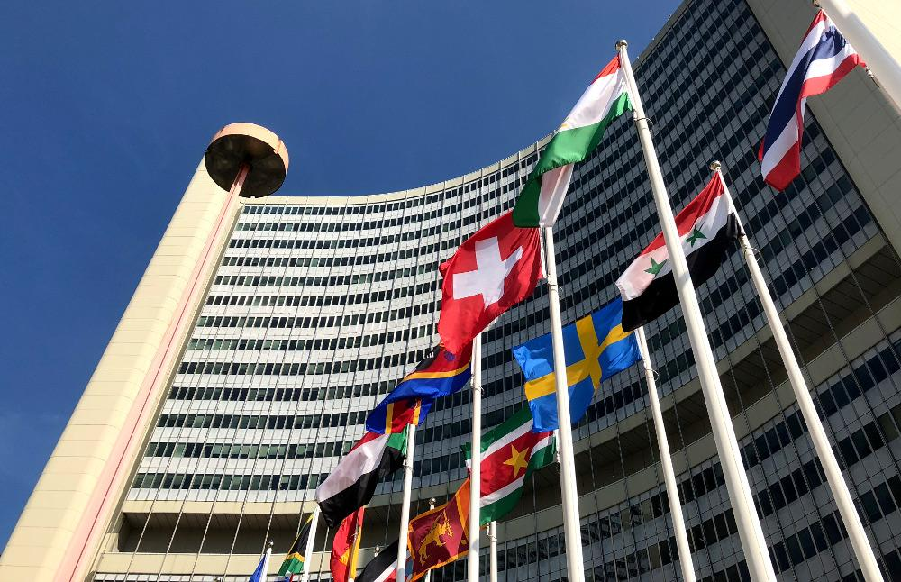
Others important results
International collaboration to accelerate the development of safe and efficient technologies (Kansasamy & Brunner 2024)
Demands of sustainability, passive safety, proliferation resistance, in-plant production, ease of installation and operation and accessibility, transportability and flexibility in site selection, with a smaller plant footprint and lower investment risk (Shobeiri et al 2023)
Public investment in research and development, combined with a series of government policies to encourage nuclear energy and strong public acceptance and support from industry (Anadón et al 2012)

Slide 17
Conclusions
SRMs have significant advantages
Resistance to proliferation
Passive security
Modularity
Lower operational complexity
Facilities integration with renewable energy sources
Suitable for a variety of applications (remote industrial sites and disaster-affected areas)
SRMs – substantial challenges
International collaborations and the development of policies based on advanced methodologies
Robust regulatory infrastructure
Effective proliferation risk mitigation strategies
Suitable for a variety of applications (remote industrial sites and disaster-affected areas)

Slide 18
AUTHOR / YEAR |  | TITLE
Smith et al. (2008) |  | SSTAR: The US lead-cooled fast reactor (LFR)
Kessudes (2012) |  | Small Modular Reactors for Enhancing Energy Security in Developing Countries
Vujiic et al (2012) |  | Small modular reactors: Simpler, safer, cheaper?
Petrovic et al. (2012) |  | Pioneering Role of IRIS in the Resurgence of Small Modular Reactors
Iyer et al. (2014) |  | Implications of small modular reactors for climate change mitigation
Sovacool et al. (2014) |  | Back to the Future: Small Modular Reactors, Nuclear Fantasies, and Symbolic Convergence
Black et al. (2015) |  | Carbon free energy development and the role of small modular reactors: A review and decision framework for deployment in developing countries
Eaves (2016) |  | Can North America’s advanced nuclear reactor companies help save the planet?
Nian (2017) |  | The prospects of small modular reactors in Southeast Asia
Kimura & Asano al (2019) |  | Ensuring Criticality Safety of SMR Core During Transport Based on Its Temperature Reactivity
Merino et al. (2019) |  | Environmental Assessment of Energy Scenarios for a Low-Carbon Electrical Network in Chile
Thomas (2019) |  | Is it the end of the line for Light Water Reactor technology or can China and Russia save the day?
Schmid (2020) |  | From “Inherently Safe” to “Proliferation Resistant”: New Perspectives on Reactor Designs
Carless et al. (2021) |  | Estimating nuclear proliferation and security risks in emerging markets using Bayesian Belief Networks
Norouzi et al (2021) |  | Thermal-hydraulic efficiency of a modular reactor power plant by using the second law of thermodynamic
Mitsoboshi & Sagara (2021) |  | Effects of U3Si2 fuel and minor actinide doping on fundamental neutronics, nuclear safety, and security of small and medium PWRs in comparison to conventional UO2 fuel
Testoni et al. (2021) |  | Review of nuclear microreactors: Status, potentialities and challenges
Daniel & Kim. (2022) |  | A Study on Integrating SMRs into Uganda’s Future Energy System
Maio et al. (2022) |  | The Contribution of Small Modular Reactors to the Resilience of Power Supply
Nian et al (2022) |  | Accelerating safe small modular reactor development in Southeast Asia
Mathew (2022) |  | Nuclear energy: A pathway towards mitigation of global warming
Zhang et al. (2022) |  | Conceptual design and neutronic analysis of a megawatt-level vehicular microreactor based on TRISO fuel particles and S-CO2 direct power generation

Slide 19
AUTHOR / YEAR |  | TITLE
Ayodeji et al. (2023) |  | Cyber security in the nuclear industry: A closer look at digital control systems, networks and human factors
Hayes & Sawers (2023) |  | A thermal natural uranium breeder reactor for large and small applications with passive safeguard designs
Saleh et al. (2023) |  | Advancing Small Modular Reactor Technology Assessment in the Czech Republic, Egypt, and Poland
Shobeiri et al. (2023) |  | Small Modular Reactor Deployment and Obstacles to Be Overcome
Zarebski & Katarzynski (2023) |  | Small Modular Reactors (SMRs) as a Solution for Renewable Energy Gaps: Spatial Analysis for Polish Strategy
Chmielewska-Smietanko et al. (2024) |  | Selected Legal and Safety Aspects of the “Coal-To-Nuclear” Strategy in Poland
Defferriere et al (2024) |  | Ionic Conduction-Based Polycrystalline Oxide Gamma Ray Detection – Radiation-Ionic Effects
Gateau et al. (2024) |  | Consequence-based security for microreactors
Kansasamy & Brunner (2024) |  | Idaho national laboratory to demonstrate collaboration first versus competition to accelerate achieving a secure clean energy future by 2031

Slide 20
ACKNOWLEDGEMENTS
The authors thank CAPES and the support of Postgraduate Program in Nuclear Technology (IPEN-CNEN).
If you have any questions, please contact me at: cristinajulia529@gamil.com

