Slide 1
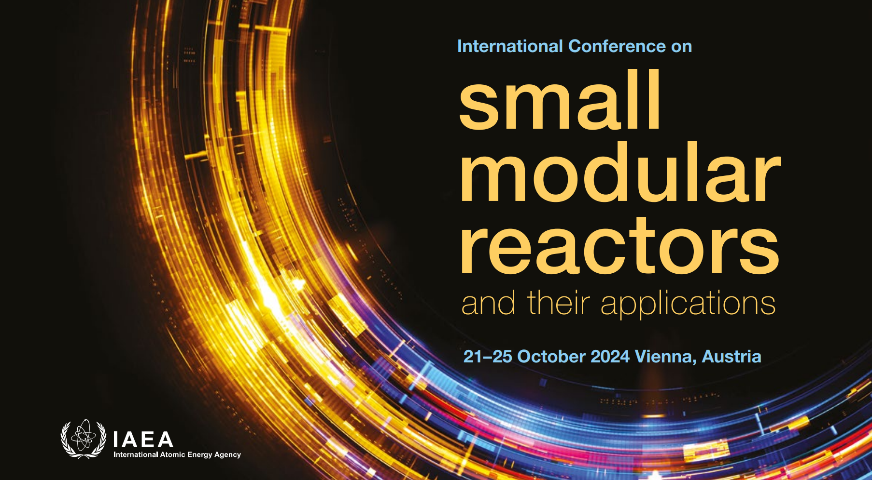

Slide 2
Paper 383: Nuclear Industry Views on the Security of Small Modular Reactors
– Results of a pilot survey
Dr Ross Peel, M.Eng.
Research Fellow
Centre for Science and Security Studies
King’s College London
Notes:
Intro

Slide 3
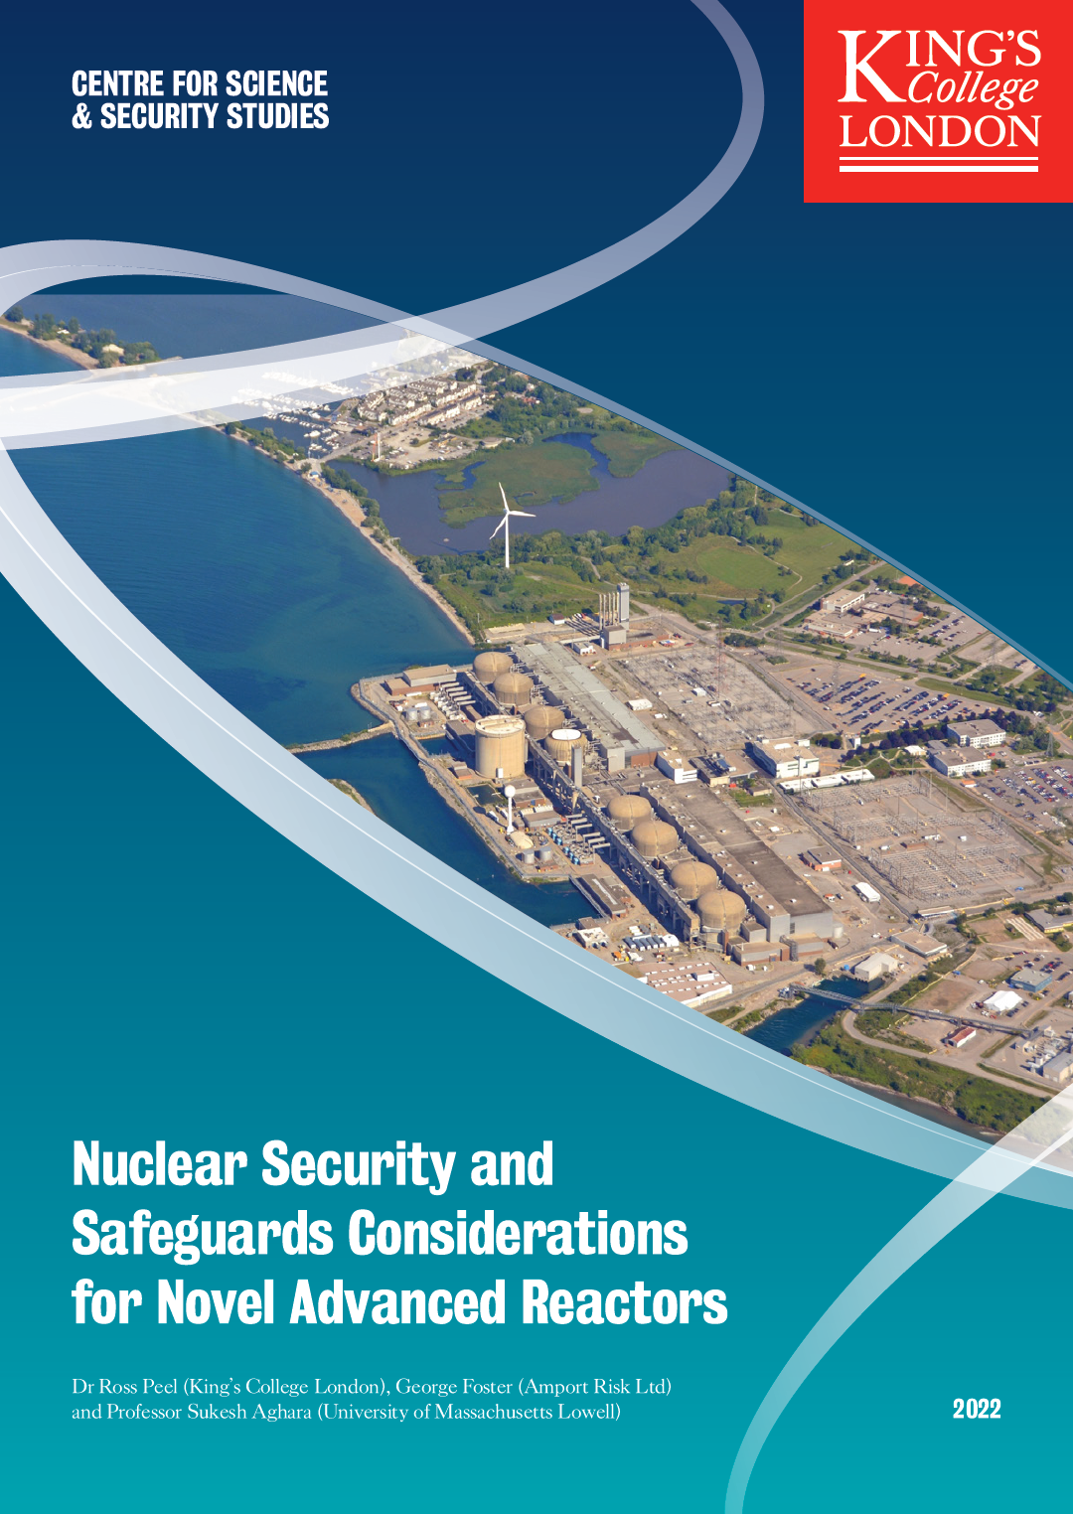
Introduction
Background
    SMR developer engagement with security appears underdeveloped in many cases
    SMRs present many novel security considerations
    Goal: Improve understanding of these issues and disseminate understanding
Approach
    Surveyed World Nuclear Association (WNA) members known to the authors through the Security Working Group
    Survey based on previous work at King’s College London
    16 responses at this pilot stage, with a view to improve survey
    11 responses answered the survey, in part or in full
    NOT REPRESENTATIVE OF THE “INDUSTRY’S VIEW”
Can be found online:
https://bit.ly/KCL-EID-report

Slide 4
Novel Features of SMR creating Security Considerations
Lower capacity and modular manufacture
  Factory module manufacture and transportation
Increased economic pressures
Cost reductions through fewer/shared staff
Digital I&C, automation, remote operation
Greater cyber threat surface, insider risk of remote workers
Novel reactor and fuel technologies
E.g., HALEU, exotic fuels, TRISO, molten salts, etc.
Flexible siting, novel deployment types
Transportable, remote/urban siting, nuclear batteries…
New vendors and business models
Startup developers, tech transfer, BOO(TR) models…
I&C – Instrumentation and Control; HALEU – High Assay Low Enriched Uranium; Gen IV – Generation IV; BOO(TR) – Build Own Operate (Transport Return)

Slide 5
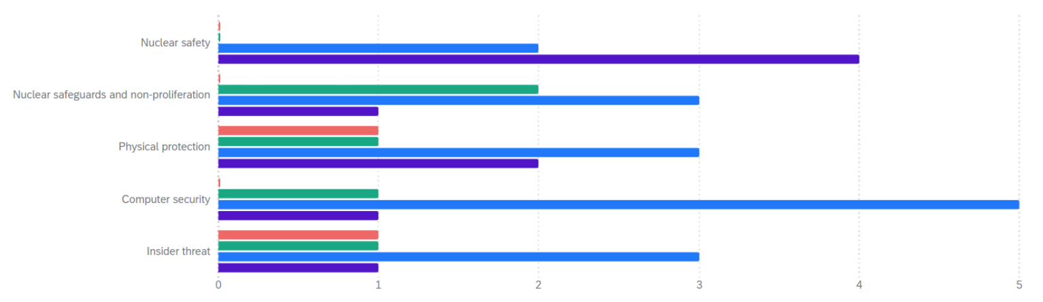
Results Overall
Respondents divided on many issues
    E.g., will current security approaches and IAEA guidance be applicable to SMRs?
    Suggests divergence in community views
Question:
  In general, are emerging reactor technology developers giving sufficient attention to the following issue areas?
Safety
Safeguards/Non-pro
Physical protection
Computer security
Insider threat

Slide 6
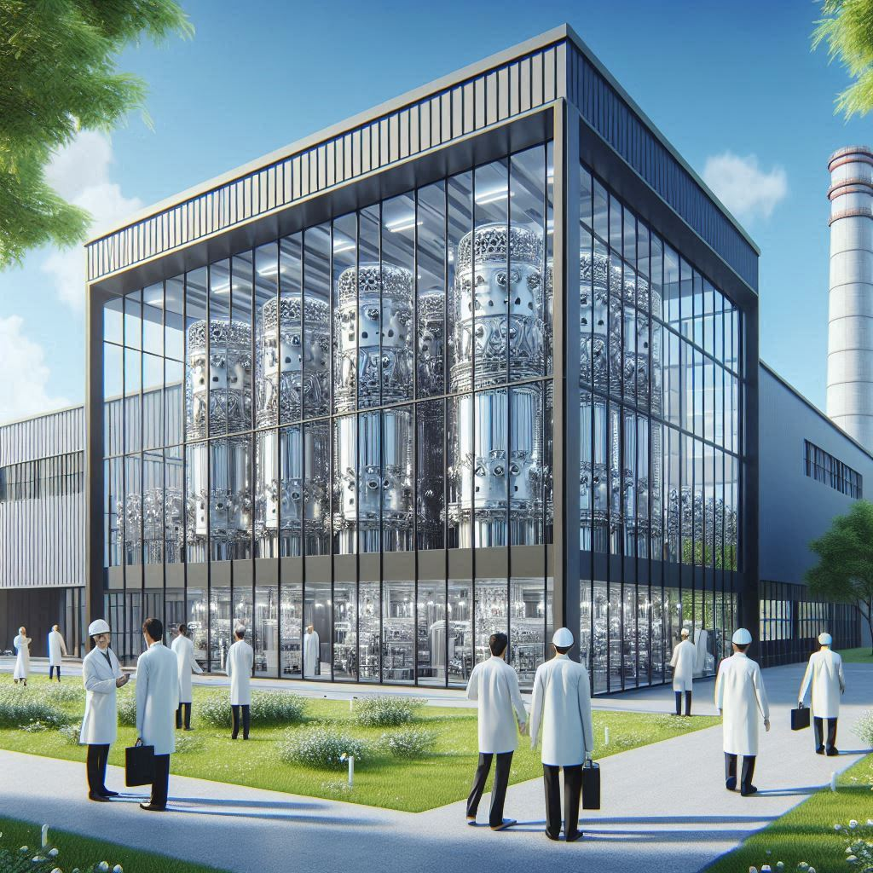
Results 1/6 – Modular Construction of Smaller NPPs
Factory manufacture
  Split view on whether security better/worse, depending on controls applied
    Manage insider risk
    Prevent introduction of CFSI
    Same measures as NPPs in construction
Modular transport
  Attractive target for threats, especially if fuelled
    Without fuel, similar to, e.g., RPV transport
    Cassette cores more challenging than transport of, e.g., LWR-type fuel assemblies

Slide 7

Results 2/6 – Economics of SMR Security
What is an appropriate security budget?
  Should be 10-20% of total operating budget
    ~20% on insider, remainder mostly cyber
    Naturally, depends on actual SMR, site, etc.
Security-by-design without guard forces?
  Possible to have several hours without response
    Could design out need for onsite security staff
    Only way to deliver cost-effective security
A single SMR PPS design for all countries and sites?
  5/8 “no way”, but 3/8 “possible”
  Deliver through security-by-design from the outset, e.g., reduce radiological consequences

Slide 8

Results 3/6 – More Digital Systems, Automation, Remote Operation
Within the coming 10 years, potential to automate…
  Detection function will change:
    Threat identification is strong
    Threat assessment is moderate
    Decision making is low
      Human roles increasingly supervisory
  Delay function is high
    “A wall is automated”
  Deterrence function is lower
    Facility below ground, few access points
    Automated patrol by UAV
  Response function must have humans, but a non-human first responder could be used

Slide 9
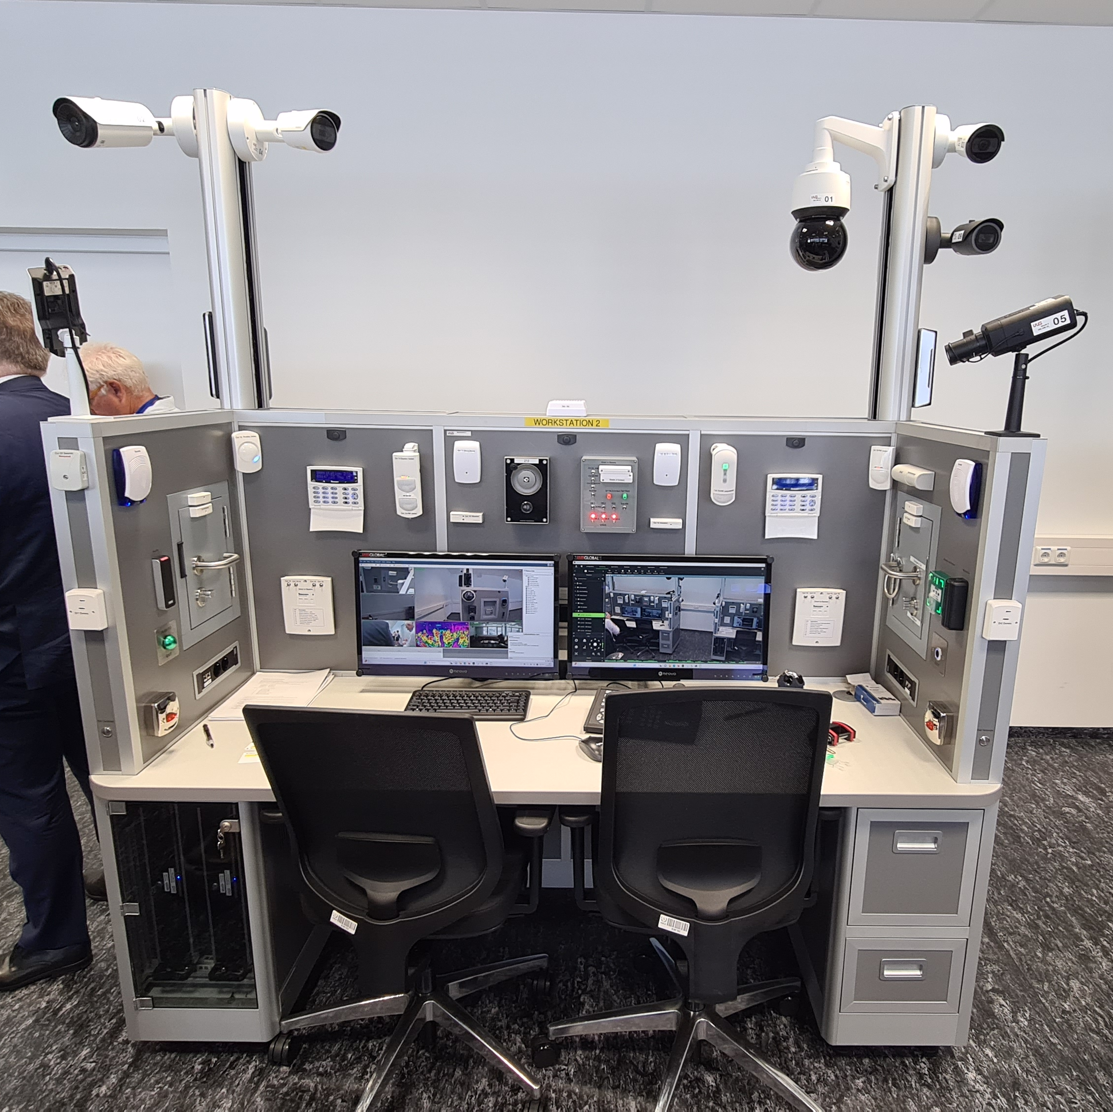
Results 4/6 – More Digital Systems, Automation, Remote Operation
Digital vs human security solutions?
  Aim for best from both in an integrated system
    Increased threat surface for cyber attack
    Fewer guards => reduced deterrence
    Human versatility in tasks and situations
    Digital twinning for whole system monitoring
Remote operation by offsite staff?
  Highly dependent on threat, vulnerabilities, and potential consequences, but possible for some roles
Offsite responders?
    Response must be within suitable distance
    Responders may be law enforcement, but need training and clear chain of command

Slide 10
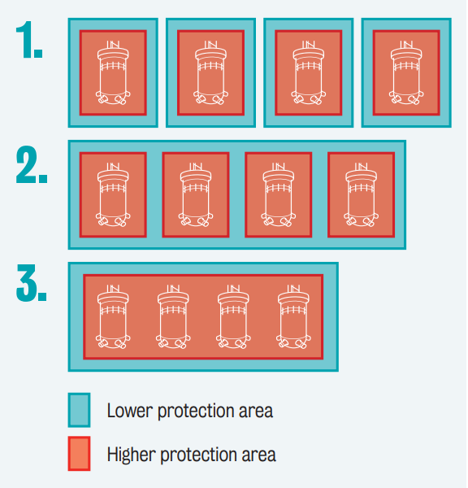
Results 5/6 – Advanced Reactors and Fuel Types
Passive safety systems will be beneficial
  Reduce sabotage consequences and pathways
Smaller quantities, higher categories
  Security net change hard to quantify overall, will depend on individual situation
    Fewer refuelling/transport operations
    HALEU 5-9.9% and 10-19.9% are different categories. ~13%+ is weapons-useable.
    Novel fuels have technical challenges, to be managed by developers
Multiple units per site
    Overall quantity may be similar to large NPP
    Shared security features give lower costs, but common points of failure

Slide 11

Results 6/6 – Wider range of siting and deployment scenarios
Small and Urban Sites
    Public acceptance challenge, harm to public confidence if an incident occurs
    Vital/inner areas may be very close to site boundaries. Need to replace distance by other means to achieve delay and enable response.
Isolated Sites
    Increased security cost due to being remote
    But also reduced consequences, so less need for security in the first place
    Local law enforcement with special training as first response, backed up by specialised responders travelling from central ‘hub’
    Need to weigh consequences vs response time and effectiveness in site selection

Slide 12
Discussion
Several key points raised again and again
    SMR developers must start thinking about security early in the design process
    Developers will need to consider the issues raised here in the specific context of their design(s)
    Site-specific factors will apply; developers will need to consider how to adapt their mass produced SMRs to each threat environment
    Security-by design will be key: Minimise consequences, maximise delay time with built in features, consider interfaces with safety/safeguards
    Computer security will be increasingly vital in highly digital plants full of networked IT/OT
“I think it is less about using automated security response systems. It is mostly about making the reactor design robust enough such that no matter how, when, who, [or] with what it is attacked, the consequences will be very low (lower or at least [the] same as the safety consequences of a postulated design [basis] accident). Thus, security-by-design of MRs and advanced reactors is of high importance and some vendor may realize it, some may not. I also hope regulators would realize it and embrace it.”

Slide 13
Contact details/for more information
Dr Ross Peel
+44 (0)20 7848 9708 ross.peel@kcl.ac.uk www.kcl.ac.uk/people/dr-ross-peel
LinkedIn: ross-peel
Twitter: @DrRossPeel
Thank you to World Nuclear Association for financial support to attend
© 2024 King’s College London. All rights reserved.
Third party images remain the property of their respective copyright owners.

