Slide 1
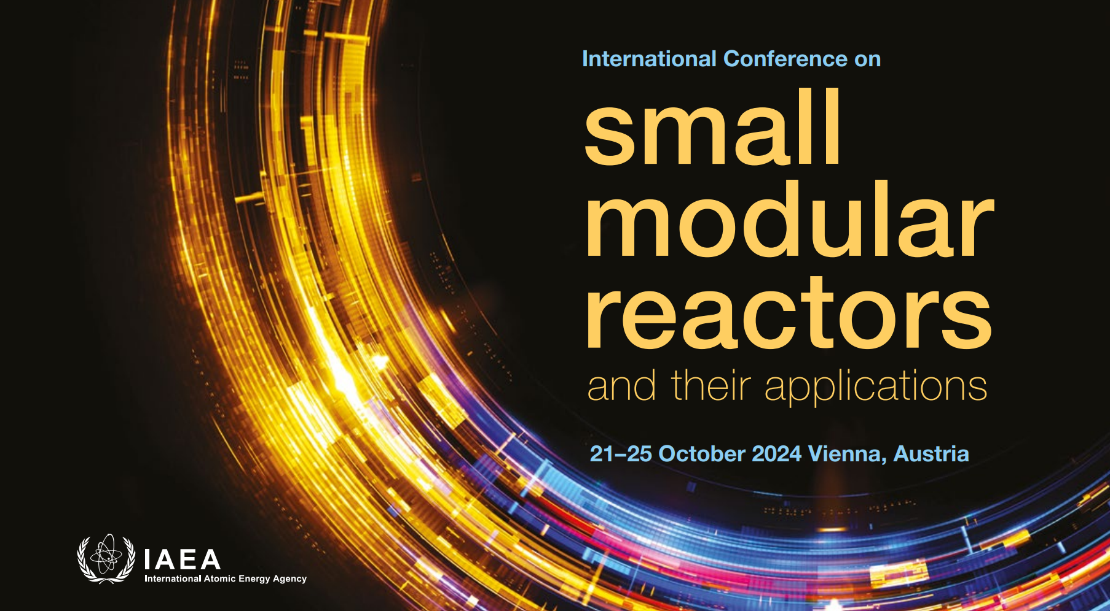

Slide 2
Paper 381: Insider Threat Security Considerations for Advanced and Small Modular Reactors
Dr Ross Peel, M.Eng.
Research Fellow
Centre for Science and Security Studies
King’s College London
Notes:
Intro

Slide 3
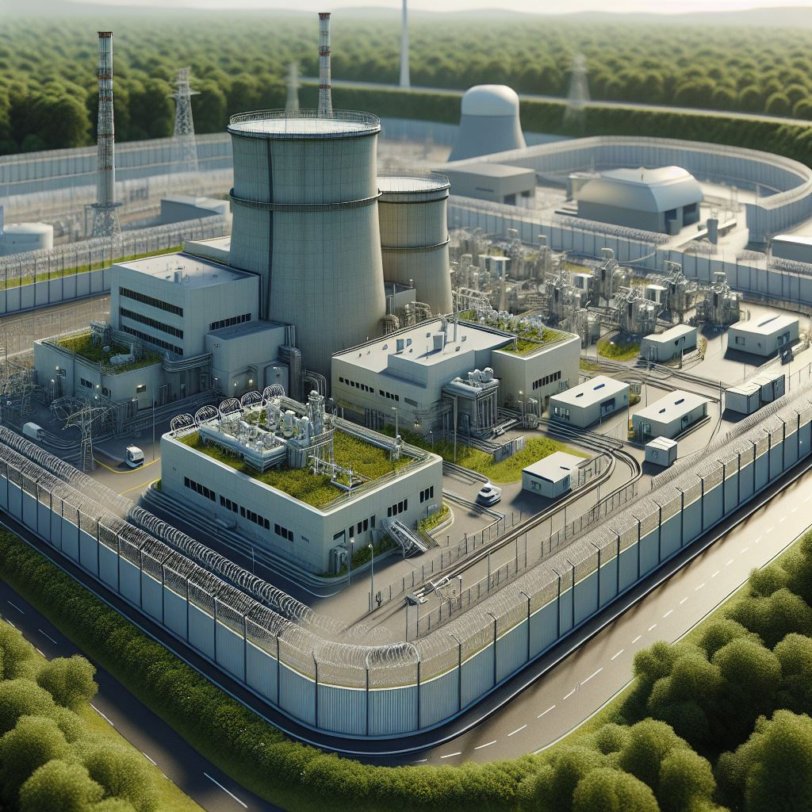
Introduction
SMR deployment expectations
    First units ~2030, potentially 375 Gwe (>1000 units) by 2050
    Wider geographical distribution, including newcomer states
    Currently in design, where there is the chance to build security in economically, rather than retrofit later at high cost to operators
Nuclear security
    Three threat types: physical, cyber, insider
    Can occur in parallel and may be coordinated

Slide 4
Insider Threat
    Insiders: Staff members, contractors, and others with authorized access to sensitive areas, materials, and/or information.
    Insiders may have access to multiple security layers, understand system vulnerabilities, can gather intelligence and plan over extended periods, and are trusted within the organization.
    This allows them to act without detection potentially indefinitely.
    Nearly all historic cases of nuclear theft and sabotage have involved insiders or their assistance
    Insider motivation can be widely varied:
Malicious intent to harm the public
Disgruntlement with employer
Desire to expose perceived issues
Coercion/inducement by criminal elements
Mental health issues
Negligence and manipulation – the accidental insider
Notes:
The “assembly of characteristics, attitudes and behaviour of individuals, organizations and institutions which serves as a means to support and enhance nuclear security.”

Slide 5
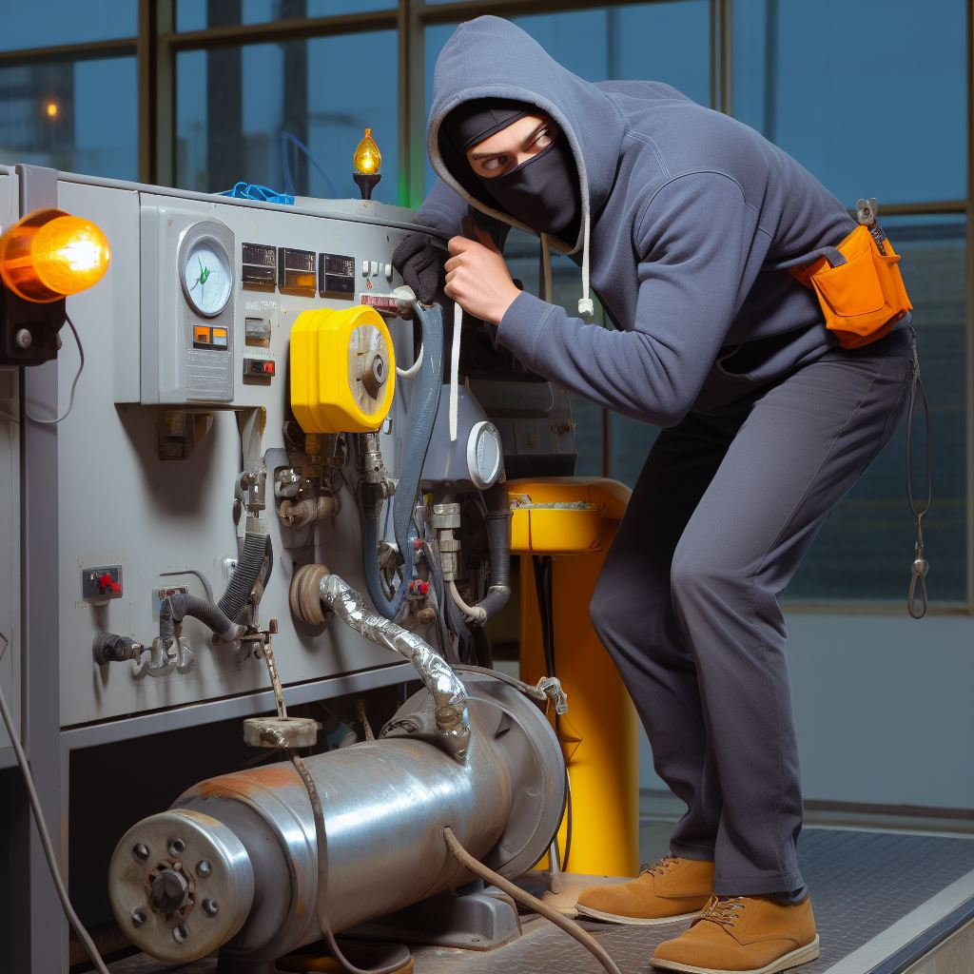
Novel Features Creating Insider Risk 1/6
Factory production of modular reactors
    Worker easy access to whole plant during assembly, when vulnerable, allowing:
    Possible sabotage
    Theft of nuclear material
    Sabotage during manufacturing should be detected during inspection/commissioning
    Cannot guarantee this
    Prevention better than cure

Slide 6
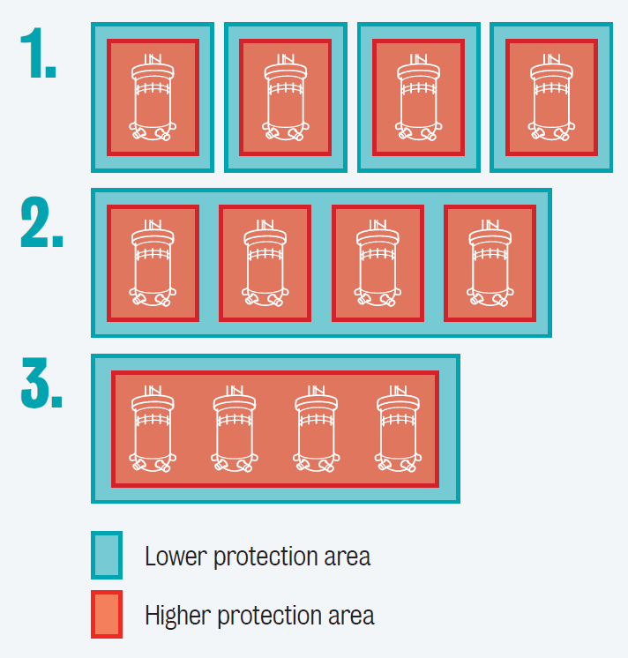
Novel Features Creating Insider Risk 2/6
Progressive deployment of multiple MR units
  Sites can have one, several or many units
  Can start with fewer and add with time
  Multi-unit sites may share security features
    Separation limits consequences but creates greater capital and operational costs
    Shared security features reduce opportunities to limit access – insiders can access more critical equipment and more nuclear material
Notes:
Separation means you need more security zones each with their own protections (similar for computer security). It also likely will slow operations down due to the need to cross several security barriers for each zone/system.

Slide 7
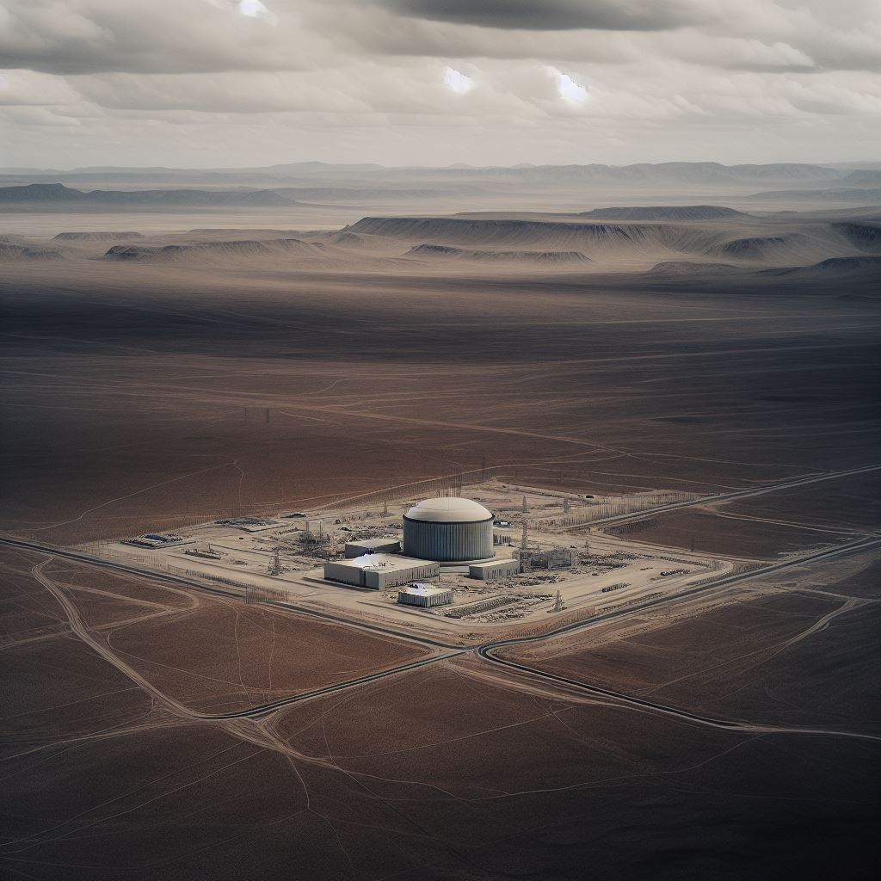
Novel Features Creating Insider Risk 3/6
Isolated sites
  Smaller units suited to islands, remote communities, isolated industry, e.g., mines
  Isolation challenges both recruitment and staff mental states
    Reduced pool of candidates willing to work away from family, infrastructure, etc.
    May have to compromise on desired traits in employees as a result
    Working in isolation presents few opportunities to relieve stress

Slide 8
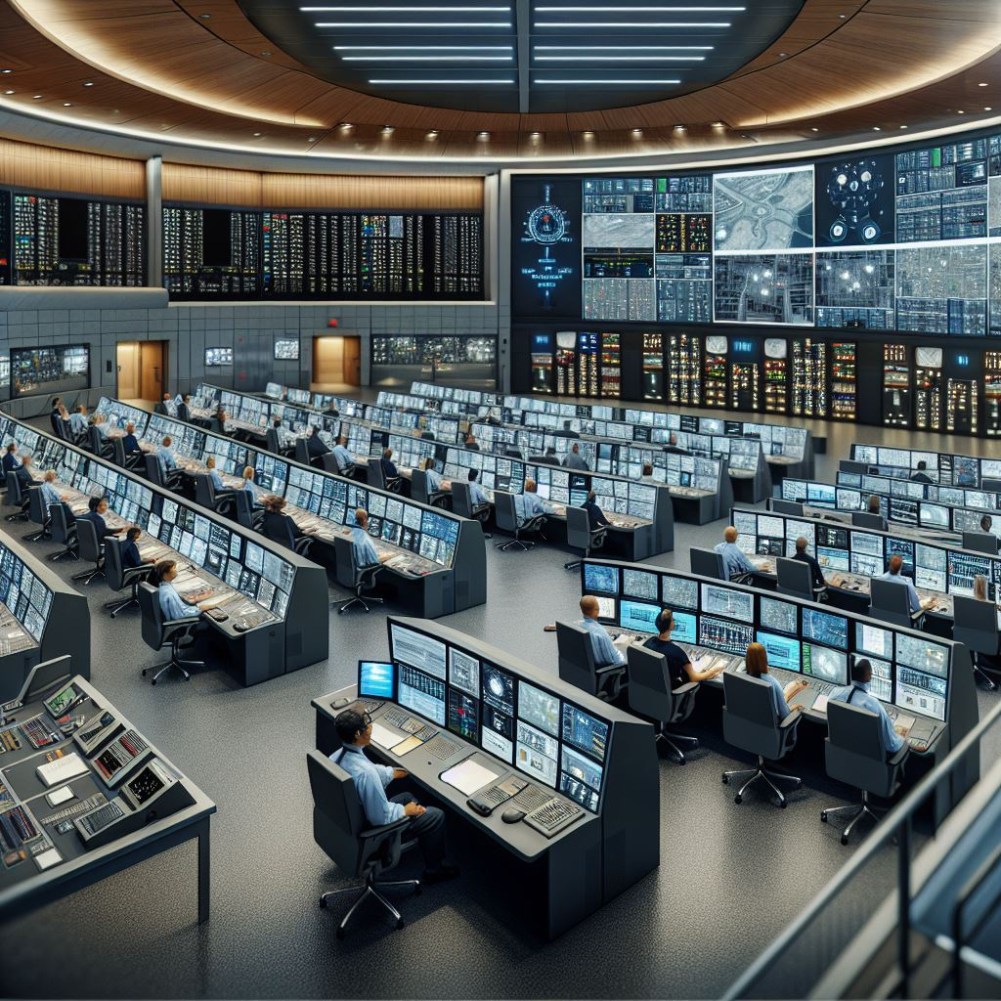
Novel Features Creating Insider Risk 4/6
Remote operation
  Teleoperation of one or more remote SMRs by remote staff in a centralised/home location
    Reduced access to facilities
    Transfers insider threat risk into digital space
    Computer security will be paramount
    But to work from home?
    Centralisation in one location facilitates behavioural monitoring, culture reinforcement, identifying/addressing risk
    With employees working from home, this becomes very challenging

Slide 9

Novel Features Creating Insider Risk 5/6
Reduced overall staff numbers
  People cost money, and SMR revenues will be relatively small compared to large NPPs
    Benefits:
    Fewer potential insider threat actors
    Can concentrate mitigation efforts
    Drawback:
    Less potential to identify threats
    Remaining staff will have greater access
  Overall, fewer insiders, each with higher risk
    Need to manage the trade-off

Slide 10

Novel Features Creating Insider Risk 6/6
Increased digitalisation
  How to reduce staff headcount? Automate roles and replace by digital systems
    SMRs will contain more computer systems, including operational technology
    Benefits include enhanced monitoring, automated decision making, etc.
  Insiders can use their access to bypass much computer security
    Greater interconnectivity and use of digital systems will give greater access and ability to sabotage/remove nuclear material

Slide 11
Insider Threat Mitigation 1/4 — Security Culture
Rationale and Current Approaches
  Security relies on human performance
    Performance made or broken by culture:
The “assembly of characteristics, attitudes and behaviour of individuals, organizations and institutions which serves as a means to support and enhance nuclear security.”
    Effective security culture must be built and maintained actively, from top to bottom
    Must address the full range of motivations
    Takes time and effort to build
    See IAEA Nuclear Security Series No. 7, “Nuclear Security Culture”
Application to Modular Reactors
    Many developer organisations are relatively new, and lack existing positive culture
    Insiders can release sensitive information publicly, share it with threat actors for future use, or even introduce vulnerabilities
  Recommendation:
  Urgently build and sustain security culture within SMR developer, operator and other stakeholder organisations to counter insider threat risk
Notes:
The “assembly of characteristics, attitudes and behaviour of individuals, organizations and institutions which serves as a means to support and enhance nuclear security.”

Slide 12
Insider Threat Mitigation 2/4 – Vetting
Rationale and Current Approaches
  Vetting: Assessing individuals with nuclear-relevant access (places, materials, information) to identify risks they may pose
    Background checks and interviews
    Not just once – redo periodically
    Can take a graded approach
    Risk factors include:
    Criminal record, employment gaps, previous disciplinary issues, vulnerabilities to improper influence, personal life issues, association with radical ideology, etc.
Application to Modular Reactors
  Traditional approaches are not sufficient, need to also consider adaptability to new technology, approaches, regulatory environments, etc.
    Failure to thrive in a changing environment may create stress and/or disgruntlement, raising insider risk
    Increasingly digital environment - any sign of motivation or ability to compromise digital systems?
    Recommendation:
    Assess these characteristics and look for risk factors, but balance against individual right to privacy, etc.
Notes:
Fewer staff, at higher levels, doing more roles, as basic functions are automated
Can they coordinate effectively with different teams with diverse expertise and experience?
Can they be readily trained and work effectively with new procedures, equipment…

Slide 13
Insider Threat Mitigation 3/4 — Access Control
Rationale and Current Approaches
  Preventing access is normal for physical attacks
    But insiders already have at least some access, so they just need to get the rest
  Underestimation of insider risk creates complacency and excessive trust
  Limit access to only those who need it, for each area and (computer) system based on their role
    Monitor personnel activities, log access
    Dual-control / four-eyes principle
    Regular, rigorous inventory audits
    Real-time materials tracking
Application to Modular Reactors
  Design for efficiency in moving between areas, without compromising security
  Frustration with security can lead insiders to circumvent protection measures
  Consider during design how to enable plant expansion to additional units without loss of security performance
  Recommendation:
  Ensure staff understand and support the application of effective security measures
Notes:
Well known factors that enable insiders to gain this access include organisational biases that underestimate insider risks, such as the "halo effect" where well-liked individuals are assumed to be trustworthy, and a lack of positive incentives or perceived negative consequences for reporting suspicious behaviour, often resulting in complacency and reluctance to act on red flags. Many organisations also struggle with fragmented responsibility across different managerial roles – with past cases illustrating instances where extreme warning signs were overlooked or disregarded due to organisational inertia [4]

Slide 14
Insider Threat Mitigation 4/4 — Human Reliability Programmes
Rationale and Current Approaches
  Ensure personnel are trustworthy, reliable and fit for duty – this can change very suddenly
    Goes beyond vetting to include, e.g., drug/alcohol tests, check-ins during or after personal crises, behavioural observation
    Training on safety/security, vigilance, preventing complacency, and human error.
    Promote accountability
    Enhance staff integrity and communal expectations
    Improve communication
Application to Modular Reactors
  Consider human factors during design – how can the potential for negative insider action be minimised?
    Identify and implement methods to reduce human error probability and consequences
    Demanding staff roles to supervise automated systems – manage fatigue
    Develop effective communication strategies between remote and on-site personnel
    Implement regular engagement between personnel to enable reporting of red flags
    Use effective systems for monitoring that balance with personal privacy

Slide 15
Conclusion
Ideal solution?
  No physical or digital access for humans during the nuclear facility lifecycle
Achievable solution
    Aim for the above and manage what risk remains
    Make insider action impossible, or at least highly detectable and traceable as deterrent
    Do not simply transfer all insider risk to physical or computer risk
    Above all, do not neglect insider risk in design, construction, operation, or decommissioning of SMRs or supporting facilities
  We now have a limited window to deliver effective security-by-design – let’s not waste it

Slide 16
Contact details/for more information
Dr Ross Peel
+44 (0)20 7848 9708 ross.peel@kcl.ac.uk www.kcl.ac.uk/people/dr-ross-peel
LinkedIn: ross-peel
Twitter: @DrRossPeel
Thank you to World Nuclear Association for financial support to attend
© 2024 King’s College London. All rights reserved.
Third party images remain the property of their respective copyright owners.

