Slide 1

U.S. Nuclear Regulatory Commission Efforts on Cybersecurity for Small Modular Reactors
International Conference on Small Modular Reactors and their Applications
21–25 October 2024, Vienna, Austria
Tammie Rivera, Cybersecurity Specialist
Office of Nuclear Security and Incident Response
U.S. Nuclear Regulatory Commission

Slide 2
What is the NRC Doing?
Developing a new risk-informed, technology-inclusive regulatory framework for advanced reactors (Part 53), including cybersecurity (proposed 10 CFR 73.110).
  Provides a graded approach for advanced reactors, including small modular reactors (SMRs), to protect digital computers, communication systems, and networks based on consequences for the differing risk levels within the advanced reactor technologies.
  Addresses challenges regarding regulating a broad landscape of novel reactor designs.
Developing implementing guidance to be used by operators to meet the proposed regulations.
Conducting research activities to better understand emerging technologies.

Slide 3
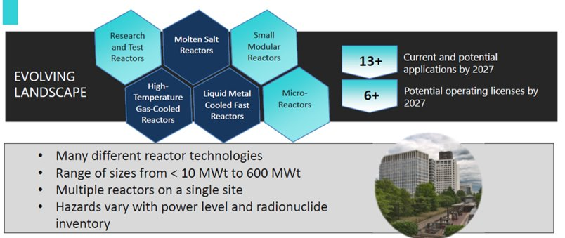
Broad Landscape of Advanced Reactor Designs
Source: Presentation on “10 CFR Part 53 Licensing and Regulation of Commercial Nuclear Plants” available via Agencywide Documents Access and Management System Accession Number ML22038A001.

Slide 4
Why Are We Doing It?
The proposed regulatory framework aims to:
  Modernize licensing
  Provide flexibility and clarity of a regulatory approach for applicants and licensees and reduces the need for regulatory exemptions
  Address a broad range of technologies and designs
  Provide a performance-based, graded approach versus prescriptive requirements
  Promote innovation and enable the use of technology advances in security requirements for physical security, cybersecurity, fitness for duty, access authorization, and emergency preparedness
  Leverage experience from research and test reactors, large light water reactors, certain fuel cycle facilities, and medical isotope facilities
  Encourage security by design
  Provide provisions for factory fuel load

Slide 5
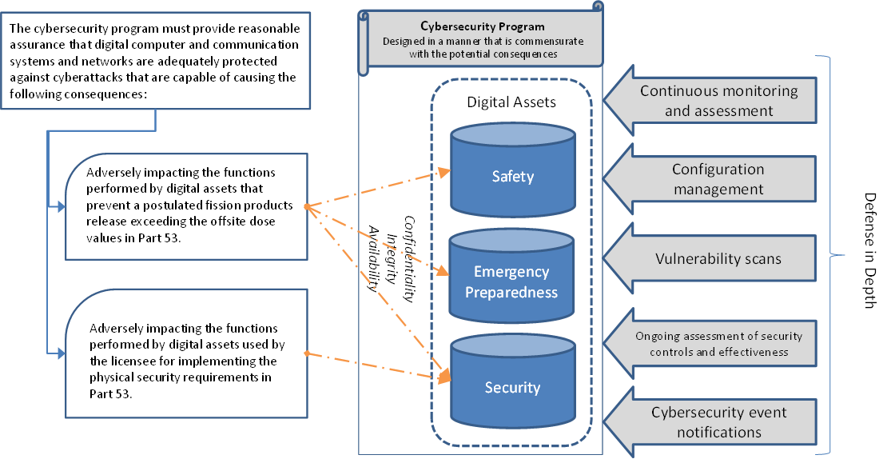
Proposed Cyber Requirements (10 CFR 73.110)
Note: This staff-proposed rulemaking and guidance has been documented in SECY-23-0021 and has been released for public comment. More information on the rulemaking process is available at https://www.nrc.gov/about-nrc/regulatory/rulemaking/rulemaking-process.html.

Slide 6
Draft Regulatory Guide Development
Draft Guidance-5075 “Establishing Cybersecurity Programs for Commercial Nuclear Plants Licensed Under 10 CFR Part 53”
An acceptable approach for meeting the 10 CFR 73.110 requirements
Effective guidance to support a technology-inclusive, performance-based, and risk-informed cybersecurity regulatory framework
Leverages IAEA and IEC security concepts

Slide 7
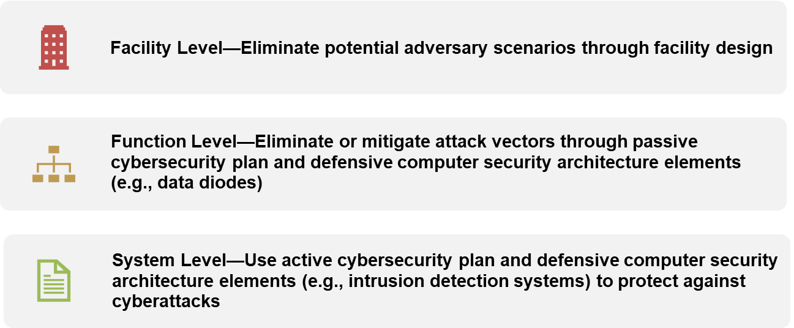
Draft Regulatory Guide
Three-Tier Analysis Approach

Slide 8




Gaining a Better Understanding Through Research
Field Programmable Gate Arrays (FPGAs)
Autonomous Control and Remote Access
Artificial Intelligence (AI)/Machine Learning (ML)
Wireless

Slide 9
Future NRC Work
Address any NRC Commission feedback on proposed rule and implementing guidance; issue final rule by 2027.
  Encourage comments and stakeholder feedback during public comment period.
Continue working on topics for inclusion in the guidance to support the proposed cybersecurity requirements such as:
  Using a performance-based approach for the selection of cybersecurity measures, and
  Implementation of emerging technologies and novel use cases, such as remote operation and autonomous operation.
Several research initiatives are underway to better understand the cybersecurity considerations associated with implementation of emerging technology.

Slide 10
Authors
Paper Title: NRC Regulatory Efforts for Cybersecurity of Small Modular Reactors
Tammie Rivera Ismael Garcia
Cybersecurity Specialist Senior Technical Advisor for Digital I&C and Cyber
Division of Physical and Cybersecurity Policy
Office of Nuclear Security and Incident Response
U.S. Nuclear Regulatory Commission (NRC)

