Slide 2

Standard Design Review Area for Security-by-Design of SMRs
Oct. 2024
Kookheui Kwon
Cybersecurity Division

Slide 3
Security-by-Design
Nuclear security measures are required to prevent radiological sabotage and unauthorized removal of nuclear materials.
Prevention/Detection/Delay/Response measures for physical protection & cybersecurity are performed and related systems are installed.
As physical protection & cybersecurity measures and systems are related to the plant design and can affect plant operations and safety,
the IAEA Nuclear Security Series & IAEA Safety Standards require integrated consideration from the plant design stage

Slide 4
Security-by-Design
IAEA Nuclear Security Series No.13 (INFCIRC/225/Rev. 5)
(Fundamental Principle E : Responsibility of License Holders)
For a new nuclear facility, the site selection and design should take physical protection into account as early as possible and also address the interface between security and safety.
IAEA Safety Standards No.SSR-2/1 (Rev.1)
(Requirement 8 : Interface of safety with security and safeguards)
Safety measures, nuclear security measures and arrangements for the State system of accounting for, and control of, nuclear material for a nuclear power plant shall be designed and implemented in an integrated manner so that they do not compromise one another.

Slide 5
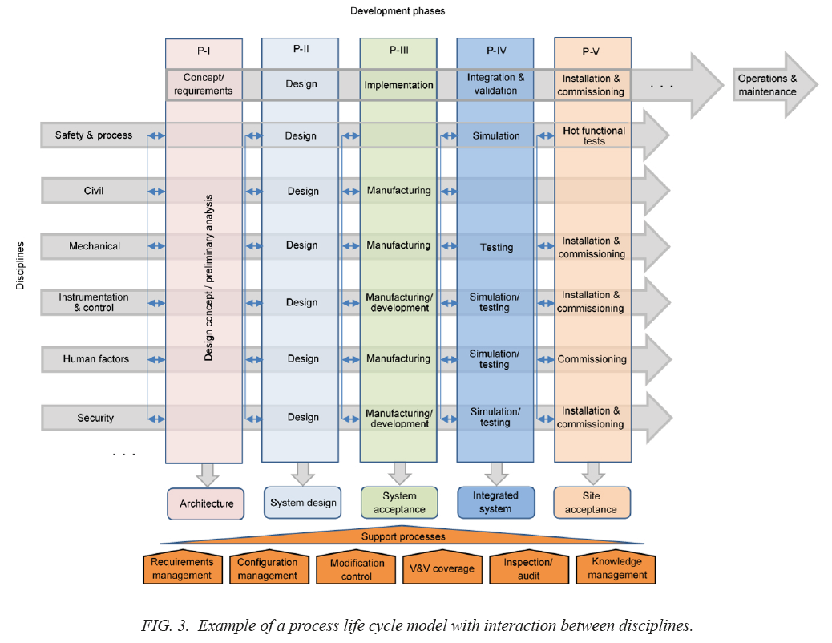
Security-by-Design
< A process life-cycle model with
interaction between disciplines >
Image source : IAEA Nuclear Energy Series NR-T-2.14

Slide 6
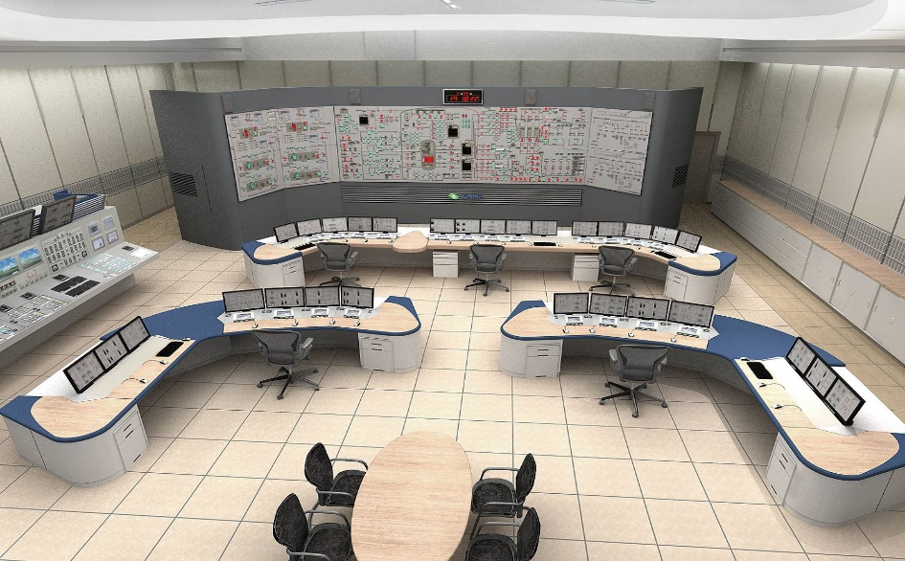
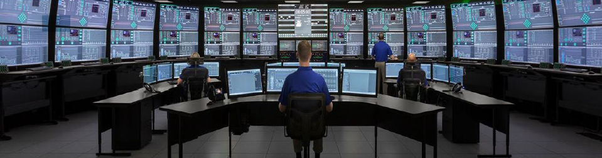
SMRs
Compared to large NPPs, SMRs have many novel aspects which may affect not only safety but also security.
A variety of wired & wireless communications and digital technologies, autonomous operations, and remote monitoring may increase cyber risk.
SMRs' compact design concentrates targets and safety features, increasing the risk of simultaneous destruction and reducing security effectiveness
Underground construction may reduce certain risks (e.g., aircraft crash)
Multiple unit sites increase the nuclear inventory and thereby the security risk
Remote sites and mobile units may present challenges for adequate and timely off-site response.
Modularization and standardization may increase supply chain risk
image credit :
(left) KHNP ARP1400 MCR
(right) NuScale Power, LLC
Notes:
Novel risks affecting SMR security include the following, which should be integrated and mitigated in the design engineering process of SMRs.

Slide 7
Key References for Review
IAEA Safety Standards
SSR-2/1 (Rev. 1), Safety of Nuclear Power Plants: Design
SSG-39, Design of instrumentation and control systems for nuclear power plants
SSG-34, Design of Electrical Power Systems for Nuclear Power Plants
SSG-53, Design of the Reactor Containment and Associated Systems for Nuclear Power Plant
IAEA Nuclear Security Series (Physical Protection)
No.13(INFCIRC/225/Rev. 5), Recommendations, “Nuclear Security Recommendations on Physical Protection of Nuclear Material and Nuclear Facilities”
No.27-G, Implementing Guide, “Physical Protection of Nuclear Material and Nuclear Facilities”
No.16, Technical Guidance, “Identification of Vital Areas at Nuclear Facilities”
No.40-T, Technical Guidance, “Handbook on the Design of Physical Protection Systems for Nuclear Material and Nuclear Facilities”
IAEA Nuclear Security Series (Cyber Security)
No.42-G, Implementing Guide, “Computer Security for Nuclear Security”
No.17-T (Rev. 1), Technical Guidance, “Computer Security Techniques for Nuclear Facilities”
No.33-T, Technical Guidance, “Computer Security of Instrumentation and Control Systems at Nuclear Facilities”

Slide 8
Interfaces with other Technical Areas
Civil Engineering Works and Structures(General Building and Area Design)
Internal and External Hazards
Auxiliary Systems (lighting, Communication, etc)
Instrumentation and Control
Electrical Power Systems
Management Systems and Quality Assurance
Or, any area related ‘the Security Program’

Slide 9
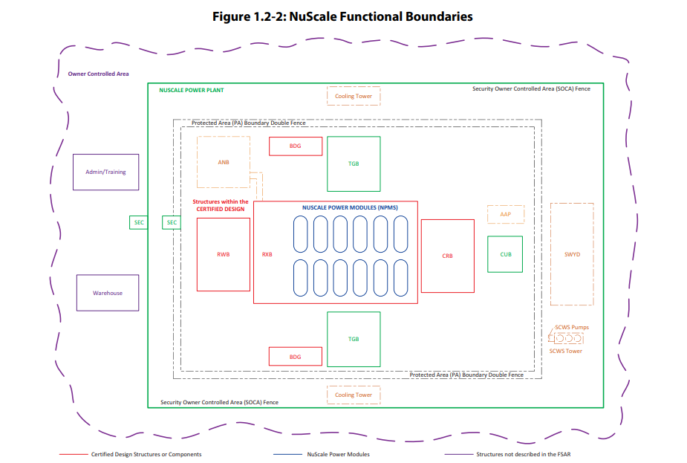
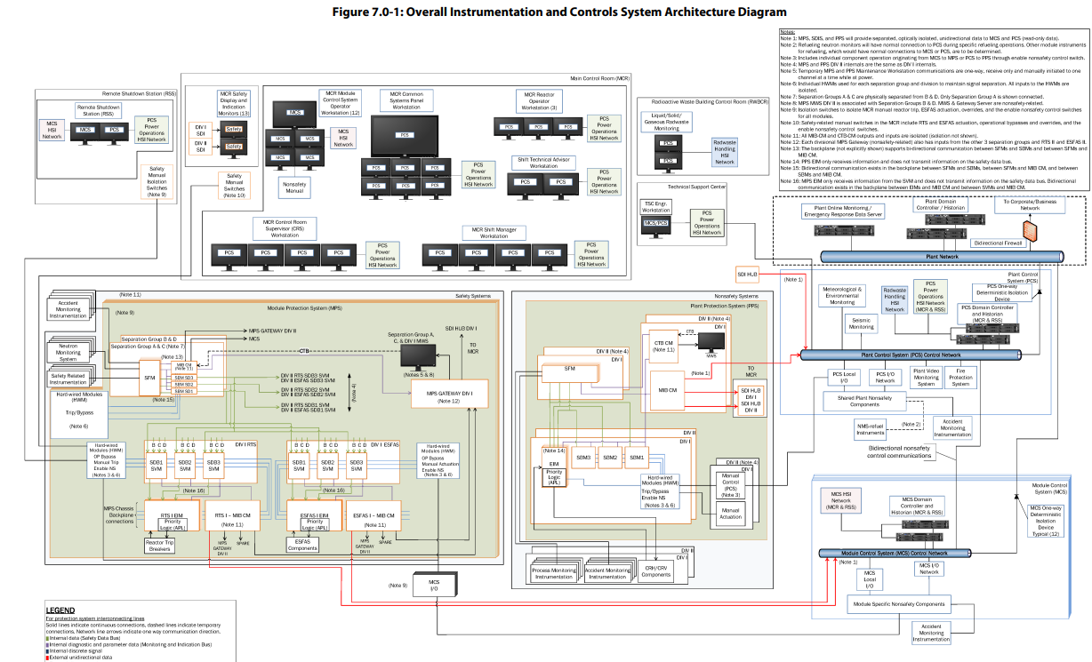
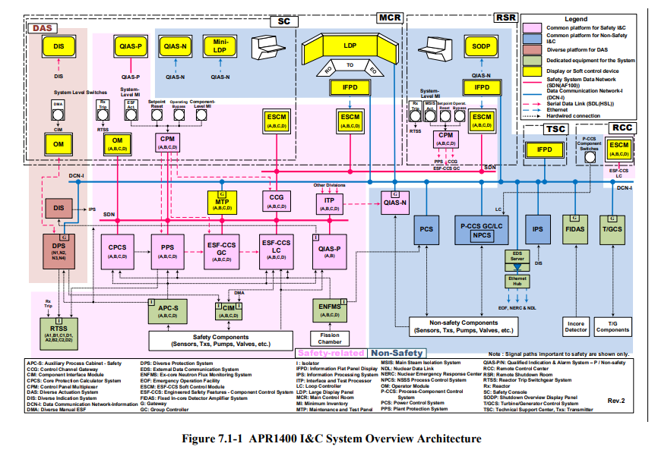
Review Area
Vendors should provide information to justify that physical protection and cybersecurity have been addressed in the SMRs standard design and integrated engineering process.
image credit :
Design Control Documents, NuScale Power, LLC, US
image credit :
Design Control Documents, KHNP, ROK

Slide 10
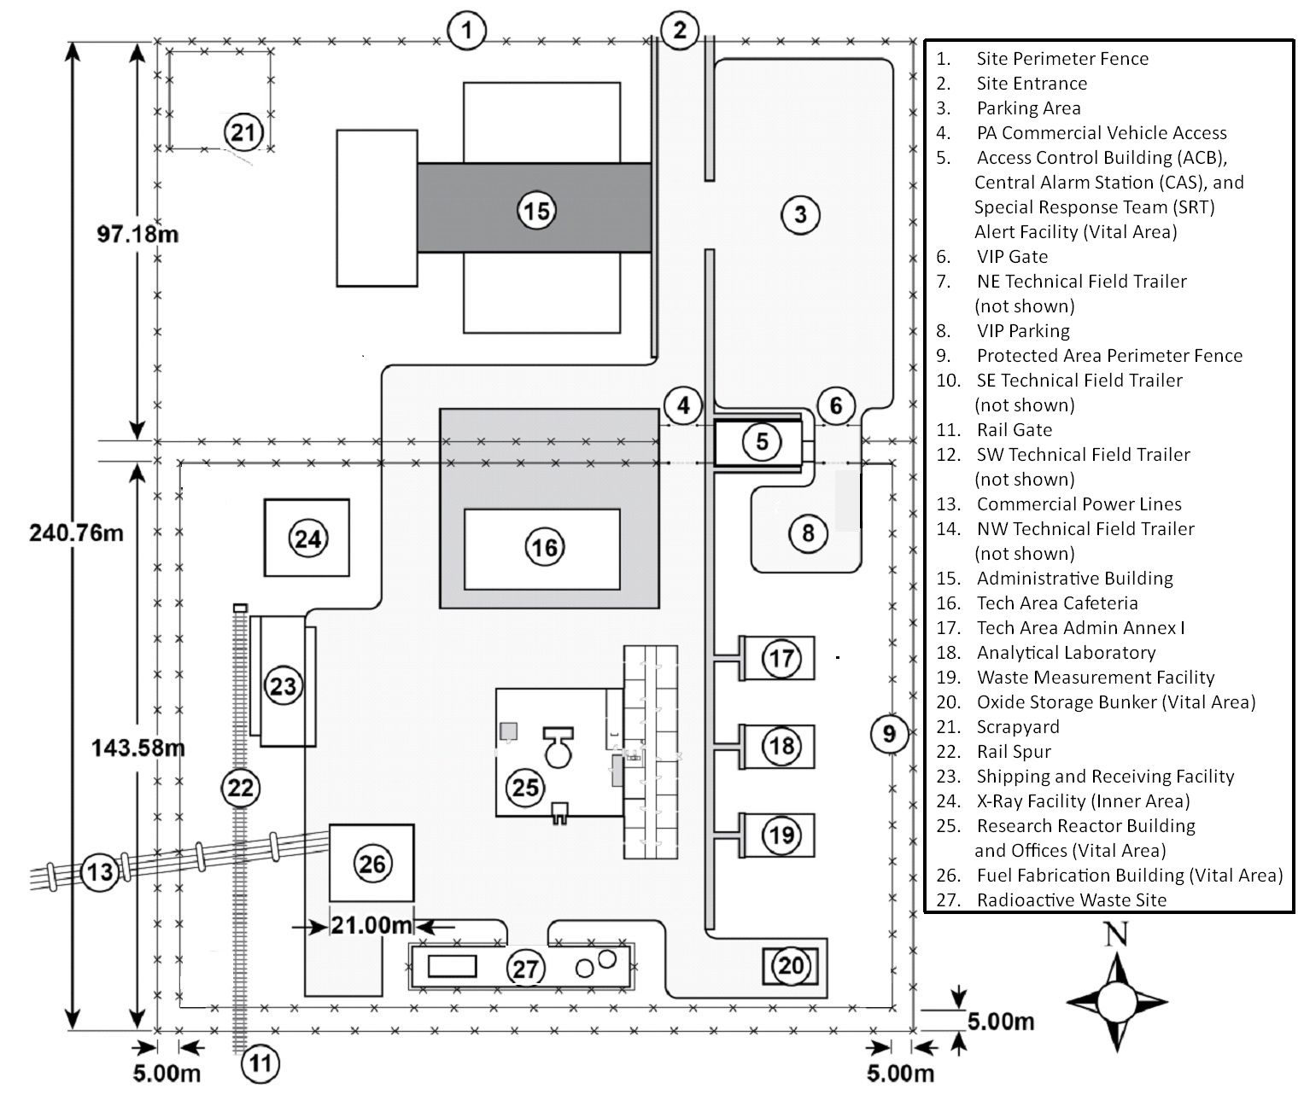
Review Area
Vendors should provide the following information;
Physical Protection
General Design process and requirements for Physical Protection
Vital Area Identification
Design information for Protected/Vital Area
(Physical Barriers, Door, Intrusion Monitor, Intrusion Detection, Access Control, etc)
Security Communication System
Security Lighting
Power Supply for Physical Protection Systems
Vehicle Barrier System
Design Features Facilitating Security Response
image credit : IAEA Shapash slides
Notes:
II.17.3.1 General Design process and requirements for Physical Protection
The review will ensure that general design plan information, including design requirements, processes and safety interface strategy for physical protection, is provided and appropriate.
II.17.3.2 Vital Area Identification
The review will ensure that vital area information, including identification methodology plan and security requirements, is provided and appropriate.

Slide 11
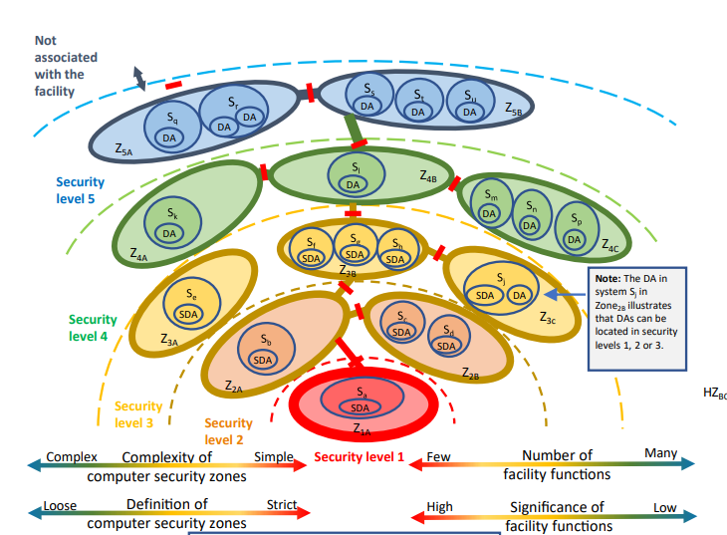
Review Area
Vendors should provide the following information;
Cybersecurity
General Design process and requirements for Cybersecurity
Sensitive Digital Systems/Assets Identification & Classification
Design information for Defensive Cybersecurity Architecture(DCSA)
(Security Level and Segmentation, Communication control between levels, etc)
Design information for Cybersecurity assessment & security controls for cyber risk mitigation
Cyber event monitoring/detection system
Security Strategy for cyber supply chain risk
image credit : IAEA NSS 17-T
Notes:
II.17.3.7 General Design process and requirements for Cyber Security
The review will ensure that general design plan information, including design requirements, processes and safety interface strategy for cyber security, is provided and appropriate.
II.17.3.8 Identification of Sensitive Digital Assets
The review will ensure that protection target information of cyber security, including sensitive digital assets identification methodology and security requirements, is provided and appropriate.
II.17.3.9 Defensive Cyber Security Architecture
The review will ensure that defensive cyber security architecture information, including general design plan and design requirements, is provided and appropriate.
II.17.3.10 Cyber Security Assessments
The review should ensure that cyber security assessment information, including assessment methodology and security controls, is provided and appropriate.

Slide 12
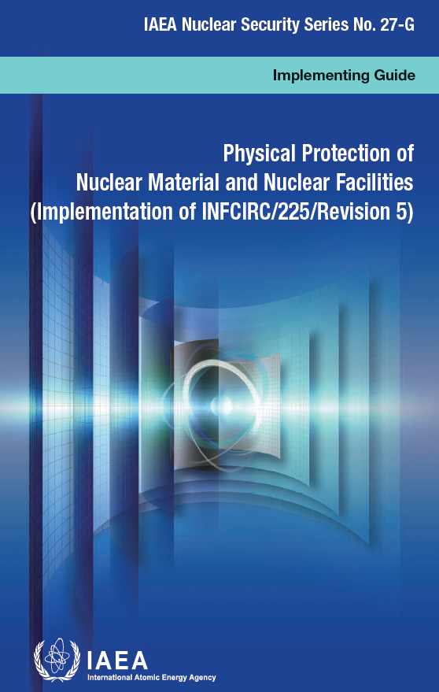
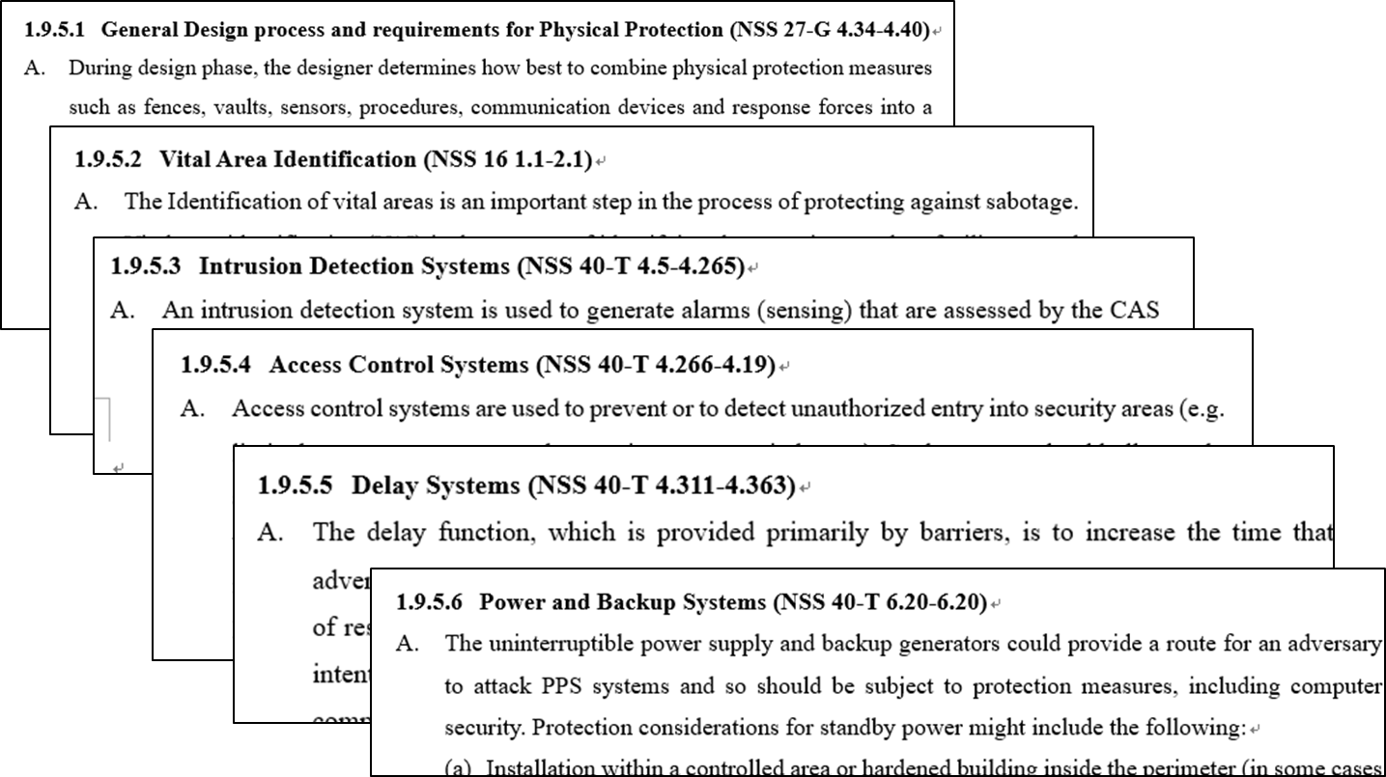
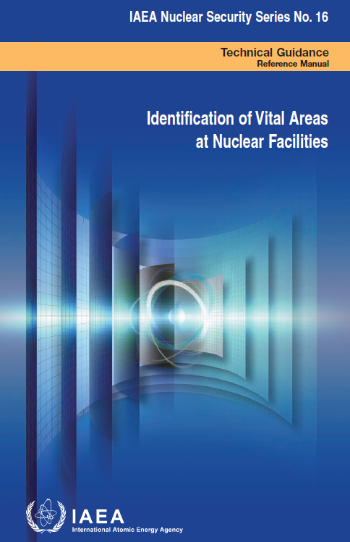
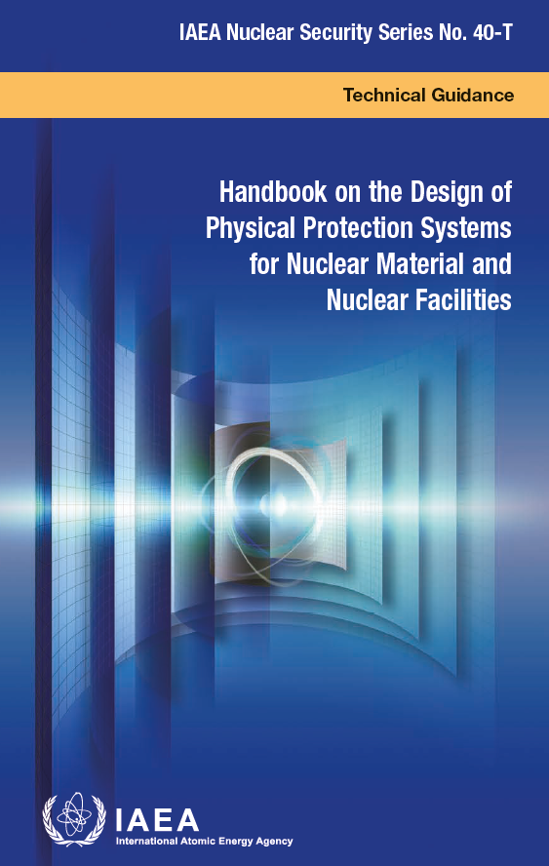
Review Criteria
The regulators may consider the following nuclear security criteria as part of standard design review.

Slide 13
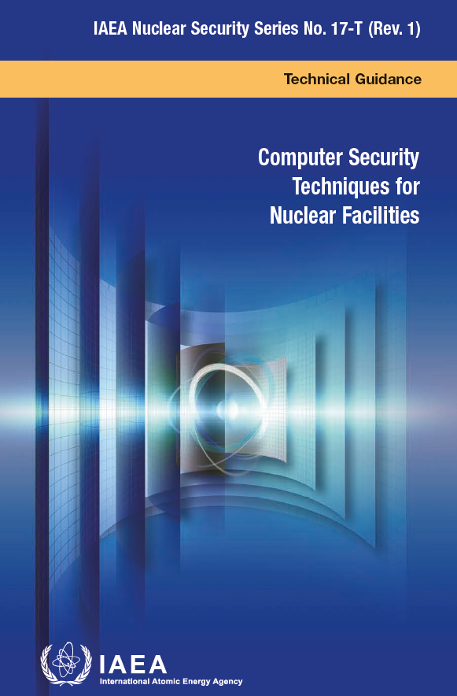
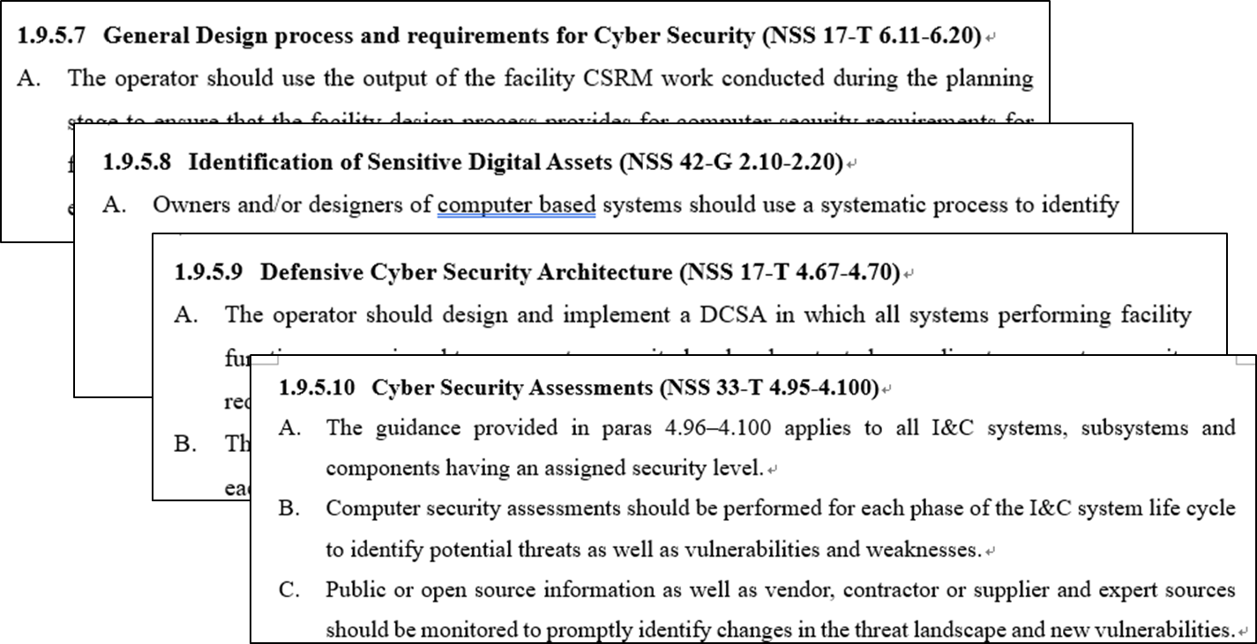
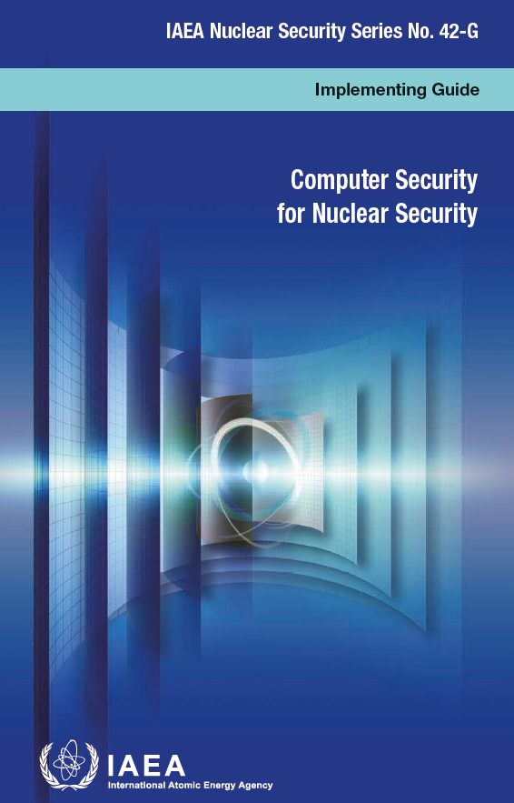
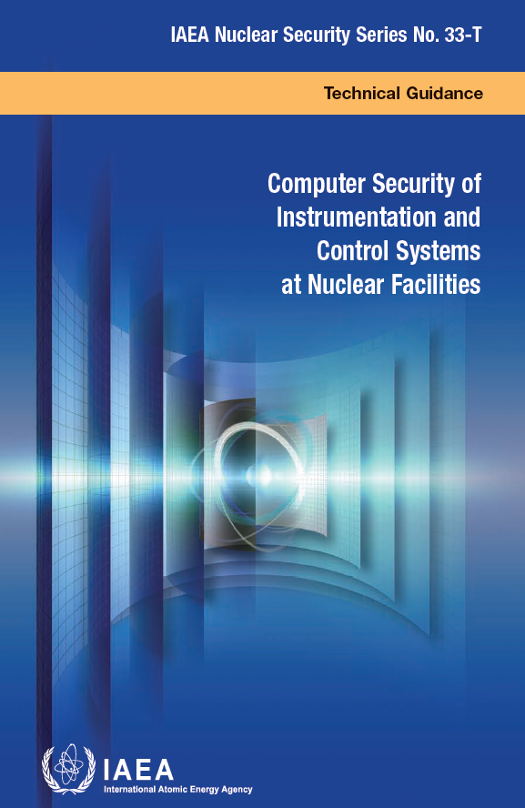
Review Criteria
The regulators may consider the following nuclear security criteria as part of standard design review.

Slide 14
Next Steps
Review Criteria & Guides
Develop specific review criteria & evaluation methods of security-by-designs
Revise the review guides based on criteria
Case Studies
Analyze security-by-design cases in existing NPPs & SMR projects
Identify best practices & insights for guides improvement
Safety-Security Interface
Facilitate consultations among regulators for safety-security integration
Notes:
Future study will focus on developing specific evaluation methods and criteria for cyber security in SMR designs. This includes creating detailed procedures for cyber security assessments and validation. Additionally, conducting case studies on the implementation of cyber security measures in existing and new SMR projects will provide valuable insights into best practices and areas for improvement. Further studies should also explore the integration of cyber security with other safety and security measures to ensure a comprehensive approach that does not compromise any aspect of SMR operations.

Slide 15
Thank you
for your attention !
vivacita@kinac.re.kr

