Slide 2
INCORPORATING INTERNATIONAL
CONSIDERATIONS INTO SYSTEMS
ENGINEERING AND REGULATORY
LIFECYCLE-BASED FRAMEWORK FOR
SECURITY-BY-DESIGN
Paper 253 | Session 11.2 | 23 October 2024
A.D. WILLIAMS, STEVEN HOROWITZ, ALAN EVANS [Sandia National Laboratories*]
KATHERINE HOLT [National Nuclear Security Administration]
*SAND2024-07759C. Sandia National Laboratories is a multimission laboratory managed and operated by National Technology and Engineering Solutions of Sandia, LLC., a wholly owned subsidiary of Honeywell International, Inc., for the U.S. Department of Energy’s National Nuclear Security Administration under contract DE-NA-0003525.

Slide 3
Roadmap
Introduction
INS Security-by-Design (SeBD) Framework
Incorporating SeBD into International Instruments
Conclusions & Insights

Slide 4
Introduction
Sandia
“early in the design process, consider the facility mission…[to] make security response … easier” or “based on operations, processes, and plant layout, determine equipment requirements for physical protection.”
What is
“security-by-design”?
WINS
“intrinsic security…as an integral part of the organization…to provide a security margin proportionate to the risk without excessive disruption of business”
CNSC
“integration of security at the earliest stages to mitigate malicious acts, and [SeBD] should be part of the facility lifecycle”

Slide 5
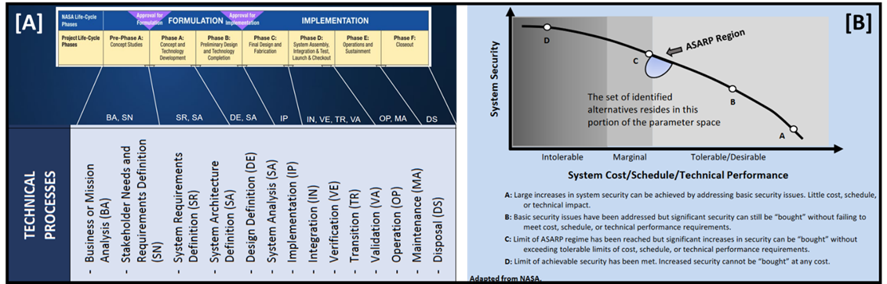
Introduction
Common Concepts
  “early”
  “integration”
  “part of the facility”
~ Systems security engineering
  Security = core or foundational
  Solutions → trade space options
  How to claim security credit

Slide 6

INS SeBD Framework
Deployment Timeline
Initial Reactor Design
Initial Facility Design
Design Certification Application
Utility Security Design
Combined Operating License
Operations
& Maintenance
Decommission
Security-by-design

Slide 7
INS SeBD Framework
Vendor/Designer
Utility/Operator
Primary Licensing Goal: Design Certification Application (DCA)
Primary Licensing Goal: Combined Operating License (COL)
Costs
Deployment Timeline
Initial Reactor Design
Initial Facility Design
Design Certification Application
Utility Security Design
Combined Operating License
Operations
& Maintenance
Decommission
Security-by-design

Slide 8
INS SeBD Framework
Vendor/Designer
Utility/Operator
Primary Licensing Goal: Design Certification Application (DCA)
Primary Licensing Goal: Combined Operating License (COL)
Baseline: Traditional retro-fit approach to security
Costs
Deployment Timeline
Initial Reactor Design
Initial Facility Design
Design Certification Application
Utility Security Design
Combined Operating License
Operations
& Maintenance
Decommission
Security-by-design

Slide 9
INS SeBD Framework
Vendor/Designer
Utility/Operator
Primary Licensing Goal: Design Certification Application (DCA)
Primary Licensing Goal: Combined Operating License (COL)
Baseline: Traditional retro-fit approach to security
SeBD Pathway #1: Traditional security earlier in lifecycle
Costs
Deployment Timeline
Initial Reactor Design
Initial Facility Design
Design Certification Application
Utility Security Design
Combined Operating License
Operations
& Maintenance
Decommission
Security-by-design

Slide 10
INS SeBD Framework
Vendor/Designer
Utility/Operator
Primary Licensing Goal: Design Certification Application (DCA)
Primary Licensing Goal: Combined Operating License (COL)
Baseline: Traditional retro-fit approach to security
SeBD Pathway #1: Traditional security earlier in lifecycle
Costs
SeBD Pathway #2: Claiming “security credit” in design phases
Deployment Timeline
Initial Reactor Design
Initial Facility Design
Design Certification Application
Utility Security Design
Combined Operating License
Operations
& Maintenance
Decommission
Security-by-design

Slide 11
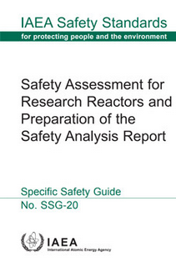
SeBD into International Instruments
IAEA’s SSG-20 Rev. 1 → outlines content of the Safety Analysis Report (SAR) of research reactors
  “Provisions for interfaces between nuclear safety and nuclear security [Pg. 41]”
  “describe the organizational structure and … conduct of operations … [to] include … interfaces with nuclear security [Pg. 81]”

Slide 12
SeBD into International Instruments
INS SeBD approach one mechanism to ensure
  “Safety measures and nuclear security measures are required to be designed and applied in an integrated manner … so that nuclear security measures do not compromise safety and safety measures do not compromise security [Pg. 84]”

Slide 13
SeBD into International Instruments
SSG-20 Rev. 1 is conceptually consistent with the INS SeBD model
  INS SeBD model allows “safety analysis … [to] proceed in parallel with the design process, with iteration between the two activities … [and] should increase as the design process progresses [3, Pg. 23]”
Safety Design Recommendations [SSG-20 Rev. 1, Chapter # in the Appendix] | Related SeBD Consideration(s)
Research Reactor Cooling & Connected Systems [6] Engineered Safety Systems [7] | Redesigning systems, structure and components to incorporate security performance
Instrumentation and Control Systems [8] | Reanalyzing diverse, reliable, and redundant pressure valves to address potential manipulation
Operational Radiation Safety [12] | Investigating nuclear material accounting and control solutions to be aligned with the frequency and assaying procedures of research reactor waste streams
Conduct of Operations [13] | Incorporating security considerations into crystallizing regular research reactor facility operations

Slide 14


Conclusions & Insights
INS SeBD model is a structured and iterative process for improving security performance
Finding numerous opportunities address A/SMR security needs through technical, functional or procedural solutions
SeBD Pathways can be viewed as a flexible engineering solutions throughout
INS model → rigorous and structured approach to identify—& optimize—SeBD opportunities
INS SeBD Framework supports international instruments → IAEA’s SSG-20 Rev.1
INS model → Mechanism to introduce security earlier, more frequently and continuously into existing approaches
INS SeBD system security engineering basis → broadly applicable
INS model → appropriate to support future IAEA guidance—even if based on different safety analysis report structures
INS SeBD Framework is a strong foundation for building collaboration & consensus
Represents a common mental model for multi-stakeholder conversations & future decisions related to SeBD

Slide 15
QUESTIONS???
Adam Williams | Sandia National Laboratories | NNSA/INSTAR
adwilli@sandia.gov

