Slide 2
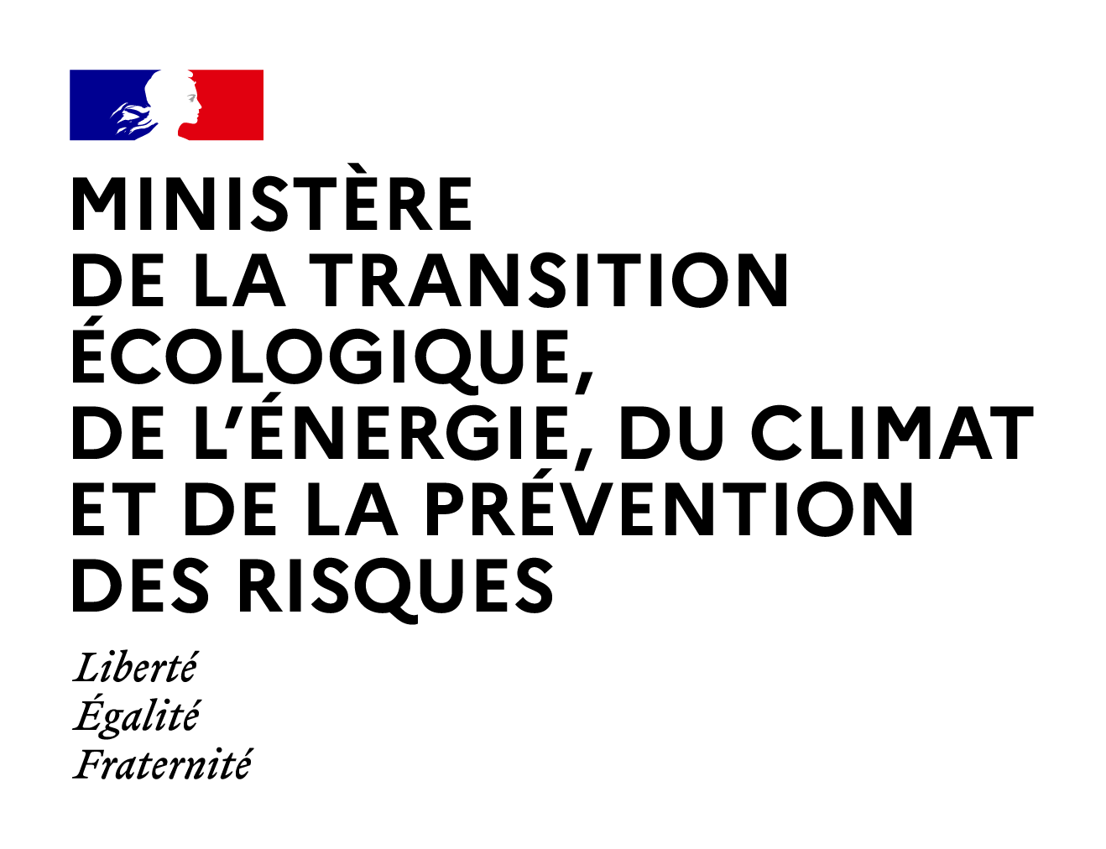



Cybersecurity matter for remote access of SMR
Sylvain BOULLEY, IRSN
Abel BENOIT ROSARIO, Nuclear Security Department
France

Slide 3
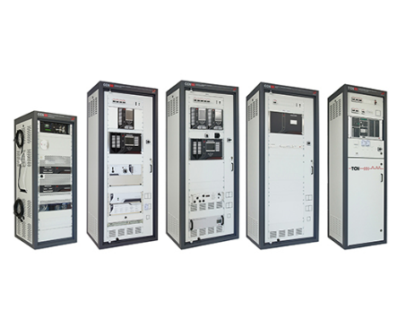
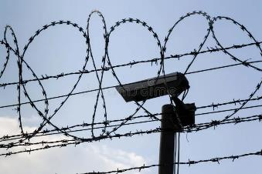
Introduction
Context: Study on challenges of remote operation
  Some FR SMR projects intend to use remote operation
    for economical reasons
    for structural reasons
Is there any regulatory barriers?
Any technical issues?
Affected systems:
+
I&C
Physical protection
3

Slide 4
Regulatory compliance
France
  Regulatory framework not specific to SMR
    Graded approach
    DiD
NIS2 directive in EU
Canada
  CSA N290.7:21, Chapter 7.4.3
    “Remote access shall not be permitted to high or moderate nuclear safety significance CEAs”
Remote access is not forbidden
➔ SMR and control room are considered as parts of the same system
4

Slide 5
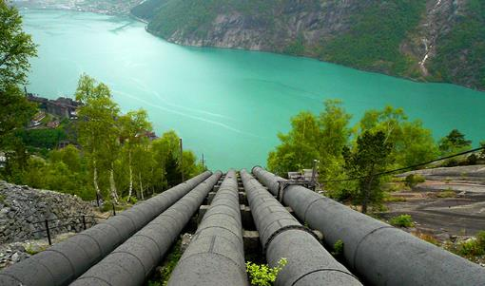

Lessons learned from other sectors
Hydroelectricity, wind & solar farms
  small installations, unmanned, in isolated locations
  Intervention under 2h
  Monitoring only
    No actions onto the system
  Possible remote shutdown
Different sensitivity level
  Not easily transferable to SMR
5

Slide 6
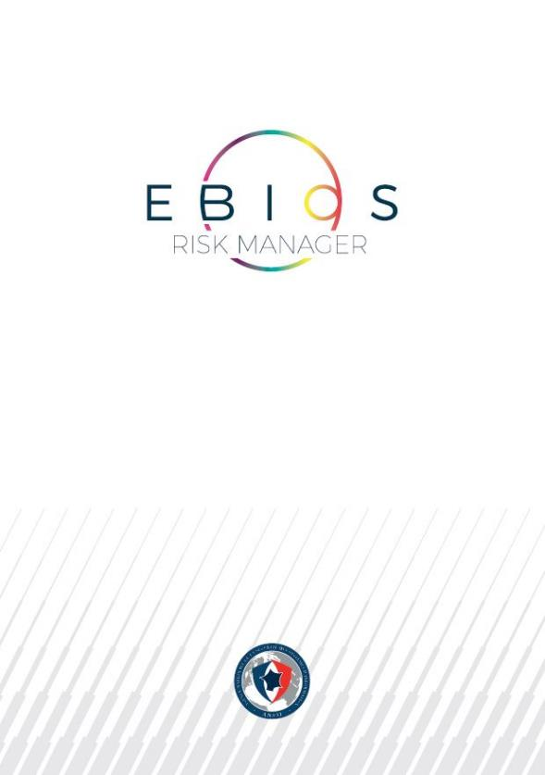
Risk analysis framework
EBIOS Risk Manager
  FR method for assessing and treating digital risks
  Links between computer security and nuclear activities based on a risk informed approach
    https://cyber.gouv.fr/en/digital-risk-management
6

Slide 7
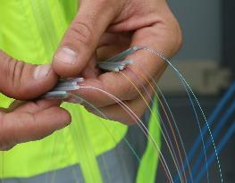
Reactor-control room com link
3 main families:
  Private link (ex: dedicated fiber)
    Better control of security features
    Potentially heavy deployment
  Pseudo-private link (ex: MPLS)
  Public link
    Easier but should be avoided
SMR operator has to set up his own security measures
Com link unavailability must be postulated:
  Random Failure
  Malicious event (DDoS)
  Impact on both security and nuclear safety
  Need for redundancy and diversification
Satellite link may be acceptable even for video
7

Slide 8
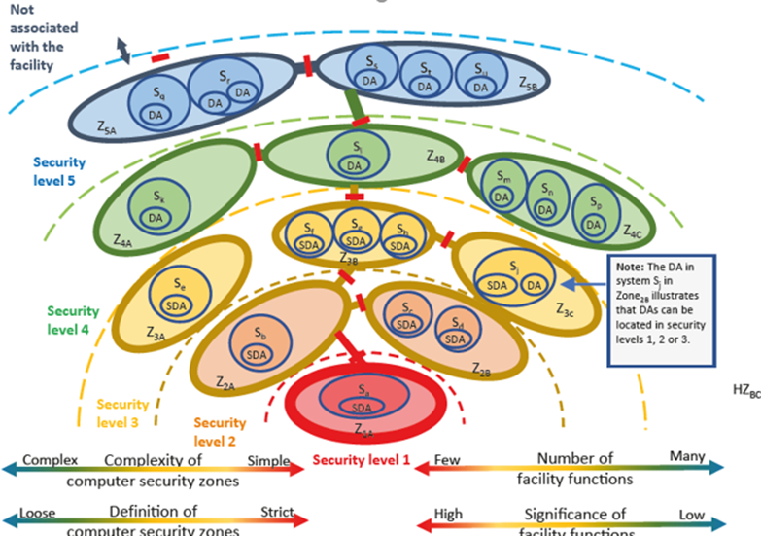
DCSA
Defensive Computer Security Architecture
Computer network split in Security Layers (5) depending on systems criticality and number
Each layer divided in zones (functional or geographical)
Graded approach for layer definition
  More critical => Higher security
  Higher security => Less systems
Security principles:
  Segmentation between layers
  Segmentation between zones of a single layer
  Protection against the external world
  Trust relationship only inside a zone
8

Slide 9
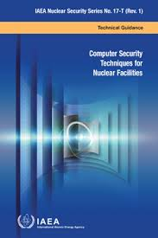

Norms & Guides
DCSA approach part of many guidance documents applicable to SMRs
IAEA GUIDANCE
NORMS
NSS 17T Rev1 – Computer security for nuclear facilities
NSS 33T – Nuclear ICS cybersecurity
IEC 62443 – ICS cybersecurity
IEC 62645 – Nuclear ICS cybersecurity
9

Slide 10
DCSA applied to SMR remote op.
SMR(s)
Control Room
10

Slide 11
DCSA applied to SMR remote op.
Application of the DCSA approach to both :
  The SMR reactor
  The distant control room
Need to protect data stream of each SL from the others
One VPN between reactor and control room is not enough
Reduced confidence zone
SMR(s)
Control Room
11

Slide 12
DCSA CNL proposal
One VPN for each SL between reactor and control room
VPN tunnel nesting
  Each layer is protected from others
  Graded approach
No remote access to SL1
12

Slide 13
Questions raised from DCSA
Available options on market
Qualification
Which security features
?
Ease of operation
Algorithms diversity
Post-quantum crypto ?
Equipment
Cryptography
Functions separation
Reliability
Key size and renewal
Performance
Diversification
Strength and lifecycle
Cost
I&C
Vidéo
13

Slide 14
Cryptographic algorithms
Cryptography
Algorithms diversity
Key size and renewal
Strength and lifecycle
  Parameters for solution design
    Robustness (resistance to attacks)
    Computation cost
    Ease of use (risk of faulty implementation)
    Maturity (risk of new attacks)
    Lifespan
  Two recommanded algorithms:
    Block cipher: AES-GCM-4
    Stream cipher CHACHA20 (with 256 bits key size)
  ECC and post-quantum crypto. algorithm are not recommanded: lack of maturity
14

Slide 15

FR proposal
Simplification
SL approaches is conserved
Balance on diversity
Still need to be benchmarked:
  For increased performance
  For increased reliability
15

Slide 16
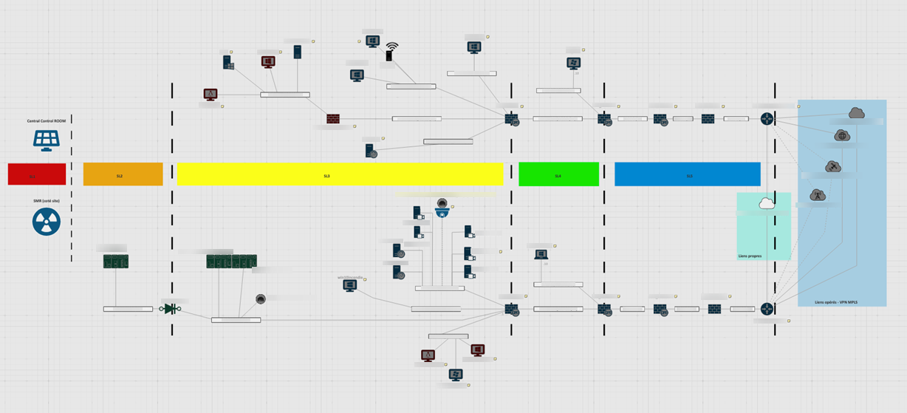
Simulation platform
16

Slide 17
Conclusion – Lessons learned
No regulatory obstacles
Links availability are never completely guaranteed
  Some types of communication links are to be preferred
  Need for redundancy and diversification
DCSA approach is compatible with VPN tunnel nesting
Physical Protection could be integrated
Search for simplification in respect of constraints
17

Slide 18

Thank you for your attention
sylvain.boulley@irsn.fr
abel.benoit-rosario@developpement-durable.gouv.fr

