Slide 2

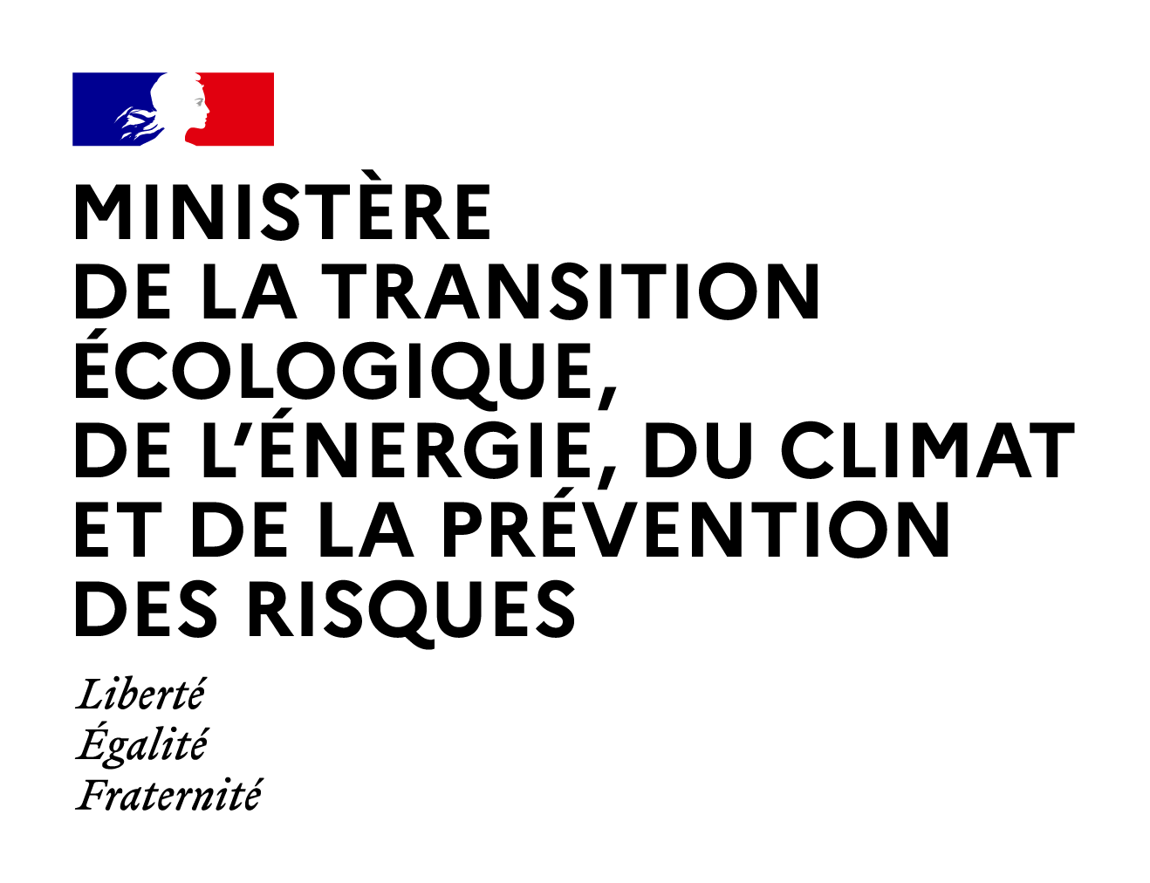
FRENCH SMRS: LESSONS LEARNT FROM TWO YEARS
OF REGULATORY SUPPORT
FOR SMR PROJECTS
Régine GAUCHER, Nuclear Security Department
France

Slide 3
Introduction
COP28 – Nuclear Energy as a tool to fight against global warming
Progress in enhancing safety and security and potential of closing the fuel cycle
Flexibility, modularity and smaller size of reactors offered by SMR
French Government Initiative “France 2030”
  To support innovation and designers
  11 designers have received financial support from the State
  4 technologies of reactors: HTR-type reactor, Lead-cooled fast reactor/Sodium-cooled fast reactor, Molten salt reactor, Pressurized water reactor
  Designers' objectives: operational reactors by 2026/2030
3

Slide 4
Process developed by the French Nuclear Security Authority
Need to adapt to start-up type interlocutors
Interlocutors not familiar with Nuclear security
Security by Design: a concept to be implemented but limited due to the confidential French nuclear Design Basis Threat (DBT)
A change in the reactor siting landscape
  Close to industrial sites
  Near residential areas
Need for comprehensive adaptation of security strategies
4

Slide 5
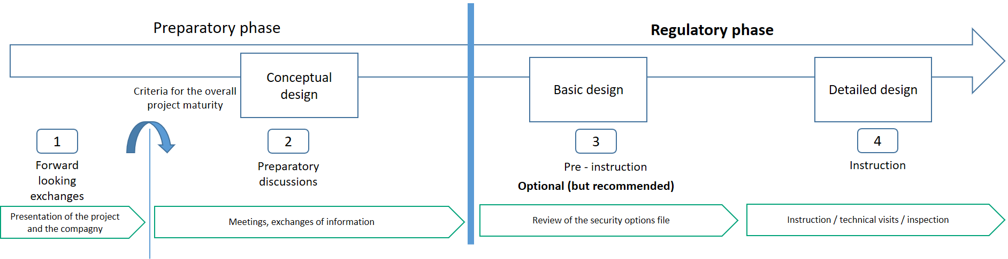
The organization put in place
A tailored approach with each designer
An instruction process in two phases
Importance to make designers aware at the earliest stage
5

Slide 6
A guide on Nuclear Security of SMRs
To support the first contact with designers
To outline the key issues of Nuclear Security and general principles
To inform the designers on the licensing process
To inform the designers on the requirements for transport of nuclear material
To encourage the designers to consider technical, organizational, and human factors to comply with regulatory requirements
To remind the components of Nuclear Security defined in our National Decree
6

Slide 7
A guide on Nuclear Security of SMRs
The 10 components of Nuclear Security
Knowledge and monitoring of threats
Prevention and protection against insider threats
Protection of information, in particular of classified information
Computer security
Nuclear materials accounting and control
Physical protection
Installation design adapted to contribute to nuclear security
Management of malicious acts, in particular terrorist acts, including measures contributing to the recovery of illicitly removed nuclear materials or measures taken to limit the consequences of malicious acts
Nuclear security management
Nuclear security culture
7

Slide 8
A guide on Nuclear Security of SMRs
Challenges faced by the Nuclear Security Authority
  To describe the principles in a concise and clear manner
  To explain “Security by Design” as a tool to make technological choices requiring fewer security resources
  To explain nuclear security strategy and performance demonstration based on the DBT to designers who don’t have security clearance
  To describe the information protection principle
  To explain cyber security risks
  To integrate the cycle of the combustible and the activity (upstream, transport, downstream)
8

Slide 9
Lessons learnt: Security by Design
Not limited to the design phase but shall be considered for the whole life cycle of the reactor
  Includes transport, reactor operation, waste storage, dismantling
Transport: a critical issue
  Transport of loaded SMR
  Design solutions to minimize radiological consequences in the event of an attack
Anticipation to accommodate updates of threats
Security costs versus business model
9

Slide 10
Lessons learnt: Nuclear Security stakes of the reactor
French Regulation
A graded approach and a mix of prescriptive requirements and performance-based requirements
Based on CPPNM and NSS13 (INFCIRC/225/Rev.5) guidelines
For theft, recommendation to use less sensitive material (category II or III)
For Sabotage, in case of consequences higher than HRC: demonstration of performance is required:
  Targets identification (similar to identifying vital areas as defined in NSS13)
  Sabotage scenarios, considering the capabilities of the Design Basis Threat (DBT)
  Justification that the nuclear security measures are adequate to mitigate these scenarios
10

Slide 11
Lessons learnt: Nuclear Security stake of the reactor
First important step: to assess whether an installation could result in consequences exceeding the HRCs in order to determine the necessary level of Nuclear Security
Constraint: details of the HRCs and the DBT are classified on the basis of national defense security and cannot therefore be transmitted to designers
Solution adopted by the French Authority - The French guide
  provides references to open source information on terrorist attacks that designers can use to create their own DBT (“designer’s DBT”) for evaluation purposes
  advises designing reactors to ensure radiological consequences remain below 50 mSv
11

Slide 12
Lessons learnt: Computer Security
Several sensitive issues identified
  Autonomous operation
  Remote operation
  Remote control and maintenance
  Remote tools to ensure security
The Guide provides a methodology for identifying the information systems that require protection (several categories of systems)
Cooperation with the French national agency for information systems security (ANSSI)
Cooperation with the French Safety Authority on interfaces
12

Slide 13
Lessons learnt: Information Protection
Clearance process is a lengthy process
DBT accessible to companies and individuals identified as “important for the nation”
  Designers are not yet identified as such
A process in several steps
  A Memorandum of Understanding is signed between the ministry and the designer
  Habilitation for the legal entity and individuals
  Considering the “need to know” principle, making classified information available
13

Slide 14
Conclusion
SMRs lead to face new challenges
Cooperation between authorities is essential
  Safety, Security, Safeguards (3S)
  National Security
  Cybersecurity
“Security by Design” is a key issue
  To limit radiological consequences
  To reduce security costs
Designers will not be necessarily operators
Designers need to be accompanied Objective of the Guide
A performance-based approach to ensure that installations with SMRs meet the same requirements as existing facilities
14

Slide 15

Thank you for your attention
regine.gaucher@developpement-durable.gouv.fr

